Slide 1
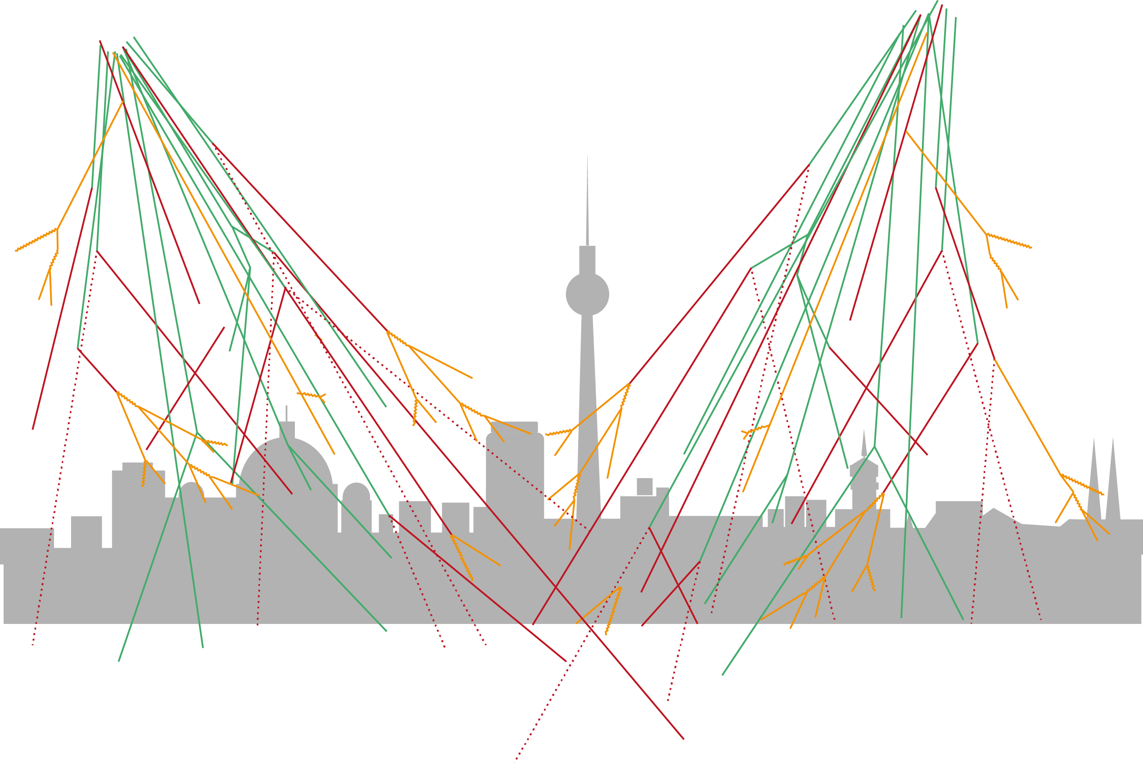
GLOBALCOSMICS.ORG
Common Website for Cosmic Ray Education Projects Worldwide
Carolin Schwerdt
Marge Bardeen
14th IPPOG Meeting at CERN, 3. November 2017

Slide 2
Carolin Schwerdt aka Caro
Office: DESY, Zeuthen
Scientific Coordination of Cosmic-Education-Project at DESY in Zeuthen and inside the German-wide Network „Netzwerk Teilchenwelt“
CosmicLab:
internship for interested high-school students of 2 weeks; support of teachers
network between scientists, students and teachers; 29 institutes at 25 cities
Experiments, Tools and Programs:
Cloud Chamber, CosMO (scintillation counters), Kamiokannen (cherenkov counters);
Auger and IceCube Masterclass;
Web base Cosmic@Web

Slide 3
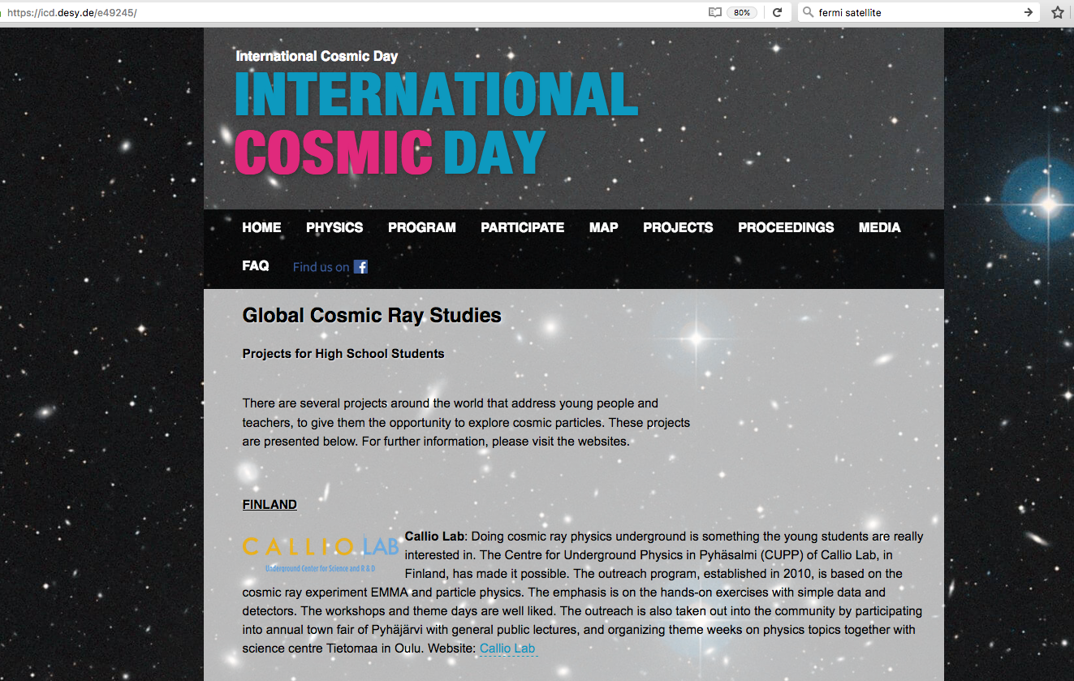
Globalcosmics.org
Aim
Build a Website:
that gives an overview of all cosmic-ray education projects worldwide,
links all of them and
lists events in which high-school students can participate.
First try:
https://icd.desy.de/e49245/
Become an independent website.

Slide 4
Globalcosmics.org
Audience
Projects
Instructors

Slide 5
Globalcosmics.org
Audience
Projects will have a common node where they can:
present themselves.
help build a network.
find contacts to other projects.
join forces and apply for events together.
Instructors

Slide 6
Globalcosmics.org
Audience
Projects will have a common node where they can:
present themselves.
help build a network.
find contacts to other projects.
join forces and apply for events together.
Instructors who act as mediators between science and school:
have access to lessons and activities for their students.
find information for themselves to inspire and for professional development of their teaching about current research.
contacts to projects, some may even be near by.

Slide 7
Globalcosmics.org
Audience
In addition, these groups can be addressed.
Students will find:
information about astroparticle physics.
contacts to a project of a local institute and projects worldwide.
overview of opportunities for them.
Scientists will find:
inspiration and ideas about how to incorporate cosmic ray studies with their own outreach activities
contact information

Slide 8
Globalcosmics.org
Contents of the website
Introduction
  which gives a rough overview of astroparticle physics and what the key topics are.
All Cosmic Ray education projects
  introduce themselves.
Maybe a world map,
  which highlights cities or countries.
Description of global activities for young people, e.g.:
  International muon week
  International Cosmic Day
  https://spexperiment.icecube.wisc.edu/
  https://masterclass.icecube.wisc.edu/
  http://www.cazadoresderayosgamma.com/
  https://www.zooniverse.org/projects/zooniverse/muon-hunter

Slide 9
Globalcosmics.org
Contents of the website
Contact
Carolin Schwerdt, Marge Bardeen and ??? responsible for maintenance of the website.
Every institute is responsible for its own content.

Slide 10
Globalcosmics.org
Next Steps
Requirements for the design of the website have to be discussed
Financing has to be clarified (preparation of the website)

