Slide 1


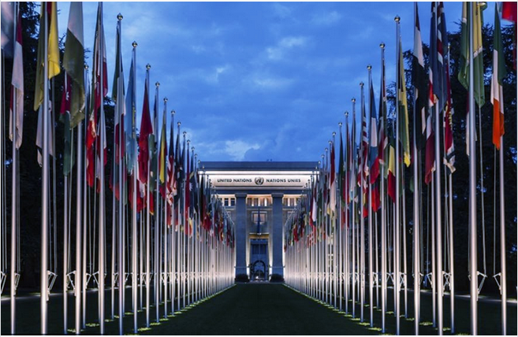
Rotary Day at the United Nations
Peace : Making a Difference
10 & 11 November 2017

Slide 2
Rotary International is the most important global humanitarian service organization, bringing together 35,000 clubs in 537 districts in more than 200 countries and territories.
Rotary Day at UN in November: Peace: Making A Difference
Celebrate Rotary’s privileged relationship with UN and shared vision for a peaceful world
Formulate the recommendations to the international community

Slide 3

http://rotarydaygeneva.com/

Slide 4
Rotary Day at UN in November: Peace: Making A Difference
Organized for the very first time in Geneva, the city known as the international center for diplomacy and peace
Theme – Peace: Making A Difference
Global event will be the perfect conclusion to this year’s Geneva Peace Week
Educate and inspire the large audience on how to actively build peace at the local, regional and global levels
More than 1000 participants
Plenary sessions and workshops - elucidate the objectives of the Sustainable Development Goals (SDGs)
Special session, organized by young leaders for young leaders
- underline the importance of education in the peace-building process

Slide 5

Special workshop for young leaders
”Education, science, a pathway to peace”
Barbora: 5 minutes sharp speech without slides
…followed by the panel discussion
Feedback & Advice! ☺
- Links between science and peace (example CERN)
- Youth empowerment through education
- Peacebuilding though education
3 messages:
Questions:
What could/should each individual do to promote peace?
What expectations are addressed to civil society organizations, in particular, what could/should Rotary do to promote peace?
What are the expectations to Governments and international organizations?
Recommendation to the international community?

Slide 6


