Slide 1

IPPOG Wrap-up
Hans Peter Beck: IPPOG Chair
Steve Goldfarb: IPPOG Chair

Slide 2
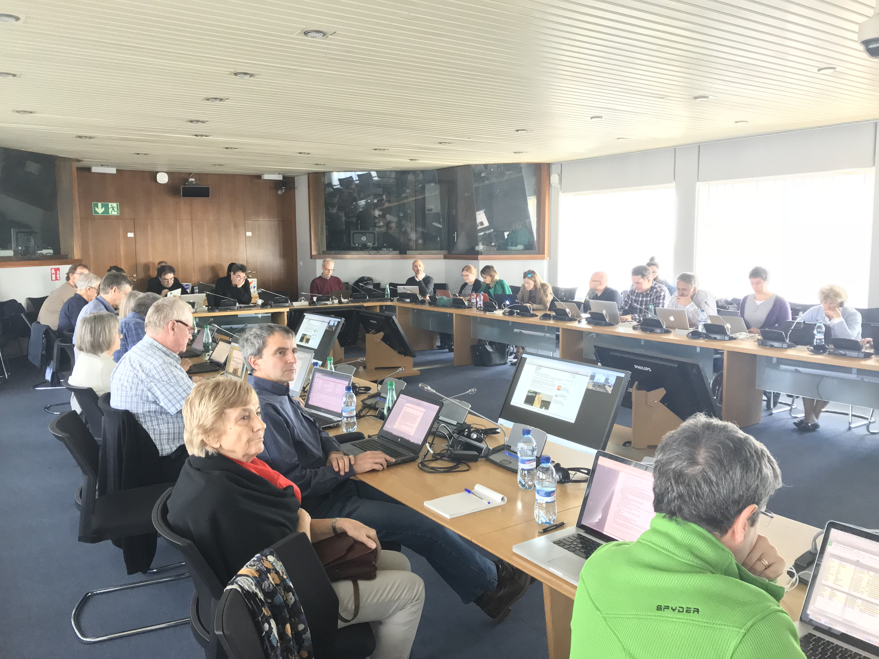
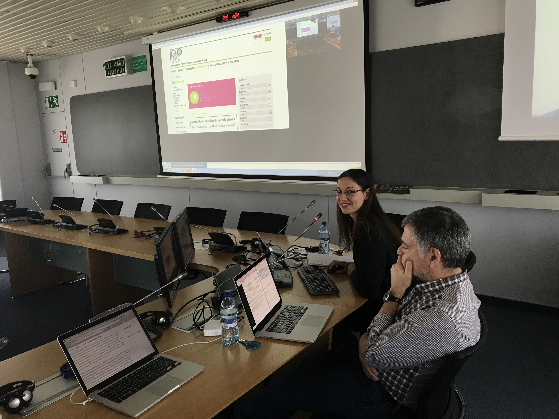
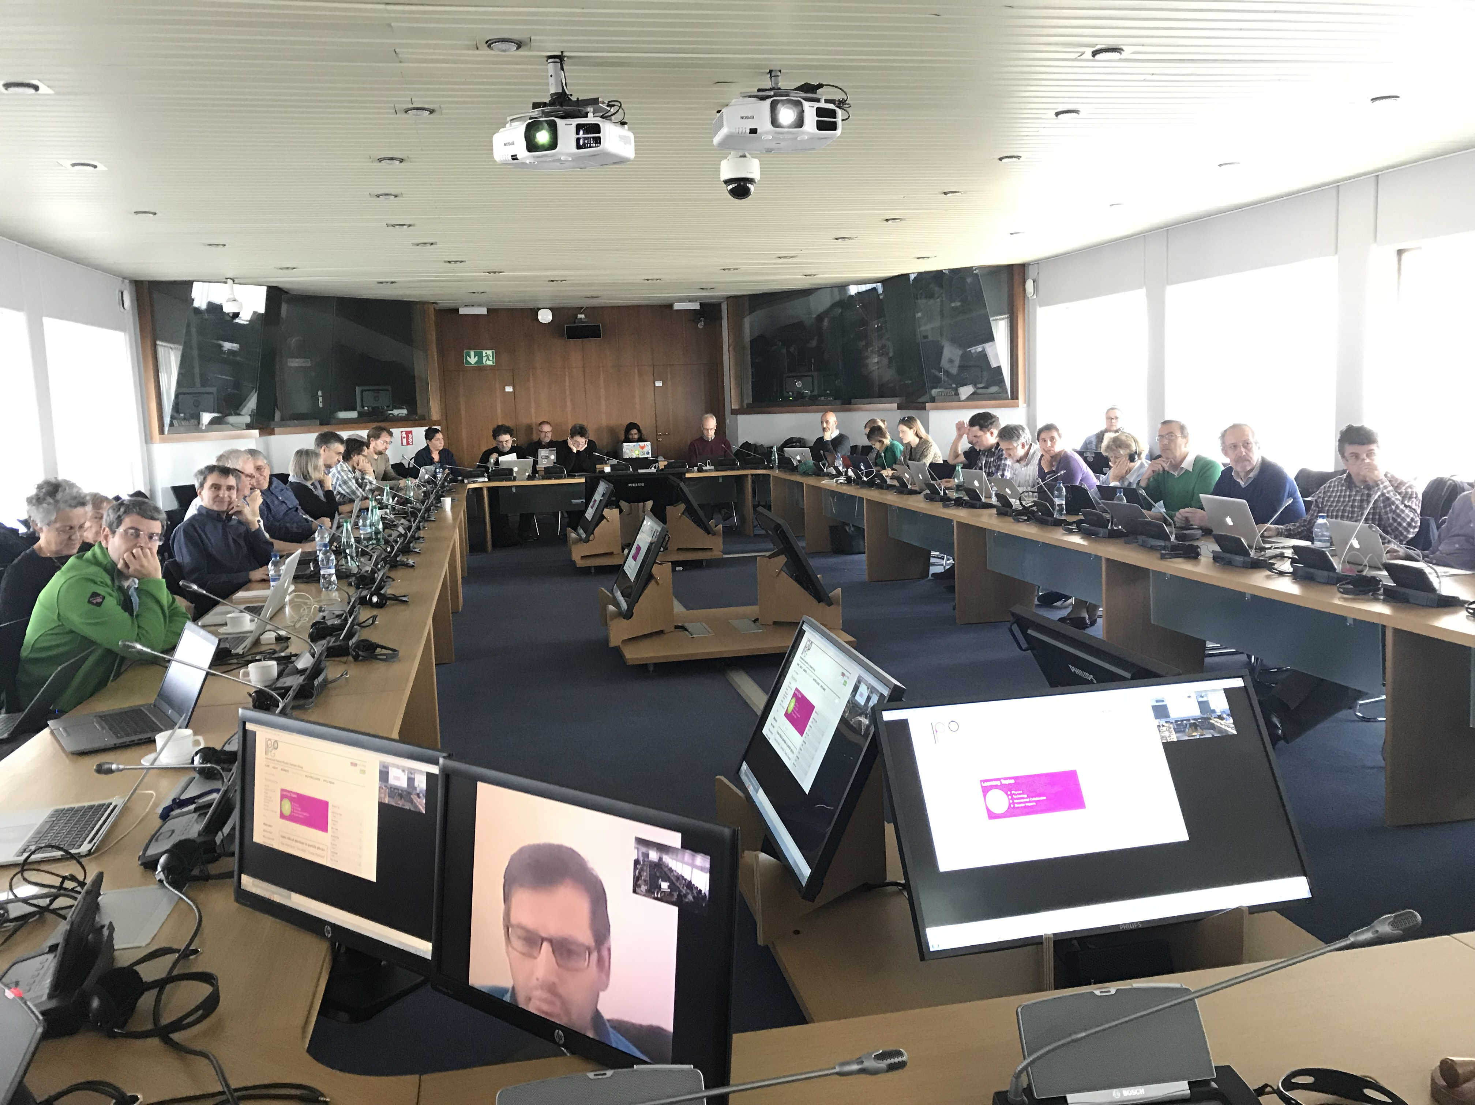
Intense 2½ days
Explaining Particle Physics Hot Topics to a Lay Audience
Beauty and Physics
Ideasquare
IPPOG and gravitational waves
Bringing Masterclasses to New Countries
Beamline for schools 2017 and call for 2018
Reaching new audiences at non-science festivals
Broadening the physics scope of Masterclasses
Inspiring success stories
Exhibitions and Event Highlights
Masterclasses 2018
Collaboration Board
MoU Addenda
Country highlights
Budget 2017 + 2018
Masterclass in a Box
Portraits
An inside view from IPPOG
Physics for everyone – What is Spin ?
Global Cosmic Rays

Slide 3
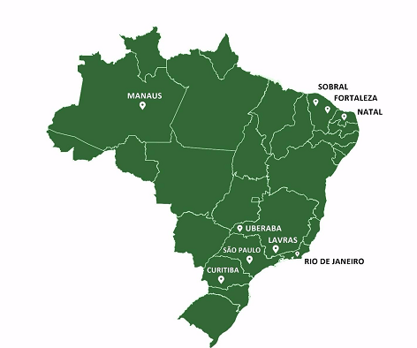
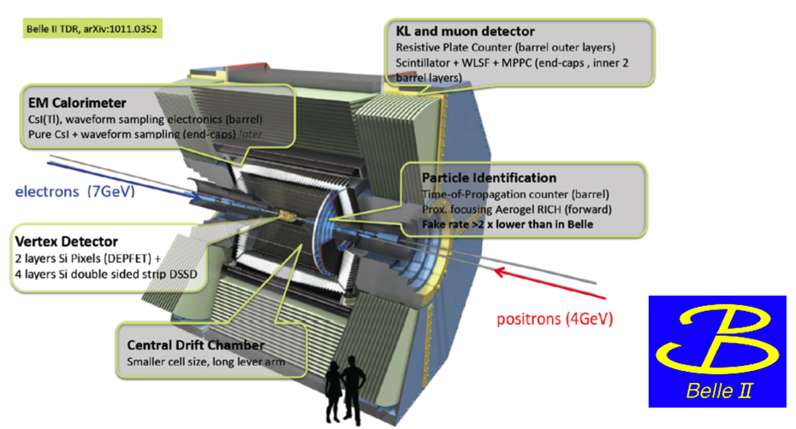
Welcome to our two new Members

Slide 5
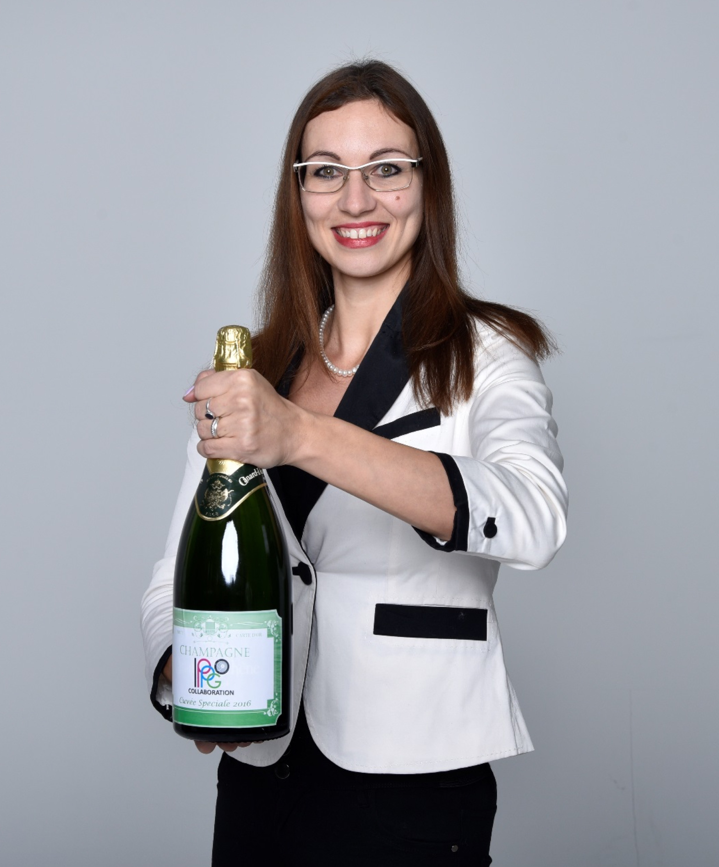
A big Thank you to all who helped
And especially to Barbora !!

Slide 6
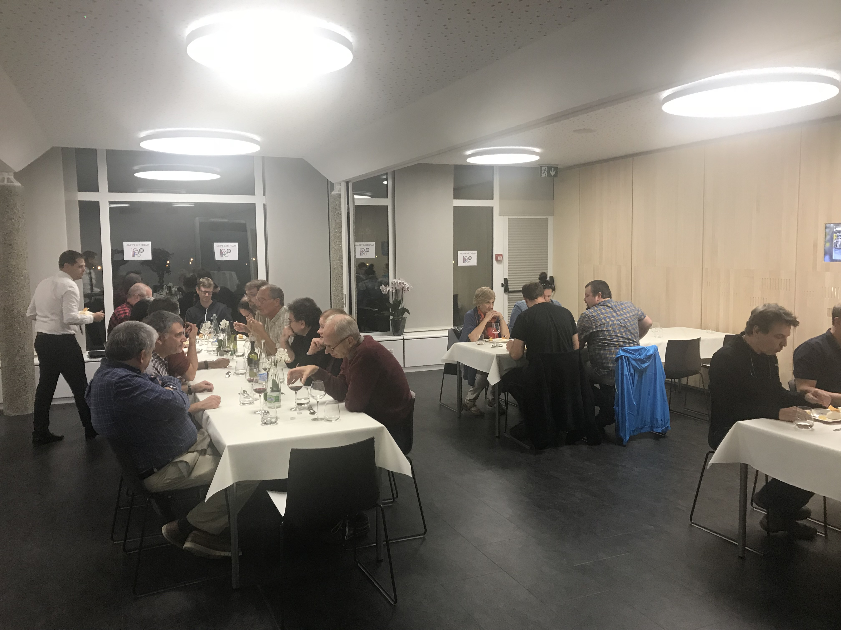
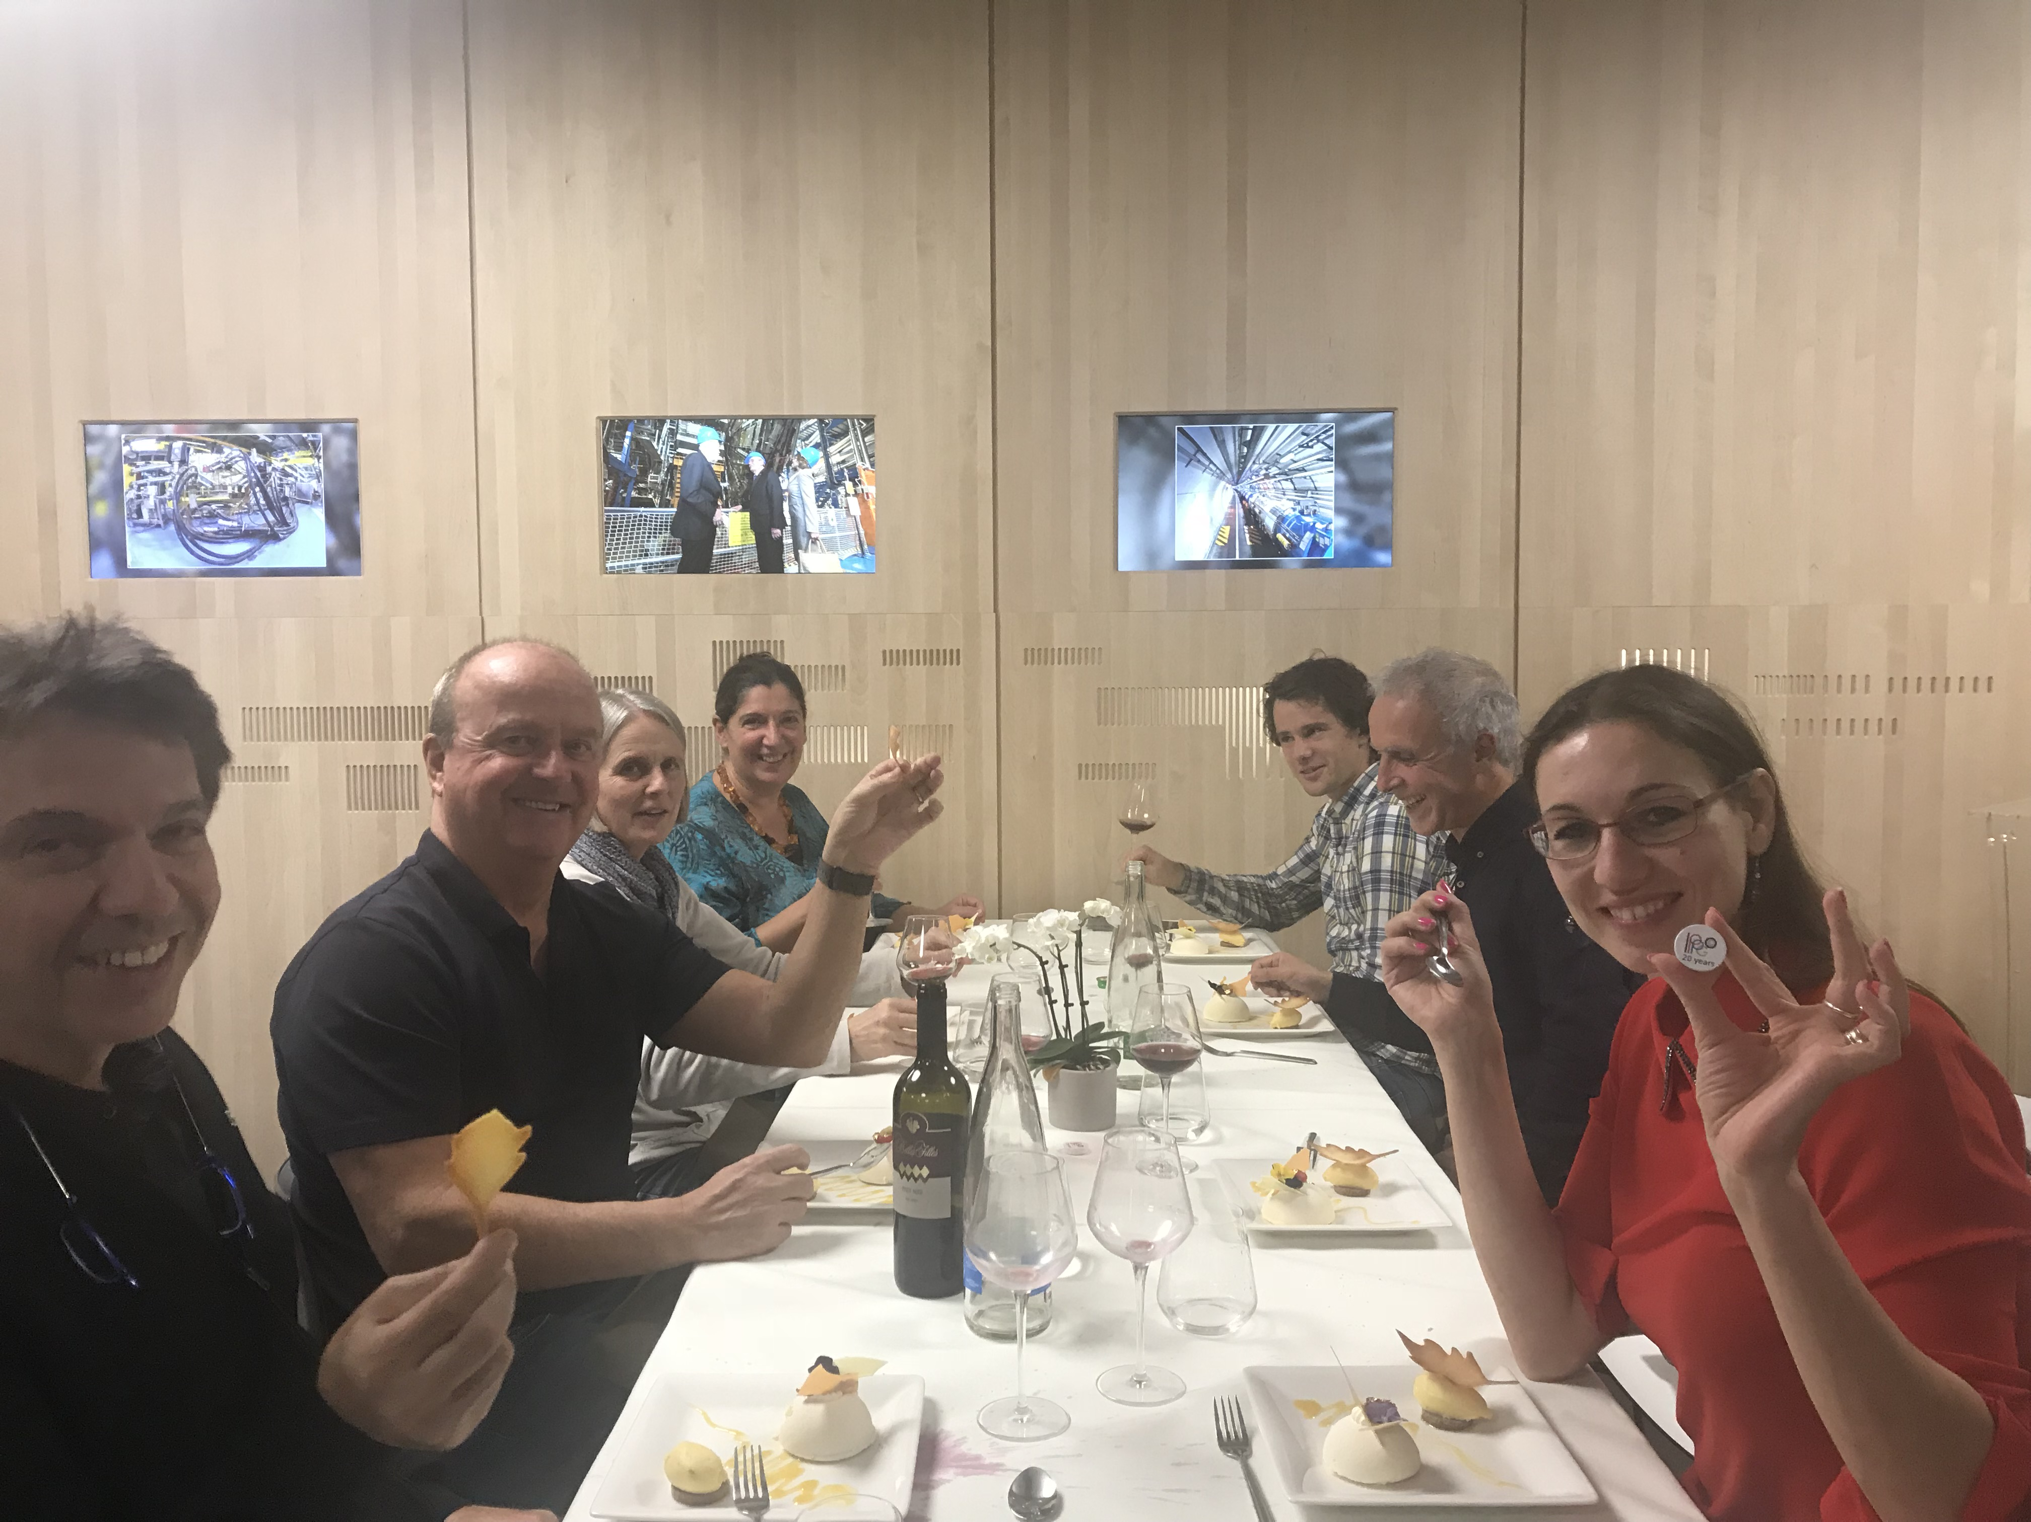
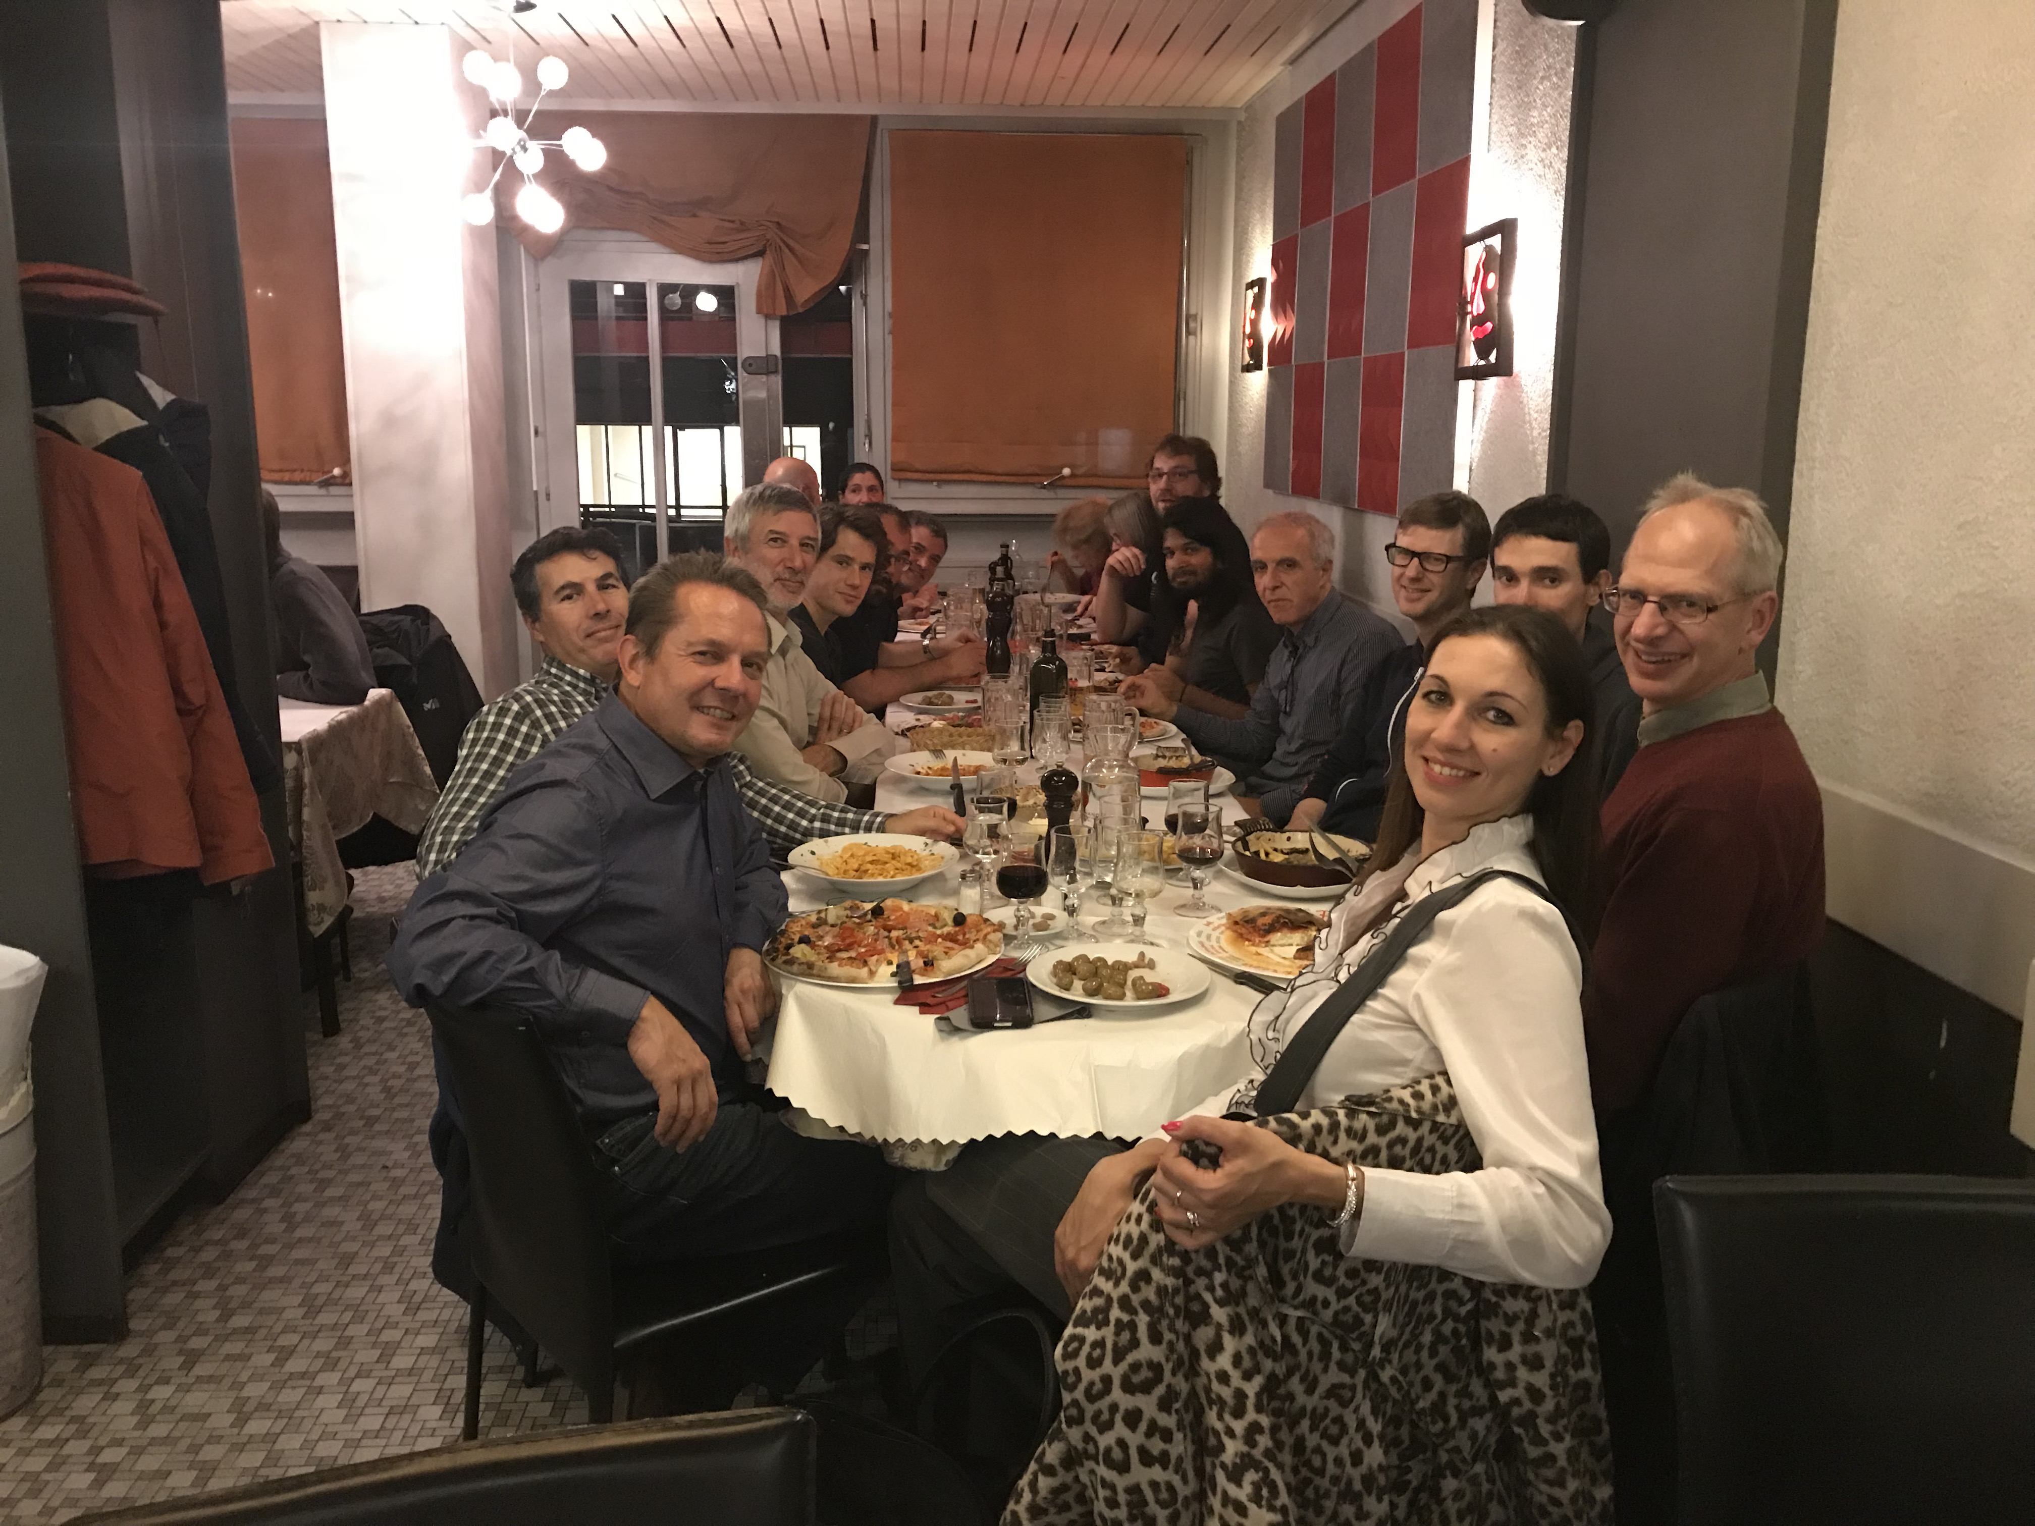
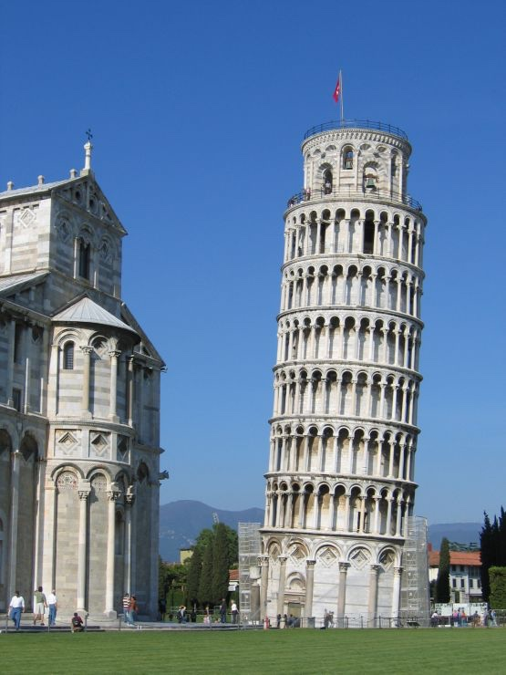
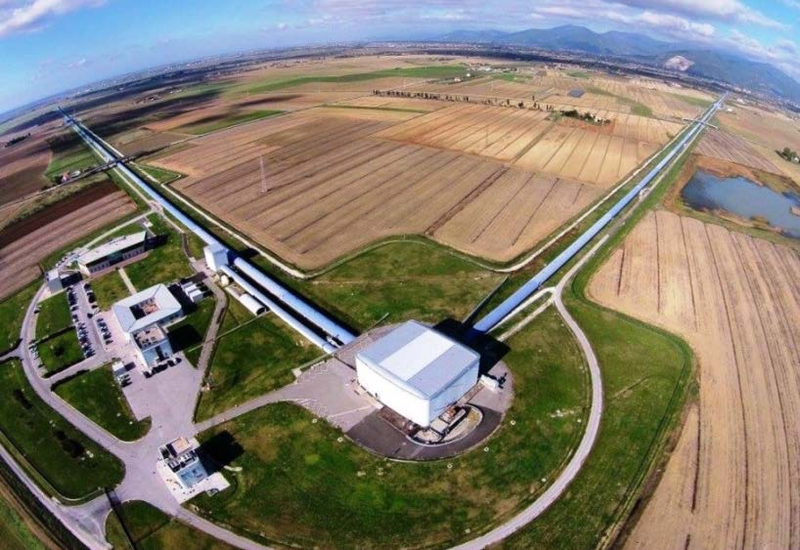
Looking forward
to seeing you all in in Pisa
Spring 2018

