Slide 1
CENF-ND-WG2
Cross Sections: theory and generators
Marco Martini and Federico Sanchez

Slide 2
Status of the WG2
A bit of Physics
Perspectives

Slide 3
Status of the WG2

Slide 4
WG2 members
39 members have subscribed to the mailing list
All the theoretical models, at least for CCQE and 2p-2h (Ghent, Martini et al, Nieves et al, Spectral Function, SuSAv2+MEC) are represented by at least one member
The main generators (FLUKA, GiBUU, GENIE, NEUT, NuWro) are represented
Not only WG2 people subscribed the WG2 mailing list

Slide 5
WG2 meetings
1 Vidyo meeting in September:
11 participants (4 theory + 7 MC/Exp.)
Informal meetings and discussion during other workshops and conferences
Several open collaborations among WG2 members to implement various theoretical models in different generators
1 NuSTEC meeting (16-17 November)

Slide 6
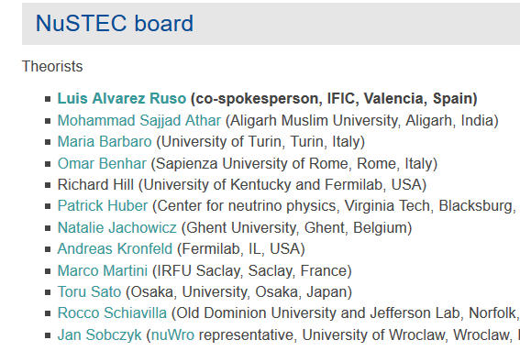
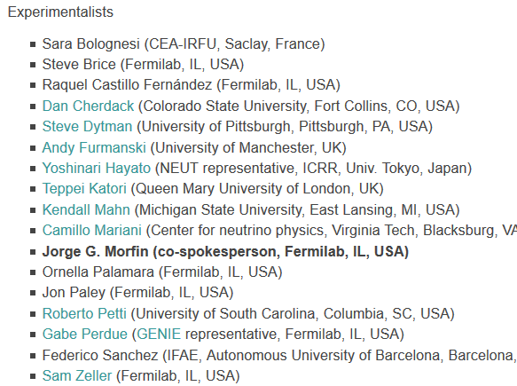
CENF-ND vs NuSTEC
*
CENF-ND members
*
CENF-ND WG conveners
*
9/9 European members of the NuSTEC board (6 theo., 3 exp.) subscribed the CENF-ND
3 are WG2 and WG3 conveners
*
*
*
*
*
*
Next NuSTEC School will be organized in 2019 at CERN
*
*
*

Slide 7
WG2 twiki page
https://twiki.cern.ch/twiki/bin/view/CENF/NearDetectorWG2
Link to many papers, presentations and conferences:
Recent review papers
Recent review talks
Conferences and workshops
Comparison theory-experiment
- CCQE, CCQE-like and CC0pi
- CC inclusive
Comparisons with electron scattering data
Neutrino versus antineutrino
Nu_mu versus nu_e
A-dependence and Argon studies
Work in progress, many parts to be added (MC papers and links, CC1π,…)
Feel free to modify it
Philosophy: not exhaustive but updated

Slide 8
A bit of Physics
CCQE, CCQE-like and CC0π
Status of 2p-2h (or np-nh)

Slide 9
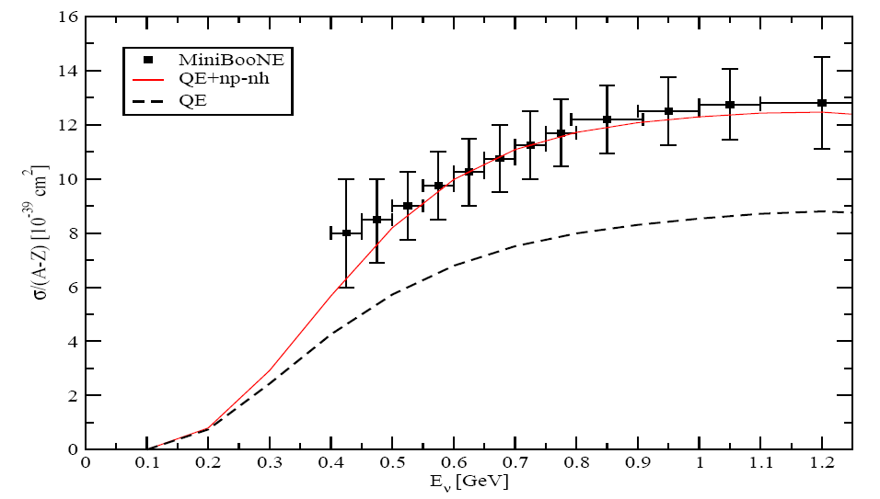
MiniBooNE: CCQE-like
Inclusion of the multinucleon emission channel
(np-nh = 2p-2h + 3p-3h)
Genuine CCQE
μ
N’
p
n
p
n
p
n
p
p
W+
n
p
n
Ʋ
p
N
Two particles-two holes (2p-2h)
μ
N’
N’
n
p
n
p
n
W+
p
n
p
p
n
p
n
p
p
Ʋ
N
N
W+ absorbed by a pair of nucleons
CCQE-like = Genuine CCQE + np-nh
M. Martini, M. Ericson, G. Chanfray, J. Marteau, Phys. Rev. C 80 065501 (2009)
Agreement with MiniBooNE without increasing M_{A}

Slide 10
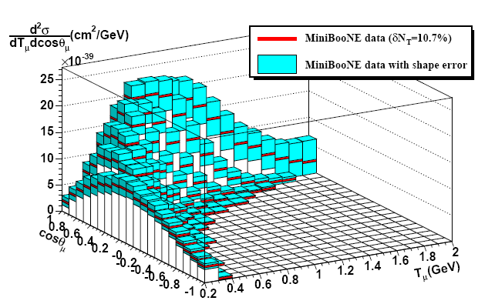
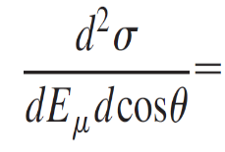
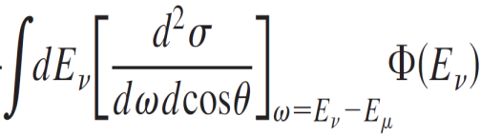
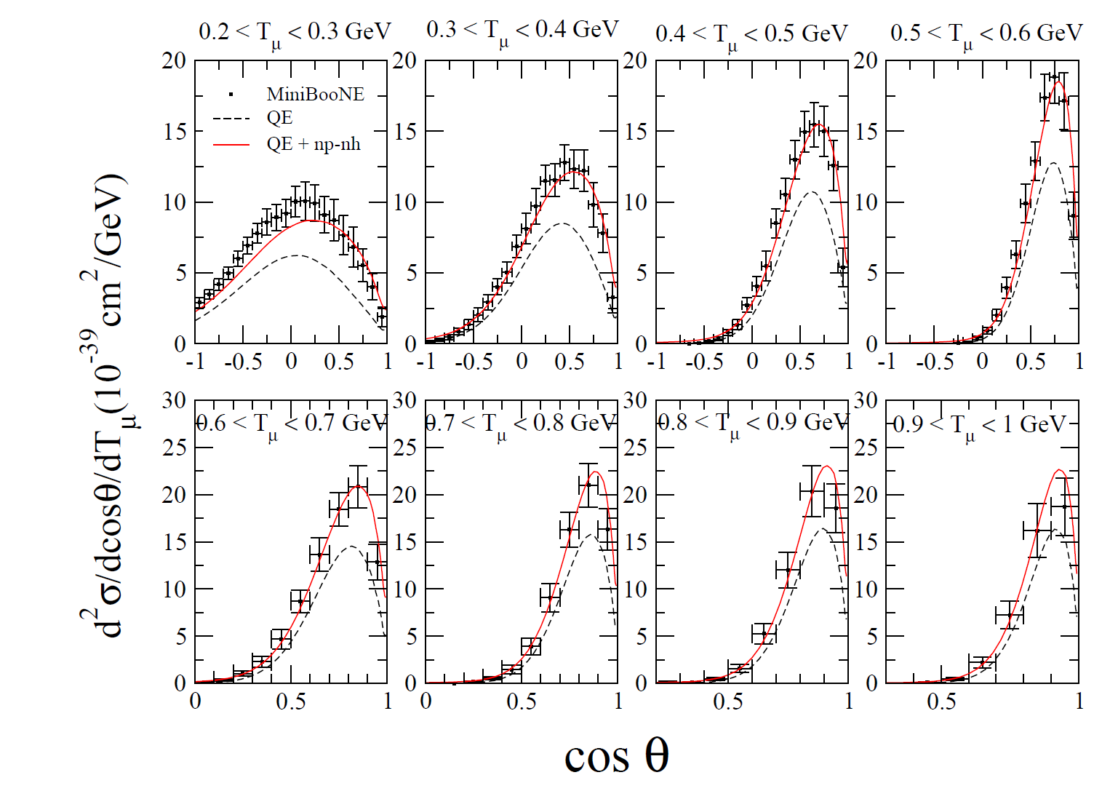
CCQE-like flux-integrated double differential cross section
Tμ
μ
)
Ʋ
n
p
θμ
n
n
p
n
p
p
n
p
n
p
Less model dependent than σ(E_{ν})
MiniBooNE, Phys. Rev. D 81, 092005 (2010)
Flux dependent
Martini, Ericson, Chanfray,
Phys. Rev. C 84 055502 (2011)

Slide 11
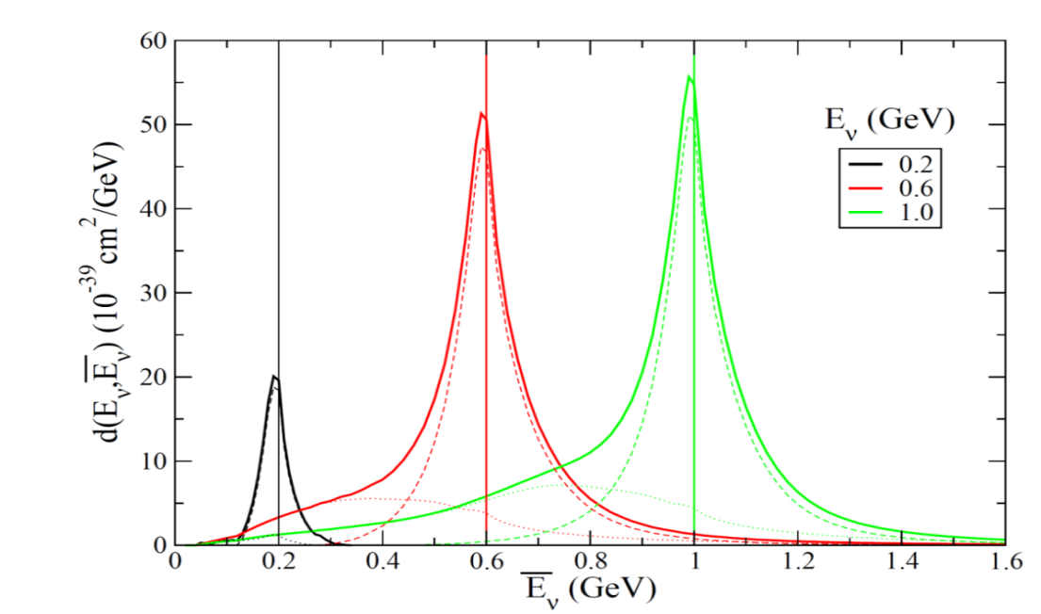
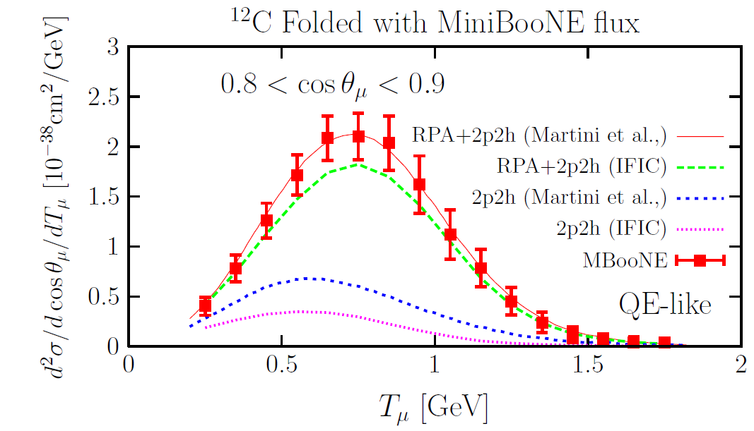
The multinucleon emission channel (or 2p-2h, or np-nh)
A lot of interest in these last years
Explanation of the axial mass puzzle
It was not included in the generators used for the analyses of ν experiments
Today there is an effort to include this np-nh channel in several Monte Carlo
An important source of systematic errors in oscillation experiments because it affects the neutrino energy reconstruction
Several theoretical calculations agree on its crucial role but there are some differences on the results obtained for this channel
M. Martini, M. Ericson, G. Chanfray, Phys. Rev. D 87 013009 (2013)
Morfin et al. Adv. HEP 2012 934597

Slide 12
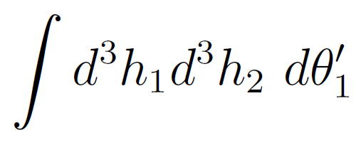
Main difficulties in the 2p-2h sector
matrix elements
7-dimensional integrals
of thousands of terms
Huge number of diagrams and terms
Divergences (angular distribution; NN correlations contributions)
Calculations for all the kinematics compatible with the experimental neutrino flux
Computing very demanding
Hence different approximations by different groups:
- choice of subset of diagrams and terms;
- different prescriptions to regularize the divergences;
- reduce the dimension of the integrals
(7D --> 2D if non relativistic; 7D -->1D if h₁ = h₂ =0)
⇓
Different final results by different groups

Slide 13
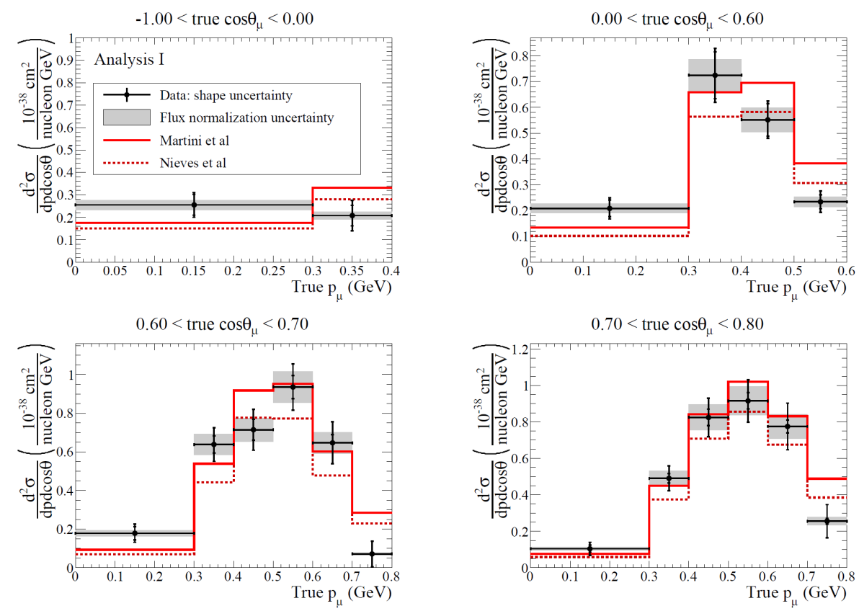
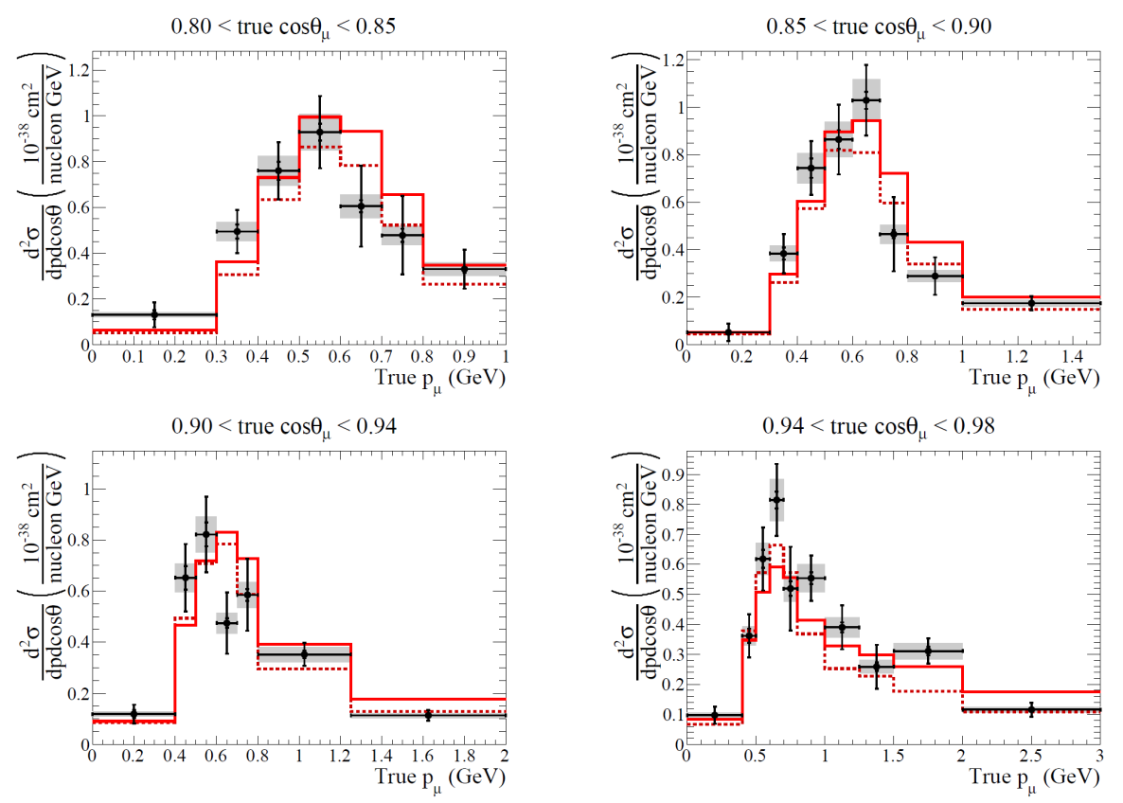
CC0π = CCQE-like without subtraction of π absorption background
It is increasingly more popular to present the data in terms of final state particles (e.g. 1μ, 0π, any p)
T2K collaboration: Abe et al. Phys. Rev. D 93 11012 (2016)
d²σ CC0π on¹²C
Martini et al.
Nieves et al.
The two theoretical models including np-nh are compatible with data
at present level of experimental accuracy

Slide 14
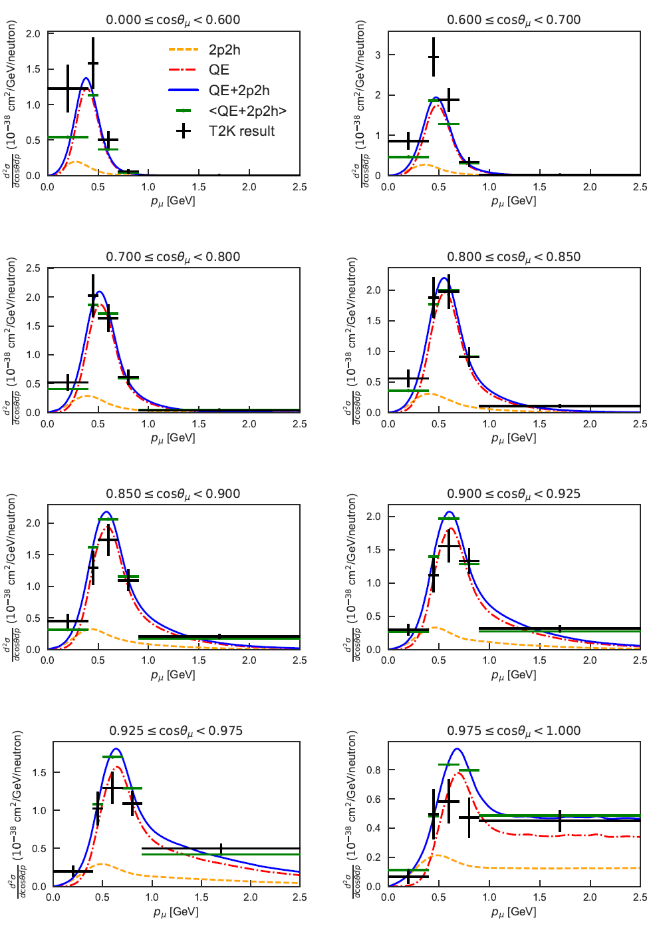
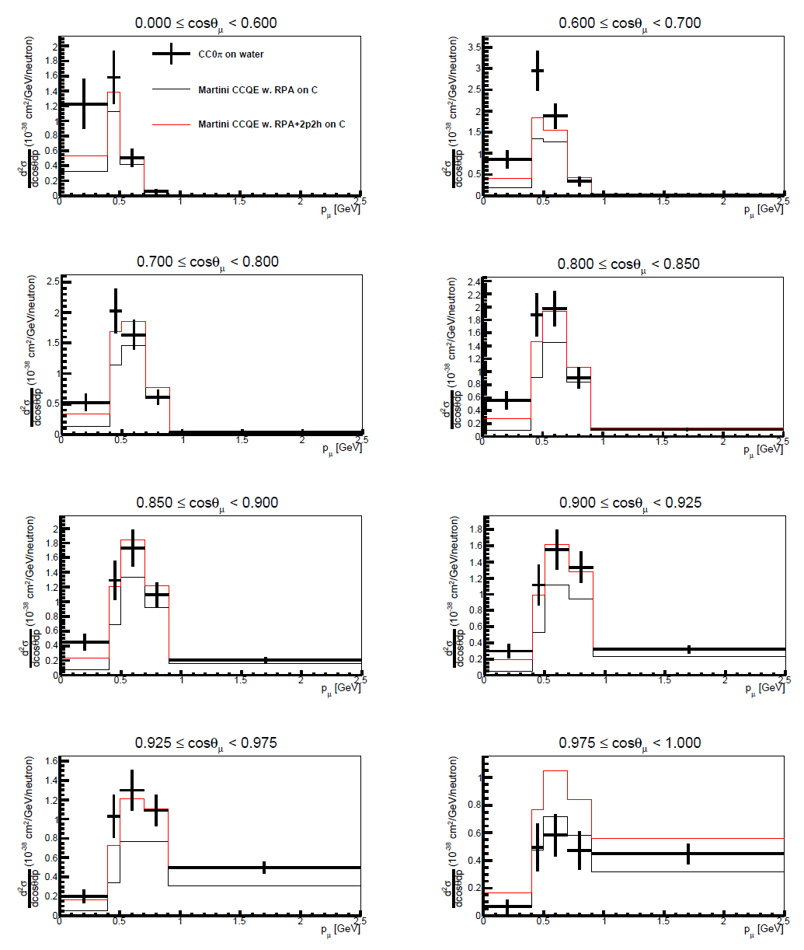
Another very recent example: T2K CC0π on water
T2K collaboration: Abe et al. 1708.06771 (2017)
Martini et al.
No pion
contribution
SuSAv2+MEC Megias Talk

Slide 15
Status of implementation of theoretical models including 2p-2h into MC
Nieves et al.
- implemented in GENIE, NEUT, NuWro
- used in MINERvA and T2K analyses
Martini et al.
- implementation in GENIE started
(work in progress: S. Bolognesi, S. Dolan, M. Martini)
- the consequent implementation in NEUT and NuWro should be straightforward
SuSAv2+MEC
- G. Megias and M. Barbaro will spend time in Saclay to collaborate with
S. Bolognesi and S. Dolan
- implementation in NEUT by B.Bourguille & F. Sanchez
Ghent model
- project of implementation in NuWro
GiBUU
  - 2p-2h implemented using an empirical response function based on e scattering

Slide 16
Examples of recent
Experimental and Monte Carlo analyses considering the Nieves et al. model

Slide 17
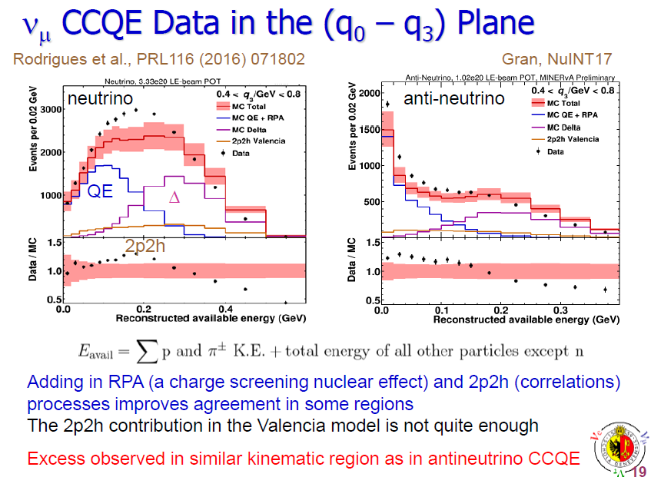
MINERvA
Patrick Cheryl, Sandro Bravar NUFACT 17

Slide 18
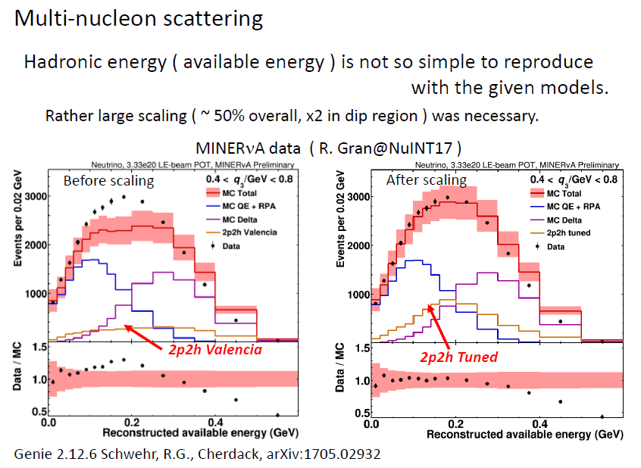
MINERvA
Patrick Cheryl, Sandro Bravar NUFACT 17
Rather large scaling (∼ 50 % overall, x2 in dip region)
is necessary

Slide 19
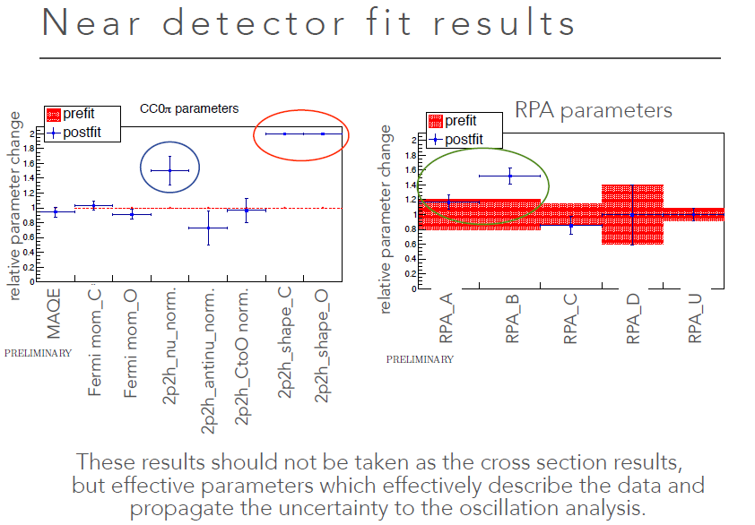
Keigo Nakamura NUFACT 17
T2K

Slide 20
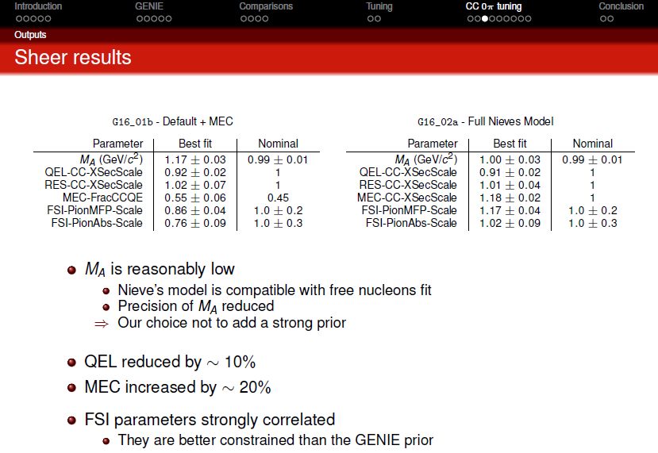
GENIE Tuning against CC0π datasets (MiniBooNE, T2K, MINERvA)
Marco Roda, NUFACT 17

Slide 21

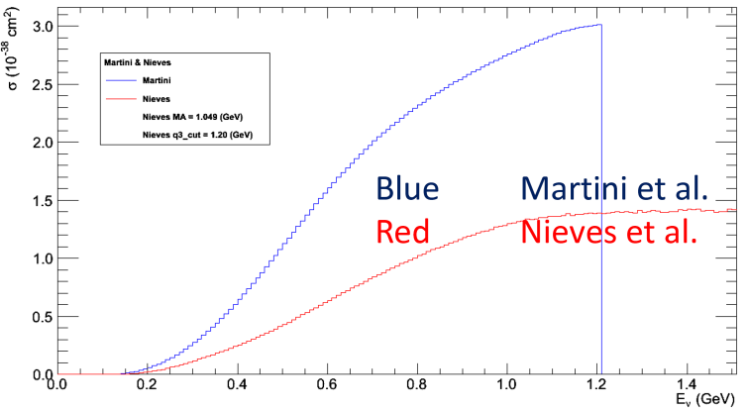
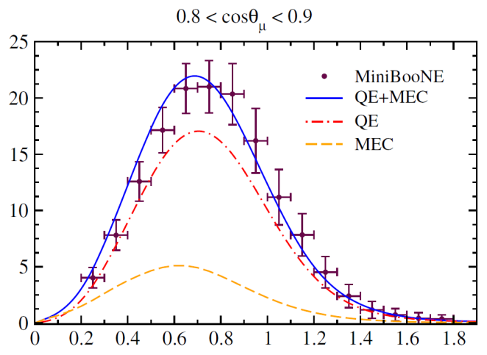
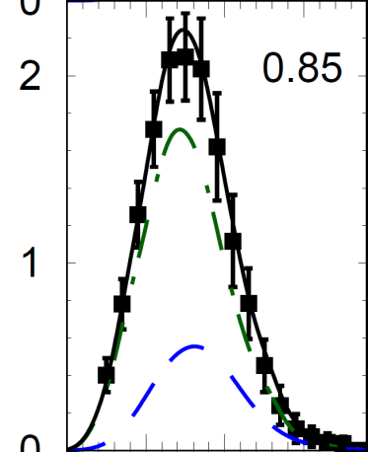
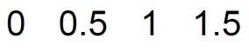
General trend of the MINERvA, T2K and GENIE analyses: the 2p-2h contributions in the model of Nieves et al. seem to be underestimated
Remind: other microscopic calculations have 2p-2h contributions larger than the Nieves et al. ones
GiBUU
SuSAv2+MEC
Megias et al.
PRD 94 (2016)
Gallmeister et al.PRC 94(2016)

Slide 22
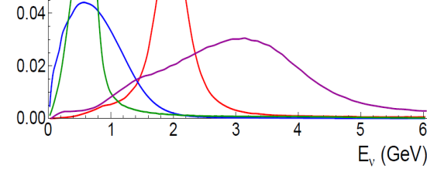
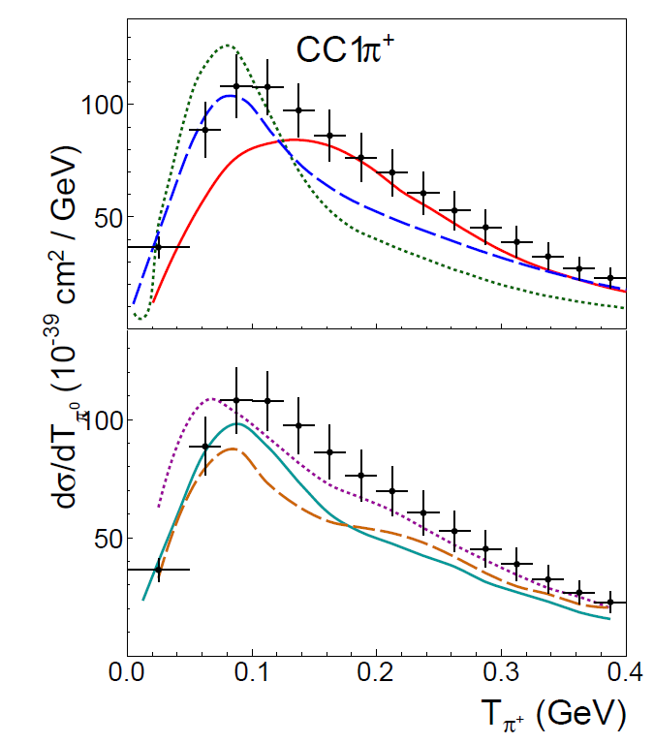
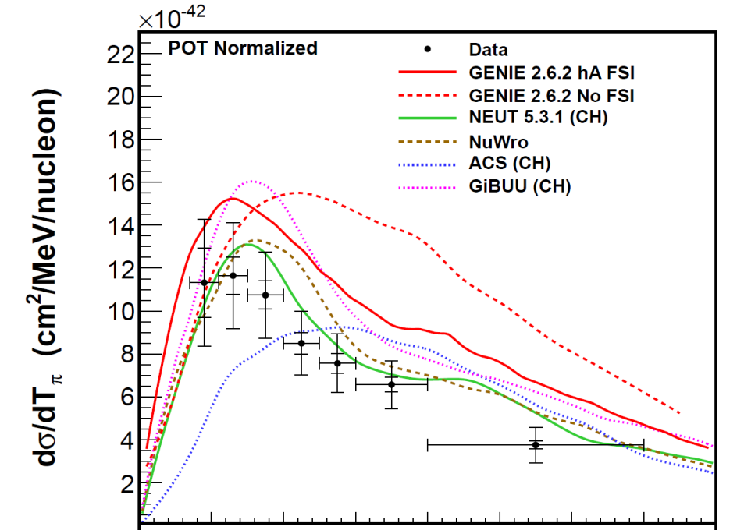
Few words on other channels: I) The CC1π puzzle
MiniBooNE
MINERνA
Fluxes
MiniBooNE
MINERνA
Rodrigues, AIP Conf. Proc. 1663 (2015)
Eberly et al. , PRD 92 (2015)
The pion puzzle
is an open question
normalization of data, normalization of theory, πFSI, DIS, hadronization, detector efficiency,…?

Slide 23
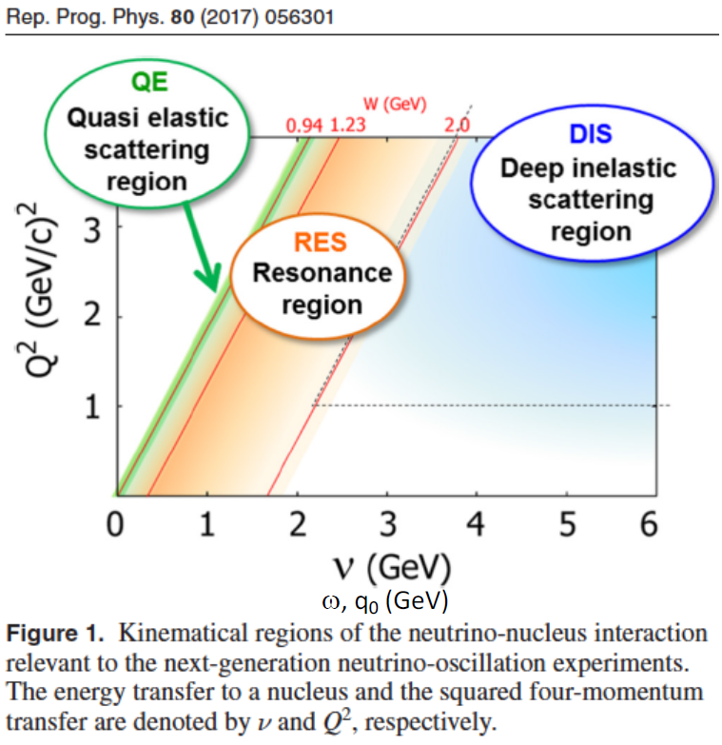
Few words on other channels: II) DIS and SIS
The DIS and SIS (from Δ to DIS) regions need further experimental, theoretical and MC investigations
These regions are particularly important for DUNE

Slide 24
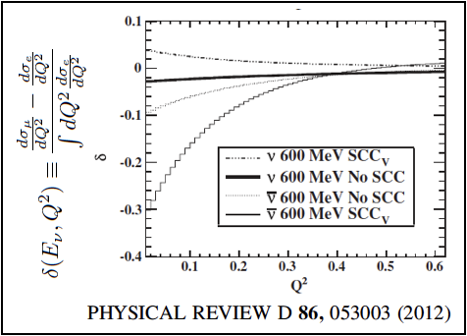
Electron neutrino cross-sections
Soon the knowledge of the electron neutrino cross-section will be critical.
  Electron mass effect convolves with nuclear uncertainties.
  Electron neutrino suffers from radiative corrections in the final state that needs to be computed inside the nucleus.
    Corrections will alter the cross-section and the energy reconstruction depending on the detector technology.
This is a very nice topic for a HEP theorist with no nuclear background and it could be computed in a reasonable time.

Slide 25
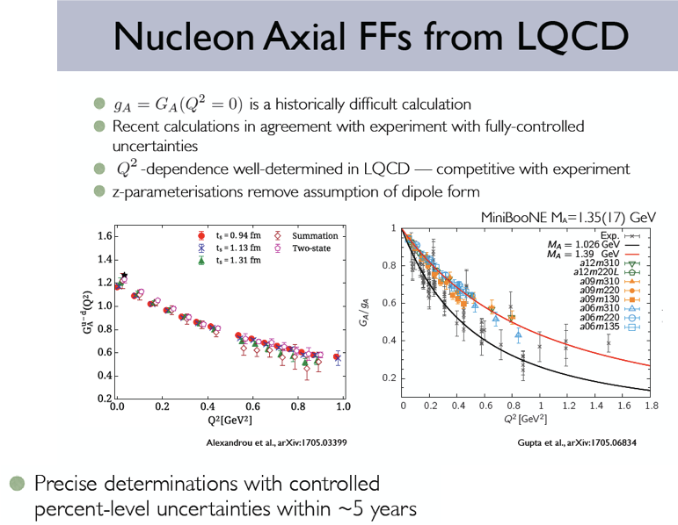
Form factors and lattice QCD
Still problems at the nucleon level.
Scalar, Pseudoscalar and tensor derived from models.
Vector form factors from electron scattering.
Axial form factor from formal guesses.
?
Experiments will require deuterium targets.
Lattice calculations will help.

Slide 26
Perspectives

Slide 27
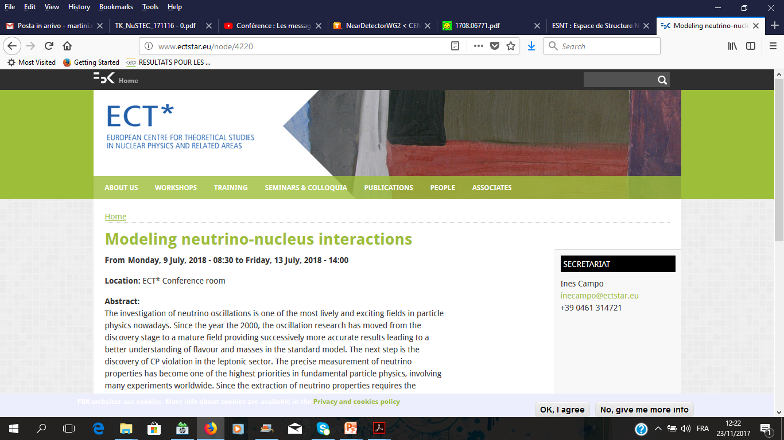
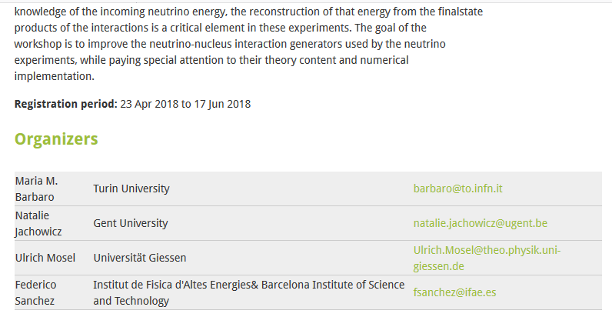
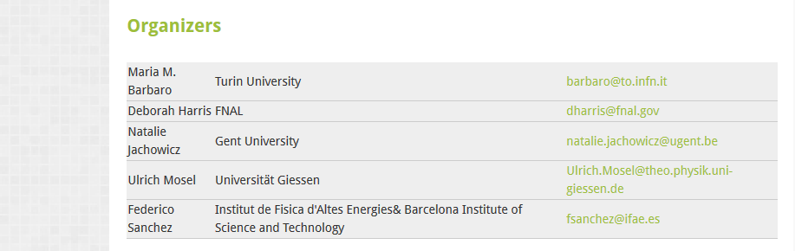
Supported by
CERN CENF
27

Slide 28
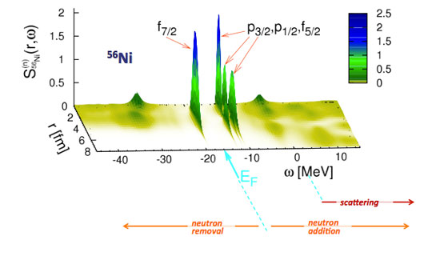
INT Program INT-18-1a
Nuclear ab initio Theories and Neutrino Physics
Seattle February 26 - March 30, 2018
Organizers:
C. Barbieri
University of Surrey
c.barbieri@surrey.ac.uk
O. Benhar
Università La Sapienza
omar.benhar@roma1.infn.it
A. Galindo-Uribarri
Oak Ridge National Laboratory
uribarri@ornl.gov
A. Lovato
Argonne National Laboratory
lovato@anl.gov
J. Menéndez
University of Tokyo
menendez@cns.s.u-tokyo.ac.jp
Program Coordinator:
Farha Habib
faraway@uw.edu
(206) 685-4286
Broad scope, from neutrino cross-section to double beta decay nuclear modeling

Slide 29
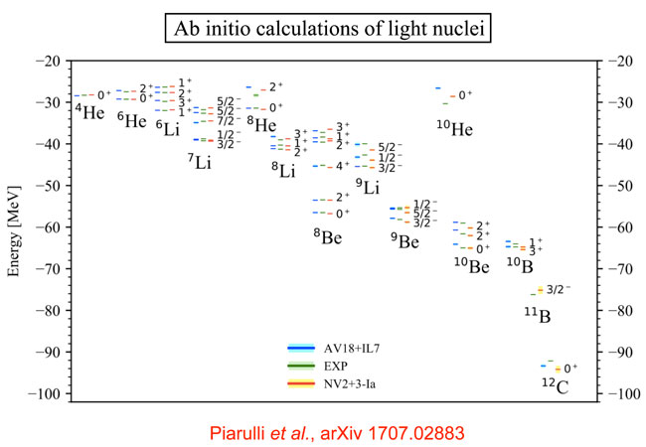
NT Program INT-18-2a
Fundamental Physics with Electroweak Probes of Light Nuclei
June 12 - July 13, 2018
Organizers:
Sonia Bacca
University of Mainz & TRIUMF
s.bacca@uni-mainz.de
Richard Hill
University of Kentucky & Fermilab
rjh@fnal.gov
Saori Pastore
Los Alamos National Lab
saori@lanl.gov
Daniel Phillips
Ohio University
phillid1@ohio.edu
Fundamental properties of neutrinos
Identifying the particle nature of dark matter
Resolving the proton-radius and deuteron-radius puzzle
Understanding light-element nucleosynthesis

Slide 30
WG2 Actions
Coordinate the European effort
Attract new people:
CERN (high energy) theorists; European (low energy) nuclear structure theorists
Synergies with NuSTEC
Further stress the impact of the model uncertainties on the oscillation analyses
Some point to discuss
Each theoretical group has its plans and perspectives which will be pursued (if founded!) independently of the WG2. WG2 is the appropriate place where informally discuss the state of the art of these researches even before publication.
Up to now the collaboration between theorists and MC developers has been easy (maybe slow!) but essentially based on punctual and personal initiatives and favorable spatial-temporal conjunctures. In the future CENF-ND can play an important role.
Neutrino cross sections database already exist inside some MC collaborations
- It would be possible to share these data with the whole community as in the case of electron scattering?
- If yes, how the “internal” work already done can be valorized?
What will be the role of GENIE and NUANCE (for example?!) in the WG2?

