Slide 1
LHCb UK Meeting 2018
Michael Alexander, Dana Bobulska, Cameron Dean, Lauren Douglas, George Coombs, Lars Eklund, Valerie Flood, Sarah Karodia, Iain Longstaff, Sneha Naik, Stephen Ogilvy, Manuel Schiller, Paul Soler, Patrick Spradlin, Murdo Traill, Kenny Wraight
Glasgow 4-5 January 2018
Welcome

Slide 2
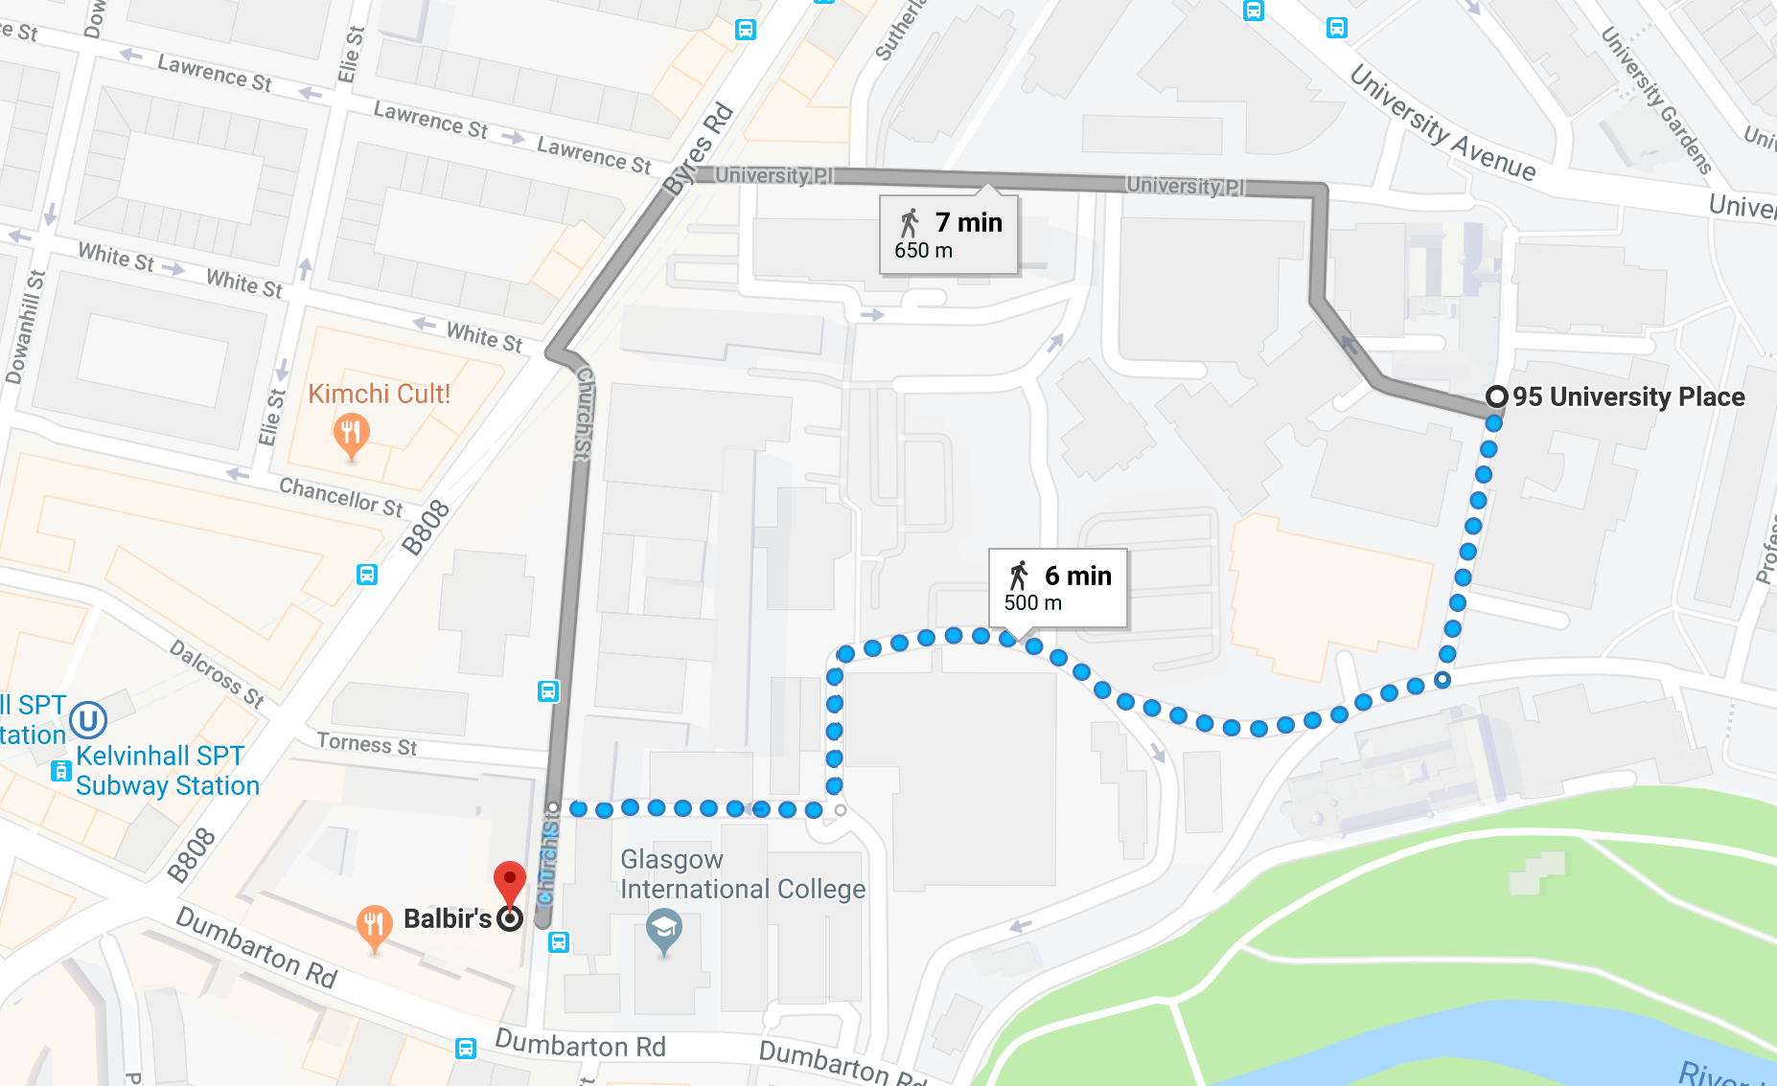
Practical Information
WiFi access
  Eduroam
  Kelvin WiFi code: 914a8a
Rest rooms
Coffee: Thursday pm and Friday am in the Common Room
Building access & exit
  Janitors present until 18:30 today and from 08:00 tomorrow
  Exit after 18:30: below main entrance, push the button
Pubs: 18:00-19:00 and after dinner
  List of pubs and venues
Dinner: Balbirs (Indian) at 19:00
  Map and details

