Slide 1
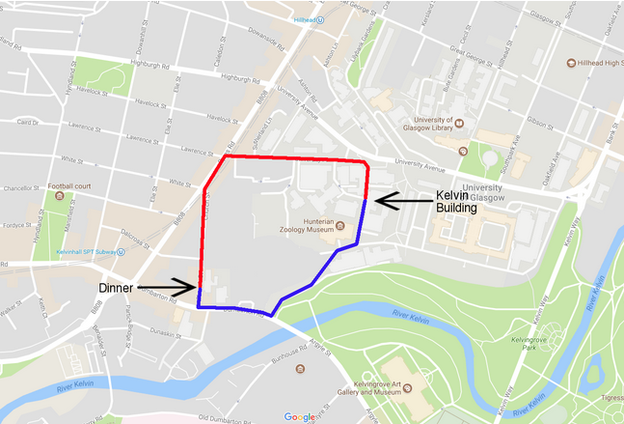
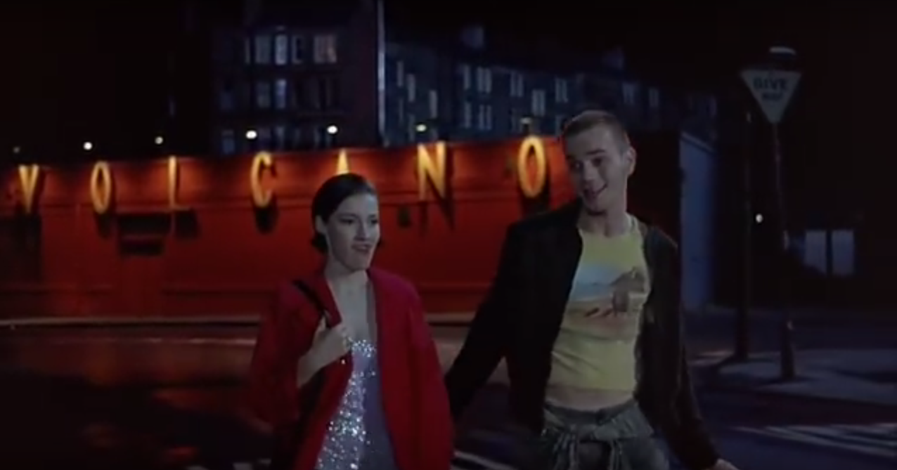
Collaboration Dinner
Dinner is at 7pm in Balbirs restaurant
There is money behind the bar for 2 drinks each
We’ll let you know when the kitty has run out
There are plenty of nearby bars, please see here
Look for this famous
Trainspotting landmark
(it’s now grey, called Sanctuary)

