Slide 1



Long Lived Particle Searches
at the LHC
Albert De Roeck
CERN, Geneva, Switzerland
Antwerp University Belgium
UC-Davis California USA
NTU, Singapore

Slide 2
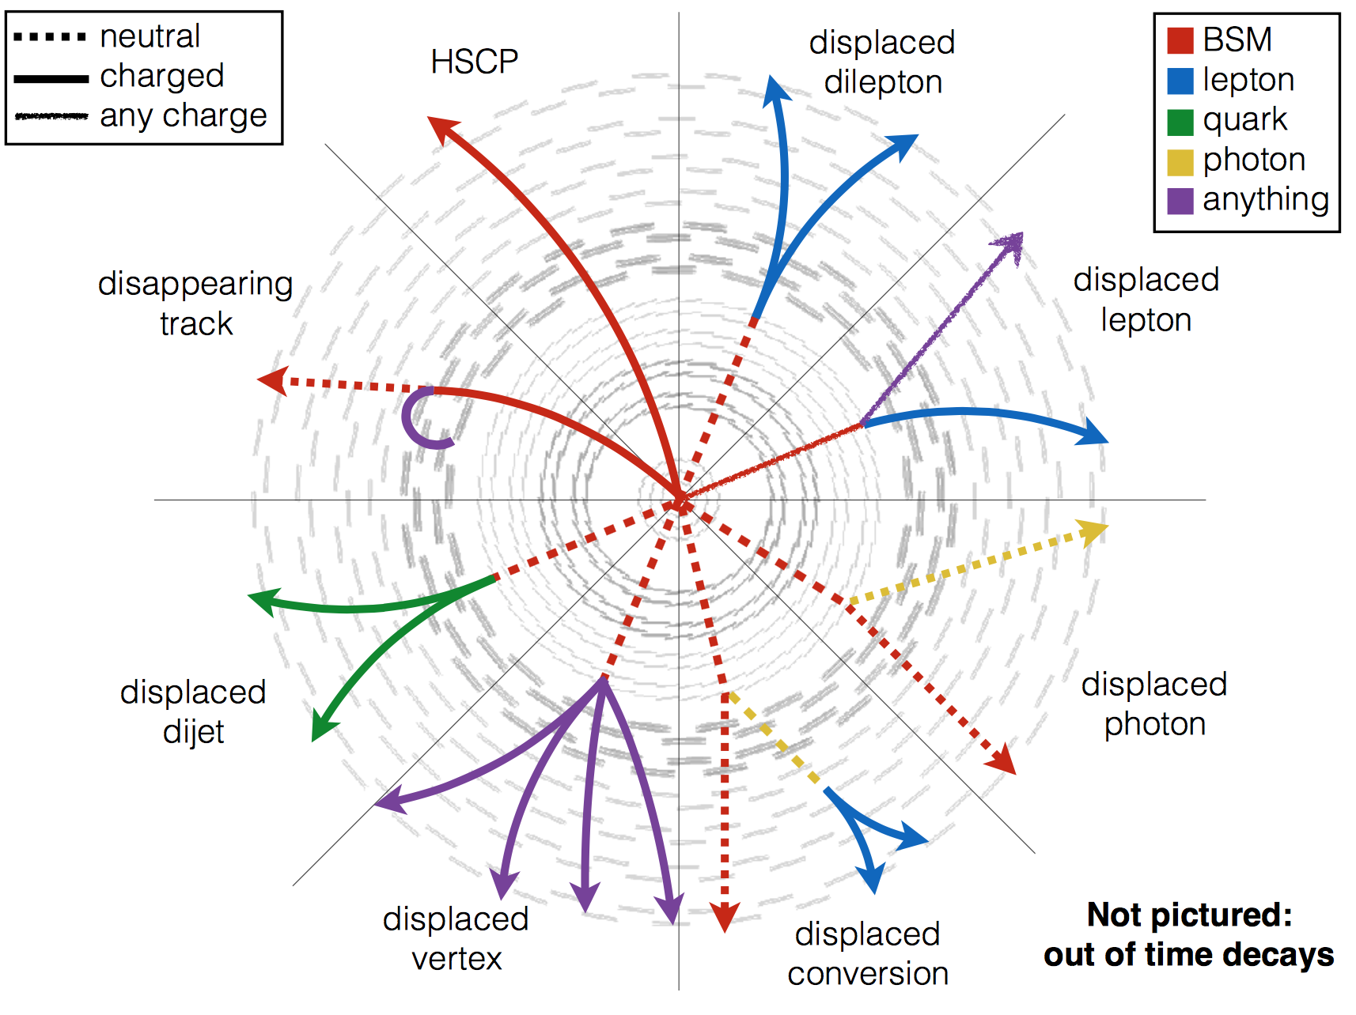
Outline
Introduction to long lived exotic
particles: why do we care?
A tour of LHC results from
various experiments
New experiments for the LHC?
Summary/Outlook
Note: this talk will give a flavor
and overview of the interest in
this field, not a complete account
of all existing results

Slide 3

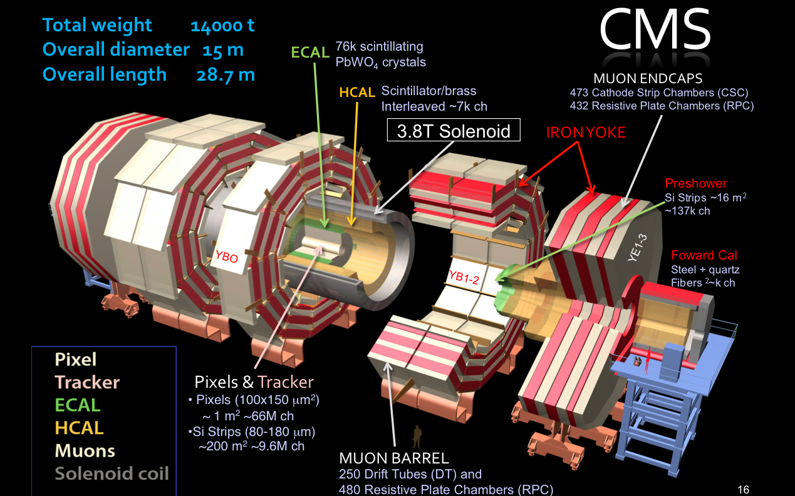
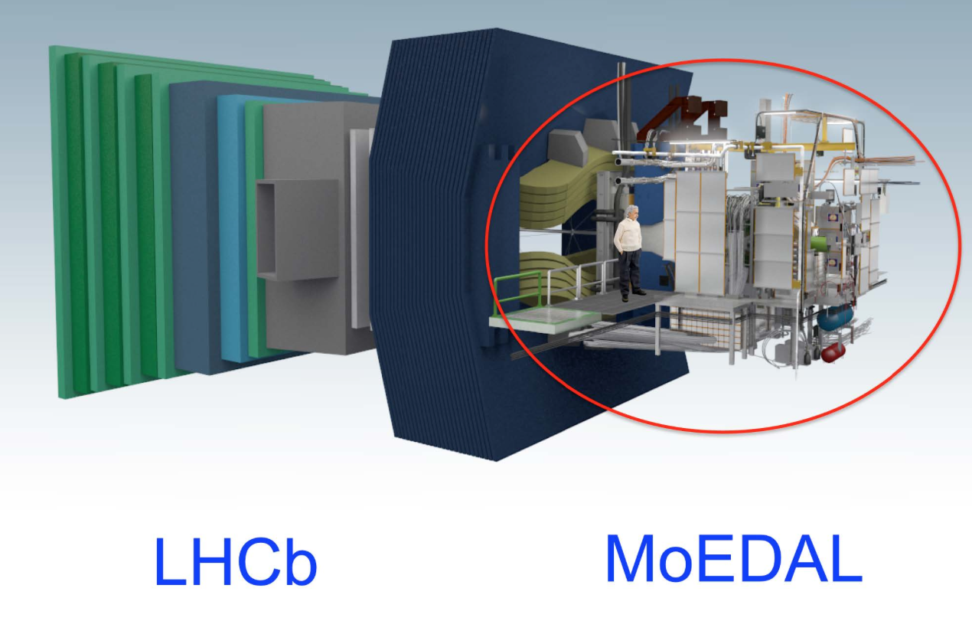
New Physics Hunters @ the LHC
The ATLAS experiment
The CMS experiment
…And also LHCb and MoEDAL

Slide 4
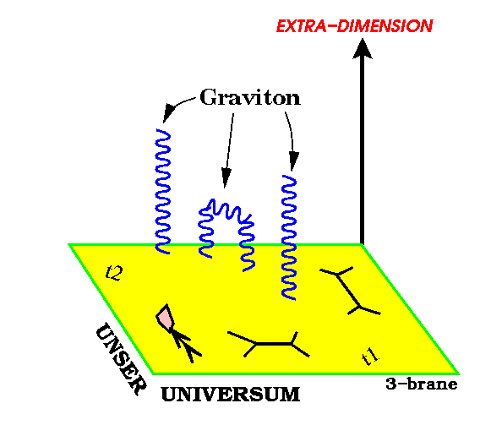
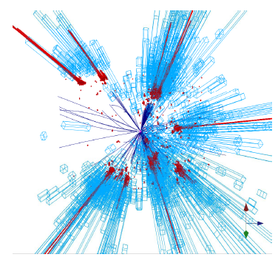
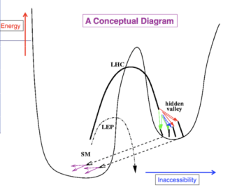
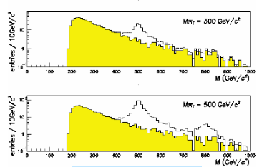
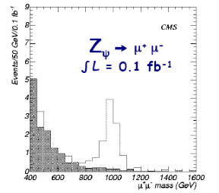
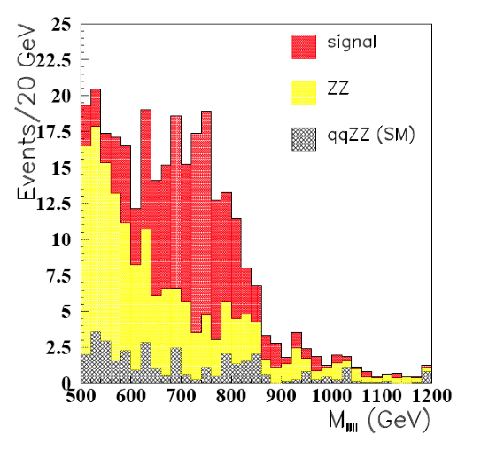
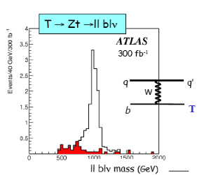
New Physics?
New Gauge Bosons?
Supersymmetry
ZZ/WW resonances?
Technicolor?
Little Higgs?
Extra Dimensions?
Hidden Valleys?
Black Holes???
What stabelizes the Higgs Mass? Many ideas, not all viable any more
A large variety of possible signals. We have to be ready for that
Notes:
3

Slide 5
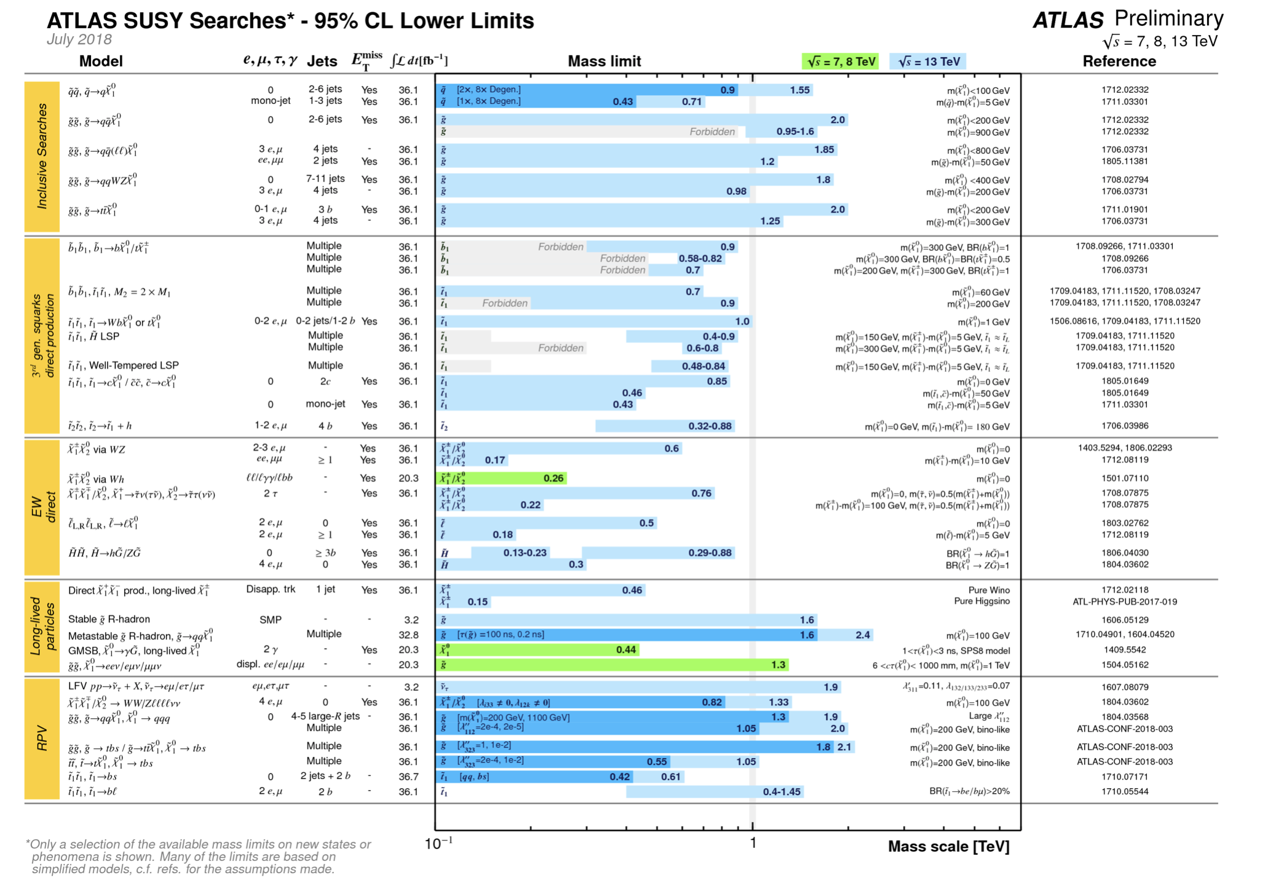
The SUSY SEARCH Chart So Far…
No Signal (yet?)

Slide 6
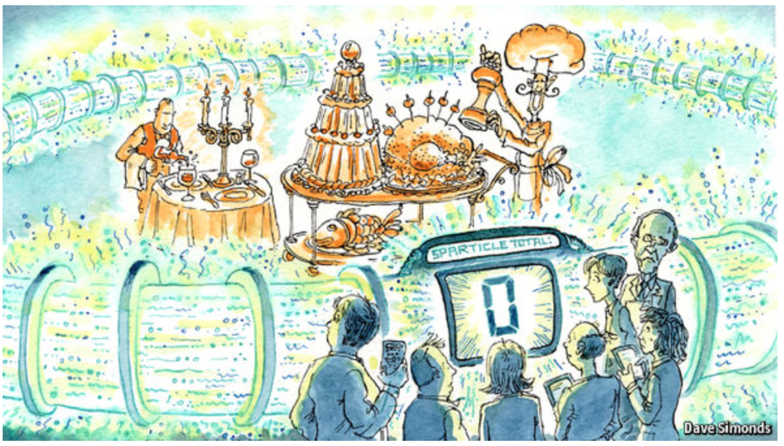


SUSY (as seen outside HEP…)
November ’16 on the web page of The Economist (!?!):
But we are not
giving up as yet!!!
Run-3/HL-LHC will
be important for
the new physics
searches
http://www.economist.com/news/science-and-technology/21709946-supersymmetry-beautiful-idea-there-still-no-evidence-support-it

Slide 7


Are we leaving no stone unturned?
The LHC BSM searches are indispensable and should be continued in the new energy regime and with increasing statistics (higher mass, lower couplings)
But if we still do not see more than a 2 sigma at the end of run 3, the HL-LHC will be likely mostly a precision physics machine, searching for subtle deviations
Are we looking at the right place? Time for more effort in thinking of complementary searches?
Are we looking at the right place?
Leave no stone unturned!!

Slide 8
Searching for Long Lived Particles

Slide 9
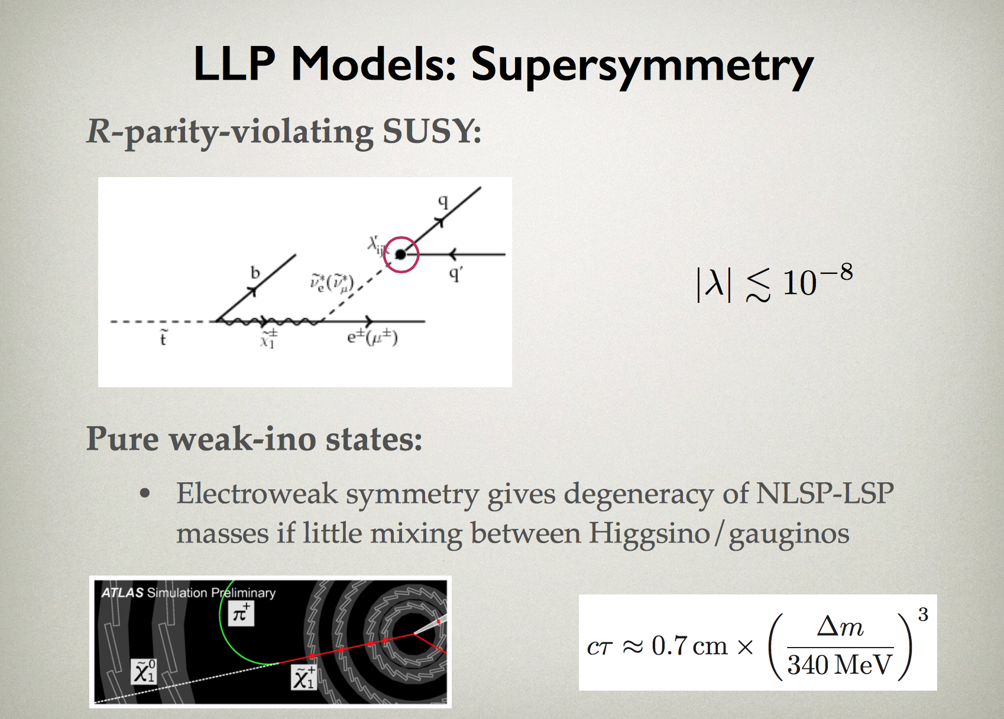
-

Slide 10
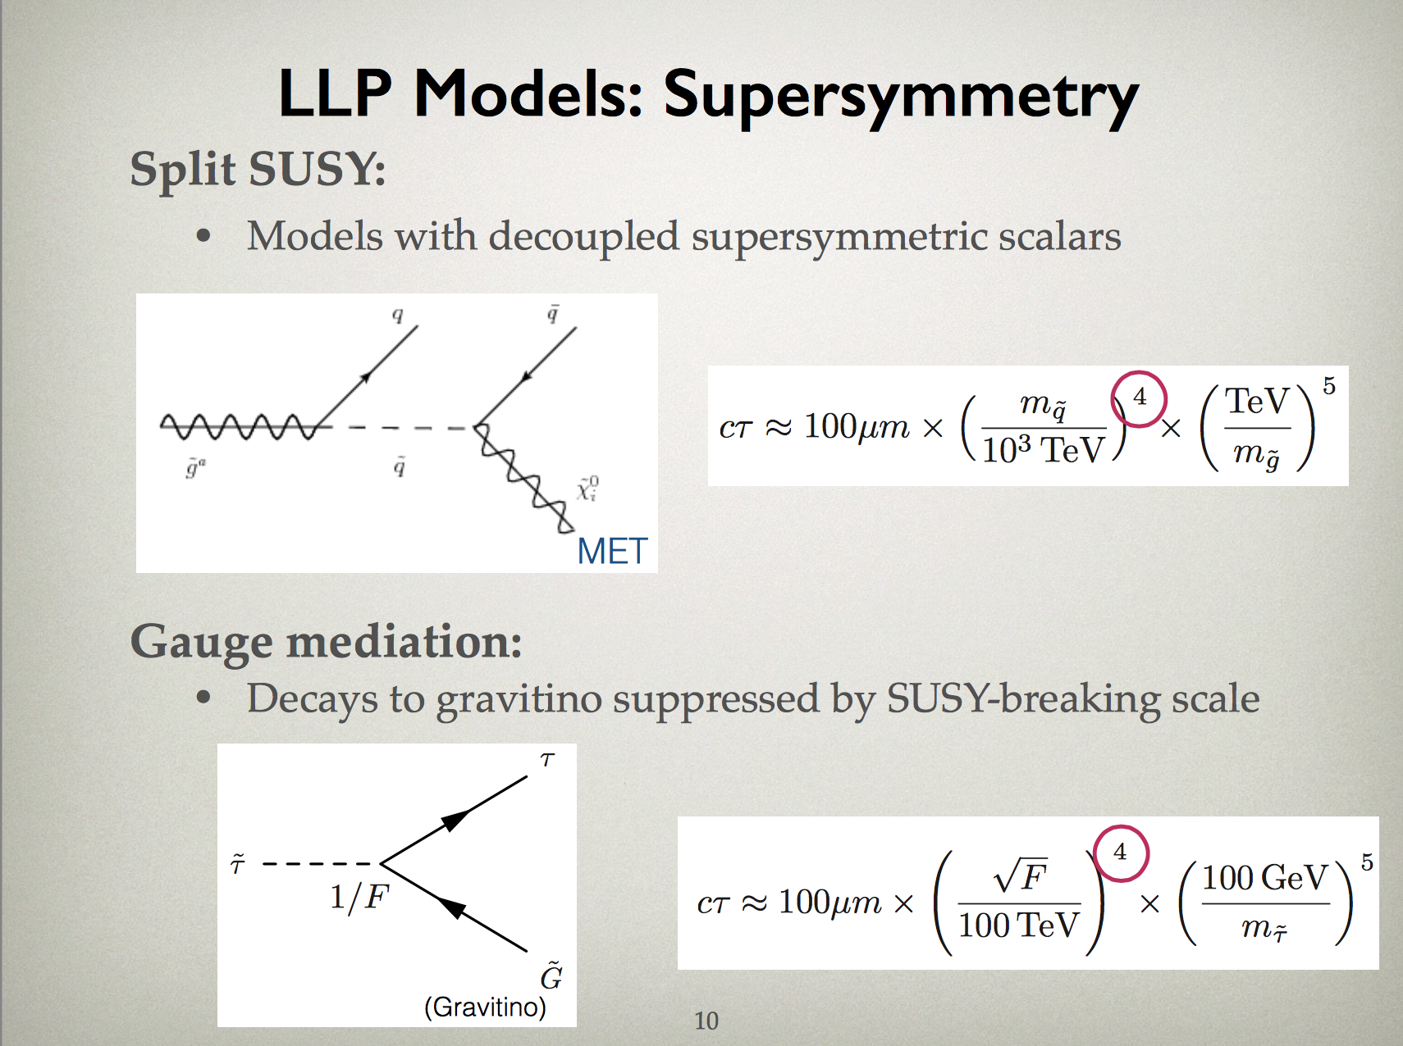

Slide 11
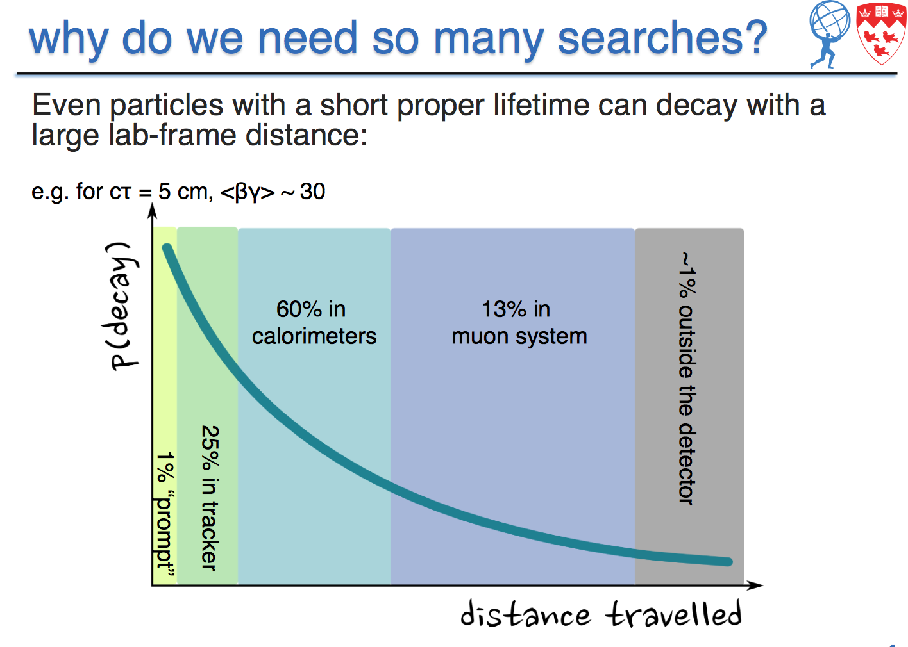

Slide 12
Long Lived Searches Overview (New)
Displaced jets, dijets, vertices
Disappearing tracks
Displaced leptons & lepton jets
Displaced photons
Dark photons
Heavy Stable Charged Particles
Stopped particles
Emerging jets
Monopoles
Heavy Neutral Lepton searches
Tracks with kinks
Strongly Interaction Massive Particles
…. (others…new ideas… )

Slide 13
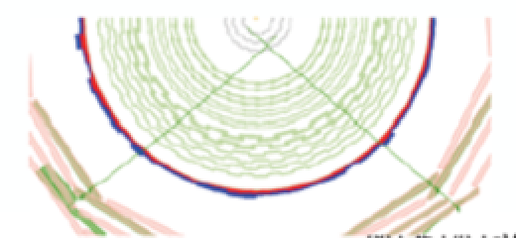


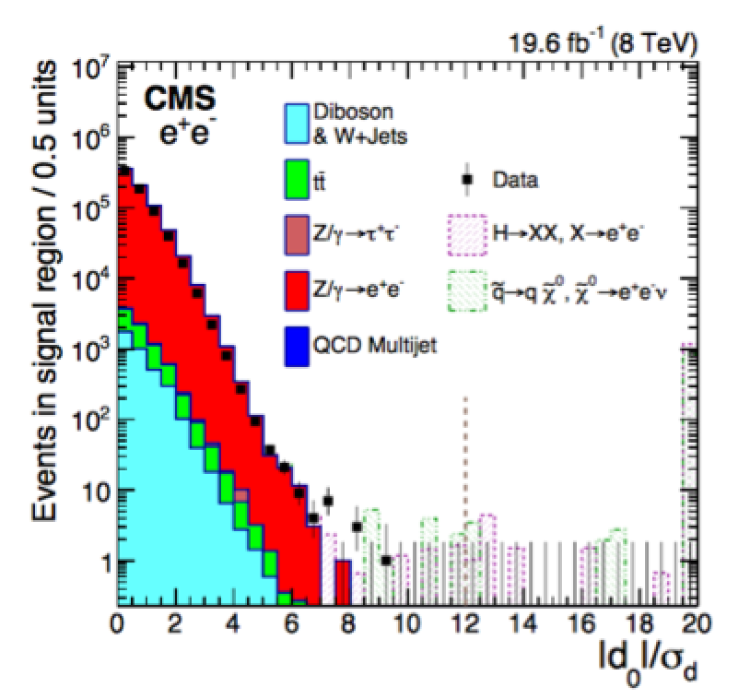
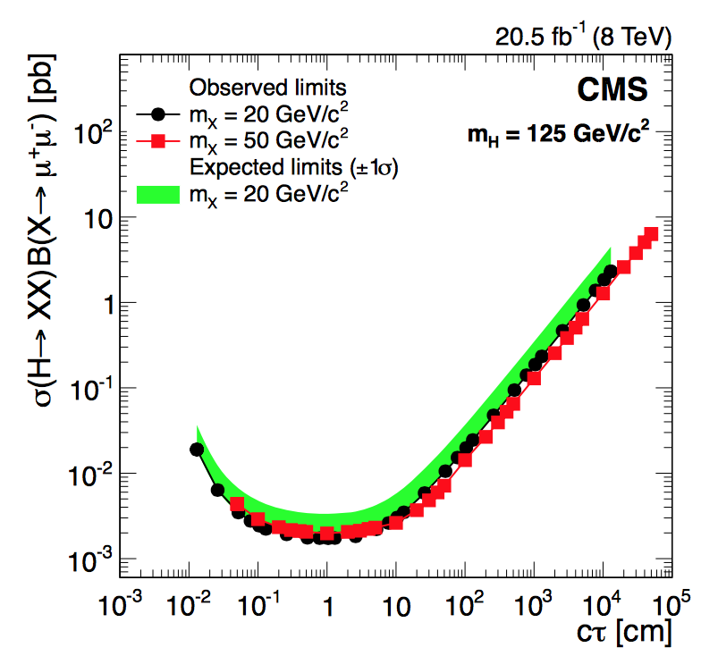
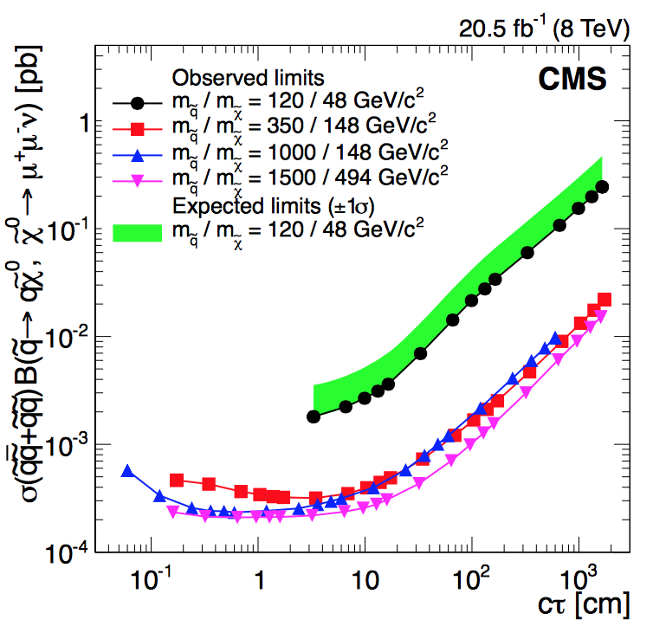
Displaced Lepton Pairs
arXiv:1411.6977
-Search for long-lived particles that decay into final states containing two muons or two electrons. Based on the CMS tracker
-Select muons pairs with p_{T} > 26 GeV, electrons with 40/25 GeV. Acceptance for Lxy till ~50 cm
-Models tested: non-Standard Model Higgs and SUSY squark production
Impact parameter significance

Slide 14
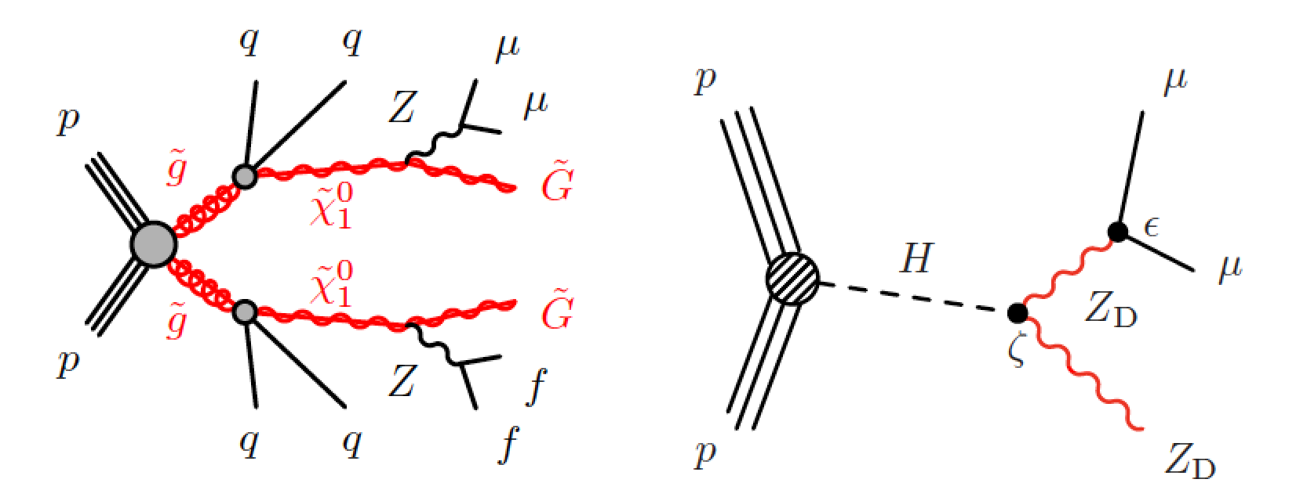
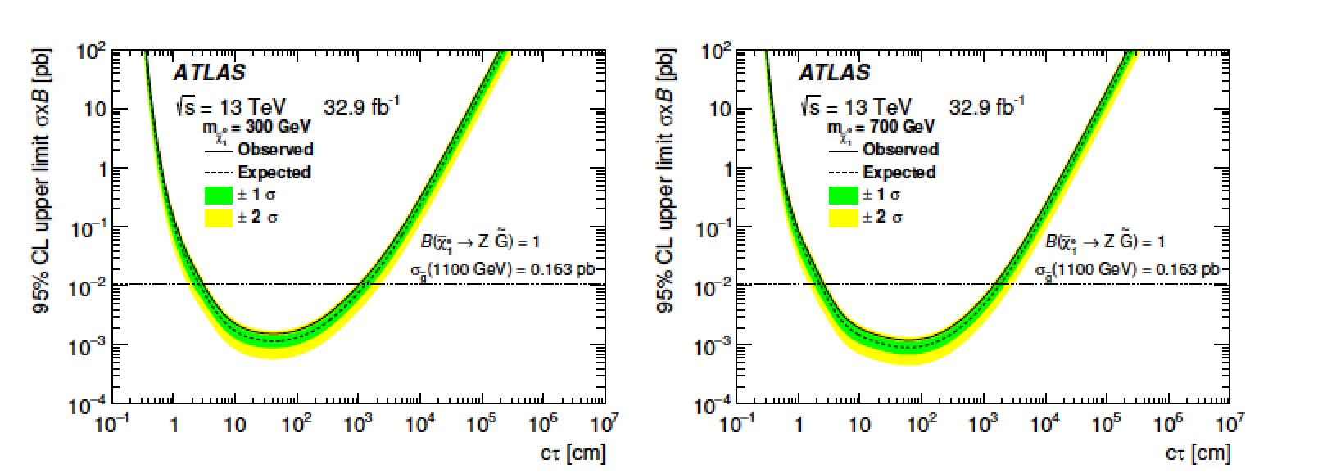
Displaced Muon Pairs
Search for displaced di-muon pair with 13 TeV data and 32 fb⁻¹
Decay vertices searched for in the range 1- 400 cm
arXiv:1808.03057
Models studied
GMSB and Higgs decaying
into dark photons
GMSB studies
1<ct<2400 cm
excluded

Slide 15
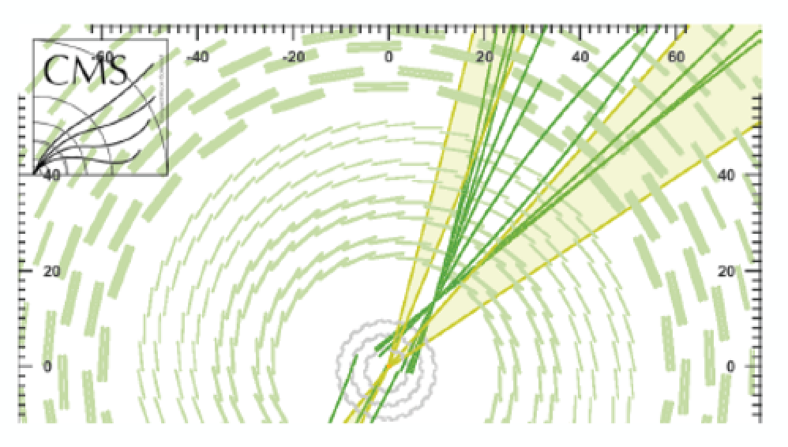
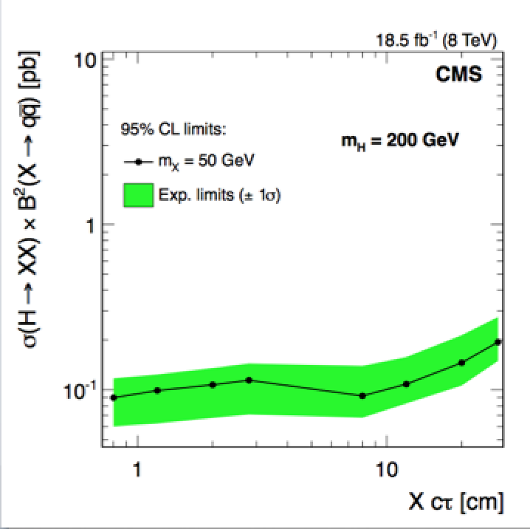
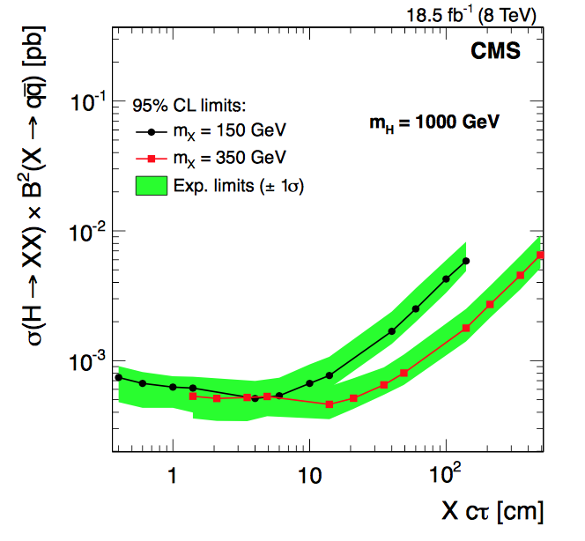
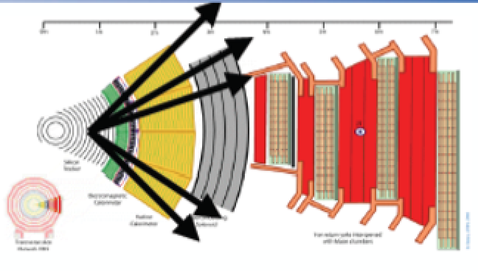
Displaced Jets
-Search for long-lived massive neutral particles decaying to quark-antiquark
pairs, leading to displaced jets with p_{T}> 60 GeV
-Range of proper decay length studied: 0.4-200 cm
-Tracker information for displaced vertex (for Lxy up to 50 cm)
-Dedicated HLT trigger matching jets tracks to the primary vertex
-Study neutral scalar H-> XX with X long lived, decaying to 2 jets
arXiv:1411.6530
arXiv:1411.6530

Slide 16
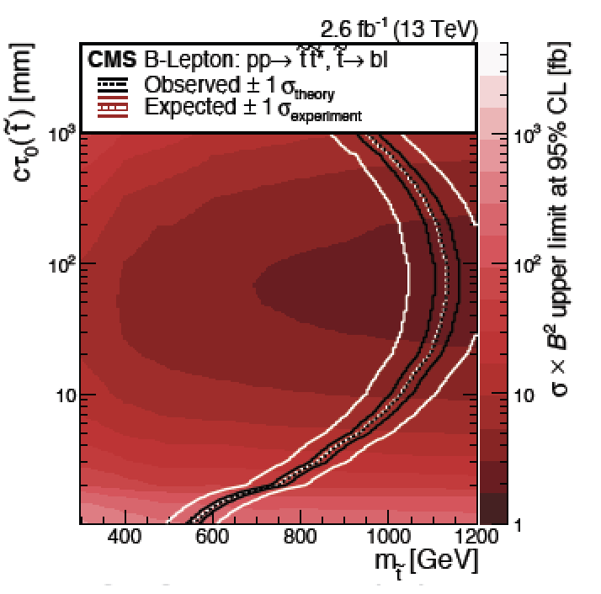
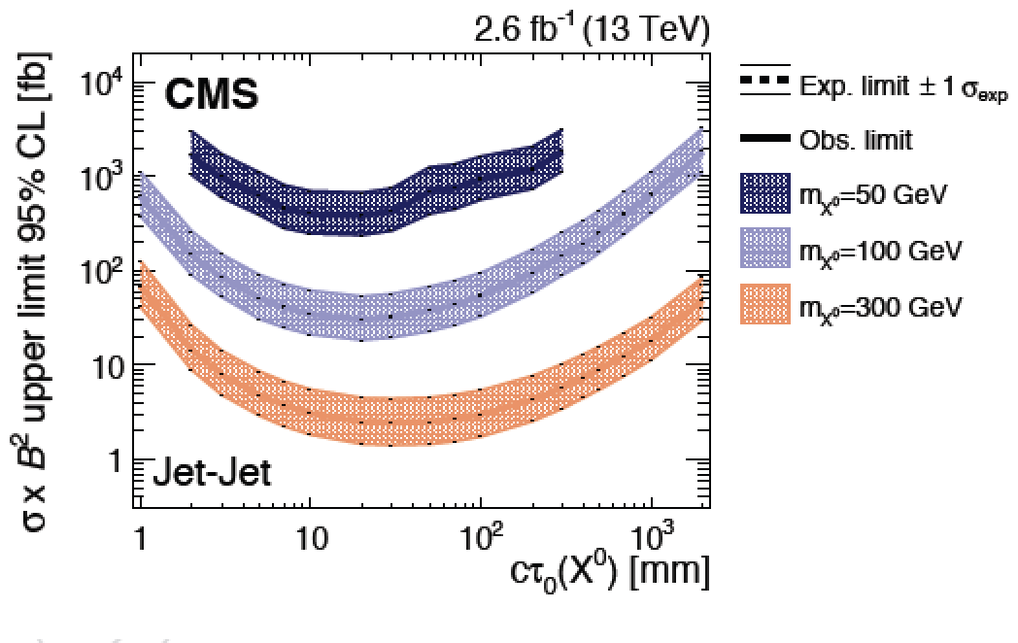
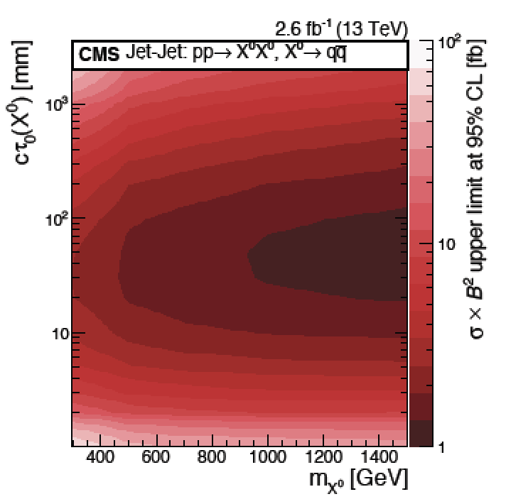
Inclusive Displaced Jets Pairs
Inclusive search for new particles decaying to displaced jets final state.
Calorimetric energy measurement. Transverse impact parameter from tracks
used as discriminator. Trigger based on total H_{T} from jets
arXiv:1711.09120
•Search for pair produced long-lived scalar neutral particles, decaying each to two jets ->four jet final states, with Lxyz 1 -1000 mm for the decay lengths
RPV Model

Slide 17
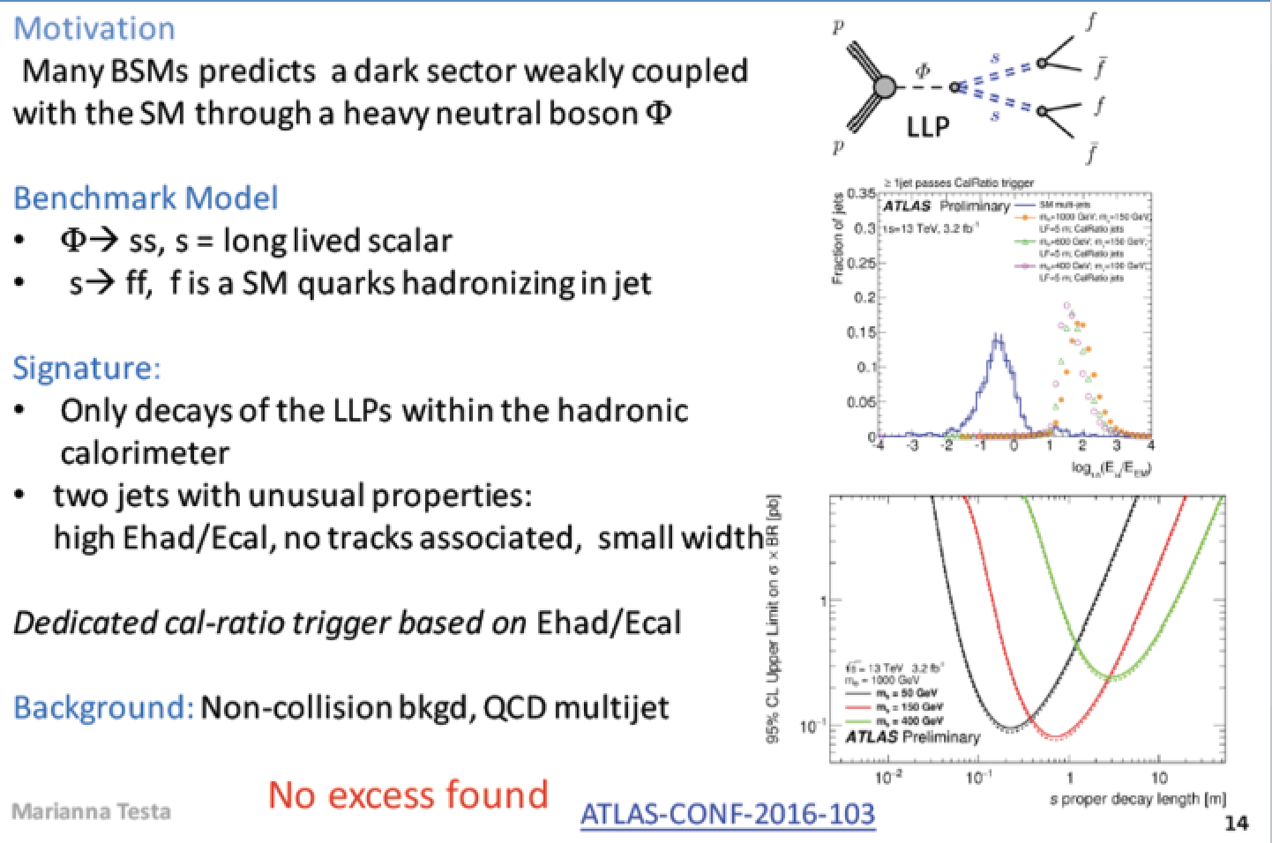
Neutral LLP Decaying into Calorimeters

Slide 18
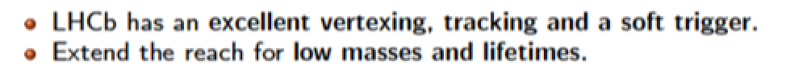
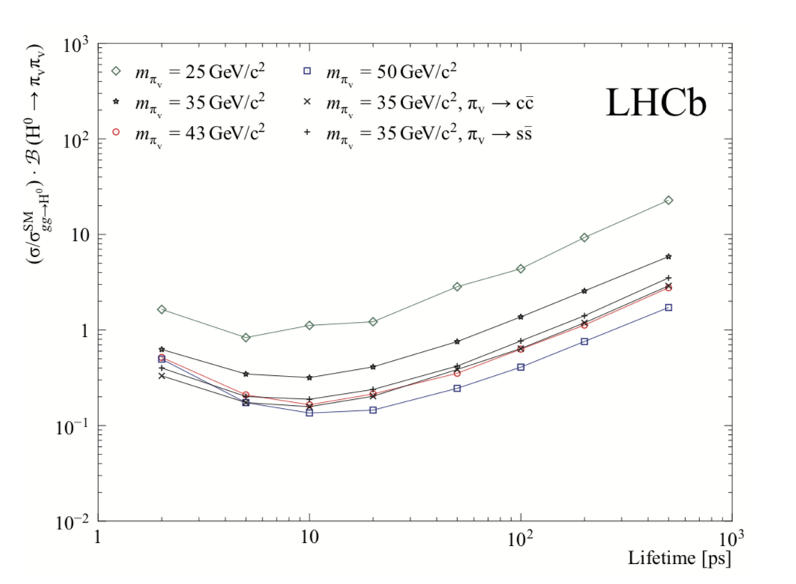
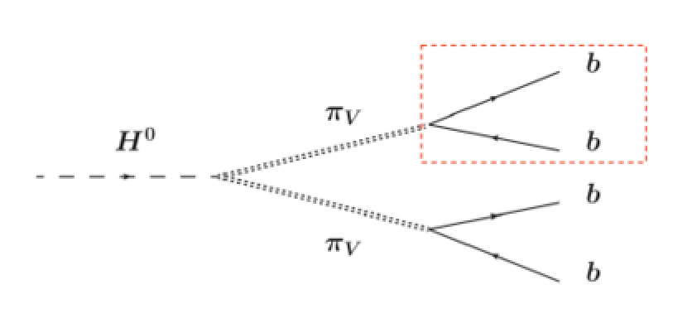
LHCb: LLP Decaying in Jet Pairs
Search for LLP with masses 25-50 GeV and lifetime of 2-500 ps in LHCb
-Test of eg Hidden Valley models H(125) decaying to two HV particles
-No excess of signal events over expected background
arXiv:1705.07332

Slide 19
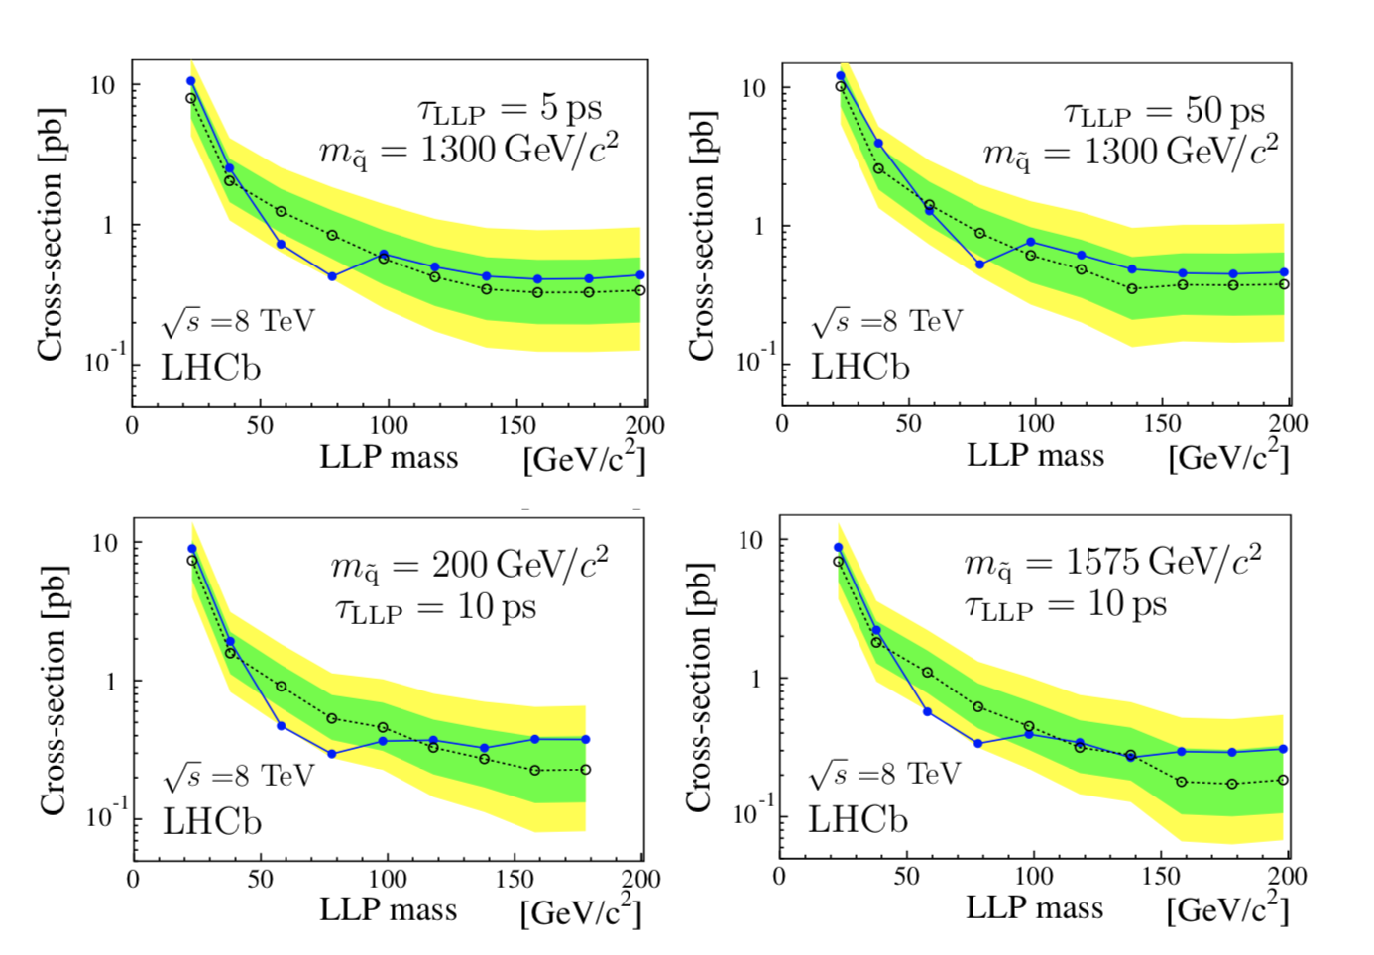
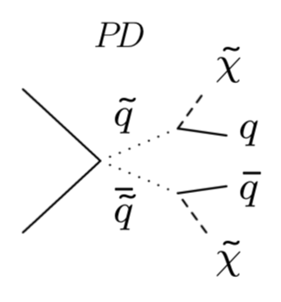
LHCb: Displaced Muon + Jets
Search for events with high multiplicity displaced vertex with
an associated muon
-Search for eg RPV SUSY of squark decays with lifetimes 5-100 ps
-Sensitivity to neutralinos decaying in muon+jets with masses
up to 200 GeV. No excess observed in data
arXiv:1612.00945

Slide 20
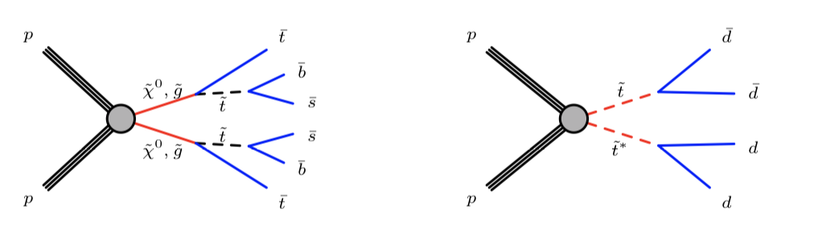
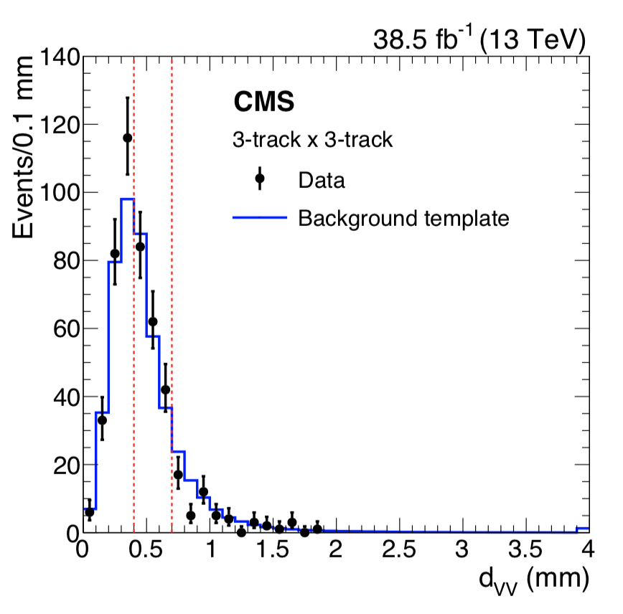
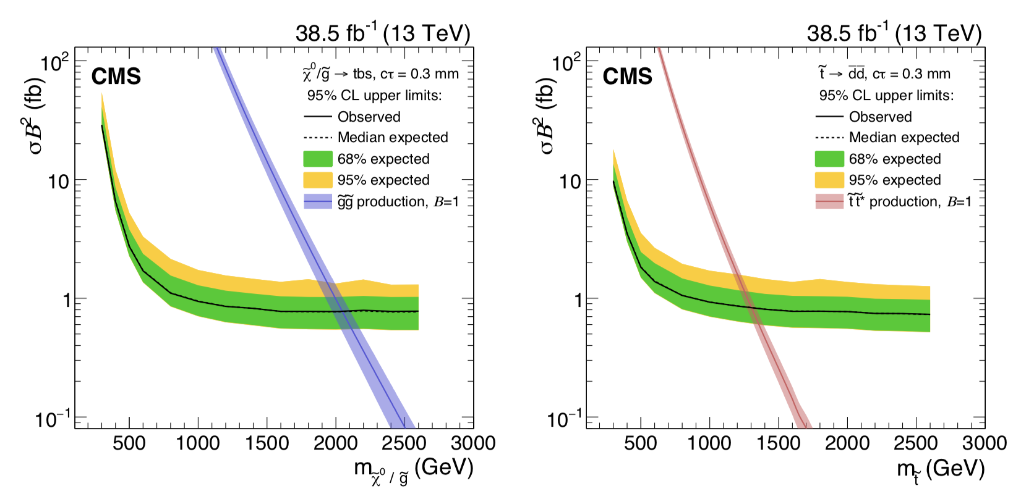
Displaced Vertices
-Instead of jets look for (pairs of) high multiplicity vertices
-Range of proper decay length studied: 0.4-5 cm (pixel only)
-Study long lived gluons/neutralinos or stops in SUSY models
arXiv:1808.03078
Control region

Slide 21
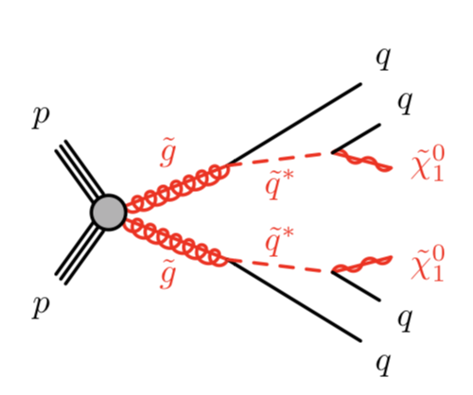
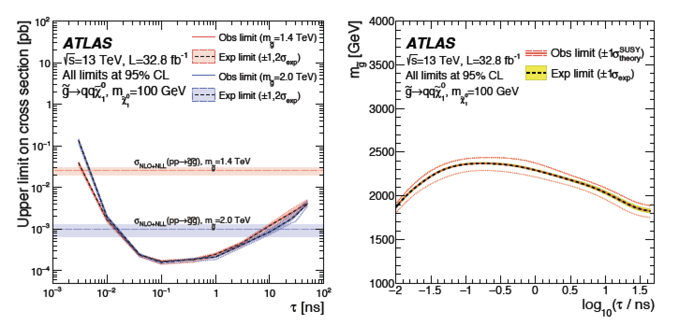
Displaced Vertices
A search for displaced vertices in the range of 1-100 mm
Minimum of 5 tracks and mass of the displaced
vertex > 10 GeV
RPV SUSY: Gluino masses excluded up to ~ 2.4 TeV
arXiv:1710.04901

Slide 22

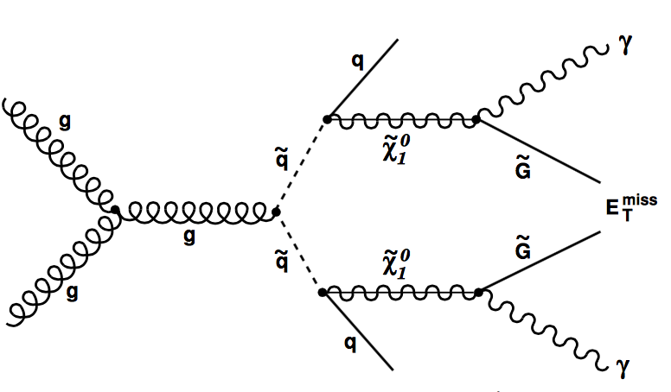
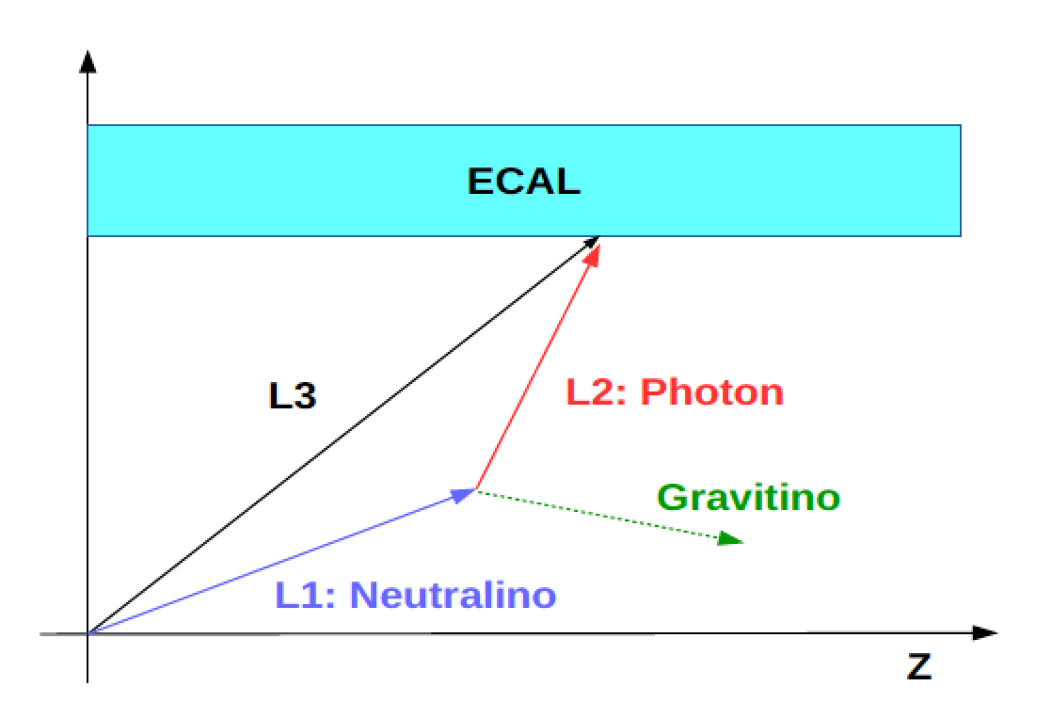
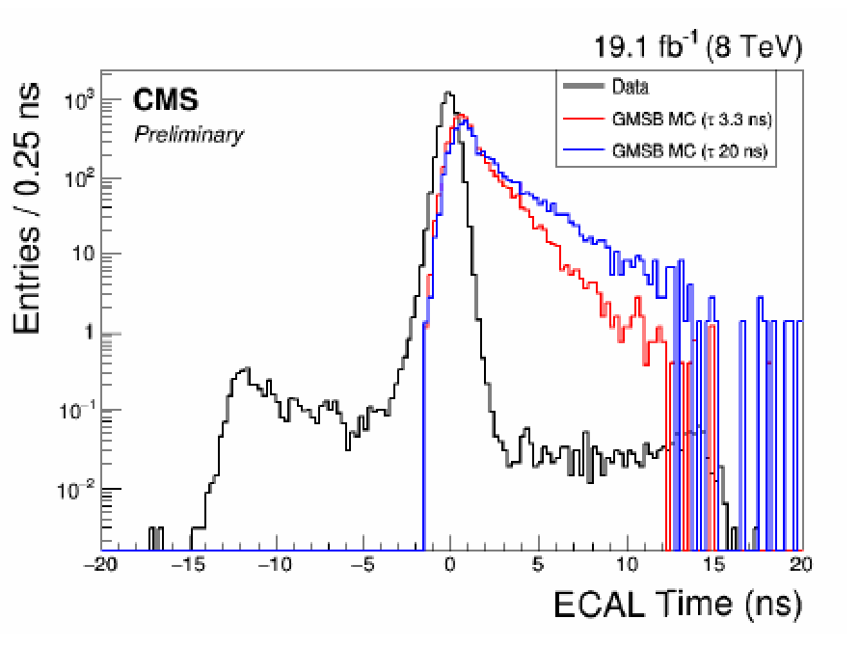
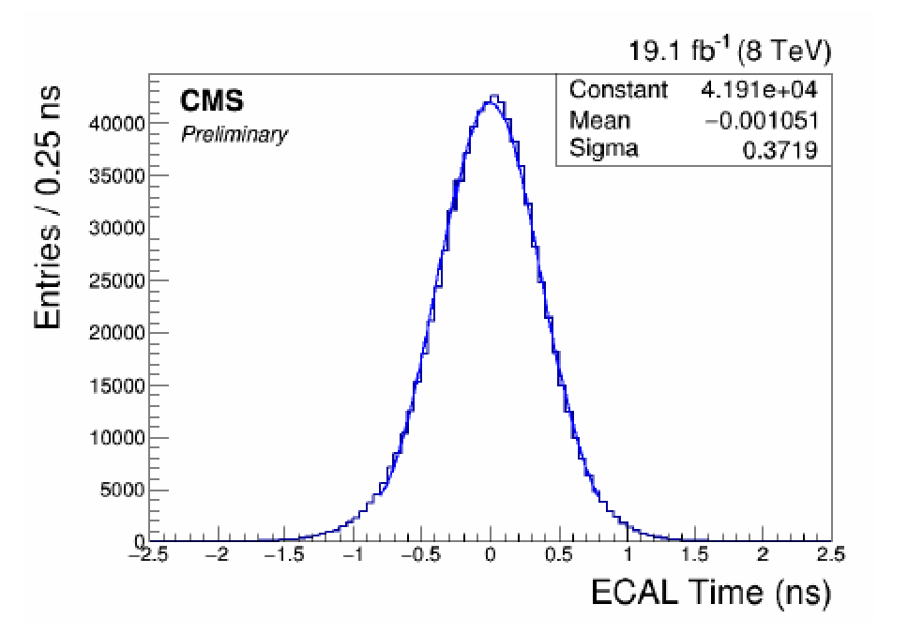
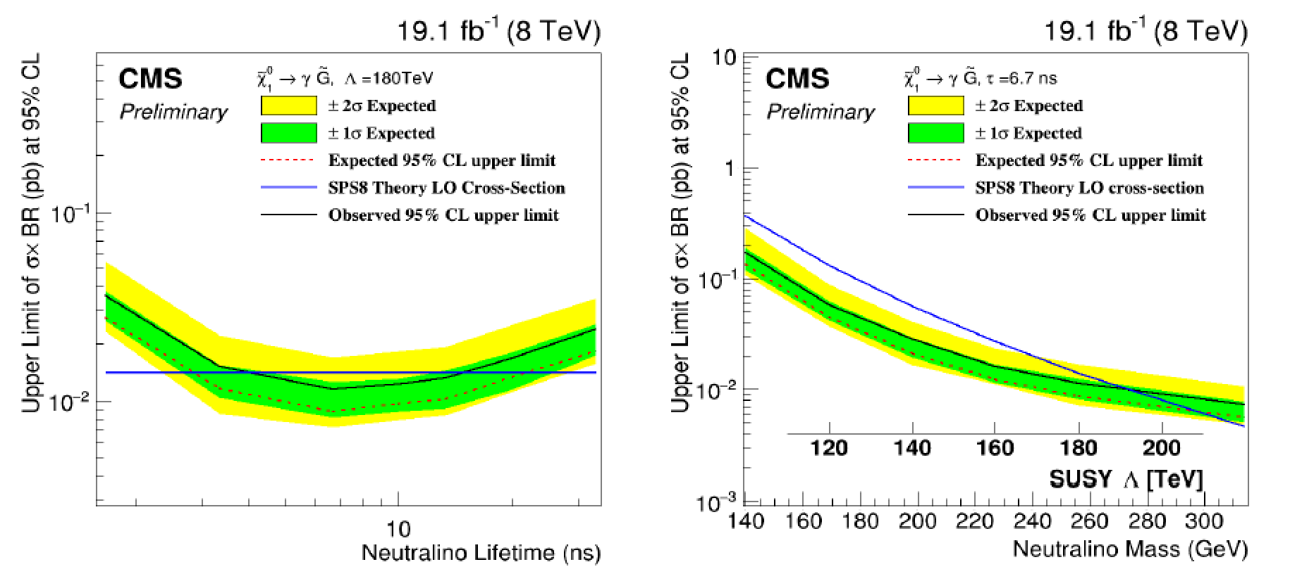
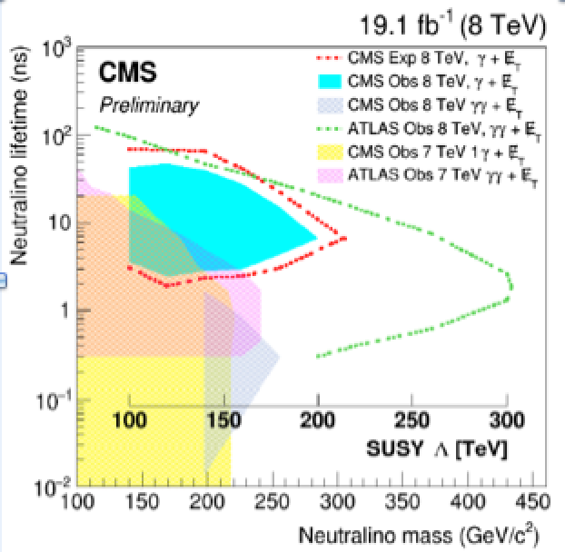
Displaced Photons Using Timing
A search for long-lived neutral particles decaying to photons, using precise
Timing in the ECAL. Eg in GMSB models:
Evens with two photons with p_{T}> 65 GeV, 2jets
and MET > 25 GeV
Efficiency for neutralinos with τ = 1-34 nsec
Resolution ~ 270 ps
CMS-EXO-12-035

Slide 23
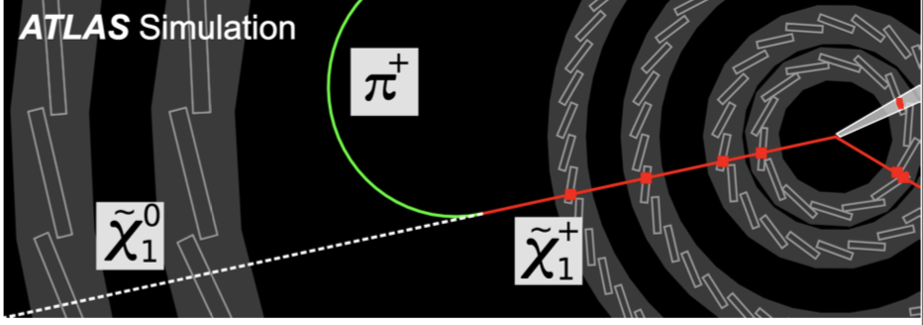
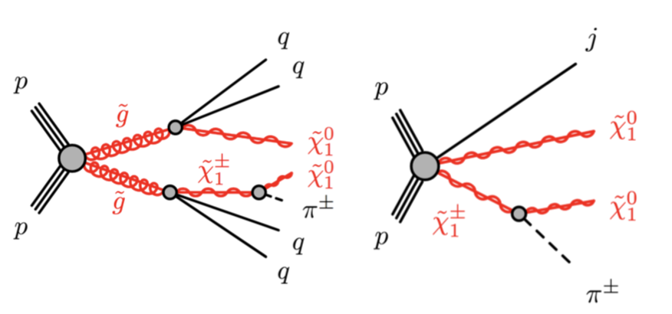
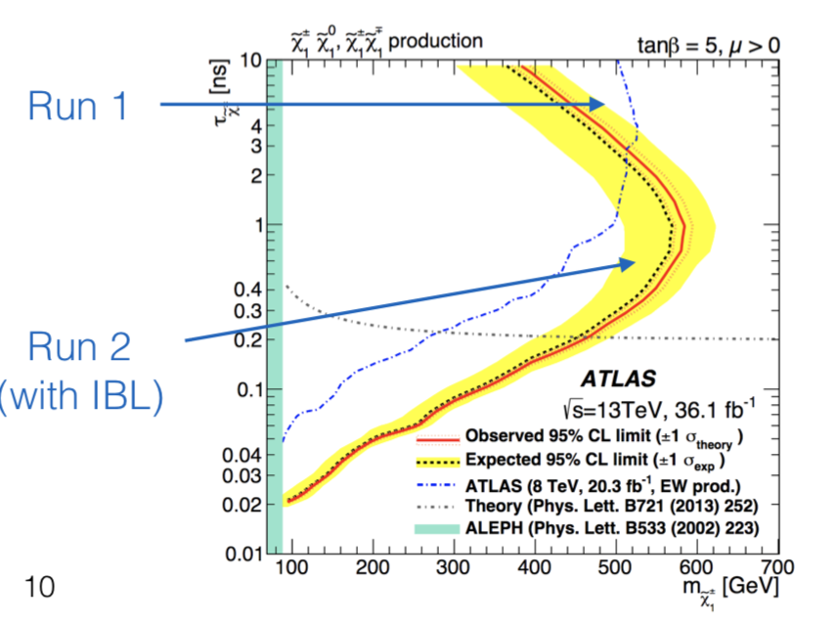
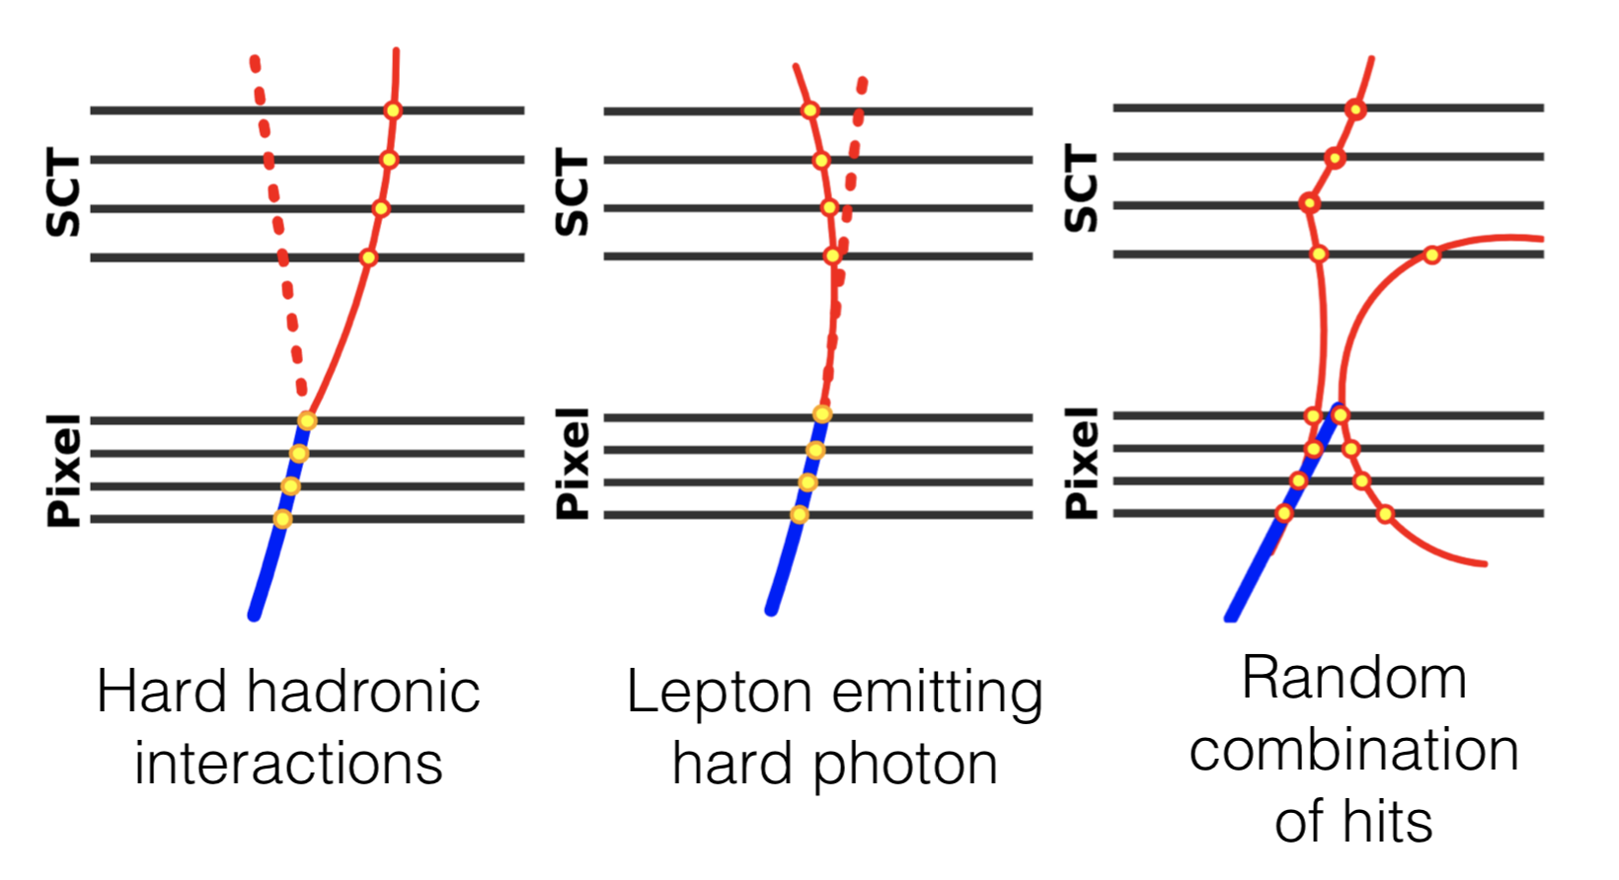
Disappearing Tracks
Search for charged tracks that decay in the tracker volume
Small mass splitting can lead to a decay and neutral and a soft particle. ATLAS
uses the 4 layer pixel to define a ‘track. Sensitive to decay lengths of 10-30 cm
arXiv:1712.02118
signal processes
backgrounds

Slide 24
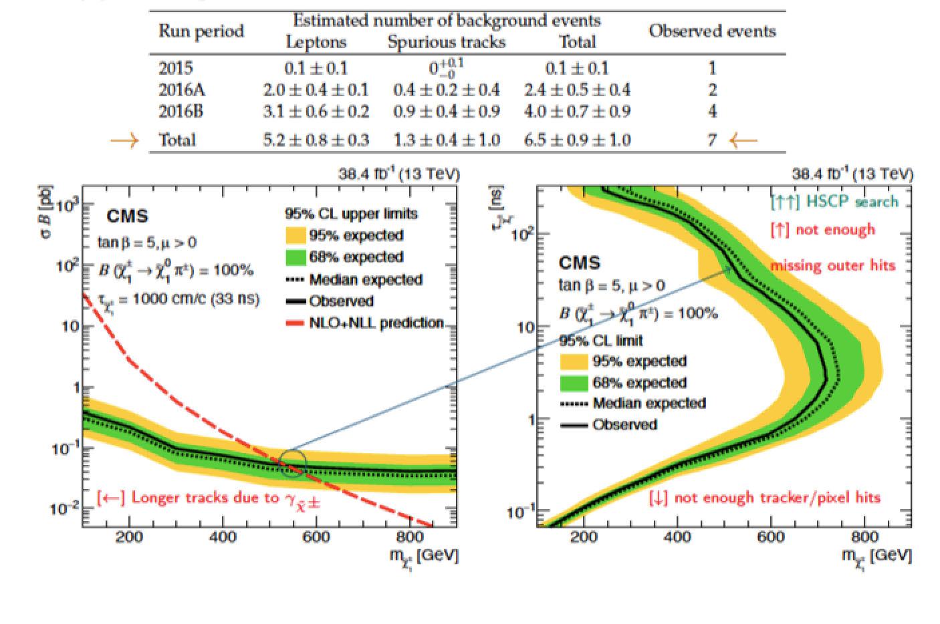
Disappearing Tracks
arXiv:1804.07321

Slide 25

Stopped Particles
Example: Split Supersymmetry
The only light particles are the Higgs and the gauginos
- Gluino can live long: sec, min, years!
- R-hadron formation (eg: gluino+ gluon): slow, heavy particles
arXiv:1501.05603

Slide 26


Stopped Long Lived Particles: Hadronic
•Search for long lived particles that stop in the detector & decay into jets
(p_{T}> 70 GeV), non-coincident with pp collisions
•586 hours trigger lifetime in 2015/16 included in this search.
•Searches for long lived gluinos and stops (R-hadrons) with jets
•13 events observed in 2015/16 -> consistent with cosmic ray background
arXiv:1801.00359
Limits on M_{stop} < 744 GeV and M_{gluino} <1385 GeV 95% CL for
lifetimes from 10 μsec to 1000s

Slide 27





Heavy Stable Ionizing Particles
Detection techniques used for (multiple/fractional)
heavy stable charge particles
• Abnormal energy loss (de/dx)
Slower than speed of light (lowβ) via time of
flight measurements with the muon system
Time of flight
EXO-16-036

Slide 28



Search for Heavy Charged Particles
-Search for heavy charge particles with de/dx in the pixel tracker 13 TeV 36 fb⁻¹
-Search for metastable and stable R-hadrons (high p_{T} tracks/muon veto or not)
-E_{T}miss trigger and event selection with selection E_{T}miss > 170 GeV
arXiv:1808.04095
Exclude metastable R-hadrons with
ct = 10 ns up to 2060 GeV 95%CL
Exclude stable R-hadrons up to
1890 GeV 95%CL

Slide 29




Reinterpretation of SUSY Searches
Prompt search analyses have sensitivity to (small) long-lived live-times
Reinterpretation of search for supersymmetry in models with variable R-parity
coupling strength and long-lived R-hadrons
ATLAS-CONF-2018-003
Gqq
model
Gtt
model
stop
model
R-hadron
model

Slide 30



Search for Heavy Neutral Leptons
Neutrino portal: νMSM (Neutrino Minimal Standard Model)
Minimal extension of the SM fermion sector by Right Handed HNLs: N1, N2, N3.
arXiv:1802.02965

Slide 31

Search for Heavy Neutral Leptons
Neutrino portal: νMSM (Neutrino Minimal Standard Model)
Minimal extension of the SM fermion sector by Right Handed HNLs: N1, N2, N3.
Sensitivity plot for the LLP white paper/ Philippe Mermod

Slide 32

Search for Heavy Neutral Leptons

Slide 33




Hidden Valley/Sector Physics
ATLAS: Calo and Muon jets
Expected produce “Weird
Jets” and a lot of secondary
vertices from b quarks
Note: ATLAS uses the muon
system more intensely than CMS
32
Notes:
32

Slide 34




Dark Showers!
•Hidden Valley models
•Neutral Naturalness
Considerable progress in TH/PH
understanding the phase space
of dark showers and on
implementing in generators or
preparing LHE files

Slide 35

Emerging Jets

Slide 36


Emerging Jets

Slide 37






Monopoles
Magnetic Monopoles to explain the quantization of electric charge (Dirac ‘31)
= n 68.5e
Symmetrizes Maxwell equations
Searched for at all colliders
Tevatron direct limits ~ 400-800 GeV
arXiv: 1112.2999

Slide 38


Monopole Searches: MoEDAL @ 13TeV
2016 data analysis base on 222 kg Aluminium to “stop” the monopoles and
search for them with a SQUID precision magnet (2.11fb⁻¹) arXiv:1712.09849
•Limits for different
monopole charges
•First monopole search
result @LHC at 13 TeV
No signal yet..

Slide 39



Monopoles Stopped in the Beampipe?
ADR et al., Eur. Phys .J. C72 (2012) 2212
Test performed with pieces of material from the LHC from 18 m away from
the interaction region
Faulty connecting “fingers” were removed
and scanned in a SQUID in Zurich
Want to use the 2012 CMS beampipe! We can have it in 2018 ???
Continuing discussion with Austin Ball and new CMS management…
A beampipe analysis effort is put into place (across experiments)

Slide 40

LHC Detector Upgrade!
A new opportunity for for a more LLP tailored detector!!
Also: making
use of the
RPC-timing
in phase II
trigger..!?!

Slide 41

New Detector Ideas

Slide 42




Possible New Experiments @LHC
MilliQan: searches for
millicharged particles
CODEX-b: searches for long lived
weakly interacting neutral particles
MATHUSLA: searches for long lived
weakly interacting neutral particles
FASER: searches for long lived
Dark photons-like particles

Slide 43



Particles with Milli-Charges?
“New” idea -> Hunting for particles with charges ~ 0.3-0.001e
Baseline paper: arXiv:1410.6816
Proposal for a new experiment/CMS subdetector ->
arXiv:1607.04669
MilliQan Experiment

Slide 44




MATHUSLA
A proposal for a large area surface array to detect ultra
long lived particles coming
from the pp collisions
Aim to cover the range
~ BBN constrained inspired
CERN-LHCC-2018-25
Possible detector
surface array eg
above ATLAS or
CMS:
(200m)²
8 x (70m)²

Slide 45




Possible New Experiments @LHC
MilliQan
•September 2017:
Installation of a 1% demonstrator.
•Collected ~ 27 fb⁻¹ mostly for technical tests in 2017
•Continuing in 2018 to
record data.
MATHUSLA physics paper: https://arxiv.org/abs/1806.07396
MATHUSLA
1-week data taken in November 2017
Continuing in 2018

Slide 46


MAPP at IP8 (LHCb/MoEDAL)
MAPP: MoEDAL apparatus for penetrating particles
Another scintillator experiment installed at the LHC, in the LHCb area
to search for low charged particles and possibly long lived neutrals
that decay close by

Slide 47

Long Lived Particle Searches

Slide 48

2016
Need a more
systematic approach

Slide 49



LHC White Paper in Preparation
Web page: https://indico.cern.ch/event/649760
White Paper being finalized
Input from ATLAS, CMS,
LHCb, proposed specialized
experiments and theory
Complete by fall 2018
(~ 250 pages)
Also meetings with
LHC Dark Matter group

Slide 50




Workshops May & October
https://indico.cern.ch/event/714087/
152 registered participants
The fourth workshop will be
in October this year
https://indico.cern.ch/event/744951

Slide 51
Summary
Clearly and increased interest in LLP searches at the LHC in CMS, ATLAS, LHCb, MoEDAL. Many analyses done or in are progress. No signal observed yet, but only top of the iceberg covered so far.
Aim for a more complete coverage of the channels than what has been done so far: -> White Paper coming. Many opportunities for new analyses/ideas.
Tendency to move to more model independent analyses, where possible and data reinterpretations
Phase-2 upgrade will allow some additional phase space coverage (timing, special triggers, other?): in progress!!
New ideas for additional small experiments at the LHC to increase the coverage: MilliQan, MATHUSLA,…
White paper is timely eg for the new groups that join and for defining common ATLAS/CMS/TH strategy

Slide 52
Backup

