Slide 1
FCC Week Overview

Slide 2
Introduction
Ensure I mention these are alternative options to the baseline.
Point towards earlier talks

Slide 3
SiW ECal (Calice)
Following next weeks Calice meeting I will have one slide describing prototype and most up to date results

Slide 4
CMS HGCAL
Again, assuming an overview will be presented at CALICE meeting next week.
Single slide overview of HGCAL

Slide 5
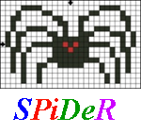
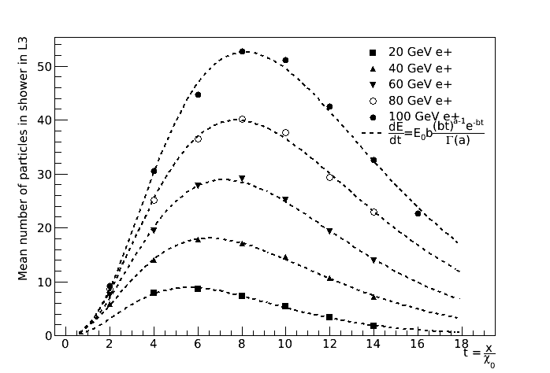
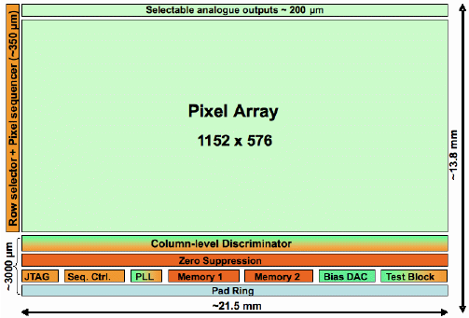
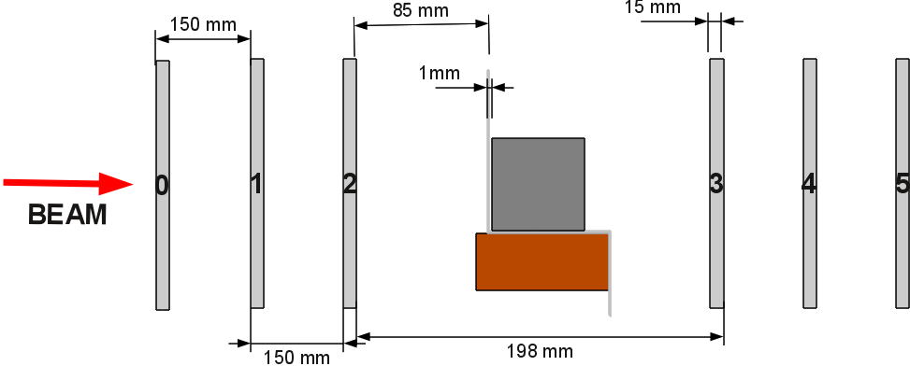
Digital Calorimetry
CERN Beam test 2010
Mimosa-26
1152x576 matrix
18.4μm Pitch
21.5x10.6 mm area
Form tracks in first 3 layers
Shower induced in W
Measure core in 4th layer 15cm from W
DECAL pixel counting shows correct shower development behaviour

Slide 6


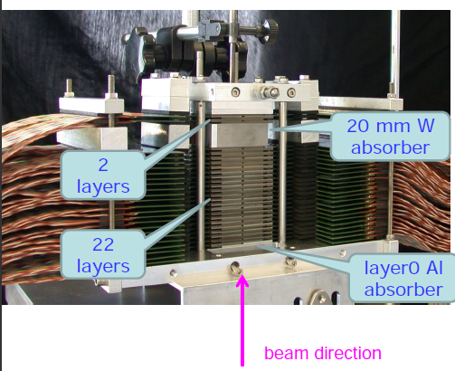
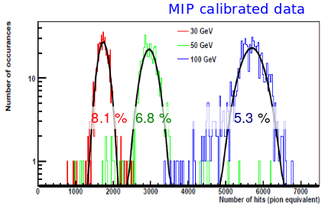
ALICE FoCal: Test beams
ALICE Forward Calorimeter (FoCal) require highly granular to separate showers
Mixture of MAPS and pad sensors proposed
Prototype uses 24 plane
Each plane consisted 4 Mimosa-23 (30μm Pitch) interweaved with Tungsten
Tested at DESY and SPS in 2012
Update slide with results from recent paper

Slide 7
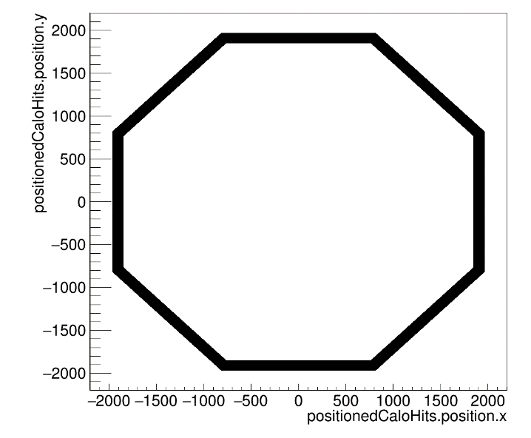
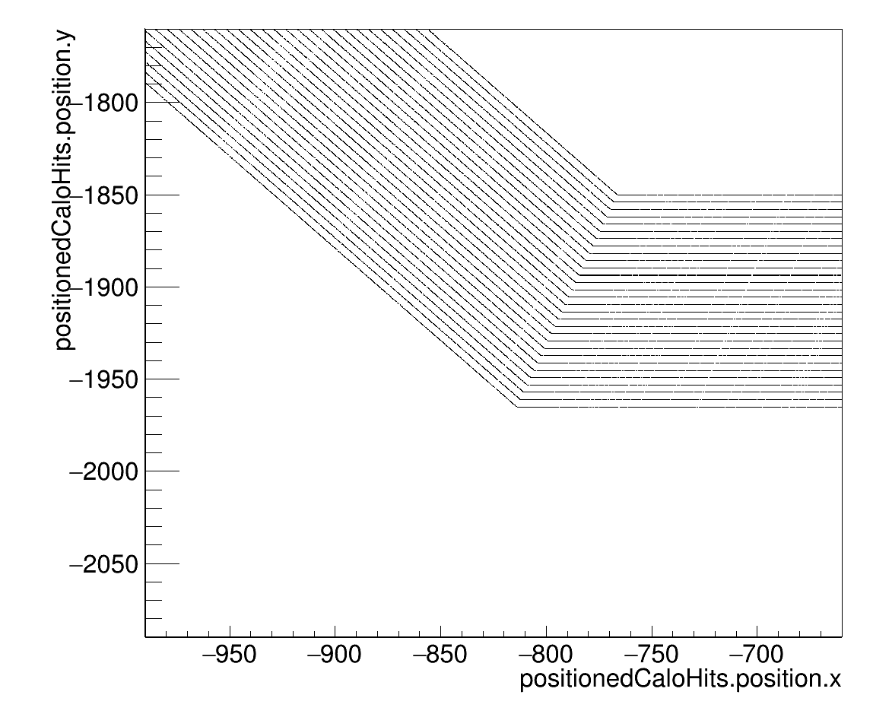
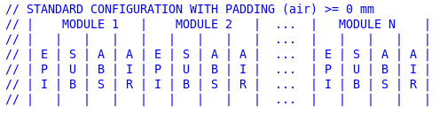
Silicon ECal within FCCSW
For hadron collider will have additional complexities compared to e+e-
  pile-up
  higher energy jets
  higher radiation environment.
FCCSW allows us to simulate such effects
Optimised layout
Current model uses 8 staves
  Epitaxial 18um thick (digital readout)
  Substrate 300um thick (analogue readout)
  Absorber material (W/Pb)
30 Layers Si Tungsten: Geantino response

Slide 8
Silicon ECal within FCCSW
Single simulation for analogue and digital modes
Comparisons can be made on an event by event basis
Saves on CPU and disk space
Geometry from XML
SensitiveDetector
DECal Resegmentation
FilterCaloHits
Resegmentation
DECal Analysis
Analogue Analysis

Slide 9
Event Display
Add images of 10, 100, 1000 GeV e- showers in analogue and digital readout

Slide 10
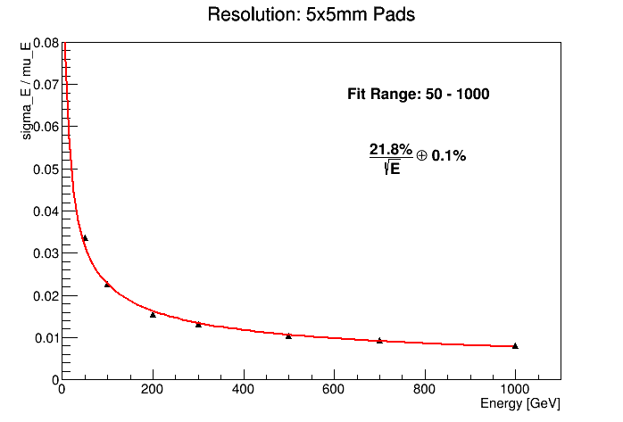
Analogue readout
Detector Configuration
  30 layers of 1.0χ₀ W
  30 layers of 1.0χ₀ Pb
  50 layers of 0.6χ₀ W
  50 layers of 0.6χ₀ Pb
Update slide when all geometries ran
Format plots

Slide 11
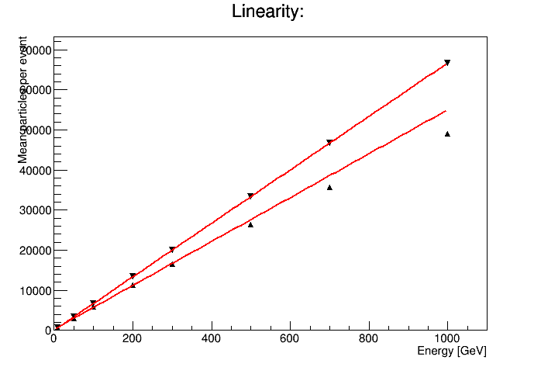
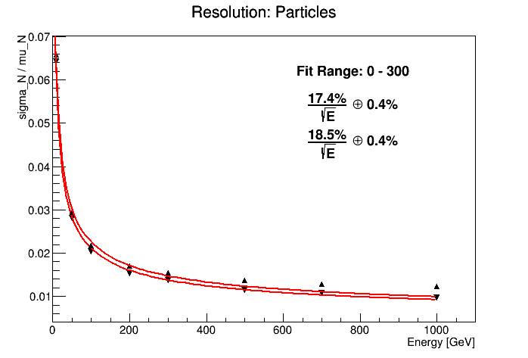
DECal
Detector Configuration
  30 layers of 1.0χ₀ W
  30 layers of 1.0χ₀ Pb
  50 layers of 0.6χ₀ W
  50 layers of 0.6χ₀ Pb
Update slide when all geometries ran
Format plots

Slide 12
Compare Analogue and DECal

Slide 13
DECal Non linearities
2 slides explaining MVA and method to account for non linearities

Slide 14
Extra Studies for DECAL
Noise hits
Pile up
Gamma separation?
HH->bbgammagamma?
Semidigital?

Slide 15
Channel Counts & Calorimeter sizes
Layers | Material | Pixel Pitch [um] | Air Gap [mm] | Total ECAL thickness [mm] | Number of Pixels *^ | Number of pads *^# | Area of Silicon *^ [m²]
30 | Tungsten | 50 | 0 | 119 | 1.40e12 | 1.40e8 | 3400
50 | Tungsten | 50 | 0 | 129 | 2.34e12 | 2.34e8 | 5900
50 | Tungsten | 50 | 3 | 278 | 2.43e12 | 2.43e8 | 6000
50 | Pb | 50 | 0 | 193 | 2.38e12 | 2.38e8 | 5900
50 | Pb | 25 | 3 | 343 | 9.50e12 | 2.48e8 | 6200
* 1800mm inner radius
# Pixels read out in 5x5mm² pads
^ Length of barrel = 10m

Slide 16
Channel Counts & Calorimeter sizes
Layers | Material | Pixel Pitch [um] | Air Gap [mm] | Total ECAL thickness [mm] | Number of Pixels *^ | Number of pads *^# | Area of Silicon *^ [m²]
30 | Tungsten | 50 | 0 | 119 | 1.40e12 | 1.40e8 | 3400
50 | Tungsten | 50 | 0 | 129 | 2.34e12 | 2.34e8 | 5900
50 | Tungsten | 50 | 3 | 278 | 2.43e12 | 2.43e8 | 6000
50 | Pb | 50 | 0 | 193 | 2.38e12 | 2.38e8 | 5900
50 | Pb | 25 | 3 | 343 | 9.50e12 | 2.48e8 | 6200
* 1800mm inner radius
# Pixels read out in 5x5mm² pads
^ Length of barrel = 10m
50 layer Pb 1/3 of depth of current ECAL envelope. Whole detector could be made smaller drastically reducing costs

Slide 17
Channel Counts & Calorimeter sizes
Layers | Material | Pixel Pitch [um] | Air Gap [mm] | Total ECAL thickness [mm] | Number of Pixels *^ | Number of pads *^# | Area of Silicon *^ [m²]
30 | Tungsten | 50 | 0 | 119 | 1.40e12 | 1.40e8 | 3400
50 | Tungsten | 50 | 0 | 129 | 2.34e12 | 2.34e8 | 5900
50 | Tungsten | 50 | 3 | 278 | 2.43e12 | 2.43e8 | 6000
50 | Pb | 50 | 0 | 193 | 2.38e12 | 2.38e8 | 5900
50 | Pb | 25 | 3 | 343 | 9.50e12 | 2.48e8 | 6200
* 1800mm inner radius
# Pixels read out in 5x5mm² pads
^ Length of barrel = 10m
50 layer Pb 1/3 of depth of current ECAL envelope. Whole detector could be made smaller drastically reducing costs
Cost of CMOS imaging sensors expected to dramatically fall over next 20 years making ECAL affordable

Slide 18
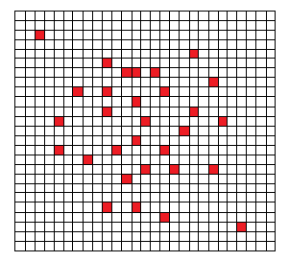
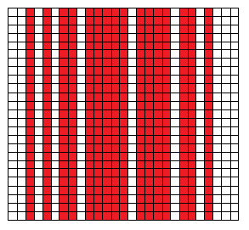
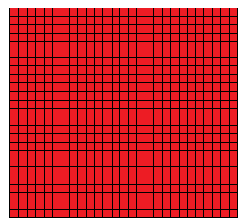
R&D Project
Developing a reconfigurable, radiation hard CMOS MAPS device.
Applications for tracking, digital calorimetry and medical applications
Architecture designed for high rate (25ns BX)
Reduce data rate by not reading every hit pixel address in 25ns but combining information in each 5x5mm² pad using fast logic
Pixel Mode
N pixels fired
N positions read out
Strixel Mode
hit column IDs read out
Pad Mode
Sum hits in all columns
# hits and Pad ID read out

Slide 19
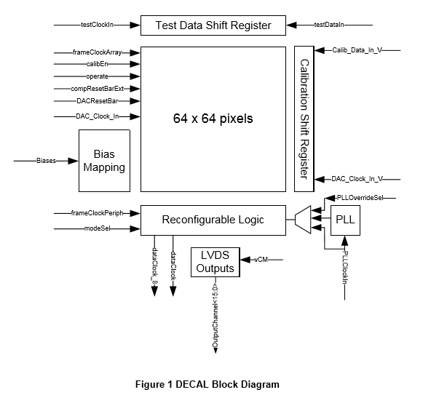
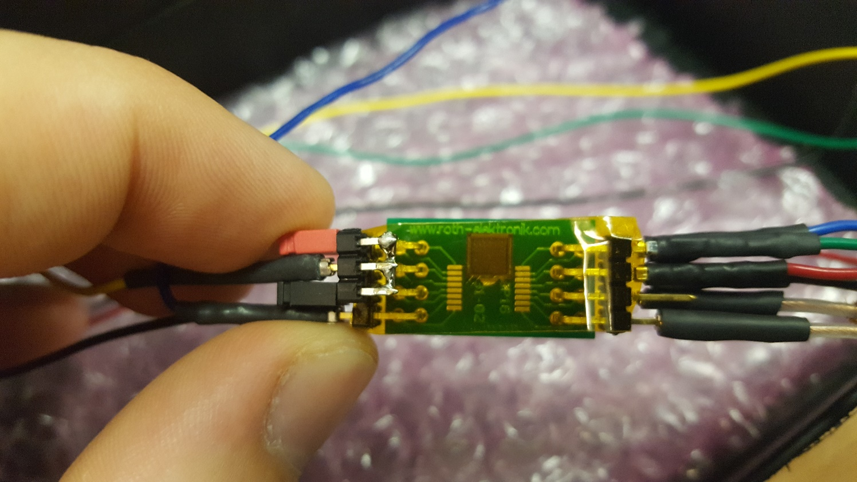
DECAL Chip
DECAL Chip on test board.

Slide 20
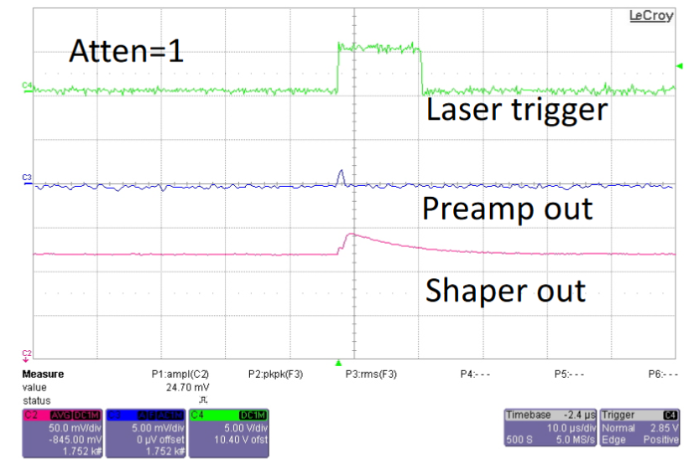
DECAL Chip Testing
Work In Progress

Slide 21
Conclusions
When I have them…

