Slide 1
EU8 Project costs eligibility

Slide 2
EU Project – Horizon 2020 in the IT Department

Slide 3
Horizon 2020 – EU projects
Budget
General conditions for eligibility costs
  Personnel declaration
  Travel
  Material and services
  Standard equipment and consumables
European Commission’s Payment

Slide 4
EU Projects Budget
Budgets are compiled on the project proposal and the budget plan is based on the approved budget. Related memo Procedures for new EU Projects with the participation of CERN.
Budget compilation:
Direct costs:
  Personnel Costs
    -personnel category
    -percentage of work
  Other costs
    Costs of travel, meetings/conference organization, invitation of collaborators, purchase of specific equipment, Audit, etc.
Direct costs of subcontracting (if eligible)
Indirect costs:
  Overheads
    Cover the standard equipment and installations provided by the Beneficiary (organization) to their members of personnel for the work execution.

Slide 5
  General conditions for eligibility costs
  To be eligible costs must be:
  Incurred in the project period
  Incurred in connection with the project actions, as described in Annex 1, and necessary for the project implementation
  Reasonable and verifiable
  Recorded in the beneficiary’s accounts and justified by the specific documents

Slide 6
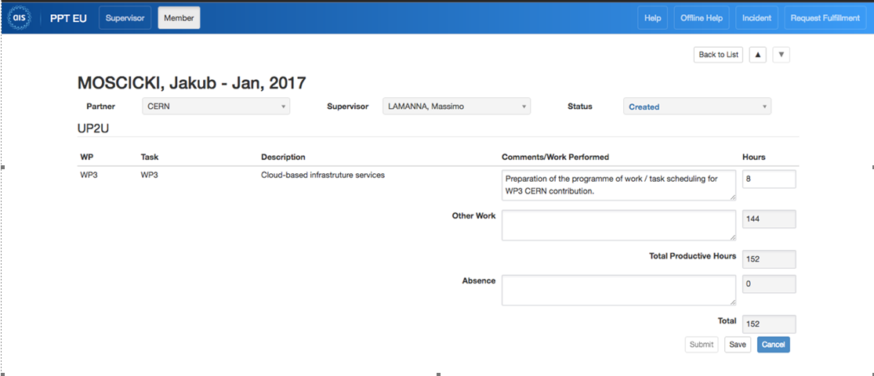
Personnel costs
Members of the personnel Staff, fellow, Doct, Tech, Admn, PJAS, Scientific associates and guest professors, working on EU projects has to be declared as ‘’Funded’’ by the project or ‘’Unfunded’’ if funds are not eligible.
Timesheets declaration
  People are registered on PPT EU by FAP-EF-EG, via Joelma Tolomeo.
  Once per month the person registered on PPT EU receive an email reminder with a link to fill in the timesheet.
It is important to fill in the timesheet as soon as possible.
  The hours related to the absence and hours spent on other work are filled automatically from EDH.
  Timesheet declaration must be made according to the percentage and tasks delivered.
  Timesheets are routed to the project leader for approval.

Slide 7
Subsistence to Cooperative Associates:
COAS, USER, VISC and Temporary workers
  Costs for people on those categories will be declared as ‘’Other direct costs’’
  Duration of collaboration for COAS, USER and VISC shall normally be limited to three months
  -> a collaboration agreement between the organisation and the Institute, stating the activity to be done for the project and the home Institution declaration are necessary for the CERN registration and for the costs eligibility.
  -> Any change of personnel assigned to a project must be notified to the it-ec-projectoffice@cern.ch as early as possible.

Slide 8
  Subcontracting costs
  Only certains tasks of a project can be subcontracted and as long as it is foreseen in Annex 1 of the Grant Agreement (GA).
  The subcontractor must be selected following CERN and EU procurement rules.
    Having the name of the subcontractor in the contractual documents such as the Annex I, does not guarantee his selection.
  In case you have to subcontract certain tasks of the project, it is highly recommended you contact fap-dep-ef-eg@cern.ch

Slide 9

Travel costs
Travel charged to the project must be justified with:
  Travel ticket (mentioning the payment details)
  Boarding pass
  All original tickets and invoices (conference fees, taxi, bus, train, etc)
  Participants list, conference website link or any other document stating your name
  Any edits, reports, notes, presented at the conference or justifying the presence at the meeting
A copy of those documents are to be attached to the EDH travel claim
If there was no project would I go to this conference?
If the answer is no, in this case the travel can be charged to the project. If the answer is maybe, then costs may be shared between CERN and the project

Slide 10
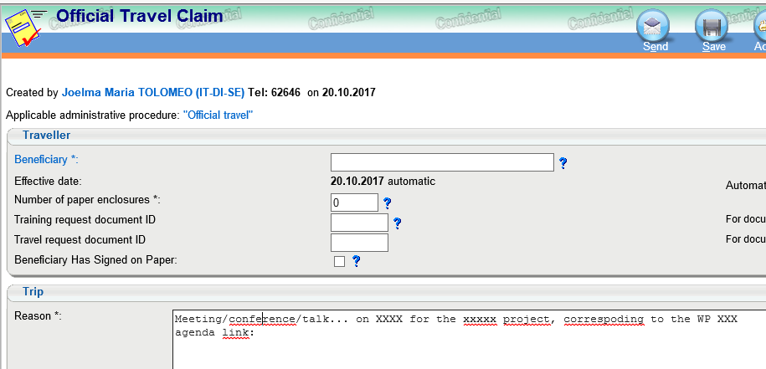

Other costs - Travel costs
Additional information to be inserted on the EDH travel documents:
Please at your last travels on EU projects and if any of those
documents or information are missing, please attach them to the claims.
The audit may be done soon after the project end!
The project name, the reason for the travel and the number of the Work Package concerned by the action must appear in the EDH document:

Slide 11
Other costs - Others
Equipment costs, costs of other goods and services may be considered as eligible costs, provided they meet the definition of eligible costs in the ECGA and are incurred in the context of the project.
For the eligibility of the following costs, please see the list of required documents:
  Invited Speaker
  official invitation letter mentioning the name of the invitee, the name and date of the event, the costs covered and their amounts
  a confirmation letter from the institute indicating there is no double reimbursement for the same invitee's expenditure
  copy of all expenditure receipts and/or invoices
  Material bought outside CERN (other than standard equipment and consumables), payment of a consultant company, etc.
  DAI: Supplier(s) offer(s), contract and invoice copy, CERN order, etc.
  Meeting organisation
  programme or agenda of the event
  participants list
  copy of the restaurant invoice
  copy of the room rental invoice (if room rented)
  Audit (CFS – Certificate on the Financial Statement)
  For projects exceeding 325kEUR the CFS is required at the end of the project.
  The audit costs ~5kEUR (covered by the EU commission funds)

Slide 12
Indirect costs - Overhead
  Standard equipment and consumables
  Unless duly stipulated in Annex I, CERN considers that standard equipment/consumables are not eligible costs.
  They are not used for the sole purpose of the project
  They are defined as any good that is provided by default by the Organization to its members of personnel in order to allow them to perfom their job
  This includes :
  Desktop computers, screens and accessories
  Printers
  Phones and phone communications
  Office furniture (e.g. desks, chairs, whiteboards, etc.)
  Office consumables (pens, paper, etc.)

Slide 13
Indirect costs - Overhead
  Overhead rate is 25% of the direct and indirect costs (no overhead for subcontracting)
  The grant is shared as follows:
  - 70% covers the exchange rate and the personnel cost variation
  - 30 % covers the installation and standard equipment and consumables

Slide 14
EU projects in IT -> budget information
  Budget summary are published on the first ITMM of the month and a copy of the table is stored at: https://espace.cern.ch/ec4it/_layouts/15/start.aspx#/default.aspx

Slide 15
Financial Costs Reporting
  Costs are reported and declared to the commission, by period: P1 , P2, etc.
  Reporting period can be for 12, 18, 24 months… The period depend on the time of the project
  Costs reporting are done by FAP-EF-EG and are based on the timesheets declaration and CET costs.
  -> for some project (specifically in IT) a quarterly report is done by FAP-EF-EG

Slide 16
European Commission’s payments
  Pre-financing payment :
  50% of the total budget -> Paid within 30 days after the Grant agreement signature by the commission, or 10 days before the starting date of the action
  5% of the pre-financing is retained by the commission and transferred into the ‘’Guarantee Fund’’
  Interim payments:
  Based on the amount declared and limited to 90% of the maximum grant amount.
  (calculation: 90% maximum grant amount – (minus) pre-financing and previous iterim payments)
  Payment of the balance
  Paid in 90 days from receiving the final report
  The guarantee funds is liberated
The payment coordination is managed by FAP-EF-EG

Slide 17
EU Projects – contacts
The Team Leader of the IT EU projects office is Bob Jones.
The Project Leader ‘’Scientist in Charge’’ is responsible for the coordination of the preparation and implementation of the project at CERN.
Any question and need of assistance on the EU project in the IT department, please contact: it-ec-projectoffice@cern.ch
EU projects in IT department are listed on the https://espace.cern.ch/ec4it/Proposals/Home.aspx
More information on the web (FAP-EF) page: Finance and Administrative Processes Department - External Grants – Financing EU projects pages
FAP-External Funding – External Grants, for all questions on the financial managment of the EU projects email : fap-dep-ef-eg@cern.ch

Slide 18
Many thanks for your attention!
I hope this presentation could provide a clarification on the financial part of the European Commission Projects.
Any comments or questions?

