Slide 1





High efficiency power source development activities in CERN
Jinchi Cai, Igor Syratchev
On behalf of HEIKA team

Slide 2
Outline
HE Klystron and code ‘KlyC’
FCC Klystron development
X-box Klystron upgrade
Other collaborations

Slide 3
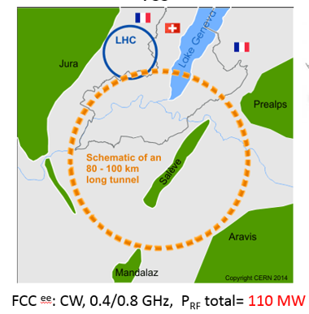
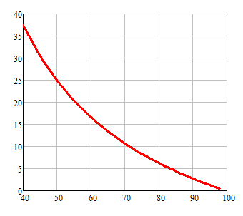
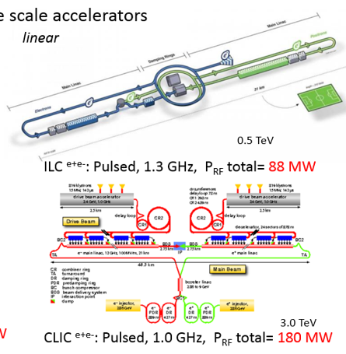

High efficiency! How high it could/should be!?
Efficiency impact on operation cost
FCC ^{e+e-} at 50 Euro/MWh and 5000 hours/year:
1 year
100 MW
10.7 M Euro
Excessive electricity bill, M Euro
9.3 M Euro
37 MW, more than twice the overall RF cryogenic power needs
Efficiency, %
Pulsed, 0.7 GHz,
92 MW

Slide 4
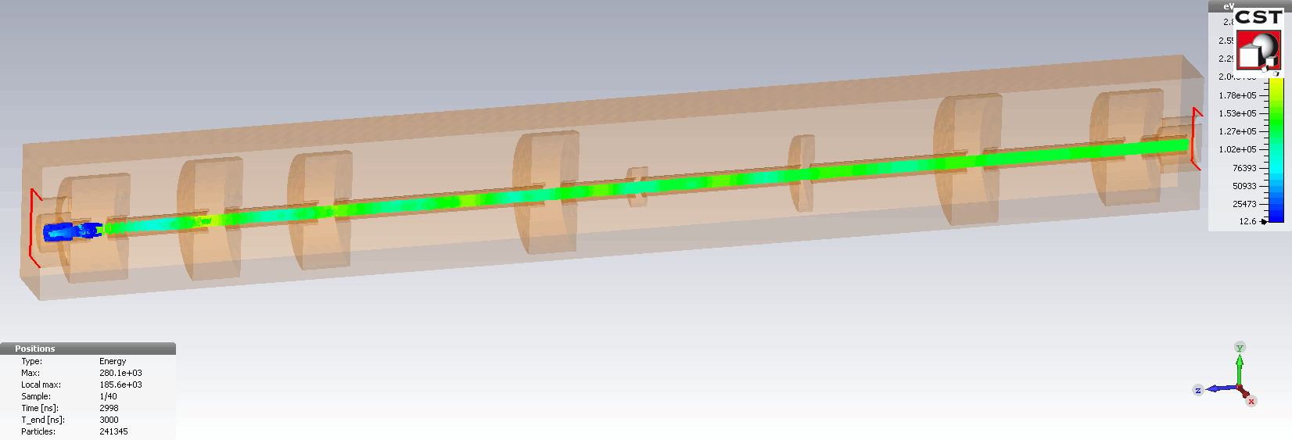
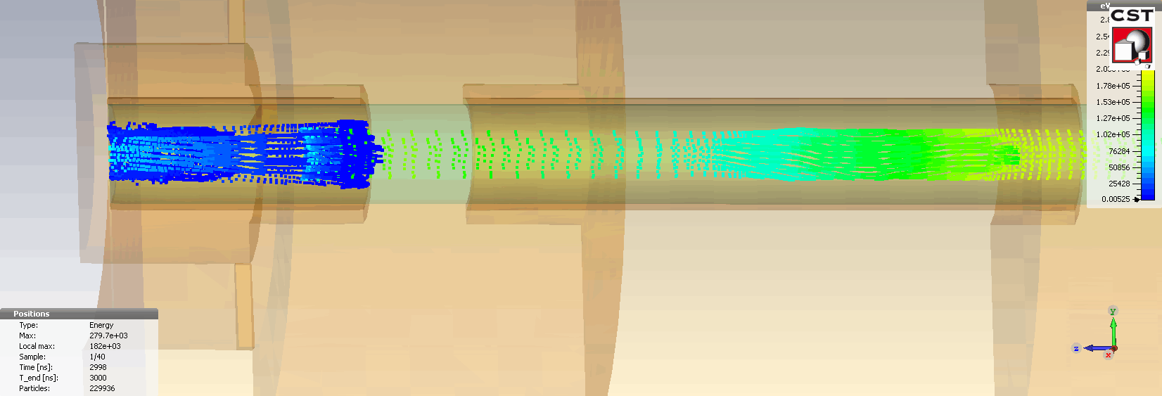
Mechanism and concepts
Input cavity
Penultimate cavity
Higher harmonic cavities
Gain cavity
Output cavity
Density modulated
Single cylindrical beam
Velocity modulated
with small input power [Pin]
Bunch circuit
Output power ~ Pin x 10^{3~6}
coupler
CSM tube: η=78%
Glossary: Saturation, velocity congregation, Radial stratification

Slide 5

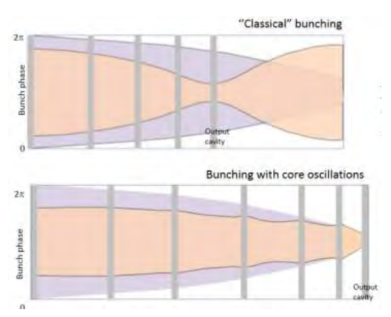
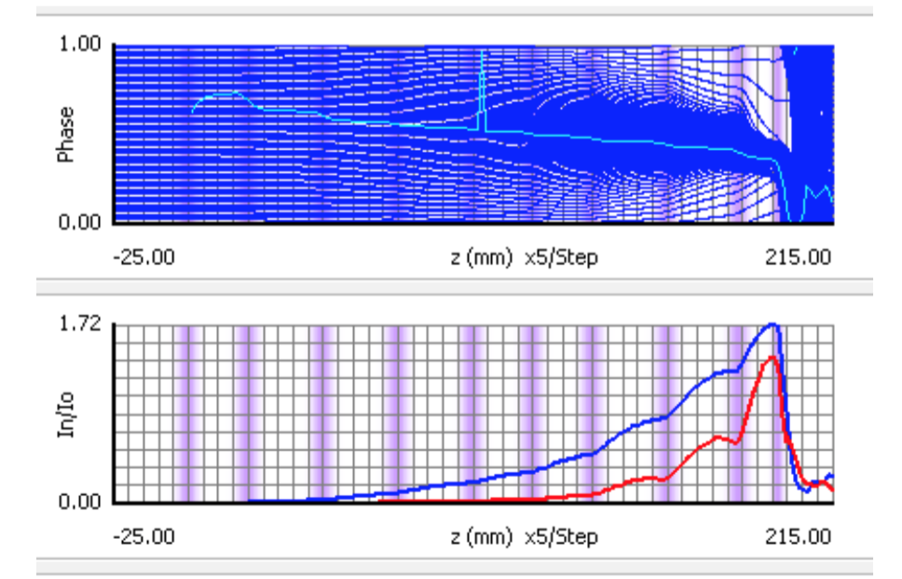
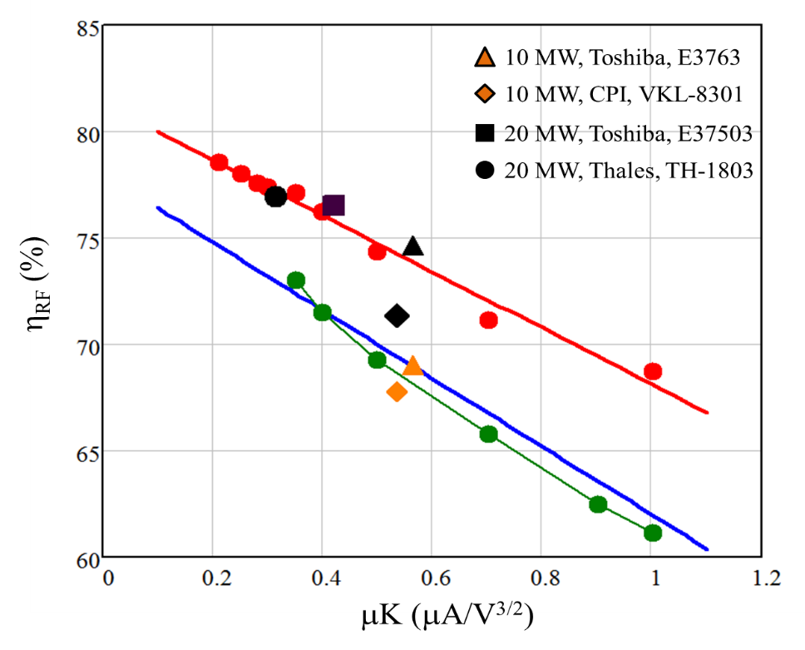
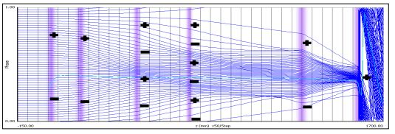
High Efficiency International Klystron Activity lead by CERN
Partitioning analysis and massive optimizations are necessary!
Kladistron
COM method
Optimised at CERN
Recommended by industry
CSM method
Notes:
COM method:
Using core oscillation to collect the peripherals

Slide 6
Available Simulation tools
Disk model: AJDISK,Klys4.5,Dev5,Klypwin
Discrete model: Tesla, KlyC
PIC:FCI,MAFIA,CST PIC, Magic, GDFIDL, Vorpal (+?)
Of all of them only AJDisk is a non-commercial product.
Klyc1D/2D potentials:
Free access for the klystron community.
Efficiency, much faster (~1/100) simulation than PIC
Precision, 2D simulation are supported (‘frozen’ beam)
Diversity, possible extension to other Klystron’s topologies (Multi-gap, Multi-beam, Traveling wave structure etc…)
Flexibility, full adapted for special needs (partitioning, bunched beam generation etc.) and versatile output data interface.
Notes:
A tool is needed to simulate a Klystron

Slide 7
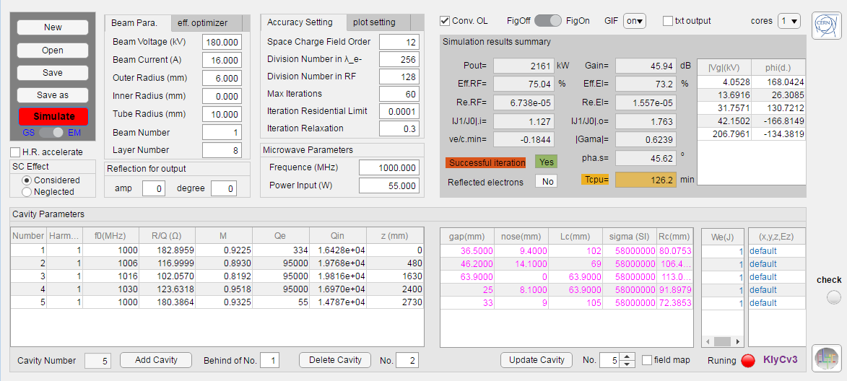
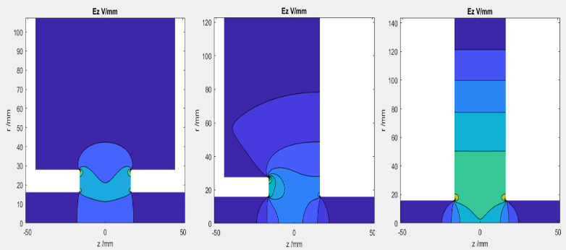
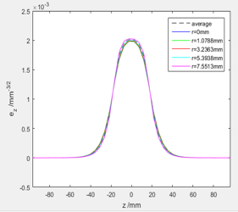
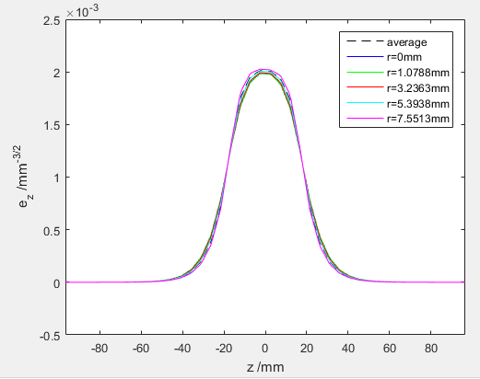
KlyC Graphical User Interface
Gaussian profile
EM 2D
Import

Slide 8
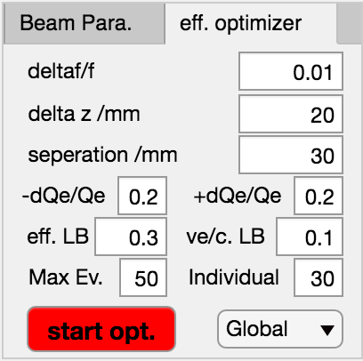
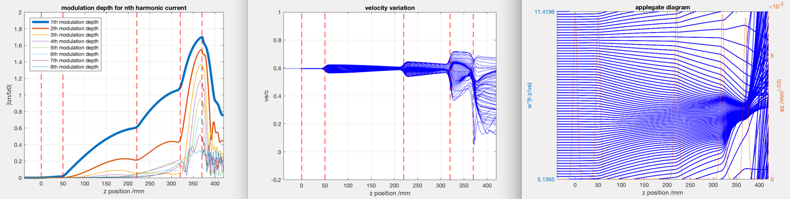
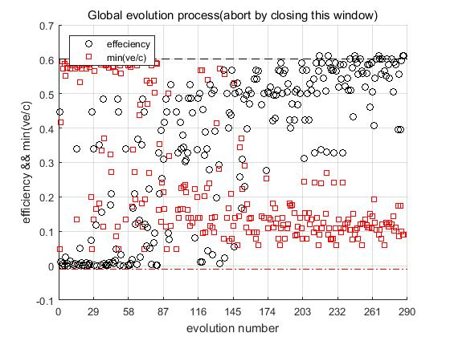
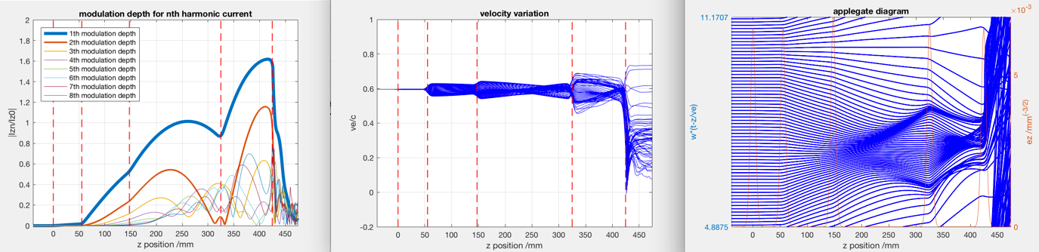
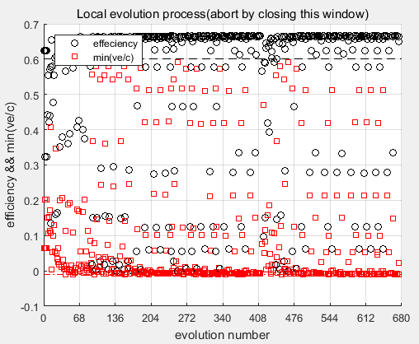
Eff. Optimizer in KlyC
45%
Global: genetic algorithm
Local: pattern search
67%
S band, perv.=1.9$μP$
Example:125kV, 80A, S
3 days for optimization

Slide 9
Outline
HE Klystron and code ‘KlyC’
FCC Klystron development
X-box Klystron upgrade
Other collaborations

Slide 10

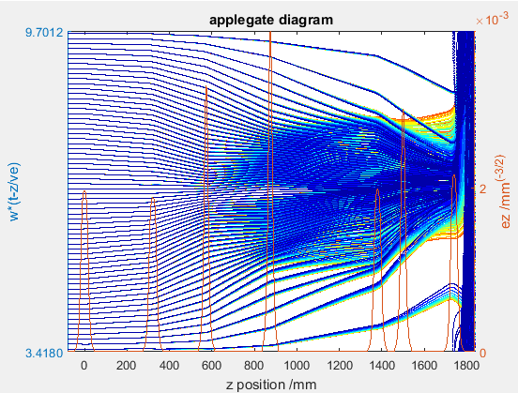
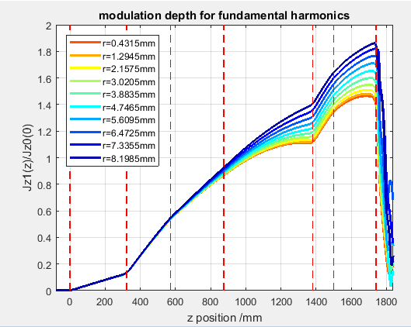
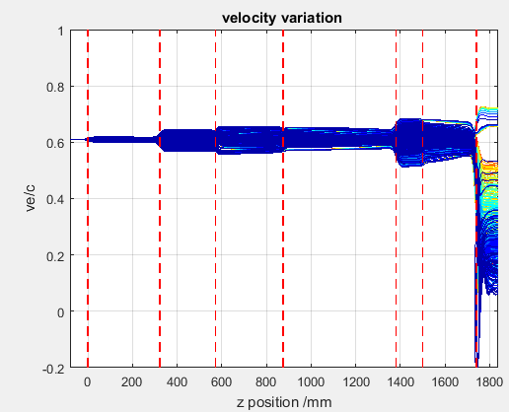
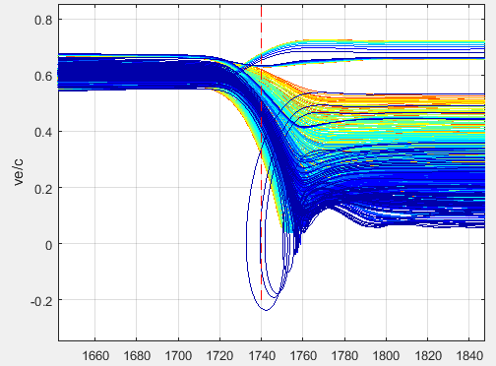
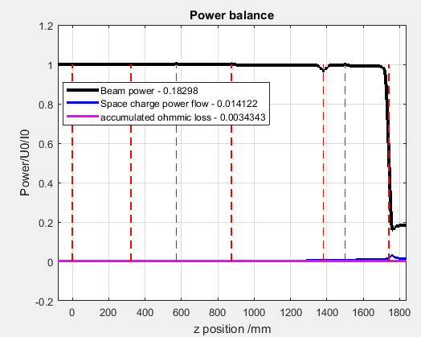
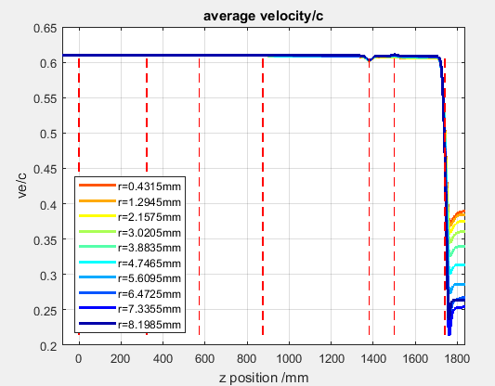
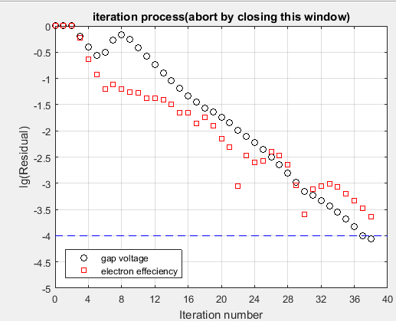
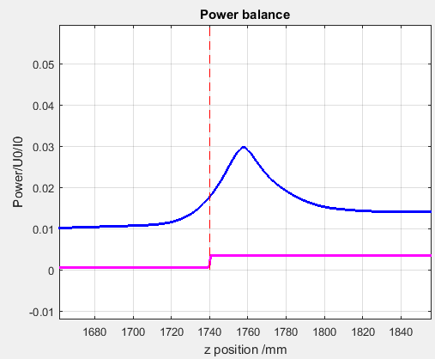
FCC e⁺e⁻:
0.8GHz,133.9kV×12.5A×80%>1.3MW
KlyC output graphics

Slide 11
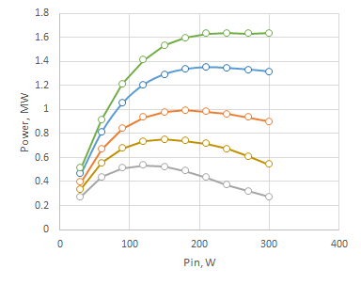
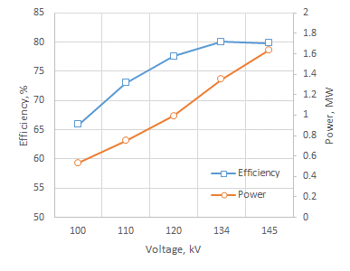
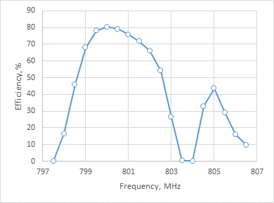
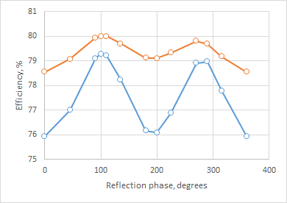
Klystron’s Power gain curves and bandwidth (KlyC).
145 kV
In saturation
134 kV
120 kV
110 kV
100 kV
134kV
In saturation
Tube operation at miss-matched RF load
4 MHz

Slide 12
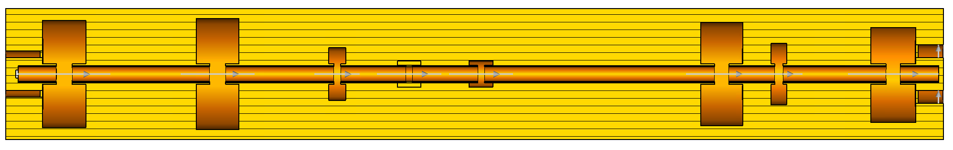
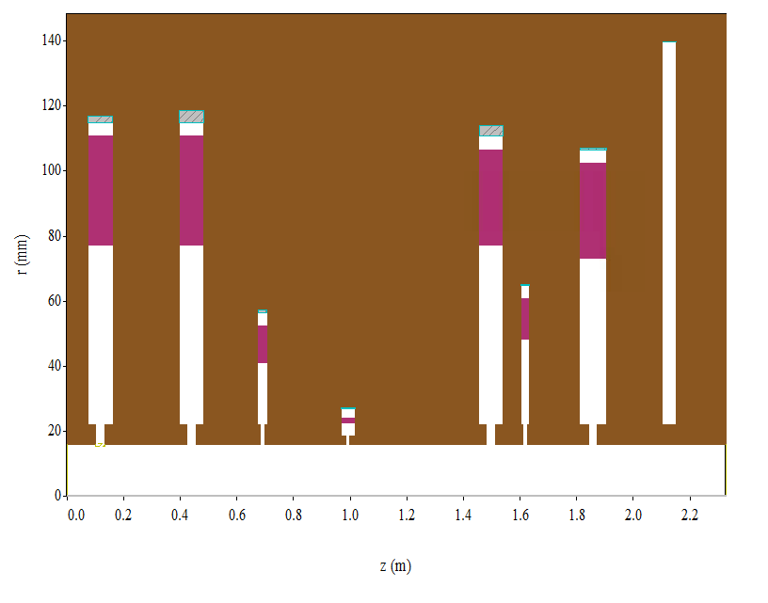
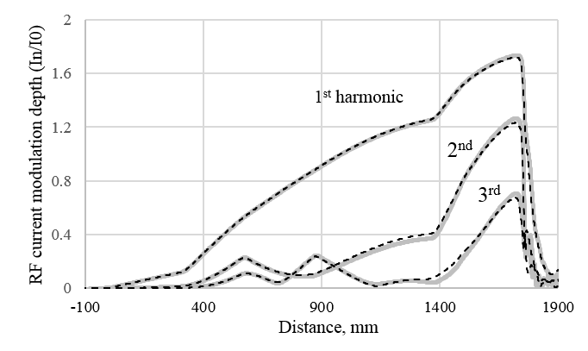
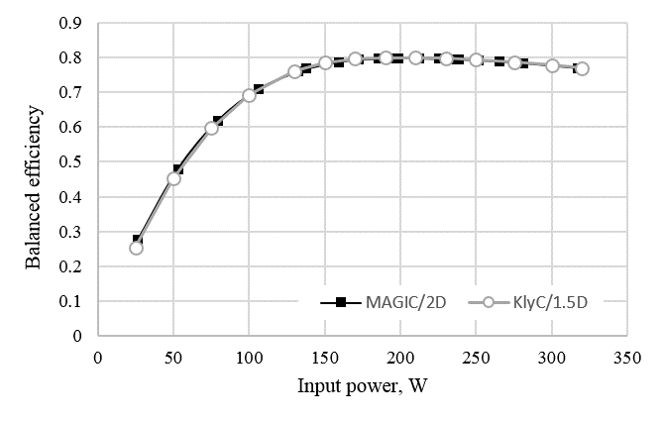
Benchmark with PIC code
Efficiency=80%@KlyC1.5D; 80% @Magic 2D and 79% @CST 3D
Time cost=20min@KlyC1.5D; 12 h @Magic 2D and 50h @CST 3D

Slide 13

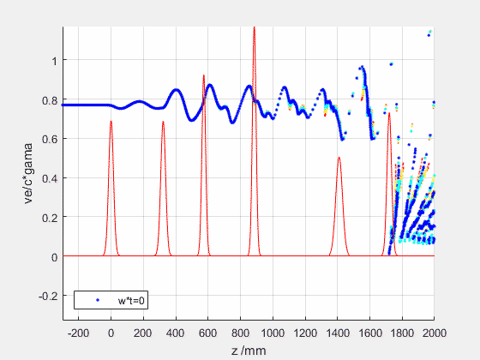
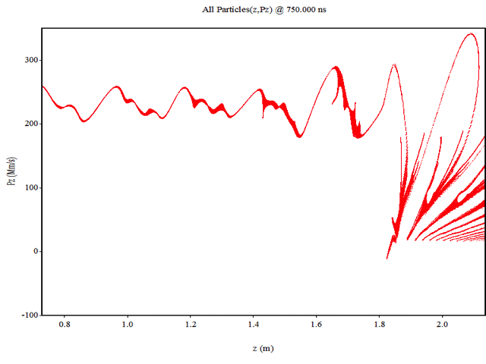
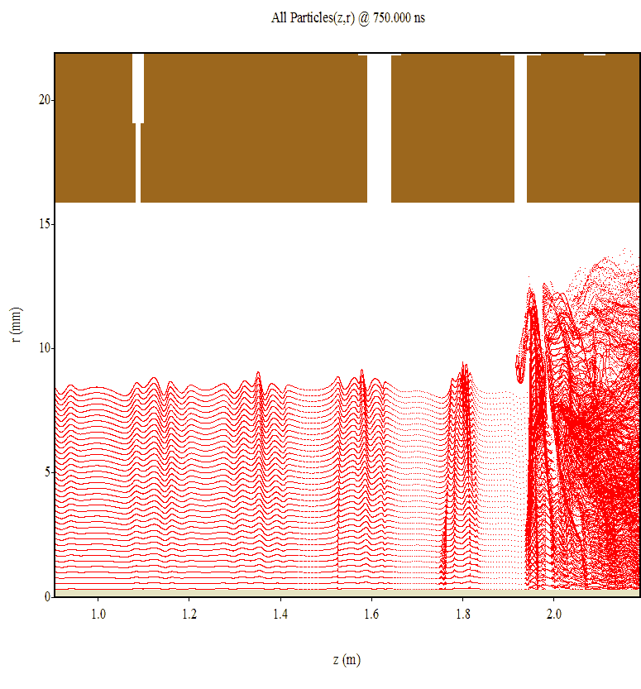
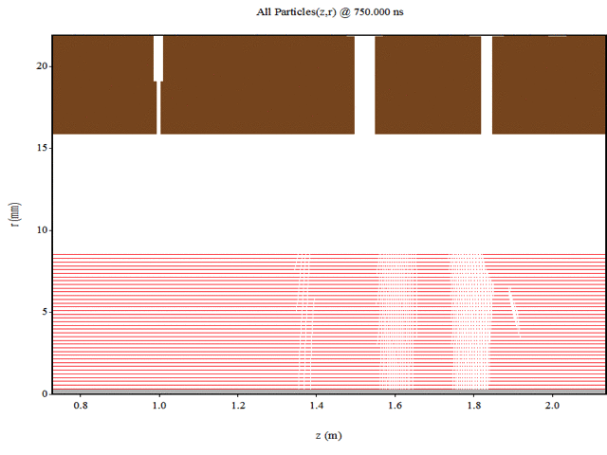
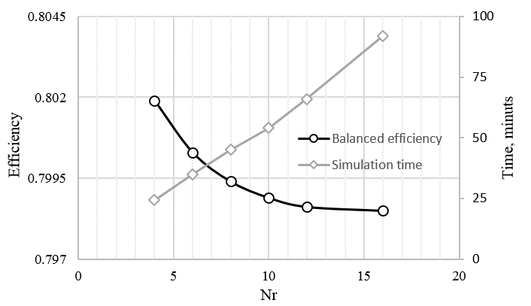
FCC#6. KlyC2D vs MAGIC
Beam settings:
MAGIC (0.07T) 2D, 79.4%
MAGIC (20T) 2D, 79.6%
Nz=256,Nr=4, η=79.9%,Tcpu= 20 min
Tcpu = 4000 min (~1ooo ns)
Nz=128,Nr=4
Saturation=97%
The radial bunch ‘expansion’ in output cavity (MAGIC2D) practically does not affect efficiency. This validates KlyC2D as an attractive (and fast) tool.
Convergent analysis

Slide 14
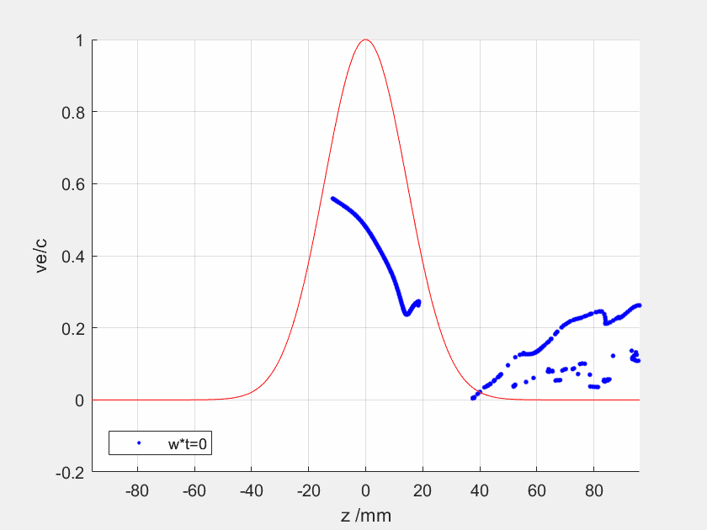
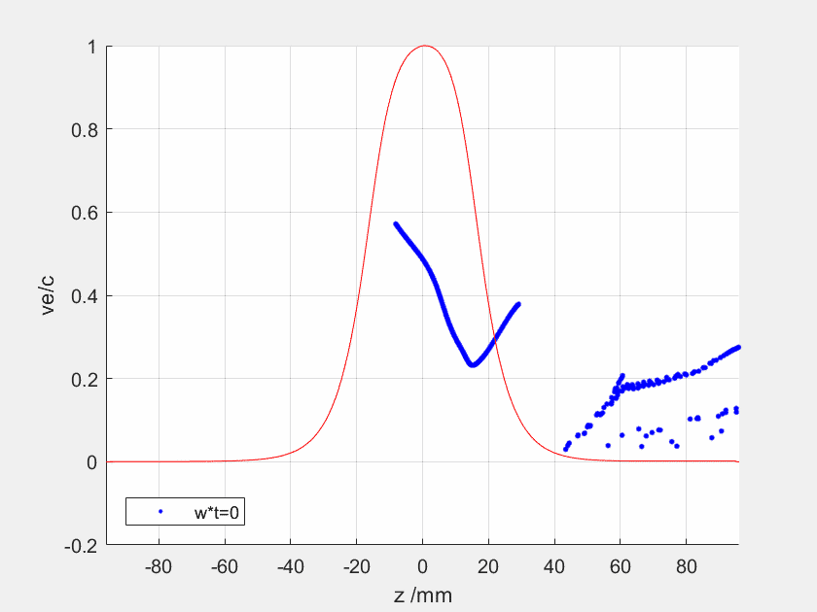
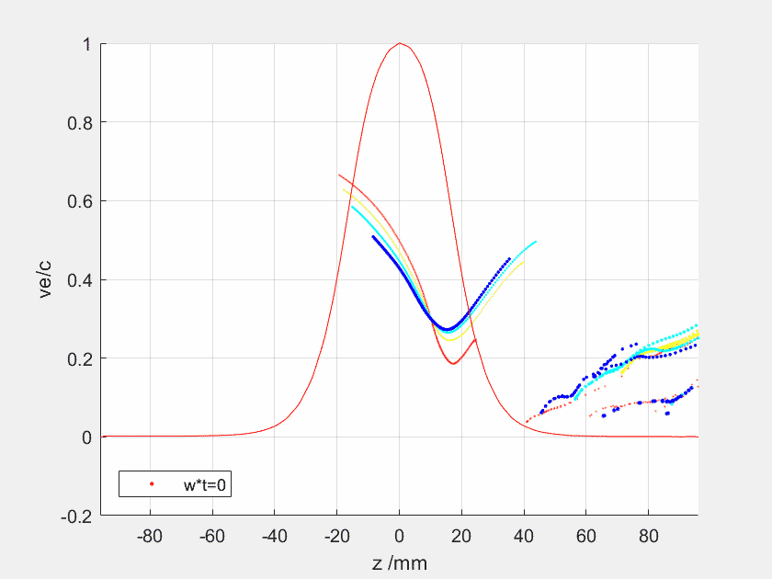
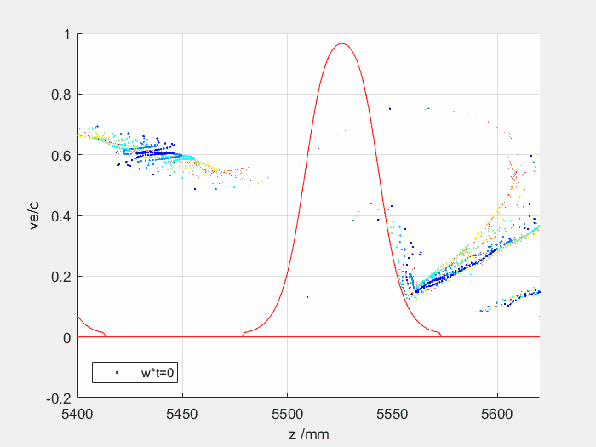
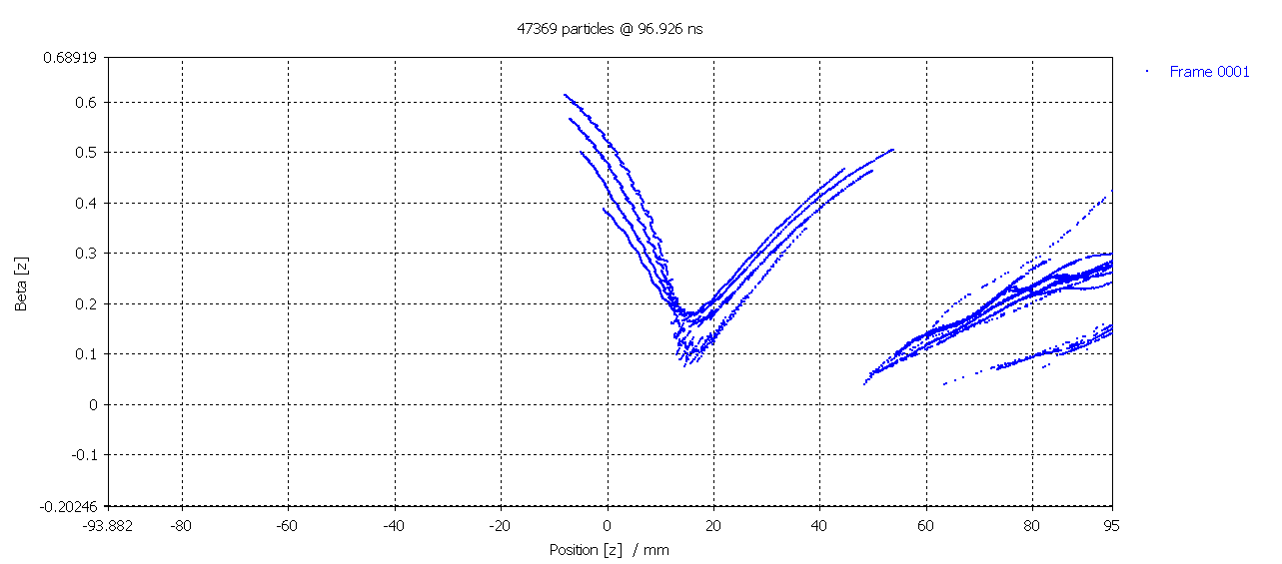
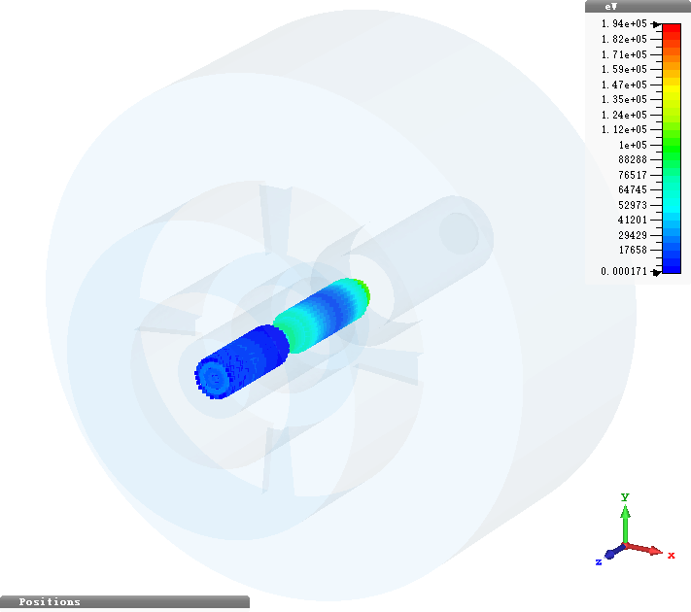
Power conversion efficiency. Limiting factors.
Fully saturated bunch
Optimised congregation
Linear congregation
Stratified bunch with linear congregation
90.1%
88.70%
84.20%
FCC CSM tube
Sabre effect and Ohmic
Benchmark with CST for the same bunch quality
80.1%
CST MWS
82.6%
Notes:
Mention zening’s name

Slide 15
Outline
HE Klystron and code ‘KlyC’
FCC Klystron development
X-box Klystron upgrade
Other collaborations

Slide 16
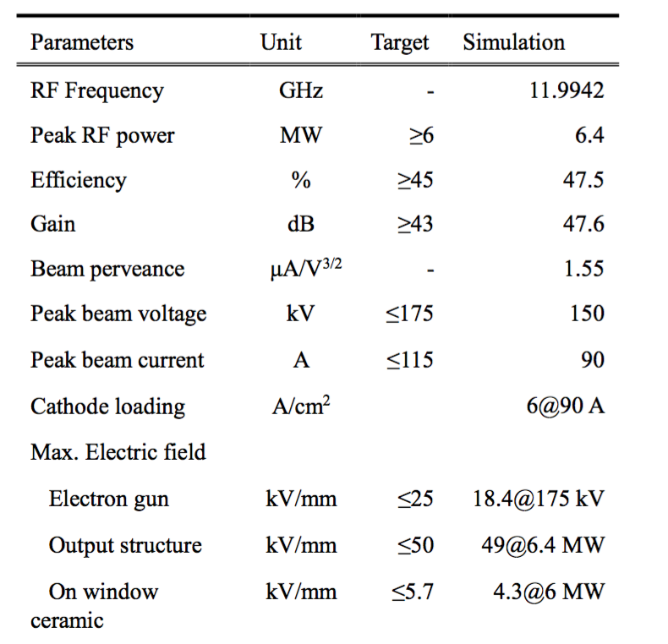
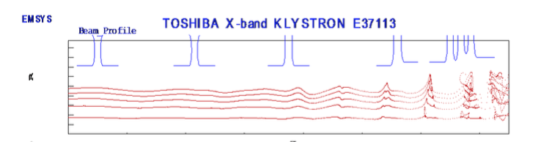
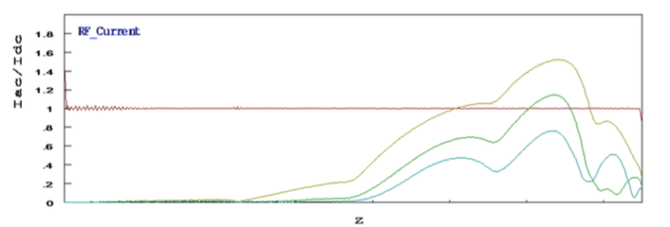
Toshiba E37113
FCI simulation results, test saturation efficiency~43%
Large beam aperture to accommodate large current
Efficiency upgrade to 60% by just changing the circuit design
Y. Okubo, et al. Development of an X-band 6MW Pulsed Klystron

Slide 17
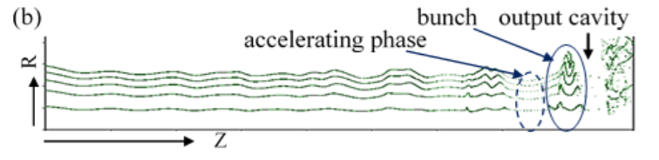
Efficiency upgrading
ultimate efficiency constrained by space charge effect
Congregation study
Optimised at CERN
Recommended by industry
60%?
Y.Okubo, et al. Status of high efficiency Klystron development in TETD (COM&BAC)
X band–relatively large beam aperture-low coupling coefficient(M~0.5)
Bunching difficulty
extraction difficulty
RF breakdown
Ohmic loss

Slide 18
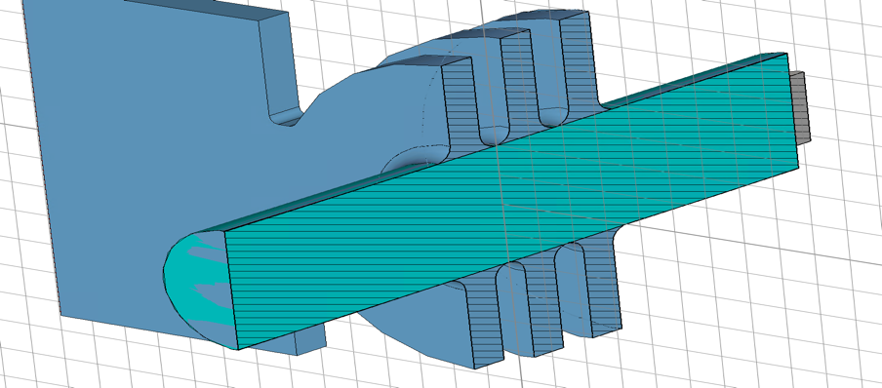

Design process
Scale and opt.
1D with ‘artificial’ output cavity(M=0.9): 73%
2D with ‘artificial’ output cavity—64%
Check
E_{max}>200MV/m
2D with real output cavity(M=0.5): 54%
2D with real output cavity—48%
Opt.
Single mode theory can’t be used any more!
Enhance the efficiency while decreasing the peak electric field by multi-cell
Weak coupling so multi-modes are coupled with each other

Slide 19




Coupling mode theory implanted into KlyC
Cell1 and cell3 coupled with cell2
𝜅 matrix can be calculated by coupling adjacent cells
mono.
 | F1 | F2 | F3
Coupled theory | 11.7704+0.0406j | 12.0114+0.1308j | 12.1735+0.0364j
HFSS eig. | 11.7710+0.0377j | 12.0051+0.1325j | 12.1722+0.0378j
CST MWS | 11.77111+0.0382j | 12.00470+0.1325j | 12.17316+0.0376j
congr.
3cell structures in previous slide

Slide 20


Design with coupled cell structure
Eff.=
62% efficiency design in KlyC
Modulation process
Velocity varation

Slide 21





CST 3D PIC verification
Benchmarked!
~100MV/m
Energy distribution
60.5% efficiency with Bz=2.5Br=0.36
Field distribution
Phase space movie in CST
Beam dynamics
KlyC reference

Slide 22



Performance evaluation
>50MHz
Next step to improve the performance
Sacrifice the high gain to broaden the bandwidth
Larger gap or tapered structure to decrease the maximum electric field(~100MV/m)
Sensitivity analysis to make the tube more robust and reliable
optimize Bz for the tradeoff between clearance and efficiency

Slide 23
Outline
HE Klystron and code ‘KlyC’
FCC Klystron development
X-box Klystron upgrade
Other collaborations

Slide 24



FCC h⁺h⁻ /LHC:
0.4GHz,54kV×9A×72%~0.35MW (Pin=80W)

Slide 25




ESS:
0.704GHz,110kV×15.272A×75%~1.3MW (Pin=90W)
Output eff.
Eff=75.8%

Slide 26

Thales tube TH2180
comparison between KlyC measurements. Simulation have been done by company

Slide 27
Conclusion & Outlook
The 1.5D computer code KlyC is a new and reliable tool for the klystron optimization. It is available in the public domain. Number of institutions, Labs and industries are using it now.
The new klystron bunching technologies have been developed at CERN within HEIKA collaboration. They have been successfully applied for the design of different klystrons ensuring that developed tubes have reached their ultimate performance.
FCC Lband 1.3MW
ESS Lband 1.3MW
LHC UHF 0.35MW
Xbox Xband 8.5MW
Optimised at CERN
Recommended by industry
1.4
1.6

Slide 28


Thanks for your attention!
Acknowledgment
Authors would like to all the contributors for their feedback for the benchmark of KlyC and design results
MAGIC PIC
Scan QR code for More benchmark work done
Notes:
75% ESS tube 110kV,16.84A; 70% LHC tube 54kV,9A

