Slide 1
Simulation studies on the RF-driven dielectric-loaded accelerating (DLA) structures
Yelong Wei*, Alexej Grudiev
CERN, European Organization for Nuclear Research
*Email: yelong.wei@cern.ch
1

Slide 2
Outline
Introduction
Dielectric-Loaded Accelerating (DLA) Structures
Corrugated DLA Structures
Summary & Outlook
2

Slide 3
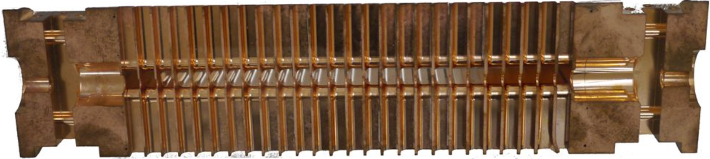
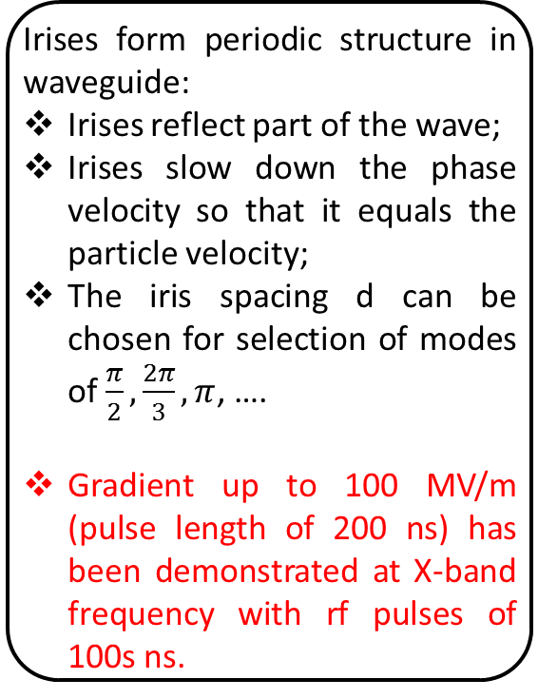
Introduction
Slow wave accelerators: Irises-loaded accelerating structures
Irises form periodic structure in waveguide:
Irises reflect part of the wave;
Irises slow down the phase velocity so that it equals the particle velocity;
The iris spacing d can be chosen for selection of modes of $\frac{π}{2},\frac{2π}{3}, π$, ….
Gradient up to 100 MV/m (pulse length of 200 ns) has been demonstrated at X-band frequency with rf pulses of 100s ns.
X-band CLIC accelerating structure
3

Slide 4
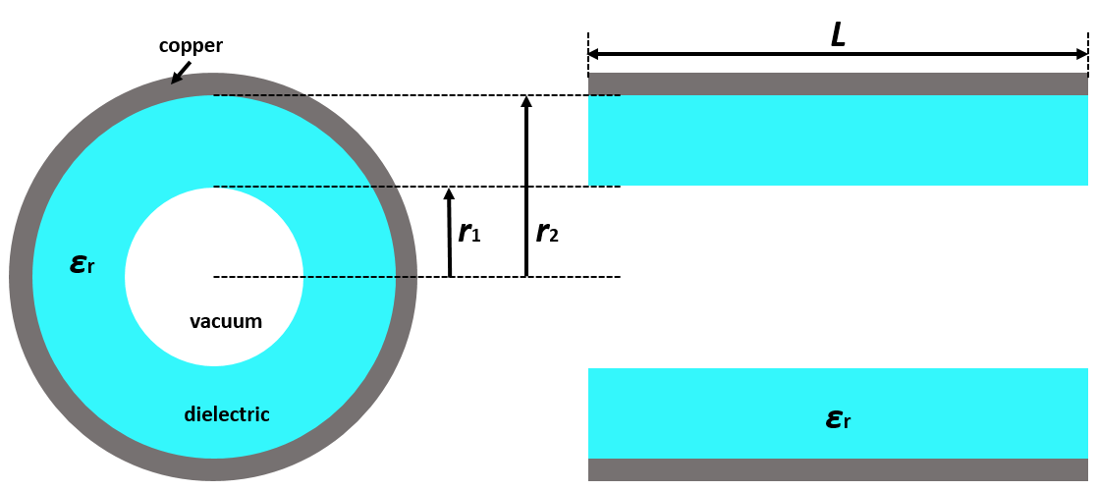
Introduction
Slow wave accelerators: dielectric-loaded accelerating (DLA) structures
Advantages of DLA:
Simple geometry for easy fabrication;
No field enhancements on irises;
Potential high gradient;
Easy to damp HOMs;
Potential high breakdown??
Disadvantages of DLA:
Low power efficiency due to most of the RF power stored in the dielectric region.
4

Slide 5
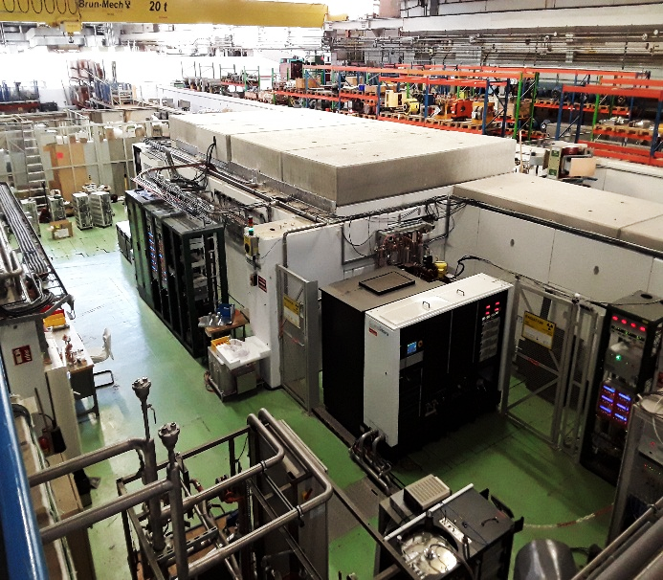
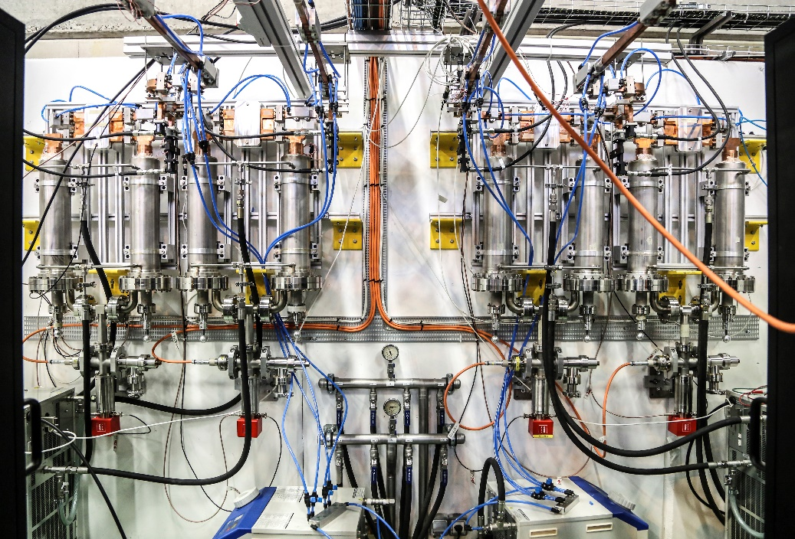
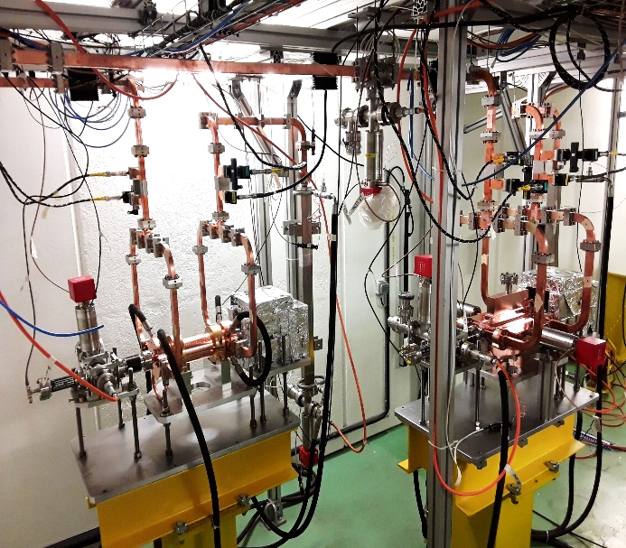
Test Stands at CERN
Xbox 1: 50 MW klystron, 50 Hz, connection with CLEAR (e⁻ linac)
Xbox 2: 50 MW klystron, 50 Hz
Xbox 3: 4x6 MW klystrons, 400 Hz, 4 structure test slots
Sbox: 43 MW klystron, 25 Hz, S-band (2.9985 GHz)
50 MW klystron with pulse duration of 1.2 μs
Pulse Compressors
CLIC test platform
Courtesy of slides from Jan Paszkiewicz
5

Slide 6
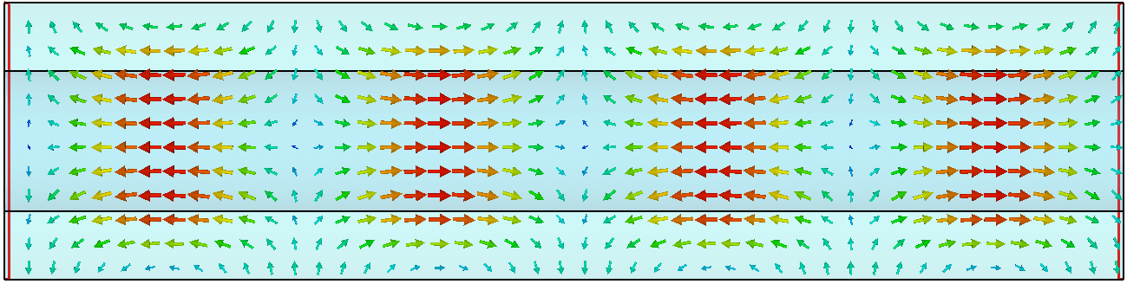
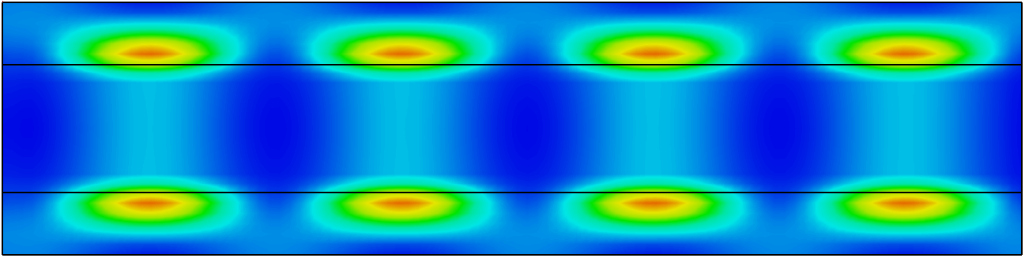
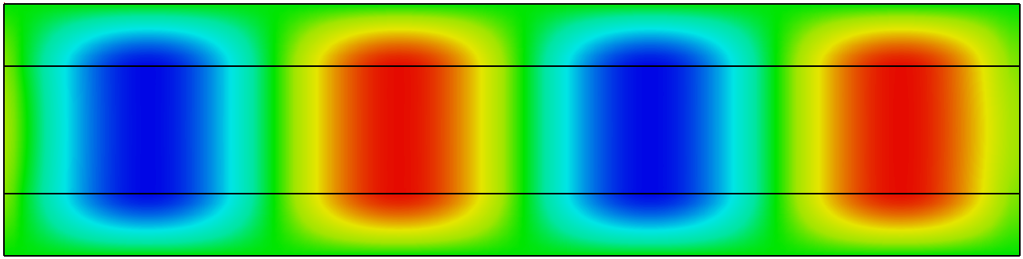
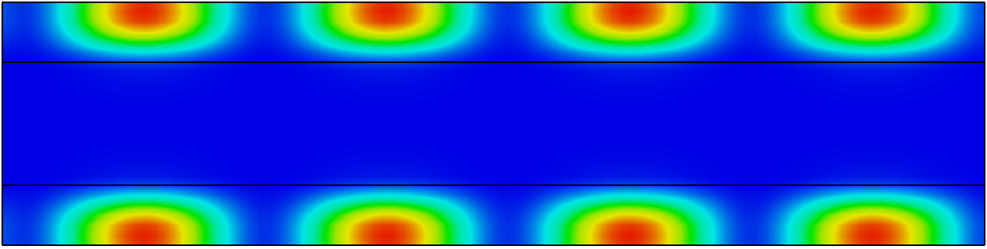


DLA Structures
E-field of the TM01 mode ($v_{p}=c$)
Electric energy density
dielectric
Vacuum
dielectric
Ez of the TM01 mode ($v_{p}=c$)
Magnetic energy density
dielectric
Vacuum
dielectric
The axial accelerating field is the maximum electric field in the structure;
The phase velocity of TM01 mode can be slowed down to c;
Most of energy is stored in dielectric area, resulting in low power efficiency.
6

Slide 7
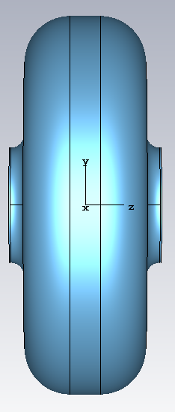
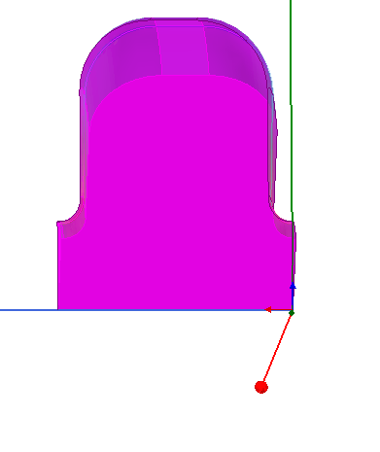
CLIC-G Iris structure
Geometry parameters | Unit: mm
a | 3.15
b | 10.35635
h | 8.332
d | 1.67
s | 0.1
ae | 0.877
be | 0.7515
Rr | 2.5
HFSS modelling
 | CST | HFSS
Phase advance | 120° | 120°
Frequency [GHz] | 11.9949 | 11.9943
Unloaded Q0 | 7295.2 | 7245
r’/Q0 [Ω/m] | 15892 | 15924
vg/c | 0.018 | 0.018
CST modelling
7

Slide 8
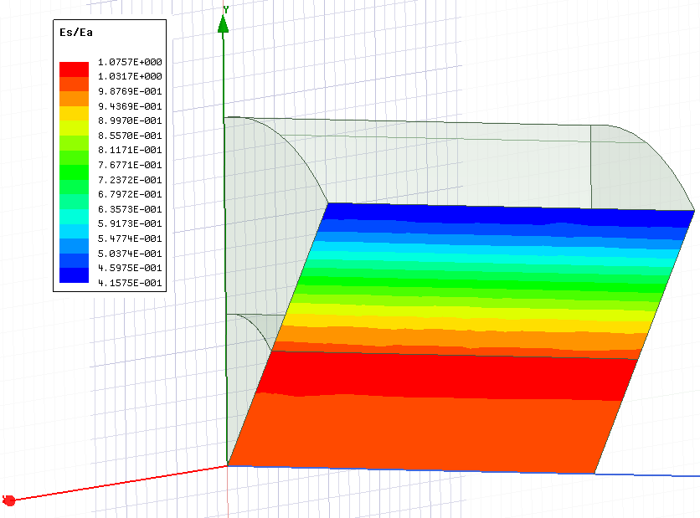
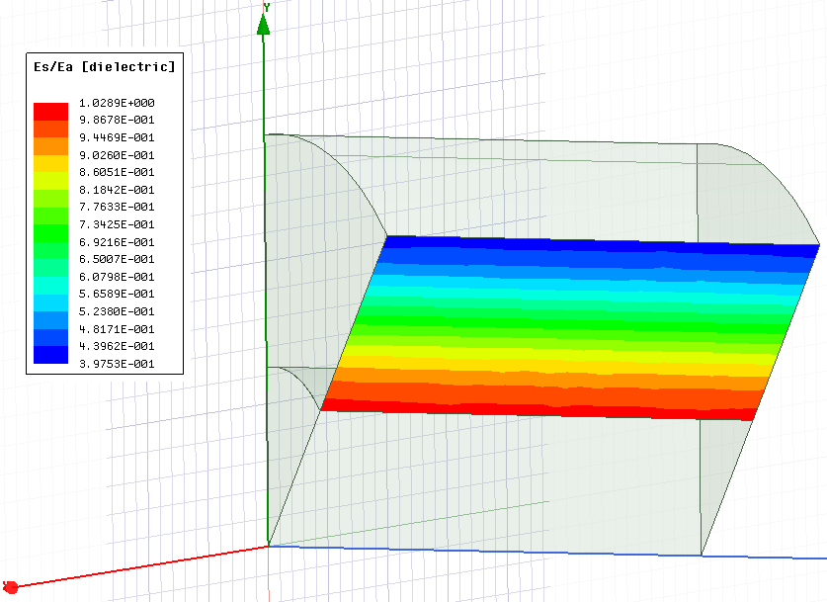
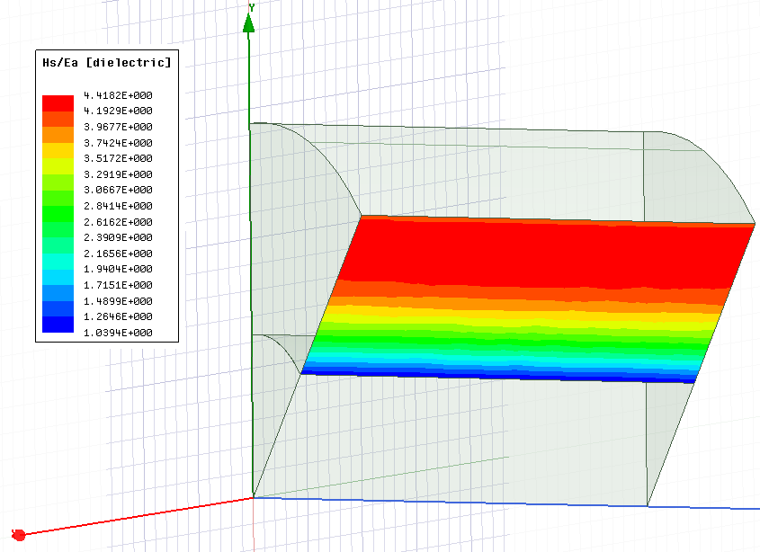
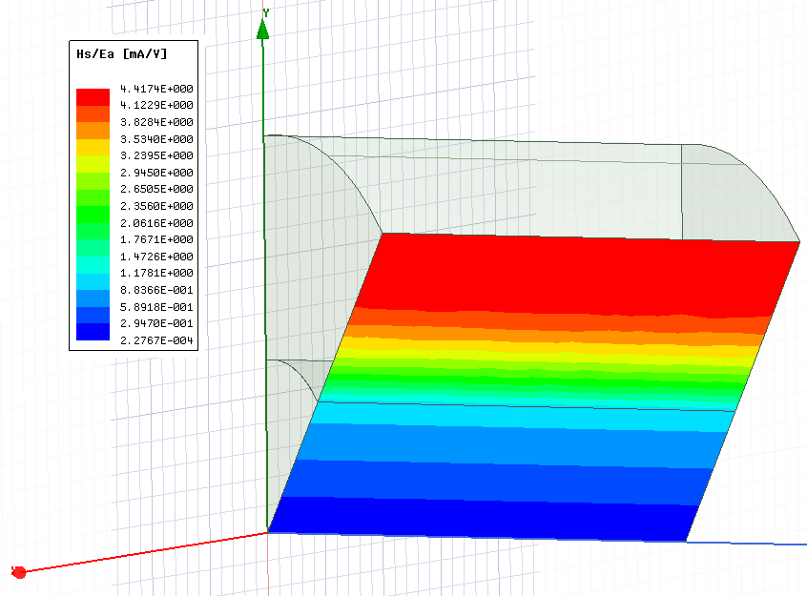
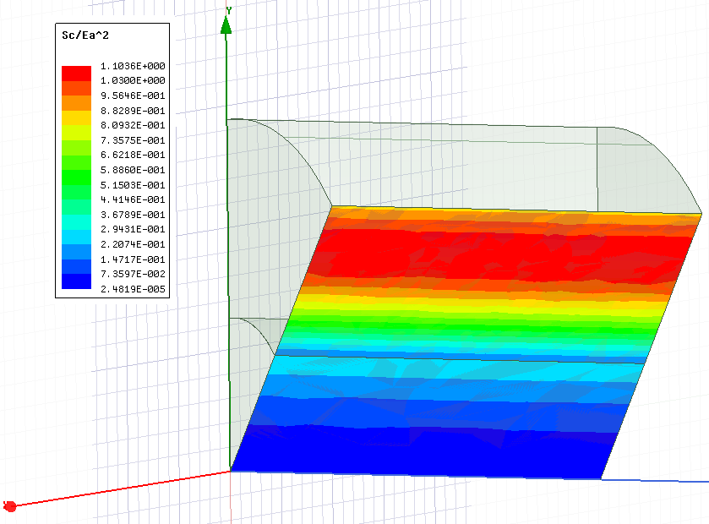
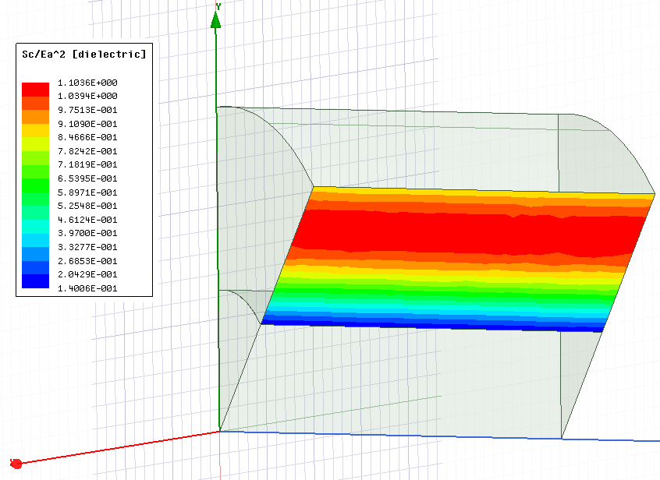
Quartz DLA structure
E_{s}/E_{a}
H_{s}/E_{a}
dielectric
Vacuum
S_{c}/E_{a}²
 | All area | Dielectric area
Es/Ea | 1.0757 | 1.0289
Hs/Ha [mA/V] | 4.4182 | 4.4174
Sc/Ea^2 [mA/V] | 1.1036 | 1.1036
8

Slide 9
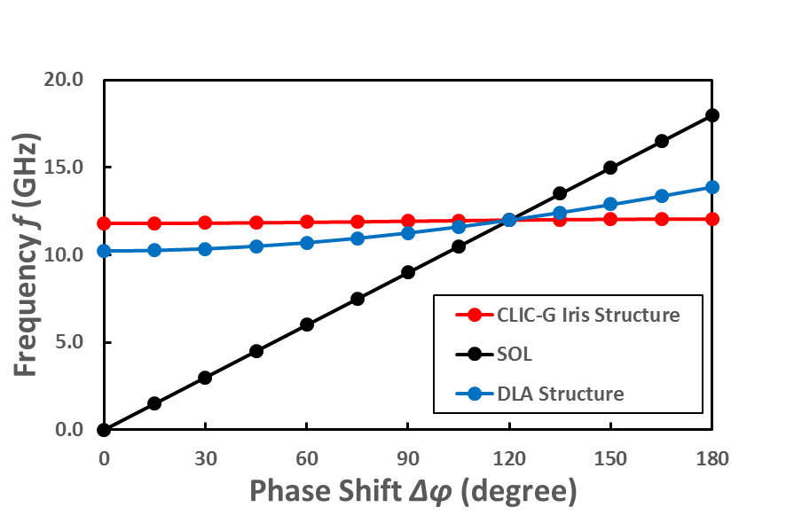
Dispersion Curves
The red line for CLIC-G iris gradually saturates, and group velocity gradually decreases to 0 with the increase of phase shift;
The blue line for DLA structure gradually increases, but group velocity can’t be 0 with the increase of phase shift.
TM01 mode
9

Slide 10
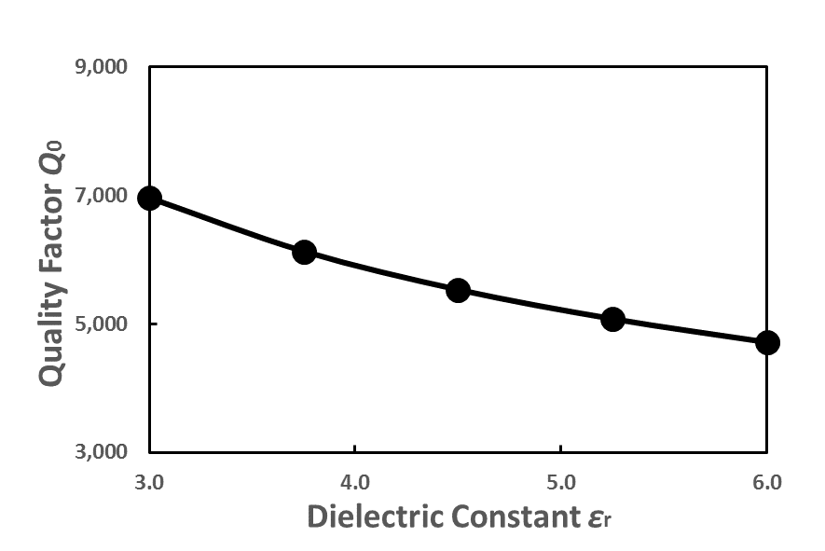
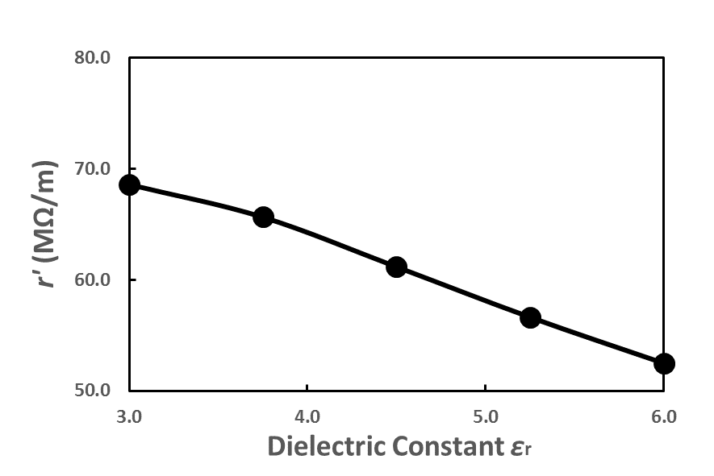
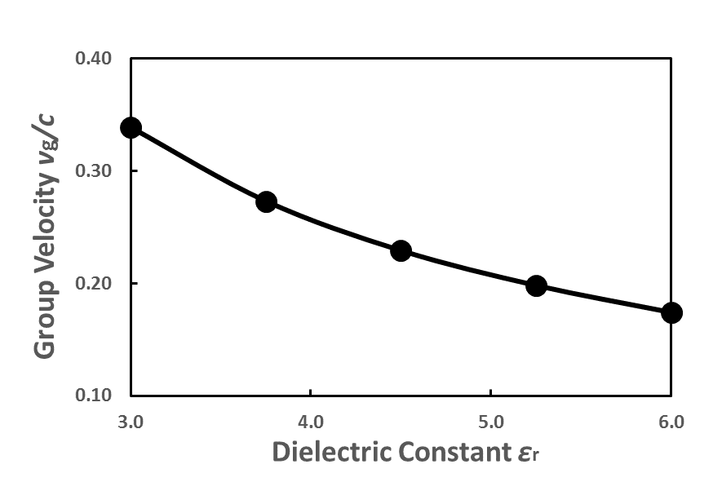
Geometry Optimizations- dielectric constant εr
Parameters
Dielectric loss tangent δ | 0.00005
r1 | 3.15 mm
r2 | It is used to tune the frequency to 12 GHz
10

Slide 11
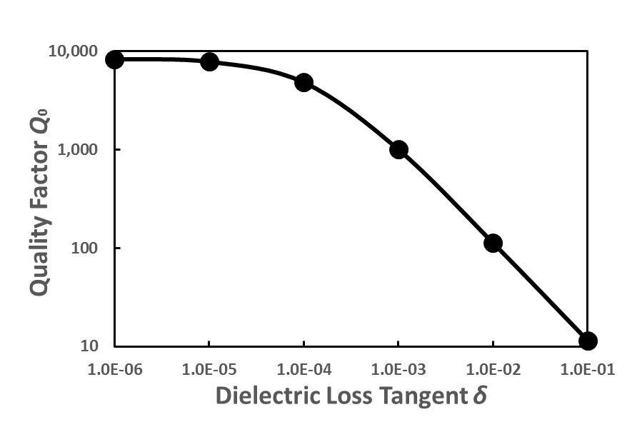
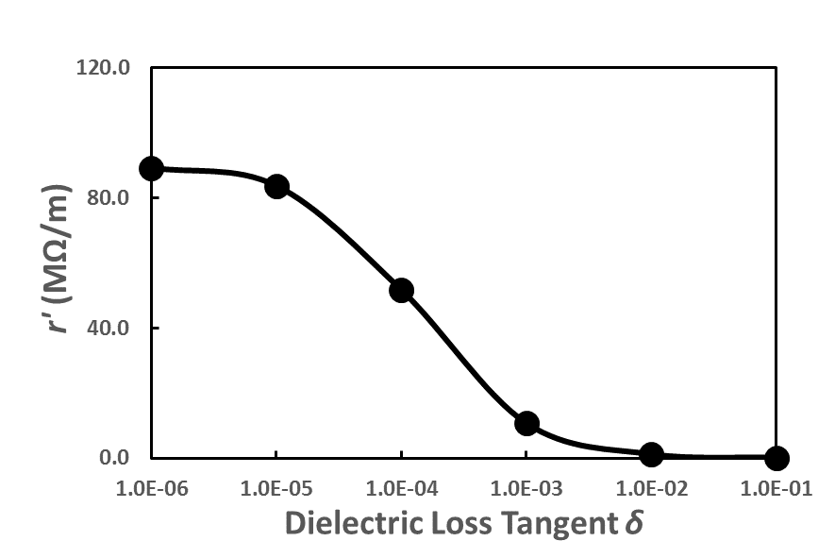
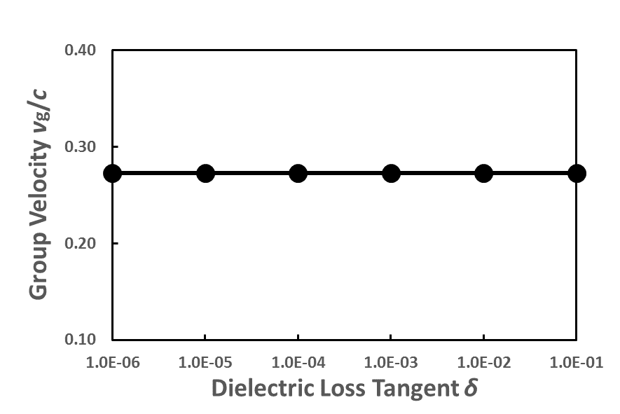
Geometry Optimizations- dielectric loss tangent δ
Parameters
Dielectric constant εr | 3.75
r1 | 3.15 mm
r2 | It is used to tune the frequency to 12 GHz
11

Slide 12
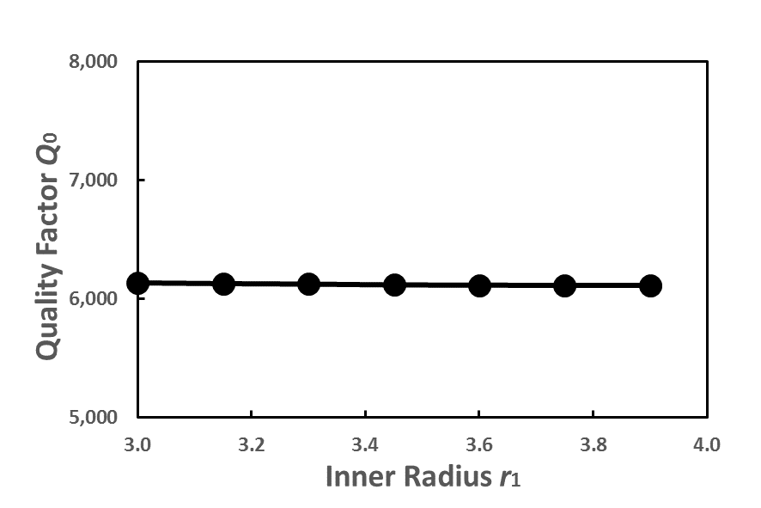
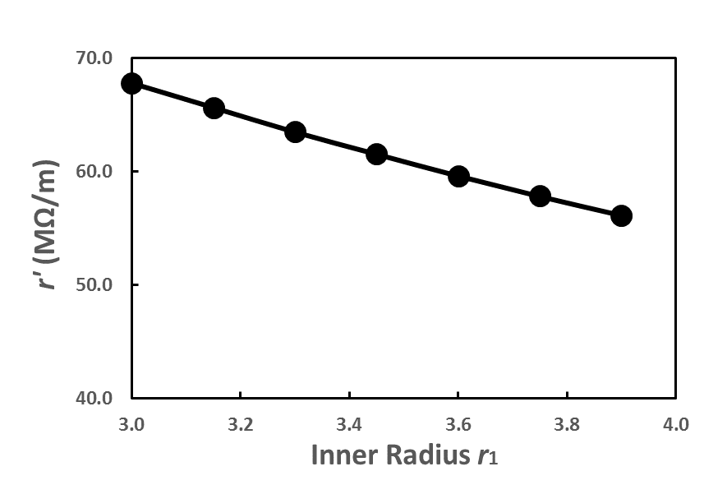
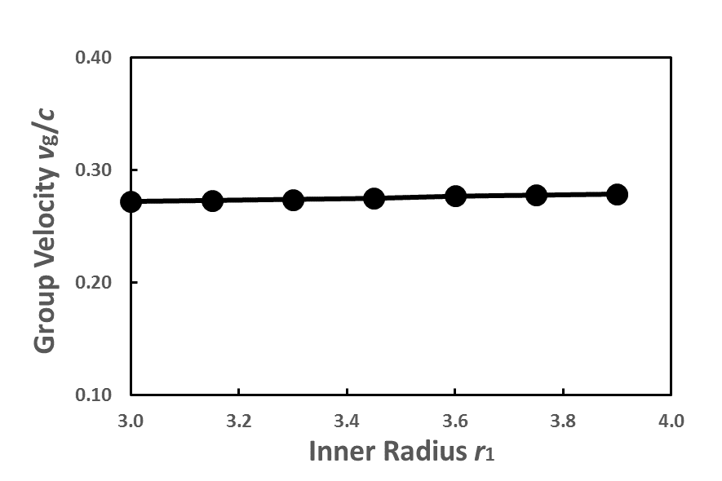
Geometry Optimizations- inner radius r1
Parameters
Dielectric constant εr | 3.75
Dielectric loss tangent δ | 0.00005
r2 | It is used to tune the frequency to 12 GHz
12

Slide 13
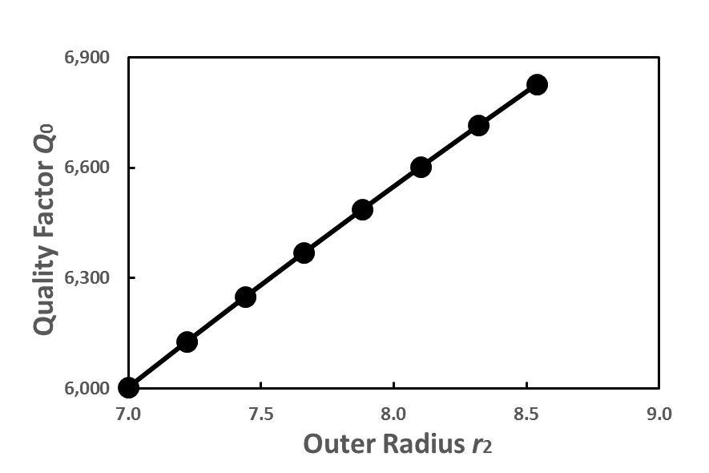
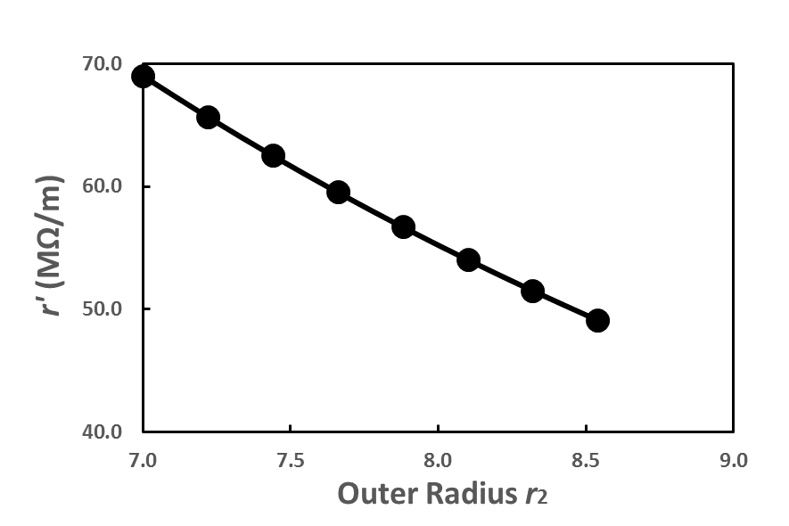
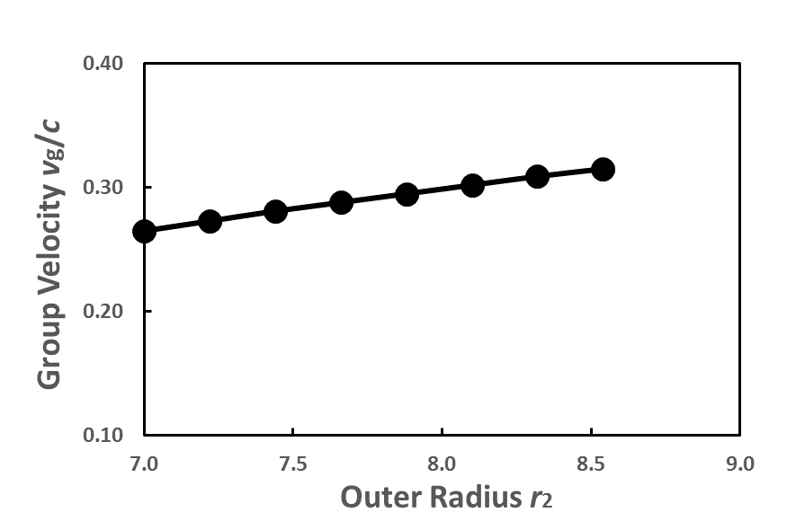
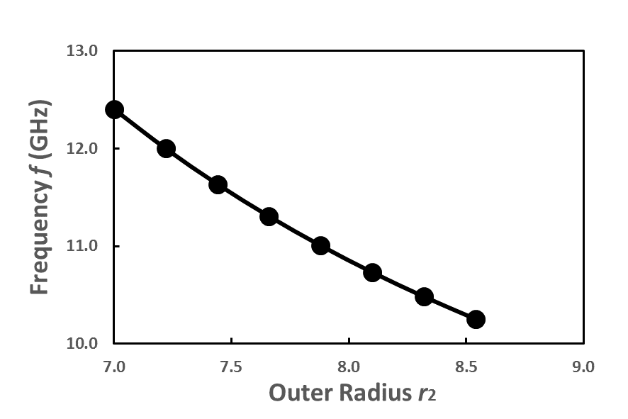
Geometry Optimizations- outer radius r2
13

Slide 14
RF parameters on DLA structures
 | CLIC-G iris structure | Quartz (SiO2) | Diamond | Alumina (Al2O3) | MgCaTi | BaTi
Dielectric constant εr |  | 3.75 | 5.7 | 9.7 | 20 | 35
Dielectric loss tangent δ |  | 0.00005 | 0.0001 | 0.0001 | 0.0001 | 0.0001
Structure length [mm] | 8.332 | 8.332 | 8.332 | 8.332 | 8.332 | 8.332
Phase advance | 120° | 120° | 120° | 120° | 120° | 120°
Inner radius r1 [mm] | 3.15 | 3.15 | 3.15 | 3.15 | 3.15 | 3.15
Outer radius r2 [mm] |  | 7.22 | 6.20 | 5.357 | 4.624 | 4.245
Frequency [GHz] | 11.9943 | 11.9990 | 11.9958 | 11.9927 | 11.9942 | 11.9919
Unloaded Q0 | 7245 | 6127 | 3998 | 3123 | 2214 | 1691
r’/Q0 [Ω/m] | 15924 | 10719 | 11166 | 10408 | 8463 | 6878
r’ [MΩ/m] | 115 | 66 | 45 | 33 | 19 | 12
vg/c | 0.018 | 0.273 | 0.183 | 0.111 | 0.057 | 0.034
Es/Ea | 2.4819 | 1.0757 | 1.0755 | 1.0757 | 1.0760 | 1.0760
Es/Ea [dielectric] |  | 1.0289 | 1.0024 | 1.0144 | 1.0152 | 1.0141
Power required to generate 100 MV/m [MW] | 45.0 | 1013 | 652 | 424 | 266 | 197
14

Slide 15
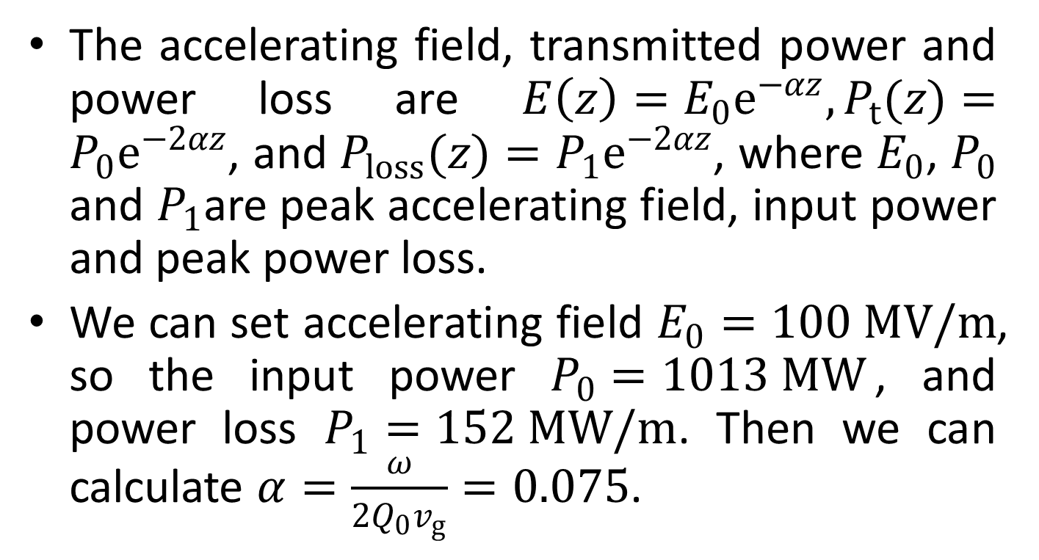
DLA structure with constant impedance
The accelerating field, transmitted power and power loss are $E\left(z\right)=E_{0}e^{−αz}, P_{t}(z)=P_{0}e^{−2αz}$, and $P_{loss}(z)=P_{1}e^{−2αz}$, where $E_{0}$, $P_{0}$ and $P_{1}$are peak accelerating field, input power and peak power loss.
We can set accelerating field $E_{0}=100 MV/m$, so the input power $P_{0}=1013 MW$, and power loss $P_{1}=152 MW/m$. Then we can calculate $α=\frac{ω}{2Q_{0}v_{g}}=0.075$.
15

Slide 16
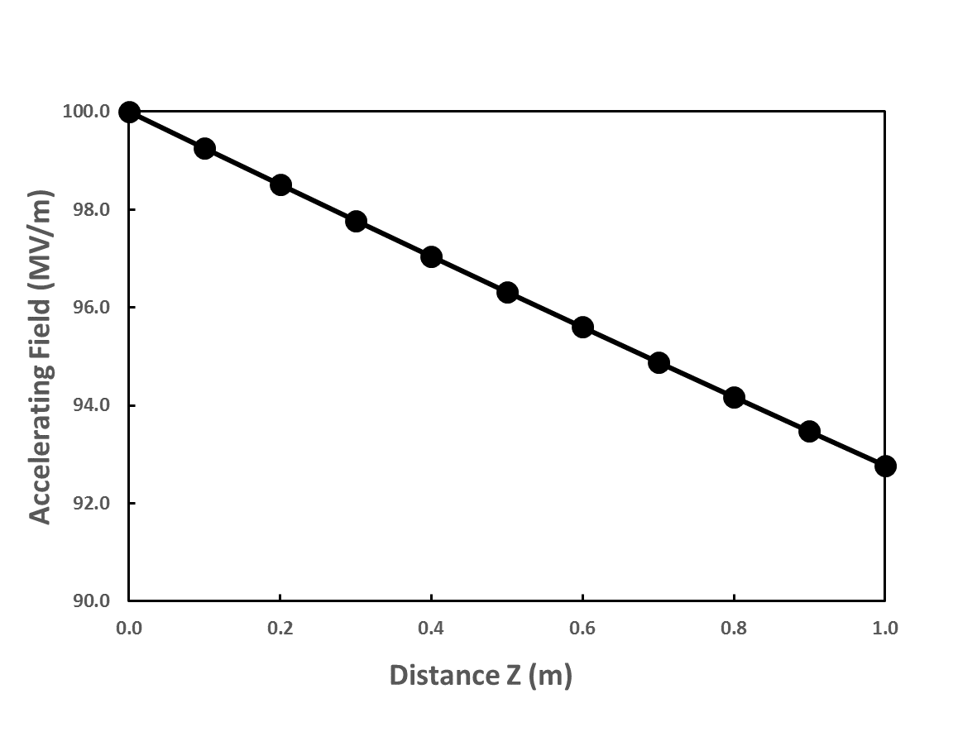
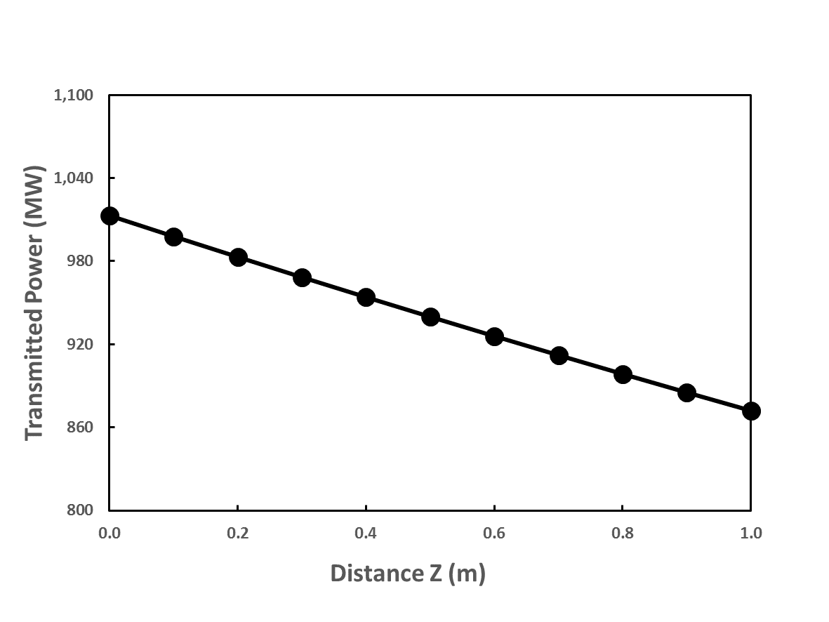
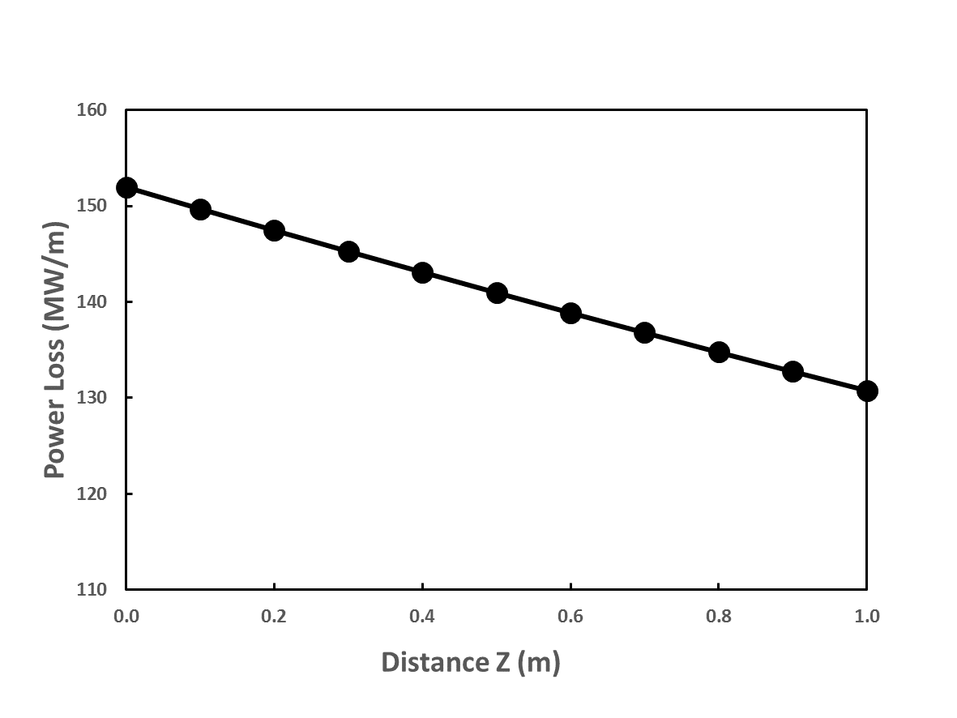
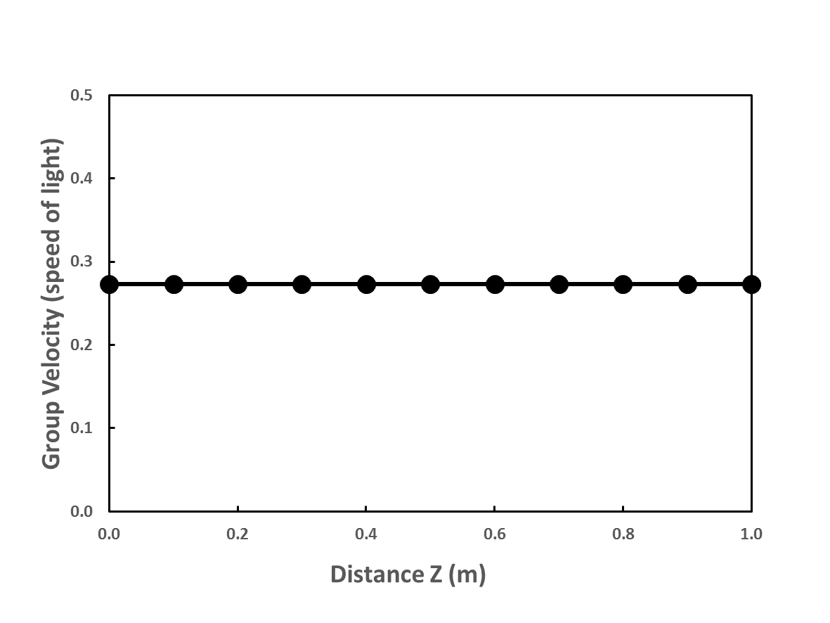
DLA structure with constant impedance
E
Pt
Ploss
vg
16

Slide 17
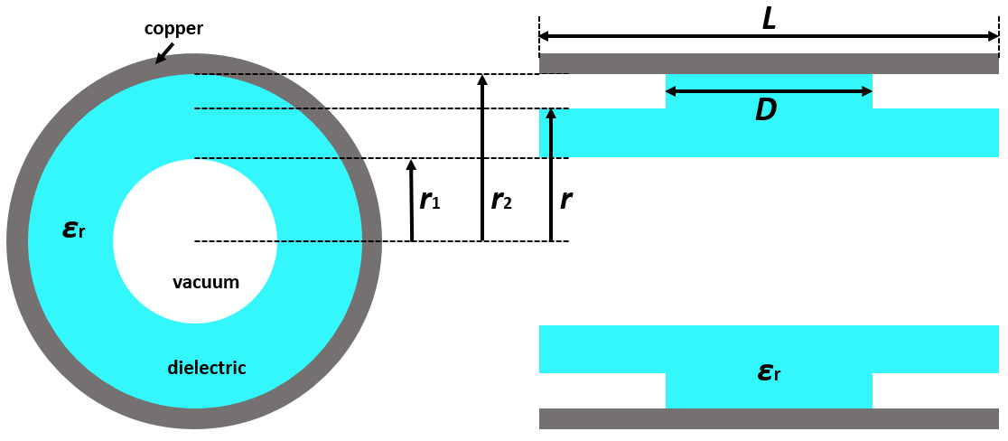
Corrugated DLA Structures
We can adjust r1, r2, r, D and εr to get the desired frequency of 12 GHz.
Such a structure has a periodicity L which can be used to slow down the group velocity of accelerating mode.
17

Slide 18
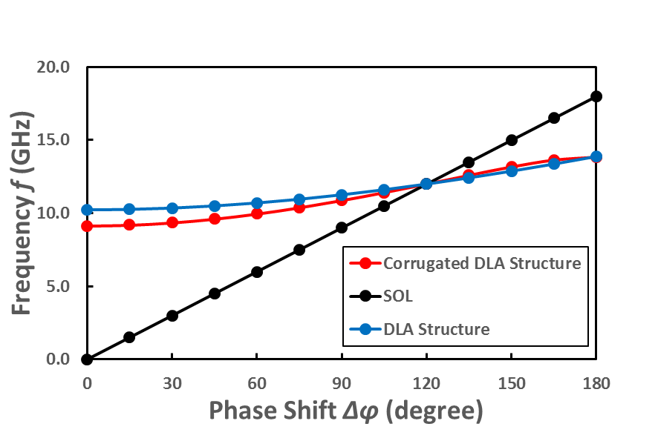
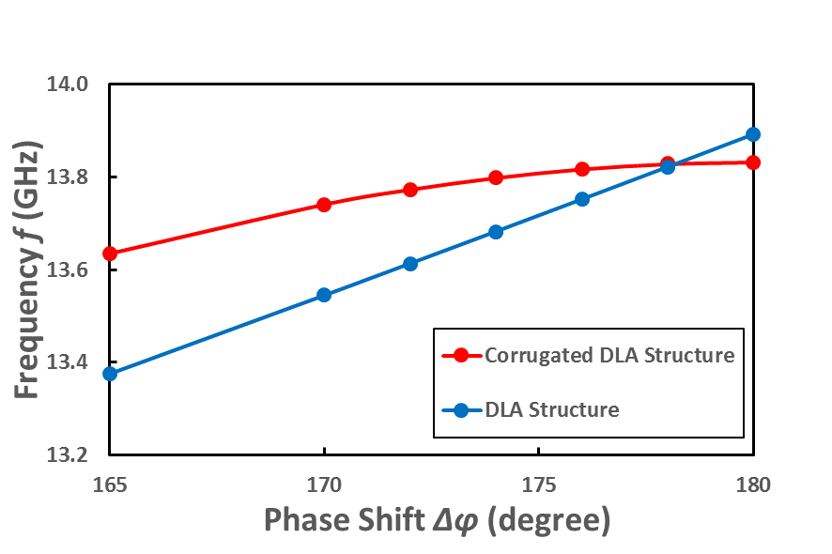
Dispersion Curves
176°
178°
Geometry parameters | Unit: mm
Dielectric constant εr | 3.75
Dielectric loss tangent δ | 0.00005
Structure length L | 8.332
r1 | 3.15
r2 | 5.97
r | 8
D | 3
The group velocity for a corrugated DLA structure gradually decreases to 0;
The phase shift of 176° and 178° can be chosen to generate a low group velocity of accelerating mode.
18

Slide 19
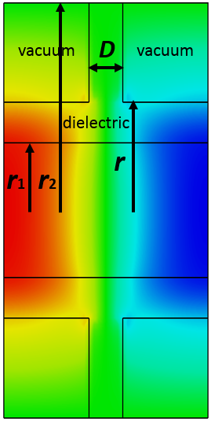

Corrugated DLA structures (0.98𝜋-mode)
period length L = 12.22 mm 0.98𝜋-mode
 | Structure 1 | Structure 2
Dielectric constant εr | 3.75 | 3.75
Dielectric loss tangent δ | 0.00005 | 0.00005
radius r1 [mm] | 3.15 | 3.15
radius r2 [mm] | 3.45 | 4.05
radius r [mm] | 11.00 | 10.00
Width D [mm] | 4.26 | 3.80
Period L [mm] | 12.22 | 12.22
Phase advance | 176° | 176°
Frequency [GHz] | 11.9995 | 11.9905
Unloaded Q0 | 13306 | 12161
r’/Q0 [Ω/m] | 7069 | 6419
r’ [MΩ/m] | 94 | 78
vg/c | 0.121 | 0.084
Es/Ea | 2.3042 | 2.2605
Es/Ea (dielectric) | 1.7565 | 1.7039
Accelerating fields
19

Slide 20
Corrugated DLA structures (0.99𝜋-mode)
period length L = 12.36 mm 0.99𝜋-mode
 | Structure 1 | Structure 2
Dielectric constant εr | 3.75 | 3.75
Dielectric loss tangent δ | 0.00005 | 0.00005
radius r1 [mm] | 3.15 | 3.15
radius r2 [mm] | 3.45 | 4.05
radius r [mm] | 11.00 | 10.00
Width D [mm] | 4.21 | 3.7
Period L [mm] | 12.36 | 12.36
Phase advance | 178° | 178°
Frequency [GHz] | 11.9942 | 11.9972
Unloaded Q0 | 13366 | 12215
r’/Q0 [Ω/m] | 6718 | 6101
r’ [MΩ/m] | 90 | 75
vg/c | 0.062 | 0.042
Es/Ea | 2.1528 | 2.1391
Es/Ea (dielectric) | 1.7631 | 1.7542
20

Slide 21
Corrugated DLA structures (𝜋-mode)
period length L = 12.50 mm 𝜋-mode
 | Structure 1 | Structure 2
Dielectric constant εr | 3.75 | 3.75
Dielectric loss tangent δ | 0.00005 | 0.00005
radius r1 [mm] | 3.15 | 3.15
radius r2 [mm] | 3.45 | 3.50
radius r [mm] | 11.00 | 10.00
Width D [mm] | 4.12 | 6.00
Period L [mm] | 12.5 | 12.5
Phase advance | 180° | 180°
Frequency [GHz] | 11.9996 | 11.9998
Unloaded Q0 | 13439 | 12047
r’/Q0 [Ω/m] | 6325 | 7154
r’ [MΩ/m] | 85 | 86
vg/c | 0.0 | 0.0
Es/Ea | 2.2364 | 2.5117
Es/Ea (dielectric) | 1.8045 | 1.9278
21

Slide 22
Summary of DLA Structures
 | CLIC-G iris structure | Quartz (SiO2) | 0.98𝜋-mode corrugated DLA structure | 0.99𝜋-mode corrugated DLA structure | 𝜋-mode corrugated DLA structure | MgCaTi | BaTi
Dielectric constant εr |  | 3.75 | 3.75 | 3.75 | 3.75 | 20 | 35
Dielectric loss tangent |  | 0.00005 | 0.00005 | 0.00005 | 0.00005 | 0.0001 | 0.0001
Period length [mm] | 8.332 | 8.332 | 12.22 | 12.36 | 12.5 | 8.332 | 8.332
Phase advance | 120° | 120° | 176° | 178° | 180° | 120° | 120°
Frequency [GHz] | 11.9943 | 11.9990 | 11.9905 | 11.9972 | 11.9996 | 11.9942 | 11.9919
Unloaded Q0 | 7245 | 6127 | 12161 | 12215 | 13439 | 2214 | 1691
r’/Q0 [Ω/m] | 15924 | 10719 | 6419 | 6101 | 6325 | 8463 | 6878
r’ [MΩ/m] | 115 | 66 | 78 | 75 | 85 | 19 | 12
vg/c | 0.018 | 0.273 | 0.084 | 0.042 | 0.0 | 0.057 | 0.034
Es/Ea | 2.4819 | 1.0757 | 2.2605 | 2.1391 | 2.2364 | 1.0760 | 1.0760
Es/Ea [dielectric] |  | 1.0289 | 1.7039 | 1.7542 | 1.8045 | 1.0152 | 1.0141
Power required to generate 100 MV/m [MW] | 45.0 | 1013 | 521 | 274 |  | 266 | 197
22

Slide 23
Summary and Outlook
Geometry optimization has been carried out for a DLA structure;
From dispersion curves, a corrugated DLA structure can be used to slow down the group velocity to 0;
The corrugated DLA structures of 0.98𝜋-mode, 0.99𝜋-mode, and 𝜋-mode are presented for high Q and high shunt impedance and low group velocity.
Further optimization and wakefield studies on DLA structures;
Design of RF high power coupler;
Fabrication and experimental studies.
23

