Slide 1
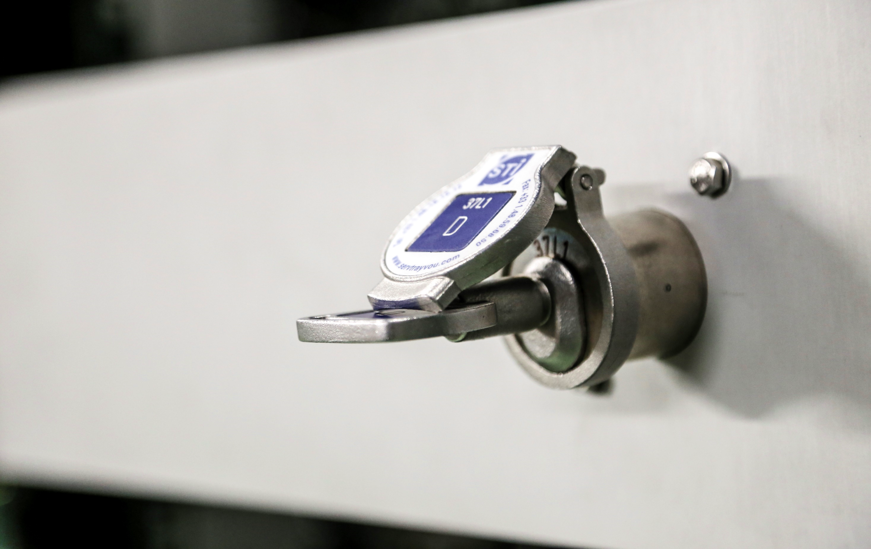




X-Band RF Test Stands at CERN
Jan Paszkiewicz on behalf of the Xbox group
SINAP, Shanghai, 4-8 June 2018

Slide 2
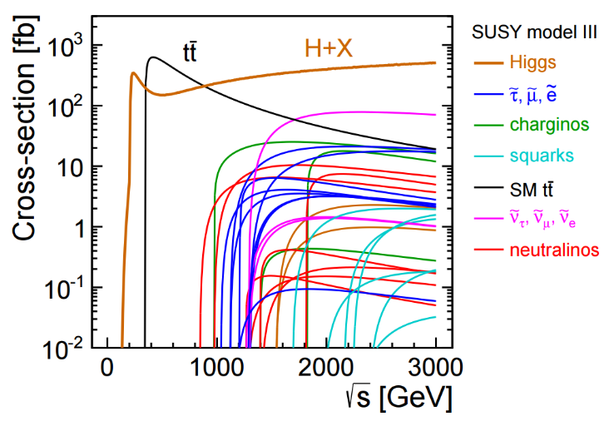
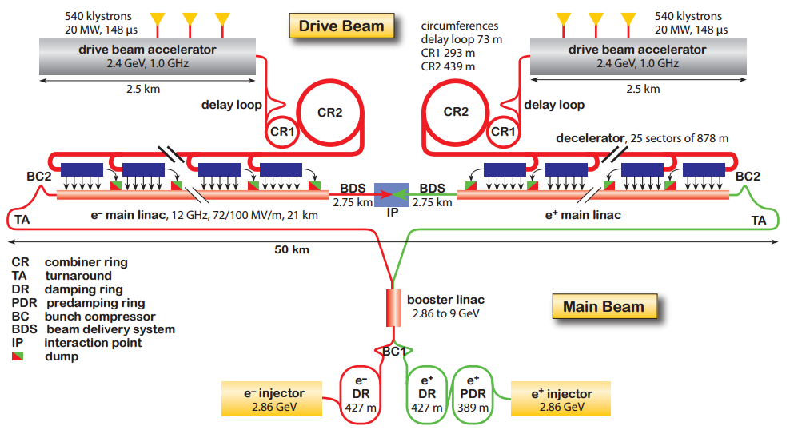
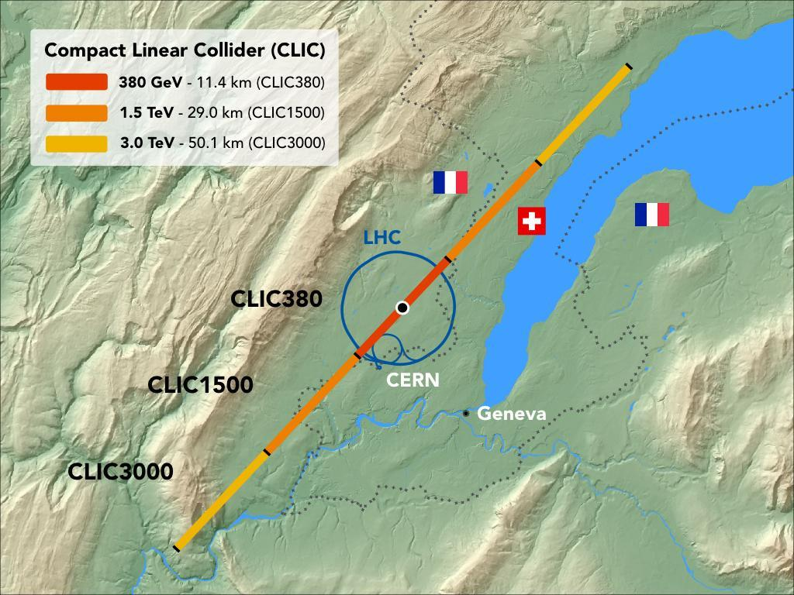
Compact Linear Collider
Linear e⁺e⁻ collider for precision particle physics measurements.
Staged implementation up to 3 TeV.
Linear due to synchrotron losses.
100 MV/m accelerating gradient for high energy with reasonable machine length.

Slide 3
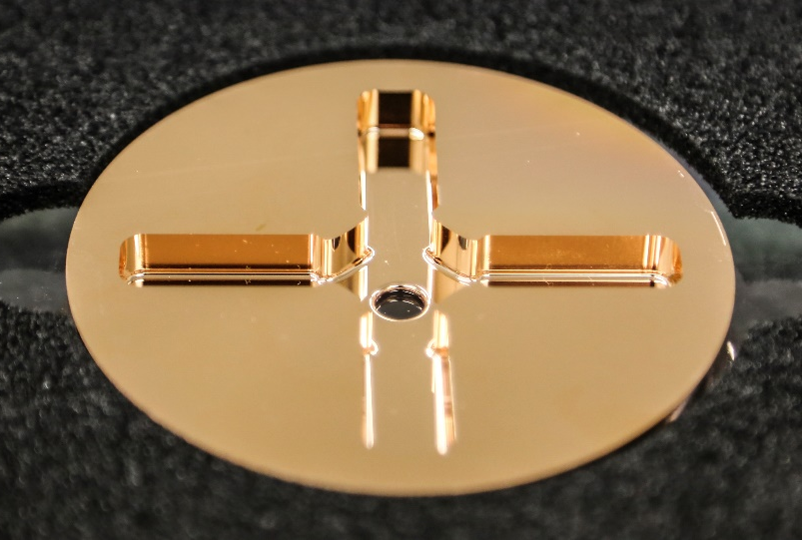
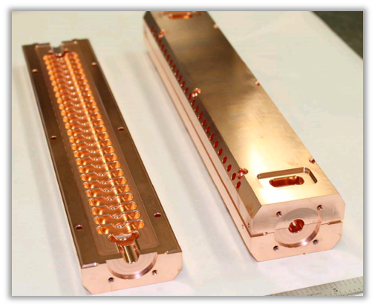
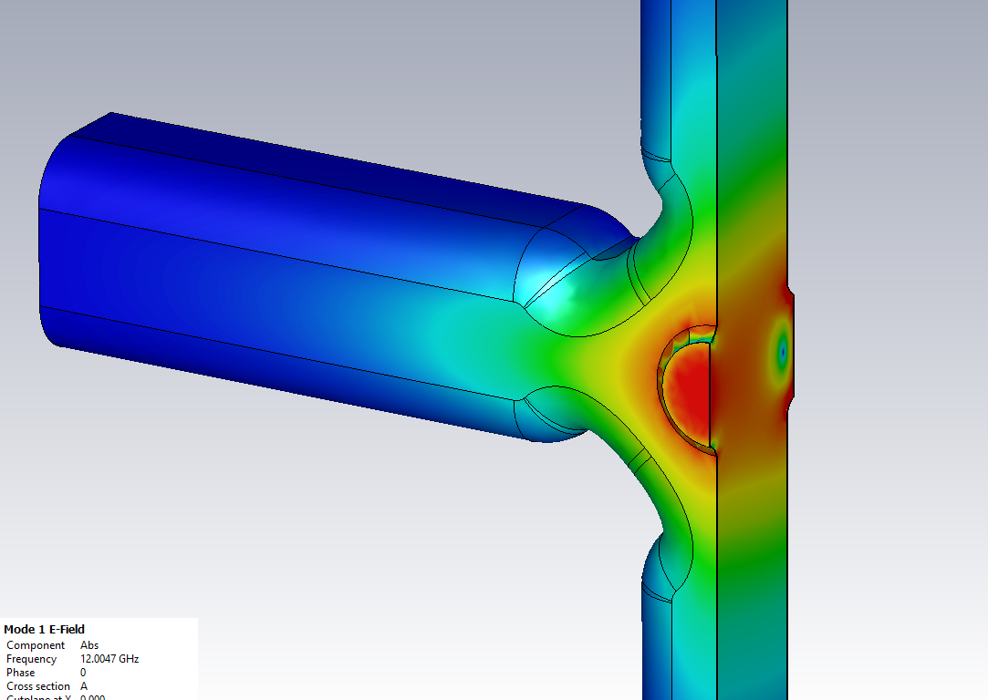
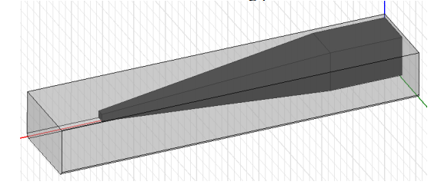
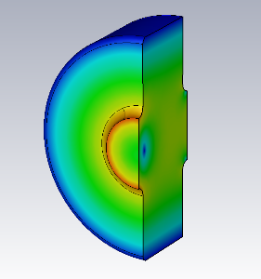
RF Accelerating Structures
X-band (11.994 GHz RF)
Traveling wave: RF pulse passes through the structure.
Accelerating gradient (energy gain of particles) = 100 MV/m
Peak surface field ≥ 200 MV/m, depends on design.
High fields require high power: 40 - 50 MW without beam.
CLIC BDR requirement: ≤ 3x10⁻⁷ bpp/m to limit losses of luminosity.
Wakefield damping due to beam dynamics requirements.

Slide 4
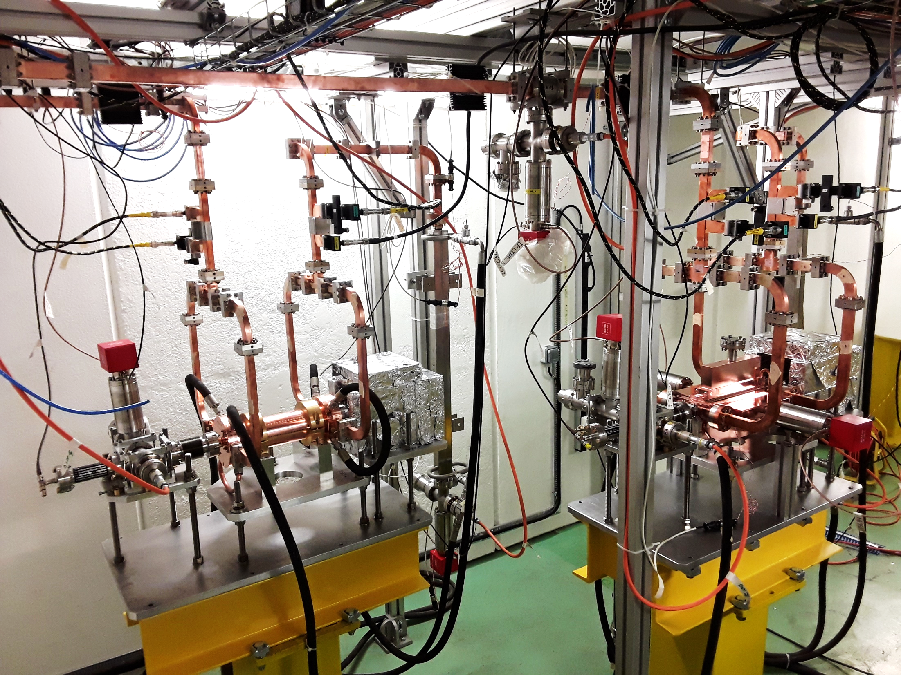
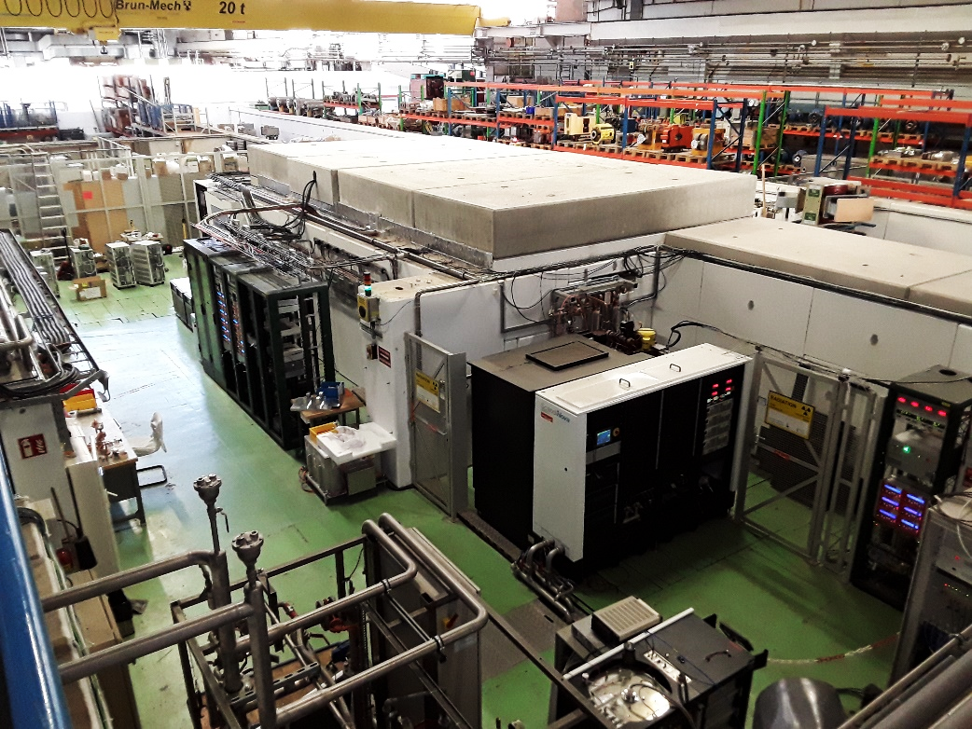
Test Stands at CERN
Xbox 1: 50 MW klystron, 50 Hz, connection with CLEAR (e⁻ linac)
Xbox 2: 50 MW klystron, 50 Hz
Xbox 3: 4x6 MW klystrons, 400 Hz, 4 structure test slots
Sbox: 43 MW klystron, 25 Hz, S-band (2.9985 GHz)

Slide 5
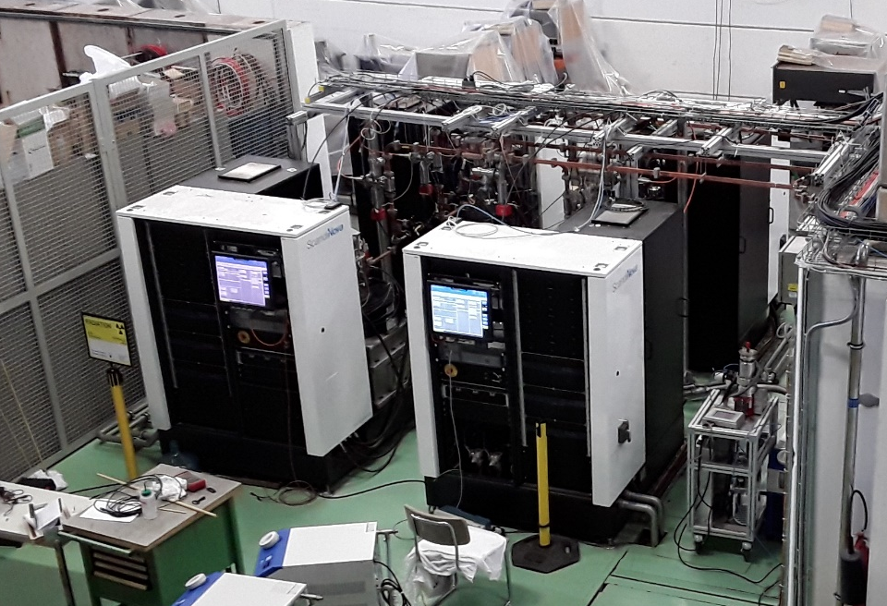
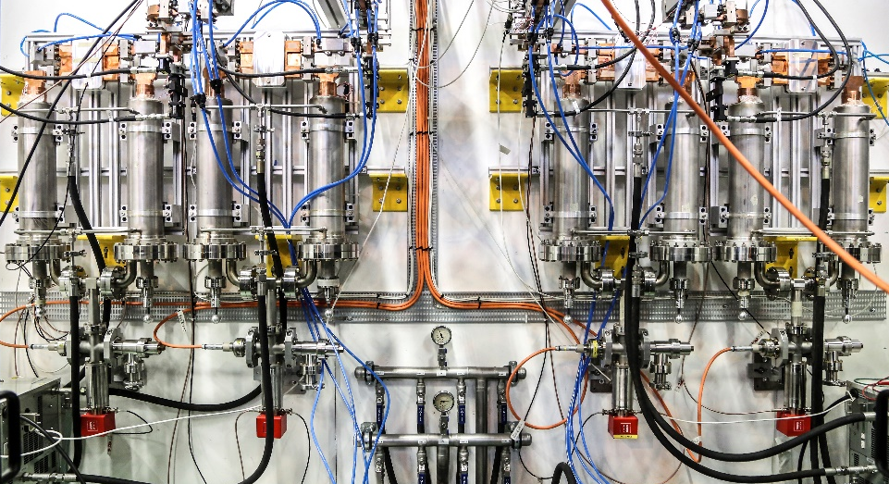
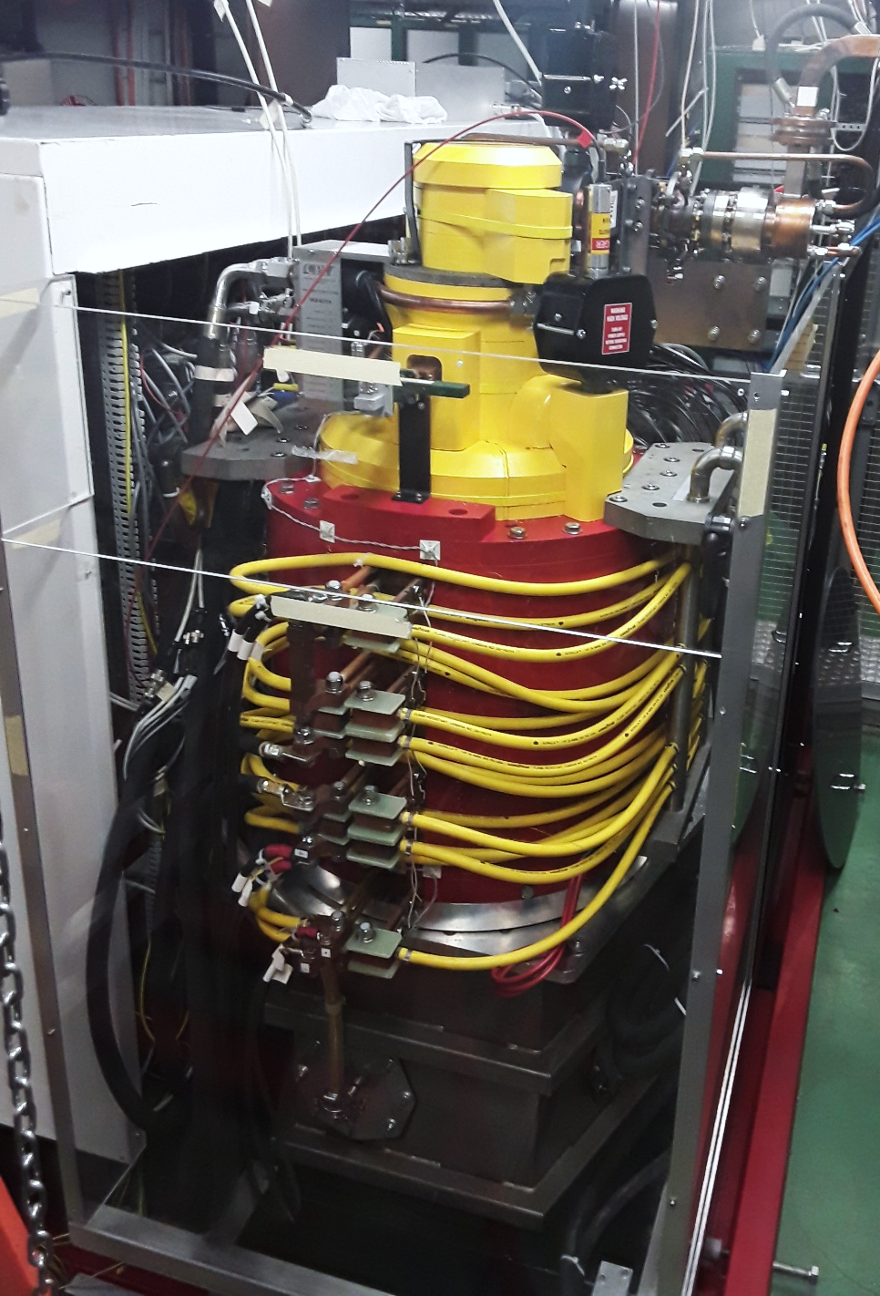
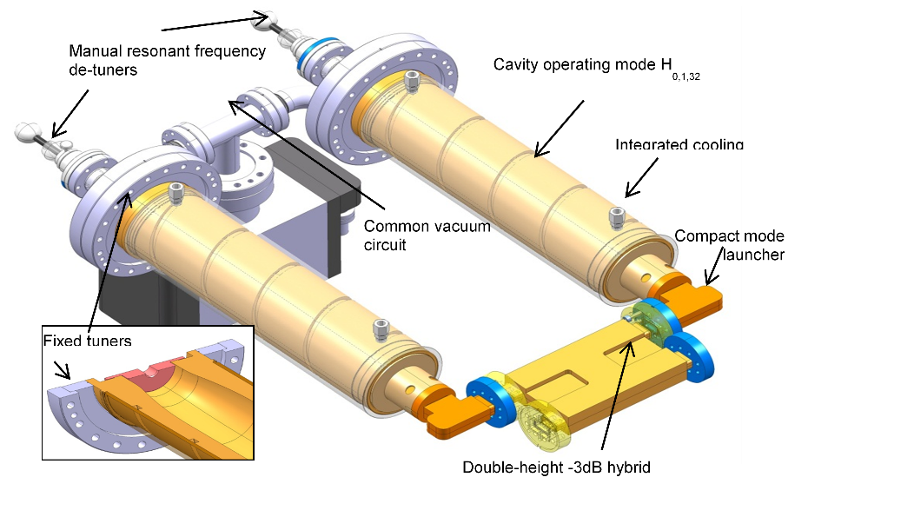
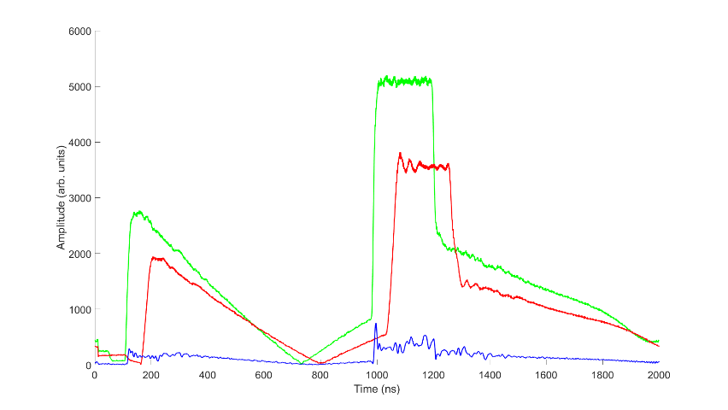
Generating High RF Power
Pulse Compressors
Modulators
Klystrons

Slide 6
Xbox 2 Block Diagram
Directional couplers
Pulse compressor
Structure under test
1 kW solid state amplifier
50 MW klystron
RF Load

Slide 7
Xbox 3 Block Diagram
Directional couplers
Pulse compressor
Hybrid coupler
Structure under test
300 W solid state amplifier
6 MW klystron
RF Load

Slide 8
Structure Diagnostics Overview
Reflected Power
Incident Power
60 dB directional coupler
RF Load
RF In From Pulse Compressor
Transmitted Power
WR90 Waveguide
Ion gauge readout
Ion gauge readout
Input coupler
Output coupler
Device under test
Beam-pipe
Beam-pipe
Upstream Faraday cup signal
Radiation Monitor
Downstream Faraday cup signal

Slide 9
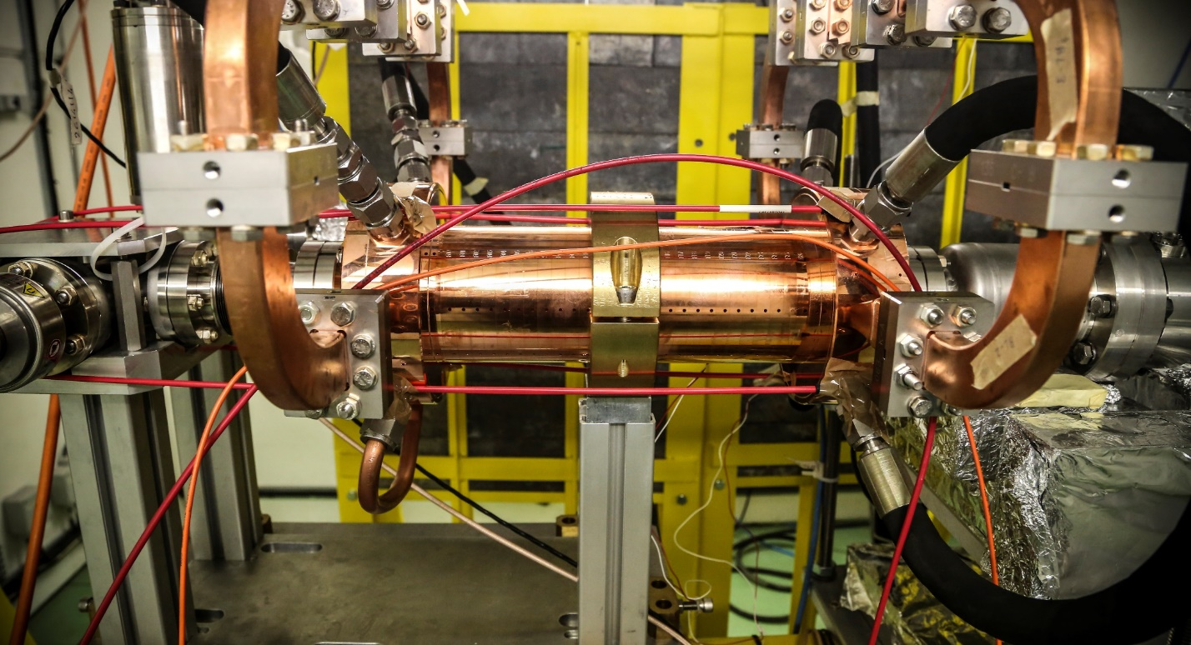
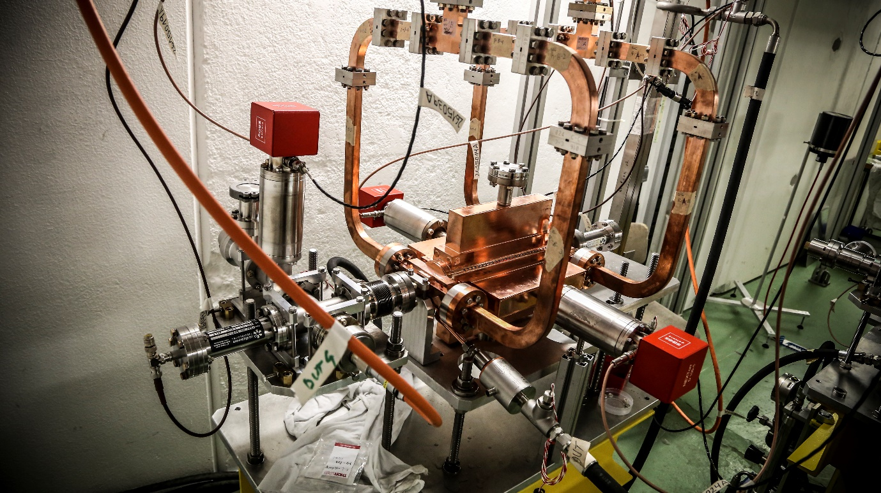
Structure Diagnostics Overview

Slide 10
Breakdown
Incident RF Pulse
Transmitted RF Pulse
Beam Axis

Slide 11
Breakdown
Incident RF Pulse
Reflected RF Pulse
Breakdown
Beam Axis
Emitted Current

Slide 12
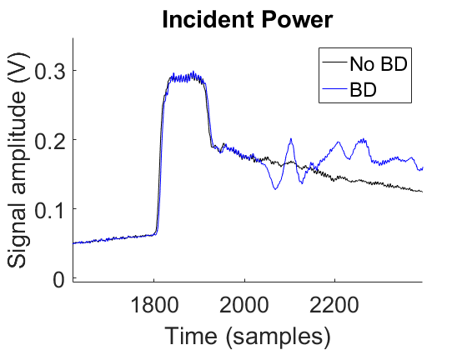
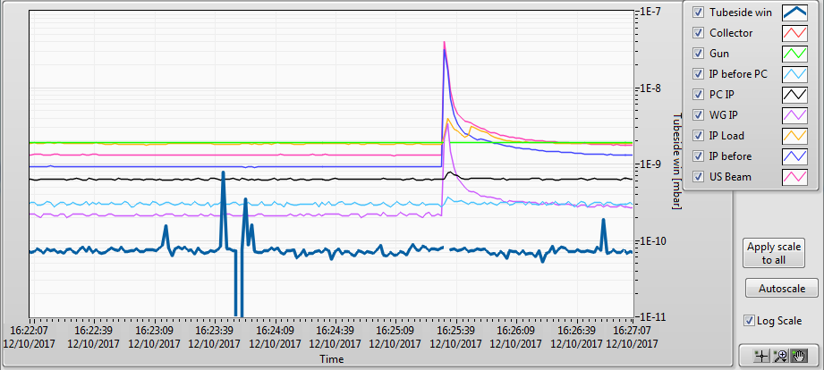
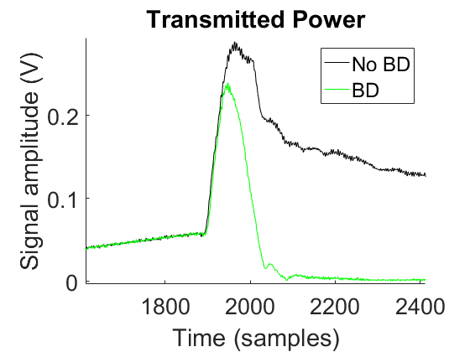
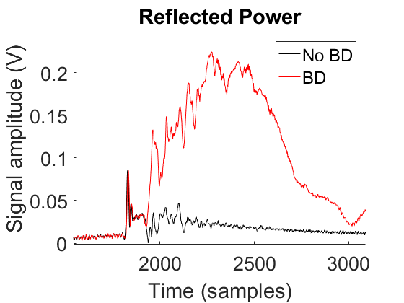
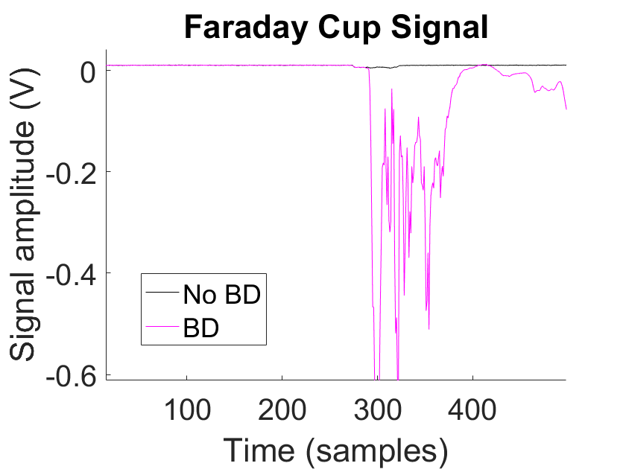
Breakdown Diagnostics
Vacuum
BD position resolved using timing of RF pulses.
Low group velocity (~0.02c), 65 ns filling time: very high time resolution not needed.

Slide 13
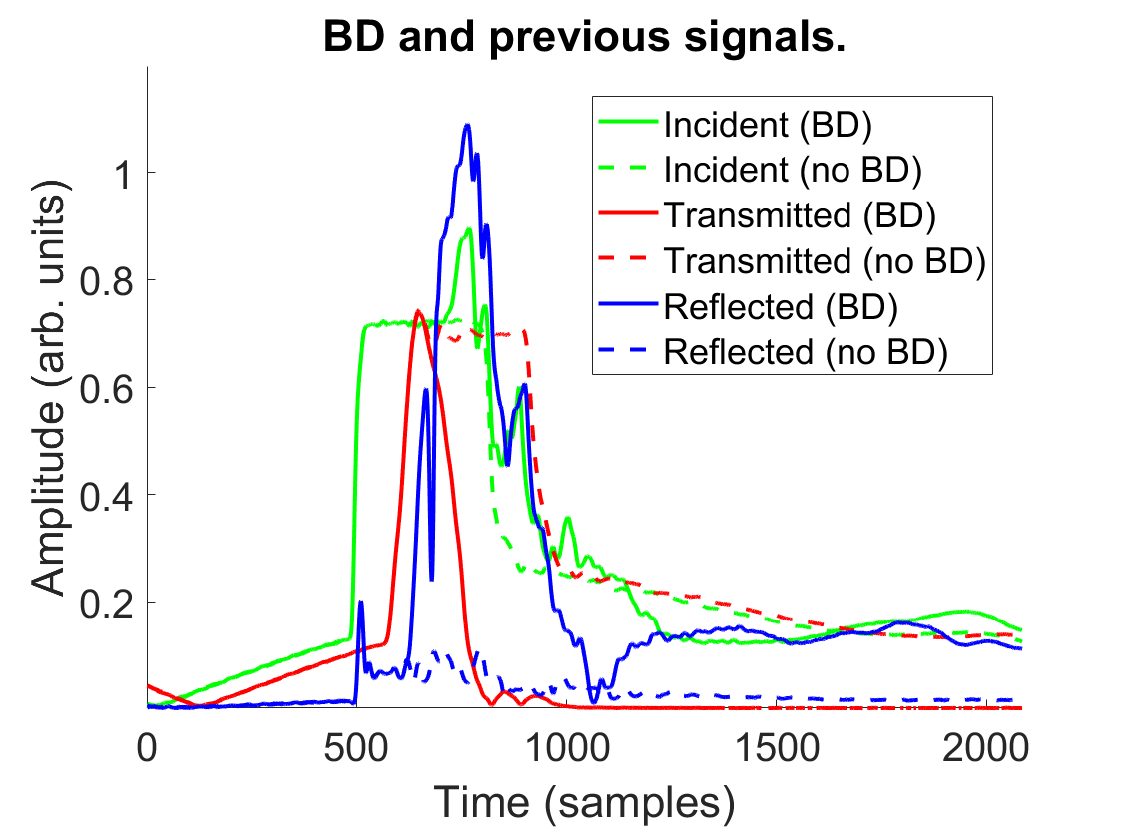
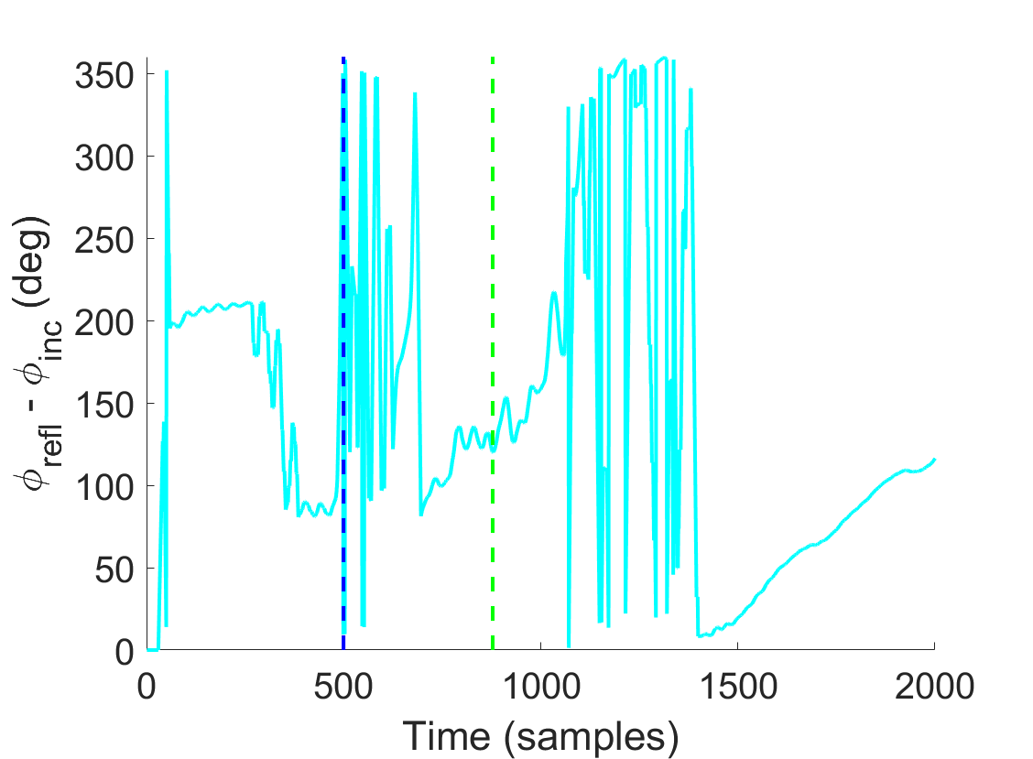
Breakdown Phase
Change in incident channel: indicates reflected RF has made a round trip. Phase sampled here.
Change in reflected channel

Slide 14
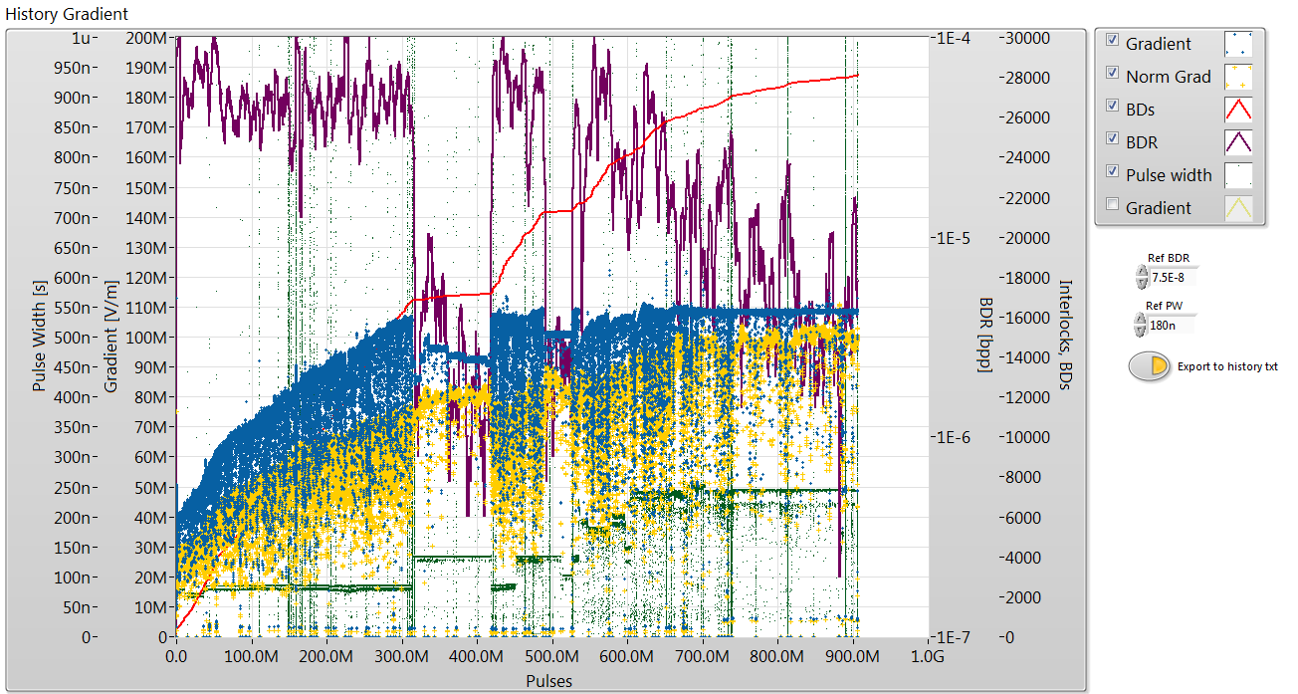
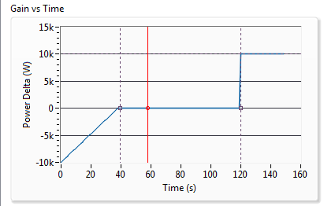
Conditioning Procedure
Ramping of gradient by algorithm
Algorithm controls power based on current BDR (based on last 360000 pulses).
Typically reach 110 MV/m accelerating gradient.
Increase pulse length in steps when gradient target reached. (50 , 100, 150, 200 ns)
Reduction in BDR during flat run
Conditioning history of TD26CCN3 in Xbox 2
Pulse length increased when target gradient reached.
Conditioning algorithm

Slide 15
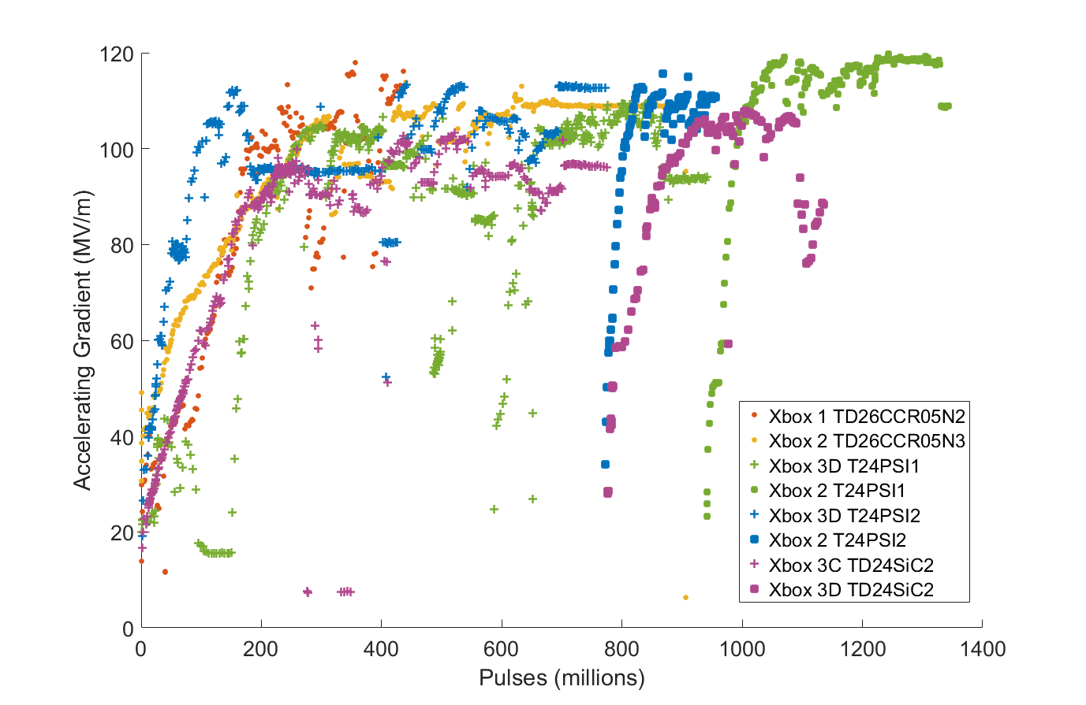
Conditioning of Different Structures
The conditioning curve can differ from the ‘ideal’ one due to constraints such as:
Limited available power
Vacuum level of other line
Radiation limits
Breakdowns in test stand itself (esp. pulse compressors)
Large breakdown clusters

Slide 16
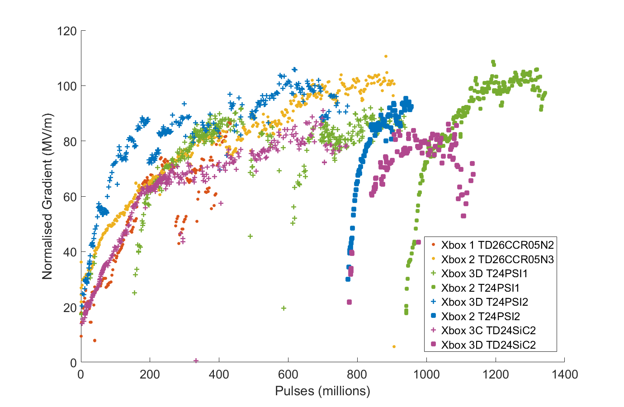
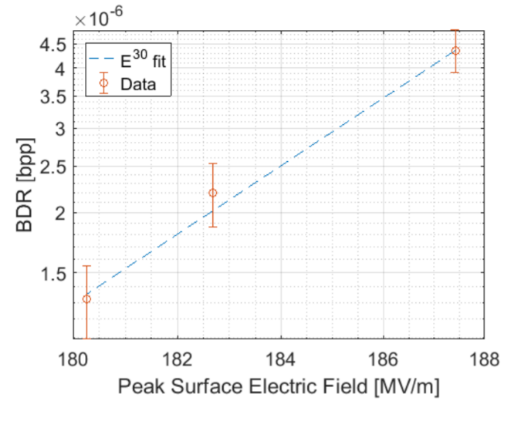


Conditioning Comparison – Normalised Gradient
Gradient, BDR and pulse width summarised using normalised gradient.
Based on empirical relationship between E, BDR and τ.
Higher normalised gradient = low BDR at high field and long pulse length, ie. well-conditioned.
$$E_{0}^{∗}= \frac{E_{0}∙τ^{1/6}}{{BDR}^{1/30}}$$
$$BDR ∝ {E_{0}}^{30}τ^{5}$$
BDR dependence on field in TD26CCN3 structure in Xbox 2. (Thomas Lucas)

Slide 17
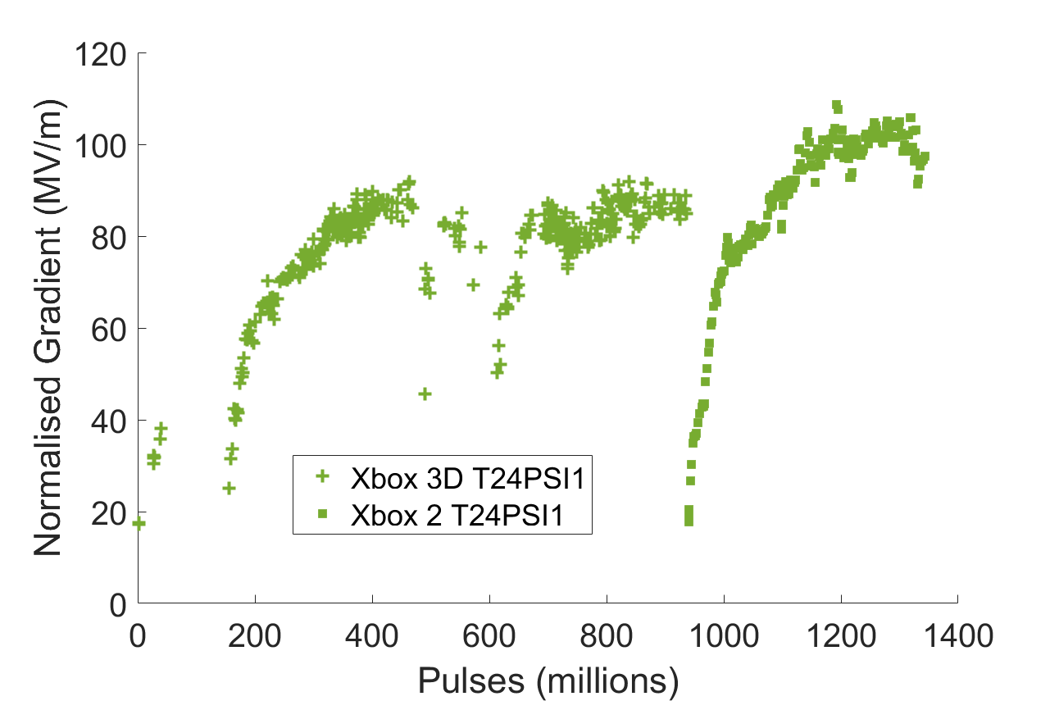
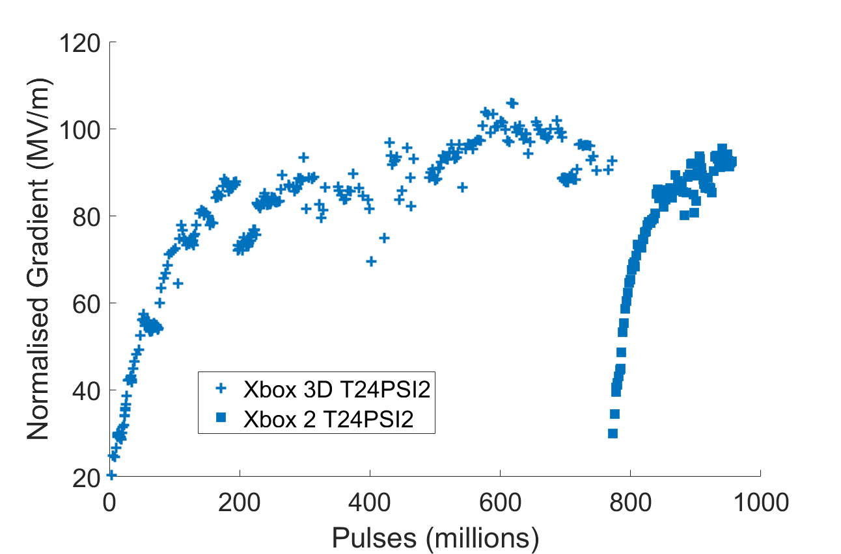
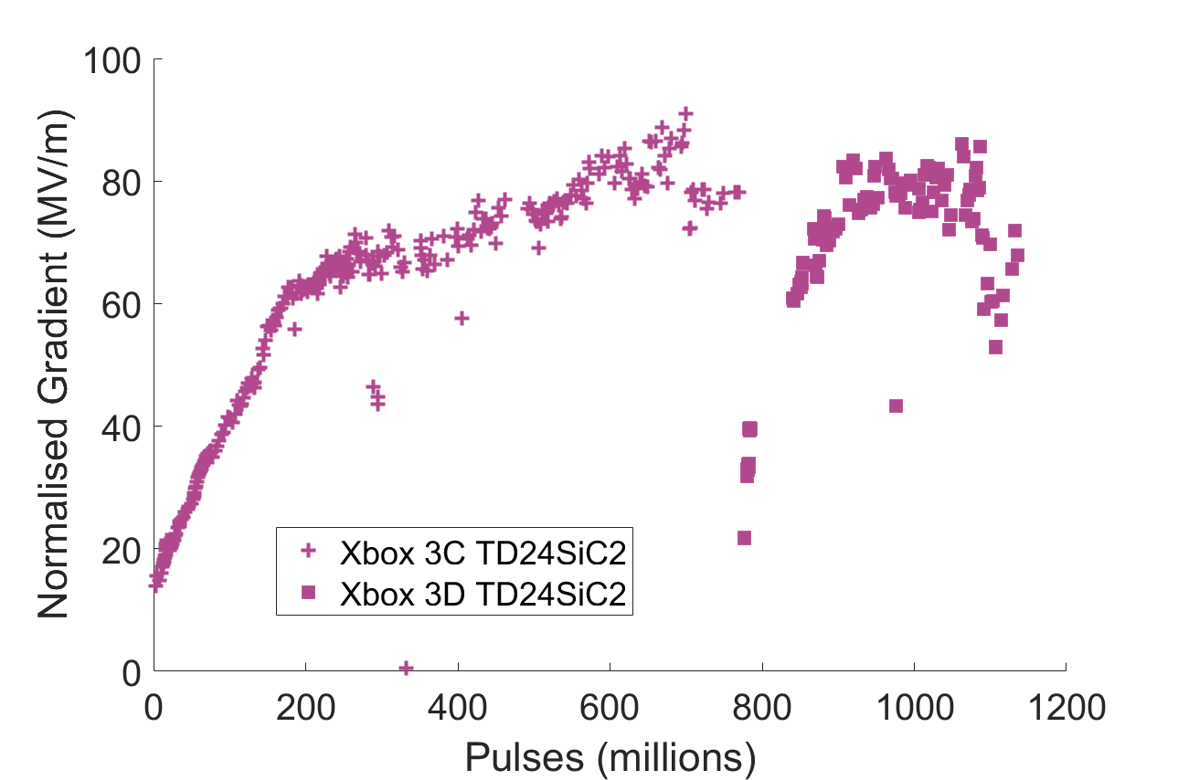
Persistence of Conditioning State
3 structures have been moved from one line to another so far to continue conditioning at higher power. During moving, the structures are exposed to air for several hours.
In each case, the structure needs some time to re-condition but it is significantly faster than the first time.
Both the PSI structures also spent some amount of time at reduced power due to external factors – normalised gradient did not increase significantly in this period.
T24 PSI 1
T24 PSI 2
TD24 SiC 2
Slow conditioning
Slow conditioning

Slide 18
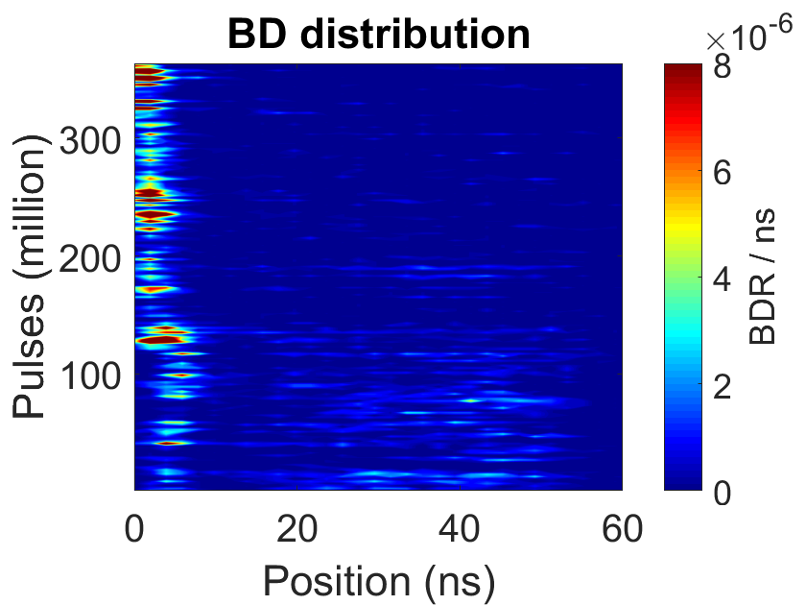
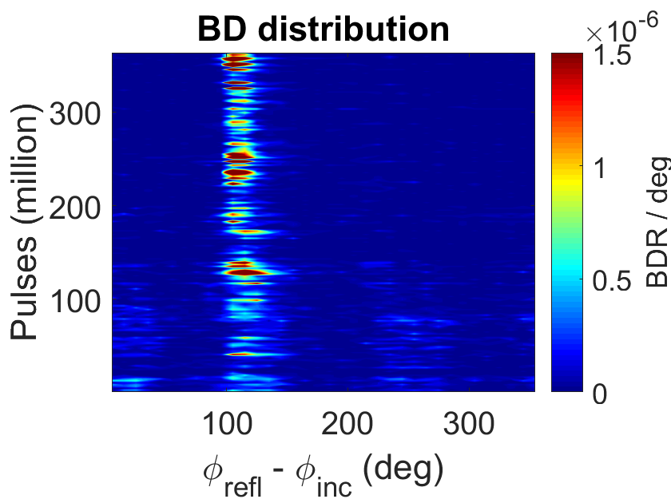
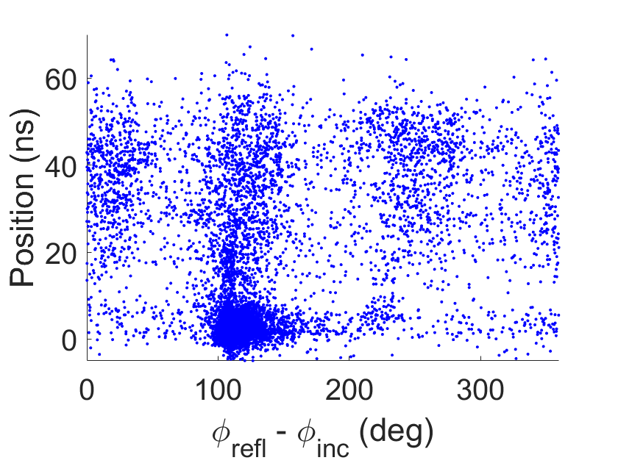
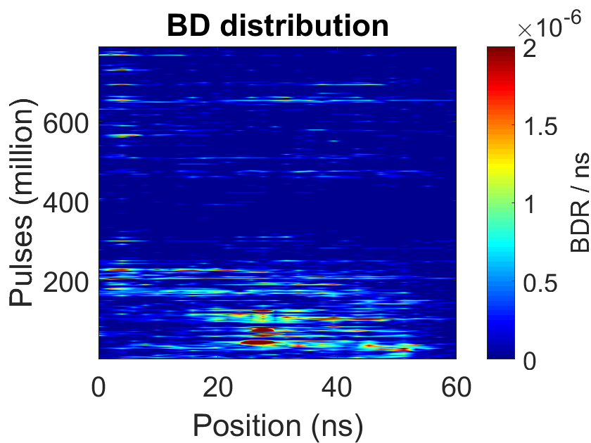
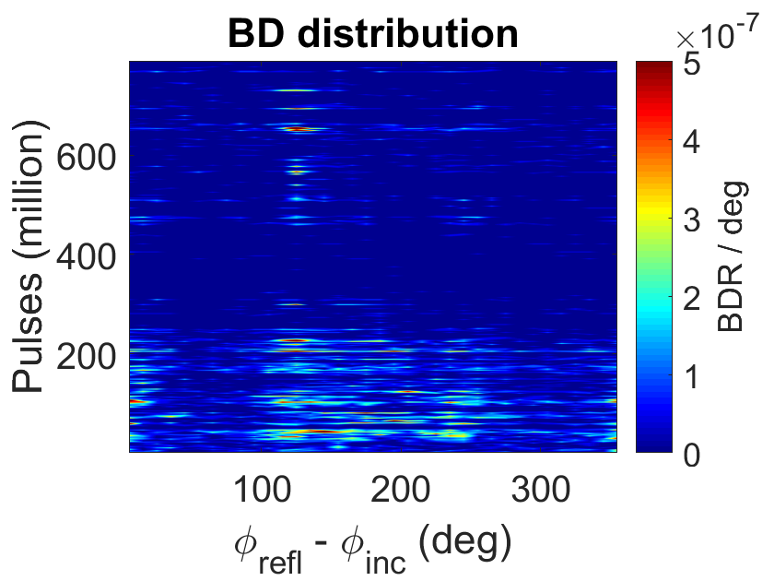
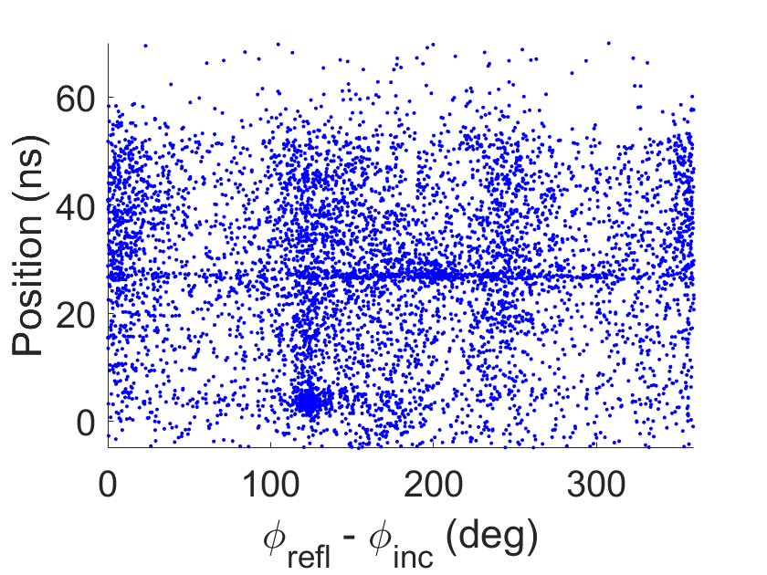
Breakdown Locations: T24 PSI 1
Xbox 2
Time
Xbox 3D

Slide 19
Breakdown Locations: T24 PSI 1
Xbox 2
Time
Likely to be artifacts, not real structure BDs.
Xbox 3D

Slide 20
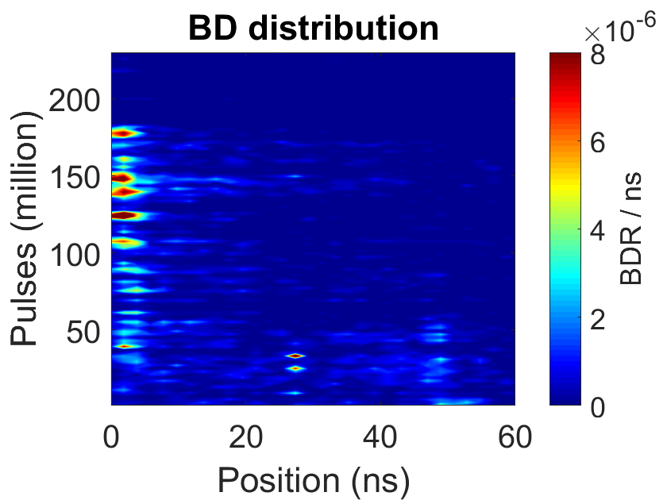
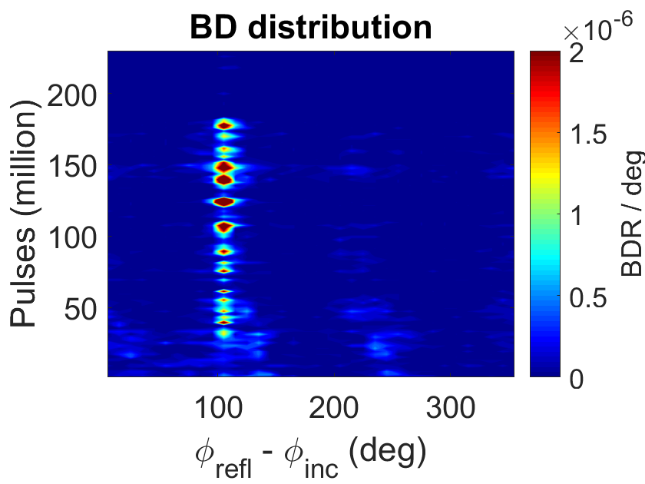
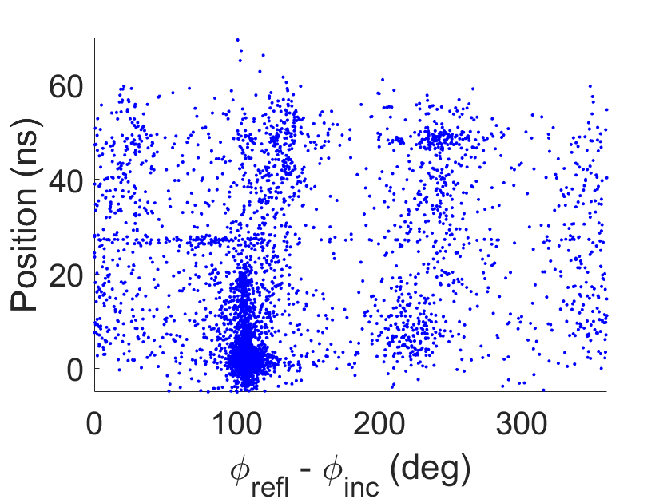
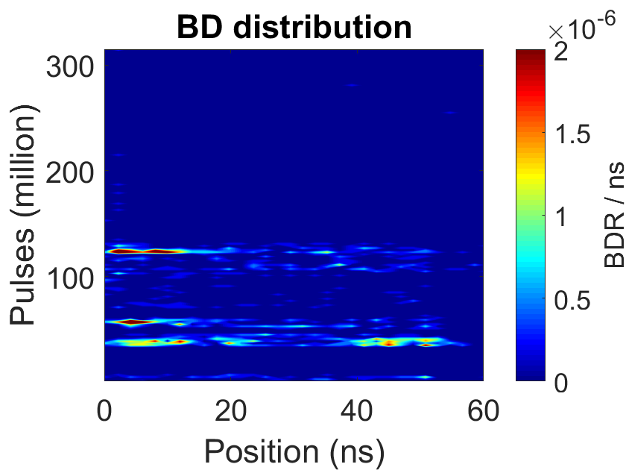
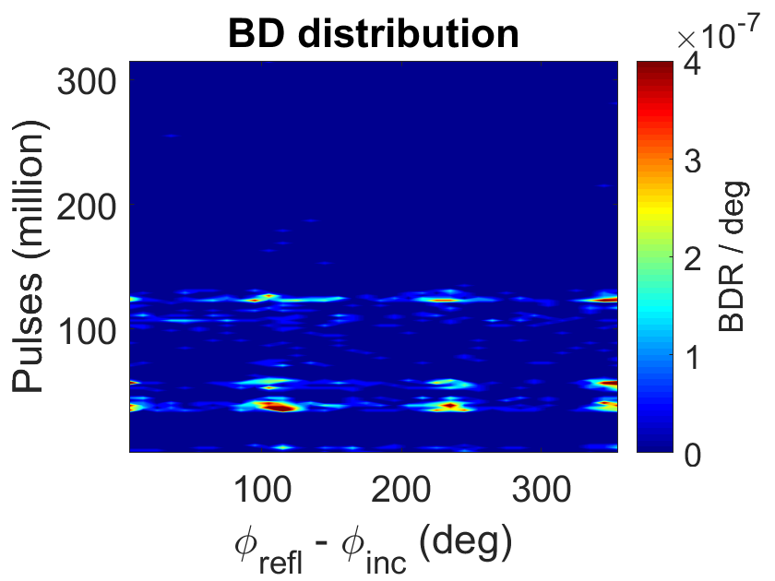
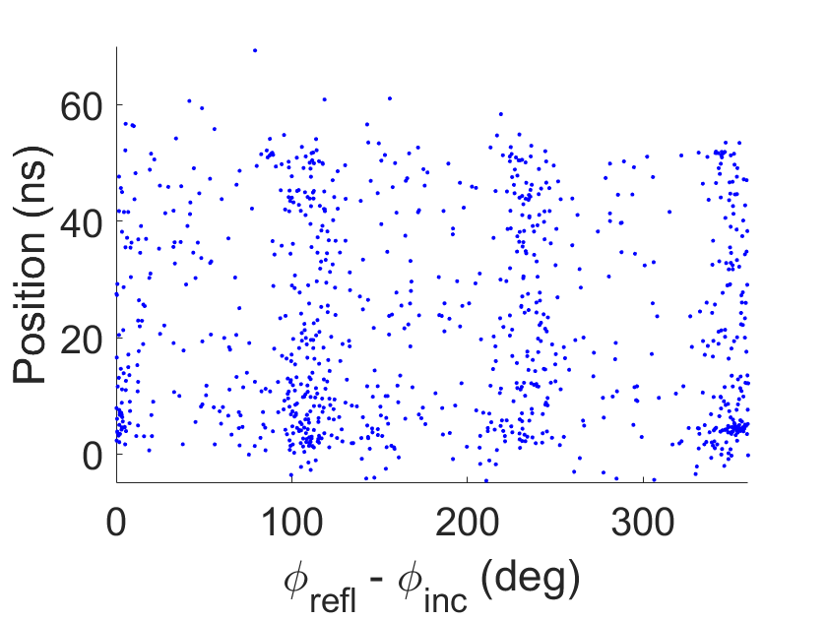
Breakdown Locations: T24 PSI 2
Xbox 2
Time
Xbox 3D

Slide 21
Breakdown Locations: T24 PSI 2
Xbox 2
Time
Most BDs in this phase occurred outside the structure
Xbox 3D

Slide 22
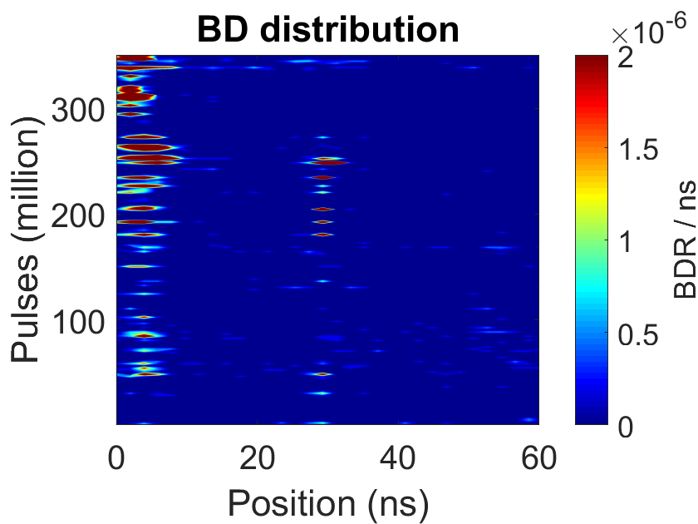
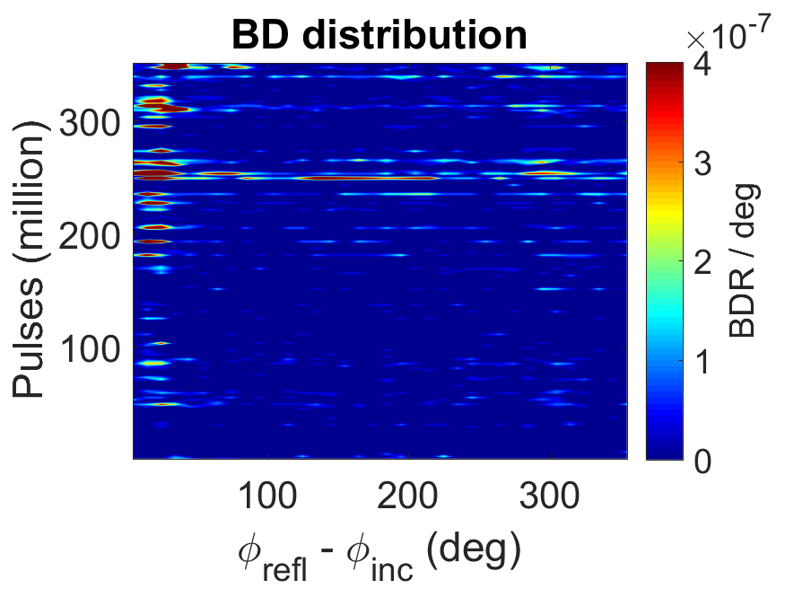
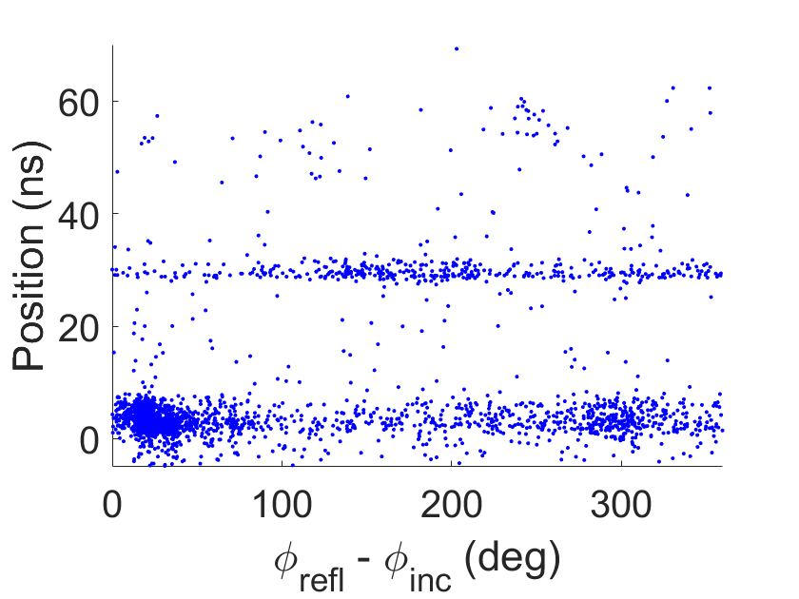
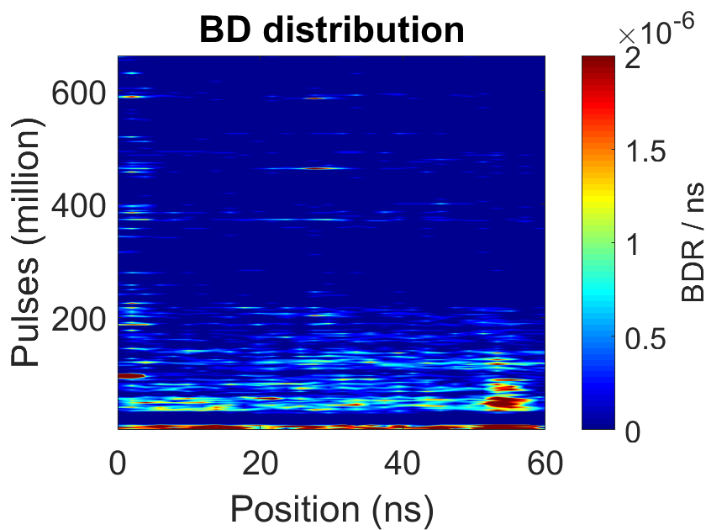


Breakdown Locations: TD24 SiC 2
Xbox 3D
Time
Xbox 3C

Slide 23
Breakdown Locations: TD24 SiC 2
Likely to be artifacts.
Xbox 3D
Time
Structure detuned: phase advance no longer 120 °
Xbox 3C

Slide 24



Breakdown Clustering
T24PSI 1 in Xbox 2
Similar average slope (breakdown rate) but instantaneous BDR is either very high or very low.

Slide 25



BDR Statistics: T24PSI1 in Xbox 2
BDR in histogram obtained using a Gaussian window with σ = 50000 pulses. BDR window for conditioning algorithm is 360000 pulses. An IIR window is essential for high dynamic range.
Gradient
Norm. Gradient
Pulse length
BDR
Each point = 30 BDs

Slide 26



BDR Statistics: T24PSI2 in Xbox 2
Gradient
Norm. Gradient
Pulse length
BDR
Each point = 30 BDs

Slide 27


BDR statistics: TD26CCN3
Gradient
Norm. Gradient
Pulse length
BDR
Each point = 30 BDs

Slide 28
Conclusions
6 X-band testing slots available at CERN.
Main diagnostics are RF signals, Faraday cups, and vacuum levels.
High gradients achieved: maximum of 119 MV/m in T24 PSI 1.
Structures retain their conditioning state after venting and moving.
Breakdowns occur in the whole structure but tend to focus at the beginning towards the end of the conditioning process.
Strong clustering of BDs in time was observed in the T24 PSI 1 but not the TD26CCN3 – more analysis to be done as data becomes available.

Slide 29
Thank you!
Questions?

Slide 30

Comparison of BDR windows

Slide 31

Structure Final Performance

