Slide 1

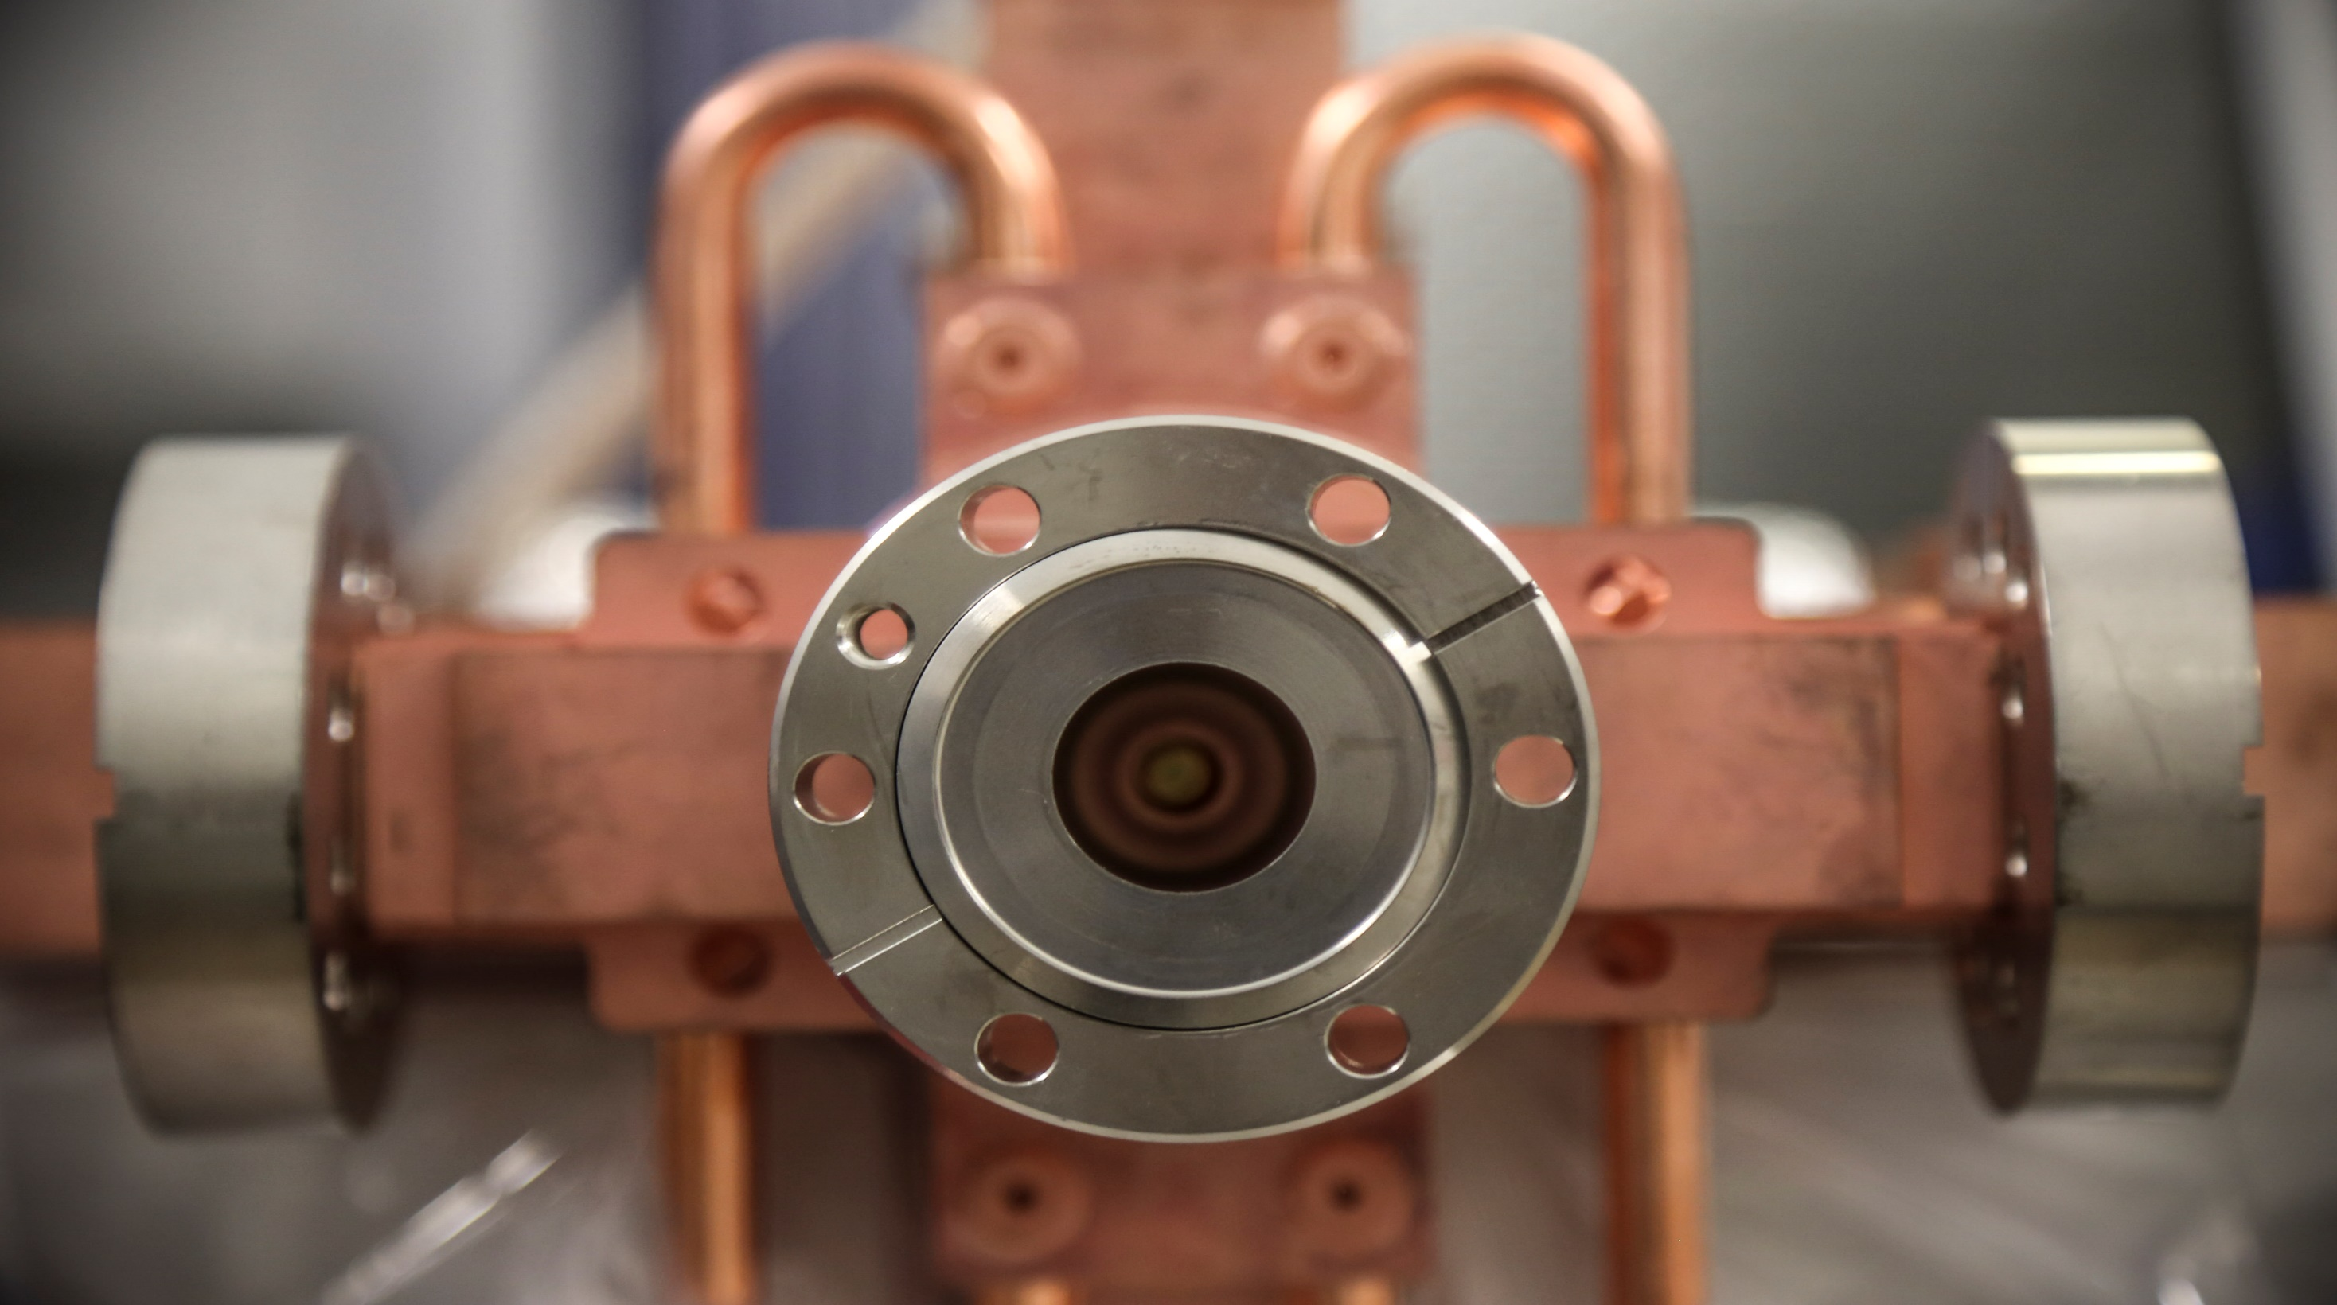



Dark Current Measurements in RF Structures
Jan Paszkiewicz SINAP, Shanghai, 4-8 June 2018

Slide 2
Field Emission Profile Measurements

Slide 3
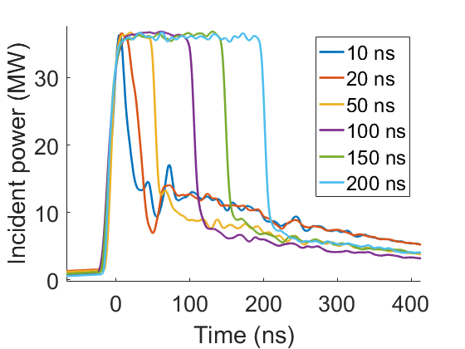
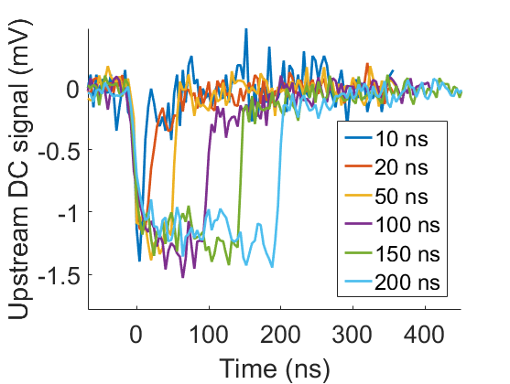
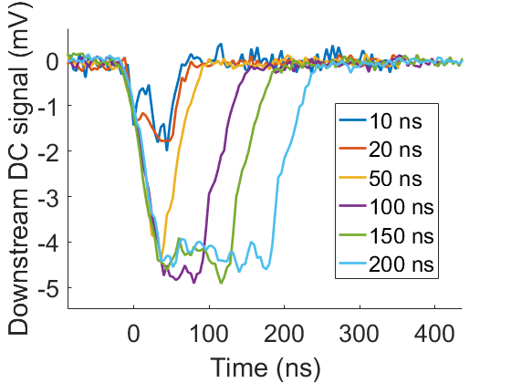
Dark Current vs. RF Pulse Shape
Dark current measured rises and falls as structure fills and unfills – contains information about different parts of the structure.
Structures have low group velocity: 0.01…0.02 c.
Emitted electrons can become relativistic within one cell.
With long RF pulses, the entire structure emits electrons simultaneously.
A very short pulse allows field emission to be probed along the structure.

Slide 4
Separating Parts of the Structure in Time
Field emitted electrons
Field emitted electrons
Long RF pulse
Accelerated electrons
Long RF pulse
Accelerated electrons
Structure under test
Structure under test
Time
Time
Dark current measured
Dark current measured
Field emitted electrons
Field emitted electrons
Short RF pulse
Accelerated electrons
Short RF pulse
Accelerated electrons
Structure under test
Structure under test
Time
Time
Dark current measured
Dark current measured

Slide 5
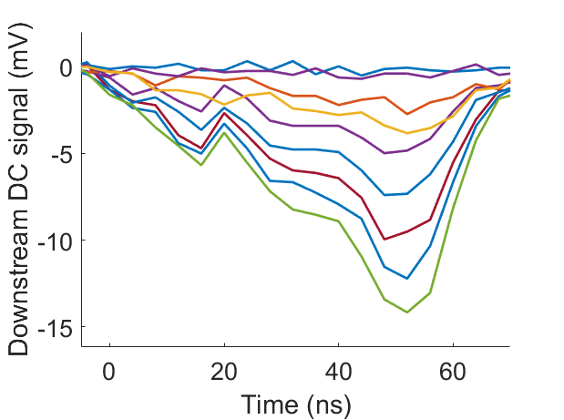
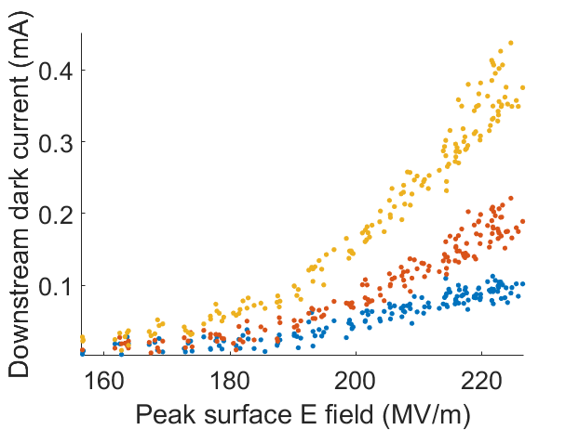
Mapping Field Emission
Dark current power scan with a 10 ns pulse length.
Dark current by sample as a function of surface E-field.

Slide 6
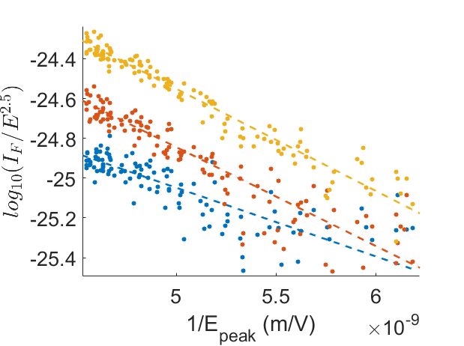
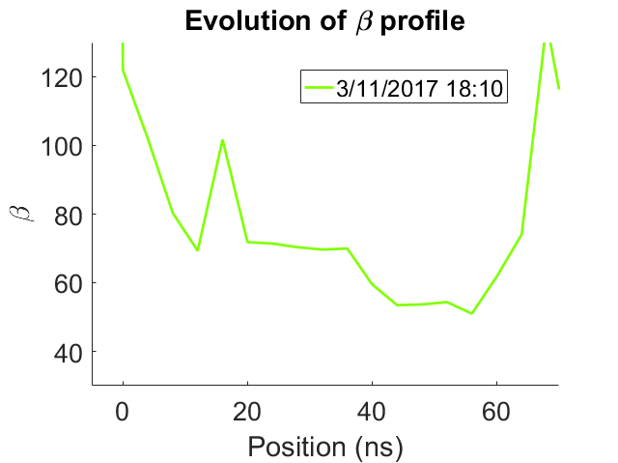
Mapping Field Emission
Fowler-Nordheim plot of dark current at each sample.
Fitted β value for each sample.

Slide 7
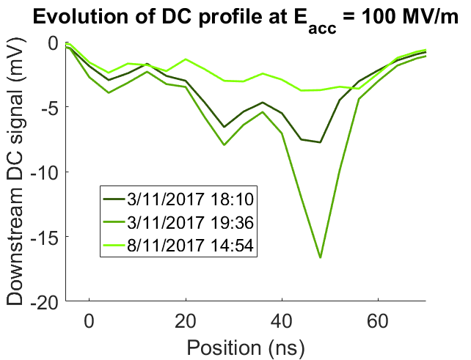
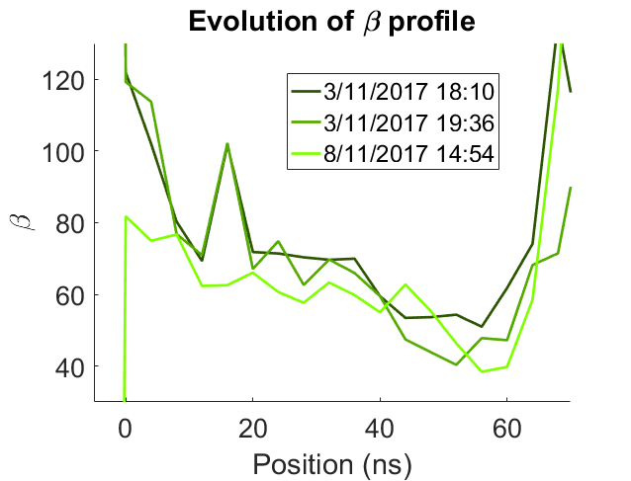
Behaviour Over Time
Dark current signal at E_{acc} = 100 MV/m on different days.
Fitted β value for each sample on different days.

Slide 8
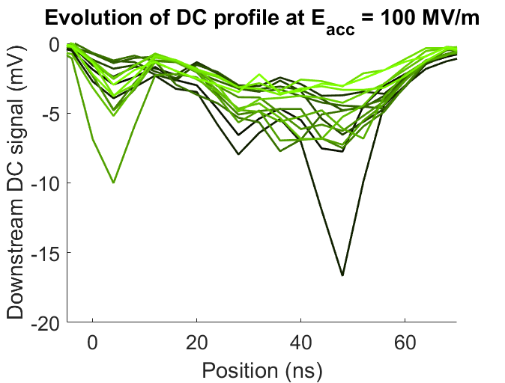
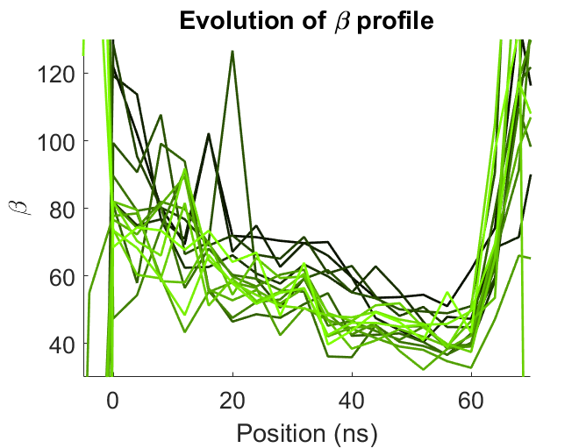
Behaviour Over Time
Dark current signal at E_{acc} = 100 MV/m on different days.
Fitted β value for each sample on different days.
Slope in DC signal and fitted beta observed. This may be due to the pulse broadening due to dispersion – to be investigated further at a future date.

Slide 9
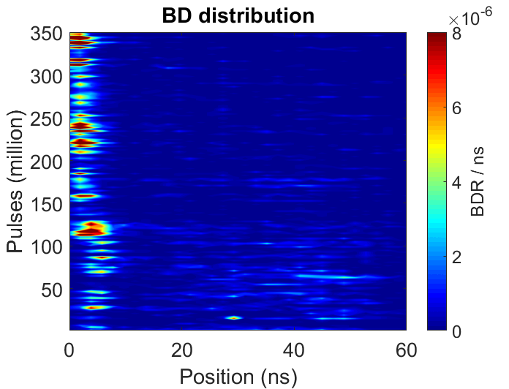
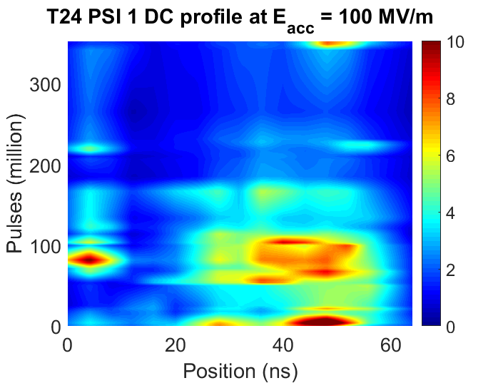
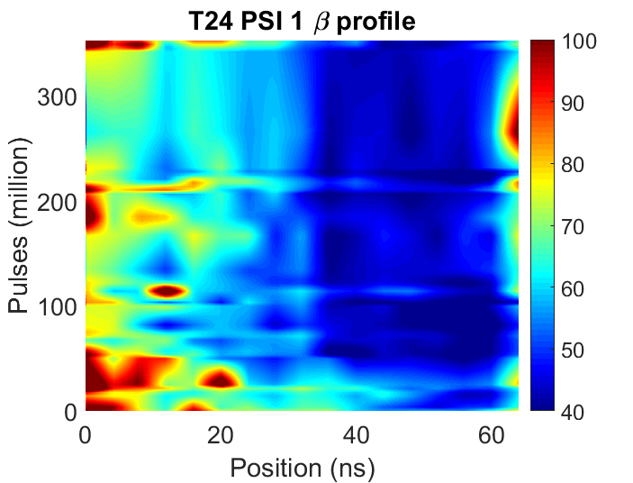
Comparison with BD position (T24 PSI 1)

Slide 10
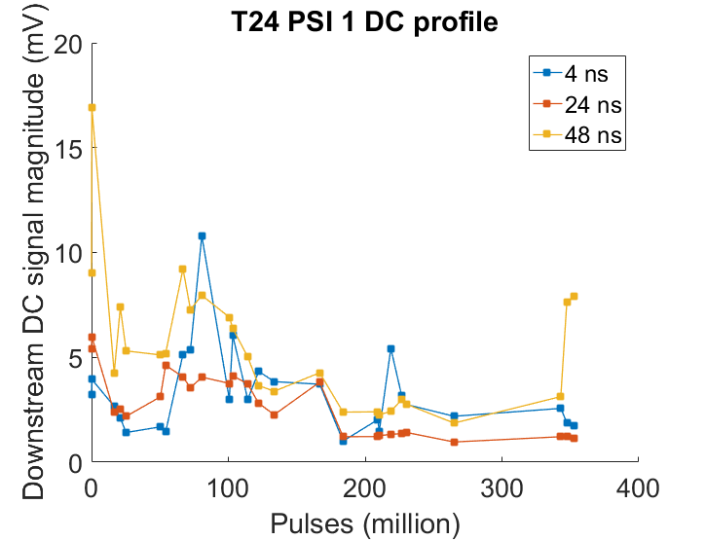
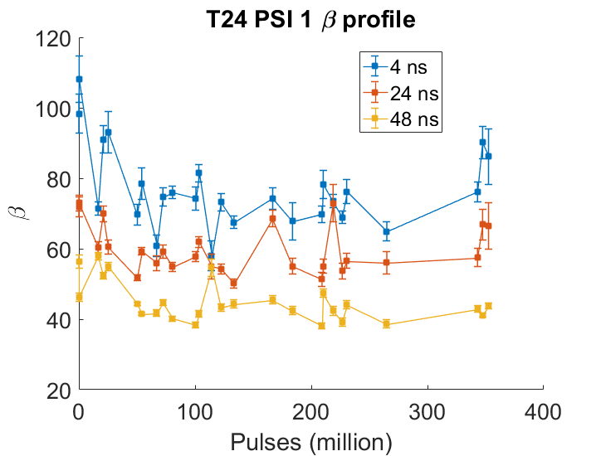
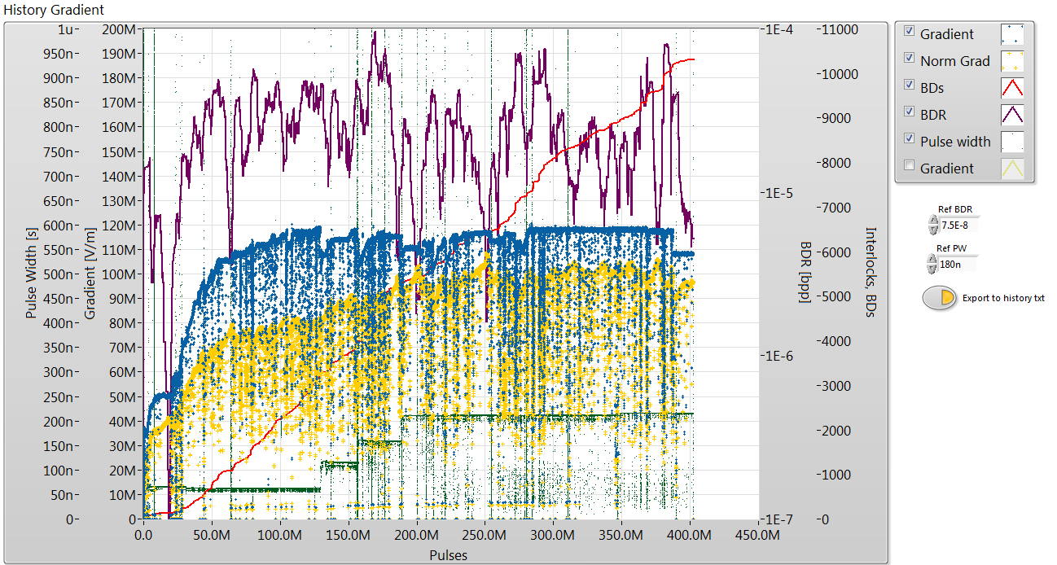

Slide 11
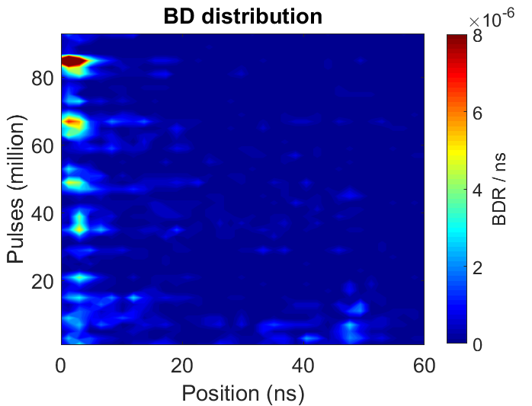
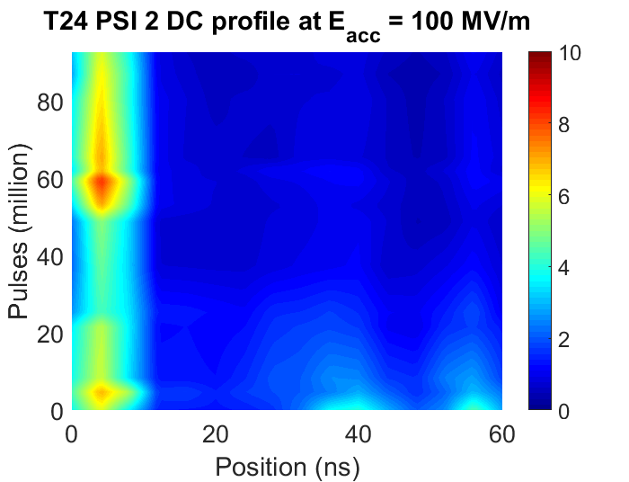
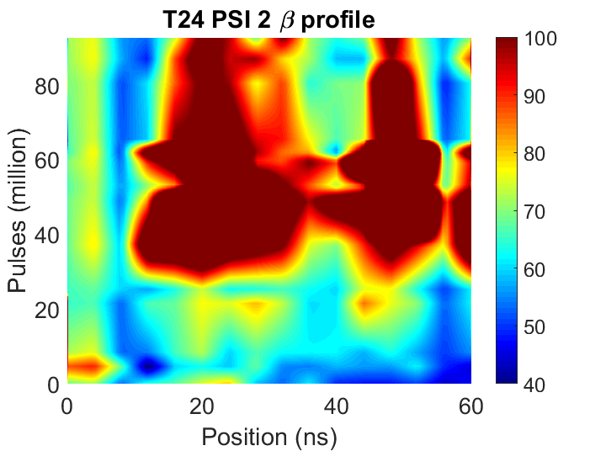
Comparison with BD position (T24 PSI 2)
Very poor fit in red area due to small signal to noise ratio.

Slide 12
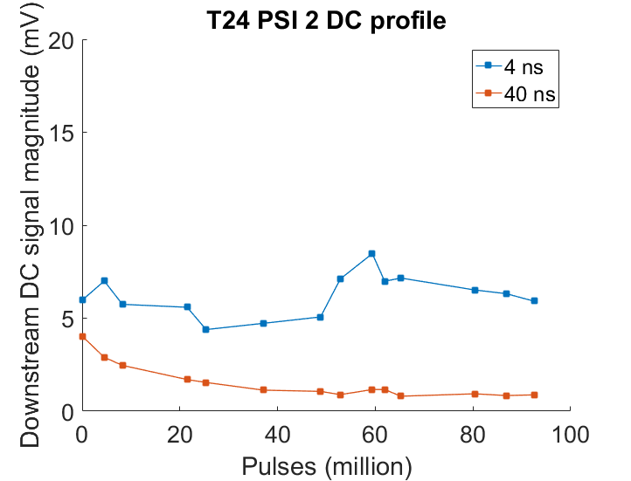
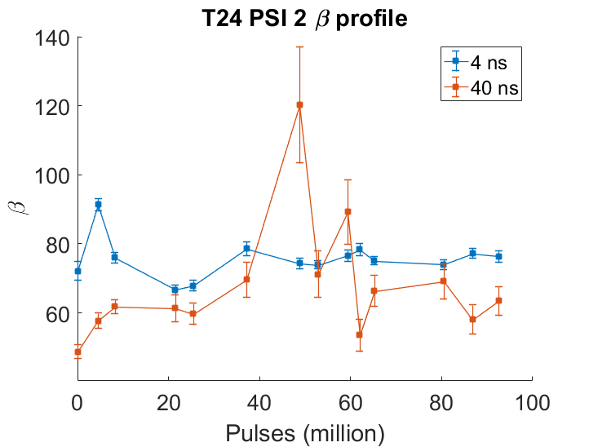
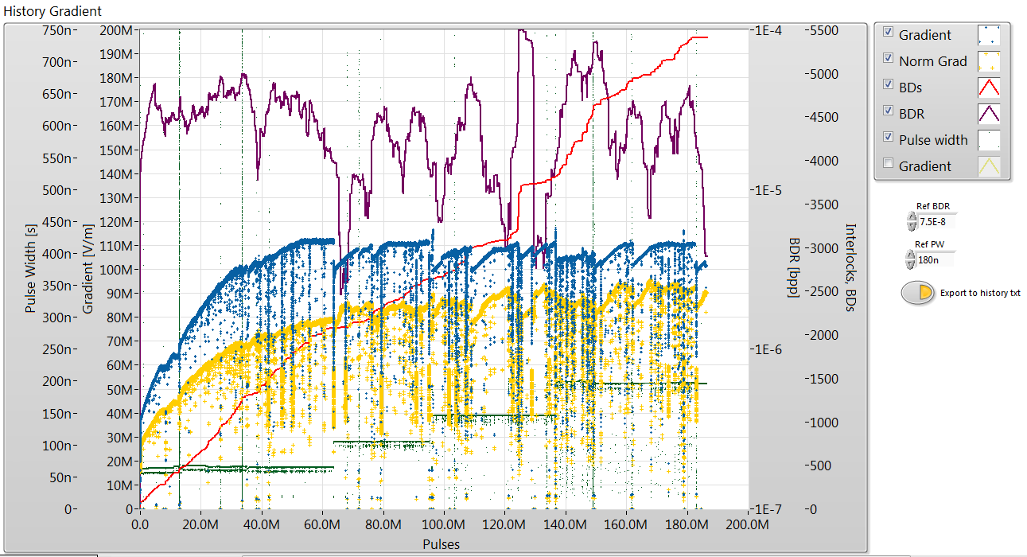

Slide 13
High Frequency Fluctuation Measurements

Slide 14
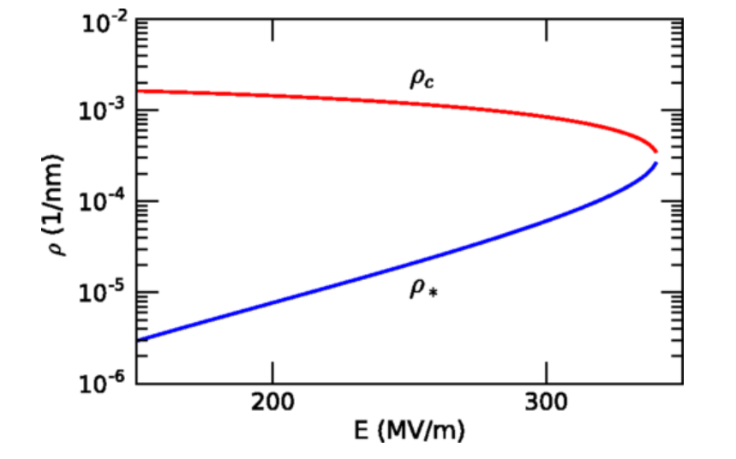
Dark Current Fluctuations in RF Structures
Stochastic model of breakdown nucleation has been proposed by Ashkenazy et.al.
Fluctuations in dark current could give insight into dislocation dynamics inside copper.
Breakdown corresponds to bifurcation point in dislocation dynamics – stable fixed point disappears.
Warning signs before breakdown might be observable.
E. Engelberg, Y. Ashkenazy, M. Assaf

Slide 15
Experimental Setup
Channel normally used for power calibration
Added for this measurement
Other RF signals
Incident RF signal
Attenuators, 12 GHz BPF, Splitter
Matrix Switch
RF diode
Bunker
60 dB coupler
RF to load
Oscilloscope
RF from klystron
Upstream FC
Downstream FC
High Pass Filter (optional)
Amplifier Chain
RF Structure

Slide 16
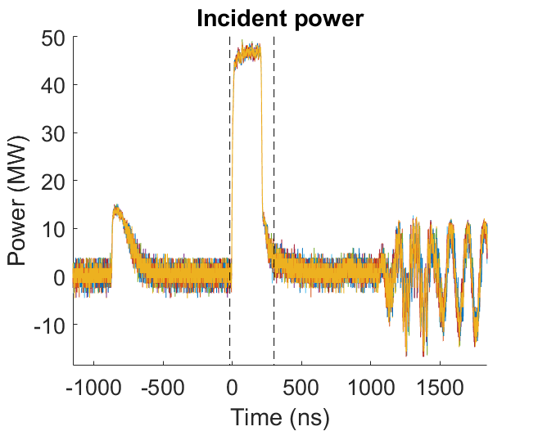
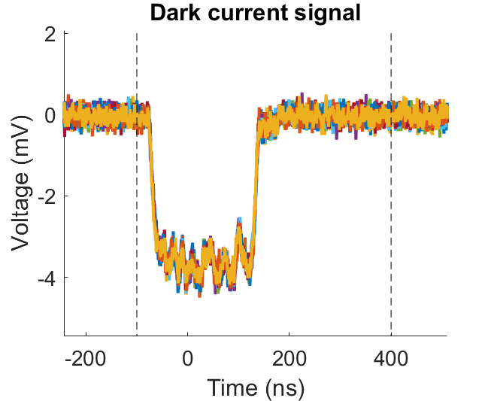
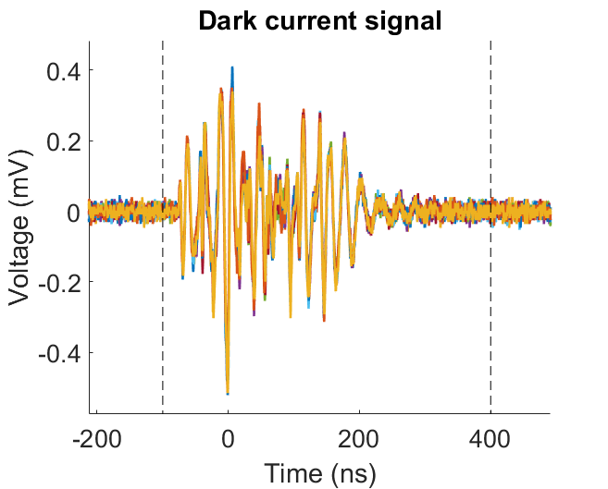
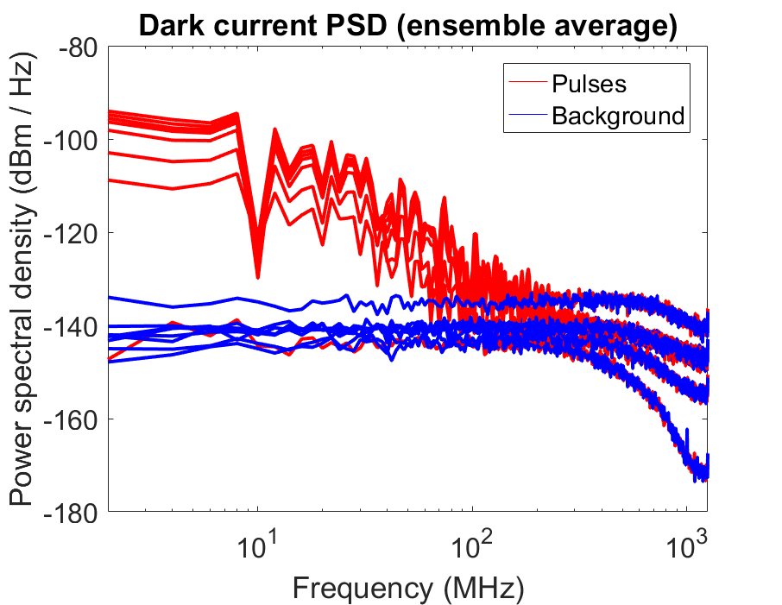
Example Signals
No amplifiers or filters on DC channel.
50 dB gain, 50 MHz high pass filter
Power spectral density of DC pulses and background at different powers.

Slide 17

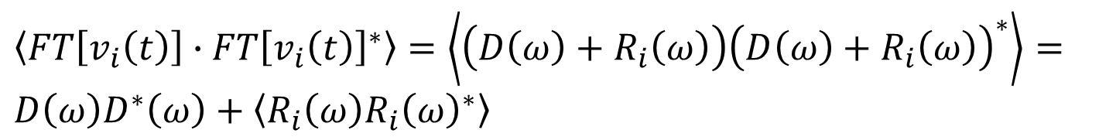
PSD of Pulse to Pulse Fluctuations
Measurement of pulsed dark current signal:
Measured signal
$$v_{i}\left(t\right)=d\left(t\right)+ r_{i}(t)$$
Deterministic component
Random component: different for every pulse
Averaging in time domain first removes random component:
$$FT\left[\left\langle v_{i}\left(t\right)\right\rangle \right]{∙FT\left[\left\langle v_{i}\left(t\right)\right\rangle \right]}^{∗}=D\left(ω\right)D^{∗}\left(ω\right)$$
PSD of deterministic component
Ensemble average of PSDs includes random component:
$\left\langle FT\left[v_{i}\left(t\right)\right]{∙FT\left[v_{i}\left(t\right)\right]}^{∗}\right\rangle =\left\langle \left(D\left(ω\right)+R_{i}\left(ω\right)\right){\left(D\left(ω\right)+R_{i}\left(ω\right)\right)}^{∗}\right\rangle =D\left(ω\right)D^{∗}\left(ω\right)+\left\langle R_{i}\left(ω\right){R_{i}\left(ω\right)}^{∗}\right\rangle$
PSD of random component – not zero due to square term. (Effectively variance of random distribution)
Taking the difference between the two leave PSD of random component only.

Slide 18
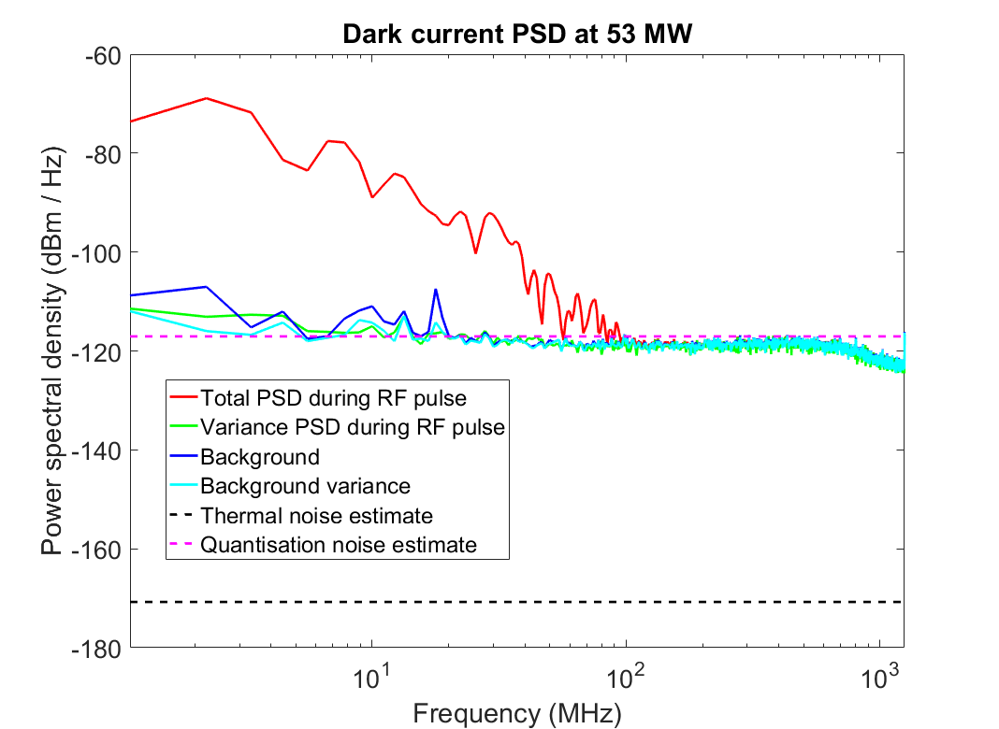
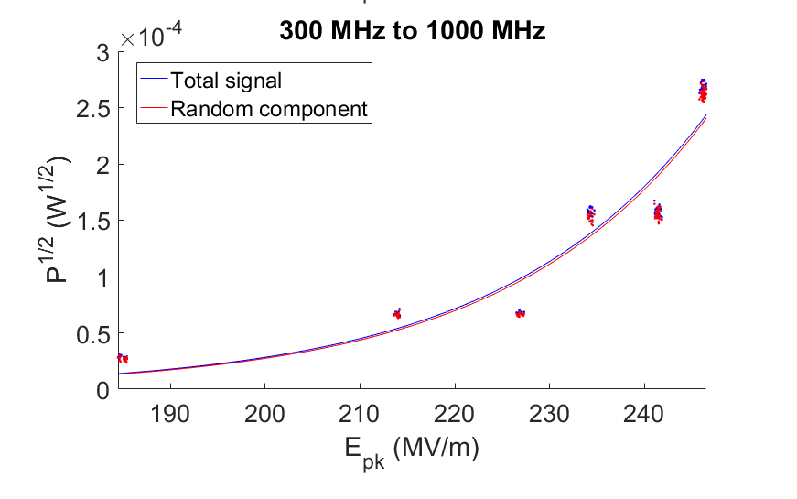
Power Spectrum with Noise Levels
Dark current fluctuations (green) can only be considered significant if they are above the background and noise.
Scope dynamic range limits the sensitivity of the measurement. Filtering out low frequencies allows the higher frequencies to be measured with greater precision.
Also, noise can be extremely misleading!
≤48 dB for an 8-bit scope
200 mV/div
100 mV/div
10 mV/div
50 mV/div
Varying the scale setting on the scope causes the noise to follow a Fowler-Nordheim curve.

Slide 19
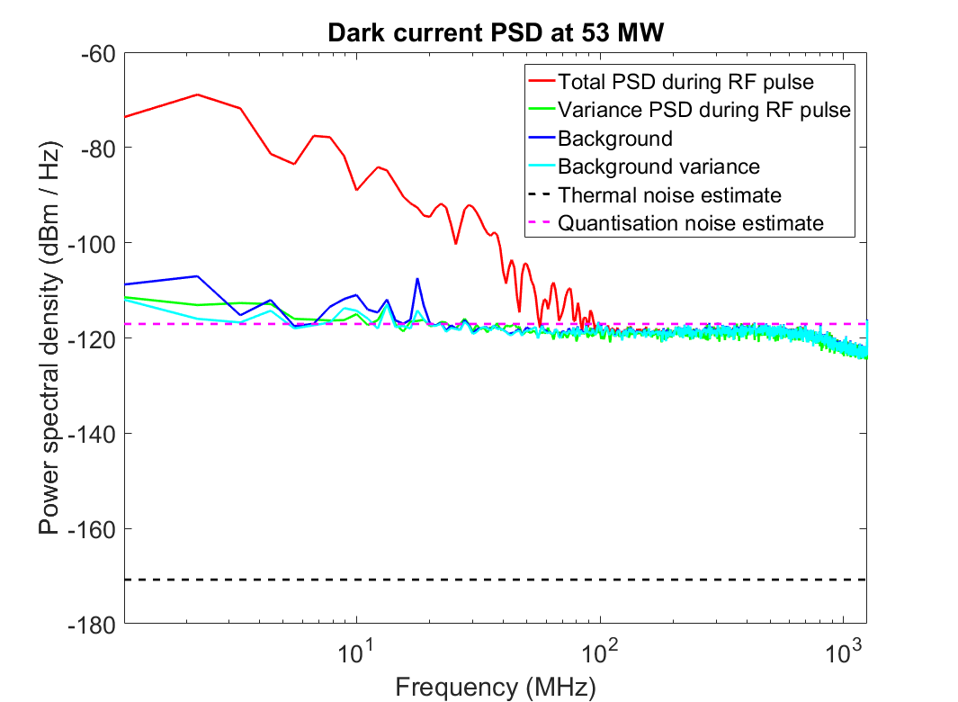
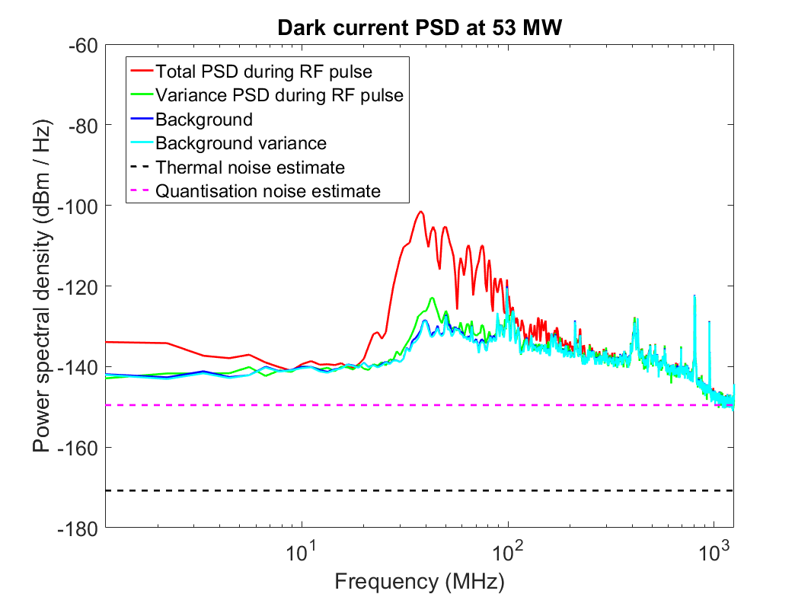
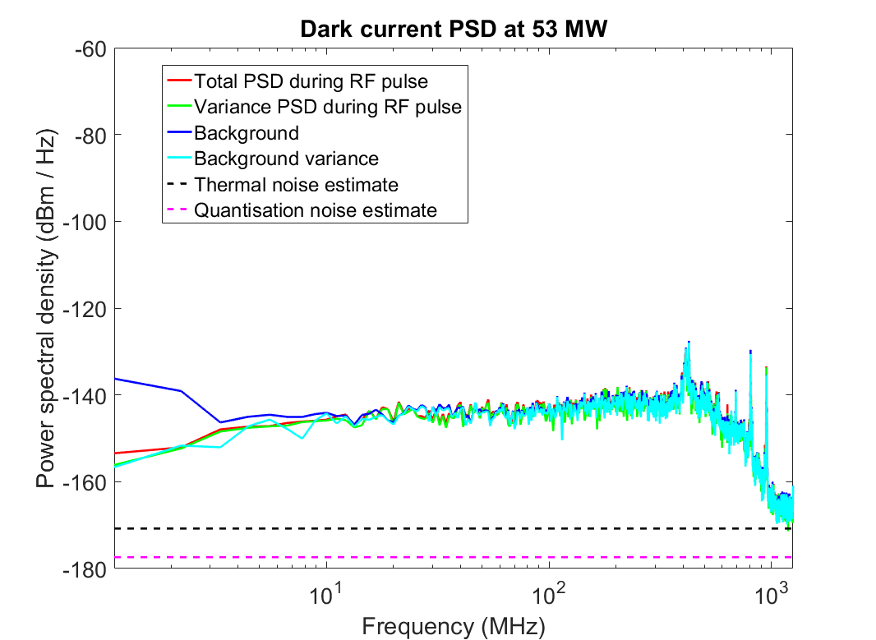
Comparison of Power Spectra
30 dB gain, no filter
50 dB gain, 50 MHz high pass
60 dB gain, 400 MHz high pass
Signal levels normalised to expected level at Faraday cup.

Slide 20
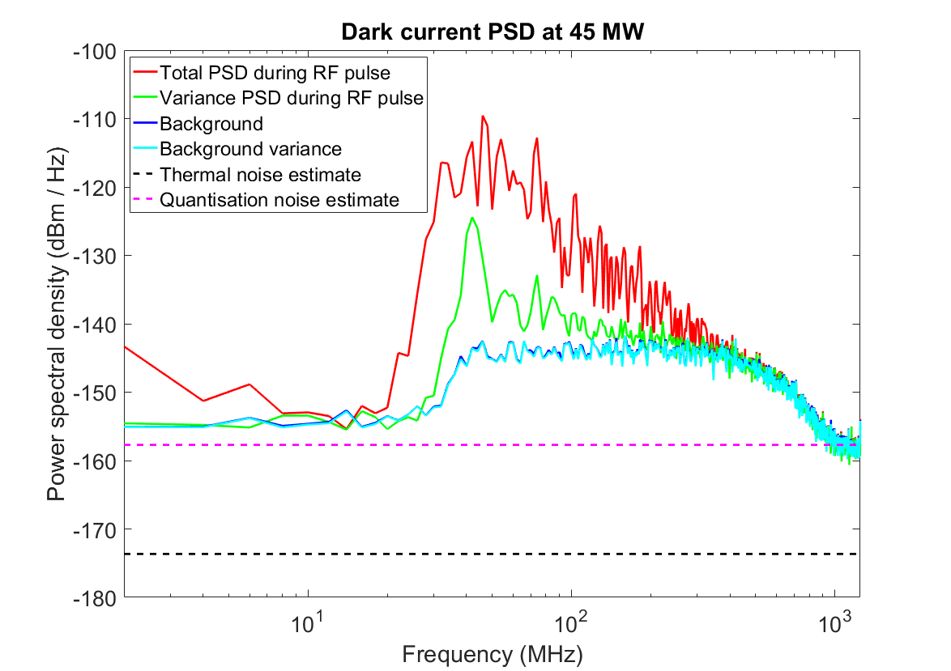
Further Measurements
Subsequent measurement set performed to specifically look at the peak observed at 43 MHz.
Measured upstream Faraday cup which is sensitive to the first cells only:
Fewer emitters (?) = more fluctuation
All BDs have been occurring in the first cells: expect more activity there.
Also measured with high pass filters and amplifiers as before, used shorter length of high-performance cable to improve SNR and reduce interference.
Result: peak is now clearly above the noise.

Slide 21
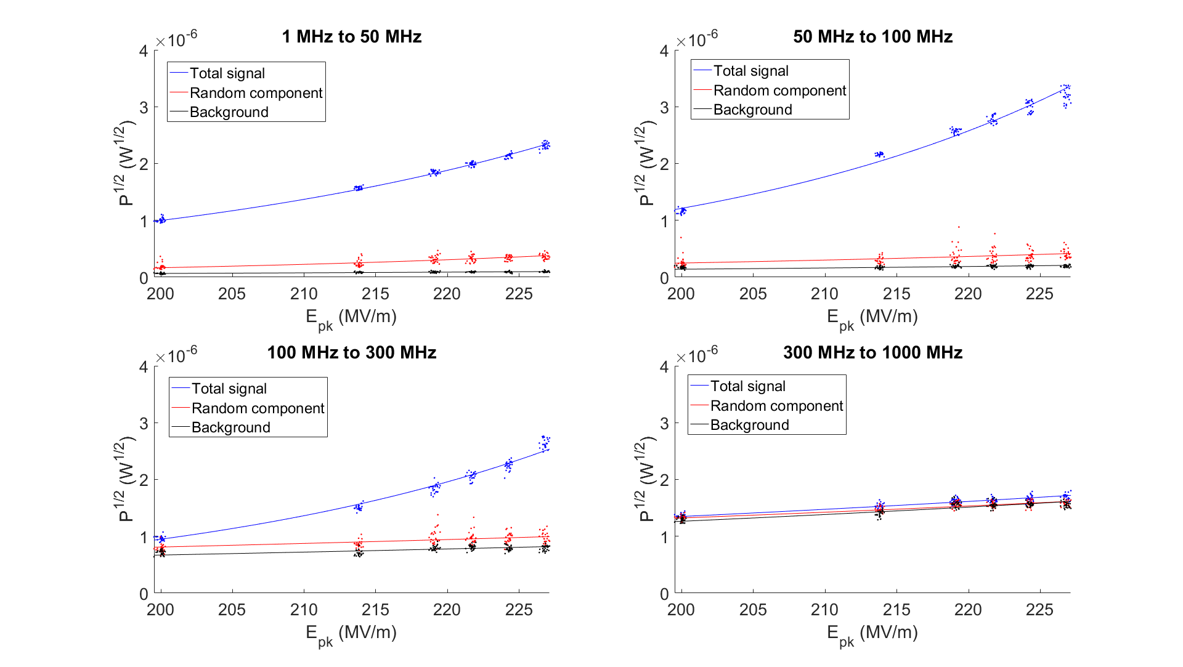
Dependence on Surface Field
Good amount of total DC signal up to 300 MHz.
Variance is clearly above the background noise from 1-300 MHz, increases with power.

Slide 22
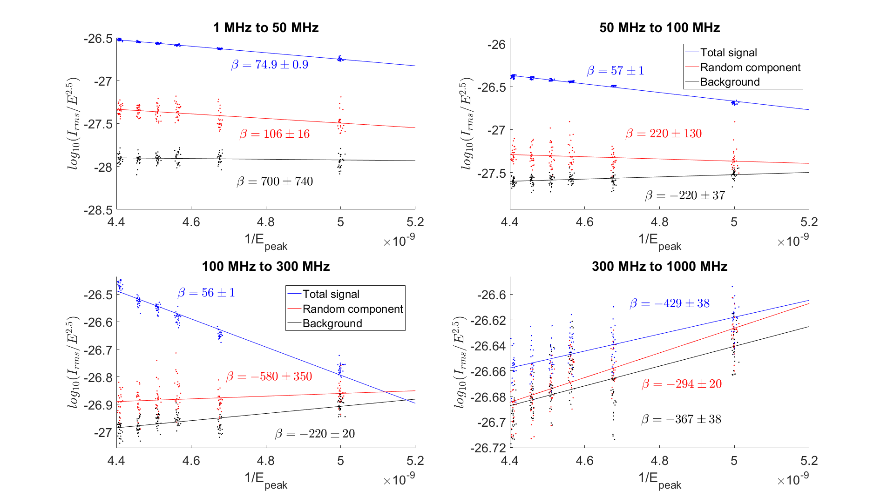
Dependence on Surface Field – FN Axes
Total signal has reasonable beta and good fit to FN curve up to 300 MHz.
Variance has higher beta, larger confidence interval, data points further away from fitted line.
Signals in 300-1000 MHz band don’t behave like field emission, seem dominated by noise.

Slide 23
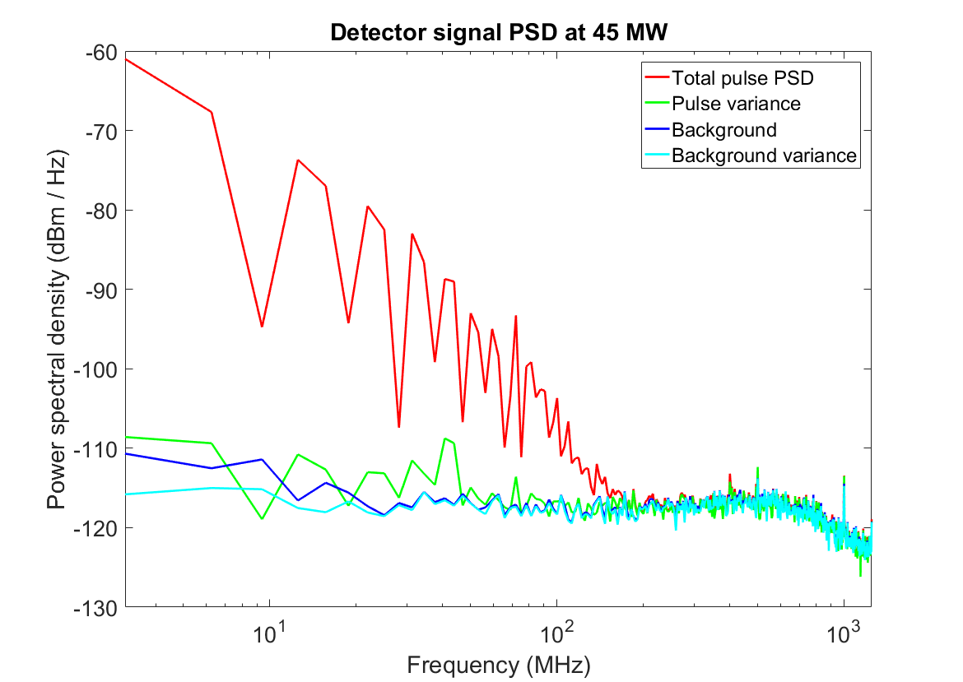
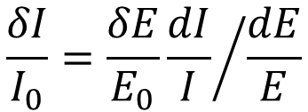




Estimating the Effect of RF Jitter
Output of diode detector also has some variance and a peak at 43 MHz – suggesting RF fluctuations may be causing DC fluctuations.
FN curve measured without any filters to obtain dependence of I on E (for upstream FC, current can be assumed to come from one emitter):
$$\frac{δI}{I_{0}}=\frac{δE}{E_{0}}{\frac{dI}{I}}/{\frac{dE}{E}}$$
All quantities expressed as ratios of PSDs to simplify normalisation of absolute signal level:
$$δI\left(f\right)= S_{II}(f)$$
$$δE\left(f\right)= S_{EE}(f)$$
$$I_{0}= S_{II}(0)$$
$$E_{0}= S_{EE}(0)$$

Slide 24
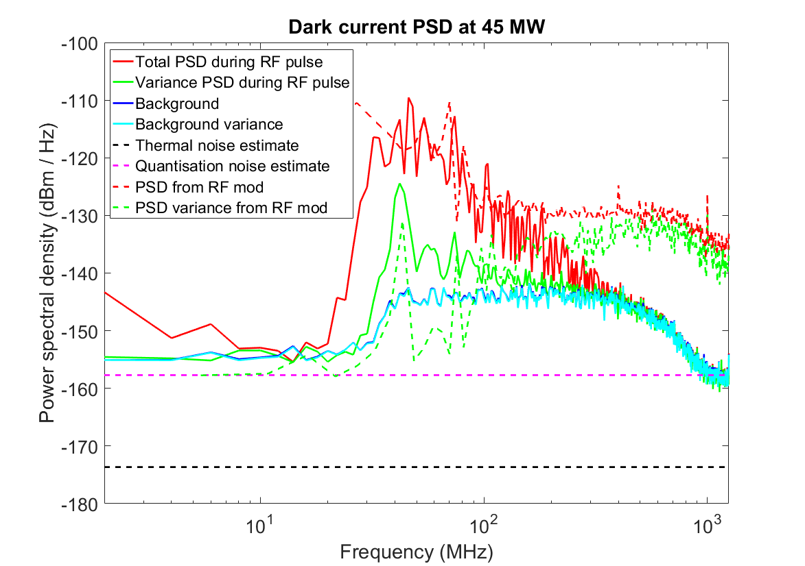
Estimated DC Signal From RF Modulation
Deterministic DC signal at high frequencies caused by deterministic ripple in RF.
Very likely that pulse to pulse fluctuations in DC caused by fluctuations in RF.

Slide 25
Conclusions and Further Steps
Random fluctuations in dark current observed, believed to be caused by fluctuations in incident RF pulse.
RF pulse frequency content and jitter should be controlled more precisely, or at least measured carefully.
Replace diode with mixer setup for better linearity and higher SNR.

Slide 26
Thank you!
Questions?

