Slide 1
Research on wakefield suppression of two bunch operation mode in X-band disk-loaded accelerating structure
Xiaoxia Huang, Wencheng Fang
Shanghai Institute of Applied Physics, Chinese Academy of Sciences

Slide 2
Outline
Tentative idea of two bunches
Wakefield suppression
Position analysis of the second bunch
Feasibility of several bunches

Slide 3
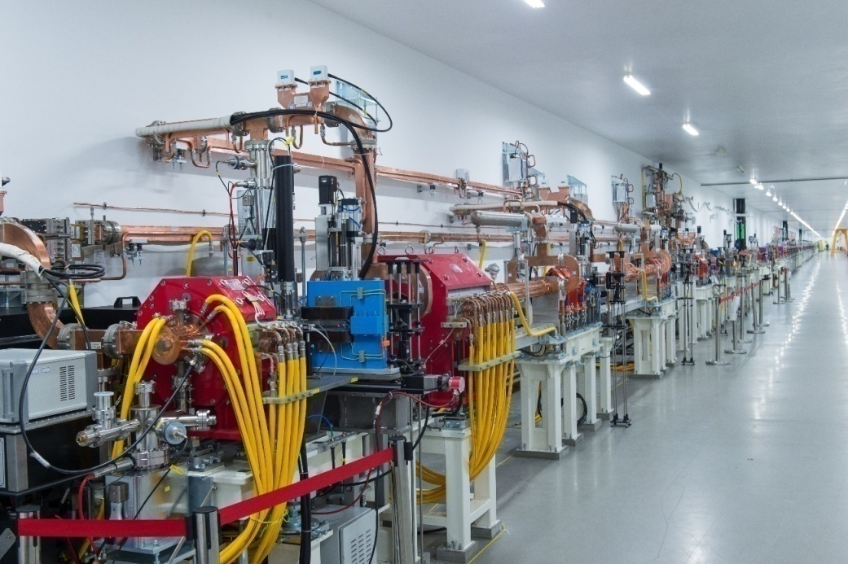
Tentative idea of two bunches
Single bunch operation mode – 50Hz
Demand of Ten Beam lines
Demand of 20 Beam lines - 100 Hz
SXFEL
Demand of 20 Beam lines
Two bunches operation mode – 50Hz
Beam Instability, Wakefield Suppression

Slide 4
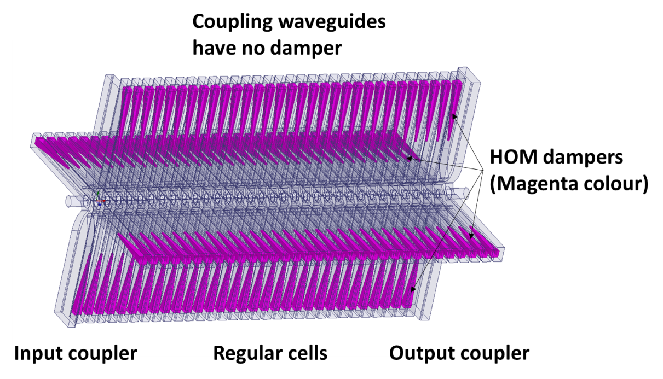
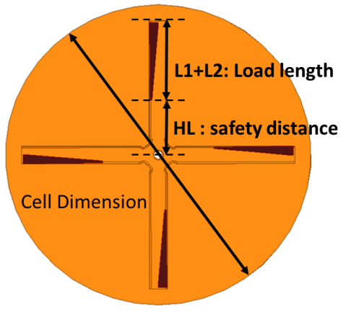
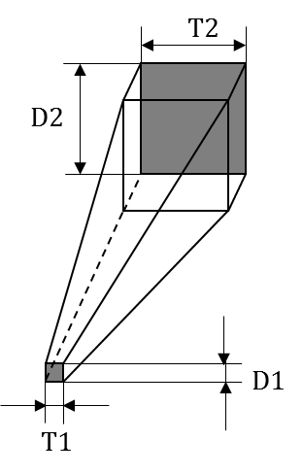
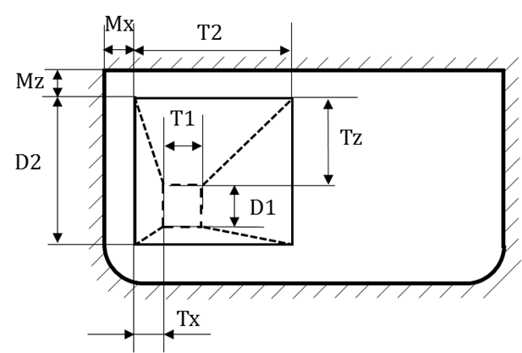
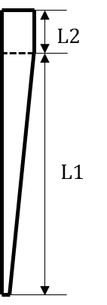
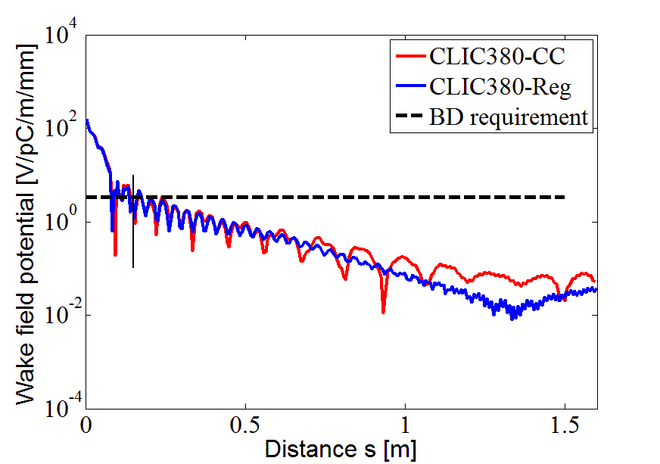
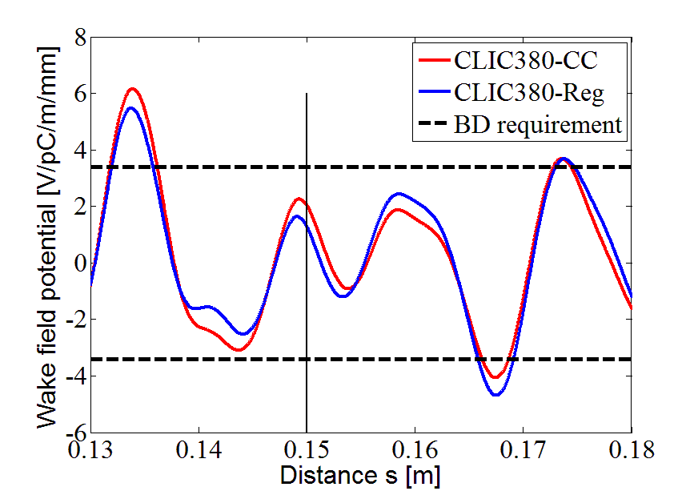
Tentative idea of two bunches
Waveguide Damped Structure:
good wakefield suppression
complex Structure

Slide 5
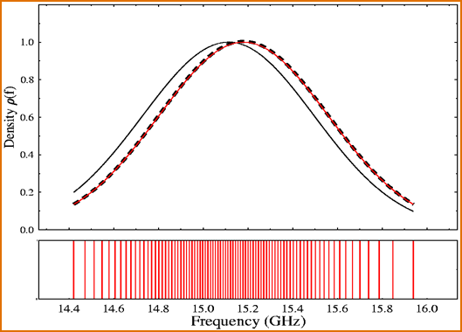
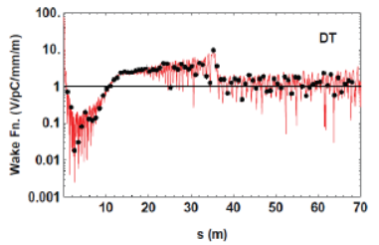
Tentative idea of two bunches
Detuned Structure
Second Bunch
Rebound phenomenon:
Limited number of cells in accelerating structure
Two bunch:
Second bunch put in valley
Gaussian detuning:
When the frequencies of the lowest two-pole field mode of the accelerating structure are Gaussian distribution, the time domain of the wakefield exhibits Gaussian attenuation.
The larger σ_{f} in frequency domain, the faster of Gaussian attenuation in time domain.
Similar to disk-loaded structure

Slide 6
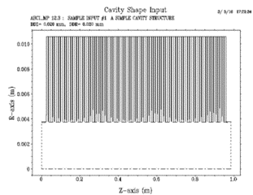
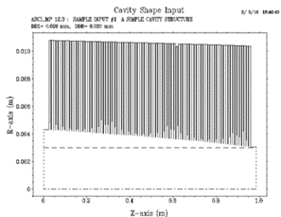
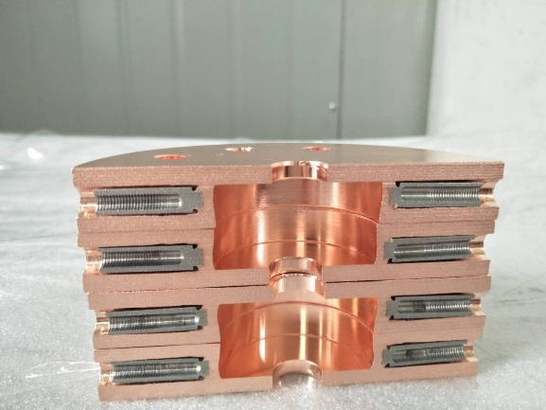
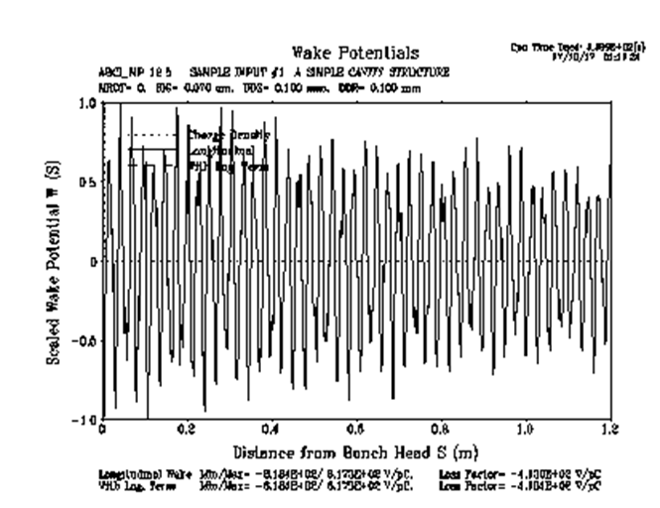
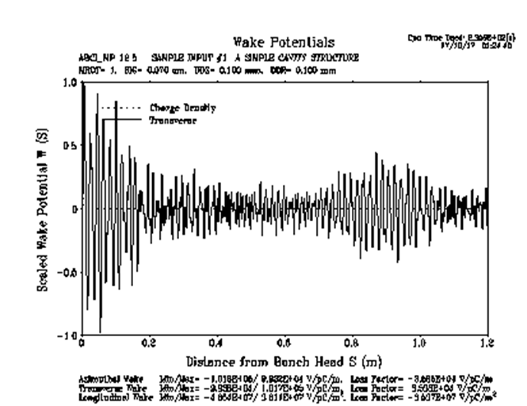
Tentative idea of two bunches
Disk-loaded Structure:
simple
constant-gradient
Transverse Wakefield
constant-impedance
constant-gradient
special design disk-loaded structure
realize two bunch operation mode

Slide 7
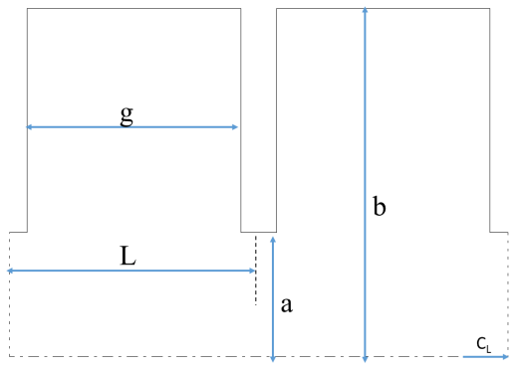
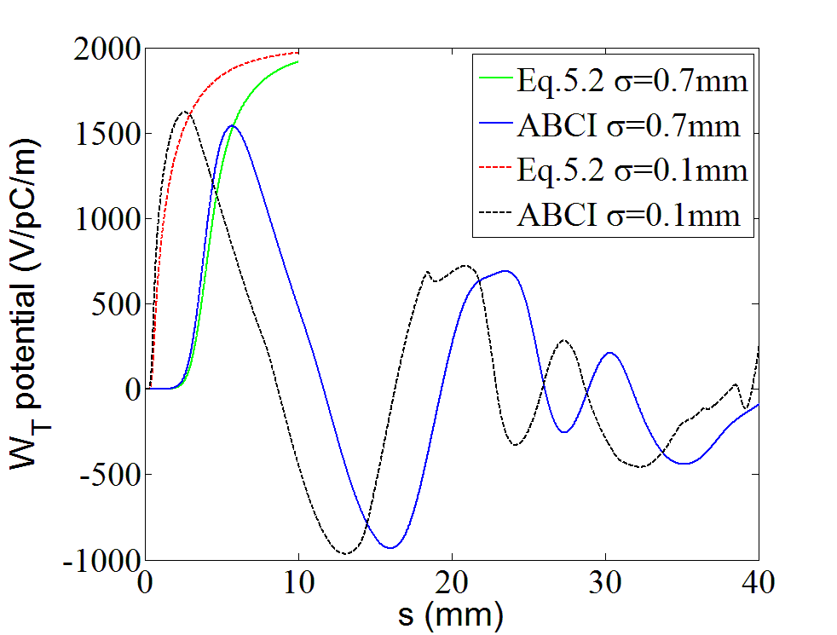
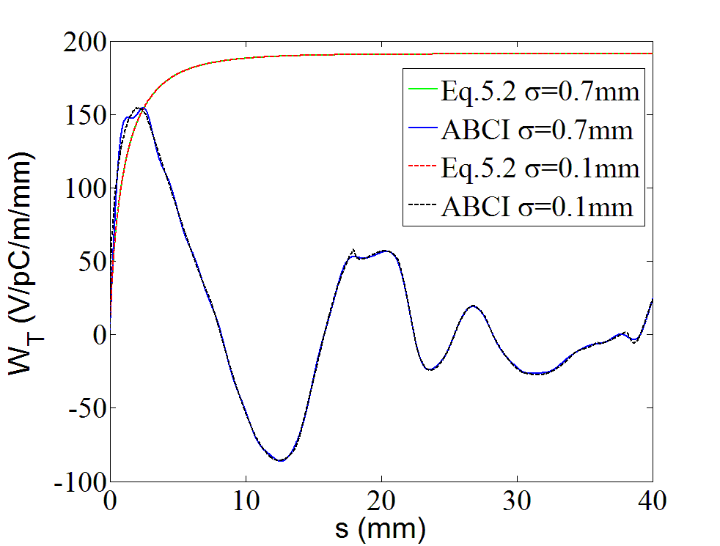
Wakefield function vs. ABCI
Infinity Period
L = 10.497 mm, a = 3.775 mm, b = 10.585 mm, t = 1.5 mm
Valid square:
s/L<0.15, 0.34<a/L< 0.69, 0.54<g/L< 0.89
Unrelated with σ

Slide 8
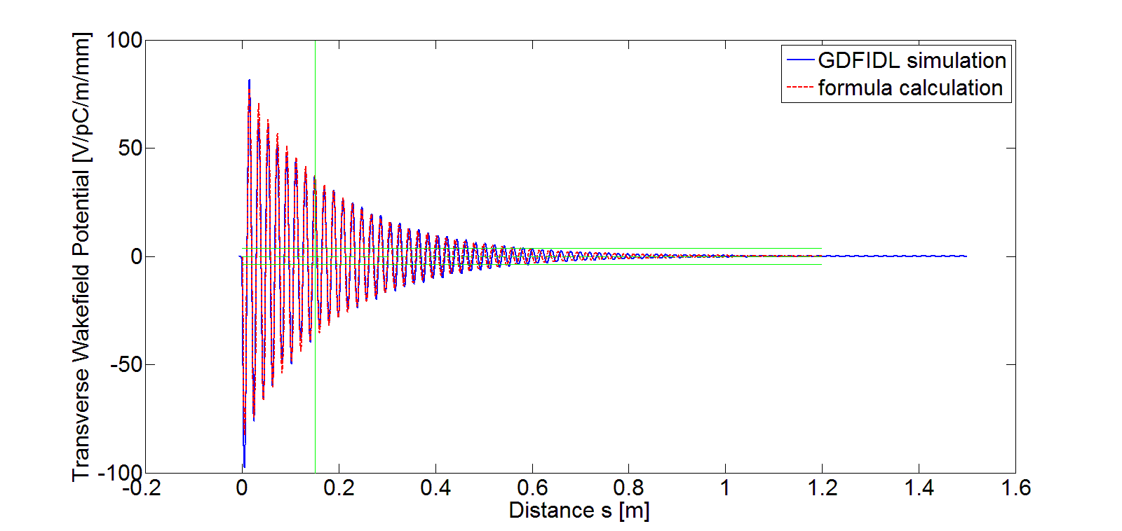
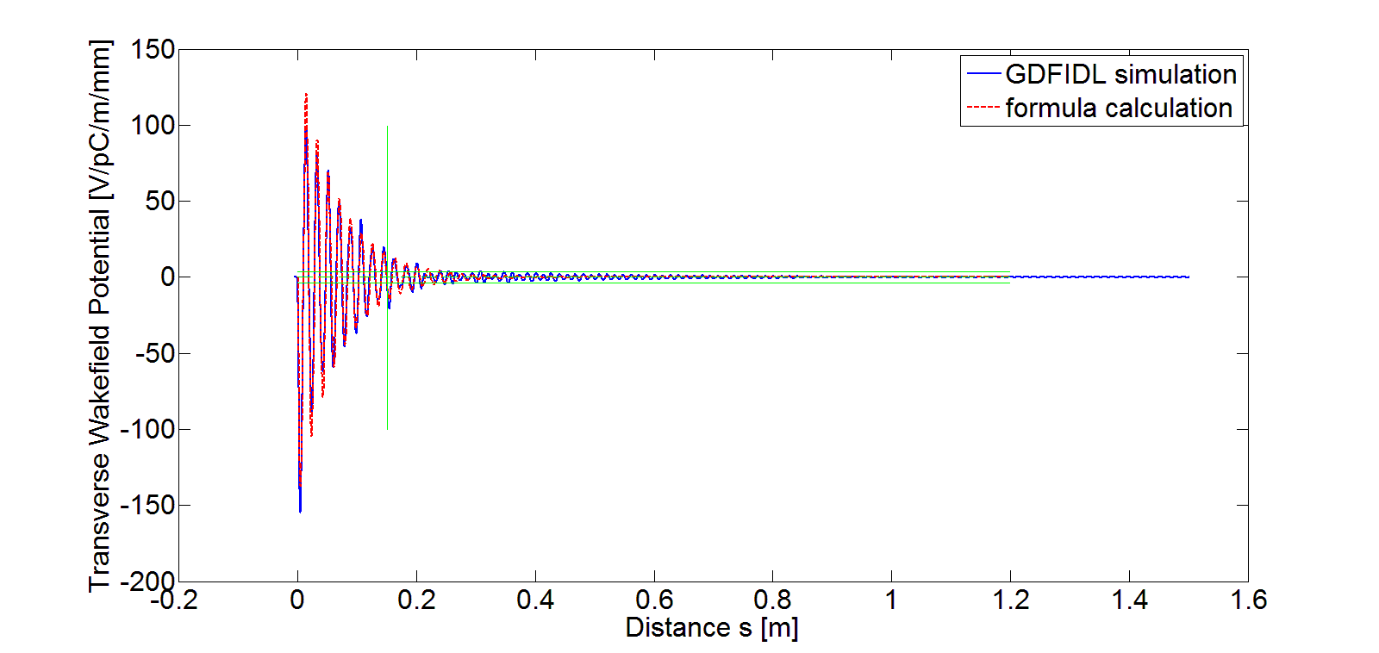
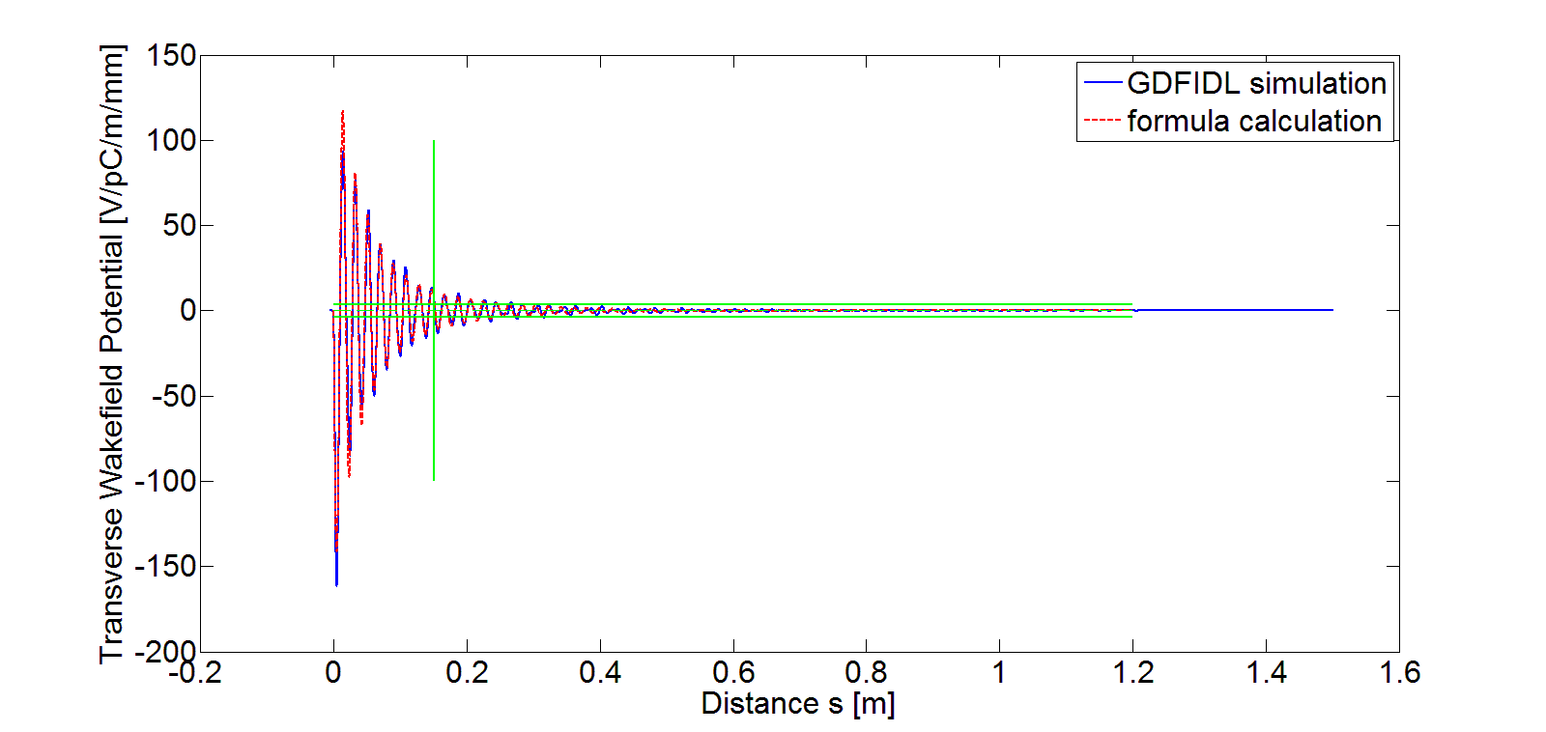
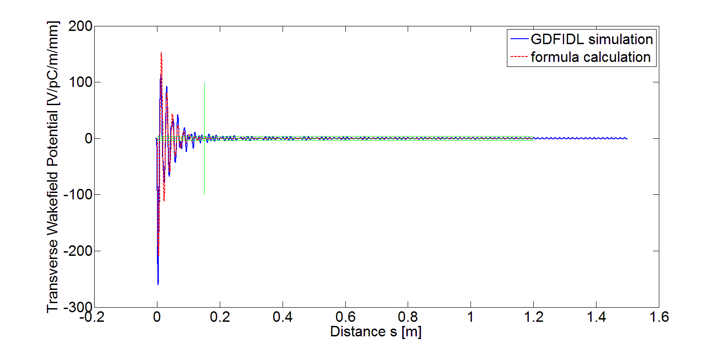
Wakefield suppression vs. Cell
Multipole fields
Similar
i=1
Example of CLIC damped structure
i=(N+1)/2
i=N

Slide 9
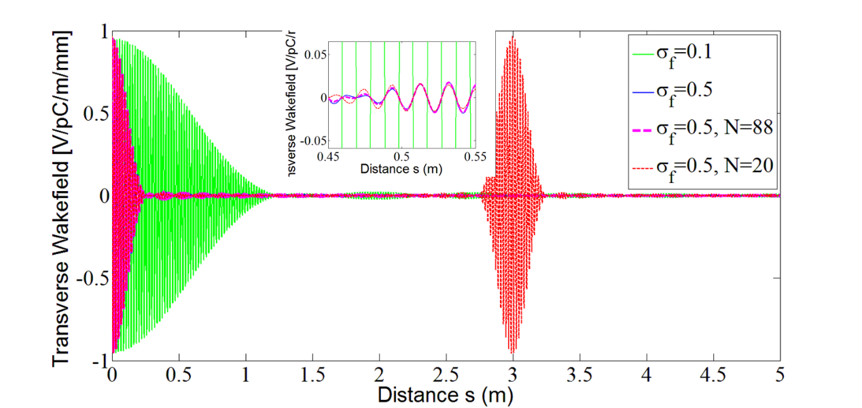
Wakefield suppression vs. Frequency
Assuming that the impedance of each cell is the same with different frequency
Assuming that the Density of frequency is the Gaussian distribution
Impedance vs. Frequency
Wakefield vs. Frequency
Bigger σ_{f} , Stronger suppression
More the number of frequency N, Rebound more late and more bunches can be placed
f₀ = 15.5 GHz

Slide 10
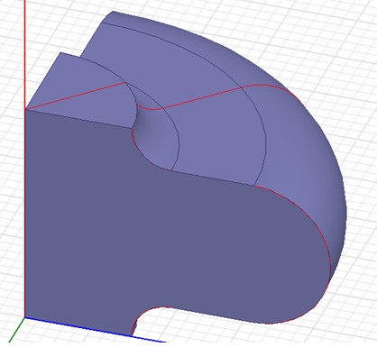
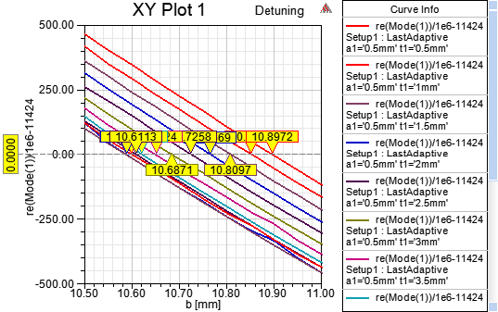
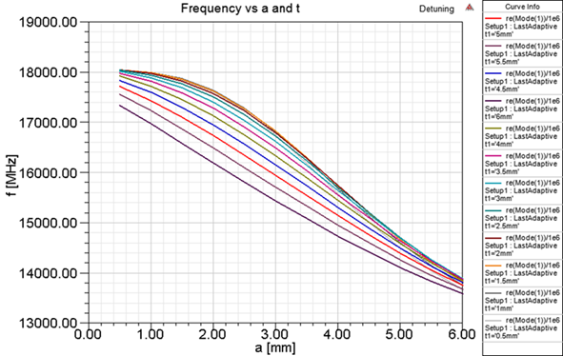
Frequency of dipole mode
L = 8.7475 mm, phase advance = 120 degree
Fundamental frequency - 11424 MHz
Simulation b in the case of different a and t
Lowest frequency of dipole mode
Under the condition of the same fundamental frequency

Slide 11
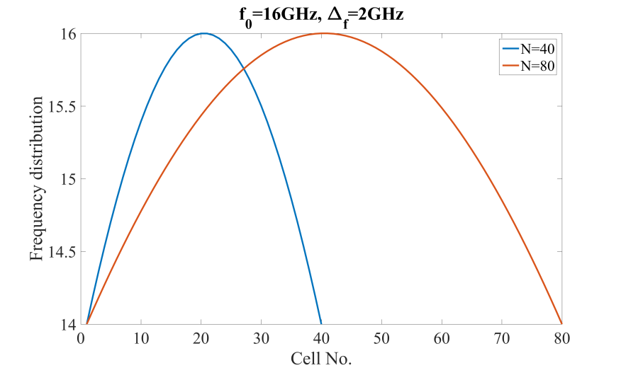
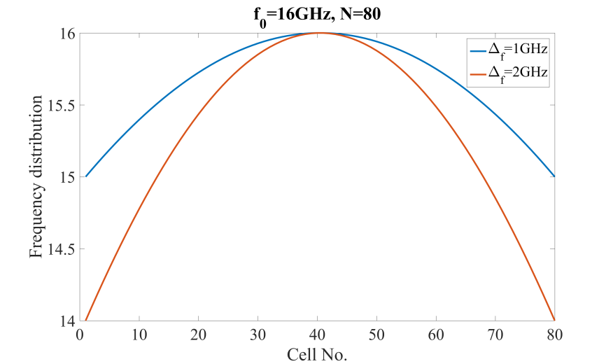
Model-1: Frequency vs. cells
Assuming that the number of cells is N, the frequency is Gaussian distribution

Slide 12
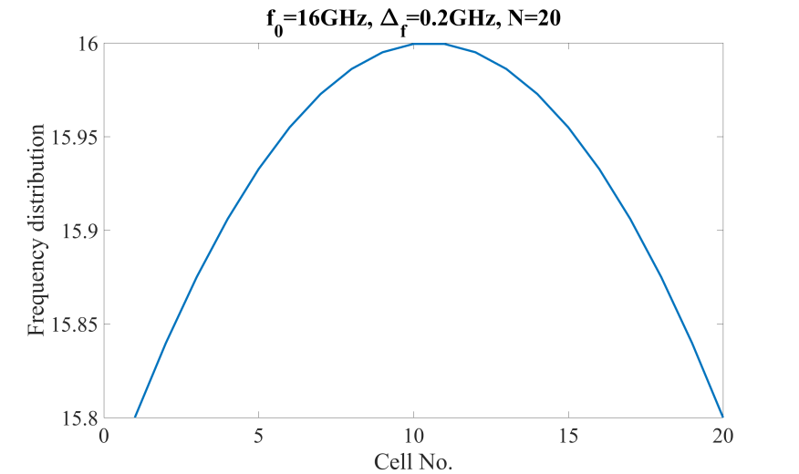
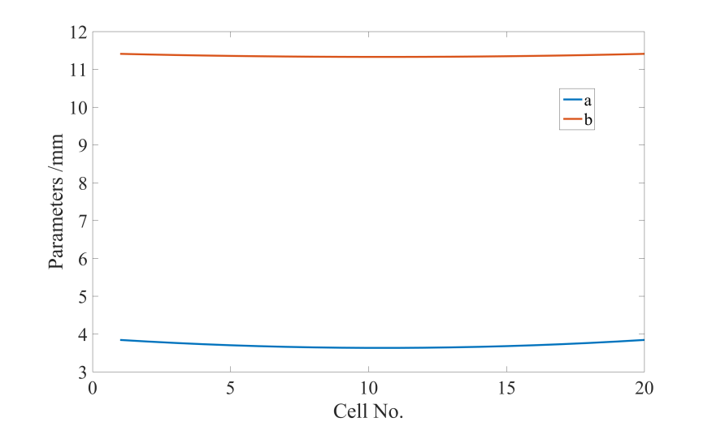
Gaussian distribution - 1
N=20, Δ_{f}=0.2GHz, f₀=16GHz,
σ_{f} = 60

Slide 13
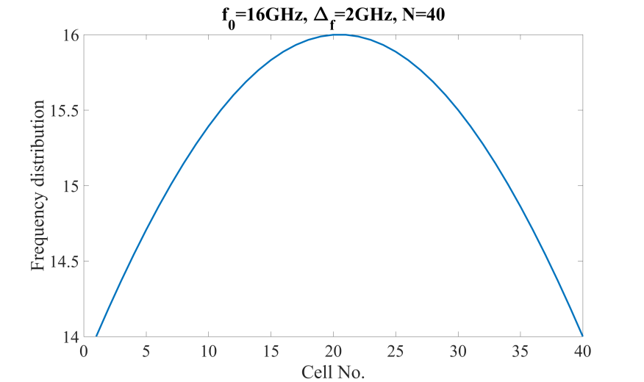
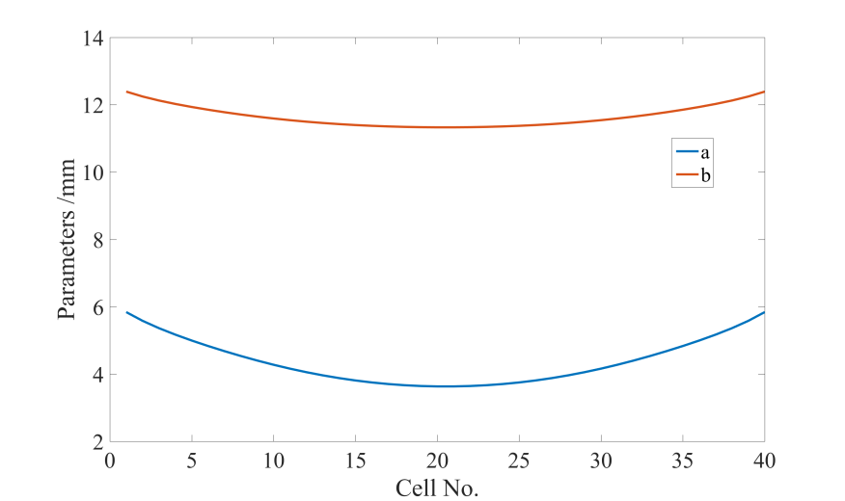
Gaussian distribution - 2

Slide 14
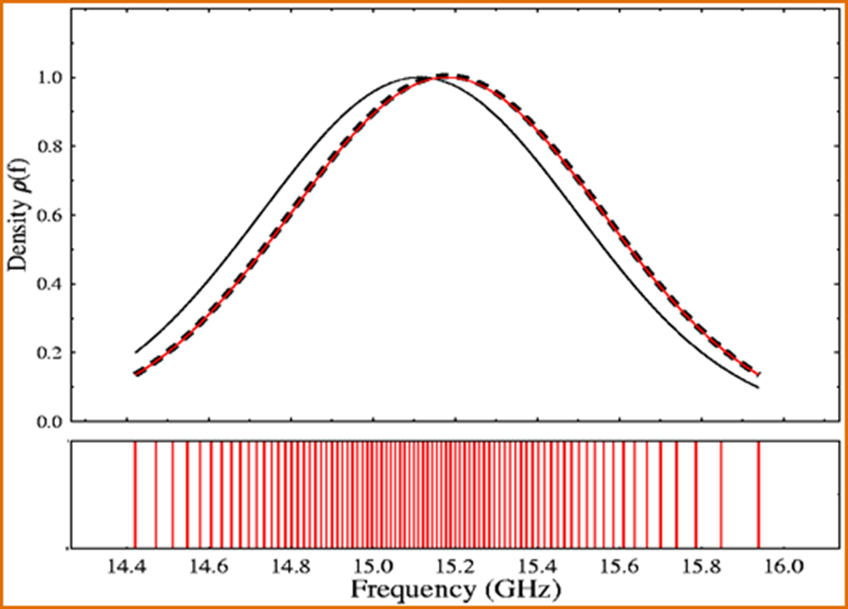
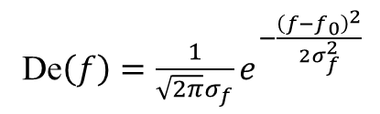
Model-2: Gaussian Density
Cell vs. Frequency
De$\left(f\right)=\frac{1}{\sqrt{2π}σ_{f}}e^{−\frac{{\left(f−f_{0}\right)}^{2}}{2σ_{f}^{2}}}$
N cells and f₁ - f_{N} :
De(f_{i})*(f_{i+1}-f_{i}) is the same
Sizes of all cells

Slide 15
Example
σ_{f} = 500 MHz, f₀ = 16.2 GHz, f_{max}-f_{min} = 2 GHz
f₁ : f₉ = 15.2 GHz : 0.25 GHz : 17.2 GHz
n(f₁)=1, n(f₂)=3, n(f₃)=5, n(f₄)=7, n(f₅)=8, n(f₆)=7, n(f₇)=5, n(f₈)=3, n(f₉)=1 N=40

Slide 16
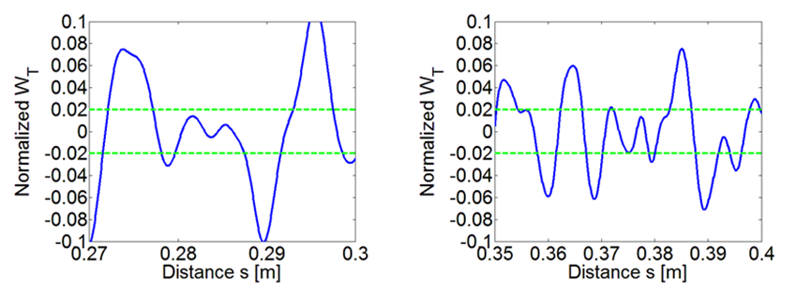
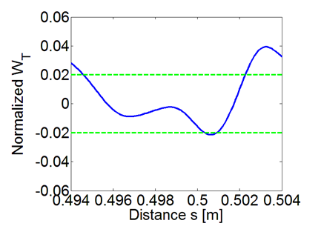
Second bunch position
s ≠ int * λ
s = 0.284 m
s = 0.375 m
Second bunch
s = 0.4986 m = 19 λ

Slide 17
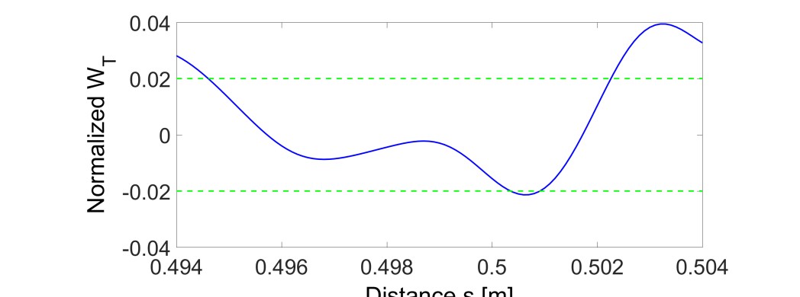
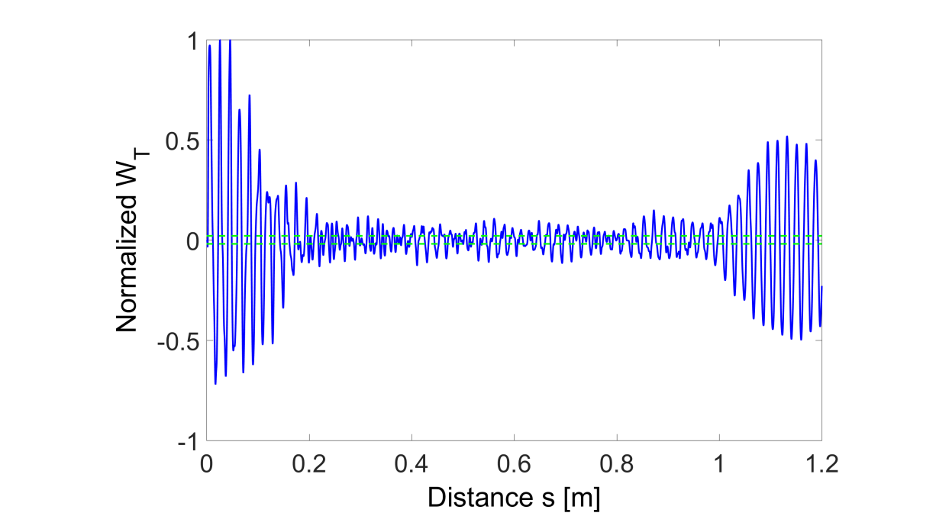
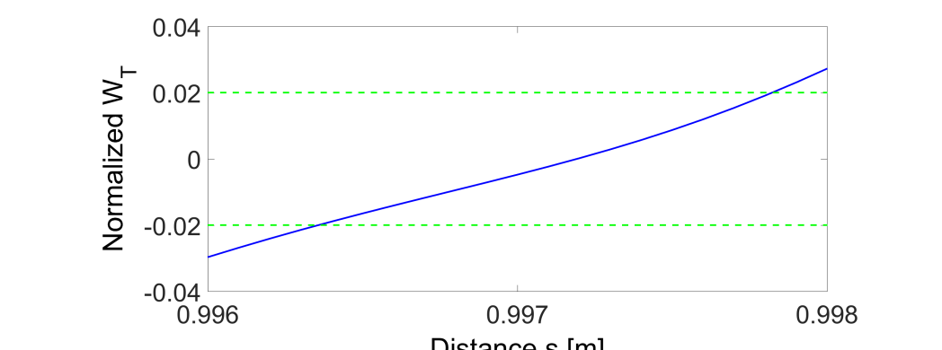
Several bunches
Second bunch
s = 0.4986 m = 19 λ
Third bunch
s = 0.9972 m = 38 λ
Further Work

Slide 18

Thanks for your attention!

