Slide 1
ReCENT PROGRESS of SHORT PULSE DIELECTRIC TWO-BEAM ACCELERATION
HG2018, Shanghai, China
drhgfdjhngngfmhgmghmghjmghfmf
Chunguang Jing
On behalf of the Argonne Wakefield Accelerator (AWA) facility

Slide 2


Background and motivation
Short pulse two-beam acceleration
- Approach to structure-based wakefield acceleration
- High gradient acceleration (200-300 MV/m)
A promising solution!
accelerator
$$E_{0}=\sqrt{2αΖ_{eff}P_{in}}$$
main beam
TBA
rf power
$$BDR∝E^{30}τ^{5}$$
drive beam
short pulse
power extractor
- Both structures can be optimized to obtain high power generation, high
gradient acceleration, and high efficiency

Slide 3
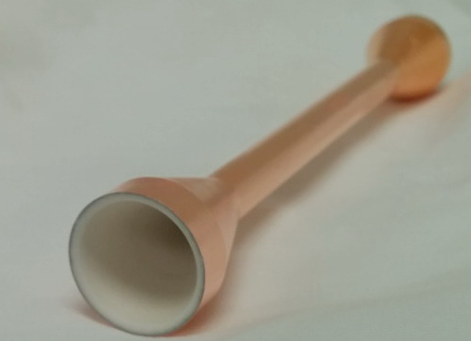
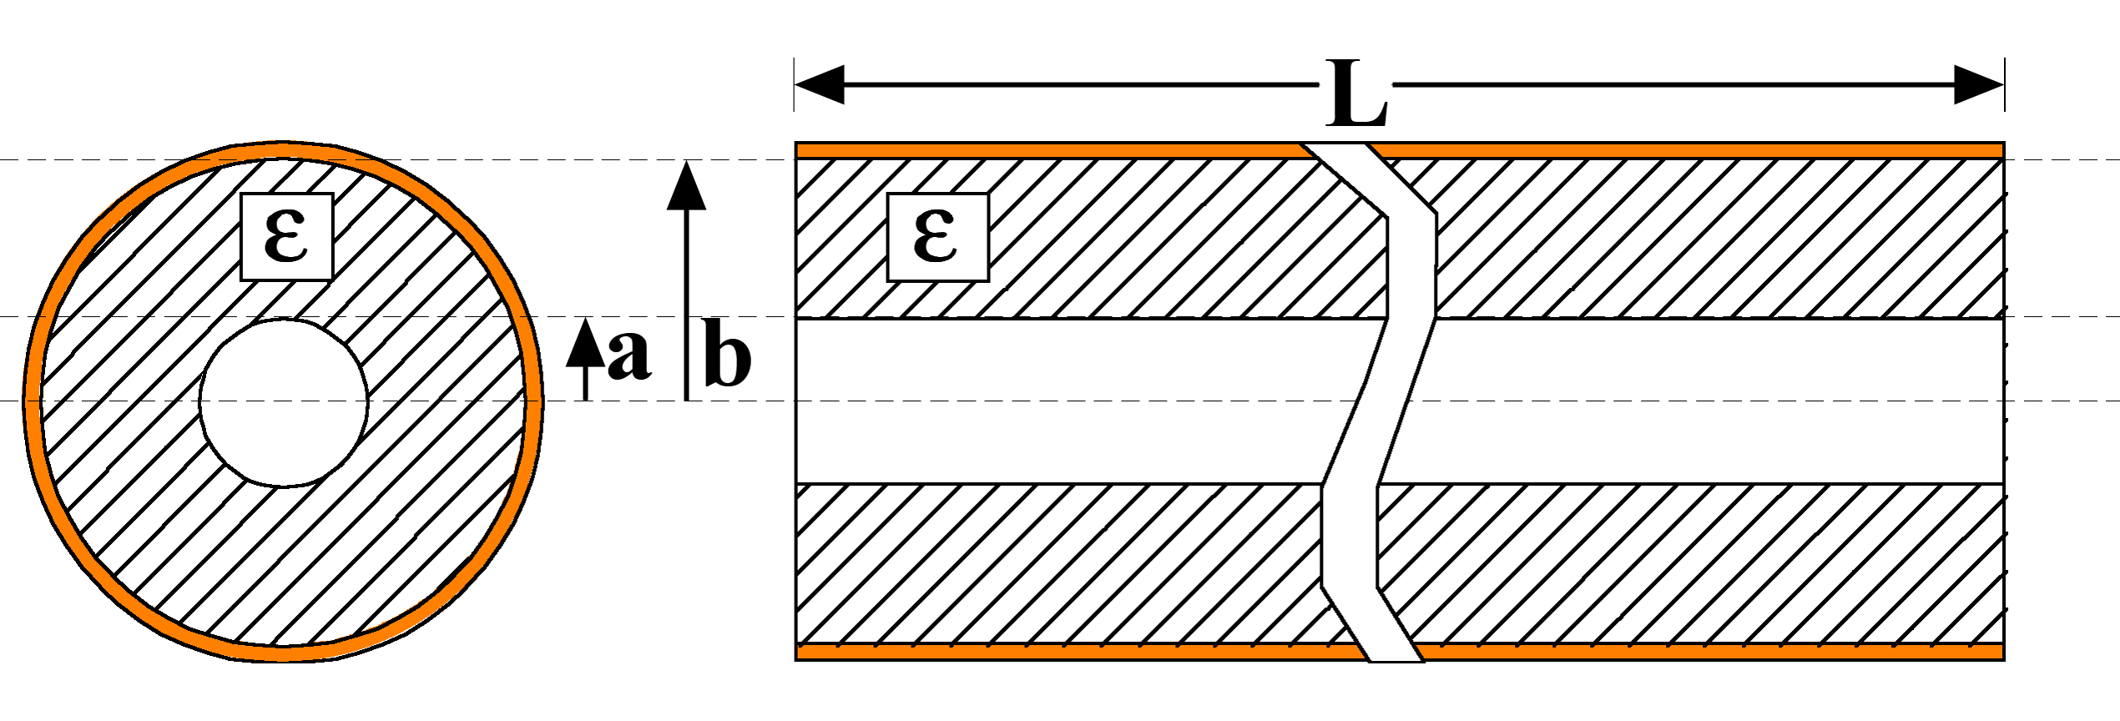
Background and motivation
Dielectric structure
- Slow-wave structure with simple geometry
uniform section
taper section
Advantages
- Simple geometry
- Small transverse size
low cost
- No surface electric field enhancement
- High group velocity: short pulse preferred
high gradient

Slide 4
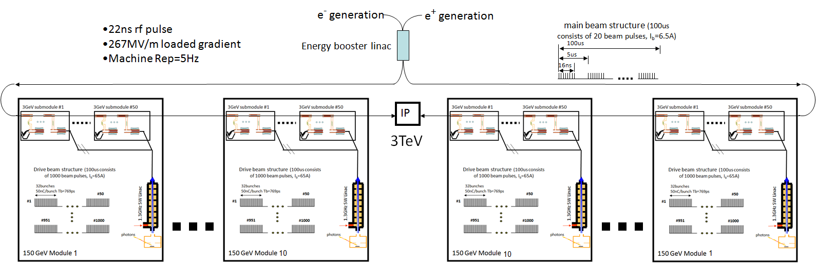
Background and motivation
Argonne Flexible Linear Collider (AFLC)
- A 3 TeV 30 MW machine based on short-pulse dielectric TBA
18km
7.5km linac
7.5km linac
Uniqueness
- High frequency (26 GHz), short rf pulse (~20 ns), high gradient (267 MV/m)
- Modular design for flexible energy upgrade

Slide 5
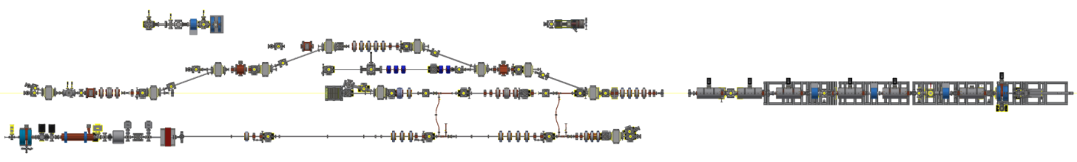
Background and motivation
Argonne Wakefield Accelerator (AWA) facility
- A flexible, state-of-art testbed for future linear colliders
breakdown
test-stand
Double emittance
exchange (DEEX)
Argonne cathode
test-stand (ACT)
wakefield experimental area
witness beam
drive beam
- 15 MeV, single bunch
- 0.05-60 nC
- 70 MeV, up to 32 bunches
Max charge: 100 nC (single)
600 nC (train)

Slide 6
Background and motivation
Argonne Wakefield Accelerator (AWA) facility
- Strong capability in research related to wakefield acceleration
- Over 15 collaborators and users
drive
Collinear
D. Wang, et al., PRL 2016 (collaboration w/ Tsinghua/SLAC)
E. Simakov, et al., PRL 2016 (collaboration w/LANL)
H. Zha, et al., PRAB 2016 (collaboration w/ Tsinghua)

Slide 7
Background and motivation
Argonne Wakefield Accelerator (AWA) facility
- Strong capability in research related to wakefield acceleration
- Over 15 collaborators and users
drive
Collinear
drive+witness
TBA
C. Jing, et al., NIM-A 2018 (collabroation w/Euclid)
Ongoing: staged drive beam distribution (collaboration w/ IIT/Euclid)

Slide 8
Background and motivation
Argonne Wakefield Accelerator (AWA) facility
- Strong capability in research related to wakefield acceleration
- Over 15 collaborators and users
drive
Collinear
drive+witness
TBA
drive+EEX
Bunch shaping Collinear
Q. Gao, et al., PRL 2018 (collaboration w/ Tsinghua)
G.Ha, et al.,PRL 2017 (collaboration w/ Postech)
A. Halavanau, et al., PRAB 2017 (collaboration w/ NIU)
G.Ha, et al.,PRAB 2016 (collaboration w/ Postech)

Slide 9
Background and motivation
Argonne Wakefield Accelerator (AWA) facility
- Strong capability in research related to wakefield acceleration
- Over 15 collaborators and users
drive
Collinear
drive+witness
TBA
drive+EEX
Bunch shaping Collinear
drive+EEX
Plasma Wakefield
Experiment in preparation (collaboration w/ UCLA)

Slide 10
Background and motivation
Argonne Wakefield Accelerator (AWA) facility
- Strong capability in research related to wakefield acceleration
- Over 15 collaborators and users
drive
Collinear
drive+witness
TBA
drive+EEX
Bunch shaping Collinear
drive+EEX
Plasma Wakefield
drive+EEX+witness
Bunch shaping TBA
Planed in Future

Slide 11
Background and motivation
Argonne Wakefield Accelerator (AWA) facility
- Strong capability in research related to wakefield acceleration
- Over 15 collaborators and users
drive
Collinear
drive+witness
TBA
drive+EEX
Bunch shaping Collinear
drive+EEX
Plasma Wakefield
drive+EEX+witness
Bunch shaping TBA
ACT
Cathode, rf breakdown
J. Shao, et al., PRL 2016 (collaboration w/ Tsinghua/SLAC)
J. Shao, et al., PRL 2015 (collaboration w/ Tsinghua/SLAC)
S. Baryshev, et al., APL 2015 (collaboration w/ Euclid)

Slide 12
Background and motivation
Argonne Wakefield Accelerator (AWA) facility
- Strong capability in research related to wakefield acceleration
- Over 15 collaborators and users
drive
Collinear
drive+witness
TBA
drive+EEX
Bunch shaping Collinear
drive+EEX
Plasma Wakefield
drive+EEX+witness
Bunch shaping TBA
ACT
Cathode, rf breakdown
Wakefield R&D
- Successful tests with metallic structures: 300 MW + 150 MeV/m for single
stage, 70 MeV/m for two stages
- Continuous effort in developing dielectric structures

Slide 13
short pulse dielectric tba in k-band
-- a prototype IN aflc

Slide 14
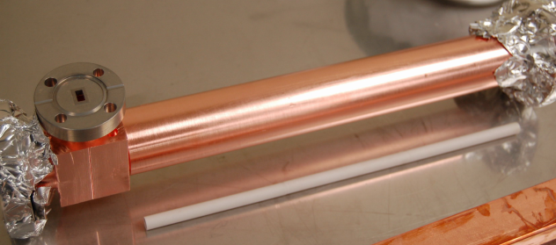
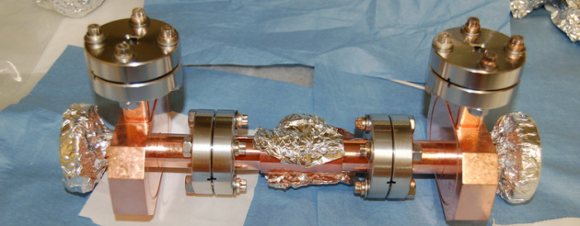
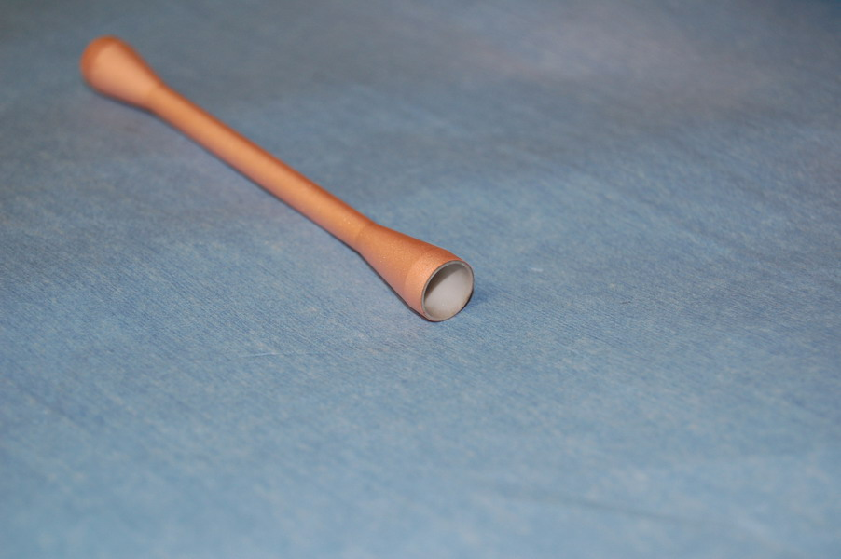
Structure overview
Prototypes for the basic TBA pair in AFLC
15cm
30cm
power extractor
accelerator
 | POWER EXTRACTROR | ACCELERATOR
Frequency (GHz) | 26 (20 x 1.3) | 26 (20 x 1.3)
ID / OD (mm) | 7 / 9.068 | 3 / 5.026
Dielectric constant | 6.64 (Frosterite) | 9.8 (Alumina)
Cu coating | No | Yes, 100 μm
Group velocity | 0.25 c | 0.1115 c
r/Q (Ω/m) | 9788 | 21983
Q | 2950 | 2295
r (MΩ/m) | 28.9 | 50.5

Slide 15
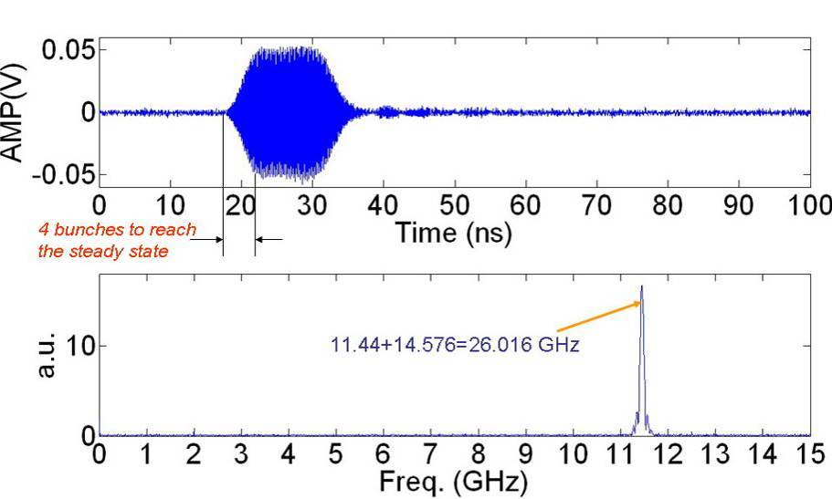
High power generation
2009: low charge
- Low charge 16-bunch train, 2 MW generated power
2016-2017: high charge
- High charge 4-bunch train, 55 MW generated power
Higher attenuation and surface damage
Mechanism under investigation

Slide 16
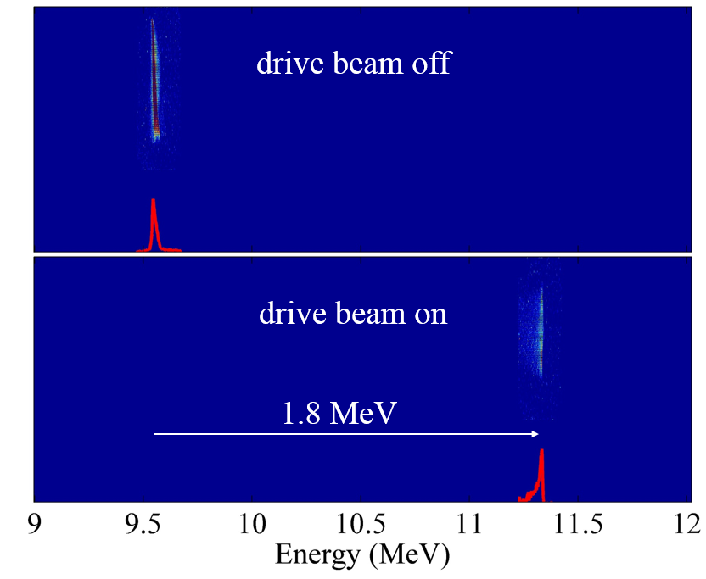
Main beam acceleration
Successful demonstration of short pulse dielectric TBA
- 1.8 MeV acceleration, 28 MeV/m average gradient
Structure inspection
- No structure damage was observed after the high power test

Slide 17
short pulse High power generation in x-band
-- beyond 100 MW

Slide 18
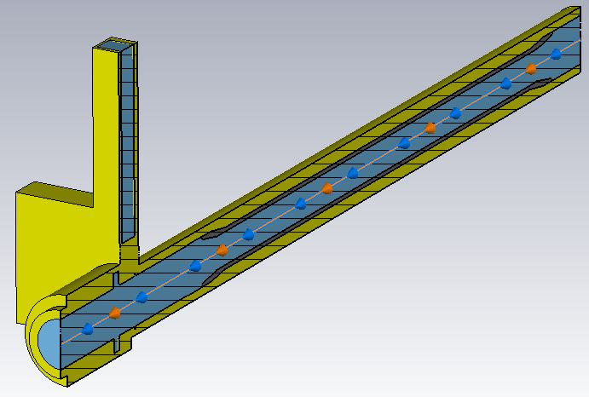
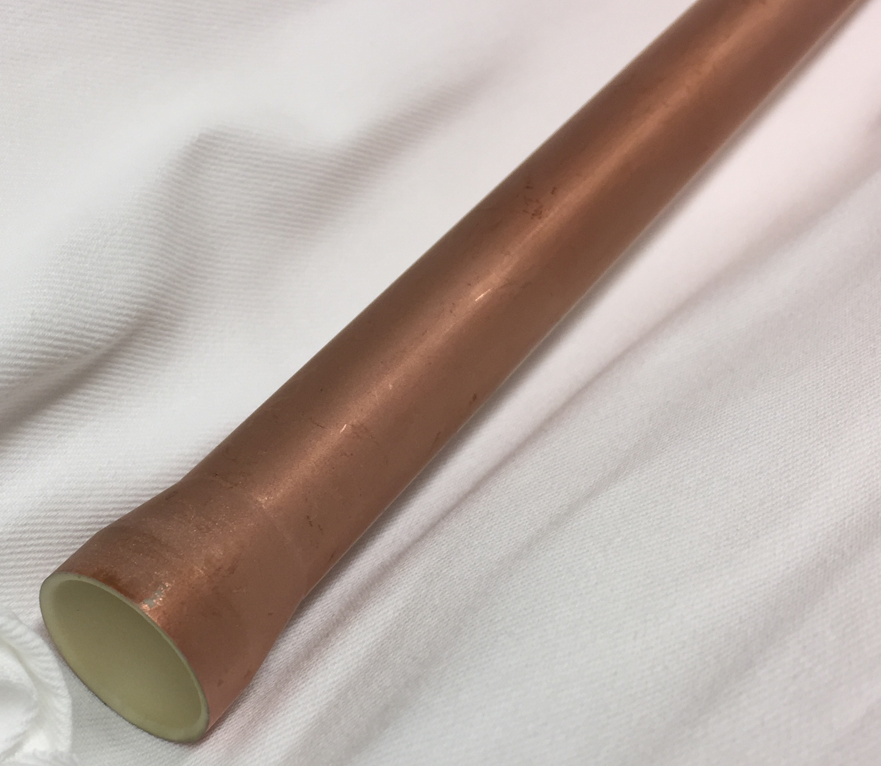
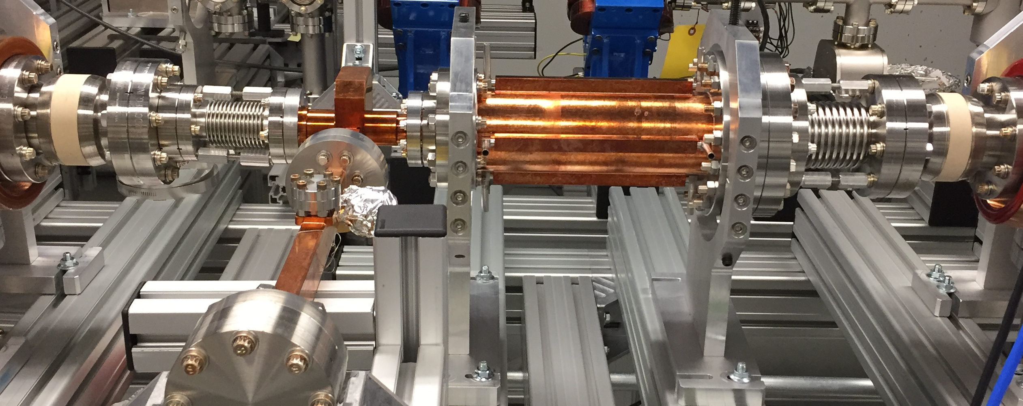
Structure overview
A X-band Structure to obtain high power at AWA
- Large iris: ensure good transmission with high charge, minimize damage from
beam irradiation
Frequency (GHz) | 11.7 (9 x 1.3)
ID / OD (mm) | 14.99 / 18.79
Dielectric constant | 9.8 (Alumina)
Cu coating | Yes, 1 μm
Group velocity | 0.1959 c
r/Q (Ω/m) | 4320
Q | 3392
26 cm
rf
drive beam

Slide 19

High power test
Low charge
- Perfect agreement between simulation and measurement
$$\sqrt{P}=\sqrt{\frac{ω}{4}\frac{r}{Q}vg}\frac{F}{1−β_{g}}Q_{b}$$
1-bunch
2-bunch
4-bunch
8-bunch
High charge
- 90 MW for 4-bunch train, 105 MW for 8-bunch train

Slide 20
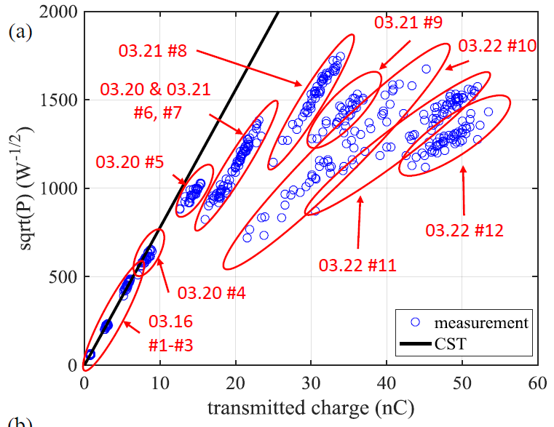
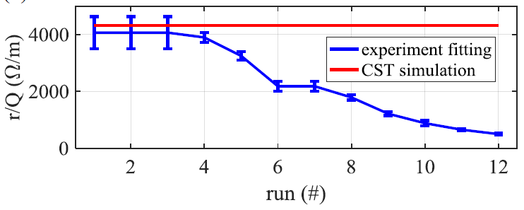
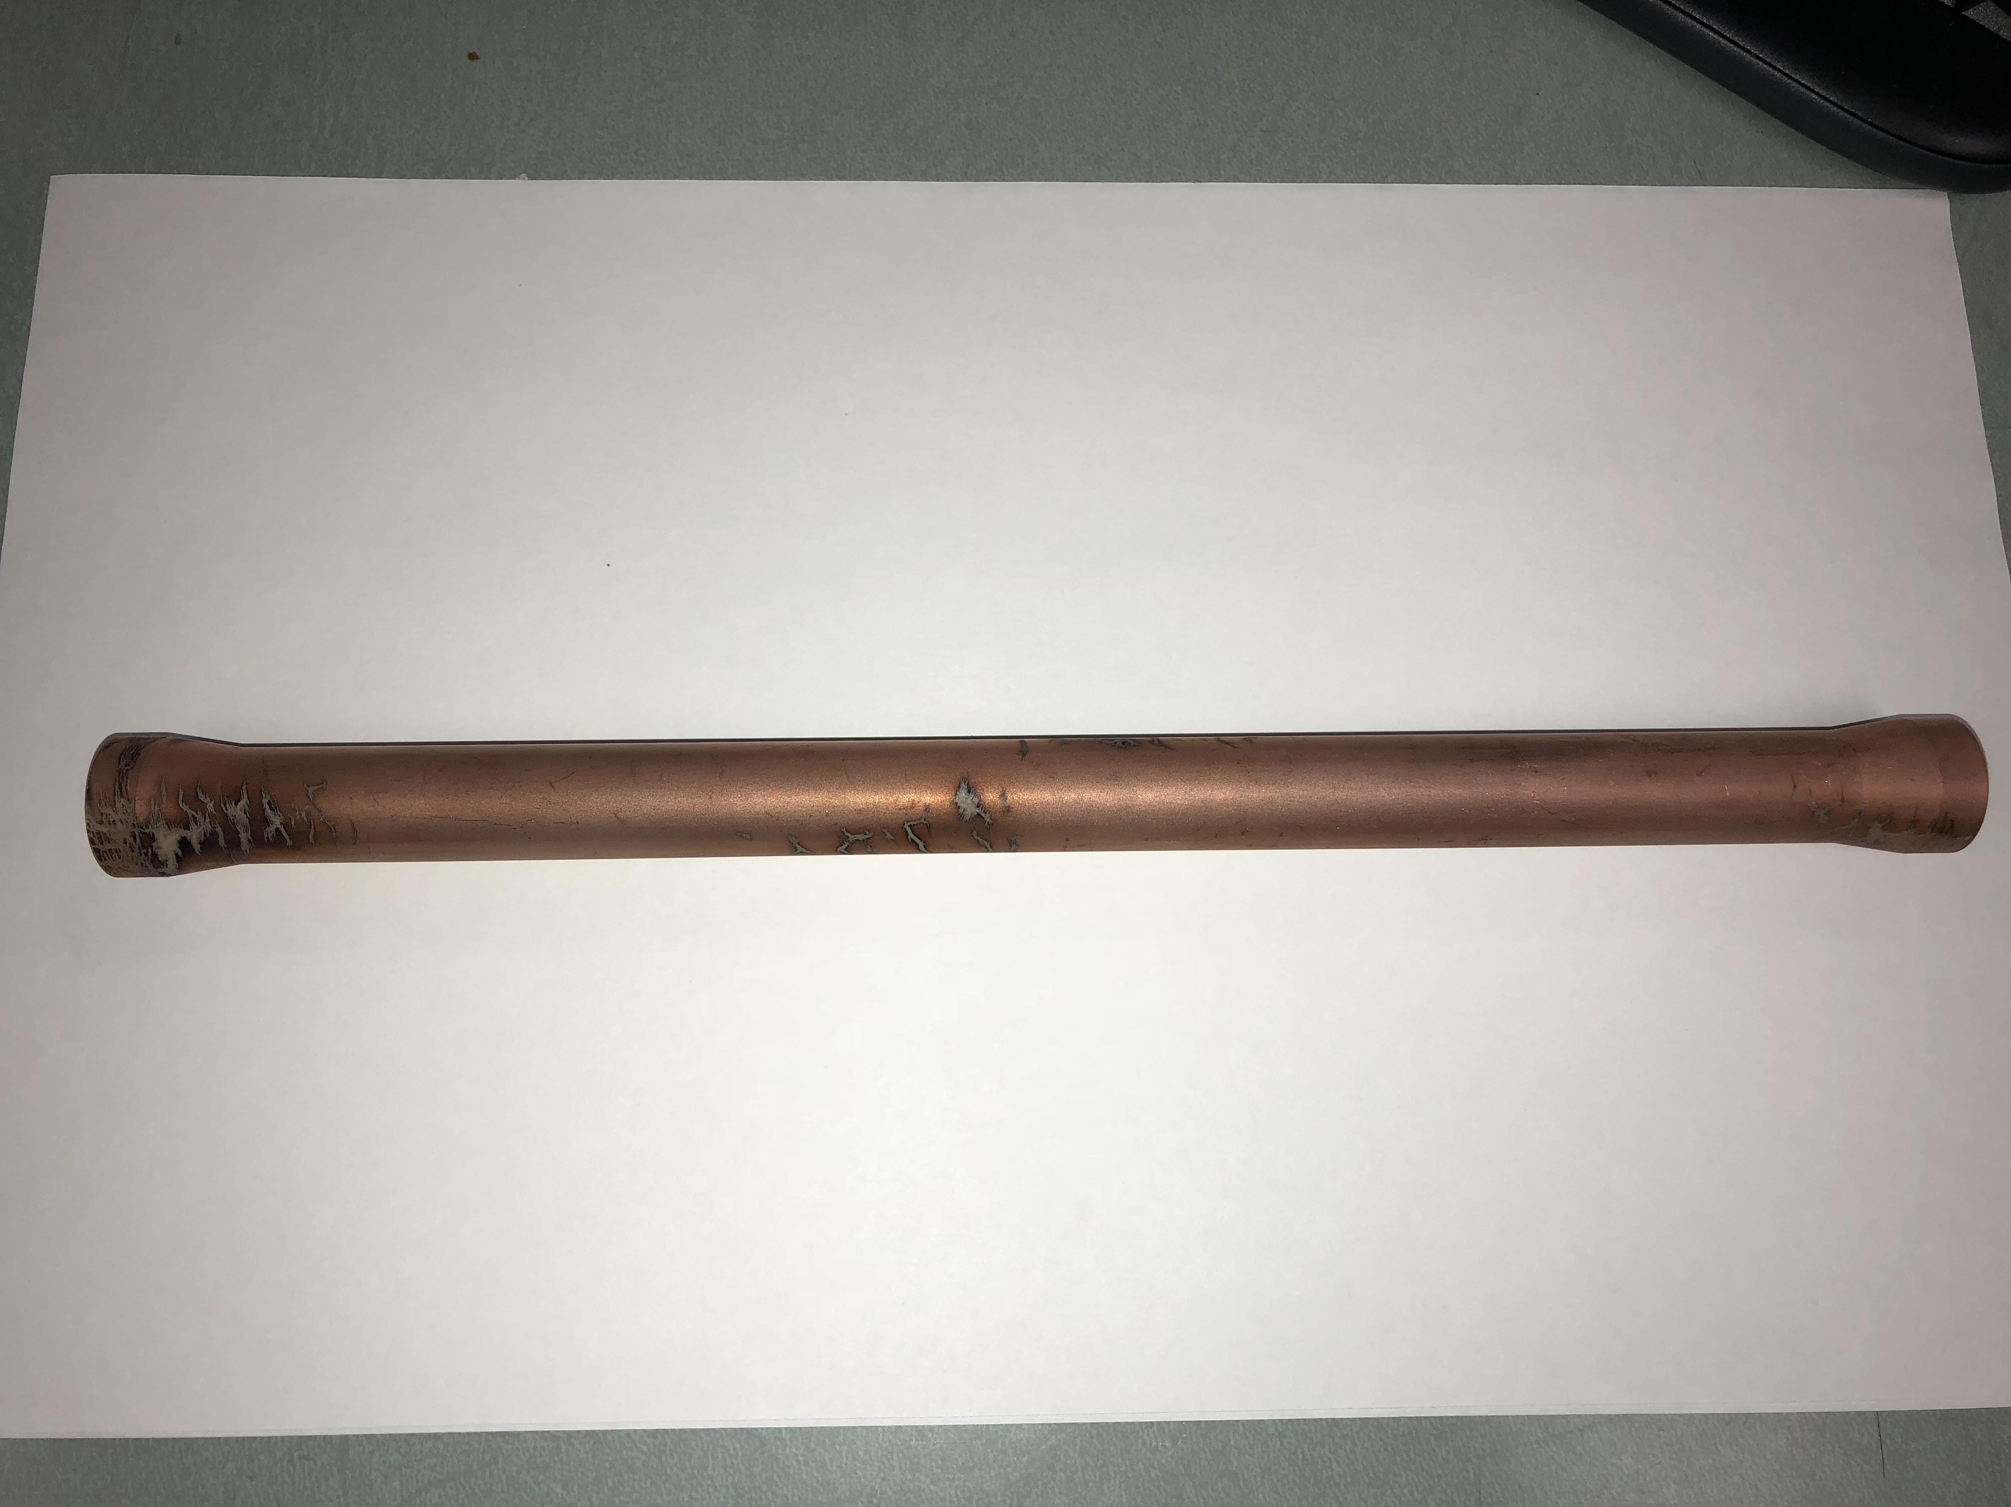
Structure coating damage
Sign of structure damage during high power test
- Gradual degrading performance
input
damage
output
Structure inspection
- Transmission drops from -2.5 dB (before) to -32.5 dB (after)
- Dielectric survive, severe damage to the thin copper coating
Thick copper coating (>100 μm) is critical!

Slide 21
Dielectric disk accelerator
-- efficiency improvement

Slide 22
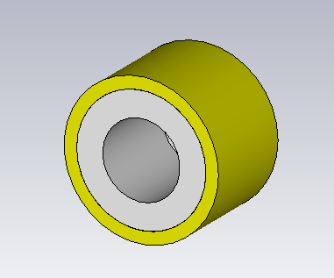
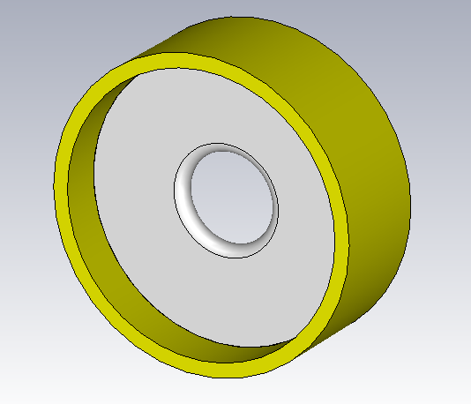
Structure overview
 | DLA | DDA
Frequency (GHz) | 26 | 26
ID (mm) | 3 | 3
Diel.constant | 9.8 | 50
Diel. loss tangent | 1x10⁻⁴ | 5x10⁻⁴
Group velocity | 0.11 c | 0.16 c
r/Q (kΩ/m) | 21.8 | 32.5
Q | 2295 | 6430
r (MΩ/m) | 50.0 | 208.8
Input power (GW) | 1.22 | 0.96
η_{rf-beam} (%) | ~9 | ~13
E_{max} (MV/m) | 365 | 660
Beam loading (%) | 15.5 | 17.1
DLA
copper
dielectric
DDA
Advantages of (DDA) over (DLA) for short pulse TBA
- High efficiency (~45% improvement with 2π/3 mode)
- Easier machining and tuning

Slide 23
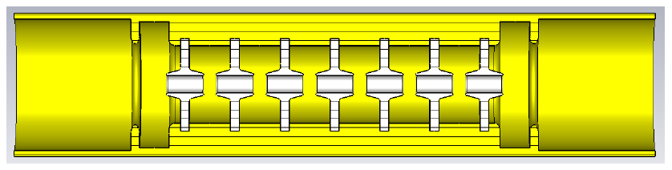
Ongoing research
PETS driven X-band prototype
- Test brazing between dielectric and copper
- Demonstrate machining and tuning
- High power test to reach ultra-high surface field (nosecone for 600 MV/m)

Slide 24
AFLc EFFICIENCY MAP
η_{AC-beam}=9.4%
297 MW
AC power
Baseline design
η_{AC - Lband} _{rf}=55%
klystrons
η_{Lband rf - drive}=86%
Drive beam
η_{drive - Kbandrf}=77%
DPETS
Drive beam dumps
η_{waveguide}=95%
Main linac
Main beam
η_{rf-main}=27%
27.8 MW
Only rf power is taken into consideration

Slide 25
AFLc EFFICIENCY MAP
η_{AC-beam}=9.4%
13.4%
297 MW
207 MW
AC power
DDA
η_{AC - Lband} _{rf}=55%
klystrons
η_{Lband rf - drive}=86%
Drive beam
η_{drive - Kbandrf}=77%
DPETS
Drive beam dumps
η_{waveguide}=95%
Main linac
Main beam
η_{rf-main}=27%
39%
27.8 MW
Only rf power is taken into consideration

Slide 26
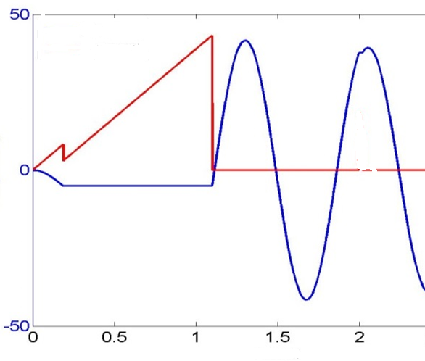
AFLc EFFICIENCY MAP
η_{AC-beam}=9.4%
13.4%
20.1%
297 MW
207 MW
138 MW
AC power
DDA
η_{AC - Lband} _{rf}=55%
klystrons
η_{Lband rf - drive}=86%
Drive beam
η_{drive - Kbandrf}=77%
+ Main beam shaping
DPETS
Drive beam dumps
η_{waveguide}=95%
Main linac
Main beam
η_{rf-main}=27%
39%
58%
27.8 MW
Only rf power is taken into consideration

Slide 27
AFLc EFFICIENCY MAP
η_{AC-beam}=9.4%
13.4%
20.1%
33.0%
297 MW
207 MW
138 MW
84 MW
AC power
DDA
η_{AC - Lband} _{rf}=55%
90%
klystrons
η_{Lband rf - drive}=86%
Drive beam
η_{drive - Kbandrf}=77%
+ Main beam shaping
DPETS
Drive beam dumps
η_{waveguide}=95%
Main linac
Main beam
η_{rf-main}=27%
39%
58%
27.8 MW
+ High efficiency klystron
Only rf power is taken into consideration

Slide 28
Summary
Short pulse dielectric TBA
- A promising candidate which may meet the requirements of high gradient,
high efficiency, and low fabrication cost of a future linear collider
Short pulse dielectric TBA at AWA
- K-band: 55 MW generated power, 28 MeV/m acceleration
- X-band: 100 MW generated power
Dielectric disk structure
- An alternative structure to remarkably improve the efficiency

Slide 29
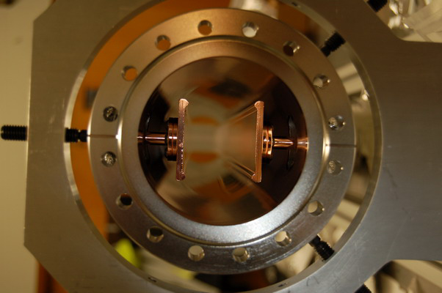
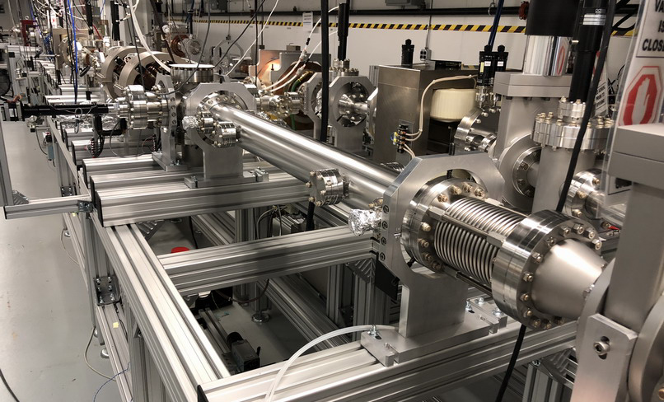
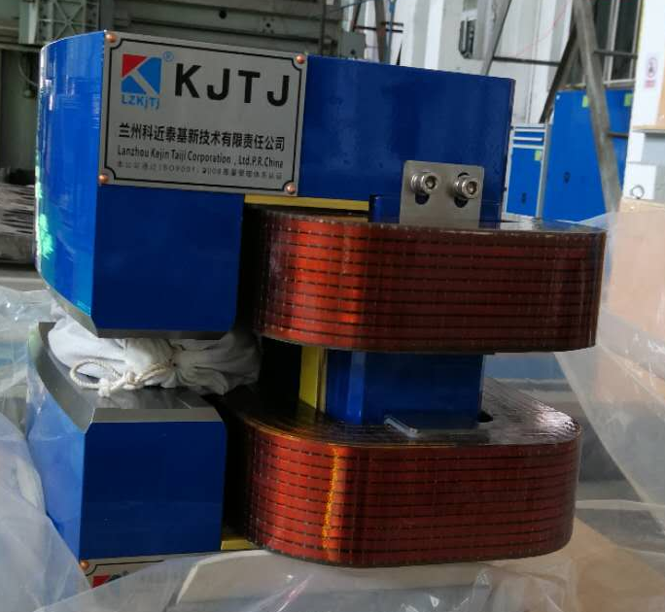
Future study
Dielectric loaded PETS
- X-band PETS with thick coating
- coating technology to suppress multipacting
- simulation and theoretical research of multipacting
Dielectric disk accelerator
- X-band prototype testing
- full optimization for AFLC
Short pulse TBA
- full staging

Slide 30
Present users
LANL--- wakefield acceleration with PBG (photonic bandgap) structure
Cornell--- wakefield excitation in PTI (photonic topological insulator) structure
Tsinghua---Thermal emittance study in CsTe cathode
MIT--- Reversed Cherenkov radiation with MWW (metamaterial wagon wheel) Structure
UCLA---High transformer ratio PWLA (plasma wakefield acceleration) using a shaped bunch
APS---200GHz wakefield acceleration for FEL application
NIU--- Flat beam generation and its wakefield excitation in a slab structure
Ralph Fiorito---single shot emittance diagnostics of space-charge dominated beams
We welcome more users to join!

