Slide 1

Design of high gradient LINAC with the new
“Gasket-Clamping” technique and compact low pulsed heating couplers
International Workshop on Breakdown Science and
High Gradient Technology (HG2018)
June 4-8 2018 Shanghai, P. R. China
Fabio Cardelli
INFN-LNF, Frascati, Italy
With the contribution of:
D. Alesini, V. Lollo, INFN-LNF, Frascati, Italy
fabio.cardelli@lnf.infn.it

Slide 2
Outline
Gasket-Clamping fabrication technique
BOLT Project: Design and realization of a LINAC prototype implementing the gasket clamping fabrication technique
  Electromagnetic design
  Mechanical design and assembly procedure
  Vacuum test on sigle cell
New compact low pulsed heating coupler studied @INFN-LNF
  Ultra-Fast C-band RF Gun
  Coupler proposal and preliminary results
Summary and future work
HG2018 - Shanghai
07-06-2018

Slide 3
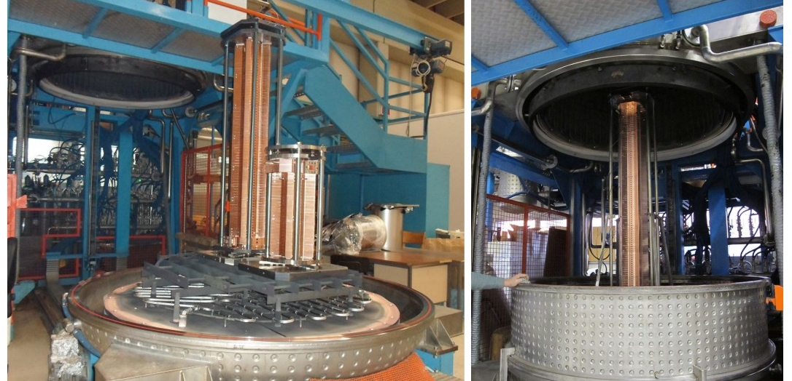
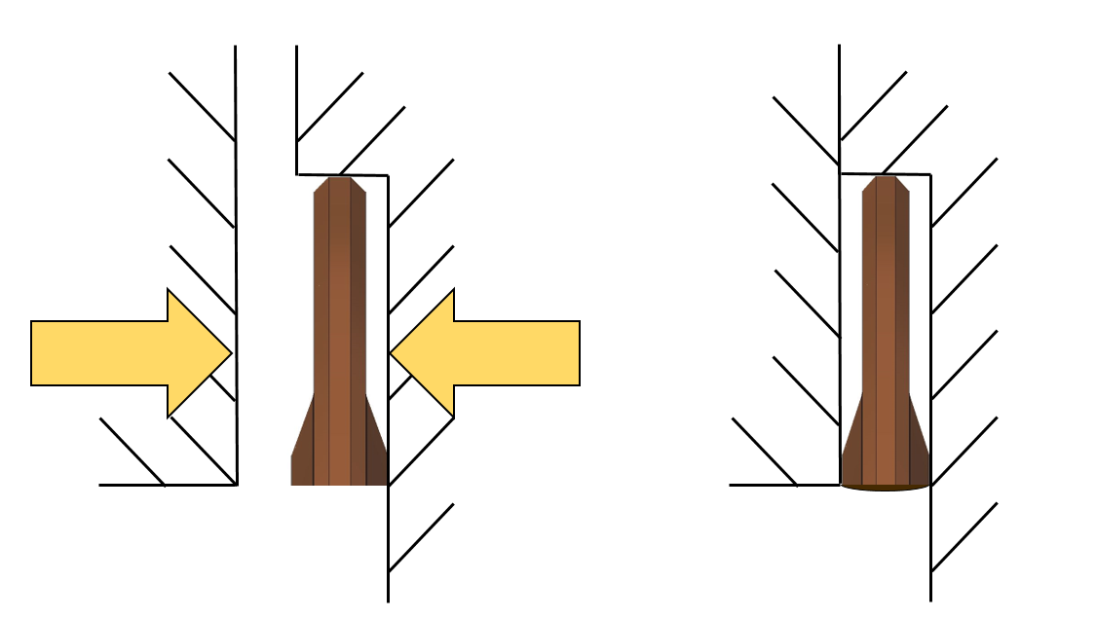
«Gasket-Clamping» fabrication technique
brazing process of ELI-NP C-band structure @ INFN-LNL
The accelerating structures generally are realized by a brazing process, but this:
⇒ requires large vacuum furnaces
⇒ is very expensive
⇒ poses a not negligible risk of failure
at the end of the process the copper is “soft”
Avoiding it should be possible to decrease the BDR and reduce the conditioning time.
New technology developed at INFN-LNF called «Gasket-Clamping» fabrication technique [1] that does not involve any brazing step
BEFORE Compression
AFTER Compression
Copper parts to be joined
Air side
Use of special RF/vacuum Gaskets:
Machined components joined by screws
Copper gasket compressed of 0.2 mm after clamping
Simultaneously guarantees the vacuum seal and the RF contact avoiding sharp edges and gaps
RF Contact
Gasket
Vacuum side
1.3 mm
Vacuum side
1.1 mm
[1] Int'l patent application PCT/IB2016/051464, D. Alesini et al. ‘’Process for manufacturing a vacuum and radio-frequency metal gasket and structure incorporating it’’ assigned to INFN
HG2018 - Shanghai
07-06-2018

Slide 4
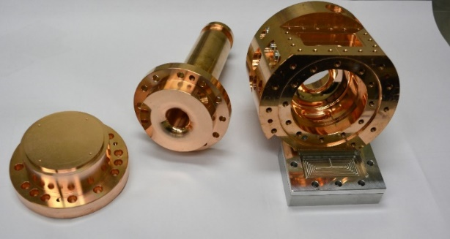
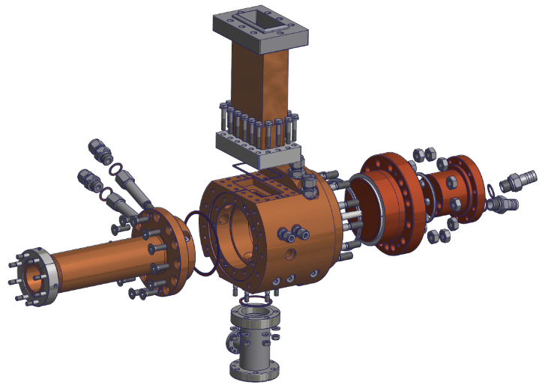
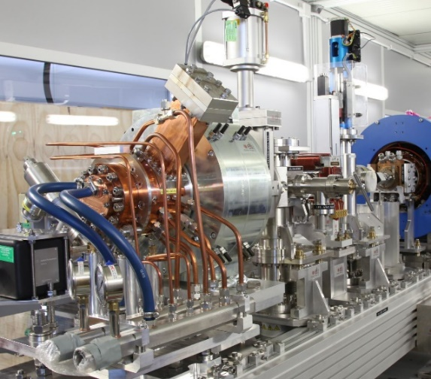
«Gasket-Clamping» fabrication technique (II)
This technique has been succesfully used for the realization of:
An RF Gun prototype currently in operation at UCLA since three years at low rep. Rate (90 MV/m, 5 Hz) [2]
The ELI-NP RF electron gun that has been tested at full power (120 MV/m, 14 MW input power, 1.5 us @100 Hz) at Bonn University [3]
Special gaskets
Extension of this technique for the realization of an entire Linac structure (S/C/X band)
In [4] has been proposed and discussed the realization of a 10 cell TW accelerating structure to study the feasibility of this application. In 2017 starts the project BOLT (Backthrough On Linac Technology) that has been funded by the INFN CNTT.
[2] D. Alesini, et al., PRST- AB 18, 092001 (2015)
[3] D. Alesini et al., “ High Power Test Results of the Eli-NP S-Band Gun Fabricated With the New Clamping Technology Without Brazing”, presented at the 8th Int. Particle Accelerator Conf. (IPAC’17), Copenhagen, Denmark, May 2017, paper THOBB1
[4] F. Cardelli et al., proceedings IPAC16, Busan, Korea, May 2016, MOPMW005.
HG2018 - Shanghai
07-06-2018

Slide 5
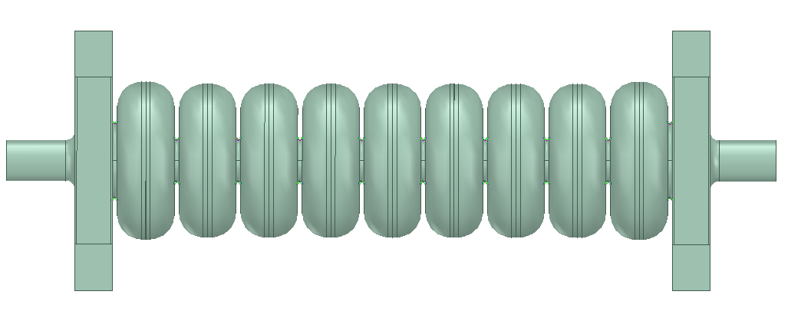
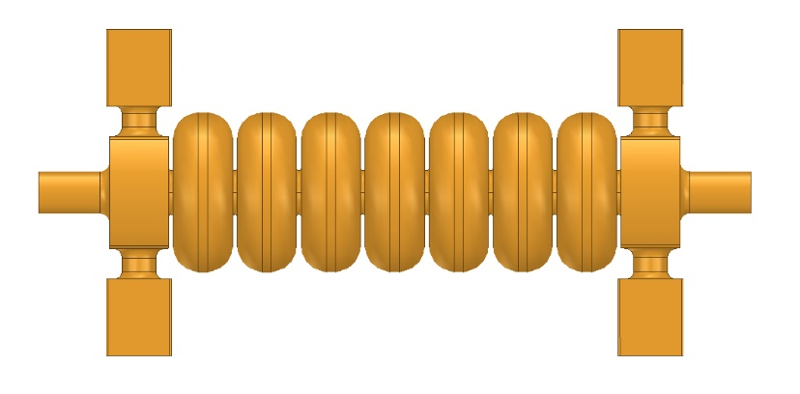
Linac with gaskets: prototype design
In the framework of the upgrade of the FERMI Linac at the ELETTRA Laboratories (Trieste) an high gradient S-band prototype has been realized [5]. In order to make a comparison between a brazed and an hard-copper clamped structure, we decided to realize a similar to the «FERMI» layout. The prototypes have a symmetrized model layout:
FERMI layout
BOLT layout
Match. cell
Match. cell
sym
3
1
2
2
sym
1
3
3
1
2
2
1
3
Waveguide Coupler
Waveguide Coupler
Slot coupler
Slot coupler
To implement the gasket clamping fabrication technique and also lower the realization costs we need to consider some design choice that influence directly the electromagnetic design:
Use of magnetic coupling (MC) coupler with a racetrack slot
  The implementation of a waveguide coupler (EC) with gaskets at the coupling cell is under study.
Internal edge roundings of the cells have been used to tune the cells at the right frequency
  The cell radius is kept constant along the structure and this allows to use the same type of gasket to join all the cells -> lower realization cost for the gaskets.
[5] C. Serpico, et al., “High gradient, high reliability, and low wakefield accelerating structures for the FERMI FEL”. In: Review of Scientific Instruments 88 (2017).
HG2018 - Shanghai
07-06-2018

Slide 6
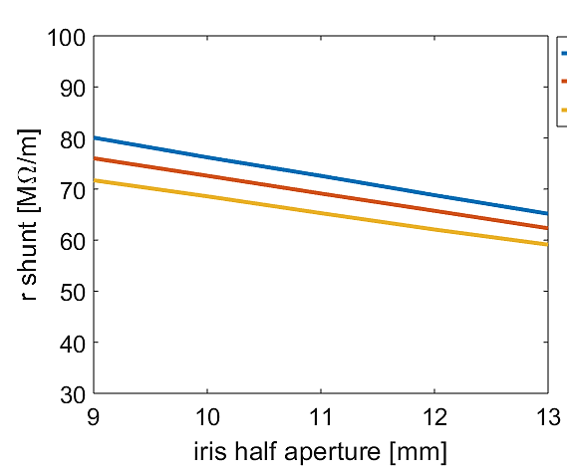
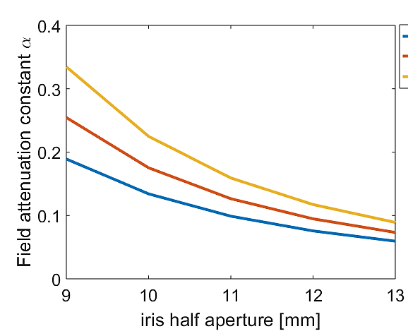
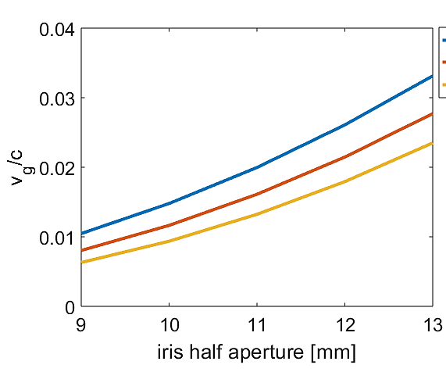

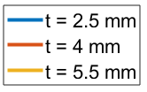
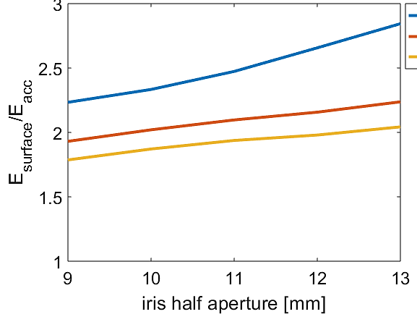
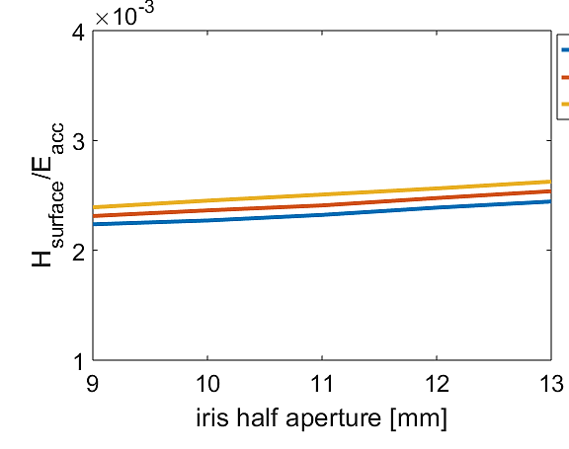
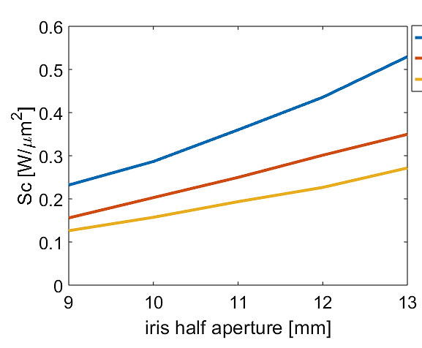

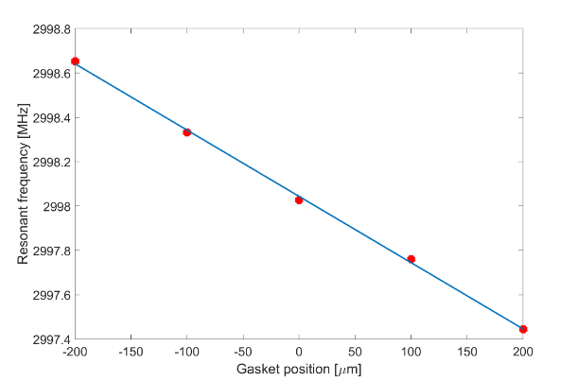
Linac with gaskets: cell analysis and tolerances
or
b
t
a
d
+200 um
Gasket position
-200 um
Δfreq = - 3 kHz/µm
Δφ = 0.005 degree/µm
Parameter | Cell Phase advance [degree/um] | Frequency Shift [kHz/um]
b | 0.14 | - 79
a | - 0.04 | 20
t | - 0.014 | 7.6
d | 0.015 | - 8.6
or | - 0.05 | 28
HG2018 - Shanghai
07-06-2018

Slide 7
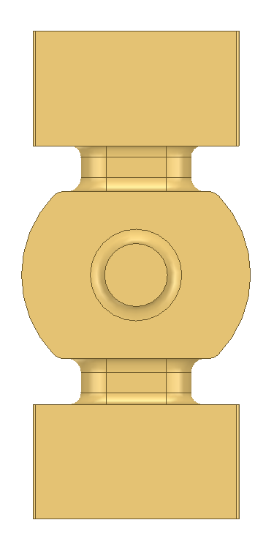
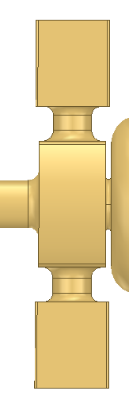
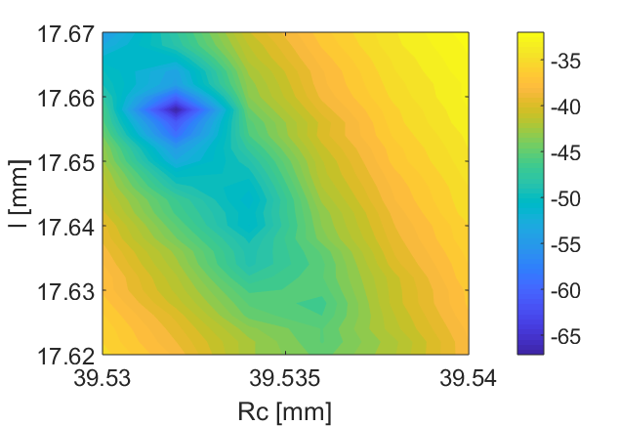

Linac with gaskets: coupler design
Slot coupler with MC that
$→$ ease the GC technique implementation
Double feed
$→$ no dipole magnetic field component
Racetrack shape
$→$compensation of the quadrupolar component
Coupling holes with strongly rounded profiles $→$ surface fields and pulsed heating reduction
w
l
t_{c}
R_{c}
Coupler tuned with the short circuit method[6], in order to minimize the S11, have flat E field and constant phase advance per cell.
ΔY
S11 coupler
[6] D. Alesini et al., Nucl. Instrum. Methods Phys. Res. A 580 (2007) 1176–83. .
HG2018 - Shanghai
07-06-2018

Slide 8
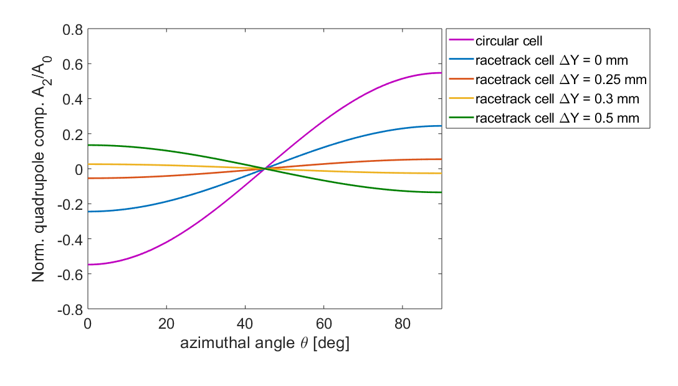
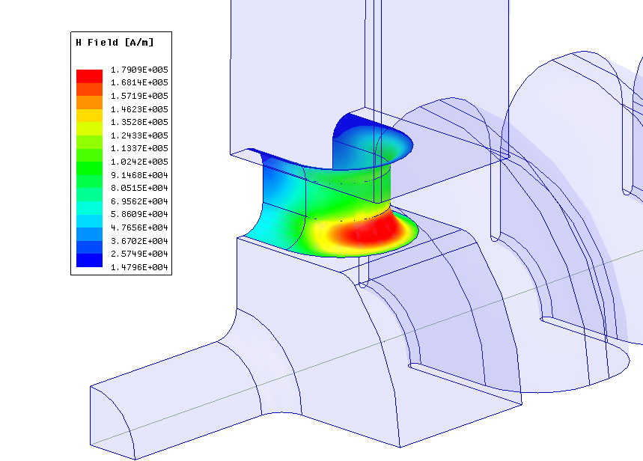


Linac with gaskets: coupler design (II)
Quadrupole field components
The azimuthal magnetic quadrupolar field component along an arc of r=5mm at the center of the coupler have been considered in figure. A fine compensation of the quadrupolar component has been performed, acting on ΔY.
Surface fields and pulsed heating evaluation @ P_{in} $≈$ 65MW, 30MV/m
H_{surf} [A/m]
E_{surf} = 80 MV/m max on the first iris
H_{surf} = 180 kA/m max on the coupler
Sc = 0.8 W/$μ$m² max on the first iris
$→BDR={10}^{−12}bpp/m$ (t_{p}=1$μ$s)
ΔT = 7°C with 1$μs$pulse length
10°C with 2$μs$pulse length
HG2018 - Shanghai
07-06-2018

Slide 9
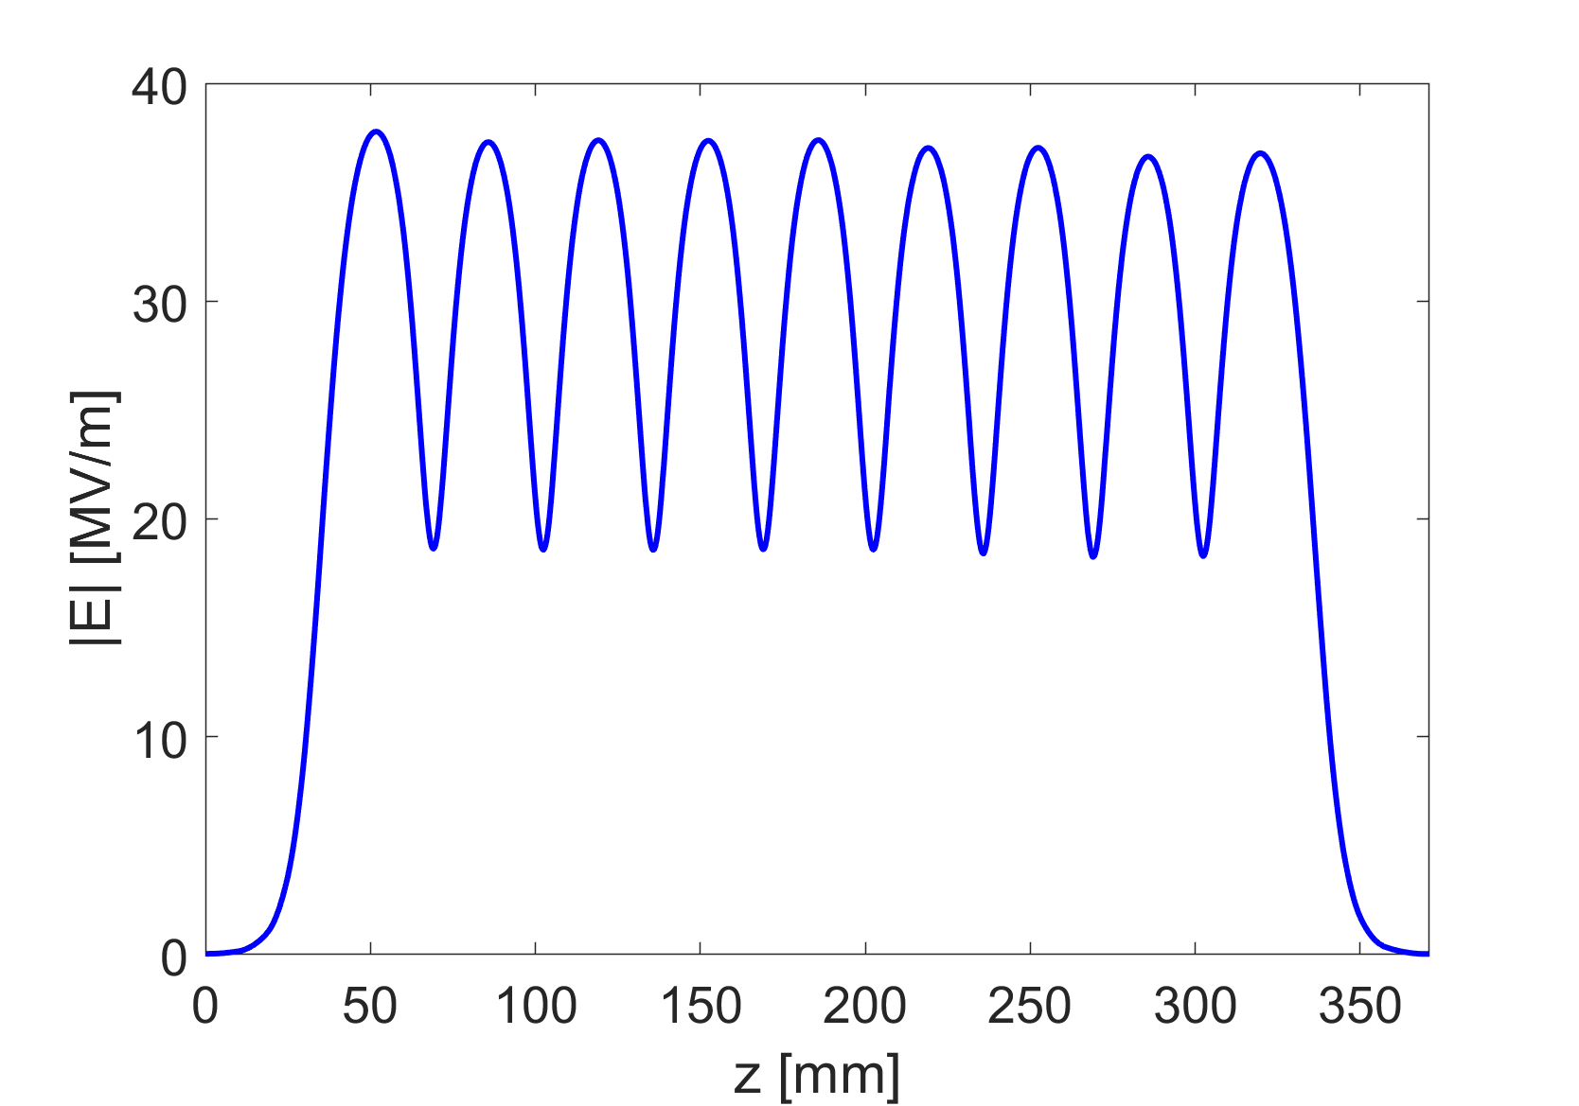
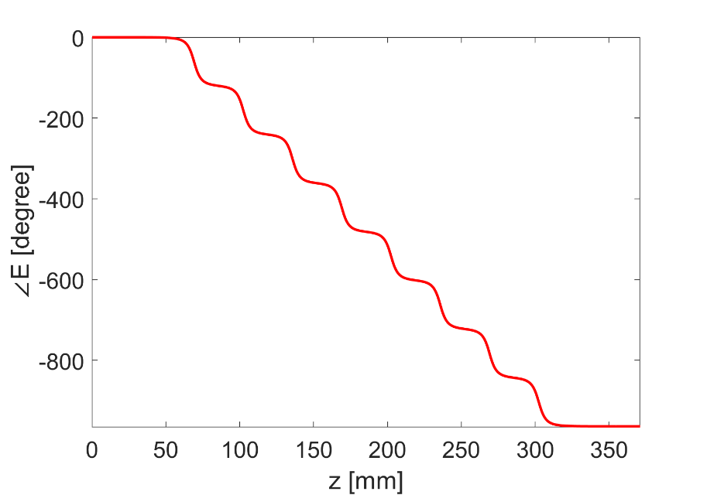
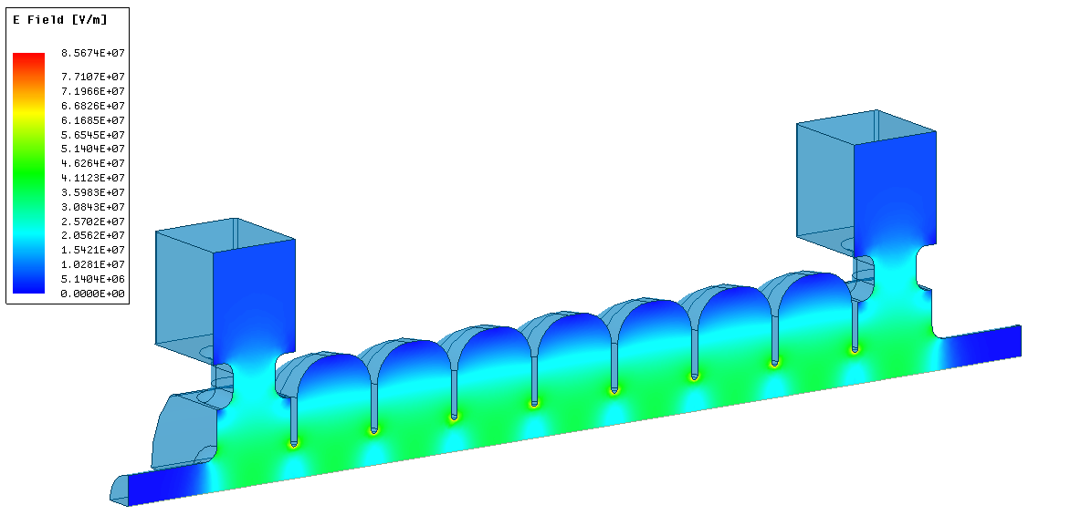
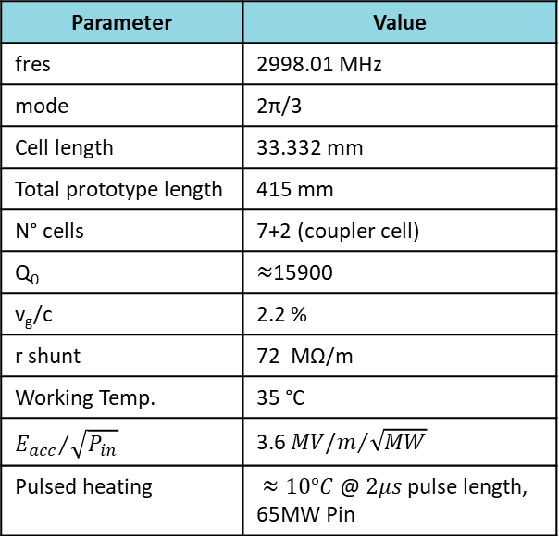
Linac with gaskets: Electromagnetic results
Parameter | Value
fres | 2998.01 MHz
mode | 2π/3
Cell length | 33.332 mm
Total prototype length | 415 mm
N° cells | 7+2 (coupler cell)
Q₀ | $≈$15900
v_{g}/c | 2.2 %
r shunt | 72 MΩ/m
Working Temp. | 35 °C
$${E_{acc}}/{\sqrt{P_{in}}}$$ | 3.6 ${MV/m}/{\sqrt{MW}}$
Pulsed heating | $≈10°C$@ $2μs$pulse length, 65MW Pin
Amplitude and Phase of the Electric field along the axis of the structure
Δφ = 120° ± 0.5°
HG2018 - Shanghai
07-06-2018

Slide 10
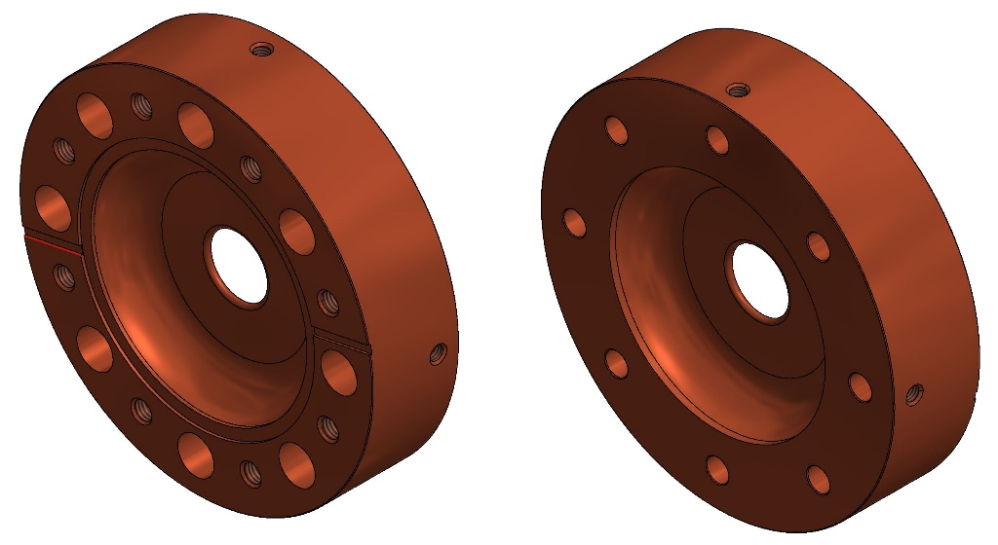
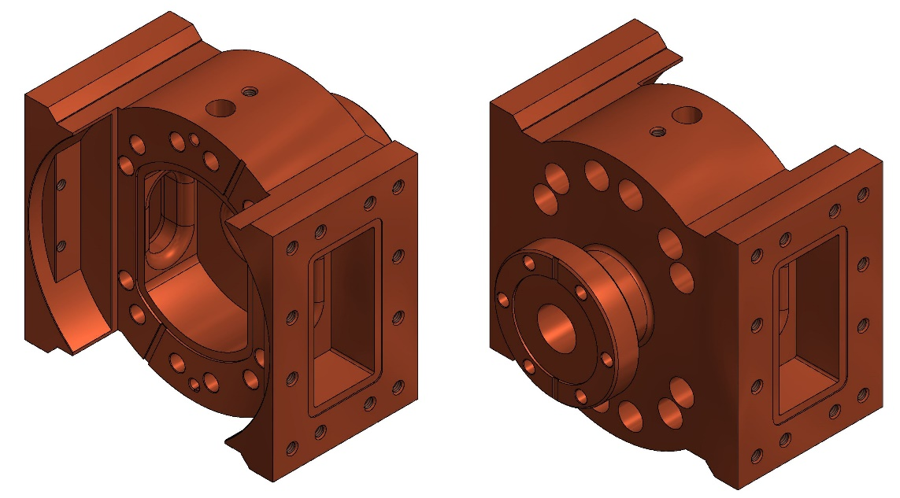
Linac with gaskets: mechanical design
In the overall design a continuous feedback between the electromagnetic design and the mechanical model has been necessary to match electromagnetic and mechanical constraints.
The structure is composed by the input and output couplers, six cell structures and two half cells.
Each cell has eight screw holes disposed at 45° to one another to provide homogeneous force on the gasket when the cells are clamped together.
Each part will be fabricated from cylinders of Oxygen Free High Conductivity (OFHC) copper using high precision lathe and milling diamond machines. Nowadays mechanical design has been finalized and the realization has been assigned to an italian company.
Cell structure
Input/Output coupler
Front view
Back view
Back view
Front view
Venting slot
Gasket seats
Gasket seat
Clamping holes
Venting slot
Rectangular Waveguide
Beam tube
Mechanical design with Autodesk Inventor.
HG2018 - Shanghai
07-06-2018

Slide 11
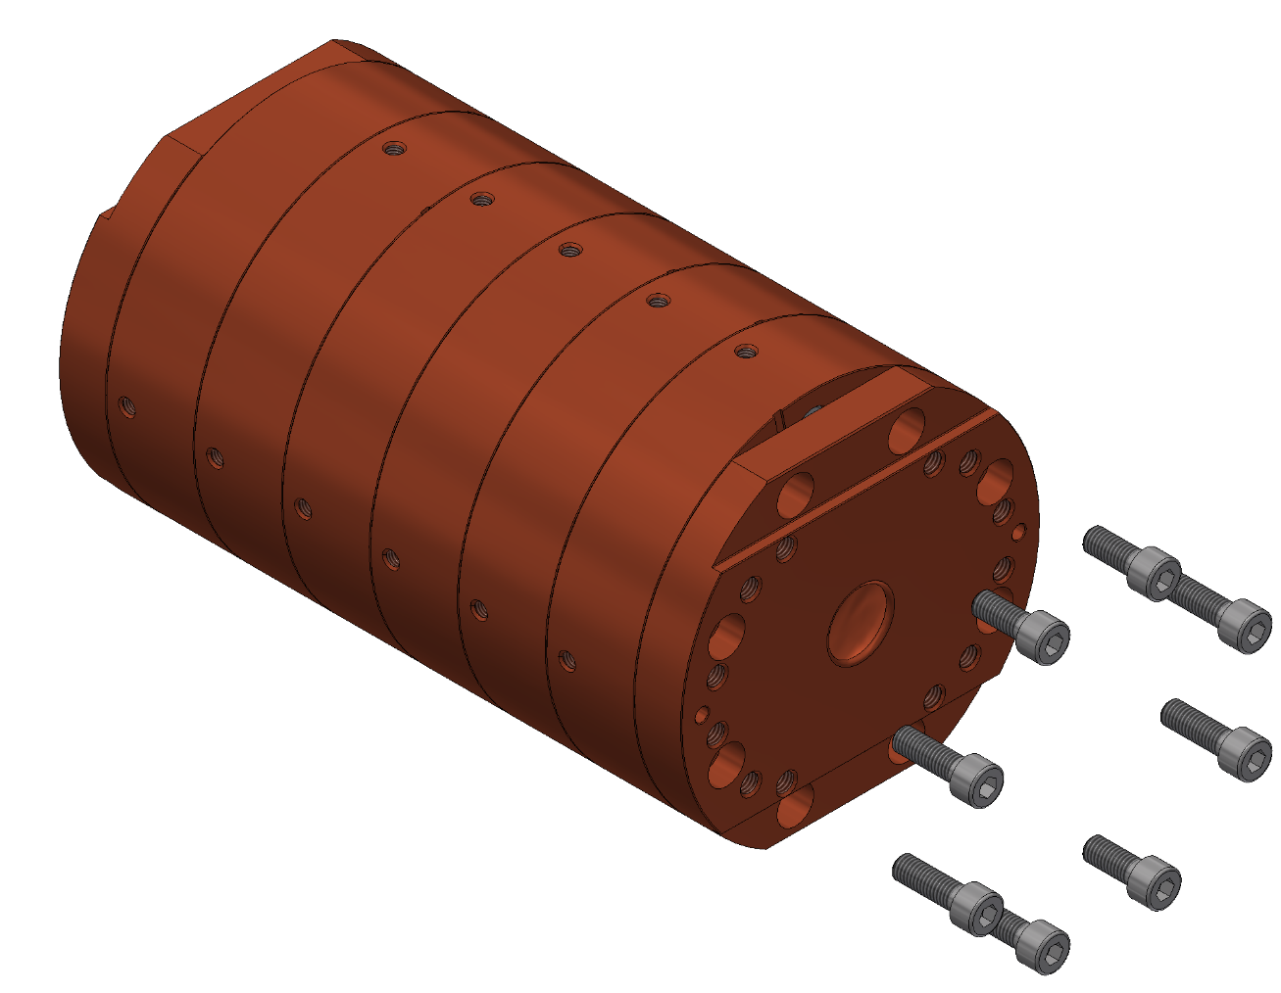
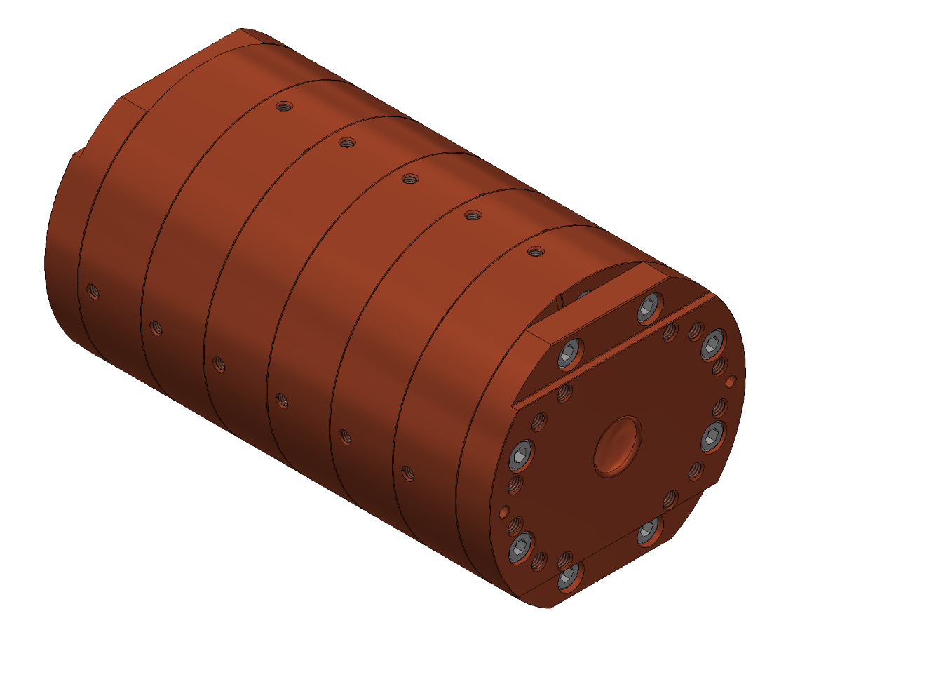
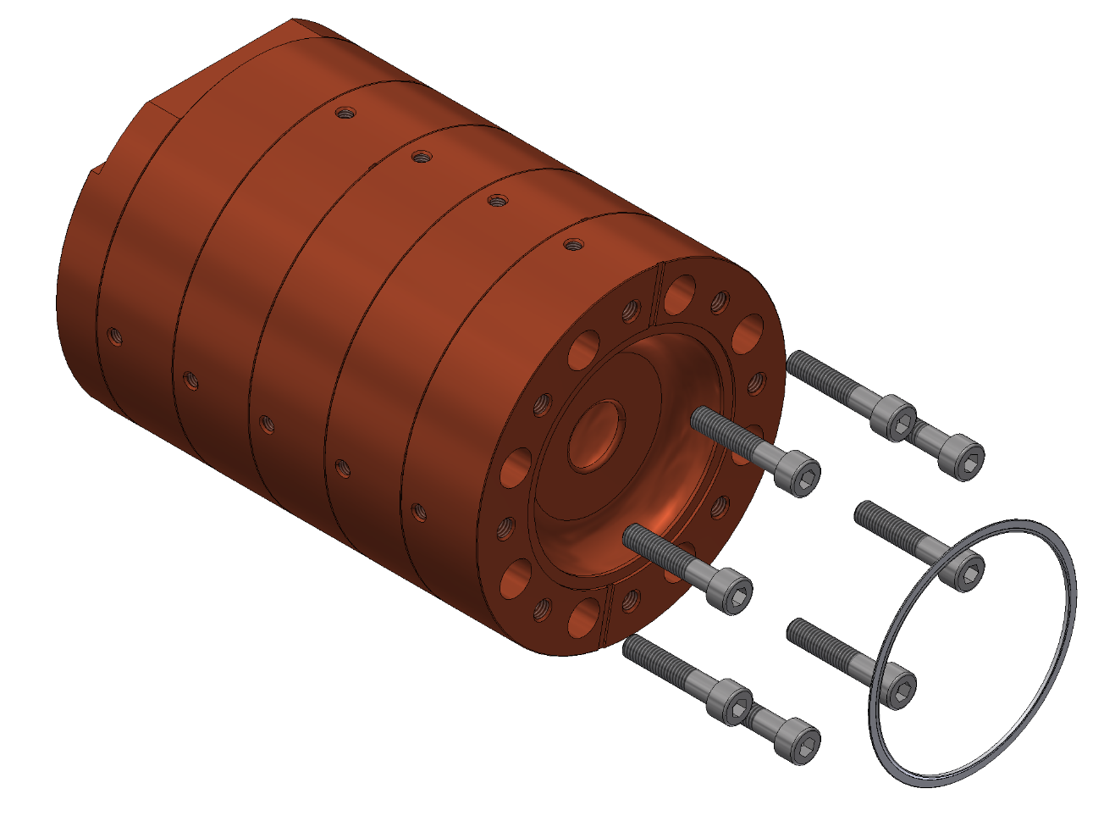
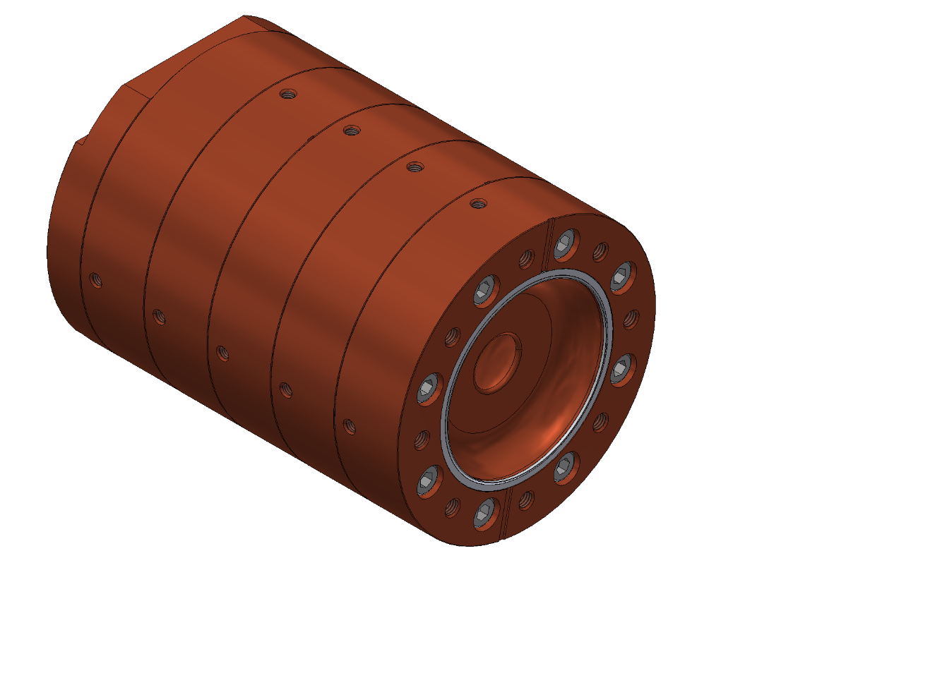
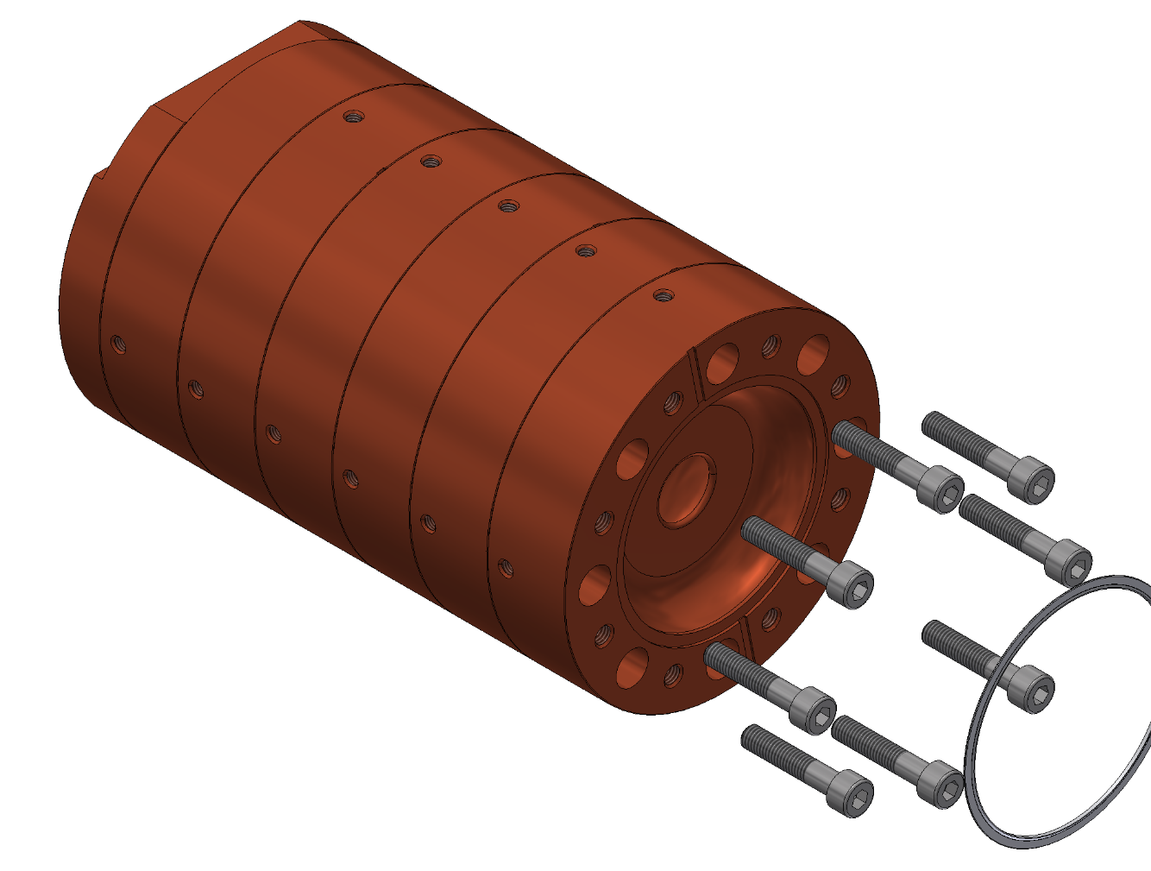
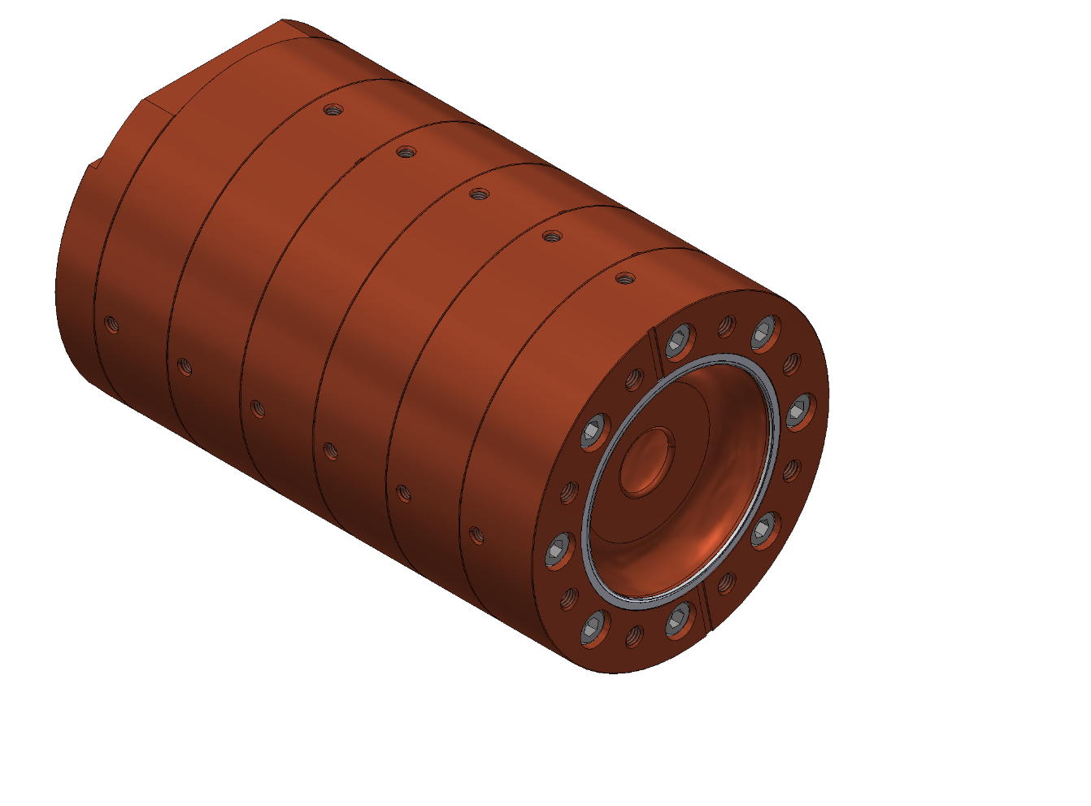
Linac assembly procedure: Phase I
The assembly procedure is divided into 3 different phases.
The structure will be assembled starting from the first half cell stacking up one cell after the other, inserting the gaskets between them and fixing each part with the previous one by screws, up to the second half cell.
At each step of assembling a vacuum leak test of the joint will be done to test the correct and uniform compression of the gasket.
Pushing force
An alignment prism will be used in this phase to guarantee the cell alignment.
cell
Alignment prism
HG2018 - Shanghai
07-06-2018

Slide 12
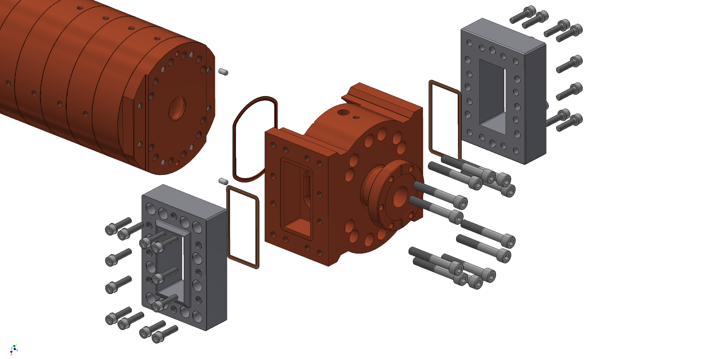
Linac assembly procedure: Phase II
Dowel pin
Racetrack gasket
Half input/output cell
LIL flange junction
Hexagon socket head cap screws
Rectangular gasket
Input/Output
coupler
Each coupler is completed by two LIL flange junction, made of steel, that are connected by rectangular copper gaskets. The fine alignment of the two couplers is guaranteed by two Dowel pin.
The proposed setup for assembling give the possibility of coupler replacement re-opening the structure and changing the gasket.
HG2018 - Shanghai
07-06-2018

Slide 13
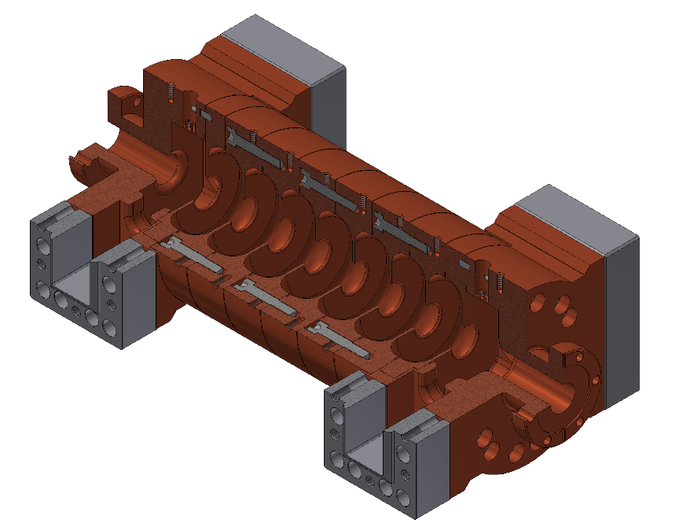
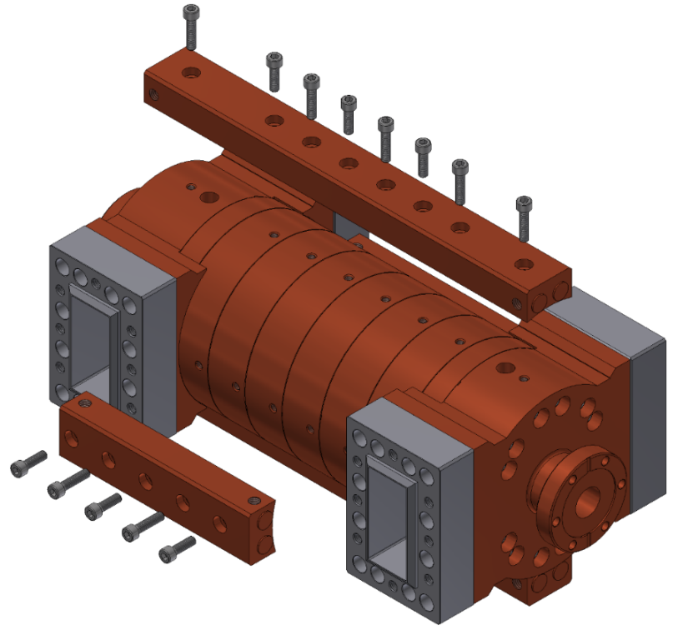
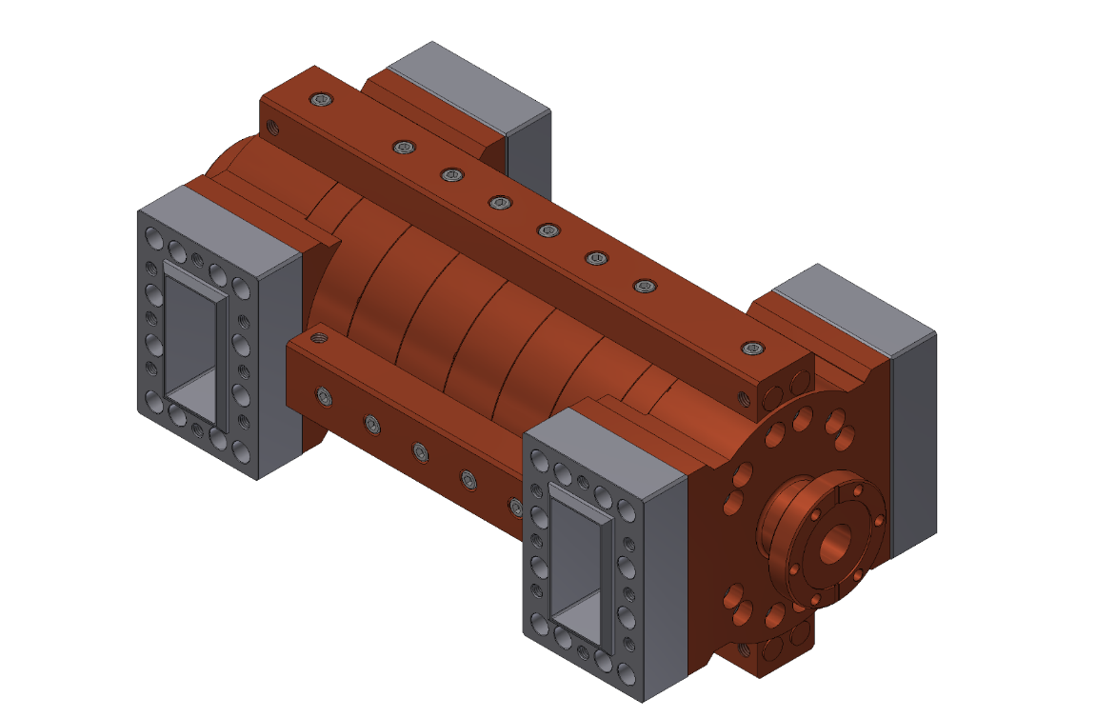
Linac assembly procedure: Final configuration
The presence of the screws around the cells limit the available space so for convenience an external cooling system has been designed for the prototype.
Cooling system
For high power test the structure will be fed through a 3 dB power splitter
Final configuration
HG2018 - Shanghai
07-06-2018

Slide 14
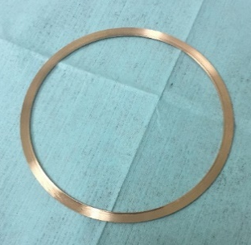
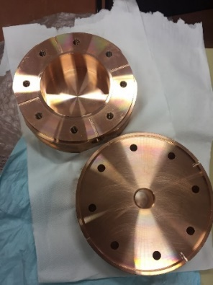
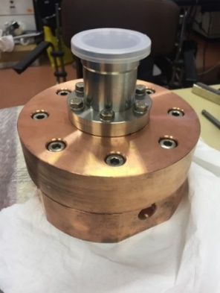
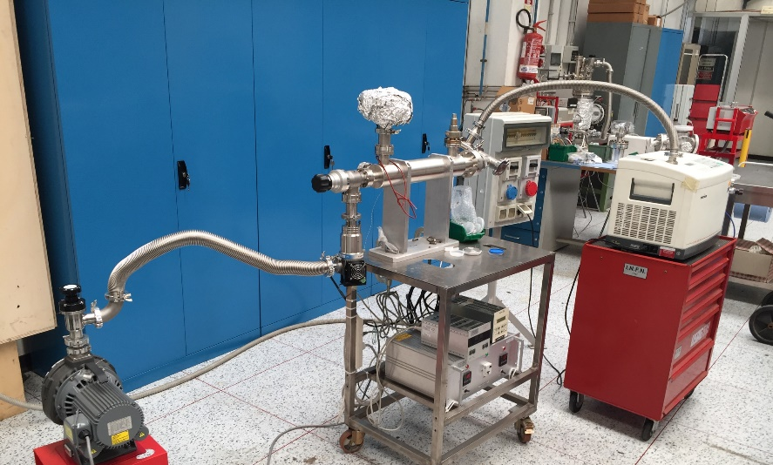
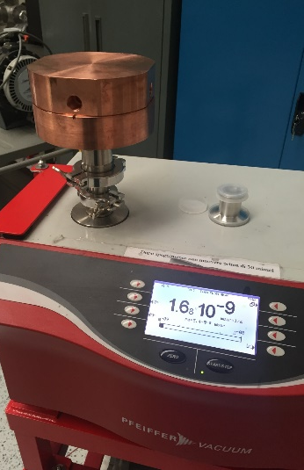
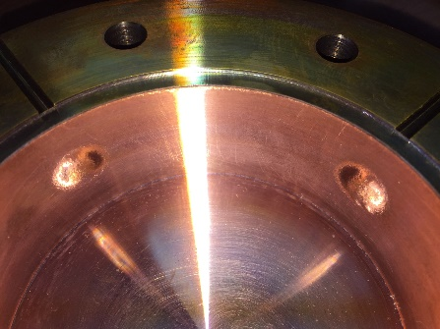
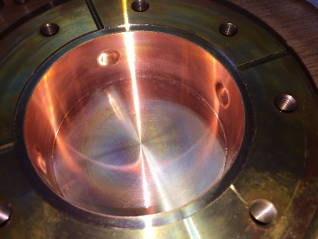

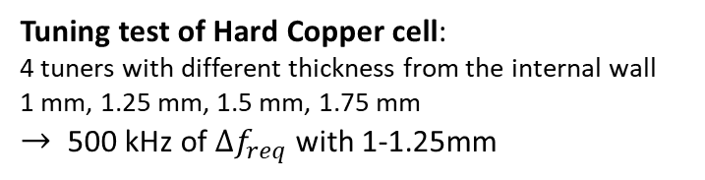

Vacuum test on a single cell clamped
Vacuum leak test:
A leak test has been performed after the connection of the two half cells, with a He sensitivity lower than $1.6×{10}^{−9 }mbar∙l/s$ and no leaks have been detected. The test has been repeated after gasket replacement and different baking cycle have been performed with the two gaskets:
Circular gasket
realized by Tecno Alarm
First gasket:
- 2x baking thermal cycle @120°C for 10 hours
Second gasket:
- 4x baking thermal cycle @120°C for 10 hours
- 2x baking thermal cycle @150°C for 10 hours
- 2x baking thermal cycle @200°C for 10 hours
Leak tests have been repeated during the baking and once after the cell cooling @24°C.
A final leak test after the baking was achieved with a He sensitivity $1.2×{10}^{−10} mbar∙l/s$ and no leaks have been detected.
Realized at INFN Roma1 workshop
Cell under test with heaters
Scroll pump
Turbo pump
Leak detector
Tuning test of Hard Copper cell:
4 tuners with different thickness from the internal wall
1 mm, 1.25 mm, 1.5 mm, 1.75 mm
$→$ 500 kHz of $∆f_{req}$ with 1-1.25mm
HG2018 - Shanghai
07-06-2018

Slide 15
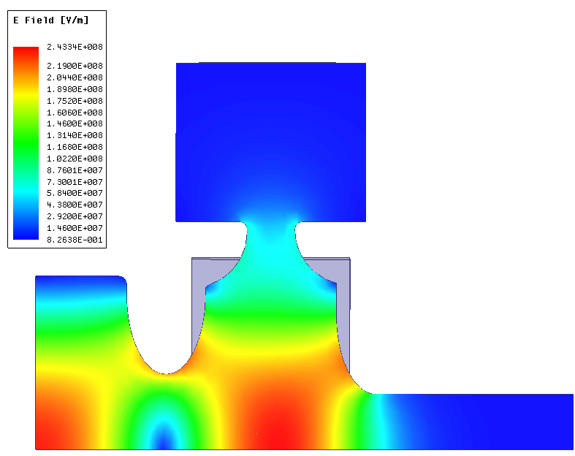
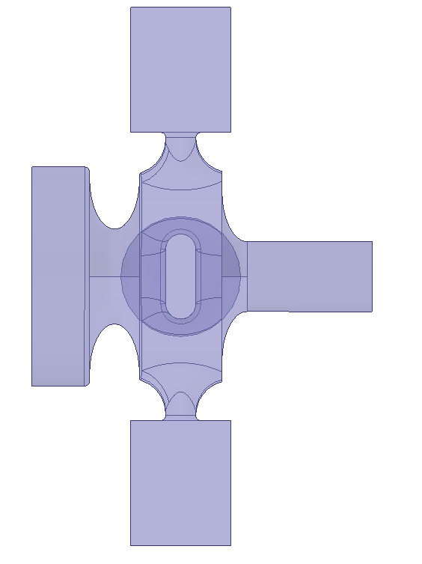



Ultra-fast C-band photocathode gun
In the framework of the XLS Compact Light collaboration – WP3: Gun and Injectors activities @INFN-LNF an Ultra Fast C-band photocathode gun with high peak electric field on cathode 240 MV and short filling time is under study.
P_{in}
P_{refl}
MC slot coupler
Input waveguide
P_{diss}
solenoid
Parameter | Value
f_{π} | 5.712 GHz
Δf | ≈ 100 MHz
Q₀ | 10450
β | 2.93
τ_{F} | 148 ns
E_{cath} | 240 MV/m
S₁₁ @res | -5.86 dB
E_{surf}/E_{cathode} | 0.9
Max Sc on coupler surface | 3 W/µm²
Field flatness | <1%
Hsurf on coupler | 700 kA/m
T_{pulsed} @ 100 ns (square pulse) @ 200 ns (square pulse) | 45°C 65°C
cathode
Quadrupole field compensation port
1
Power
Splitter
Input waveguide
d
a
2
3
Ecath=240MV/m
Pr $\sim 15MW$
HG2018 - Shanghai
07-06-2018

Slide 16








Low pulse heating coupler
We need to have a compact gun to have the possibility to place the solenoid immediately after the full cell (no mode launcher type) and low surface fields and pulsed heating.
Proposed coupler: Electric coupling (EC) coupler based on TM020 mode on the full cell.
Different kind of geometries have been investigated:
H field
E field
P_{in}
P_{in}
Type A
Type B
Type C
P_{in}
P_{in}
P_{in}
Waveguide comes alligned with the half cell
The short circuit plane and the slots are shaped to match the field at the coupling cell
Needs a power splitter
Waveguide short circuited at $\sim λ_{g}/4$
Waveguides run sideways the half cell
Coupled with rounded slots
Needs a power splitter
Waveguide short circuited at $λ_{g}/4$
Circular slot
Tapered waveguide
symmetric ports for vacuum pumping and quadrupolar component compensation
Waveguide run around the half cell
Coupled with rounded slots
Doesn’t need a power splitter
Waveguide short circuited at $λ_{g}/4$
Circular slot
Tapered waveguide
HG2018 - Shanghai
07-06-2018

Slide 17

Low pulse heating coupler results
Parameter | slot coup. | Type A | Type B | Type B comp. | Type C
f_{res} | 5.712 GHz | 5.7124 GHz | 5.7144 GHz | 5.7141 GHz | 5.714 GHz
freq. separation 0/$π$mode | ≈ 100 MHz | ≈ 80 MHz | ≈ 80 MHz | ≈ 80 MHz | ≈ 80 MHz
Q₀ | 10455 | 14421 | 14347 | 14368 | 14350
β | 2.93 | 2.95 | 2.96 | 2.94 | 3.17
Q_{L} | 2660 | 3646 | 3623 | 3649 | 3416
τ_{F} | 148 ns | 203 ns | 201 ns | 203 ns | 191 ns
E_{cath} [MV/m] | 240 | 240 | 240 | 240 | 240
Esurf/Ecath (on the coupler) | 0.34 | 0.88 | 0.91 | 0.88 | 0.86
Hsurf [kA/m] (on the coupler) | 700 kA/m | 340 kA/m | 357 KA/m | 379 kA/m | 324 KA/m
T_{pulsed} (square pulse) @ 100 ns @ 200 ns | 46°C 65°C | 11°C 15.6°C | 12.2°C 17.3°C | 13.8°C 19.5°C | 10°C 14.2°C
Max Sc [W/$μ^{2}$] (on the coupler) | 3 | 4.1 | 4 | 3.9 | 4
$$\frac{E_{CAT}}{\sqrt{P_{diss }}} \left[{MV}/{m\sqrt{MW}}\right]$$ | 61.5 | 56 | 56.4 | 55.64 | 55.92
Results obtained with Ansys Electronic Desktop simulations.
HG2018 - Shanghai
07-06-2018

Slide 18


Low pulse heating coupler multipolar components
In the slot coupler and type B gun the magnetic quadrupolar field component has been compensated introducing symmetric port holes connected with circular pipes below cut-off, to be used as pumping ports.
HG2018 - Shanghai
07-06-2018

Slide 19





C-band TW structure: coupler type B
Racetrack coupling slot
Waveguides run sideways the accelerating cells
5 cells + 2 coupling TM020 cells
Preliminary results:
f_{res} = 5.712 GHz
S11 = -35 dB
Hsurf = 118 kA/m
Pulsed heating @Pin=40MW
T<5°C with 1us pulse length
Rc
w
HG2018 - Shanghai
07-06-2018

Slide 20
Summary and future work
The «gasket-clamping» is a new technique for the realization of RF structures that avoids copper brazing (and the associated drawbacks). This technique has been succesfully used for the realization of two S-band RF guns.
The possibility to extend the use of this technique to the realization of a Linac (S/C/X band) has been investigated through the design of a prototype in the project BOLT (funded by INFN CNTT).
The electromagnetic and mechanical design of a 7 cell TW S-band prototype have been presented together with the assembly procedure.
Vacuum test on single cell joint has been succesfull. A vacuum test on the Coupler cell joint is foreseen.
The mechanical design with all the tolerances has been completed and the realization of the different parts has been assigned to an italian company. The components will be ready in September and we will start the assembling procedure.
After the realization and assembly of the prototype, vacuum and low power RF test will be performed at INFN-LNF laboratories. The high power test will be carried out probably in January at ELETTRA-Sincrotrone Trieste laboratory.
In the framework of XLS Compact Light an high gradient ultra fast C-band gun is under study at INFN-LNF.
In order to have a compact RF gun, a design based on the magnetic coupling slot type coupler has been investigated. The main limitation for this type of coupler remains the high surface magnetic field and pulsed heating on the coupling slot.
Thus, different couplers geometries have been studied based on a TM020 mode full cell electrically coupled with the waveguide.
The feasibility of such couplers has to be further investigated and electromagnetic design has still to be optimized. Preliminary simulations give promising results as far as the pulsed heating is concerned.
Simulations also open the possibility of using this type of coupler to feed a TW accelerating structure.
HG2018 - Shanghai
07-06-2018

Slide 21
Thank you for the attention
Aknowledgement:
C. Serpico, ELETTRA - Sincrotrone Trieste, Trieste, Italy

