Slide 1

Introdction of HVAC
Shanghai Hang Ye Vacuum Equipment Science and Technology Co.,Ltd. (HVAC) is a special engineering and manufacturing company for custom designed equipment. The company's technical strength is based on its experienced staff and the successful completion of challenging development and manufacturing of equipments with universities and institutions in the past years.
Products and Services
Microwave Devices | RF Accelerating Units Energy Doublers Wave-guides
Charged Particle Components, Beam Line | Electron Gun Ion Source Beam Line
Film Deposition System | Sputter Deposition Vacuum Evaporation
Custom Design and Manufacture | Vacuum Chamber and System Vacuum Brazing

Slide 2
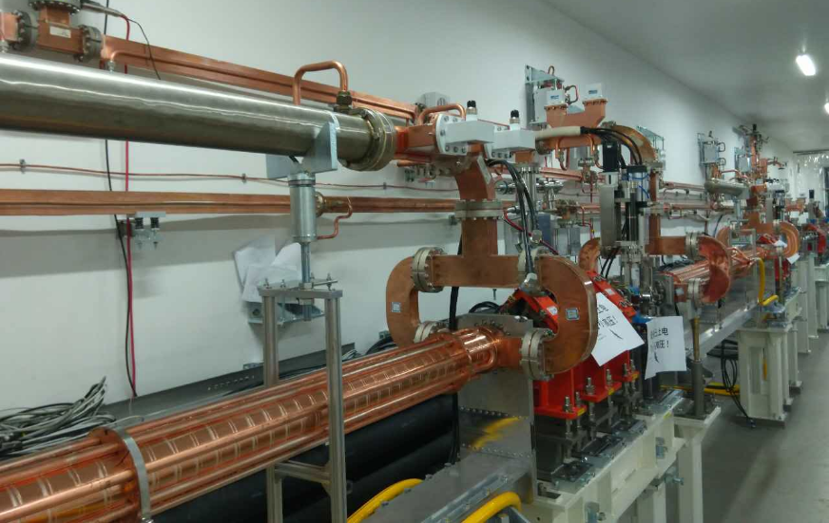
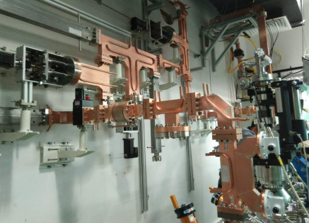
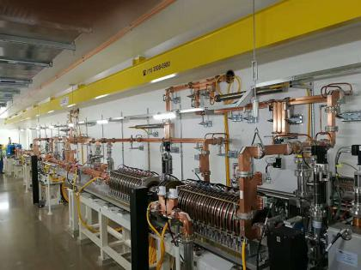
Microwave Devices:RF Accelerating Units,Energy Doublers,Wave-guides
Wave-guides for SINAP
Wave-guides for SJTU
Wave-guides for SIRIUS
The microwave devices introduced here were developed by SINAP and HVAC. Physcial design and microwave measurement was made by SINAP. HVAC carried out the engineering design and manufacturing.

Slide 3
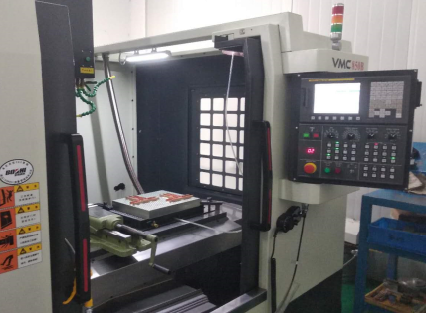
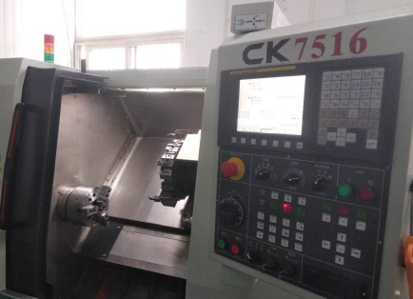
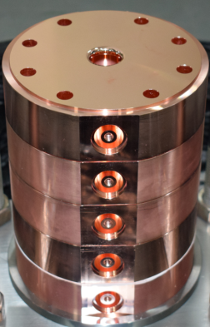
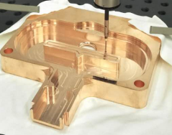
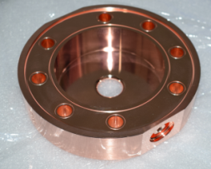
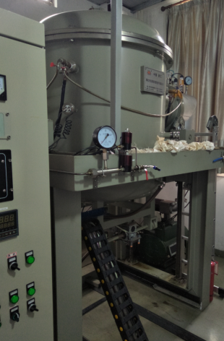
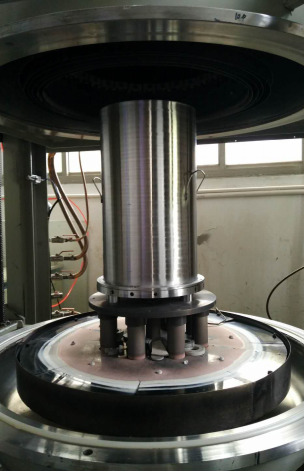
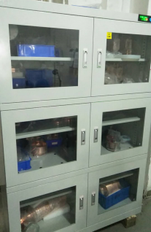
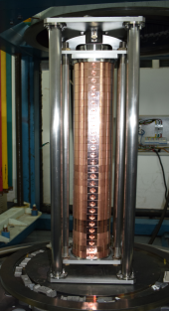
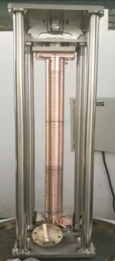
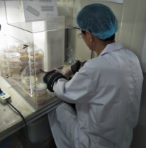
Machining
Vacuum Brazing

Slide 4
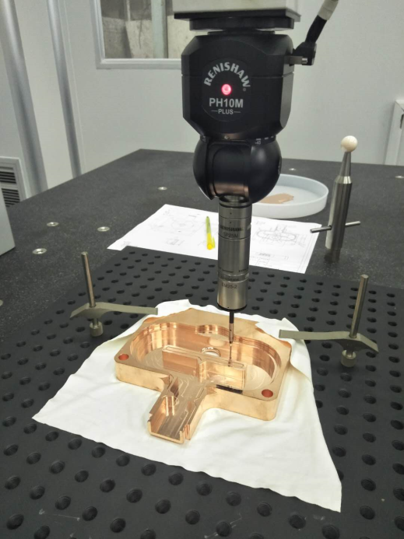
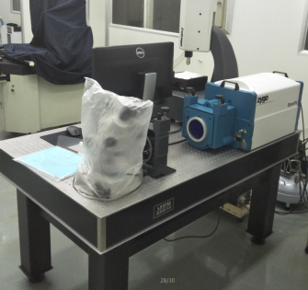
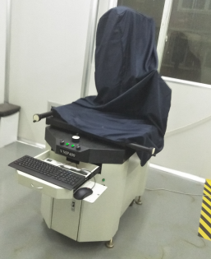
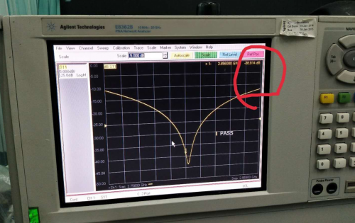
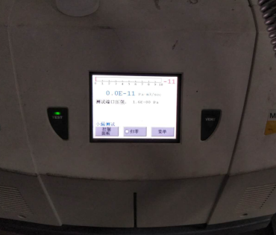
Measuring (by SINAP)

Slide 5
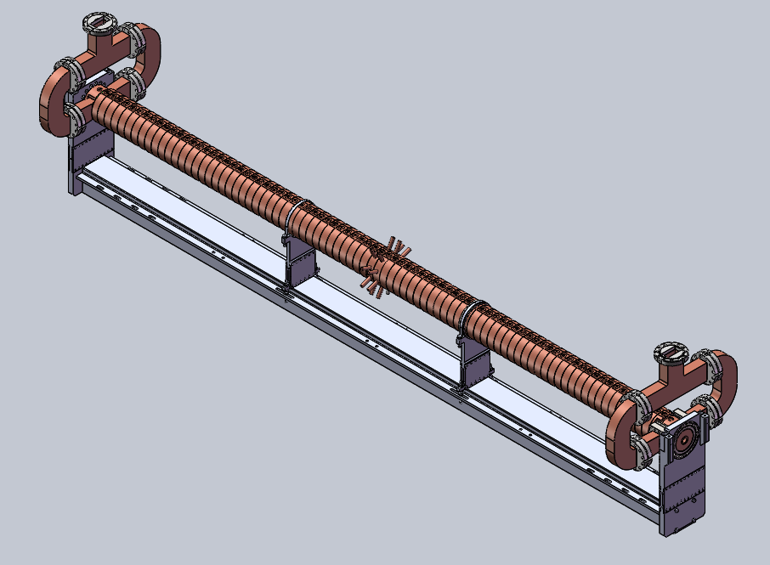
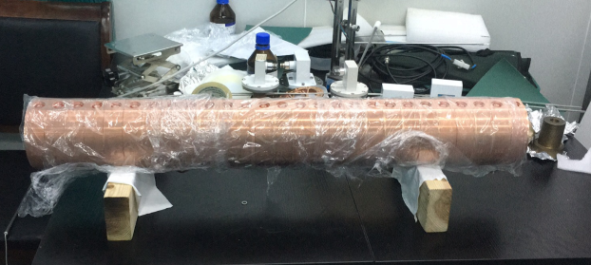
S band accelerating units
Structure | On-axis coupled traveling wave
Accelerator Material | OFHC
Accelerator Length | 3 m
Acceleration Frequency | 2856 MHz
Phase Advance Per Cell | 2π/3
Leak Rate | < 2E-10 torr∙l/s
Flange Material | 316L,μ≤1.03
Water cooling | Inner
Physical design and microwave measurement: SINAP
Engineering design and manufacturing: HVAC

Slide 6
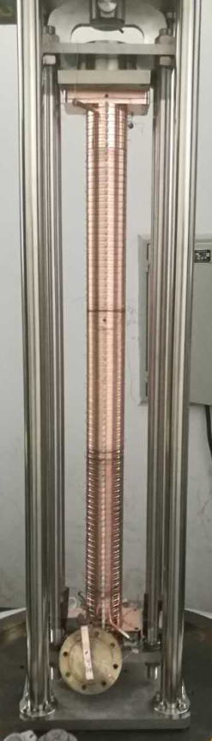
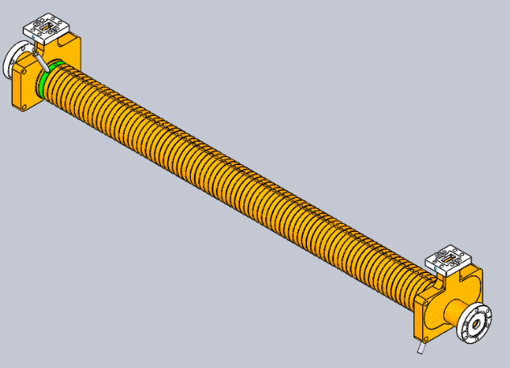
X band accelerating units
Structure | On-axis coupled traveling wave
Accelerator Material | OFHC
Accelerator Length | 1.08 m
Acceleration Frequency | 11424 MHz
Leak Rate | < 2E-10 torr∙l/s
Flange Material | 316L,μ≤1.03
Water cooling | Inner
Design and maching: SINAP
Brazing: HVAC

Slide 7
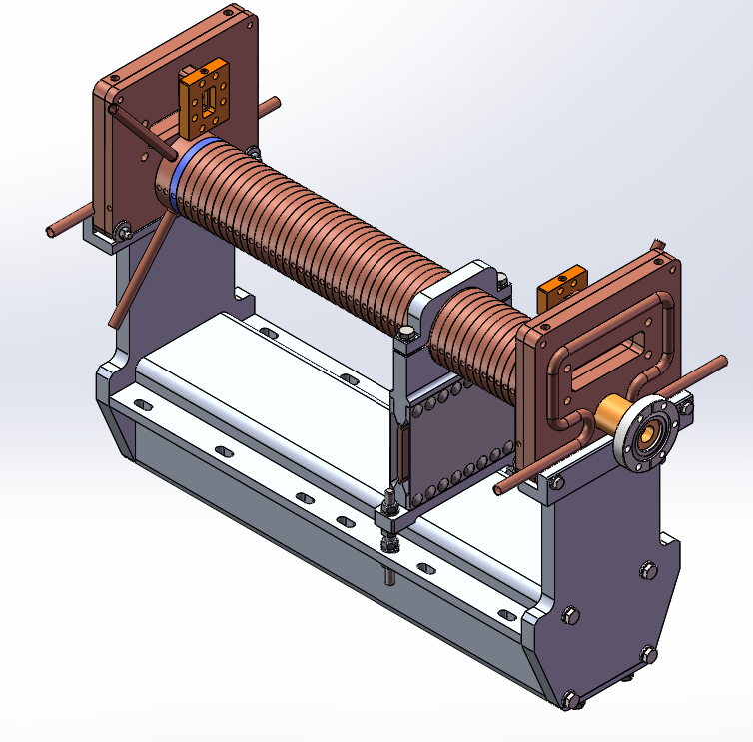
Deflecting cavity
Physical design and microwave measurement: SINAP
Engineering design and manufacturing: HVAC
Structure | On-axis coupled traveling wave
Cavity Material | OFHC
Cavity Length | 0.65 m
Frequency | 11424 MHz
Work mode | 2π/3
Leak Rate | < 2E-10 torr∙l/s
Flange Material | 316L,μ≤1.03
Water cooling | Inner

Slide 8
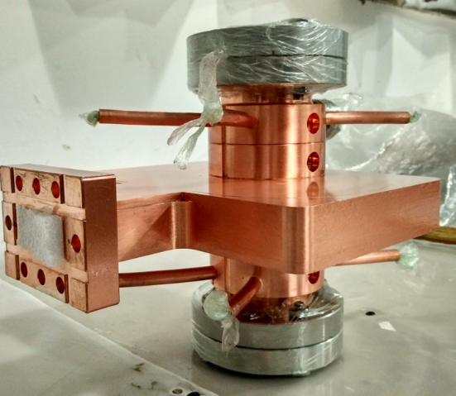
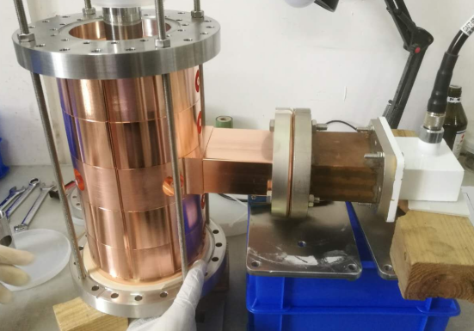
C band 5 Cell cavities
S band 5 Cell cavities
Brazing by HVAC
Maching by HVAC

Slide 9
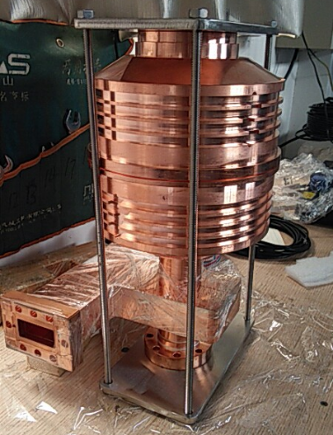
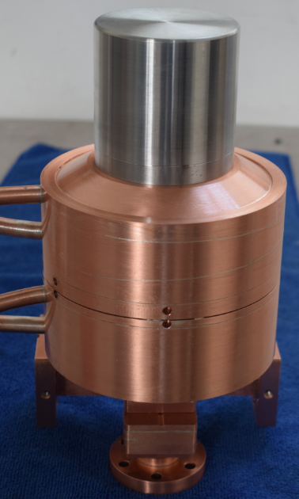
Sphere energy doubler
Frequency range: 5712 MHz
Work mode: TE114
Frequency adjustable range: 2MHz
Coupling degree: 5±5%
Quality factor: 100000±5%
Leak rate: < 2E-10 torr∙l/s
Material: copper(waveguide) 316L,μ≤1.03(flange)
Water cooling: inner
Frequency range: 11424 MHz
Work mode: TE113
Frequency adjustable range: 4MHz
Coupling degree: 4.6±5%
Quality factor: 95000±5%
Leak rate: < 2E-10 torr∙l/s
Material: copper(waveguide) 316L,μ≤1.03(flange)
Water cooling: inner
Physical design and microwave measurement: SINAP
Engineering design and manufacturing: HVAC

Slide 10
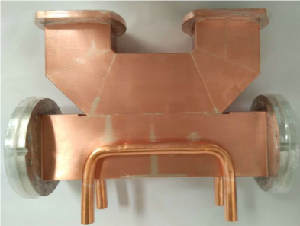
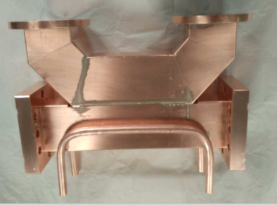
Directional coupler
Frequency range: 2.997 GHz ± 5 MHz
Work mode:TE10
VSWR, max. : 1.05 @2.997 GHz
Coupling degree: -50dB±2dB
Isolation degree: 20dB
Leak rate: < 2E-10 torr∙l/s
Material: copper(waveguide),316L,μ≤1.03(flange)
Ceramic windows:99% AL₂O₃
Water cooling: on request
Frequency range: 5.712 GHz ± 5 MHz
Work mode:TE10
VSWR, max. : 1.05 @2.997 GHz
Coupling degree: -50dB±2dB
Isolation degree: 20dB
Leak rate: < 2E-10 torr∙l/s
Material: copper(waveguide),316L,μ≤1.03(flange)
Ceramic windows:99% AL₂O₃
Water cooling: on request
Physical design and microwave measurement: SINAP
Engineering design and manufacturing: HVAC

Slide 11
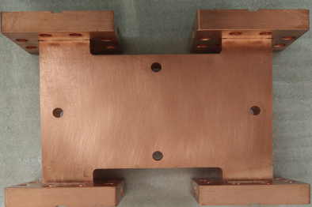
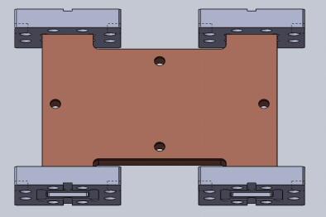
Power splitter
Frequency range: 5712 MHz
Work mode:TE10
Input reflection: 20dB
Output reflection: 20dB
Transportation: 3dB±0.15dB
Leak rate: < 2E-10 torr∙l/s
Material: copper(waveguide),316L,μ≤1.03(flange)
Water cooling: on request
Frequency range: 11424 MHz
Work mode:TE10
Input reflection: 20dB
Output reflection: 20dB
Transportation: 3dB±0.15dB
Leak rate: < 2E-10 torr∙l/s
Material: copper(waveguide),316L,μ≤1.03(flange)
Water cooling: on request
Physical design and microwave measurement: SINAP
Engineering design and manufacturing: HVAC

Slide 12
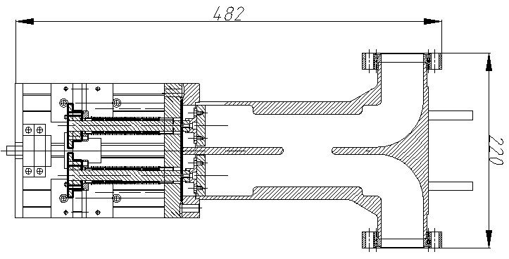
Phase shifter
Frequency range: 5712 MHz | Pulser power rating: 5 MW
VSWR, max. : 1.10 @5712 MHz | Insertion loss, typ.: 0.2 dB
Phase shifter range: ± 200° | Setting accuracy: 2°
Material waveguide: copper | Flanges: 316L,copper plated
Connectors for water cooling: on request | Leak rate: < 2E-10 torr∙l/s
Physical design and microwave measurement: SINAP
Engineering design and manufacturing: HVAC

Slide 13
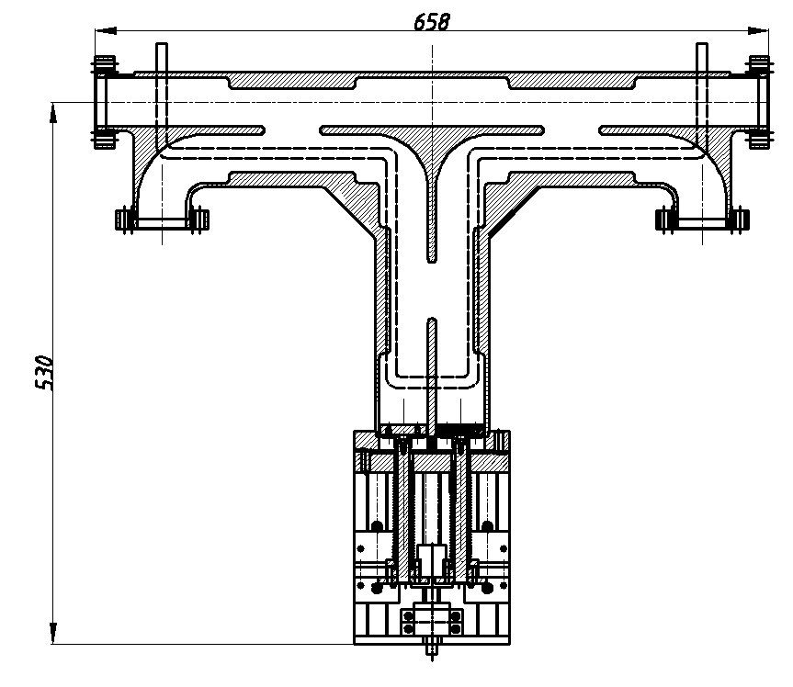
Variable power splitter
Frequency range: 5712 MHz | Pulser power rating: 5 MW
VSWR, max. : 1.10 @5712 MHz | Insertion loss, typ.: 0.2 dB
Transmission attenuation: 0.1 to 50 dB | Setting accuracy: 2°
Coupling attenuation correspondingly: 50 to 0.1 dB
Setting accuracy:0.1 dB (0.1 to 8 dB),0.2 dB (8 to 13 dB),0.5 dB (13 to 50 dB)
Material waveguide: copper | Flanges: 316L,copper plated
Connectors for water cooling: on request | Leak rate: < 2E-10 torr∙l/s
Physical design and microwave measurement: SINAP
Engineering design and manufacturing: HVAC

Slide 14
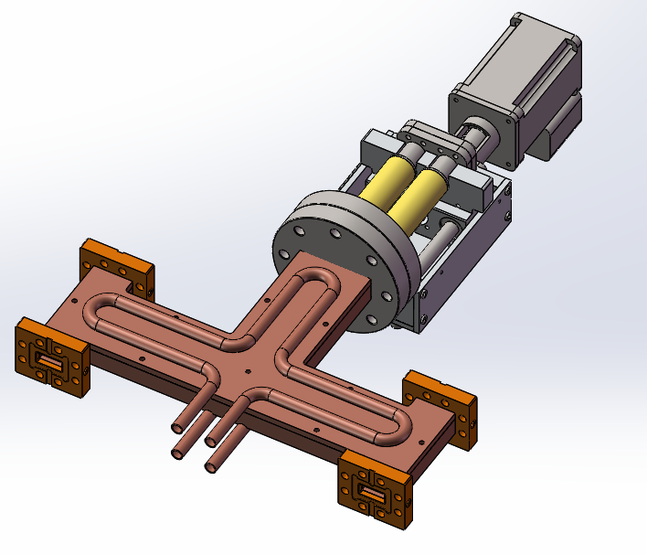
Variable power splitter
Frequency range: | 11424 MHz
Input reflection: | -25dB
Power adjustable range: | 0-30dB
Isolation degree: | -26dB
Leak rate: | < 2E-10 torr∙l/s
Material: | Copper(waveguide),316L, μ≤1.03(flange)
Water cooling: | on request
Physical design and microwave measurement: SINAP
Engineering design and manufacturing: HVAC

Slide 15
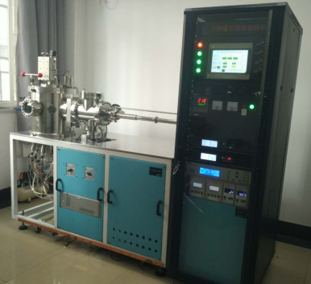
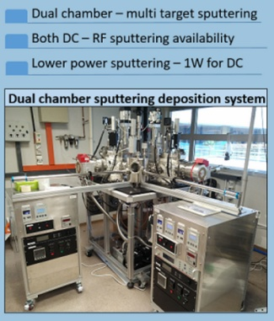
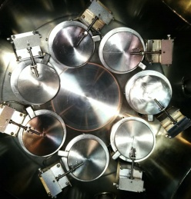
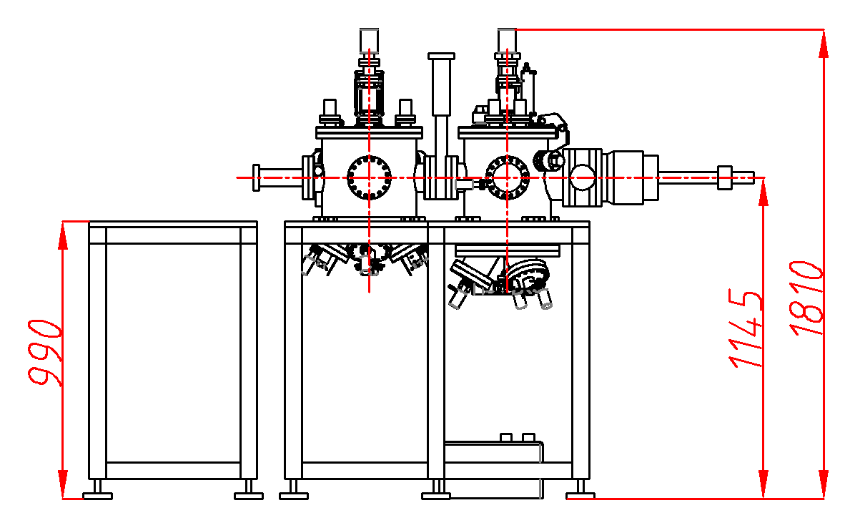
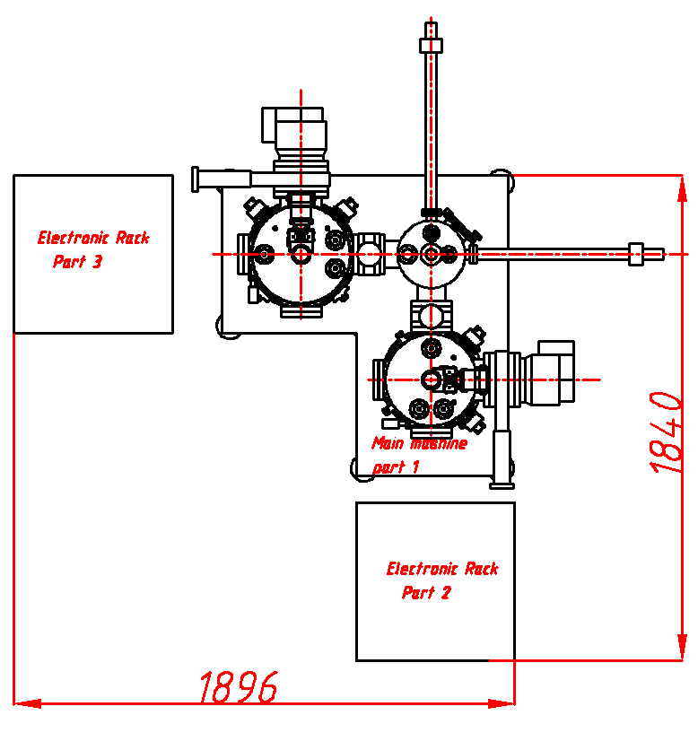
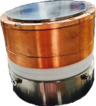
七靶磁控溅射镀膜机
A 7-targets Sputtering Deposition System with Load Lock
双腔室磁控溅射镀膜机
A 7-targets Sputtering Deposition System with Load Lock
Chamber
· 316L stainless steel, all internal welds.
· Inner diameter is 350mm.
· All internal welds, polished internal surfaces.
· Connecting Load lock with pneumatic gate valve.
· View port with manual shutter.
· Connecting Turbo pump with throttling gate valve.
· Spare ports blanked.
· N₂ vent port and gas feed port.
Magnetron sputter sources
· Seven 2 inch confocal magnetrons.
· Pneumatic shutter for each magnetron.
· Remote controlled gas feed port for each magnetron.
· Connected to the chamber with metal seal.
Heater and substrate
· Two Halogen lamps act as heater, 1kW.
· Heater shielded by quartz windows.
· Top loaded substrate holder with 0-20rpm rotation.
· Substrate can be moved ±20mm in vertical direction.
Power supplies
· 2 DC(500W) and 1RF (500W) power supplies.
· 2 switch box for switching between power supplies and magnetrons.
· Interlock interrupting system for water flow.
Controller
· Siemens touch screen and PLC for control routines and RS232 programming.
· Remote controlled pumping, gas feed, venting, deposition, heating.
Parts
· High quality products from PFEIFFER, MKS, VAT, MDC.
Vacuum Performance
· For the main chamber, ultimate pressure of 5 x 10⁻⁹ Torr can be reached.
· For the lock load chamber, ultimate pressure of 8 x 10⁻⁸ Torr can be reached.
Pressure and temperature
· Heater capable of reach temperature up to 800℃.
· Throttle gate valve capable of adjust working pressure from 0.1m Torr to 20m Torr.
1. Chamber 1 :
1.1 4 units of 2 inch confocal magnetrons with shutter
1.2 Substrate holder with 0-20rpm rotation
1.3 Substrate teperature can reach up to 800 ℃
1.5 Ultimate pressure <5E-8 Torr
1.6 Working pressure 1m Torr to 20 m Torr
2. Chamber 2 :
2.1 3 units of 2 inch confocal magnetrons with shutter
2.2 Substrate holder with 0-20rpm rotation
2.3 Substrate teperature can reach up to 800 ℃
2.5 Ultimate pressure <6E-9 Torr
2.6 Working pressure 1m Torr to 20 m Torr
3. Load load lock Chamber :
3.1 Dual level substrate transfer mechanism
3.2 Ultimate pressure <5E-7 Torr
4.Power supplies:
4.1 Switch box
4.2 DC power supply,2 units, 300-500W
4.3 RF power supply,1 units, 300-500W
5.Gass delivery and control
5.1 Ar and N₂ (0-100 sccm)
5.2 Two gass lines with shut off valves
5.3 4-channel mass flow unit controller
for CUG
for NTU in Singapore

Slide 16
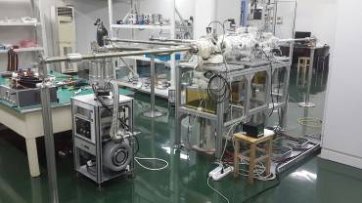
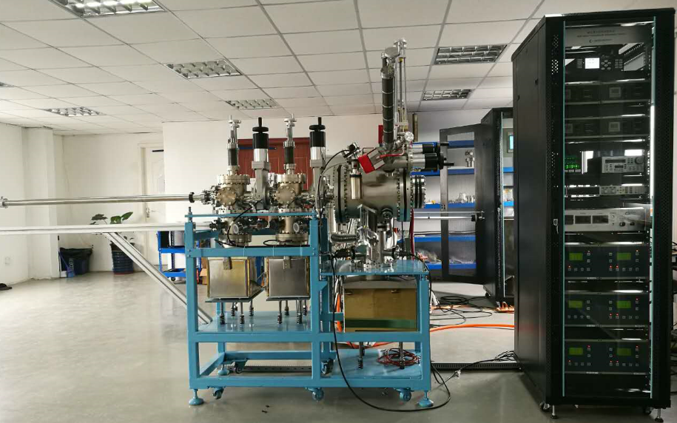
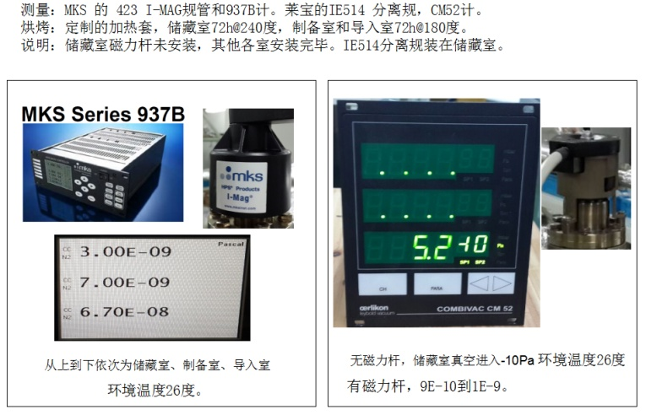
for IHEP
A Preparation System for K₂CsSb Photocathode
A Preparation System for GaAs Photocathode
Chamber | Presure/Pa | Leak rate/Pa. m³/s | Pumps/L/s
Load-lock | ＜5×10⁻⁸ | ＜1.0×10⁻¹⁰ | 200SIP+800NEG
Storage chamber | ＜5×10⁻⁹ | ＜1.0×10⁻¹⁰ | 200SIP+800NEG
Fabrication chamber | ＜5×10⁻⁹ | ＜1.0×10⁻¹⁰ | 300SIP+1600NEG
Source chamber | ＜1×10⁻⁸ | ＜1.0×10⁻¹⁰ | 15SIP

Slide 17
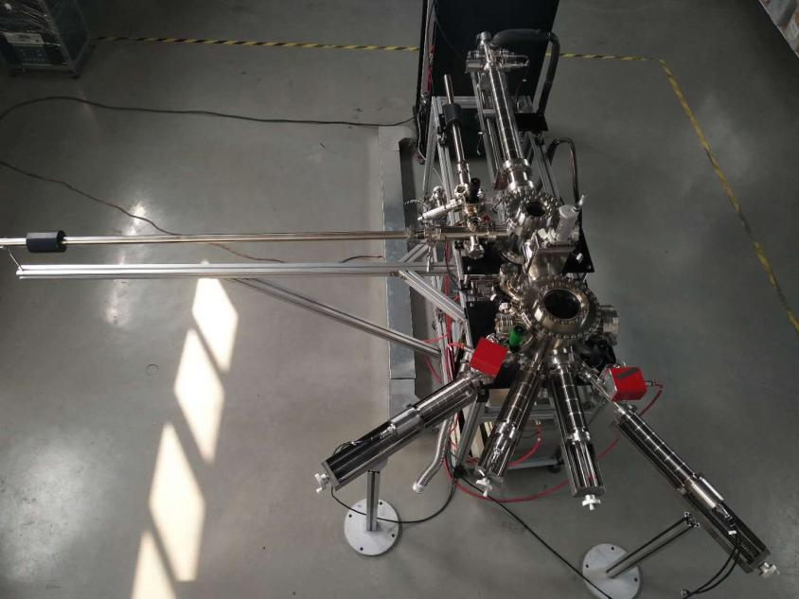
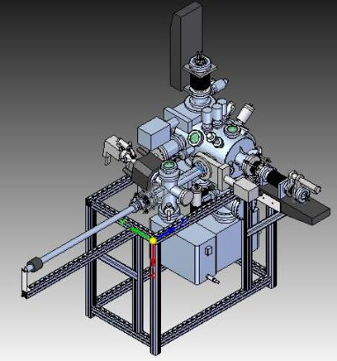
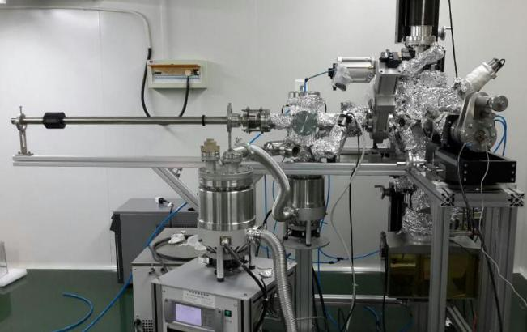
A Preparation System for Alkaline Photocathode
A Photocathode Fabrication and Transportation System
Photocathode transport in vacuum environmentSurface clean
Photocathode fabrication and activation
Quantum efficiency measurement
Vacuum:<5×10⁻⁹Pa
Chamber | Presure/Pa | Leak rate/Pa. m³/s | Pumps/L/s
Load-lock | ＜5×10⁻⁸ | ＜1.0×10⁻¹⁰ | 15SIP
Transport chamber | ＜5×10⁻⁹ | ＜1.0×10⁻¹⁰ | 400SIP+2000NEG
Fabrication chamber | ＜5×10⁻⁹ | ＜1.0×10⁻¹⁰ | 600SIP+3000NEG
Source chamber | ＜2×10⁻⁸ | ＜1.0×10⁻¹⁰ | 15SIP
for SINAP
for PKU

Slide 18
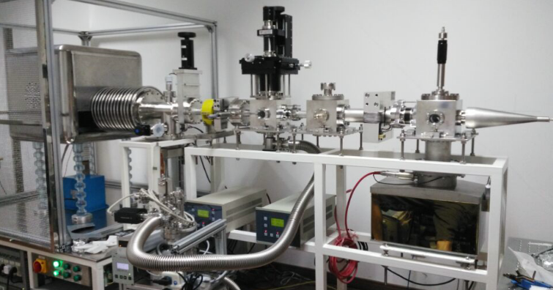
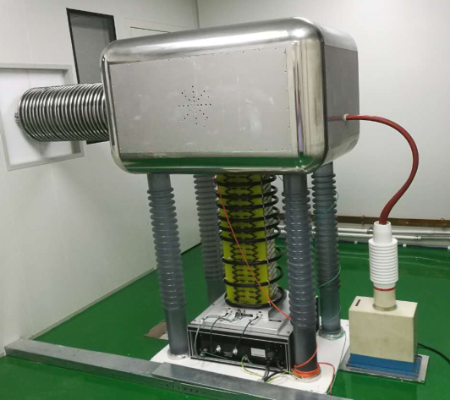
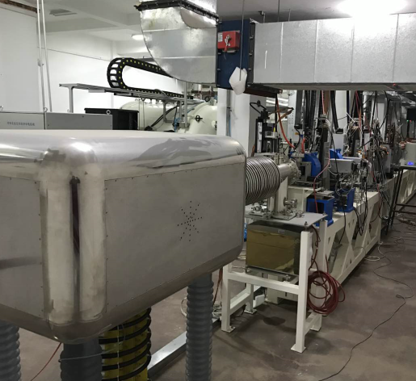






Electron gun
Electron gun
Beam Engergy | 100keV
Pulser Current | 0-1mA
Pulser Width | 1-10nS
Repeat Frequency | 5Hz
Beam Diameter | ≤φ3mm
for SJTU
Beam Engergy | 100-200keV
Pulser Current | 1μA-1mA
Pulser Width | 200pS
Repeat Frequency | 100Hz
Beam Engergy | 10-2000eV
Pulser Current | ≈1μA
Pulser Width | ≈1nS
Repeat Frequency | 20kHz
for FUU
for IHEP

Slide 19





Laser ion source
Electron gun
设计指标 | 数 值
1. 能量范围 2. 高压精确度 3. 高压纹波 4. 高压漂移 5. 靶上束斑直径 6. 靶上电子通量范围 7. 靶上电子流稳定度 8. 靶上电子流精确度 9. 靶上电子流均匀度 10. 靶上电子半散角 11. 电子流时间结构 | 50－250 keV 好于1% 好于0.1% 好于0.05%@8小时 50 mm 10 ⁵－10 ⁹ /cm² s 好于 5%@30 min 好于2.0 % 好于10% 好于1度 连续
for FUU
Electron beam ion source
for NSSC
能量范围：100eV～30keV，可调
能量散度：优于1%或10eV（取二者小值）
能量绝对测量精度：优于1%±10eV
束流动态范围：10³～10¹⁰/cm²·s，可调。
束流测量精度：优于±5％（束流大于10⁻¹²A时)
束斑大小：直径70mm
束流均匀度：10%
束半散角: 不大于1〫
稳定性:±5%
for NSSC
for FUU

Slide 20





Beam line for ECR ion source
Beam line for DC-Gun
高压, Voltage | 100kV
束斑, Beam diameter | ≤ ϕ1mm
束流, Beam current | ~uA
源口真空, Vacuum at source output | ≤10⁻⁷mbar / ≤10⁻⁶mbar
束线真空,Vacuum at beam line | ~10⁻⁹mbar
for FUU
for IHEP

Slide 21
Thank you
for watching

