Slide 1
Correlations between fission fragment yields and the PFGS
15th Conference Nuclear Reaction Mechanisms
Patrick Jaffke
T-2 Postdoc, Los Alamos National Lab
P. Talou, T. Kawano, M. Devlin, N. Fotiadis, I. Stetcu
C.-Y. Wu, A. Chyzh
15th NRM Varenna, Italy June 11, 2018
LA-UR-18-24933

Slide 2
Outline
The Tools
  Brief CGMF primer and input yields
    Prompt γ-ray emission calculation
    Gaussian parameterization
Impact of changing yields
  PFGS softening and hardening
  Discrete transition intensities (some complexities)
Conclusions and outlook
15th NRM Varenna, Italy June 11, 2018

Slide 3
The punchline
Bulk Y(A) properties influence bulk PFGS
Specific Y(A) properties influence specific PFGS lines
Slope changes with diff. Y(A)
Intensities of discrete peaks vary with Y(A)
15th NRM Varenna, Italy June 11, 2018

Slide 4
Tools
CGMF:
  Monte Carlo Hauser-Feshbach de-excitation of fission fragments
  Starts with input yields Y(A,Z,U,J^{π})
_{n}
  Emit prompt neutrons then prompt γ rays
  Prompt γ rays come from products!
Open source version coming soon!
_{n}
_{γ}
Excitation energy
_{n}
_{γ}
_{γ}
_{γ}
S_{n}(A-1,Z)
S_{n}(A,Z)
15th NRM Varenna, Italy June 11, 2018

Slide 5
Tools
Yields:
  Gaussian parameterization for the input mass yields
  Charge distribution follows Wahl systematics
  Easy to vary output yields for test cases
15th NRM Varenna, Italy June 11, 2018

Slide 6
High energy slope changes
Similar shape in ²³⁵U and ²³⁹Pu
125<A<135 contribution
Average γ-ray energy peaks near the shell closure (larger level spacing)
125<A<135 can dominate PFGS slope at high E_{γ}
 | Y₀(A) | Y₁(A) | Y₂(A) | Y₃(A) | Y₄(A) | Y₅(A)
125<A<135 | 16.6% | 21.0% | 29.6% | 33.8% | 29.2% | 18.7%
Slope (1/MeV) | -0.241 | -0.236 | -0.226 | -0.222 | -0.228 | -0.243
15th NRM Varenna, Italy June 11, 2018

Slide 7
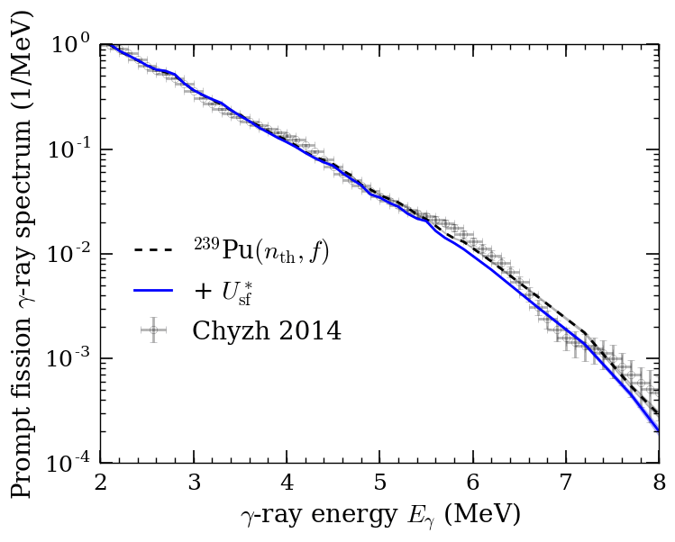

Impact of yields
A. Chyzh, PJ, et al. (accepted PLB 2018)
Test of toy fission reaction
  Start with ²³⁹Pu(n_{th},f) and then change properties to reflect ²⁴⁰Pu(sf)
U* from ~6.53 MeV to 0 MeV
Y(A) from ²³⁹Pu(n_{th},f) to ²⁴⁰Pu(sf)
<TKE> from 177.7 MeV to 179.4 MeV
Less U* softens!
Y(A) near N=82 hardens!
Similar effect in ²⁴²Pu*
15th NRM Varenna, Italy June 11, 2018

Slide 8
Discrete transitions
Determine contribution of specific γ-ray lines
  ¹⁰⁰Zr peak
    212.53keV (2⁺ → 0⁺) contaminated with ¹¹³Rh
    Can quantify background sources with CGMF!
15th NRM Varenna, Italy June 11, 2018

Slide 9
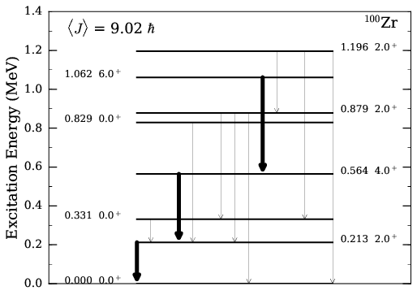

Impact of level corrections
  γ-ray cascade always flows through the transition (100%)
  Not true for most transitions!
  Insensitive to yields, but sensitive to Y(U,J^{π})
 | 2⁺ → 0⁺ Flow % | 4⁺ → 2⁺ Flow %
Y₀(A) | 88.3% | 76.8%
Y₁(A) | 88.5% | 75.1%
Y₂(A) | 89.0% | 76.4%
Y₃(A) | 89.3% | 76.8%
Y₄(A) | 88.9% | 76.6%
Y₅(A) | 88.9% | 76.5%
N. Fotiades, P. Casoli, PJ, et al. (submitted PRC)
15th NRM Varenna, Italy June 11, 2018

Slide 10
Conclusion
Yields can impact bulk properties of PFGS
  Neutron-induced vs. spontaneous can have an impact
  Y(A) peaked near N=82 creates harder spectrum
  Coupled with lower <J> of (sf) will make it even harder
Specific transitions are governed by fission yields (and neutron emission)
  Can link γ-ray intensity to fission yield!
    Caveats:
      Level corrections (J-dependence)
      Contaminations, detector effects (multiplicity cuts)
A. Chyzh, PJ, et al. (accepted PLB 2018)
N. Fotiades, P. Casoli, PJ, et al. (submitted PRC)
15th NRM Varenna, Italy June 11, 2018

Slide 11
Thanks!
15th NRM Varenna, Italy June 11, 2018

Slide 12
Extra
15th NRM Varenna, Italy June 11, 2018

Slide 13
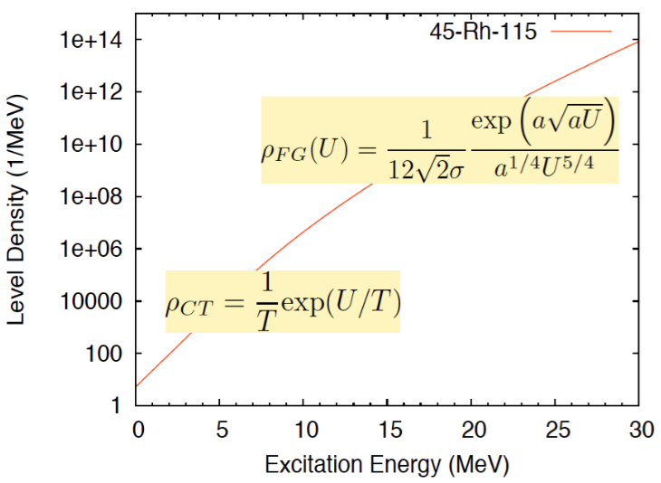
Hauser-Feshbach Model
Need transmission coefficients and level densities
RIPL discrete levels
+
Gilbert-Cameron with a(U)
T_{γ}(ε_{γ}) from strength-function formalism
T_{n}(ε_{n}) from optical model calculations
Global optical potential from Koning & Delaroche ideal for spherical nuclei close to stability. Can we generalize?
15th NRM Varenna, Italy June 11, 2018

Slide 14
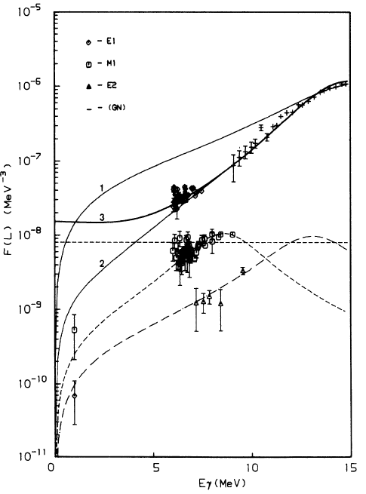
Hauser-Feshbach Model
J. Kopecky, M. Uhl PRC 41 (1990)
Gamma transmission coefficients:
  f_{XL} are gen. (E1) or std. (M1 & E2) Lorentzian forms
  Higher multipolarity transitions are neglected in CGMF
Neutron transmission coefficients:
  Scattering matrix from optical model calculations
Gen. Lorentzian
A. Koning & J. Delaroche NPA713 (2003)
Std. Lorentzian
15th NRM Varenna, Italy June 11, 2018

Slide 15
Excitation Energy Sharing
Currently: vary R_{T} until ν(A) matches (CGMF)
Heavy fragment takes extra E*
Next: share E_{int} via maximum entropy
E_{T} = E_{int} + E_{def}
Max Entropy
15th NRM Varenna, Italy June 11, 2018

Slide 16
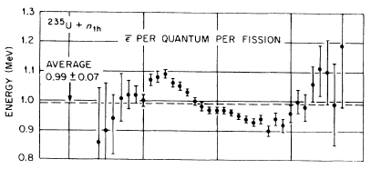
Yields in (n,f) vs. (sf)
Both model (Möller) and data show wider Y(A) in (n,f)
Y(A) for (sf) are sharply peaked near N=82 closure!
F. Pleasonton et al. PRC 6 1023 (1972)
Avg. E_{γ} increase is a property of products ρ, J^{π}, and U*
15th NRM Varenna, Italy June 11, 2018

Slide 17
Impact of spin
Changing the <J> has a more dramatic effect on PFGS hardness
Yields are ~0.5x the effect of a J±2 change
15th NRM Varenna, Italy June 11, 2018

Slide 18
Discrete transitions
Can use CGMF to identify contaminants
  Only as good as the discrete levels we put in!
  Doppler broadening does not make a large impact
  Typical energy resolution of HPGe (~1.8 keV @ 300keV)
15th NRM Varenna, Italy June 11, 2018

Slide 19
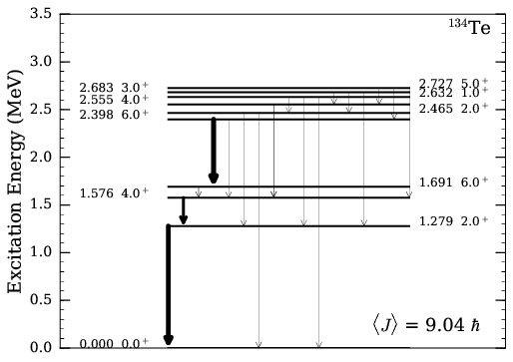

Impact of spin
Change <J> of fragments arbitrarily
  Can have a much larger impact on the level correction!
  Especially with long-lived isomers (164ns in ¹³⁴Te)
<J> | 2⁺ → 0⁺ Flow % | 4⁺ → 2⁺ Flow %
8.01 | 23.1% | 15.0%
9.42 | 19.0% | 12.8%
10.01 | 15.8% | 11.0%
Even the 2⁺ → 0⁺ transition can be sensitive to <J>
15th NRM Varenna, Italy June 11, 2018

Slide 20
Use of multiple gates
Test detector effects on inferred yields
  Multiplicity cuts, energy resolution, double-coincidence
  Infer level corrections and contamination in these circumstances
N. Fotiades et al. (submitted to PRC)
Mo/Sn hit hardest
Dbl-coincidence lowers the yield!
15th NRM Varenna, Italy June 11, 2018

