Slide 1
Shell-model studies of the astrophysical mirror rp-reactions ³⁴S(p,ϒ)³⁵Cl and ^{34g,m} Cl(p,ϒ)³⁵Ar
Werner Richter
University of Stellenbosch
iThemba LABS, South Africa
Alex Brown, Chris Wrede, Cathleen Fry
National Superconducting Cyclotron
Laboratory, Michigan State University
Richard Longland
University of North Carolina

Slide 2
OUTLINE
Introduction
Shell-model calculations
The SDPF-MU interaction
Results for the (p,γ) reaction rates
Conclusions

Slide 3
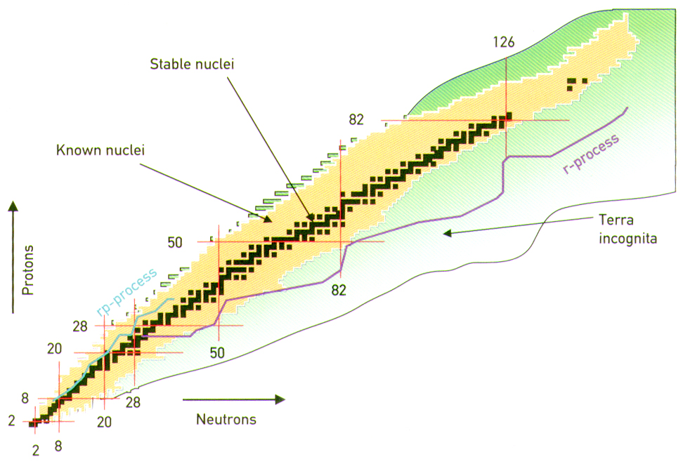

Slide 4
In explosive stellar environments, which include classical novae and x-ray bursters, thermonuclear radiative capture reactions on unstable nuclei determine the path of nucleosynthesis toward the proton drip line.
The thermonuclear ^{34g,m}Cl(p,γ)³⁵Ar reaction rates are unknown at nova temperatures due to a lack of experimental nuclear physics data for the resonances up to about 800 keV above the ³⁵Ar proton separation energy
(S_{p} = 5.896 MeV) .

Slide 5
Energies for ³⁵Ar are generally known in the resonance region but few spins and parities. For example, Fry et al. (2015) have measured 17 new levels in the 5.9 – 6.7 MeV range with the ³⁶Ar(d,t)³⁵Ar reaction but no spins or parities were determined.
Reaction rates govern energy release and final isotopic abundances. Some of the capture rates along the rp–process are not determined experimentally, so many have to rely on theoretical input.

Slide 6
In a recent experiment by Gillespie et al. the ³⁴S(³He,d)³⁵Cl proton-transfer spectroscopic factors (2J + 1)C²S were measured for 21 states in an energy region of about 1 MeV above the threshold energy (Sp = 6.371 MeV).
SHELL-MODEL CALCULATIONS
^{34g,m}Cl(p,γ)³⁵Ar

Slide 7
Previous predictions of reaction rates have generally assumed that all interacting nuclei
are in the ground state. Schatz et al. showed
that the capture on the low-lying first-excited state of ³²Cl was crucial for the ³²Cl(p,γ)³³Ar reaction rate.
Griniviciute et al. (2014 – unpublished) also made a study of p capture on low-lying excited states in the sd shell and reported significant enhancement in a number of cases.

Slide 8
The impact of the excited states in the tar-
get nuclei that are thermally populated in astrophysical plasma is expressed in terms of a “stellar enhancement factor” (SEF).
^{34m}Cl has an isomeric first excited state
(3⁺, Ex = 146.36 keV, T_{1/2} = 31.99 min) whose contribution to the rate should be included.
stellar capture rate
SEF =
ground state capture rate

Slide 9
Uncertainties in the reaction rates translate to uncertainties in ³⁴S production in models of classical novae on oxygen-neon white dwarfs.
³⁴S abundances have the potential to
aid in the classication of presolar grains.
A fast thermonuclear reaction rate leads to the destruction of ³⁴Cl and bypasses the
production of ³⁴S, the beta decay daughter of ³⁴Cl (T_{1/2} = 1.53 s). The isotopic ³²S/³⁴S
ratio depends strongly on the ³⁴Cl(p,γ)³⁵Ar
reaction rate.

Slide 10
Calculation of (p, γ) reaction rates for
the rp process
The properties of many levels in the proton-
rich nucleus are generally not well known,
particularly in the present case, thus requiring
theoretical input.
These are the calculated partial gamma-decay
widths above the proton emission threshold,
the proton decay widths of states (which
depend on the relevant spectroscopic factors),
as well as energies.

Slide 11
REACTION RATES
³²Cl(p,g)³³Ar reaction rate for T=0.4 x 10⁹ K
Gamow peak shown
Coulomb
penetrability
Boltzmann e^{-E/kT}

Slide 12
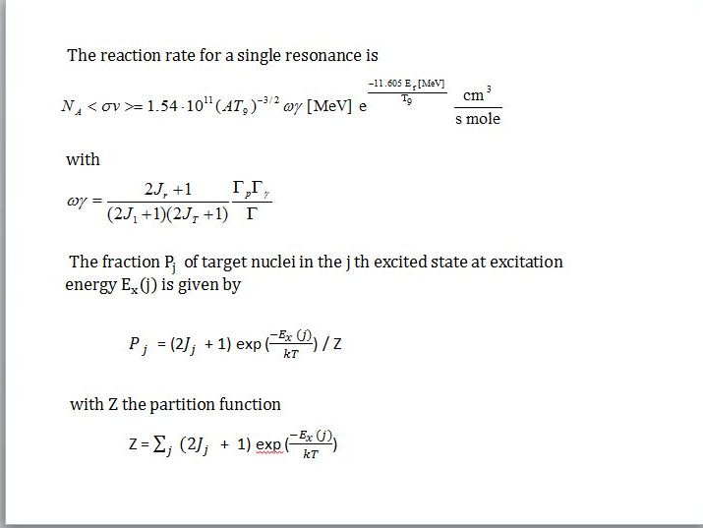

Slide 13
THE SDPF-MU interaction
Utsuno et al. (2012) USD for sd shell
GXPF1B for pf shell (Honma et al. 2008)
Monopole interactions V^{T=0,1} _{0d3/2,0d5/2} based on SDPF-M (Utsuno et al. 1999)
Monopole and quadrupole pairing matrix elements
^{<0f}_{7/2}^{0f}_{7/2}^{|V|0f}_{7/2}^{0f}_{7/2}^{> J=0,2 replaced with those of}
^{KB3 (Poves-Zucker 1981)}
^{Cross-shell part given by V}_{MU} ^{(Otsuka et al. 2010)}

Slide 14
REACTION RATES FOR
^{34g,m}Cl(p,γ)³⁵Ar

Slide 15
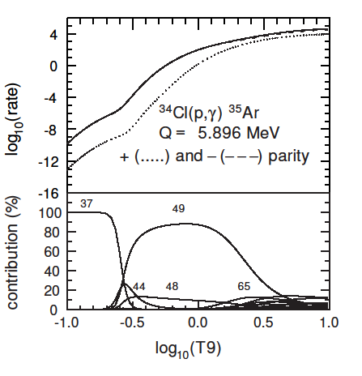

Slide 16
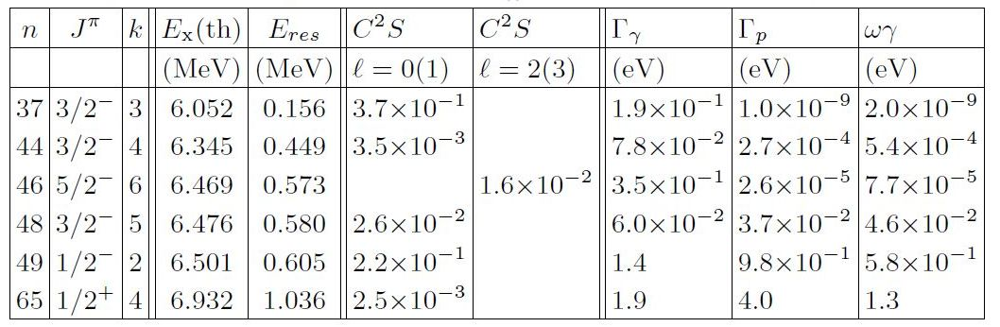
TABLE I: Properties of the rp-resonance states for transitions from the ground state of ³⁴Cl

Slide 18
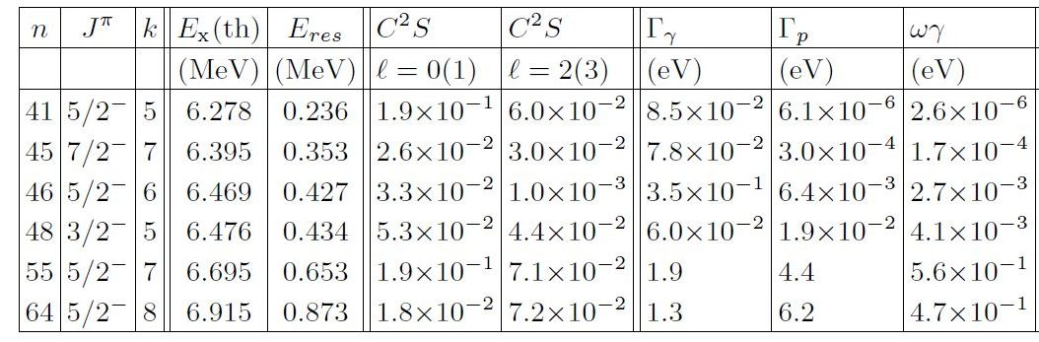
TABLE II: Properties of the rp-resonance states for transitions from the first excited state of 34Cl

Slide 20
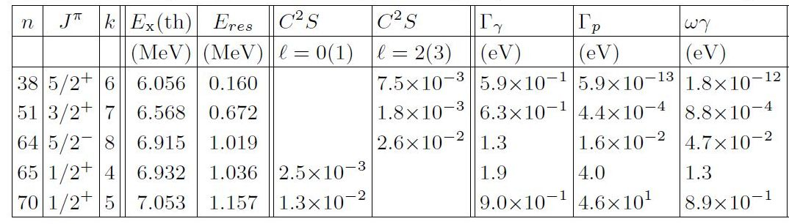
TABLE III: Properties of the rp-resonance states of positive parity for transitions from the ground state of ³⁴Cl

Slide 21
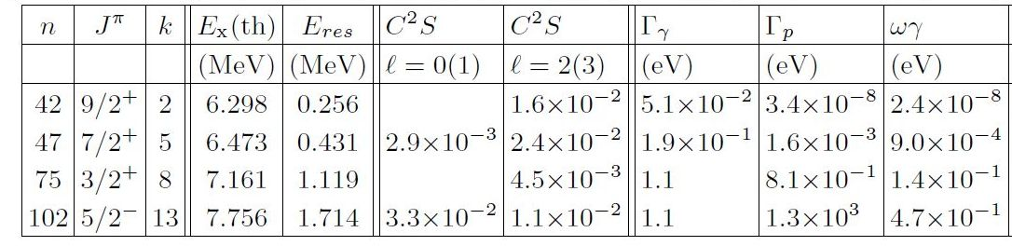
TABLE IV: Properties of the rp-resonance states of positive parity for transitions from the first excited state of ³⁴Cl

Slide 22
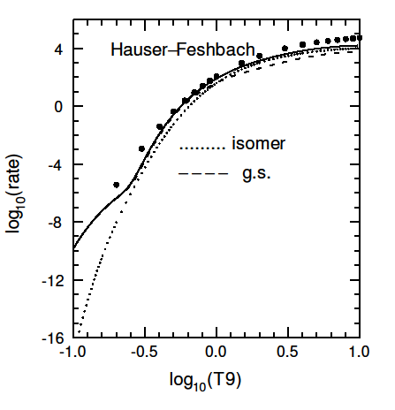

Slide 23
REACTION RATES FOR ³⁴ S(p,γ)³⁵Cl
In a recent experiment by Gillespie et al. the ³⁴S(³He,d)³⁵Cl proton-transfer spectroscopic factors (2J + 1)C²S were measured for 21 states in an energy region of about 1 MeV above the threshold energy (Sp = 6.371 MeV).
The reaction rate could be determined
directly from the experimental data.
We compare the results with our calculations,
similar to those for ³⁴Cl(p,γ)

Slide 25
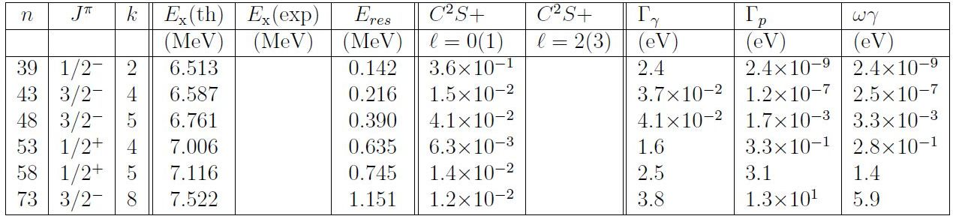
TABLE V: Properties of the rp-resonance states of both parities for transitions from the ground state of ³⁴ S

Slide 26
In the next figure we show the minimum and maximum rates from Gillespie and our result.
Above 2.7 GK [log₁₀ (T9) ~ 0.43] a statistical Hauser-Feshbach model (from Iliades 2001) was used by Gillespie et al. normalised to the minimum and maximum rates.

Slide 29
CONCLUSIONS
Our theoretical analysis for ^{34g,m}Cl(p,γ)³⁵Ar shows that the total rate for negative parity states is larger than for positive parity, and thus the many negative parity states in the energy region above threshold dominate the reaction rate.
The calculated rates take into account the relative populations of the ground and first excited states of ³⁴Cl as a function of temperature.

Slide 30
The contributions from the isomeric first excited state of ³⁴Cl for both positive and negative parity are small relative to that for the ground state at lower temperatures, but become dominant at higher temperatures.
The calculations also identify the most
prominent resonances in the reaction rates, and the analysis should serve as a guide for experiments as the spin-parity assignments of the most prominent resonances and their relative strengths are given.

Slide 31
In the comparison of our calculations for
³⁴ S(p,γ)³⁵Cl with the recent experiment of
Gillespie et al. on ³⁴S(³He,d)³⁵Cl there is good
agreement between the calculated total rate
and the experimental rate up to 2.7 GK,
except in the low-temperature region where
the theory is up to an order of magnitude
larger. The difference is due to the spectro-
scopic factor of the 1/2_(2) state. Adopting
the experimental value resolves the problem.
The contribution from negative parity also
dominates except for an intermediate region
near T ~ 1 GK. The dominant resonances are
also indicated.

Slide 32
Uncertainties in the reaction rates:
These will be obtained using a Monte Carlo sampling of shell-model uncertainties in the calculated resonance properties. The rate program is currently being modified to produce inputs for STARLIB.
**********

Slide 33
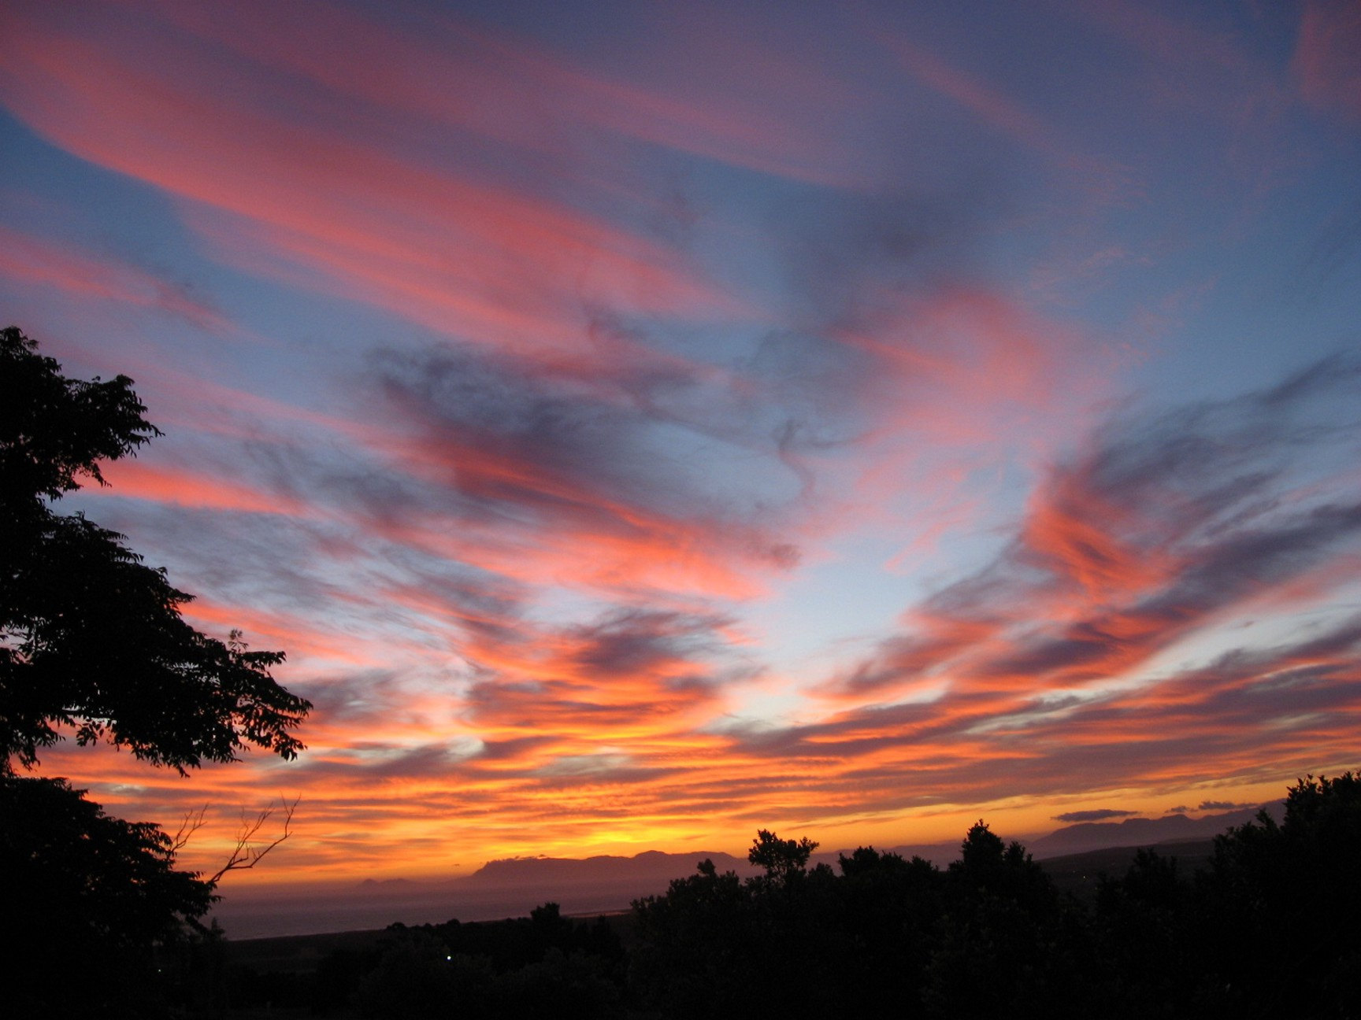
THANK YOU !
Thank you !

Slide 34
We need to find a way to put an error bar on the rates.
I attach a figure for the p (l=1) spectroscopic factors and labeled
the most important states from your table.
What we need to do is slide the whole spectrum up by about 1 MeV in 0.1 MeV steps
and get a rate for each one (the new input I sent amounts to moving everything up
by about 0.7 MeV). The min-max from the obtained rates will provide an error bar on the rates.
The point of this paper will be to discuss this error.
Perhaps you can modify the rp program (or the input) to do this.
If not we can discuss in Ischia.

Slide 35
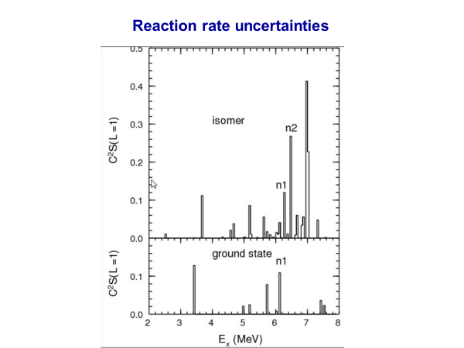

Slide 36
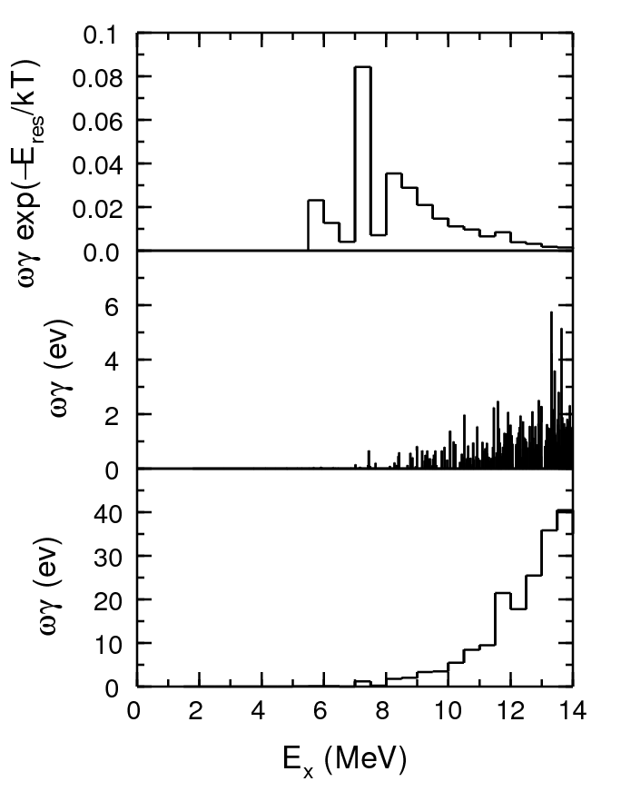
Figure 6. Relative contributions to the reaction rates for x = -E_{res} /(kT) with T9 = 10. Resonant reaction rate α Σ_{f} ωγ_{i f} e ^{-Eres /(kT)} .

Slide 37
