Slide 1

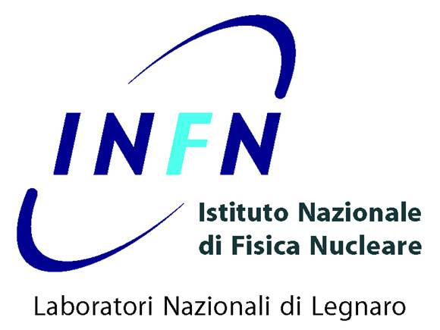
Multinucleon transfer processes in the ¹⁹⁷Au+¹³⁰Te reaction
studied with a high-resolution kinematic coincidence
Franco Galtarossa for the PRISMA collaboration
INFN Laboratori Nazionali di Legnaro
15th Varenna Conference on Nuclear Reaction Mechanisms
11-15 June 2018

Slide 2
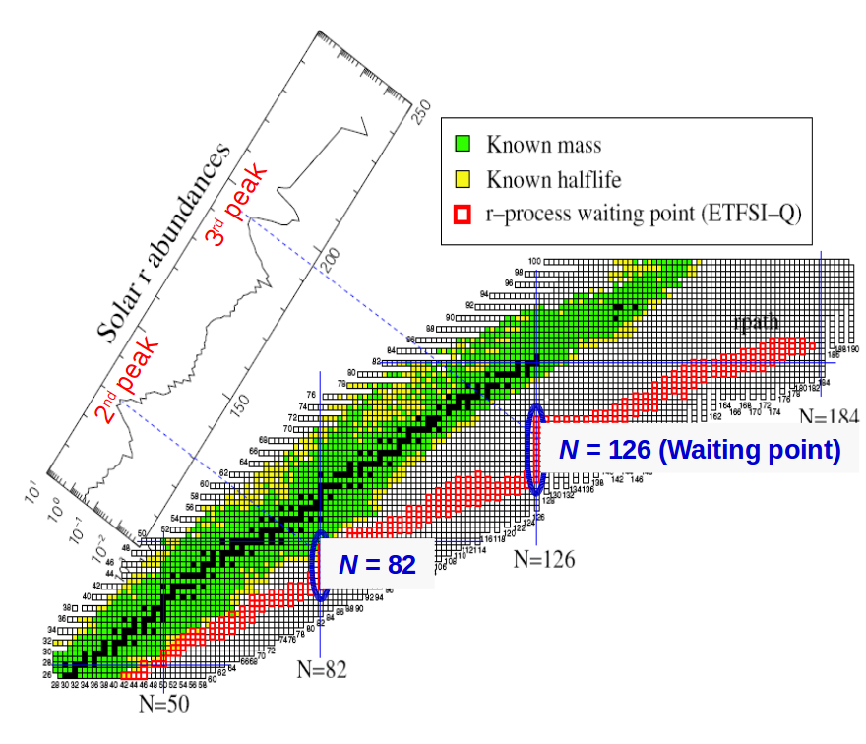
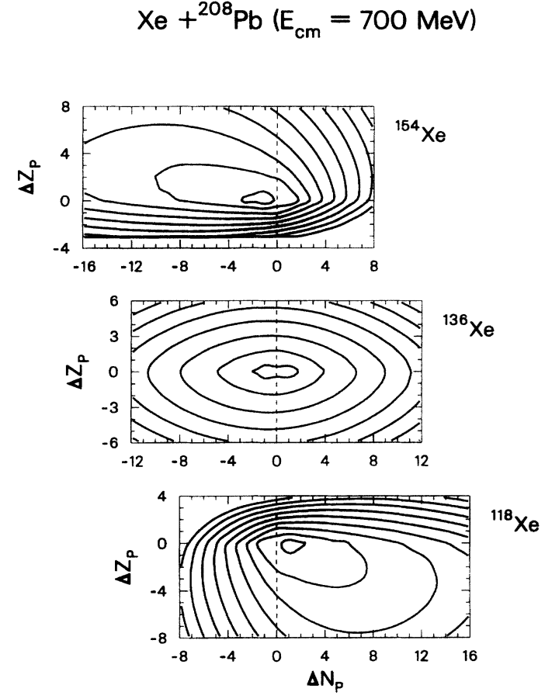
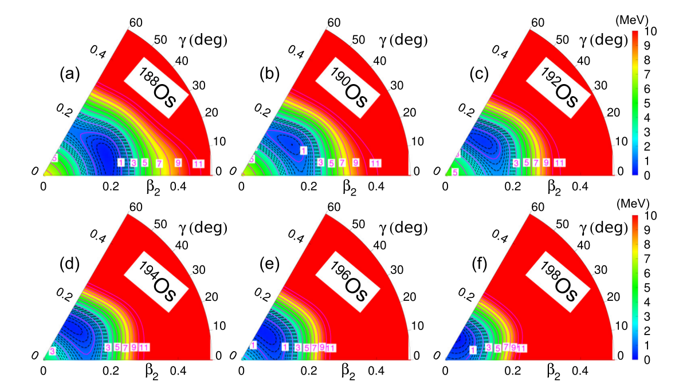
Motivation for the study of neutron-rich heavy nuclei
More accurate description of the reaction mechanism leading to the population of neutron-rich heavy nuclei
Nuclear structure studies in the vicinity of N=126
Astrophysical r-process
Investigation of prolate-to-oblate shape transition moving towards the neutron-rich Pt-Os region
P. R. John et al., PRC 90 (2014) 021301(R); PRC 95 (2017) 064321.
H.Grawe et al., Rep. Prog. Phys. 70 (2007) 1525
C. H. Dasso, G. Pollarolo, A. Winther, PRL 73 (1994) 1907
F. Galtarossa, INFN LNL
15th Varenna conference on Nuclear Reaction Mechanisms (11-15 June 2018)

Slide 3
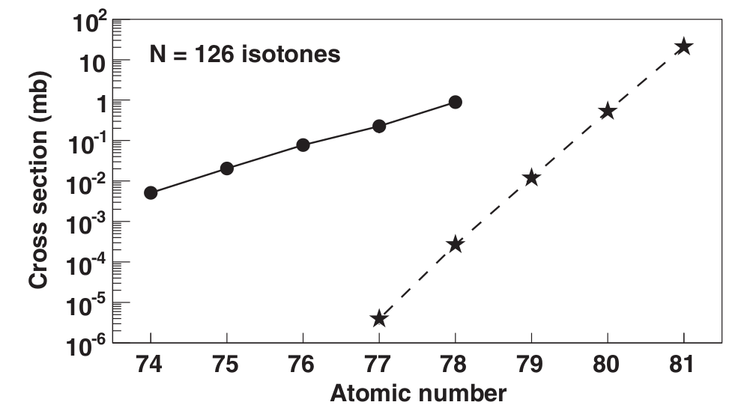
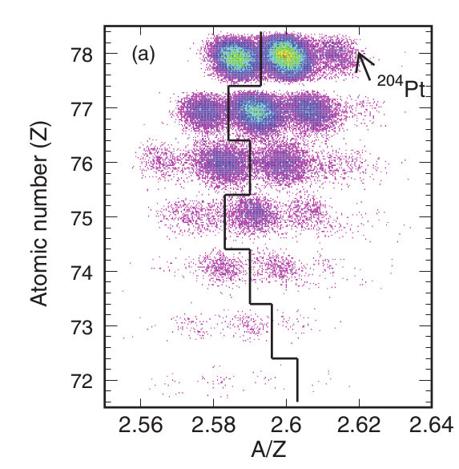
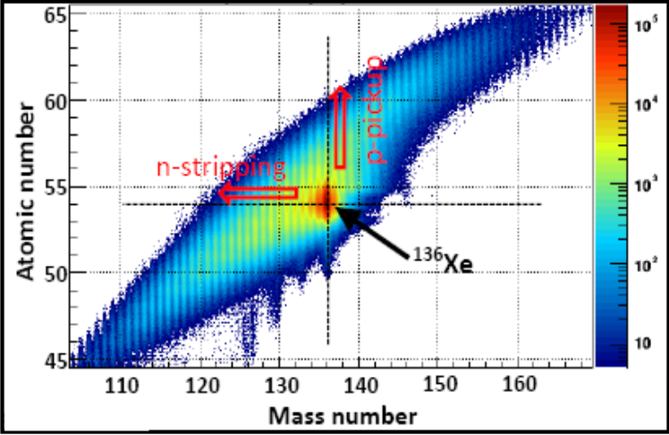
How to access neutron-rich nuclei close to N=126
It is important to understand which is the most suitable mechanism for the production of nuclei close to the Z = 82 and N = 126 region of the nuclide chart.
²⁰⁸Pb+Be @ 1 AGeV
Fragment Separator
In-flight separation
¹³⁶Xe+¹⁹⁸Pt @ 8 AMeV
VAMOS+EXOGAM
γ-particle coincidences
T. Kurtukian-Nieto et al., PRC 89 (2014) 024616
Y. X. Watanabe et al., PRL 115 (2015) 172503
Multinucleon transfer is a complementary mechanism to the fragmentation of actinides or lead on light targets for the population of heavy neutron-rich nuclei
BUT
direct identification is very difficult
F. Galtarossa, INFN LNL
15th Varenna conference on Nuclear Reaction Mechanisms (11-15 June 2018)

Slide 4
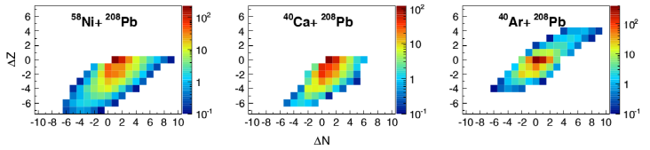
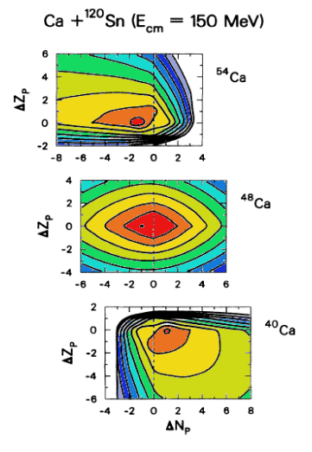
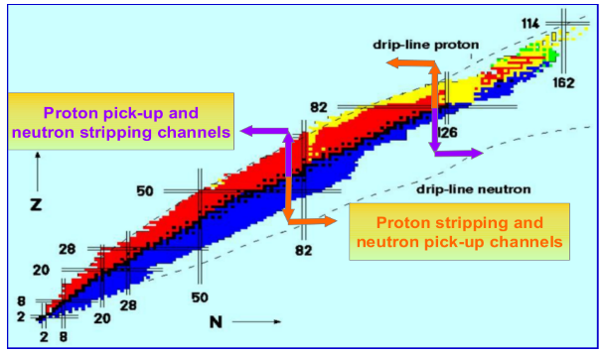
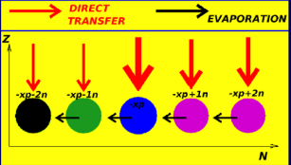
Populating neutron-rich nuclei via MNT reactions
T. Mijatović et al., PRC 94 (2016) 064616
C. H. Dasso, G. Pollarolo, A. Winther, PRL 73 (1994) 1907
F. Galtarossa, INFN LNL
15th Varenna conference on Nuclear Reaction Mechanisms (11-15 June 2018)

Slide 5
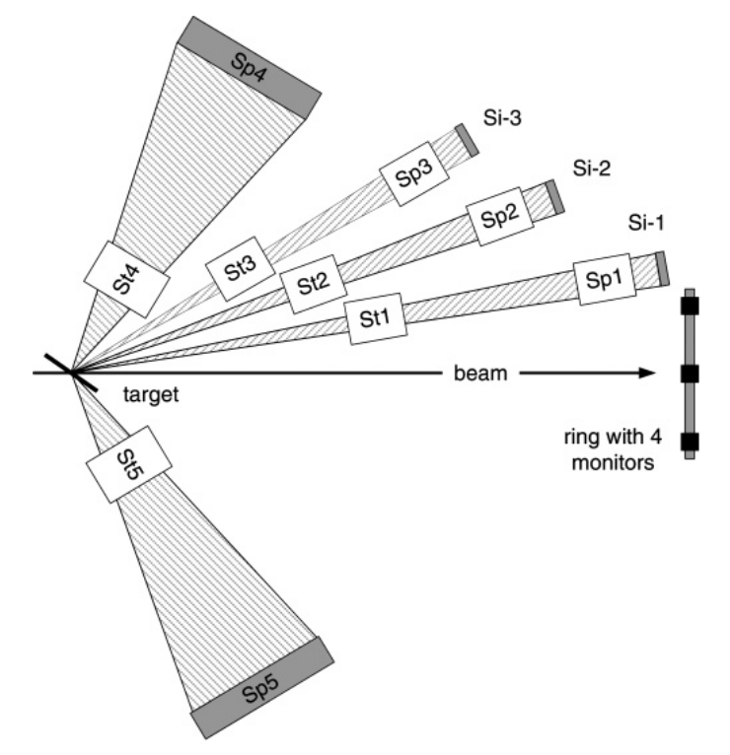
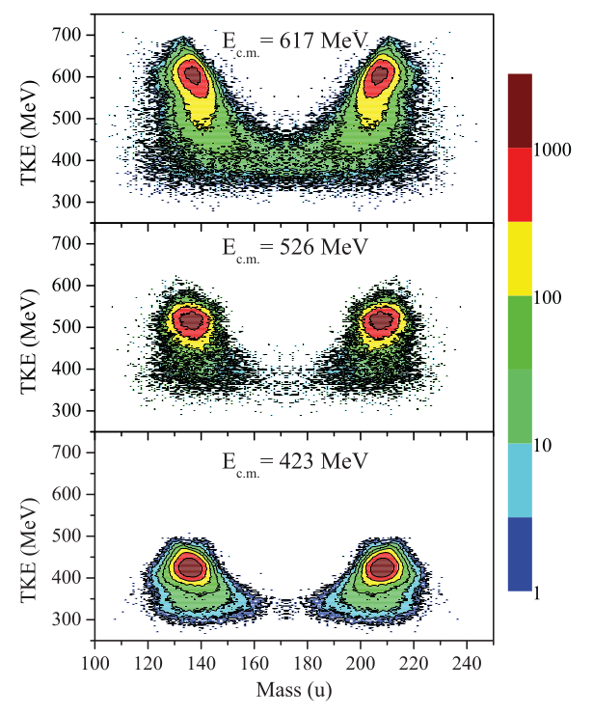
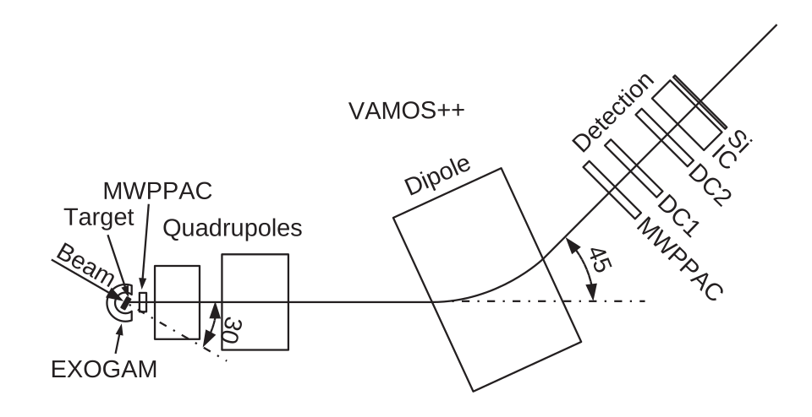
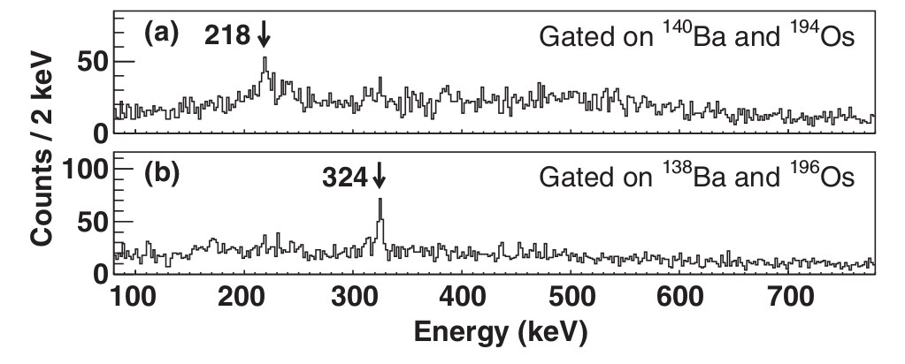
Exploring the neutron-rich heavy region via MNT
High-resolution but low-efficiency measurements, tagging the light partner with high-resolution spectrometers with the possibility to detect coincident Doppler-corrected γ rays of the heavy partner
High-efficiency but low-resolution kinematic coincidences between binary partners (direct or inverse kinematics)
Y. X. Watanabe et al., PRL 115 (2015) 172503
E. M. Kozulin et al., PRC 86 (2012) 044611
F. Galtarossa, INFN LNL
15th Varenna conference on Nuclear Reaction Mechanisms (11-15 June 2018)

Slide 6
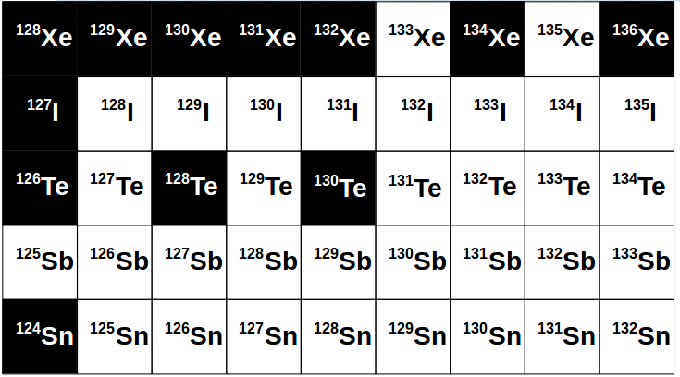
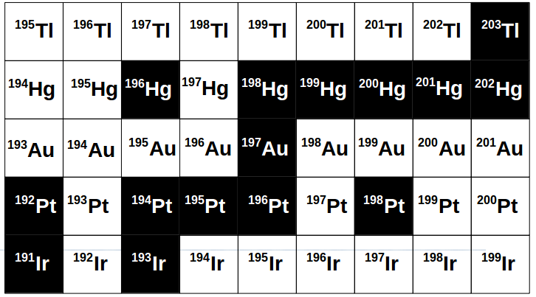
A benchmark system at LNL: ¹⁹⁷Au+¹³⁰Te @ 1.07 GeV
Goal: to understand the production mechanism for neutron-rich nuclei in the A=200 region and the effect of secondary processes on the final yields.
Via proton pick-up and neutron stripping channels from ¹³⁰Te one produces neutron-rich nuclei around A=200.
We will mainly focus here on neutron transfer channels
F. Galtarossa, INFN LNL
15th Varenna conference on Nuclear Reaction Mechanisms (11-15 June 2018)

Slide 7
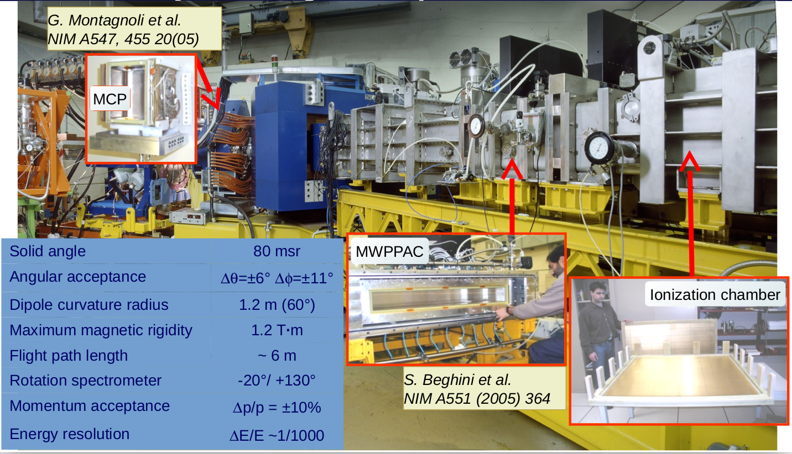
The large-acceptance magnetic spectrometer PRISMA
F. Galtarossa, INFN LNL
15th Varenna conference on Nuclear Reaction Mechanisms (11-15 June 2018)

Slide 8
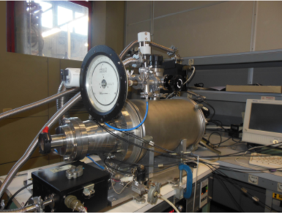
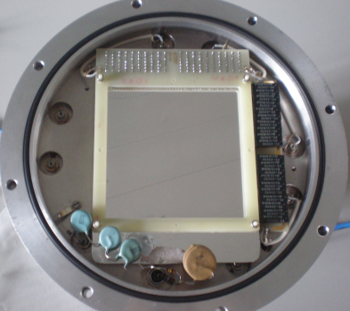
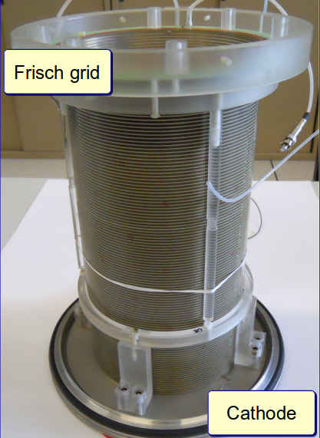
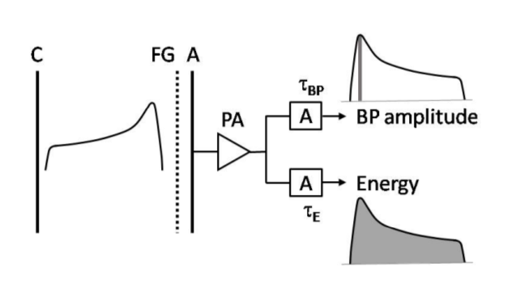
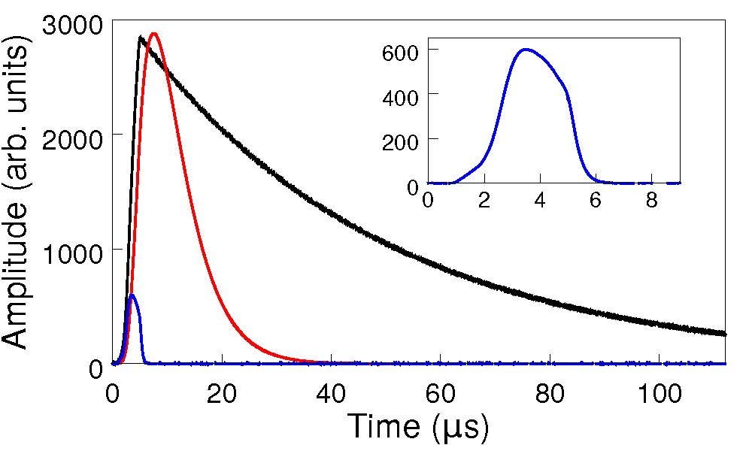
NOSE, an ancillary particle detector coupled to PRISMA
NOSE
MWPPAC
Axial-field IC
Bragg Curve Spectroscopy
E. Fioretto et al., NIM A 899 (2018) 73-79
F. Galtarossa, INFN LNL
15th Varenna conference on Nuclear Reaction Mechanisms (11-15 June 2018)

Slide 9
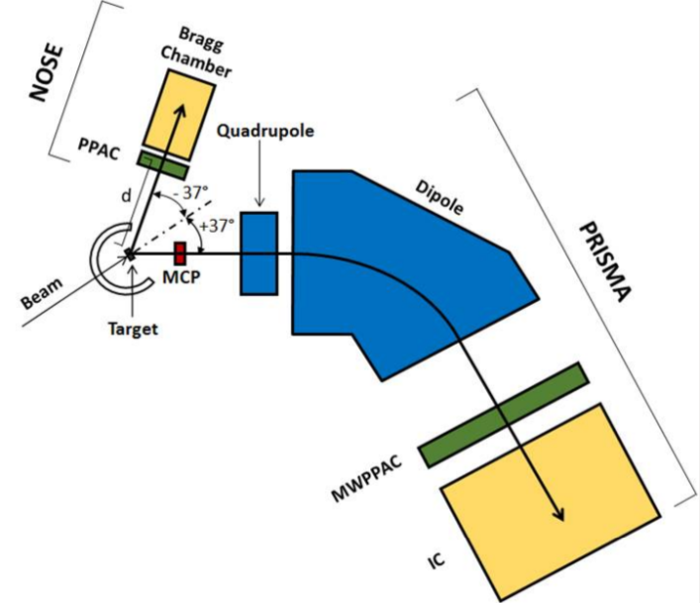
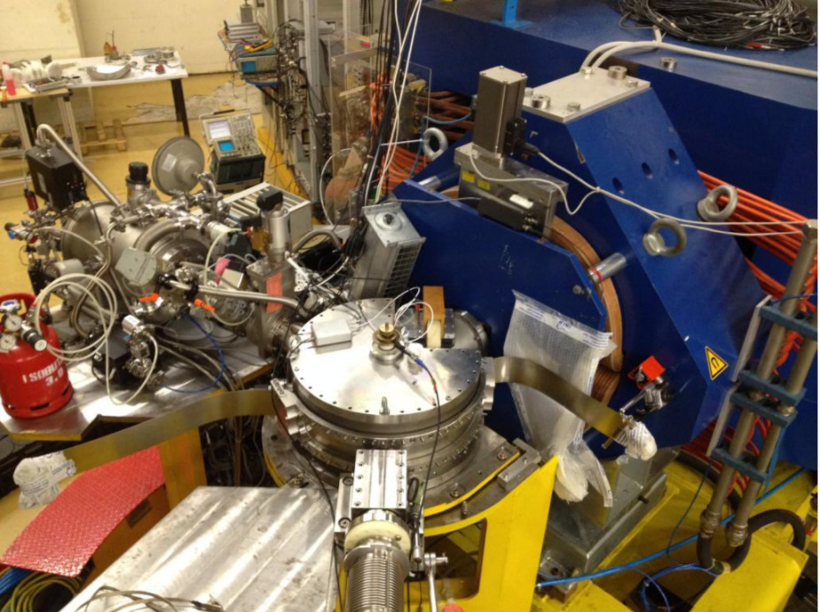
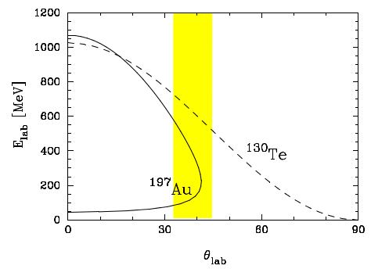
The experimental set-up
TLF in PRISMA (master trigger)
(x, y) at the entrance MCP -> (θ, φ)
(X, Y) at the MWPPAC
ToF between MCP and MWPPAC
Z from E-ΔE in the IC
PLF in NOSE
(x’, y’) at the entrance PPAC -> (θ, φ)
ΔToF between PRISMA MCP and NOSE PPAC
Z from E-ΔE in the IC
F. Galtarossa, INFN LNL
15th Varenna conference on Nuclear Reaction Mechanisms (11-15 June 2018)

Slide 10
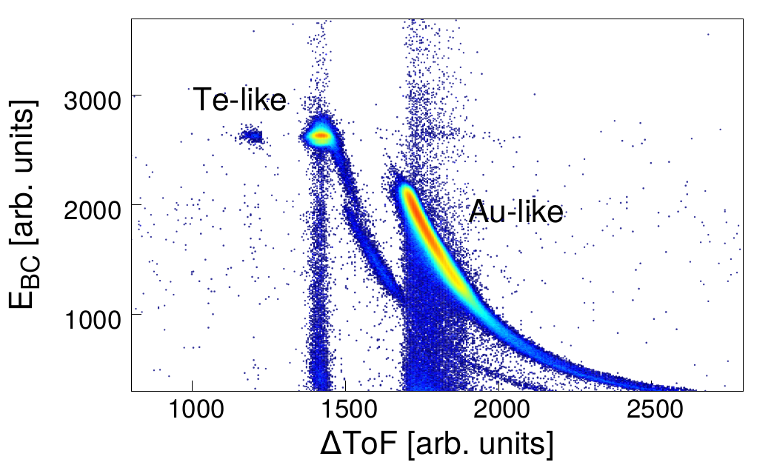
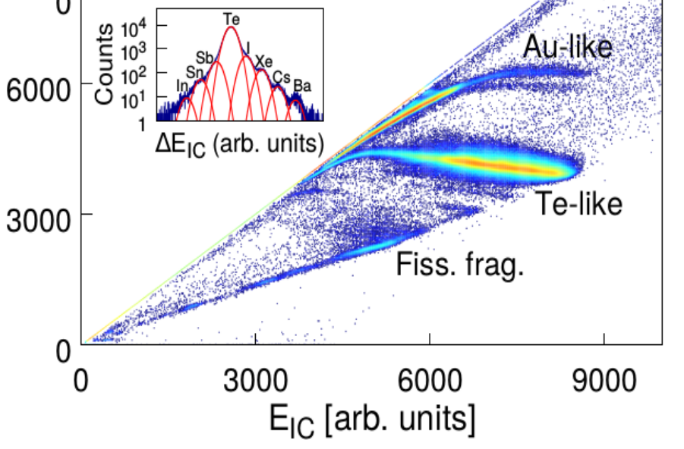
Z identification in PRISMA and NOSE
In PRISMA (optimized for the light partner) the Z resolution is sufficient to distinguish different proton transfer channels, which nonetheless have very low cross section at this low bombarding energy.
In NOSE (optimized for the heavy partner) the PLF and TLF can be clearly separated but no Z identification is possible due to the very low energy of Au-like ions.
ΔE_{IC} [arb. units]
F. Galtarossa, INFN LNL
15th Varenna conference on Nuclear Reaction Mechanisms (11-15 June 2018)

Slide 11
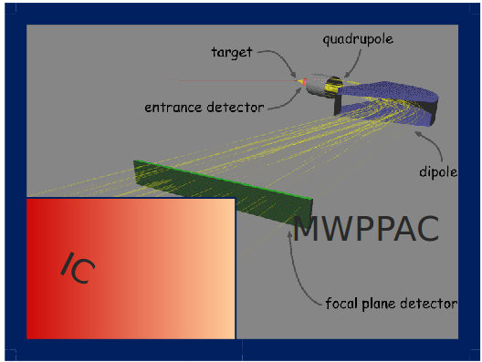
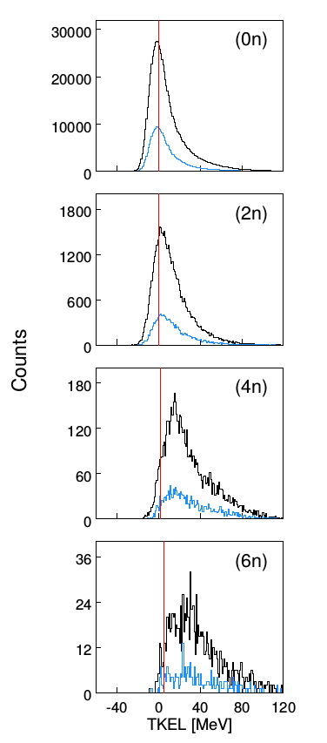
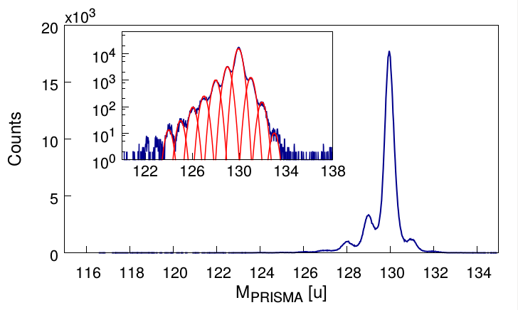
Mass identification of the light partner
Through an event-by-event trajectory reconstruction in PRISMA the mass distribution of Te ions is obtained. The yields are extracted with a multi-Gaussian fit.
Total kinetic energy loss (TKEL) distributions are obtained for the different transfer channels, showing an increasing contribution of DIC components as more neutrons are transferred.
ΔA/A ~ 1/240
F. Galtarossa, INFN LNL
15th Varenna conference on Nuclear Reaction Mechanisms (11-15 June 2018)

Slide 12
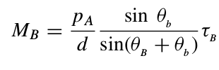
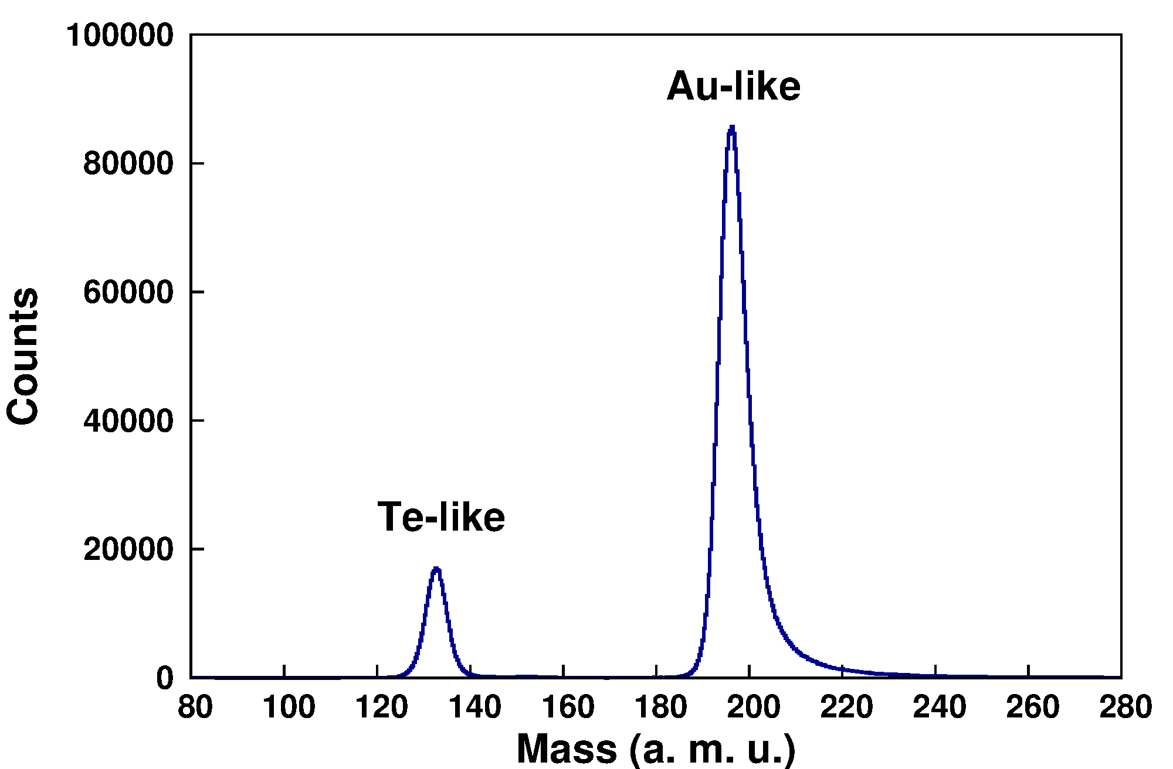
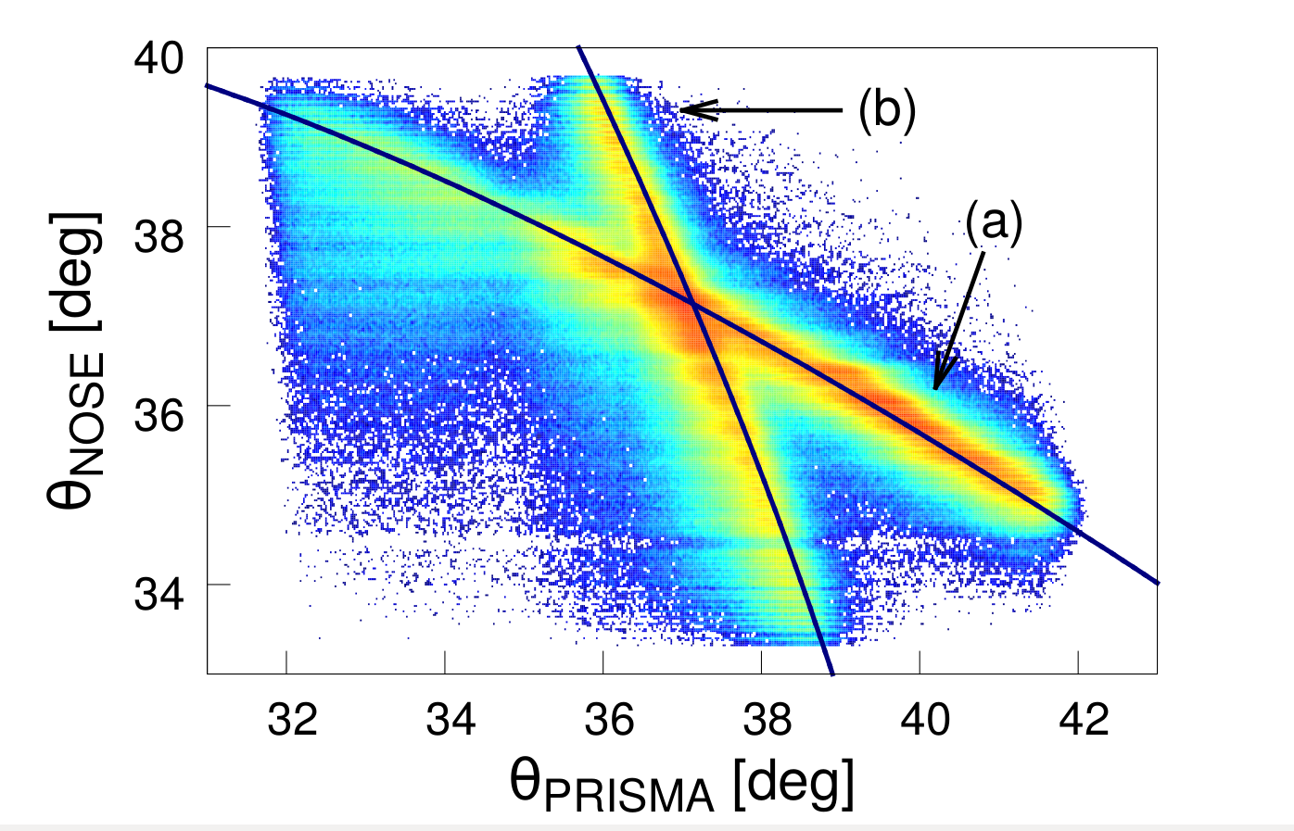
Mass reconstruction of the heavy partner
A+a → B+b, where A is the heavy projectile (Au) and a the target nucleus (Te). The mass M_{B} of the heavy PLF can be deduced from momentum conservation assuming a binary character of the reaction.
ΔA/A ~ 1/40
F. Galtarossa, INFN LNL
15th Varenna conference on Nuclear Reaction Mechanisms (11-15 June 2018)

Slide 13
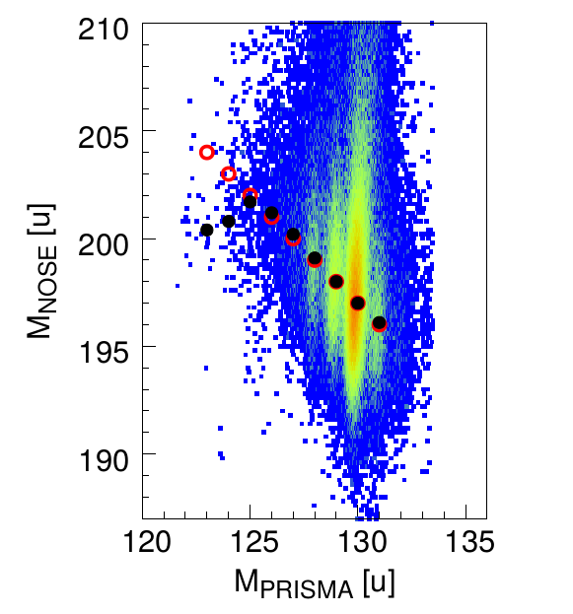
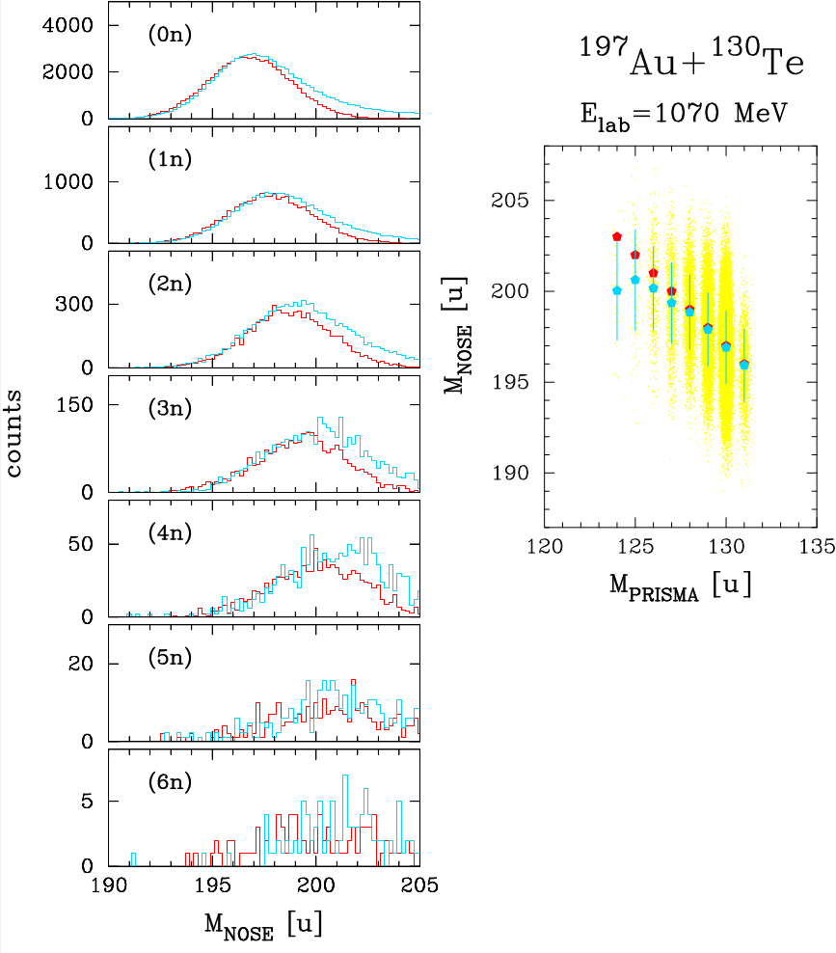
Mass-mass correlation matrix
The simulations incorporate a successive evaporation of neutrons with a uniform energy distribution and take into account the experimental resolution.
F. Galtarossa et al., PRC 97 (2018) 054606
F. Galtarossa, INFN LNL
15th Varenna conference on Nuclear Reaction Mechanisms (11-15 June 2018)

Slide 14
The GRAZING code
The GRAZING code calculates distributions in masses, charges, energies and angular momenta of fragments in collisions between heavy nuclei according to a semiclassical model. This model has been successfully applied in the description of transfer reactions and can reproduce the near-barrier fusion excitation functions and extract barrier distributions.
The trajectory is calculated by solving the system of classical equations for the variables of relative motion and the deformation parameters for the surface modes. The two ions interact via a Coulomb plus nuclear interaction and may exchange nucleons.
The exchange of many nucleons proceeds via a multi-step mechanism of single nucleons (both, protons and neutrons, via stripping and pick-up processes). The different single-particle states that are participating to the transfer process are described by introducing average single-particle level densities.
The model includes the low-lying 2+ and 3− states of both projectile and target.
program GRAZING. http://www.to.infn.it/nanni/grazing
A. Winther, NPA 572 (1994) 191; NPA 594 (1995) 203.
F. Galtarossa, INFN LNL
15th Varenna conference on Nuclear Reaction Mechanisms (11-15 June 2018)

Slide 15
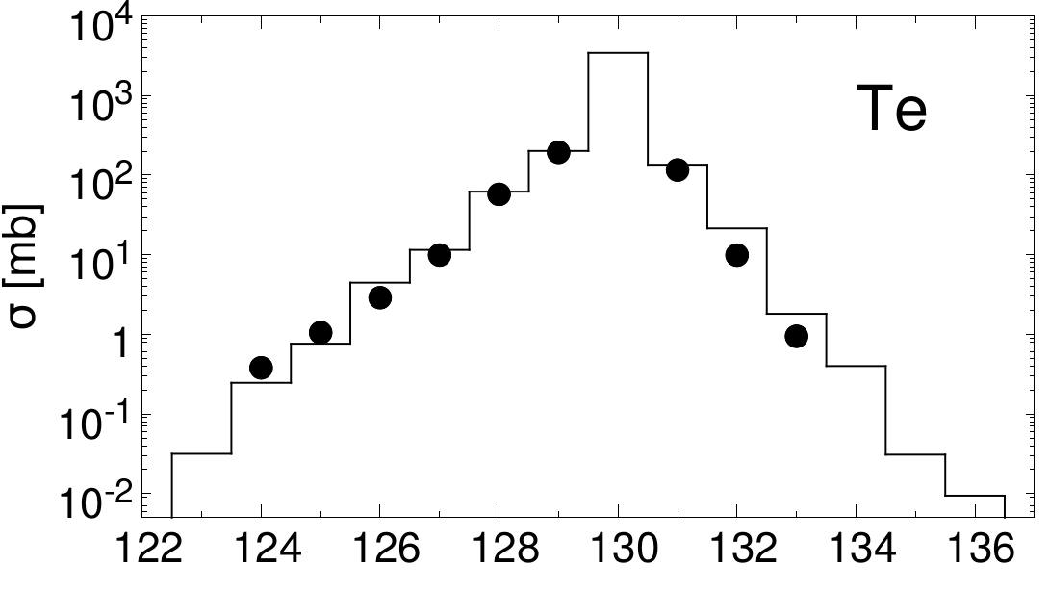
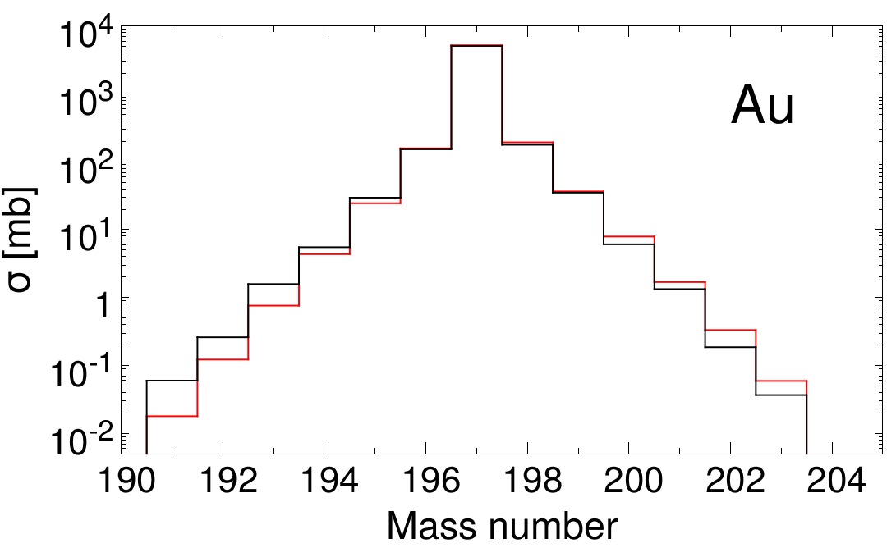
Comparison with GRAZING predictions
The cross sections for neutron transfer channels were compared to GRAZING after normalizing to the (1n) channel. GRAZING calculations include the effect of neutron evaporation.
The good agreement between experimental and theoretical cross sections and between experimental and simulated mass distributions of the heavy partner allows us to show the predictions of the same code for the production of Au isotopes.
Mass number
F. Galtarossa, INFN LNL
15th Varenna conference on Nuclear Reaction Mechanisms (11-15 June 2018)

Slide 16
Conclusions
We studied MNT processes in the ¹⁹⁷Au+¹³⁰Te system at E_{lab} = 1.07 GeV with a kinematic coincidence where one of the two detectors was a high-resolution large-acceptance magnetic spectrometer;
We determined the mass of the light partner in PRISMA through an event-by-event trajectory reconstruction and the mass of the heavy partner in NOSE from momentum conservation;
We correlated the masses of the light and heavy partner in a mass-mass correlation matrix and through the comparison with a simple Monte Carlo simulation we could follow the behavior of the heavy partner and infer about the effect of evaporative processes;
We compared the measured cross sections for neutron transfer channels of the light partner with GRAZING calculations and showed its prediction for the heavy partner.
F. Galtarossa, INFN LNL
15th Varenna conference on Nuclear Reaction Mechanisms (11-15 June 2018)

Slide 17
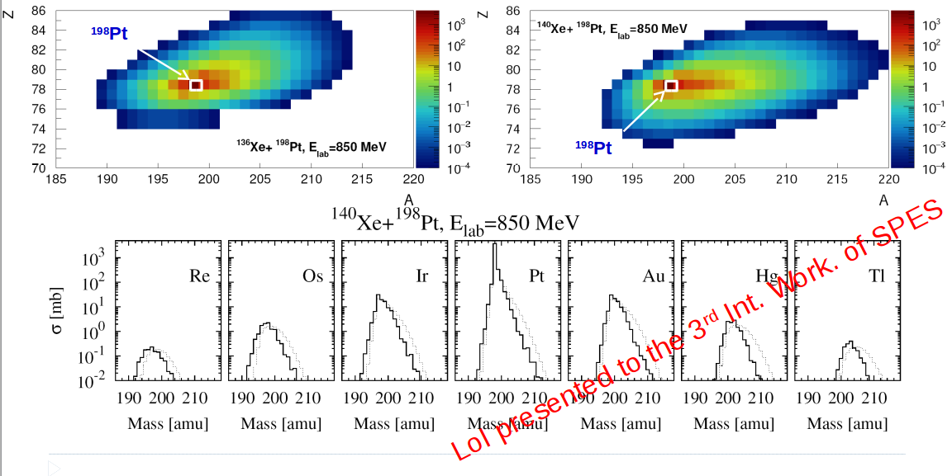
Perspectives: towards SPES, a RIB facility @ LNL
Cortesy of E. Fioretto
F. Galtarossa, INFN LNL
15th Varenna conference on Nuclear Reaction Mechanisms (11-15 June 2018)

Slide 18
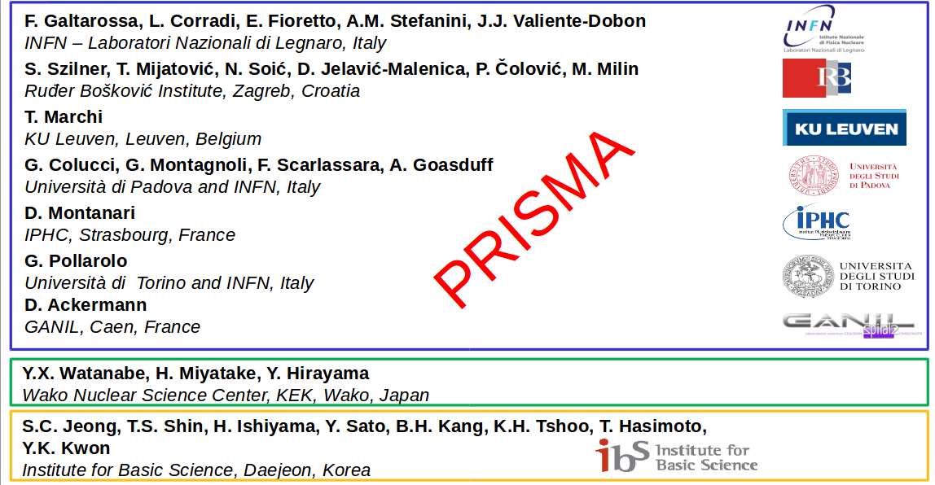
Collaboration
F. Galtarossa, INFN LNL
15th Varenna conference on Nuclear Reaction Mechanisms (11-15 June 2018)

Slide 19
Backup slides

Slide 20
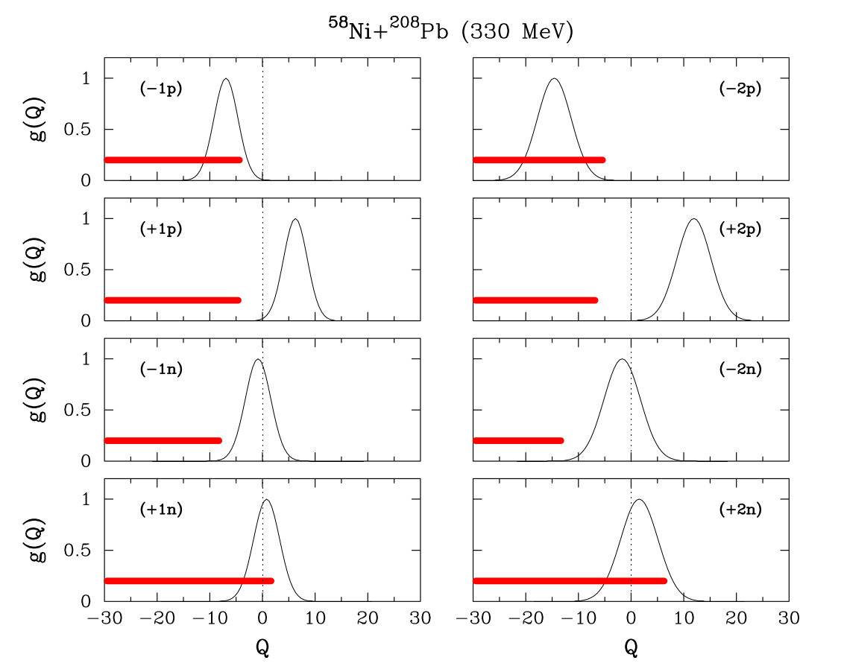
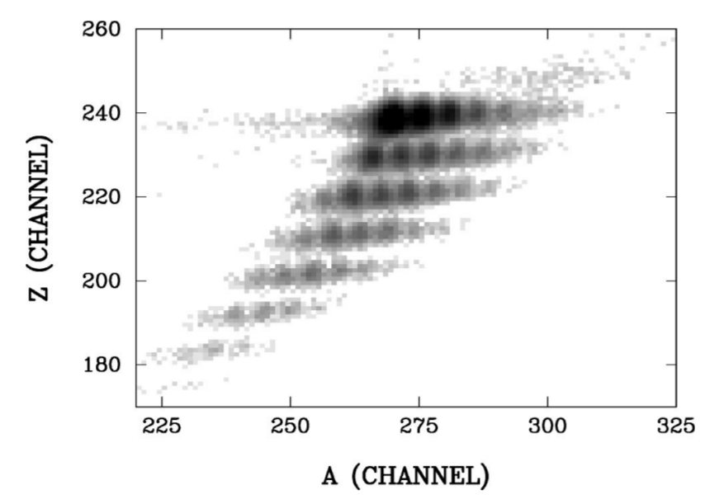
Multinucleon transfer reactions at barrier energies
Multinucleon transfer reactions at energies around the Coulomb barrier are governed by optimum-Q-value considerations.
With a neutron-poor projectile only proton stripping and neutron pick-up channels are open.
F. Galtarossa, INFN LNL
15th Varenna conference on Nuclear Reaction Mechanisms (11-15 June 2018)

Slide 21
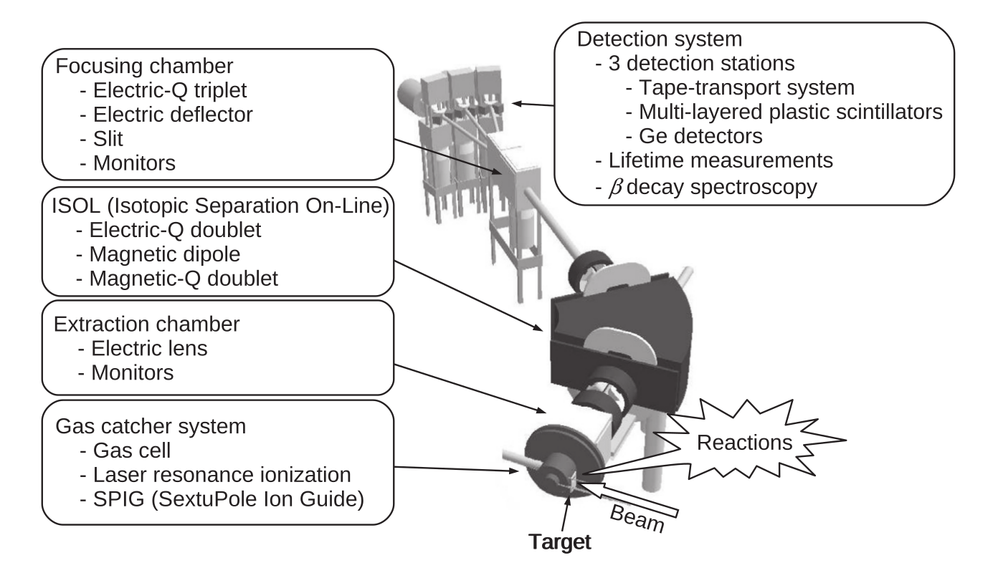
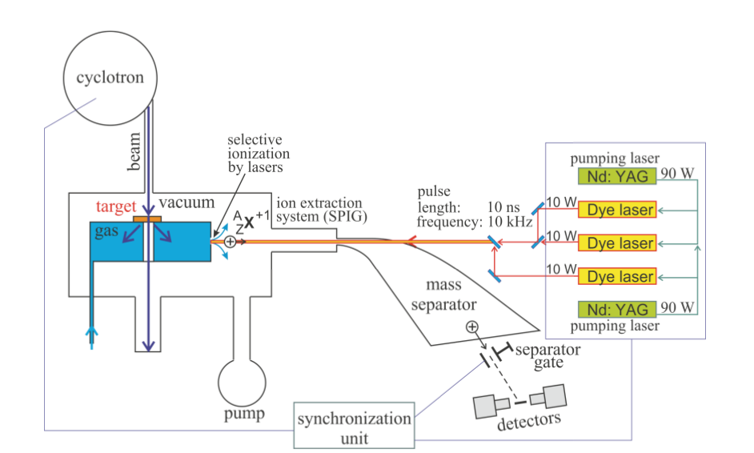
New set-ups for β and γ spectroscopy of heavy nuclei
KEK Isotope Separator System (KISS) for β-decay spectroscopy of neutron-rich nuclei with A~200 and N~126
Gas cell and Laser ion & Separation (GaLS) setup for β spectroscopy of neutron-rich nuclei at N~126
F. Galtarossa, INFN LNL
15th Varenna conference on Nuclear Reaction Mechanisms (11-15 June 2018)

Slide 22
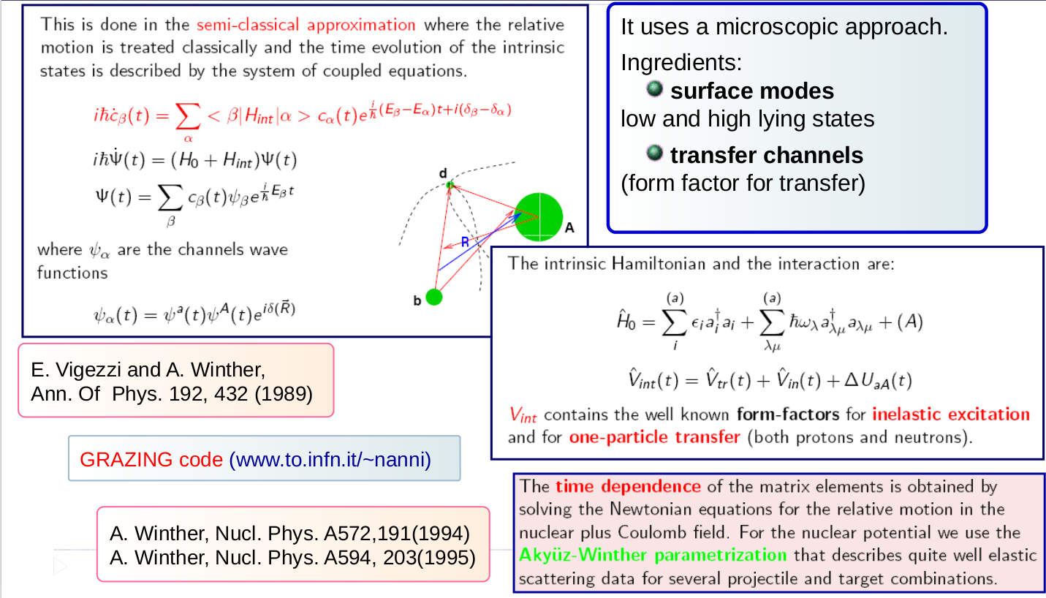
GRAZING
F. Galtarossa, INFN LNL
15th Varenna conference on Nuclear Reaction Mechanisms (11-15 June 2018)

Slide 23
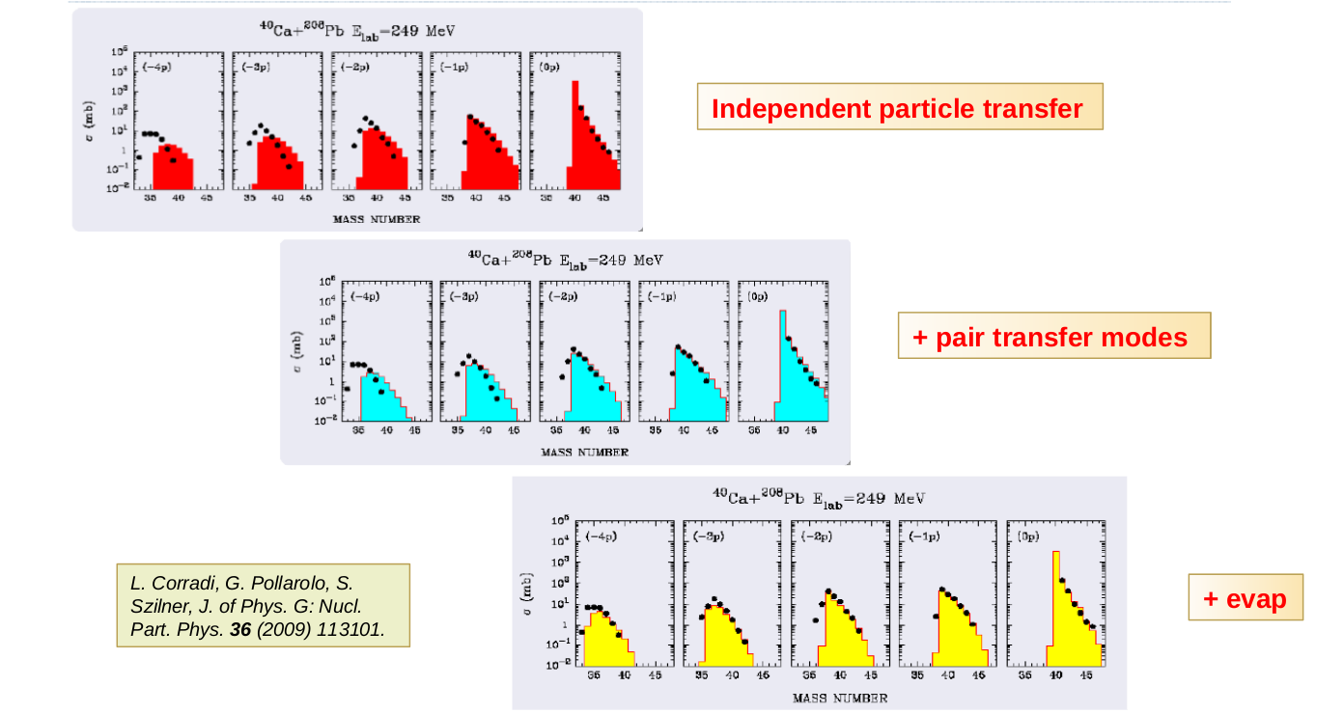
GRAZING
F. Galtarossa, INFN LNL
15th Varenna conference on Nuclear Reaction Mechanisms (11-15 June 2018)

Slide 24
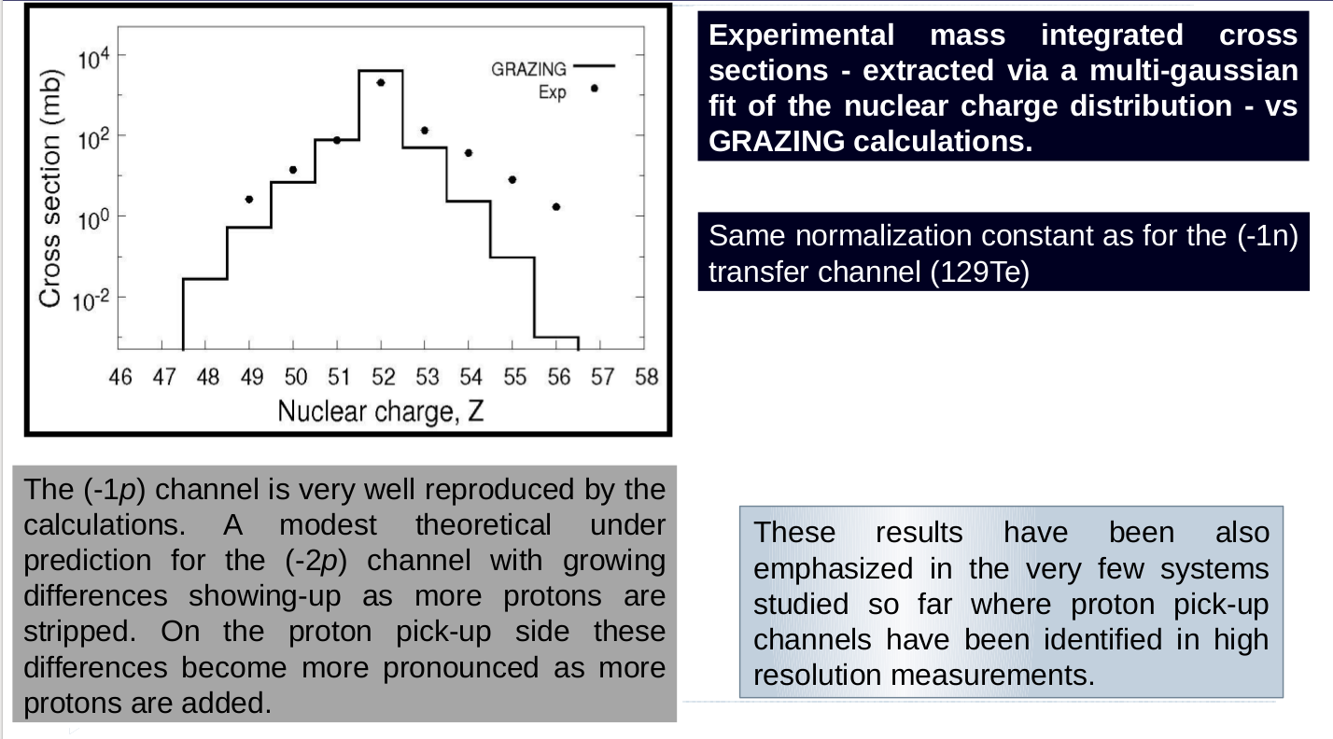
Proton transfer channels
F. Galtarossa, INFN LNL
15th Varenna conference on Nuclear Reaction Mechanisms (11-15 June 2018)

Slide 25
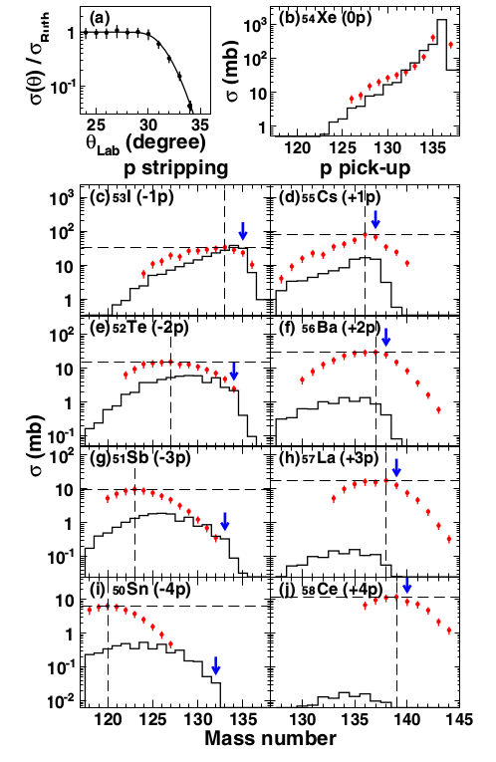
Comparison with the ¹³⁶Xe+¹⁹⁸Pt system
F. Galtarossa, INFN LNL
15th Varenna conference on Nuclear Reaction Mechanisms (11-15 June 2018)

