Slide 1
How physics helped me to survive behind the Iron Curtain and what happened after its fall
15th Varenna Conference on Nuclear Reaction Mechanisms
Evening Session, 13 June 2018
Pavel Obložinský
Slovak Academy of Sciences, Bratislava (1967-1993)
IAEA Nuclear Data Section, Vienna (1993-2000)
Brookhaven National Laboratory, Upton, NY (2000-2011)

Slide 2
Contents
Bratislava and Iron Curtain
Miracle in the socialistic misery: Smolenice Castle
Preequilibrium modelling of nuclear reactions
From Bratislava to Vienna, 1993
My toughest moment in the IAEA: Arima Panel, 1995
My pleasant moments in the IAEA: research projects
From Vienna to US National Nuclear Data Center, 2000

Slide 3
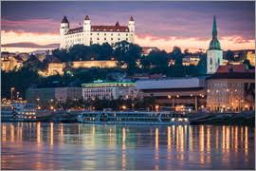
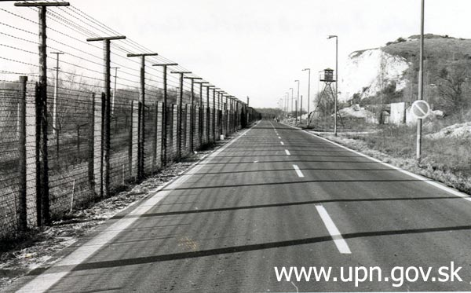
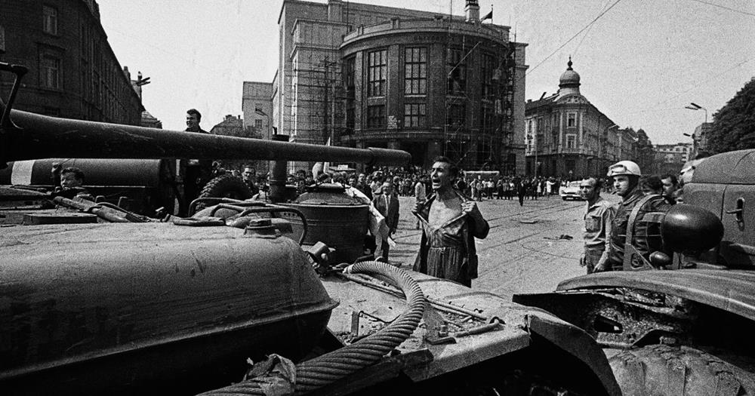
Bratislava and Iron Curtain
Bratislava: capital of Slovakia since 1918
  It has 3 very different names
  Pressburg in German, with Germans dominating for centuries
  Pozsony in Hungarian, capital of Hungary
  in 1563-1830 (coronations of 10 kings,
  1 lady king Maria-Theresa and 8 queens)
  Located on Danube, directly on the border with Austria, 65 km to Vienna
I was born less than 1 km from Austria
  If the Almighty would made just a tiny
  correction in delivery…
  I have seen the Iron Curtain every day, causing me enormous frustration
Witnessed Soviet tanks in August 1968
  Shaped my views on communism
Active participant in the 1989 Velvet Revolution
  Top representative of the Slovak Acad. Sci. for 3 critical weeks in 1989
  Addressed crowd of 100 000 people …
Bratislava: castle, dome, Danube
Bratislava: Iron Curtain
Bratislava: tanks, August 1968

Slide 4
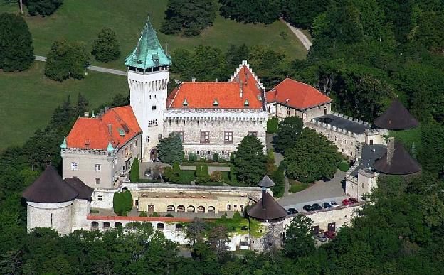
Miracle in the socialistic misery: Smolenice Castle
The biggest asset of the Slovak Academy of Sciences: Smolenice Castle
1974-1989 a series of conferences on Neutron-induced Reactions helped us to keep in touch with colleagues from both
  West (Blann, Cindro, Gadioli, Hodgson, Iwamoto, Raman, Reffo, Vonach, Weidenmüller, …)
  East (Ignatyuk, Russia, then 47: his 1st foreign trip ever, in 1979, numerous tricks used!)
Preequilibrium model was hot
topic which put us all together
IAEA meeting in 1983
  235U and 252Cf fission
  Evaluation guru: W. Poenitz
  1st meeting USA attended after
international boycott of Israel for
its 1981 bombing of Iraqi reactor
  50 phone calls to Prague to get
  permit: „We do not object…“
  My 1st touch with nuclear data
Jewel of Carpathian Mountains, 55 km from Bratislava,
owned by the Slovak Academy of Sciences since 1953

Slide 5
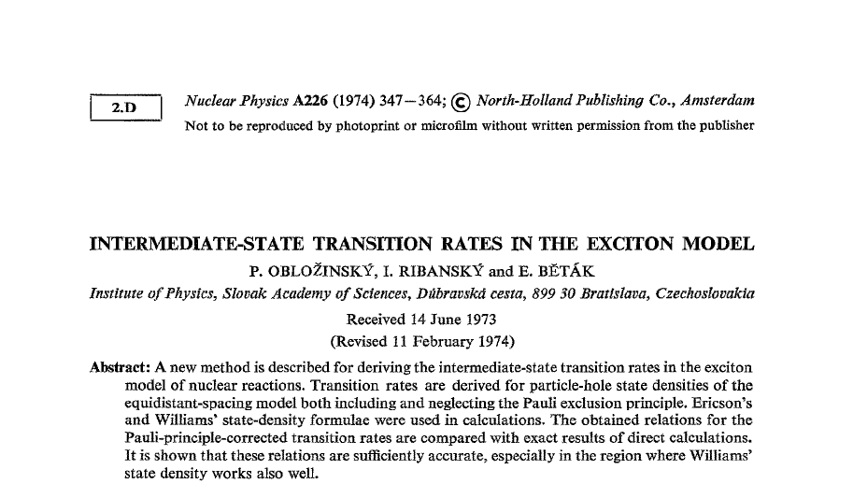
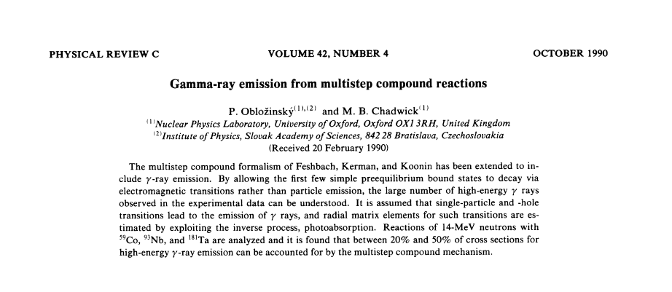
Preequilibrium modelling of nuclear reactions
In 1966, J. Griffin came with a sort of revolutionary idea of preequilibrium reactions
  Our young group in Bratislava jumped on it: transition rates, complex particle emission,
  p-h level densities, master
equation, γ emission, …
  My collaboration with Mark Chadwick, his 1st PRC paper
Preequilibrium influenced the
whole generation of nuclear
reaction physicists
  Today, many preequilibrium guys have important positions in nuclear data (M.Chadwick, M. Herman, A. Koning…)
Nucl. Phys. A226, 1974
Transition rates, my PhD
Phys. Rev. C42, 1990
Mark Chadwick‘s 1st PRC paper

Slide 6
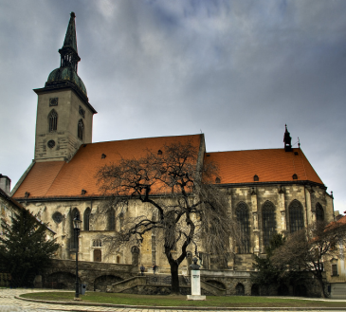
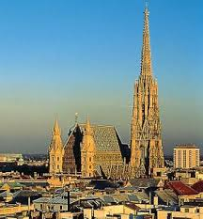
From Bratislava to Vienna, 1993: cultural shock
I got position in the IAEA Nuclear Data Section, Vienna as deputy section head in 1993
  It looked simple: 1 hour drive, cross the Danube from the left side to right side and that‘s it
Cultural shock, threefold
  I was crossing the Iron Curtain regularly, it took me a year to get used to it
  Bratislava was gray, Vienna was colorful
  My salary jumped by a factor of 20: from 9 000 crowns to 60 000 schillings (rate 3:1), taxfree, leading to psychological problem: for what they pay me so much?
Vienna started my career in nuclear data
  My 1st boss was Charlie Dunford, head of the US National Nuclear Data
  Charlie served in the IAEA for two years (1993-1995) as a sort of crisis manager
Distance from the Gothic Cathedral of St. Martin in Bratislava to St. Stephan‘s Dome in Vienna is just
66.4 km according to the historical border stone
St. Martin, Bratislava
St. Stephan, Vienna

Slide 7
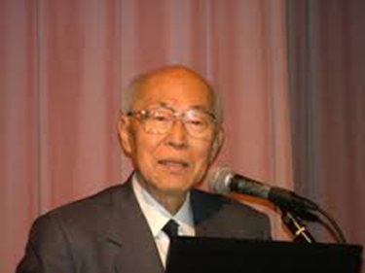
My toughest moment in IAEA: Arima Panel 1995
Dense atmosphere around the IAEA Nuclear Data Section
Post-Chernobyl trauma, strong anti-nuclear feelings everywhere, IAEA wanted to show due response and shift money from nuclear data program (research) to safety
Charlie left in July 1995 and I was put in charge: he told me - do not worry, nothing can happen in summer in the IAEA
  IAEA management figured that this is the right moment for an action
  They grossly underestimated my resolve and experience fighting bureaucracies
  Nuclear data world was strongly coupled (IAEA funding goes down -> US is next, etc)
  I felt that whole ND world lies on my shoulders
High-ranking review panel, chair Arima
Panel was put together with unsual speed
Our response was vigorous
  Numerous colleagues and friends were allerted
  Message delivered to all members of the panel
Panel met in Vienna for 2 days in August 1995
  Shock to management: positive outcome!
  Full report in September, acknowledged
  after 3months of bitter IAEA maneuvering…
Akito Arima: IBM model, RIKEN
Director, Mr. Science of Japan

Slide 8
My pleasant moments in IAEA: research projects
Reference Input Parameter Library (RIPL)
  In 1990-ies it took weeks to prepare input for nuclear reaction model calculations
  RIPL shortened it dramatically
  RIPL-1 published in 1998
  IAEA had rigid planning system which I mastered using know-how from socialistic Czechoslovakia, smuggled RIPL-2 into the IAEA planning book to ensure due follow-up
  RIPL-2 (Mike Herman)
  RIPL-3 (Roberto Capote)
  This library is widely used around the world
Medical radioisotope production
  Suggested by Syed Qaim, then chair of the International Nuclear Data Committee
  Finished in 2000, of continued interest
  Two talks at this Conference (Qaim, Capote)
RIPL-1 Project: 1994-1997
Technical officer: P. Obložinský
Chair: P. Young, LANL

Slide 9
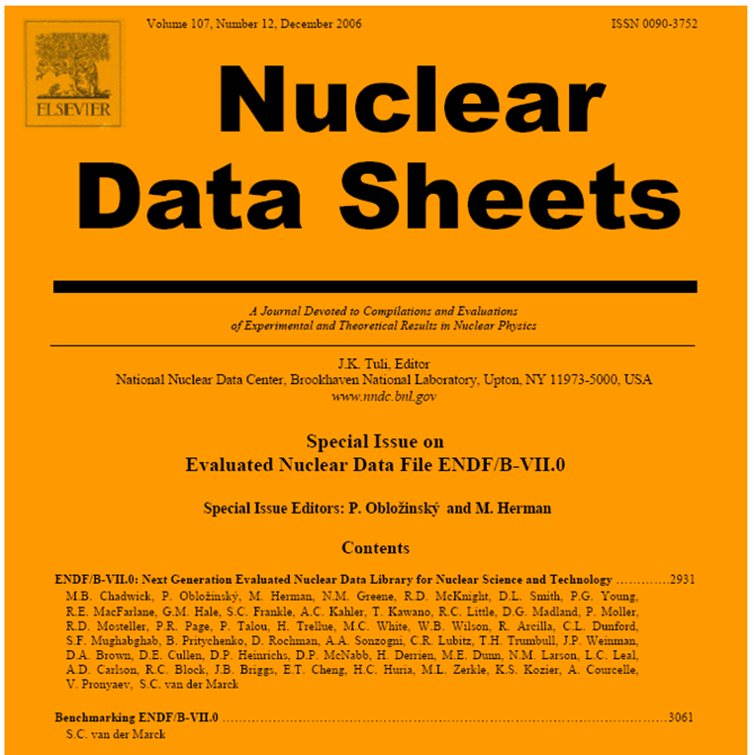
From Vienna to USA, 2000
(US National Nuclear Data Center, BNL)
I moved from the right side of Danube to the right side of Atlantic in 2000
  After staying in Vienna for 7 years, Charlie Dunford (NNDC head) brought me to BNL
  Charlie‘s plan stunned me: come as my deputy, then we switch positions and
  you will become the boss!
  I was sure this will not work and told
  Ludmila: I cannot say no to Charlie, but I
  can ensure you that in 1 year we are back
  It worked, I was NNDC head for 7 years and
  we stayed in BNL double 1=11 years
Achievement: ENDF/B-VII.0 library, 2006
  Major release of the US evaluated nuclear
  data library for science & technology
  Huge collective effort since 1966
  For the 1st time duly published, in Nuclear
  Data Sheets, pioneering effort driven by
  Mark Chadwick and myself
  Why it is my most cited paper and
  how I fought with Mark over articles (the, a)
  and his Oxford English…
I will stop here as Mike covered the rest…
1st Special Issue on Nuclear
Reactions, Dec 2006

Slide 10
Thank you!
In 2011, I retired from BNL and returned to Bratislava where I have been waiting for 7 years to get award in Varenna

