Slide 2
LIU-PS Beam Dynamics
Working Group
LIU-PS Beam Performance Meeting
23 November 2017
H. Damerau, V. Forte, M. Fraser, A. Huschauer, A. Lasheen

Slide 3
LIU-PS Beam Dynamics Working Group
Mandate
  Offer a forum for detailed discussion between experts from all fields
  List the required LIU studies with milestones, timeline and responsible person
  Ensure that the work remains focused on the agreed topics and provide timely results
  Cover LIU related topics from PSB to PS injection to PS flat top. Include PS-to-SPS transfer, in collaboration with SPS BD WG and LIU-SPS management
  Present activity outcomes to dedicated LIU PT meetings
  Cover both protons and ions
Launched on 23 August 2017
7 meetings for far, one more to come in 2017, alternating topics
  3 meetings dedicated to PS injection studies
  4 meetings on longitudinal and transverse issues in the PS ring
Detailed list of topic and priorities attached to indico page
  Latest version: https://indico.cern.ch/event/680681/

Slide 4
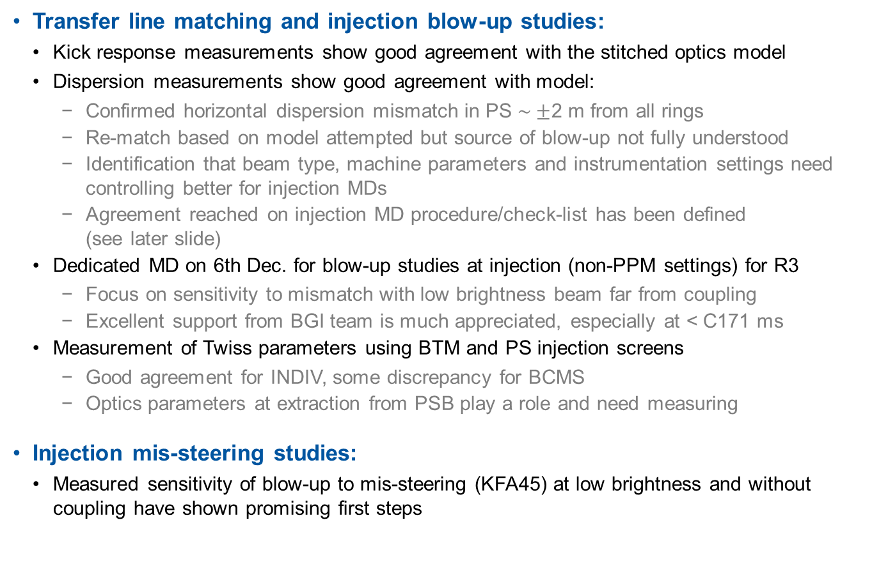
Transfer and injection studies I
Transfer line matching and injection blow-up studies:
  Kick response measurements show good agreement with the stitched optics model
  Dispersion measurements show good agreement with model:
    Confirmed horizontal dispersion mismatch in PS $\sim ±$2 m from all rings
    Re-match based on model attempted but source of blow-up not fully understood
    Identification that beam type, machine parameters and instrumentation settings need controlling better for injection MDs
    Agreement reached on injection MD procedure/check-list has been defined (see later slide)
  Dedicated MD on 6th Dec. for blow-up studies at injection (non-PPM settings) for R3
    Focus on sensitivity to mismatch with low brightness beam far from coupling
    Excellent support from BGI team is much appreciated, especially at < C171 ms
  Measurement of Twiss parameters using BTM and PS injection screens
    Good agreement for INDIV, some discrepancy for BCMS
    Optics parameters at extraction from PSB play a role and need measuring
Injection mis-steering studies:
  Measured sensitivity of blow-up to mis-steering (KFA45) at low brightness and without coupling have shown promising first steps

Slide 5
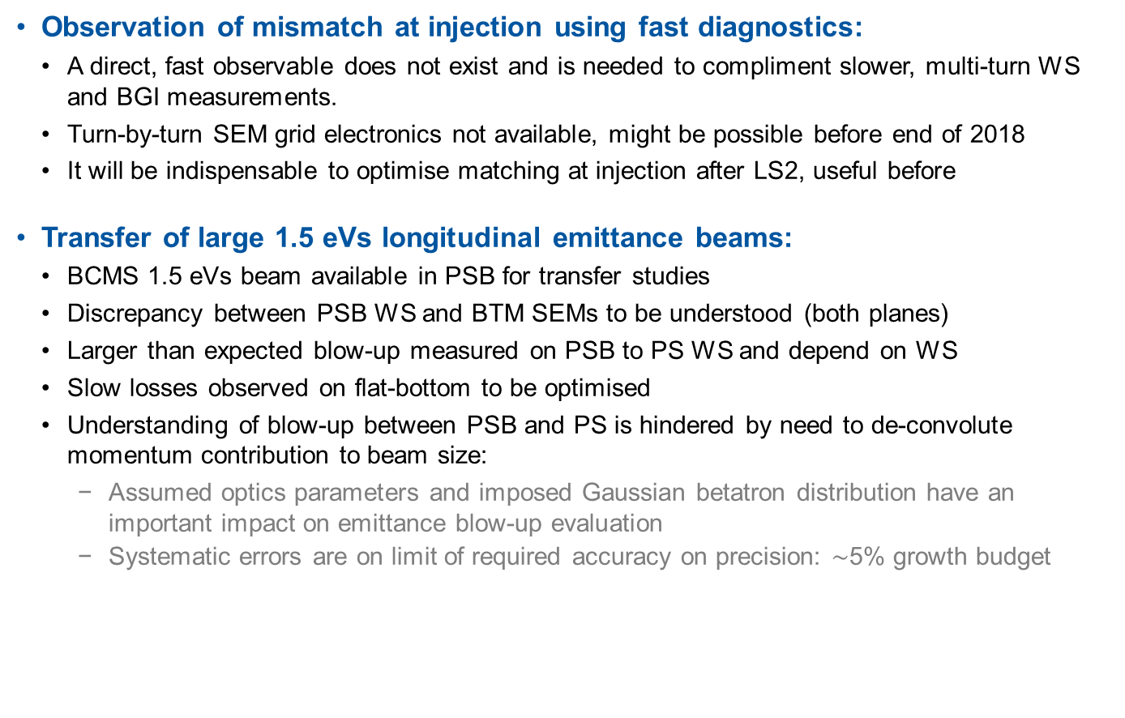
Transfer and injection studies II
Observation of mismatch at injection using fast diagnostics:
  A direct, fast observable does not exist and is needed to compliment slower, multi-turn WS and BGI measurements.
  Turn-by-turn SEM grid electronics not available, might be possible before end of 2018
  It will be indispensable to optimise matching at injection after LS2, useful before
Transfer of large 1.5 eVs longitudinal emittance beams:
  BCMS 1.5 eVs beam available in PSB for transfer studies
  Discrepancy between PSB WS and BTM SEMs to be understood (both planes)
  Larger than expected blow-up measured on PSB to PS WS and depend on WS
  Slow losses observed on flat-bottom to be optimised
  Understanding of blow-up between PSB and PS is hindered by need to de-convolute momentum contribution to beam size:
    Assumed optics parameters and imposed Gaussian betatron distribution have an important impact on emittance blow-up evaluation
    Systematic errors are on limit of required accuracy on precision: $\sim$5% growth budget

Slide 6
Transverse studies I
Definition of standardized protocol for MDs
  Aim: provide reproducible and comparable conditions for different MDs
  Wide range of parameters to be optimized in general, critical for understanding source of blow-up
  Created wiki page summarizing the most important steps for MD cycle preparation:
    https://wikis.cern.ch/display/PSOP/LIU+PS+INJECTION+MD
Validation of BCMS cycle with low chromaticity and TFB
  Possibility to disentangle different contributions to the blow-up at injection
  Setup of the cycle implies:
    Chromaticity reduction with PFW
    Coupling correction with skew quadupoles
    TFB operating along the low-energy part
  No degradation of beam quality observed, slightly smaller vertical emittance compared to operational cycle
  Horizontal blow-up at injection in the order of 30%
  Important step towards injection of 1.5 eVs BCMS bunches from PSB

Slide 7
Transverse studies II
Beta-beating measurements for improved emittance determination
  Collaboration with the LHC optics team
  Comparison of different methods to improve knowledge of beta functions at the WSs
  First results are in agreement measurements performed in the past:
    Horizontal beta-beat: ~ ± 5%
    Vertical beta-beat: ~ ± 10%
  Tools are being further improved to include coupling
Horizontal BGI
  First results show excellent agreement between WS and BGI measurements at flat top (comparison at flat bottom to be carried out)
  Modulation of the beam size observed (changing from cycle to cycle)
  Turn-by-turn measurement seems very challenging due t to insufficient signal

Slide 8
Longitudinal studies I
Intensity reach with nominal longitudinal emittance
  Dipole coupled-bunch oscillations well damped up to 2 · 10¹¹ ppb
  BCMS: maximum bunch intensity of about 2.1 · 10¹¹ ppb
  Dipole and quadrupole instabilities beyond: promising with 40 MHz system for increased Landau damping at flat-top
  Preliminary set of parameters for Landau RF system during acceleration
  Effect of impedance of 3rd 80 MHz cavity
    Significant blow-up during RF manipulations at flat-top
    Emittance grows towards the tails bunches already at 2.5 GeV
Longitudinal impedance model
  PS longitudinal impedance model: cavities, transmission line kickers (KFA45, KFA71/79), vacuum valves, bellows
    Simulations predict low-frequency resonances (< 100 MHz) from ejection kickers
    Internal dump oscillating as λ/4-resonator → important impedance at ~150 MHz
  Beam-based impedance measurements (10 MHz), 20 MHz, 40 MHz and 80 MHz RF systems
    Tomographic calibration of cavity probes

Slide 9
Longitudinal studies II
Optimization of PS-SPS bunch rotation
  80 MHz to linearize first part of bunch rotation (phase switching) → minor improvement
  3rd 80 MHz cavity during bunch rotation → minor improvement
  Parameter optimization of bunch rotation (timings and relative phases) efficient
  Powerful tool: longitudinal tomography in SPS to evaluate distribution from PS
Post-acceleration in PS to remove uncaptured particles before transfer
  Investigate contribution of uncaptured particles at PS-SPS transfer
  Demonstrated fixed frequency post acceleration at 40 MHz
    Remove uncaptured particles after RF manipulations at high energy
    Well defined longitudinal shaving of large amplitude particles
  Limitation from 40 MHz RF system power supplies
    Limited to 36 bunches at ~1.3 · 10¹¹ ppb
    Expected improvements in 2018 from new power converters
  Extensive measurement campaign in SPS with post-accelerated beam
  Part of losses in SPS are caused by uncaptured/large amplitude particles from PS

Slide 10
THANK YOU FOR YOUR ATTENTION!

