Slide 2
PSB: Status of Studies and Recent Progress
S. Albright, F. Antoniou, G.P. Di Giovanni, D. Quartullo,
Gian Piero Di Giovanni - LIU Beam Performance Meeting - 2017/11/23

Slide 3
Scope of the LIU-PSB Beam Dynamics WG
A new working group has been set up to discuss measurements and simulations for all PSB beams post-LS2.
Kick-off meeting on Monday 27th November at 14h00.
Provide a forum to support studies in the PSB, complementing the effort in PS and SPS.
Closely follow-up ongoing MDs as well as steer the priorities.
Report back to the LIU/LIU-PSB management.
Today we present a few selected highlights of the ongoing activities.
Notes:
Profit from other working groups’ expertise
Highlights that do not do justice to all the work

Slide 4
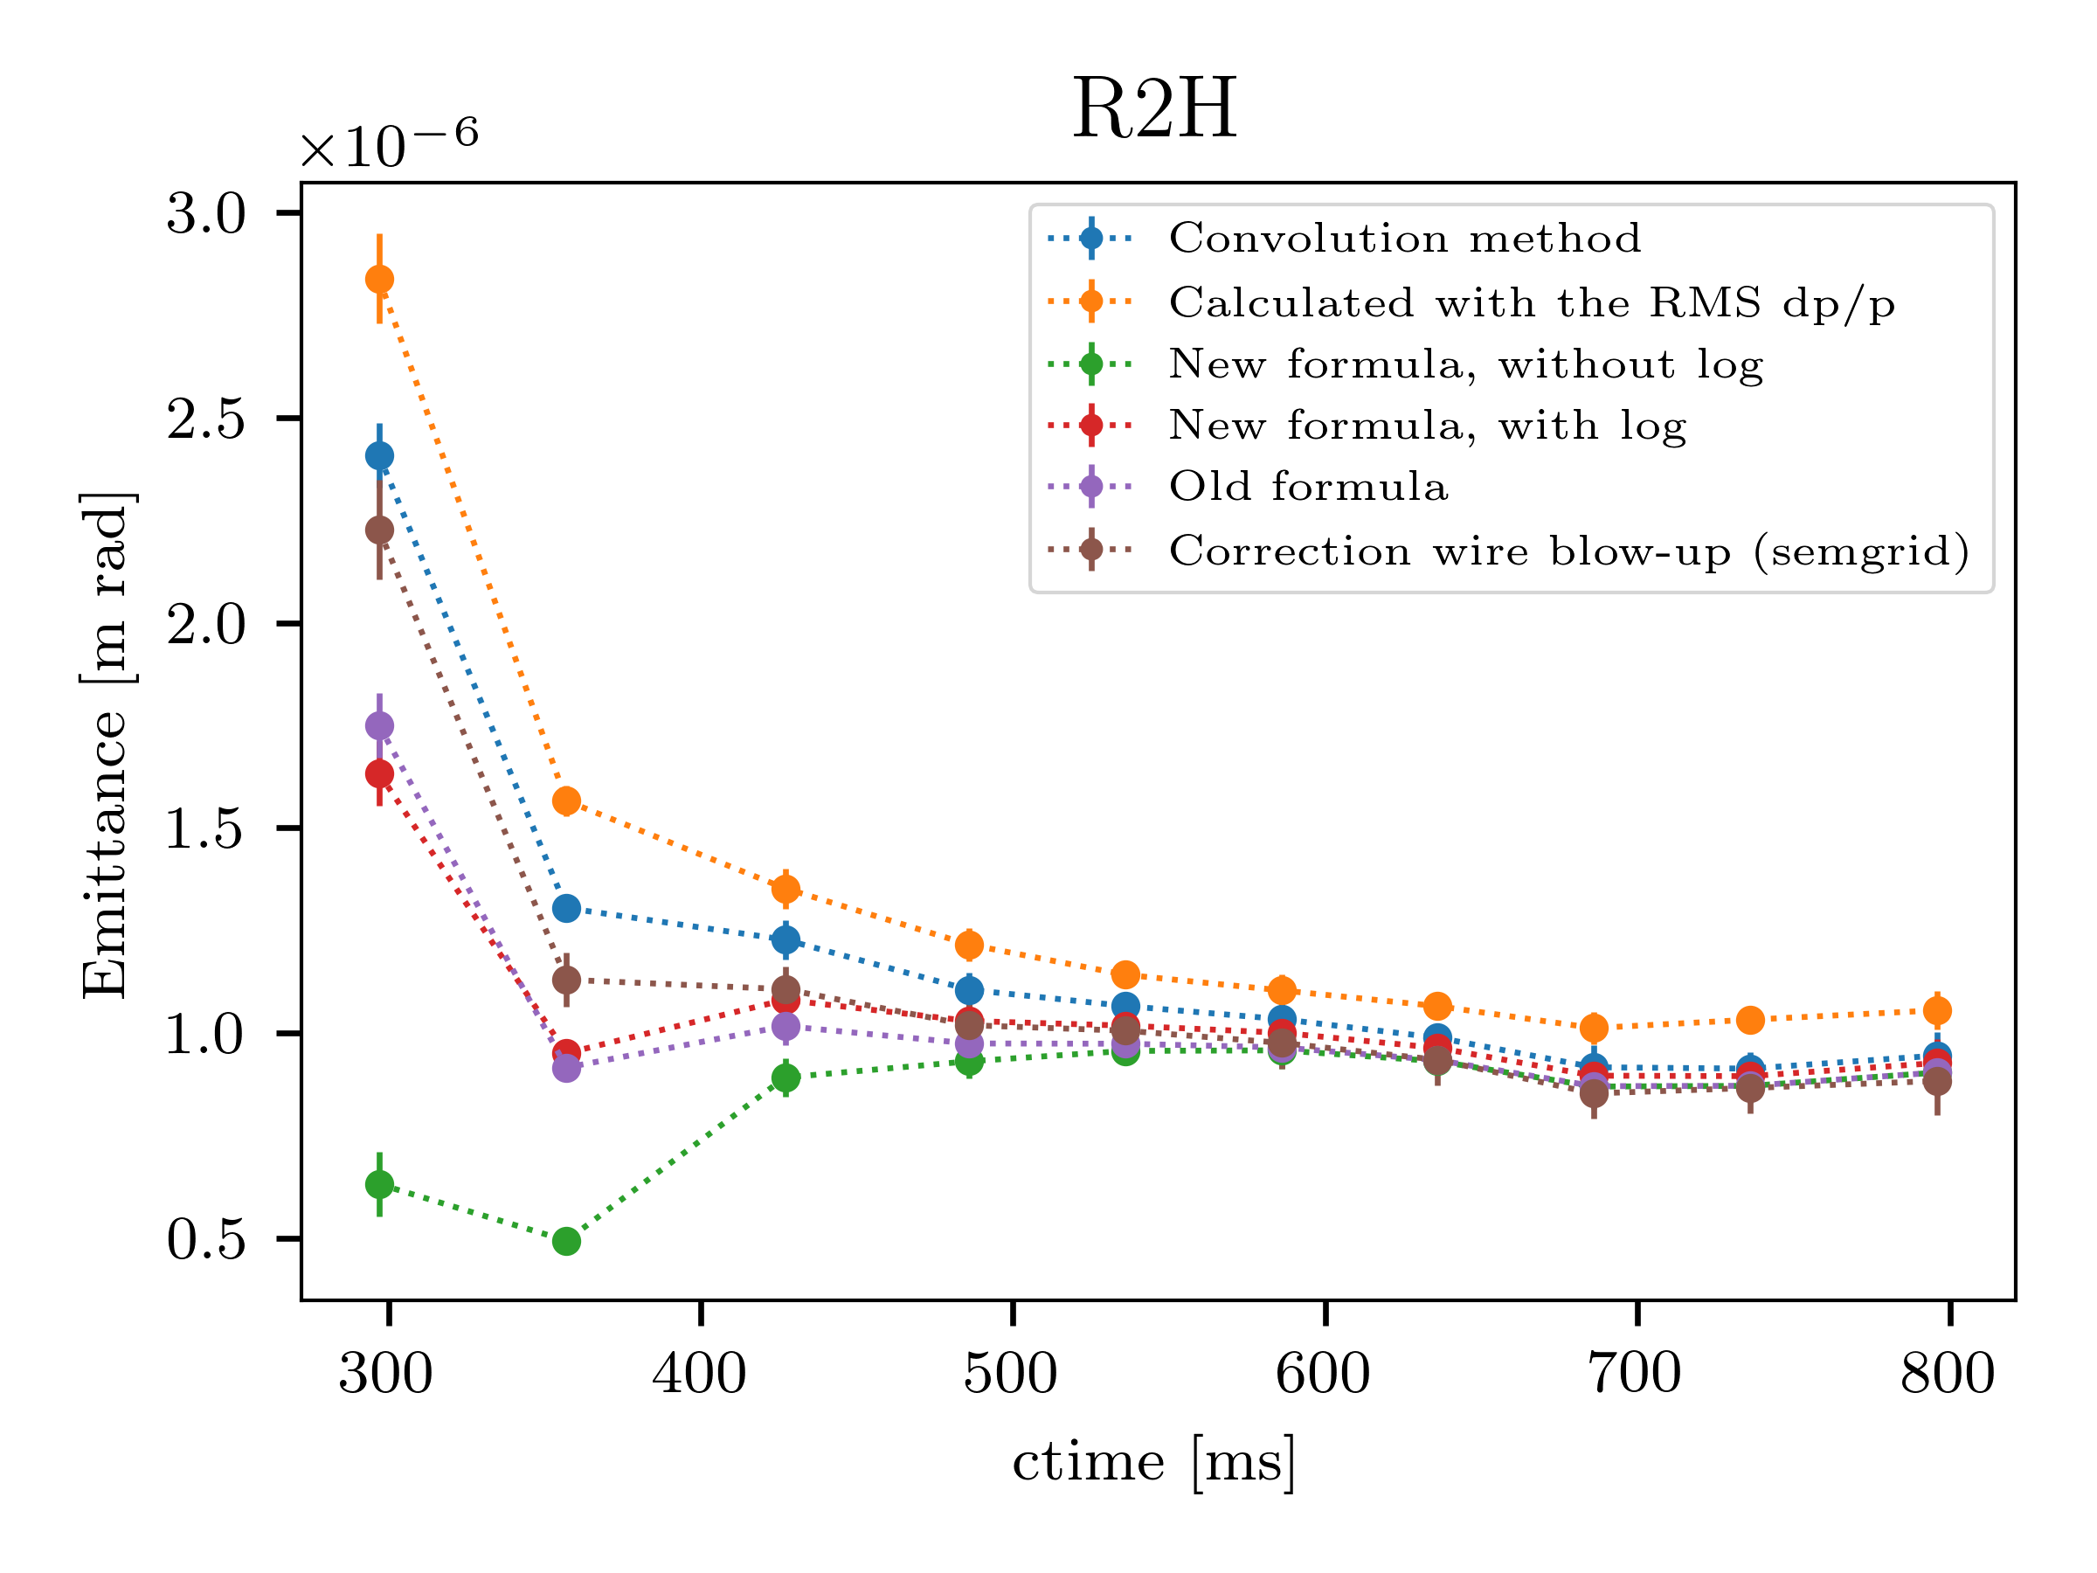
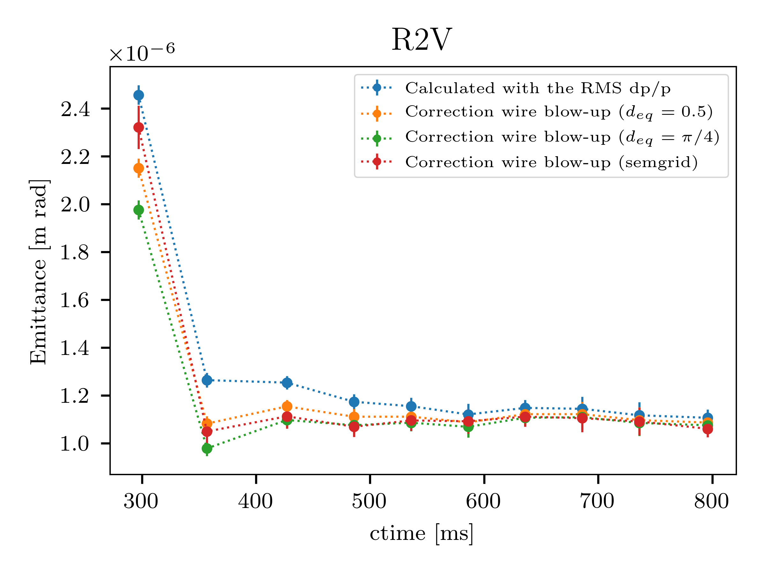
Transverse Emittance Along the Cycle
A. Santamaria Garcia
Deconvolution of the dispersive contribution in the beam profile.
Correction of multiple Coulomb scattering due to the wire scan:
  Experimentally by using the relative emittance difference at the SEM-grids.
  Analytically from average scattering angle and emittance growth formulas.
Emittance preserved along the cycle (first point is influenced by losses at injection.)
BCMS-type beam: Intensity~85E10 ppp, ε_{H/V} ~ 1.0 μm, dp/p ~0.9E-3 at extraction.
Notes:
Analitical method is computed assuming elastic scattering and that the particles are scattered in a small angle and calculating the change of action due to a change of x’ of the particles

Slide 5
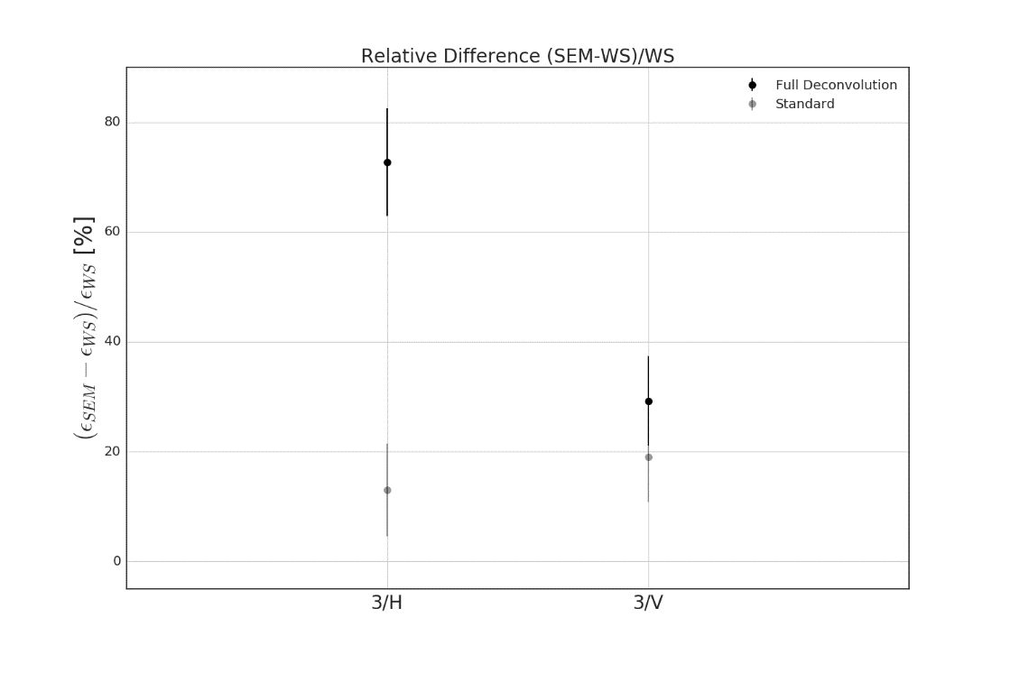
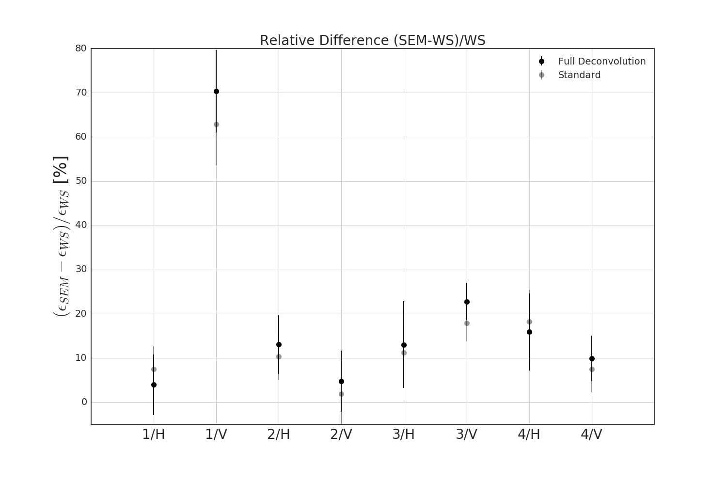
Transverse Emittance Comparison
G.P. Di Giovanni/V. Forte
Allocated budget for transverse emittance growth is 5%.
Available instrumentation need to be able to measure emittance with a precision < 5%.
Systematic comparison between WS and SEM grids showed that the emittance measured at
the SEM grid is ~10% larger than the respective measurement at the WS.
Up to 70% difference for the large longitudinal (1.5 eVs) emittance beams, baseline for LIU.
Studying the systematic effects in the measurements. Also need beta-beat measurement at PSB extraction (ongoing commissioning of the BTMS and beta-beat measurements).
BMCS25
BMCS25 1.5 eVs
Speed: 10 m/s
Speed: 10 m/s

Slide 6
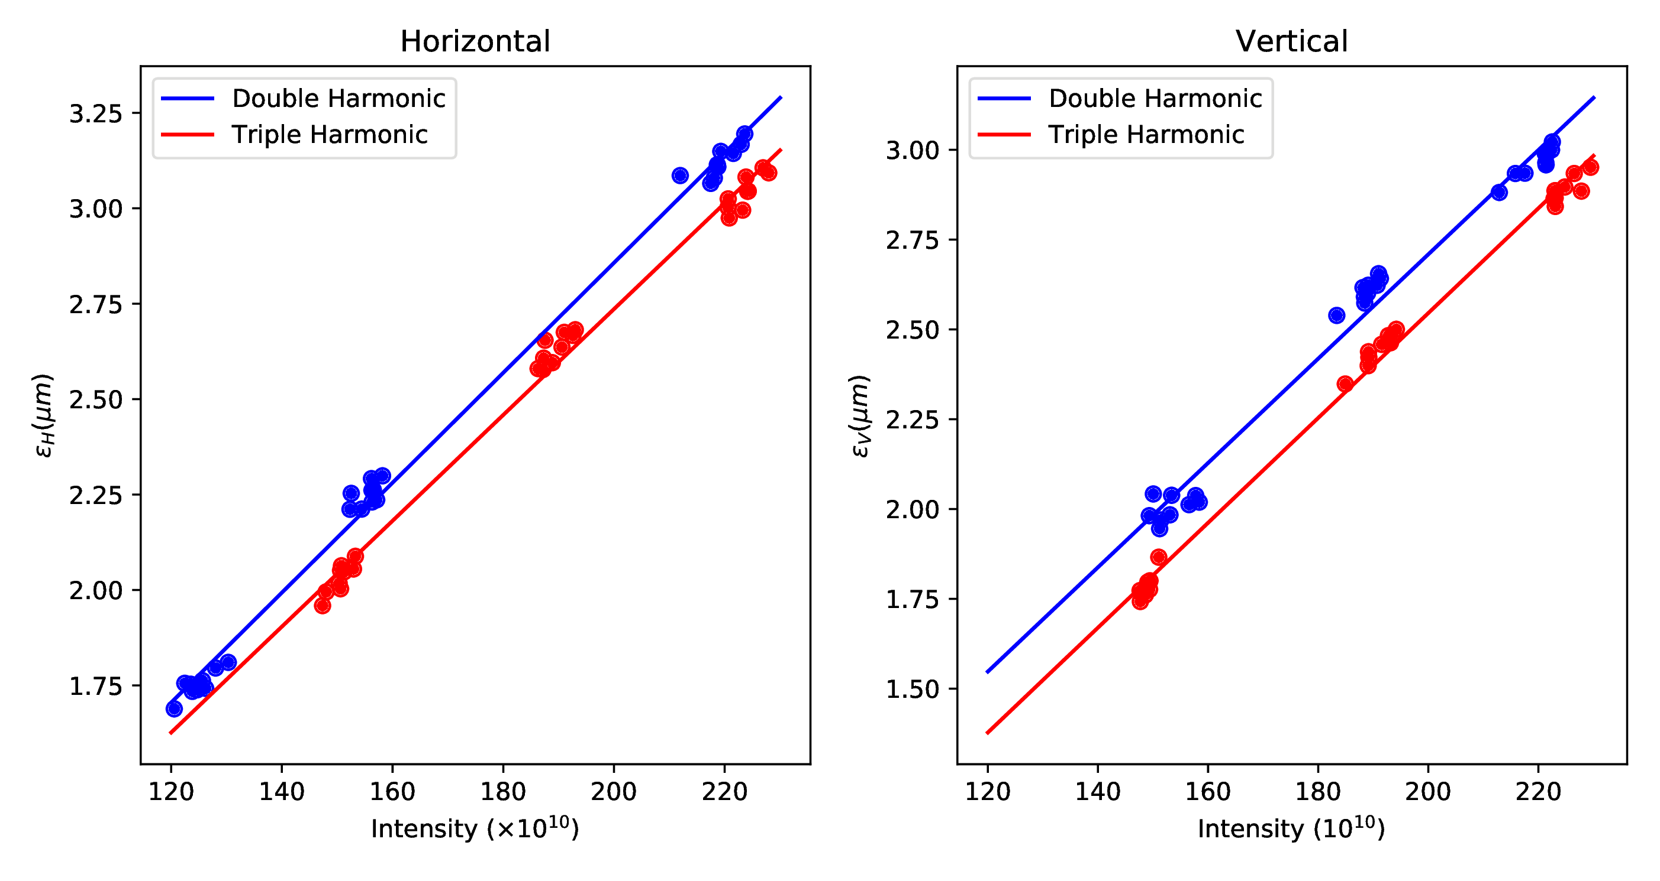
Triple Harmonic Capture
S. Albright
  PSB brightness essential for LHC beam parameters: Expect factor 2 higher brightness
  with Linac4 and 160 MeV injection.
  PSB currently operates at the expected brightness.
  Improved brightness demonstrated with triple harmonic capture on LHC25 with Finemet®:
    0.1 μm reduction in ε_{H}, and 0.2 μm reduction in ε_{V}
  Successful application also to high intensity beams, i.e. ~10% brighter MTE beam.

Slide 7
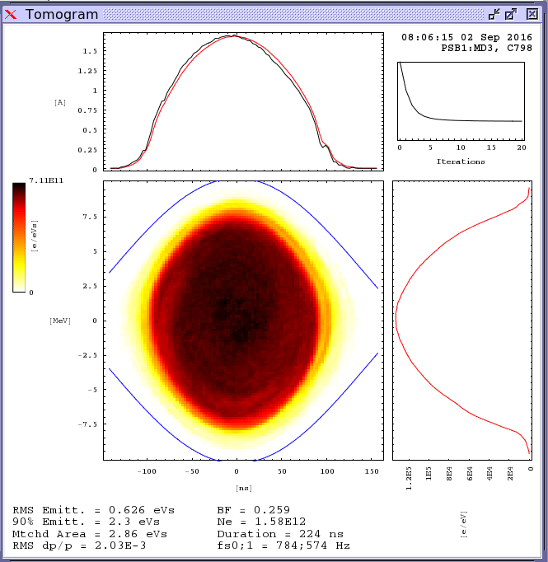
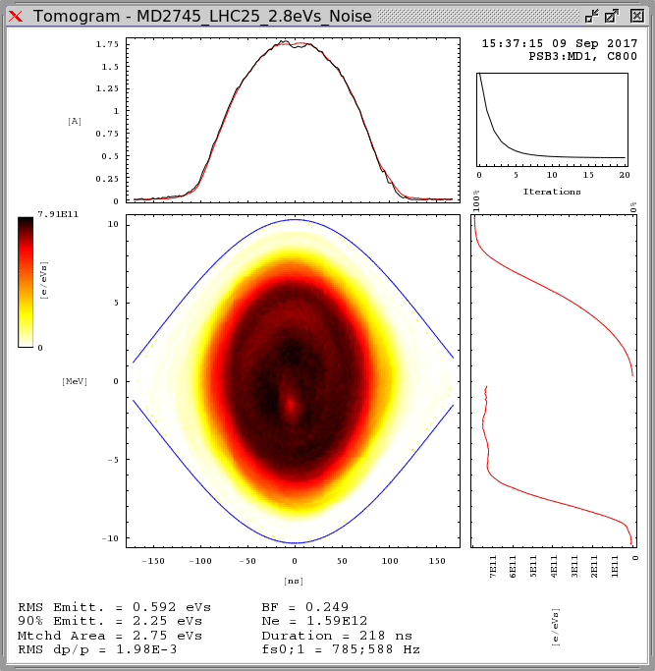
Longitudinal Emittance Blow-Up
Longitudinal emittance blow-up in the PSB is required for stability and space charge
mitigation in the PS.
Currently the C16 cavity is used with sinusoidal phase modulation.
Research is ongoing into the use of phase noise on the main harmonic as an alternative:
  Simpler to control/understand wrt higher harmonic BU.
→ Promising results with the phase noise BU!
Longitudinal emittance blow-up in the PSB is required for stability and space charge
mitigation in the PS.
Currently the C16 cavity is used with sinusoidal phase modulation.
Research is ongoing into the use of phase noise on the main harmonic as an alternative:
  Simpler to control/understand wrt higher harmonic BU.
S. Albright/D. Quartullo/M.E.Angoletta
HIGH HARMONIC
PHASE NOISE
Used operationally in PSB and PS.
High harmonic is modulated at a single frequency.
Resonance conditions at different points in the bunch cause increase in emittance.
Used operationally in SPS and LHC.
Main harmonic is modulated with band limited white spectrum.
All particles within the noise band excited to higher synchrotron amplitudes.

Slide 8
B-Train and TFB
B-TRAIN
Commissioning of the new White-Rabbit B-Train started!
Successful milestones reached (TE-MSC in collaboration with BE-RF):
  The magnetic field in Ring 3, measured with the existing sensor, was processed by the new system and transmitted via White Rabbit to the Ring 3 LLRF:
    → Beam captured and accelerated seamlessly.
  White-Rabbit and up/down distributions of the B-field can be acquired in parallel in the PSB LLRF systems and displayed in OASIS as separate signals.
  Also managed to accelerate beam on R2/4 with the new R2/4 coils!
Logging of the main parameters available on CALS.
Diagnostic panel available on the operational WorkingSet.
Ready for longer reliability test and systematic comparison using operational beams.
New electronics for the TFB available for R3H for testing before YETS17/18:
  Possibility to switch to new electronics in a PPM fashion.
  Control knobs recently made available for BE-OP.
  → Ready to start testing the basic functionalities.
TFB

Slide 9
High Priority Items
PSB is performing well and the MD users are very active.
Still a lot of ground to cover:
  Finalise transverse and longitudinal emittance characterization.
  Build tools for beta-beating measurement/loss map/resonance compensation.
  Refine the impedance model.
  Commission B-Train and TFB.
  Refine simulations of future PSB injection:
    Confirm horizontal aperture.
    Provide input on how to produce all beams during LS2 commissioning phase.
    Use realistic Linac4 beam current.
  Vertical beta beating compensation.
  Longitudinal painting.

Slide 10
Summary
A lot of parallel MD activities ongoing in the PSB during 2017.
We expect that the number of studies will ramp up during 2018.
New working group will help defining the priorities in an organic way and synchronize them with the downstream machines.
Review simulation studies together with MD activities.
Encourage documentation and reproducibility of the studies, i.e. common code repository.
Set the basis for future endeavors post-LS2.

