Slide 1



CERN Service Management
Simplify your life and supporters’ life by providing
ONE point of contact (ONE #, ONE url, ONE place)
ONE behaviour; unified processes for all services
ONE tool shared by all service provides
ONE business service catalog
How can I access LXPLUS?
I need help about car sharing
I can not access to wifi
Heating issue ..
I need a key for my new office !
My computer
account
is blocked
Notes:
Good morning everybody,
My name is XXX and I would like to welcome you warmly on behalf of the CERN Service management team. The aim of this presentation is to tell you how to get helped, because during your time at CERN, you may encounter problem or simply have questions.
Indeed as you all know, CERN is a big Laboratory hosting thousands of people and offering many different services.
So, the purpose of Service management at CERN is to simplify your life and the one of those providing the service by providing
- One point of contact for different services: one phone number to remember, ONE url to use, ONE physical place to go
- One behaviour based on unified processes and best practice for all services
- One tool to facilitate the work between services
- And finally ONE business service catalog listing all services that are provided

Slide 2






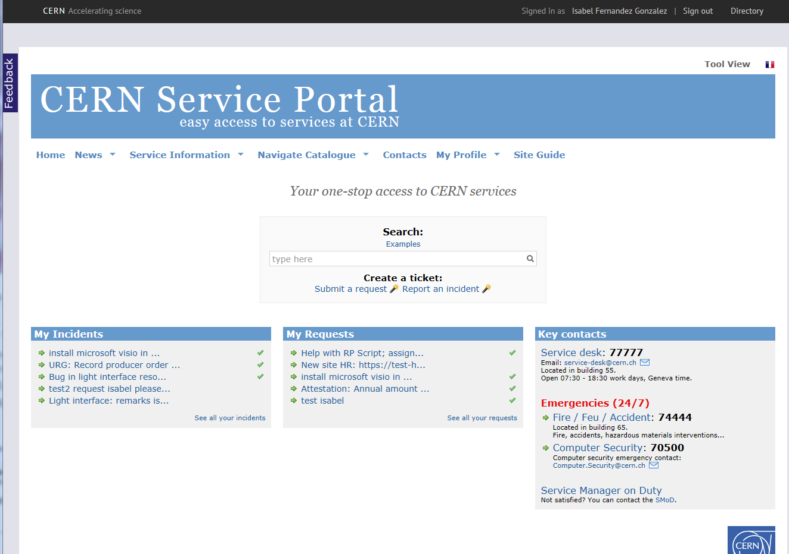



CERN Service Management
@ https://cern.ch/service-portal
Service desk
  Blocked Computer Account
  Unable to connect to Wifi
  LXPLUS batch issue
  Need to reserve car from car sharing pool
  Heating in your office
  Door lock
Notes:
As I just mentioned, during your stay at CERN
You may encounter:
computer problems,
network issues,
general service request
as example:
- need to reserve a car from the car sharing pool,
- heating did not start in your office,
- a door lock issue
or simply ask for information…
NEXT: Who should you contact?

Slide 3











CERN Service Management
Service desk
  Account is blocked
  Wifi connexion
  LXPLUS batch issue
  Help with Car sharing
  Heating issue
  Door lock issues
  Identity management
  WIFI Service
  LXPLUS Service
  Car pool and Rental Service
  Heating, ventilation, Air Conditioning and Compressed Air Service
  Locks and Keys Service
https://cern.ch/service-portal
Notes:
Who should you contact?
You have 2 options:
The 1st one is a human interface through the CERN Service desk
The 2nd one is a web interface through the CERN Service Portal
Both are here to channel your request to the most appropriate service

Slide 4
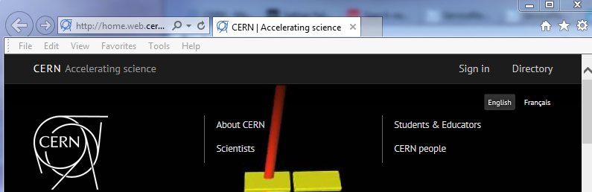
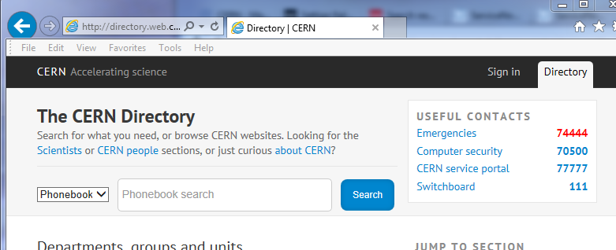
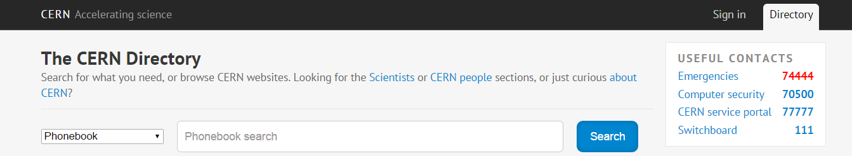
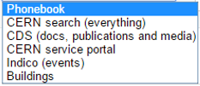
CERN Service Portal
https://cern.ch/service-portal
Notes:
Where can you find the Service Portal ?
From the CERN main page : click on the top right corner: Directory
It brings you to the CERN internal main page
You will see on the top right corner
Useful contacts: CERN service portal link with the telephone number 77777
When you perform a search, you can also select to restrict the search to CERN ‘s service portal

Slide 5
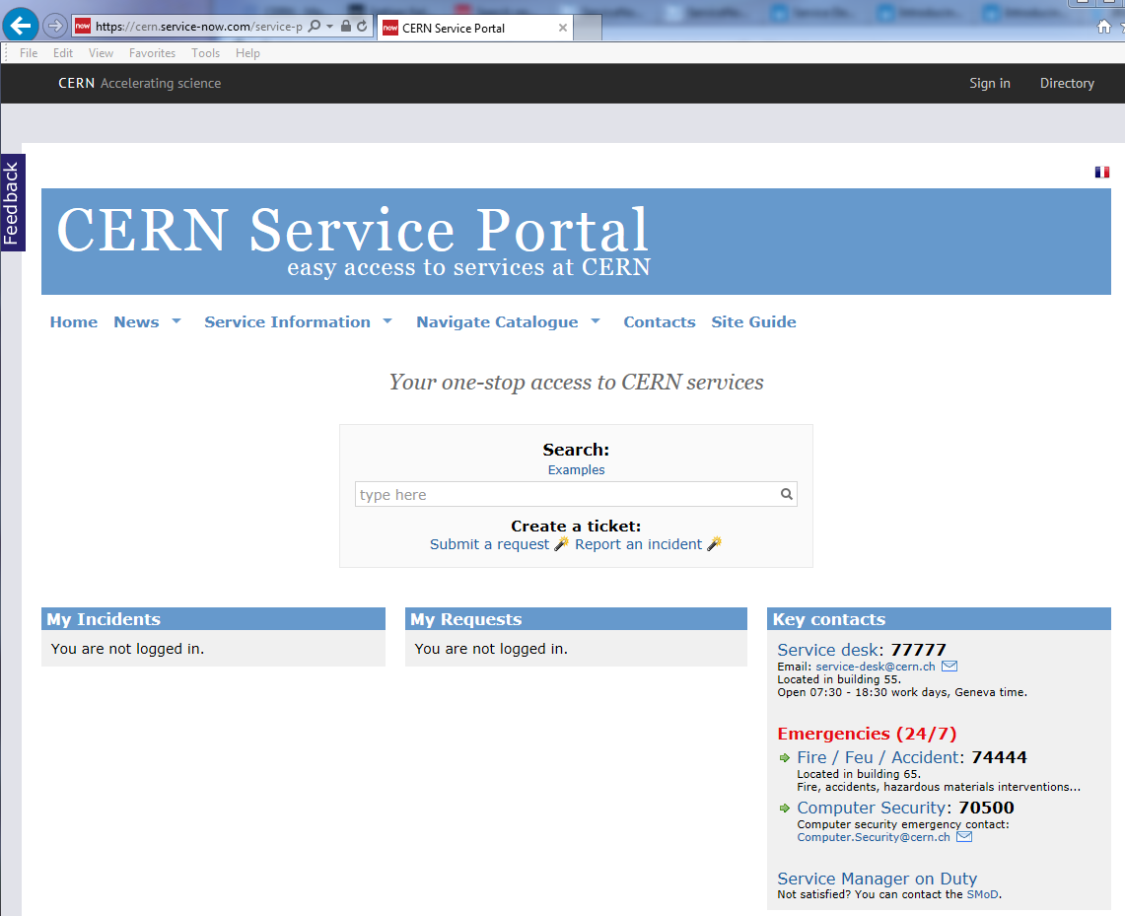

CERN Service Portal
Service desk
https://cern.ch/service-portal
Notes:
This is the CERN Service Portal main page
You can see the Key contacts on the bottom right corner
You have to remember that in case of fire or an accident call the Emergency number 74444 and NOT the Service Desk.
NEXT: Otherwise for any other kind of issue you can contact the Service Desk

Slide 6


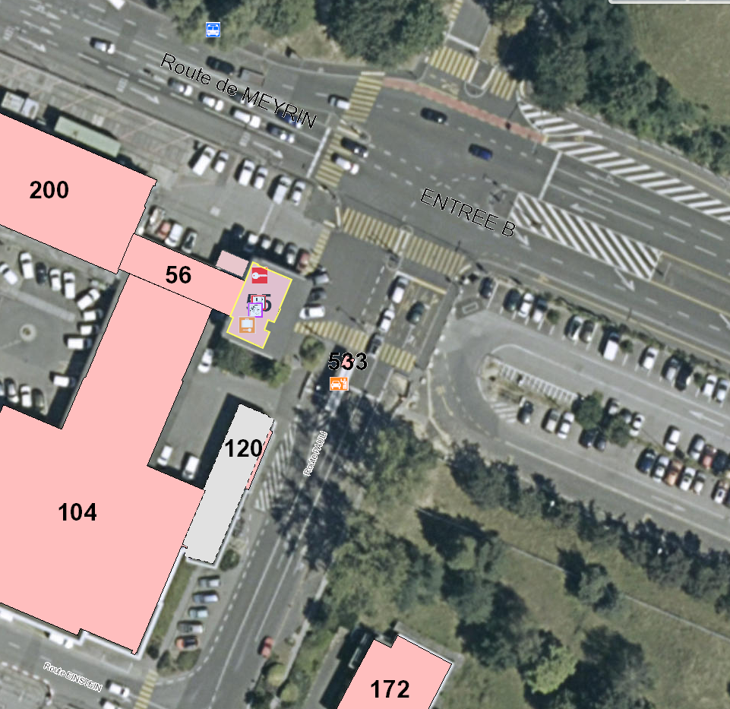
CERN Service Desk
3 possible ways to contact the Service Desk
Email: service-desk@cern.ch
Phone: 77777 (+41 22 76 77777 from outside CERN)
By visiting: building 55 (entrance B)
Open
from 07:30 to 18:30
Work days
Geneva time
ENTRÉE B
55
https://cern.ch/service-portal
Notes:
Otherwise for any other kind of issue you can contact the Service Desk
By email
By phone 77 7 77
You can visit the Service Desk, located in building 55 next to Entrance B,
- the building where you are going to activate your computer account, and get your access card.
The Service Desk is open from 07:30 to 18:30 during working days acts as a single point of contact.
The Service Desk team will register your issue in a so called ticket in a tracking system called Service-now or Snow.
So your issue can be submitted via:
- email,
- telephone,
- by visiting the Service Desk and you can also
- create tickets directly from the CERN Service Portal
NEXT: How can you do that?

Slide 7
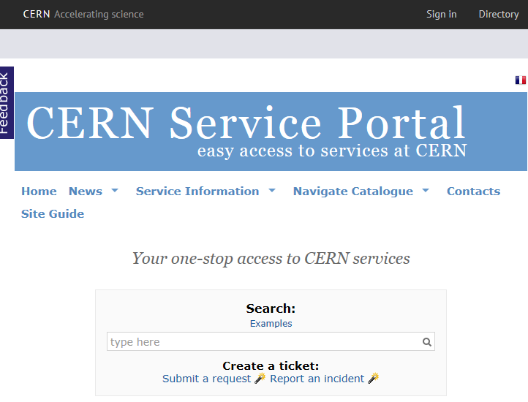
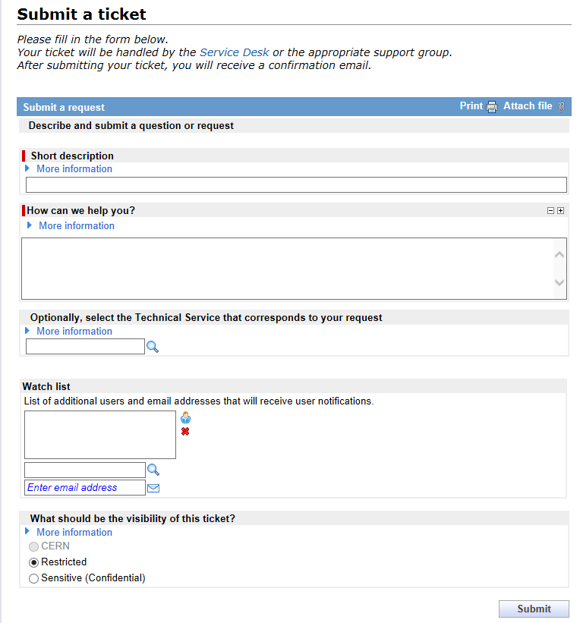
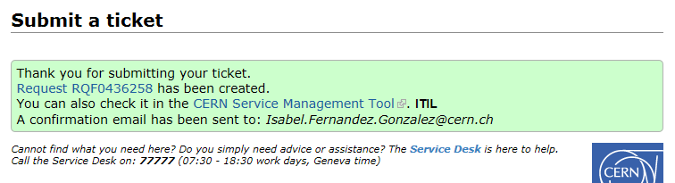
CERN Service portal: Create your tickets
  Report an incident
  Submit a request
1
Simple interface
I have a question about…
Dear colleagues,
I would appreciate your help…
This is a …
2
Eric Lienard
3
Notes:
You can submit your issue from the CERN Service Portal main page. You may ask yourself: How can I do that?
It’s easy, once you are logged in, you can either
- Report an incident, if something does not work as expected or
- Submit a request.
Let’s submit a request via a simple form where you need to provide:
- a short description of your request,
- a more detailed explanation
- And you may add someone in the watch list to follow your ticket as you would use the CC field of your email
Once submitted,
A ticket will be created in the tracking system that is called Service-Now or Snow with a reference number INC or RQF and
It will be handled by the Service Desk who will send it to the appropriate service, if they can not solve it.
And you will receive a notification email confirming the creation of the ticket.
From then on, the Service desk has 10 minutes max to either solve your request or to escalate it to the most appropriate service.
NEXT: Once your ticket has been created how can follow-it-up?

Slide 8


Track your tickets
CERN Service Portal
easy access to service at CERN
Email
@ https://cern.ch/service-portal
@ Your computer
Notes:
You can follow the status of your issue or update its information:
Via the
Portal
Or by replying to the email notifications you have received

Slide 9

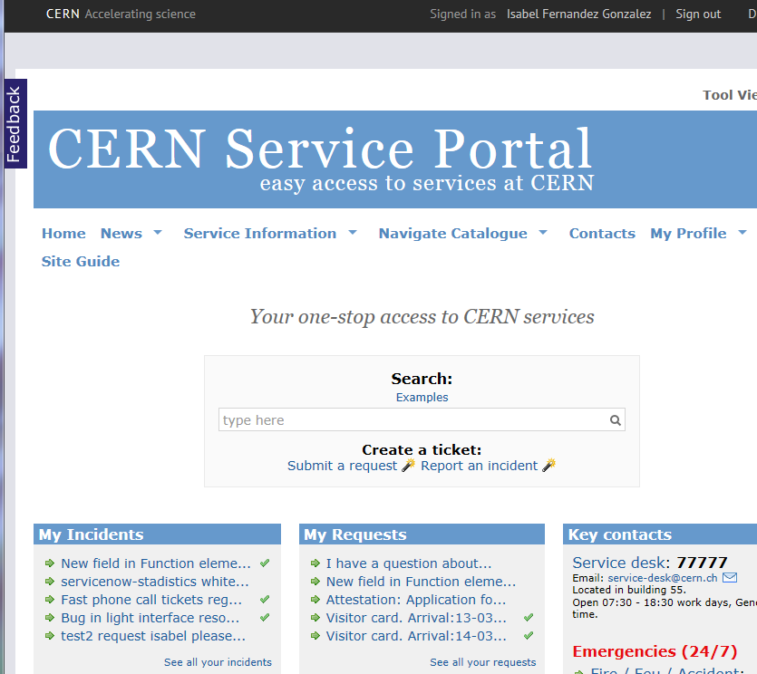
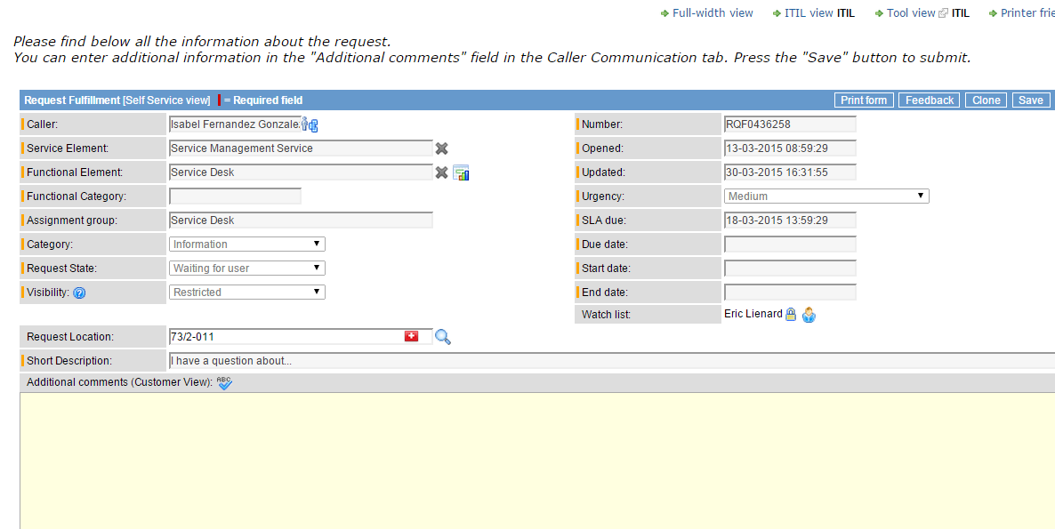
Track your tickets
Easy update from ticket
(add comments)
2
Yes, I would need it, as I am currently working on….
1
https://cern.ch/service-portal
Notes:
In the portal,
You can see the list with your ‘on-going’ tickets and you can follow their status
Should you need to update the information you provided on a specific ticket,
- Click on the ticket you want to update and provide your comments and don’t forget to save it!

Slide 10
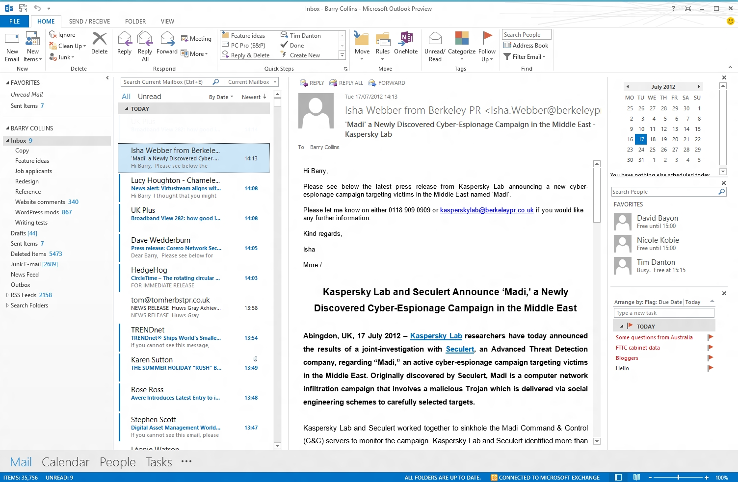
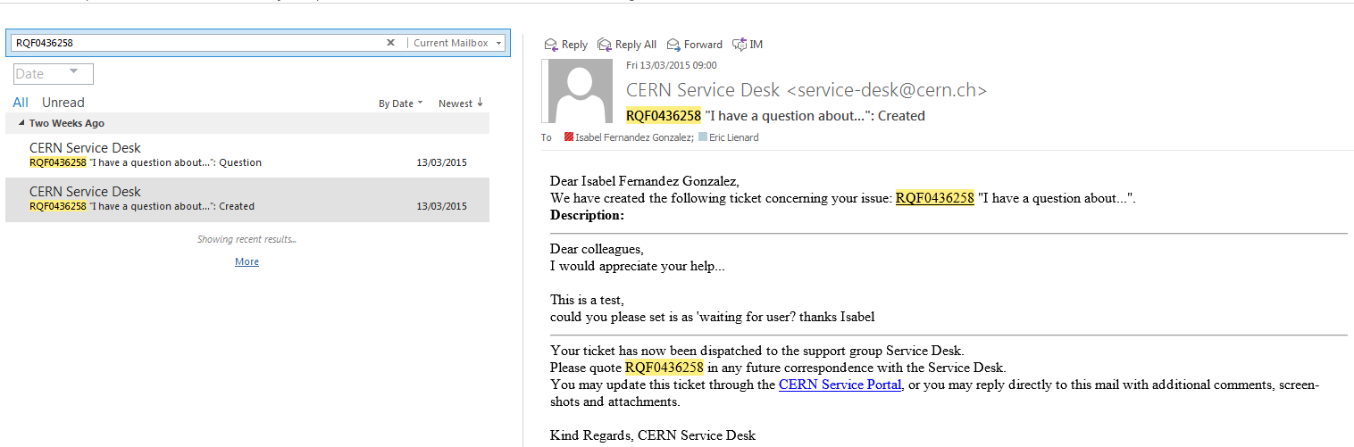
Track your tickets
Email
Easy update from email notification
Notes:
OR You can also update the ticket information by Replying to the notification you have received.
Please note that all the notifications comes from CERN Service desk even if the Service desk is not dealing with your issue.
NEXT: Now Let’s finish with how to browse and search the Service Portal?

Slide 11
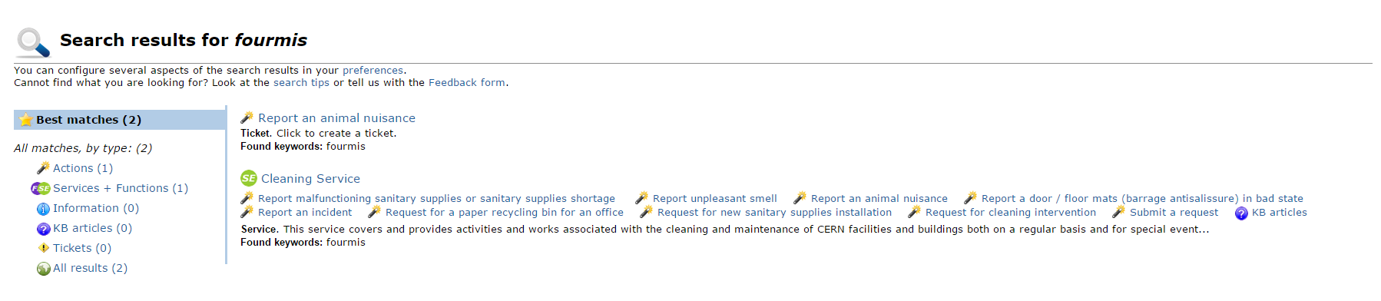
CERN Service portal
Browse / search the Service Catalogue
Fourmis
https://cern.ch/service-portal
Notes:
CERN Service Portal allows you to access to services many services provided at CERN as previously said.
From there, you can search in French or English as an example
If you have ants in your office, you can search on ‘ant’ or ‘fourmis’
It proposes you
to report an animal nuisance
And the Cleaning Service

Slide 12
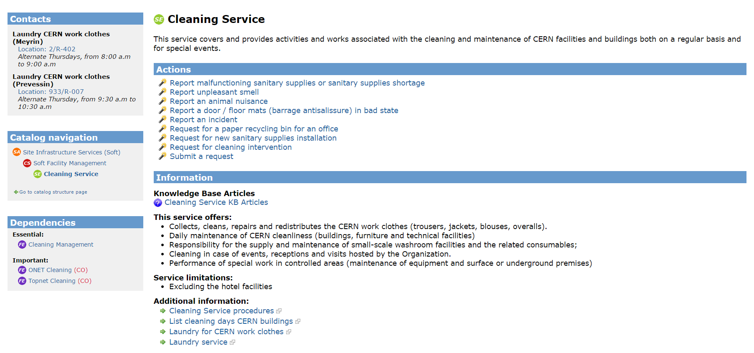
CERN Service portal
User oriented
Access to knowledge base (FAQ)
Web forms
https://cern.ch/service-portal
Notes:
Upon Visiting the service you will find its description, contact, web forms to submit your issues and Knowledge articles.
The same structure is followed to describe all services
What is important for you to remember here is that you have access to around 5’000 knowledge articles. I am pretty sure will find the answer to your problem. If not, do not hesitate to contact the Service Desk.
NEXT: We have seen the main highlights of the CERN Service Portal and the Service desk.

Slide 13

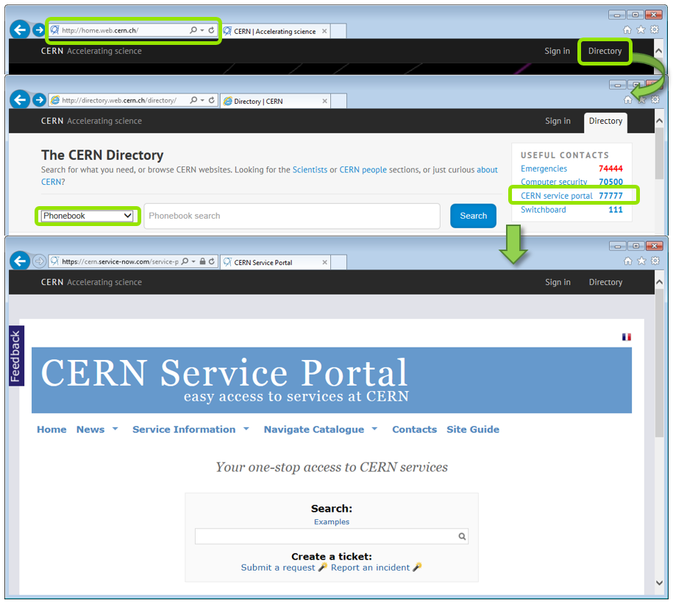
Service desk
service-desk@cern.ch
77777
(+41 22 76 77777 from outside CERN)
https://cern.ch/service-portal
Notes:
You have seen the main highlights of the CERN Service Portal and the Service desk.
I hope they will be helpful to you during your stay.
Do you have any questions?
If not, I wish you a pleasant and fulfilling stay at CERN!
Thank you!

