Slide 2
Les Services Informatiques
Induction v 5.05
Notes:
Part of this information will be familiar to you if you have already been working at CERN.
The goal of this presentation is not to show you all the available services but only the one of immediate interest to you, and point you to the places where you can find more information and specially get help.

Slide 3
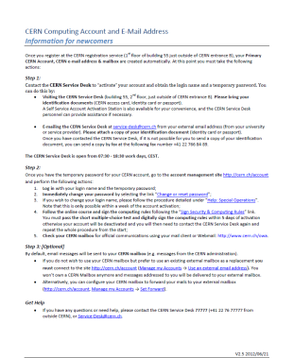
Obtenir un compte
Au Service Enregistrement (Bat 55/1),
vos comptes ‘Primary’, mail et EDH sont crées,
en même temps que votre carte d’accès,
Activation des comptes au Service Desk (B 55/2-001)
  Borne au Service Desk avec carte d’accès
  Envoyant un scan de votre pièce d’identité avec e-mail extérieur au Service Desk
➔ Mots de passe temporaire: 1/ ‘Primary Account’ 2 / Signature EDH
Changez immédiatement vos 2 mots de passe
5 vrais jours pour suivre le cours de sécurité et signer le règlement informatique OC5
  http://cern.ch/wizard
Notes:
The first computing action you need to perform is to get your hands on your accounts. The procedure I am describing here is documented in the handout you have received at the induction presentation.
If you have already been at CERN your accounts already exist but they may be locked.
If it is your first stay at CERN your accounts are created for you when you register at the Registration Service. You get your access card, your Primary Account, your email address and your EDH account.
EDH is the main tool that you will use for most of your administrative actions:
ask for leaves
ask for access to restricted area
ask for a GSM phone
manage your official trip
ask for training
order material and furniture from the CERN Store
You connect to EDH using your primary account password. But some actions require a second “signature password” that must be obviously different than your ‘Primary Account’ password.
At that point you need to activate your accounts, even if you have been at CERN before:
Either by passing at the Service Desk with your access card and use the dedicated booth to activate your Primary Account
Or email a scan of your photo ID to Service Desk from an external email account such as gmail or Yahoo mail
Please 10-15 minutes before activating your accounts at the booth after you have collected your access card.
You will receive the temporary password of your ‘Primary Account’ and if it is your first stay at CERN, the temporary password of your EDH account.
Change immediately the received passwords you will be provided
And you have 5 real (not working) days you follow a computing security course and sign the computing rules called Operational Circular #5
You can do these actions from the portal: http://cern.ch/account

Slide 4
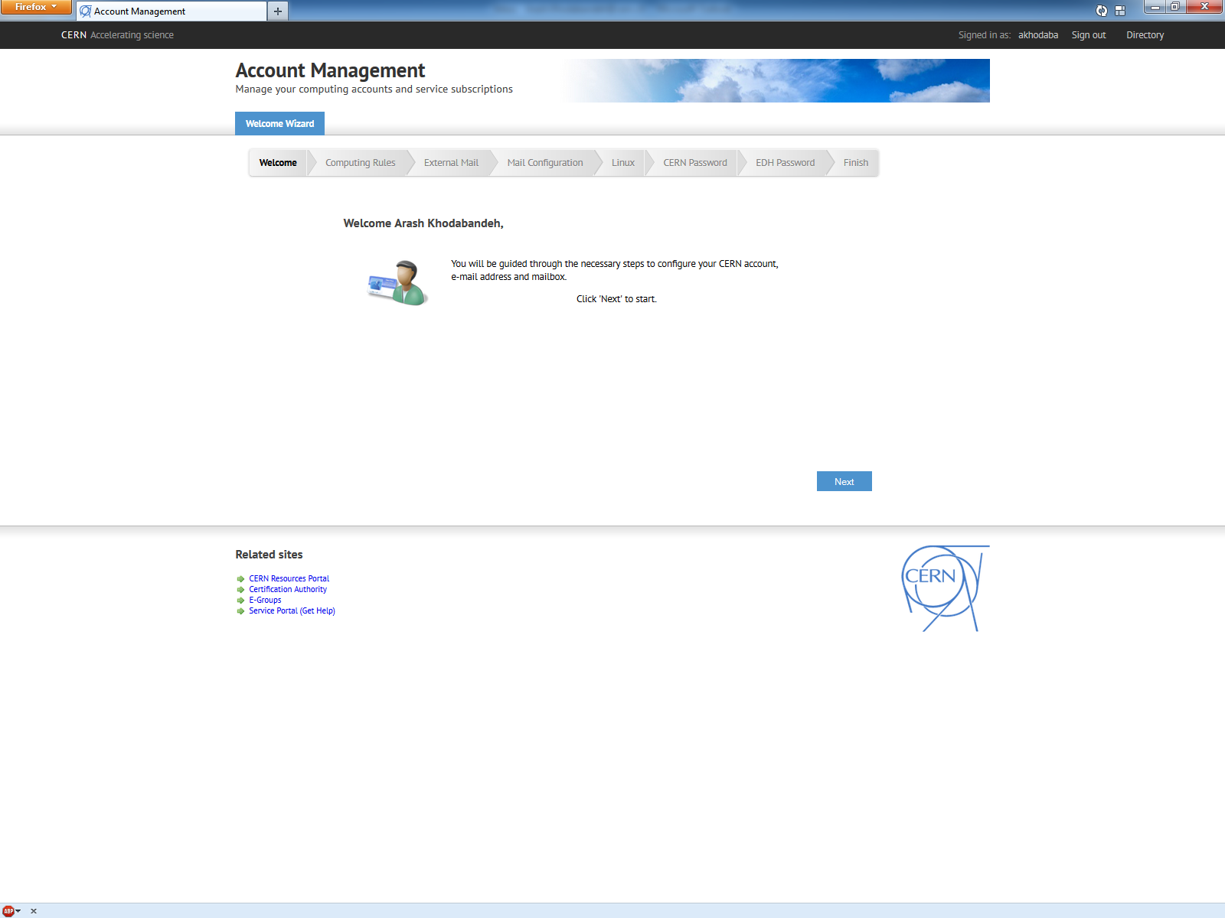
  https://cern.ch/wizard
Notes:
This is the wizard that will take to through the steps describes on the previous slide

Slide 5
Connecter mes appareils
OUI
Possibilité de connecter votre ordinateur / téléphone / tablette
Devez enregistrer votre appareil:
  http://cern.ch/net
  Ou la première connexion pour les mobiles
Notes:
What if you need to connect your personal devices.
This is possible, but first you need to register/declare your device:
Preferably, go to the network web site and follow the link to connect a new device
Or, for mobile devices, follow the steps at the first connection
This is simple but indispensable step.

Slide 6
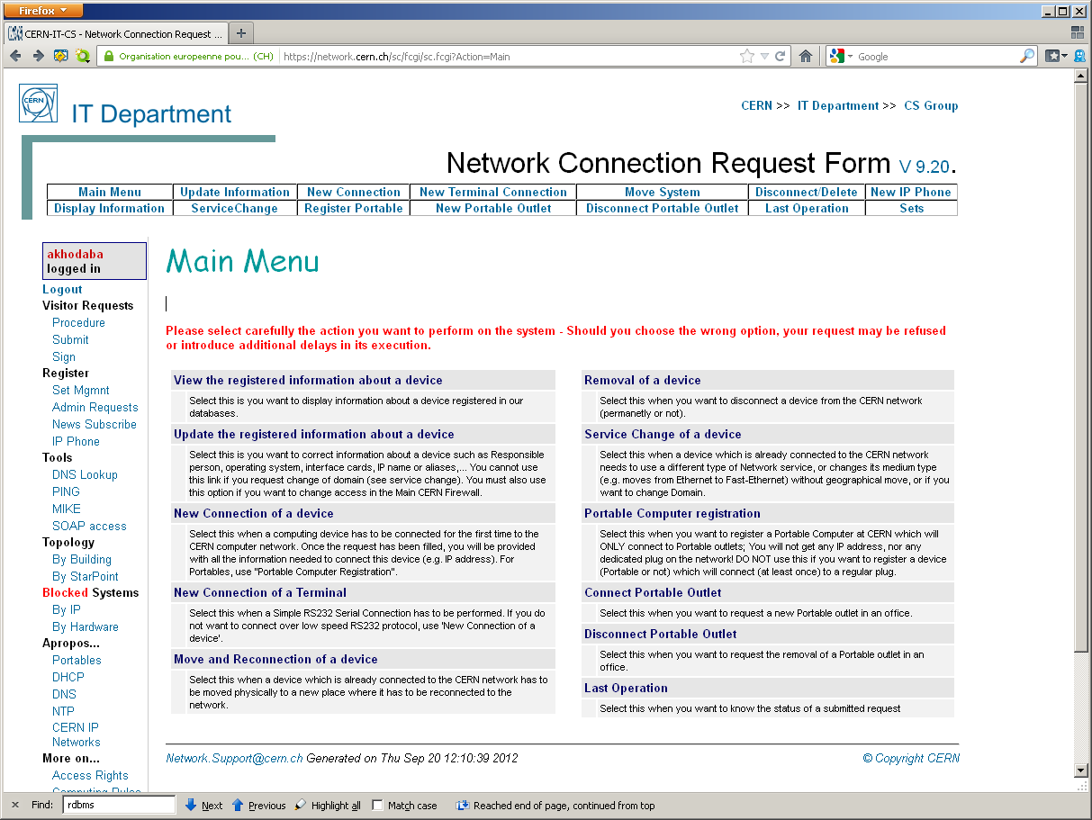
Notes:
This is the link you need to follow on the net.cern.ch web site to register your devices.

Slide 7
Connecter mes appareils
MAIS
Ne faire aucune modification non autorisée au réseau du CERN
  Utiliser les services mises a disposition (impression, wifi)
  Nous contacter si des besoins ne sont pas couverts
Dans le respect des règles de sécurité notamment
Notes:
The CERN network seems to be open, and it is so to some extend, but it is not unmanaged.
The actions performed on the network are monitored for our security.
You do not perform unauthorized changes: e.g. you do not need to connect your printer, WiFi hotspot, rooter.
IT offers a lot of central services to print anywhere, to connect anywhere. Do make use of these services and if you notice any missing feature or problem let us know so that we can take the corrective actions or extend the services.
And of course follow the security rules that you will read and sign.

Slide 8
Suivez les règles informatiques
http://cern.ch/computingrules
Dans le milieu académique du CERN (comme à la maison) vous êtes responsable de la sécurité de vos ordinateurs, fichiers, programmes, services
L’ équipe de sécurité informatique et le département IT sont là pour vous aider dans cette tâche
Votre activité ne doit pas être illégale, commerciale, politique, offensive
N'est pas autorisé : consultation de matériel pornographique ou autre matériel illicite (e.g. incitation à la violence, discrimination)
Notes:
The rules OC5 can be found at this URL http://cern.ch/computingrules.
They are mostly common sense.
At home, at CERN you are responsible of the security of your devices, files, programs and services.
The IT security team and all the IT services are ready to help you to fulfill this responsibility.
Your activities should not be illegal, commercial, politic nor offensive.
We can not access pornographic or illicit material.

Slide 9
Protégez vos ordinateurs
Utilisez un logiciel anti-virus et appliquez les mises à jour de sécurité régulièrement
L’anti-virus CERN est gratuit pour l’utilisation domestique
Prudence avec emails et web
Stop - réfléchissez - cliquez
N’ouvrez pas les liens, emails ou pièces jointes inattendues ou suspectes
Protégez vos mots de passe
Ils sont personnels
Faites-les complexes
Ne les réutilisez pas
Ne les publiez pas
Protégez votre écran
Respectez le droit d’auteur
Ne distribuez pas de matériels avec des droits d'auteurs
Evitez les applications de partage de fichiers ou des services d'hébergement
Notes:
Protect your devices:
The CERN anti-virus is free for home use as well. You can install it on your personal laptop
Do scan and update your devices on a regular basis
Be careful with mail and web
Stop – think and only then click
Do not open suspicious or unexpected attachments
Protect your passwords
They are personal
Make them complex and long
Do not reuse them (across accounts and over time)
Publishing can happen without you noticing. For example you send an email to support describing your connection problem and you leave the password in clear text.
And last, lock your screen otherwise the above steps are useless.
Respect copyright
Do not redistribute protected material
Avoid sharing applications and hosting services

Slide 10
Pour la sécurité
Utilisez les services IT &
laissez IT s'occuper de la sécurité
Bénéficiez de formation et d'aide:
http://cern.ch/security
computer.security@cern.ch
http://cta.cern.ch
Notes:
In the general security interest
Use the central IT services and let IT deal with security. The services managers do take measure for the services offered.
Take advantage of the help and trainings offered to secure what you develop and deploy

Slide 11
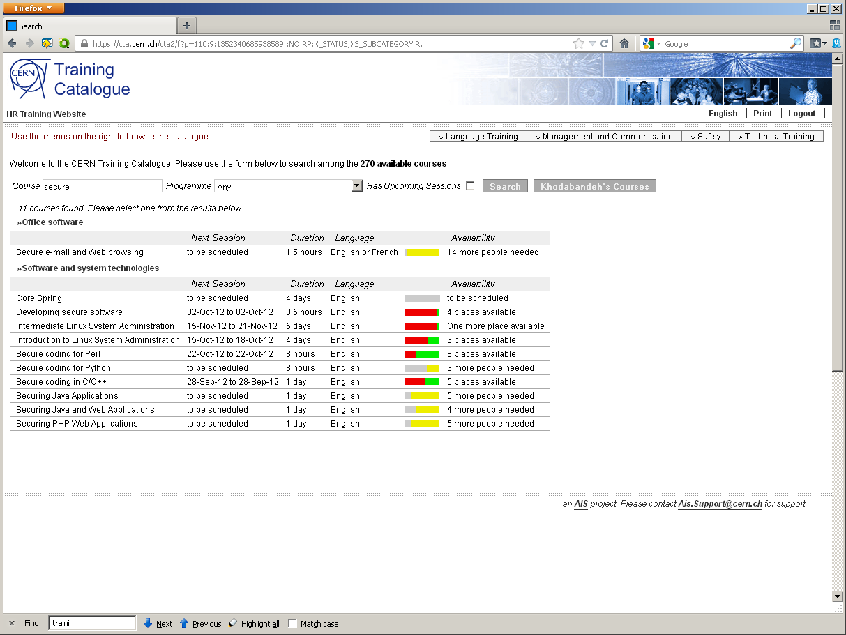
Notes:
The training catalogue offers courses on safety and security:
I would like to draw your attention to the first one called “ safe e-mail and Web browsing” . This course is targeted at everybody, regardless of your profile and background. It is very short (1.5 hours) and dense and I encourage you to follow it. As it is a recording, you can follow it when and where you want.
There are also more technical courses for those of you who will be developing applications.

Slide 12
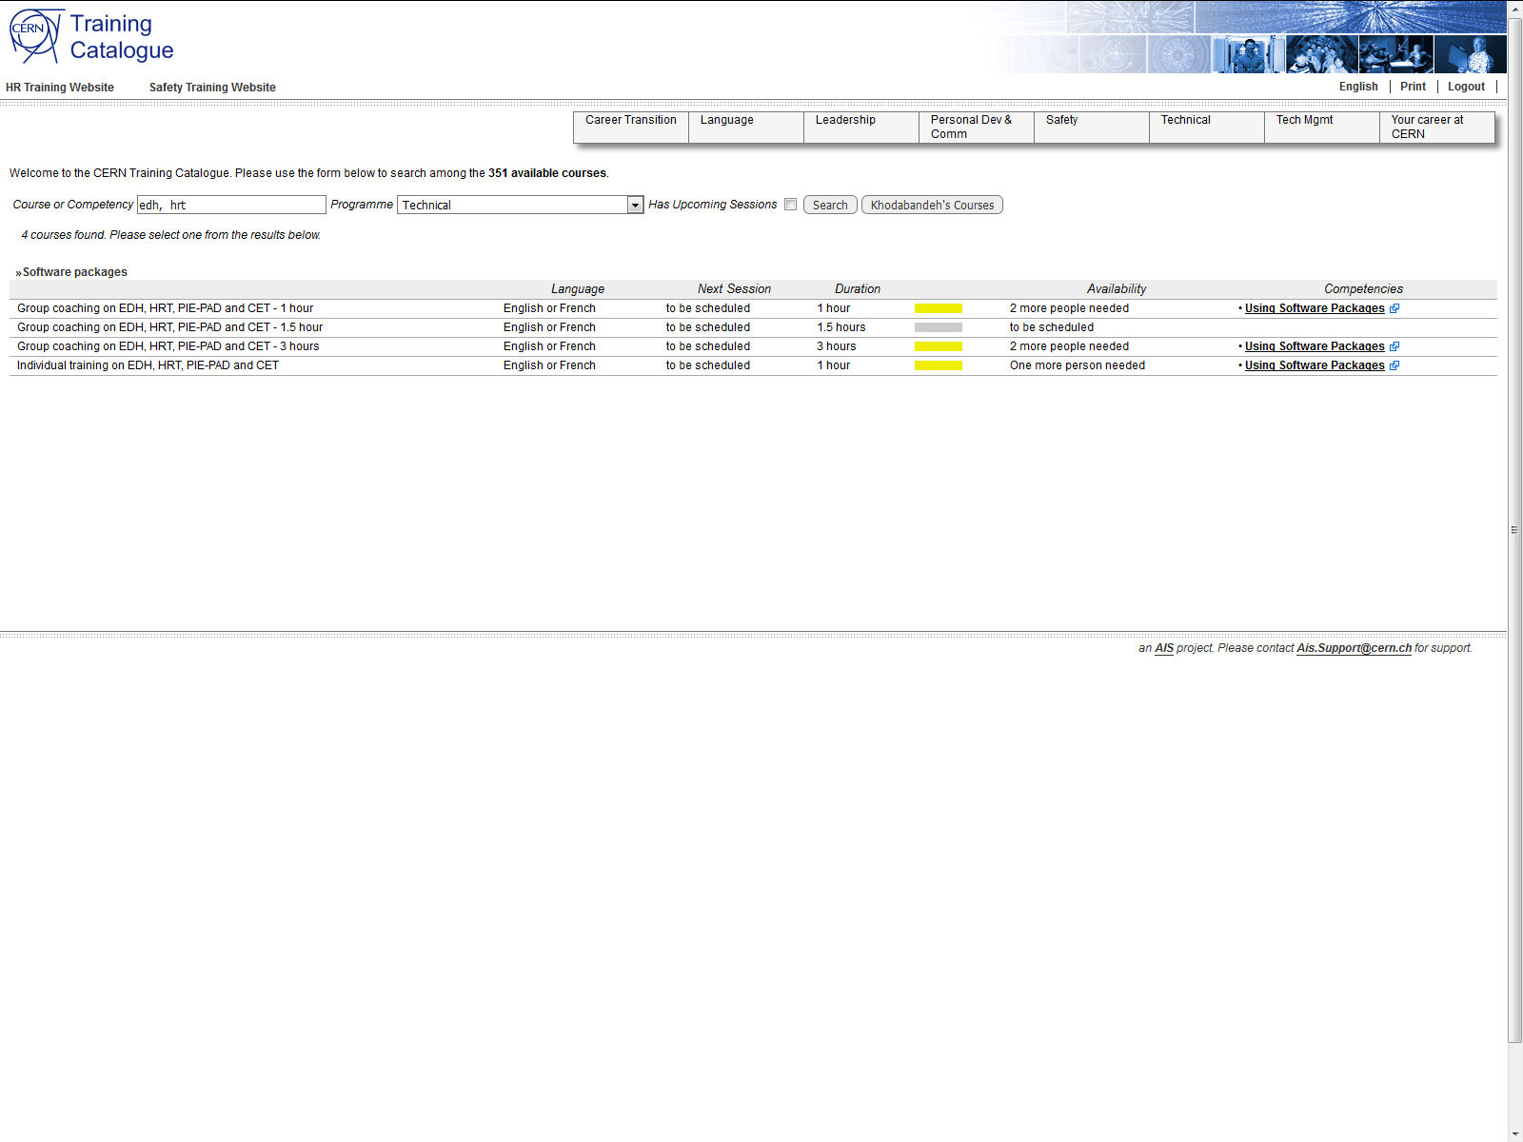
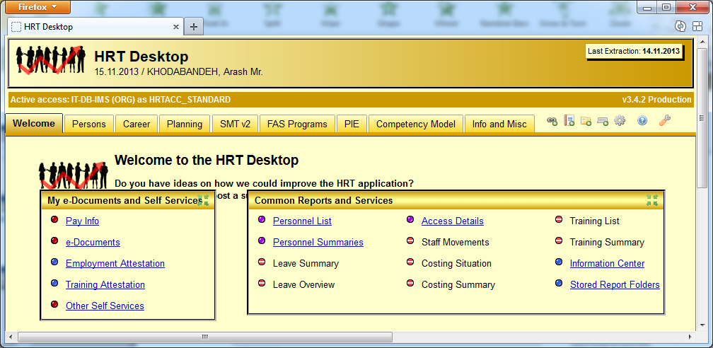
Notes:
While we are on training, I would like to point you short courses on administrative tools I mentioned before EDH and HRT. These are few individual or group coaching sessions. And also a recording for EDH that you can watch on your own screen.
HRT, the human resource tool where you can find some administrative documents, such as your pay information or proof of employment.

Slide 13
Services mis à disposition
DeskTop supportés et recommandés
W7 (NICE) : http://cern.ch/winservices
SLC Scientific Linux CERN (Red Hat Enterprise Linux) : http://cern.ch/linux
Gestion centralisée des machines
Gestions des installations centralisés / mises à jours / répertoires Home / systèmes de fichiers partagé / répertoires par département / sauvegarde des données
Supporté mais pas géré centralement
Mac : http://cern.ch/mac
Egroup: support-macosx@cern.ch
Non supporté mais ‘community fora’ (Android, Ios)
Notes:
For your desktop there are 2 recommended and supported platforms:
Windows 7
Scientific Linux, which is based on Red Hat Enterprise Linux
With these services you have a centrally managed computer with
centrally managed installation of the computer and software/packages
regular updates and security patches
Home directory with backup
Shared file systems with backup
It is recommended to use the central storage:
Your central data is backed up
In case of infection your local PC and local drive will be reinstalled and your local data on the local drive lost
MAC is also supported but not centrally managed. This means that you do not receive centrally the patches and security updates.
But you have access to the central shared file servers.
Andriod and Ios are not supported. There are community fora.

Slide 14

S’informer
CERN Alerts
IT Web Page
  http://cern.ch/it
CERN Web Page
  http://cern.ch/directory
Notes:
To conclude let me show you few locations where you can get more information.

Slide 15
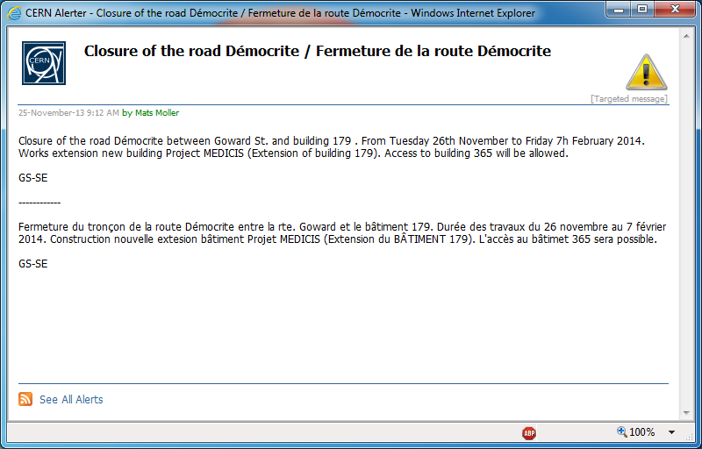
Utilisateurs Mac/Linux voir article KB (portal) →‘What is CERN Alerter’
RSS feed au http://cern.ch/cernalerts
Notes:
- The CERN Alerter
Used to push important information to targeted users or to all users.
It can be computing information, or logistic information (e.g. road problem because of heavy snow)
This is by default on all centrally managed PCs. For Mac and Linux users, please look a the KB on ‘What is CERN Alerter’
Or subscribe to the RSS feed from http://cern.ch/cernalerts

Slide 16
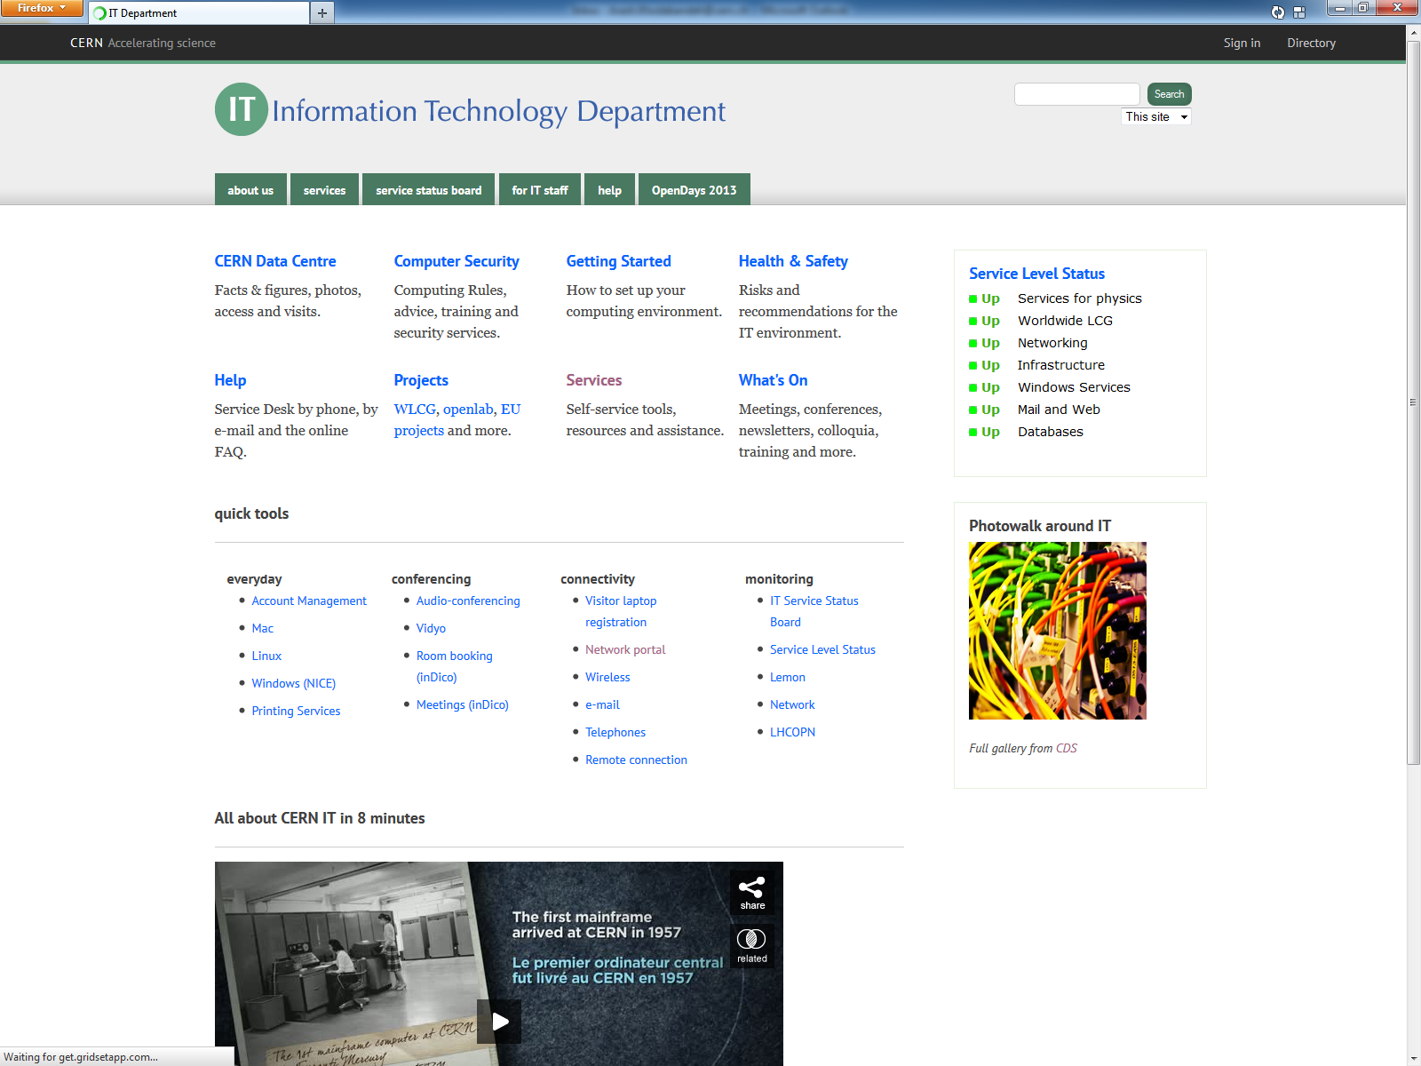
http://cern.ch/it
Notes:
- The IT web pages, where you have:
Link to the Service page with the full list of services
The most popular services are displayed at the top level
Link to the status board (what are the current problems and planned interventions). Interesting place to go if you notice a something is not working as expected before opening a ticket with Service Desk, in case the problem was already reported.

Slide 17
Notes:
Thank you for your attention and welcome to CERN.

