Slide 1


Beam induced heat loads on HL-LHC Beam Screens
G. Iadarola with input from:
G. Arduini, D. Berkowitz Zamora, S. Claudet, P. Dijkstal, R. De Maria, L. Mether, E. Metral, G. Rumolo, G. Skripka
HLLHC-TCC Meeting, 2 November 2017

Slide 2
Outline
LHC experience
Estimates for HL-LHC
  Arcs
  Inner triplets
  Other LSS magnets
Backup scenario: 8b+4e scheme

Slide 3
Outline
LHC experience
Estimates for HL-LHC
  Arcs
  Inner triplets
  Other LSS magnets
Backup scenario: 8b+4e scheme

Slide 4
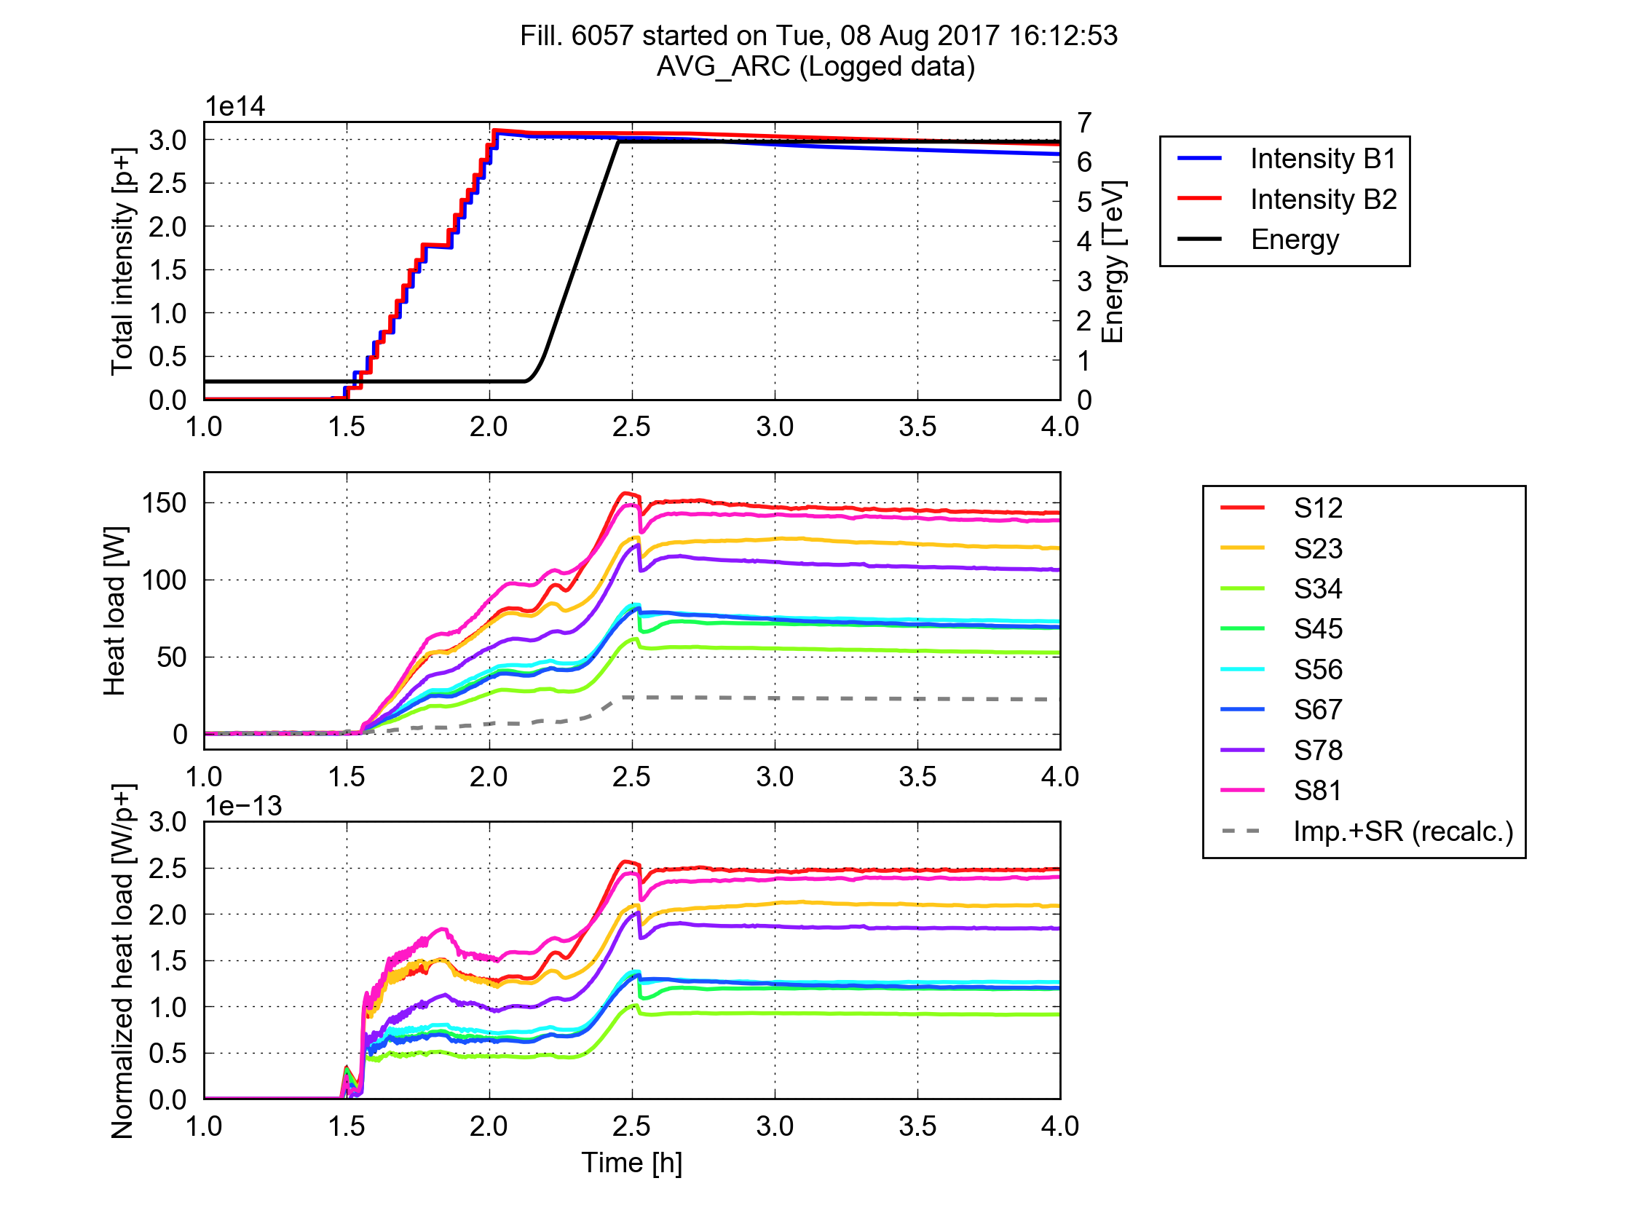
LHC experience
A challenge for LHC operation with 25 ns in Run 2: total load on the cryo-plants dominated by beam induced heating on arc beam screens
Much larger than expected from impedance and synchrotron radiation
Large differences observed between sectors
Several observed features compatible with e-cloud effects
Being followed-up by dedicated Task Force led by L. Tavian
More info can be found here

Slide 5
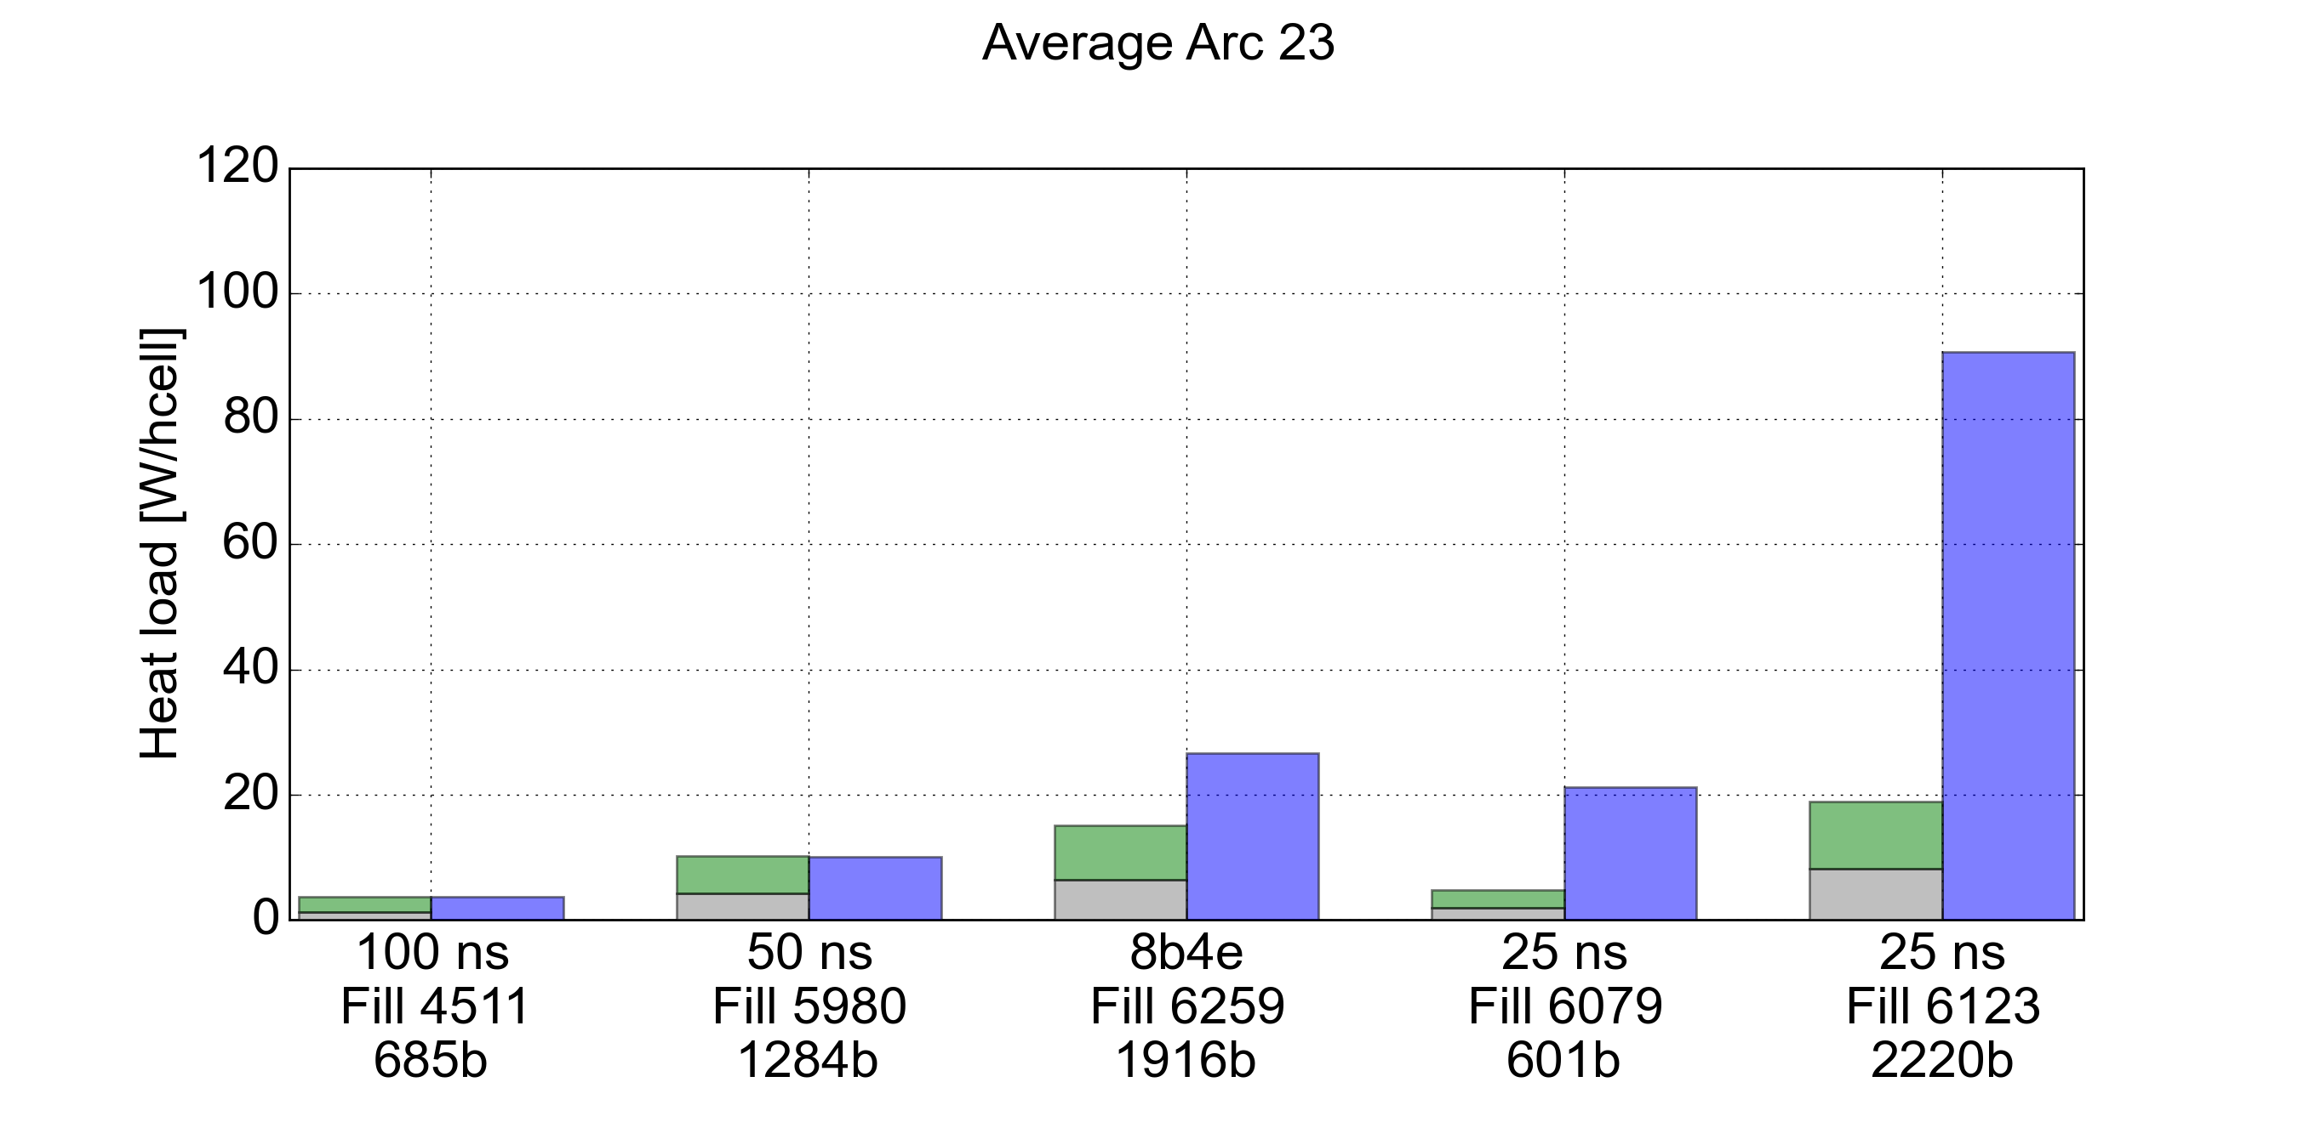
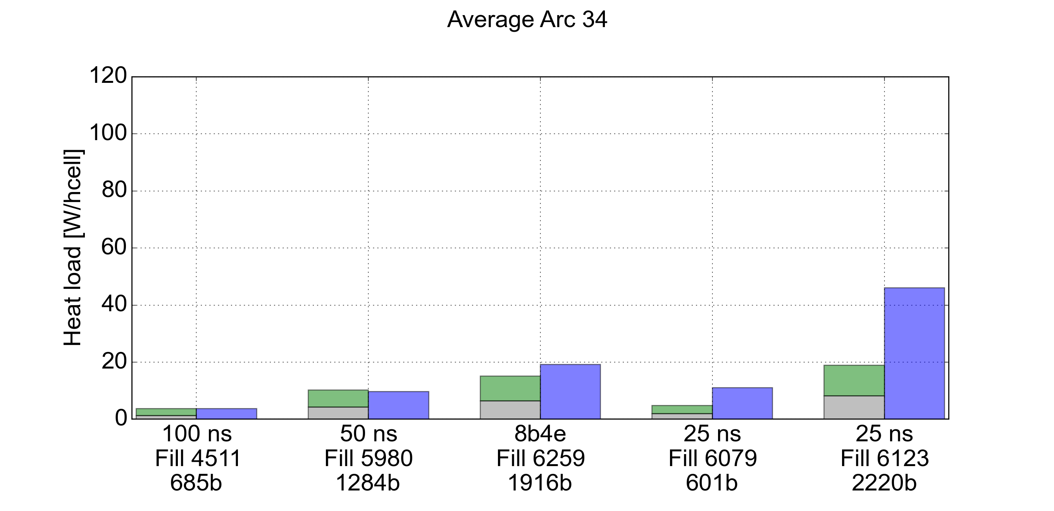
LHC experience: dependence on bunch pattern
A strong dependence on the bunch spacing is found
Arc 23
Arc 34
Synchrotron Radiation
Impedance (R.W.)
Measured
More info can be found here

Slide 6
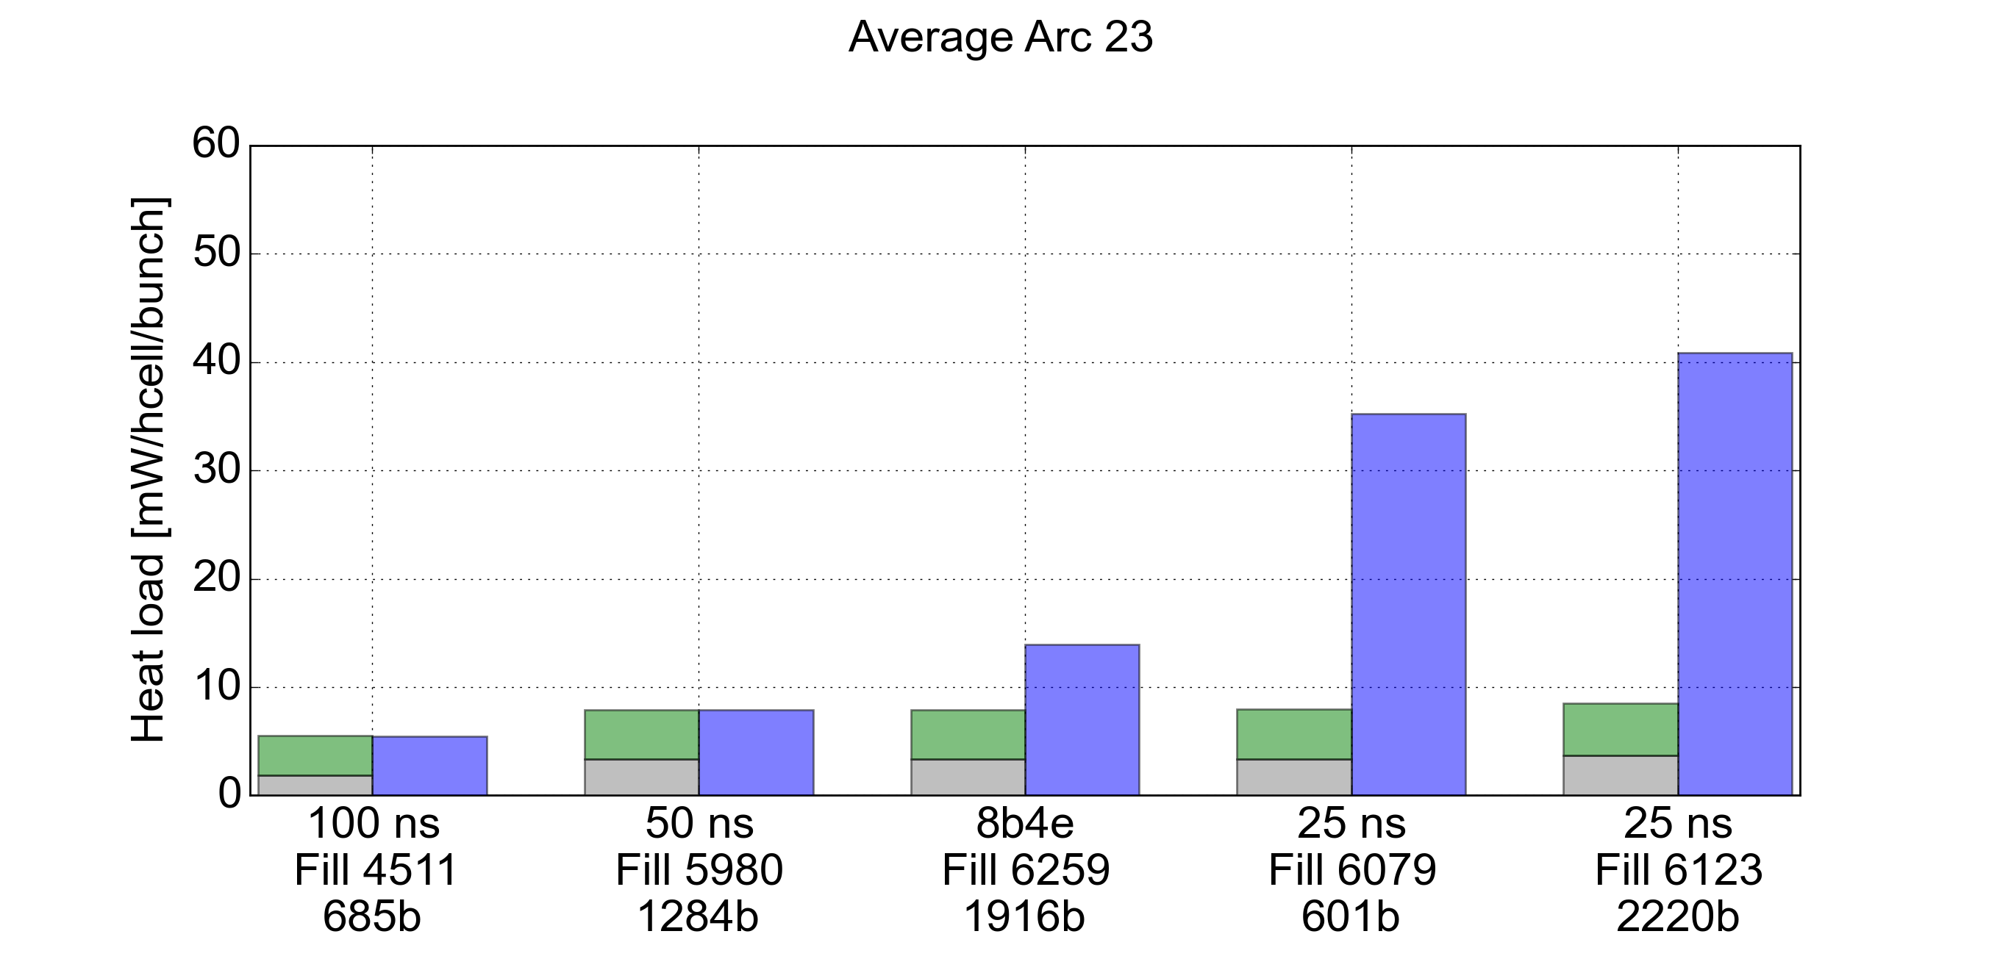
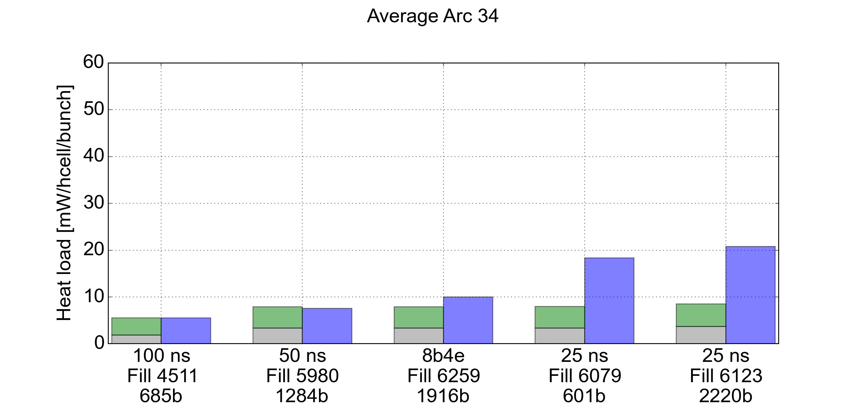
LHC experience: dependence on bunch pattern
A strong dependence on the bunch spacing is found
Normalizing to the number of bunches, we observe an increase in specific heat load by a large factor between 50 ns and 25 ns bunch spacing
This allows excluding that a large fraction of the heat load is due to impedance or synchrotron radiation
Arc 23
Arc 34
Synchrotron Radiation
Impedance (R.W.)
Measured

Slide 7
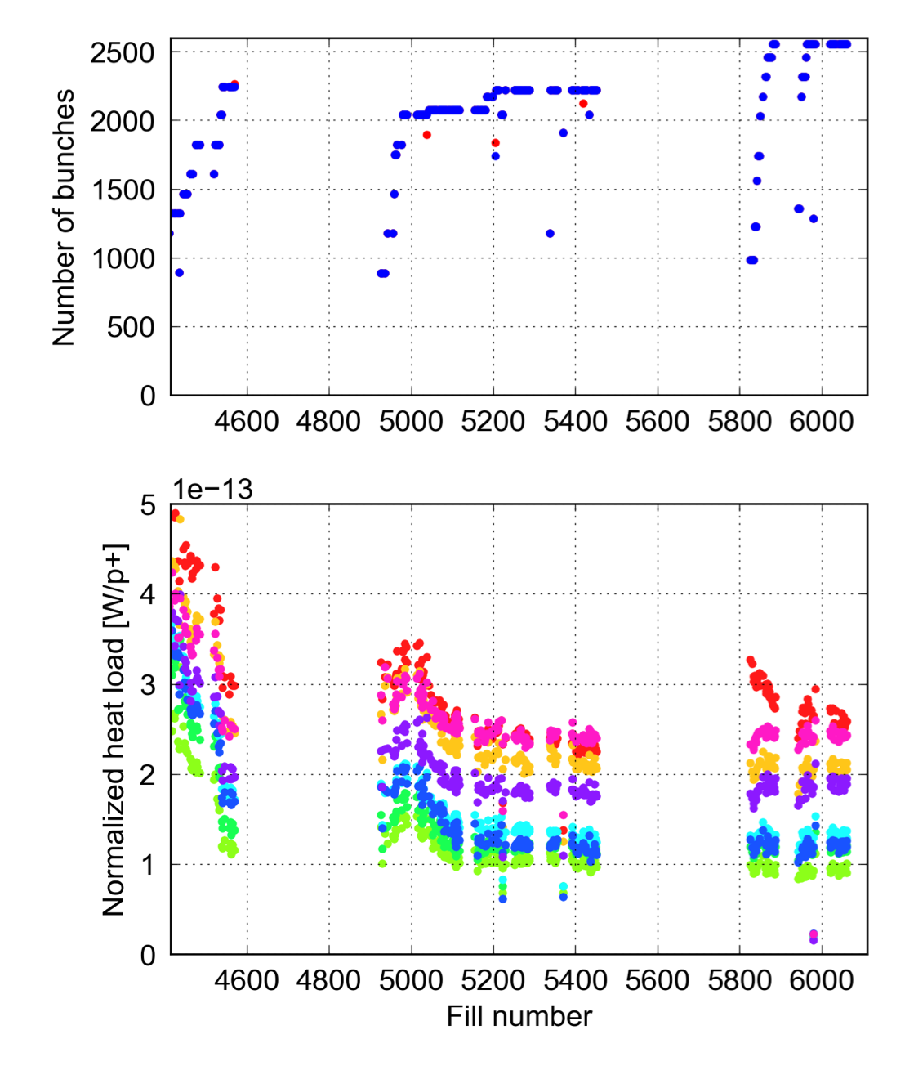
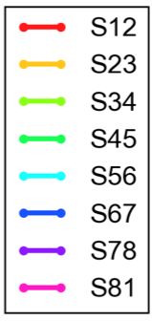
LHC experience: evolution during Run2
6.5 TeV
Beam induced scrubbing was observed at the beginning of Run 2
No significant evolution is observed since mid 2016 (with the exception of S12 vented in the EYETS 2016-17)
Differences in normalized heat loads among sectors stayed practically unchanged (unaffected by scrubbing)
2015
2016
2017
Vented
More info can be found here

Slide 8
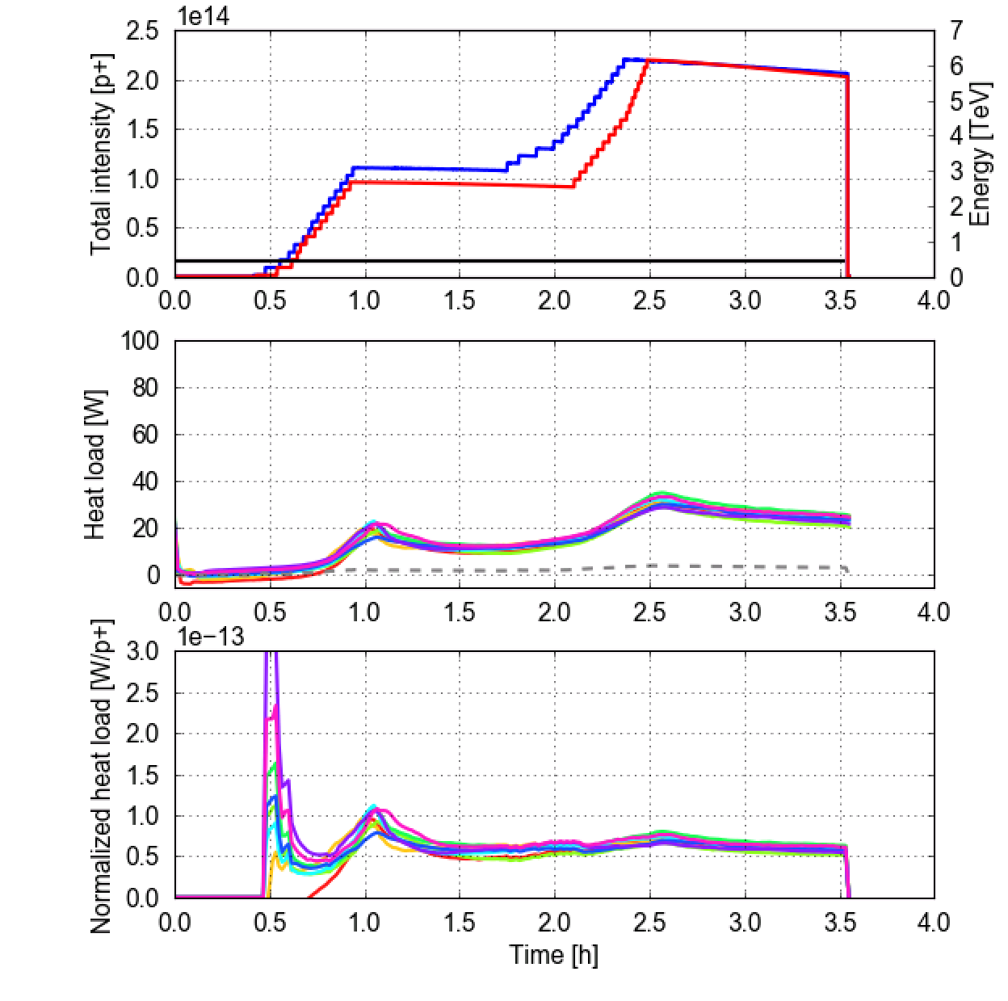
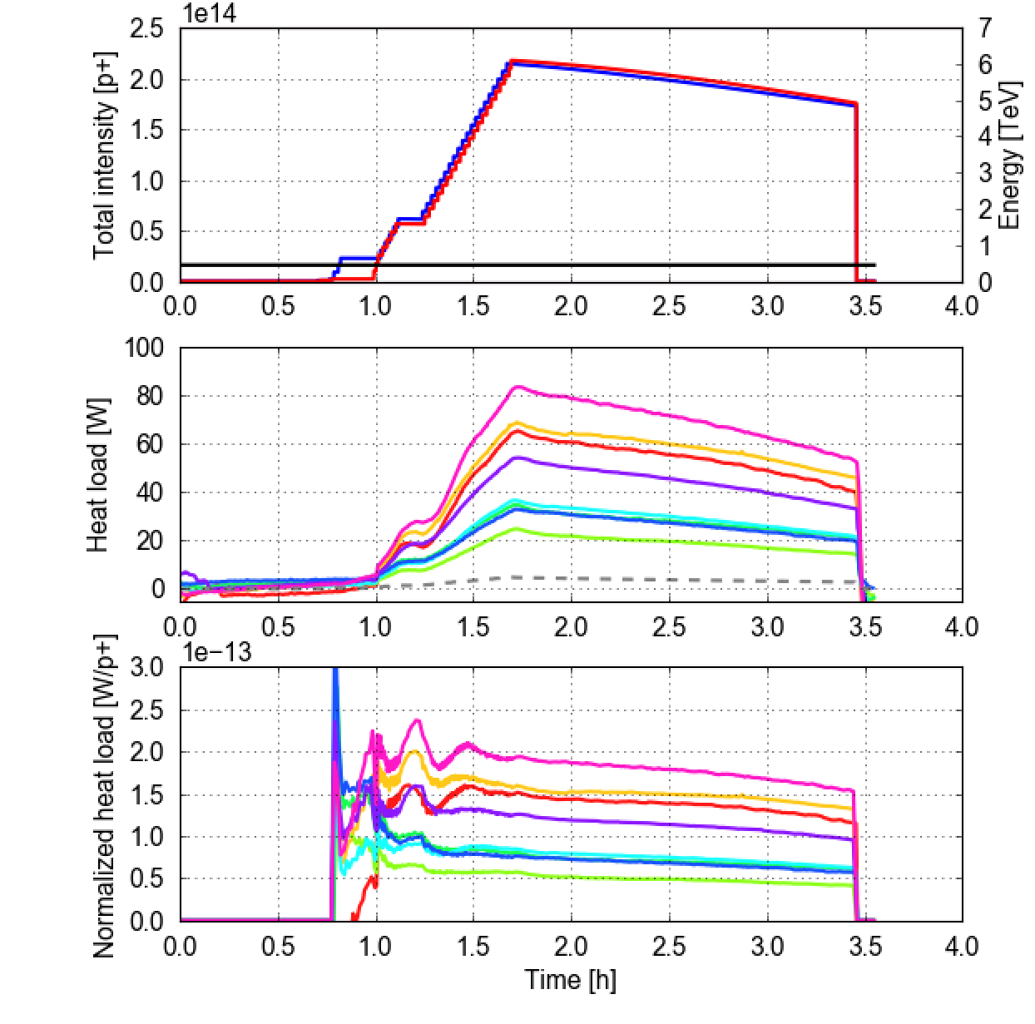
LHC experience: before and after LS1
We used the raw data recorded during tests with 25 ns in 2012 at that time to reconstruct the cell-cy-cell heat load → can be directly compared with Run 2 data
2012 (after 3 d of scrubbing at 450 GeV)
2017 (after 7 d of scrubbing at 450 GeV)
Trains of 72b
at 450 GeV
Trains of 72b
at 450 GeV
In the high load sectors, present loads are 4 times larger than before LS1
Differences were not present in 2012!
It is fundamental to avoid further degradation in view of HL-LHC
More info can be found here

Slide 9
Outline
LHC experience
Estimates for HL-LHC
  Arcs
  Inner triplets
  Other LSS magnets
Backup scenario: 8b+4e scheme

Slide 10
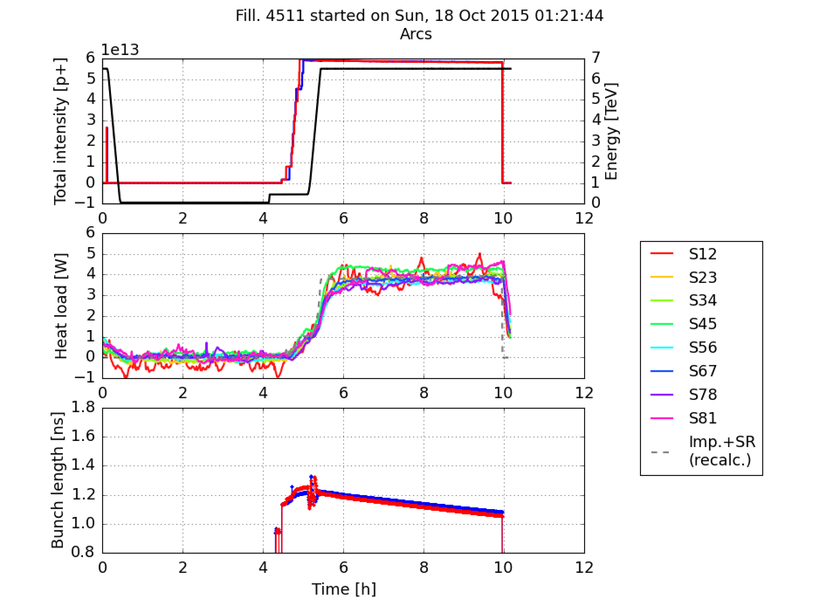
Heat load estimates for HL-LHC
Collaboration between WP2 and WP9 to build a full inventory of expected beam induced heating on the beam screens for HL-LHC:
Effects taken into account:
  Synchrotron radiation (analytic estimates, relevant only for the arcs)
  Impedance heating (analytic estimate, taking into account effect of temperature, magnetic field, longitudinal weld)
  Electron cloud effects (based on numerical simulations)
Estimates crosschecked against studies done at the time of the LHC design and against machine observations
Bunch spacing: 100 ns (2015)

Slide 11
Outline
LHC experience
Estimates for HL-LHC
  Arcs
  Inner triplets
  Other LSS magnets
Backup scenario: 8b+4e scheme

Slide 12
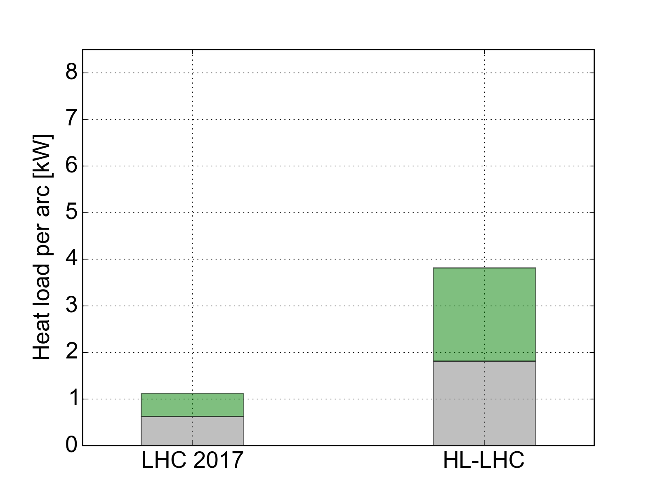
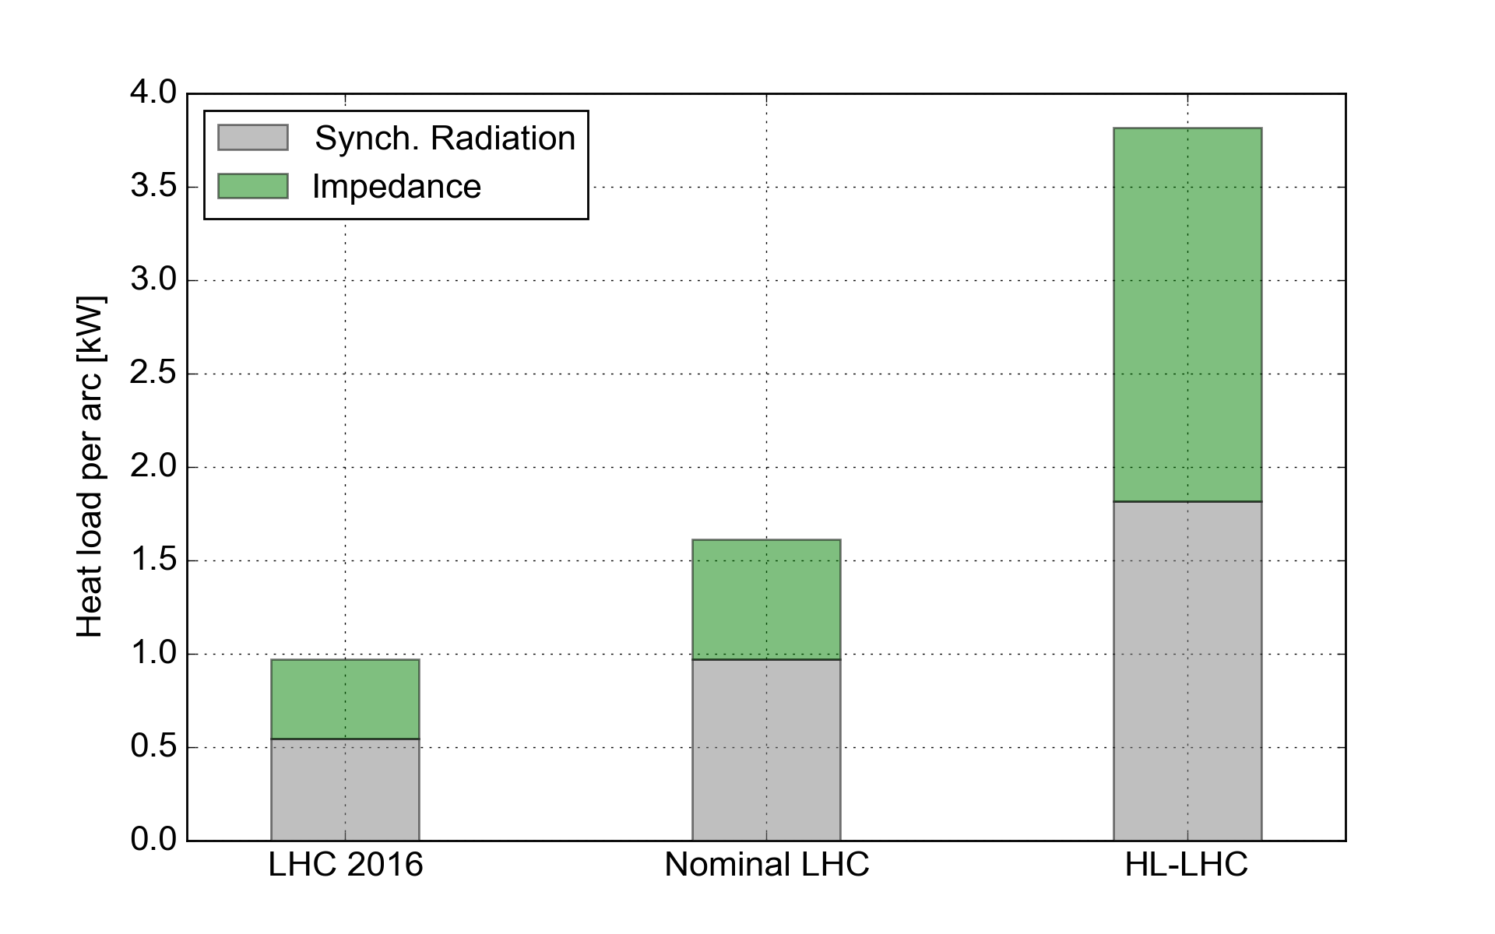
Arc heat loads from impedance and synchrotron radiation
In Run 2 configuration: small contributions from impedance and synchrotron radiation → used large available margins to cope with e-cloud
When moving to larger beam intensities (and to 7 TeV) the margin reduces strongly
Maximum allowed by cryogenics
Margin
~7 kW
Margin
~4 kW
e-cloud S12
(2017)
~6 kW
e-cloud S34
(2017)
~2kW
2556b
1.1e11 p/bunch
6.5 TeV
2748b
2.2e11 p/bunch
7 TeV

Slide 13
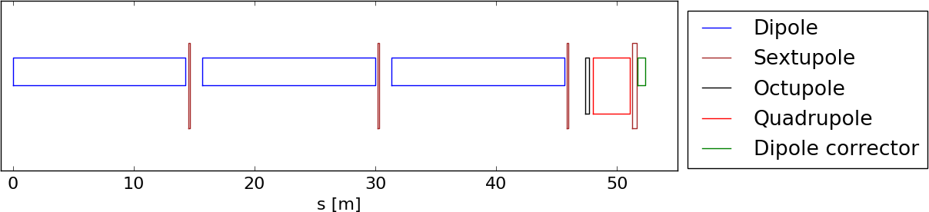
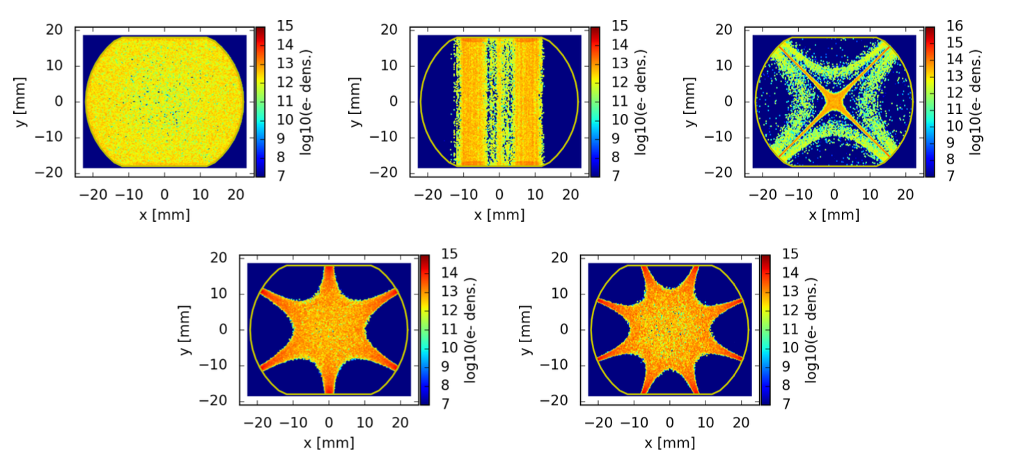
Arc heat loads from e-cloud – the model
  Estimates for the arcs are more delicate than for IRs due to the important role of photoelectrons generated by the beam synchrotron radiation
  Decided to focus on the present LHC at first to develop a solid model to be then applied for HL-LHC predictions (performed literature review to identify the best available knowledge on photoelectron yield for the LHC beam screens, correctly handling the effect of the saw-tooth)
  The defined models have been used to simulate the relevant element of the arc half-cell
Details in P. Dijkstal et al., “Simulation studies on the electron cloud build-up in the elements of the LHC Arcs at 6.5 TeV”, CERN-ACC-NOTE-2017-0057

Slide 14
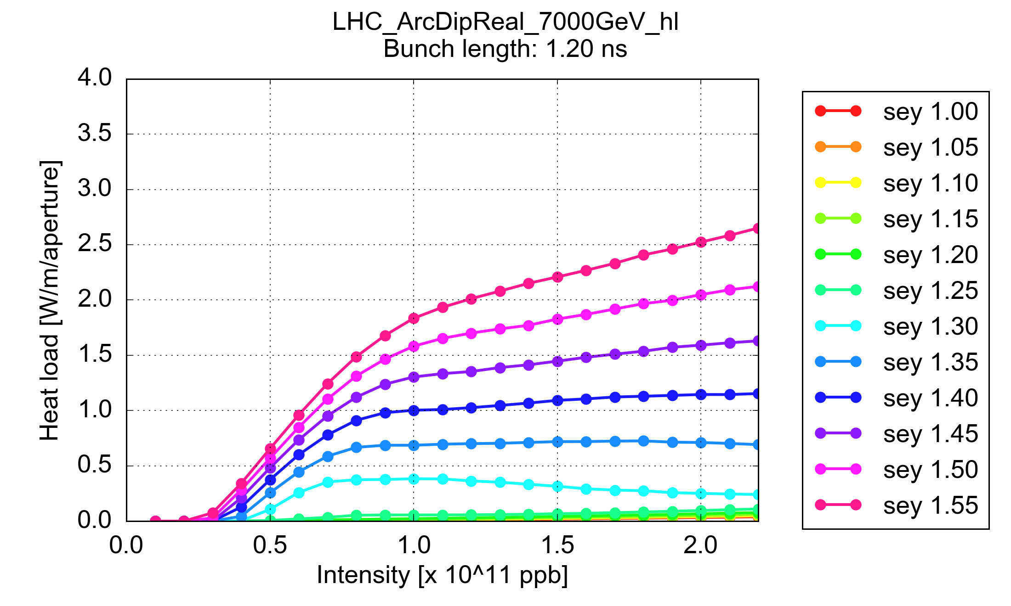
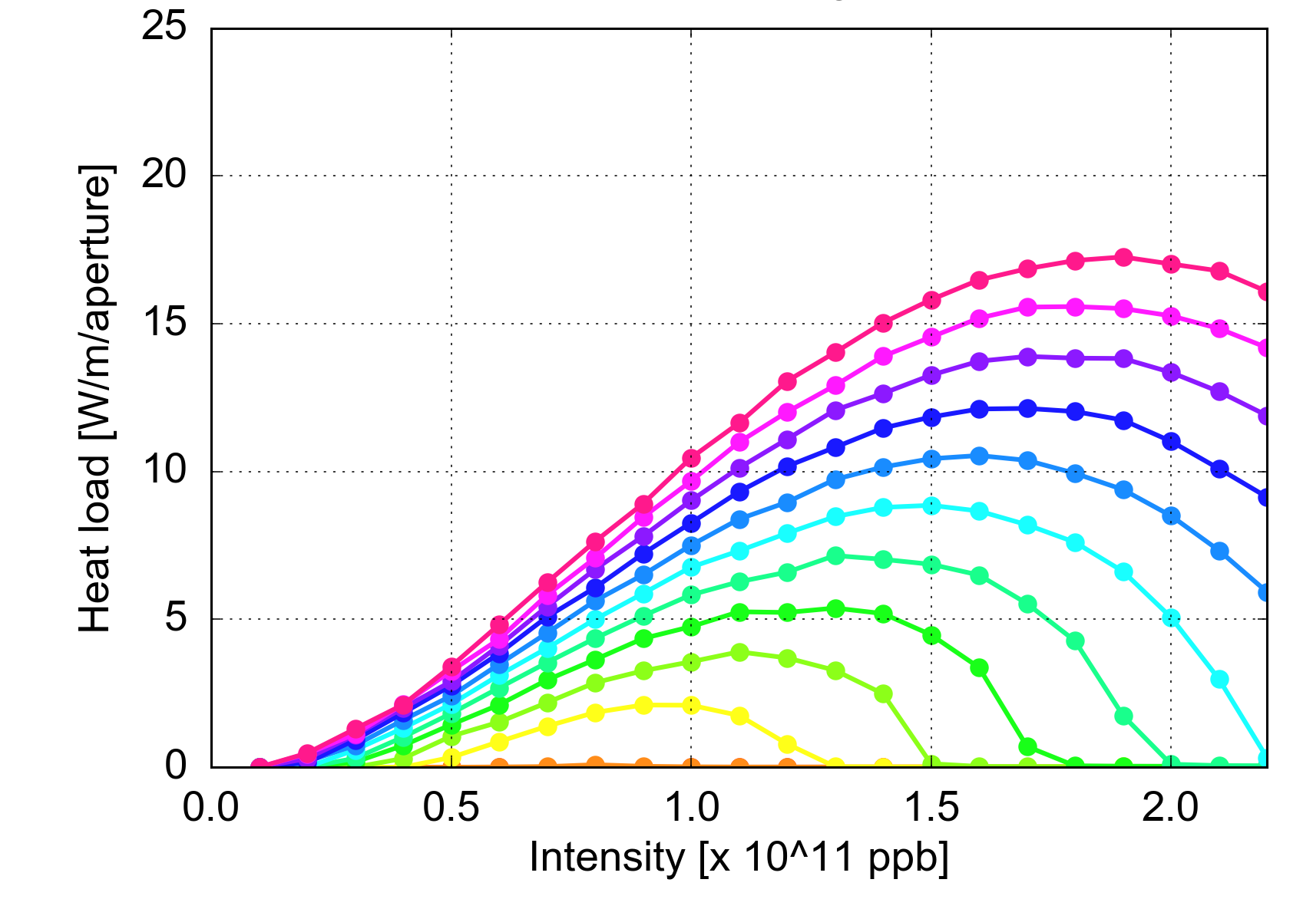
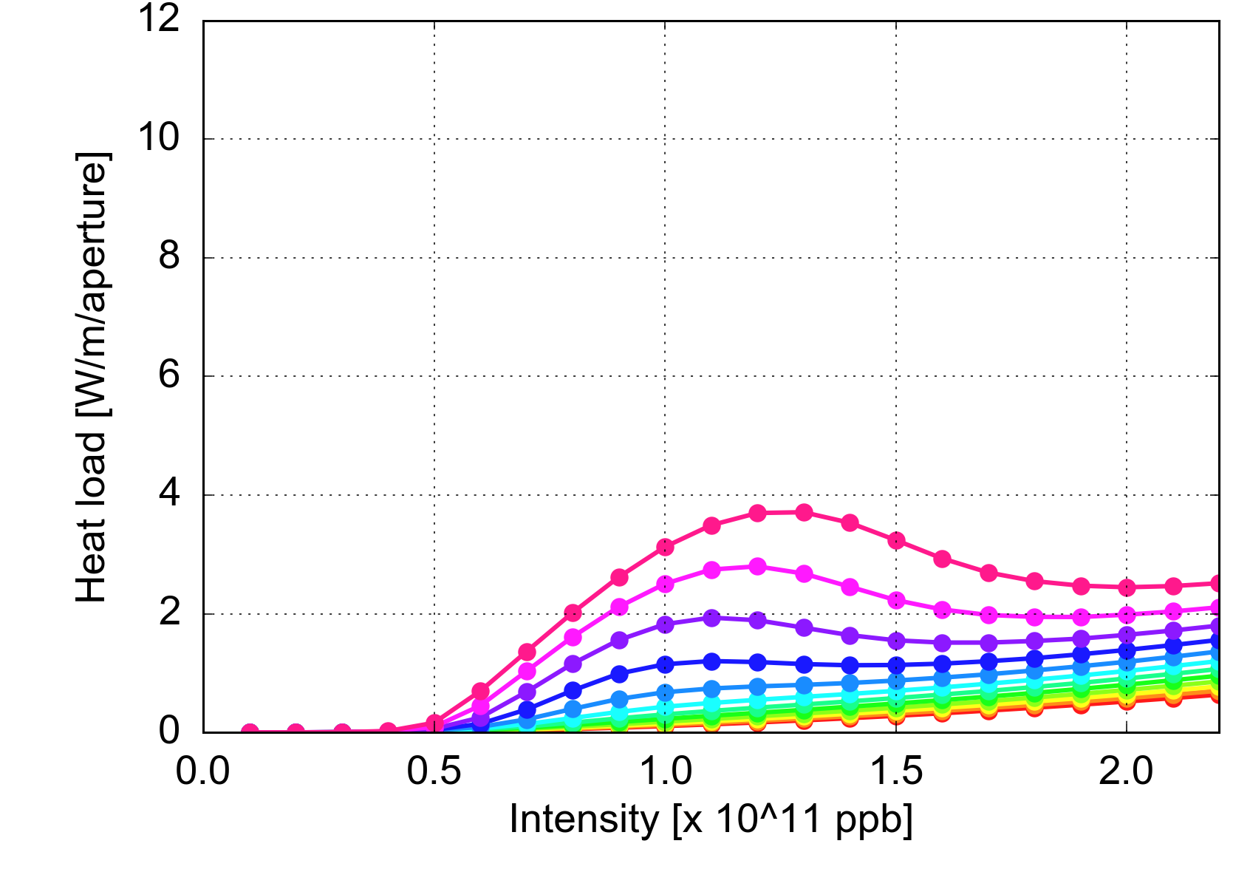
Arc heat loads – effect of bunch intensity
Dipole
  Assessed with PyECLOUD simulations:
  The dependence of the heat load on the bunch intensity strongly depends on the surface properties (SEY parameter)
  The expected dependence on the bunch intensity is strongly non linear
  Full experimental validation of these curves possible only after LS2
Quadrupole
Drift

Slide 15
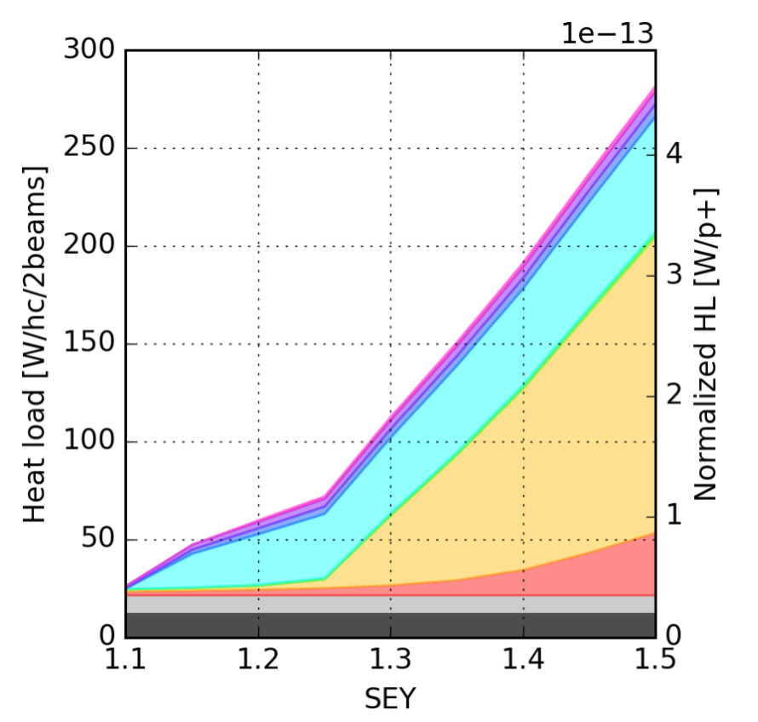
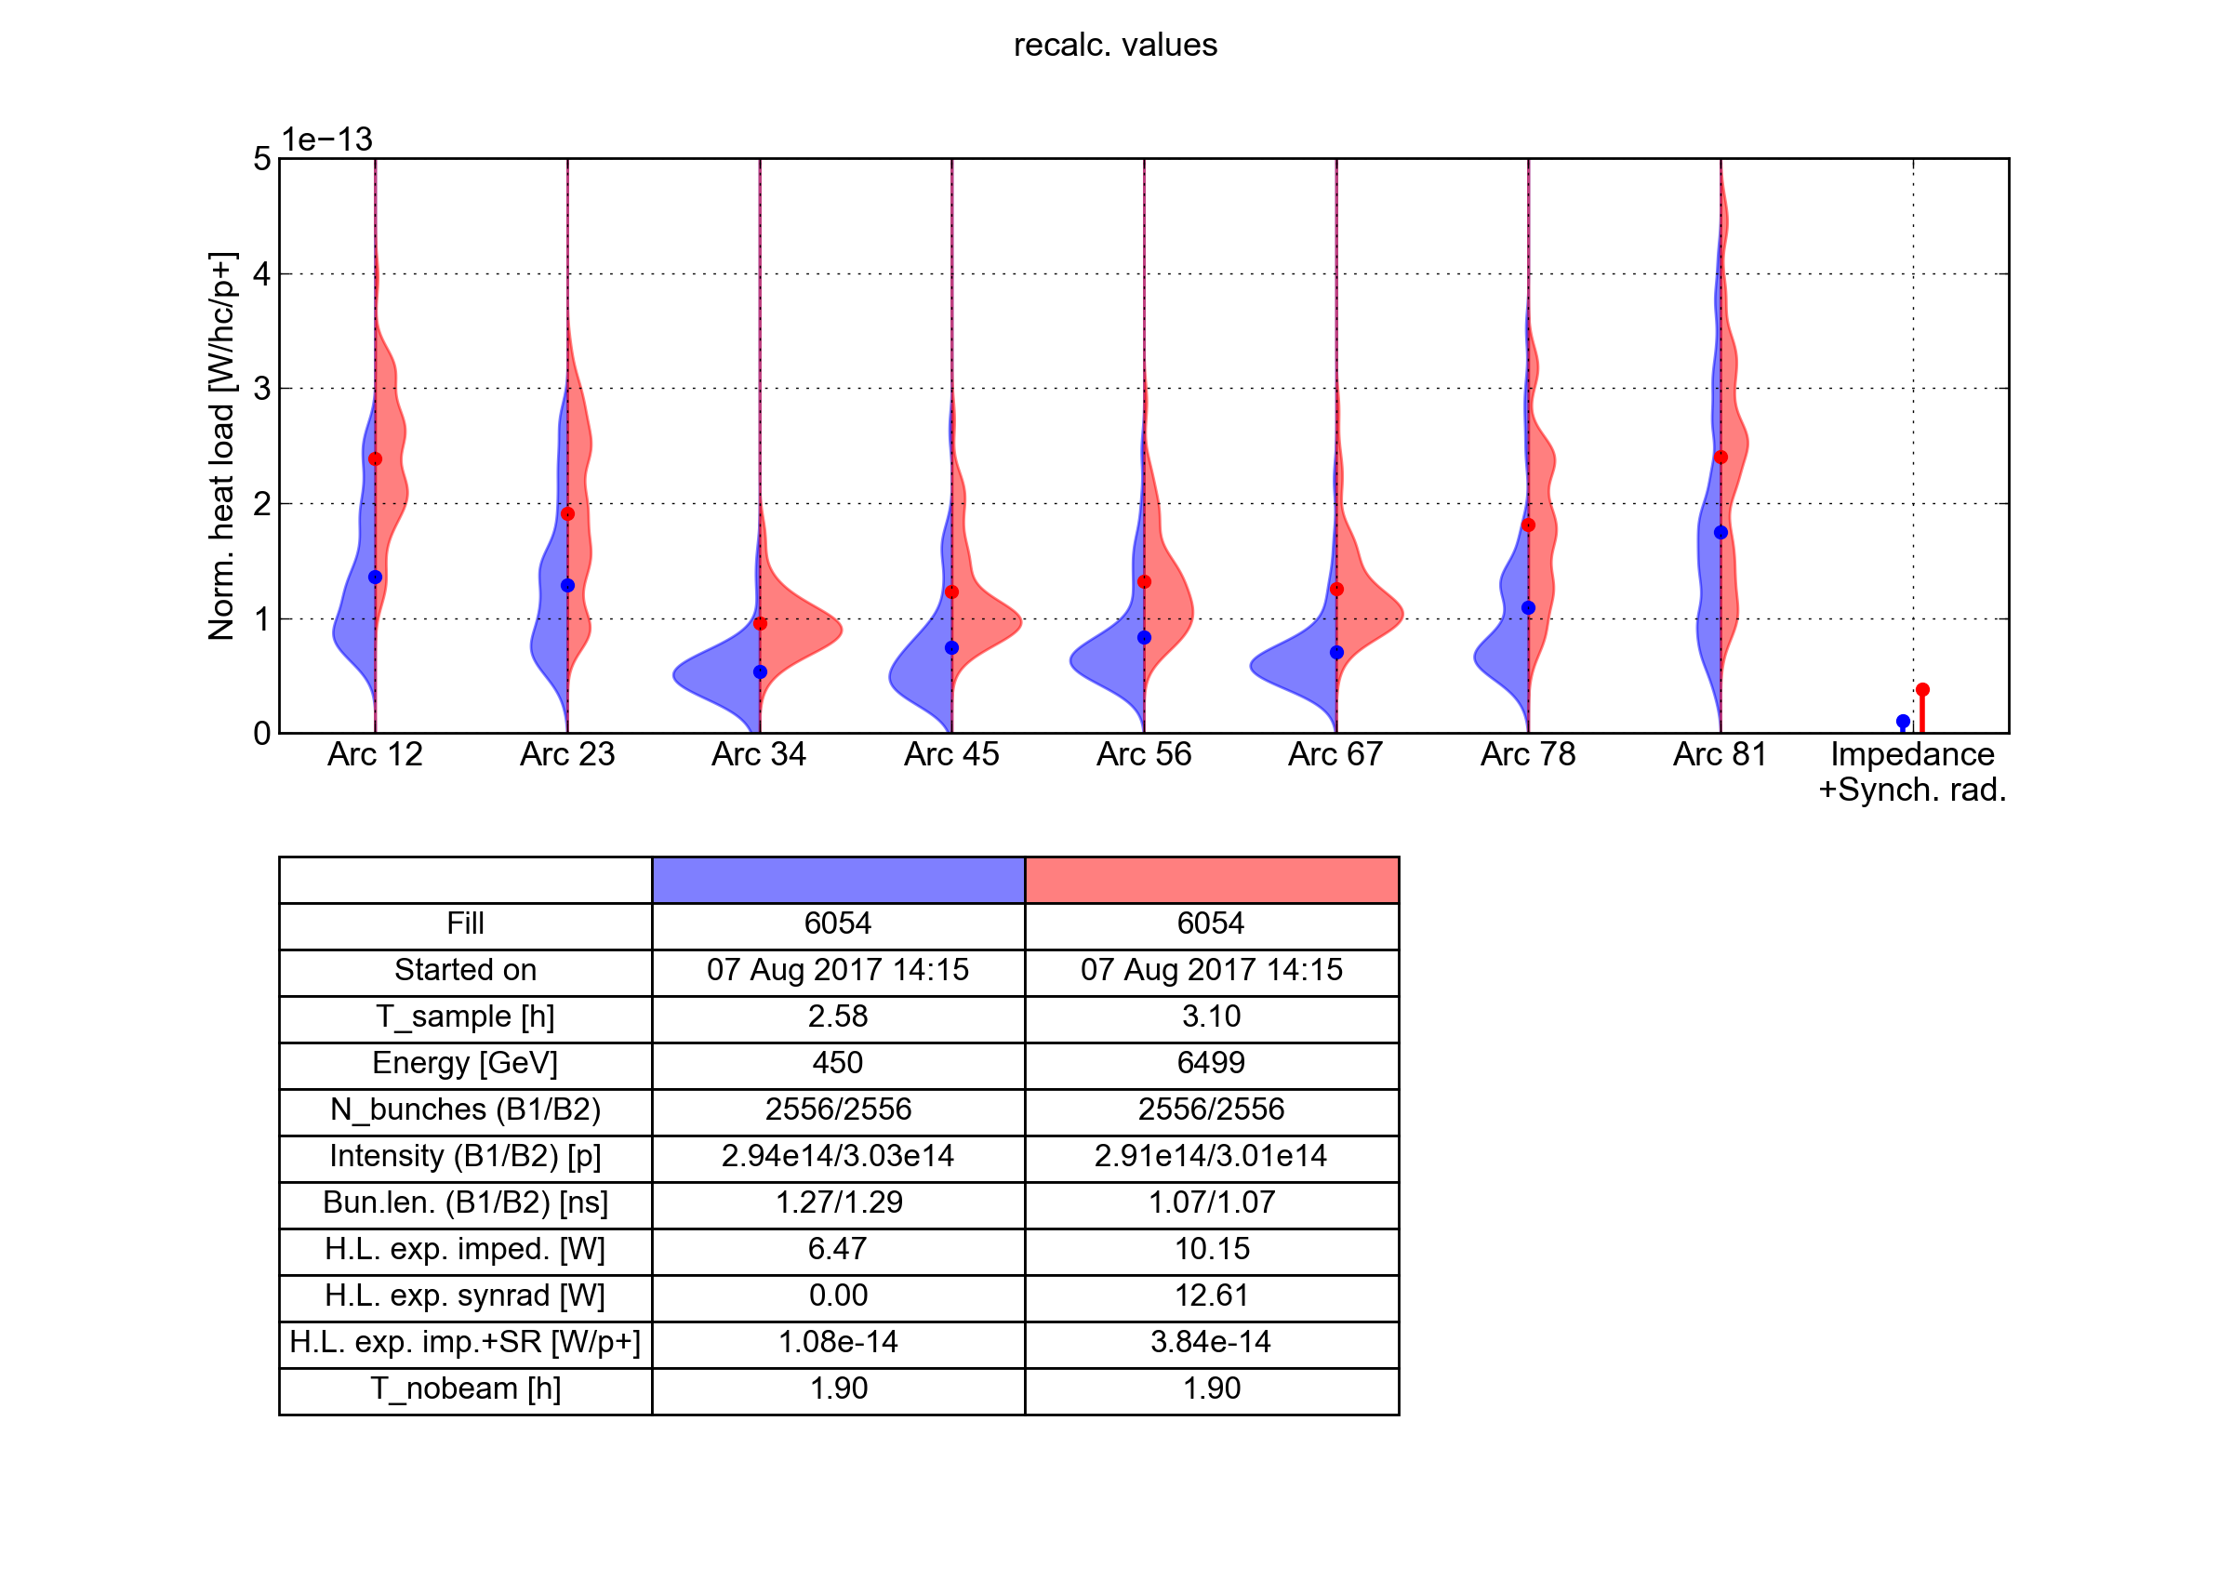
SEY estimates for present LHC
  SEY estimates can be made by comparing heat load measurements against simulations for LHC beam parameters (assuming uniform SEY over each half cell)
Simulations
Measurements
6.5 TeV
450 GeV
6.5 TeV
  Based on these assumptions:
Avg. high load sectors (S12, S81): SEY = ~1.35
Avg. low load sectors (S34, S45, S56, S67): SEY = ~1.25

Slide 16
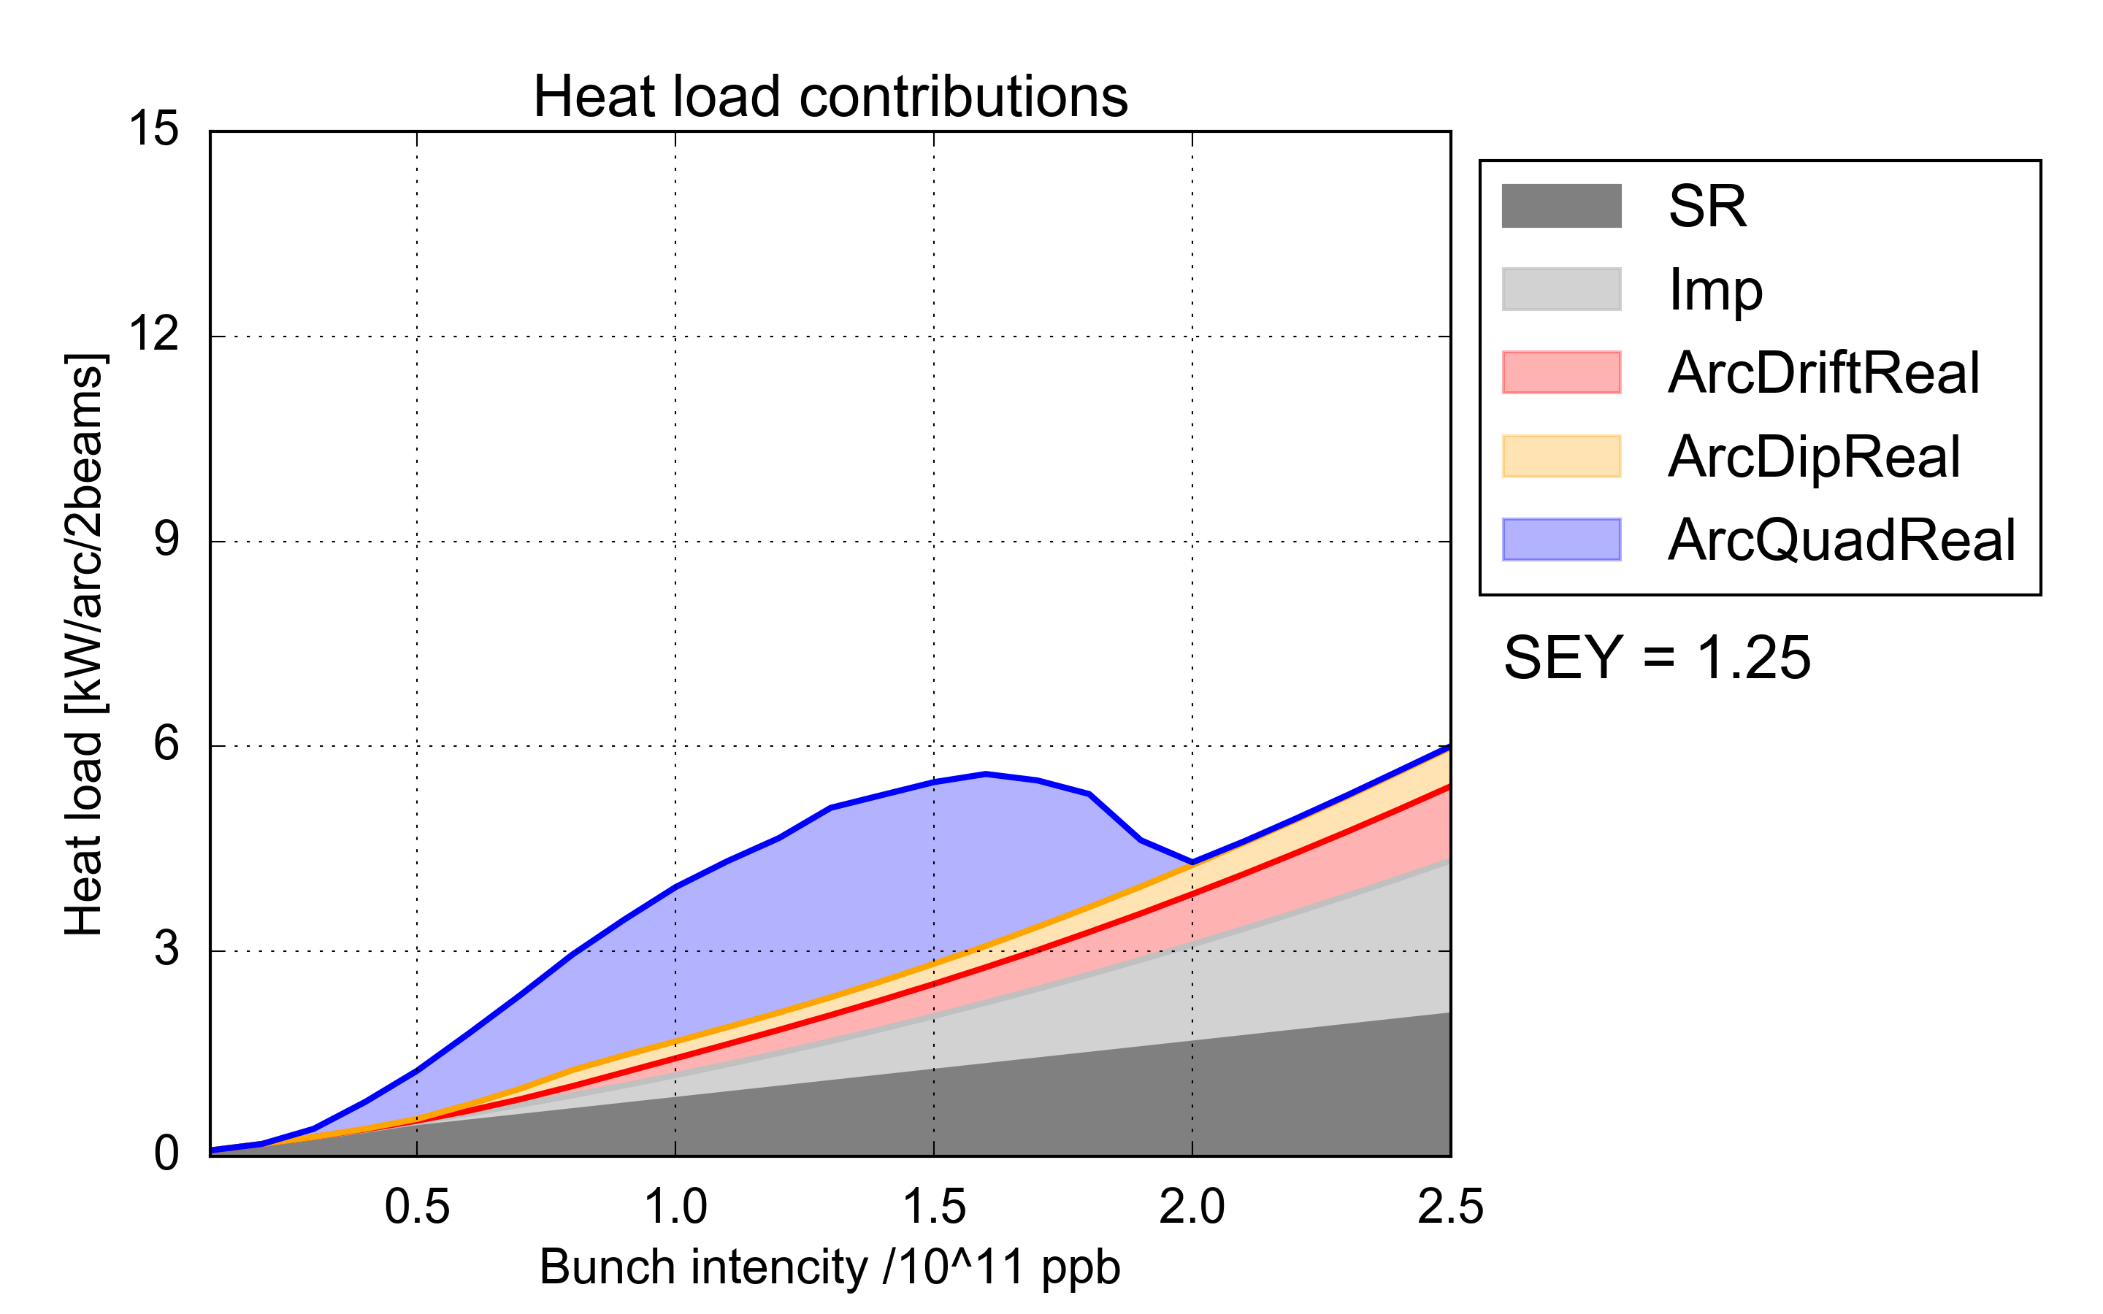
Arc heat loads: simulations for HL-LHC
Synchrotron radiation
Impedance
  HL-LHC
e-cloud in drifts
e-cloud in dipoles
e-cloud in quadrupoles
  8 kW/arc (~160W/hcell)
  Present situation in the low-load sectors
  For high bunch intensity significant heat load is observed already for low SEY (from impedance, synchrotron radiation, photoelectrons in the drifts)
  Present conditioning achieved in the low-load sectors is compatible with HL-LHC

Slide 17
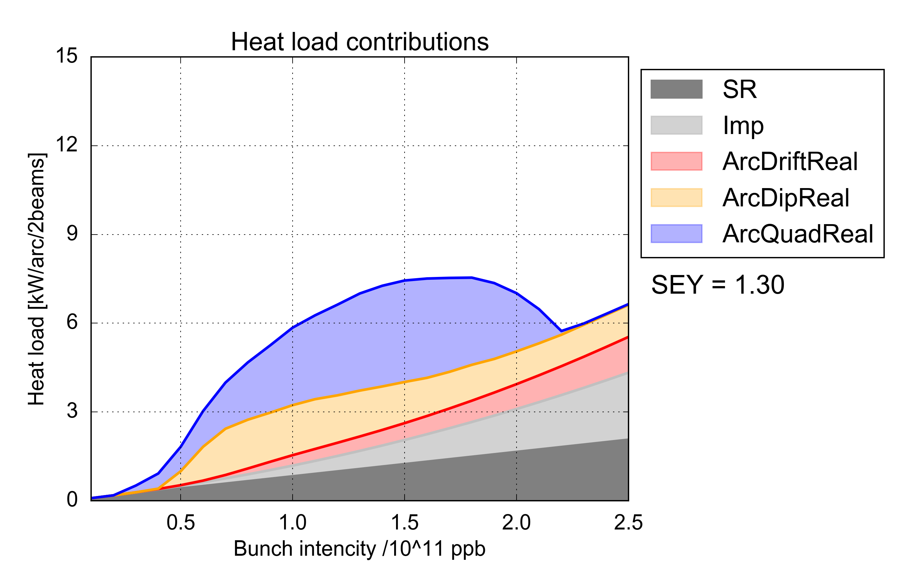
Arc heat loads: simulations for HL-LHC
Synchrotron radiation
Impedance
  HL-LHC
e-cloud in drifts
e-cloud in dipoles
e-cloud in quadrupoles
  8 kW/arc (~160W/hcell)
  For high bunch intensity significant heat load is observed already for low SEY (from impedance, synchrotron radiation, photoelectrons in the drifts)
  Present conditioning achieved in the low-load sectors is compatible with HL-LHC

Slide 18
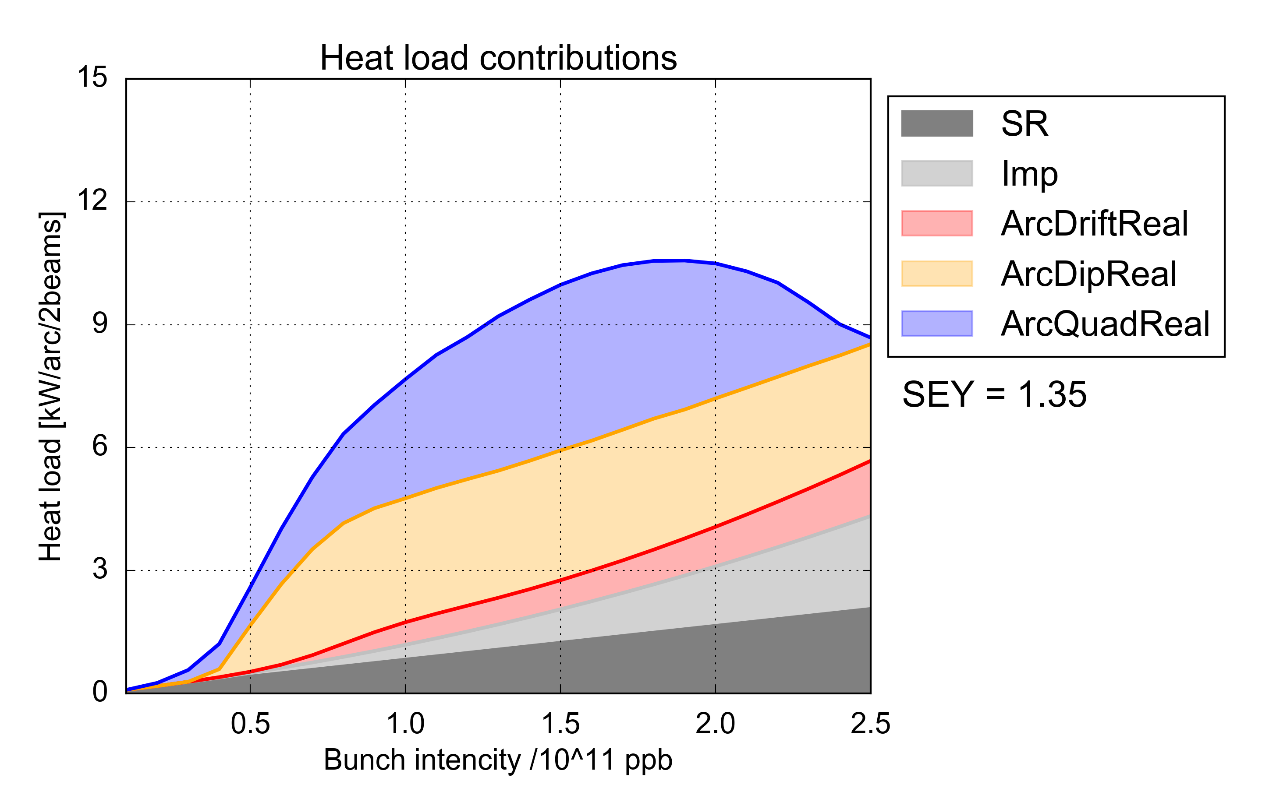
Arc heat loads: simulations for HL-LHC
Synchrotron radiation
Impedance
  HL-LHC
e-cloud in drifts
e-cloud in dipoles
e-cloud in quadrupoles
  8 kW/arc (~160W/hcell)
  Present situation in the high-load sectors
  For high bunch intensity significant heat load is observed already for low SEY (from impedance, synchrotron radiation, photoelectrons in the drifts)
  Present conditioning achieved in the low-load sectors is compatible with HL-LHC
  Expected heat load for the high-load sectors is ~10 kW/arc → not acceptable for HL-LHC
    Ongoing work to identify and suppress the source of differences among arcs is very important for HL-LHC

Slide 19
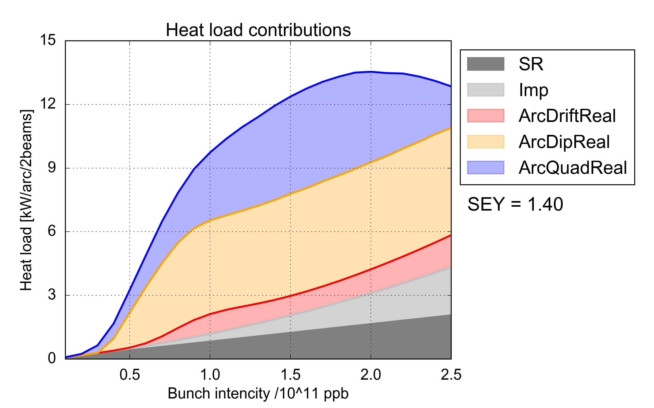
Arc heat loads: simulations for HL-LHC
Synchrotron radiation
Impedance
  HL-LHC
e-cloud in drifts
e-cloud in dipoles
e-cloud in quadrupoles
  8 kW/arc (~160W/hcell)
  For high bunch intensity significant heat load is observed already for low SEY (from impedance, synchrotron radiation, photoelectrons in the drifts)
  Present conditioning achieved in the low-load sectors is compatible with HL-LHC
  Expected heat load for the high-load sectors is ~10 kW/arc → not acceptable for HL-LHC
    Ongoing work to identify and suppress the source of differences among arcs is very important for HL-LHC

Slide 20
Outline
LHC experience
Estimates for HL-LHC
  Arcs
  Inner triplets
  Other LSS magnets
Backup scenario: 8b+4e scheme

Slide 21
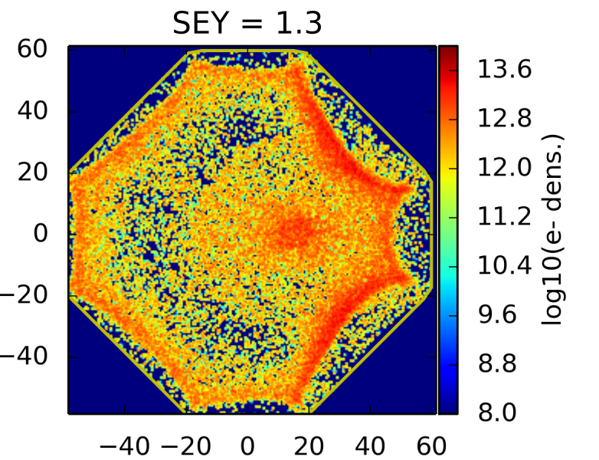
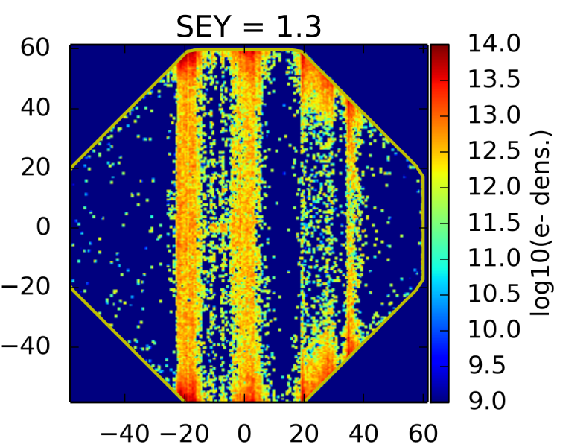
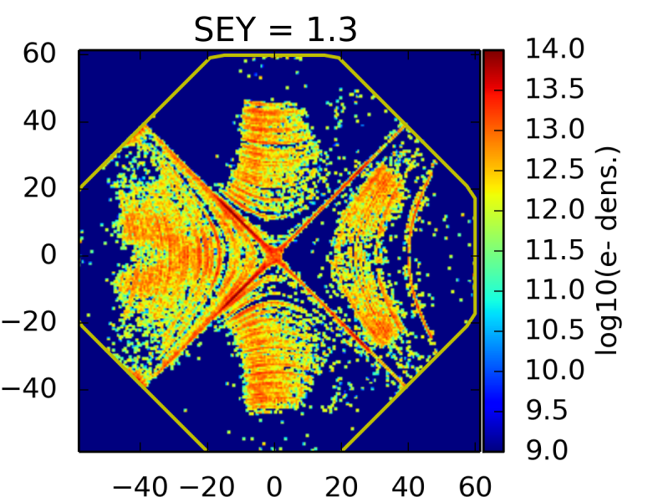
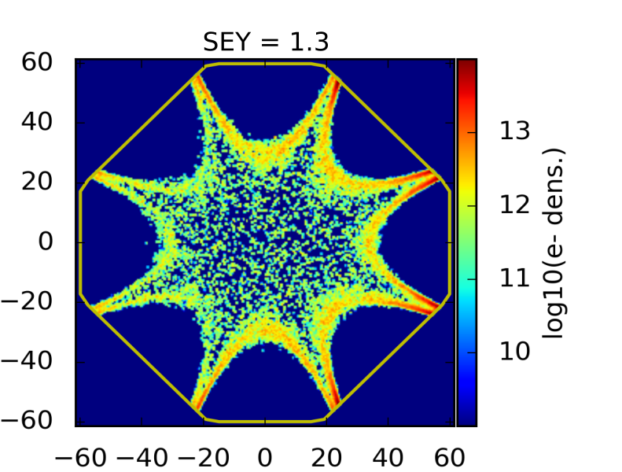
Inner triplets
  Impedance heating: estimated taking into account impact of magnetic fields and temperature (assumed to be 70 K for IP1&5 and 20 K for IP2&8)
  e-cloud heating: studied with macroparticle simulations:
    e-cloud mitigation by surface treatment (a-C coating) is foreseen
    Baffle plates (with low SEY) will be installed behind the pumping slots to avoid direct impacts of the electrons on the cold bore
    Heavy simulation studies: device needs to be sliced to take into account different time of arrivals, transverse positions and sizes of the two beams

Slide 22
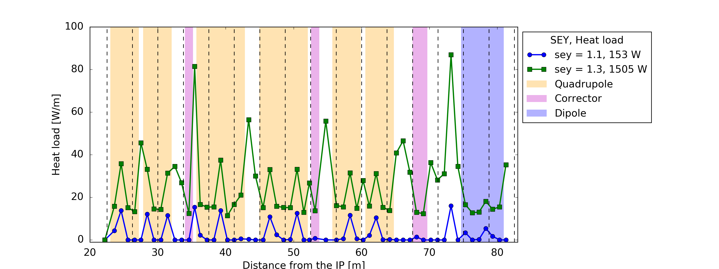
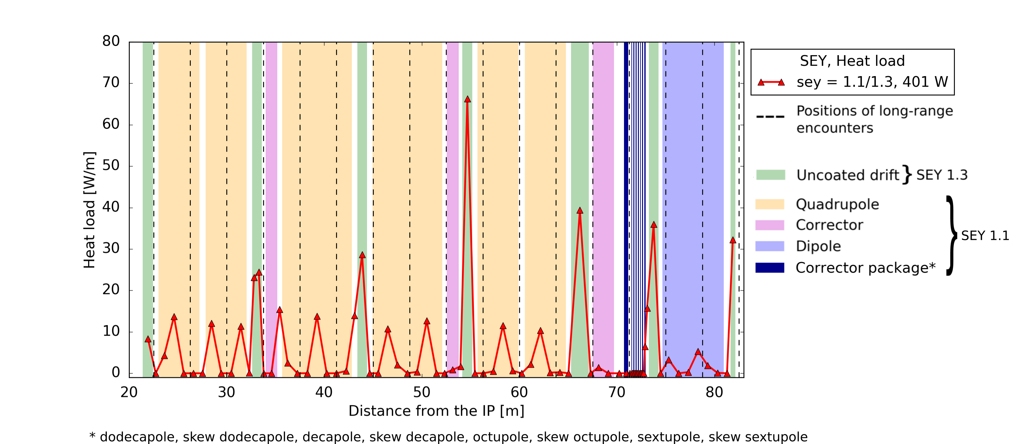
Inner triplets
Coating with SEY<1.1 provides a strong heat load reduction
To asses the impact of having short uncoated sections (bellows, BPMs) we simulated the case in which all sections outside the cold masses have SEY_{max} = 1.3

Slide 23
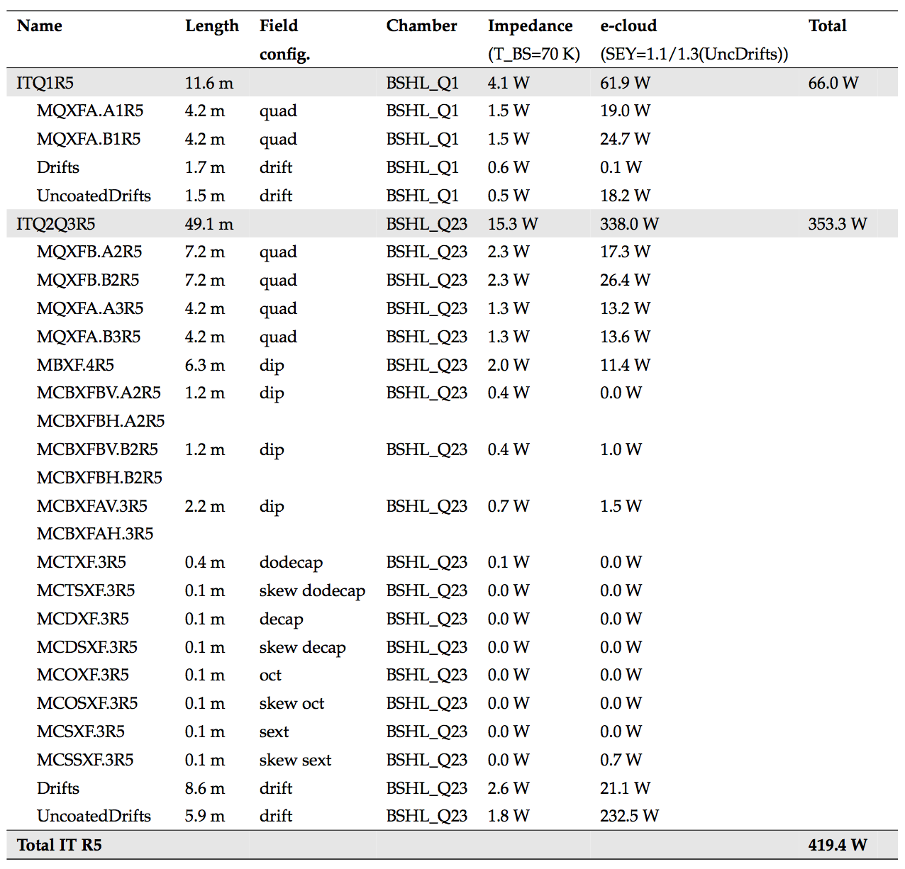
Inner triplets
Triplets in IR1&5
Detailed tables have been compiled
See also G. Skripka and G. Iadarola, “Beam-induced heat loads on the beam screens of the inner triplets for the HL-LHC”, to be published, draft available here

Slide 24
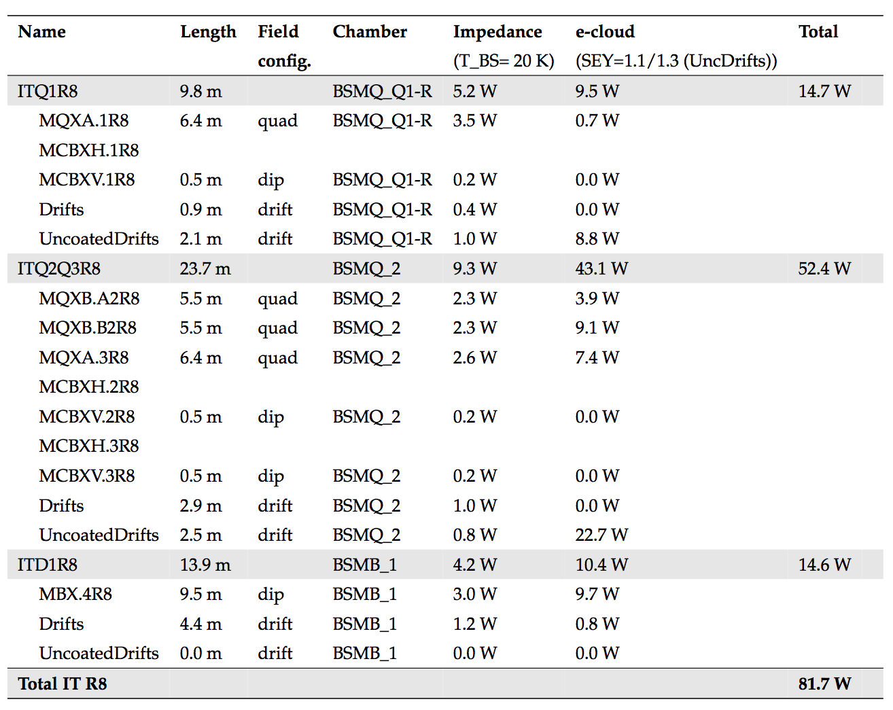
Inner triplets
Triplets in IR2&8
Detailed tables have been compiled
Studies performed also for Inner Triplets in IR2 and IR8
See also G. Skripka and G. Iadarola, “Beam-induced heat loads on the beam screens of the inner triplets for the HL-LHC”, to be published, draft available here

Slide 25
Inner triplets
 | SEY = 1.3 | SEY = 1.1 | SEY=1.1 (cold masses) SEY=1.3 (elsewhere)
Inner Triplet IR1&5 | 1.5 kW | 170 W | 420 W
Inner Triplet IR2&8 | 1 kW | 50 W | 82 W
Large heat load reduction (10-fold) expected from low SEY coating
Significant load added by e-cloud in un-coated drifts between the cold masses, especially in IR1&5. Proposed strategy:
  Length of uncoated parts should be minimized
  Remaining load should be taken into account in the design of new cryo for IR1&5 (info provided to WP9)
  Impact on beam stability needs to be crosschecked
Ongoing work: quantify effect of possible electron accumulation over many turns in the low SEY range (1.0<SEY<1.1)

Slide 26
Outline
LHC experience
Estimates for HL-LHC
  Arcs
  Inner triplets
  Other LSS magnets
Backup scenario: 8b+4e scheme

Slide 27
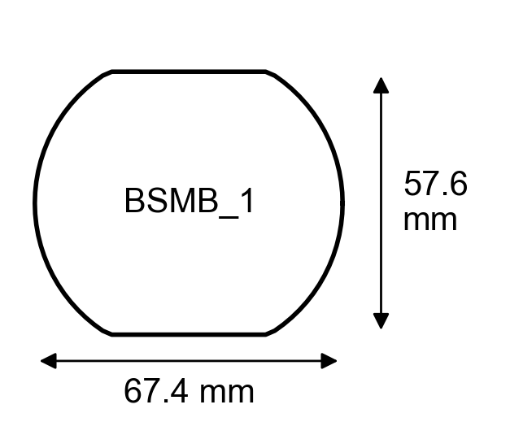
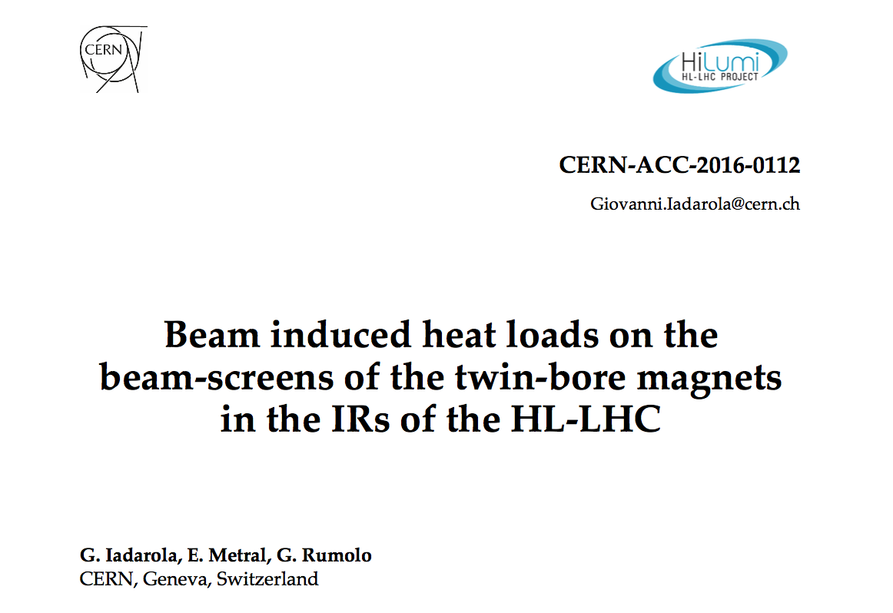
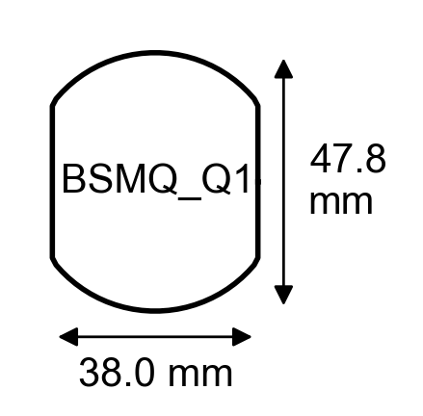
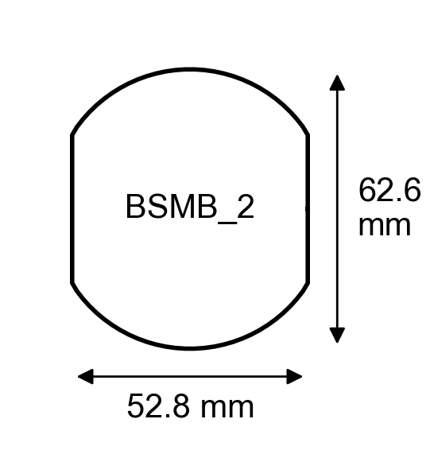
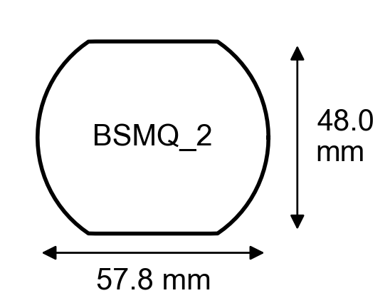
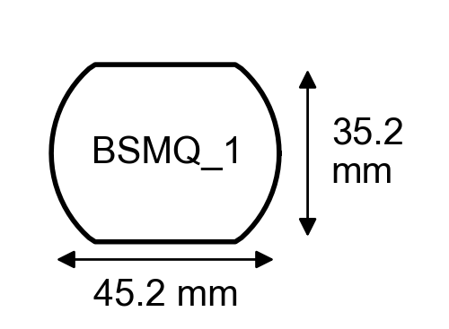
Twin-bore magnets in the LSS
Heat load estimates have been carried out also for all cold twin-bore magnets in the insertion regions
The main results are available at: https://cds.cern.ch/record/2217217?ln=en
Naming convention used in the following

Slide 28
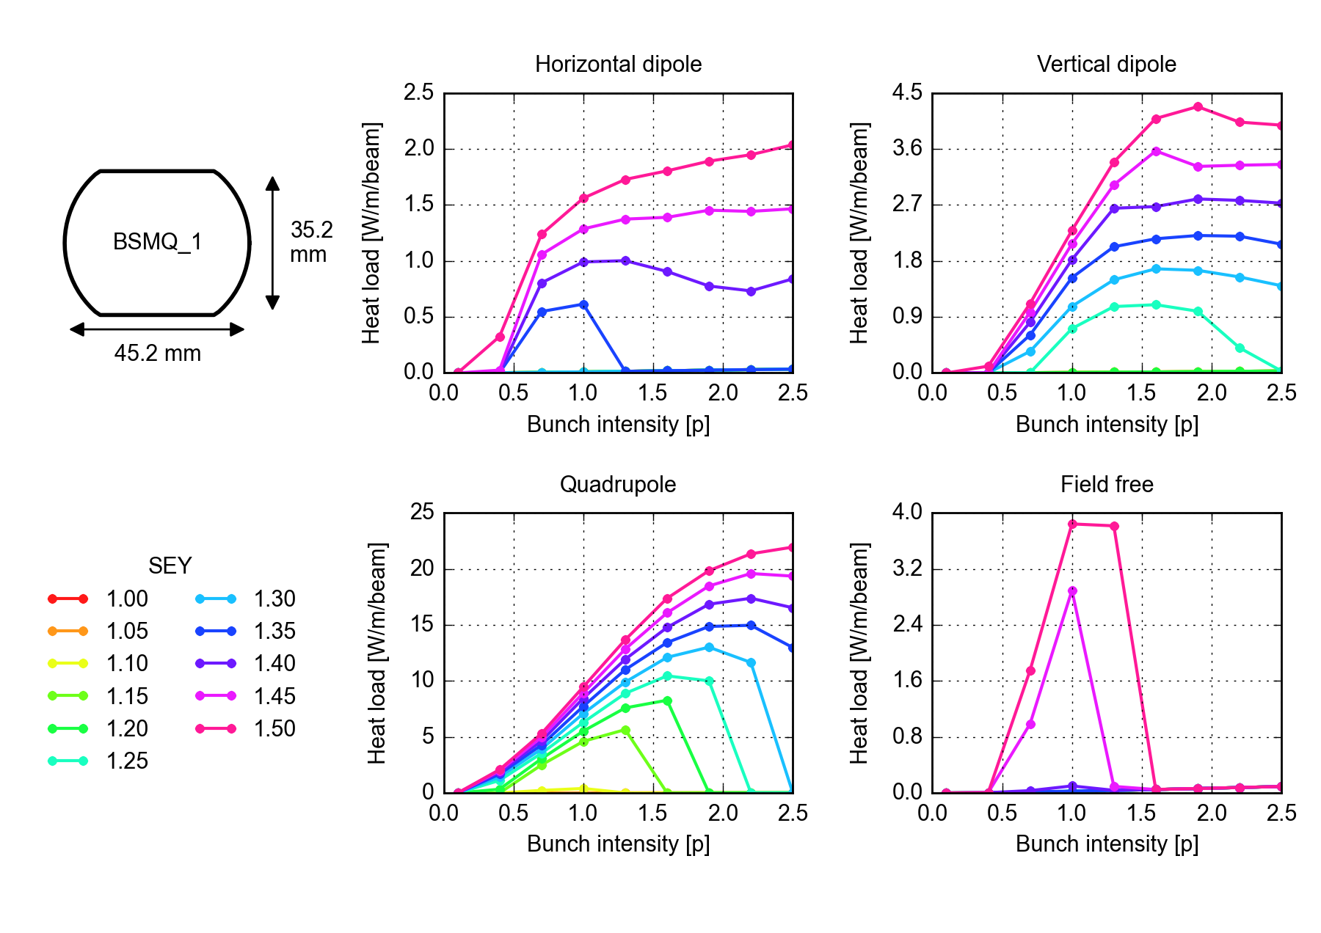
Twin-bore magnets in the LSS
For each chamber type the heat load from e-cloud has been evaluated for different magnetic field configurations

Slide 29
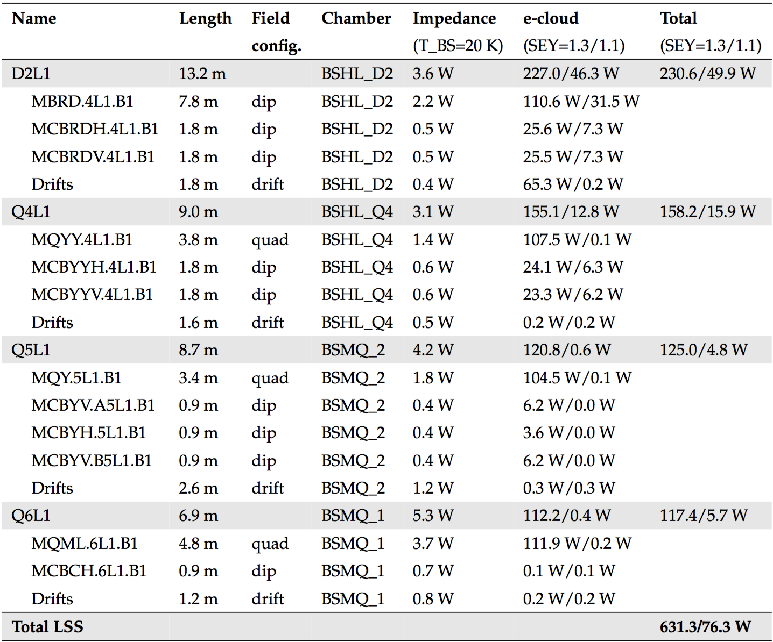
Twin-bore magnets in the LSS
Generated a table for each IR, combining the estimates from impedance and e-cloud effects
Dipole correctors and “drifts” can be non-negligible w.r.t. total!
For SEY =1.3 e-cloud contribution is dominant
Surface treatment providing SEY=1.1 very effective in reducing the heat load

Slide 30
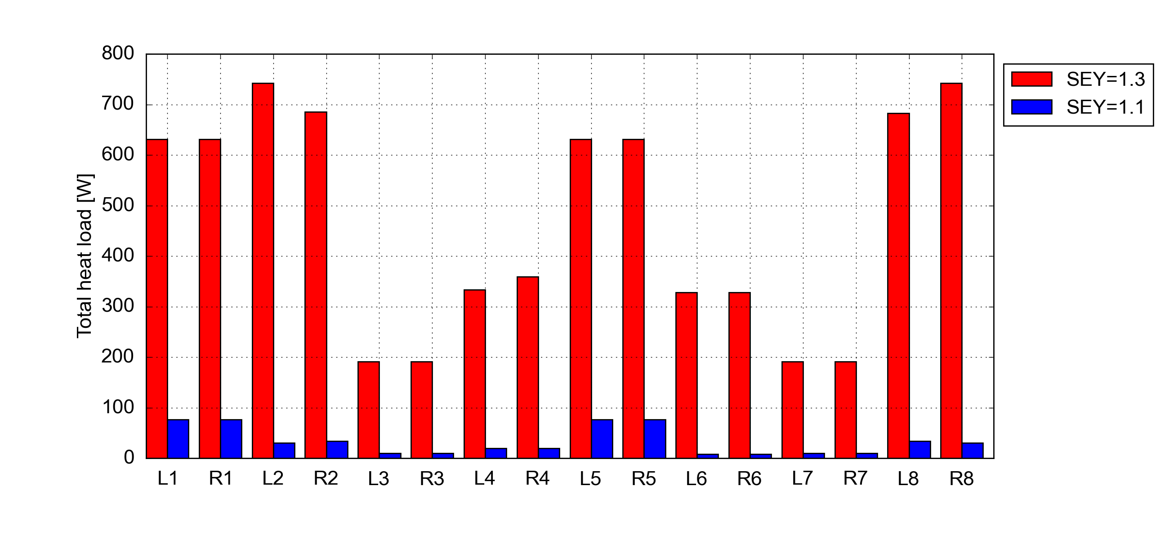
Twin-bore magnets in the LSS
The experimental IRs are by far the most critical (due to larger number of cold devices)
  Load IR2 and IR8 will affect the neighboring arcs
    Low SEY coating of the matching sections is desirable, especially at R2 and L8 which are cooled by less powerful cryoplants (see presentation by WP9)
  IR1 and IR5 will be equipped with dedicated cryoplants → if not coated, load of matching sections needs to be taken into account in the design (info provided to WP9)
  Presently baffle plates are installed behind pumping slots of all SAM magnets (to support hydrogen cryosorber) → if no drawback, this should be kept also for magnets operated at 1.9 K

Slide 31
Outline
LHC experience
Estimates for HL-LHC
  Arcs
  Inner triplets
  Other LSS magnets
Backup scenario: 8b+4e scheme

Slide 32

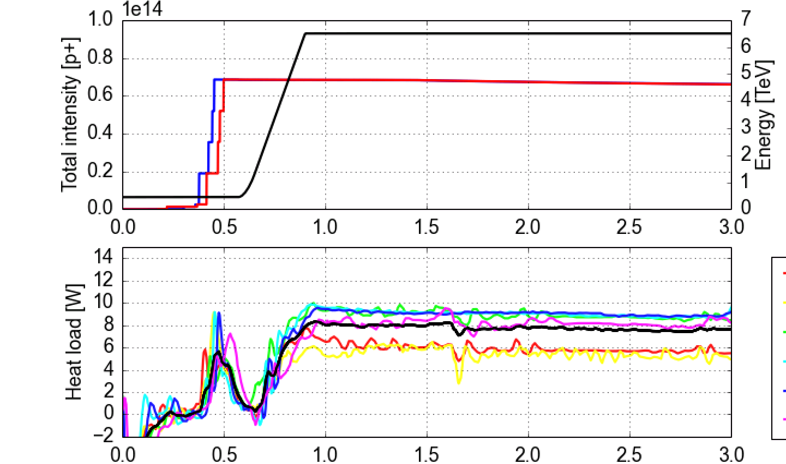
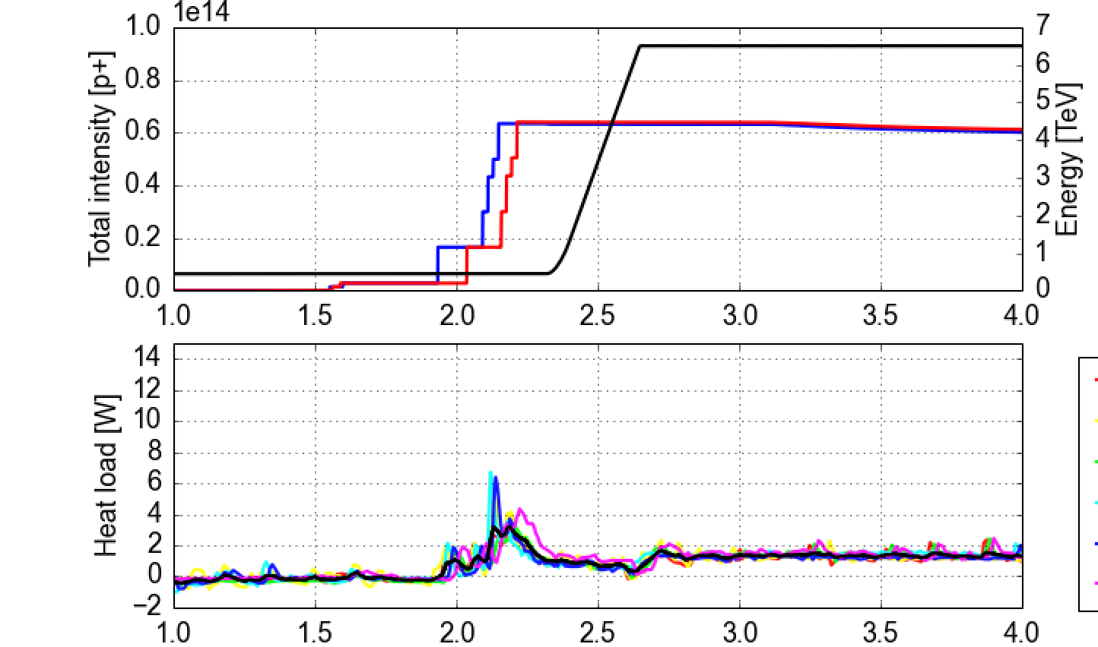
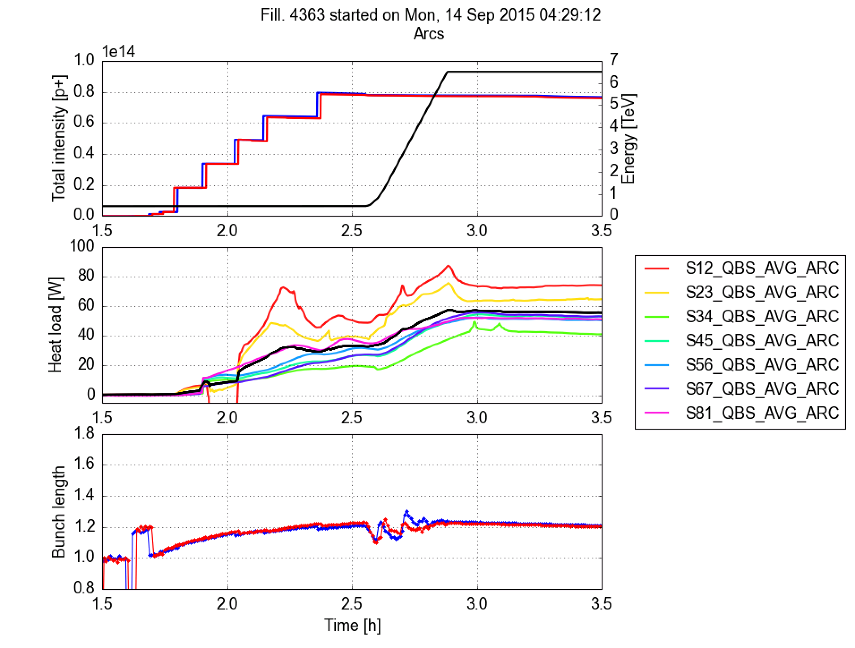
8b+4e scheme
Filling pattern designed to suppress the e-cloud build-up (~30 % less bunches w.r.t. nominal)
Confirmed experimentally in the LHC in 2015
Included in the HL-LHC TDR as backup scenario in case issues with e-cloud
Standard 25 ns beam
“8b+4e” beam
Dipoles (instrumented cells in S45)
Dipoles (instrumented cells in S45)
Average
Impedance+synch. rad

Slide 33
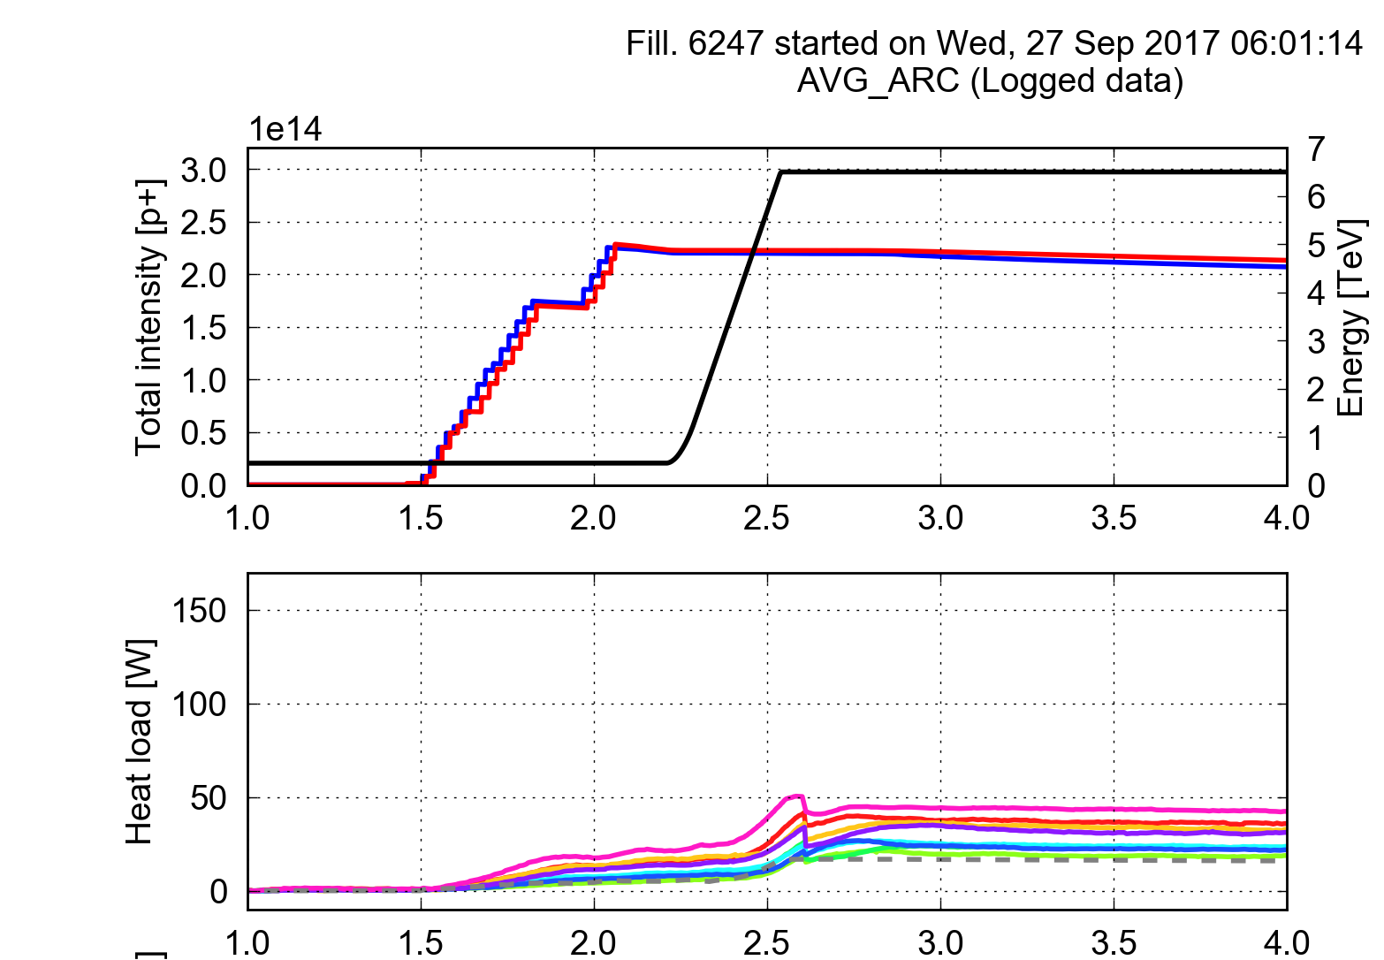
8b+4e scheme
Filling pattern designed to suppress the e-cloud build-up (~30 % less bunches w.r.t. nominal)
Confirmed experimentally in the LHC in 2015
Included in the HL-LHC TDR as backup scenario in case issues with e-cloud
Used in operation in the last part of the 2017 Run (to mitigate fast losses in 16L2)
Standard 25 ns trains and 8b4e trains can be combined in the same filling scheme in order to adapt the heat load to the available cooling capacity (tested in MD in 2016)
25 ns (2556b)
8b+4e (1916b)

Slide 34
Summary and conclusions
Collaboration between WP2 and WP9 to build a full inventory of expected beam induced heating on the beam screens for HL-LHC. Main outcomes:
Arc beam screens (assuming that heat load differences are due to different SEY):
  Present conditioning state of the low load sectors (S34, S45, S56, S67) should allow operation with HL-LHC beam parameters within the present available cooling capacity
  The estimated load for the high load sectors (S12, S23 S78, S81) is of the order of 10 kW (more than presently available) → ongoing work to identify and suppress the source of these differences is fundamental for HL-LHC
Inner Triplets: large heat load reduction (10-fold) expected from low SEY coating
  Significant load added by e-cloud in un-coated drifts between the cold masses, especially in IR1&5 → length of uncoated parts should be minimized, remaining load should be taken into account for cryo-plant design
Other LSS magnets: the experimental IRs are by far the most critical (due to larger number of cold devices)
  Load in IR2 and IR8 will affect the neighboring arcs → Low SEY coating of the matching sections is desirable, especially at R2 and L8 (ex-LEP cryoplants)
If no drawback, baffle plates should be installed behind the pumping slots of all devices
Tests in 2015-16 and operation in 2017 confirmed the effectiveness of the 8b+4e scheme for heat load mitigation (HL-LHC backup scenario)

Slide 35
Thanks for your attention!

Slide 36
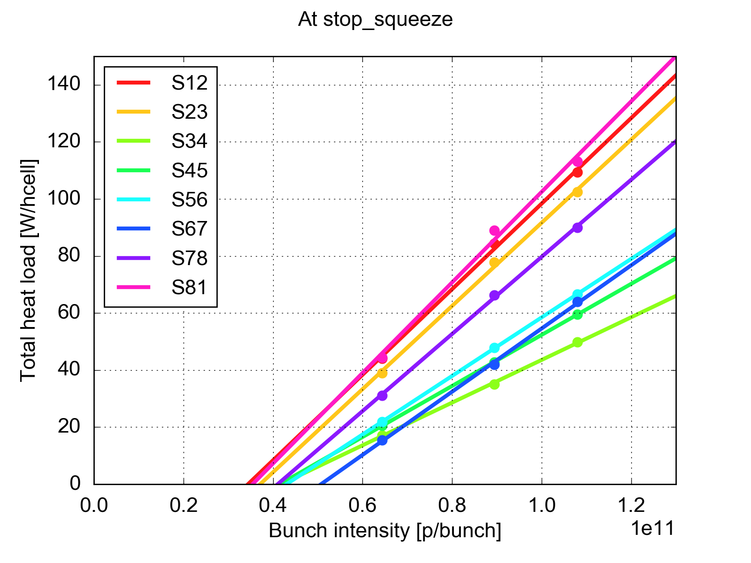
Heat load estimates: impact of the filling scheme
Intensity dependence measured in MD in 2016 keeping the same bunch length and filling scheme
Measured points are fitting quite well with linear dependence with intensity threshold in the range 0.4 to 0.7 x 10¹¹ p/bunch
Dependence is quite steep → effect can be sizable when increasing the bunch charge from 1.1 x 10¹¹ p/bunch to 1.3 x 10¹¹ p/bunch

Slide 37
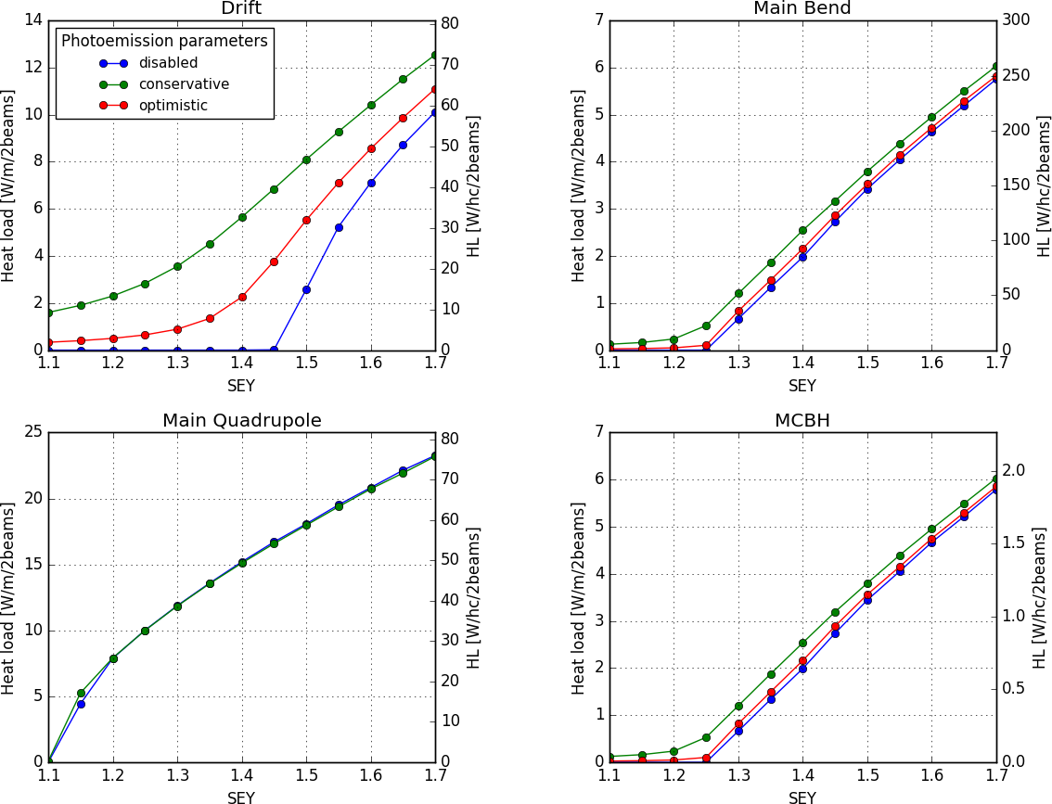
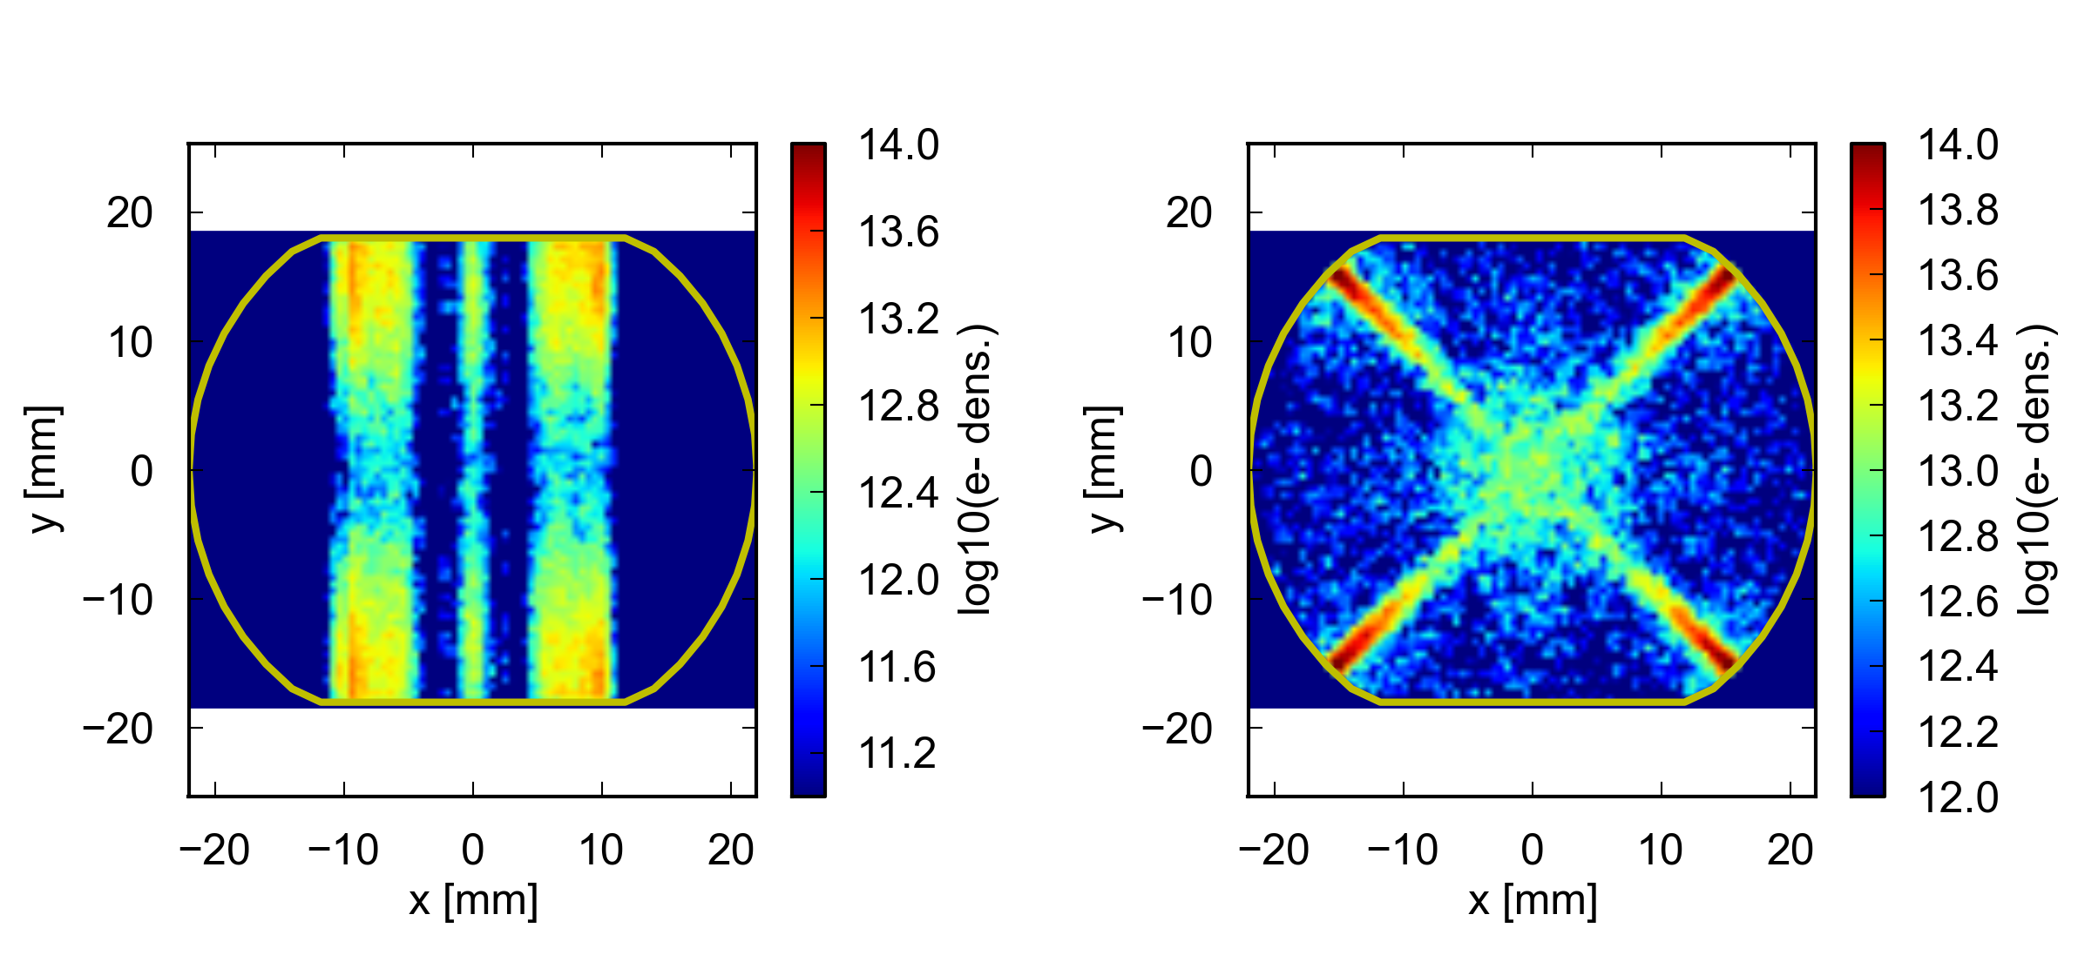
Arc heat loads – results for LHC beam parameters
  The defined models have been used to simulate all the element of the arc half-cell
Dipole
  The impact of the photoelectrons is very strong the drift sections:
  For the other elements, in the presence of a vertical magnetic field, only photoelectrons from reflected photons (<10%) can be accelerated by the beam and contribute to the heat load
Details in P. Dijkstal et al., “Simulation studies on the electron cloud build-up in the elements of the LHC Arcs at 6.5 TeV”, to be published, draft available here

Slide 38
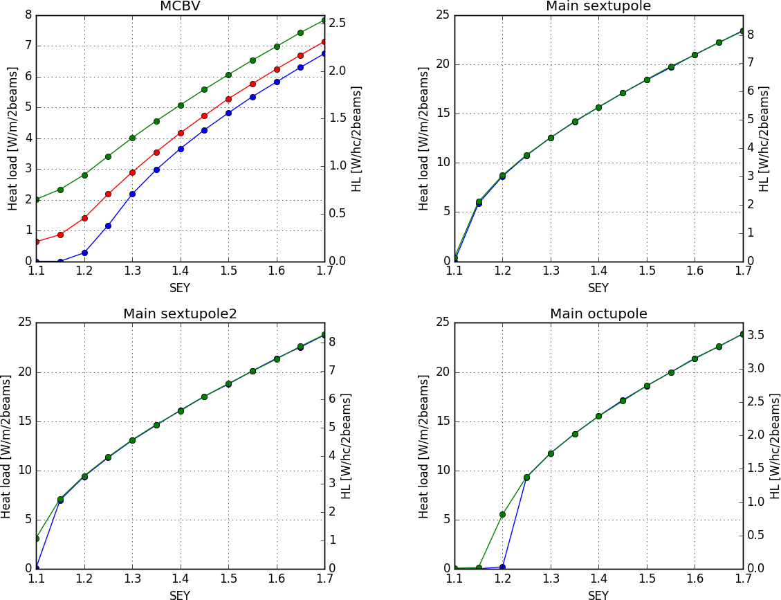
Arc heat loads – results for LHC beam parameters
  The defined models have been used to simulate all the element of the arc half-cell
Details in P. Dijkstal et al., “Simulation studies on the electron cloud build-up in the elements of the LHC Arcs at 6.5 TeV”, to be published, draft available here

Slide 39
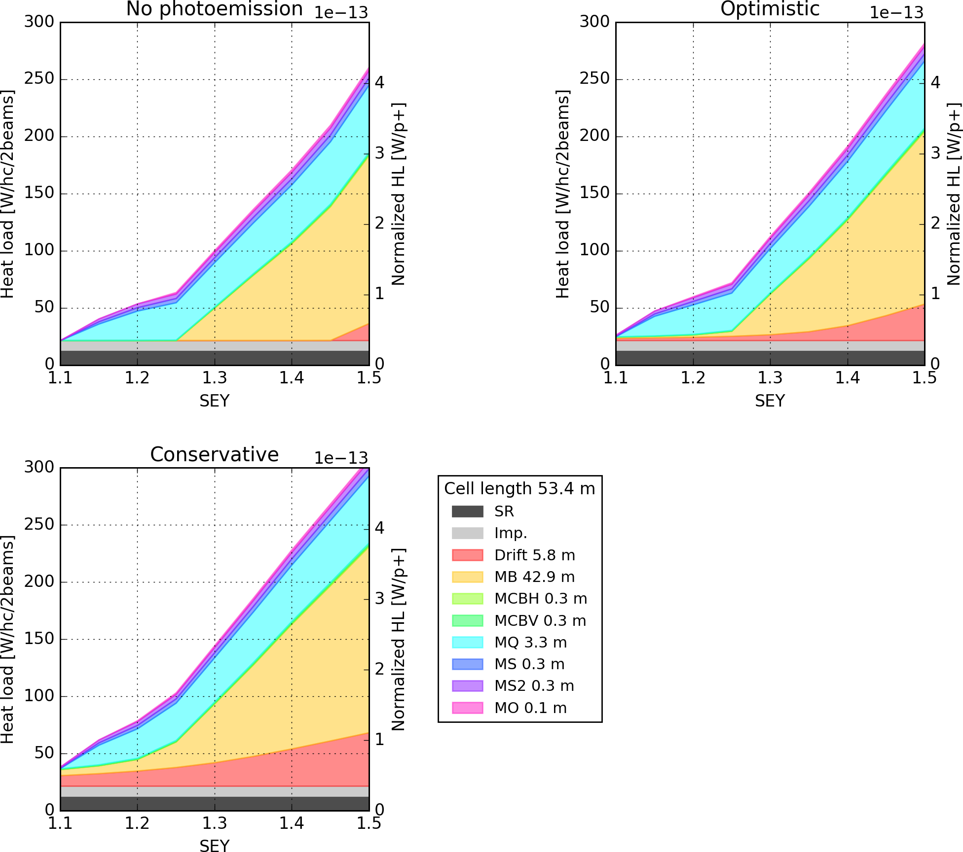
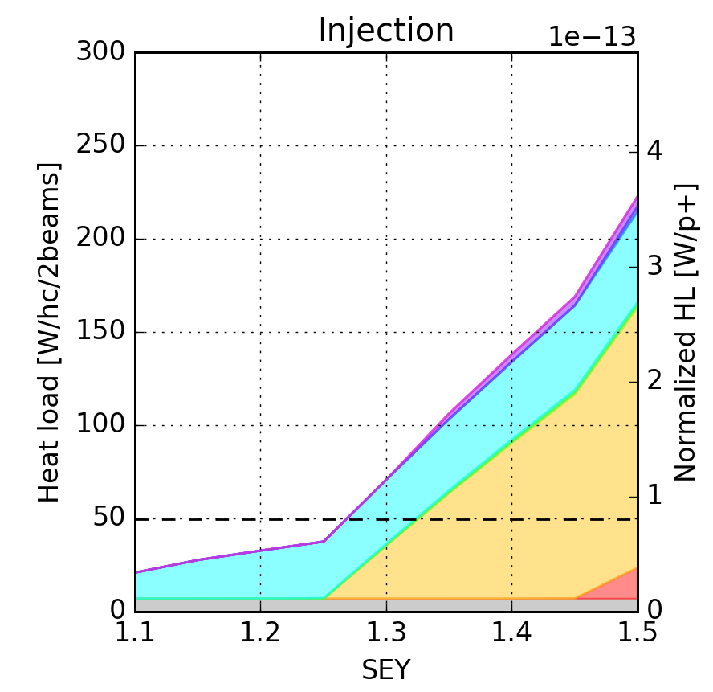
Arc heat loads – results for LHC beam parameters
Total loads
(assuming SEY uniform in the cell)
Details in P. Dijkstal et al., “Simulation studies on the electron cloud build-up in the elements of the LHC Arcs at 6.5 TeV”, to be published, draft available here

Slide 40
Comparison against simulations - optimistic
Simulations
Measurements

Slide 41
Comparison against simulations - optimistic
(using averages)

Slide 42


25 ns (2556b)
8b+4e (1916b)

