Slide 1
Engineering changes and advances in the HL-LHC s.c. circuits
[since the last Internal Circuit Review in March 2017]
Felix Rodriguez Mateos for the MCF
TCC – 2nd November 2017

Slide 2
Content
Background and global current status
Changes to the IT
Changes to the MS
Changes to the 11T dipole
Conclusions

Slide 3
Background
The last Internal Circuit Review that took place on the 17th of March 2017, turned out to be a really useful exercise that provided many recommendations and statements. Now, after months of common work together with the relevant work packages at the Magnet Circuit Forum (MCF) (since the review the MCF has hosted more than 10 regular meetings and 7 topical meeting), there have been changes applied with respect to the previous baseline. This presentation summarizes the status of advancements on the different circuits and the follow-up points from the Review.

Slide 4
Follow-ups after the review
Circuit | Item | Action | Status
11T dipole | Trim crowbar resistance is required to limit the currents to 250 A in case of power abort (it is proposed to take 250 A as nominal design value for the trim leads) | WP6a, WP6b | Implemented
 | Study the impact of the trim PC on the QDS in case of power abort on the 11T and neighbouring MB magnets in SM18, feasibility study | TE-MSC-TF, WP11, WP7 | Not adopted
 | Test the full-length prototypes in order to elaborate a suitable quench detection strategy | WP7, WP11 | Work in progress
 | Qualify the present (conduction-cooled) current leads or make a new design | WP6a | Work in progress
 | Decision on the qualification of the trim circuit in terms of HVWLs | WP6b | Implemented
Matching section | The relevant groups (TE-MSC, TE-CRG) should launch a task force effort in order to agree on the requirements and the procedure for the dismantling and the reassembly of the DSL [In case of a dismantling of the DSL, the corrector SC cables should be kept at a rating of 600 A to include a possible change from MCBY correctors to MCBYY correctors] | WP6a | Work in progress
 | Connection in series for four Q4 corrector magnets (2 circuits with two magnets each) be adopted in order to reduce the leads from 16 to 12 and hence eliminate the local powering | WP3, WP6a, WP6b, WP7 | Implemented
 | Q5 correctors to be powered individually by providing local powering for the missing leads | WP6a | Implemented
Inner triplet | Only one between IQH and CLIQ is needed (the decision is to be taken after the test of the first long prototype) | WP3 | To be decided
 | Updates on the trim to be placed on Q1a | WP2, WP3, WP6b, WP7 | Well-advanced
 | Consequences of the upgrade the 2 kA and 120A sc trim cables in the sc link to a rating of about 5-6 kA and 5 MIITs | WP6a | Implemented
 | Studies on cold diodes (development, tests up to 18 kA, radiation levels qualification, etc.) | WP7, WP6b | Work in progress
 | Integration of cold diodes | WP3 | Work in progress
 | Studies to be carried out on the connection of D1 magnet to the inner triplet using both a three-cable configuration or a nested connection | WP7 | Well-advanced
 | Design and integration of the bus-bars | WP3 | Work in progress
 | Design and integration of the cables and feedthroughs for CLIQ | WP3 | Work in progress
 | Design and implementation of interconnects and splices | WP3, WP6a | Work in progress
 | Design and integration of the instrumentation | WP3, WP7 | Work in progress
 | An internal staffer to be designated to take full responsibility for the required studies including benchmarking | WP7 | Implemented
 | Follow-up on crowbars maximum voltage | WP6b | Implemented
 | Follow-up on circuit separators | WP6b | Work in progress

Slide 5
Open Issues & Class of Uncertainty
Estimate classification | % of complete definition
Class 1 | 50 – 100
Class 2 | 30 – 70
Class 3 | 10 – 40
Class 4 | 1 – 15
Class 5 | 0 – 2
Section | Open issue | Class
IT | Study on the IT alternative configurations from WP6a | 1
 | Q1a k-modulation circuit follow-up | 2
 | Bus-bars design | 3
 | Circuit separators follow-up | 3
 | Design and integration of the cables and feedthroughs for CLIQ | 3
 | Study on the polarities for test campaigns | 3
 | Study on the polarities of the connection between quench heaters and CLIQ | 3
 | Local integration of leads for corrector package | 4
 | Cold diodes project as recommendation from the Internal Circuit review | 4
 | Design and implementation of interconnects and splices | 4
 | Design and integration of instrumentation | 4
MS | Local integration of 120A leads in the HL-LHC cryostats | 3
 | Follow-up on the DSL | 4
11T | Official statement regarding 11T interlock strategy | 1
 | Test the full-length prototypes in order to elaborate a suitable quench detection strategy | 3
 | Current leads for 11T trim | 3
 | Study the impact of the trim PC on the QDS in case of power abort on the 11T and neighbouring MB magnets in SM18 | 4

Slide 6
2) Changes to the IT
Counter-check simulations on the IT. Simulations on Q1a k-modulation circuit
Bus-bars
Circuit separators
Cold diodes project
Document co-authored by WP6a and MCF
Current leads for the IT correctors

Slide 7
2.a) Counter-check simulations on the IT. Simulations on Q1a k-modulation circuit

Slide 8
Conclusions from simulations & analysis in a nutshell
For standard cases, over-currents can go up to 4.3 kA and 2.2 MIITs (approx. nominal and ultimate currents included) => 5 kA current capability in s.c. would suffice for not quenching the conductors within the s.c. link
For the very conservative scenario, those values could go up to 6.1 kA (nominal) and 6.8 kA (ultimate), and 5 MIIts (nominal and ultimate approx.), these numbers are obtained considering a full magnet suddenly quenching in its whole volume
the analysis covers the whole spectrum of operating conditions, from low to ultimate current
May 2017

Slide 9
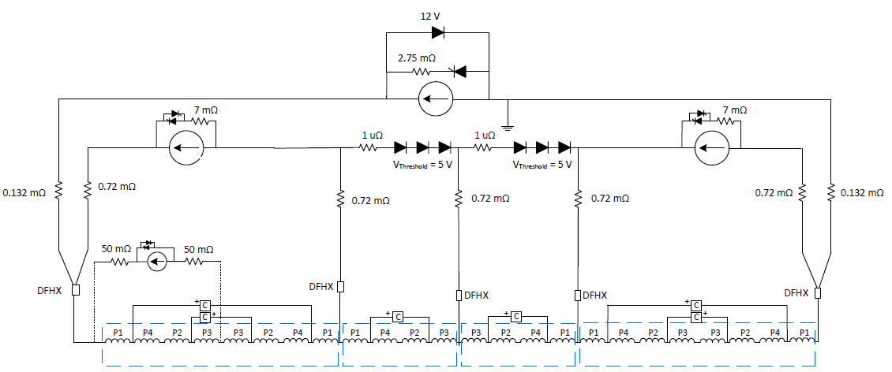
Counter-check simulations
October 2017
M. Mentink
Assumptions
Maximum current, ramp rate, and MIITS evaluated under different scenarios (Reference cases provided by E Ravaioli)
Regular quench: Detection + validation time = 15 ms
Global magnet quench: Detection + validation time = 10 ms
Trim Q1
Trim Q3
F
A
B
C
D
E
Highest values | Leads A / E | Leads B / D | Lead C | Lead F | Trim Q1 | Trim Q3
Current [kA] | 17.8 | 6.1 | 4.3 | 4.1 | 5.1 | 4.2
Ramp rate kA/s | 250 | 170 | 100 | 70 | 160 | 160
MIITs | 32.6 | 3.8 | 1.9 | 1.5 | 2.9 | 1.9
Generally consistent results compared to previous TALES calculations (Some
differences due to circuit modification / starting assumptions)

Slide 10
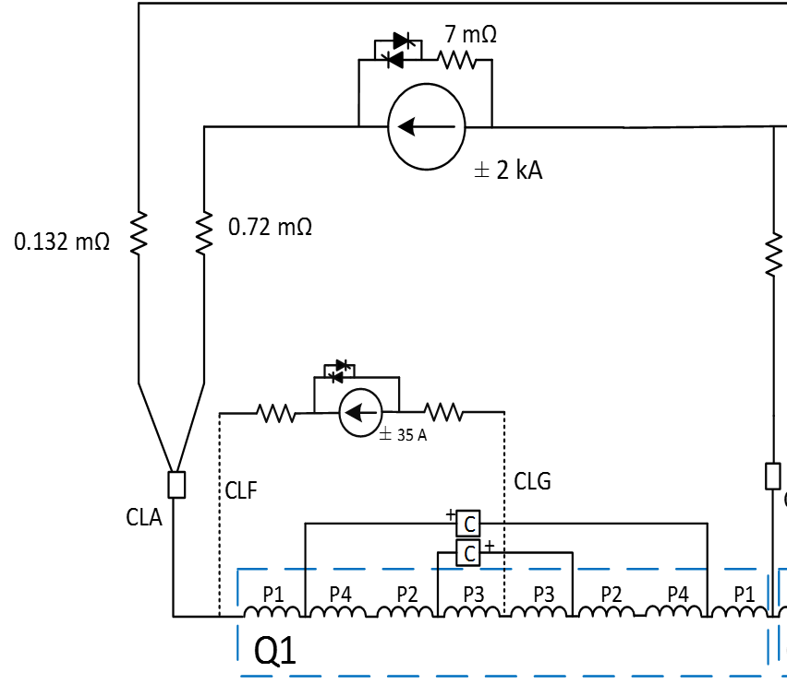
Q1a k-modulation circuit simulations
Developed simulations on
Current profile during magnet quench
Current profile during power aborts (without quench)
Required PC voltage
Control performance during operation
Copper cable section for cold powering
Summary of the simulations
DC cable resistance (resistance during operation) value of less than 265 mOhm is optimal from a powering point of view (PC voltage and design)
DC cable resistance + Crowbar resistance should be at least 230 mOhm to limit current looping above the DC design value of the circuit
Overcurrent due to quench for the ‘most conservative scenario’ generate a hot spot temperature of 314 K.
If integration accepted, it is fairly straightforward to define the parameters of the circuit (2x20mm2).
Standard HL-LHC-60A-10V can be therefore used.
Current proposal
Circuit resistance: 230 mOhms
Max current: 4.2 kA
Max MIITs: 1.66
Copper cable section: 20 mm2
Hot-spot temperature: 314 K

Slide 11
2.b) Bus-bars for the IT main circuit

Slide 12
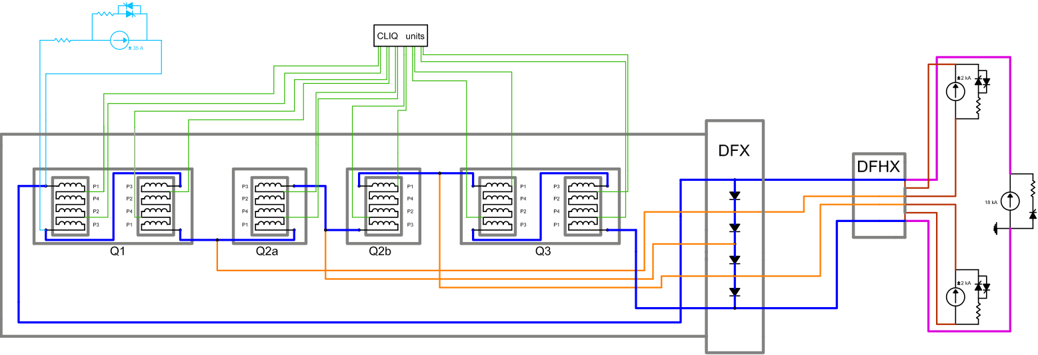
Circuit with Cold Diode Option
More Detailed Schematic of the Circuits :
Connection tbc
Under study: Insertion of a cold diode across Q1a k-modulation circuit

Slide 13
Options to protect bus-bars
Protection baseline: Any quench in any element → Fire all the QHs/CLIQ systems
When introducing the cold diodes, two possible strategies:
  One element quenches → All QHs/CLIQ systems will be fired. Diodes carry only the over-currents (7 kA or less) for an equivalent time = 100 ms
  One element quenches → Selective QHs/CLIQ fired. Diodes carry 18 kA, time constant = 100 s
Possible advantage for option2: If a quench of the other magnets following the first cannot be completely avoided, these would happen at lower current, reducing the stress on the magnet and the heat introduced into the cryogenic system, which will allow a faster recovery.
Time of discharge of circuit with 50V RQX Crowbar = 350s.

Slide 14
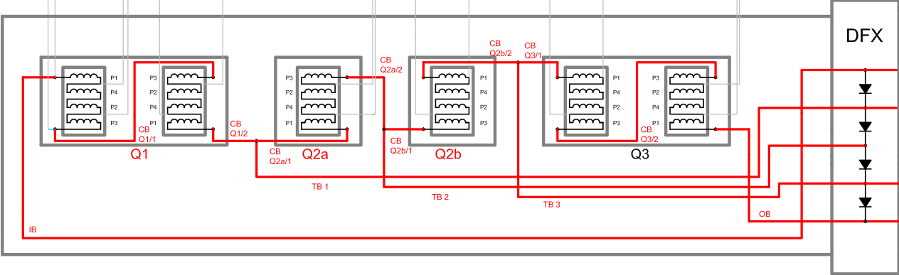
Option 1 – Quench Protection Strategy
Any busbar quenching → Firing all protection systems
Diodes carry only the over-currents (7 kA or less) for time constant or equivalent time = 100 ms

Slide 15
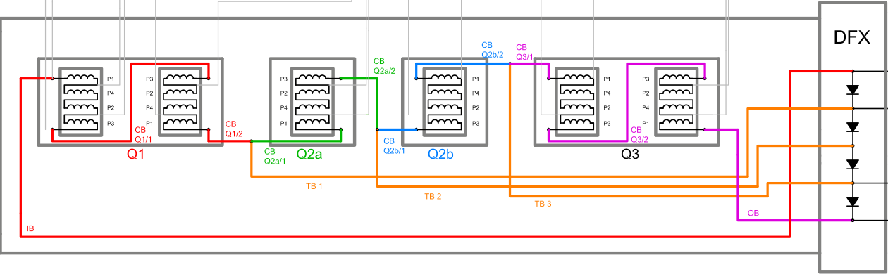
Option 2 – Quench Protection Strategy
  If any of IB, CB Q1/1 and CB Q1/2 quenches → QPS of Q1 will be triggered
Protection
strategy
  If any of CB Q2a/1 and CB Q2a/2 quenches → QPS of Q2a will be triggered
  If any of CB Q2b/1 and CB Q2b/2 quenches → QPS of Q2b will be triggered
  If any of OB, CB Q3/1 and CB Q3/2 quenches → QPS of Q3 will be triggered
  If any TB1, TB2 and TB3 quenches → QPS of the two adjacent magnets will be triggered

Slide 16
Conclusions
Option 1: One element quenches → All QPS systems will be fired
Advantages to WP3:
Bus-bar integration in the cryostat is less complex
No need to size the trim bus bars to 18 kA (sc state and quenching state
No need to integrate heat sinks for diodes
Advantages to WP7:
Keeps the QDS reliability like in the LHC’s IT circuit
The triplet circuit in itself is the most complex HL-LHC circuit. Option 1 does not add further complexity from the QDS point of view.
The use of the LHC diodes if qualified for radiation levels.
Disadvantages:
When quench, no quick distinction between quench in coil and bus-bars in terms of detection
Option 2: Selective quench strategy
Possible advantages of the selective quench protection:
Triggering of the QHs/CLIQ of the other (not initially-quenching) magnets at a lower current (expected ca. 10% less from one magnet to the adjacent one)
It will allow more energy to be dissipated in the crowbar of the RQX PC
Disadvantages:
It includes complexity in the implementation of the QDS which leads to a less reliable system.
Due to the quench propagation, all the magnets could eventually be fired (in the order of ten seconds between the quench of the different magnets)
Diodes (+heat sinks) and bus-bars will be significantly bigger
Imposes new (non-LHC) diodes to support the current of 18 kA
After discussions, MCF considers option 1 as more adequate

Slide 17
2.c) Circuit Separators

Slide 18
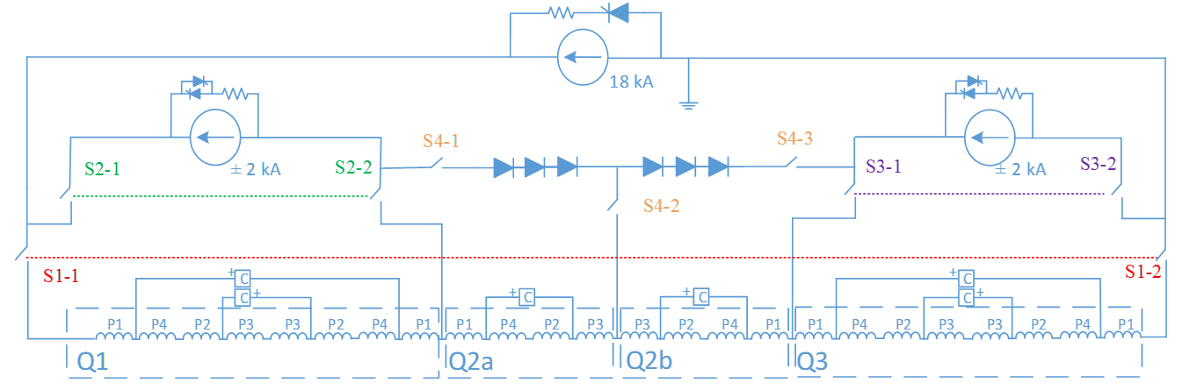
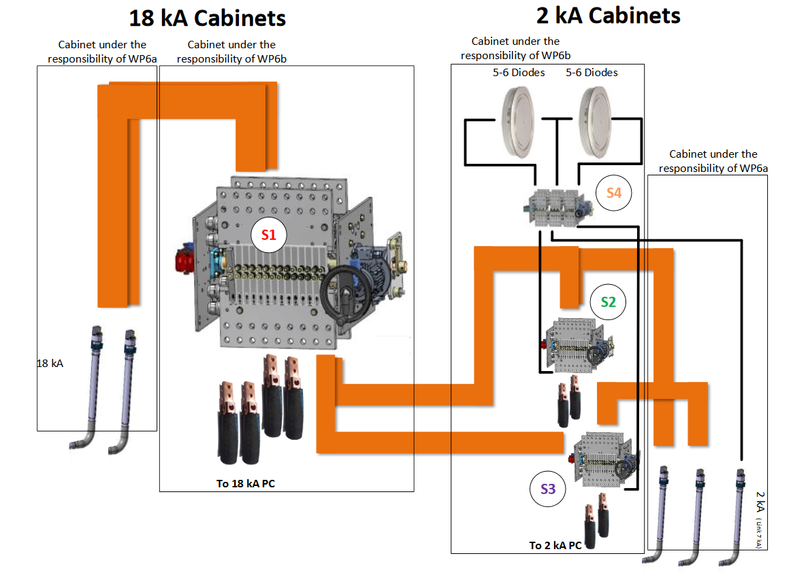
Proposal for Separators for the IT Main Circuit
Number of cabinets is preliminary and needs to be studied in details
We can have short circuit positions on the three sub-circuits
Circuit of Q1a not shown for simplification but can have the same principle
Four separators in total (could be reduced to 3 [2x2 poles + 1x3poles] if short circuit position is not needed)

Slide 19
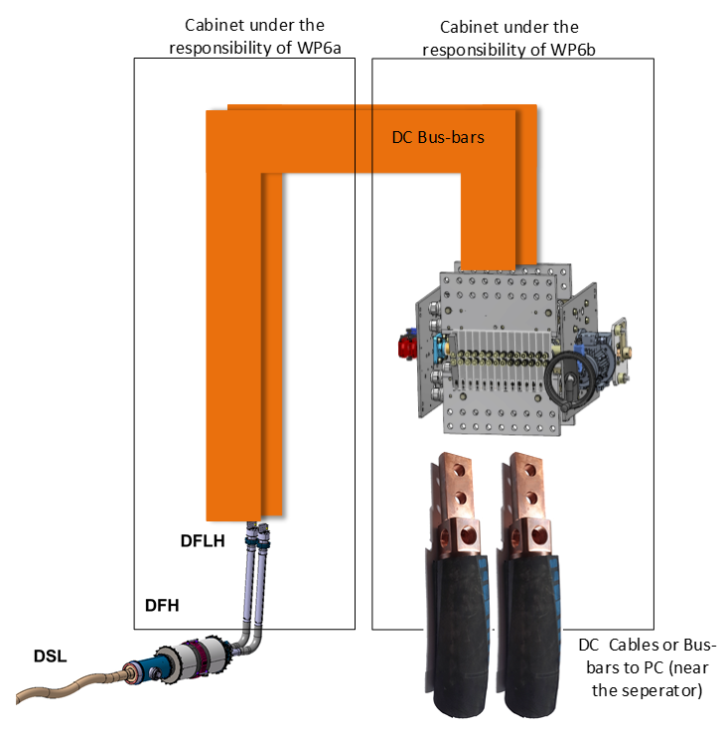
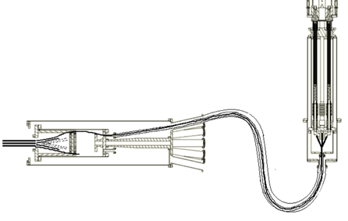
Proposal for Separators for D1/D2/OCs
13 kA or 2 kA OC separators
8 separators
Can we integrate 2x2 kA separators per cabinet?
3 positions: connected, disconnected and short-circuit
DFLH close to PC → distributed leads:
Is this feasible?

Slide 20
2.d) Cold diodes project (Follow-up from internal circuit review)

Slide 21
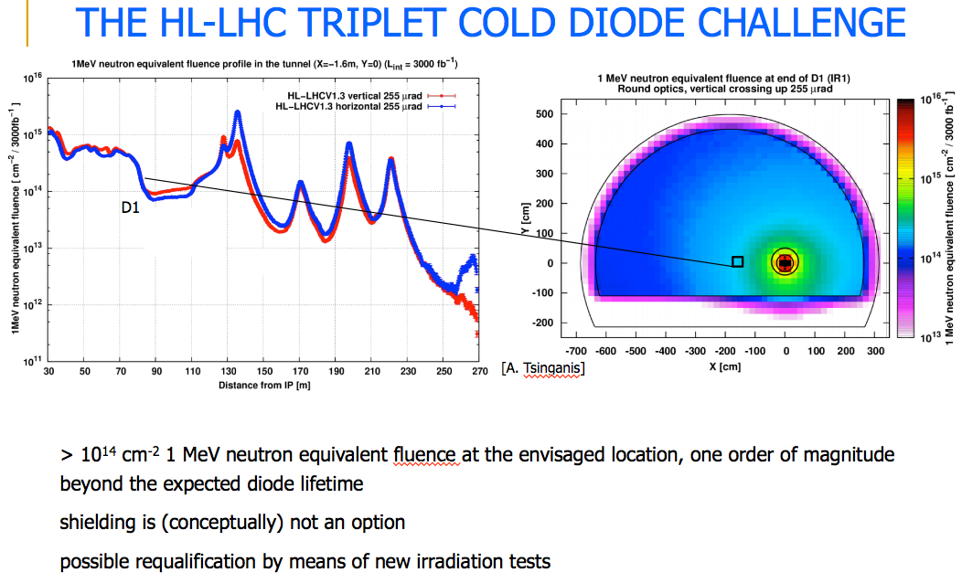
Radiation
Courtesy F. Cerutti, R2E Cost and Schedule Review, 12.10.2017
LHC type diffusion diodes tested (15 years ago) up to ~2 kGy and 3x10¹³ n cm⁻² (LHC project Report 688)
Qualification required up to 30 kGy and 10¹⁵ n cm⁻²

Slide 22
Qualification of cold diodes for HL-LHC triplet circuit
Adapting the LHC type diffusion diodes for triplet currents and time constants (18 kA, ~100 s or 7 kA, ~ 100 ms )
Qualification for HL-LHC radiation levels required
Staged approach:
  Irradiation and in-situ testing in CHARM in 2018 to reproduce earlier results
  Depending on results further testing in CHARM or other facility OR modification of diodes and re-testing
A. Will -- TE-MPE-PE section meeting, 26.10.2017
22

Slide 23
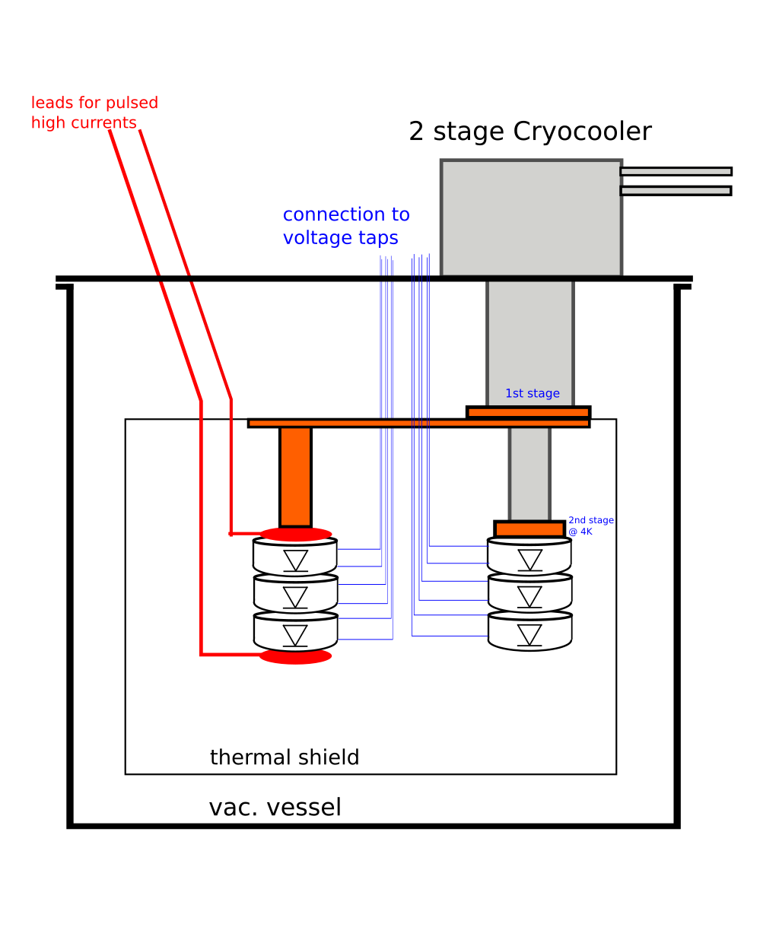
Experimental setup
Two stage Pulse Tube cryocooler
Simultaneous operation at
77K (1st stage) and 4K (2nd stage)
Temperature on both stage controlled via heaters
metal seals, no electronics in cold head
Cooling power of 1W@4K, ~90W@77K
Vacuum vessel
Aluminium
EPDM seals for radiation hardness
Multi pin feed throughs
Two stage interface for sample mounting
Leak tightness for ~ 6 months
Thermal shields + MLI
A. Will -- TE-MPE-PE section meeting, 26.10.2017
23

Slide 24
2.e) Document co-authored by WP6a and MCF

Slide 25
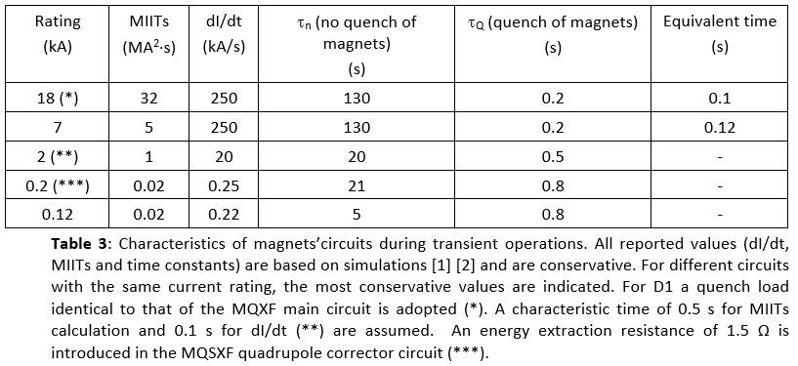
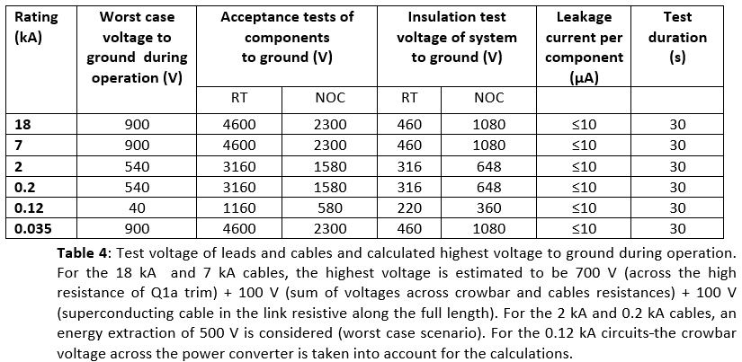
Document co-authored by WP6a and MCF - IT
This document summarizes the total number of High Temperature Superconducting (HTS) current leads and cables, the latter contained inside the Superconducting Link, needed for the powering of the HL-LHC Triplets and D1. The design current rating of both leads and cables is also indicated. The values reported in this document reflect the modifications introduced in the HL-LHC Cold Powering System in June 2017 in order to take into account the changes in the magnet circuits announced after the HL-LHC Magnets Circuits Internal Review (EDMS N. 1807471, May 2017). The components described in this document are part of the WP6a Cold Powering system.
Circuits simulations providing the input for transient modes, protection and high voltage insulation tests are part of the Magnet Circuit Forum activity. The input is used for the design of the Cold powering System.

Slide 26
2.f) HL-LHC IT correctors (120A-200A) current leads integration

Slide 27
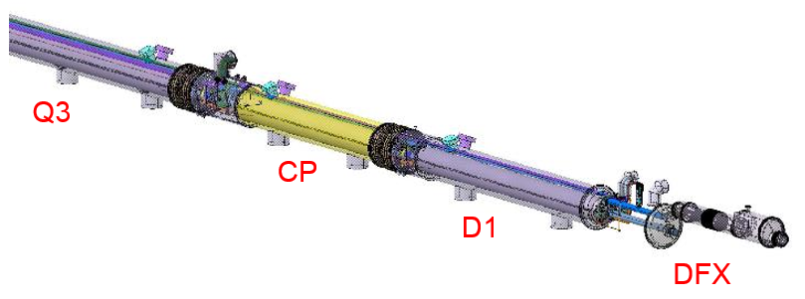
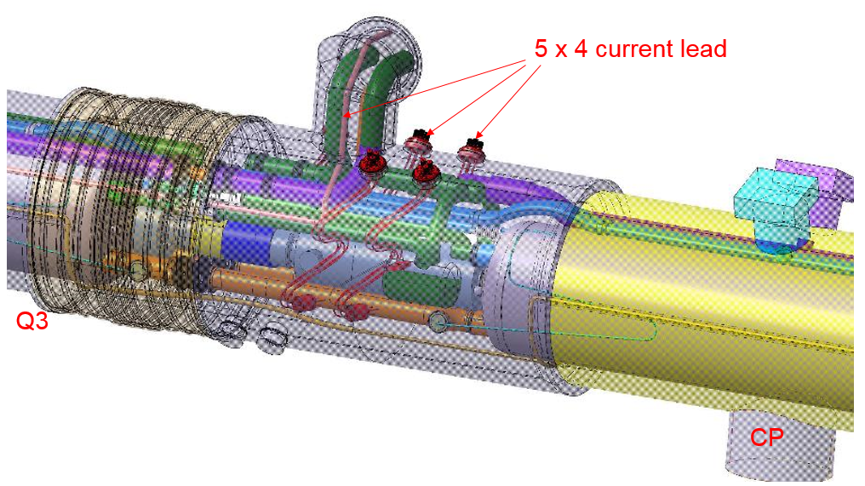
Current leads for the IT (12A-200A) correctors
See Amalia’s presentation today
Courtesy R. Betemps
The integration is possible:
5 block of 4 current lead => 5 times the same design
Some modifications need on the actual design
New design for the current lead.
Next step
Check the assembling phase.
Optimisation of the current lead design and shape

Slide 28
3) Changes to the MS

Slide 29
Status
Q4 and Q5 correctors will be powered individually
Upon a request by WP6b (transmitted to the MCF), WP6a has accepted to provide enough leads to feed individually the corrector MCBY magnets of Q4 and Q5. This means that 1 set of local four-lead assembly will be integrated in the Q4 cold mass and 3 sets in the cold mass of Q5. This will mitigate the development of a new family of power converters to deal with the high energy and the inductance of two MCBYs in series.
The decision on the necessity of dismantling the DSL during LS3 should be taken by the end of 2017. By then, a roadmap on the strategy will be proposed to MCF and TCC.

Slide 30
Document co-authored by WP6a and MCF - MS
Magnet | Circuit type | Current (A) | Feedbox Type | Lead Type | N_{TOT} leads | SC Link Type | N_{TOT} cables in the SC link
MQY | Q4 Quadrupole | 6000 | *DFBL | HTS* | 3 | *DSL | 3*
MCBY | Q4 Correctors | 120 120 | *DFBL - | Resistive* Local** | 12 4 | DSL - | 12* -
MQY | Q5 Quadrupole | 6000 | *DFBL | HTS* | 3 | *DSL | 3*
MCBY | Q5 Correctors | 120 | - | Local** | 12 | - | -
MQML | Q6 Quadrupole | 6000 | *DFBL | HTS* | 3 | *DSL | 3*
MCBC | Q6 Correctors | 120 | - | Local** | 4 | - | -
MCBRD | D2 Correctors | 600 | DFHM | HTS*** | 8 | DSH | 8***
MBRD | D2 Recombination Dipole | 13000 | DFHM | HTS*** | 2 | DSH | 2***
Circuit | Rating (A) | Worst case V to Gnd (V) | Acceptance |  | Installation |  | Current (µA) | Time (s)
 |  |  | RT | NOC | RT | NOC
D2 | 13000 | 110 | 1440 | 720 | 335 | 705 | 10 | 30
D2 Corr. | 600 | 660 | 3640 | 1820 | 364 | 792 | 10 | 30
Q4 | 6000 | 110 | 1440 | 720 | 150 | 150 | 15 | 30
Q4 Corr.* | 120 | 160 | 1640 | 820 | 300 | 600 | 3 | 30
Q4 Corr.** | 120 | 60 | 1240 | 620 | 300 | 600 | 3 | 30
Q5 | 6000 | 110 | 1440 | 720 | 150 | 150 | 15 | 30
Q5 Corr. | 120 | 60 | 1240 | 620 | 300 | 600 | 3 | 30
Q6 | 6000 | 110 | 1440 | 720 | 260 | 480 | 15 | 30
Q6 Corr. | 120 | 60 | 1240 | 620 | 300 | 600 | 3 | 30

Slide 31
4) Advancements on the 11T dipole
11T interlock system
11T current leads
11T dipole – powering and protection document

Slide 32
4.a) 11T dipole interlock system

Slide 33
Proposed implementation of 11T trim
PIC RB quench loop
odd side
PIC RB quench loop
even side
PIC
odd
3 km QPS
RB quench loop
PC ±250A
QPS
QPS
PIC
even
PC 13kA
11 T trim proposal
PIC 11T quench loop
Hardware connection to the PIC main dipole quench loop
Separate the 11T trim and the RB circuit → easier diagnostics in case of trip
SPA request could be implemented via the PIC, if required, as a function of the main RB circuit status → requires change of safety critical code

Slide 34
4.b) 11T dipole trim current leads

Slide 35
11T dipole trim current leads
WP6a has confirmed that they will “re-use” the LHC 120 A conduction-cooled leads
WP6a presented that they have already launched:
Proposal of powering one polarity via two leads (to make feasible-flexible-the conduction-cooled option);
Discussion with TE-EPC for protection of leads against over-heating and possibility of identifying non homogenous current distribution;
Initiative to re-make an integration study with the objective of keeping as much as possible the existing LHC solution;
Integration work carried out by R. Betemps (in interface with SCD and CMI). Found solution for keeping the same length of each lead, i.e. same design of leads and thermalization blocks, but different shape. Responsibility under MSC-SCD.

Slide 36
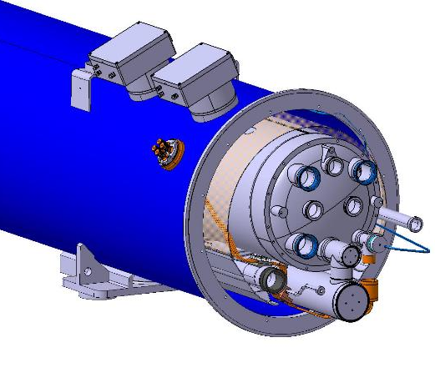
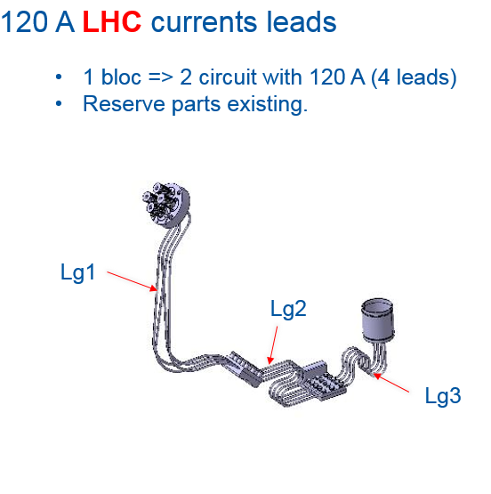
Current leads actual design
Courtesy R. Betemps
Status
~ Same parts as LHC 120A current lead.
Change the flange position.
Add a slit on the thermal screen.
Next steps
Final design.
New bending Tools.
See Amalia’s presentation today

Slide 37
4.c) 11T dipole powering and protection document

Slide 38
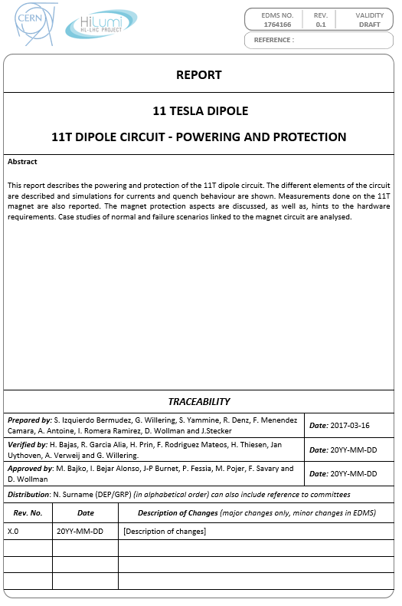
11T dipole powering and protection
This report describes the powering and protection of the 11T dipole circuit. The different elements of the circuit are described and simulations for currents and quench behaviour are shown. Measurements done on the 11T magnet are also reported. The magnet protection aspects are discussed, as well as, hints to the hardware requirements. Case studies of normal and failure scenarios linked to the magnet circuit are analysed.
EDMS no: 1764166 (Link)
Authors: S. Izquierdo, G. Willering , S. Yammine, R. Denz, F. Menendez, A. Antoine, I. Romera, D Wollman and Jens Steckert
Under verification process

Slide 39
5) Conclusions

Slide 40
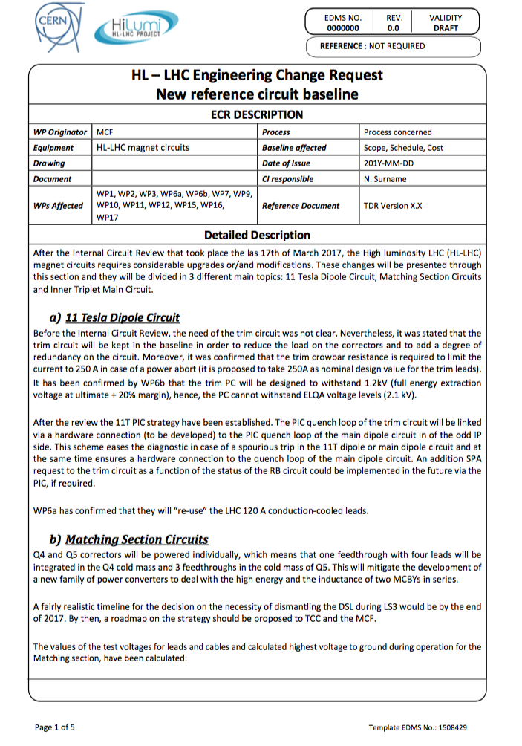

Conclusions
Great effort carried out with the different work packages
A great deal of advancements to optimize the circuits
Recommendations from the review taken into account
Draft ECR on the modifications
Good status with respect to the open issues

Slide 41
Thanks for your attention

Slide 42
Spare slides

Slide 43
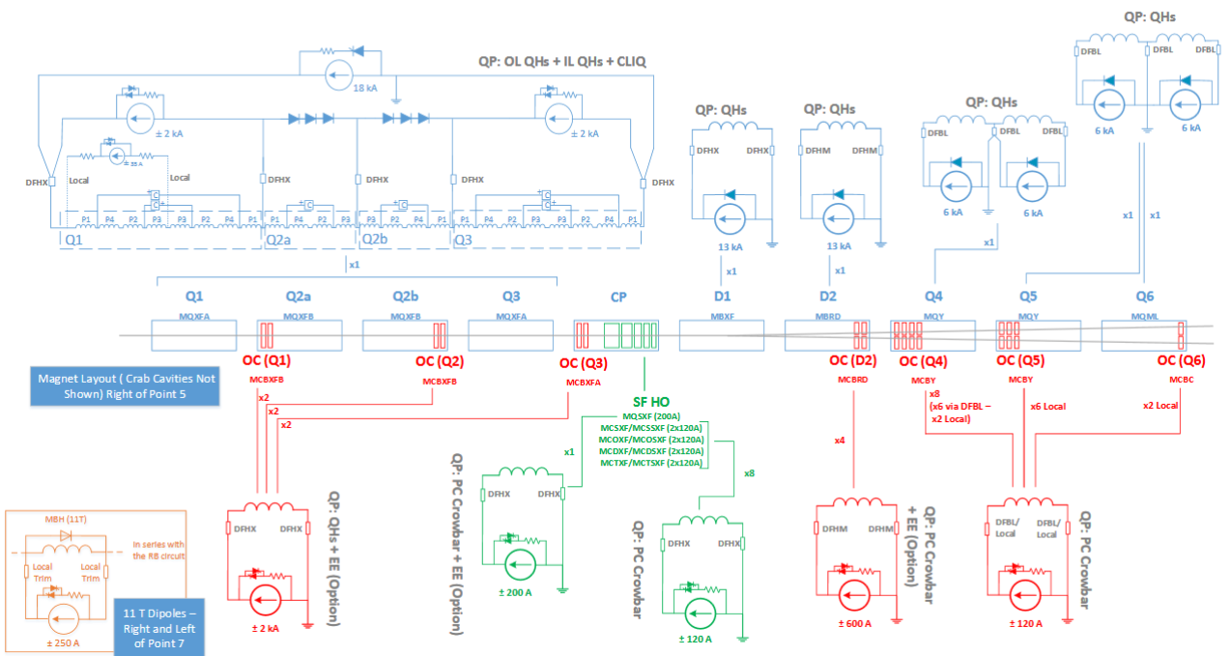
Circuits Layout

Slide 44
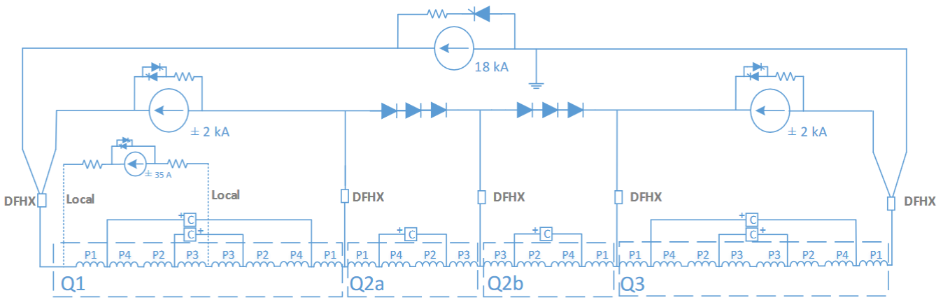
Inner triplet circuit
1 Circuit per IP side
Power converters (located in the UR):
  1 x 18 kA (2quad)
  2 x 2 kA (4quad)
  1 x 60 A (4quad) tentative
Cold Powering (feedbox: DFHX at UR):
  2 x 18 kA leads
  3 x 2 kA leads
Quench protection:
  Outer-layer heaters
  Inner-layer heaters
  CLIQ

Slide 45
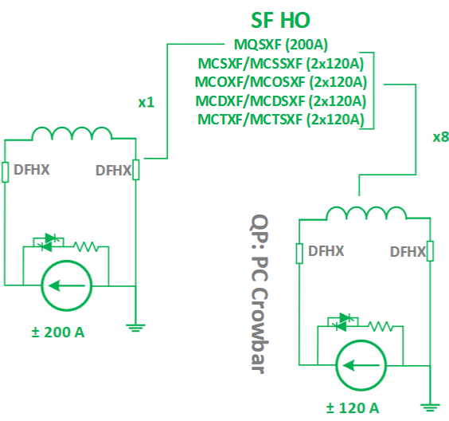
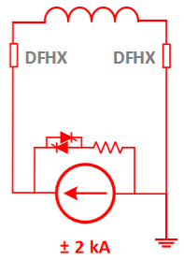
Correctors for the IT main circuit
Orbit correctors
High order superferric correctors
6 Circuits per IP side
Power converters (located at UR):
  6 x 2 kA (4quad)
Cold powering (feedbox: DFHX at UR):
  12 x 2 kA leads
Quench protection:
  Quench heaters (baseline)
  EE system (option)
9 Circuits per IP side
Power converters (located at UR):
  1 x 0.6 kA limited to 0.2 kA (4quad)
  8 x 0.12 kA (4quad)
Cold powering (feedbox: DFHX at UR):
  2 x 0.2 kA leads
  16 x 0.12 kA leads
Quench protection:
  PC Crowbar
  EE system
  (dump resistor
  1.5 Ohms) for
  Quadrupole
Proposal
Corrector Package (CP) – Locally powered for 120 and 200 A circuits

Slide 46
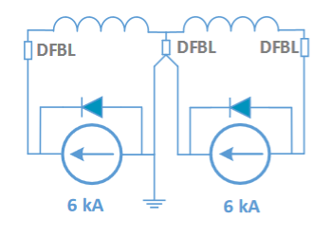
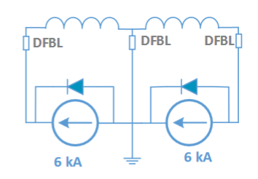
Quadrupoles Q4, Q5 and Q6
Quadrupole Q4
Quadrupoles Q5 and Q6
2 Circuits per IP side
Power converters (located at RR):
  2 x 6 kA (1quad)
Cold powering (feedbox: DFBL at RR):
  6 x 6 kA (1quad)
Quench protection:
  Quench heaters
1 Circuits per IP side
Power converters (located at RR):
  2 x 6 kA (1quad)
Cold powering (feedbox: DFBL at RR):
  3 x 6 kA leads
Quench protection:
  Quench heaters

Slide 47
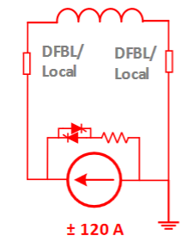
Q4, Q5 and Q6 correctors
Q4 correctors
Q5 correctors
Q6 correctors
8 Circuits per IP side
Power converters (located at RR):
  8 x 0.12 kA (4quad)
Cold powering:
  12 x 0.12 kA leads via DFBL
  4 x 0.12 kA leads in local powering
Quench protection:
  PC crowbar
6 Circuits per IP side
Power converters (located at RR):
  6 x 0.12 kA (4quad)
Cold powering:
  12 x 0.12 kA leads in local powering
Quench protection:
  PC crowbar
2 Circuits per IP side
Power converters (located at RR):
  2 x 0.12 kA (4quad)
Cold powering:
  4 x 0.12 kA leads in local powering
Quench protection:
  PC crowbar

Slide 48
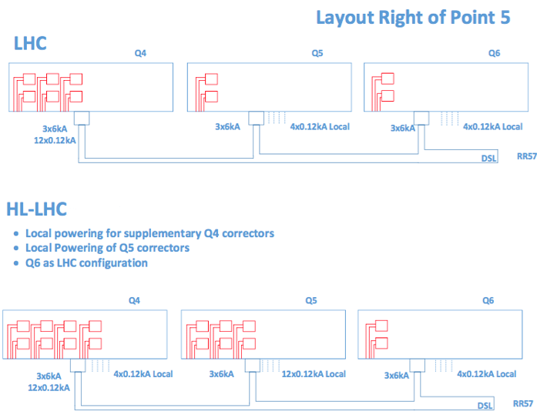
Q4, Q5 and Q6 correctors

Slide 49
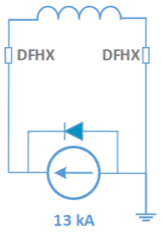
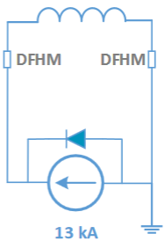
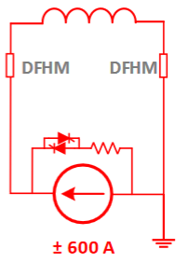
Dipoles D1, D2 and D2 correctors
Dipole D1
Dipole D2
D2 correctors
1 Circuits per IP side
Power converters (located at UR):
  1 x 13 kA (1quad)
Cold powering (feedbox: DFBL at UR): :
  2x 13 kA leads
Quench protection:
  Quench heaters
1 Circuits per IP side
Power converters (located at UR):
  1 x 13 kA (1quad)
Cold powering (feedbox: DFHM at UR):
  2x 13 kA leads
Quench protection:
  Quench heaters
4 Circuits per IP side
Power converters (located at UR):
  4 x 0.6 kA (4quad)
Cold powering (feedbox: DFHM at UR):
  8 x 0.6 kA leads
Quench protection:
  PC crowbar
  EE (option)

Slide 50
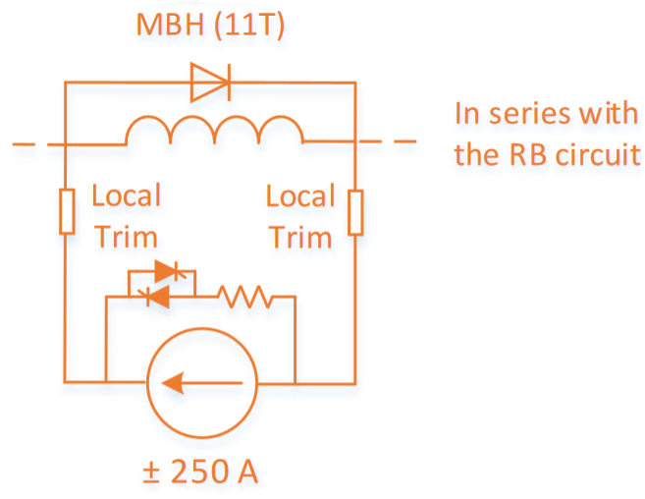
11T dipole
Power converters (located in the RR):
  1 x 250 kA (4quad)
Cold Powering (local – 2 leads per polarity as tentative):
  Current leads: LHC DCFs as tentative
Quench protection:
  Quench heaters
  EE from RB circuit

Slide 51
3.e) Quantitative studies on alternative solutions (WP6b and WP7)
Three-cable configuration
Four-layer nested configuration

Slide 52
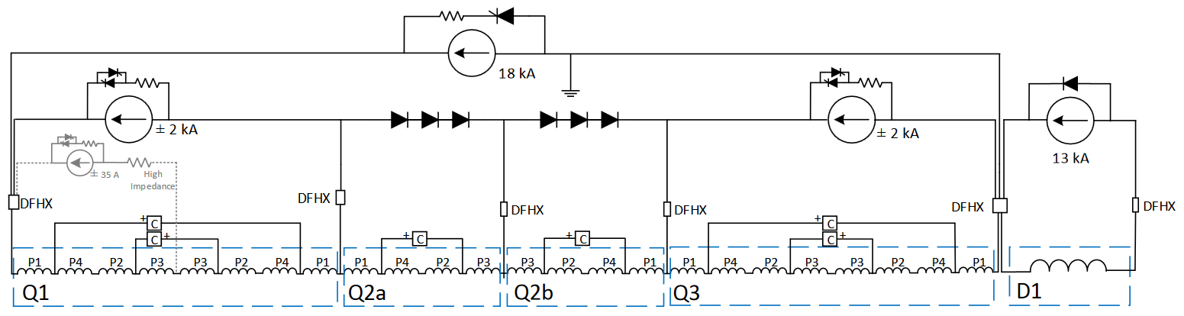
Scheme of the three-cable configuration
WP6b
WP7
Advantages | Disadvantages
No clear advantages for WP6b (Transparent to control, same number of power converters, etc.). | Electrical common point for two different circuits
 | Additional complexity in searching for earth faults
 | Longer estimated MTTR time for TE-EPC (12 hours + 50 %)
 | Electrical issue on D1 circuit impacts IT circuit and vice et versa
 | Four cables connection on the current leads (or circuit separator) (2 for 18 kA – 1 for 13 kA and 1 for 2 kA)
Advantages | Disadvantages
1x 18 kA lead less | ELQA to be performed all together (incl. higher voltage withstand requirements of triplet on D1, ...)
 | Quench cross talk between triplet and D1
 | PC regulation more complicated
1x spare lead / link | 4th cable at warm
 | Commissioning more complicated
 | More simulations required to study failure cases etc. (→ manpower)

Slide 53
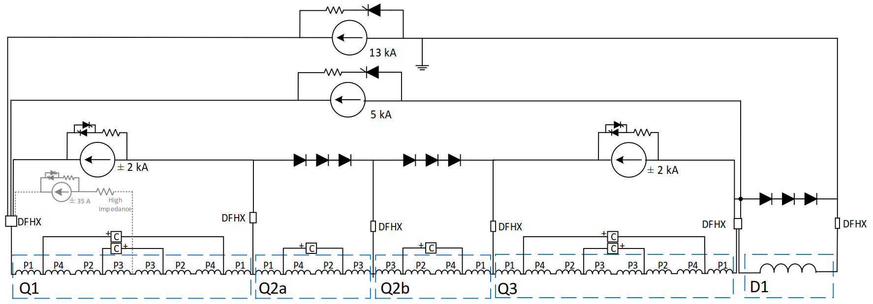
Scheme of the three-cable configuration
WP6b
WP7
Advantages | Disadvantages
Lower current ratings for main power converters (13 kA still needed for D2) | Even more electrical coupling between IT main quadrupole sub-circuits and D1 circuit
 | Even longer MTTR for TE-EPC (+200% estimated) (higher intervention time to repair in case of failure since multiplying the sources of failures in one circuit).
 | Increase in the need for spare parts since more of them are used during interventions
 | Additional constraints on the circuit control and precision: 4 layer nested circuits and additional source of noise
 | Additional complexity Decoupling matrix implementation (Ethernet communication, algorithms, etc.) For commissioning and operation For circuit protection (current looping, crowbar definition, etc.) In the reconstitution of failure events
Advantages | Disadvantages
1x 18 kA, 1x 13 kA, 1x 5 kA leads → gain 18 kA | ELQA to be performed all together (incl. higher voltage withstand requirements of triplet on D1, ...)
 | Quench always triplet and D1 together
 | Longer quench training
Lower PC rating | PC regulation much more complicated & no experience at CERN with four layer nesting
 | Commissioning more complicated
 | New failure scenarios with D1 (diff. inductance to Q1/Q3 and Q2a/b) → imbalances, over voltages, over currents
 | More simulations required to study new failure cases etc. (→ manpower)
 | Re-do studies already performed for baseline (→ manpower)

