Slide 1
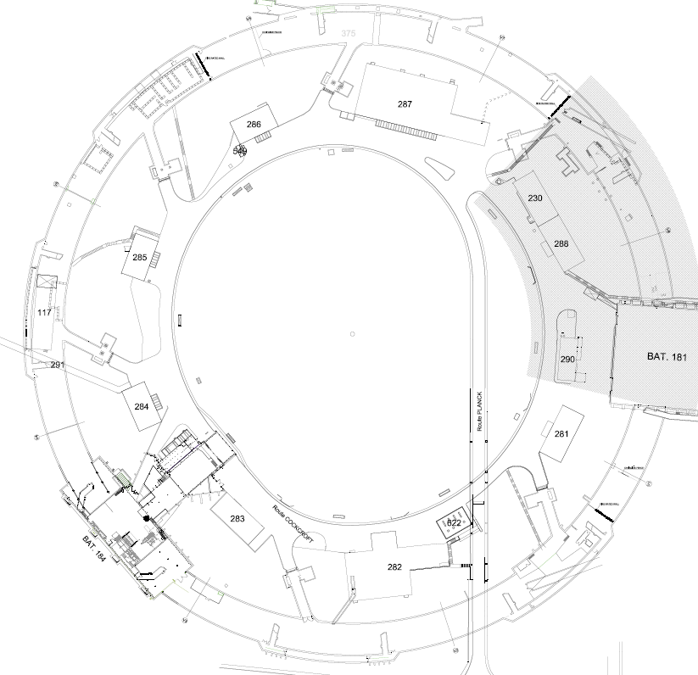
Technical work packages
STATUS & UPDATES
Organisation,
Planning & Budget vs. Baseline
C. Colloca
RWTCS Steering Commitee

Slide 2
INFRASTRUCTURE WORK
WORK PACKAGES | WORK PACKAGE OWNER | WORK PACKAGE TEAM
Civil engineering & building work | C. Colloca SMB/SE | L. Maricalva, R. Ortega SMB/SE
Electricity | J. Gomez SMB/SE | F. Vincent SMB/SE
HVAC | G. Rouge SMB/SE
Cranes & handling/lifting equipment | H. Lourenco EN/HE | S. Fumey EN/HE
IT networks | L. Borakiewicz IT/CS
Access control | R. Nunes BE/ICS | N. Rama BE/ICS
Fire detection | D. Raffourt BE/ICS

Slide 3
- Crane support extension ISR4
- Cranes feeding & anticollision system
- New metallic doors (bldg. 184)
- ISR8L plateform
- Underground galleries waterproofing (ISR2-3-5-6-7-8)
- Ceiling, corbels, walls painting (ISR5-6)
- Electricity (ISR5-6)
- Fire detection (ISR5-6)
- Local urgent slab repairs
FINISHED WORK (JUNE - NOV 17)

Slide 4
- Fire doors (ISR3, ISR4, ISR5, ISR6, ISR7)
- External barrack installation
- New meeting room & changing rooms (bldg. 184)
- New sanitary block (bldg. 184)
- Electricity (ISR4, bldg. 184)
- Resin samples (ISR3, ISR5)
- Floor sealing holes (ISR5, ISR7L)
On going/starting WORK

Slide 5
- HVAC : IT preparation
- Infrastructure supports for HVAC : study
- Replacement of metallic stairs (ISR2, ISR4, ISR8) : DO preparation
- BLDG 573, 574, 225: budget & planning on going
On going/starting STUDIES

Slide 6
CONDITIONAL PERIODS OF AVAILABILITY
o n - g o i n g
S2 2018
S1 2021
S2 2022
S1 2022
S1 2017
S2 2016
S1 2020
S2 2015
S2 2015
ISR 2
ISR 3L
ISR 3R
ISR 5L
ISR 5R
ISR 6L
ISR 6R
ISR 7L
ISR 7R
Storage of LS2 rad. Waste.
Move of
- tritiated water to B.573
- Magnets >8t to ISR 5.
- Comb. RW to B.225
Treatment by cont.enclosure by S1 2019.
Elimination of cables and combustible RW.
Move of residual combustible RW to B.225
No floor access
(shielded areas for highly rad. waste).
Storage of not-stackable RW (pallets).
Dismantling of old shielded area.
Floor available in ¼ octant
Elimination of LEP RF Cavities, Pb vacuum chambers and asbestos RW.
HSE-RP
B.573 refurb. by S2 2017
Containment enclosure by S2 2018
B.225 refurb. by S1 2018
Evaporation in B.573 by end of S2 2017
B.225 refurb. with sprinkler by S1 2018 (to be discussed).
Floor waterpr. compatible with the existing sh. area.
Keep storage racks in place.
Floor waterproofing before sh. area extension
Asbestos facility avail. By S1 2018
Civil eng. work and HVAC possible before S2 2022. Partial waterprof. in S1 2018.
Elec., fire det., access ctrl, waterproof. & painting in S1 & S2 2022 (per ½ sector)
Waterpr. partially possible after ISR6 sh. extension. Elec., IT & painting ongoing. HVAC in 2018
All other work in 2017
Civil eng. work and HVAC possible before S2 2018.
Elec., fire det., access ctrl, waterproof. & painting in S2 2018
Floor waterpr. and all remaining work possible in 2017
HVAC in 2018
Civil eng. work possible in 2017. HVAC 2018.
Elec., fire det., access ctrl, waterpr.& painting ? POSSIBILITY WITH RACKS IN PLACE TO BE VERIFIED
Civil eng. work possible in 2017. HVAC 2018.
Elec., fire det., access ctrl, waterproof. & painting in S1 2020.
INFRASTR.

Slide 7
PLANNING 1/2

Slide 8
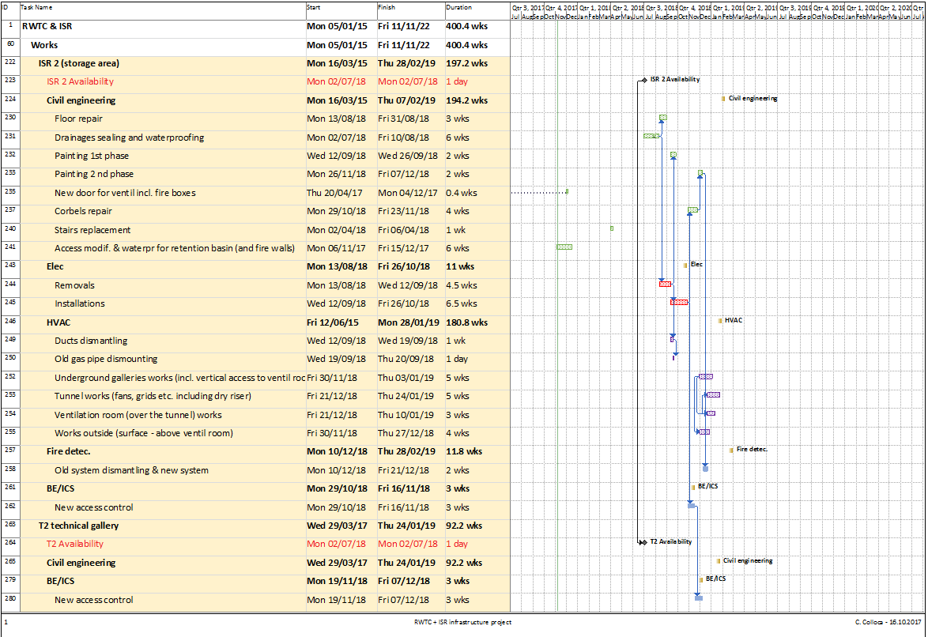
PLANNING 2/2

Slide 9
SPENDING PROFILE
EXPENDITURES (FOR TUNNEL WORK ONLY – NO SECURITY) | 2017 | 2018 | 2019 | 2020 | 2021 | 2022 | 2023
GLOBAL BUDGET* (kCHF) | 1’270 | 1’370 | 1’750 | 200 | 240 | 400 | 40
TOTAL | 5’270
COMMITTED : 1’600 kCHF
SPENT : 1’270kCHF
*Without ‘Access control’, ‘Human resources’

Slide 10
BLDG. 573, 522 AND 574
UPGRADE/CHANGE OF DESTINATION | BLDG. 225 | BLDG. 573 | BLDG. 574
GLOBAL BUDGET* (kCHF) | 280 | 325 | 215
*These estimates take into account: Building work Electricity HVAC IT Fire detection They do not take into account fire compartments, sprinklers or smoking extraction systems (risk analysis on going for bldg 225)
Planning on going
Current estimated duration : 2 years from the IPP approval
(if the new bldg. close to bldg. 184 is ‘postponed’)

Slide 11
HSE/RP CONTROL BLDG
Budget : 800 kCHF
Duration : 2 years from the start of design
Constraints : one of ISR4 access condemned +
parking reduction

Slide 12

THANK YOU
FOR THE ATTENTION!

