Slide 1
High-Availability Logs/Metrics Collector @ CSCS
Dino Conciatore – System Engineer – HPC Operations
May 17th , 2018
HEPiX Spring 2018

Slide 2
Motivation
Logs are a critical part of our systems
Debugging problems is usually easier if you can correlate information from different sources
Having all logs together
  Enables us to do automatic message processing (field extractors)
  Search through terabytes of data easily with almost-human language
  Trigger actions or notifications when critical events happen
  Generate complex dashboards
Collect all system/services metrics and correlate with logs
Post-factum incident analysis
  actually possible and not just a chimera

Slide 3
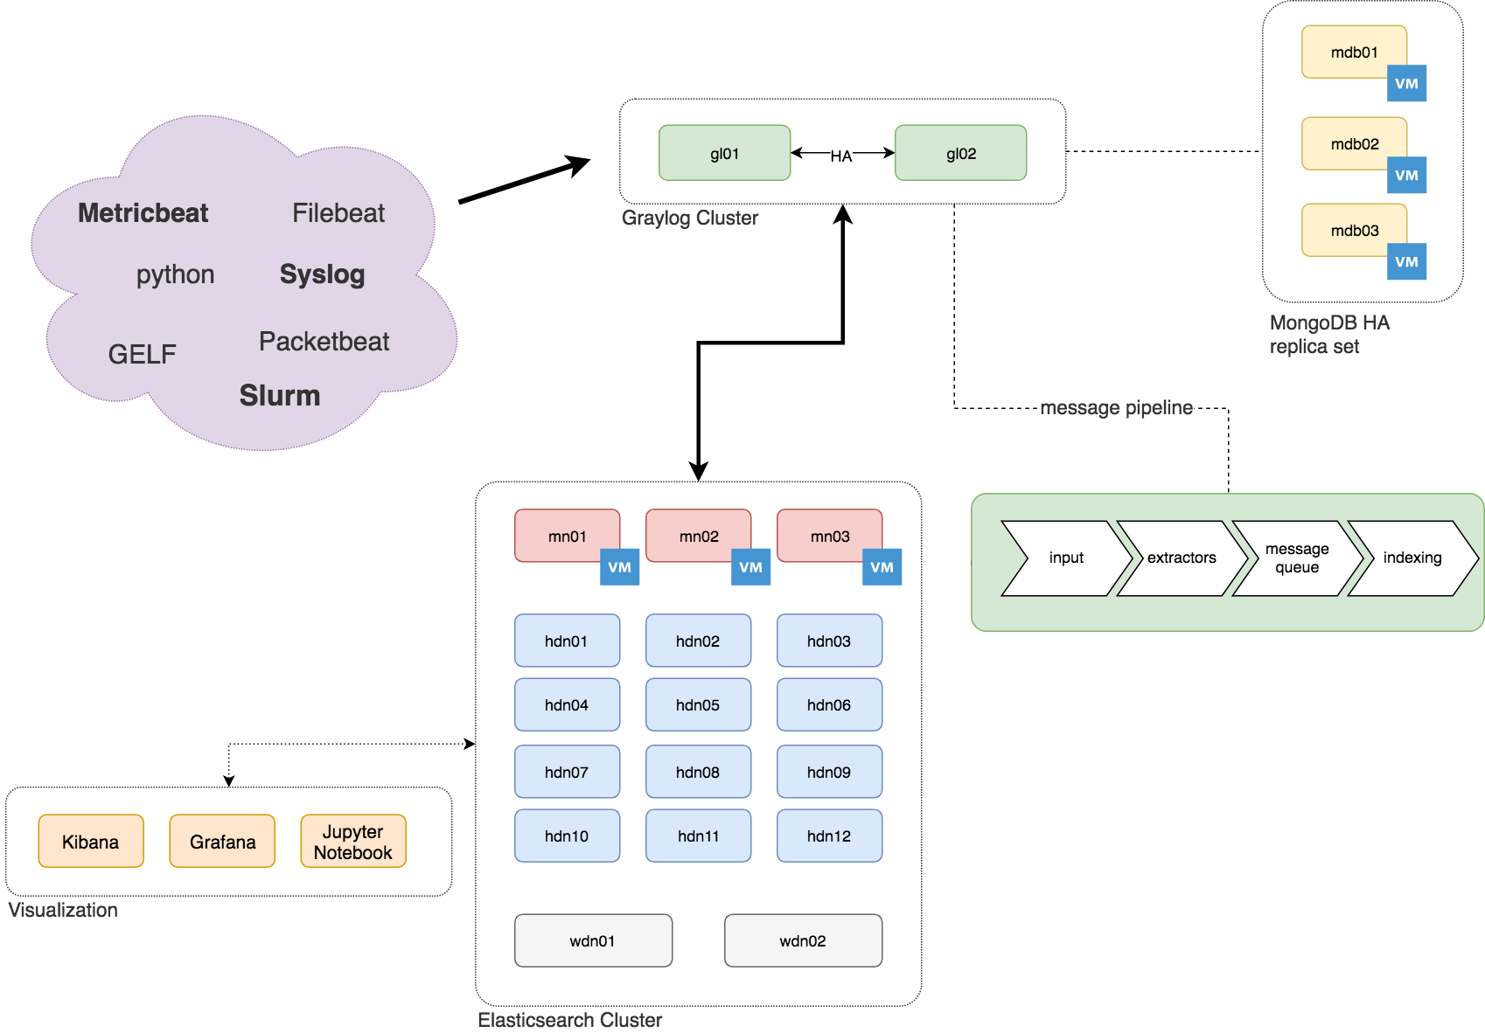
Cluster Overview

Slide 4
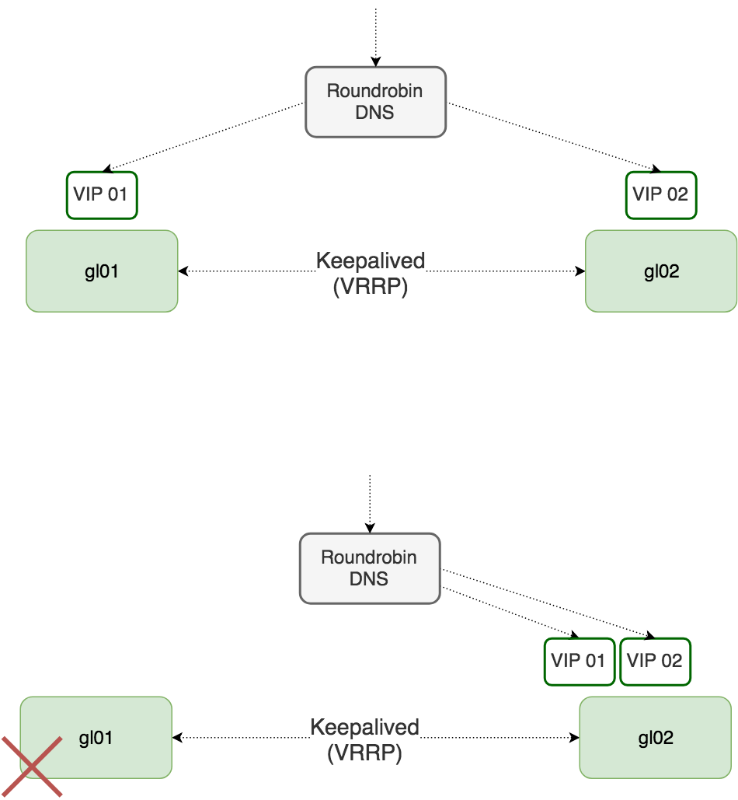
How Graylog works in HA
Normal operation
Node Failure
or
Manual LB Override

Slide 5
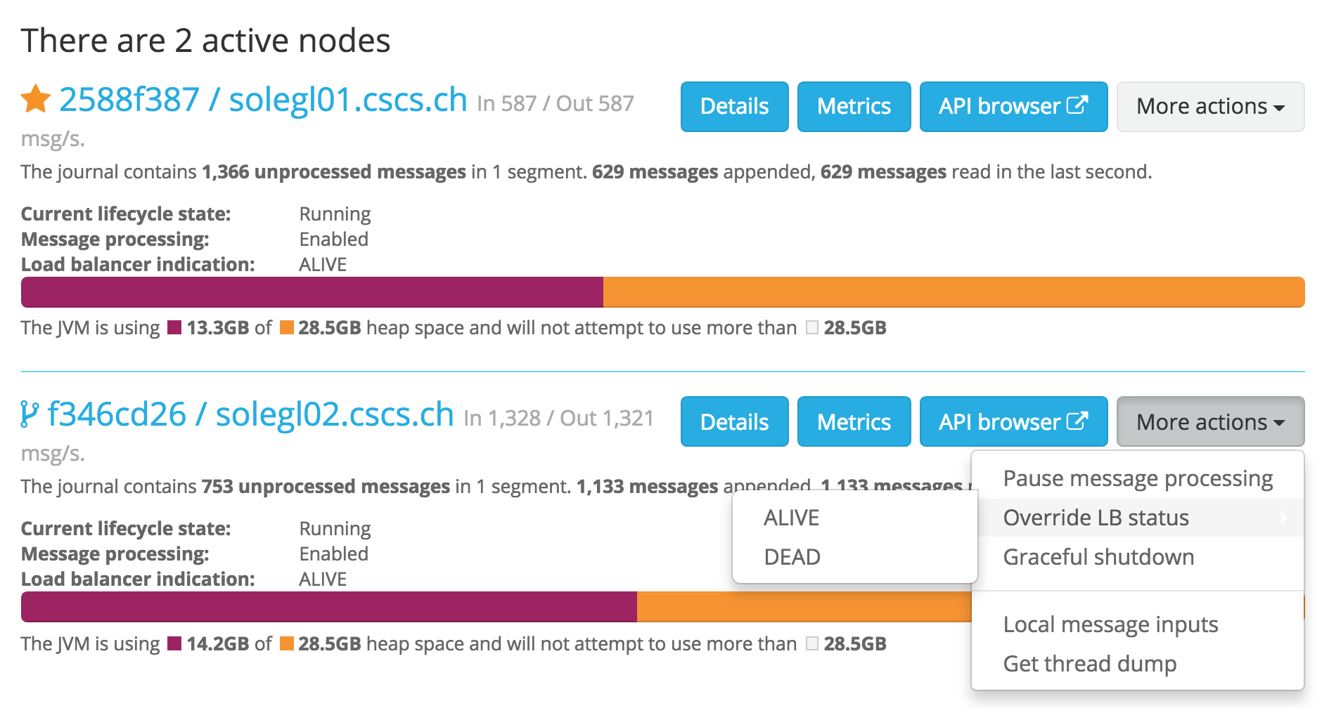
Graylog – Nodes Overview – LB Override

Slide 6
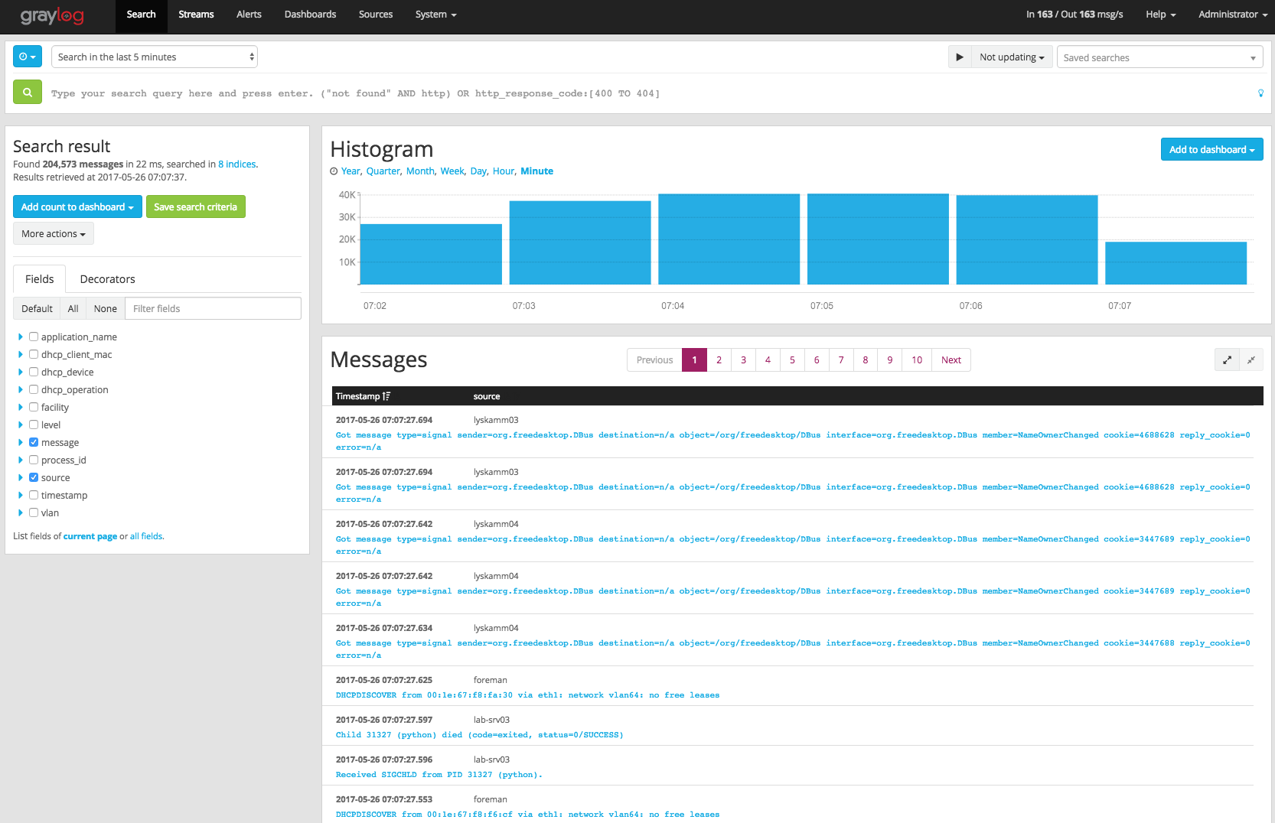
Graylog – Search *

Slide 7
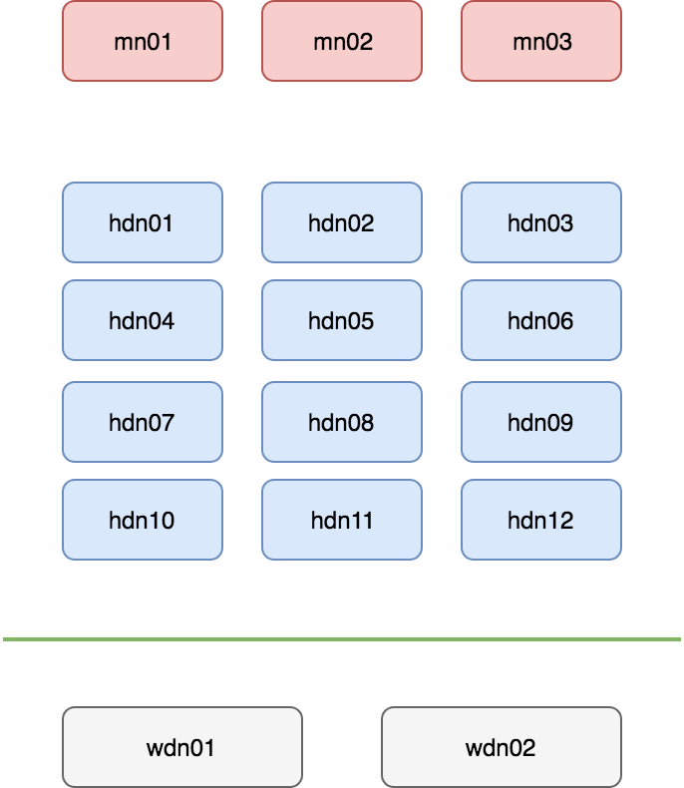
Elasticsearch Cluster
Master Nodes
Virtual
10G vSwitch
Hot Data Nodes:
Hardware
  Fast Flash NVMe
  10G Network
Configuration
  Shard Allocation Awareness
  Fat Shards
  1 Replica
Warm Data Nodes:
Hardware
  Spinning Disks
  10G Network
Configuration
  Shard Allocation Awareness
  1 Replica

Slide 8
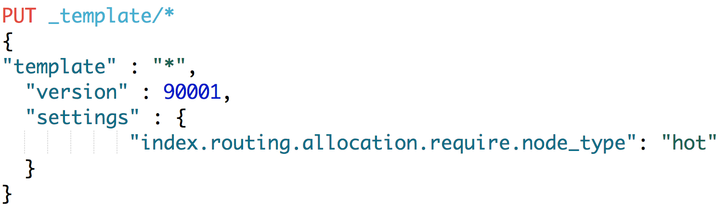
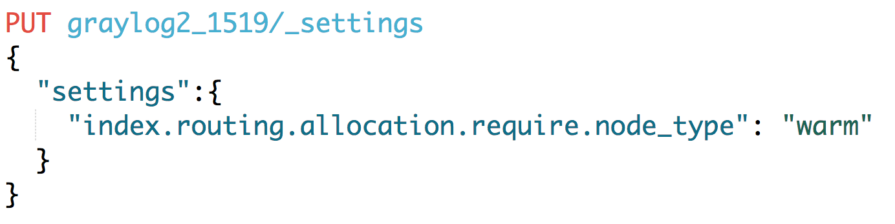
Moving data from Hot to Warm nodes
Default _template

Slide 9
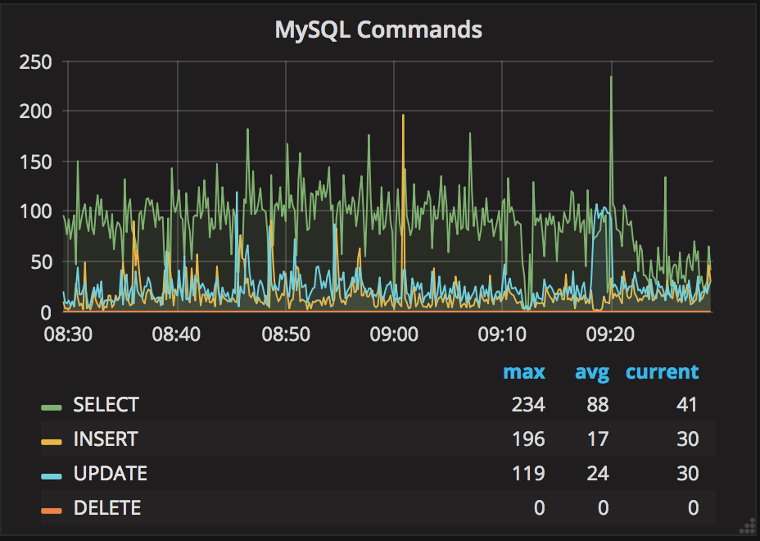
Metricbeat for system and services metrics
System module metricsets:
cpu
core
load
memory
network
process
process_summary
diskio
filesystem
fsstat
  Services modules:
  MySQL
  HAProxy
  NGINX

Slide 10
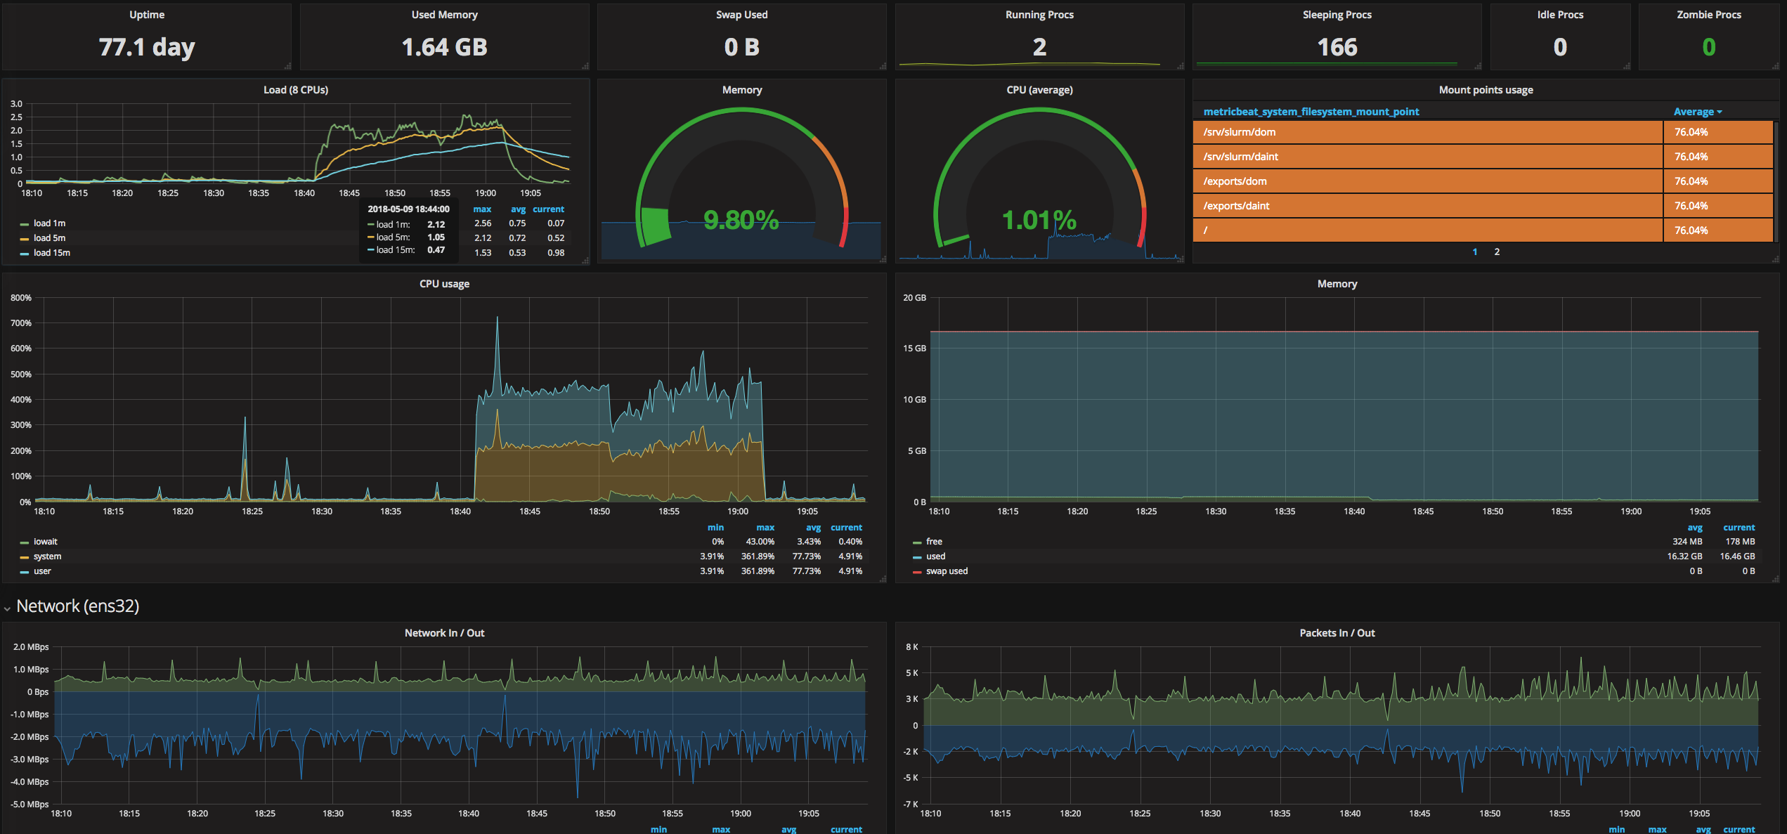
Grafana (Metricbeat dashboard)

Slide 11
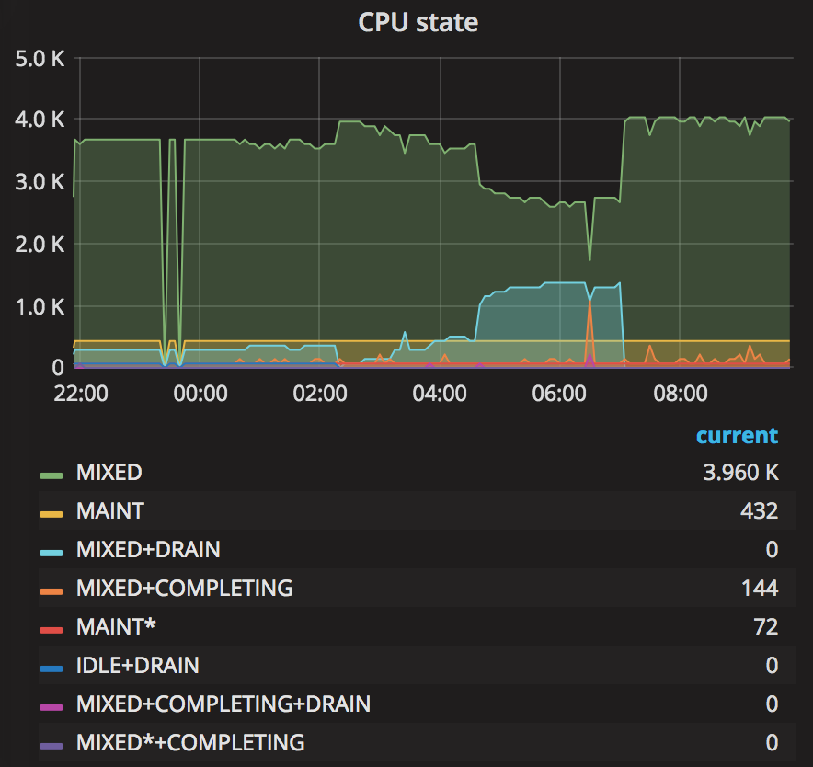
Python scripts for Slurm Metrics collection
Jobs status
  Working dir
  Status (RUNNING, PENDING, FAILED, …)
  Submit, start and end time
  …
Slurm statistics (RPC)
  MESSAGE_EPILOG_COMPLETE
  ACCOUNTING_UPDATE_MSG
  MESSAGE_NODE_REGISTRATION_STATUS
  REQUEST_BUILD_INFO
  REQUEST_CANCEL_JOB_STEP
  ….
Slurm Configuration (changes history)
Node status
  ALLOCATED
  IDLE
  MIXED
  DOWN+DRAIN

Slide 12
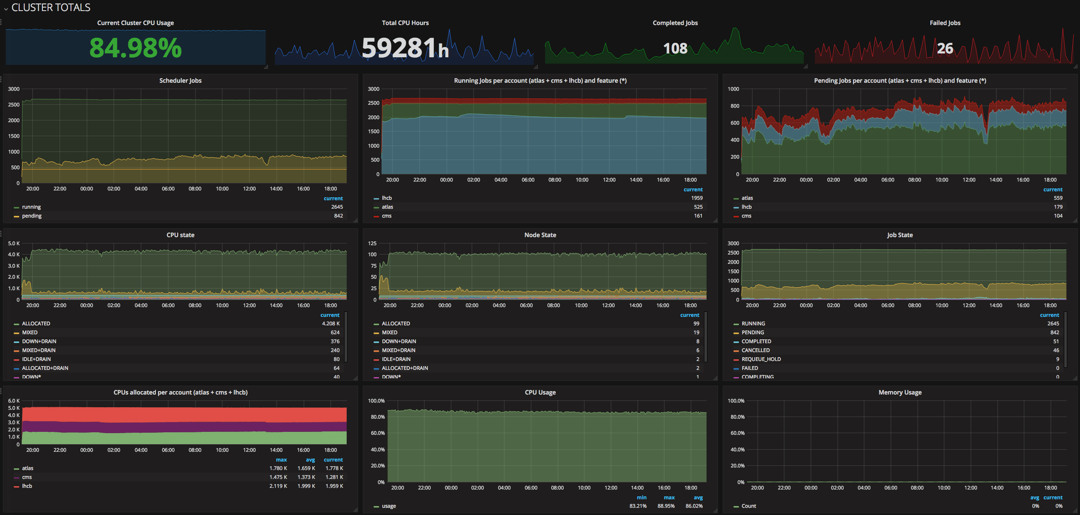
Grafana (Slurm metrics)

Slide 13
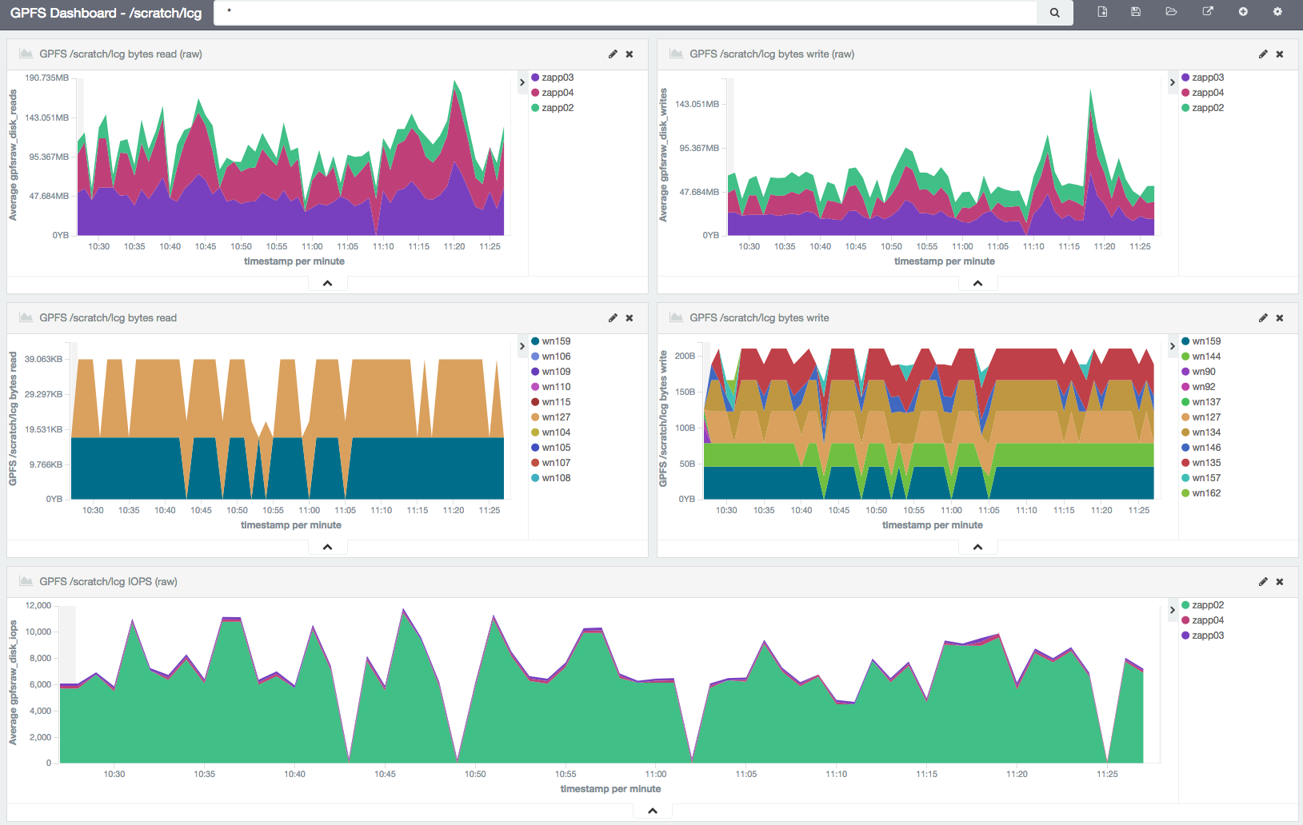
Kibana

Slide 14
Simple Security with NGINX Proxy
All users can just read: limiting methods
Using NGINX Location (example):
Read
Just Write
location ~* ^(/metricbeat_*|/graylog2_*|/slurm_*) {
proxy_pass http://es001:9200;
...
if ($request_method !~ ^(GET)$ ) {return 403; }
}
location ~* ^(/slurm/jobcomp) {
proxy_pass http://es001:9200;
...
if ($request_method !~ ^(POST)$ ) {return 403; }
}

Slide 15
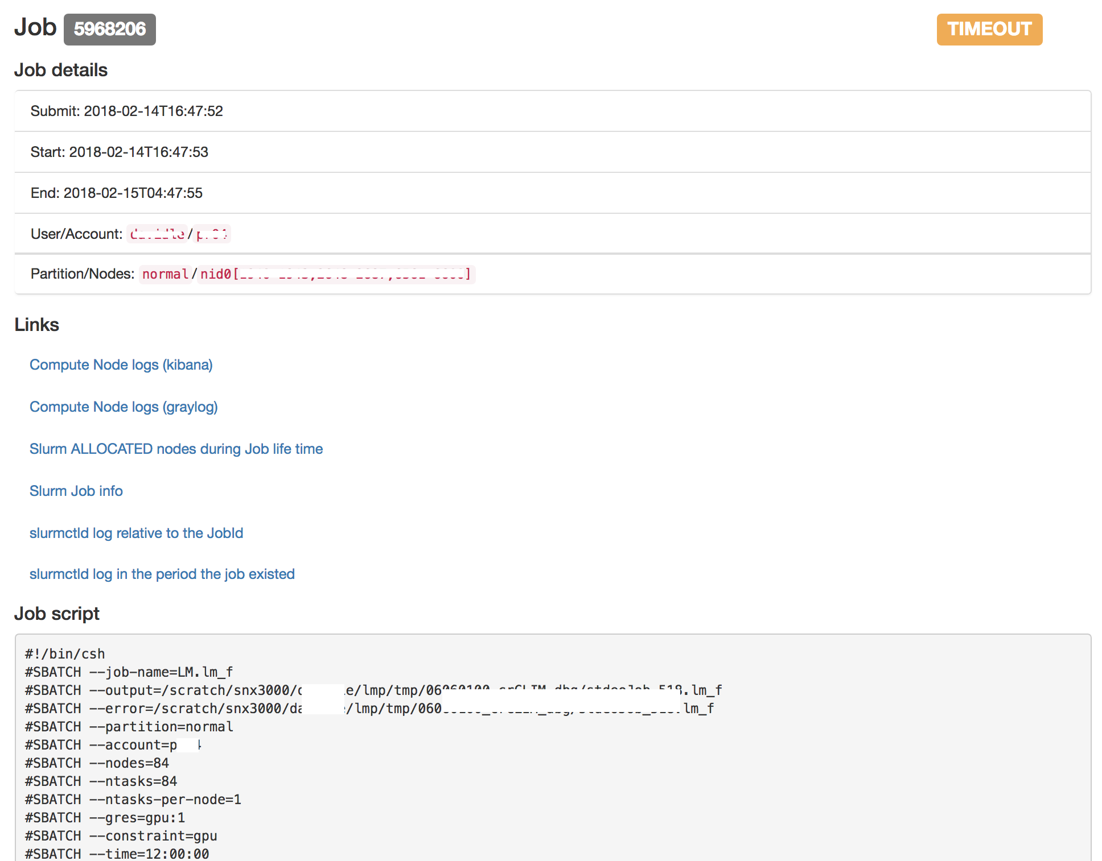
Search Helpers (Flask API)

Slide 16
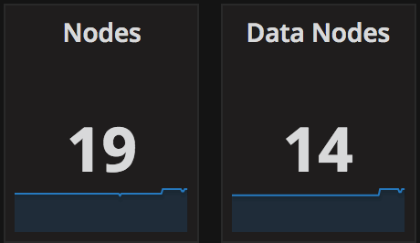
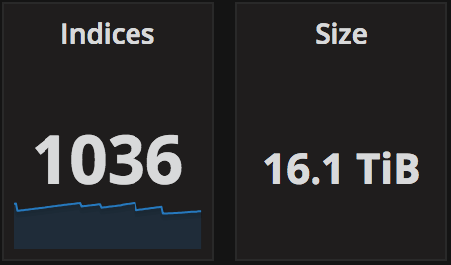
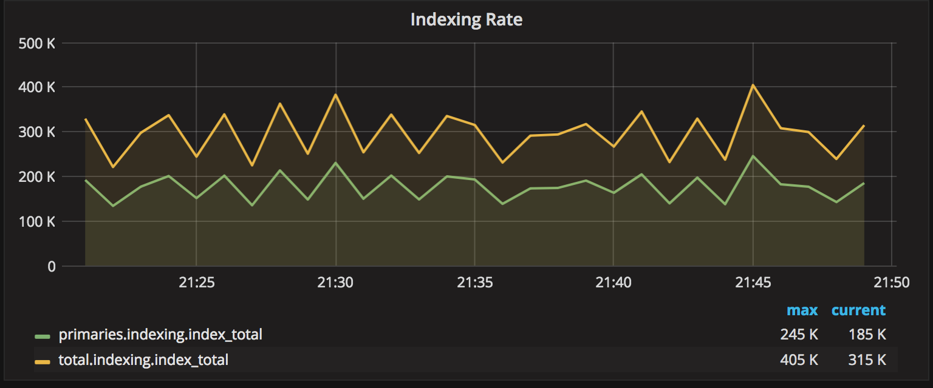
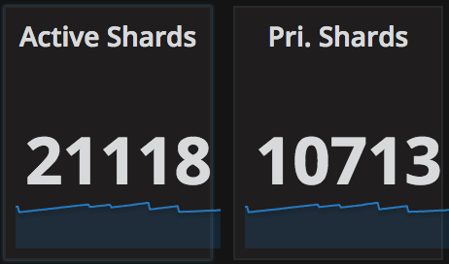
Cluster Numbers
Input | 1’500 doc/sec Average | 5’000 doc/sec Max
Max troughput | 40’000 doc/sec (Benchmark)
Input Cache | 500 GB Graylog internal Kafka
Total | 20 Bil docs (16 TB)
Archive | 40 Bil docs (35 TB)

Slide 17
Thank you for your attention.

