Slide 1
The low-energy magnets for the PS-LIU
D Bodart 14/11/2017

Slide 2
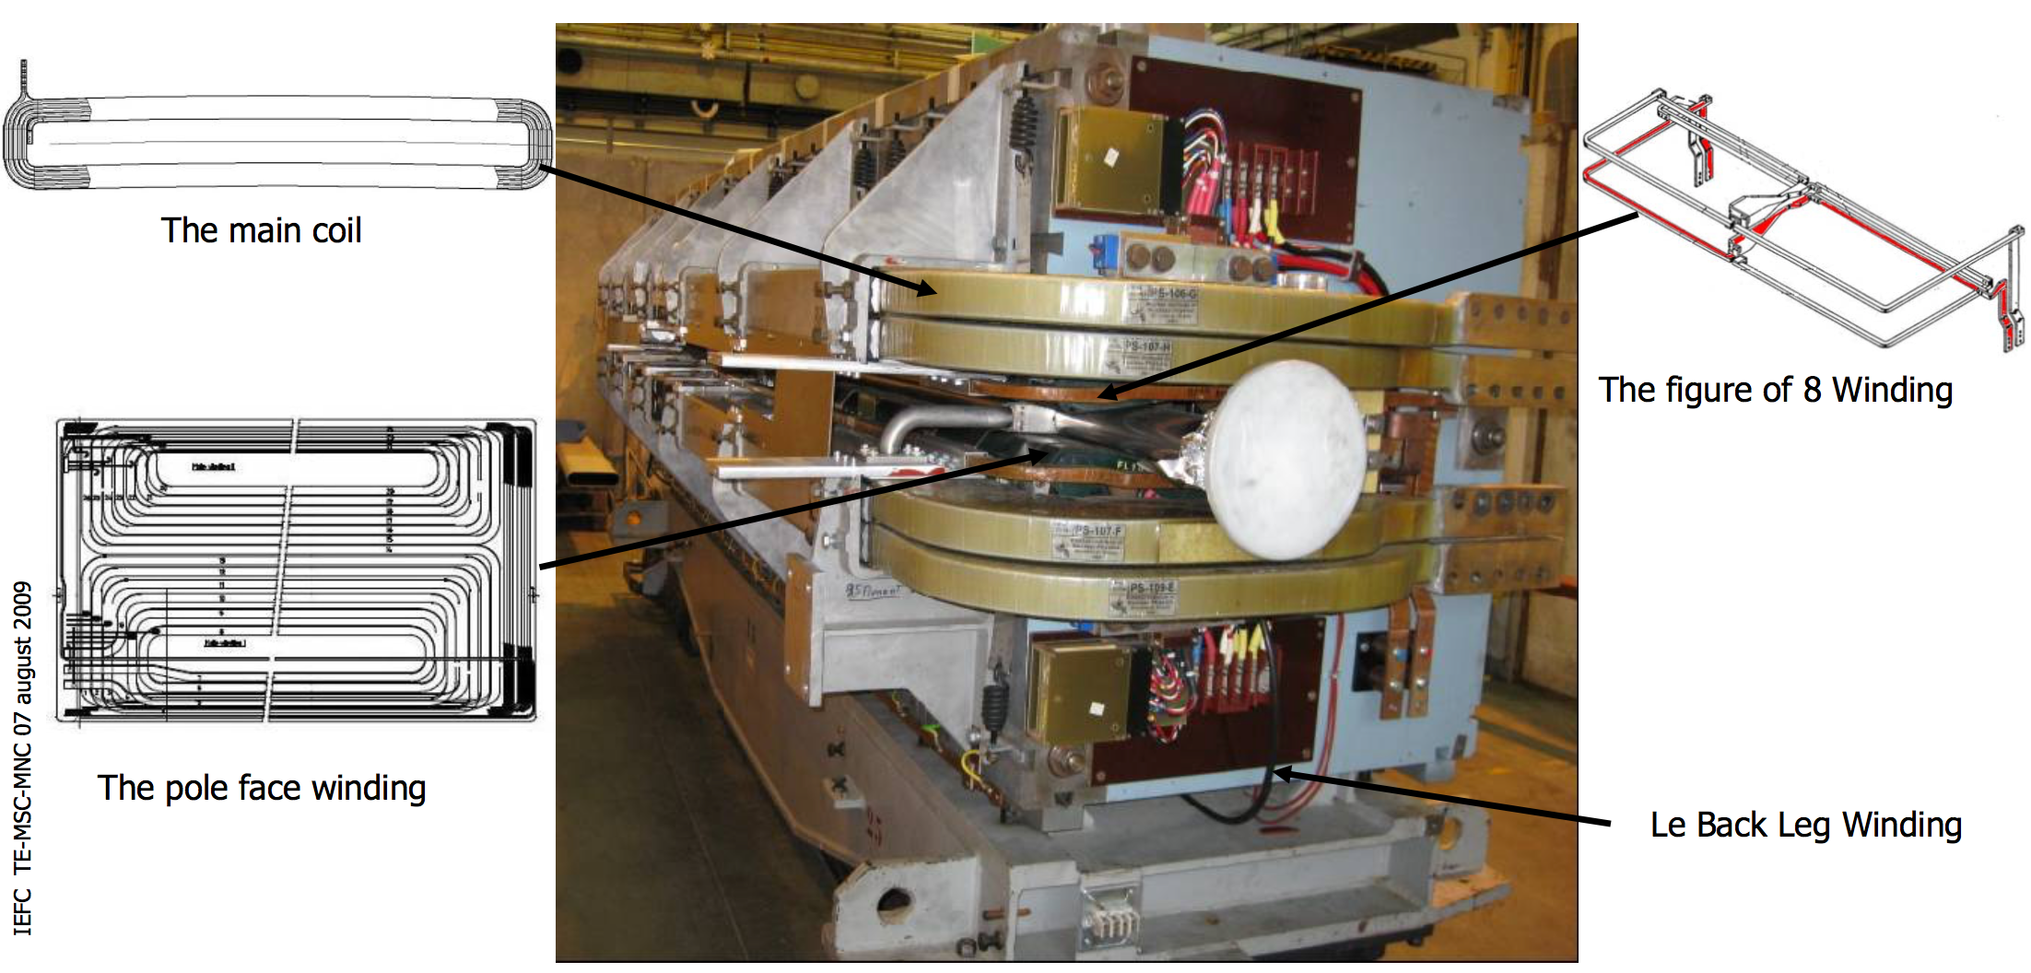
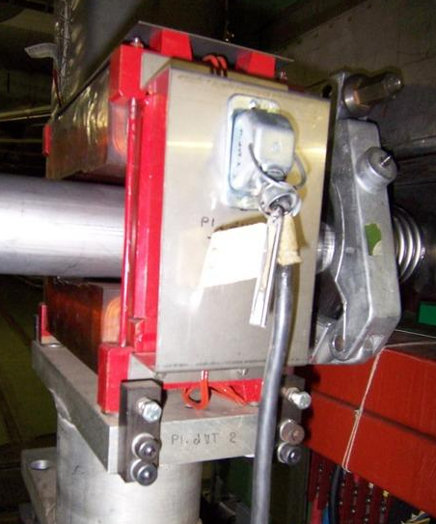
Proposal for the PS-LIU
Here is a detailed proposal resulting from the study for the compatibility of the actual magnet to be used for LIU at 2 GeV operation. This proposal refers to the requirements detailed in the edms #1769435.
Low energy Horizontal correctors (back leg windings):
Modification of the peak current will be made to allow more corrections on the horizontal plane by doubling the peak current.
Low energy Vertical correctors:
Two types of vertical correctors are present in the machine.
The straight section magnets type 202: the performances can be increased to cope with the LIU requirements, rms current limit increased by 40%.
 | I Peak | I rms | Integrator period
Today | 10 | 11 | 10
LIU | 20 | 20 | 10
Proposal | 20 | 20 | 10
 | Integrated field peak | I rms max [A] | Integrator time period
Today | 3.5 mTm at 10A | 6 | 24
LIU | 3.42 mTm
Proposal | 7 mTm at 20A (51% margin) | 10 (40 % increase) | 48

Slide 3
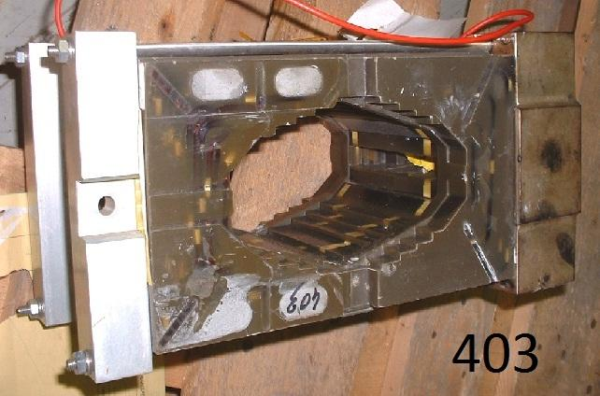
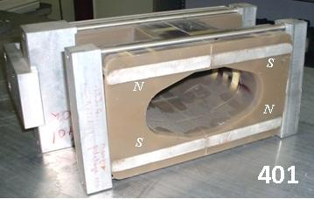
Proposal for the PS-LIU
The embedded vertical corrector type 403: the performances can be increased, the maximum rms current raised by 1 amps, and the integrator period from 24 to 48 seconds.
Low energy normal quadrupoles 401: The performances are compatible with the LIU, and the rms current can be increased by 0.5 amps, and the integrator from 10 to 48 seconds.
 | Integrated field peak | I rms max [A] | Integrator time period
Today | 2.63 mTm at 10A | 3.5 | 24
LIU | 3.42 mTm
Proposal | 5.26 mTm at 20A (35% margin) | 4.5 (22% increase) | 48
 | Integrated field peak | I rms max [A] | Integrator time period
Today | 55 mT at 10A | 6 | 10
LIU | 71.5 mT
Proposal | 110 mT at 20A (65% margin) | 6.5 (8% increase) | 48

Slide 4
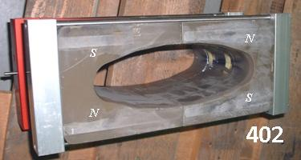
Proposal for the PS-LIU
Low energy normal quadrupoles 402: The performances are compatible with the LIU, and the rms current can be increased from 6 to 6.5 amps, integrator period from 10 to 48 seconds.
Low energy skew quadrupoles 403: The performances are compatible with the LIU, and the rms current can be increased, integrator period from 10 to 48 seconds.
 | Integrated field peak | I rms max [A] | Integrator time period
Today | 43.3 mT at 10A | 6 | 10
LIU | 56.3 mT
Proposal | 86.6 mT at 20A (35% margin) | 6.5 (8% incresase) | 48
 | Integrated field peak | I rms max [A] | Integrator time period
Today | 38 mT at 10A | 3.5 | 10
LIU | 50 mT
Proposal | 76 mT at 20A (34% margin) | 4.5 (22% increase) | 48

Slide 5
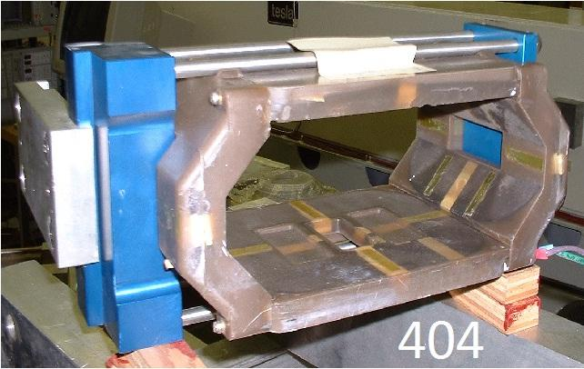
Proposal for the PS-LIU
Low energy normal quadrupoles 404: The performances are compatible with the LIU, and the rms current can be increased from 6 to 6.5 amps, integrator period from 10 to 48 seconds.
 | Integrated field peak | I rms max [A] | Integrator time period
Today | 11.77 mT at 3.5A | 3.5 | 10
LIU | 15.3 mT
Proposal | 67.26 mT at 20A (77% margin) | 5.5 (36% increase) | 48

Slide 6
Proposal and conclusion
The low energy magnets detailed here above are compatible with the LIU operation.
Ajustements are made to provide more flexibility especially for the machine developments where the integration period and the maximum rms current of the current limiter is increased. A supercycle length of 40 basic periods is considered.
The operation of the magnets at higher levels increase their operating temperature.
Since the replacement of the low-energy magnets are no more needed, we propose to deploy the WIC hardware interlock protection for those magnets except the horizontal correctors to ensure stable operation and to avoid consequences of possible SIS upgrades bugs. 1 FTE is needed to install the hardware on the magnet side +/- 60 kCHF + WIC deployment.
It is also remarked that 10 vertical correctors located in magnets 3, 37, 53, 69, 79, 83, 84, 87, 91, 97 and 2 skew quadrupoles inmagnets 64, 76 are not operated. Investment in the procurement of power converter and cabling would allow more flexibility of the machine. Costs for deployment to be evaluated.

