Slide 2
De-convolution algorithm to properly remove dispersive profile for emittance calculations
G. Sterbini and J. F. Comblin
Special thanks to A. Oeftiger, A. Huschauer, H. Bartosik, B. Mikulec

Slide 3
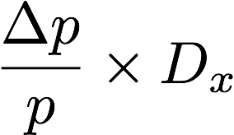
The deconvolution problem and beam emittance
By using the Wire Scanner (WS) we can measure the transverse profile of a beam, ρ_{WS}, i.e., the convolution of the betatronic profile ρ_{β} and the dispersive profile ρ_{D}
ρ_{WS} = ρ_{β} ⊗ ρ_{D}.
our
UNKNOWN,
needed to compute
beam emittance
We present some details of the various deconvolutions algorithms.
For more details /eos/user/s/sterbini/MD_ANALYSIS/2017/PS/Deconvolution.ipynb

Slide 4
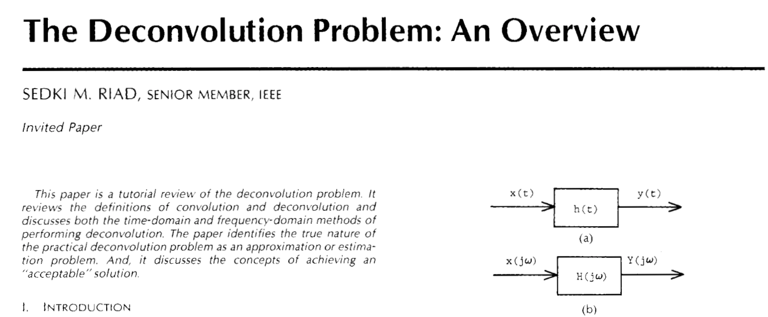
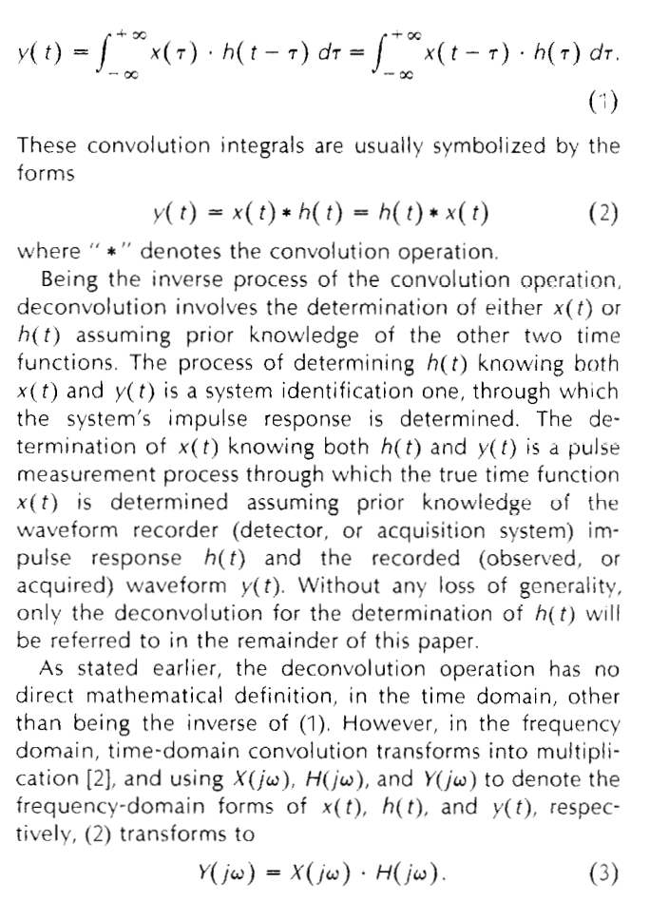
The deconvolution problem
ρ_{WS} = ρ_{β} ⊗ ρ_{D}
The deconvolution it is a typical system identification problem (get input from output, get impulsive response of the system…).
It is an ill-posed problem difficult to solve in presence of noise.
On can attack the problem
by introducing working hypotheses on the two profiles (ρ_{β} and ρ_{D} are Gaussian, present approach, trivial deconvolution),
in frequency-domain (difficult),
in time-domain (difficult),
by introducing a working hypothesis on one profile (ρ_{β} is Gaussian, approach proposed by A. Oeftiger)

Slide 5
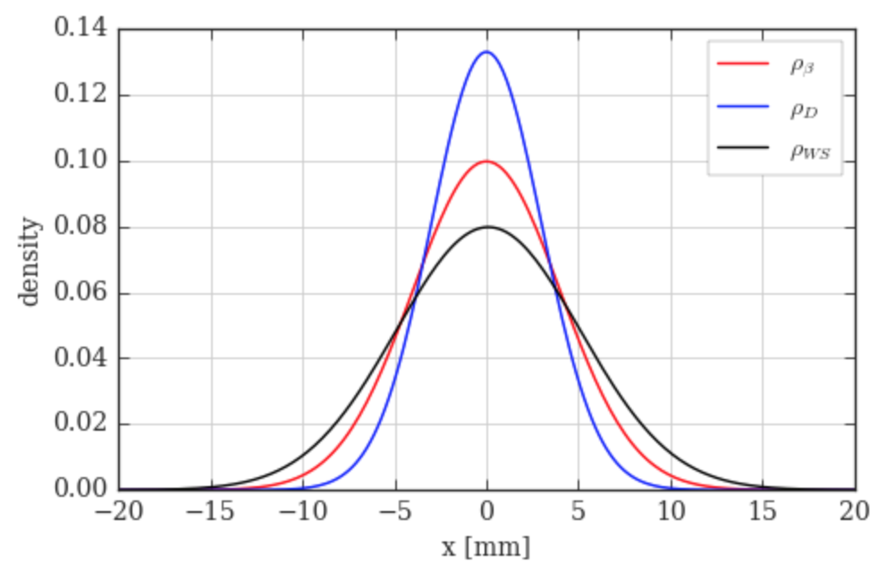
1. Assuming ρ_{β} and ρ_{D} Gaussian
The convolution of two Gaussian profiles is also Gaussian, with variance being the sum of the original variances. The deconvolution in this case is straight-forward since reduces to an algebraic problem (trivial deconvolution).
σ_{β}² = σ_{WS}² - σ_{D}².
We consider Gaussians with σ_{WS}=5 mm and σ_{D}=3 mm their de-convolution will have σ_{β}⁼4 mm.
ρ_{WS} = ρ_{β} ⊗ ρ_{D}
from the WS
from the tomo

Slide 6
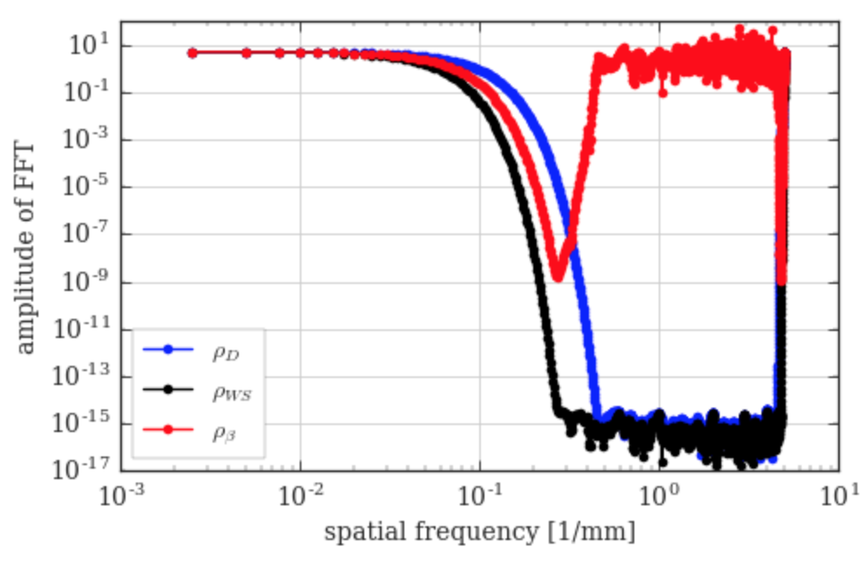
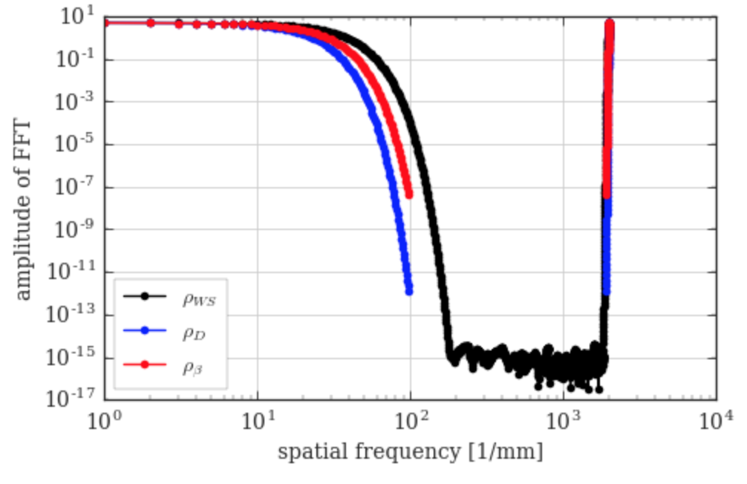
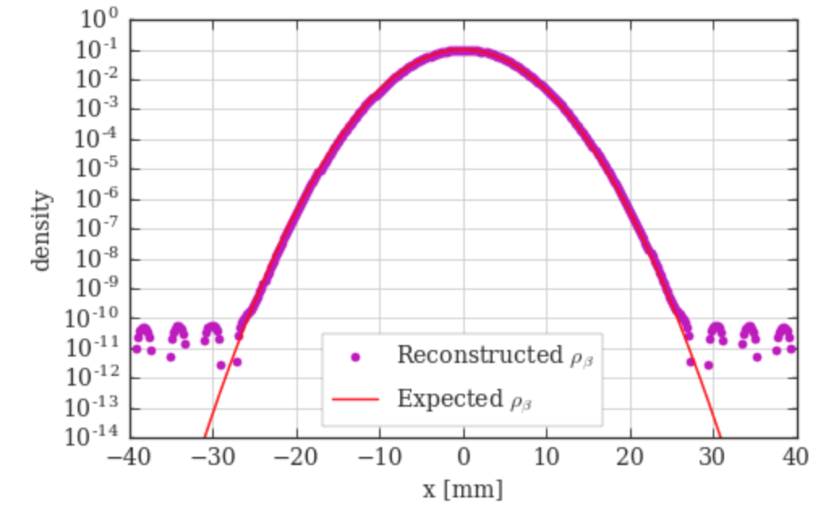
2. Deconvolution in frequency domain
ρ_{WS} = ρ_{β} ⊗ ρ_{D}
No special assumptions.
ρ_{β}=IFFT(FFT(ρ_{WS})/FFT(ρ_{D}))
“Filtered”

Slide 7
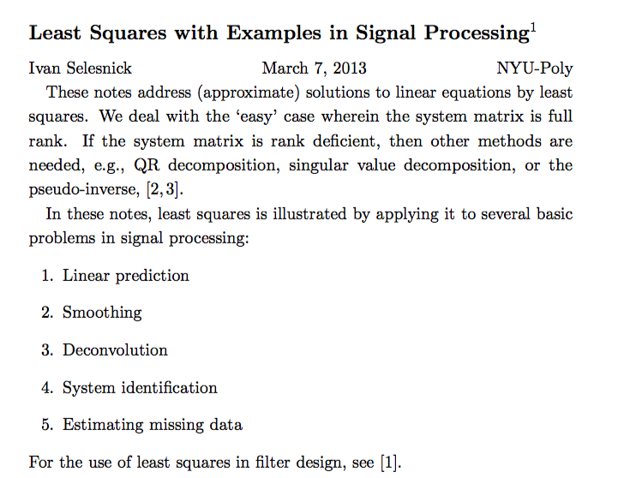
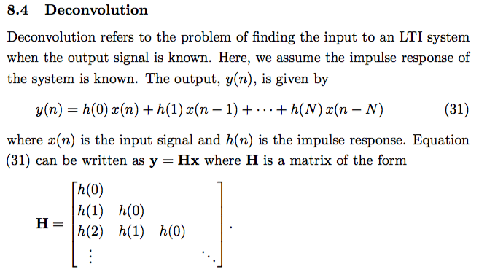
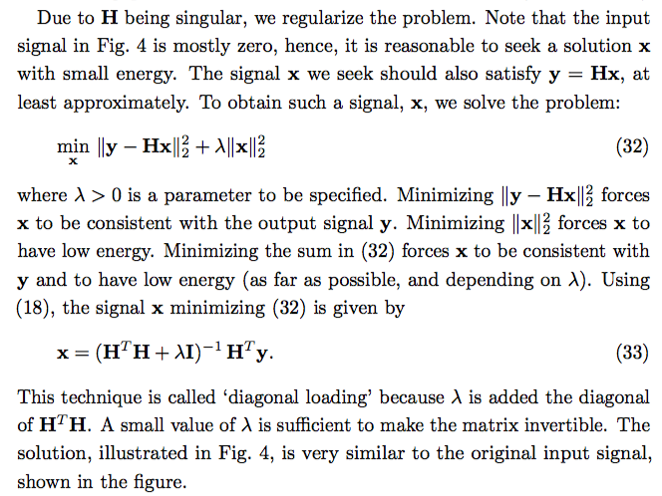
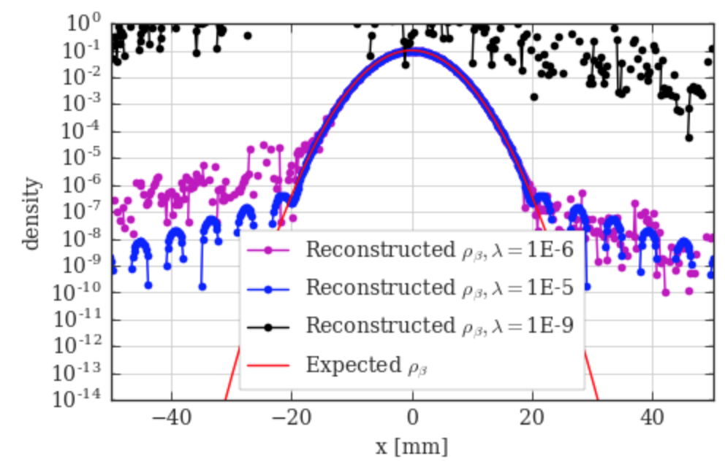
3. Deconvolution in time domain
ρ_{WS} = ρ_{β} ⊗ ρ_{D}
No special assumptions.
Convolution and Toeplitz matrix

Slide 8
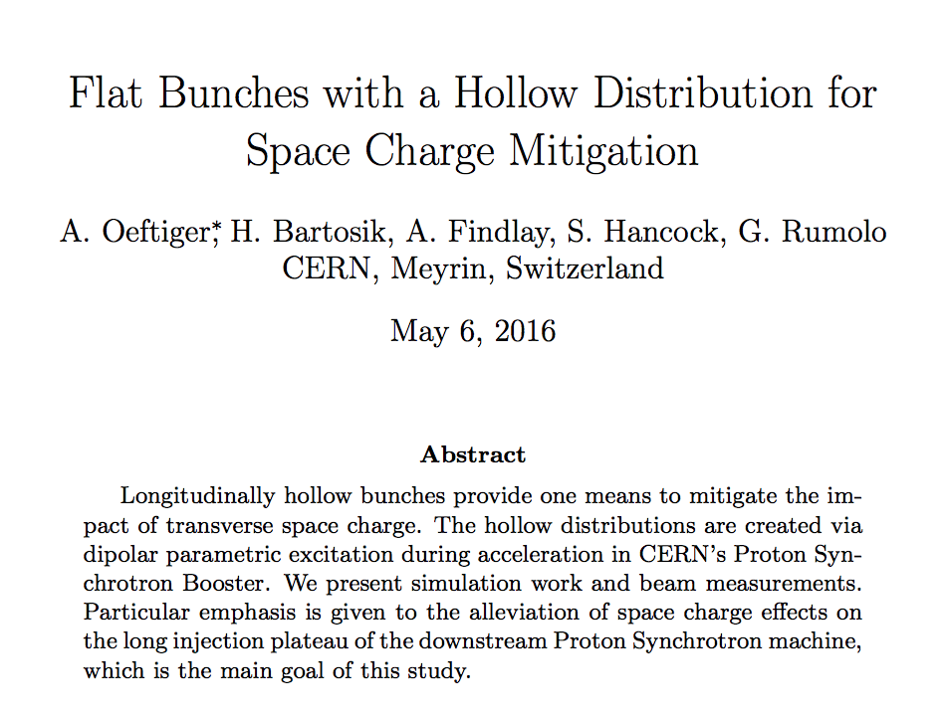
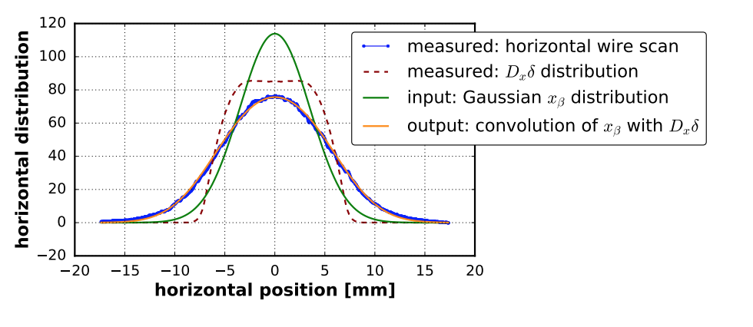
4. Assuming ρ_{β} Gaussian
ρ_{WS} = ρ_{β} ⊗ ρ_{D}
Sanity check on the working hypothesis
For convenience we need to center and normalize the distributions ρ_{WS} and ρ_{D}
so we can solve in the least square sense a problem with a single parameter (σ_{β}).
The stability of the algorithm is much improved since the unknown is a scalar and not a function.
An offline code for this algorithm is available, see for instance /eos/project/l/liu/Instrumentation/tomography/ExtractProfileCPS.ipynb
Recently this algorithm has been implemented in a GUI by J.F. Comblin.

Slide 9
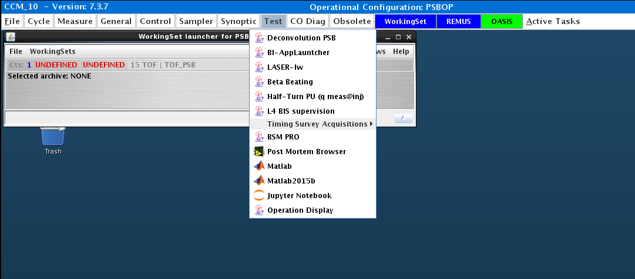
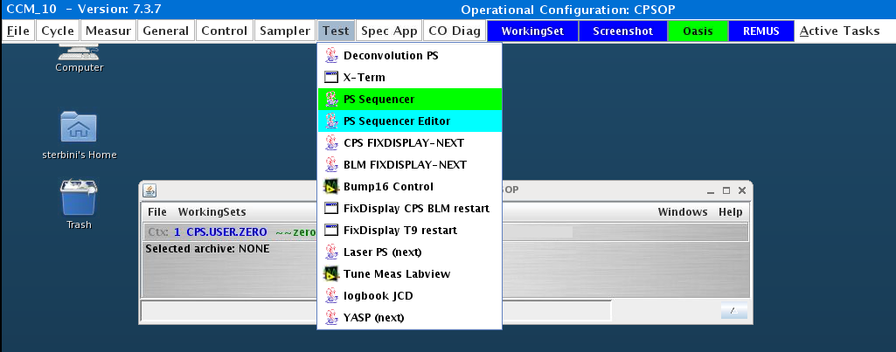
Test application of the WS and deconvolution
BIG THANK TO J.F. Comblin
Applications still under test.
Your help and contribution are needed!
No yet in CALS.

Slide 10
Example in the PSB
In the next examples we will consider the operational cycles 8b4e
PSB>LHC3>8b4e_BCS
PS>MD8> LHC25#32b_BCS_8b4e
PSB at extraction
ρ_{WS} = ρ_{β} ⊗ ρ_{D}
ρ_{β}
ρ_{D}
ρ_{WS}

Slide 11
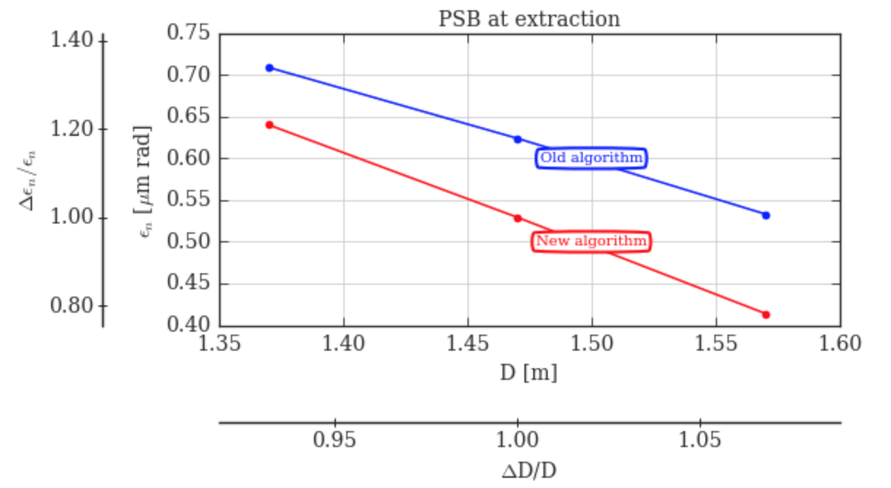
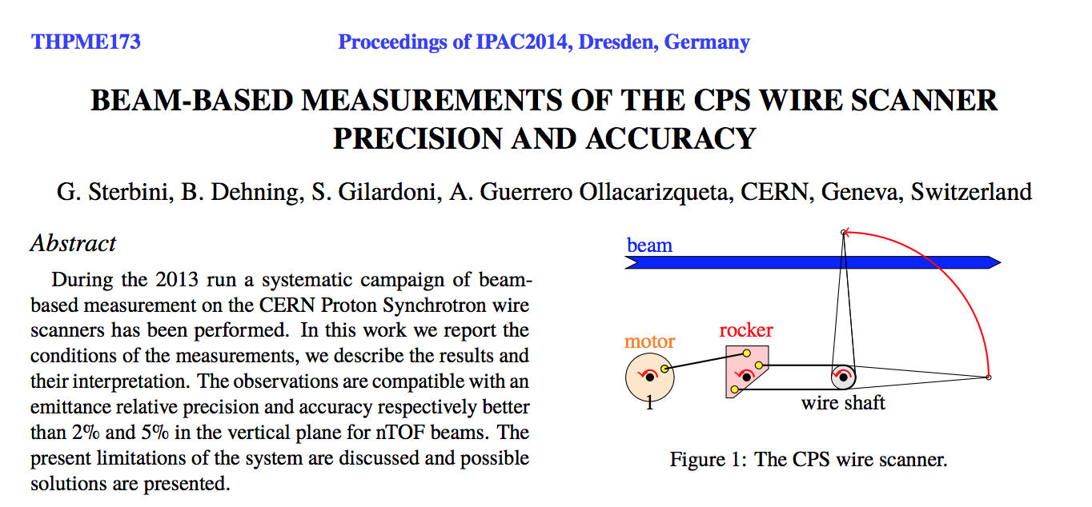
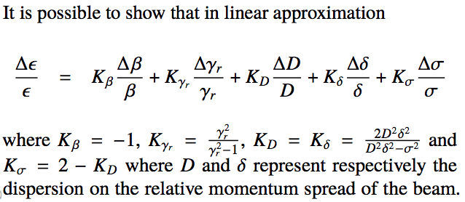
Example in the PSB
Strong dependence on dispersive profile.

Slide 12
Example in the PS
PS at injection
ρ_{β}
PS at extraction
ρ_{D}
ρ_{WS}
ρ_{β}
ρ_{D}
ρ_{WS}

Slide 13
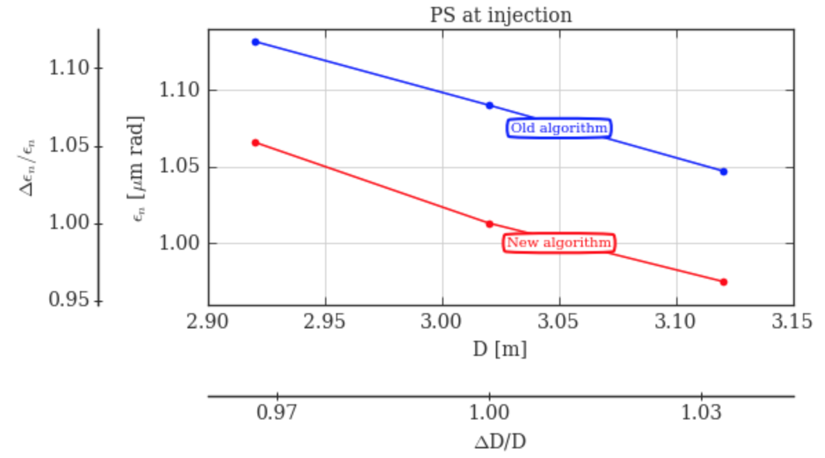
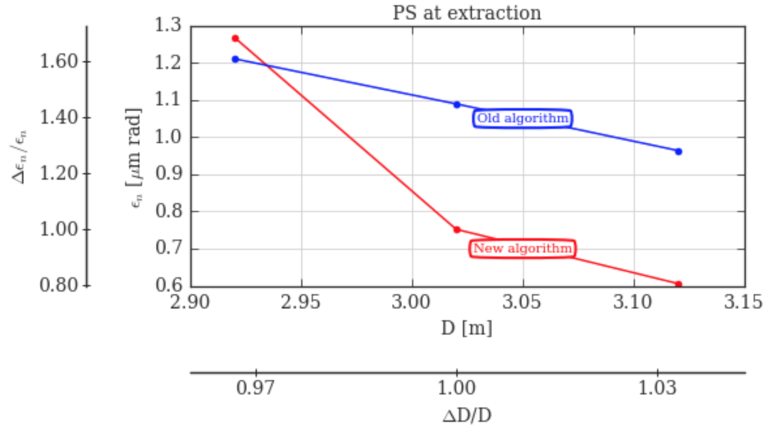
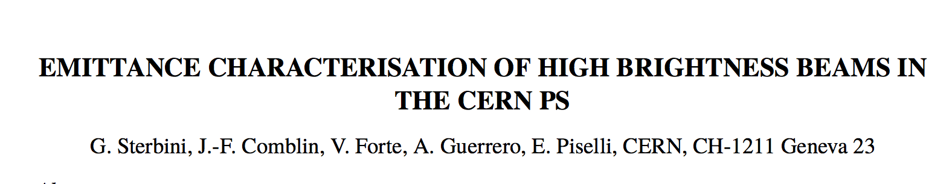
Example in the PS
PS at injection
Strong dependence on dispersive profile.
PS at extraction
PS D_{x} at extraction

Slide 14
Summary
Different approaches to solve the deconvolution problem to get ρ_{β}.
As planned, a GUI interface has been prepared to ease the new (more general) approach.
  CALS logging still missing
  Tab to consider the effect of the dispersion
In the regime of the present beam/optics the dispersive contribution to the WS profile is VERY important (sometime dominant). This will even get worse for LIU beams.
In this regime, an error in the dispersive profile will result in a significant error in the H emittance computation.
Can we improve the accuracy of the measurement of the dispersion at WS?
How can we improve the situation? Can we reduce the DeltaP/P during the WS measurement at PS top energy?

