Slide 1
Report on PSB Wire-Scanners and
SEM Grids Measurements
G.P. Di Giovanni, V. Forte, G. Guidoboni, B. Mikulec, F. Roncarolo, A. Santamaria
LIU-PS Beam Dynamics Meeting
2nd November 2017

Slide 2
Outline
Motivations
Beam Instrumentation Setting
PSB WS and SEM Grids Comparative Analysis
Plans and Conclusions

Slide 3
Motivations
Initial Goal: Investigate the performance of the SEM grids in view of LIU beams.
  Is the SEM grid spacing small enough to resolve the bright LIU beams?
  → Study focused on BCMS-type beam with nominal intensity ~80E10 ppb.
A bi-product of the analysis is the attempt to understand and harmonize the emittance
measurements among the different instrumentation available in the PSB.
  The WS is the baseline instrument to assess the PSB (and PS) performance.
  Vincenzo already presented results on BCMS 1.5 eVs, http://tinyurl.com/y7ge7zbu
  This presentation will show results on the ‘standard’ BCMS as the focus is to
  understand the instrument performance under operational conditions.
As a side note Greta is also exploring, in collaboration with TE-ABT, the possibility to
measure the PSB emittance in the BTM line via quadrupole scan:
  Tests ongoing using BTM.QNO20 + 2nd SEM grid on BCMS beam.
  Not part of this presentation…

Slide 4
Beam Instrumentation Setting: WS
Standard setting for BCMS25 type beams at nominal intensity (~80E10 ppp):
  R1V/R3V speed at 10 m/s. The rest of the WS speed is at 15 m/s.
  Filter ranges between 0.5-2.0% and PM is between 600-1000 per mill for 10 m/s
  and 300-500 per mill for 15 m/s.
  Measurements at extraction flat-top (C796) with the “IN” direction.
  Typical dp/p ~ 0.9E-3.
Nominal horizontal/vertical dispersion = -1.4658/0 m.
Used the measured dispersions in 2016: measured values compatible with the 2017
measurements (Greta, Andrea and Vincenzo), see Table later.
β-function is coming from MADX.
All measurements done before the
breakage of R2H and its following
replacement in ITS3.

Slide 5
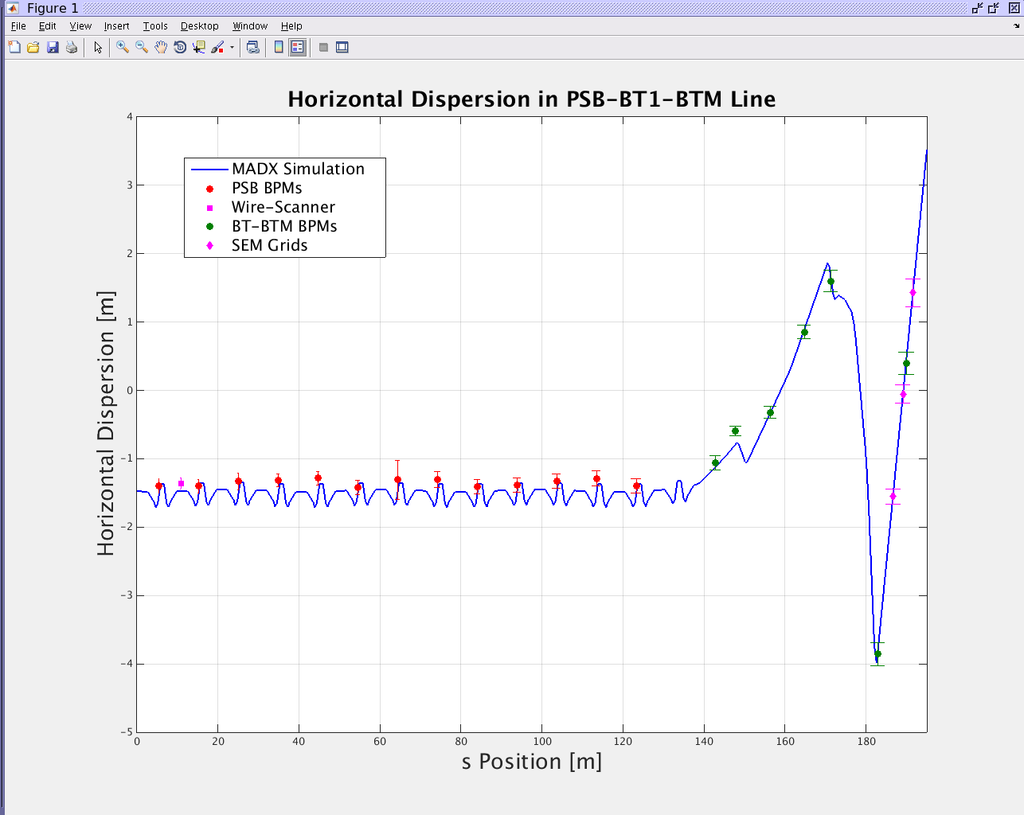
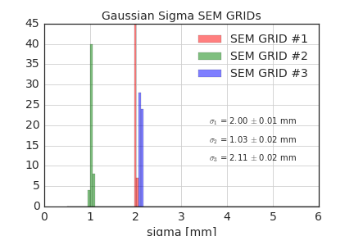
Beam Instrumentation Setting: SEM GRIDS
PSB is equipped with 3 SEM grids in the BTM line to measure emittance and Twiss parameters.
Since 2016 we have different setting per ring: Generally the optics model of the PSB extraction line
describes well the data. → Multiple tests already done by Vincenzo.
Used the measured dispersion in 2016. Once again compatible with the measurements in 2017.
Since there is no active element between the grids, we replaced the optic model with a drift.
The transport matrix only depends on the distance between grids measured at the mm-level!
GEODE longitudinal mis-alignment included in the data treatment (no impact on the final results).
Example of data/simulation comparison
Typical beam size at the SEM grids

Slide 6
Dispersion Measurements Summary
The measured horizontal dispersion in the WS is ~10% lower than the MADX model.
Non-negligible contribution in both horizontal and vertical planes for the SEM grids.
→ When testing the deconvolution algorithm, apply it to both WS and SEM grids.
Ring/Plane | WS [m] | SEM GRID1 [m] | SEM GRID2 [m] | SEM GRID3 [m]
R1H | -1.3619 | -1.5515 | -0.052911 | +1.4290
R1V | -0.0919 | 0.32782 | -0.0262 | -0.39807
R2H | -1.3884 | -1.2368 | +0.038622 | +1.2936
R2V | -0.0114 | 0.25384 | 0.062838 | -0.12573
R3H | -1.3634 | -1.1798 | +0.039221 | +1.2243
R3V | -0.0299 | 0.029354 | 0.027425 | 0.04821
R4H | -1.3827 | -1.5313 | -0.14812 | +1.1998
R4V | -0.1101 | 0.034784 | 0.14163 | 0.30977

Slide 7
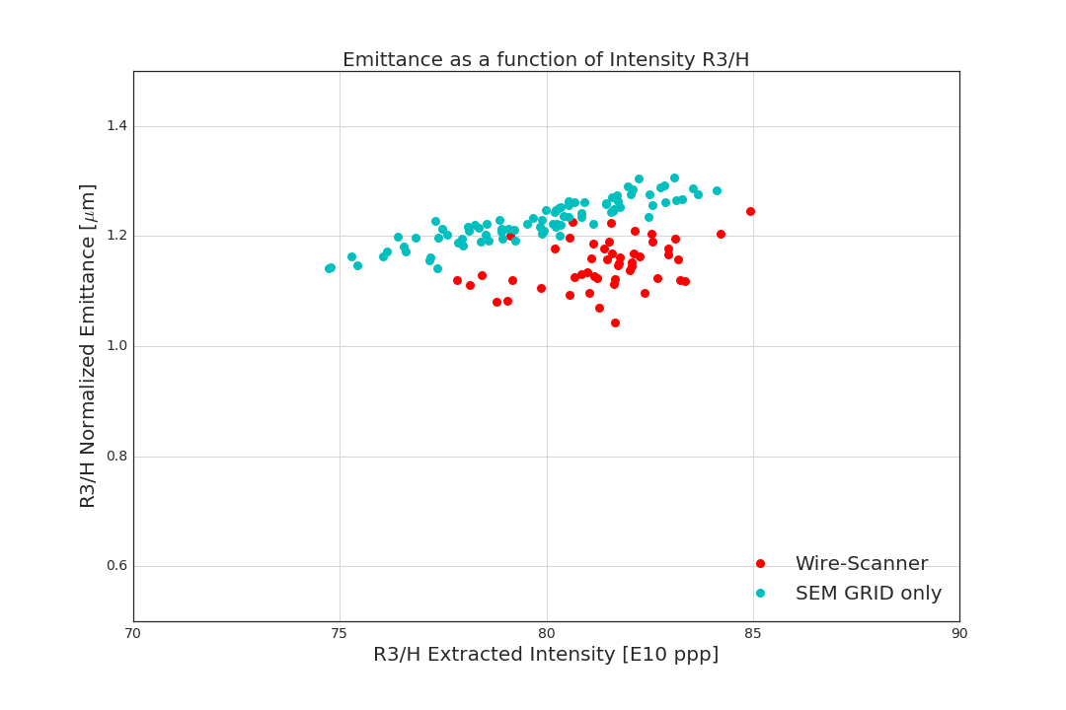
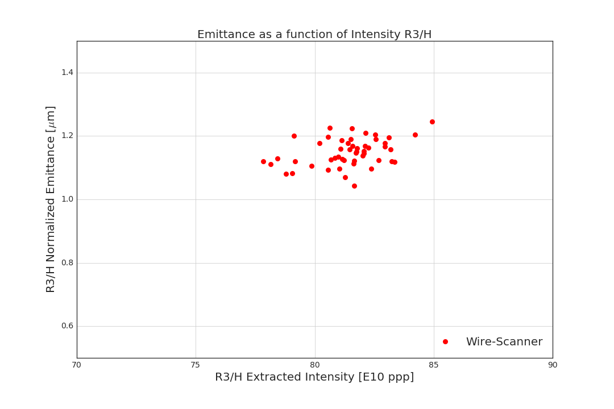
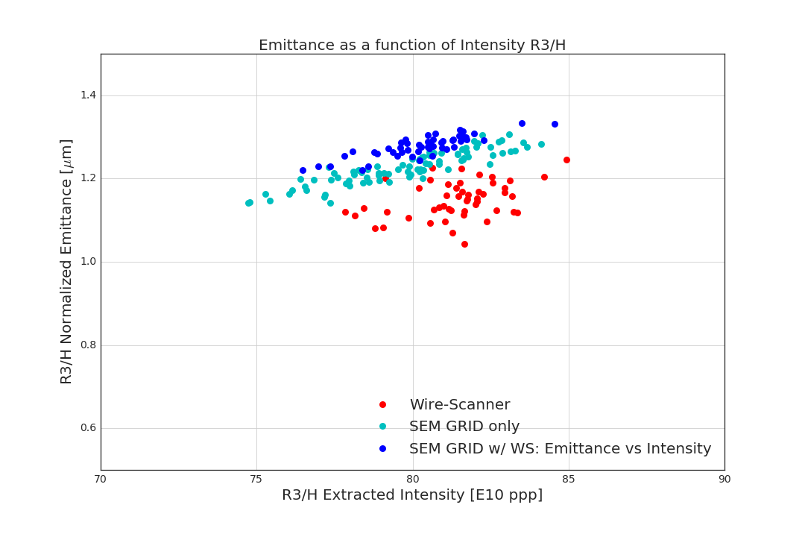
Measurements Examples
Consecutive measurements under the same conditions (at least 20 shots per sample):
  Emittance vs Intensity for the WS.
Consecutive measurements under the same conditions (at least 20 shots per sample):
  Emittance vs Intensity for the WS
  Emittance vs Intensity for the SEM only, NO WS done at the same time
Consecutive measurements under the same conditions (at least 20 shots per sample):
  Emittance vs Intensity for the WS
  Emittance vs Intensity for the SEM only, NO WS done at the same time
  While flying the WS we also recorded the SEM grid measured emittance
    Visible few % blow-up because of scattering induced by the scanner
    Andrea is currently performing a detailed analysis of this effect at different energies
Consecutive measurements under the same conditions (at least 20 shots per sample):
  Emittance vs Intensity for the WS
  Emittance vs Intensity for the SEM only, NO WS done at the same time
  While flying the WS we also recorded the SEM grid measured emittance
    Visible few % blow-up because of scattering induced by the scanner
    Andrea is currently performing a detailed analysis of this effect at different energies
→ To better correlate WS and SEM, we neglect for a moment the induced blow-up by the WS
and compare the WS and SEM measurements for the very same shot → Both equipment experience
the same shot-to-shot variations.
In the next slides we will focus on ring3 to show the analysis done
and then summarise the status for all rings/plane

Slide 8
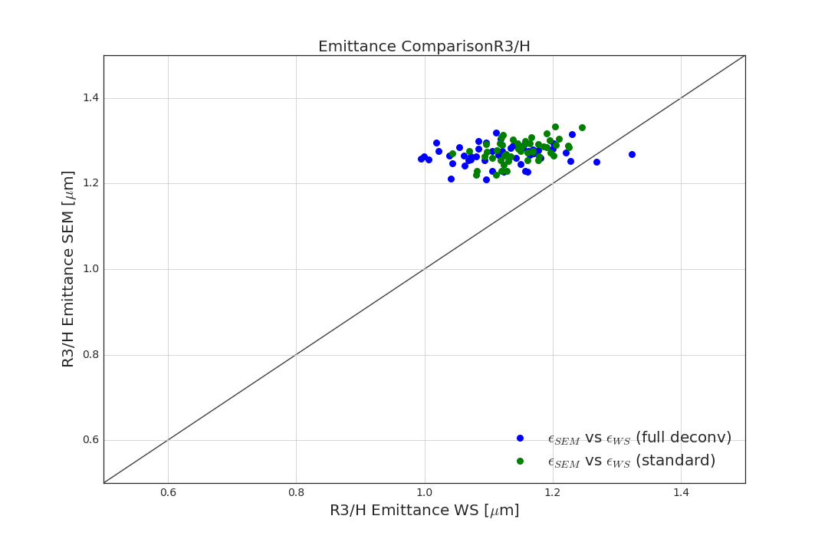
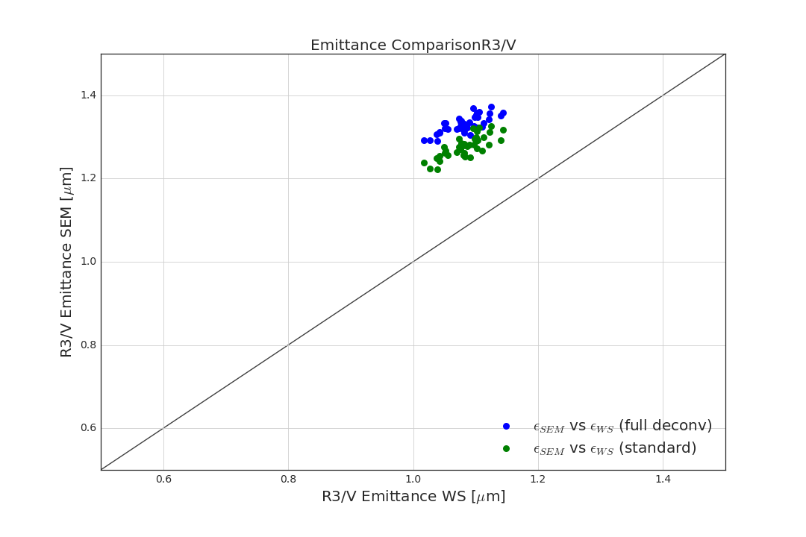
R3: Emittance Correlation
Comparing the transverse emittance in the WS and SEM grid for the same shots.
Ideally the measurements should lie on the bisecting line, again neglecting for a now
the scattering due to the WS.
The blue dots are the measured emittances after deconvolution, both WS and SEM grids.
In green both emittance measurements use the standard dispersion removal formula.
Tomogram common to both WS and SEM grid and taken at PSB extraction.
R3H measurements not well correlated
R3V measurements well correlated
Speed: 15 m/s
Speed: 10 m/s
Speed: 10 m/s

Slide 9
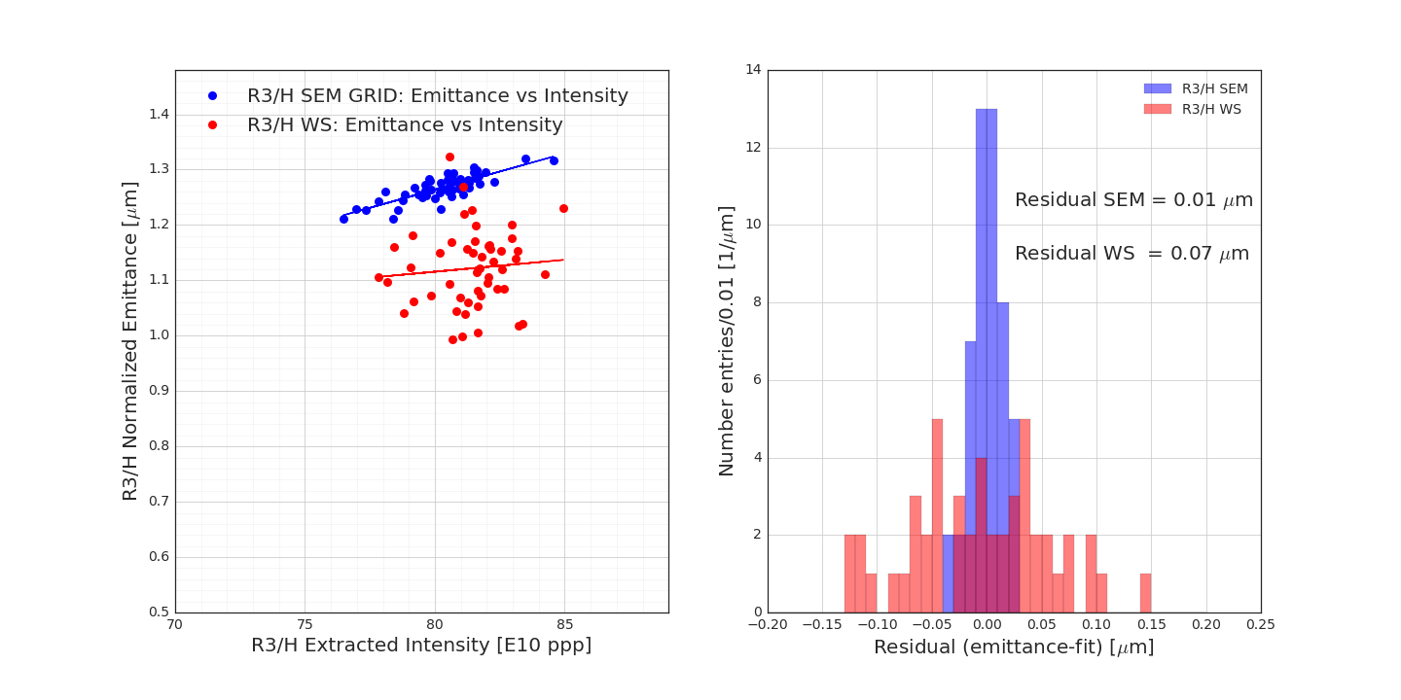
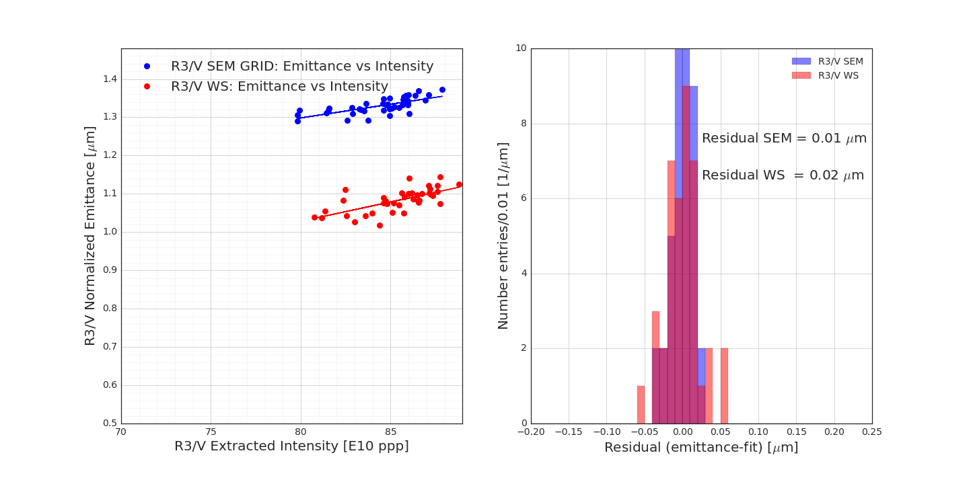
R3: Residuals
Emittance as a function of intensity: Add the linear fit to compute the residual.
Assuming that the linear fit is the mean value, the residual is calculated as “measured value – fit” and should provide information about the resolution of the instrument.
In plots we showed the emittances fully deconvoluted.
→ R3H: Less spread in the SEM residuals than WS
→ R3V: Compatible results in both instruments
Speed: 15 m/s
Speed: 10 m/s

Slide 10
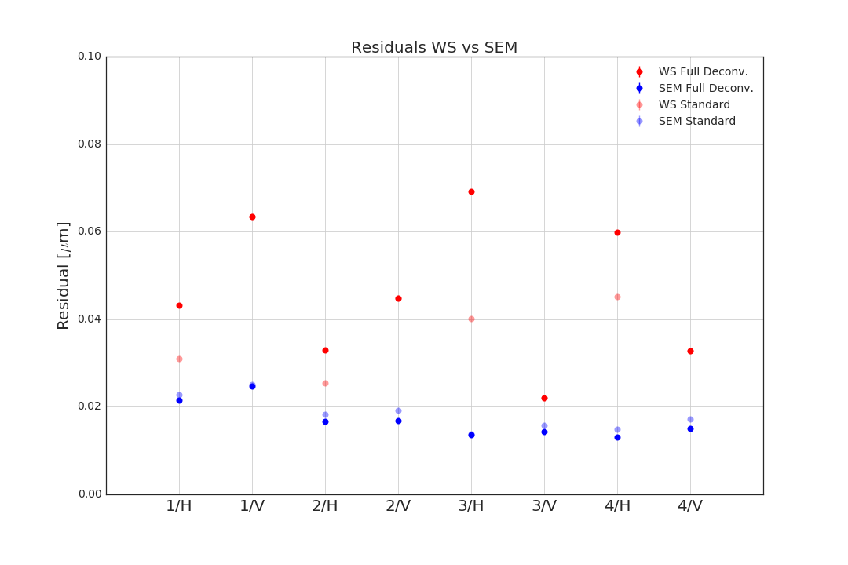
Residuals
Residual in WS is generally larger than the one in the SEM grids.
The spread in the WS measurements is amplified when applying the deconvolution algorithm.
No major effect of the deconvolution on the spread of the SEM grids measurements.
Why the larger spread?
Speed: 10 m/s
Speed: 10 m/s

Slide 11
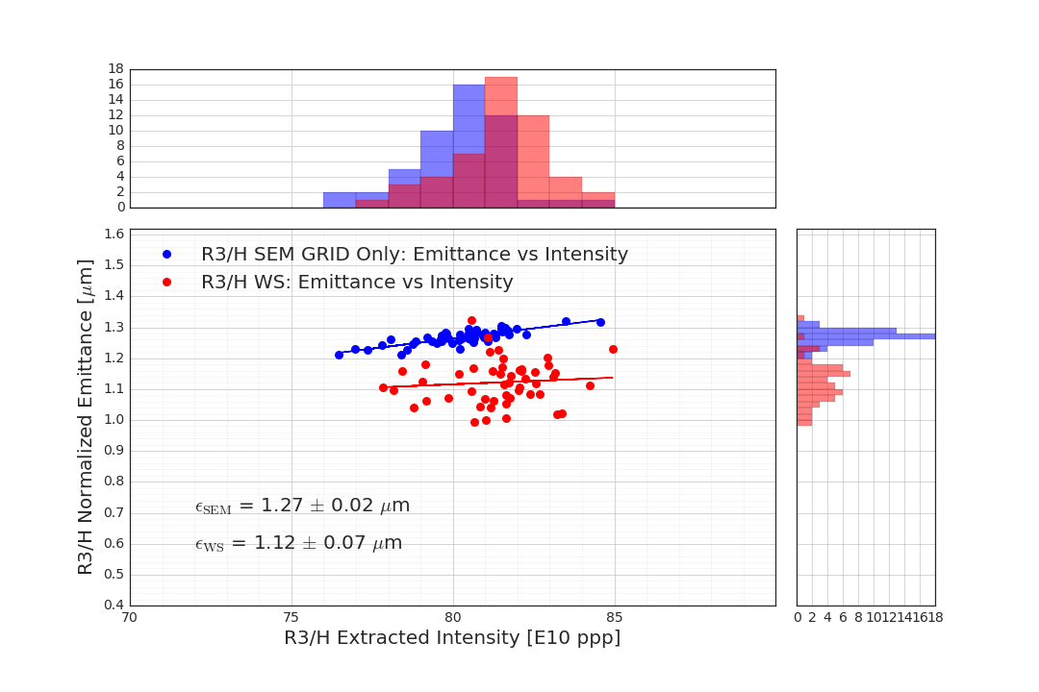
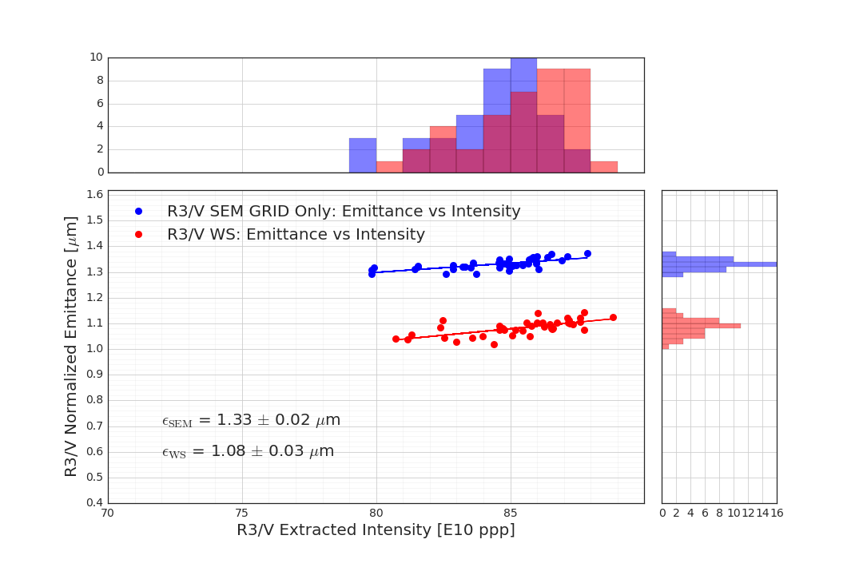
R3: Emittance
Now just looking at the emittances, i.e. projection along the y-axis.
Compare mean and standard deviation.
Speed: 10 m/s
Speed: 15 m/s

Slide 12
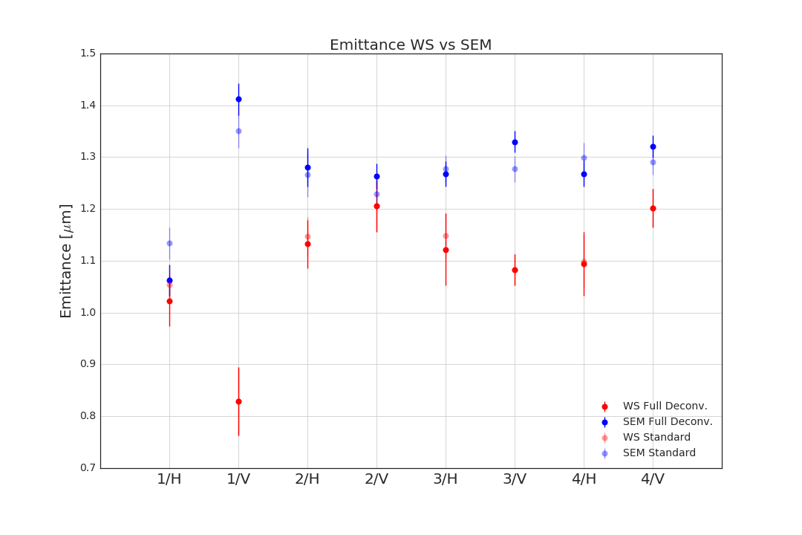
R3: Absolute Emittance
Emittance measured at the SEM grid is systematically larger than the correspondent
measurement at the WS.
Situation particularly worse for R1V.
Speed: 10 m/s
Speed: 10 m/s

Slide 13
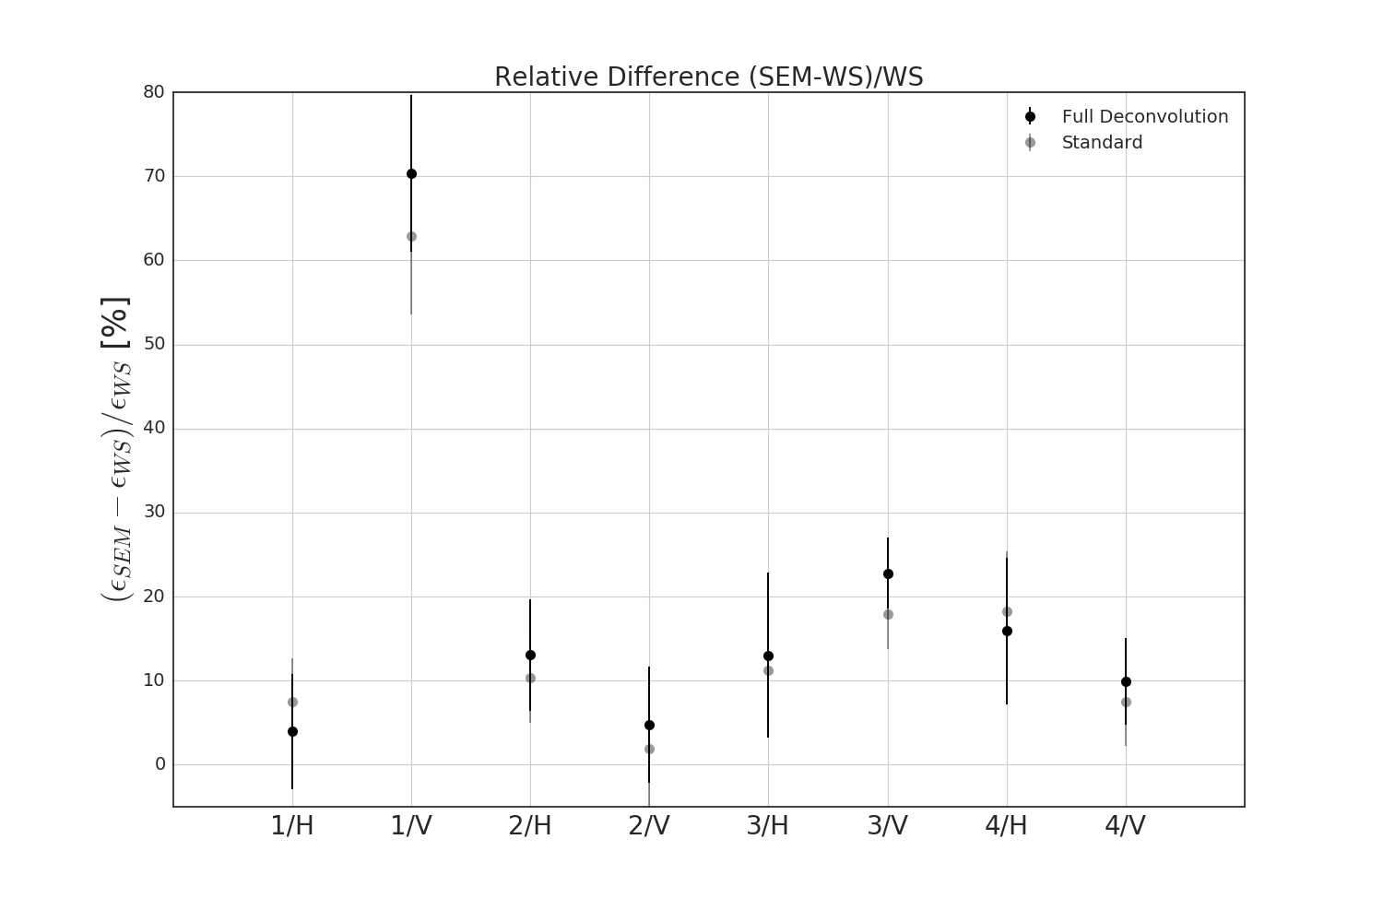
R3: Relative Emittance
Emittance measured at the SEM grid is systematically larger by ~10% than the
correspondent measurement at the WS
Speed: 10 m/s
Speed: 10 m/s

Slide 14
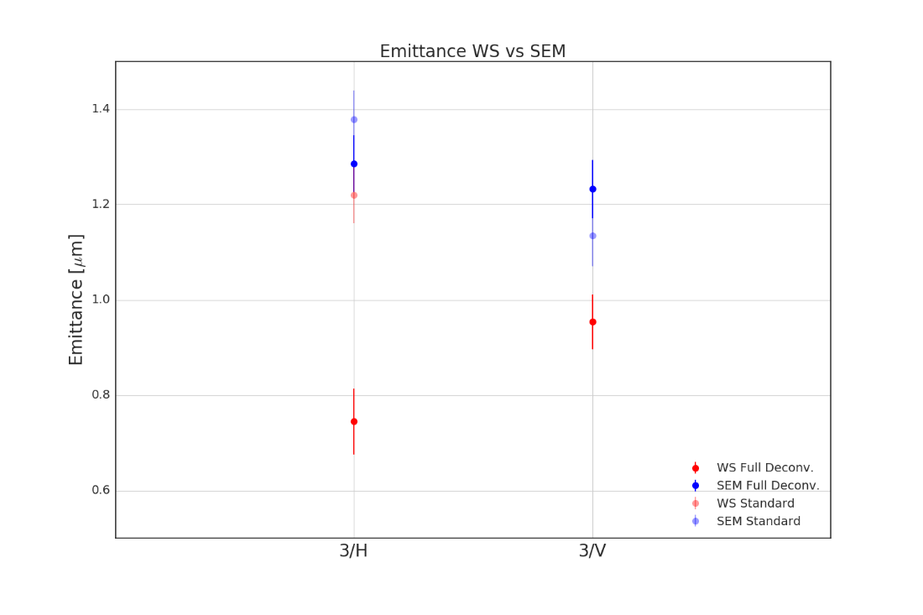
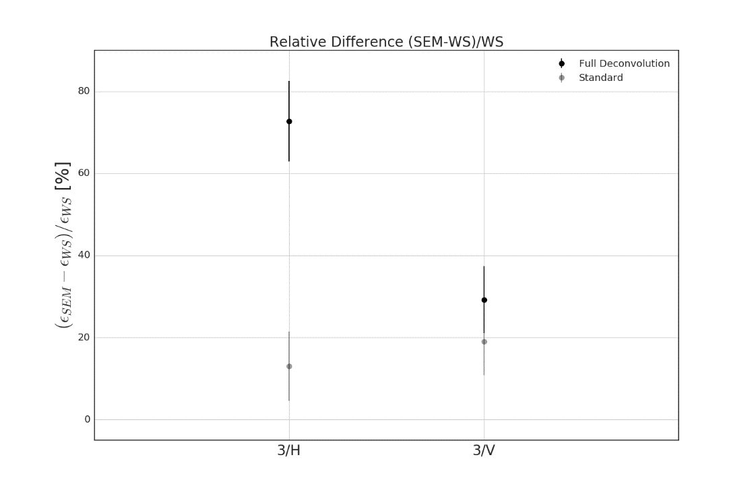
R3: BCMS 1.5 eVs, A Reminder From Last Week
Emittance measured at the SEM grid is systematically larger by ~20% than the
correspondent measurement at the WS with the standard algorithm
Difference increases up to ~70% in the horizontal plane when applying the full deconvolution algorithm…

Slide 15
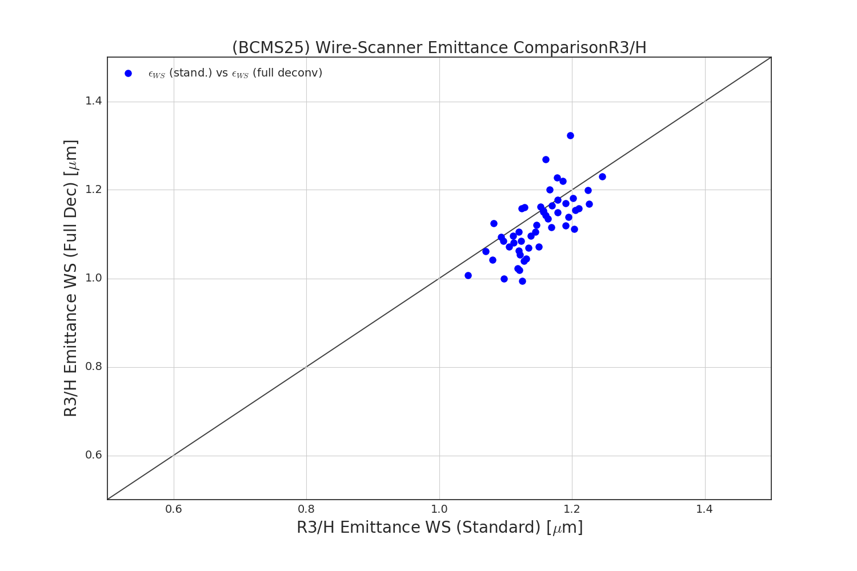
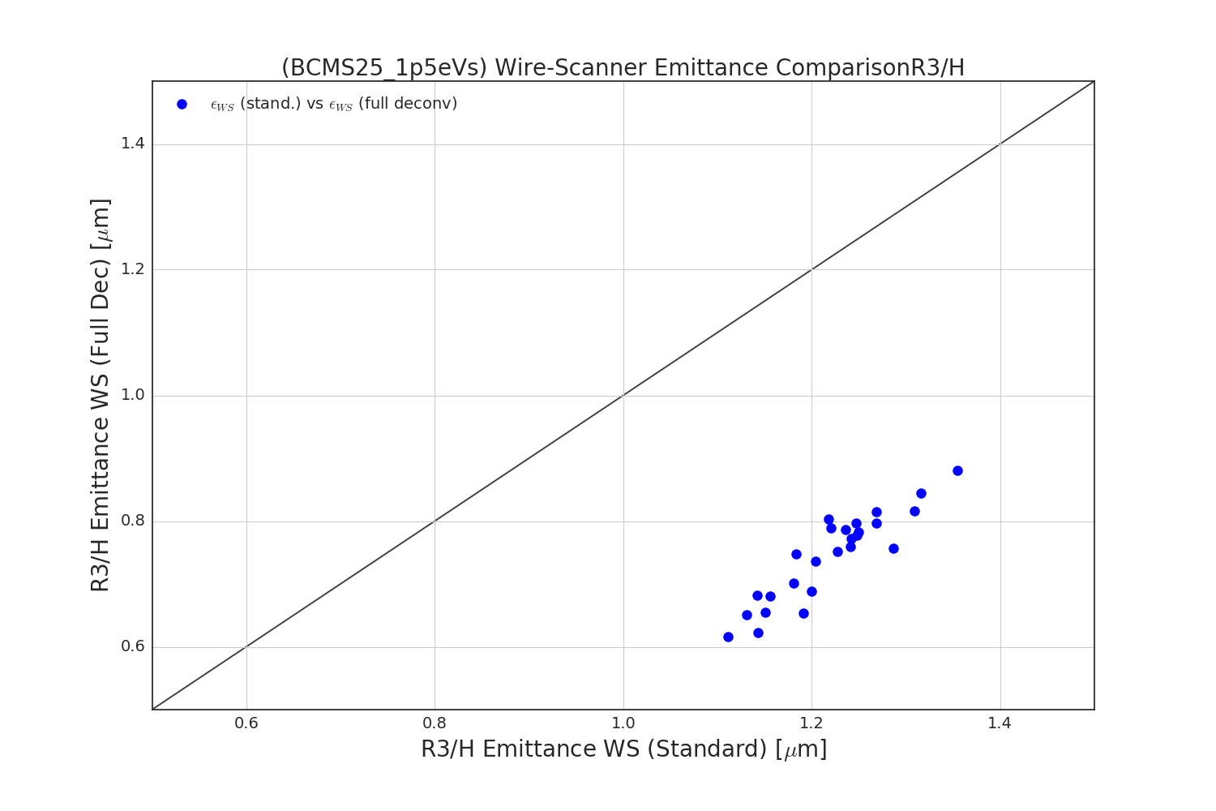
Deconvolution
Comparing the emittances measured at the WS with the full deconvolution versus the
conventional algorithm for BCMS25 and BCMS25 1.5 eVs.

Slide 16
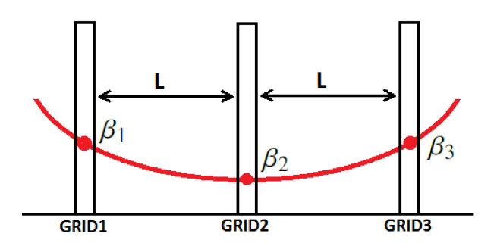
R3: Sigma
Just looking at the measured emittance is not the whole story...
The smaller beam size is, by optics design, at the 2nd SEM grid.
  This is confirmed by the measured sigma.
Typical beam size at the SEM grids
Does the sigma scale with intensity in WS and SEM grid?
The concern is to check if we have reached the lower resolution
of the equipment and end up in a situation like the sketched one
σ
Intensity

Slide 17
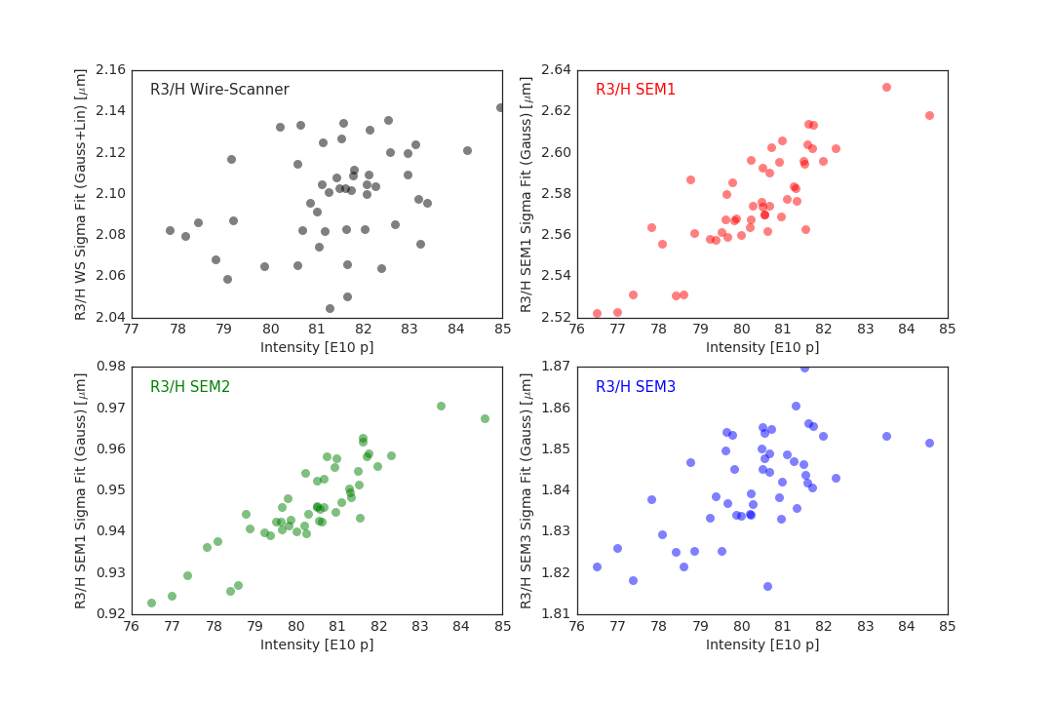
R3: Sigma
Sigma scales with the intensity for a BCMS-type beam, within the typical intensity range.
The sigma spread reflects the observation done for the emittance measurements, i.e. a
larger spread in the WS measurements.

Slide 18
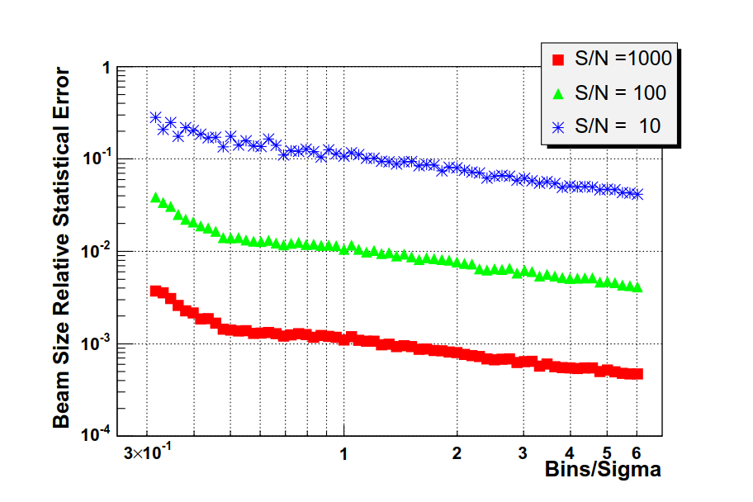
R3: Sigma
Federico already performed a similar study in his thesis, mainly focusing on the
resolution of the sigma measured at the SEM grid, an example below.
Under ‘standard’ conditions (signal/noise ~ 100) with even less than a bin per sigma the
statistical error on the sigma is of the order of 1%.
For a BCMS-type beam we generally have 1 or 2 bins per sigma.
Relative error as a function of resolution and random noise
(courtesy of F. Roncarolo, page 53 of https://cds.cern.ch/record/1481835)

Slide 19
Summary
Presented a comparative study of the emittance measurements in the WS and SEM grids in
the PSB, before the breakage of R2H and its following exchange during ITS3.
SEM grids systematically measure higher emittance with respect to the WS for BCMS25:
  About 10% higher emittance measured with the SEM grids.
  Up to 70% in R1V!
  The only parameter not yet known is the beta function at the WS (or at least close by).
WS generally has a larger spread in the measurements, which is somehow amplified when
applying the full deconvolution algorithm.
There is no indication today that the SEM grids are at the limit of resolution for BCMS-type
beams, which gives us some degree of confidence for LIU.
Need to follow up with additional study to explore the hypothetical SEM grids limits.
Since we could replace a WS during the YETS2017/2018, my proposal would be to replace
R1V WS.

Slide 20
SUPPORTING SLIDES

Slide 21
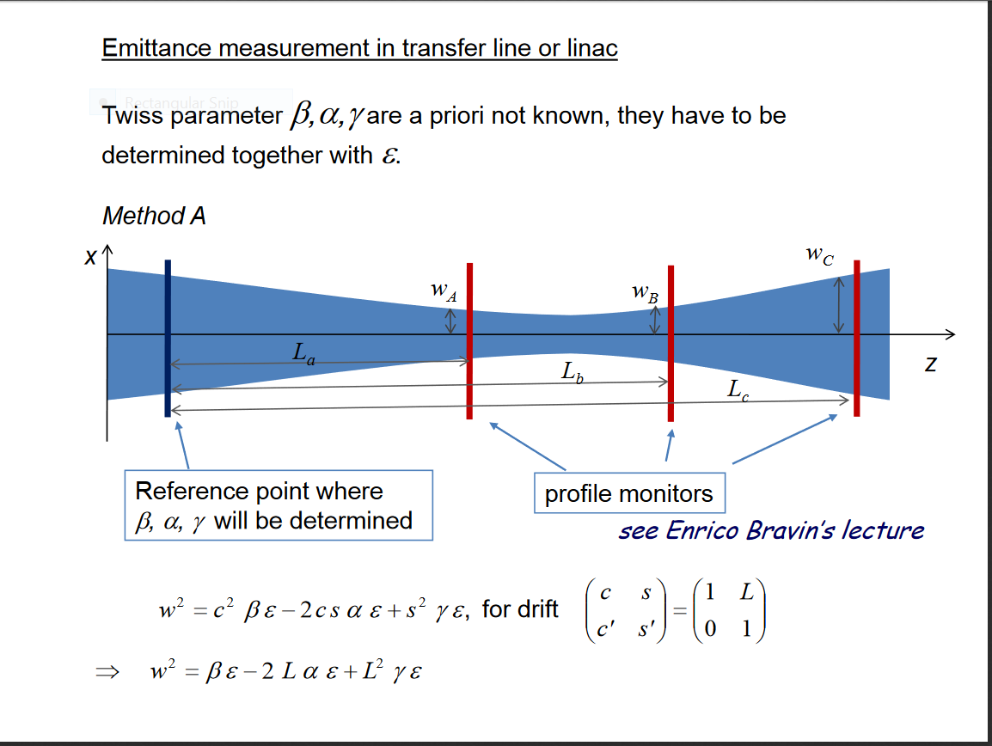
https://cas.web.cern.ch/cas/France-2008/Lectures/Braun-Emittance.pdf

Slide 22
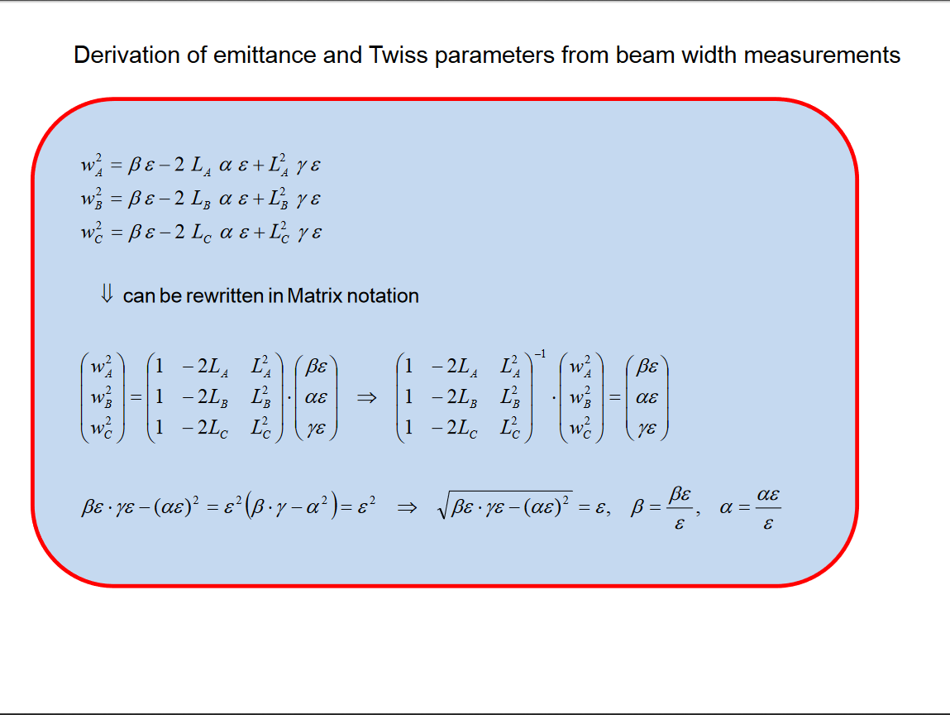
https://cas.web.cern.ch/cas/France-2008/Lectures/Braun-Emittance.pdf
https://cas.web.cern.ch/cas/France-2008/Lectures/Braun-Emittance.pdf

Slide 23
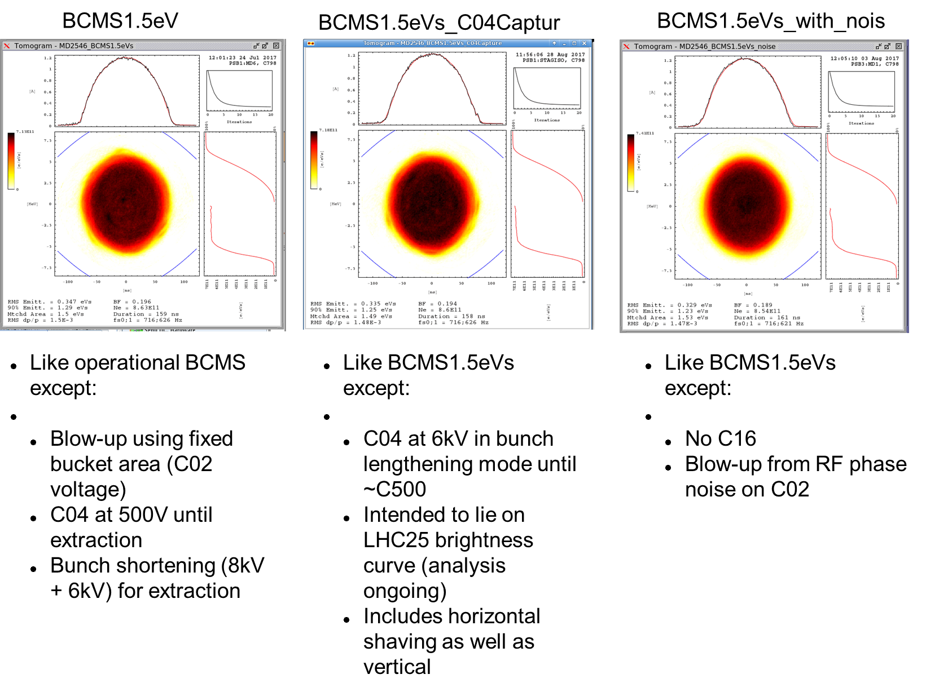
The production of BCMS 1.5 eVs from the PSB

Slide 24
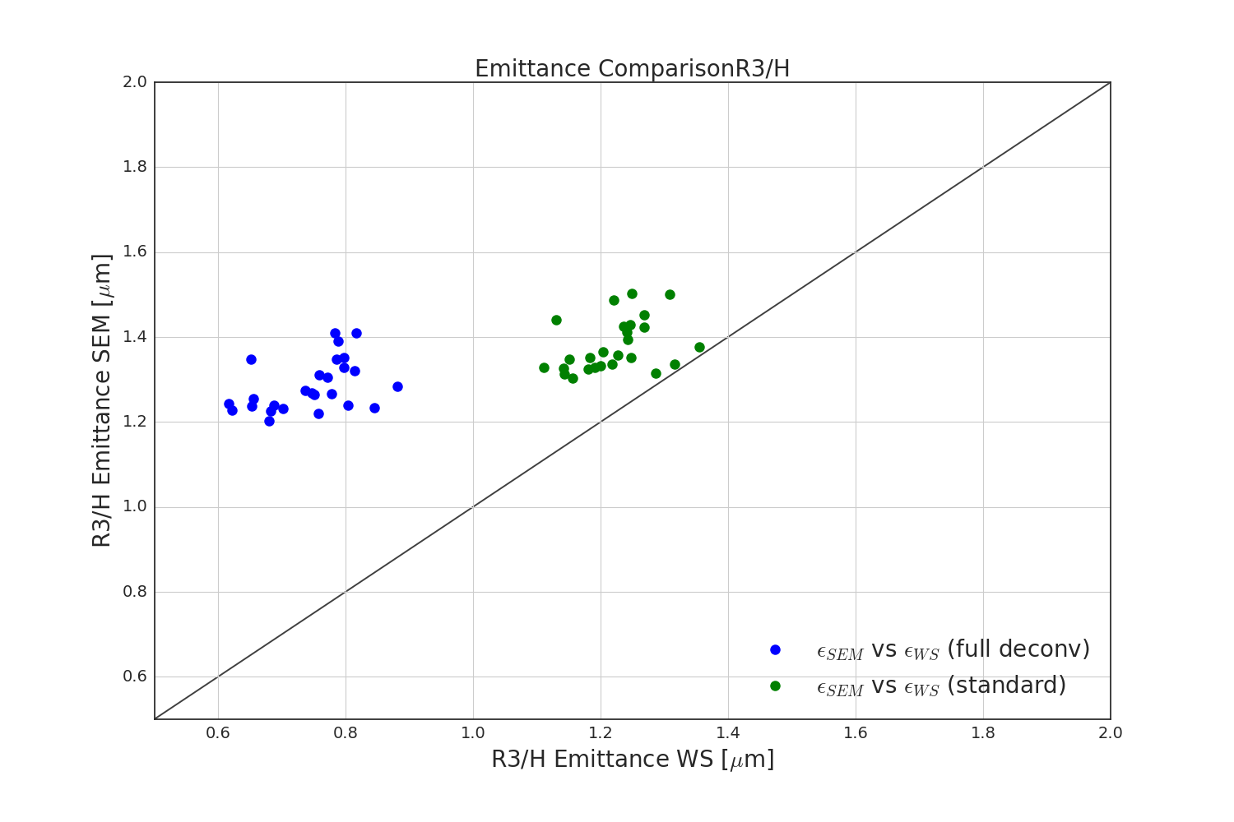
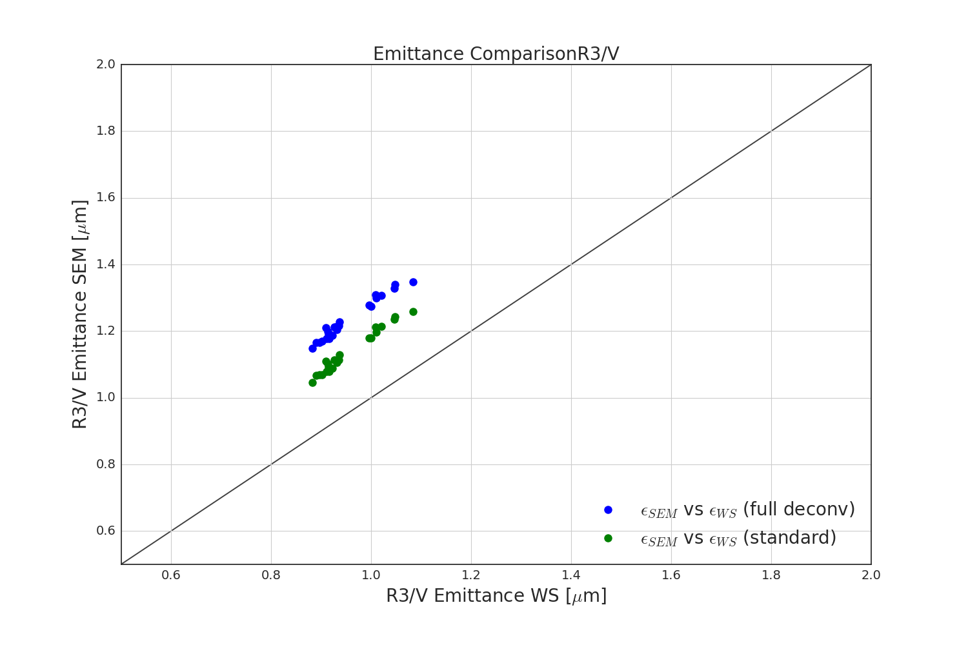
PSB R3 emittance correlation
Comparing the transverse emittance in the WS and SEM grid for the same shots.
Ideally the measurements should lie on the bisecting line, again neglecting for now
the scattering due to the WS.
The blue dots are the measured emittances after deconvolution, both WS and SEM grids.
In green both emittance measurements use the standard dispersion removal formula.
Tomogram common to both WS and SEM grid and taken at PSB extraction.
Speed: 15 m/s
Speed: 10 m/s
24

Slide 25
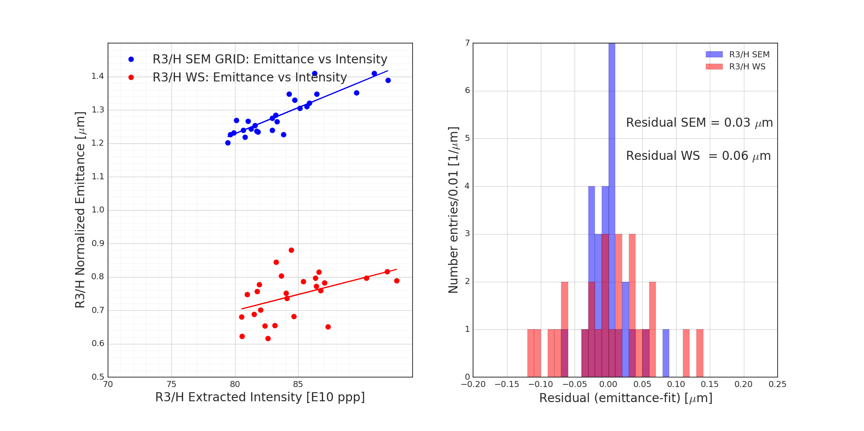
PSB R3 emittance residuals
Emittance as a function of intensity: Add the linear fit to compute the residual.
Assuming that the linear fit is the mean value, the residual is calculated as “measured value – fit” and should provide information about the resolution of the instrument.
In plots we showed the emittances fully de-convoluted.
→ R3H: Less spread in the SEM residuals than WS
Speed: 15 m/s
25
25

Slide 26
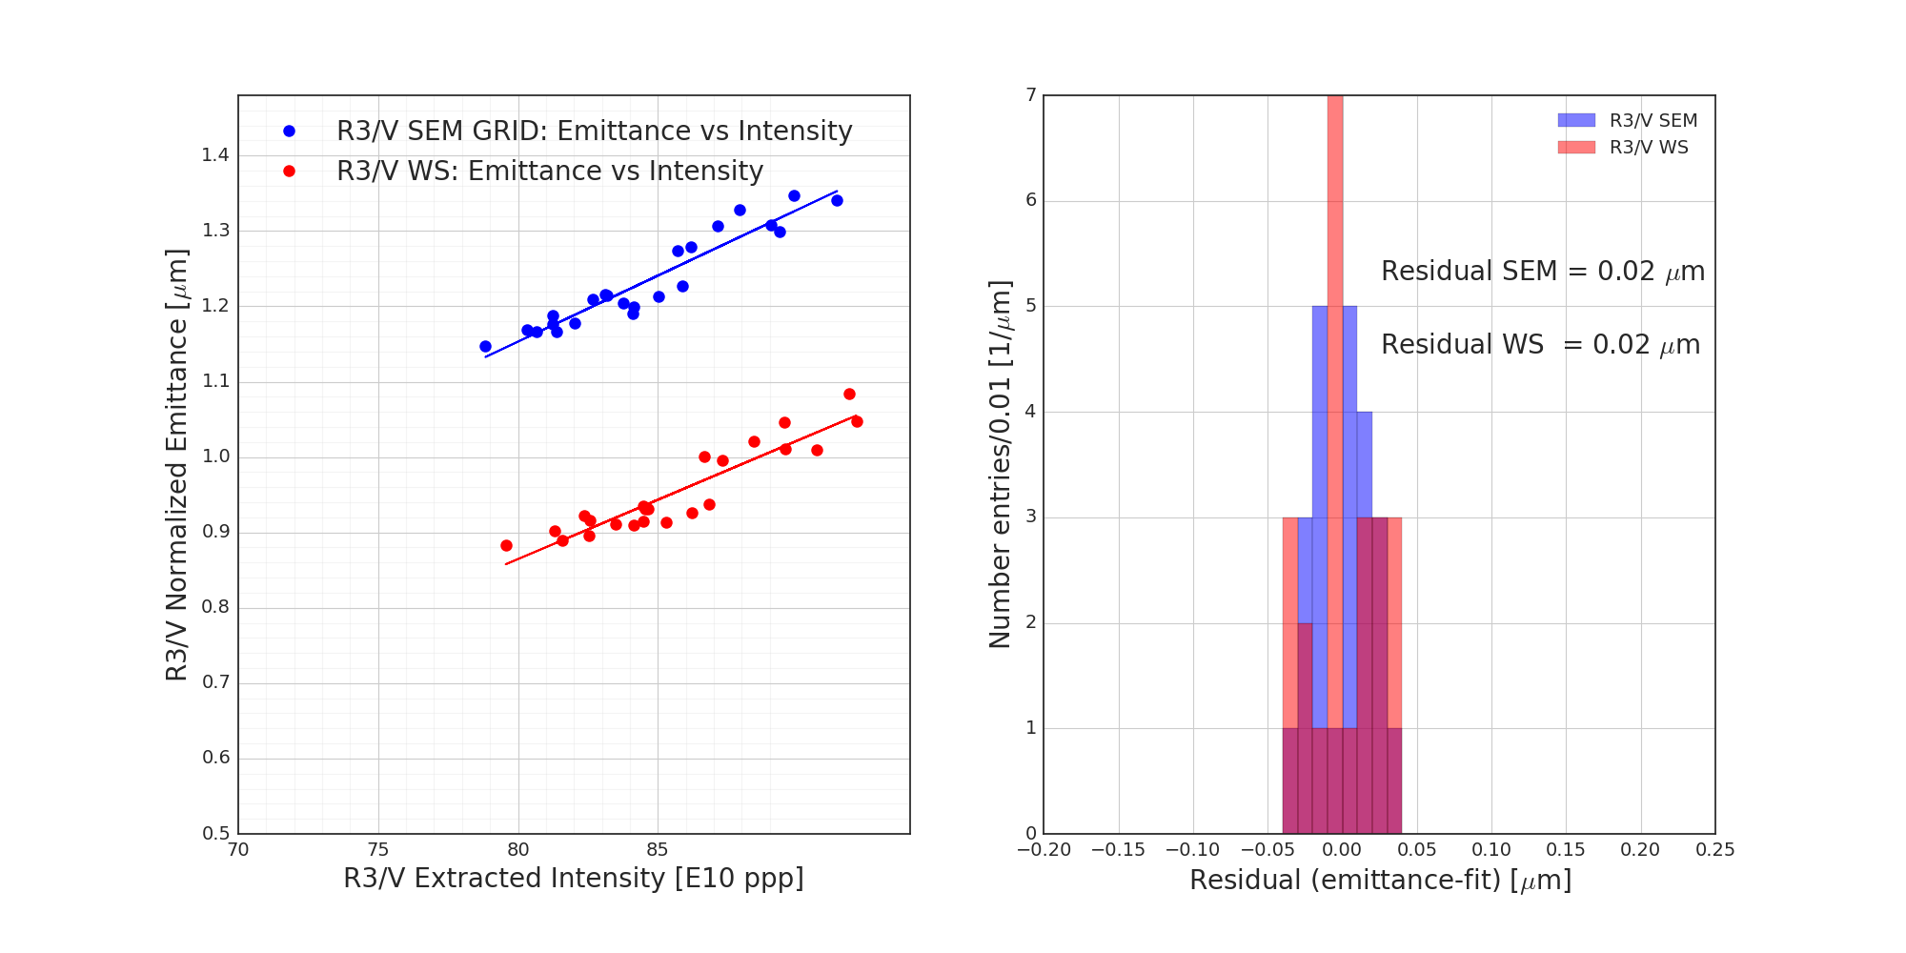
PSB R3 emittance residuals
Emittance as a function of intensity: Add the linear fit to compute the residual.
Assuming that the linear fit is the mean value, the residual is calculated as “measured value – fit” and should provide information about the resolution of the instrument.
In plots we showed the emittances fully de-convoluted.
→ R3V: Compatible Residuals
→ R3H: Less spread in the SEM residuals than WS
Speed: 10 m/s
Speed: 15 m/s
26
26

Slide 27
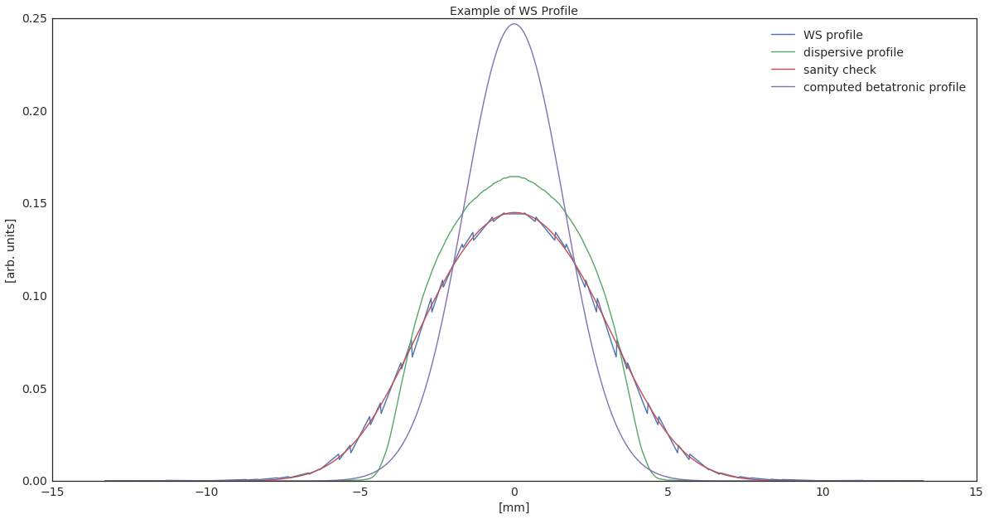
PSB Back-Up Slide
Example of deconvolution at the WS (PSB)

Slide 28
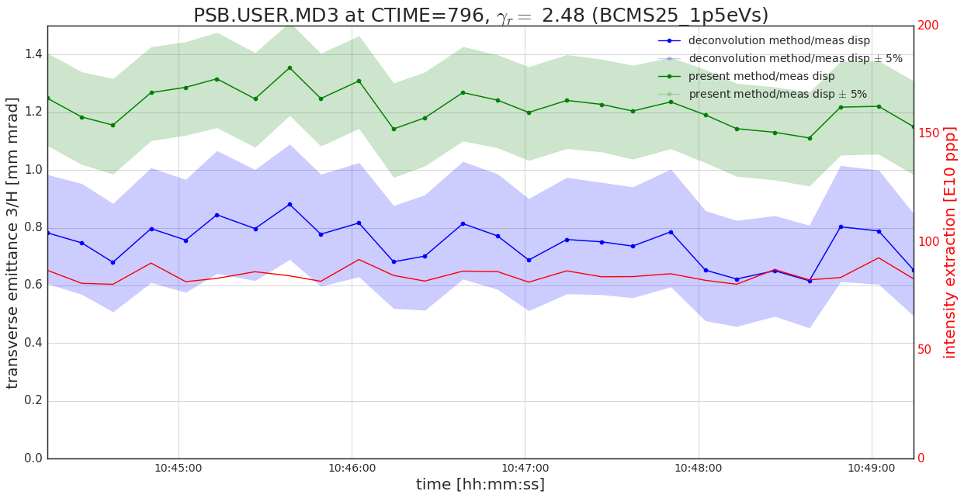
PSB Back-Up Slide
If varying the dispersion by +/- 5%

Slide 29
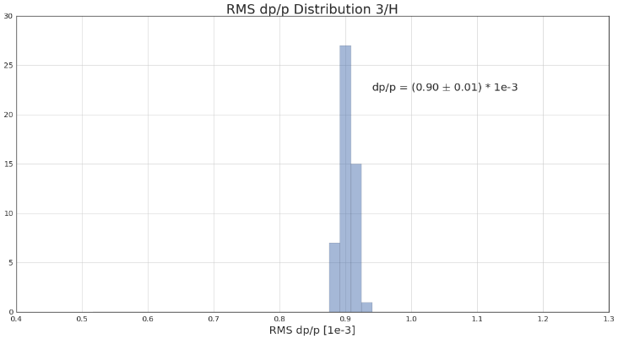
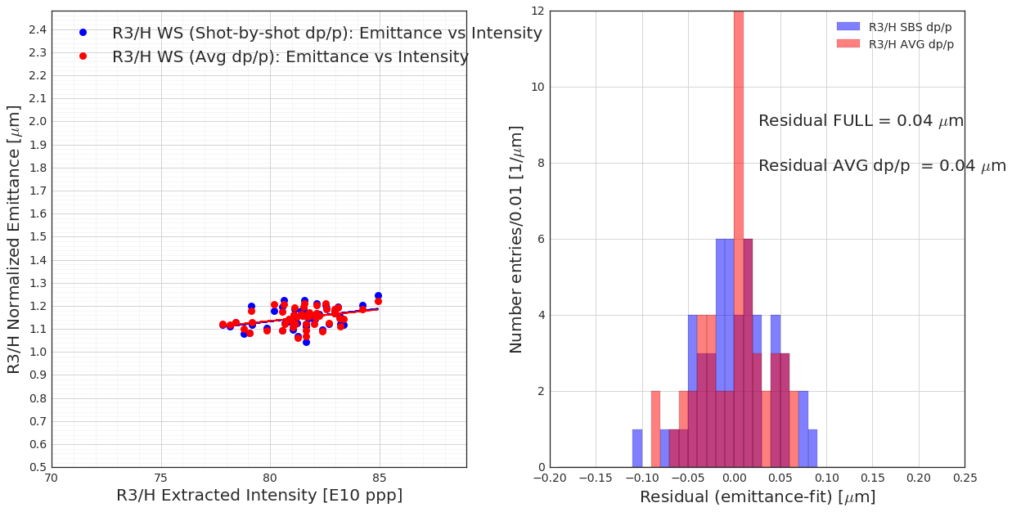
PSB: Test with dp/p
Instead of using a dp/p which changes shot-by-shot, just taking the average and apply the
standard algorithm and compare to the case when dp/p varies from shot-to-shot
The goal of the test is to check the effect of the dp/p variations in the spread of the residual → minor effect of the dp/p distribution on the residual estimation.

