Slide 1
Injection steering studies in the PS
E.Senes, V.Forte, A.Huschauer, F.Tecker
Acknowledgement: F. Asvesta, G.P. di Giovanni, A. Oeftiger
LIU PS Beam Dynamics working group
02.11.2017

Slide 2
Outline
Goal and methods
Emittance measurements
First simulations
Space charge contribution (?)

Slide 3
Goal and method
Goal: understand whether the steering is a source of emittance growth at the injection in the PS
Idea: from the optimal steering situation, randomly change the injection kicker strength of KFA45 and observe the emittance growth.
Kick strength: 90% to 106% of the nominal kick (due to power converter limitations)
Beam types (only first bunch injected)
Beam | Intensity (10¹⁰ ppb) | εx / εy (mm mrad) | Brightness index
BCMS | 78 | 1.4/1.2 | 60
INDIV | 13 | 1.75/0.75 | 10.4
INDIV_HI_HE | 26 | 2.6/1.8 | 11.2
Notes:
BCMS in different working points and with different coupling condition

Slide 4
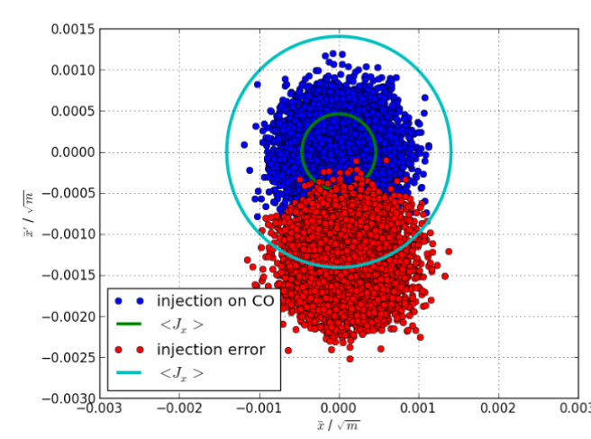
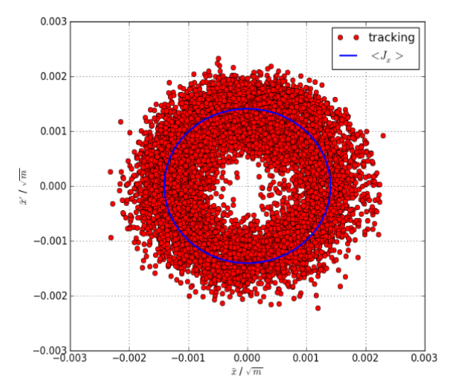
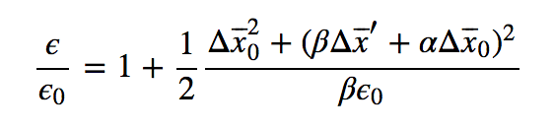
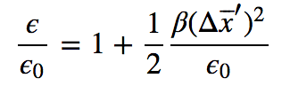
Analytitcal expectation for missteering
Injecting a beam offcenter in the phase space leads to emittance growth after the filamentation occurs
V. Kain, CAS Erice
The emittance blowup can be estimated using the following
At the kicker location

Slide 5
Analytitcal expectation for missteering
Injecting a beam offcenter in the phase space leads to emittance growth after the filamentation occurs
!
The analytic formula assumes that the two planes are completely decoupled
The emittance blowup can be estimated using the following
At the kicker location
Notes:
So working out the red formula one expects eps = eps0 + beta/2 * kick^2

Slide 6
One word about the emittance calculation
Δp/p of the beams used is small, e.g. < 0.85e-4 (BCMS)
Dispersive component deconvolution do not impact significantly on the emittance measurement
Usual measurements setup:
  H: BWS65, V: BWS85
  C185, 15m/s
  Measured twiss parameters are used (see appendix)
  The dispersive component has not been subtracted

Slide 7
BCMS beam
Nominal settings: linear coupling is exploited (clone of the operational beam)
Expected a parameter is β/2:
KFA45: β/2 = 11.26 (MADx model)
Notes:
So good news
We are optimised in the nominal injection
Bad news:
- The model is more complicated

Slide 8
BCMS beam
Correcting coupling: skew quads are used to compensate the linear coupling

Slide 9
INDIV beam
Clone of the operational INDIV beam

Slide 10
INDIV_HI_HE beam
Modified INDIV beam in the PSB with higher emittance and intensity than INDIV

Slide 11
First simulations results
pyHeadTail have been used to simulate the injection oscillations. For the moment no coupling is implemented
Parameters: similar BCMS beam
Intensity = 80*10¹⁰ protons
ε_{x} = 1.5 *10⁻⁶ um / ε_{y} = 1.3 *10⁻⁶ um
Initial kick = 1 mrad
Filamentation takes ~100 turns

Slide 12
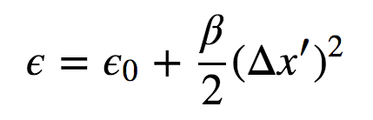
First simulations results
Simulation bechmarking is still in progress
Simulation
β/2 ~ 18 (expected 8)
Nominal BCMS beam
Analytical expectation for decoupled motion
Measured
β/2 ~ 3.6
Analytical expectation
β/2 ~ 11.26
Notes:
Simulation good in shape, but too steep ! → under investigation

Slide 13
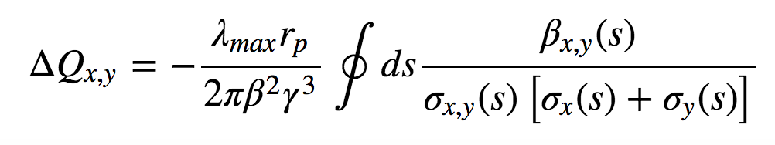
Space charge induced tune shift
BCMS like beams:
For all the measurements the maximum tune shift has been computed
BCMS beams
INDIV beam
Notes:
High brigthness → linear

Slide 14
INDIV_HI_HE beam (again)
Modified INDIV beam in the PSB with higher emittance and intensity than INDIV
Tune footprint is smaller (0.07, 0.08),
Useful to disentangle the effects

Slide 15
Summary
KFA45 was used to test the contribution of the injection missteering to the emittance blowup
For nominal operations the injection seems to be optimised in most cases
Simulation work have just been started. The next step is include coupling.
Disentangling the effects is the key point:
  Small tune footprint beams
  Measuring and simulating coupling
The precision in the emittance measurement is the key issue when it comes to talk about tune shift, the new measurement paradigm should help a lot in that sense

Slide 16
Spares

Slide 17
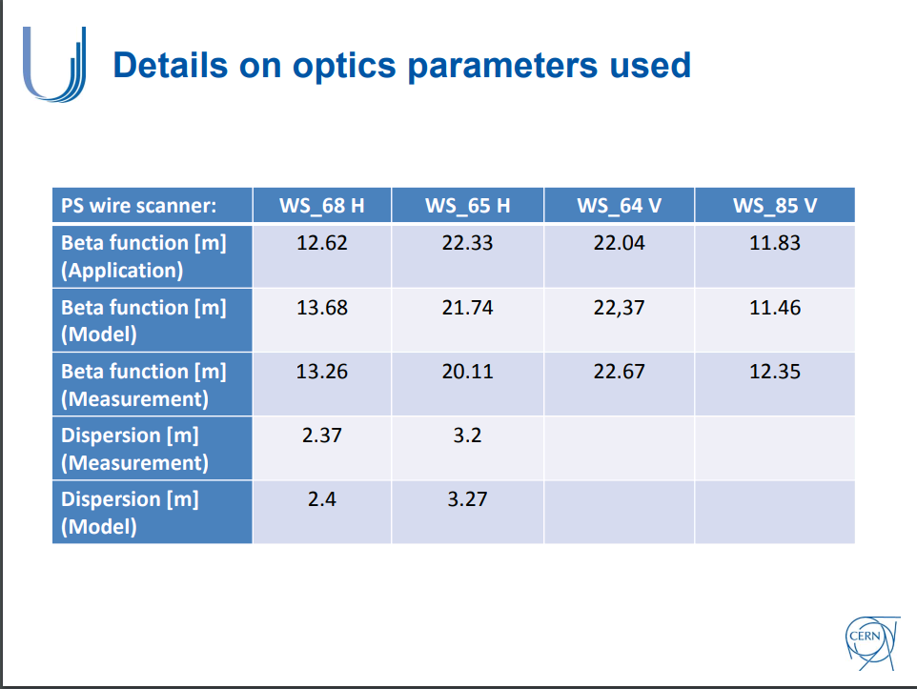
Emittance calculation
Used Guido’s dispersive component deconvolution function
The used twiss parameters are the measured one (Vincenzo’s presentation last meeting)
BCMS operational conditions
From H. Bartosik et al.
at MD days 2017

Slide 18
BCMS changing the working point

