Slide 1

Update on correlation between DA and Lifetime with Beam-Beam
Y. Papaphilippou and D. Pellegrini
with contributions of: F. Antoniou, S. Fartoukh,
G. Iadarola, N. Karastathis, G. Sterbini
HI-LUMI WP2 – 07/11/2017

Slide 2
A foreword on DA
The DA obtained from tracking simulations depends on several conventions:
  Number of turns: 1M = 90 s of beam time
  Choice of initial momentum: 27e-5 ~ ¾ of the bucket height (see also D. Pellegrini, 81st WP2)
  Number of angles for min DA: 5
  Specific machine realisation (typically without errors)
  LHCb normally in the good polarity, levelled by separation at 2e32 Hz/cm²
We use them as a reference for the DA vs lifetime comparison (i.e. different considerations can lead to different DA vs lifetime
correlation).

Slide 3
Experience from 2016
Recap from 93rd WP2

Slide 4
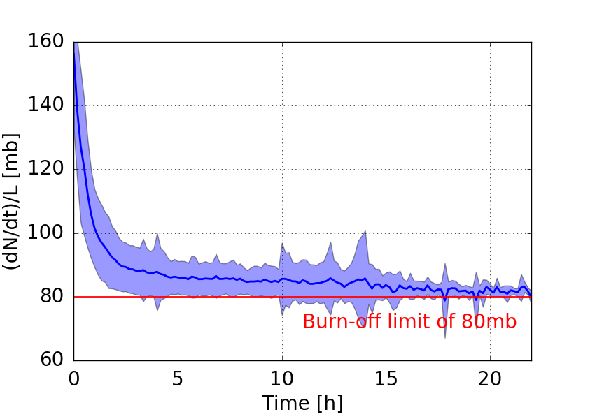
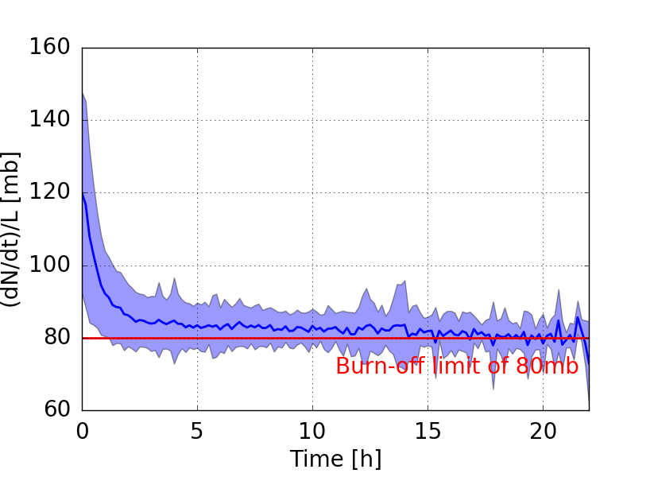
Losses during the fill
Beam 1
Beam 2
F. Antoniou
Normalised loss-rate, approaches burn-off limit within first 2-3h.
These early losses appear to be correlated with DA.

Slide 5
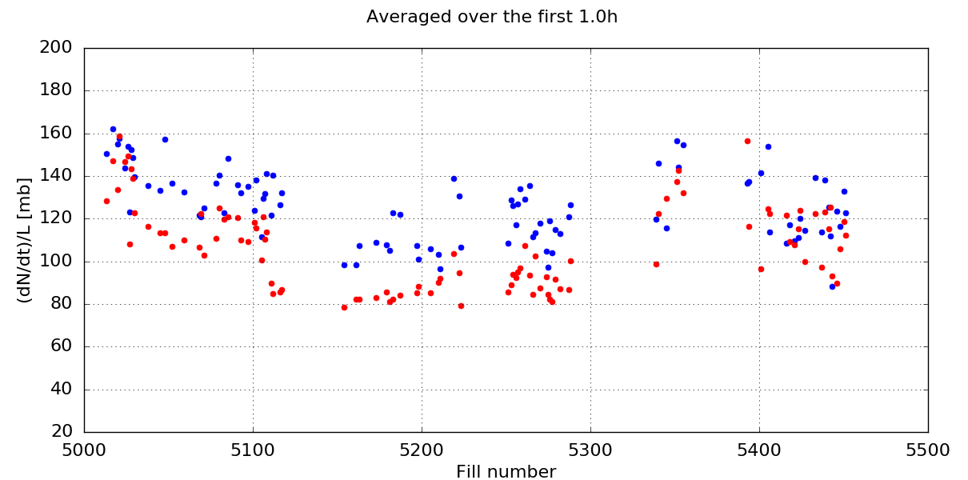
1st hour losses along the year
Beam 1
Beam 2
B1 Tune Adj
Transition to BCMS
Crossing angle reduction
Burnoff Limit
Larger DA over this period
F. Antoniou

Slide 6
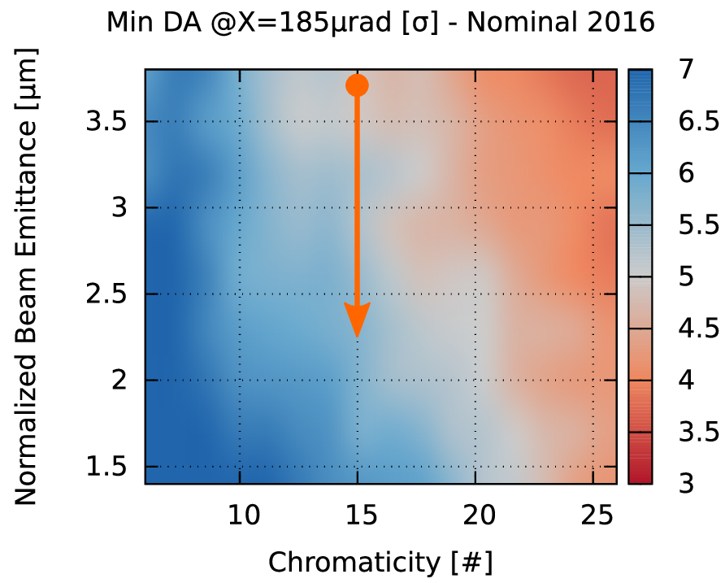
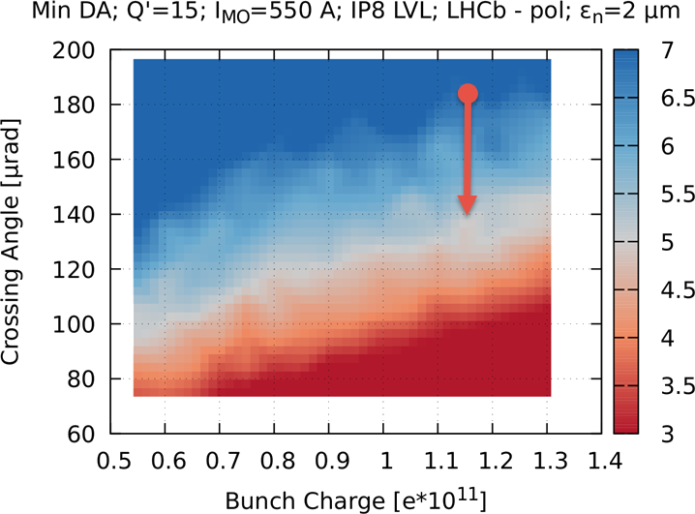
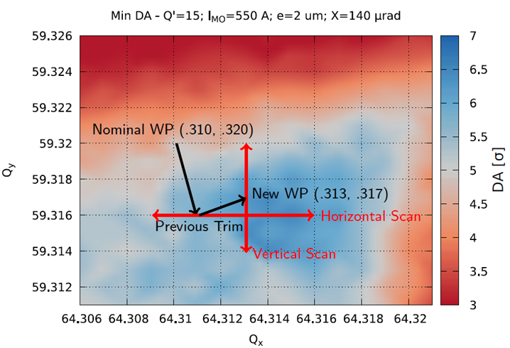
DA follow up along 2016 Run
Reduction of emittance, increasing the DA from 5 to 6 σ
Reduction of crossing angle, reducing the DA from 6 to 5 σ
Tune adjustment bringing restoring the DA from 5 to 6 σ
What is the impact on the integrated luminosity?

Slide 7
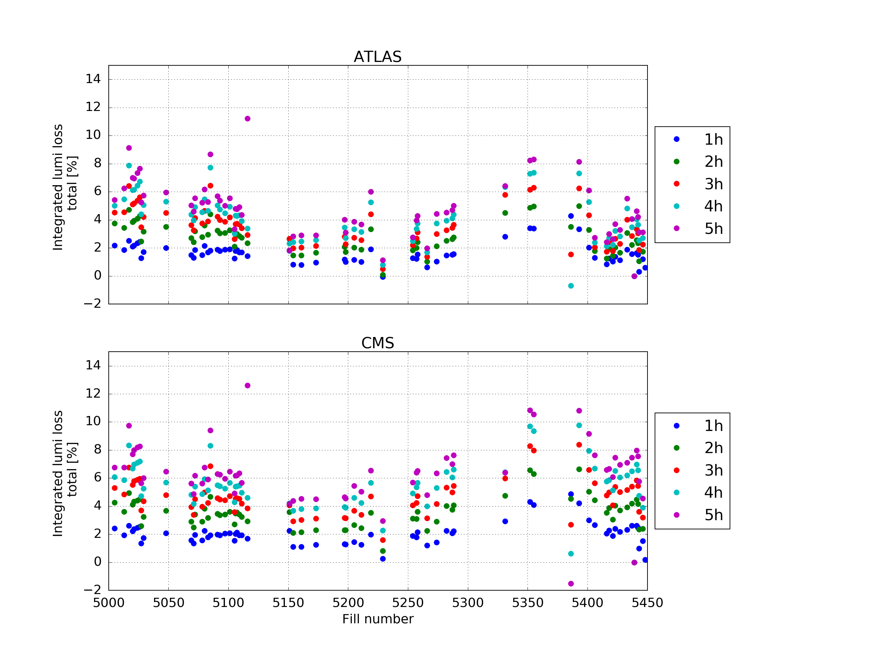
Luminosity loss
  The integrated luminosity loss along the fills from:
  emittance blow-up (compared to the expected evolution), extending for the entire fill duration.
  beam losses localised in the first few hours.
  The contribution of losses is up to 2~3 %, while the crossing reduction came with a 10 % increase.
  Trading DA for performances can be worth the losses.
Some uncertainty from BSRT recalibrations
F. Antoniou

Slide 8
Improvements in 2017

Slide 9
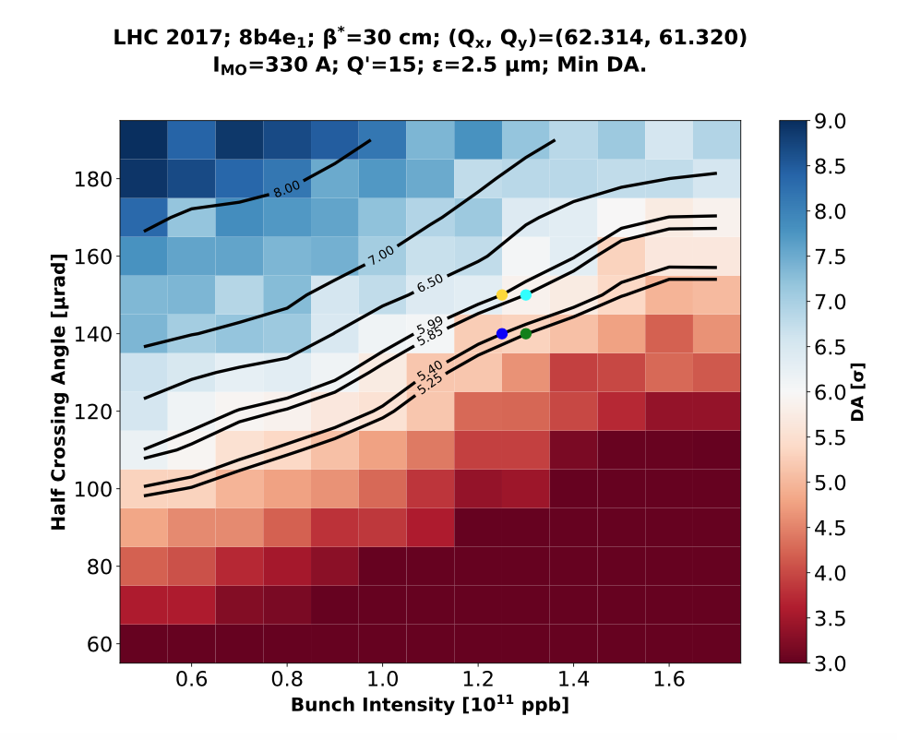
Crossing angle anti-leveling: a test for DA
Each intensity allows for a specific crossing angle in terms of DA
Steps for crossing angle reduction based on DA simulations
Steps translated into time for OP…
N. Karastathis et al.

Slide 10
Crossing angle anti-leveling: a test for DA
Reduction steps not always applied at the right intensity
Sometimes resulting in aggressive settings
N. Karastathis et al.

Slide 11
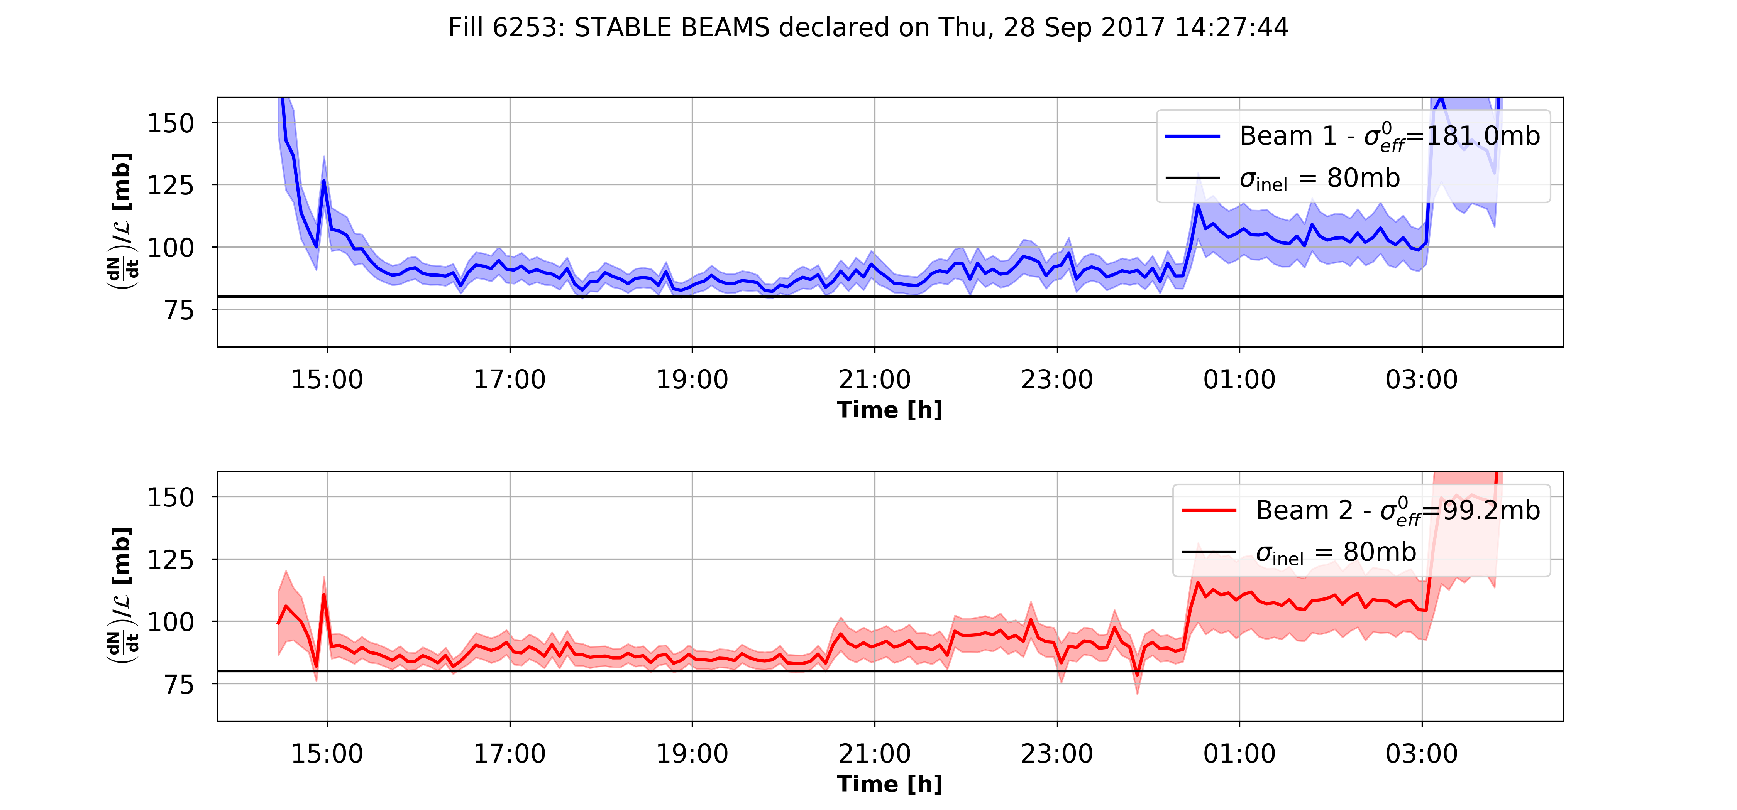
Crossing angle anti-leveling: a test for DA
110μrad
100μrad
Fill 6253 - 8b4e - Tue 28 Sep 2017
N. Karastathis
Lifetime approaches the burnoff limit very quickly.
Aggressive settings are seen on the beam lifetime and cross section.

Slide 12
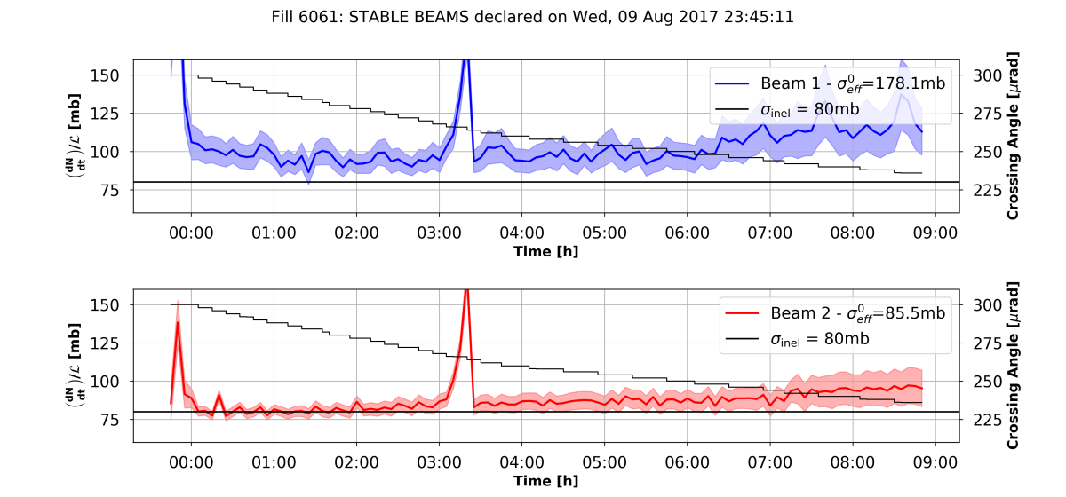
Fill 6061: Continuous variation of crossing angle
Atlas lumi issue
N. Karastathis
Smooth losses without large dips
Proposed for HL-LHC

Slide 13
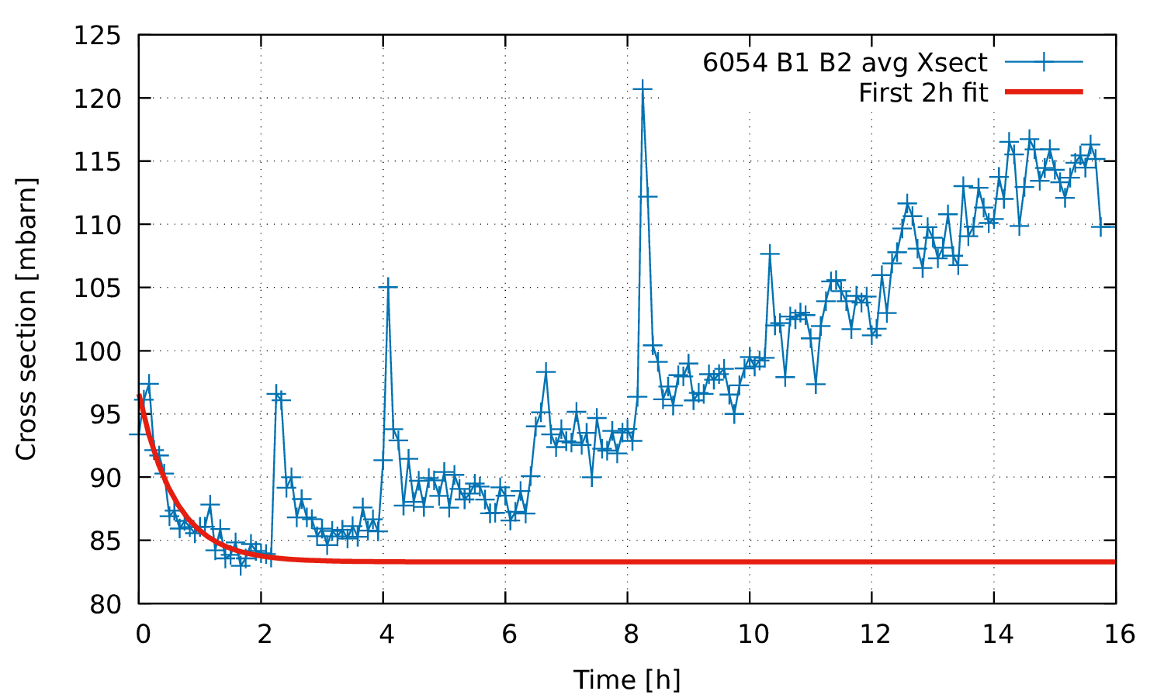
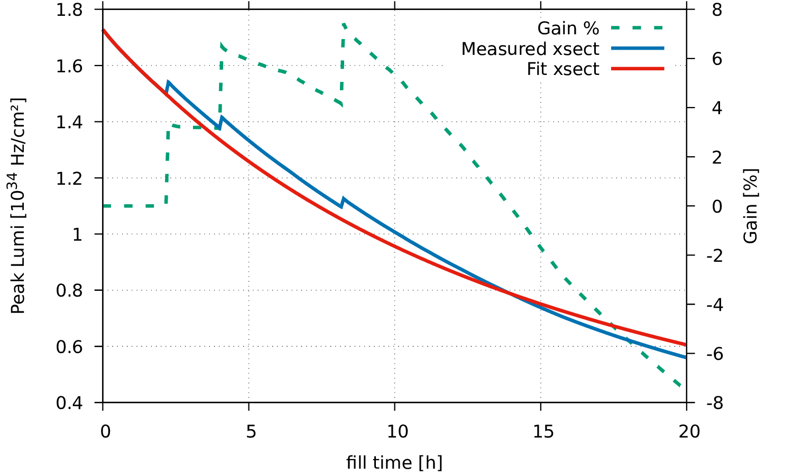
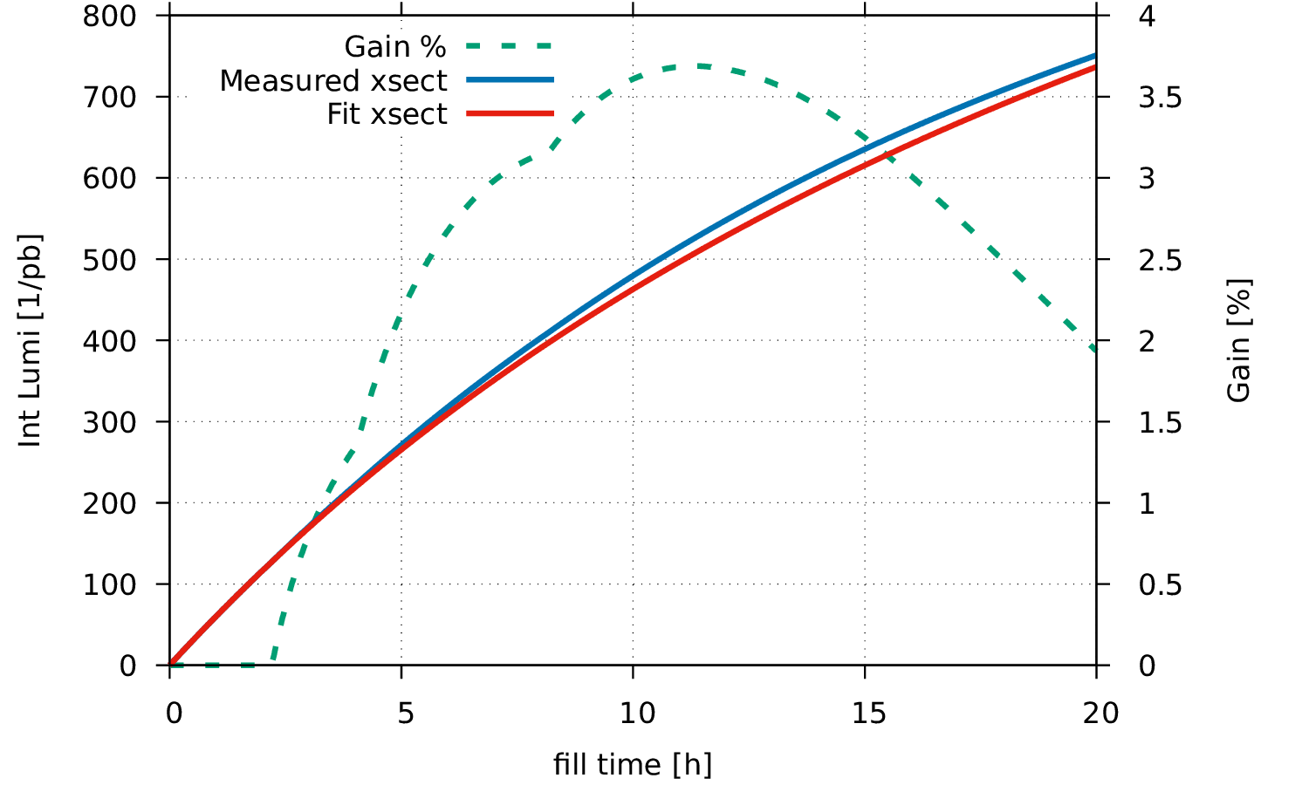
A word on performance
Perform integration with:
  Measured (fill 6054) cross section and realistic crossing angle steps,
  Cross section fitted on the first 2h and fixed crossing angle.
Aggressive crossing steps, still ~3% gain of integrated luminosity.
120 µrad
130 µrad
150
140

Slide 14
Putting all together
Feed all the machine settings and beam measurements to DA simulations and benchmark with lifetime.
MD2209 (G. Iadarola, D. Pellegrini et al.) Crossing angle with high intensity 8b4e bunches chosen:
  Reduction of the crossing angle in steps;
  Very good tune and lumi control along the fill;
  Attempt to recover lifetime at the smallest crossing by reducing octupoles and chroma.

Slide 15
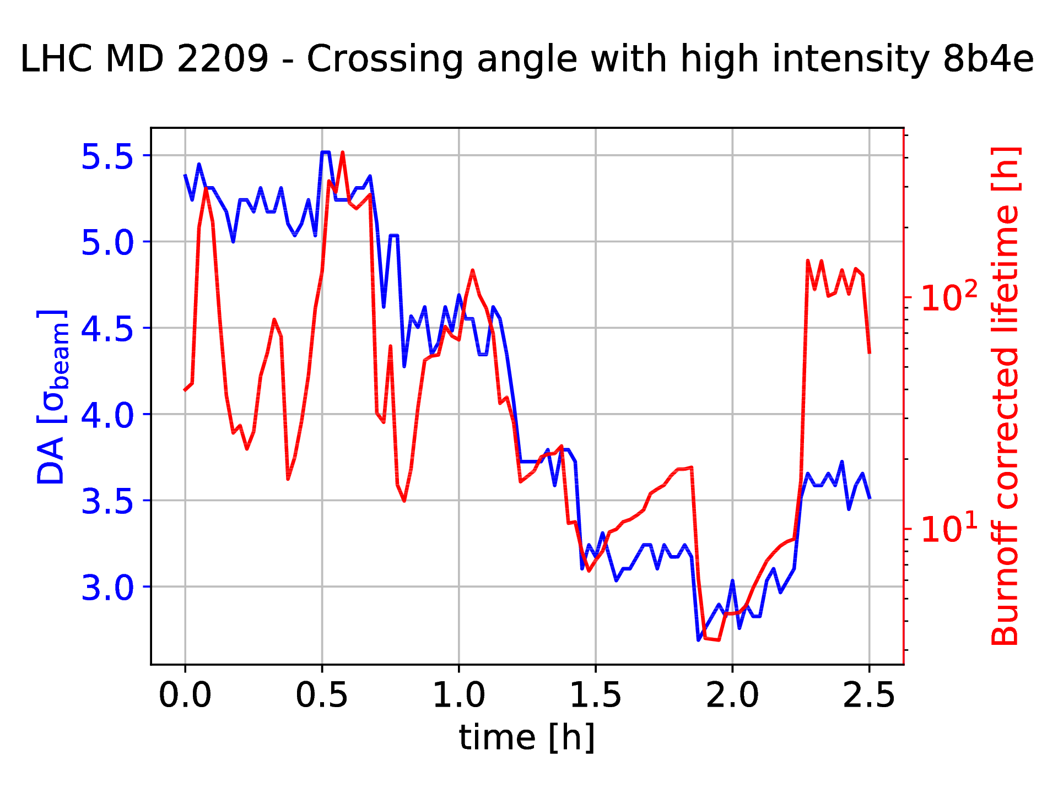
Lifetime vs DA

Slide 16
Lifetime vs DA
Tune and Luminosity optimisation

Slide 17
Lifetime vs DA
150
Crossing angle steps
130
110
100
90
Tune and Luminosity optimisation

Slide 18
Lifetime vs DA
150
Crossing angle steps
130
110
100
90
Tune and Luminosity optimisation
Chroma and octupoles reduction

Slide 19
Lifetime vs DA
150
Crossing angle steps
130
Crossing angle
relaxed
110
100
100
90
Tune and Luminosity optimisation
Chroma and octupoles reduction

Slide 20
Conclusions
Flexible crossing angle operation extremely useful, also in MDs!
First-of-the-kind exercise of feeding of both beam and machine parameters along the fill to DA simulations.
Remarkable agreement between the steps in burnoff-corrected lifetime and DA.
DA can be affected by systematics.
Cannot reproduce the raise of lifetime after aggressive steps or when relaxing the crossing angle:
  Intensity and emittance variations are not enough to explain.

Slide 21
Outlook
  Move to lifetime simulations, taking into account the particles already lost in the previous tracking intervals to understand the quick gain of lifetime after the perturbations.
  Extend the analysis to additional fills to improve the statistics.
  Possibly identify more lifetime-affecting settings in order to improve the general understanding.
  Initiate beam 2 simulations with beam-beam.

Slide 22
Backup

