Slide 1
WG7: Common Test Facilities
Eraldo Oliveri
Yorgos Tsipolitis

Slide 2
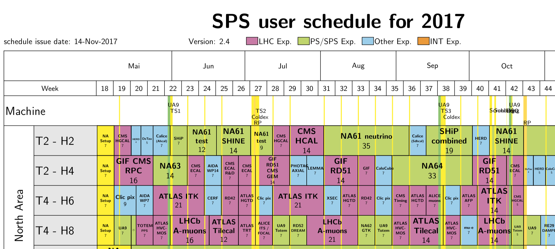
2017
5-19 Jul.
2-16 Aug.
2-15 Oct.
Test on beam and characterization of final (or almost) detectors (and services) ready for experiment
Consolidated and standard MPGD technologies: R&D for short term applications in experiments/application
Novel MPGD based solution: R&D for long term applications in experiments/application
(Almost) Final Detector
“Consolidated” MPGD
Novel Structures

Slide 3
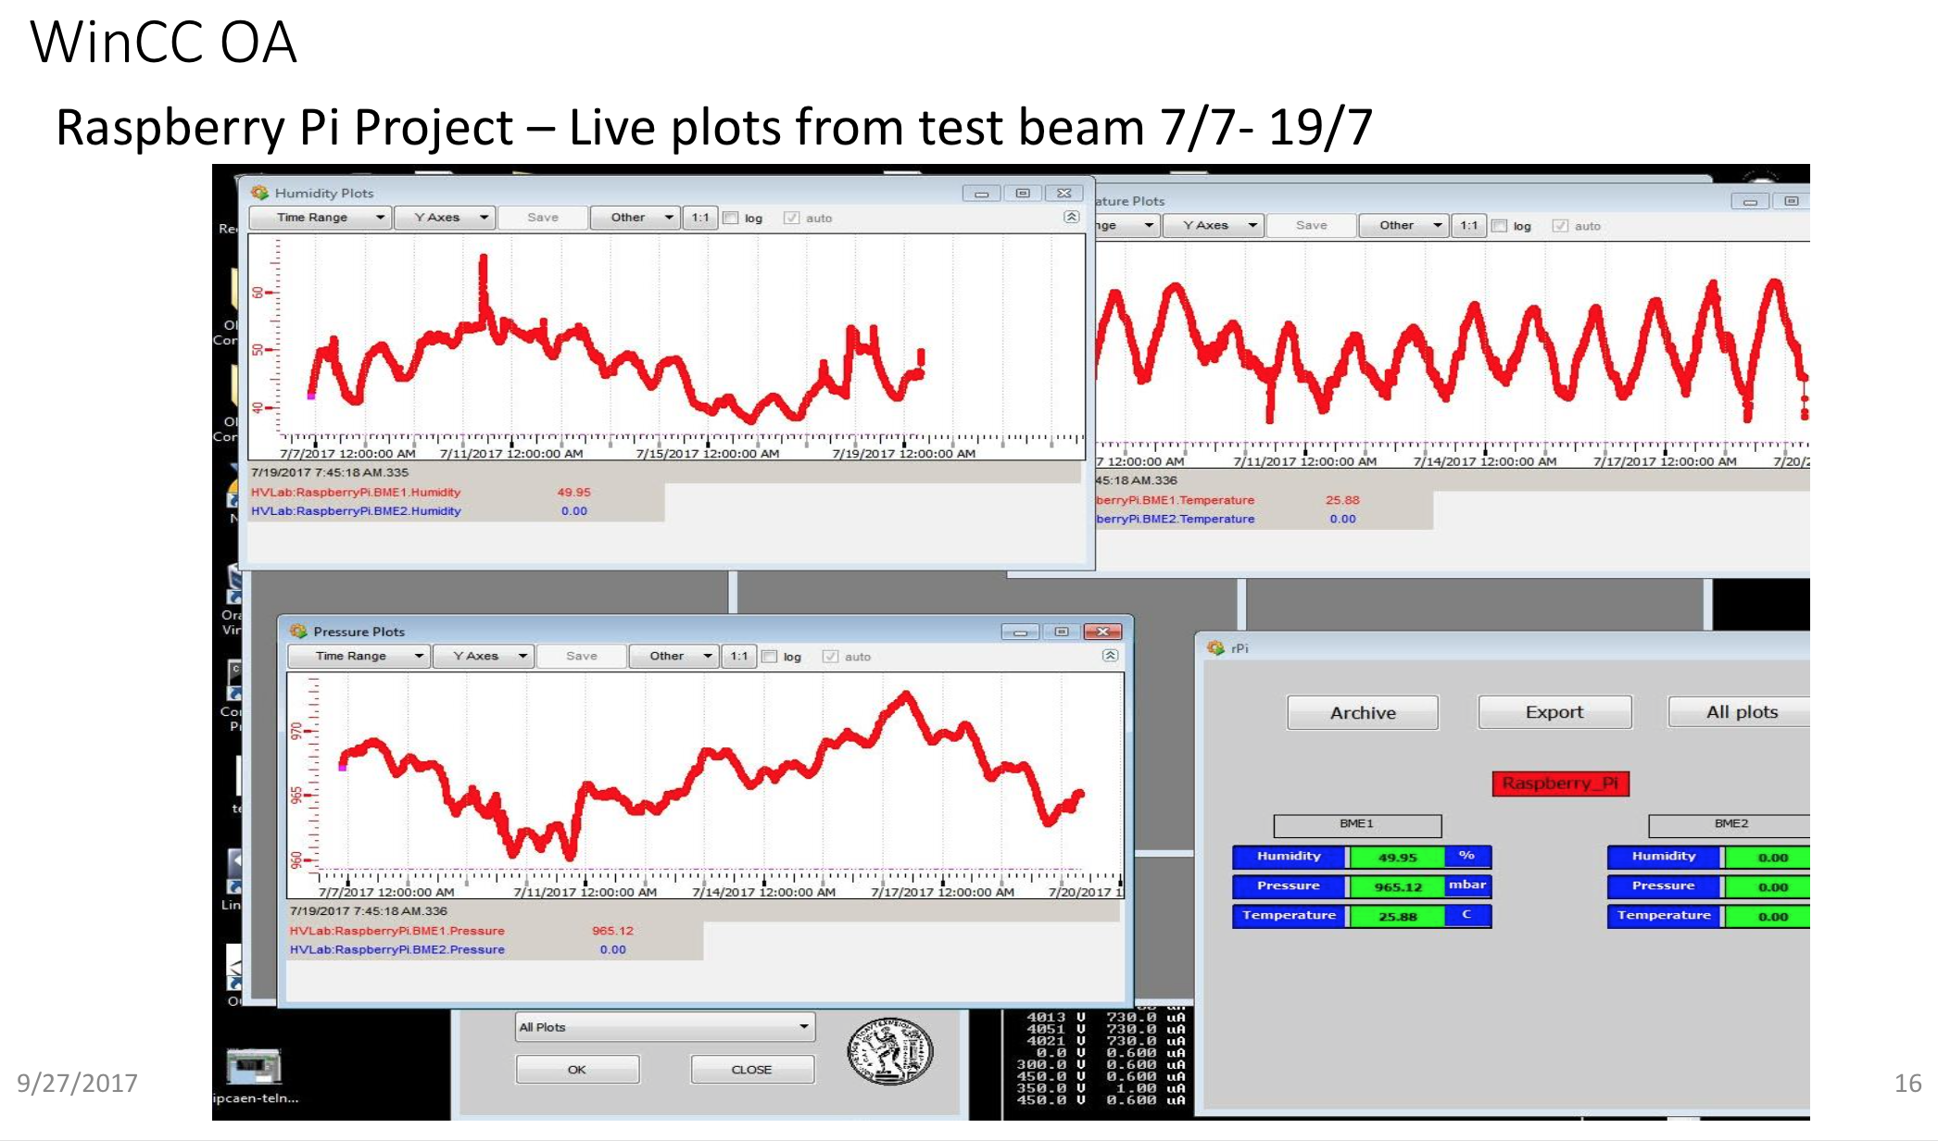
New Raspberry system for environmental parameters
https://indico.cern.ch/event/667256/contributions/2732843/attachments/1530635/2395518/Anna_Zacharopoulou.pdf

Slide 4
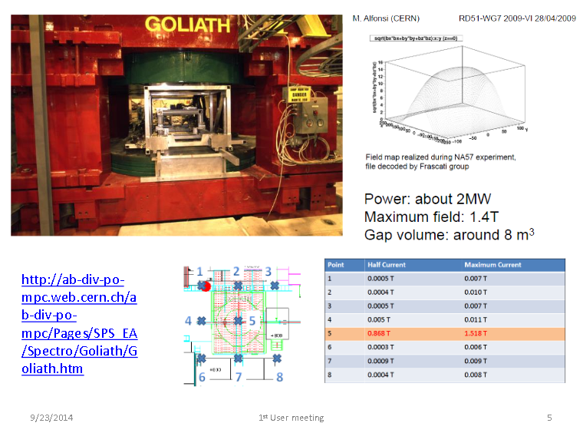

Slide 5
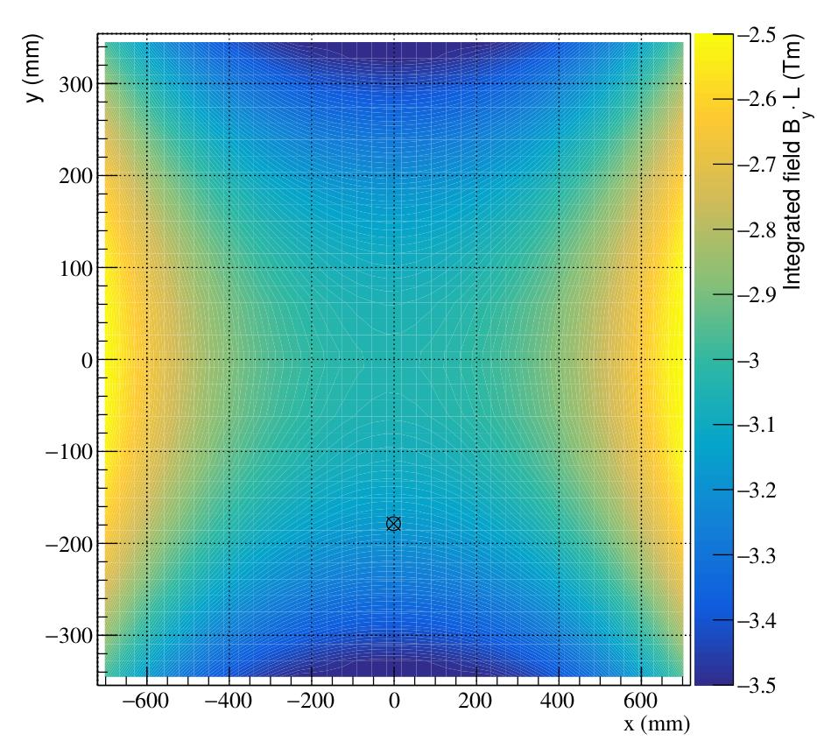
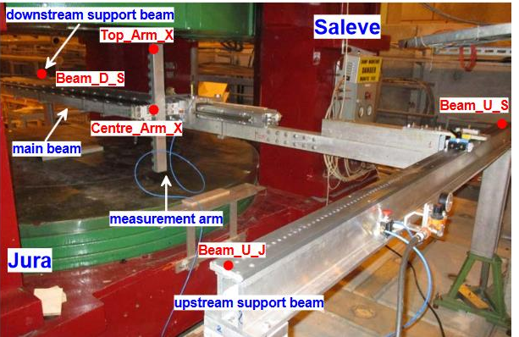
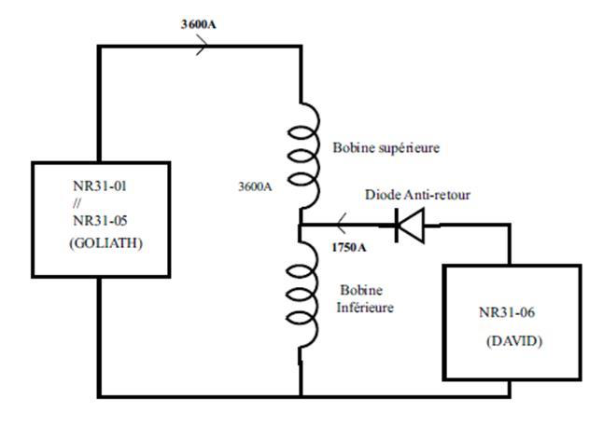
New Measurement of GOLIATH Field
VERY PRELIMINARY
15 probes in vertical direction: Δy = 59 mm
To have GOLIATH with full field we have to have also DAVID on

Slide 6
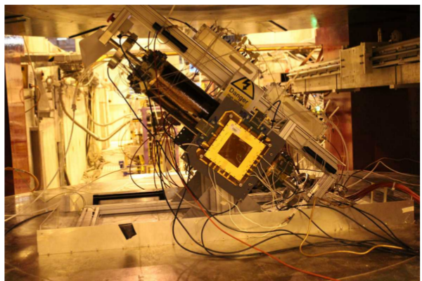
BES III
July period
(Almost) Final Detector
run with pions
HV scan – no B
HV scan – B = 1.5 T
B scan
Drift field scan
Transfer field scan
Induction field scan
https://indico.cern.ch/event/667256/contributions/2733261/attachments/1530896/2396029/bes3_activities_Mezzadri.pdf

Slide 7
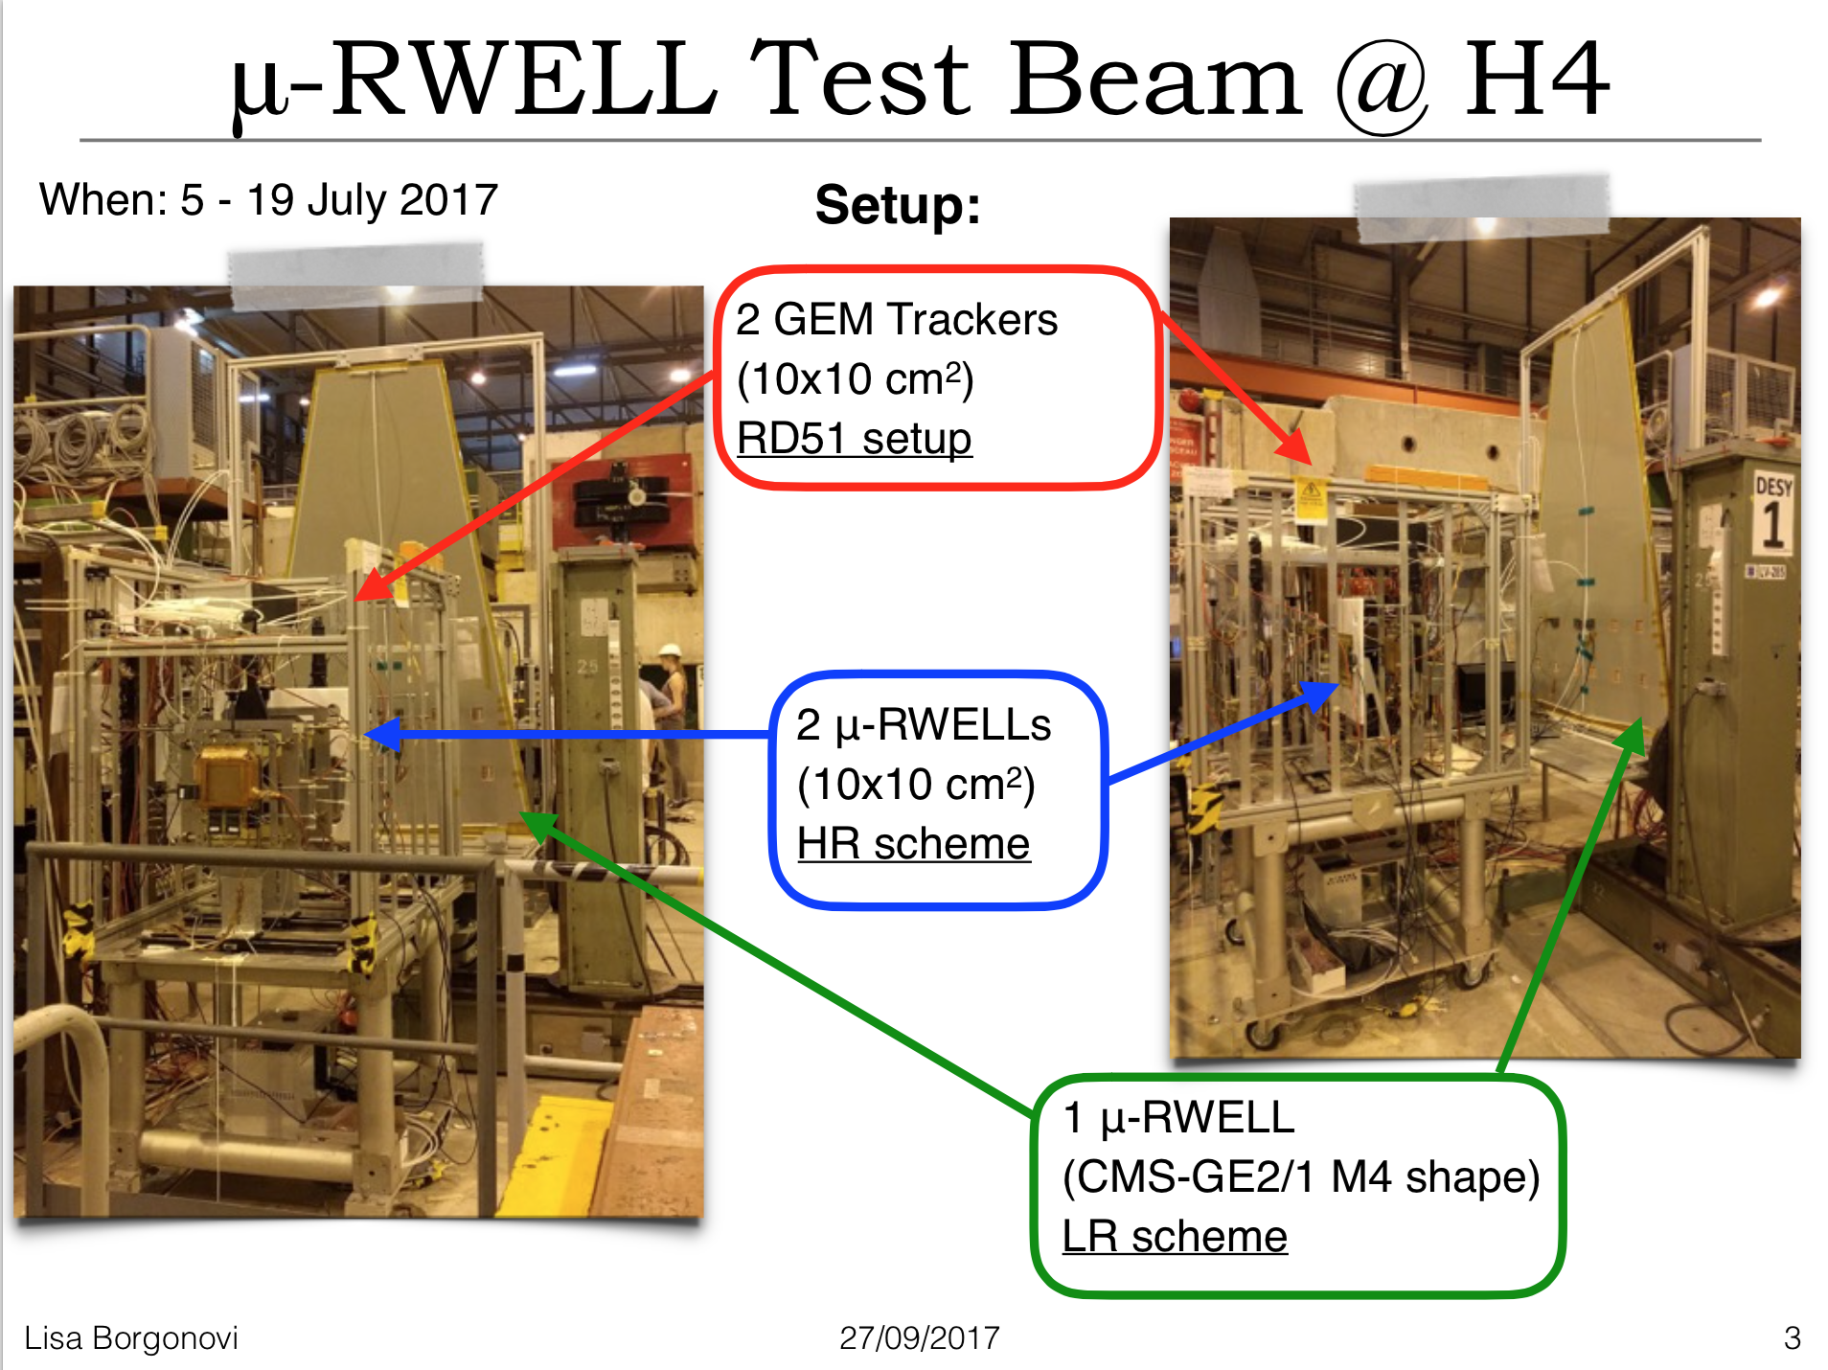
July period
Novel Structures

Slide 8
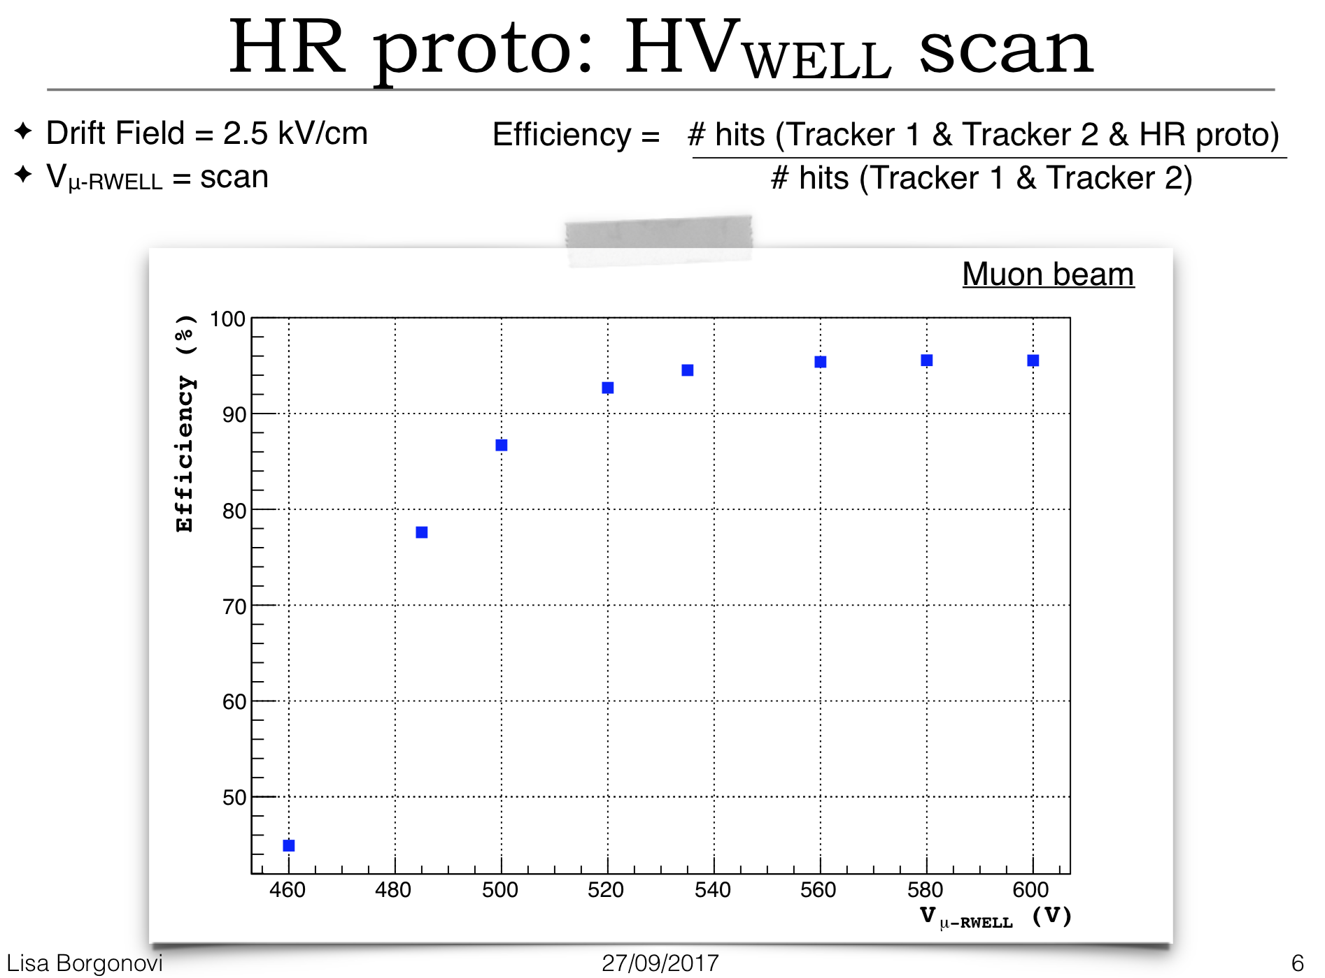
July period
VERY PRELIMINARY
https://indico.cern.ch/event/667256/contributions/2732290/attachments/1530959/2396158/RD51_uRWELL_TB.pdf

Slide 9
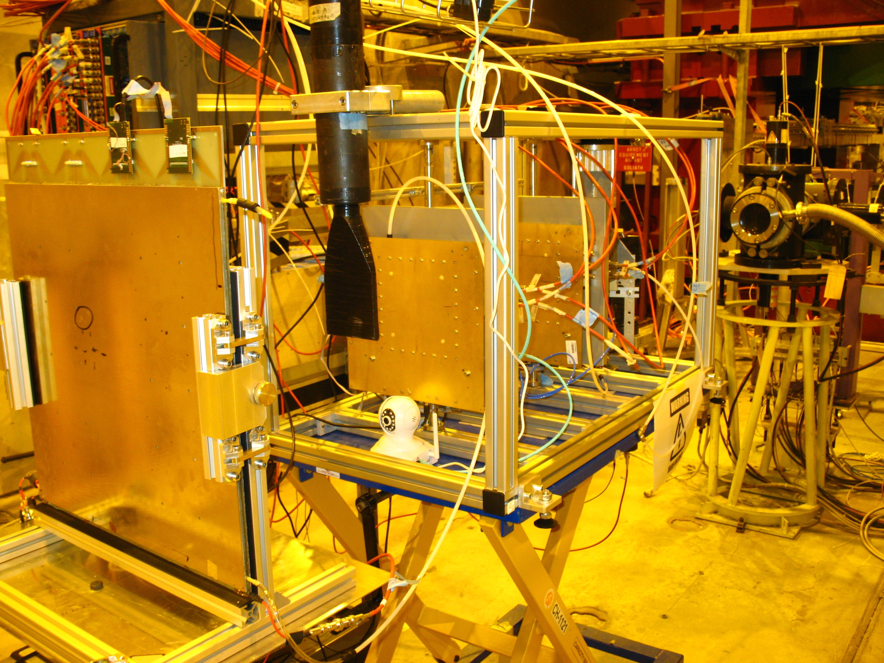
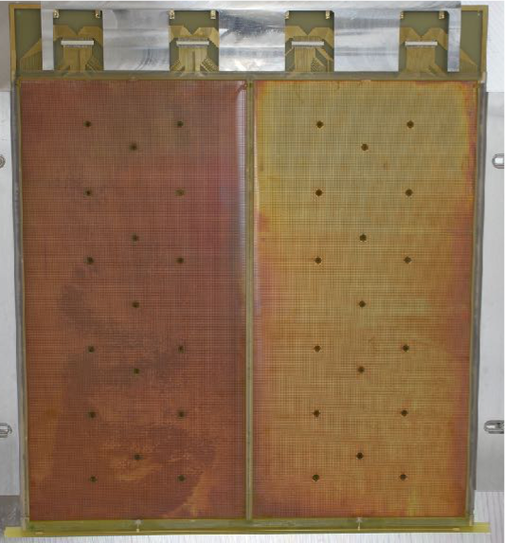
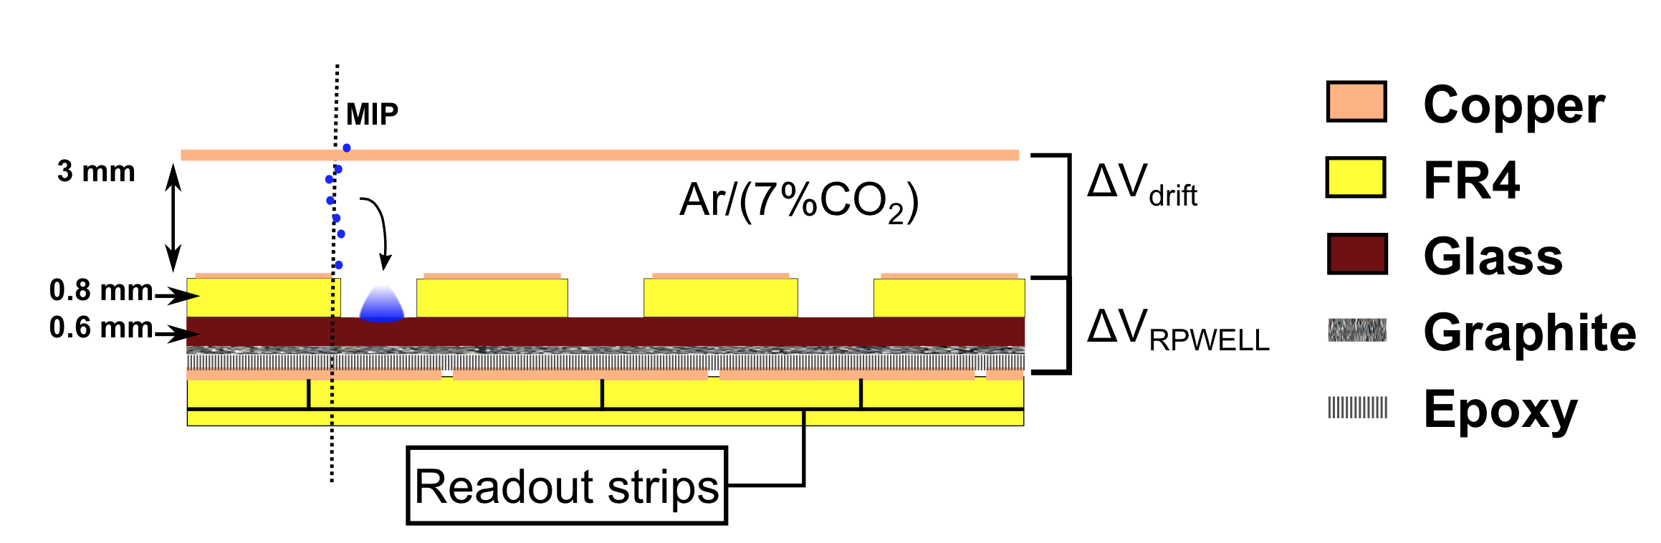
RPWELL
July period
Novel Structures
500 x 500 mm²
Measurements accomplished: ✓Scan area with muons
✓Gain uniformity
✓Electrical stability
https://indico.cern.ch/event/667256/contributions/2732275/attachments/1531164/2396554/RD51-meeting-170927_TB17.pdf

Slide 10
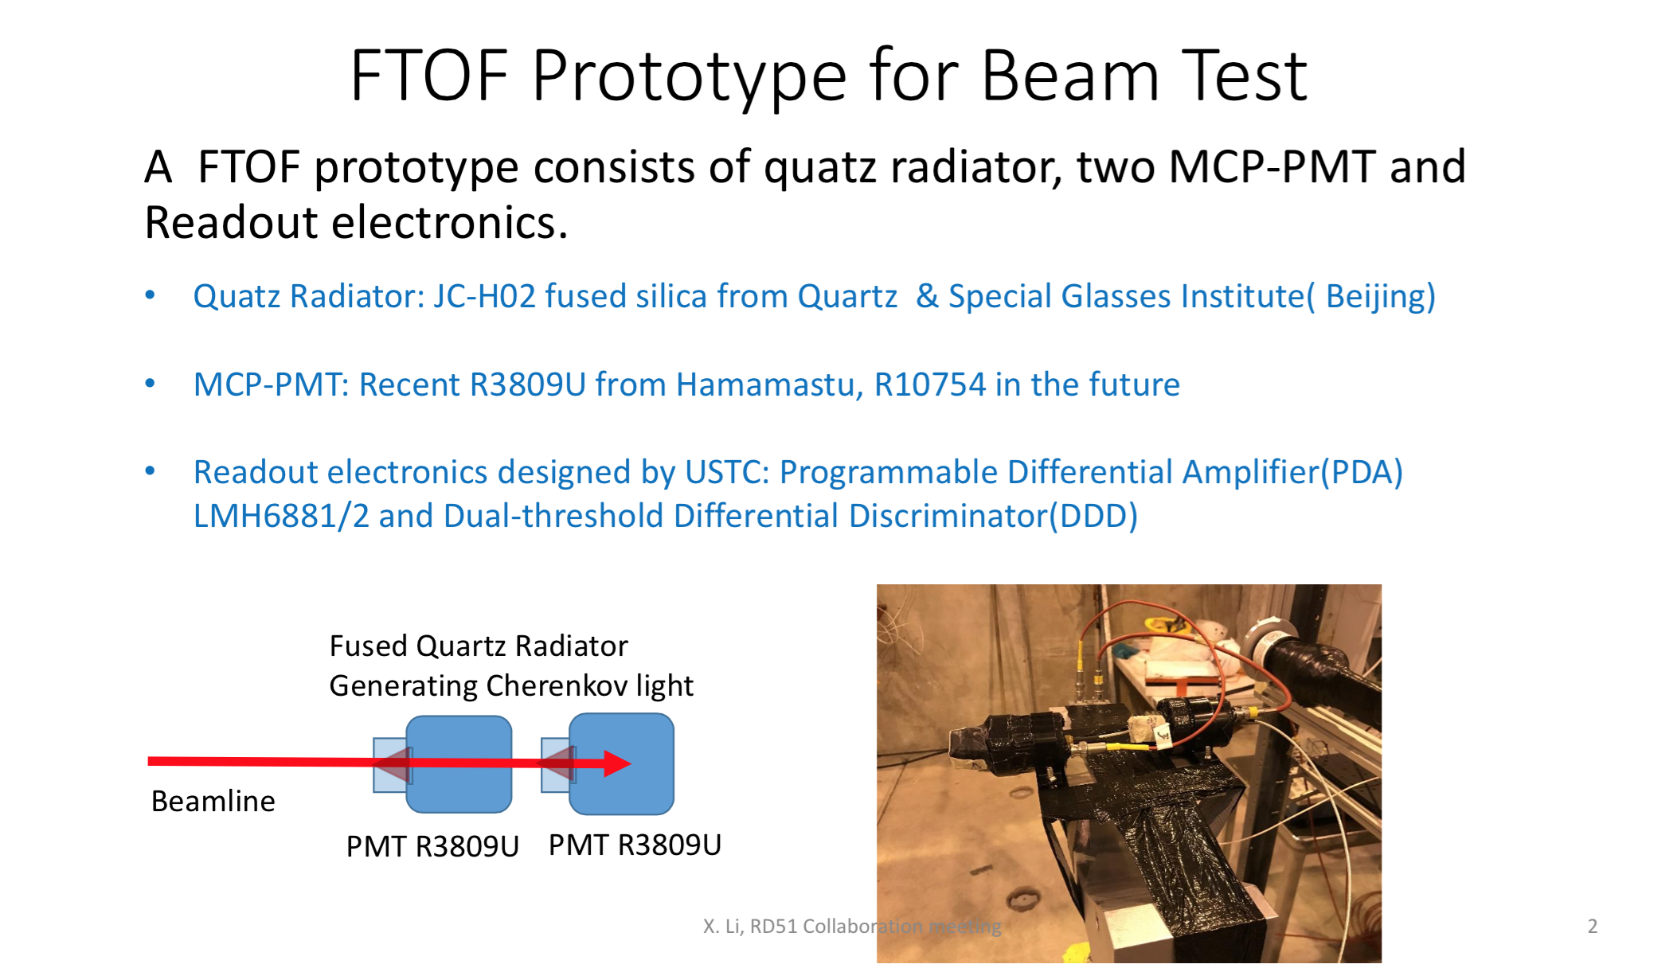
FTOF
August period

Slide 11
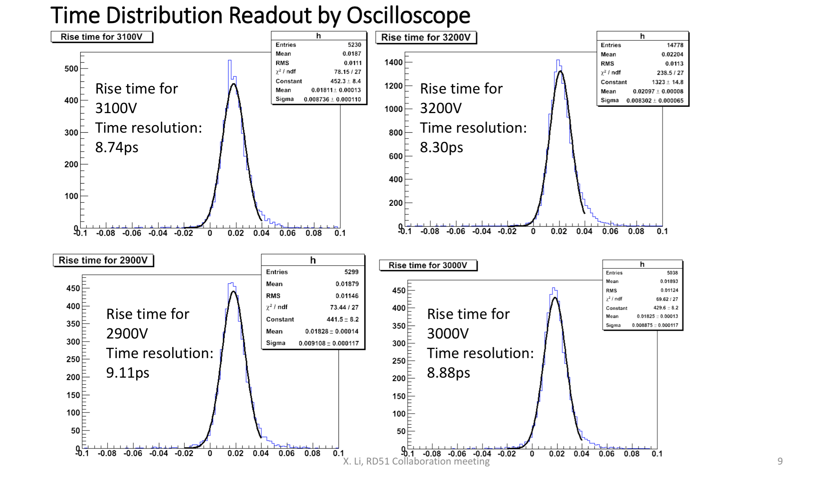
FTOF
August period
VERY PRELIMINARY
https://indico.cern.ch/event/667256/contributions/2735968/attachments/1530213/2395914/RD_of_FTOF.pdf

Slide 12
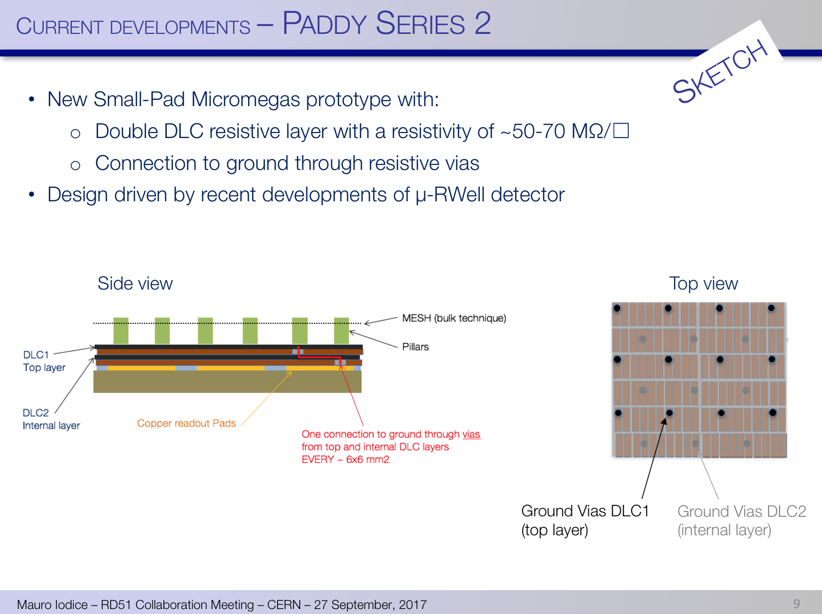
PADDY
October period
“Consolidated” MPGD
For more details see Mauro’s talk in WG2

Slide 13
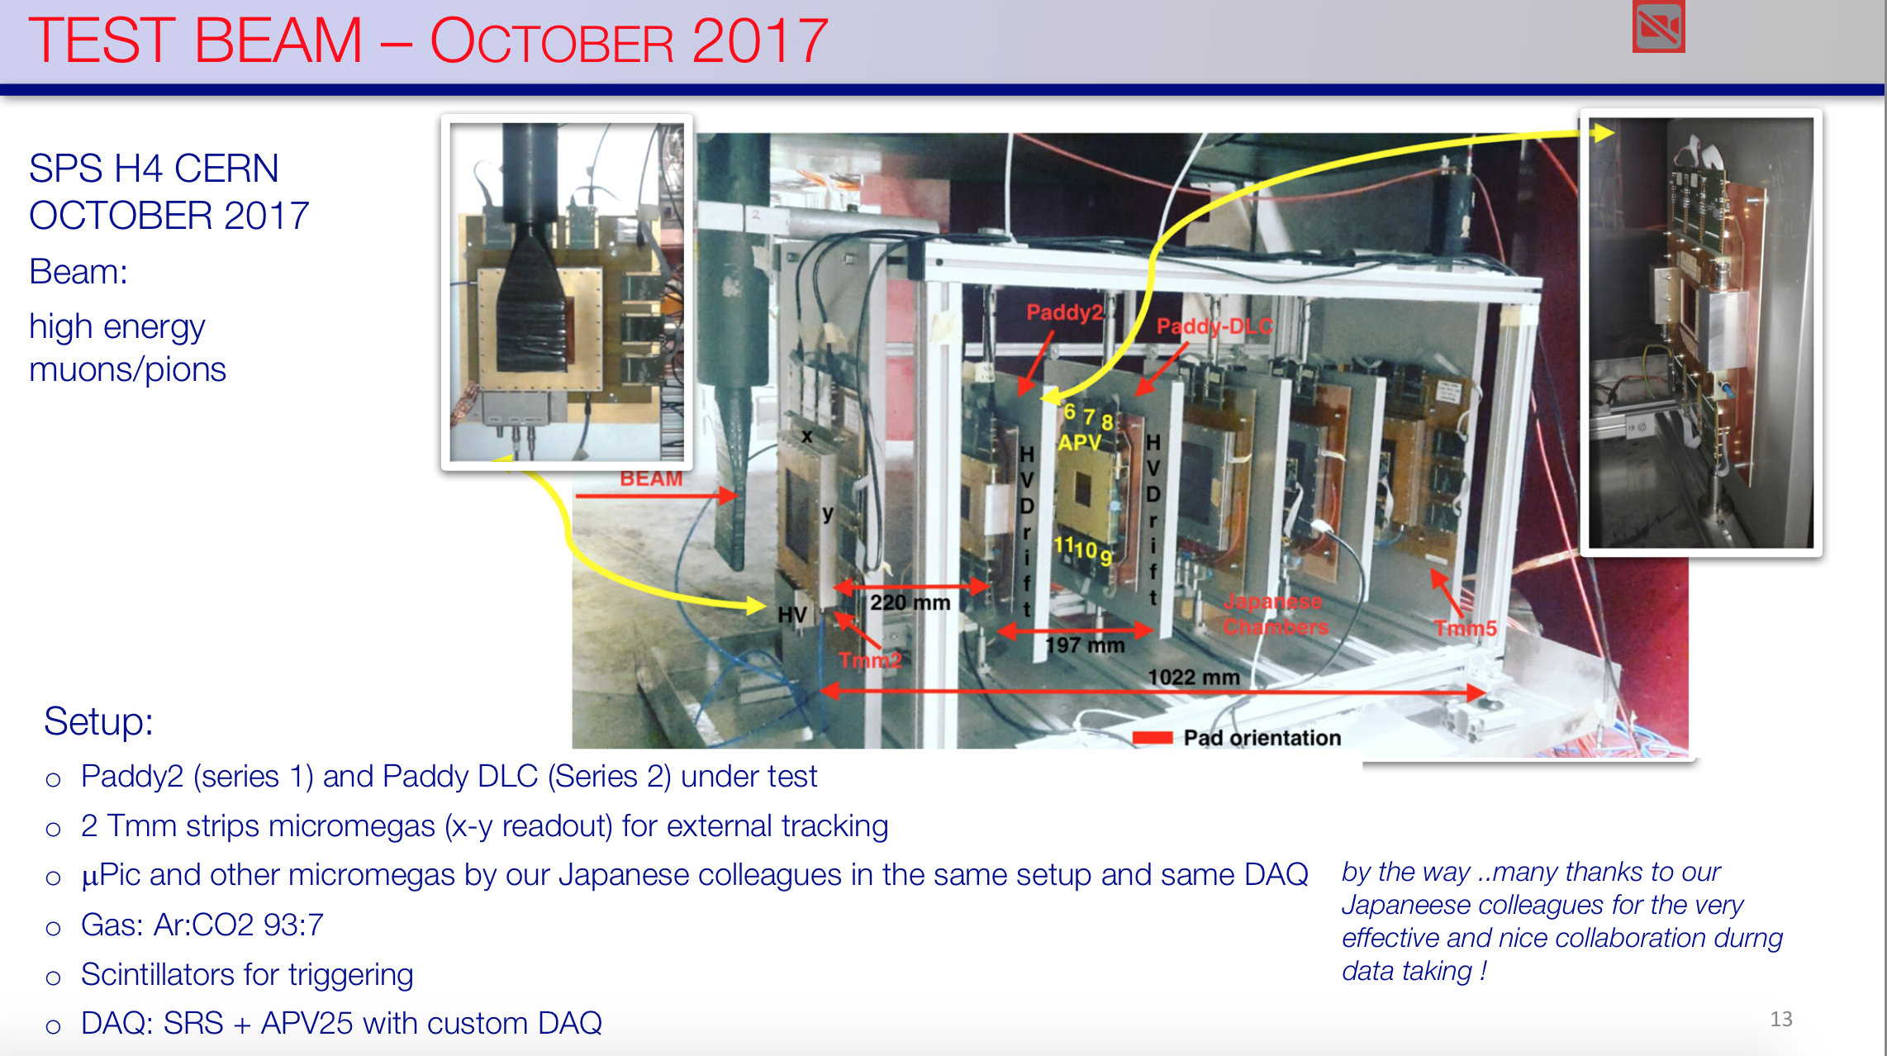
PADDY
October period
“Consolidated” MPGD
https://indico.cern.ch/event/676702/contributions/2820589/attachments/1576110/2488917/Paddy_Update_15Dec2017_v4.pdf

Slide 14
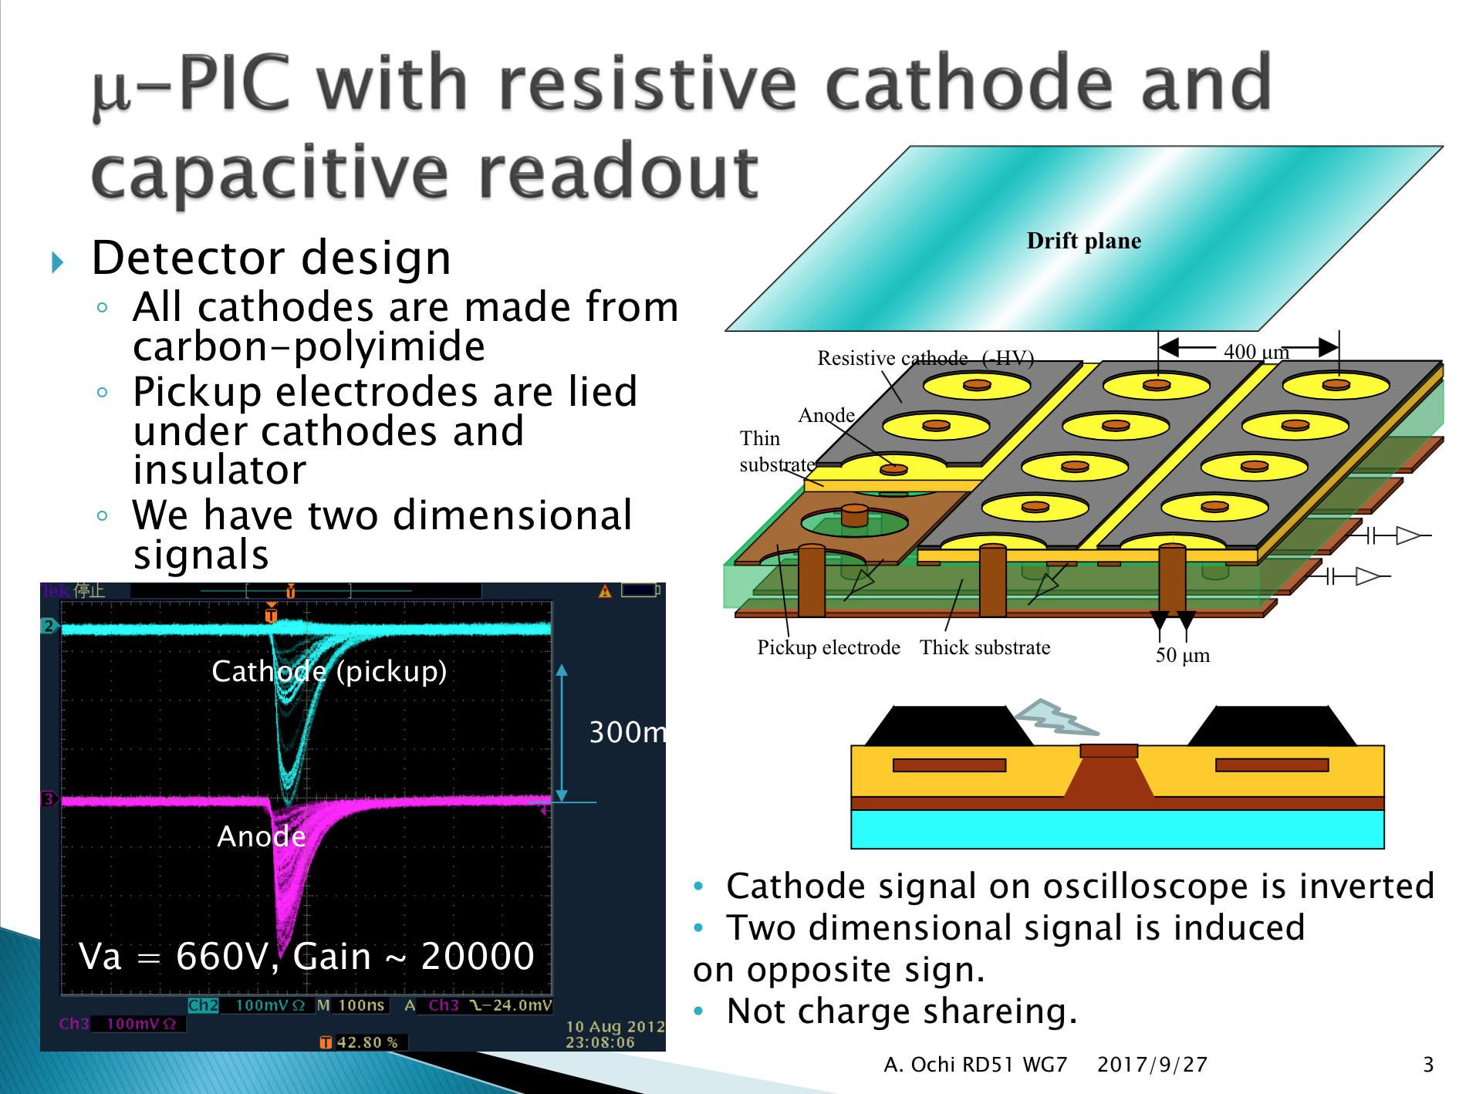
μPIC
October period
“Consolidated” MPGD

Slide 15
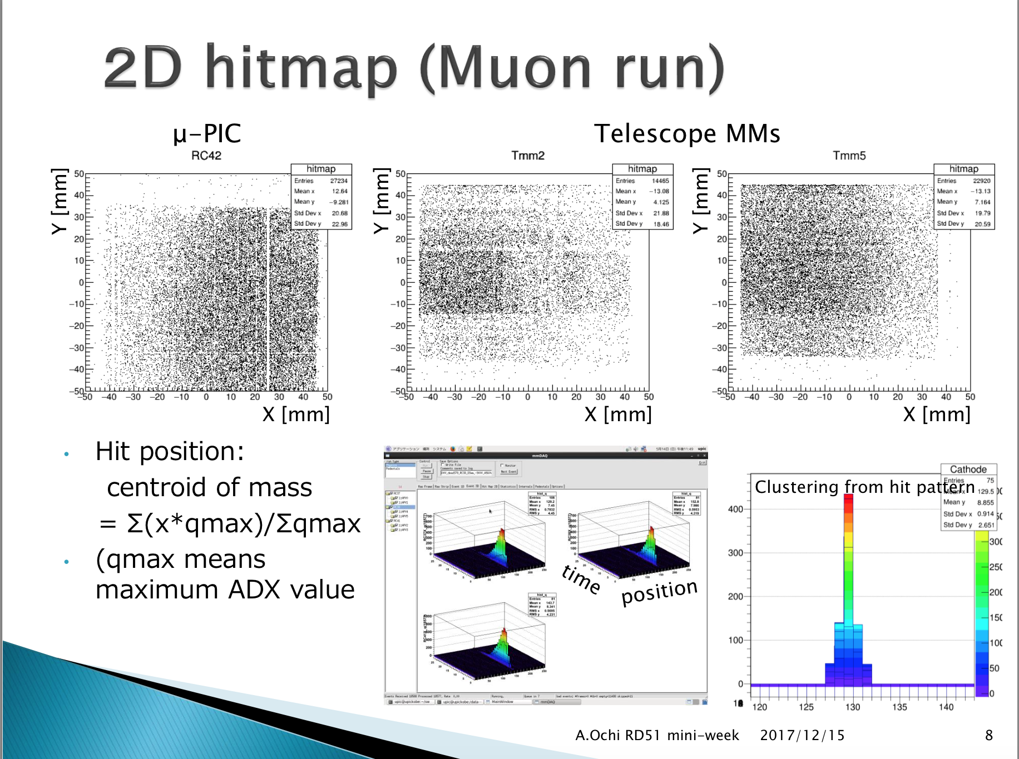
μPIC
https://indico.cern.ch/event/676702/contributions/2819146/attachments/1576207/2489252/ochi_upic_171215_v2.pdf

Slide 16
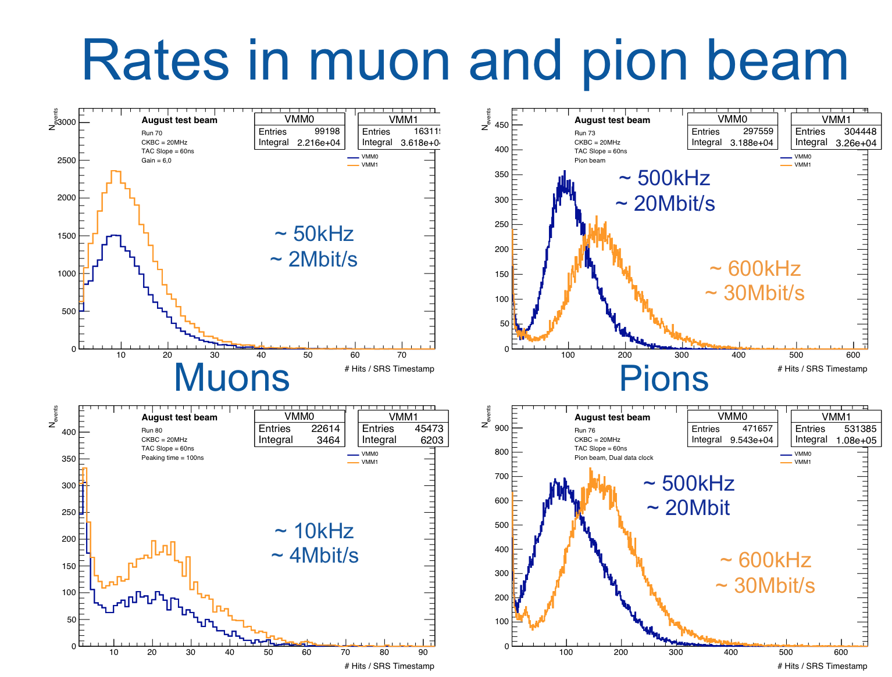
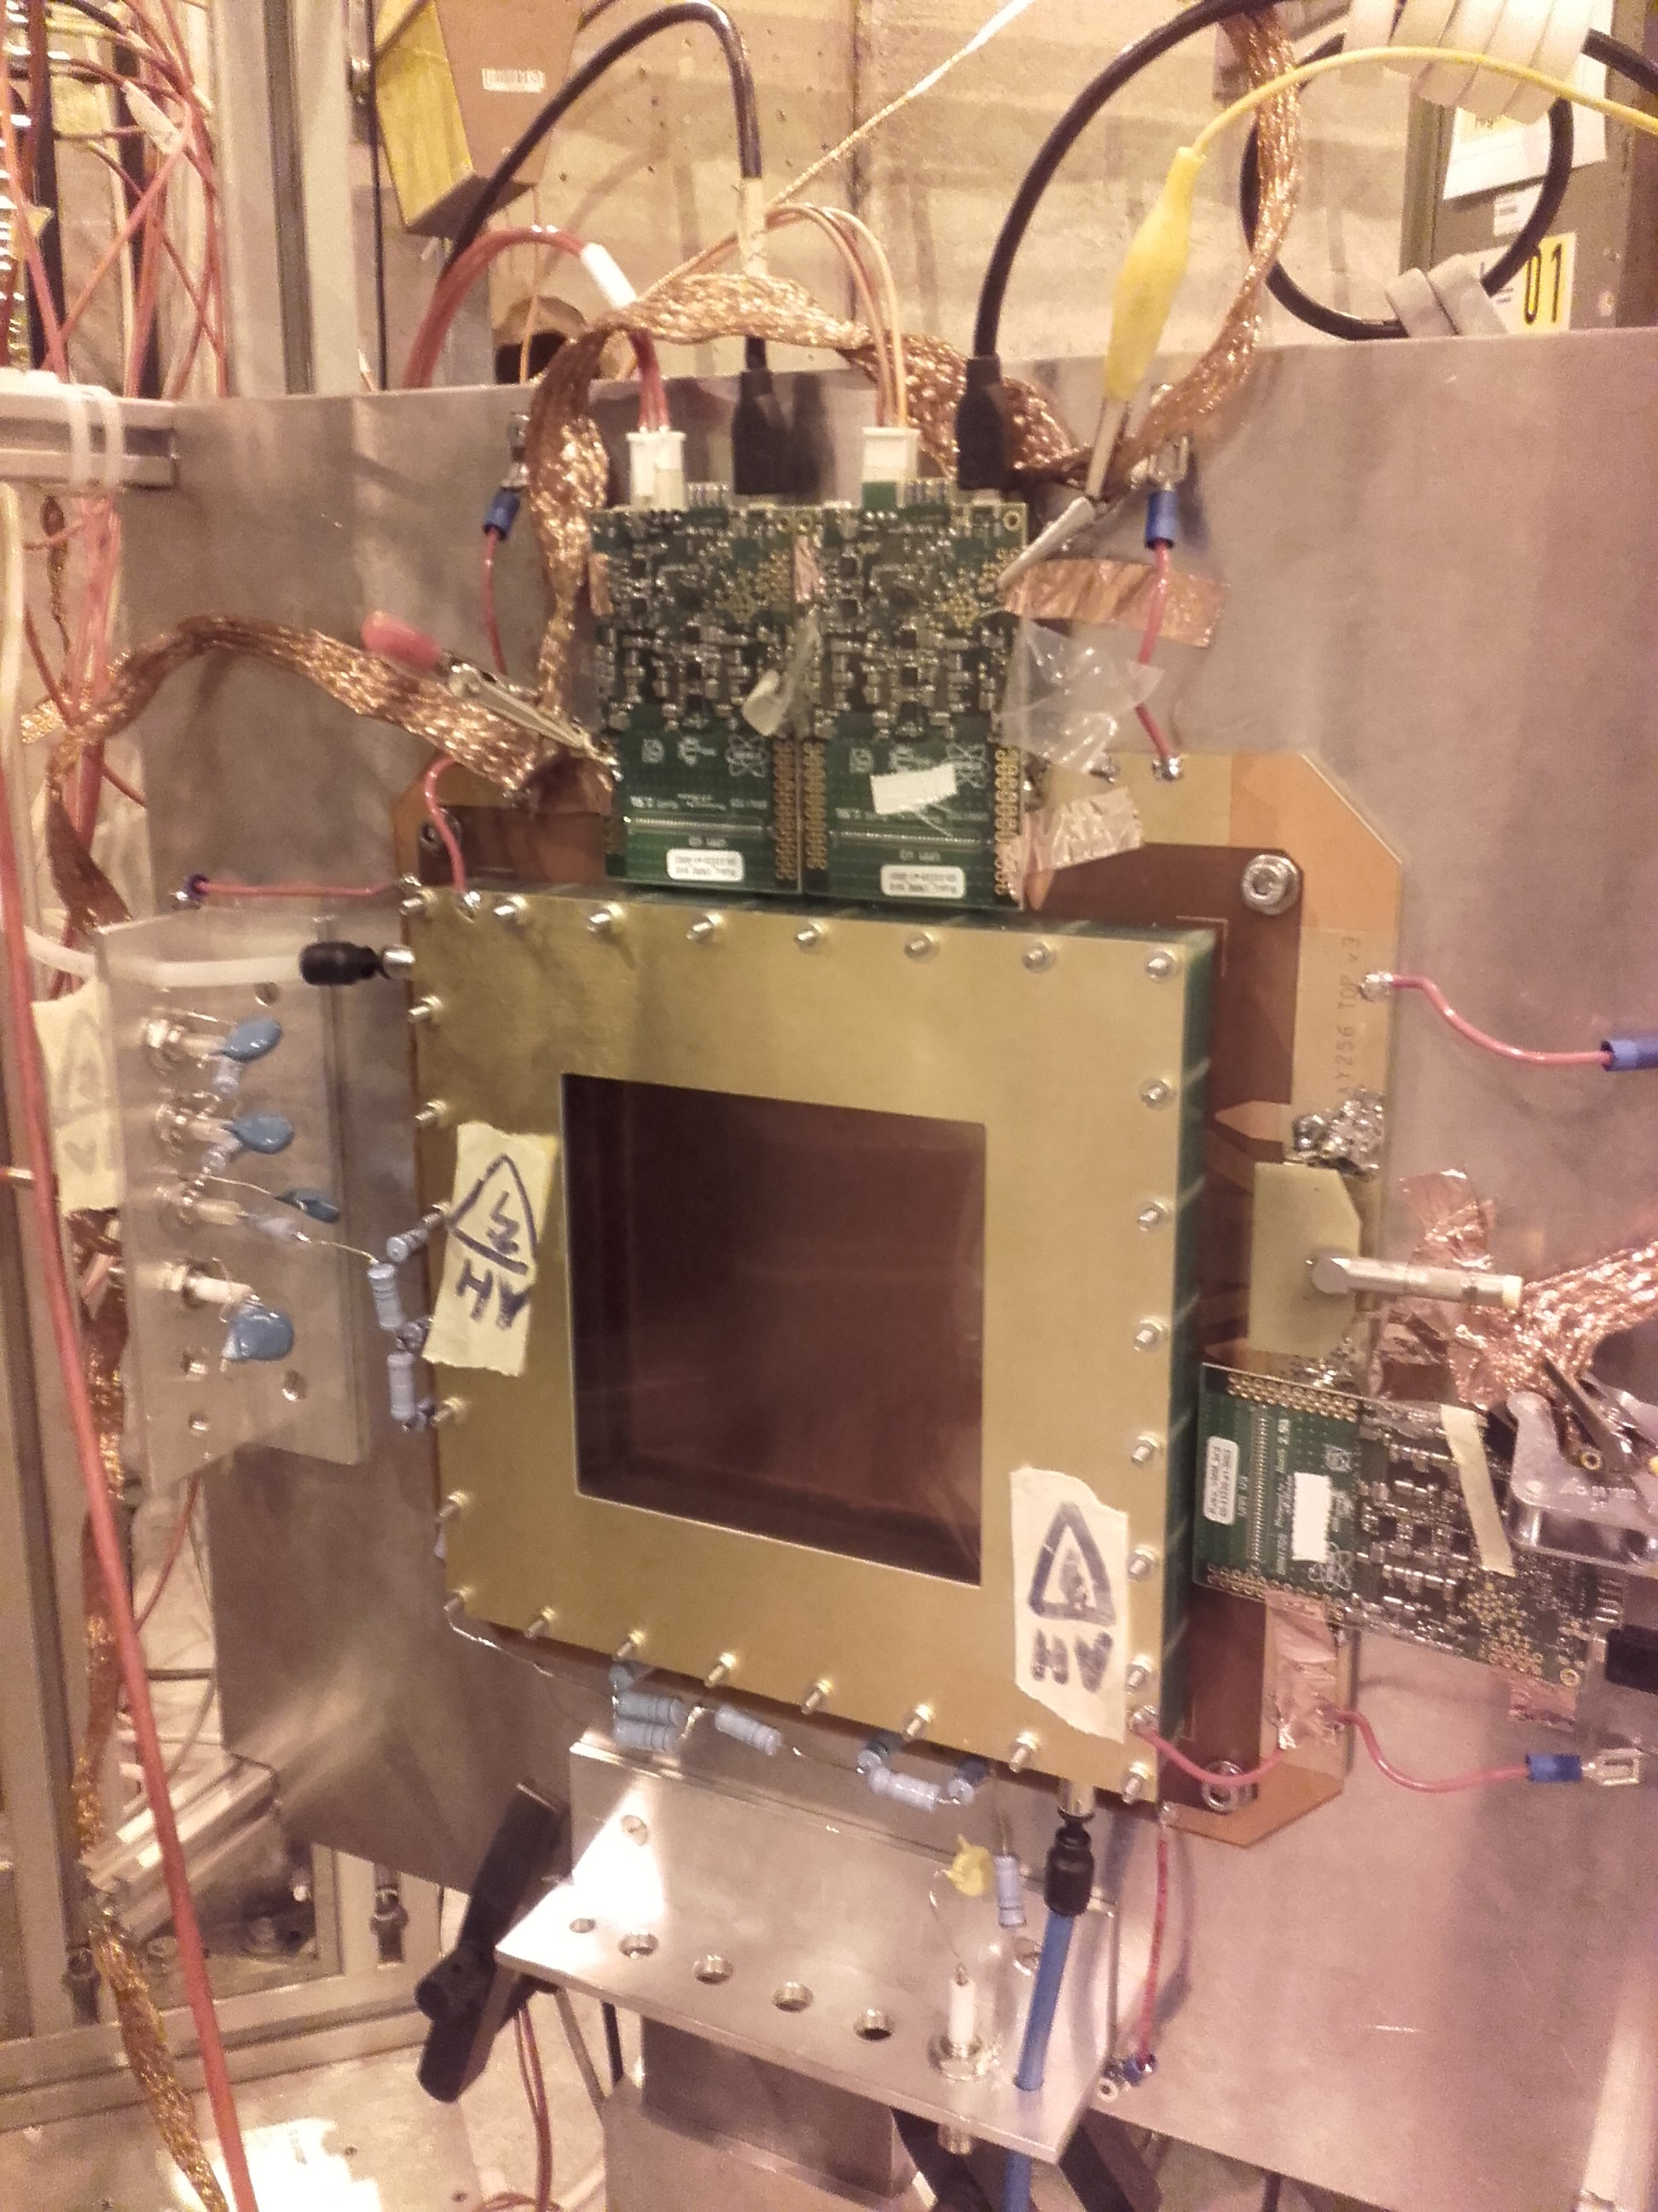
VMM Test
July, August & October period
https://indico.cern.ch/event/676702/contributions/2820911/attachments/1575722/2488184/RD51_Miniweek_VMM3.pdf

Slide 17
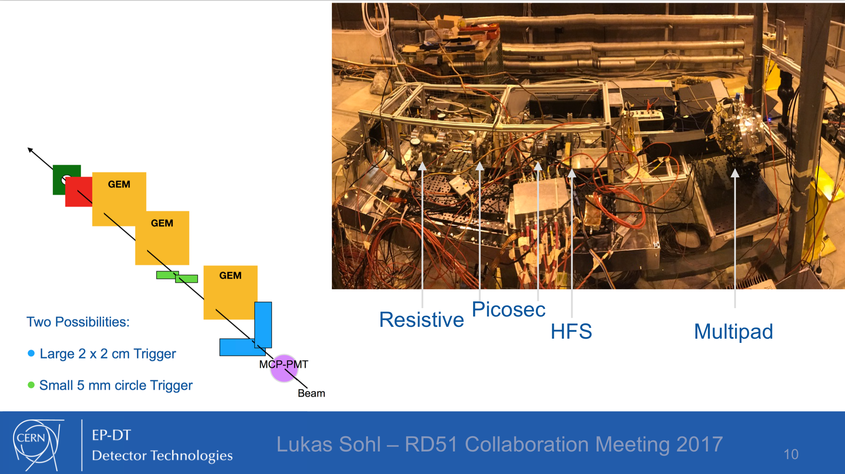
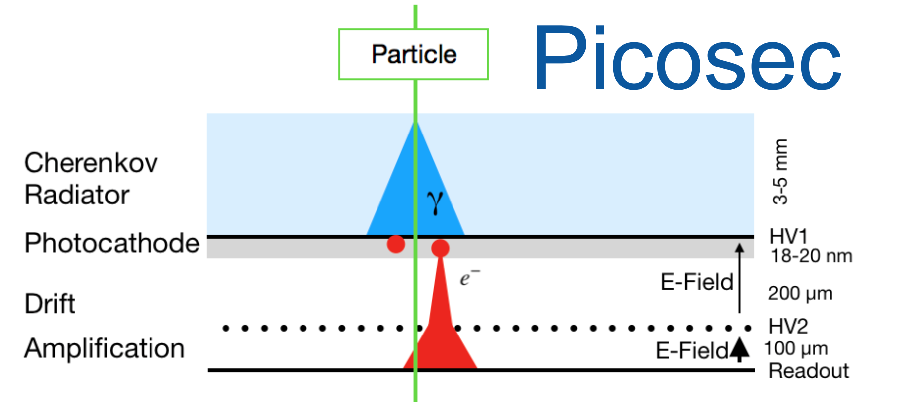
PICOSEC
July, August & October period
Novel Structures
https://indico.cern.ch/event/667256/contributions/2732292/attachments/1530884/2396008/Collaboration_Meeting_sohl.pdf
https://indico.cern.ch/event/667256/contributions/2730933/attachments/1529763/2394157/20170926_FJIguaz_WG1_Picosec.pdf

Slide 18
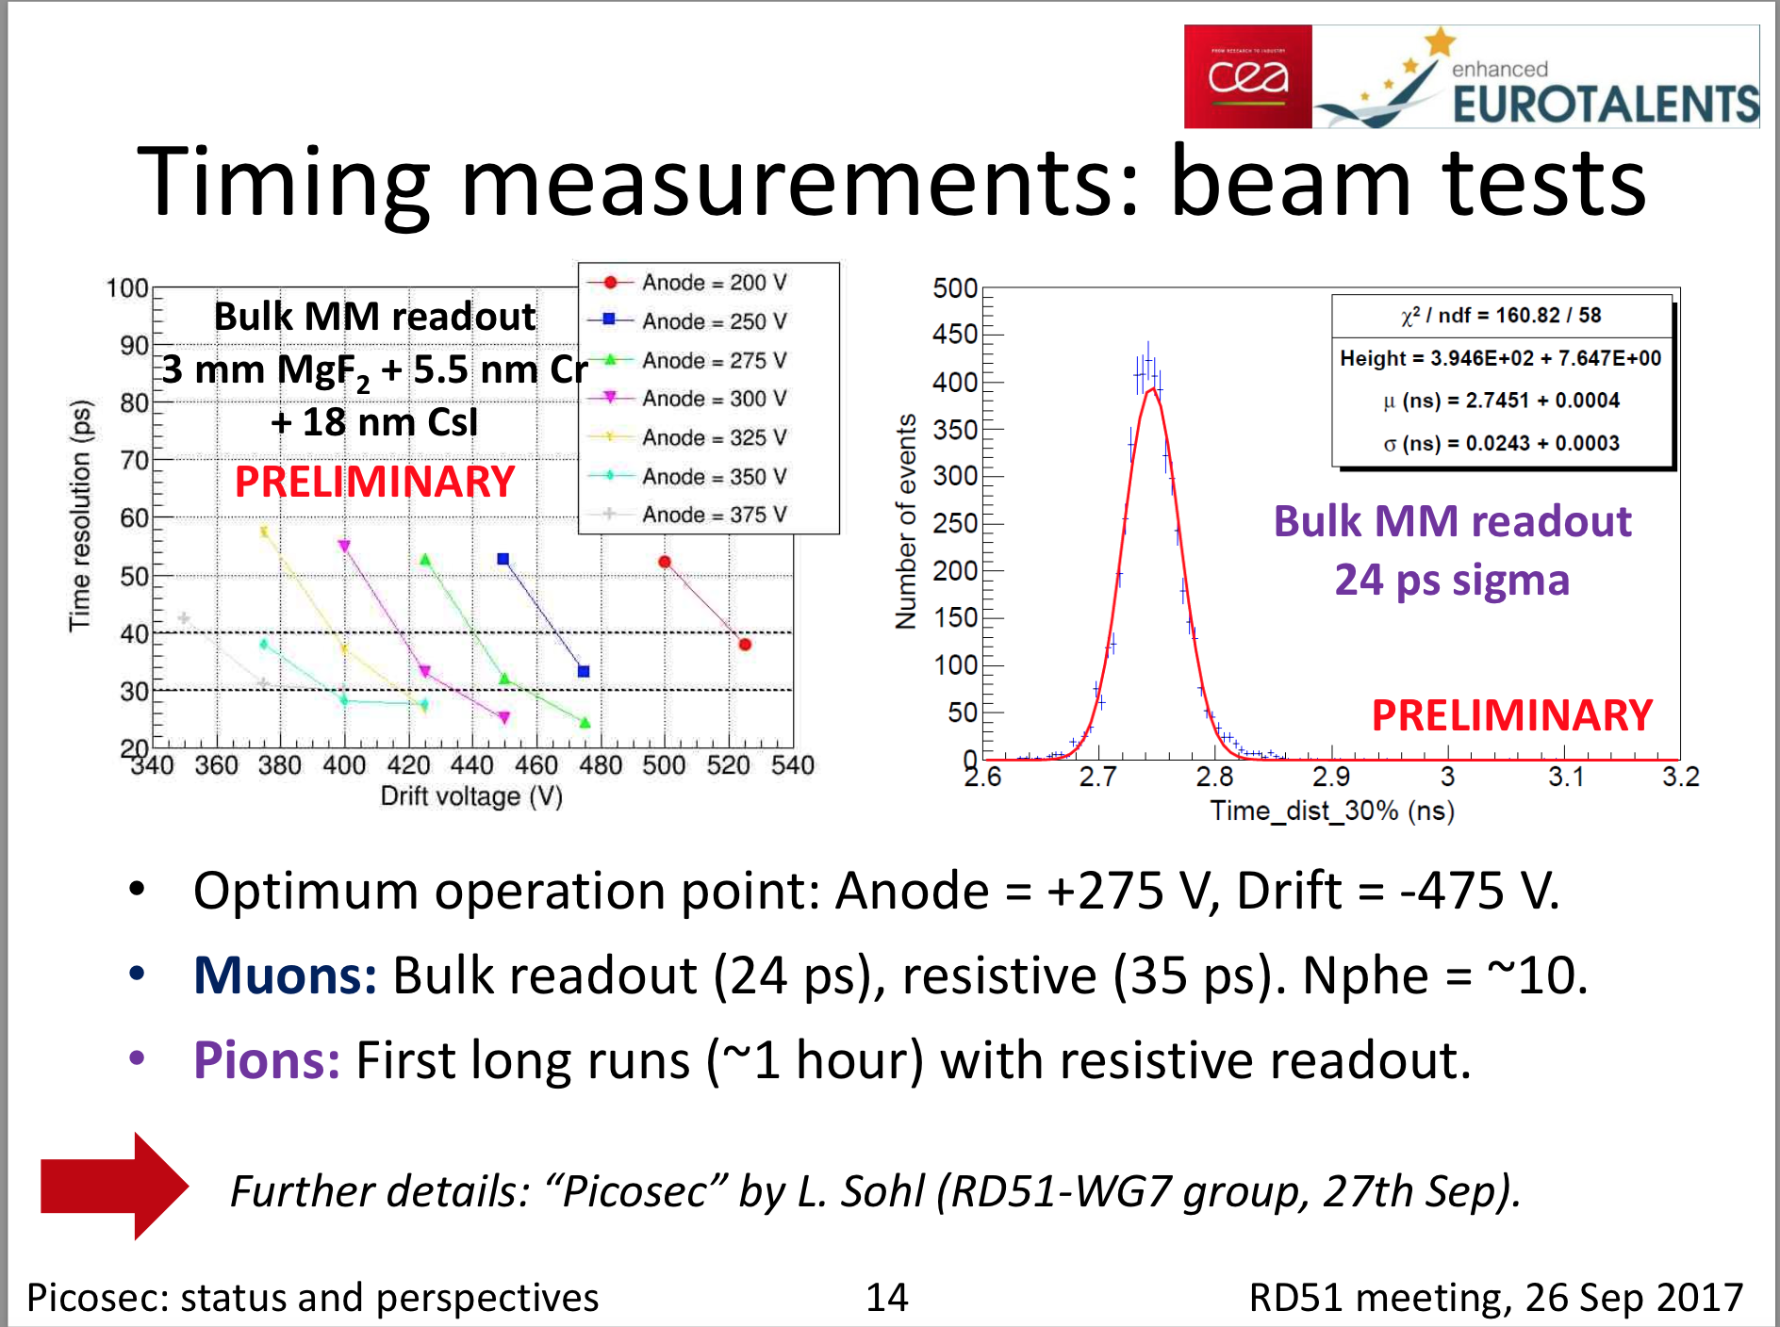
PICOSEC

Slide 19
Plans for 2018
2018 is the last chance for test beam before the LS2
We have requested 3 periods of 2 weeks each
SPS schedule will come out around the end of January

