Slide 1
Large size GEM production
RD51 mini week 15/12/17

Slide 2
Mecaronics
Techtra
Micropack
CERN

Slide 3



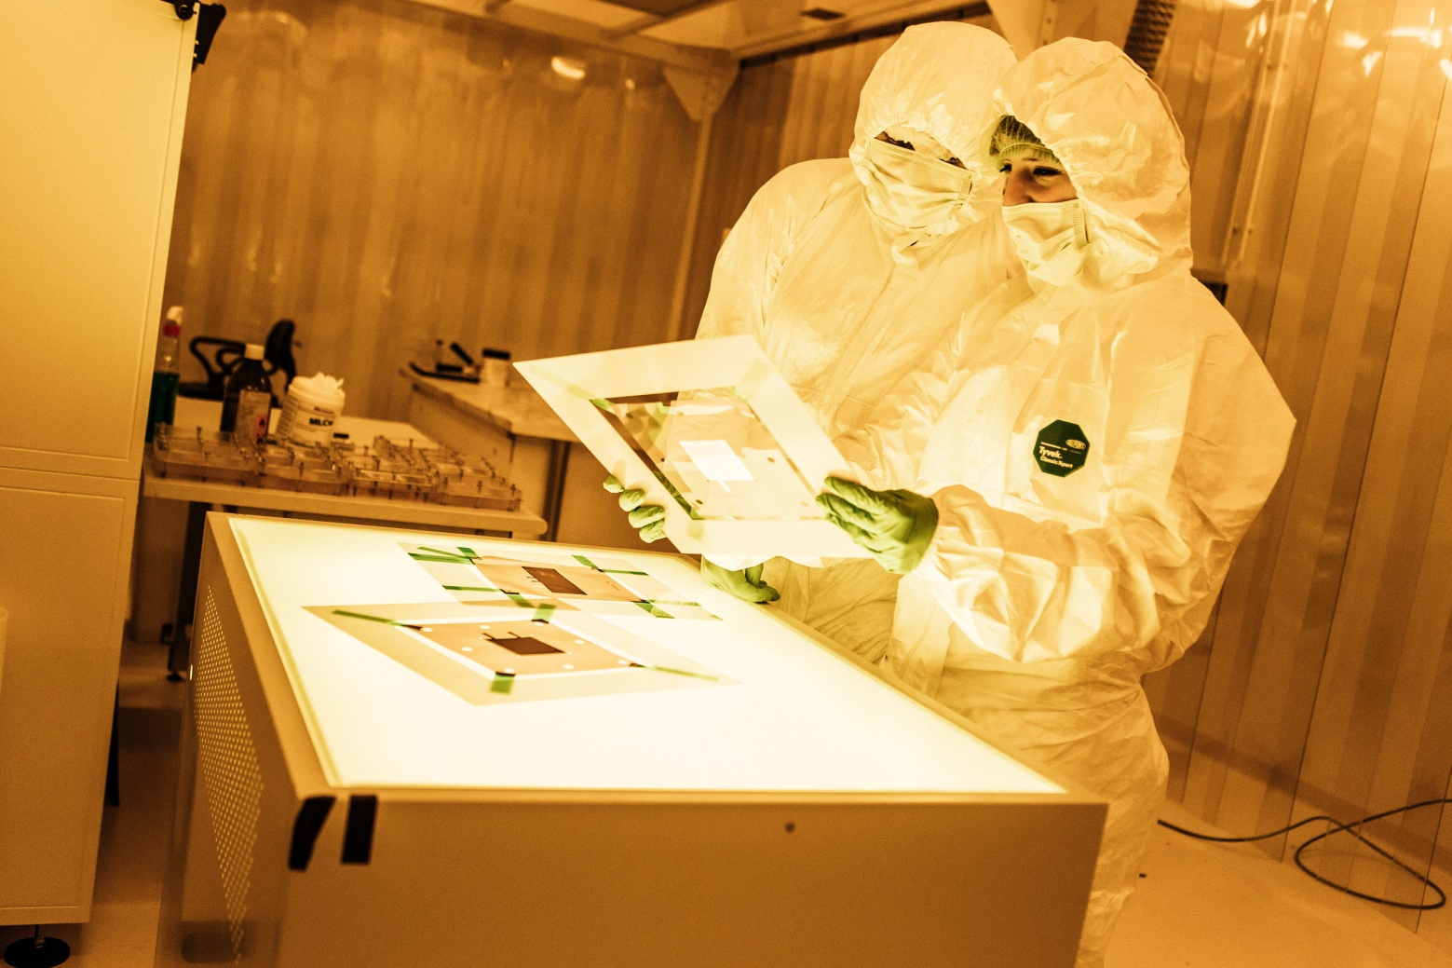
Production of GEM foils
TTA TECHTRA Sp. z o.o.
ul. Dunska 13 phone: +48 71 798 58 85
54-427 Wroclaw www.techtra.pl
Poland e-mail: techtra@techtra.pl
RD51, 15 Dec. 2017

Slide 4
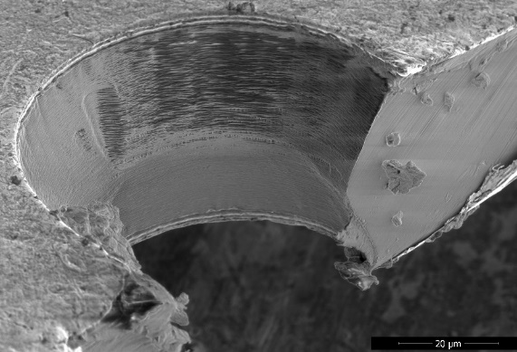
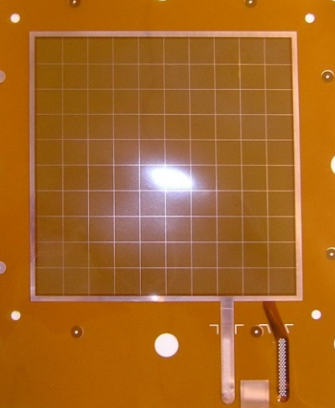
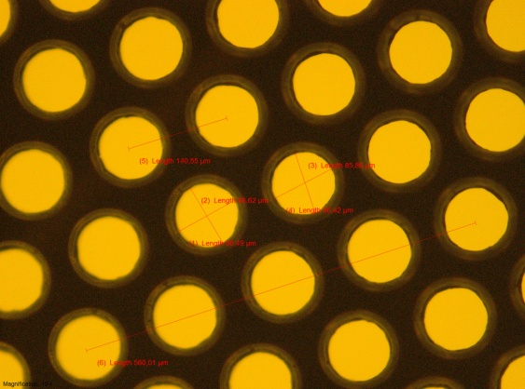
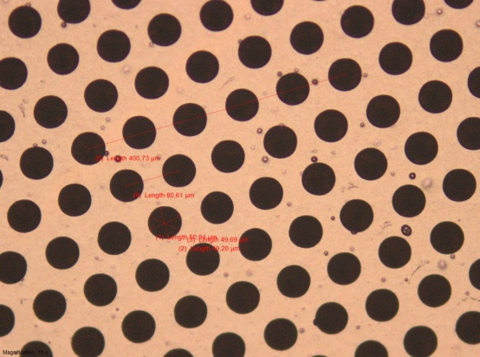
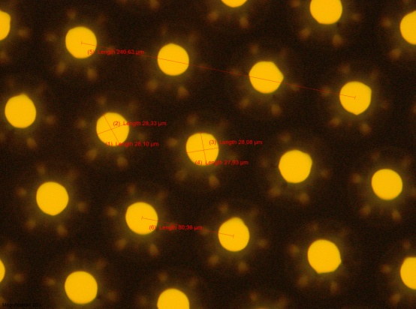
Production of small GEMs
Microscopic view of GEM hole, Techtra
Chrome GEM, Techtra
Since 2010 Techtra has produced over 1800 small GEM foils of different parameters: pitches, shapes, conical and cylindrical openings, ect
We make both large orders and individual foils.
We use CERN technology to get the same GEMs parameters.
GEM foils with different holes diameters, sizes ect, Techtra

Slide 5
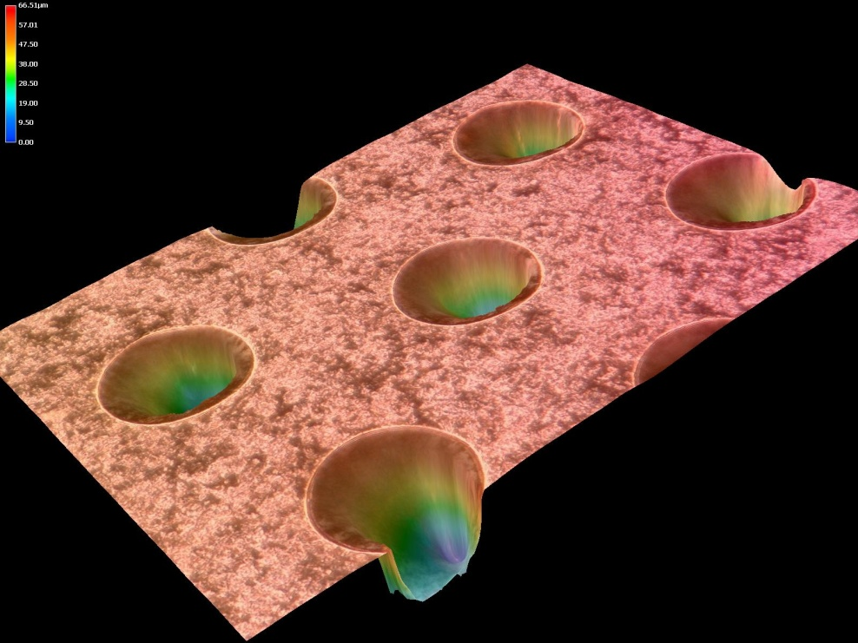
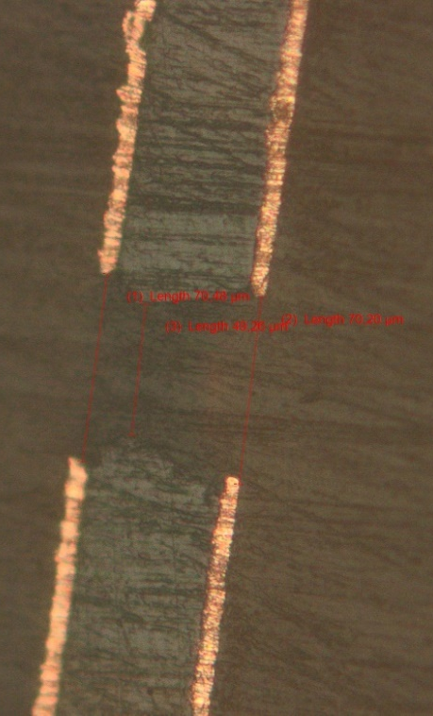
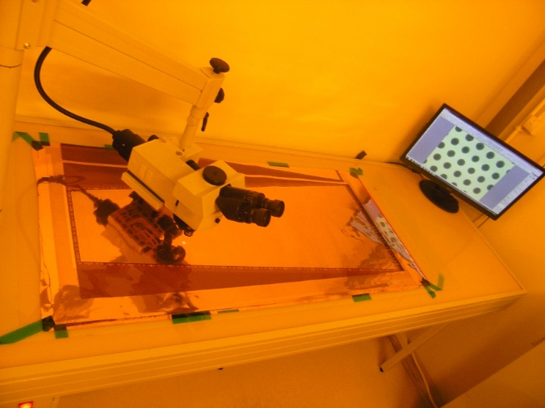
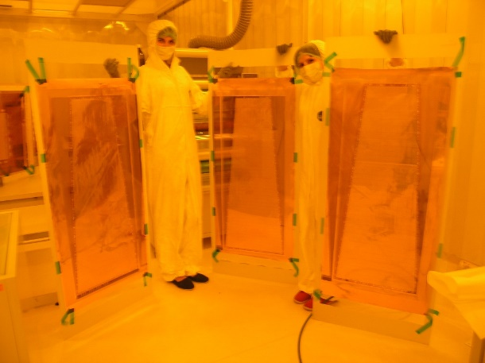
Production of „big” GEMs
Microscopic view of GEM hole, Techtra
Techtra has produced many big foils with single-mask technique.
The quality of the foils has reached an acceptable level.
Production efficiency and yield must be significantly increased in order to obtain production profitability.
We use CERN technology to get the same GEMs parameters.
„Big” GEM production, Techtra

Slide 6
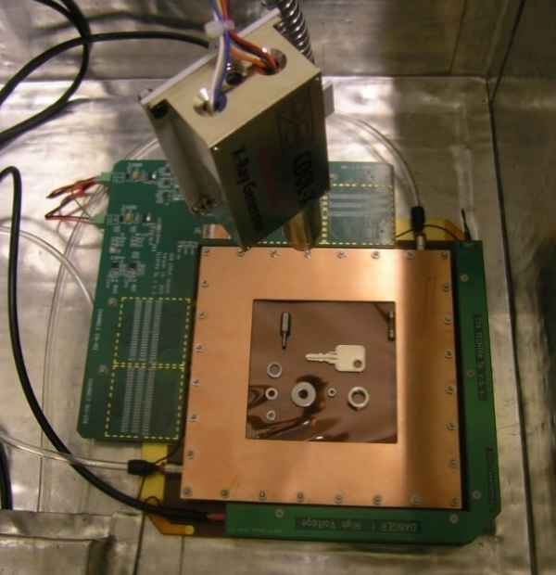
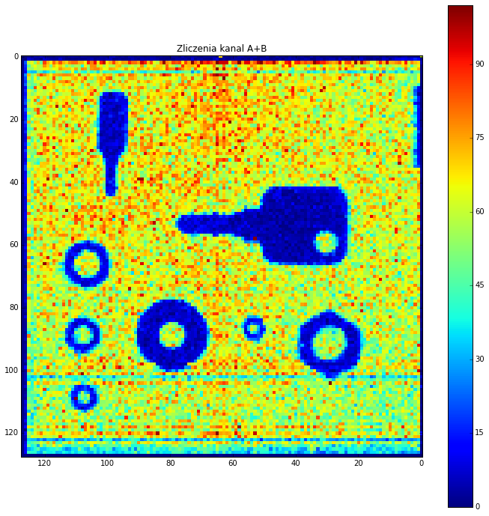
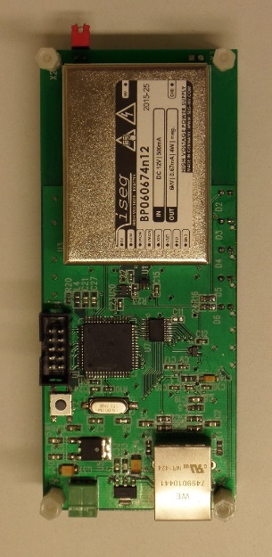
Production of GEM detectors
HV power supply for GEM detectors, Techtra
Commercially offered GEM detectors, Techtra.
Radiograph made with miniature X-ray tube, Techtra
Techtra offers 10x10cm2 GEM detectors fully compatibile with CERN XY256 detector kit. The detectors are built with:
256 CH’s readout system with USB/Ethernet communication module
Dedicated electronic DAQ system
High Voltage power supply controlled via Ethernet,
PC software for data aqusition and visualisation
GEMs, HV dividers, screws, gas box, gas system, cables, ect
RD51, 15 Dec. 2017

Slide 7

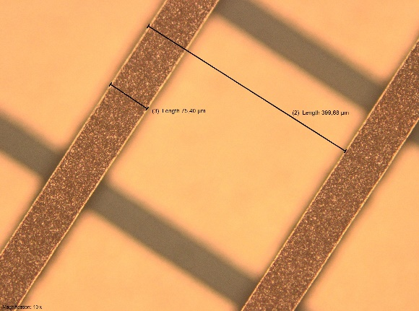
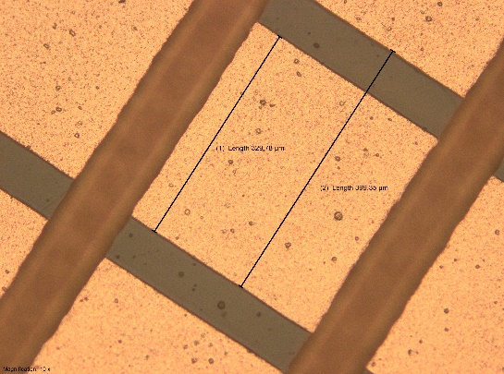
A new project: Production of read-out boards
256 X readout strips
256 Y readout strips
First 10x10cm2 readout board
made by Techtra.
R&D work is ongoing. First fully operational boards will be ready in 6 months from now.
Second phase of project is to build 30x30cm2 readout boards.
Third phase of the project is to build 30x30cm3 GEM detector.
RD51, 15 Dec. 2017

Slide 8
www.micropack.in
GE 1/1 PCB Status
Received order for initial batch of Long Readout / Drift , Short Readout / Drift PCBs in June 2016
Bare PCBs manufactured as per IPC 6012 Class 3 standards and the trial lot offered for inspection in August of 2016.
Was inspected by CERN team and representatives from the Indian Institutes of BARC and Delhi University
Cleared for pilot lot production.
www.micropack.in

Slide 9
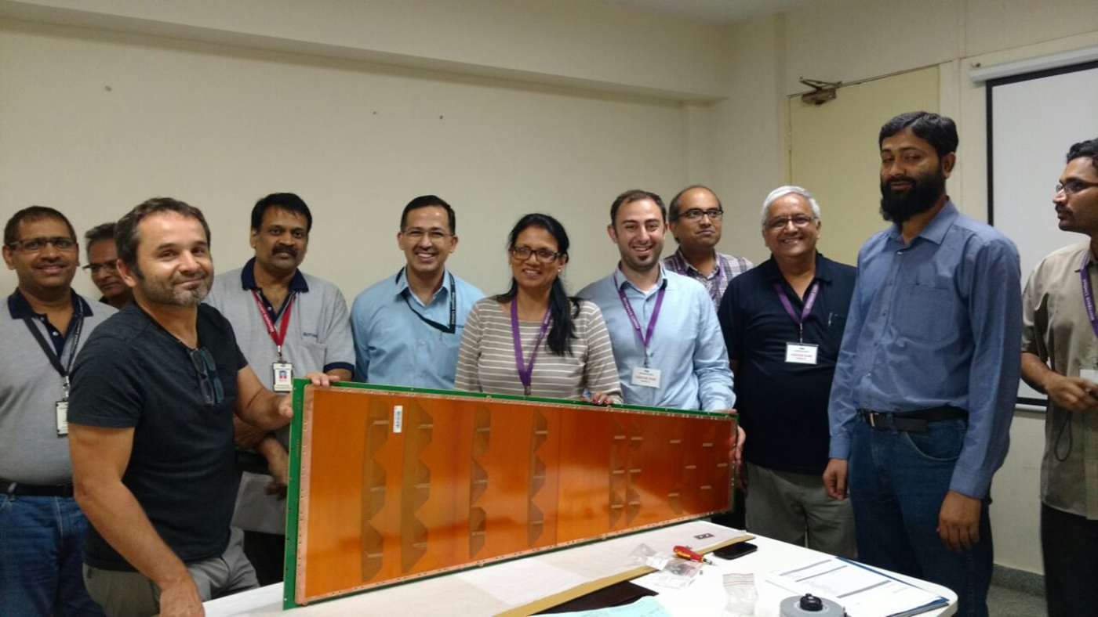
CERN team & Indian institute representatives during the Sep 2016 visit
www.micropack.in

Slide 10
GE 1/1 status
Supplies made till date against orders received from CERN / Indian Institutes:
Short Drift PCBs - 52 nos
Long Drift PCBs - 52 nos
Short Readout PCBs with connector assembly- 48 nos
Long Readout PCBs with connector assembly - 34 nos
Bare Short Readout PCBs - 4 nos
Bare Long Readout PCBs - 4 nos
Total PCBs - 194 nos
www.micropack.in

Slide 11
Thin GEM Foils
Initial development of Thin GEM to be with 100mm x 100mm active area.
Had issues with the availability of the special raw material (FCCL) initially.
Since 2016 almost 20-25 100mmx100mm GEM foils were fabricated and submitted to different agencies for evaluation including CERN, BARC and Delhi University
Has been able to achieve good uniformity as well as consistency across the 100x100mm foils
www.micropack.in

Slide 12
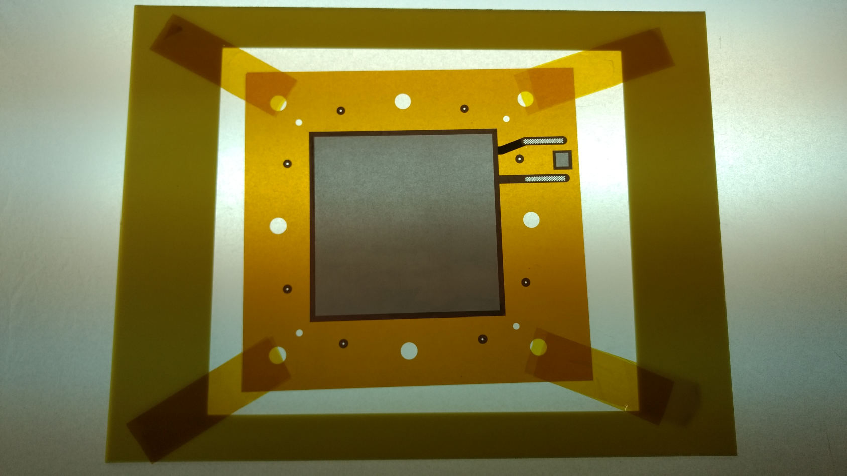
100mm x100mm active area - 70 microns dia / 140 microns pitch
www.micropack.in

Slide 13
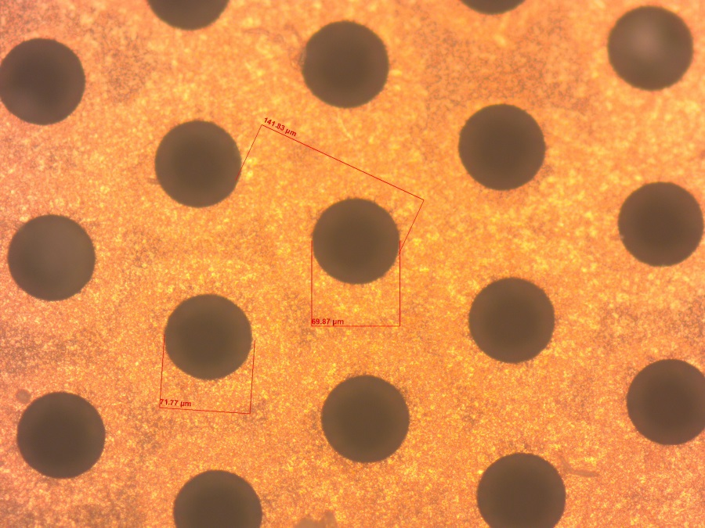

Images from the recent lot
100mm x100mm active area - 70 microns dia / 140 microns pitch
www.micropack.in

Slide 14
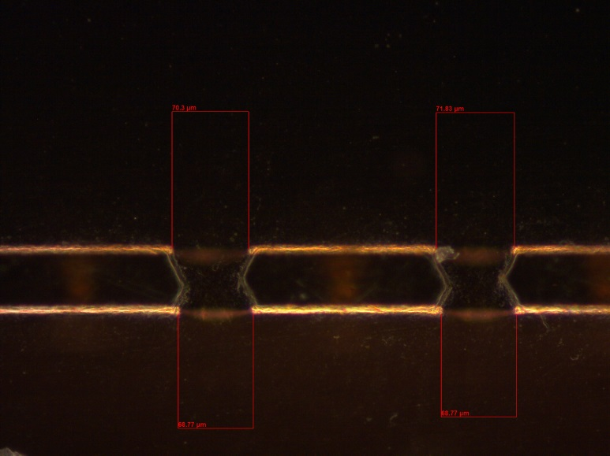
Consistent Double cone profile
Internal verification :
Optical Inspection – Outer copper Hole diameter / Inner Hole diameter / Uniformity
Insulation resistance – @ 600 V DC – Min 6 Giga Ohms for 60 seconds
www.micropack.in

Slide 15
Status & Work ahead – Thin GEM foils
Has stabilized the process for 100x100 Thin GEM foils
Also has started working on 300 x 300mm thin GEM foils.
Process requirements for a bigger panel size, especially with regard to PI etching established.
Further trials and process optimization in progress based on inputs from CERN & various agencies
www.micropack.in

Slide 16
CERN MPT workshop
GEM main projects in production
Production projects Completion
ALICE TPC GEM 1.6m x 400mm 772 GEM 80%
CMS GE1/1 GEM 1.2m x 450mm 480 GEM 70%
BESIII detector 600mm x 400mm 10 detectors 80%
CBM GEM 1m x 450mm 100 GEMs 50%
BM@N Dubna GEM detectors 1.8m x 0.6m 7 detectors 95%
BM@N Dubna GEM detectors 1.8m x 0.5m 7 detectors 0%
BM@N Dubna GEM detectors 2m x 0.6m 7 detectors 0%
R&D project
Bonus 12
Gadolinium triple GEM detector
ESS
AL GEM
Main GEM R&D project in progress

Slide 17
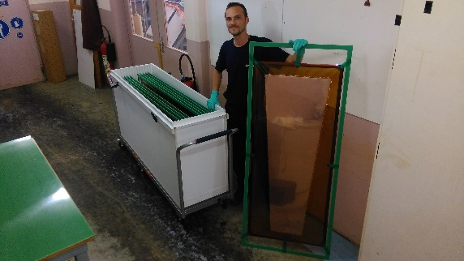
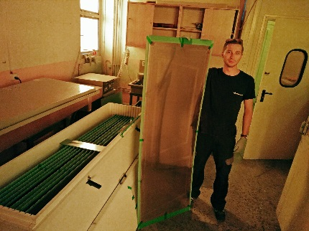
ALICE/CMS Status
5 FSU technicians + 2 CERN staff part time
Year 2016 2017 June/2018
Expected 140 220 120 total 480
reality 140 233
CMS
Yield:
initial 10 GEM/tech/4w
now 12 GEM/tech/4w
Year 2016 2017 April/2018
Expected 174 378 220 total 772
reality 174 353
ALICE TPC
Yield:
initial 16 GEM/tech/5w
now 20 GEM/tech/5w

