Slide 1
Aluminum GEM
RD51 mini week 15/12/17
R&D IPPLM (Warsaw)/CERN

Slide 2
Aluminum knowledge at CERN MPT workshop
GEM process
Malter effect
Low mass Read-out possibilities with Al strips

Slide 3
Material budget
Material | Radiation length [cm] | Density [gr/cc] | Resistivity [uohms*cm]
Gold | 0.3 | 19.3 | 2.4
Copper | 1.4 | 9.0 | 1.7
Aluminum | 8.9 | 2.7 | 2.7
Glass epoxy | 19.4
Polyimide | 29.0
Beryllium | 35.3 | 1.9 | 3.3
Copper is close to 6.5 times less transparent than aluminum
And aluminum has only 1.6 times the resistivity of copper
Polyimide is 1.5 times better than glass epoxy.

Slide 4
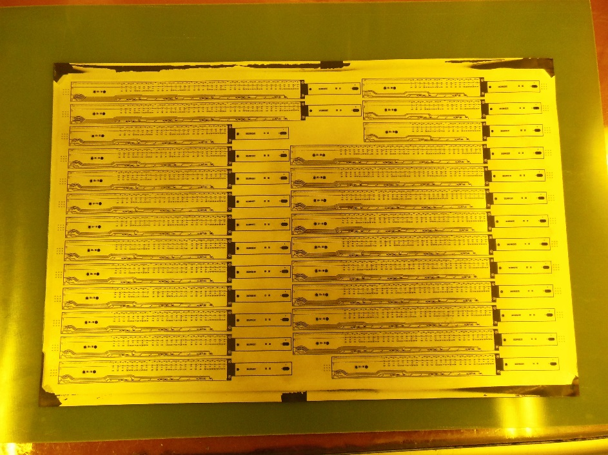
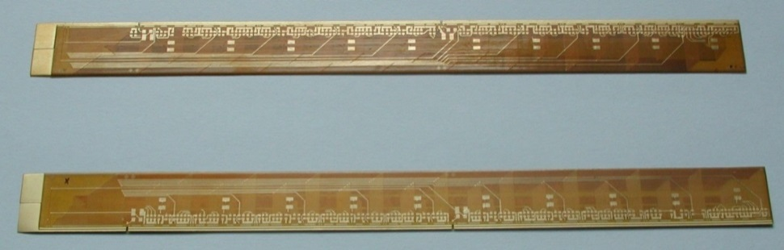
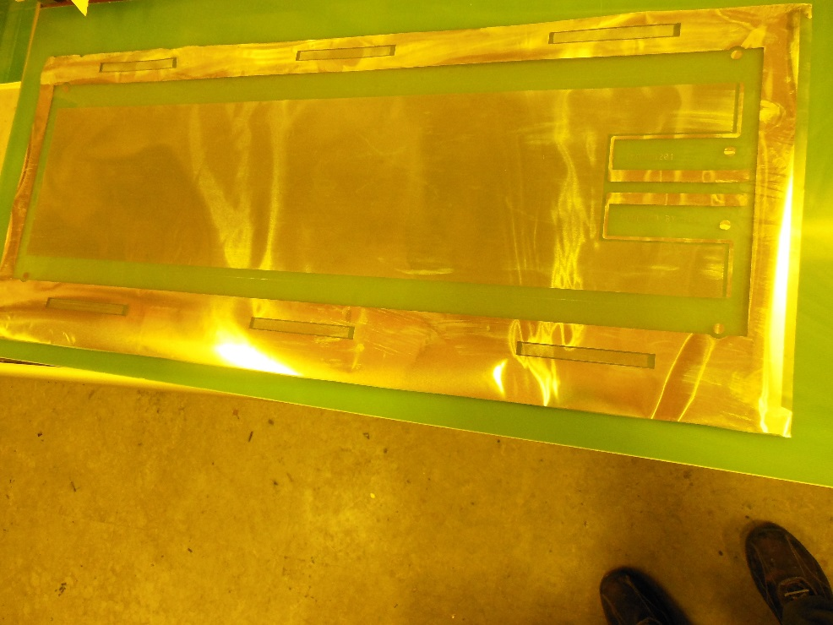
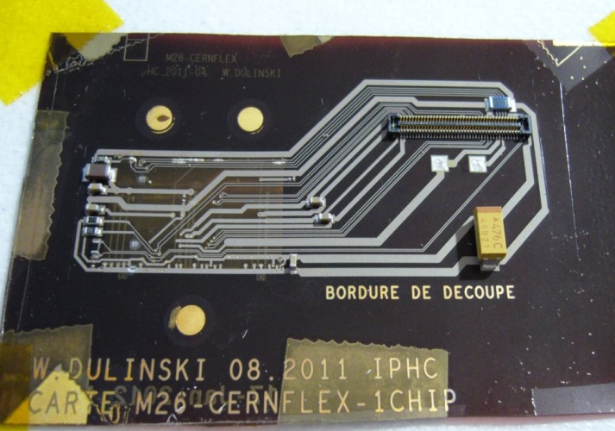
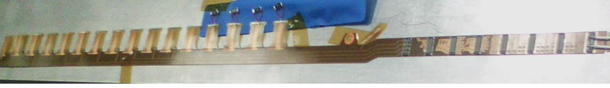
Existing Alice inner tracker bus
Aluminium Heater
Alice inner tracker upgrade bus
Silicon detector embedded in flex
ATLAS IBL bus

Slide 5
Aluminum capabilities at CERN-MPT
Glued aluminum foils : 7um to 200um
Vacuum deposited AL up to 30um
Microvia plating
Ni/Au plating
Multilayer structures

Slide 6
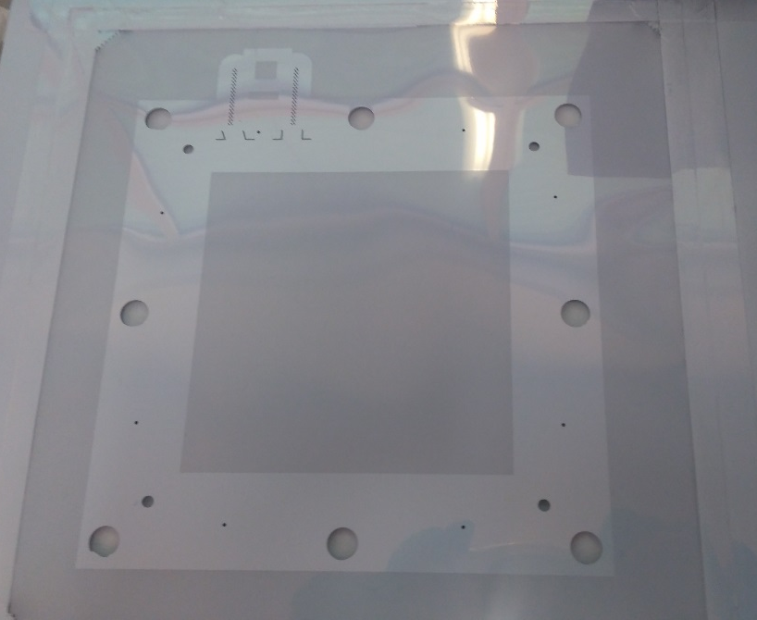
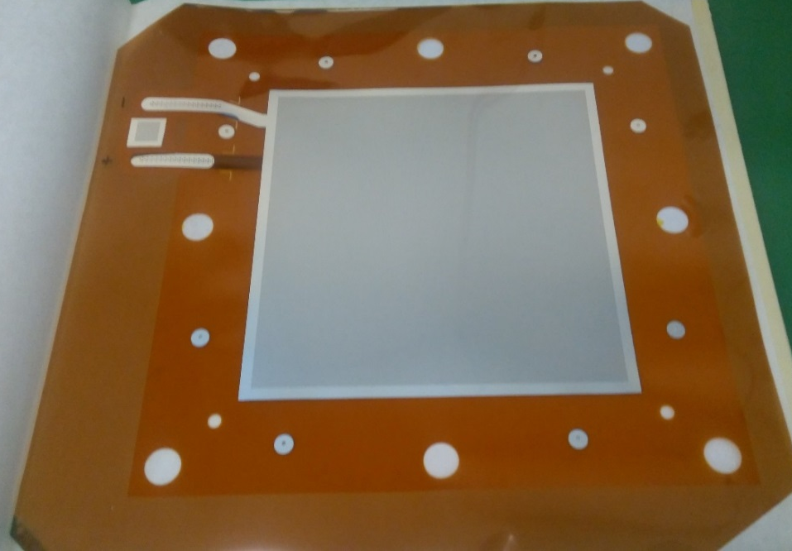
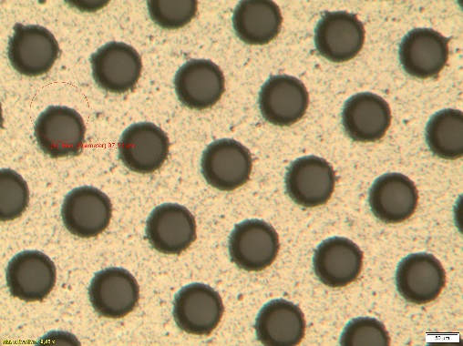
Aluminium GEM Before processing
Finished Aluminium GEM
STD pattern 140um /70um
Less than 10nA at 600 V

Slide 7
Process flow
Kapton 5/50/5
Hole patterning in Cu
Polyimide etch
Copper and chromium etch
Aluminum pvd coating 5um
Selective Aluminum and chromium etch with a new method
3um Aluminum at the end

Slide 8
shaking
Low etching rate bath
Etching rate much bigger in the holes
Typ : 25 min
Initial Al Thickness 5 um
Final Al Thickness 3um

Slide 9
Malter effects
We are thinking to use Alodine treatment to stabilize the oxides and keep surface electrical conductivity. (Chromic acid treatment)
This treatment is available with Cr VI and Cr III
Thicknesses from a few atomic layers up to 3um
Other treatments like Eloxage or Anodization will only create a strong oxide protection increasing Malter effect
Treatment not yet tested

Slide 10
Low mass read-out
DLC
X axis AL lines
Kapton
Y axis AL lines
Full Al structure
5um minimum Al thickness
Ni/Au treatment of connectors for STD assembly
No Kapton etching
Rate and Cluster size related to DLC resistivity
Spark protected

