Slide 1
Online software and controls for VMM SRS
Morten Jagd Christensen
European Spallation Source
Data Management and Software Centre (DMSC)
Copenhagen

Slide 2
About ESS
Multidisciplinary research facility
Powerful pulsed neutron source, Lund, Sweden
Joint effort of 17 european countries
Operational from 2023 with (initially) 15 instruments
Everything is built from scratch
  Instrument hardware
  Detectors
  Readout electronics
  Data processing and management software

Slide 3
Relation to RD51
Three detectors will cover 5(6) of the new instruments
  Multigrid x2 (x3)
  Multiblade (x2)
  Gd-GEM
All three detectors will use VMM3 for electronic readout
Gd-GEM currently uses SRS

Slide 4
Context
Data Management and Software Centre
  Situated in Copenhagen, Denmark
Responsible for all software related to data
  Acquisition, event formation, aggregation, storage and analysis
Focus on early integration
  Early info on data formats, rates, processing requirements
  Collaboration with ESS Detector Group

Slide 5
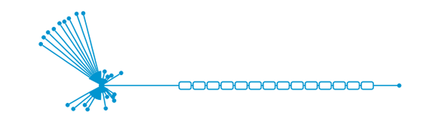




System data flow
instruments
detectors
event formation
aggregator
nexus writer
storage
inst1_det1
inst1_det2
...
instN_detM
Notes:
Explain data path - mention that beyond the 'live' data lies Mantid, scientists and Nobel prizes
Mention the control path for setting up experiment parameters but that those should be irrelevant for the EFU
Still undefined whether the event formation units should be dynamically reconfigurable and to what extent
Important: this presentation is only concerned with the detectors/event formation part

Slide 6
Detector to EFU
readout system
event formation
readout
Instr. 1 Detector 1
switch
EFU
Instr. 1 Detector 2
EFU
Instr. 2 Detector 1
EFU
Notes:
For the EFU the specific detector/readout system interconnection is unimportant
Assumption: a single detector is handled by a single EFU and that no communications between EFU’s are necessary
It is possible, but currently undefined, if there will be more than one Ethernet link between the readout system and a specific EFU

Slide 7
Event Formation Unit (EFU)
Main function
  receive detector data
  calculate detector position (pixel)
  generate events <t, pixel>
  forward events to scalable storage
Multi threaded C++ application
  Linux (Ubuntu and CentOS) and Mac
Detector Framework
  Loading and launching processing pipelines
  Publish realtime metrics/counters with Graphite
  Logging with Graylog
  Command line API for remote operation
  Streaming of event data with Kafka
  Custom detector processing plugins can be added

Slide 8
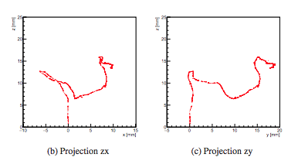
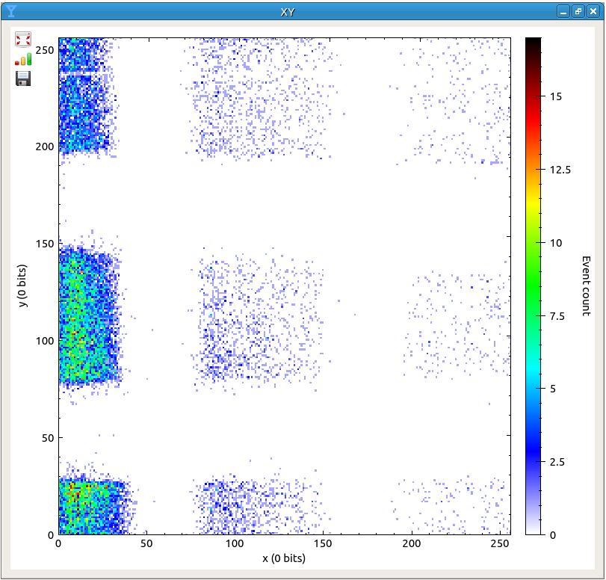
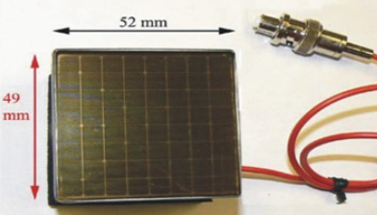
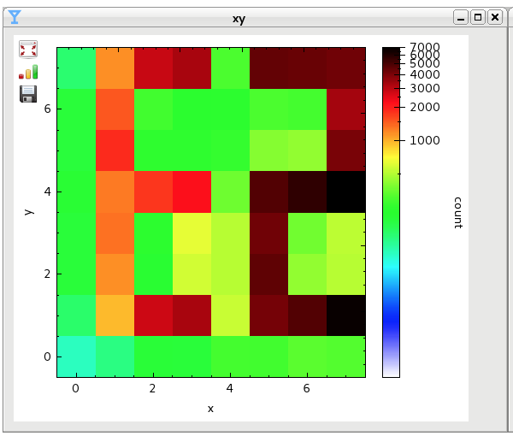
Pixels: from complex to simple
(fec, asic, channel, TOF, adc)
pixel 1
(asic, channel, TOF)

Slide 9
Event Formation Unit (EFU)
Main function
  receive detector data
  calculate detector position (pixel)
  generate events <t, pixel>
  forward events to scalable storage
Multi threaded C++ application
  Linux (Ubuntu and CentOS) and Mac
Detector Framework
  Loading and launching processing pipelines
  Publish realtime metrics/counters with Graphite
  Logging with Graylog
  Command line API for remote operation
  Streaming of event data with Kafka
  Custom detector processing plugins can be added

Slide 10
EFU Framework
servers
broker_ip:9092
user interaction
Detector
Data
UDP
TCP
Kafka
Broker
input
processing
efu_ip:9000
output
Command
Client
TCP
efu server
TCP
Graphite
db
Grafana
Live
Metrics
efu_ip:8888
graphite_ip:2003
grafana_ip:3000
TCP
Graylog
file system
config .json
calibration
data
greylog_ip:12201
Notes:
Data path - network, pipeline, streaming
Control path - static and dynamic configuration
Reporting - Graphite, Graylog

Slide 11
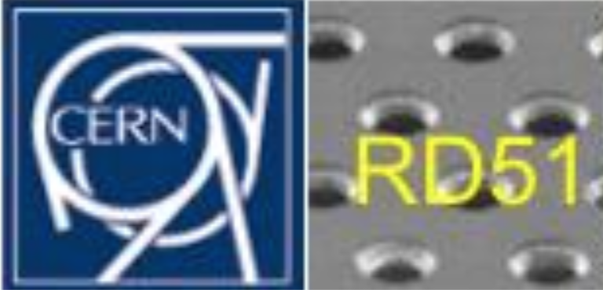
EFU as VMM/SRS DAQ
Software bundle on single workstation
  Readout software
    RD51 VMM Slow control
  Event Formation Unit
    Parser for SRS/VMM data format
    Clustering and Event formation implementation
    Software ‘hook’ to write readout data to disk
  Kafka
    Data aggregation
  DAQuiri
    Detector image visualization from Kafka topics
    Histograms, particle track samples, TOF spectra, ...
  Graphite/Grafana
    Visualizing EFU time series data
  Wireshark
    Raw readout data capture, low level readout inspection
Open source software, ESS developed software is under BSD license.

Slide 12
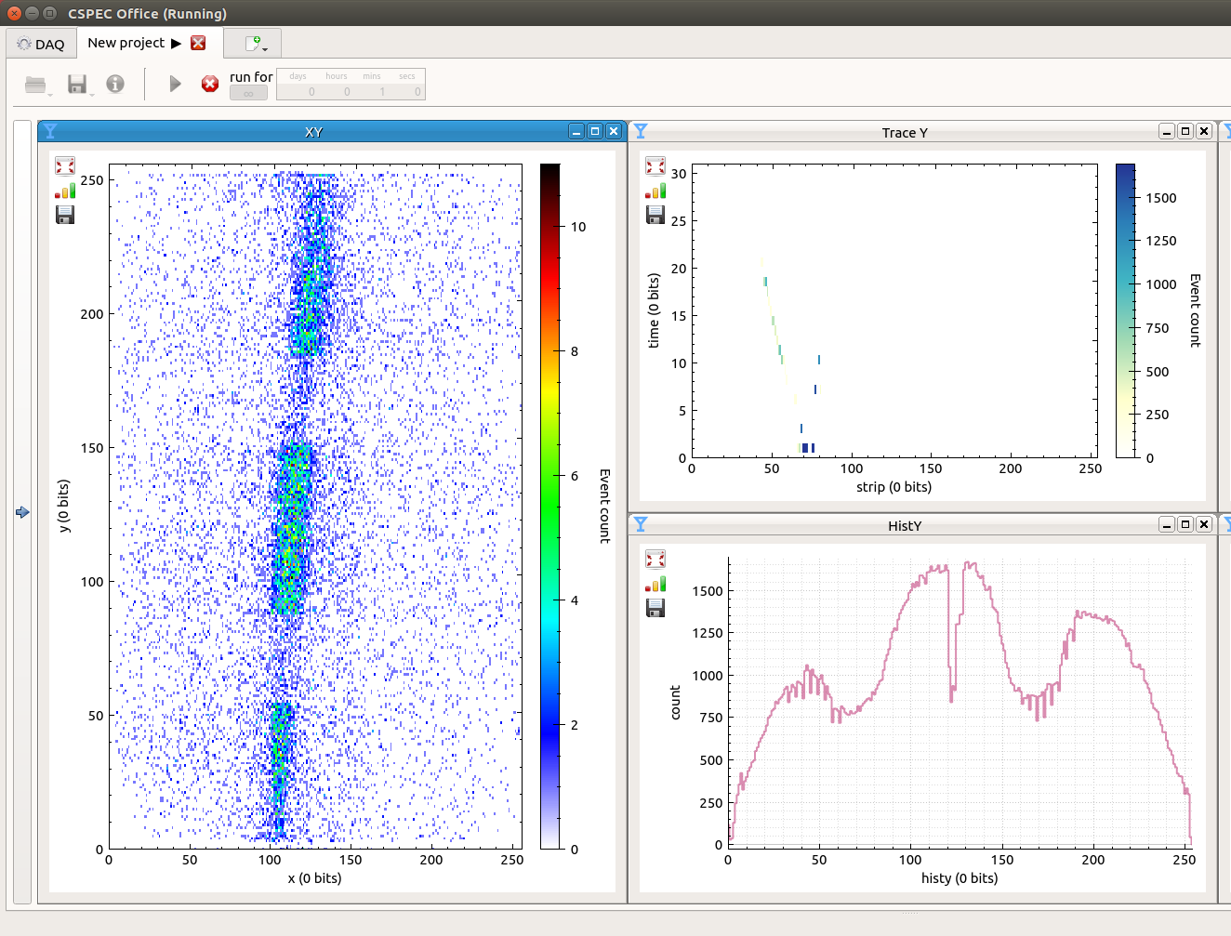
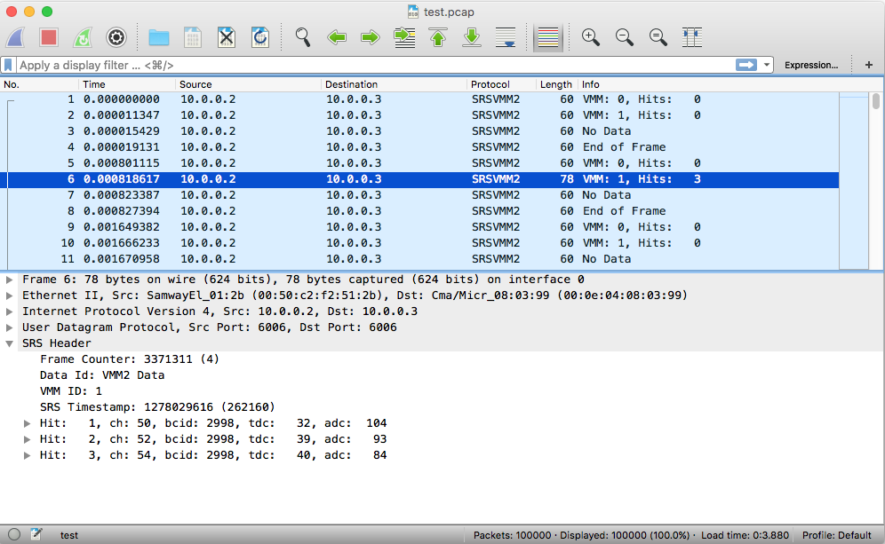
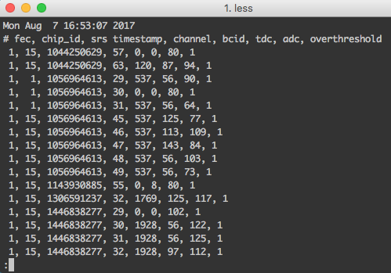
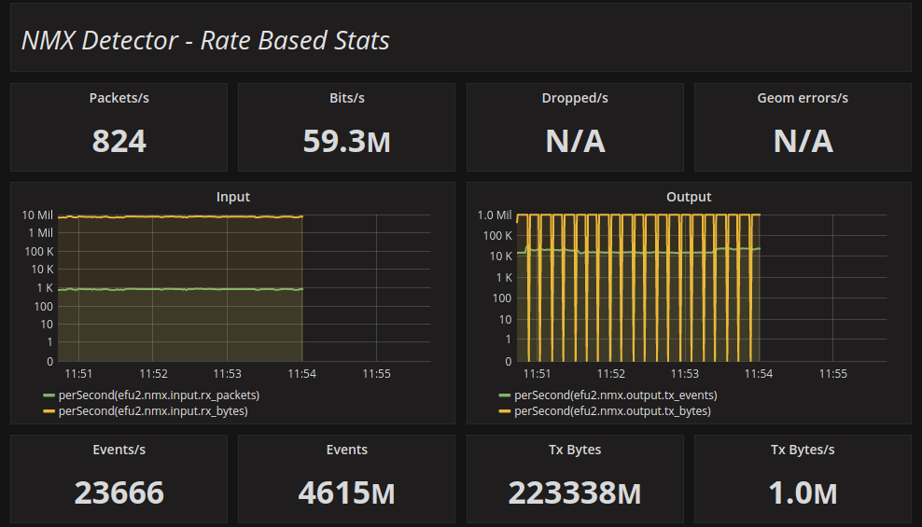
Detector data taps
Analog/Electric
Digital HW
Event Formation
Data Aggregation
EFU
Events
Gd-GEM Detector
SRS
Input
Proc.
Output
Histograms (x,y)
Particle tracks (x,y)
SoNDe Detector
IDEAS
Multigrid
ESS
Multiblade
File Storage
raw data captures
Decoded data dump
Counters & Stats
Activity dashboards
Notes:
Busy slide - sorry
Data path again
Domains
Data TAPS

Slide 13
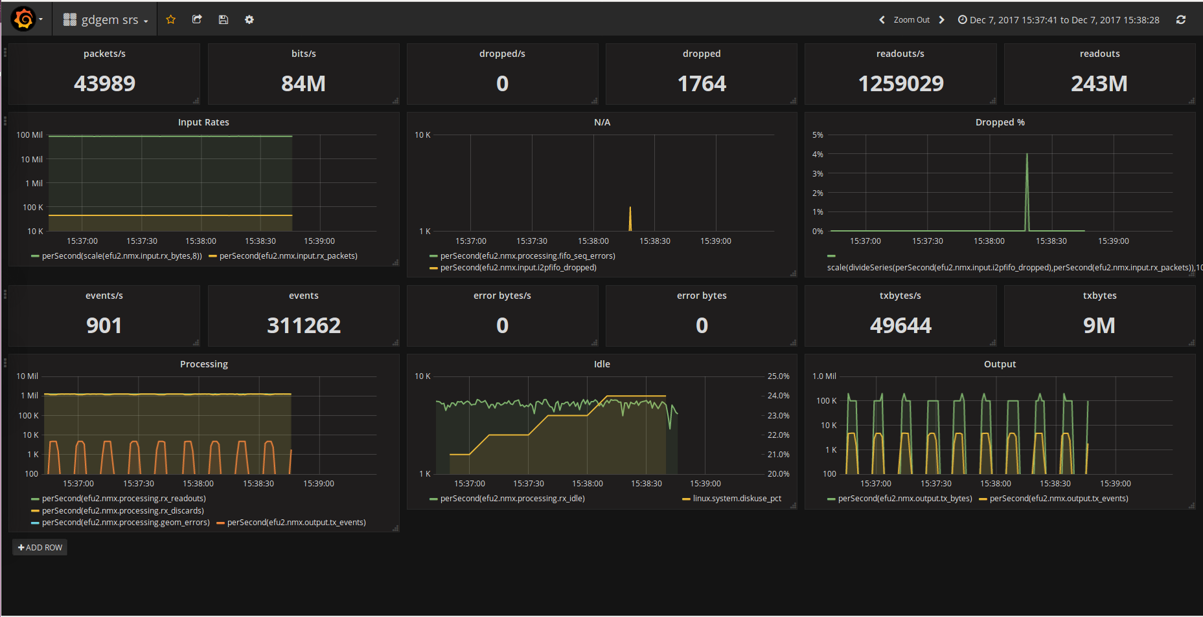
VMM/SRS readout stats

Slide 14
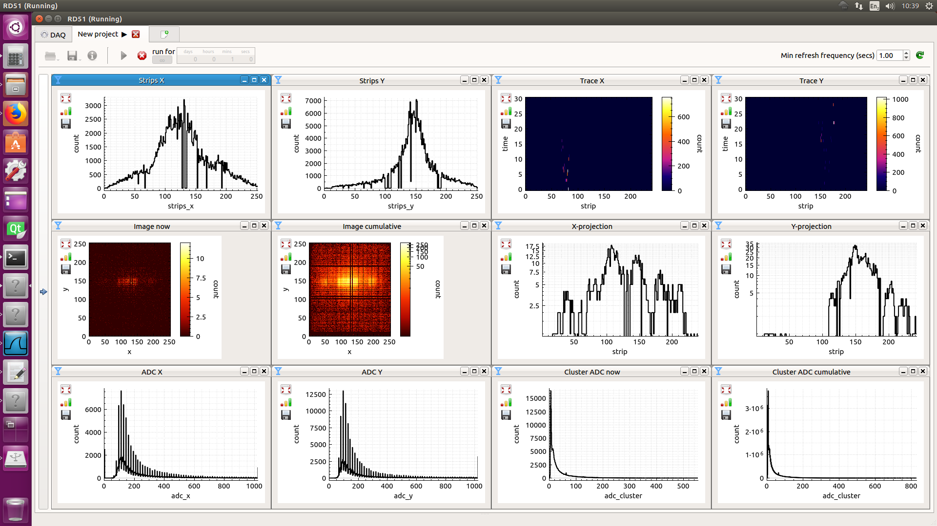
VMM data visualization

Slide 15
Performance
Recent experiments on real ESS detector readout data
  Linux
  Xeon E5-2620 v3 @ 2.40GHz CPU
  1G Ethernet
  using two cores: input and processing
  When writing to disk, speeds are lower
detector | packets/s | bits/s | dropped | events/s | geomerrors/s
Multiblade | 83k | 957M | 5% | 2.4M | 3.7M
Multigrid | 13k | 117M | 0% | 2.7M | 56k
SoNDe | 94k | 949M | 0% | 23.2M | n/a
Gd-GEM | 239k | 78M | 0% | 10k | n/a?

Slide 16
Conclusions
Using the anticipated infrastructure for early detector experiments we
  get early validation of the implementation
  obtain a common understanding of the interface
  establish early collaboration across the organization
  Identify processing bottle necks for later improvement
Providing tools for live data and statistics visualization
  Efficient use of beam time
  Expert views can be customized for protoype detectors
  Processing algorithms can be quickly tested and validated

Slide 17
links
Event Formation Unit
  https://github.com/ess-dmsc/event-formation-unit
DAQuiri
  https://github.com/ess-dmsc/daquiri
Grafana
  https://grafana.com/ or run in Docker container
  https://github.com/ess-dmsc/utils
Apache Kafka
  https://kafka.apache.org/
Graylog
  https://www.graylog.org/
We can provide detailed installation instructions – get in touch

Slide 18
