Slide 1
SRS system @ CERN status
FEC v6 based SRS system status
Marek Gruchała

Slide 2
Outline
Setup description
Debugging strategy
General problem with the raw files
  Too many ADC words
  Empty events
  Events full of meaningless data (data overload)
Hardware modifications.
Results comparison.

Slide 3
Setup description
HDMI 0
Working channel
One ADC unit
Malfunctioning channel
Soft
PC
DT
Hardware
SWITCH
One ADC unit
FEC 1
Firmw
FEC 2
ADC 1
ADC 2
HDMI 7
APV
APV
APV
APV
APV
APV
ADC back panel

Slide 4
Debugging strategy
ISSUE:
NOT WORKING SRS SYTEM
HARDWARE
FIRMWARE
SOFTWARE
Black box
Black box
Full control
Replaced four capacitors C141, C142, C187, C188 form 33pF to 18 pF capacitacne.
Adding two 0 ohm resistors in R90 and R92 positions.
In order to determine if the problem is firmware related we are establishing a machine with RD51LabView software . Problem occurs no matter the firmware version.

Slide 5
Test description
The FEC v6 were tested using two firmwares: ZS one and non_ZS one (default).
ZS test performed, using the SRS chain with different number of ADC channels in use.
Non ZS test performed, using the LabView based software from the RD51 community, one channel at the time.

Slide 6
Test results
FEC v1.3 |  | FEC v6
nonZS firmware | ZS firmware | nonZS firmware | ZS firmware
nonZS: In case of the LabView dedicated Vis, the signal was observed only for first 8 channels (4HDMI ports).
ZS: Reasonable data coming only when using first 8 channels.
nonZS: Signal seen in any of 16 channels.
ZS: Proper initialization, reasonable data from all channels.

Slide 7
Raw data file str.
31 ADC words example
...............................................................................
Size:216 (header:80) Version:0x0003000e Type:PhysicsEvent
RunNb:145 nbInRun:28 burstNb:0 nbInBurst:0 ldcId:1 gdcId:VOID time:Fri May 26 17:43:18 2017 +479044usec Attributes:noAttr(00000000.00000000.00000000)
triggerPattern: 0)00000002 1)00000000 2)00000000 3)80000000 detectorPattern:00000000[invalid]
0) 00000088 00000016 00000003 00000000 | .... .... .... .... |
16) 00000000 00000000 00000004 00000000 | .... .... .... .... |
32) 41505a06 aabb0fa0 0100001e 00000000 | .ZPA .... .... .... |
48) 5a000b00 f0ffecff eaffeeff f7fff5ff | ...Z .... .... .... |
64) f6ffffff 07000400 0100f2ff 04000200 | .... .... .... .... |
80) f9fff2ff e4ffefff faffebff eeffecff | .... .... .... .... |
96) f3fff3ff 0400f7ff edffebff f9ffff9d | .... .... .... .... |
112) 00000001 41505a07 aabb0fa0 0000001e | .... .ZPA .... .... |
128) 00000000 fafafafa | .... .... |
HEADER
#hits & #bins
Channel #
Time bins val.

Slide 8
Raw data file str.
Empty words
.
.
................................................................................
Size:272 (header:80) Version:0x0003000e Type:PhysicsEvent
RunNb:136 nbInRun:1 burstNb:0 nbInBurst:0 ldcId:1 gdcId:VOID time:Fri May 26 15:02:20 2017 +717344usec Attributes:noAttr(00000000.00000000.00000000)
triggerPattern: 0)00000002 1)00000000 2)00000000 3)80000000 detectorPattern:00000000[invalid]
0) 000000c0 00000016 00000003 00000000 | .... .... .... .... |
16) 00000000 00000000 00000004 00000000 | .... .... .... .... |
32) 41505a00 aabb0fa0 0000001e 00000000 | .ZPA .... .... .... |
48) 00000001 41505a01 aabb0fa0 0000001e | .... .ZPA .... .... |
64) 00000000 00000002 41505a02 aabb0fa0 | .... .... .ZPA .... |
80) 0000001e 00000000 00000003 41505a03 | .... .... .... .ZPA |
96) aabb0fa0 0000001e 00000000 00000004 | .... .... .... .... |
112) 41505a04 aabb0fa0 0000001e 00000000 | .ZPA .... .... .... |
128) 00000005 41505a05 aabb0fa0 0000001e | .... .ZPA .... .... |
144) 00000000 00000006 41505a06 aabb0fa0 | .... .... .ZPA .... |
160) 0000001e 00000000 00000007 41505a07 | .... .... .... .ZPA |
176) aabb0fa0 0000001e 00000000 fafafafa | .... .... .... .... |
...............................................................................
Size:272 (header:80) Version:0x0003000e Type:PhysicsEvent
RunNb:136 nbInRun:2 burstNb:0 nbInBurst:0 ldcId:1 gdcId:VOID time:Fri May 26 15:02:20 2017 +718450usec Attributes:noAttr(00000000.00000000.00000000)
triggerPattern: 0)00000002 1)00000000 2)00000000 3)80000000 detectorPattern:00000000[invalid]
0) 000000c0 00000016 00000003 00000000 | .... .... .... .... |
16) 00000000 00000000 00000004 00000000 | .... .... .... .... |
32) 41505a00 aabb0fa0 0000001e 00000000 | .ZPA .... .... .... |
48) 00000001 41505a01 aabb0fa0 0000001e | .... .ZPA .... .... |
64) 00000000 00000002 41505a02 aabb0fa0 | .... .... .ZPA .... |
80) 0000001e 00000000 00000003 41505a03 | .... .... .... .ZPA |
96) aabb0fa0 0000001e 00000000 00000004 | .... .... .... .... |
112) 41505a04 aabb0fa0 0000001e 00000000 | .ZPA .... .... .... |
128) 00000005 41505a05 aabb0fa0 0000001e | .... .ZPA .... .... |
144) 00000000 00000006 41505a06 aabb0fa0 | .... .... .ZPA .... |
160) 0000001e 00000000 00000007 41505a07 | .... .... .... .ZPA |
176) aabb0fa0 0000001e 00000000 fafafafa | .... .... .... .... |
.
.
.

Slide 9
Raw data file str.
Data overload
...............................................................................
Size:16184 (header:80) Version:0x0003000e Type:PhysicsEvent
RunNb:160 nbInRun:1 burstNb:0 nbInBurst:0 ldcId:1 gdcId:VOID time:Fri Jun 2 14:30:46 2017 +501582usec A
ttributes:noAttr(00000000.00000000.00000000)
triggerPattern: 0)00000002 1)00000000 2)00000000 3)80000000 detectorPattern:00000000[invalid]
0) 00003ee8 00000016 00000001 00000000 | .>.. .... .... .... |
16) 00000000 00000000 00000004 00000000 | .... .... .... .... |
32) 41505a00 aabb0fa0 0000001e 00000000 | .ZPA .... .... .... |
48) 00000001 41505a01 aabb0fa0 0000001e | .... .ZPA .... .... |
64) 00000000 00000002 41505a02 aabb0fa0 | .... .... .ZPA .... |
80) 0000001e 00000000 00000003 41505a03 | .... .... .... .ZPA |
96) aabb0fa0 0000001e 00000000 00000004 | .... .... .... .... |
112) 41505a04 aabb0fa0 0000001e 00000000 | .ZPA .... .... .... |
128) 00000005 41505a05 aabb0fa0 0000001e | .... .ZPA .... .... |
144) 00000000 00000006 41505a06 aabb0fa0 | .... .... .ZPA .... |
160) 0000001e 00000000 00000007 41505a07 | .... .... .... .ZPA |
176) aabb0fa0 0000001e 00000000 cacacaca | .... .... .... .... |
192) cacacaca cacacaca cacacaca cacacaca | .... .... .... .... |
208) cacacaca cacacaca cacacaca cacacaca | .... .... .... .... |
224) cacacaca cacacaca cacacaca cacacaca | .... .... .... .... |
.
.
.
16080) cacacaca cacacaca cacacaca cacacaca | .... .... .... .... |
16096) cacacaca fafafafa | .... .... |

Slide 10
Raw data file structure
Data overload (zeros)
...............................................................................
Size:48008 (header:80) Version:0x0003000e Type:PhysicsEvent
RunNb:157 nbInRun:1 burstNb:0 nbInBurst:0 ldcId:1 gdcId:VOID time:Fri Jun 2 11:06:41 2017 +404759usec A
ttributes:noAttr(00000000.00000000.00000000)
triggerPattern: 0)00000002 1)00000000 2)00000000 3)80000000 detectorPattern:00000000[invalid]
.
.
.
192) 41505a0a aabb0fa0 8000001e 00000000 | .ZPA .... .... .... |
208) 00000000 00000000 00000000 00000000 | .... .... .... .... |
224) 00000000 00000000 00000000 00000000 | .... .... .... .... |
240) 00000000 00000000 00000000 00000000 | .... .... .... .... |
256) 00000000 00000000 00000000 00000100 | .... .... .... .... |
272) 00000000 00000000 00000000 00000000 | .... .... .... .... |
288) 00000000 00000000 00000000 00000000 | .... .... .... .... |
304) 00000000 00000000 00000000 00000000 | .... .... .... .... |
320) 00000000 00000000 00000000 02000000 | .... .... .... .... |
.
.
.
8080) 00007f00 00000000 00000000 00000000 | .... .... .... .... |
8096) 00000000 00000000 00000000 00000000 | .... .... .... .... |
8112) 00000000 00000000 00000000 00000000 | .... .... .... .... |
8128) 00000000 00000000 00000000 00000000 | .... .... .... .... |
8144) 00000009 41505a0b aabb0fa0 8000001e | .... .ZPA .... .... |
80_{HEX}=128_{DEC}

Slide 11
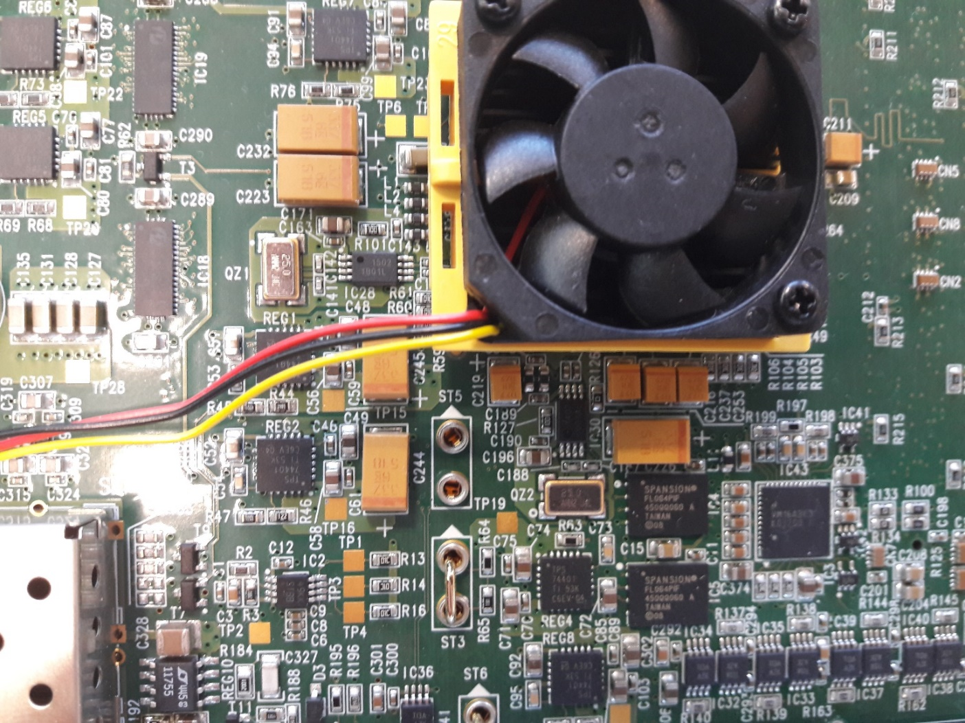
Hardware issues
Capacitors?
RESULT
No change
Capacitors: C141, C142, C187 and C188 replaced from the nominal 33pV capacitance to 18 pF one. (company instruction)

Slide 12
Hardware issues –cap.
After successfull replacing the capacitors ADC scan performed again.
Only The FEC with changed capacitors was in use.
FEC mask | Result
0x001 - 0x00FF | Correct data
0x03FF | ZEROS
0x0FFF | ZEROS
0x3FFF | ZEROS
0xFFFF | ZEROS
0xF3FF | ZEROS
0xC0FF | CACA....
0x3CFF | ZEROS
0xF0FF | ZEROS

Slide 13
Test result summary
Action | FEC v1.3 |  | FEC v6
 | nonZS firmware | ZS firmware | nonZS firmware | ZS firmware
FECs off the box
Capacitor exchange | X | X
X
No action performed, modification not applicable to the listed card.

Slide 14
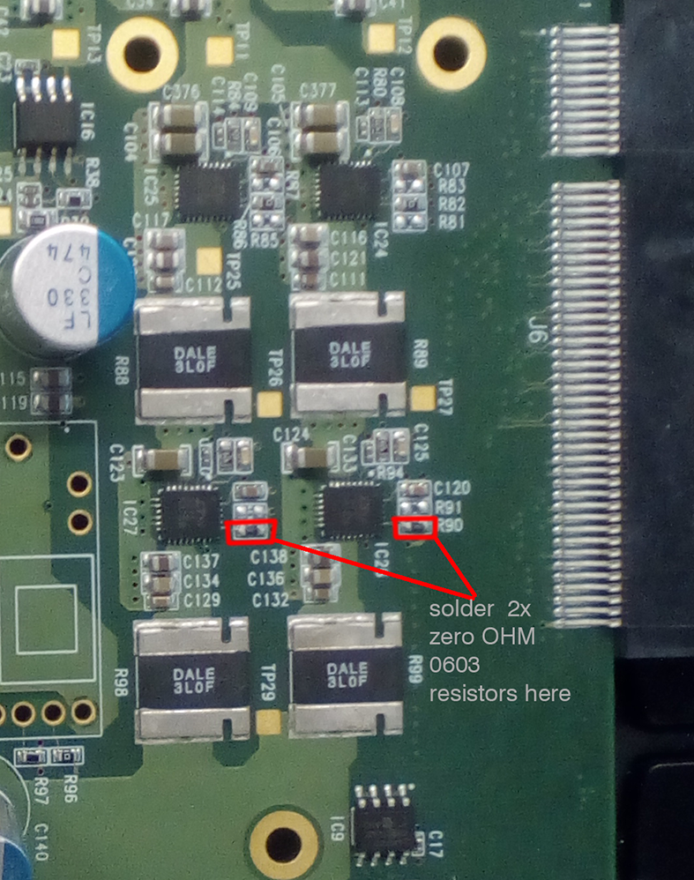
Hardware issues
Resistors?
Change
Two 0 ohm resistors increase FPGA core voltage by 50 mV.
Result
Proper initialization of the second ADC unit. No problem in the data observed. Success?
Resistors: R90, R92 – added 0 Ohm resistors

Slide 15
Test results summary
Action | FEC v1.3 |  | FEC v6
 | nonZS firmware | ZS firmware | nonZS firmware | ZS firmware
FECs off the box
Capacitor exchange | X | X
 |  |  | Old capacitors. | Old capacitors.
Resistors aded | X | X
?
?
Modification seems to be successfull, but we need to confirm it is „regular”. In case of one pair of v6 FECs improvement is observed.
?

Slide 16
V6 vs v1.3 Test results comparison
Tests performer, using the same chamber GE1/1-X-S-CERN-0002.
The same X-Ray gun settings.
Very similar ambient conditions.
Same PC (same software).
Only difference in the SRS chain - FECs

Slide 17
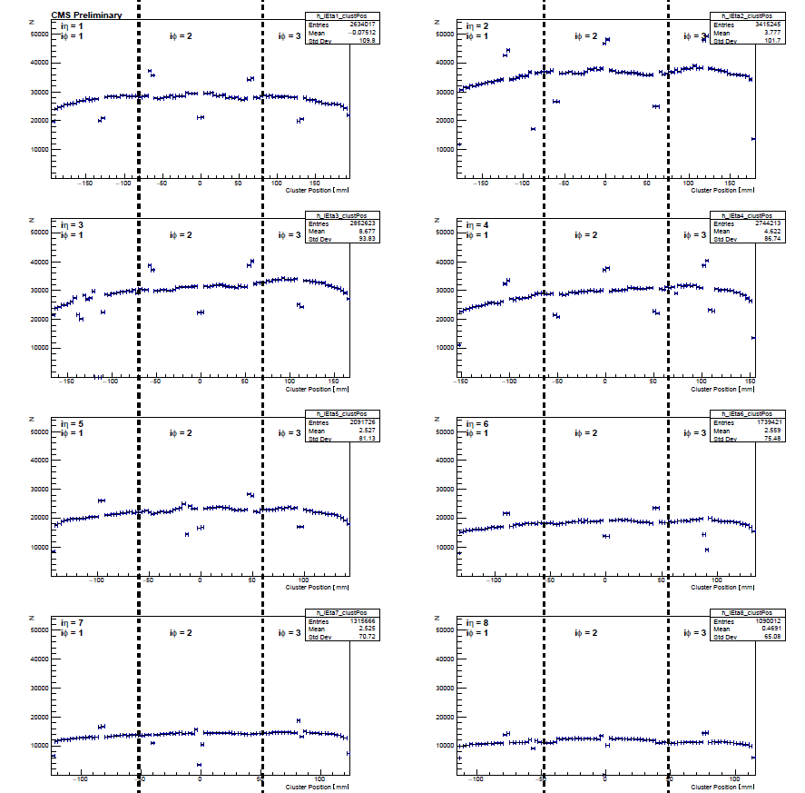
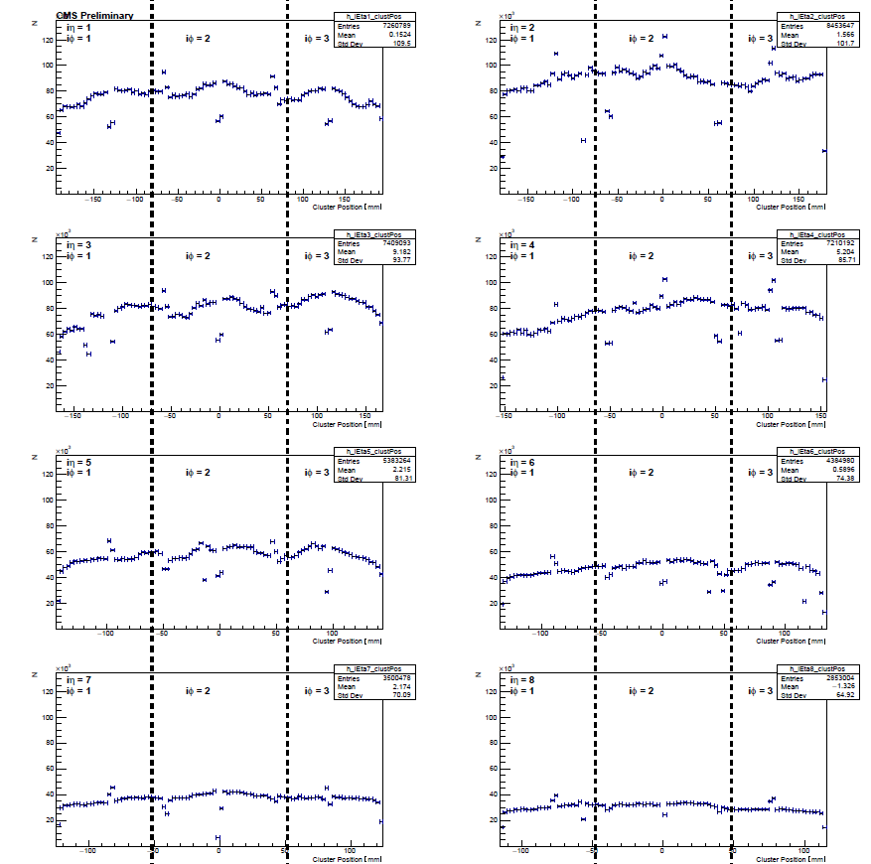
V6 vs v1.3 Test results comparison
ClusterPos
v1.3 | v6

Slide 18
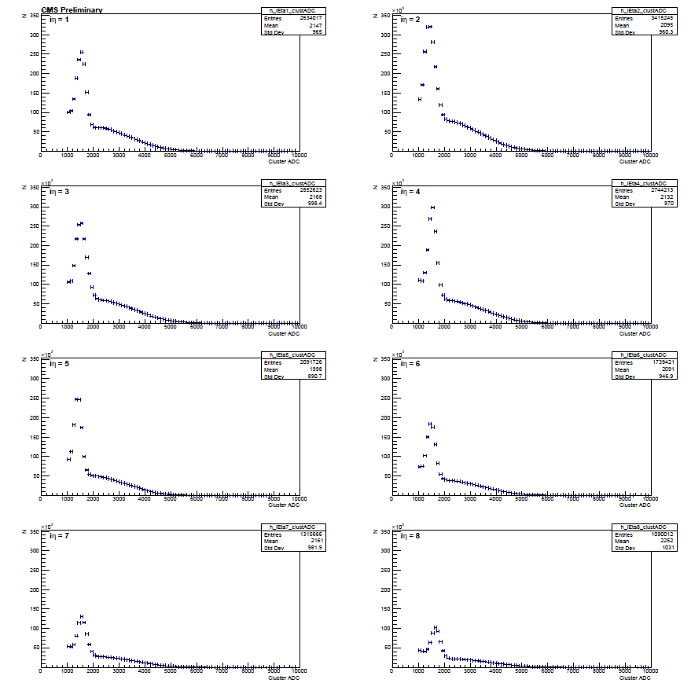
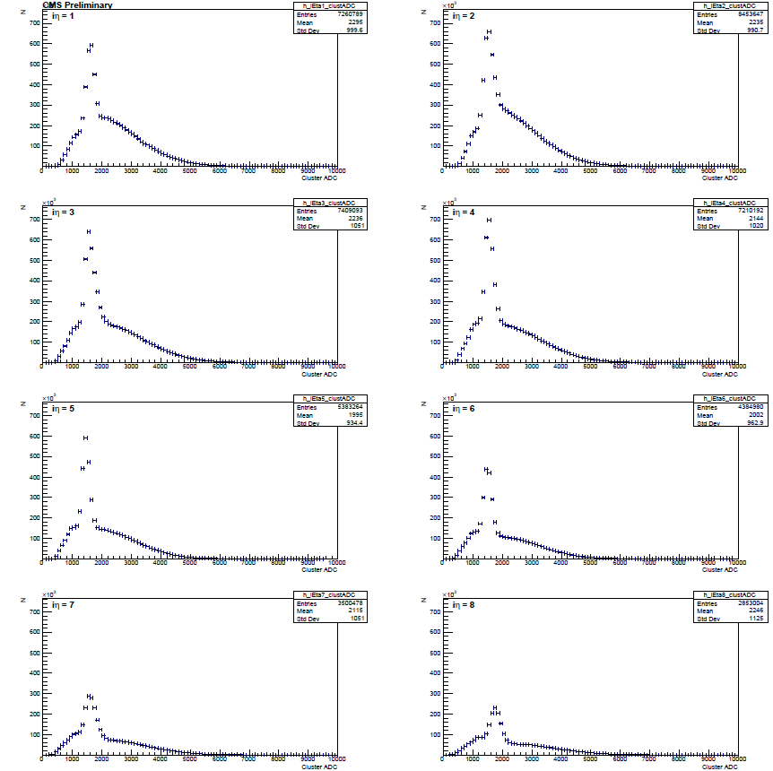
V6 vs v1.3 Test results comparison
Fluorescence peak pos.
v1.3 | v6

Slide 19
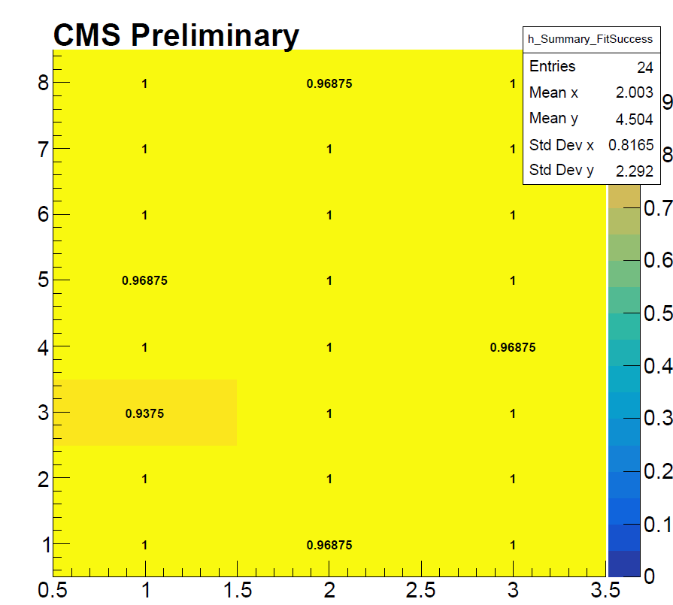
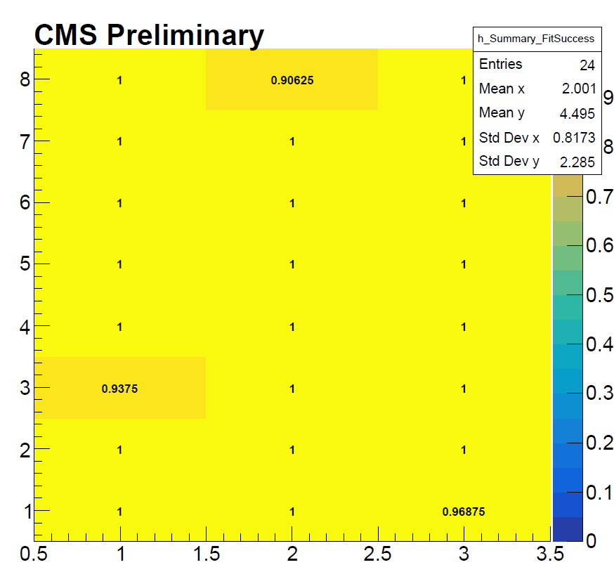
V6 vs v1.3 Test results comparison
Fit Success
v1.3 | v6

Slide 20
Feature plans
Applying the solution to two spare FECs in the GEM lab.
Success | Failure
Propagating the solution to all available FEC v6 in the GEM community. V6 exchane for v1.3 upon the request of the interested site. | Further debugging the FEC cards.

