Slide 1
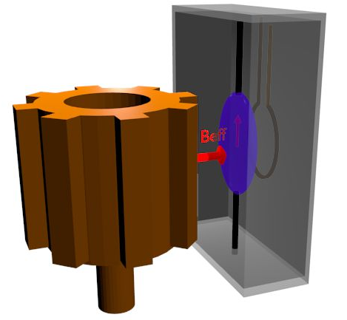
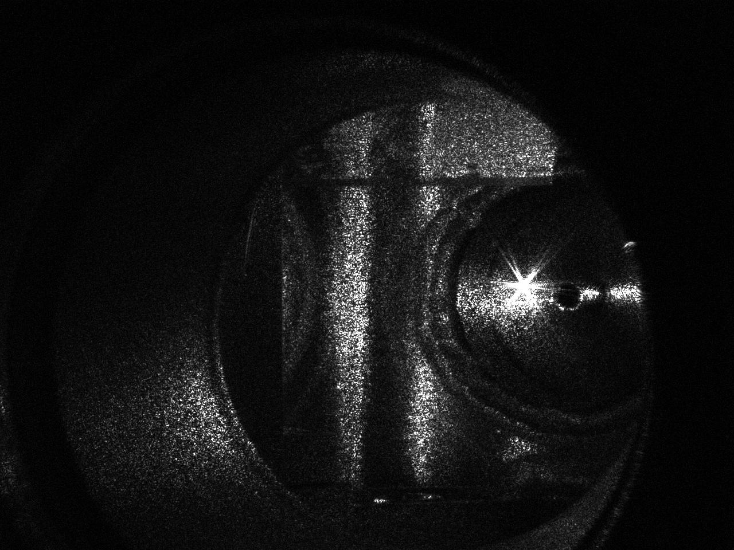
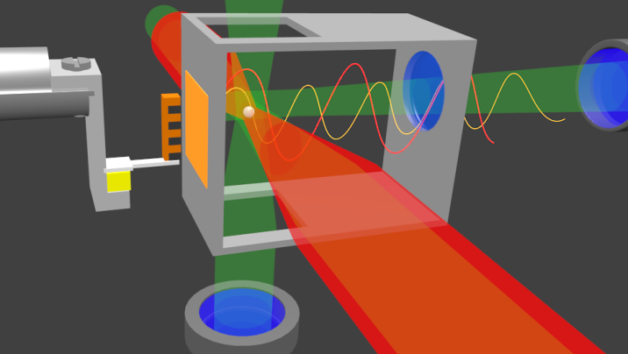
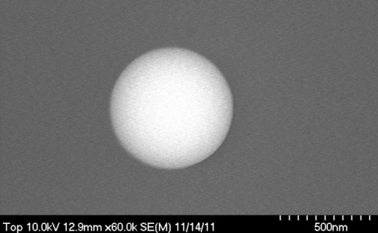





Hunting for fifth forces and axions with AMO-based sensors
GGI Florence: Beyond the Standard Model,
where do we go from here?
A. Geraci, Northwestern University

Slide 2


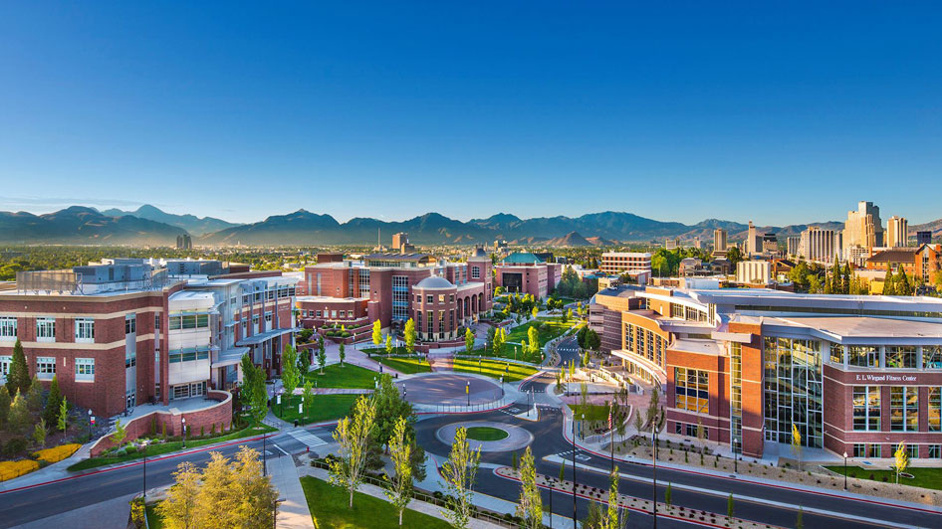
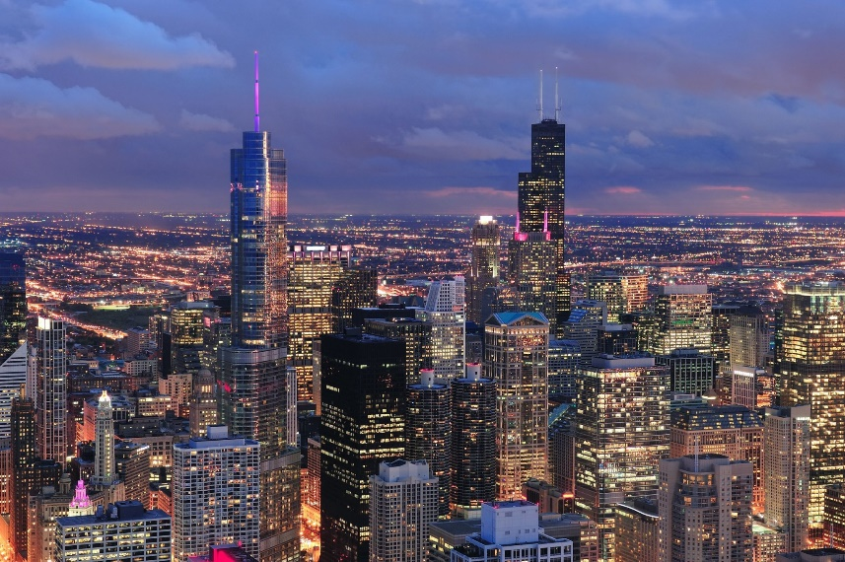
Our lab has moved!
Center for Fundamental Physics (CFP)
Openings for Postdocs and students!

Slide 3
Fifth forces
1) Mass dependent -- Testing gravity at short-range with optically levitated nanospheres
2) Spin dependent -- The ARIADNE axion experiment

Slide 4
The Standard Model
Provides an adequate description of the
electromagnetic, weak, and strong interactions.
The Interactions:
Strong: Holds nucleons together
Electromagnetic: Acts between charged particles
Weak: Causes certain decays
Gravity: Attraction between masses
For two protons in nucleus:
P
P
-7
-36
Strong : Electromagnetic : Weak : Gravity= 20 : 1 : 10 : 10
The Hierarchy Problem: Why is Gravity so small?

Slide 5
Testing gravity at short range
Exotic particles (new physics)
r
λ < 1 mm
Supersymmetry/string theory
(moduli, radion, dilaton)
Particles in large extra dimensions
(Gravitons, scalars, vectors?)
m
m
1
2

Slide 6
Landscape for non-Newtonian corrections
Adapted from Ann. Rev. Nucl. Part. Sci. 53 77 (2003),
PRL 98, 021101 (2007),
PRD 78, 022002 (2008),
arXiv:1410.7267 (2014)
Laboratory
Terrestrial and satellites
Lunar laser ranging
Planetary
E.G. Adelberger, B.R. Heckel, A.E. Nelson, Ann. Rev. Nucl. Part. Sci. 53 77, (2003)

Slide 7
Experimental challenge: scaling of gravitational force
2r
m
m
for
1
2
In the range of experimental interest:
r~10 µm ;

Slide 8
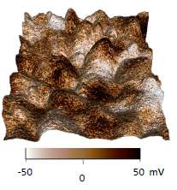
Experimental challenge: electromagnetic background forces
Casimir effect (1948):
Electrostatic Patch Potentials:
z
A
J. L. Garrett, D. Somers, J. N. Munday
J. Phys.: Condens. Matter 27 (2015) 214012

Slide 9
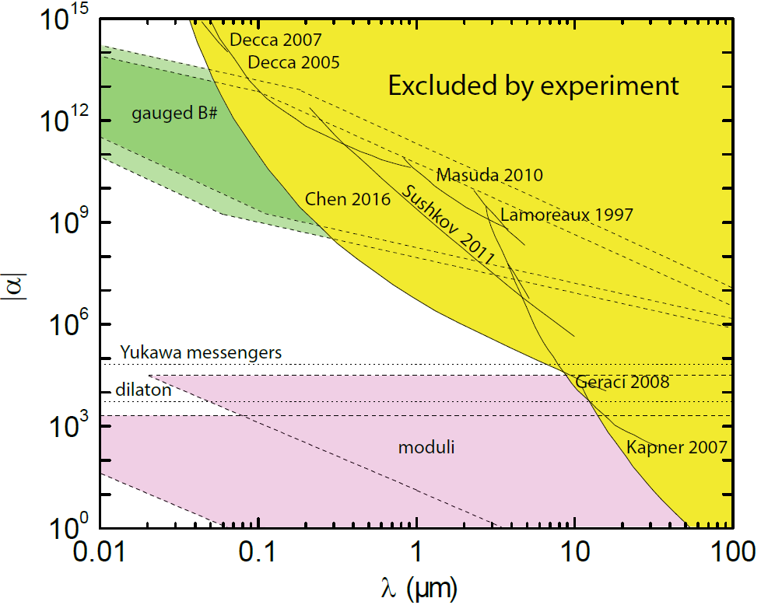
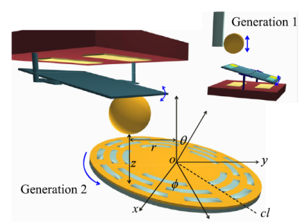
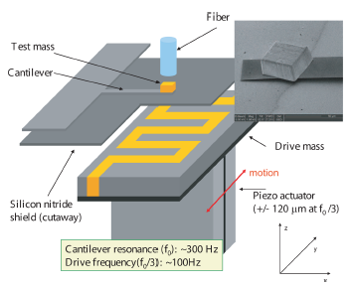
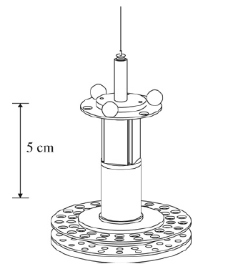
Force-distance parameter space
Casimir measurements (Indiana)
Cantilevers
(Stanford)
Torsion balance
experiments
(U Washington)

Slide 10
Resonant force detection
Cantilever is like a spring:
F
l
w
t
Sinusoidal driving force
Amplitude:
Constant force
A
Driving force on resonance
of cantilever ω₀
ω
ω₀
Q can be very large >100,000

Slide 11
Fundamental limitation: thermal noise
Brownian motion – random “kicks” given to particle due to thermal bath
fluid molecule
dust particle
Random “kicks” are given to cantilever due to finite T of oscillator
Notes:
Skip brownian motion

Slide 12
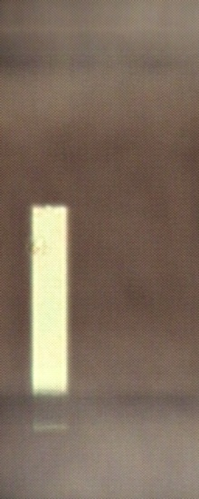
Example: Silicon microcantilevers
Fiber
Lens
w= 50 µm
l= 250 µm
t=0.3 µm
Cantilever
w
Silicon Cantilevers:
F_{min} ~ 10 x 10⁻¹⁸ N/√Hz at 4 K at Q=10⁵

Slide 13
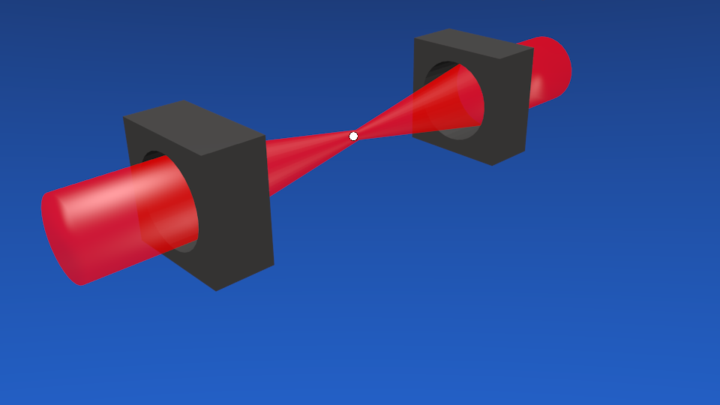
Improving sensitivity
Levitate the force sensor!
Fiber
Lens
Cantilever
CM motion decoupled from environment –
no clamping, materials losses
Limitations on Q: Clamping, surface
imperfections, internal materials losses

Slide 14
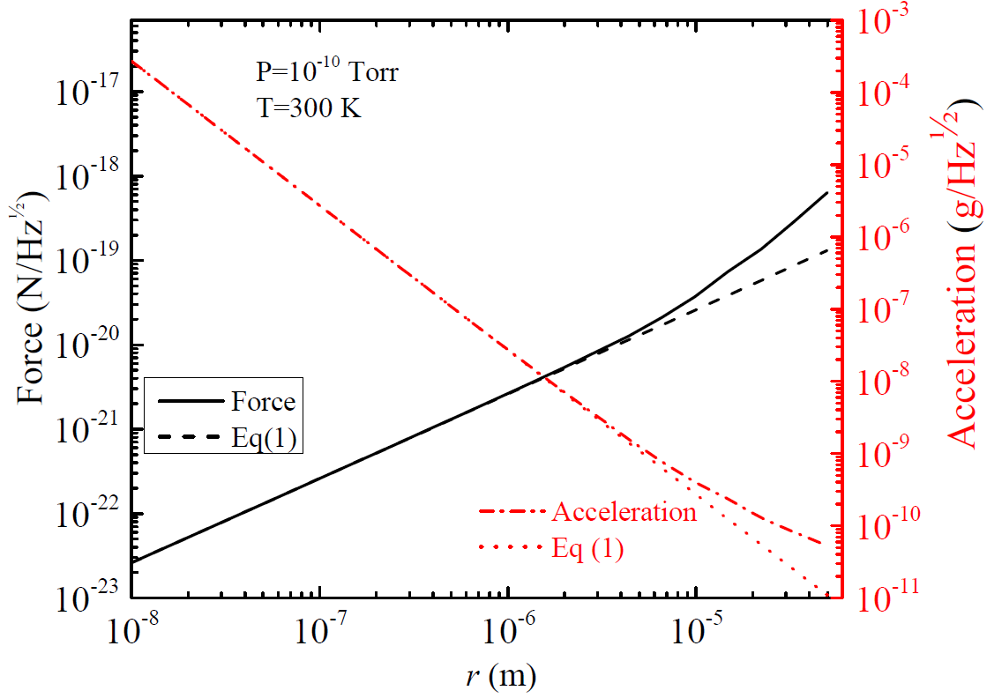
Projected force sensitivity
Photon recoil heating
Seen recently by
Novotny group
V. Jain et. al.,
PRL 116, 243601 (2016)
Cantilevers
20 zN/Hz^{1/2} Gieseler, Novotny, Quidant (Nature Phys. 2013)
Z. Yin, A. Geraci, T. Li, Int. J. Mod. Phys. B 27,1330018 (2013).

Slide 15
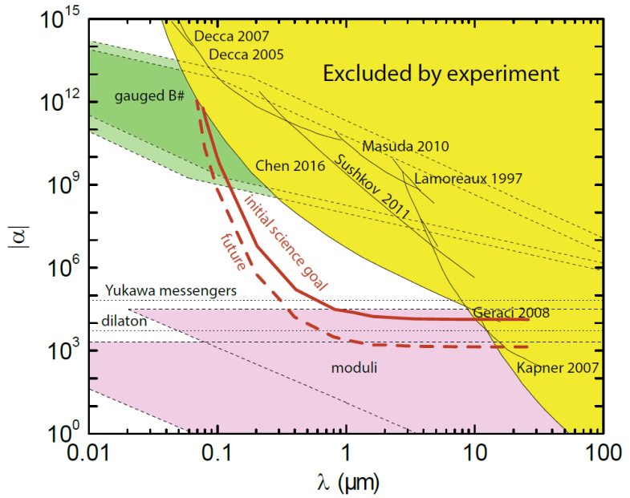
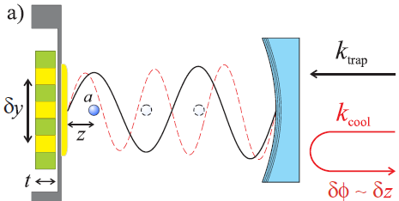
Projected sensitivity
nanosphere, d < λ/2
Drive mass
device (Au/Si)
gold coated SiN membrane
(stationary)
AG, S.B. Papp, and J. Kitching, Phys. Rev. Lett. 105, 101101 (2010)

Slide 16
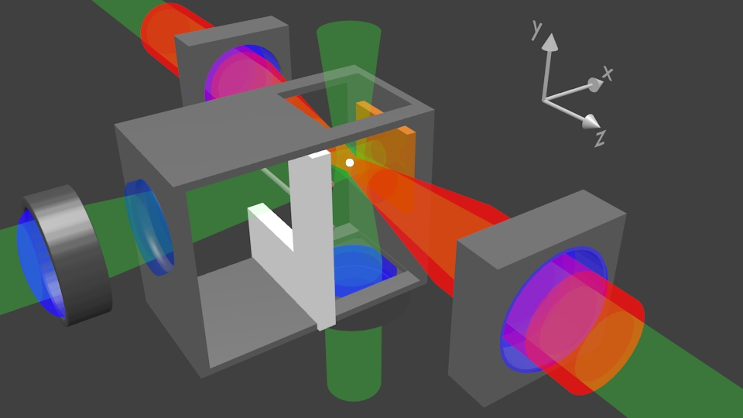
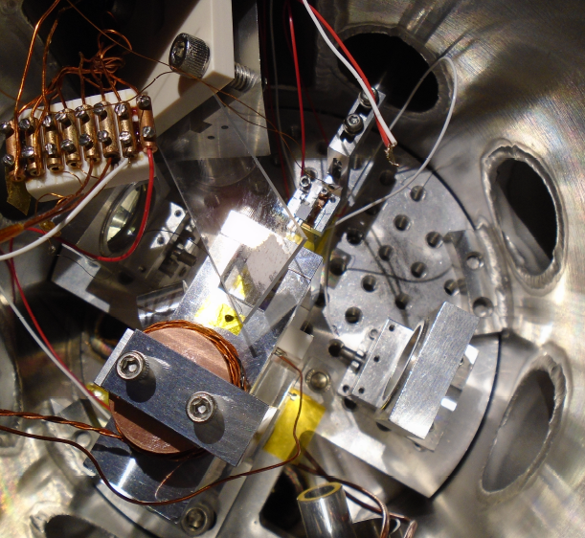
Experimental Setup
Drive mass
actuator
Dipole beams
Cavity beams
300 nm silica bead
300 nm silica bead
Cavity beams
Dipole beams
feedback beams
AG, S.B. Papp, and J. Kitching, Phys. Rev. Lett. 105, 101101 (2010)
G. Ranjit et.al., PRA 91, 051805(R) (2015).
G. Ranjit et.al. , Phys. Rev. A, 93, 053801 (2016).

Slide 17
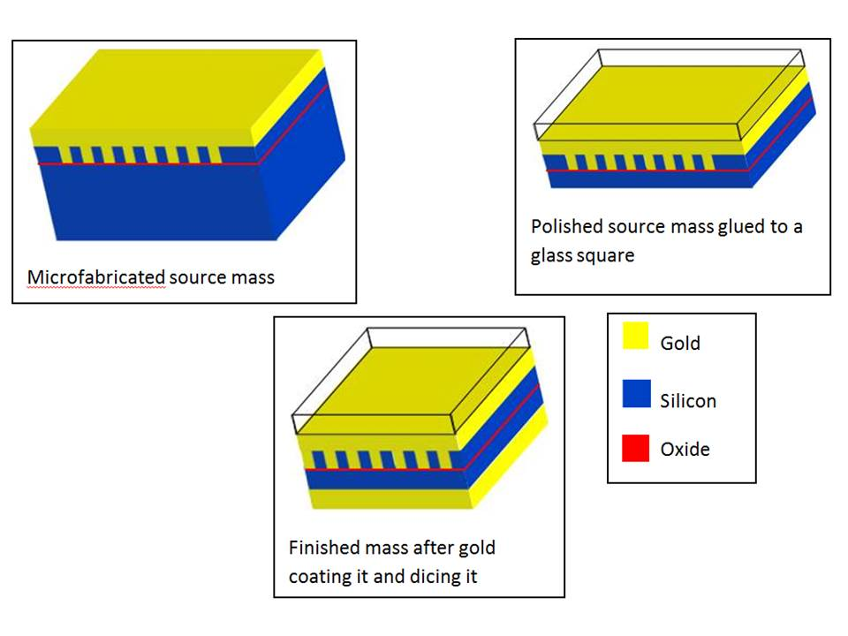
Drive Mass fabrication
20 µm
Gold
Buried drive mass technique – eliminates corrugation
during polishing process
Silicon
removing Silicon
Gold
20 µm

Slide 18
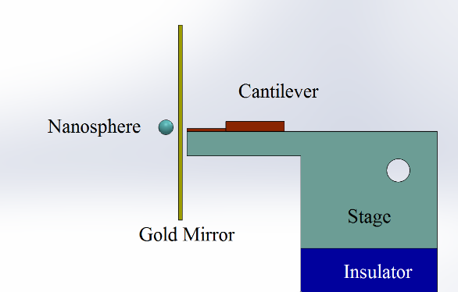
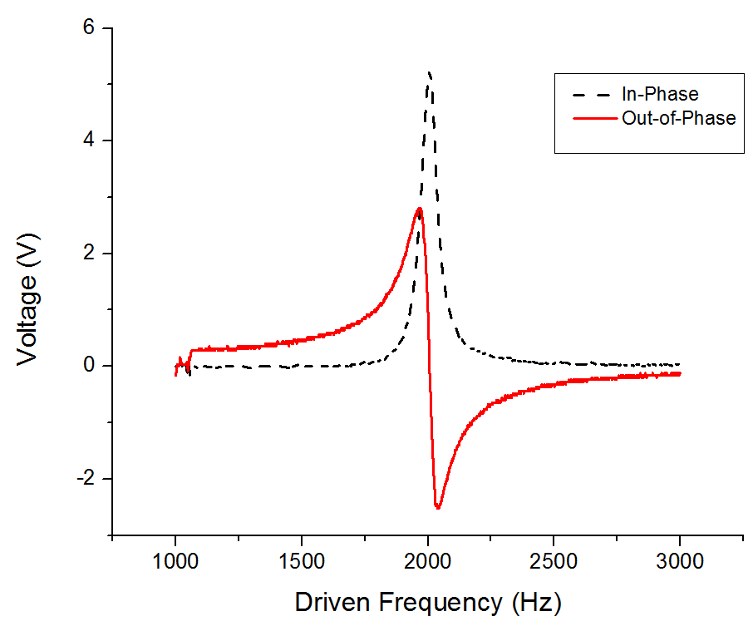
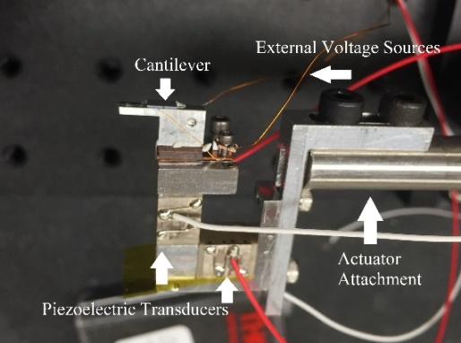
MEMS actuator
Device for positioning drive mass
100V DC, 10V AC
~5 um displacement
Drive mass

Slide 19

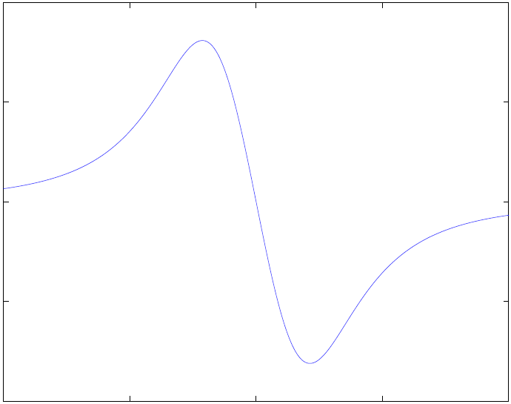
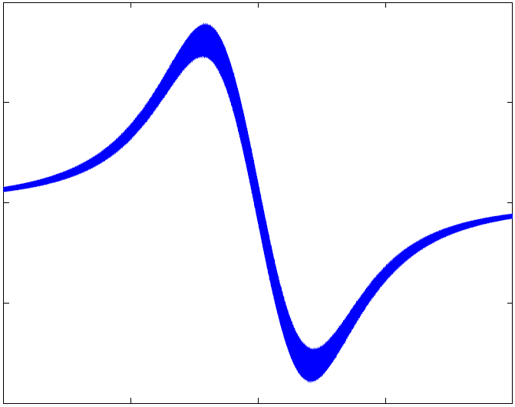
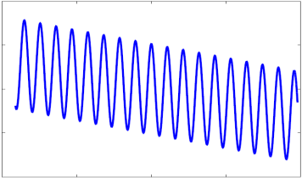
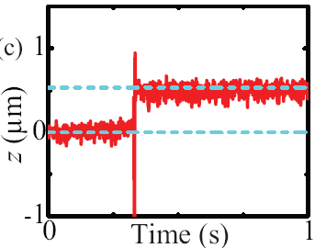
Standing wave optical trap
Dipole beams
Cavity beams
feedback beams
Fz (pN)
z(µm)

Slide 20
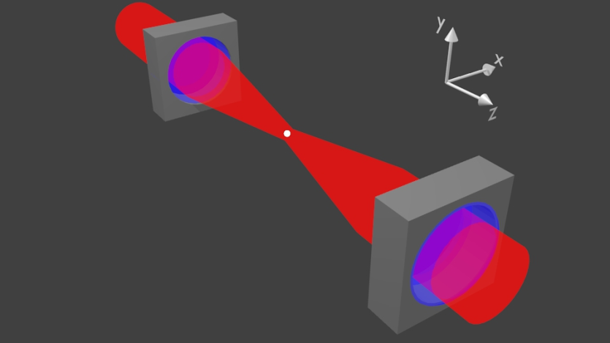
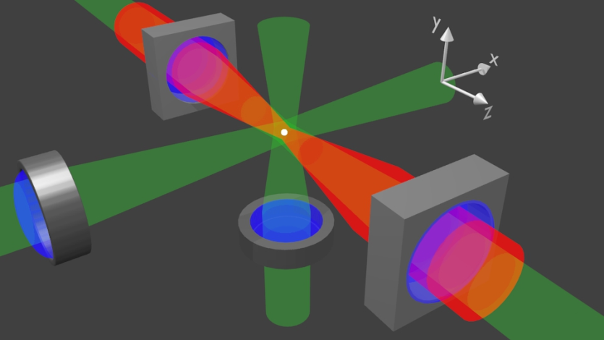
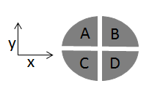
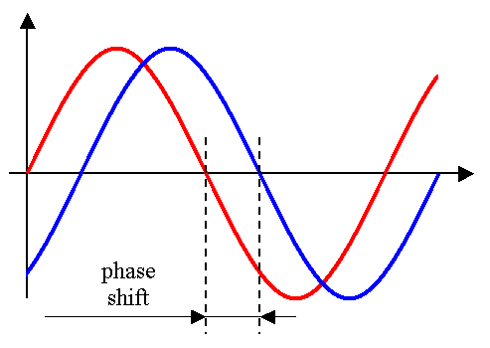


3D feedback cooling of a nanosphere
Needed to stabilize the particle, damp and cool it
Mitigate photon recoil heating
AOM
$$x(t)$$
780 nm
$$v_{x}\left(t\right)$$
Ranjit et.al., PRA 91, 051805(R) (2015).

Slide 21
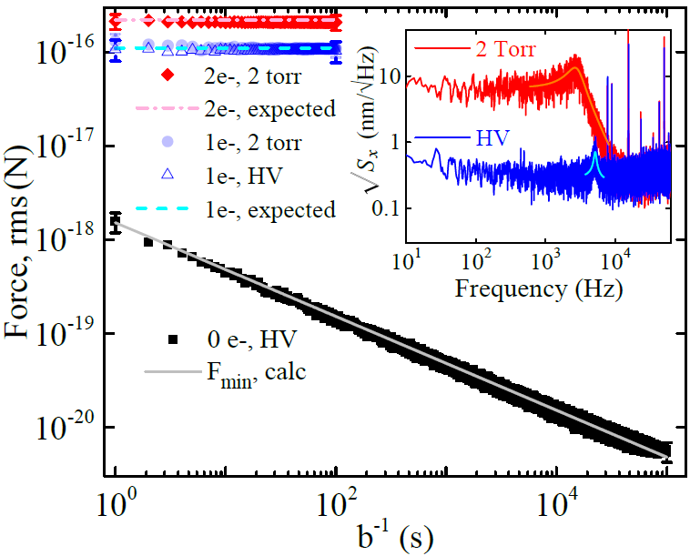
Zeptonewton force sensing
6 zN
Sensitivity
G. Ranjit, et.al. , Phys. Rev. A, 93, 053801 (2016).

Slide 22
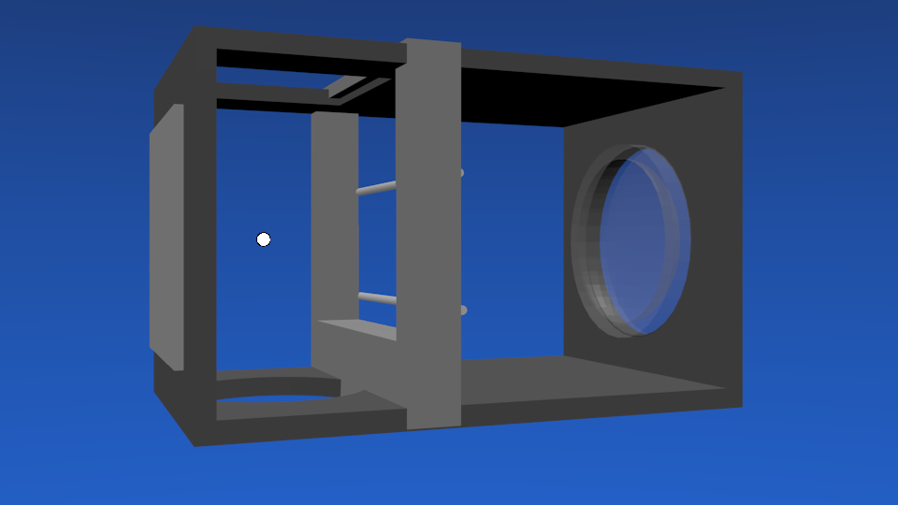
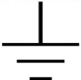
Zeptonewton force sensing
Electrostatic
Calibration
90% of beads are neutral
Neutral beads stay neutral
Charge stays constant over days
6 zN
Calibration electrodes
Sensitivity
G. Ranjit, et.al. , Phys. Rev. A, 93, 053801 (2016).

Slide 23
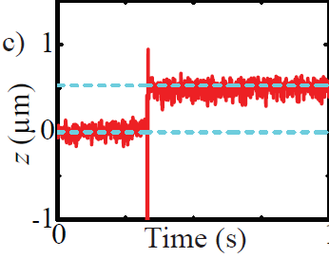
Zeptonewton force sensing
Optical lattice
calibration
6 zN
Useful for neutral objects
Method consistent with
electric field approach
Sensitivity
G. Ranjit, et.al. , Phys. Rev. A, 93, 053801 (2016).

Slide 24
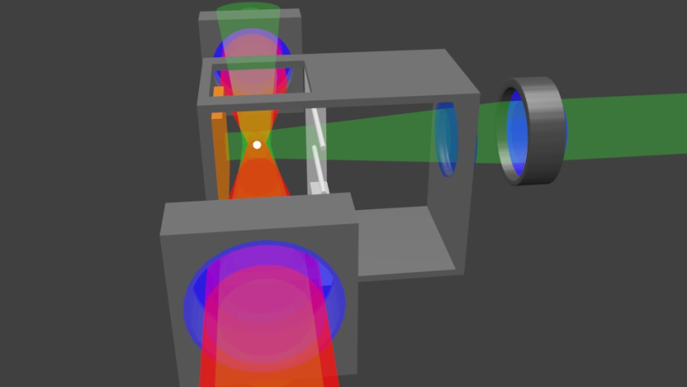
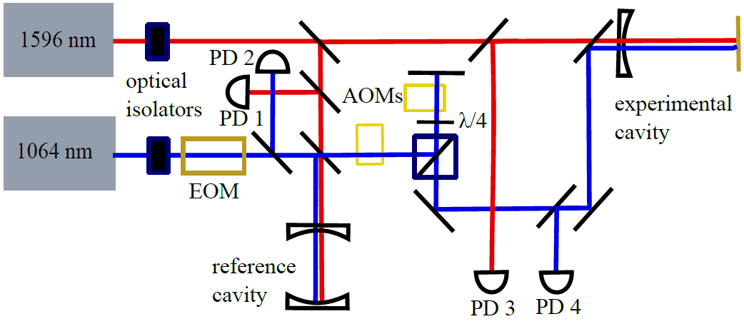
Next: Cavity Trapping and cooling
1596nm beam to trap a bead at its antinode → localization
1064nm beam to cavity cool the CM of bead → position readout
300 nm bead

Slide 25
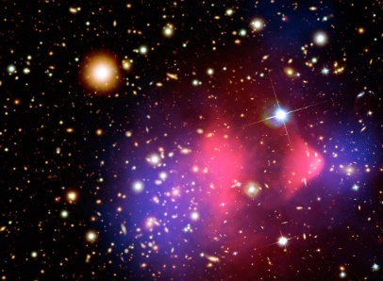
Axions
Light pseudoscalar particles in many theories Beyond Standard model
Peccei-Quinn Axion (QCD) solves strong CP problem
Dark matter candidate
Experiments: e.g. ADMX, CAST, LC circuit, Casper
R. D. Peccei and H. R. Quinn, Phys. Rev. Lett. 38, 1440 (1977);
S. Weinberg, Phys. Rev. Lett. 40, 223 (1978);
F. Wilczek, Phys. Rev. Lett. 40, 279 (1978).
J. E. Moody and F. Wilczek, Phys. Rev. D 30, 130 (1984).

Slide 26
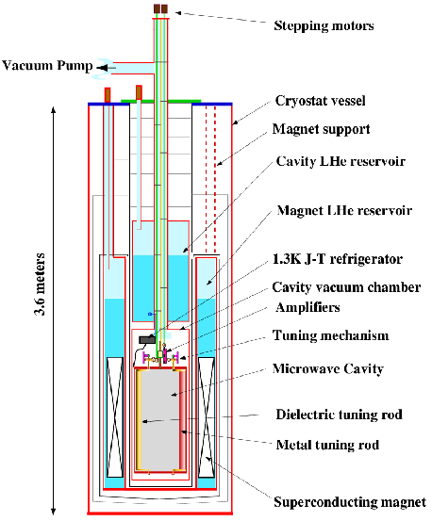
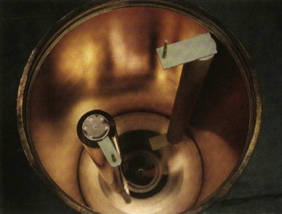
ADMX experiment
Axion couples to 2 photons g_{aγγ} → Resonant axion to photon conversion in
Microwave cavity in background magnetic field
Cavity resonance tuned to match
oscillation frequency of cosmic axion field
http://www.phys.washington.edu/groups/admx/home.html

Slide 27
Axions
Light pseudoscalar particles in many theories Beyond Standard model
Peccei-Quinn Axion (QCD) solves strong CP problem
Dark matter candidate
Experiments: e.g. ADMX, CAST, LC circuit, Casper
Also mediates spin-dependent “fifth-forces”
at short range (down to 30 µm)
R. D. Peccei and H. R. Quinn, Phys. Rev. Lett. 38, 1440 (1977);
S. Weinberg, Phys. Rev. Lett. 40, 223 (1978);
F. Wilczek, Phys. Rev. Lett. 40, 279 (1978).
J. E. Moody and F. Wilczek, Phys. Rev. D 30, 130 (1984).
→ Can be sourced locally

Slide 28





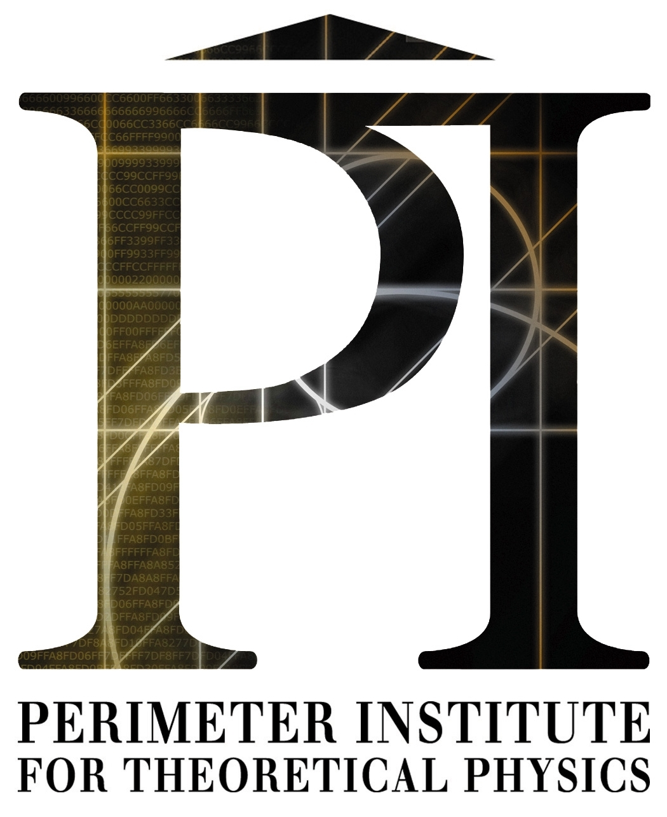
Axion Resonant InterAction DetectioN Experiment
Collaborators: Andrew Geraci (Northwestern), Asimina Arvanitaki (Perimeter), Aharon Kapitulnik (Stanford), Alan Fang (Stanford), Sam Mumford (Stanford), Josh Long (IU), Chen‐Yu Liu (IU), Mike Snow (IU), Inbum Lee (IU), Justin Shortino (IU), Yannis Semertzidis (CAPP), Yun Shin (CAPP), Yong‐Ho Lee (KRISS), Lutz Trahms (PTB), Allard Schnabel (PTB), Jens Voigt (PTB)
Grant No. PHY-1509176, 1510484, 1506508
Center for Fundamental Physics (CFP)

Slide 29
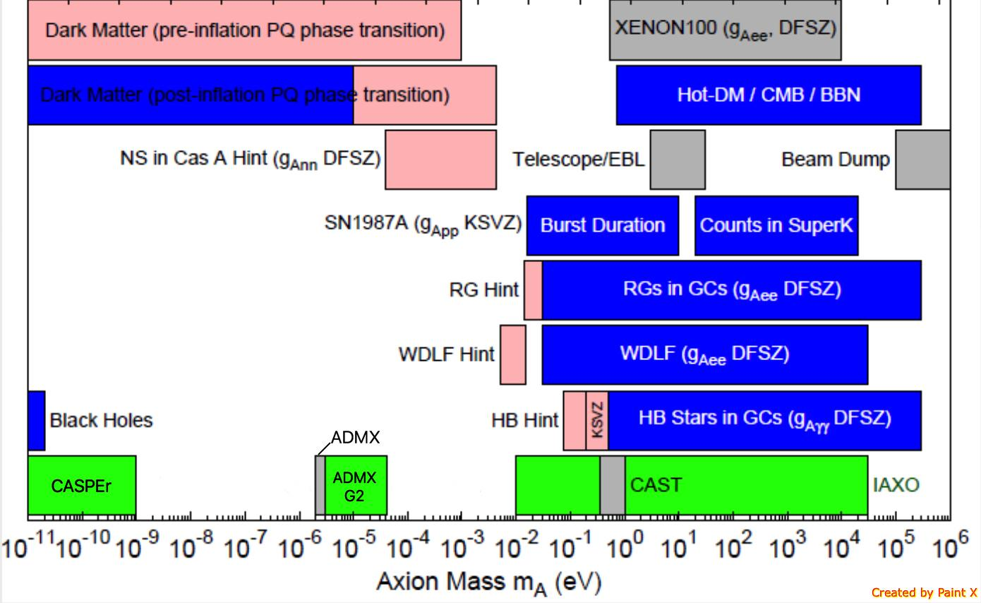
QCD Axion Parameter Space
DM Radio
LC Circuit
ABRACADABRA
ARIADNE
Adapted from http://pdg.lbl.gov/2015/reviews/rpp2015-rev-axions.pdf

Slide 30
Axion and ALP Searches
Source
Coupling
 | Photons | Nucleons | Electrons
Dark Matter (Cosmic) axions | ADMX, HAYSTACK, DM Radio, LC Circuit, MADMAX, ABRACADABRA | CASPEr | QUAX
Solar axions | CAST IAXO
Lab-produced axions | Light-shining-thru- walls (ALPS, ALPS-II) | ARIADNE

Slide 31

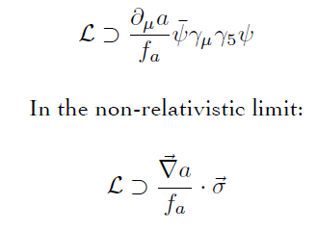
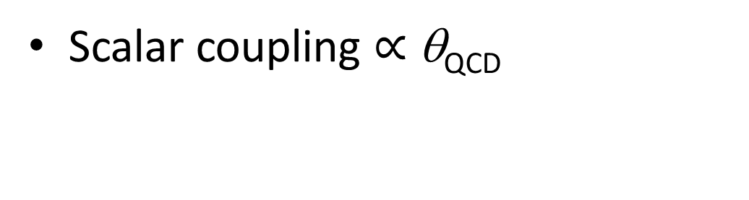
Axion-exchange between nucleons
Scalar coupling $∝$ θ_{QCD}
Pseudoscalar coupling
Axion acts a force mediator between nucleons
N
N
Monopole-monopole
Monopole-dipole
dipole-dipole

Slide 32
Spin-dependent forces
r
m_{f}
σ
Monopole-Dipole axion exchange
m_{a} < 6 meV
λ_{a} > 30 μm
Different than ordinary B field
Does not couple to angular momentum
Unaffected by magnetic shielding
Fictitious magnetic field

Slide 33
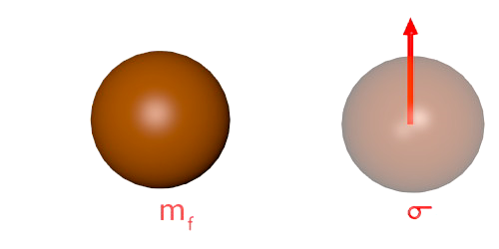
NMR for detection
Spin ½ ³He Nucleus
Oscillate the mass at
Larmor frequency
B_{eff}
Bloch Equations
Time varying Axion B_{eff} drives spin precession
→ produces transverse magnetization
Amplitude is resonantly enhanced
by Q factor ~ ωT₂.
Can be detected with a SQUID
A. Arvanitaki and A. Geraci, Phys. Rev. Lett. 113, 161801 (2014)

Slide 34
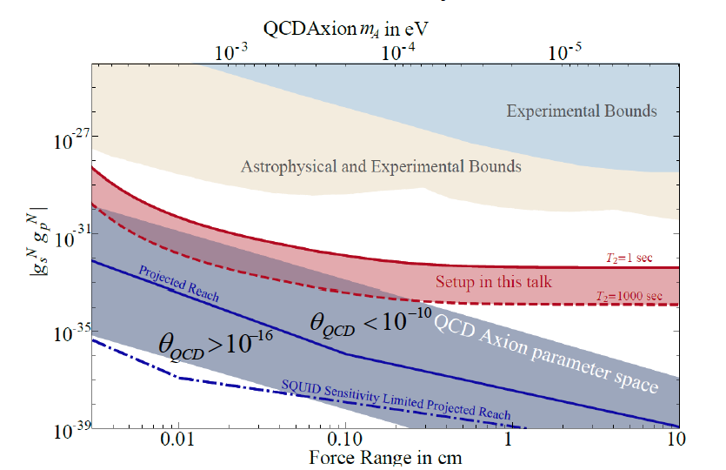
Constraints and Sensitivity
[4],[5],[6],[7]
[3]
[3] G. Raffelt, Phys. Rev. D 86, 015001 (2012)] [4] G. Vasilakis, et. al, Phys. Rev. Lett. 103, 261801 (2009).
[5] K. Tullney,et. al. Phys. Rev. Lett. 111, 100801 (2013) [6] P.-H. Chu,et. al., Phys. Rev. D 87, 011105(R) (2013).
[7] M. Bulatowicz, et. al., Phys. Rev. Lett. 111, 102001 (2013).
A. Arvanitaki and AG., Phys. Rev. Lett. 113,161801 (2014).

Slide 35
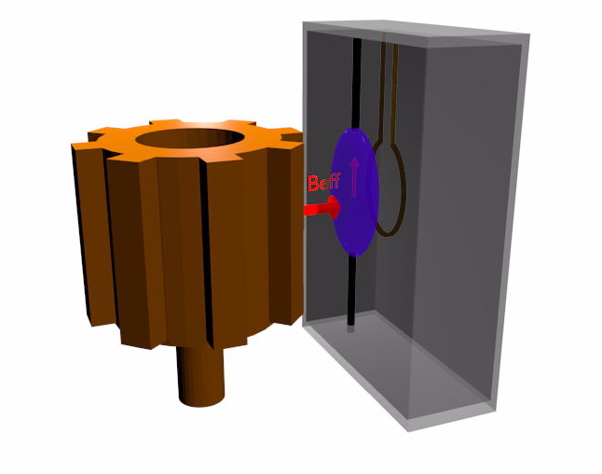
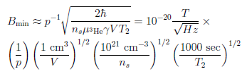
Concept for ARIADNE
Unpolarized (tungsten) segmented cylinder sources B_{eff}
Applied Bias field B_{ext}
Laser Polarized ³He gas senses B_{eff} (Indiana U)
squid pickup
Loop (CAPP)
Limit: Transverse spin projection noise
Superconducting shielding (Stanford)
A. Arvanitaki and A. Geraci, Phys. Rev. Lett. 113,
161801 (2014).
Notes:
Similar techniques used in short-range gravity experiments

Slide 36
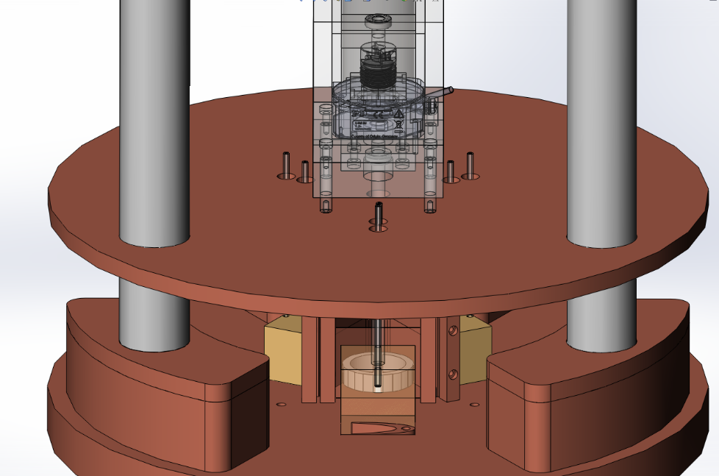
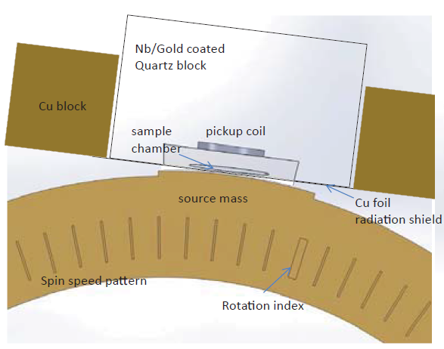
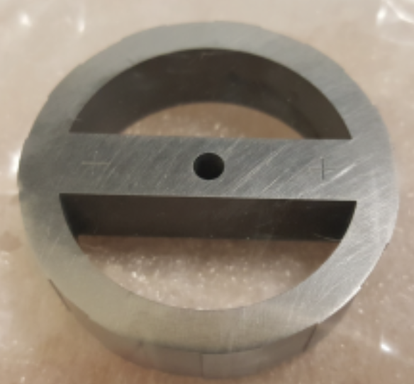
Experimental parameters
Rotational stage
3 sample chambers
4 mm
source mass
3.8 cm diameter
Tungsten source mass (high nucleon density)
11 segments
100 Hz nuclear spin precession frequency
2 x 10²¹ / cc ³He density
10 mm x 3 mm x 150 µm volume
Separation ~200 µm

Slide 37

Experimental challenges
Magnetic gradients
Nonlinearities
Barnett Effect
Trapped magnetic flux
Vibration isolation
Magnetic noise from thermal currents
Design/Simulation Work: Magnetic gradient reduction strategy
Experimental testing in progress: Vibration tests, Shielding factor f test thin-film SC

Slide 38








The Problem of Unwanted Images
$$\overset{⃑}{m}$$
ARIADNE uses magnetized spheroid
  Constant interior field
3He
$B_{in}=const.$
$\overset{⃑}{B_{in}} ∥ \overset{⃑}{m_{i}}$
3He
3He
$$\overset{⃑}{B}$$
Magnetic shielding introduces “image spheroid”
  Interior field varies
→ variations in nuclear Larmor frequency
$$\overset{⃑}{m}$$
$$\overset{⃑}{m}$$
$B_{in}≠const.$
$\overset{⃑}{B_{in}} ∦ \overset{⃑}{m_{i}}$
3He
3He
3He
$$\overset{⃑}{B}$$
But want to drive entire sample on resonance
Notes:
ARIADNE detects + “transduces” axion forces w/ He-3 spheroid
Spheroids are nice b/c of constant field parallel to individual moments
When superconducting shielding is introduced, “image” spheroid appears
Field neither constant nor parallel to moments
We care about this b/c of…

Slide 39


Gradient Cancellation
No cancellation
Gradient cancellation
98 times flatter
I = 1.6 A
s_{Frac} = 0.17%
enabling T₂ of ~100 s
Sample
area
Notes:
Gradient cancellation 98x flatter!
Maybe recover T₂ O(100 s)
Compare to T₂ O(1 s) w/o cancellation

Slide 40


Thin Film Superconducting Shielding
Shield out ordinary magnetic noise
Sputtered Niobium on quartz tubes/different geometries for tests
Tests of adhesion, Tc, shielding factor done by CAPP and Stanford collaborators
Younggeun Kim, Dongok Kim, Yun Chang Shin, Andrei Matlashov CAPP/IBS

Slide 41

Source Mass Characterization
Magnetized the wheel with a 30 mT magnet
Wheel was brought under multichannel SQUID device in shielded room
After degaussing, the magnetic moment is reduced by one order of magnitude to about 2 pT
In addition, the wheel generates Johnson noise of some 1-1.5 pT (peak to peak)
Lutz Trahms (PTB)
Notes:
In image: vertical component of the magnetic field of wheel as it is measured in a plane some 2-3 cm above.
The magnetic dipole of about 20 nAm² is in the plane of the wheel as it is oriented in the photograph. This corresponds to a magnetic field some 500pT in the plane of the wheel.
After degaussing the magnetic moment is reduced by one order of magnitude to about 2 pT, which is in the range of the measurement noise.

Slide 42

Speed stability test - direct drive stage
Stage speed stability error – unloaded, in air
Optical encoder
Current feedback control
Rotation speed control
8.3 Hz ~ 1 part in 10000
RMS ~ 1 part in 3000
Allows utilization of T2 > 100s

Slide 43




Rotary test Assembly
Rod details
Material: Ti6Al4V
Diameter: 5 ± .01mm
Length: 7.5 ± .1”
Ovality: < .0004"
Runout: < .0005"
Original runout .0005" reduced to .0003"
after bearing attachment

Slide 44

SQUID Magnetometers
Y.H. Lee, KRISS
1 cm
Field noise (fT_{rms}/√Hz)
4.5 fT_{rms}/√Hz
Frequency (Hz)
Measured inside a magnetically shielded room (without Nb tube)

Slide 45
Conclusions
Fifth-force seaches with AMO-based methods
Calibrated zeptonewton force sensing with optically levitated nanospheres
→ Micron-distance gravity tests
→ High frequency gravitational waves
ARIADNE → New resonant NMR method
Gap in experimental QCD axion searches
0.1 meV < m_{a} < 10 meV
Complementary to cavity-type (e.g. ADMX) experiments
No need to scan mass, indep. of local DM density

Slide 46


Acknowledgements
Geraci Lab 2017
Back row (L to R): Cris Montoya (G), William Eom (UG), Jason Lim (UG), Harry Fosbinder-Elkins (UG), Mindy Harkness (UG), Andrew Geraci (PI)
Front row (L to R): Ryan Danenberg (UG), Kathleen Wright (UG), Isabella Rodriguez (UG), Chloe Lohmeyer (G), Ohidul Mojumder (UG), Jordan Dargert (G), Chethn Galla (G), Colin Bradley (UG).

