Slide 1
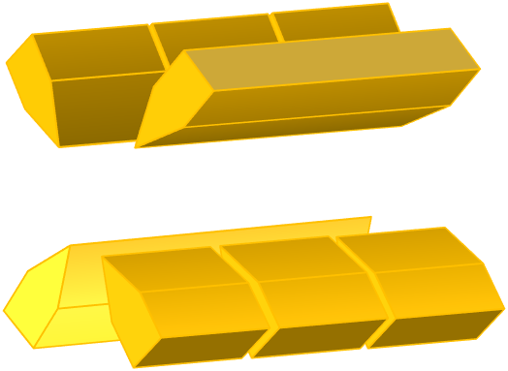
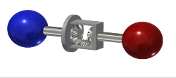

Probing light new physics with Isotope shift spectroscopy
GGI 2018
Laser
⁺
Roee Ozeri
Weizmann Institute of Science
Rehovot, Israel
Delaunay, RO, Perez and Soreq Phys. Rev. D 96, 093001 (2017)
Berengut J. C.; Budker D.; Delaunay C.; Flambaum V. V.; Frugiuele C.; Fuchs E.; Grojean C.; Harnik R.; RO; Perez G.; Soreq Phys. Rev. Lett. 120, 091801 (2018)

Slide 2

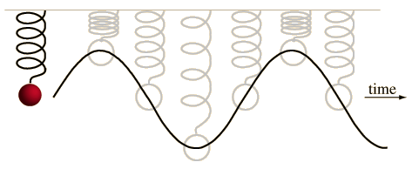
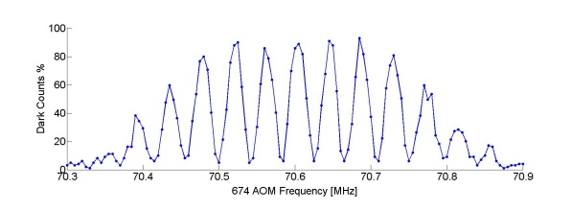
Atomic Spectroscopy: the Naïve picture
Steady-state response:
Rabi Spectroscopy:
drive
time
Ramsey Spectroscopy:
time

Slide 3

Atomic Spectroscopy
|↑⟩
=
|↓⟩

Slide 4
Quantum two-level system
The Bloch sphere
|↑⟩
Z
|↑⟩
X
Y
|↓⟩
|↓⟩

Slide 5
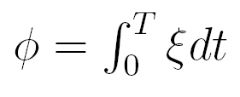
Ramsey Spectroscopy
1st Ramsey pulse
2nd Ramsey pulse
The Bloch sphere
θ = π/2
ϕ = 0
θ = π/2
ϕ = 0→2π
|↑⟩
Z
X
T
Y
|↓⟩

Slide 6
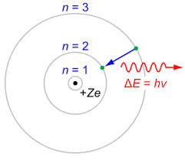
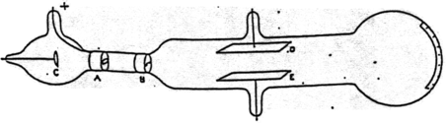

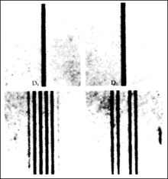
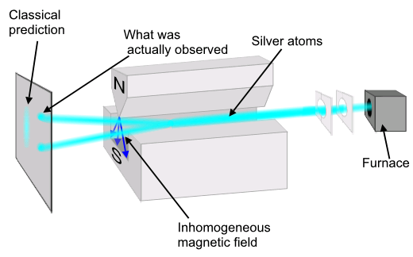
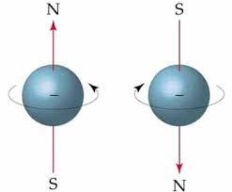
Hand in hand with beam accelerators
Thomson and Rutherford
(Cambridge, 1897)
Ångstrom and Rydberg
(Upsala, Lund 1888)
Bohr atom model
(Copenhagen, 1913)
+
=
Stern and Gerlach
(Frankfurt, 1922)
Zeeman
(Leiden, 1896)
Uhlenbeck and Goudsmit
(Leiden, 1925)
+
=

Slide 7
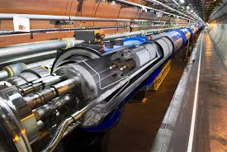
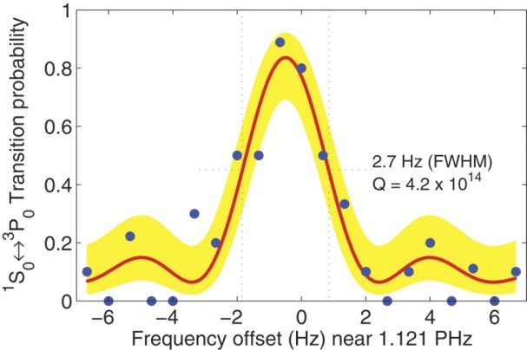
Separate ways
High Energy
High Precision
Large Hadron Collider
Aluminum-ion optical atomic clock
NIST, Boulder CO
13 TeV
Precision ~ 10⁻²
Few eV
Precision ~ 10⁻¹⁸

Slide 8
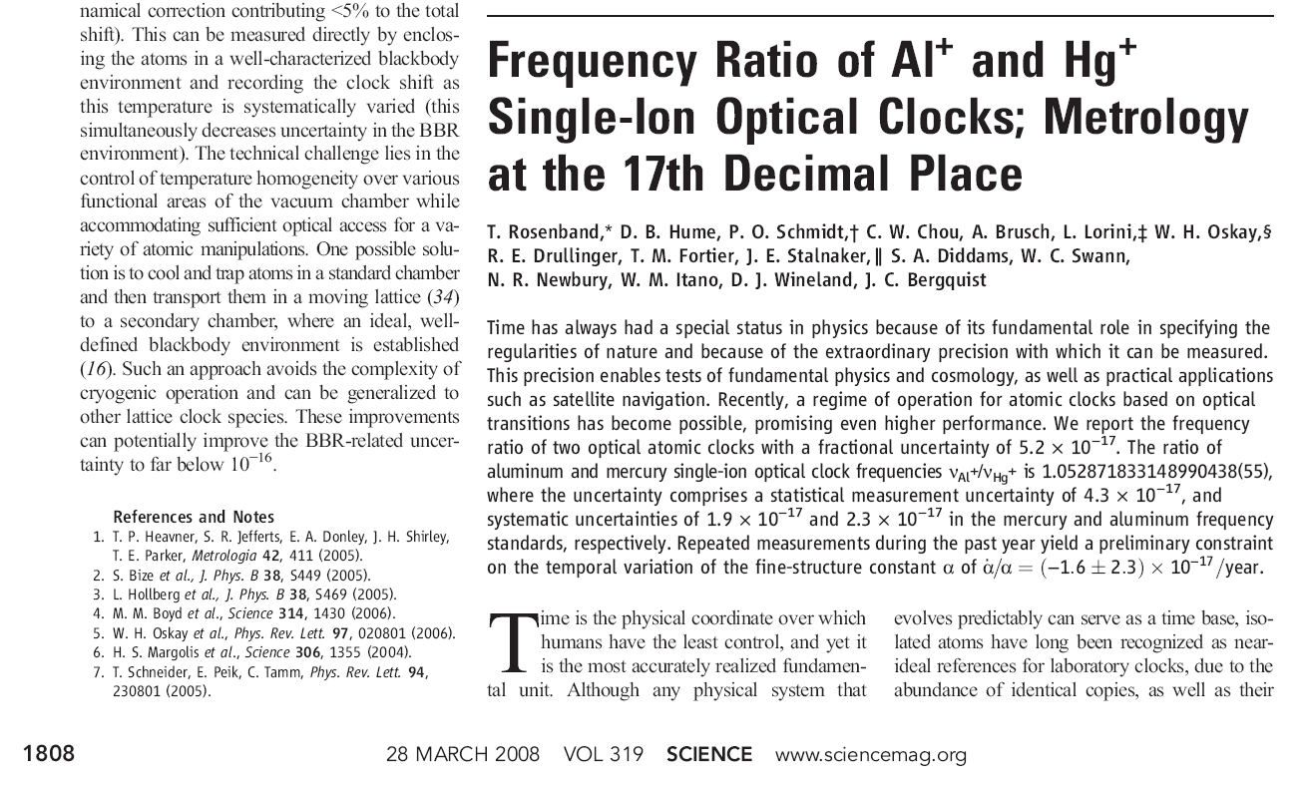
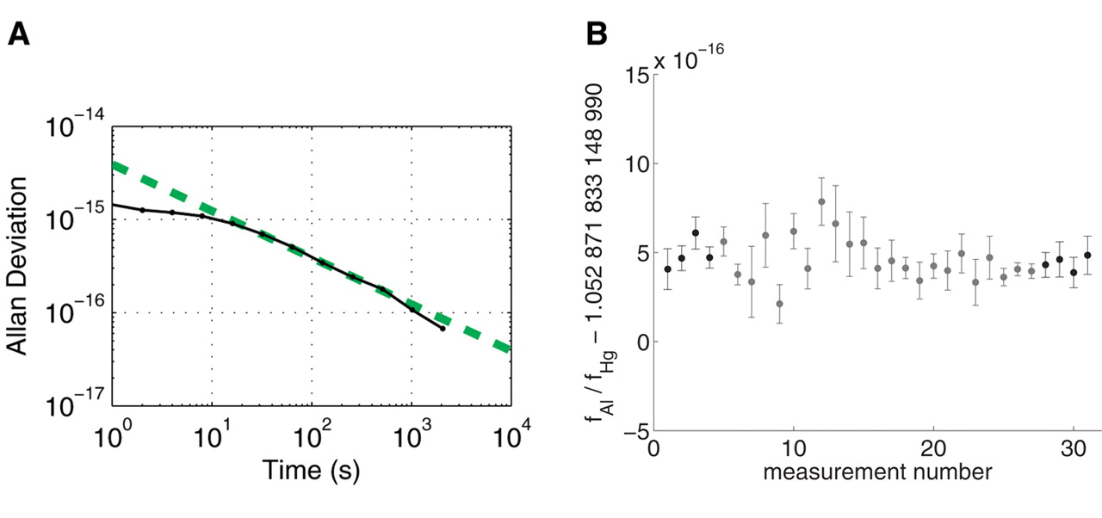
The most accurate
measurement of anything, ever.
Few 10⁻³ Hz

Slide 9
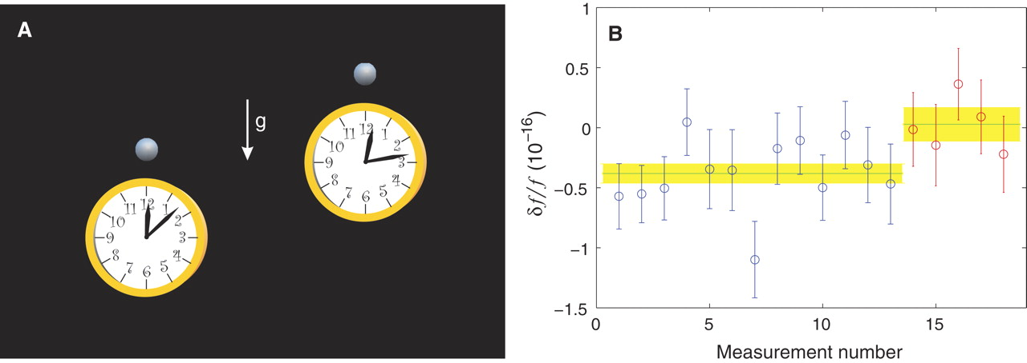
Gravitational red-shift@ 33 cm
Chou, Hume, Rosenband and Wineland, Science, 329, 1630, (2010)

Slide 10
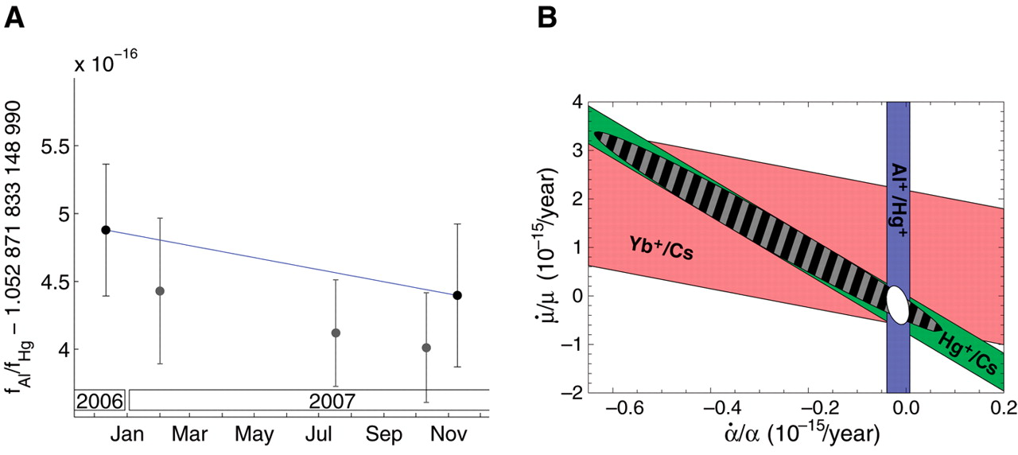

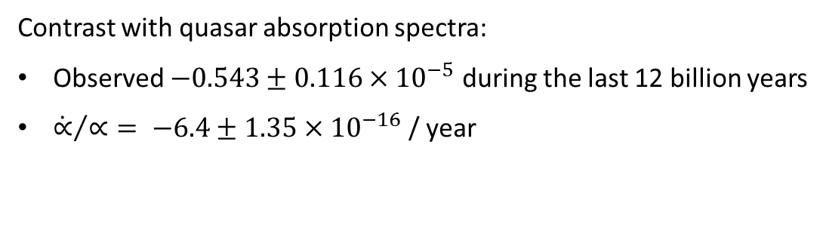
Time variation of fundamental constants
Contrast with quasar absorption spectra:
Observed $−0.543±0.116×{10}^{−5}$ during the last 12 billion years
${\dot{∝}}/∝= −6.4±1.35×{10}^{−16}$ / year
Rosenband et. al., Science, 319, 1808, (2008)

Slide 11
Search for New Scalar or Vector Fields
Search for physics Beyond the Standard Model highly motivated:
Flavor Mass Hierarchy problem
Strong CP problem
Neutrino oscillations
Matter vs. anti-matter asymmetry
Dark Matter
Many theoretical solutions result in (pseudo) scalar or vector fields
(axions/familons/ relaxions/ dark photons..)
Multitude of experimental searches
Graham et. al. Ann. Rev. Nuc. Part. Sci. 65, 485 (2015)
Safronova, Budker, et. al. Reviews of Modern Physics, 90, 025008 (2018)

Slide 12
NP detection through spectroscopy
A new force between the electron and nucleus will modify the electronic spectrum in atoms

Slide 13
NP detection through spectroscopy
Now with numbers…
4 ²D_{5/2}
γ = 0.4 Hz
y_{e}y_{n}~10⁻⁶ ↔ 100 Hz
Can’t differentiate this contribution from QED background
(calculate transition freq. with 10⁻¹³ accuracy)
440 THz
674nm;
accuracy 0.01 Hz
5 ²S_{1/2}

Slide 14
Symmetry breaking in spectroscopy
Parity symmetry: APV experiments
Charge symmetry: Anti-hydrogen spectroscopy
CP symmetry: electron EDM
Lorenz symmetry: LLI experiments
Time and space translation symmetry: Time variation of fundamental constants
Will not work with scalar, vector forces....
or anything else that respects all the symmetries QED respects

Slide 15
Isotope Shift Spectroscopy
y_{e}y_{n}~10⁻⁶ ↔ 100 Hz
4 ²D_{5/2}
γ = 0.4 Hz
New physics contribution to IS: 2 Hz
440 THz
(calculate IS with 10⁻⁸ accuracy)
674nm;
accuracy 0.01 Hz
5 ²S_{1/2}
Lybarger Jr., Berengut and Chiaverini Phys. Rev. A 83, 052509 (2011)

Slide 16
Isotope Shift Spectroscopy
A closer look
Mass shift
Normal Mass shift(NMS): Change to electron reduced mass
Specific Mass shift (SMS): Change to quasi-particle mass (many electrons)
Field shift
Due to the breaking of point-charge approximation for nucleus
Factorization: separation of electronic and nuclear contributions
W. H. King “Isotope Shifts in Atomic Spectra” Springer (1984)

Slide 17
Isotope Shift Spectroscopy
A closer look
Factorization: separation of electronic and nuclear contributions
W. H. King “Isotope Shifts in Atomic Spectra” Springer (1984)

Slide 18
King Comparison
Two transitions
King’s linear relation between normalized IS:
W. H. King “Isotope Shifts in Atomic Spectra” Springer (1984)

Slide 19
King Plot
Dy King plot. Budker et al 1994

Slide 20
King Linearity holds
Relative accuracy ~ 10⁻³ – 10⁻⁴
Nonlinear anomalies; e.g. Samarium; due to level degeneracies

Slide 21
New Physics and King linearity
Coupling
Electronic
Nuclear
New Physics is likely to break King linearity

Slide 22
Bounds on new physics
Estimate for new physics coupling:
measured
Minimal theory input:
expectation value (atomic structure calculations)
(theory)

Slide 23
What do we need?
Two narrow optical transitions (optical clocks) with the same nucleus
Transitions between as different states as possible
At least four stable (even) isotopes without nuclear spin for three independent IS comparisons

Slide 24
Are King plots really linear?
Higher order terms
Nuclear polarizability
Many-body effects
King linearity will provide solid bounds (baring cancelation)
Observation of nonlinearity will require further investigations
Flambaum, Geddes, Viatkina Phys. Rev. A 97, 032510 (2018)

Slide 25
Current and projected bounds
Massless limit:
Heavy mass limit:
Renormalization of Coulomb interaction
Inseparable from other nuclear effects: loss of sensitivity
Intermediate regime

Slide 26
Recent accurate IS measurements
Comparison between two lattice clocks
Uncertainty:
Takano, Mizushima and Katori arXiv:1706.02905 (2017)
Origlia et. al. arXiv:1803.03157 (2018)v

Slide 27
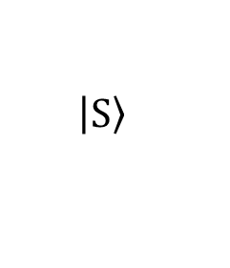
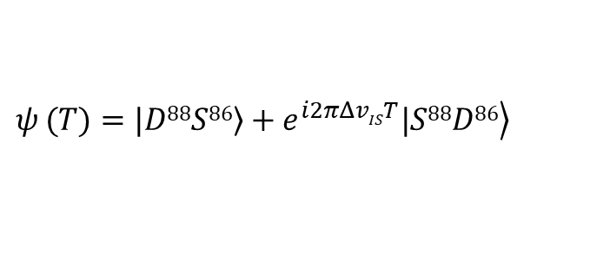
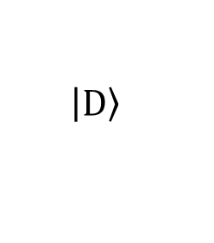
IS measurement in a Decoherence-Free Subspace
The optical Quadruple transition in Sr+
⁸⁸Sr⁺
⁸⁶Sr⁺
$$\left.\left|\text{D}\right.\right\rangle$$
4 ²D_{5/2}
~ 570 MHz
Optical Transition
674 nm ~400 THz
$$\left.\left|\text{S}\right.\right\rangle$$
5 ²S_{1/2}
Measuring the Isotope shift in decoherence free subspace
$$ψ_{ }(T)=\left.|D88S86\right\rangle +\left.e^{i2πΔvIST}|S88D86\right\rangle$$

Slide 28
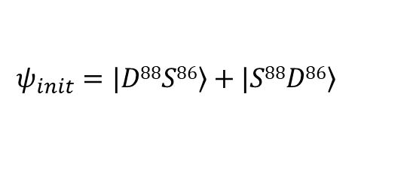
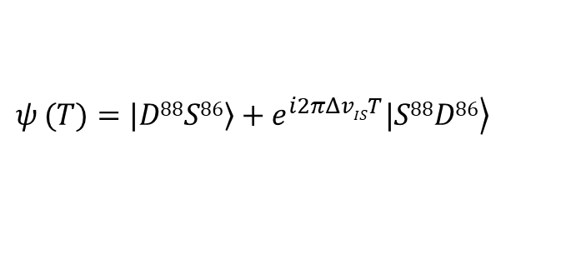

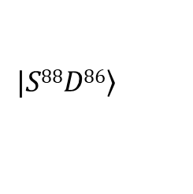
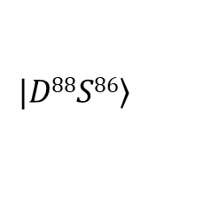
IS measurement in a Decoherence-Free Subspace
$$ΔvIS$$
$$\left.|D88S86\right\rangle$$
$$ψ_{init}=\left.|D88S86\right\rangle +\left.|S88D86\right\rangle$$
$$\left.|S88D86\right\rangle$$
$$ψ_{ }(T)=\left.|D88S86\right\rangle +\left.e^{i2πΔvIST}|S88D86\right\rangle$$
Zeeman shifts
Quadrupole shifts
BBR
2nd order Doppler
Canceled up to gradients

Slide 29


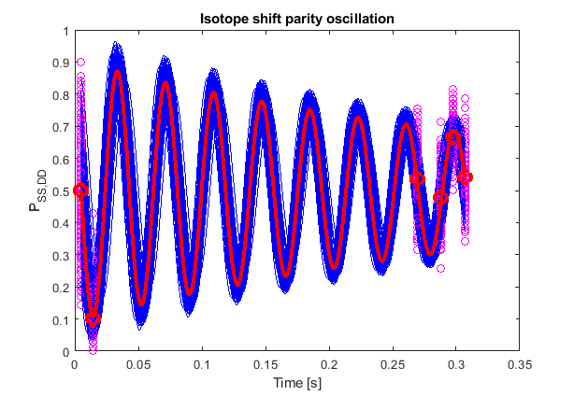
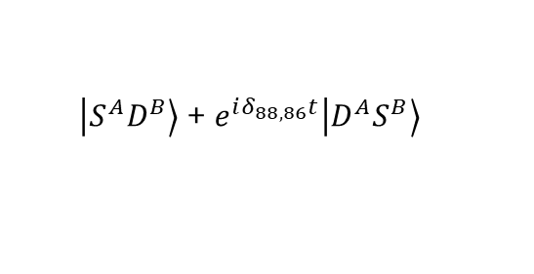

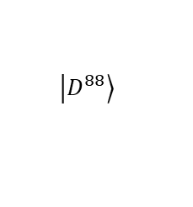
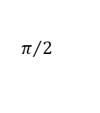

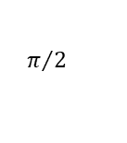
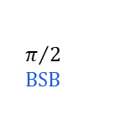
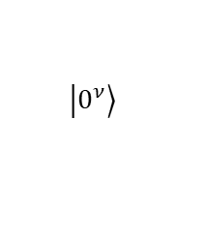
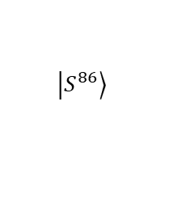
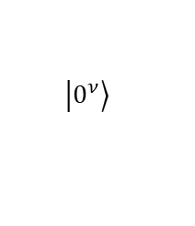
IS measurement in a Decoherence-Free Subspace
Nitzan Akerman
Preliminary
RF (Local Oscillator)
EOM/AOM
Laser
Tom Manovitz
$Parity=P_{SS}+P_{DD}$ - ($P_{DS}+P_{SD})$
Initializing Entangling Interrogating Detecting
$$\left.\left|D^{88}\right.\right\rangle$$
$$π/2$$
$$\text{BSB}$$
$$π/2$$
$$\left.\left|0^{ν}\right.\right\rangle$$
$$π$$
$$\text{RSB}$$
$$\left.\left|0^{ν}\right.\right\rangle$$
$\left.\left|S^{A}D^{B}\right.\right\rangle$ + $\left.e^{iδ_{88,86}t}\left|D^{A}S^{B}\right.\right\rangle$
$$\left.\left|S^{86}\right.\right\rangle$$
$$π/2$$

Slide 30
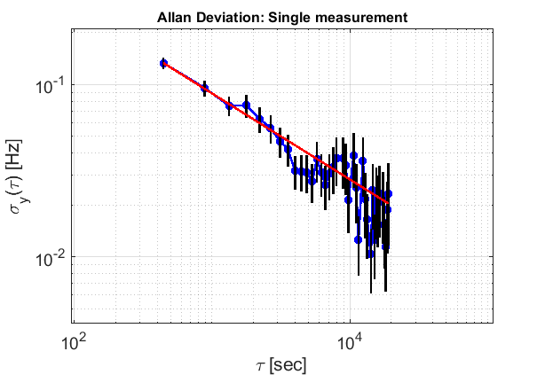
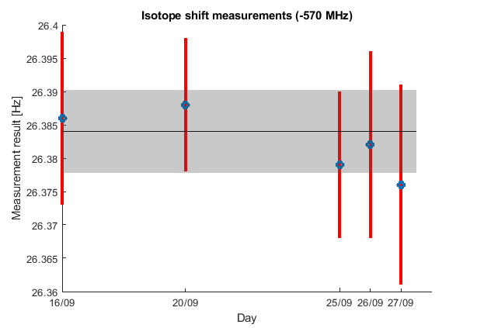
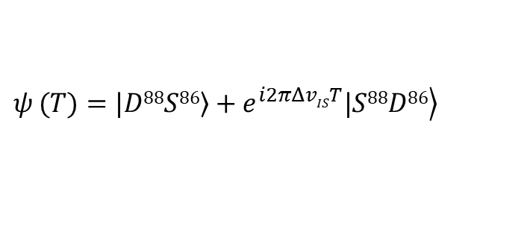
IS measurement in a Decoherence-Free Subspace
$$ψ_{ }(T)=\left.|D88S86\right\rangle +\left.e^{i2πΔvIST}|S88D86\right\rangle$$
Preliminary
IS clock
MW clock (~ 570.281 MHz) with optical clock systematics (e.g. 2nd – order Doppler)
Statistical uncertainty < 10 mHz

Slide 31
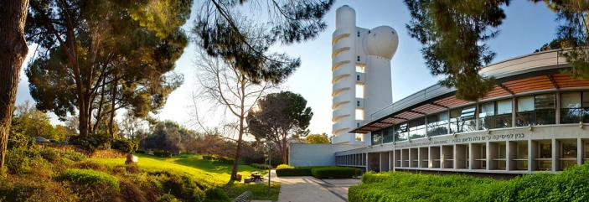




Weizmann Institute Trapped-ion group
Roee Ozeri
Nitzan Akerman
Ravid Shaniv
Lee Peleg
Yonatan Piasetzky
Meirav Pinkas
Tomas Sikorsky
Ruti Ben-Shlomi
Tom Manovitz
Yotam Shapira
Meir Alon
Collaborators:
Gilad Perez
Cedric Deleunay
Yotam Soreq
Dima Budker
Christoph Grojean
Julian Berengut
Victor Flambaum
Claudia Frugiuele
Elina Fuchs
Roni Harnik
Available postdoc positions

Slide 32
Geometric Interpretation

Slide 33
Geometric Interpretation
King linearity = co-planarity of

Slide 34
Geometric Interpretation
Nonlinearity:

Slide 35
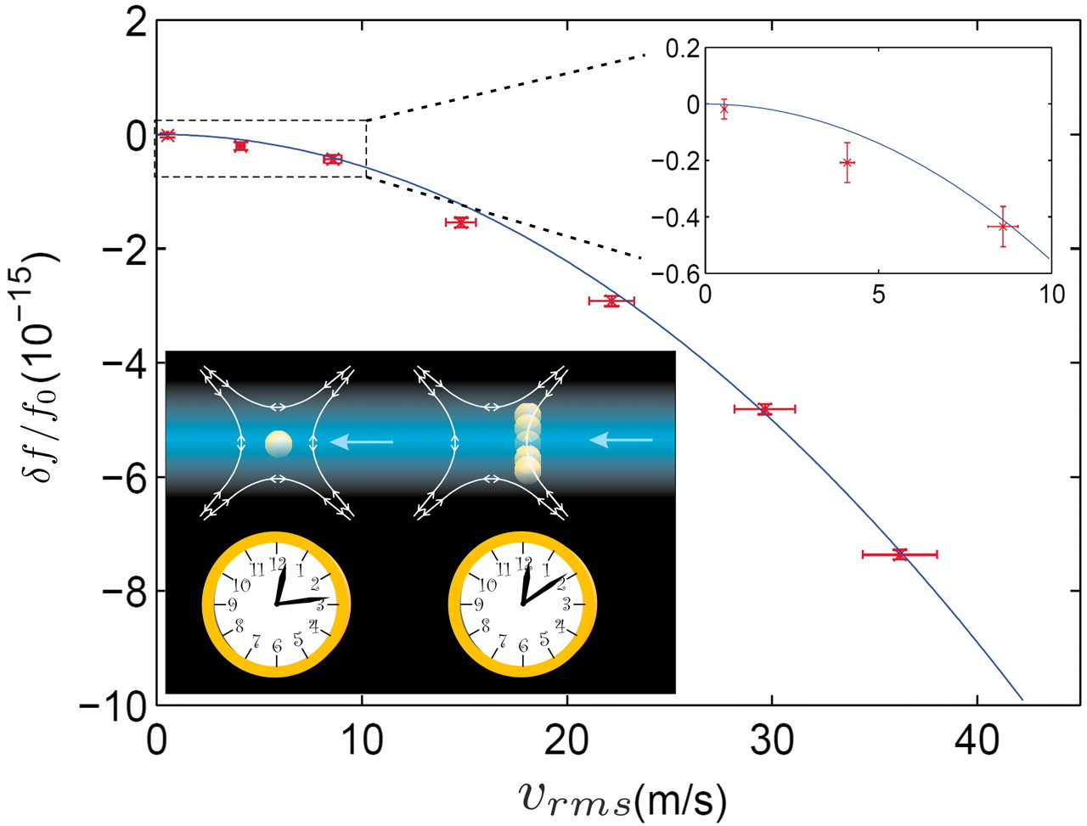
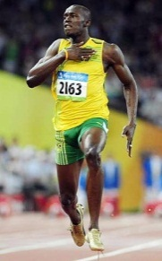
The twins paradox at running speed
Chou, Hume, Rosenband and Wineland, Science, 329, 1630, (2010)

Slide 36
Precision mass measurements: 10⁻¹⁰

Slide 37
King Linearity holds
Relative accuracy ~ 10⁻³ – 10⁻⁴
Nonlinear anomalies; e.g. Samarium; due to level degeneracies

Slide 38
Yb⁺ ion-clock

Slide 39
Fundamental and New Physics Searches
Parity violation: nuclear electroweak neutral charge
Search for electron electric-dipole moment: SUSY breaker
Search for time variations of fundamental constants
Measurement of the electron anomalous g-factor: validity of QED
Tests of CPT: Spectroscopy of anti-matter
Rydberg constant and Proton charge radius: Spectroscopy in Hydrogen or Muonic Hydrogen
Dark matter searches
Axion searches
Search for violation of Lorenz invariance

