Slide 1
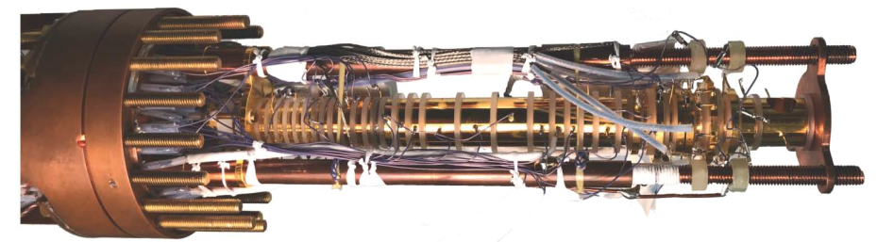







PRECISION TRAPS
Stefan Ulmer
RIKEN
Fundamental Symmetries Lab
2018 / 01 / 15

Slide 2
Outline
Motivation and Introduction
Trapping of Charged Particles
Basic Methods
Antiproton Measurements in Penning traps
  Charge – to – Mass Ratios
  Magnetic Moments

Slide 3
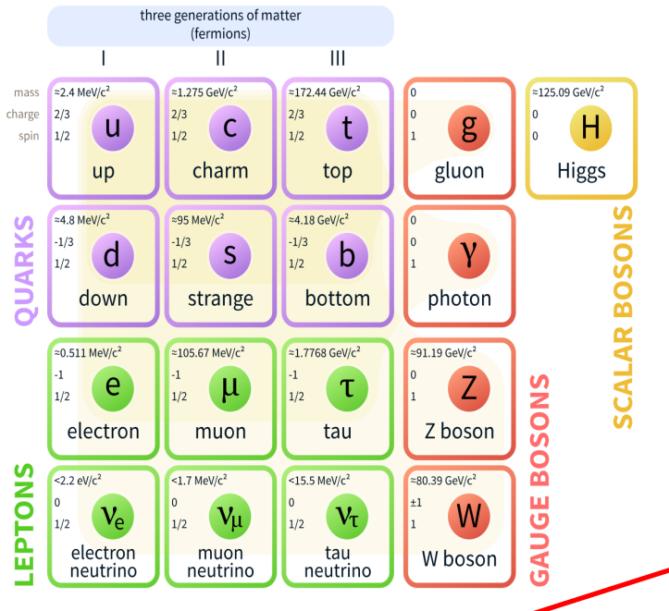
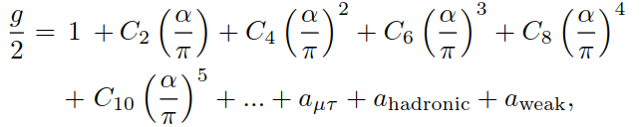
Fundamental Physics in 2018
Relativistic quantum field theories of the standard model describe a plethora of particle physics phenomena
The Standard Model is not just a list of particles and a classification - it is a theory that makes detailed, precise quantitative predictions!
g / 2 = 1.001 159 652 180 73 (28)
!!! At the same time, the Standard Model is the biggest success and the greatest frustration of modern physics !!!

Slide 4
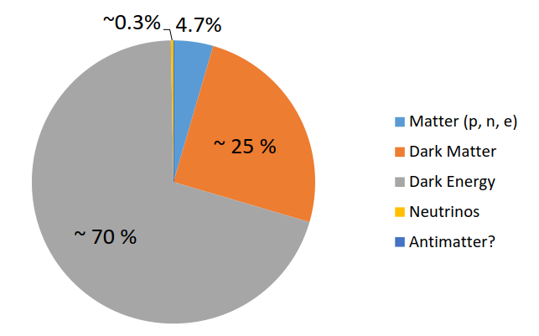
Beyond Standard Model Physics
Standard model is incomplete
  contains 19 free parameters which need to be tuned by experiments
observations beyond the SM
  neutrino oscillations
  dark matter
  energy content of the universe
  several fine-tuning problems
  origin of lepton helicity
  absence of antimatter in the universe:
  known Standard Model CP violation produces one baryon in 10¹⁸ photons observed CMBR density: one baryon in 10⁹ photons
so at least we know, that we know quite a lot about almost nothing
what’s next?
how can we produce input to solve at least some of the problems?

Slide 5
How to solve problems in physics?
Prominent and rather fruitful strategy:
  Investigate very well understood, simple systems and look of unexpected deviations.
Example: Hydrogen
QED effects
Asymmetric WI-effects
Bethe / Schwinger
Basic models
Bohr / Schroedinger
Relativistic models
Dirac
HFS – coupling and nuclear
effect
Pauli / Bloch etc.
1
10⁻⁴
10⁻⁷
10⁻⁴ to 10⁻¹¹
!!! A single particle in a trap is one of the simplest systems you can think of !!!

Slide 6
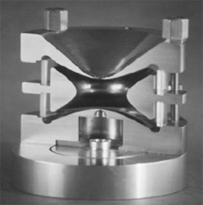
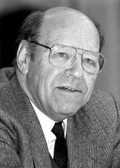
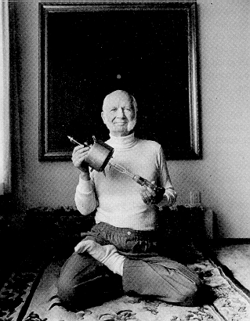
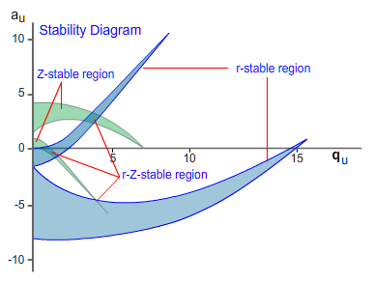
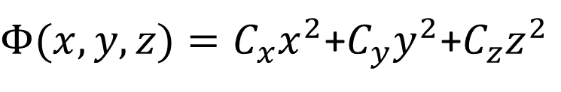

How to trap charged particles…
Maxwell equations:
$$∆Φ=0$$
Harmonic potential:
$Φ(x,y,z)=C_{x}x^{2}$+$C_{y}y^{2}$+$C_{z}z^{2}$
Earnshaw theorem: Not possible to trap particles in static electric fields.
Dynamic approach: Paul Trap
Static approach: Penning Trap
Physics idea: Oscillating rf-fields drive particles back to center – time average attractive (particle ping/pong)
Physics idea: counteract the radial saddle-potential by superimposing a strong magnetic field
Nobel prize in 1989
Natural consequence: both trap-types have stability issues…

Slide 7
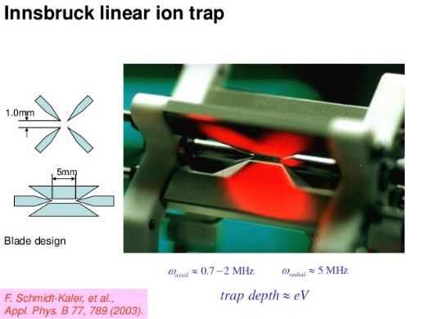
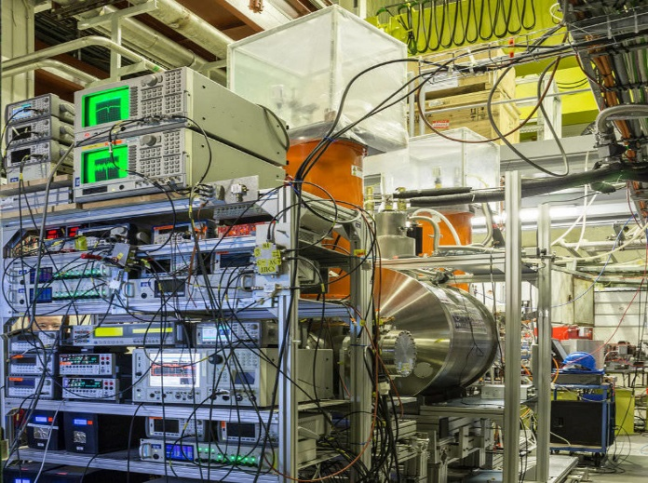
Paul Trap vs. Penning Trap
Cheap
Variable
Open access
Noisy
Micromotion
Expensive
Constrained
Closed system
STABILITY
Controlability
Reliability
Use Paul trap once you’re interested in physics properties which are defined by internal interactions in composed charged systems.
Use the Penning trap for ultra-high precision studies or experiments dealing with complex many particle systems.
Prominent in quantum information
Prominent in fundamental studies

Slide 8
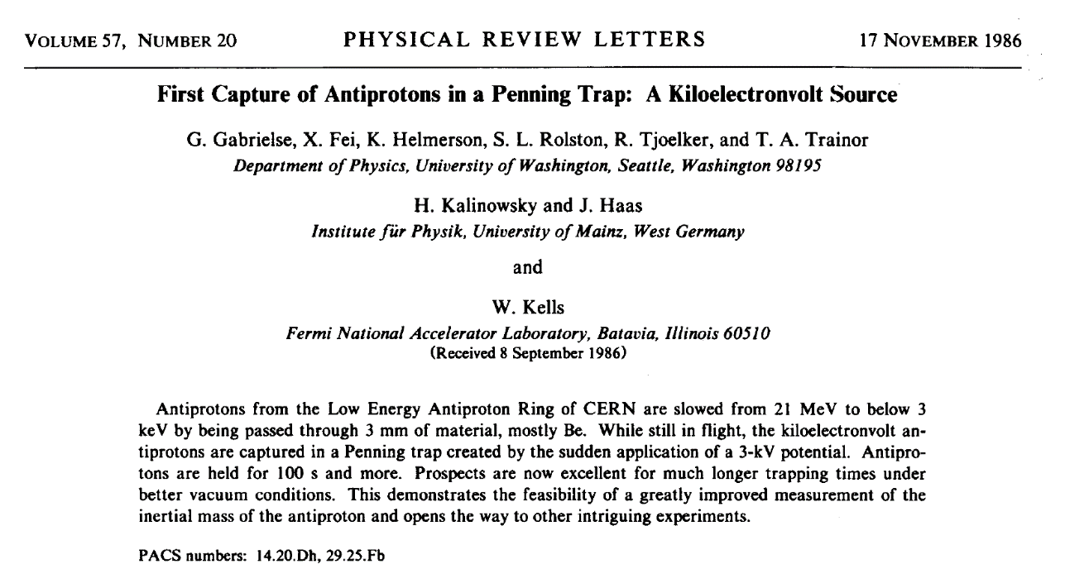
Traps in Antimatter Physics
The Penning trap is the “work-horse” of the antimatter physics community.
Trap as a container for positrons and antiprotons to produce antihydrogen (see lectures by Testera and Yamazaki)
First paper on trapped antiprotons
Trap as an instrument to study the fundamental properties of trapped antiparticles (this lecture / Smorra lecture).
This entire field of physics would likely NOT EXIST without traps!

Slide 9
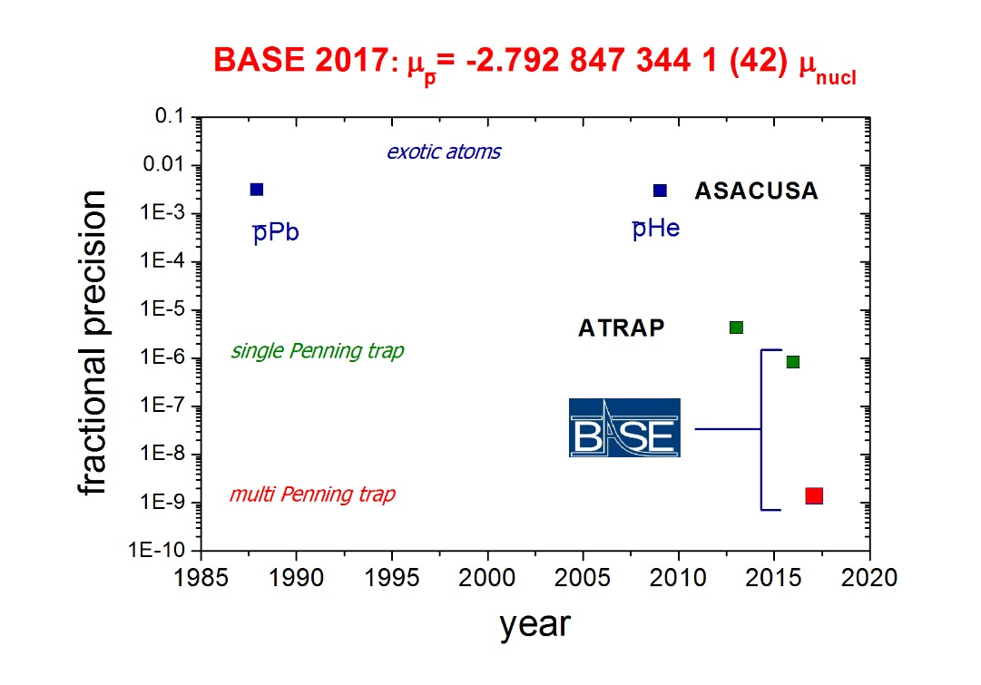
Trap Results in Antimatter Physics
Two collaborations dealing with single particles in traps – ATRAP and BASE
  (A)TRAP pioneered fundamental experimental methods.
  BASE enhanced fractional precision of these experiments.
??? What is behind all that ???

Slide 10
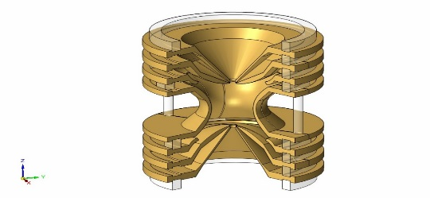
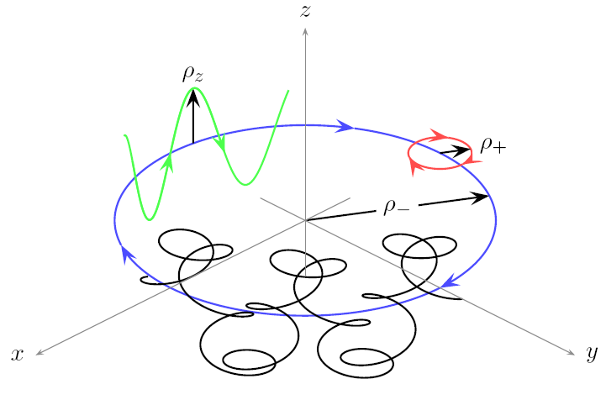
Penning Trap
radial confinement of charged particles by a constant magnetic field
B
Superimpose the simplest electrostatic potential you can think of
results in three harmonic oscillator modes
axial mode
modified cyclotron mode
magnetron mode
single particle in a trap: simplest superimposed static magnetic and static electric fields result in three fully decoupled harmonic single-particle oscillators.

Slide 11
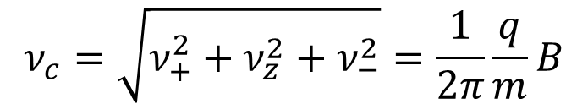
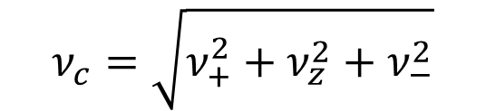
The Invariance Theorem
The three trap frequencies can be combined to a robust invariance relation
tilted trap
drifts B(t)
potential
$$ν_{c}=\sqrt{ν_{+}^{2}+ν_{z}^{2}+ν_{−}^{2}}$$
contaminants
B2 and B1
shift in B1
image charge
misalignment of B-axis and E-axis cancels out
ellipticities of trap potential cancel out
image current
Single particles in Penning traps give direct access to the fundamental properties of trapped particles
$$ν_{c}=\sqrt{ν_{+}^{2}+ν_{z}^{2}+ν_{−}^{2}}=\frac{1}{2π}\frac{q}{m}B$$
Precise frequency measurements in traps provide information about fundamental properties of trapped particles.

Slide 12

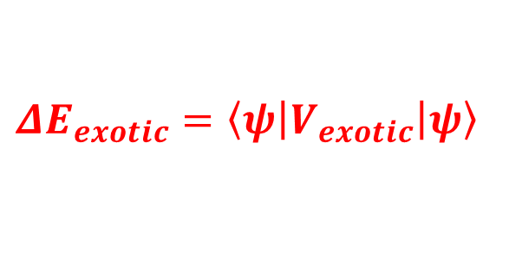




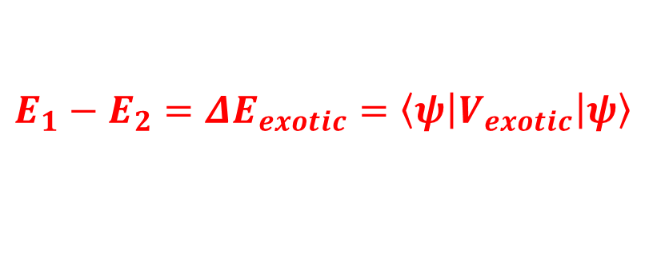
Different Perspective: Fundamental Symmetries
Within the framework of classical physics, a single particle in a Penning trap is a well understood, very simple system (three harmonic oscillators).
Penning traps thus provide perfect boundary conditions to test exotic theories and search for physics beyond the Standard Model.
How would a yet undiscovered physics effect look like?
Whatever it is:
Need to ask the right questions
System 1
System 2
$H ψ=\left(H_{0}+ V_{exotic}\right)$ $ψ$
$$ΔE_{1}$$
$$ΔE_{2}$$
$$ΔE_{1}$$
$$ΔE_{2}$$
$$ΔE_{exotic}=\left\langle \left.ψ\right|V_{exotic}\left|ψ\right.\right\rangle$$
$$E_{1}−E_{2}=ΔE_{exotic}=\left\langle \left.ψ\right|V_{exotic}\left|ψ\right.\right\rangle$$
A precision trap is an artificial, highly modular, extremely exotic atom

Slide 13

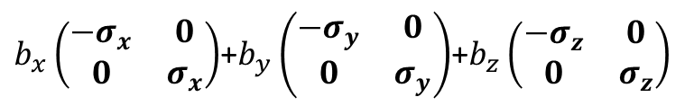
Interaction Potentials – Minimal SME
Example: Standard Model Extension
$$\left(iγ^{μ}D_{μ}−m−{a_{μ}γ}^{μ}−b_{μ}γ_{5}γ^{μ}\right)ψ=0$$
Inspired by string theory translated to SM via effective field theory
Idea of construction: Consider all possible low dimension bi-linears within the Poincare group (useful but not fundamental).
Dirac equation
CPT-odd modifications
$b_{μ}γ_{5}γ^{μ}→b_{x}\left(\begin{matrix}0 & 1 \\ 1 & 0\end{matrix}\right)\left(\begin{matrix}0 & σ_{x} \\ −σ_{x} & 0\end{matrix}\right)$+$b_{y}\left(\begin{matrix}0 & 1 \\ 1 & 0\end{matrix}\right)\left(\begin{matrix}0 & σ_{y} \\ −σ_{y} & 0\end{matrix}\right)$+$b_{z}\left(\begin{matrix}0 & 1 \\ 1 & 0\end{matrix}\right)\left(\begin{matrix}0 & σ_{z} \\ −σ_{z} & 0\end{matrix}\right)$
$b_{x}\left(\begin{matrix}{−σ}_{x} & 0 \\ 0 & σ_{x}\end{matrix}\right)$+$b_{y}\left(\begin{matrix}−σ_{y} & 0 \\ 0 & σ_{y}\end{matrix}\right)$+$b_{z}\left(\begin{matrix}−σ_{z} & 0 \\ 0 & σ_{z}\end{matrix}\right)$
Pseudo-magnetic field, with different coupling between matter and antimatter
Measurements:
coefficients can be constrained by searching for diurnal variations in comagnetometer measurements.
comparisons of particle/antiparticle magnetic moments in traps
Physics: such interactions can e.g. be induced by CPT-odd dark matter couplings

Slide 14
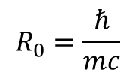

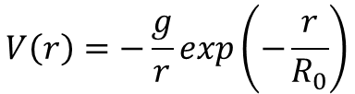
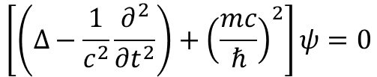
Interaction Potentials – Non-Minimal SME
$$ΔV_{int}=\tilde{b_{z,D}}\left(\begin{matrix}0 & 0 \\ 0 & ±σ_{z}\end{matrix}\right)$$
these types of interactions can only be uncovered by explicit measurements on antimatter
Yukawa picture:
$$\left[\left(∆−\frac{1}{c^{2}}\frac{∂^{2}}{{∂t}^{2}}\right)+{\left(\frac{mc}{ℏ}\right)}^{2}\right]ψ=0$$
Potentially sensitive to exchange bosons, exclusively coupling to antimatter.
Potentially sensitive to heavy exchange bosons at strong interaction strenghts.
Complementary approach to HEP
Stationary Yukawa potential:
$$V\left(r\right)=−\frac{g}{r}exp\left(−\frac{r}{R_{0}}\right)$$
$$R_{0}=\frac{ℏ}{mc}$$
Effective interaction length:

Slide 15
The Penning Trap – Key Techniques

Slide 16
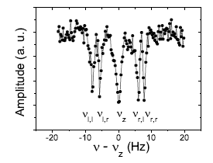
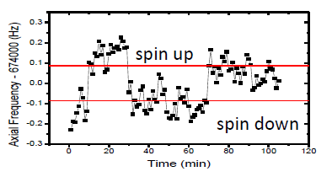

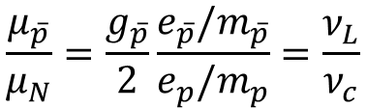
Blueprint Measurements in Penning traps
Cyclotron Motion
Larmor Precession
g: mag. Moment in units of
nuclear magneton
simple
difficult
$$\frac{μ_{\overline{p}}}{μ_{N}}=\frac{g_{\overline{p}}}{2}\frac{e_{\overline{p}}/m_{\overline{p}}}{e_{p}/m_{p}}=\frac{ν_{L}}{ν_{c}}$$
$$\frac{ν_{c,\overline{p}}}{ν_{c,p}}=\frac{e_{\overline{p}}/m_{\overline{p}} }{e_{p}/m_{p} }$$
S. Ulmer, A. Mooser et al. PRL 107, 103002 (2011)
S. Ulmer, A. Mooser et al. PRL 106, 253001 (2011)
Determinations of the q/m ratio and g-factor reduce to measurements of frequency ratios -> in principle very simple experiments –> full control, (almost) no theoretical corrections required.

Slide 17
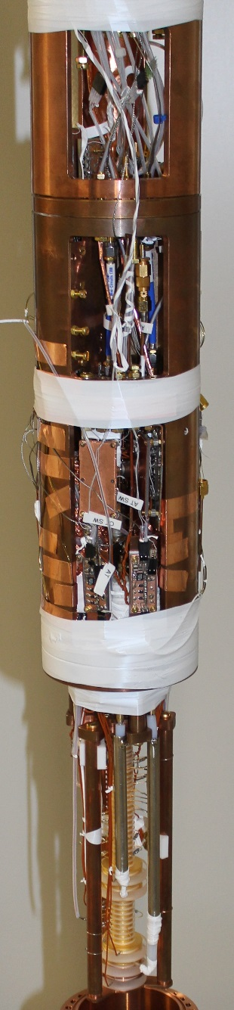
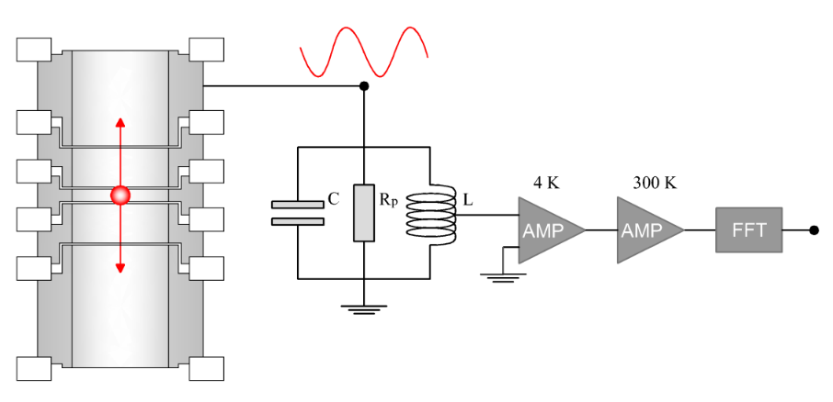
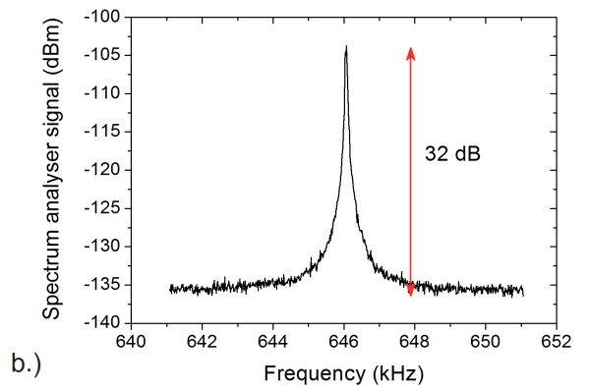
Non Destructive Particle Detection (see Smorra lecture)
Idea: Oscillating particle induces image currents in trap electrodes.
What are we dealing with?
single charge
10⁻¹⁶ A/mm
Image current detection:
  Requires detection systems with high sensitivity
  Non destructive – long observation times – precise information about trapped particle
  Real time observation of particle manipulation
Q=30000

Slide 18
Example: Resistive Cooling and Peak Detection
Power dissipated in detection resistor
Particle is cooled resistively

Slide 19
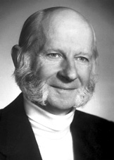
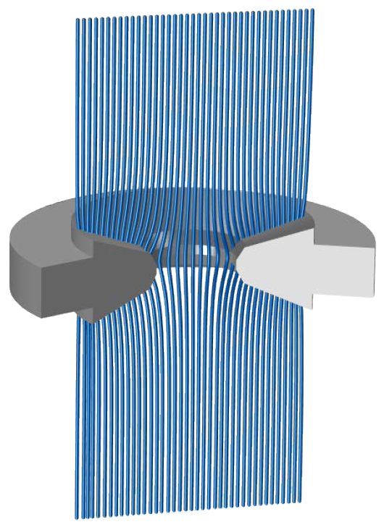
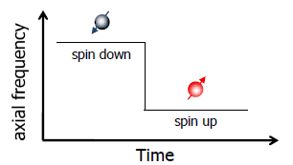
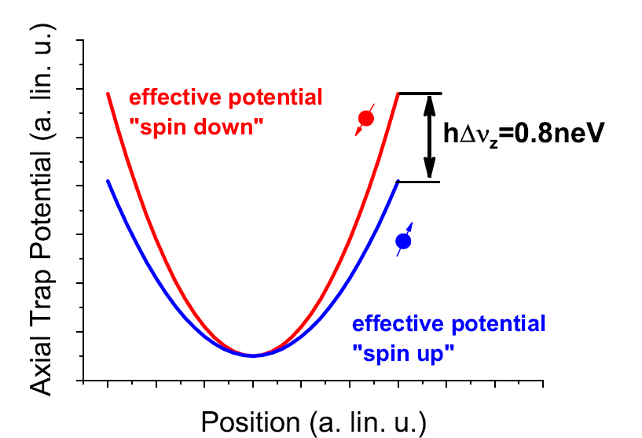
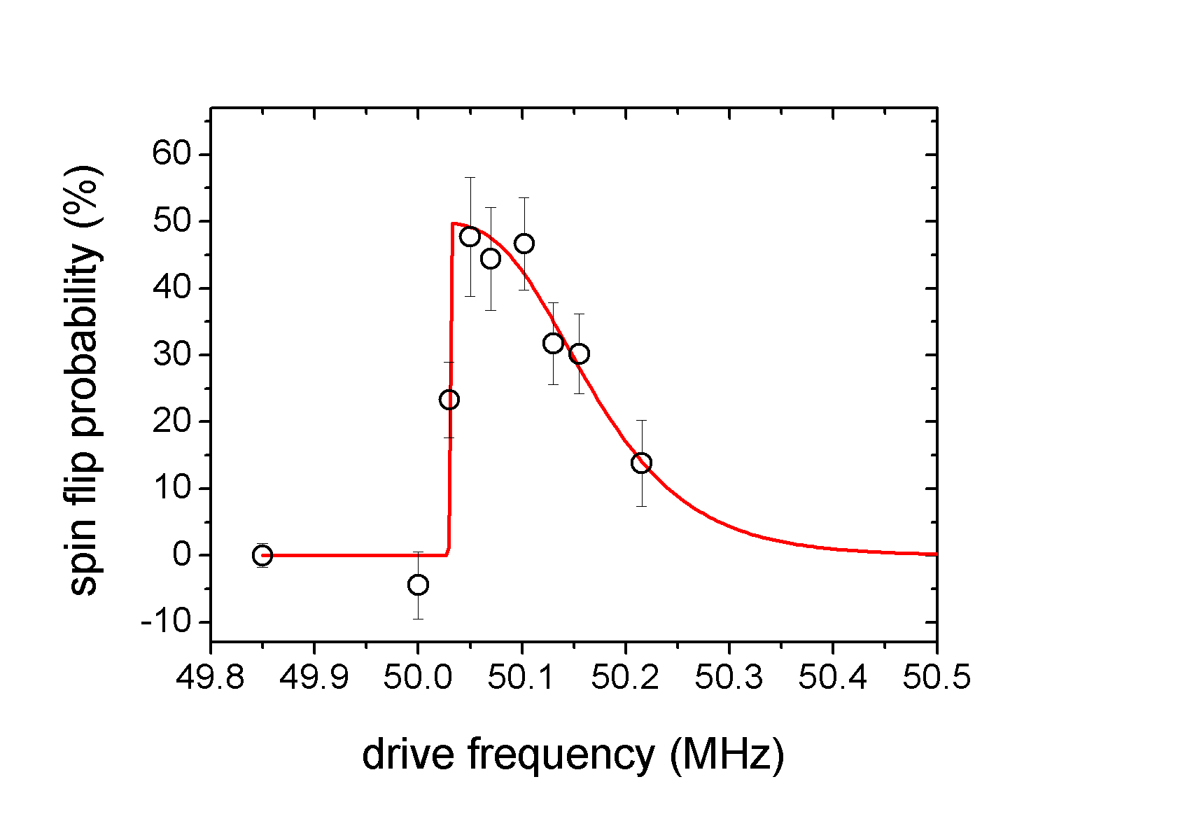
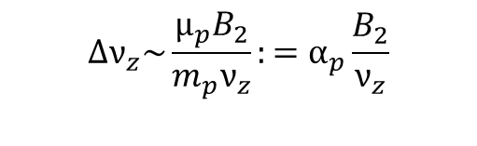
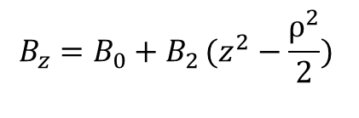

The Continuous Stern-Gerlach Effect
Measurement based on continuous Stern Gerlach effect.
Energy of magnetic dipole in magnetic field
$$Φ_{M}=−\left.(\vec{μ_{p}}⋅\vec{B})\right.$$
Frequency Measurement
Leading order magnetic field
correction
$$B_{z}=B_{0}+B_{2}\left.(z^{2}−\frac{ρ^{2}}{2}) \right.$$
Spin is detected and analyzed via an axial frequency measurement
This term adds a spin dependent quadratic axial potential -> Axial frequency becomes function of spin state
$$Δν_{z}\sim \frac{μ_{p}B_{2}}{m_{p}ν_{z}}:=α_{p}\frac{B_{2}}{ν_{z}}$$
Single Penning trap method is limited to the p.p.m. level
S. Ulmer, A. Mooser et al. PRL 106, 253001 (2011)

Slide 20
The Penning Trap – Ingredients

Slide 21
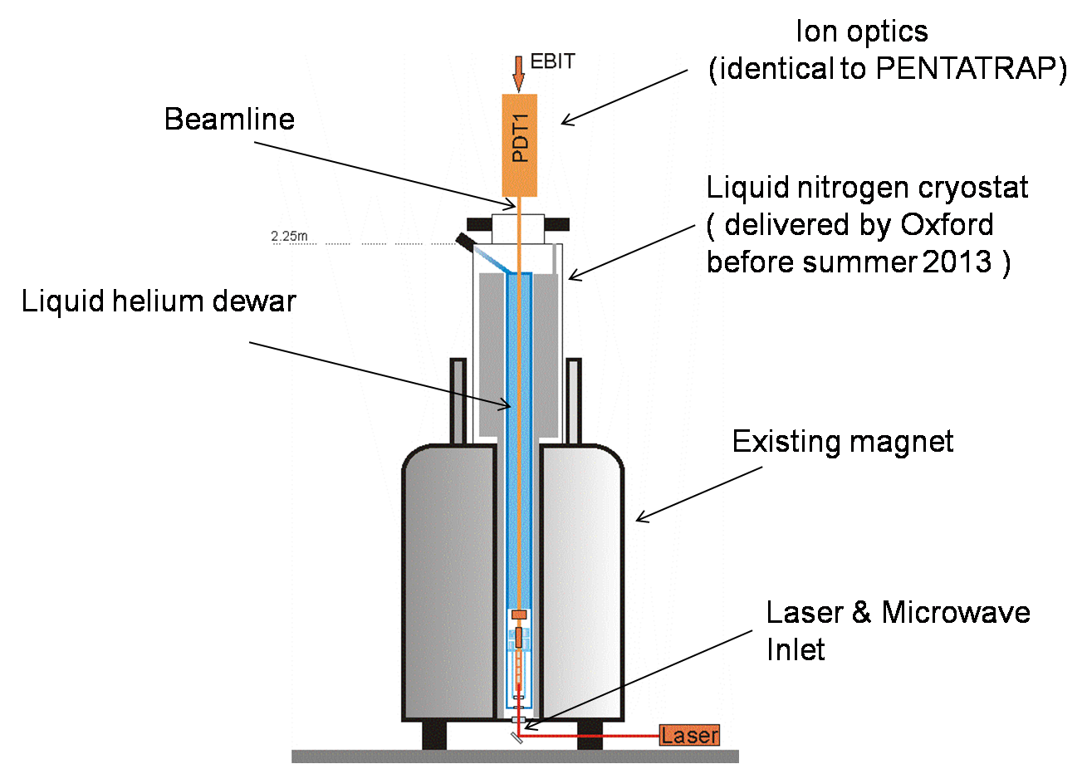
Some basic homework
Typical ingredients of Penning trap experiments
  Stable and homogeneous superconducting solenoid
  Precisely machined trap electrodes
  RF electronics
  Ultra stable power supplies
  Most of the high-precision experiments are operated under cryogenic conditions.
  Cryogenic operation -> good vacuum
HCI experiment at University of Mainz
Sturm / Blaum / Quint / Werth
Centre of a good magnet
Paramter | Value
dB/dt | < 10⁻¹¹/h
B1 | < mT/m (NMR shimming limit)
B2 | < 0.5 T/m² (NMR shimming limit)
Supplies-rack of CERN’s BASE experiment
Ulmer / Mooser / Smorra

Slide 22
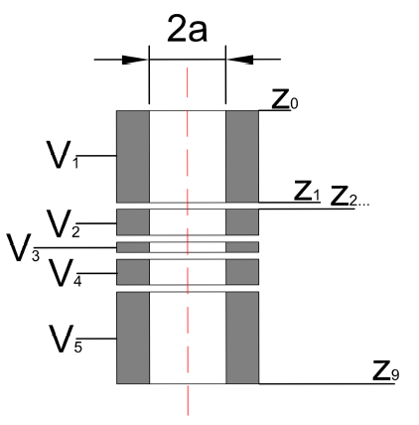
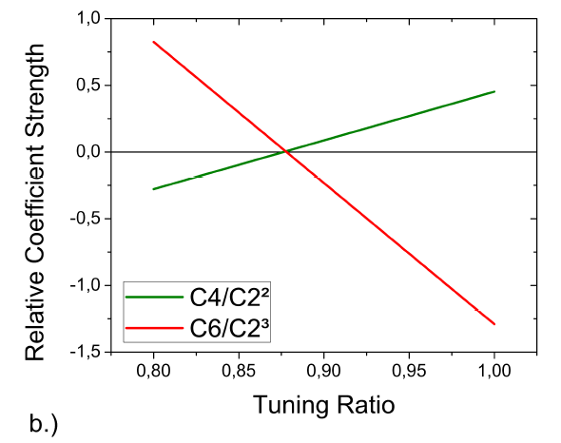
Cylindrical Trap Design
Degrees of freedom for defined radius:
1.) Length of ring electrode
2.) Length of correction electrode
3.) Compensation/Ring voltage
1.) C4 = 0
2.) C6 = 0
3.) orthogonality
easy to understand / simple to optimize / easy to machine

Slide 23
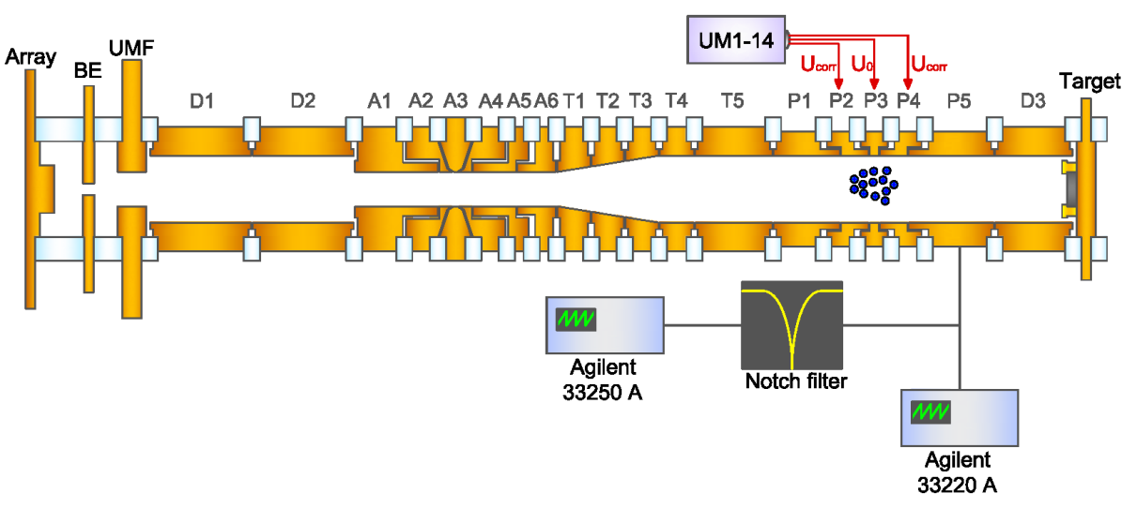
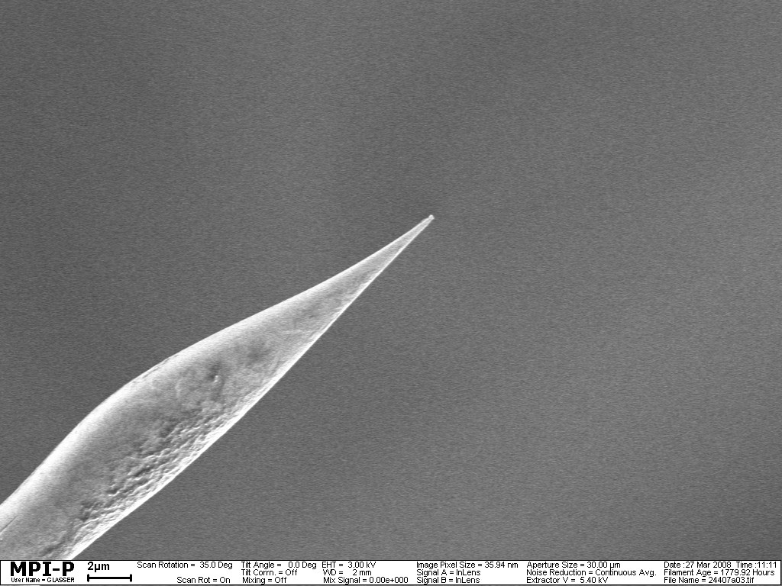
Particle Loading – Matter (here protons)
In-trap creation by bombarding an appropriate target with an electron beam

Slide 24
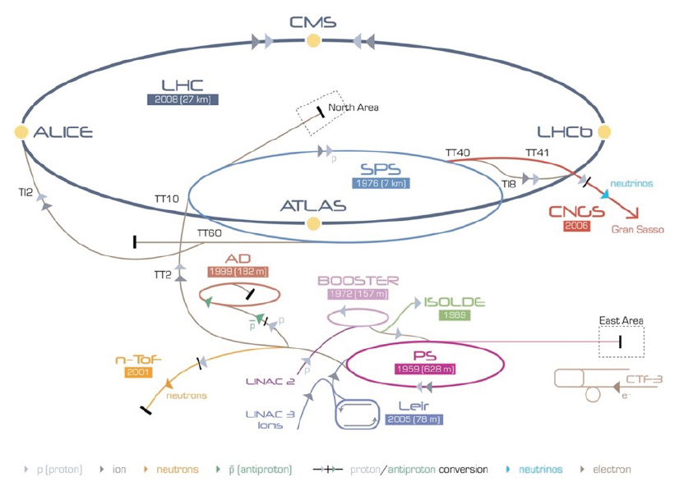
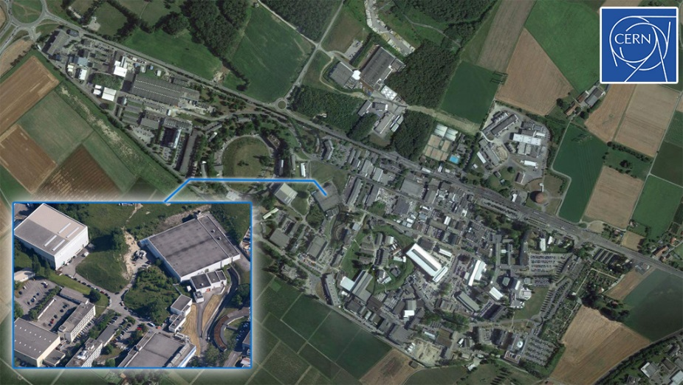
Particle Loading - Antiprotons
5.3 MeV antiprotons
25 GeV/c protons
3.5 GeV/c antiprotons
-> Degrader -> 1keV
Particles in the trap, what’s next?

Slide 25
Electron Cooling / Electron Kickout
Idea: Store antiprotons and electrons in the same trap volume
Coulomb interaction -> electrons cool fast due to cyclotron radiation
Obtain a cold cloud of antiprotons
Get rid of electrons…
Cold particles in the trap, what’s next?

Slide 26
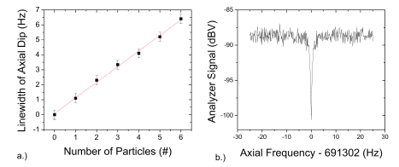
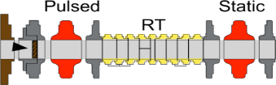
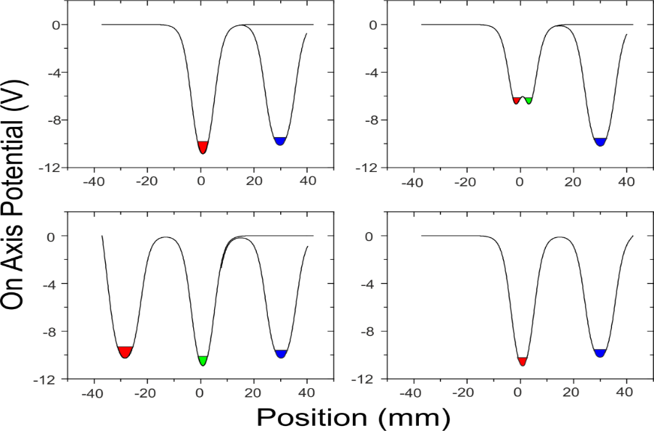
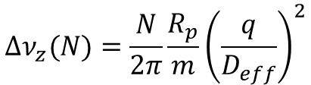
Preparation of a Single Particle
Evaporation:
$$Δν_{z}(N)=\frac{N}{2π}\frac{R_{p}}{m}{\left(\frac{q}{D_{eff}}\right)}^{2}$$
Single particle extraction by trap potential manipulation:
C. Smorra, Int. Journ. Mass. Spec (2015)

Slide 27
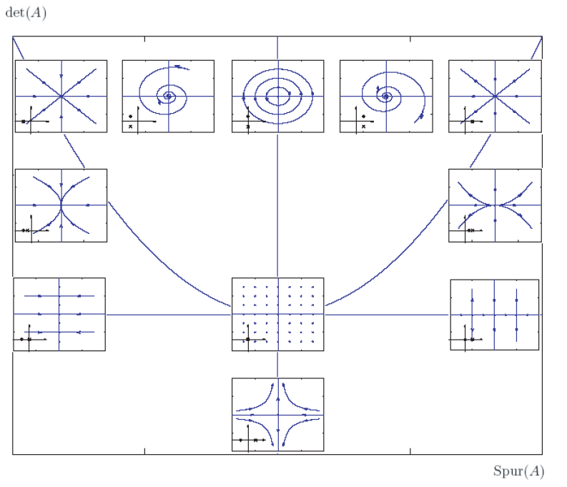
Sideband Coupling/Cooling
Application of a quadrupolar drive at sum or difference frequency of two involved modes:
coupled
system
important coupling
practically applied by injecting rf on segmented, rf-blocked electrodes
Rotating wave approximation
coherent TRACELESS system at complex eigenvalues
Diagonalization

Slide 28
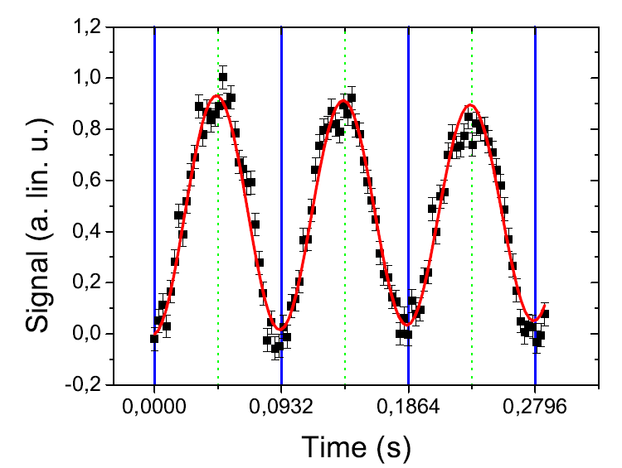
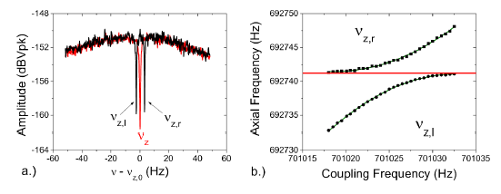





Examples: Sideband Coupling
Effectively: Amplitude modulation of particle motion
$$z\left(t\right)=z_{0}cos\left(\frac{Ω}{2}t\right)sin\left(ω_{z}t+φ_{z}\right)$$
Classical “Dressed states”
$$ν_{l}=ν_{z}−\frac{δ}{2}−\frac{Ω}{4π}$$
$$ν_{r}=ν_{z}−\frac{δ}{2}+\frac{Ω}{4π}$$
practically nothing
else but
the FFT of an
amplitude
modulated signal
ν𝑙+ν𝑟=ν𝑧+ν𝑟𝑓−ν±𝑎
widely used to measure temperature of the radial modes.
also useful for efficient cooling of radial modes
S. Ulmer et al. Phys. Rev. Lett 107, 130005 (2011)

Slide 29
Temperature in Sideband Cooling
Sideband cooling -> dynamics in quantum states and cooling dynamics stops if n_{+,-}=n_{z}
Cooling Limit:

Slide 30
EXPERIMENTS – Charge to Mass Ratios

Slide 31

Results of proton/antiproton mass comparisons
Historical measurements for current antimatter physics program
Progress ???
[J. Harrington et al., XXX XX, (201X)]<
Limitations of 1995 measurement and last factor of 10 improvement?
[G. Gabrielse et al., PRL 82, 3198 (1999)]

Slide 32












Why would we want to use a hydrogen ion rather than a proton
Slightly inhomogeneous magnetic field.
Offset potentials on the electrodes of the cryogenic trap.
Change of polarity leads to position shift of the particle.
Systematic uncertainties due to the particle position are large (~10⁻⁹)
For protons (polarity inversion (dV=10V)) much larger as for H- ions (dV=0.005V).
$$Take a ratio of measured cyclotron frequency$$
$of antiproton{ ν}_{c\overline{p}}$to H⁻ ion $ν_{cH^{−}}$ => reduces to antiproton to proton charge-to-mass ratio
Magnetic field cancels out!
$$R=\frac{ν_{c\overline{p}}}{ν_{cH^{−}}}=\frac{{(q/m)}_{\overline{p}}}{{(q/m)}_{H^{−}}}x\frac{B/2π}{B/2π}=\frac{{(q/m)}_{\overline{p}}}{{(q/m)}_{H^{−}}}$$
$$m_{H^{−}}=m_{p}(1+2\frac{m_{e}}{m_{p}}−\frac{E_{b}}{m_{p}}−\frac{E_{a}}{m_{p}}+\frac{α_{pol,H^{−} }B_{0}^{2}}{m_{p}})$$
$$B_{0}+B_{1} z$$
$$H^{−}$$
$$U_{H^{−}}$$
$$\overline{p}$$
$$U_{\overline{p}}$$
R_{theo} = 1.001 089 218 754 2(2)
$$U_{p}$$
$$p$$

Slide 33





Measurement
AD cycle
$$ν_{l}=ν_{z}−\frac{δ}{2}−\frac{Ω}{4π}$$
$$ν_{r}=ν_{z}−\frac{δ}{2}+\frac{Ω}{4π}$$
ν𝑙+ν𝑟=ν𝑧+ν𝑟𝑓−ν±𝑎
Measurement cycle is triggered by the antiproton injection into the AD
One BASE charge-to-mass ratio measurement is by 50 times faster than
achieved in previous proton/antiproton measurements.
First high-precision mass spectrometer which applies this fast shuttling technique

Slide 34





BASE Measurements – Proton to Antiproton Q/M
Result of 6500 proton/antiproton Q/M comparisons:
Rexp,c = 1.001 089 218 755 (64) (26)
$\frac{{(q/m)}_{\overline{p}}}{{(q/m)}_{p}}$ $−1=1\left(69\right)×{10}^{−12}$
Most precise test of CPT invariance with Baryons.
Consistent with CPT invariance
Constrain of the gravitational anomaly for antiprotons:
$$\frac{ω_{c,p}−ω_{c,\overline{p}}}{ω_{c,p}}=−3(α_{g}−1) U/c^{2}$$
Our 69ppt result sets
a new upper limit of
$\left|α_{g}−1 \right|$ $<$ 8.7$×{10}^{−7}$
S. Ulmer et al., Nature 524 196 (2015)

Slide 35
Example: Resolution Limit in BASE
Sideband based magnetic field measurements:
Sideband measurement in presence of a magnetic field inhomogeneity
Sideband measurement in homogeneous magnetic field, in presence of running accelerator
Sideband measurement using a self shielding solenoid
??? Physics understood ???
Further improvement by direct measurement methods

Slide 36
EXPERIMENTS – Magnetic Moments

Slide 37





Magnetic Moment Measurements
Measurement based on continuous Stern Gerlach effect.
Energy of magnetic dipole in magnetic field
$$Φ_{M}=−\left.(\vec{μ_{p}}⋅\vec{B})\right.$$
Frequency Measurement
Leading order magnetic field
correction
$$B_{z}=B_{0}+B_{2}\left.(z^{2}−\frac{ρ^{2}}{2}) \right.$$
Spin is detected and analyzed via an axial frequency measurement
This term adds a spin dependent quadratic axial potential -> Axial frequency becomes function of spin state
$$Δν_{z}\sim \frac{μ_{p}B_{2}}{m_{p}ν_{z}}:=α_{p}\frac{B_{2}}{ν_{z}}$$
- Very difficult for the proton/antiproton system.
$$B_{2}\sim 300000 T/m^{2}$$
- Most extreme magnetic conditions ever applied to single particle.
$${∆ν}_{z}\sim 170 mHz$$
Single Penning trap method is limited to the p.p.m. level
S. Ulmer, A. Mooser et al. PRL 106, 253001 (2011)

Slide 38






0.8 p.p.m. Measurement
co-magnetometer measurement
single particle in the magnetic bottle
measurement
  Measure cyclotron frequency
  Measure Larmor frequency
  Measure cyclotron frequency
evaluate g-factor
repeated the scheme in total six times
$$ν_{c}$$
$$ν_{L}$$
task: resolve these two «cut» frequencies
$$\frac{g_{\overline{p}}}{2}=\frac{ν_{L}}{ν_{c}}$$

Slide 39






Result and Limitations
Result
noise driven random walk in the magnetron mode traces magnetic field.
from six independent g-factor measurements
$$\frac{dν_{c}}{ν_{c}}=−\frac{1}{2π^{2}m_{\overline{p}}ν_{z}^{2}}\frac{B_{2}}{B_{0}}dE_{−}=\frac{5.2 p.p.m.}{μeV}dE_{−}$$
$$\frac{g_{\overline{p}}}{2}=2.792 846 5 (23)$$
250 kHz
250 Hz
Ultimately limits g-factor measurement to the 1 p.p.m. to 0.1 p.p.m. level

Slide 40

Can we do better ?
probably, by putting a lot of effort in we would be able to reach with the single-trap method the 0.1 p.p.m. - level.
apply alternative measurement schemes: multi-trap methods

Slide 41




«Simplest»: The Double Penning-Trap Method
comparison
single-trap method
!!! measured !!!
$$\frac{B_{2,AT}}{B_{2,PT}}>{10}^{6}$$
multi-trap method
!!! measured !!!
$$\frac{B_{2,AT}}{B_{2,PT}}>{10}^{6}$$
inhomogeneous magnetic field for spin state analysis
homogeneous magnetic field for frequency measurements

Slide 42


The Double Penning-Trap Method
Initialize the spin state
1.) measure cyclotron $ν_{c}$
2.) drive spin transition at $ν_{rf}$
particle transport
analyze the spin state
no spin-flip in PT
spin flipped in PT
measures spin flip probability as a function of the drive frequency in the homogeneous magnetic field of the precision trap

Slide 43
Challenges – High-Fidelity Single Spin-Flip Resolution
To conclude in which quantum state the particle leaves / returns from precision trap, the double trap method requires high-fidelity spin-state resolution
this is the game changer...
p.p.m.
SSF not resolved
p.p.b.
SSF resolved
...where all the work is in...
resolving single antiproton spin flips is a challenge

Slide 44


Challenges – High-Fidelity Single Spin-Flip Resolution
observation of antiproton spin transitions with high-fidelity requires ultra-cold particles
cold particle (50mK)
hot particle (1K)
Physics
  heating by rf at a noise density of about $100 pV/\sqrt{Hz}$ drive radial cyclotron quantum transitions.
  transition rates scale with the cyclotron quantum number.
fidelity at 65%, not useful for measurements
high-fidelity spin state resolution

Slide 45


Sub-Thermal Cooling
Cold particle is prepared by resistive cooling in the PT
thermalize particle (6 min.)
12 min.
Analyze temperature using the magnetic bottle
particles with single spin-flip resolution are in this temperature range
particle below threshold -> MEASURE
particle above threshold
NOTE: each cyclotron frequency measurement heats the particle to about 300K
works (see BASE-Mainz measurements), but sub-thermal cooling is EXTREMELY time consuming

Slide 46
Current Time Budget of a (CERN) Double-Trap Experiment
maintenance
spin analysis
Cooling is a problem
frequency measurements
transport
requires new ideas
multi-trap multi-particle methods
This talk
Sympathetic cooling of protons and antiprotons
MOOSER
COOLING

Slide 47


BASE Two-Particle Method
Idea: divide measurement to two particles
«hot» cyclotron particle which probes the magnetic field in the precision trap
«cold» cyclotron particle to flip and analyze the spin- eigenstate
challenges:
  transport without heating
  more challenging systematics
pay: measure with two particles at different mode energies
win: 60% of time usually used for sub-thermal cooling useable for measurements

Slide 48






The Magnetic Moment of the Antiproton
G. Schneider et al., Science 358, 1081 (2017)
$$\frac{g_{p}}{2}=2.792 847 344 62 (82)$$
first measurement more precise for antimatter than for matter...
...so how about the proton magnetic moment?
$$\frac{g_{\overline{p}}}{2}=2.792 847 344 1 (42)$$
C. Smorra et al., Nature 550, 371 (2017)

Slide 49
Thanks very much for your attention

Slide 50
Phase Sensitive Methods I
prepare a coherent cyclotron state with well-defined phase:
wait for certain evolution time
Apply sideband pi-pulse and couple cyclotron energy to axial mode, which conserves the phase
...thus, imprints cyclotron phase to axial phase
Measure for different evolution times and unwrap phase.
Direct measurement of cyclotron frequency (more stable)
BUT: Systematic error (special relativity, B₂) ~ r₊² !
D. Pritchard, J Thompson, S. Rainville, E.Cornell, E. Myers, M. Redshaw,…..many papers

Slide 51


P’n’A - Method
Solution: Phase-conserving parametric amplification
Pulse
Nothing
Amplify
²⁸Si¹³⁺
E.g. applied in recently published most precise measurement of the electron mass.
dΓ/ Γ ~ 4 10⁻¹¹
[S. Sturm et al., PRA 87, 030501 (2013)]

Slide 52
Phase Sensitive Axial Detection
Idea: Instead of frequency measurement – measurement of phase relative to locked drive
Measured in 1s per trial.
[S. Ulmer et al., PhD Thesis (2011)]

Slide 53

Sympathetic Cooling
Idea:
  Laser-cool ⁹Be⁺ ion(s)
  Design a trap for resonant coupling
  Energy exchange
«Laser-cooled» antiprotons (mK-cooling within ms) !!! -> Higher precision, specifically in magnetic moment measurements.
[C. Ospelkaus Group, PTB Braunschweig]

Slide 54




Coupled Oscillators
Two charged particles trapped in direct vicinity interact via coulomb interaction.
Static
Dynamic
Resonant Coupling:
Effective Energy Exchange
0.5s/mm³
[C. Ospelkaus Group, PTB Braunschweig]

Slide 55

Proton Spin Quantum Transitions
Improvement of apparatus, trap wiring, quality of detection systems (lower noise, faster measuring cycles).
Based on Bayesian filter -> fidelity of > 90% achieved
A. Mooser, K. Franke, S. Ulmer et al. Phys. Rev. Lett. 723, 78 (2013)

Slide 56




Frequency Shifts in Penning Traps
Particles in imperfect Penning traps -> Anharmonic Oscillators
This can be one of the considerable limitations in frequency ratio measurements !
e.g. a not considered offset potential (50mV) and adjustment of resonance voltage shifts ratio (p/pbar comparison) by already 30ppt!

Slide 57
Trap Tuning
Adjust voltages of correction electrodes to make the trap harmonic.
Allows for trap tuning to mV.

Slide 58


Additional Frequency Shifts
What else modifies the result of your precision experiment?
Effective potential of the induced image charge
  Modification of the quadrupolar potential
  Correction of the invariance theorem
  Strong scaling with trap radius.
  Typical traps (1cm diameter) ->
Modifies cyclotron frequency at level of 1e-10

Slide 59
QUESTION
In a perfect Penning trap
- Homogeneous magnetic field
- Perfect electric quadrupole
- large trap (no image charge shift)
Any additional frequency shift?

Slide 60

Resolution Limits
Dip measurements are limited to a certain precision
  Line width
  Signal-to-noise ratio
  Averaging time
  Voltage drifts and scatter
ν𝑙+ν𝑟=ν𝑧+ν𝑟𝑓−ν±𝑎
scatters
scatters
scatters

Slide 61
Direct Measurements
Measurement of cyclotron frequency with cyclotron resonator
[J. Harrington et al., XXX XX, (201X)]<
Problem: Cyclotron detectors are not very sensitive (small inductance) -> considerable frequency shifts due to large particle energy.
[G. Gabrielse et al., PRA 82, 3198 (1999)]

