Slide 1
Electron Cooling
Gerard tranquille
Be-be-ea

Slide 2
Electron Cooling (an introduction)
What
Why?
Basic theory of electron cooling
Electron cooling hardware
Diagnostics

Slide 3
What is electron cooling?
A fast process to shrink the size, divergence and energy spread of a stored charged particle beam without the loss of intensity.
  Phase-space compression.
Proposed by G. Budker in 1966.
First demonstration on the NAP-M ring in Novosibirsk.

Slide 4
Why electron cooling?
Loss free compression of ion beams
  Accumulation of rare species of charged particles
  Luminosity increase for colliding beam experiments
  Smaller spot sizes for fixed-target experiments
  High resolution experiments with internal targets
Compensation of beam heating effects
  Intrabeam, residual gas and internal target scattering
Electron target for precision experiments e.g. recombination

Slide 5
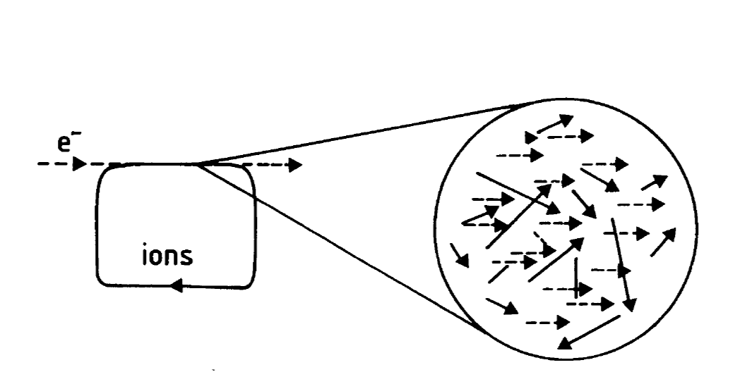
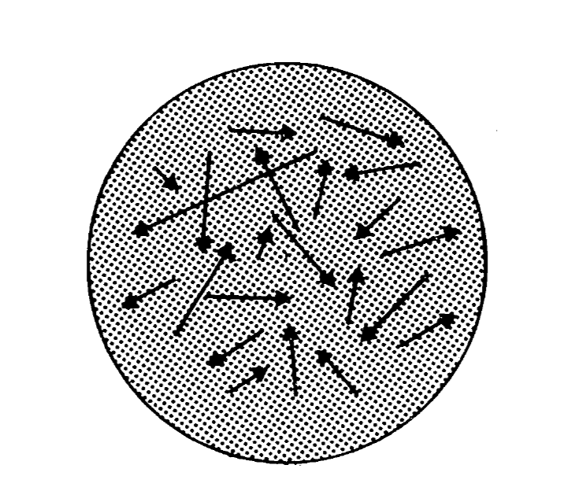
Electron cooling theory
To cool a stored ion beam with electrons a monochromatic electron beam is overlapped with the ion beam in a straight section of the ring.
The velocity of the electrons is made to match the average velocity of the ion beam.
In the rest frame of the electrons the ions are seen as passing through the electron gas with a variety of velocities
The ions transfer their energy to the electrons through Coulomb scattering.
The electrons are continuously renewed -> heat exchanger

Slide 6
Analogy with the mixing of gases
Two gases of different
temperatures T1 an T2
tend to an equilibrium
temperature T3
As the electron beam is
continuously renewed, the
ion beam temperature tends
to the electron beam temperature.
The velocity spread is reduced
by a factor (m/M)^{1/2}

Slide 7
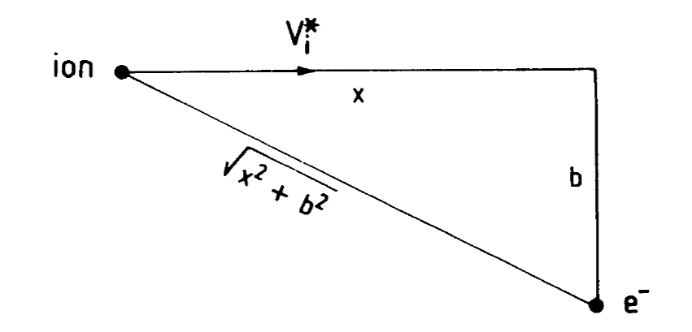

The cooling force
Consider a single electron-ion collision in the electron beam rest frame.
The ion moves with a velocity V_{i}* and scatters from the electron at impact parameter b.
The momentum transfer is:
$$ΔP^{∗} = \int_{−∞}^{∞}{φc dt= \int_{−∞}^{∞}{\frac{Ze2}{x2+b2}dt}}$$
ϕ_{c} being the Coulomb force

Slide 8



As we consider times from negative to positive infinity we can neglect the longitudinal part of the force and we can replace the Coulomb force with the transverse component
$$φ_{⊥} = φc \frac{b}{\sqrt{x2+b2}}$$
$$∆P^{∗} = \int_{−∞}^{∞}{φ_{⊥}dt= \frac{Ze^{2}}{V_{i}^{∗}}\int_{−∞}^{∞}{\frac{b dx}{{(x^{2}+b^{2})}^{3/2}}=\frac{2Ze^{2}}{V_{i}^{∗}b}}}$$
The energy transferred from the ion to the electron is
$$∆E^{∗}(b)= \frac{{∆P^{∗}}^{2}}{2m_{e}}=\frac{2Z^{2}e^{4}}{mb^{2}V_{i}^{∗2}}$$

Slide 9
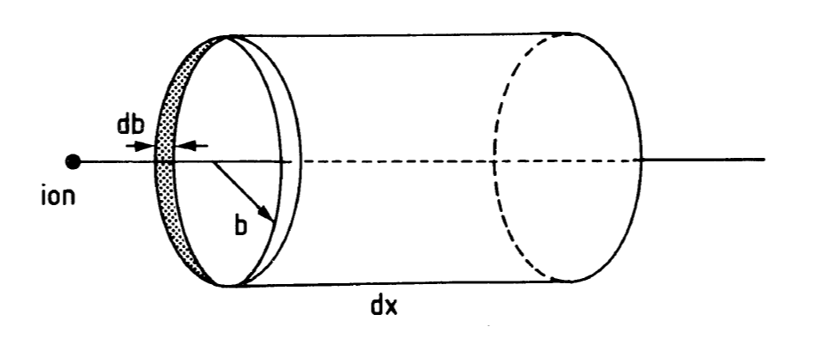


So far we have only considered a single electron-ion collision.
When an ion passes through a large number of electrons, we have to integrate over all possible impact parameters to obtain the energy lost as it travels a length dx through an electron cloud of density n_{e}*.
$$−\frac{{dE}^{∗}}{dx}=2π \int_{b_{min}}^{b_{max}}{b db n_{e}^{∗}{∆E}^{∗}\left(b\right)= \frac{4πZ^{2}e^{4}}{m_{e}V_{i}^{∗2}}n_{e}^{∗}ln\frac{b_{max}}{b_{min}}}$$
$$ln\frac{b_{max}}{b_{min}}= L_{c}$$
Logarithmic ration of maximal to minimal impact parameters is called the
Coulomb logarithm

Slide 10





Minimum impact parameter is determined by the maximum momentum transfer to the electron (head-on collision):
$$\frac{2Ze^{2}}{V_{i}^{∗}b_{min}}=∆P_{max}^{∗}=2m_{e}V_{i}^{∗}→b_{min}=\frac{Ze^{2}}{m_{e}V_{i}^{∗2}}$$
$$r_{e}=\frac{e^{2}}{m_{e}c^{2}}$$
Using the classical electron radius we obtain:
$$b_{min}=Zr_{e}β_{i}^{∗−2}$$
In a system of charged particles the Coulomb field is shielded and falls off exponentially at the Debye radius
$$r_{D}=\sqrt{\frac{m_{e}V_{e}^{∗2}}{8πe^{2}n_{e}^{∗}}}$$
The Deybe radius is usually smaller than the electron beam radius. If not the latter is taken as the maximum impact parameter
$$b_{max}=r_{D} or r_{0}$$

Slide 11
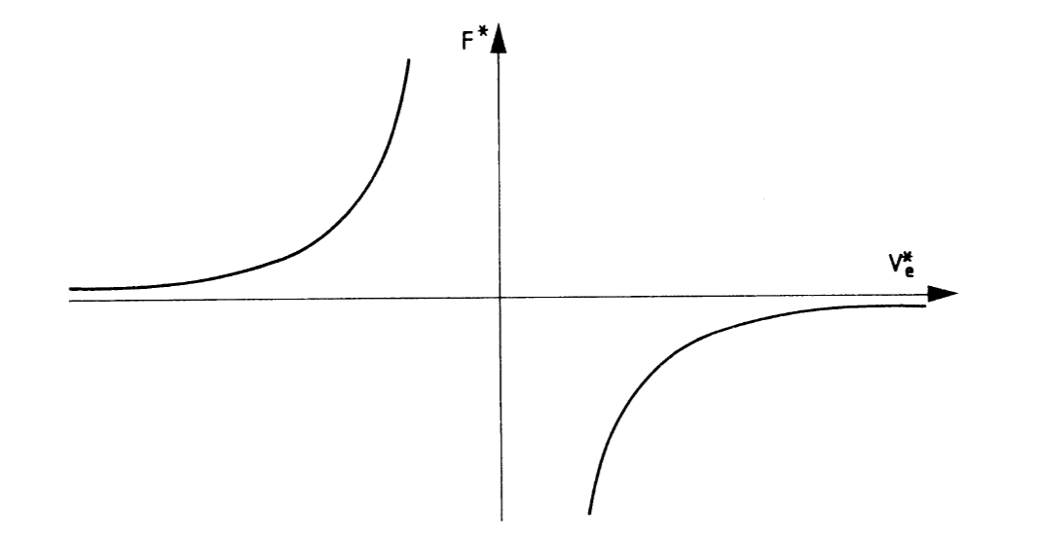

We can finally write the cooling force as:
$$F^{∗}=\frac{4πZ^{2}e^{4}}{m_{e}V_{i}^{∗2}}n_{e}^{∗}L_{c}=−4πZ^{2}e^{2}c^{2}r_{e}n_{e}^{∗}L_{c}V_{i}^{∗−2}$$

Slide 12




Cooling rate (time)
The rate of velocity change at which the ion is slowed down in the electron gas can be written as:
$$δ^{∗}=−\frac{{dV_{i}^{∗}}/{dt}}{V_{i}^{∗}}$$
Using the following relations:
$$E^{∗}=\frac{m_{i}}{2}V_{i}^{∗2}$$
$$\frac{dV_{i}^{∗}}{dt}=\frac{dV_{i}^{∗}}{dE^{∗}}\frac{dE}{dx}\frac{dx}{dt}=\frac{1}{m_{i}V_{i}^{∗}}F^{∗}V_{i}^{∗}$$
The friction rate can be expressed as:
$$δ^{∗}=−\frac{F^{∗}}{m_{i}V_{i}^{∗}}=−\frac{F^{∗}}{p_{i}^{∗}}$$

Slide 13




The inverse of the friction rate is defined as the cooling time.
$$τ^{∗}=\frac{1}{δ^{∗}}=−\frac{P_{i}^{∗}}{F^{∗}}$$
$$r_{i}=\frac{e^{2}}{m_{i}c^{2}}$$
$$τ^{∗}=\frac{V_{i}^{3}}{4πZ^{2}c^{4}r_{i}r_{e}n_{e}^{∗}L_{c}}$$
Inserting we obtain
To get the cooling time in the laboratory frame we note that n_{e} = γn_{e}* , hence
$$τ=\frac{γτ^{∗}}{η}=\frac{γ^{2}V_{i}^{3}}{4πZ^{2}c^{4}r_{i}r_{e}n_{e}L_{c}}$$
where η is the ratio of the cooling length to the ring circumference

Slide 14




We have considered electrons has being stationary. However, they have a finite temperature T_{e} and hence a velocity distribution f(V_{e}) which can be considered to be Maxwellian characterised by its velocity spread Δ_{e}.
$$f\left(V_{e}^{∗}\right)=\frac{e^{{−V_{e}^{∗2}}/{∆_{e}^{2}}}}{∆_{e}^{3}}$$
$$T_{e}=\frac{m_{e}∆_{e}^{2}}{2}$$
To account for this we have to replace the ion velocity with the ion-electron velocity difference and average over the electron velocity distribution.
The expression for the frictional force becomes:
$$u^{∗}=V_{i}^{∗}−V_{e}^{∗}$$
$$F^{∗}=−4πZ^{2}e^{2}c^{2}r_{e}n_{e}^{∗}L_{c}\int{f(V_{e}^{∗})\frac{u^{∗}}{{\left|u^{∗}\right|}^{3}}}d^{3}V_{e}^{∗}$$

Slide 15
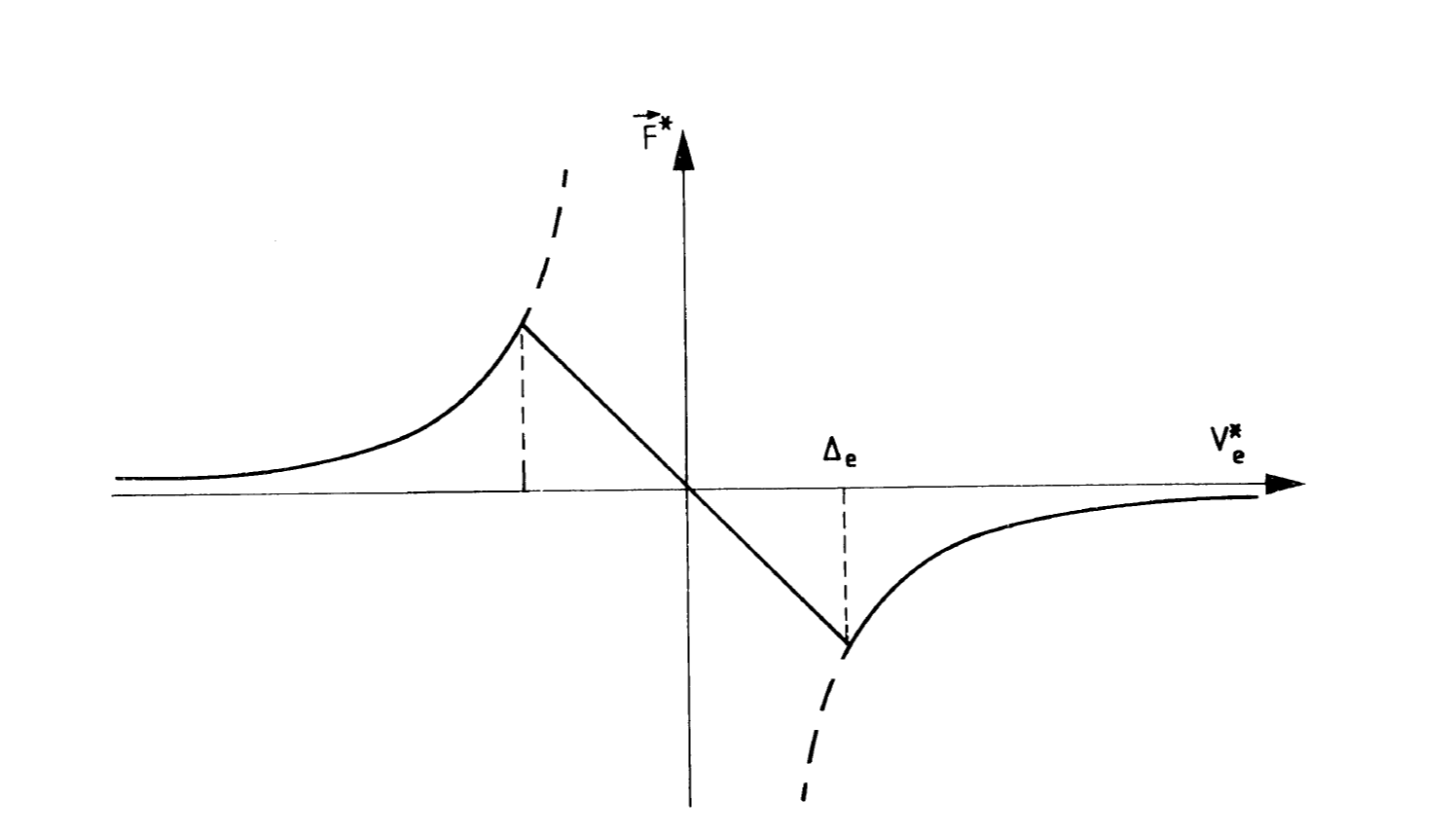

For an electron beam with a rectangular velocity distribution the cooling force is shown below
$$f(V_{e}^{∗})=\left\{\begin{aligned}const, \left|V_{e}^{∗}\right|≤∆_{e} \\ & 0, \left|V_{e}^{∗}\right|>∆_{e}\end{aligned}\right.$$

Slide 16
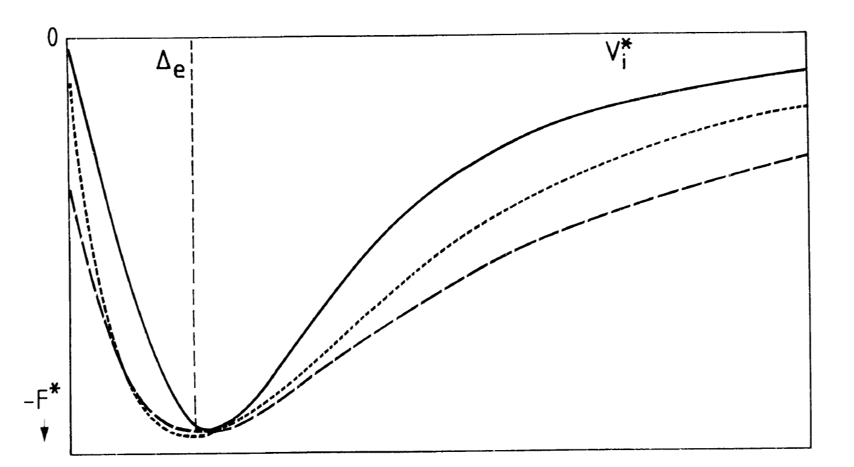

For a Maxwellian velocity distribution the cooling force has to be evaluated numerically.
However a good approximation is:
$$F^{∗}=−12πZ^{2}e^{2}c^{2}r_{e}n_{e}^{∗}L_{c}\frac{V_{i}^{∗}}{{\left|V_{i}^{∗}\right|}^{3}+2∆_{e}^{3}}$$

Slide 17



Using this approximation the cooling time in the laboratory frame can be written as:
$$τ=\frac{γ^{2}}{η}\frac{V_{i}^{∗3}+2∆_{e}^{3}}{12πZ^{2}c^{4}r_{i}r_{e}n_{e}L_{c}}$$
In general the electron temperature T_{e} is independent of the beam energy and hence Δ_{e} is a constant of the device.
We can distinguish two domains of cooling:
Cooling of hot beams
  Cooling time is proportional to
Cooling of “warm” beams
  Cooling time practically independent of V_{i}* since Δ_{e} is constant
  τ is independent of ion beam intensity
  $τ∝γ^{2}$
  $τ∝\frac{1}{r_{i}Z^{2}}∝\frac{A}{Z^{2}}$
  $τ∝\frac{1}{n_{e}}$
$$V_{i}^{∗3}$$

Slide 18




Equilibrium
Ideally cooling will continue until the ion beam temperature reaches the electron beam temperature
and
$$T_{i_{⊥}}=T_{e_{⊥}}$$
$$T_{i_{∥}}=T_{e_{∥}}$$
$$θ_{i_{⊥}}=\sqrt{\frac{m_{e}}{m_{i}}}θ_{e_{⊥}}$$
$$γ\frac{Δp}{p}=\sqrt{\frac{m_{e}}{m_{i}}}θ_{e_{∥}}$$
Resulting in an ion divergence and momentum spread
In practice heating effects will prevent us from reaching this regime

Slide 19
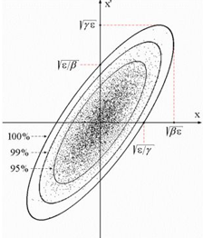




Digression on ion beam and storage ring properties
Beam emittance: The volume of phase space occupied by the beam
6-dimensional space generated by the transverse and longitudinal coordinates and their derivatives
(x,x’,y,y’,Ε(z),ϕ(Δp/p))
Projections in the 3 dimensions define the transverse and longitudinal emittances.
x = $√$βε x’ = $√$γε r = D$\frac{\text{∆}p\text{/}p}{p}$
$$T_{h}=\frac{1}{2}mc^{2}β^{2}γ^{2}{\left\langle x^{′}\right\rangle }^{2}$$
$$T_{∥}=\frac{1}{2}mc^{2}β^{2}{\left(\frac{Δp}{p}\right)}^{2}$$
$$T_{v}=\frac{1}{2}mc^{2}β^{2}γ^{2}{\left\langle y^{′}\right\rangle }^{2}$$

Slide 20
How to build an electron cooler
Source: cathode
Beam dump: collector
Acceleration system: electron gun
Beam transport: solenoids, steering magnets
Vacuum, diagnostics

Slide 21
The electron gun
Electrons are produced in an electron gun where they are accelerated electrostatically to the desired energy.
A thermionic cathode is heated resistively to 1000°C and electrons are emitted from the surface.
Electrons are emitted from the cathode in all directions because of their thermal energy.
Due to space-charge, an electron cloud is formed just in front of the cathode.
Electrons are extracted from this cloud and accelerated to required energy by a series of electrodes.
Cathodes are normally oxide-coated and indirectly heated by a filament.
BaO (or a mixture with SrO and CaO) is the most common used oxide due to its low work function.
Modern cathodes are also doped with chemicals or compounds of metals with a low work function which form a metal layer on the surface to emit more electrons.
The lifetime of these cathodes is determined by the purity of the cathode materials.
The heater consists of a fine wire or ribbon, made of a high resistance metal alloy like nichrome, similar to the heating element in a toaster but finer. It runs through the centre of the cathode, often being coiled on tiny insulating supports or bent into hairpin-like shapes to give enough surface area to produce the required heat. Typical heaters have a ceramic coating on the wire.

Slide 22




The cathode is surrounded by the Pierce shield, an electrode on cathode potential shaped to produce perpendicular potential lines to the beam axis.
Special attention must be paid to the design of the subsequent accelerating electrodes to keep the field lines perpendicular.
The final electron current follows Child’s law:
ρ is called the perveance and is essentially determined by the ratio of the beam radius r₀ and the cathode-anode distance d.
The electron gun is embedded in a longitudinal field to avoid the electrons being lost.
Transverse motion of the electrons are transformed into spirals about the magnetic lines with the cyclotron frequency and radius
$$I=ρU^{3/2}$$
$$ρ=7.3 μP{\left(\frac{r_{0}}{d}\right)}^{2}$$
$$ω_{c}=\frac{eB}{m_{e}γc}$$
$$r_{c}=\frac{V_{e⊥}}{ω_{c}}$$

Slide 23
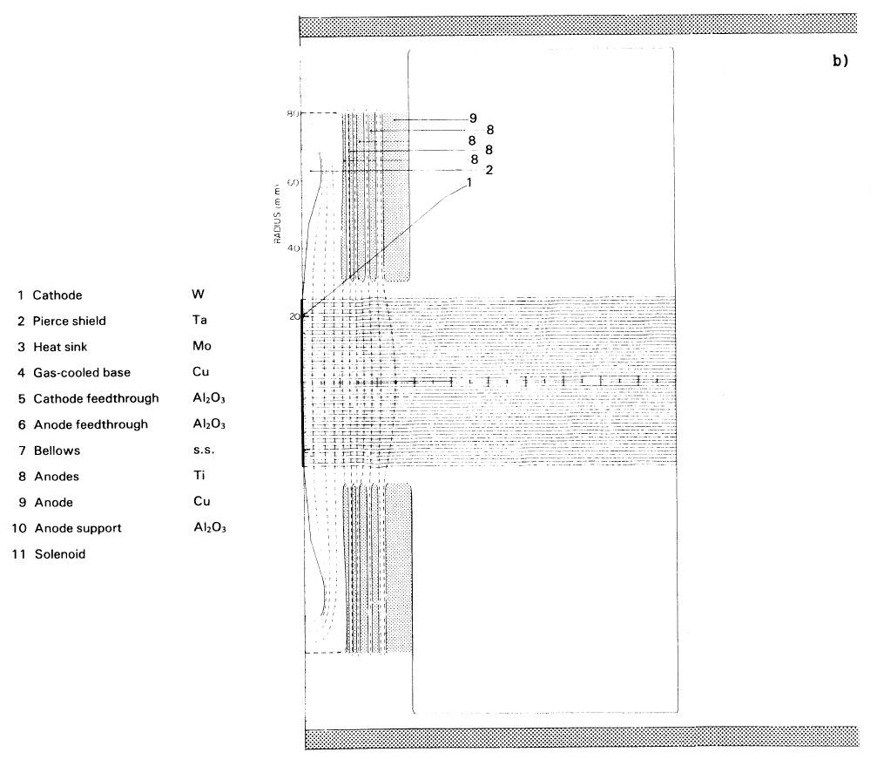
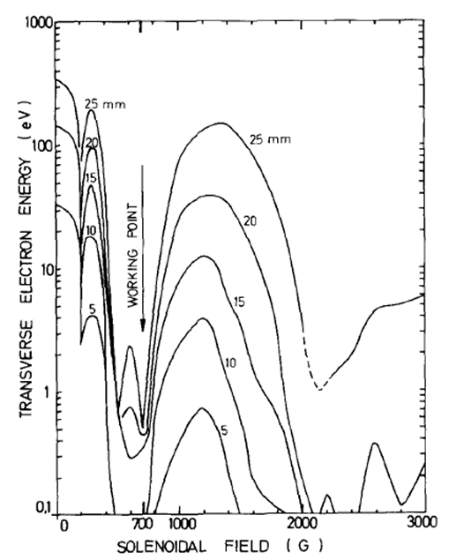


Two types of gun have been used on electron coolers:
  Resonant-optic gun
  Adiabatic gun
Resonant-optic guns require the magnetic field to be matched with the spiral length of the electrons i.e. the time the electrons need to pass through the acceleration column is equal to a multiple n of the inverse of the cyclotron frequency.
Resulting in the length of the accelerating column
$$λ_{R}=n\frac{V_{e}}{ω_{c}}=n\frac{V_{e}}{eB}m_{e}γc$$
$$B=nβγ\frac{m_{e}c^{2}}{eλ_{R}}$$

Slide 24
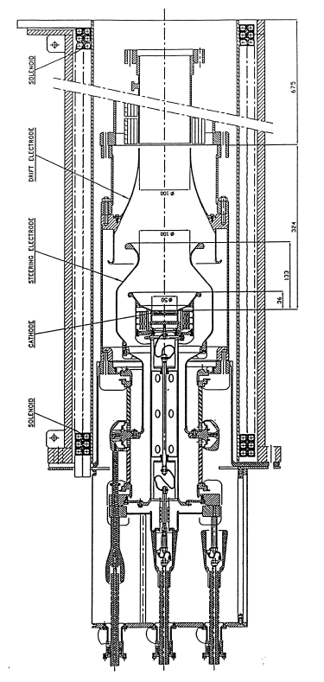
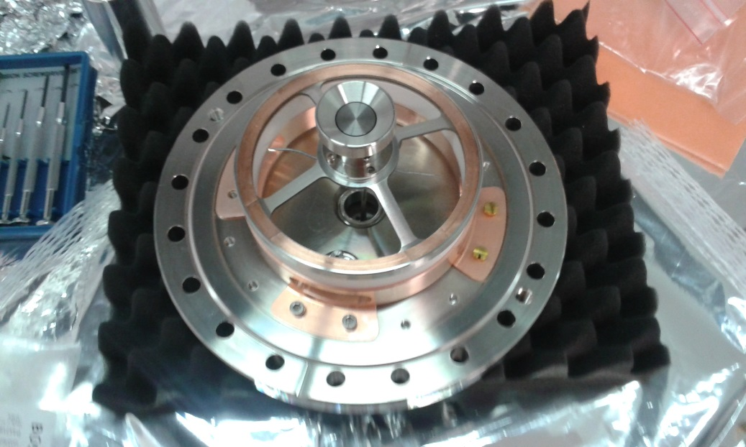
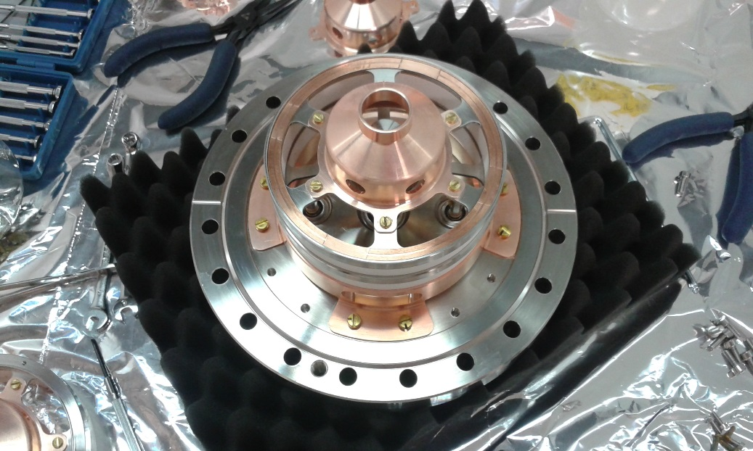
An adiabatic gun works at a fixed value of the magnetic field regardless of the electron energy.

Slide 25
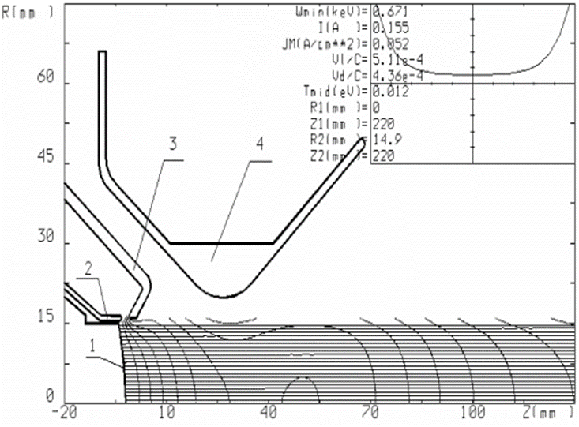
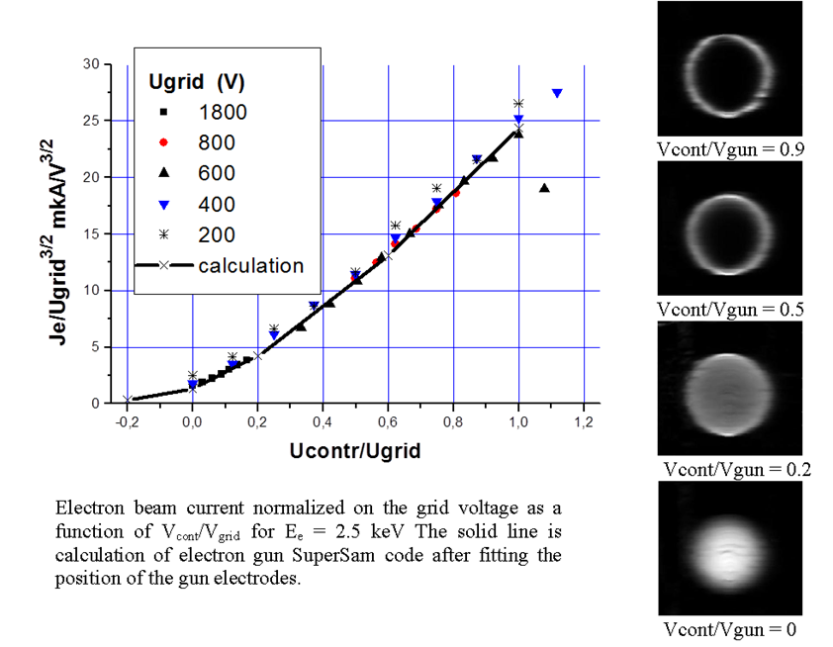
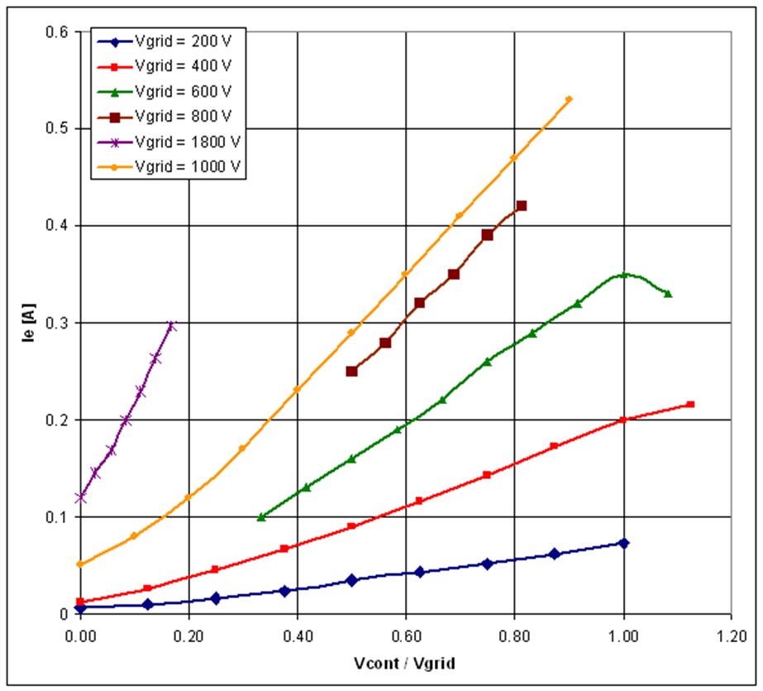
1. 14mm convex cathode
2. Control electrode (modifies density distribution and intensity)
3. Pierce electrode
4. Grid electrode (fixes the intensity)

Slide 26




Electron beam transport
After the gun, the electrons enter a drift region where they are transported to the interaction section where the cooling of the circulating ion beam takes place.
In the drift region the electric potential lines are parallel to the electron trajectories with increasing space going from the centre to the edge of the beam. The radial behaviour of the electric field is described by the potential of a homogeneous charge distribution with sharp boundaries.
$$ΔU=\frac{m_{e}c^{2}}{e}n_{e}r_{e}πr^{2}, r≤r_{0}$$
$$n_{e}=\frac{I}{πr_{0}^{2}eβc}=\frac{ρU^{3/2}}{πr_{0}^{2}eβc}$$
$$eU=\frac{m_{e}c^{2}β^{2}γ}{2}$$
Substituting for and
$$\frac{ΔU}{U}=\frac{r_{e}ρ}{ec}\sqrt{{\left(\frac{m_{e}c^{2}}{e}\right)}^{3}}\frac{γ}{2}\frac{r^{2}}{r_{0}^{2}}$$

Slide 27

The change of electric potential across the electron beam has two consequences:
A radial electron velocity distribution of a parabolic form
ExB situation leading to an azimuthal drift of the electron beam with velocity:
$$V_{d}=\frac{r}{ω_{c}}\frac{r_{e}}{{2γ}^{2}}n_{e}c^{2}$$

Slide 28
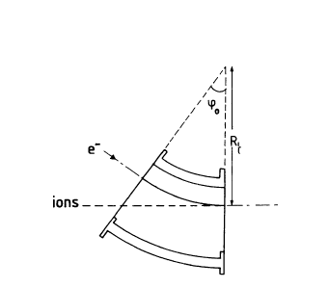
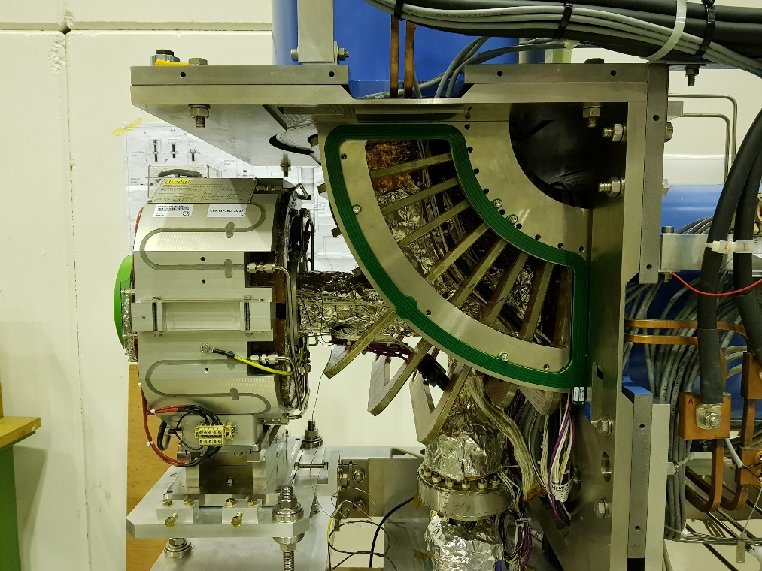
The magnetically confined electrons are bent into the interaction region with a curved solenoid or toroid.
An additional dipole field is required to compensate the centrifugal force experienced by the electrons.
The properties of the magnetic field are important to guarantee a good cooling efficiency of the ion beam and to ensure that the electron beam is not heated. In the cooling region the angle between the magnetic field lines and the ion beam should be small compared to the average transverse temperature of the electron beam.

Slide 29
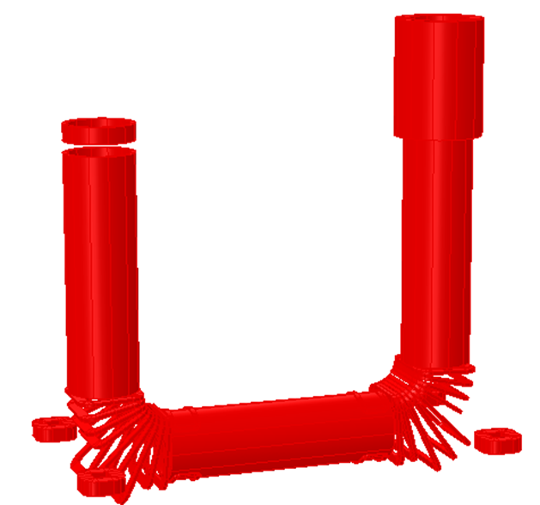
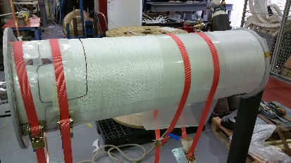
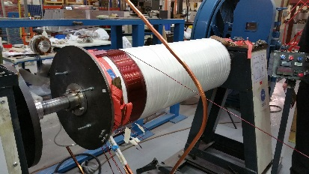
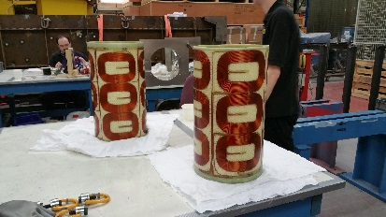
ELENA cooler magnetic system components
Main cooler solenoid
Gun solenoid
Collector solenoid
Expansion solenoid
Squeeze coil at collector
2 x Toroid section consisting of
9 racetrack coils each
Various corrector coils to
ensure good field quality
Orbit correctors
Solenoid compensators

Slide 31
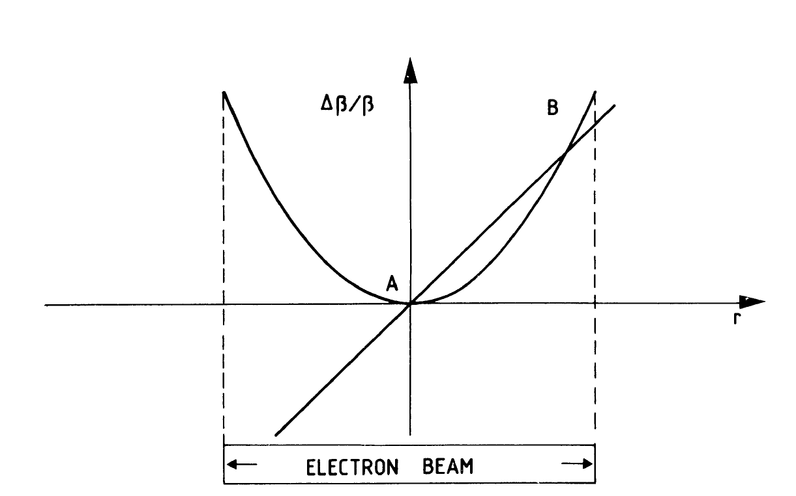
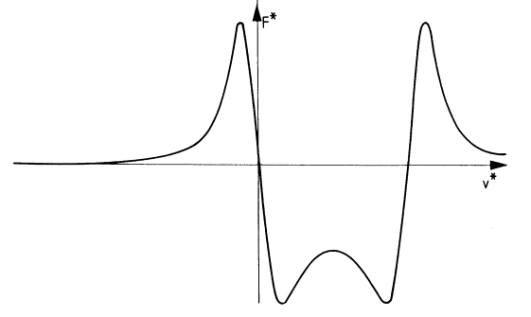
The cooling section
Have to match velocities, position and angle

Slide 32
Electron beam collector
Reduce the power of the electron beam to the lowest possible value.
Capture the electrons with maximum efficiency.
Electrons are decelerated in the collector. The remaining power is dissipated on the collector surface.
Deceleration is done in two steps to avoid the formation of a virtual cathode at the collector entrance
Secondary electrons emitted from the collector surface or reflected electrons can bounce back and forth between the gun and collector and be lost on the vacuum chamber. Careful design and the use of the magnetic field can improve the collection efficiency

Slide 33

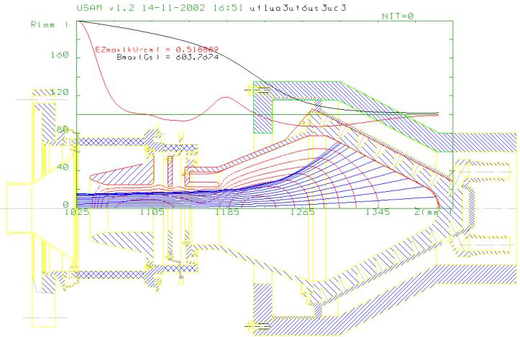
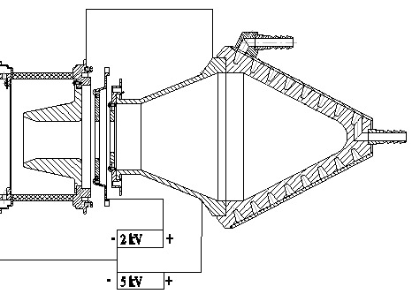
Suppressor electrode slows down the primary electrons at the collector entrance.
Magnetic field is reduced to spread out the electrons on the collector surface.
Surface on which the electrons are collected is water cooled.

Slide 34
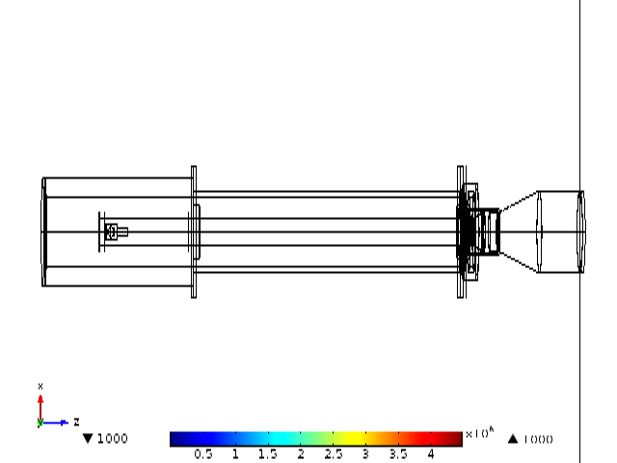
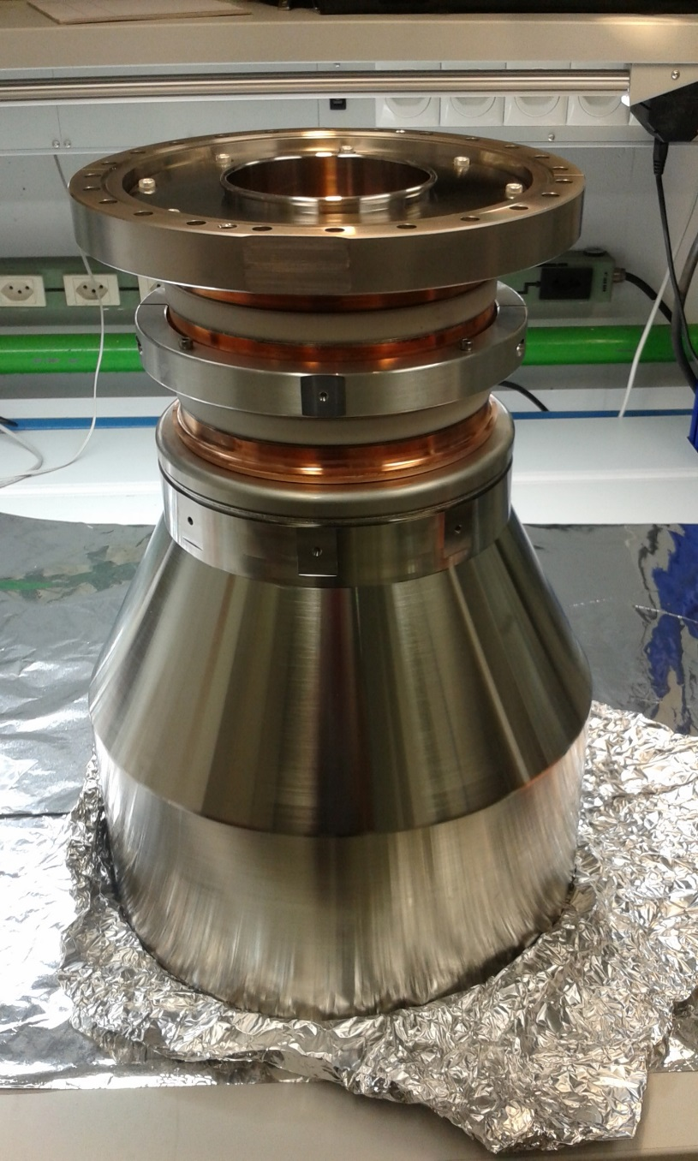

Slide 35
Vacuum system
Electron coolers operate under ultra-high vacuum conditions (<10⁻¹⁰ Torr).
Main outgassing comes from:
  Hot cathode
  Collector
  Electron loss on the vacuum chamber
Cooler must be bakeable.
Differential pumping system between gun/collector and cooling section.
Careful choice of vacuum chamber material (316LN stainless steel, avoid trapped volumes).
NEG coating of the vacuum chamber for increased pumping.

Slide 36
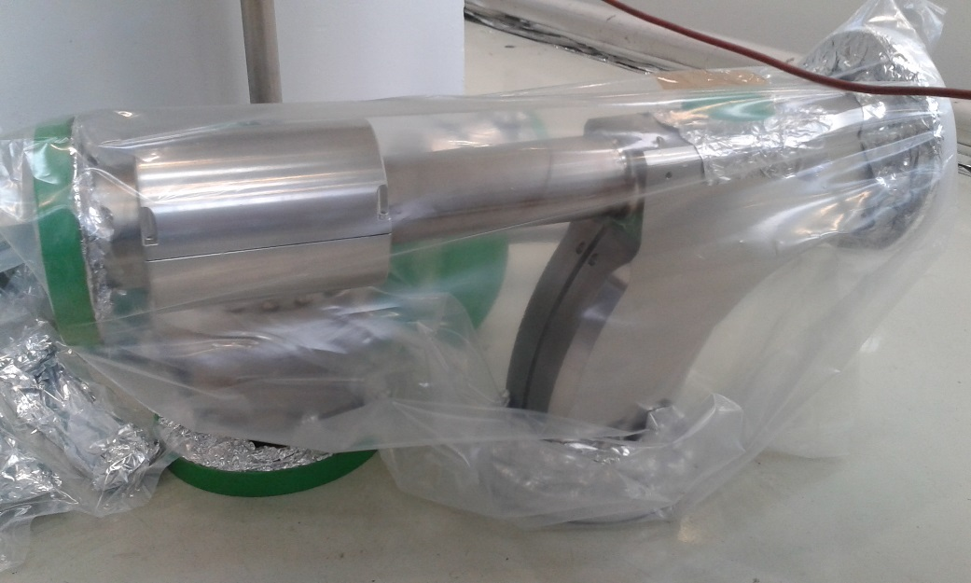
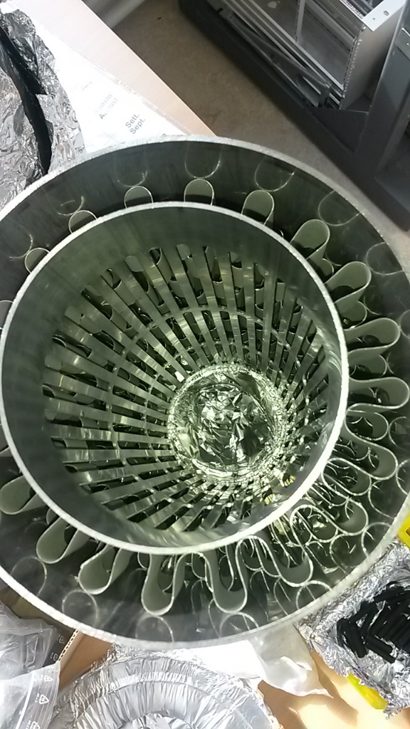
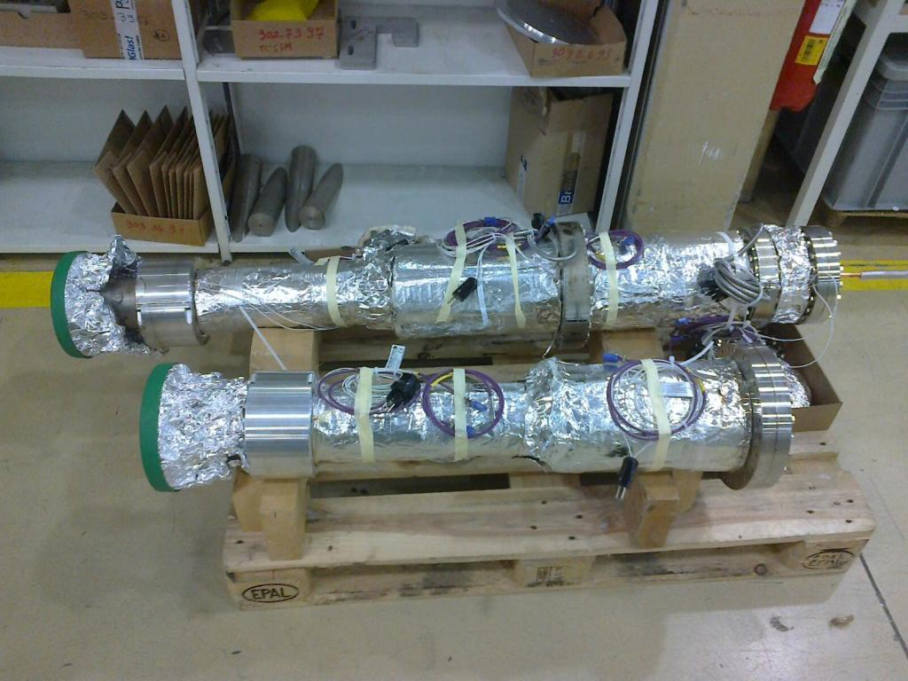

Slide 37
Additional effects to improve cooling
Flattened electron beam distribution
  After acceleration in the gun the longitudinal velocity spread is compressed giving a smaller longitudinal temperature
Magnetised electron cooling
  Electrons make many rotations enhancing the exchange of energy
Beam expansion
  Reduction of the electron transverse temperature
Electrostatic bend in the toroids
  ExB field for full compensation of the excitation of reflected electrons in the vertical B field of the toroid

Slide 38
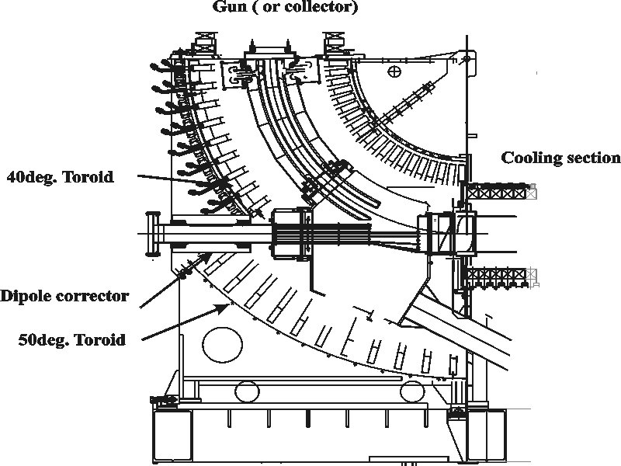
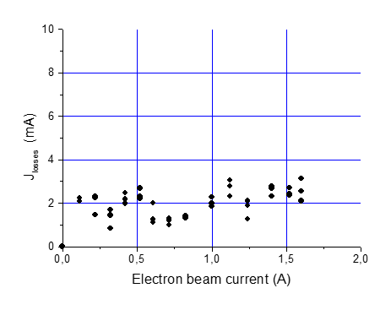
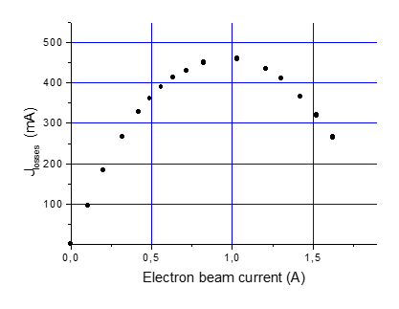
Electrostatic bend
Electrons experience a centrifugal force in the toroid.
This drift can be compensated by an additional magnetic field in the opposite direction.
Reflected and secondary electrons however are excited by this field and can oscillate between the gun and collector before being lost.
Complete compensation is obtained by superimposing an electric field on the magnetic field

Slide 39
Beam expansion
Needed for:
  Adapting the electron beam size to the injected beam size for optimum cooling.
B_{o}=0.235T, B=0.075T, r_{o}=14mm => r=24.8mm
  Reducing the magnetic field in the toroids, thus reducing the closed orbit distortion.
  Reducing the transverse thermal temperature of the electron beam.
B_{o}=0.235T, B=0.075T, E_{o}=100meV => E=32meV

Slide 40




Effects of the cooler on the circulating beam
Deflection of the circulating beam due to the vertical field in the toroid.
$$Θ[rad]=\frac{\int{B_{z}dl}}{B_{0}ρ_{0}}$$
$$Δx=\frac{B_{0}R_{t}^{2}}{B_{0}ρ_{0}}\left|φ_{0}−tanφ_{0}\right|$$
Tune shift due to the focusing effect of the electron beam.
$$Δυ=0.5 \left\langle β_{h,v}^{∗}\right\rangle n_{e}r_{p}β^{−2}γ^{−3}L$$
The solenoidal field of the cooler twists the ion beam by an angle:
$$θ\left[rad\right]=\frac{L}{βc}ω_{c}\frac{m_{e}}{m_{i}}$$
Effect is negligible unless working close to a resonance

Slide 41
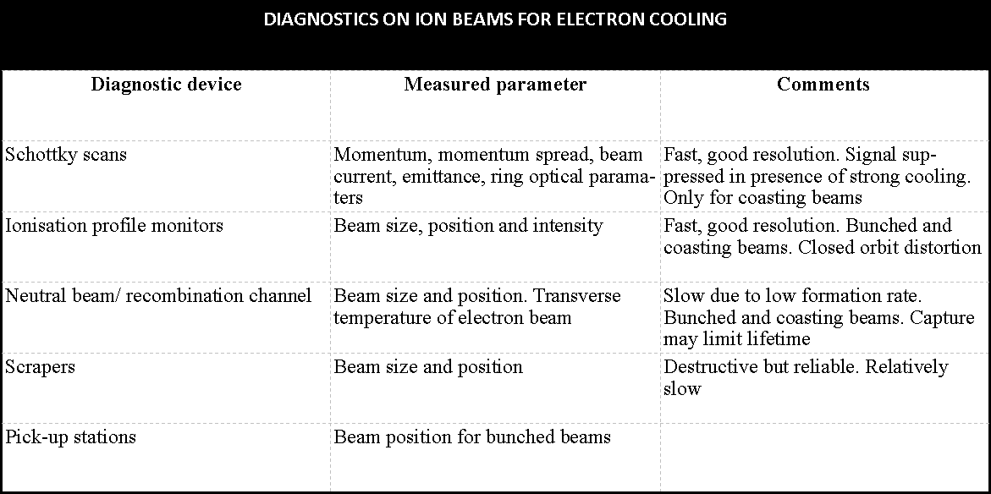

Slide 42
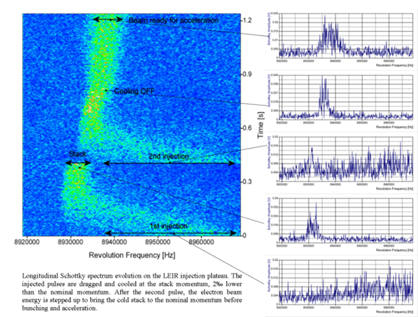
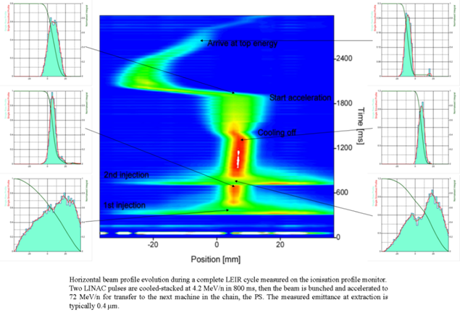

Slide 43
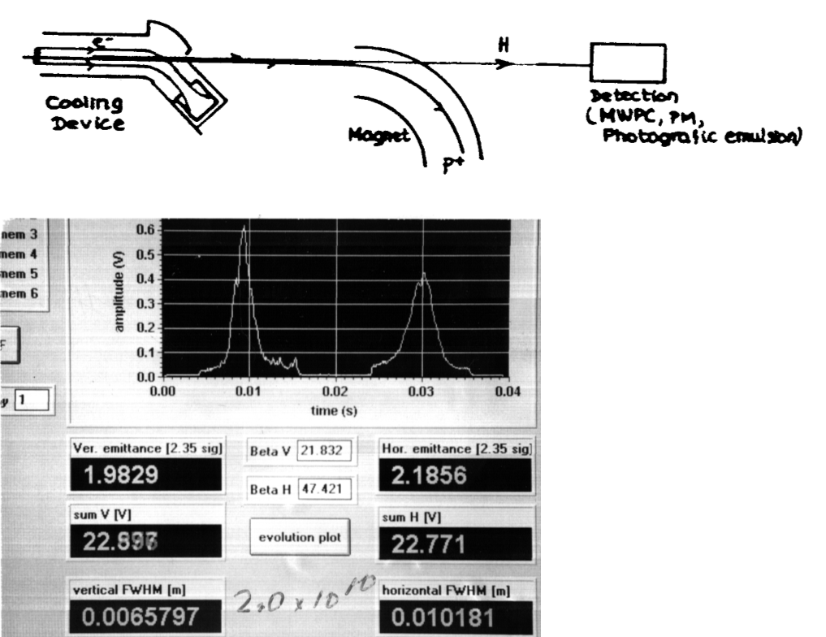
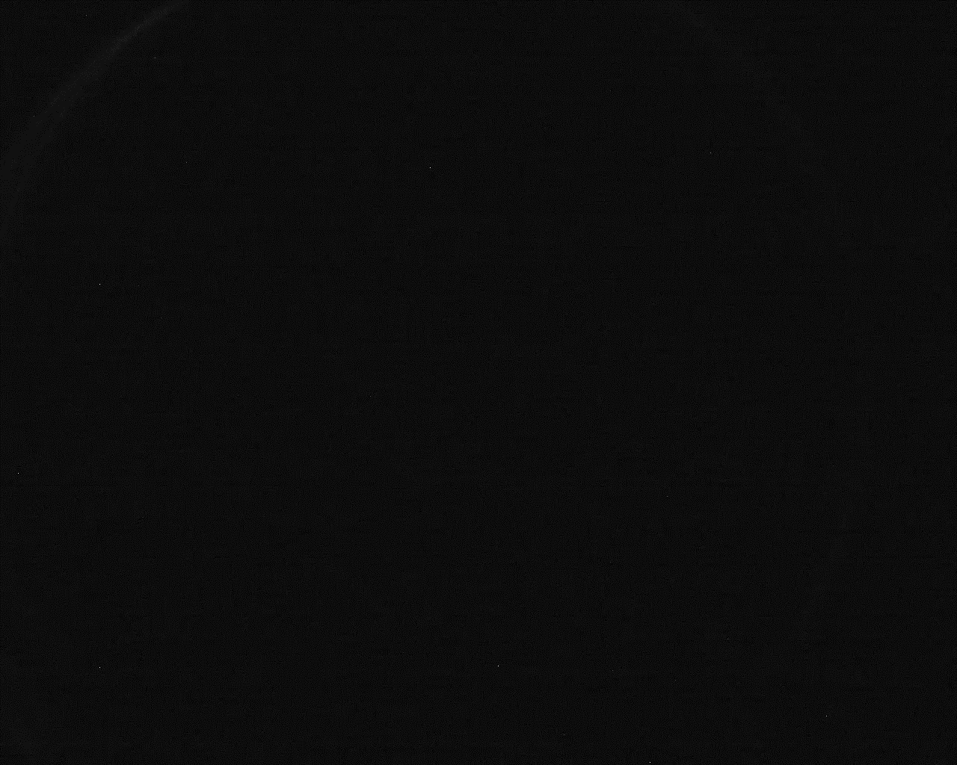

Slide 44
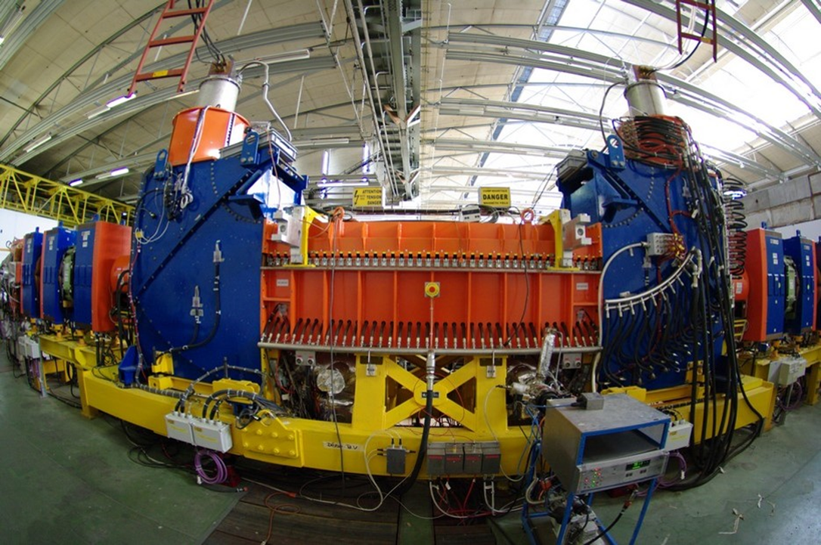
Electron coolers at CERN
LEIR
E_{e} up to 6.5 keV
Ie = 600 mA
k = 3, r = 14 to 25mm
B (in cooling section) = 750 G

Slide 45
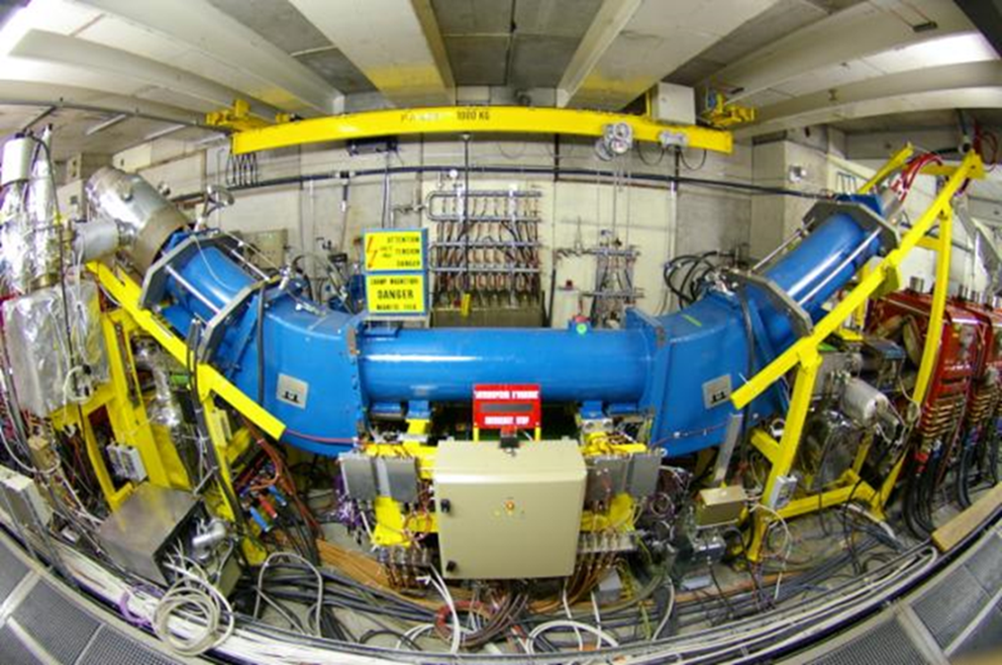
AD
E_{e} up to 35 keV
Ie = 2.5 A
B = 600 G
40 years old!

Slide 46
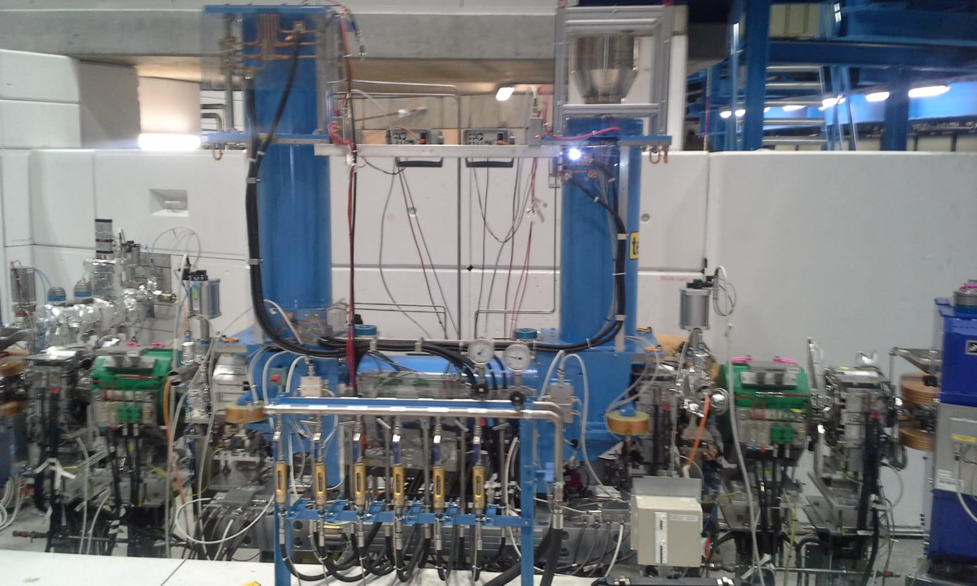
ELENA
Compact cooler
E_{e} up to 355 eV
Ie = 5m A
k = 10, r = 8 to 25mm
B (in cooling section) = 100 G
Being commissioned

