Slide 1
Beam diagnostics (Non-destructive methods)

Slide 2
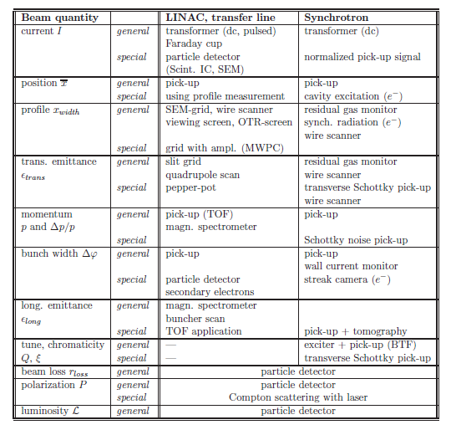
Demand for beam diagnostics
Essential for any accelerator
‘Organ of sense’
Deal with real beam with imperfections
Three categories
  Reliable, quick measurements for general functionality, e.g. current transformer
  For a daily check of performance and stability, e.g. profile determination
  Complex instrumentation, e.g. Emittance measurement
P. Forck, Lecture Notes on Beam Instrumentation and Diagnostics, Joint University Accelerator School, January – March 2012
Notes:
Reliable, quick measurements to determine the basic parameters of a machine setting used as a fast check of the general functionality
Instrumentation built for a daily check of performance and stability, or for the control of wanted parameter changes in the accelerator setting.
Complex instrumentation for the commissioning of a new accelerator component, for the
development of higher performance and for solving more serious problems in case of a malfunction.

Slide 3
Beam Position Monitoring

Slide 4
Electrostatic BPM
courtesy O.R. Jones
R
V
-
+
-
+
-
-
+
-
+
-
+
-
-
+
-
+
-
+
-
+
-
-
+
-
+
-
+
-
+
-
+
-
-
+
-
+
+
-
-
-
-
+
-
+
-
-
-
-
+
+
-
+
-
-
+
-
+
-
-
-
-
-
-
-
-
-
+
-
+
+
-
+
+
-
+
-
-
+
-
+
-
+
-
+
-
+
+
+
+
-
+
-
-
+
-
+
+
+
+
+
+
+
+
+
+
+
+
+
+
+
+
+
+
+
+
+
+
+
+
+
+
+
+
+
+
+
+
+
+
+
+
+
+
+
+
+
+
+
+
+
+
+
+
+
+
+
+
+
+
+
+
+
+
+
+
+
+
+
+
+
+
+
+
+
+
+
+
+
+
+
+
+
+
+
+
-
+
+
-
+
+
-
-
-
-
+
-
-
+
-
-
+
+
+
-
-
+
-
+
+
-
-
-
+
-
+
-
-
-
-
-
-
+
-
+
+
+
+
-
+
-
-
+

Slide 5


Beam Position Monitor Principle
The BPM principle is based on symmetry
  The beam displacement d is detected by a pair of symmetrical arrange electrodes
  BUT: Hoops, wait a minute, not so fast…
  What happens if the beam / bunch intensity changes?!
    The $Δ$-signal still contains beam intensity information!
    Need to “normalize” the $Δ$-signal
courtesy
O.R. Jones
$$Δ∝pos×int$$
d
–
=

Slide 6
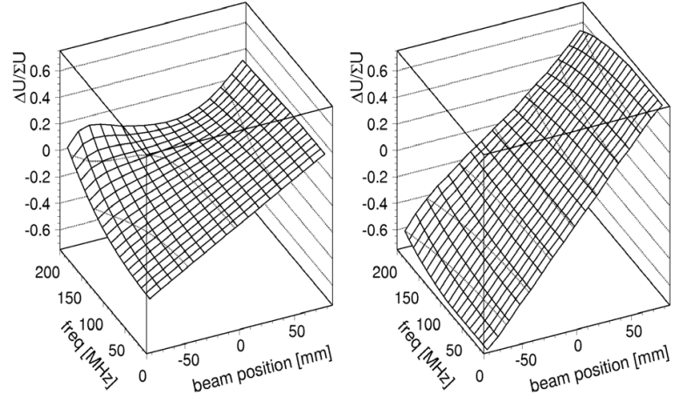
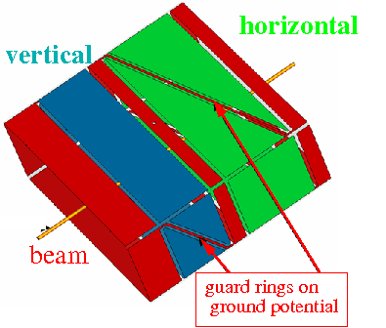
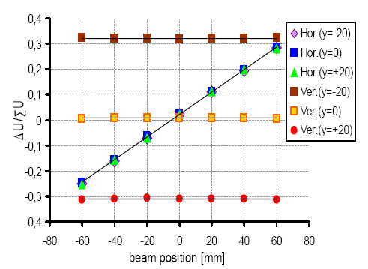
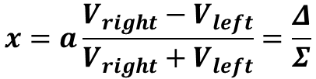


“Shoe-box” BPM
Split-plane
(“shoe-box”) BPM
with ground-guards
  Improved sensitivity and
  reduced cross-talk
  Improved linearity
without
with
ground guards
courtesy P. Kowina
$$V_{left}=\left(a+x\right)\tan{α}$$
$$V_{right}=\left(a−x\right)\tan{α}$$
$$x=a\frac{V_{right}−V_{left}}{V_{right}+V_{left}}=\frac{Δ}{Σ}$$

Slide 7
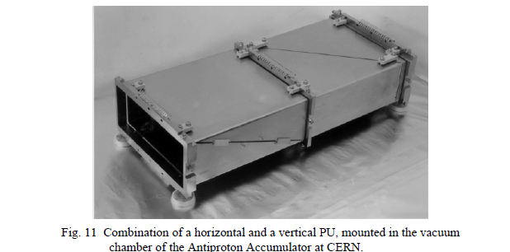
Spit-Plane BPM
Pros
  Linear position response
    No correction for non-linearities required, simple analog read-out electronics without post-processing
  high transfer impedance at low frequencies
    Good match for long bunches, low-β beam
    High signal levels, allows operation at low frequencies with high load impedance
Cons
  Complicated mechanics, requires sufficient real-estate
  High capacitive source impedance, reflective
  Eigenmodes at low frequencies, high beam coupling impedance
    Limited to low frequency operation, typically <300 MHz

Slide 8
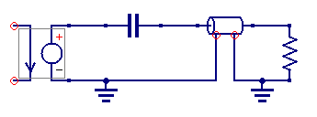
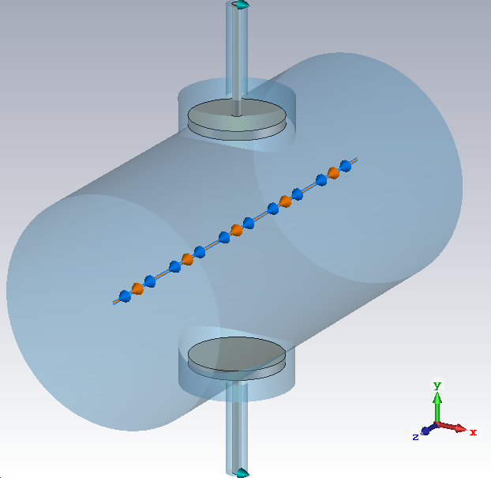
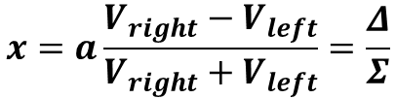









Button BPM Equivalent Circuit
$$Z_{0}$$
$$R_{load}$$
$$w_{g}$$
$$t_{b}$$
$$I_{beam}$$
$$V_{button}$$
$$C_{button}$$
$$r_{pipe}$$
typically
50 Ω
$$r_{b}$$
Increase | Effect
Radius_{button} (larger area & C_{button}) | Higher signal level Lower resolution
Thickness_{button} (larger volume) | Lower wake impedance Lower resolution, higher weight
Width_{gap} (more trapped modes) | Higher resolution Higher wake impedance
courtesy M. Wendt
$$x=a\frac{V_{right}−V_{left}}{V_{right}+V_{left}}=\frac{Δ}{Σ}$$

Slide 9
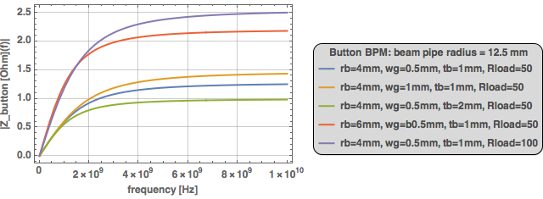
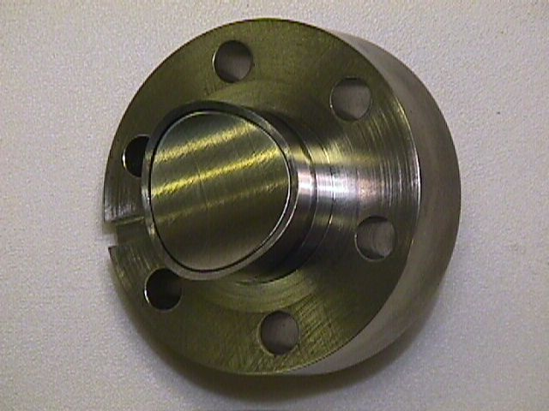
Button BPM
Pros
  Robust simple construction, cost effective, minimum real-estate
    RF UHV feedthrough and button is a single element
Cons
  High-pass characteristic with high cut-off frequency
    Typically >= 500 MHz,
    bad match to operate with long bunches, or at low frequencies
  Capacitive source impedance, reflective
LHC Button BPM
(CERN)

Slide 10
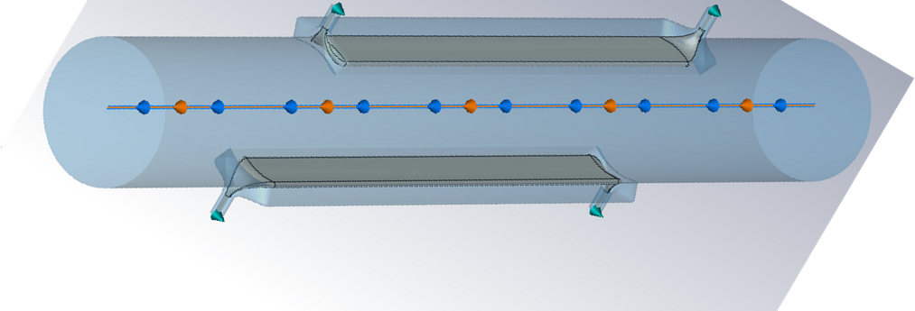
Stripline or Directional Coupler BPM
+
+
+
+
+
Upstream Port (term.)
Downstream Port (term.)
Up
Down

Slide 11
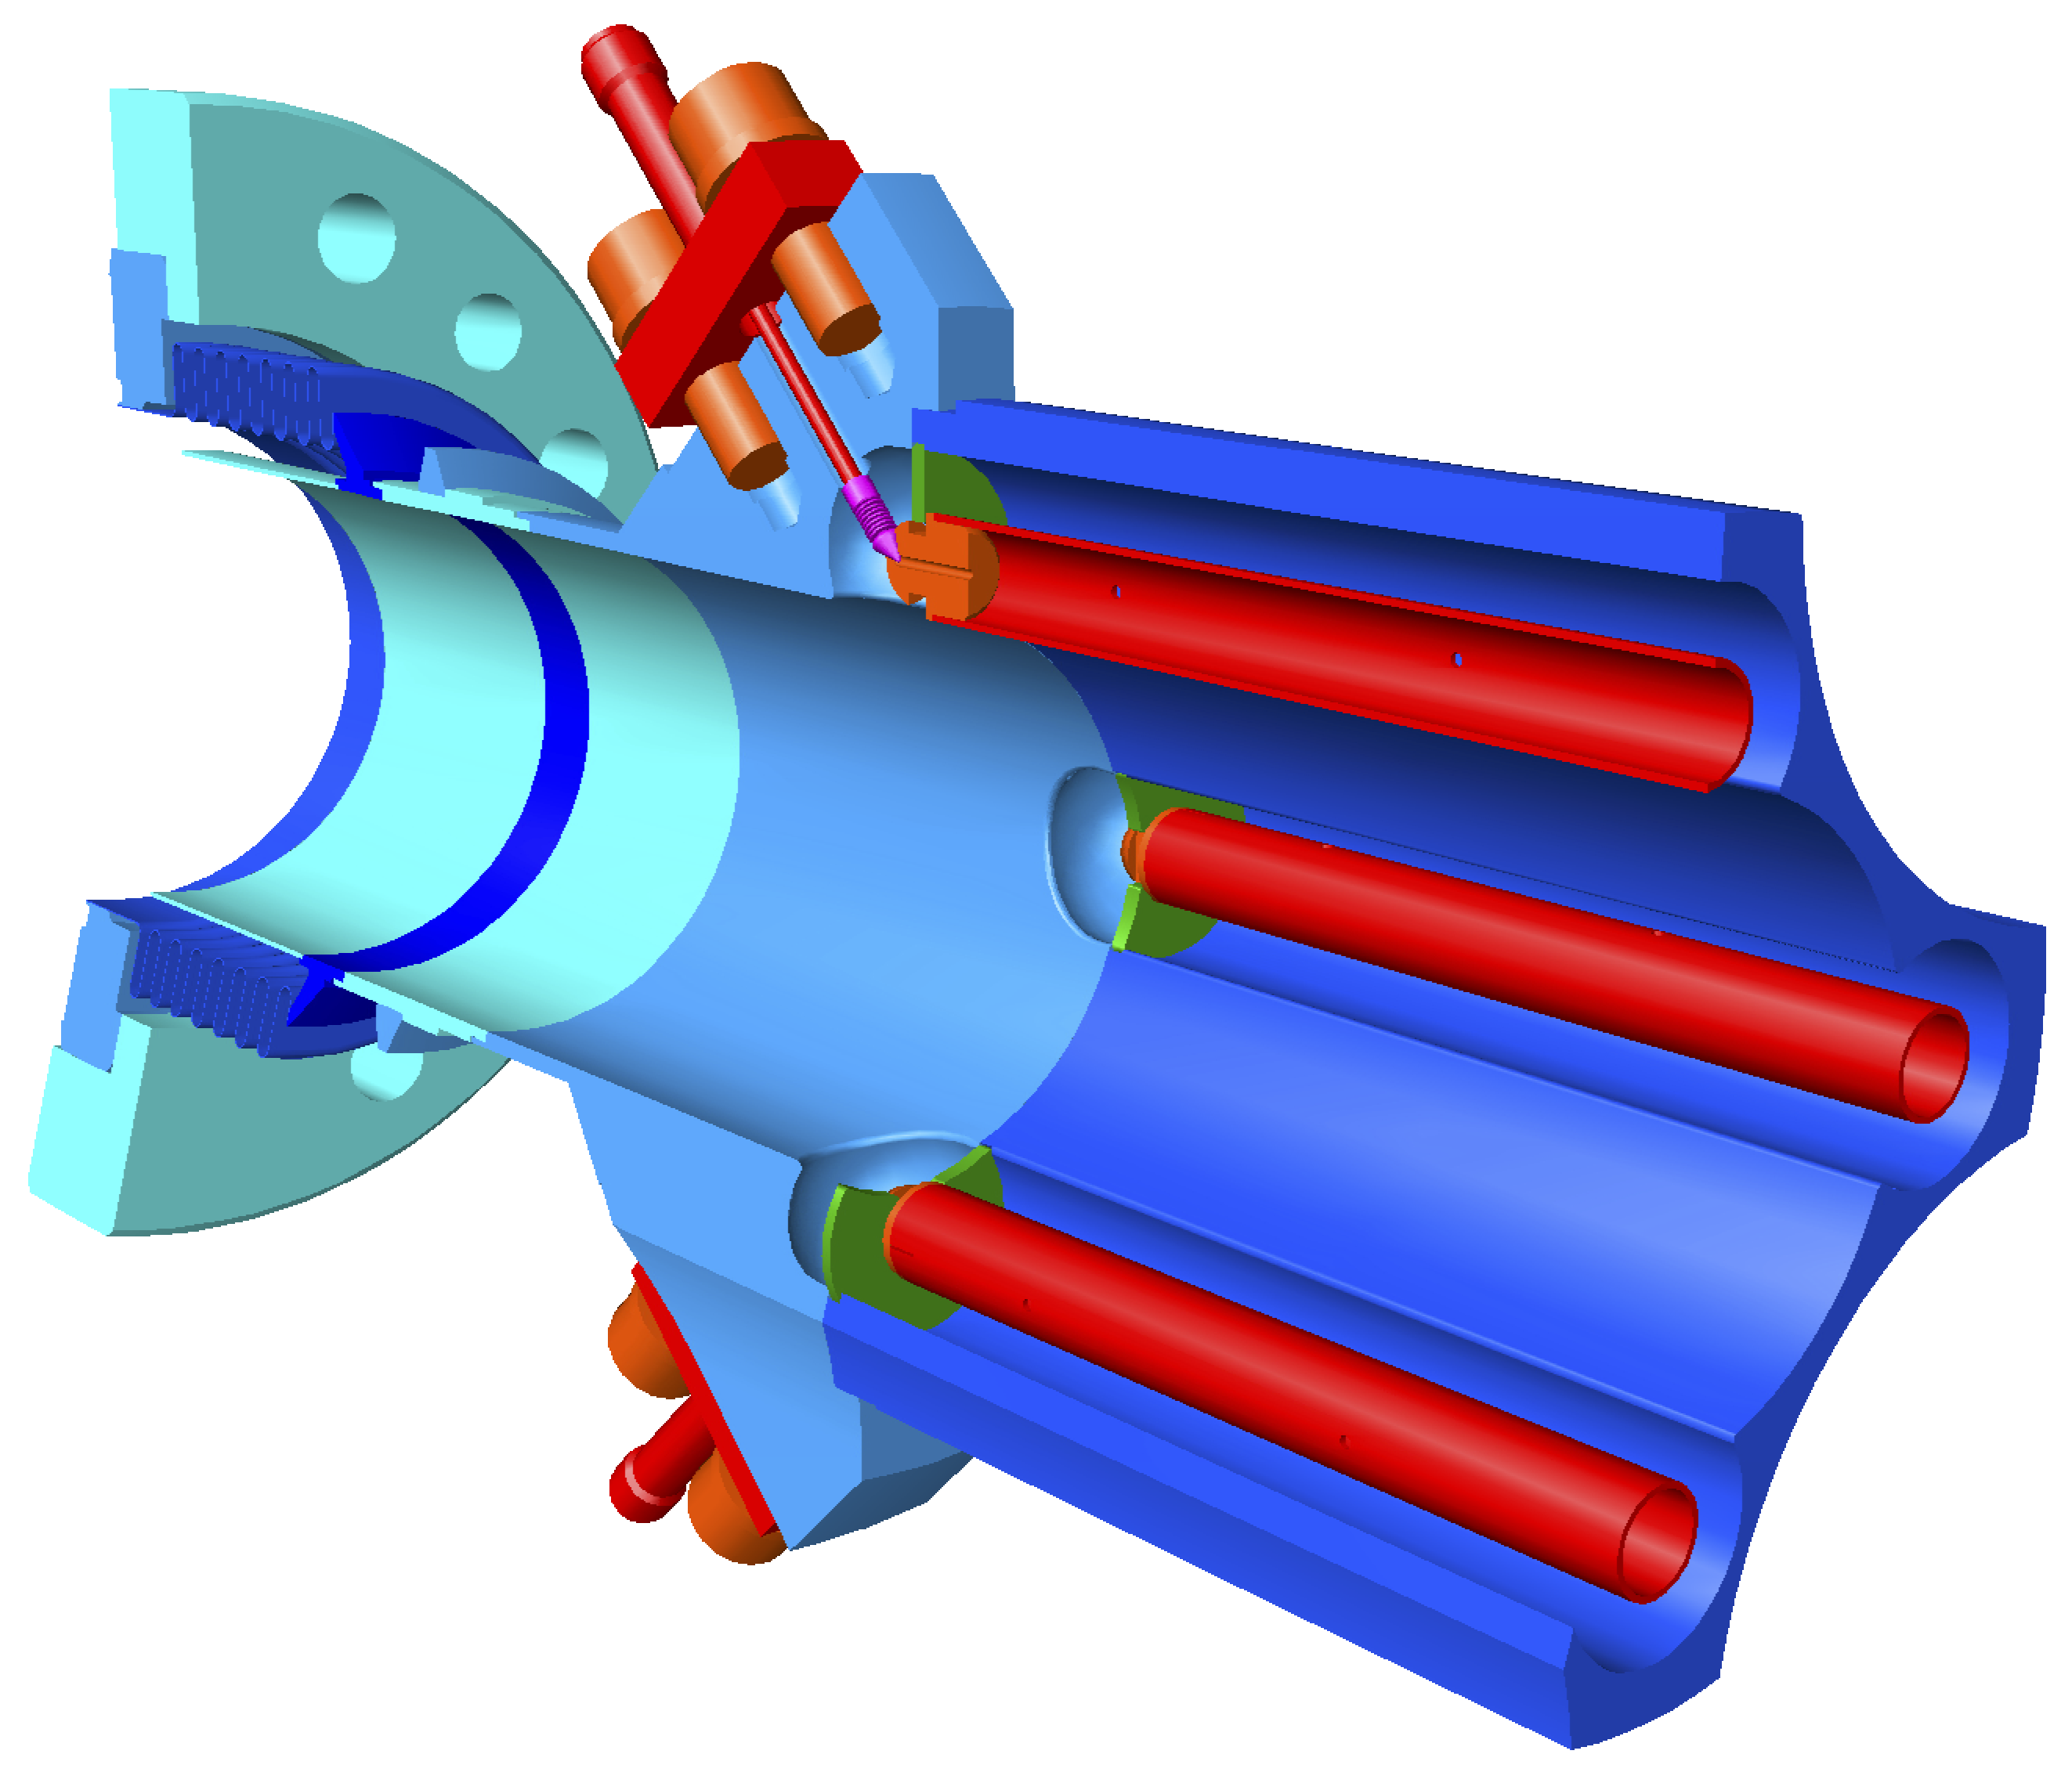
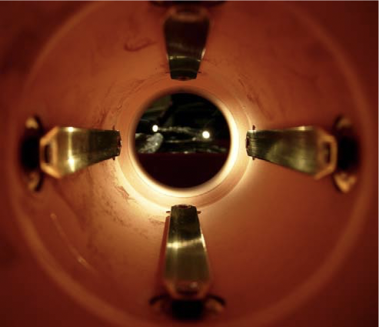
Stripline BPM
Pros
  Well defined, and high transfer impedance function
    For striplines with l >> w, TEM operation
    Can be “tuned” to match a dominant beam frequency
      Optimizing the length of the stripline
  Matched characteristic impedance with 50 Ω source
    Only for terminated ports
      Shorted downstream port: 0 Ω source, no directivity
    Reduced reflection effects between generator (stripline BPM)
    and read-out electronics!
  Directivity
    Separate beam position measurement of counter-rotating beams
      e.g. near the IP in a ring collider
Cons
  Complicated, fragile mechanics, high costs, requires sufficient real-estate
    More RF feedthroughts required, impedance control of the stripline, strip-electrode may require a support structure
Stripline BPM
FLASH (DESY)
Stripline BPM
LHC (CERN)

Slide 12
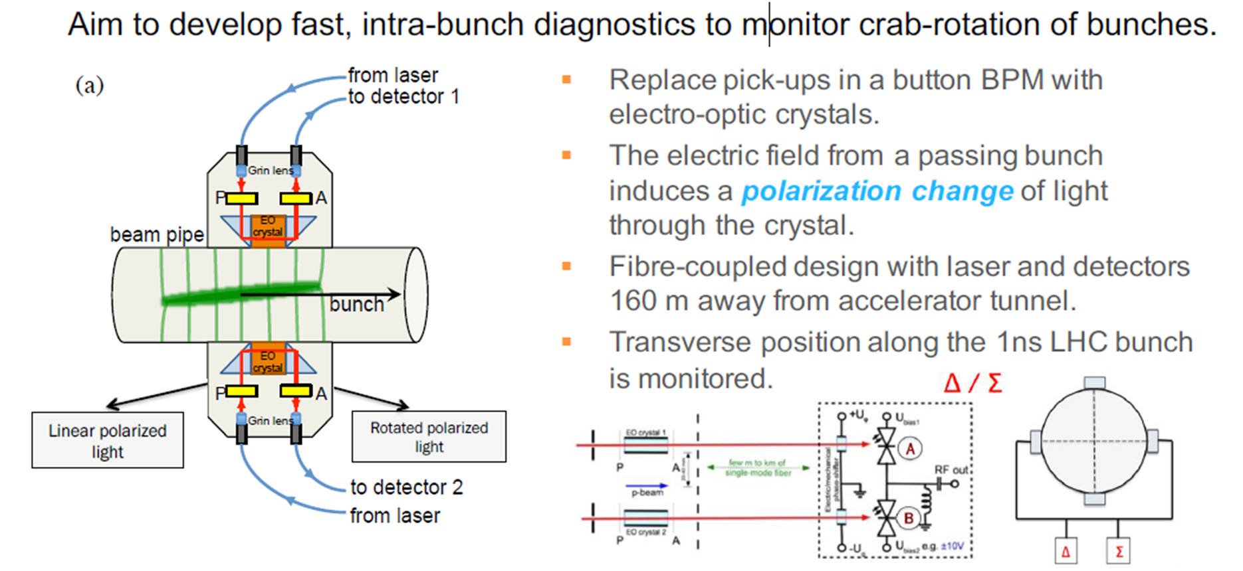
Electro-Optic Beam Position Monitors
courtesy S. Gibson

Slide 13
Beam Current Monitoring

Slide 14
Current measurement
What is the beam current?
  In an accelerator the current is formed by N particles of charge state q per unit of time t or unit of length l and velocity β = v/c.
Measurement methods
  Faraday cup
  Wall current monitor
  Current transformer
  Cryogenic Current Comparator (CCC)
We can measure the beam through the electric and magnetic fields created by the beam.

Slide 15
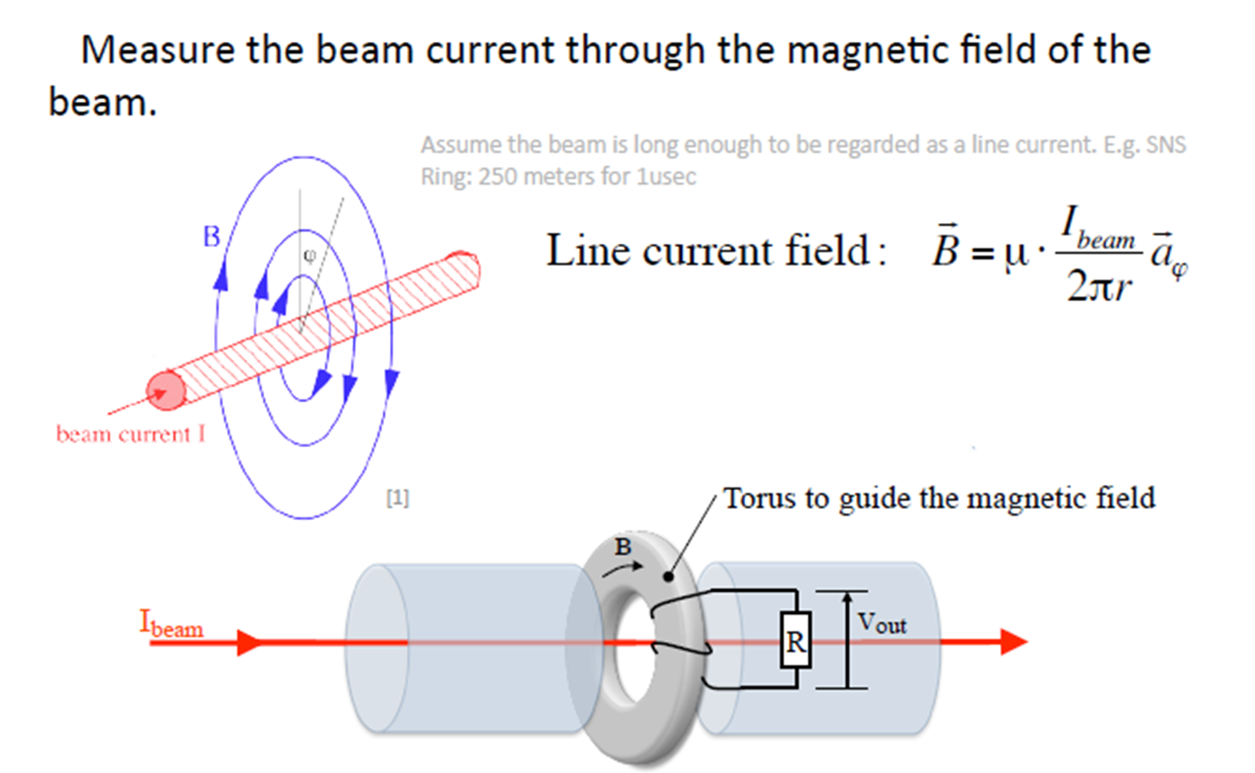
Beam transformer
Courtecy: W. Blokland

Slide 16
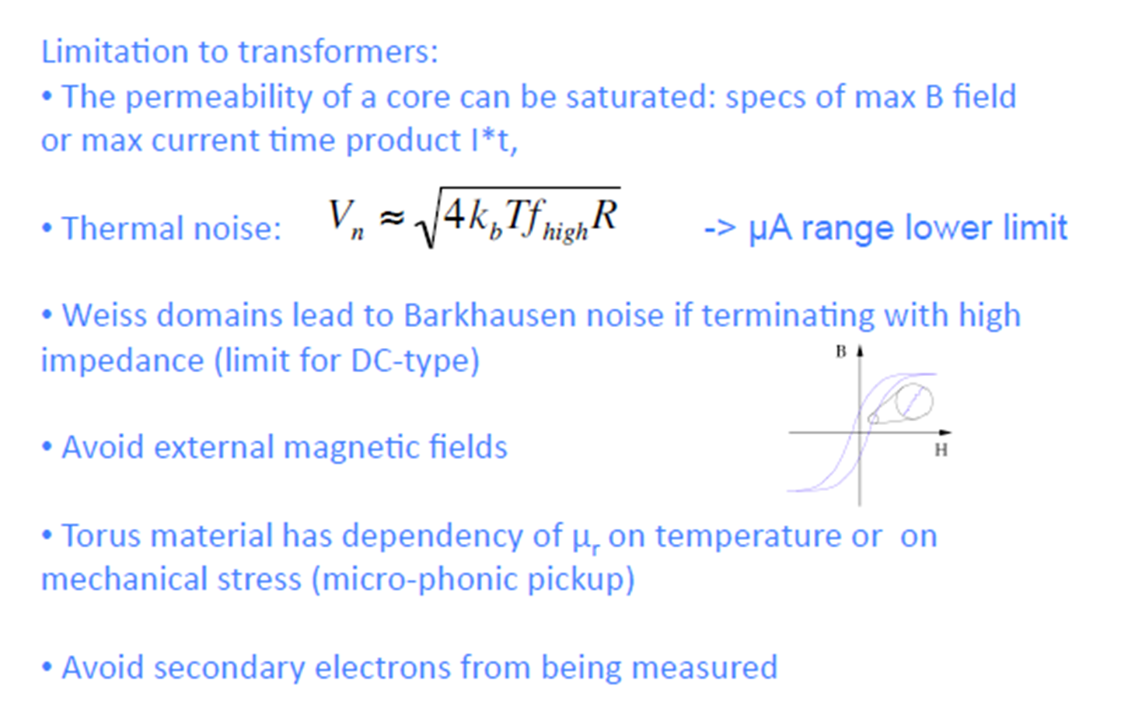
Current Monitor Limitations

Slide 17
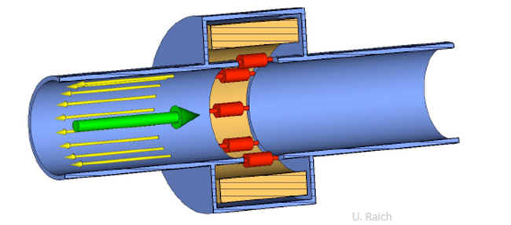
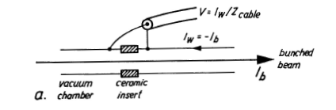
Wall-Current Monitors
The image current accompany the beam current.
A voltage proportional to beam current can be measured across the resistors
Also the noise issue will limiting the resolution

Slide 18
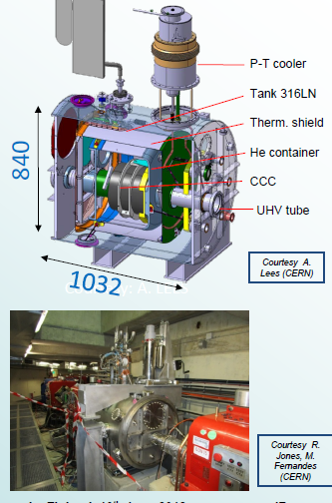
Cryogenic Current Comparator (CCC)
Non-destructive measurement device for low intensity beams (between 1 nA an 10 μA)
The CCC consists of:
  Cryogenic device
  SC pickup coil,
  High efficient SC shield,
  High performance SQUID
  measurement system.

Slide 19
Beam profile Monitoring

Slide 20
Measure the beam profile
Intercepting methods
  Scintillating screen
  Optical transition radiation (OTR)
  Wire scanner
  Scraper
Non intercepting methods
  Synchrotron radiation
  Laser wire
  Rest gas ionisation
  Beam induced fluorescence
  Gas jet beam profile monitor

Slide 21
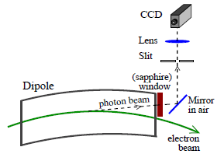
Synchrotron radiation
Charged particles emit electromagnetic radiation when accelerated
Synchrotron radiation: change of direction
Light is radiated only in the forward direction, tangent to the beam’s instantaneous circular path through a bend.
Credit: U. Iriso and F. P´erez, ALBA

Slide 22
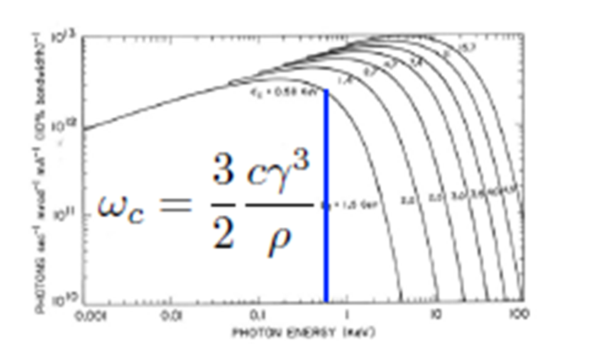
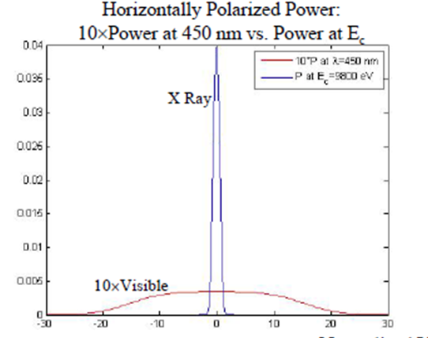
Synchrotron radiation
Synchrotron radiation is broad band.
Visible wavelength
  Optical component is easy to implement.
  diffraction limits the resolution at longer wavelengths when the beam is small
X-ray
  Better resolution
  Hard to form an image
    Pinhole camera
    Zone plates

Slide 23
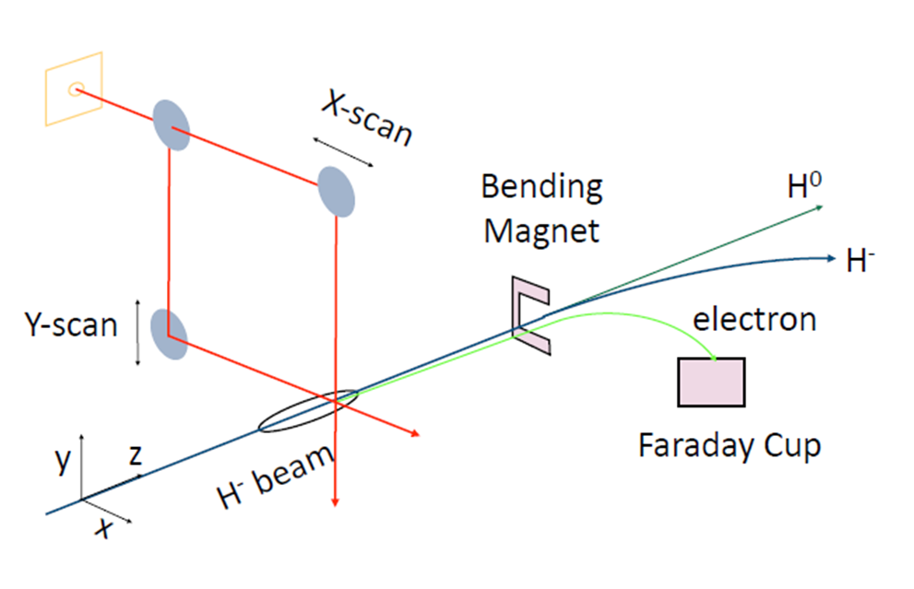
Laser wire
First ionization potential for H‐ ions is 0.75eV.
Photons with λ<1500nm can separate H‐ ion into free electron and neutral H.
The H‐ ion has no excited states so the electron is removed into the continuum.
Laser can be used to mark a portion of beam by neutralization.
Once a porton of the beam is marked, measurements can be made on the neutral beam, the removed electrons, or the reduced beam current with beam current transformer or BPM stripline.
T. Shea, Laser Diagnostics for H- beams, , Accelerator Beam diagnostics, USPAS 2009

Slide 24
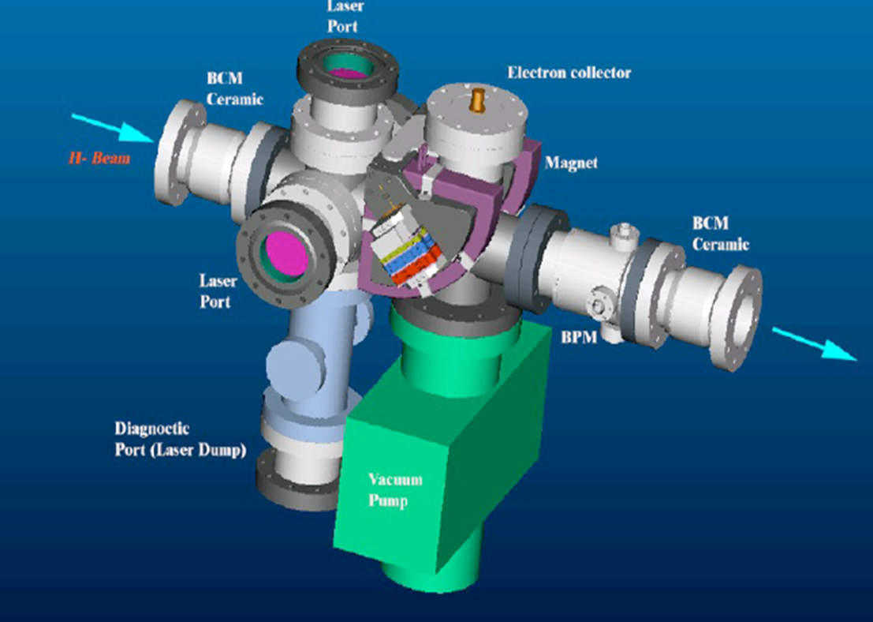
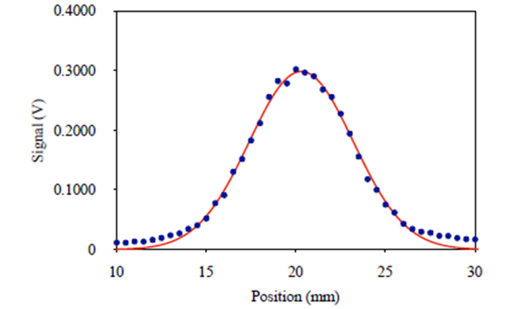
Laser wire scanner station @ SNS
Q‐switched Nd:YAG laser
▪λ = 1.06 μm
▪frep = 30 Hz, Tw = 7 ns
▪Ep = 50 – 200 mJ
T. Shea, laser diagnostics, USPAS 2009

Slide 25
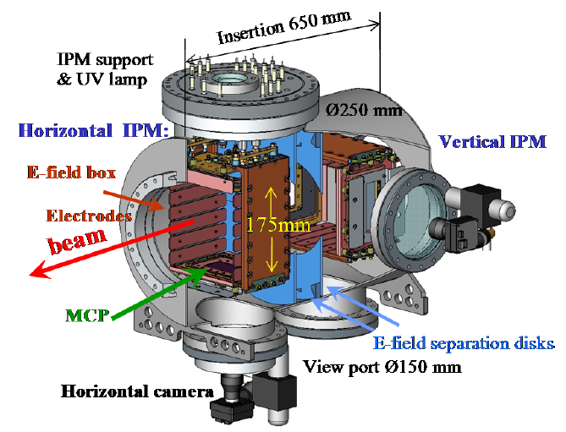
Residual gas based Ionization Profile Monitor
Credit: P. Fork, GSI

Slide 26
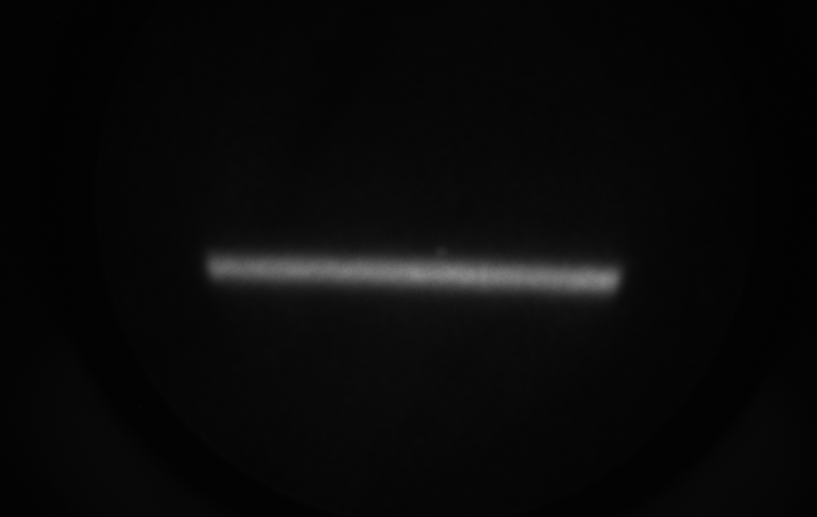
Residual gas image of a electron beam
Secondary ions or electrons are collected.
Magnetic field are used to compensate the profile distortion by self space charge force or wake fields.
Secondary particles are collected by electronics or optical (scintillator plus MCP)
E-Beam direction
Give you a one dimensional profile!

Slide 27
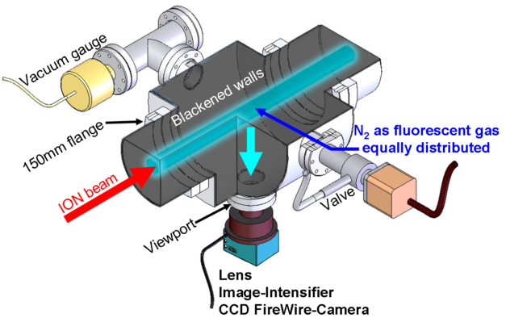
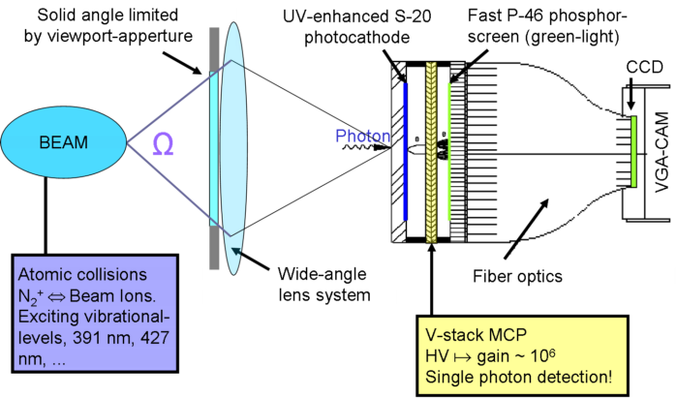
Beam induced fluorescence (BIF)
Schematic drawing of the BIF-monitor as installed at GSI UNILAC. *
BIF detection principle - How the beam induced fluorescence light is imaged, intensified and detected.*
*Credit: GSI, http://www-bd.gsi.de/dokuwiki/doku.php

Slide 28
IPM and BIF
The cross section for impact ionization and fluorescence dependent on the beam energy, residual gas species, and certain fluorescent wavelength.
BIF has longer integration time due to lower cross section and viewed at certain solid angle.
Might need gas injection using a leaking valve to increase the local pressure.
Normally N₂ has higher cross section, other gases such as Ne, Ar has been used.
Using Supersonic gas jet！

Slide 29
Motivation to use gas jet
Low temperature
High directional jet
Non-invasive or minimum-invasive
Not dependent on beam species, energy and intensity
No damage threshold
Not affect the vacuum very much

Slide 30
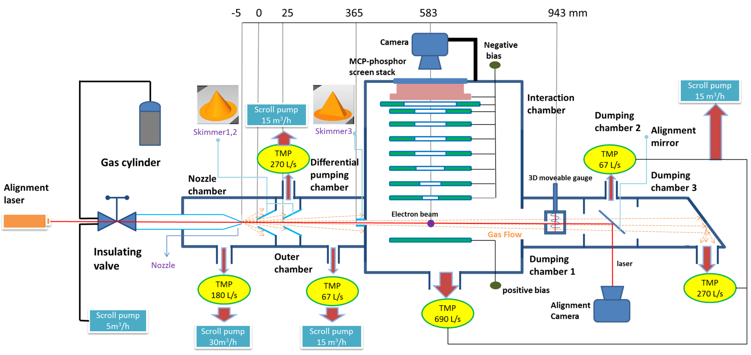
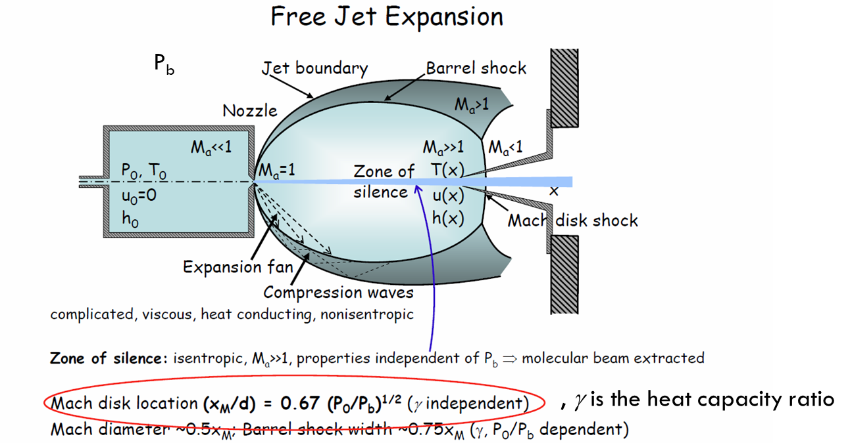
Gas jet profile monitor in Cockcroft institute

Slide 31
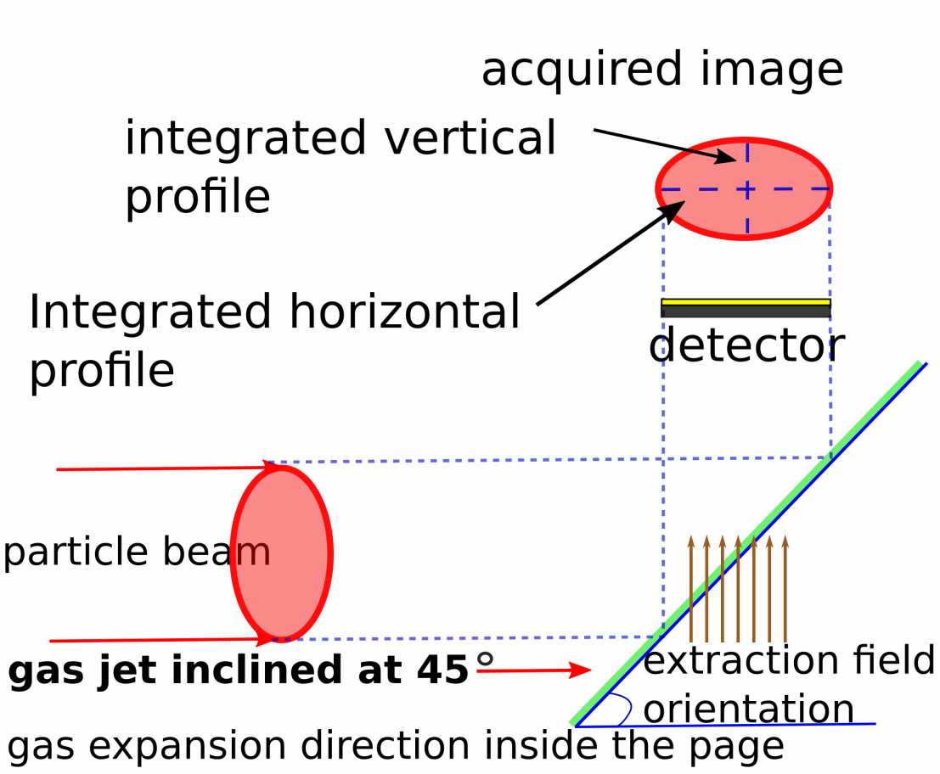
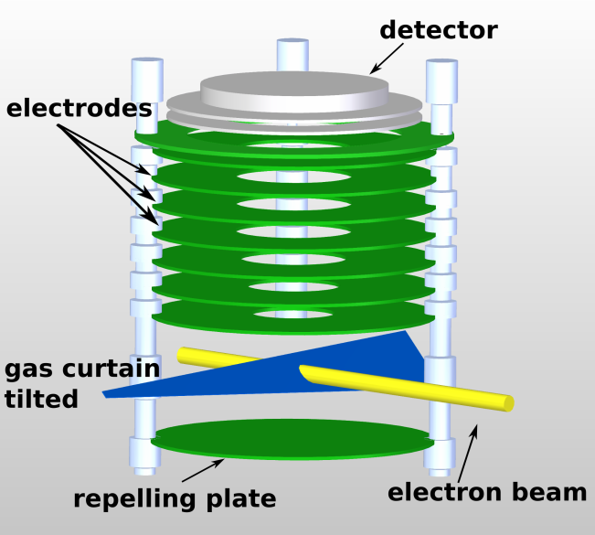
Gas jet beam profile monitor
Visible light
Estimated jet property
Phosphor screen
Parameter | Value
Density | 2.5*10¹⁶ particle/m³
Thickness | 0.5 mm
Vertical size | 5 mm
MCP
Ions extraction
Ionization
Estimated integration time = 1 ms

Slide 32
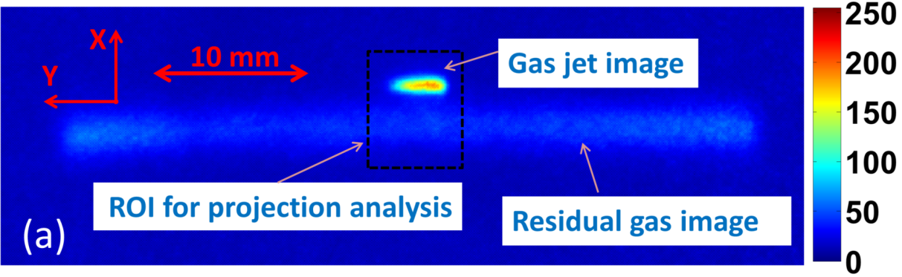
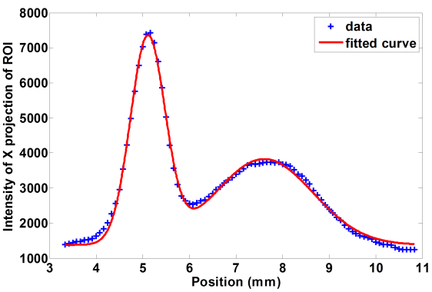
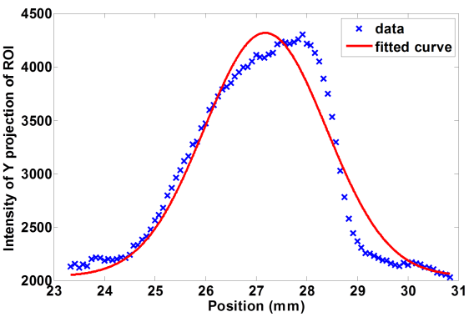
Typical results at CI
Setting | Value
Energy | 3.75 keV
Current | ~5.0 μA
External field | 7.5 kV/m
Exposure | 70 ms
size | Value
Xrms | 0.42
Yrms | 1.23
Xrms from residual | 1.01

Slide 33
Beam halo Monitoring

Slide 34
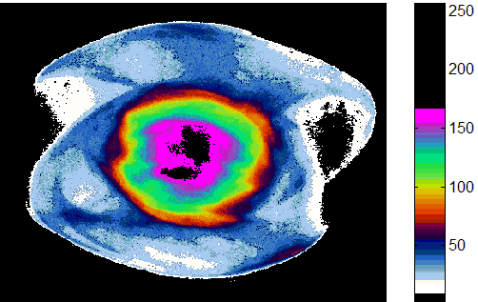
Halo Formation and Negative Effects
Causes of Beam Halo
Nonlinear forces due to space charge
Parametric resonances
Scattered Laser Light in Photo-cathodes:
Misalignment, Magnet error, noise
Beam Halo has many negative effects
  Nuclear Activation of The Transport Channel
  Emittance Growth
  Emission of Secondary Electrons
  Increasing Noise in The Detectors
Notes:
Beam halo is group of particles outside the beam core.
Beam halo can be caused by parametric resonances or nonlinear forces due to space charge [2], as well as field emission, light scattered on photo-cathodes, or by numerous other phenomena
It brings many negative effects such as emittance growth, emission of sencondary electrons and so on. Because of this negative effects, we want to avoid halo by study the phenomenon.
Experimentally, the challenge to measure faint halos is we need a method with high dynamic range about 10_5 or 10_6. people using image system to detect the halo using coronagraphy method, the mask usually is not adaptive when the beam core shape changes.
Today, we will introduce an adaptive mask method to measure halo using a device call DMD().

Slide 35
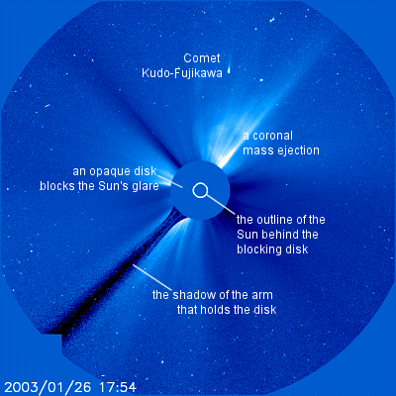
Halo measurements with coronagraph
A coronagraph is a telescopic attachment designed specifically to block out the direct light from a star, so that nearby objects can be resolved without burning out the telescope's optics. Most coronagraphs are intended to view the corona of the Sun, The coronagraph was introduced in 1930 by the astronomer Bernard Lyot.
The simplest possible coronagraph is a simple lens or pinhole camera behind an appropriately aligned occulting disk that blocks direct sunlight; during a solar eclipse, the Moon acts as an occulting disk and any camera in the eclipse path may be operated as a coronagraph until the eclipse is over.
http://en.wikipedia.org/wiki/Coronagraph

Slide 36
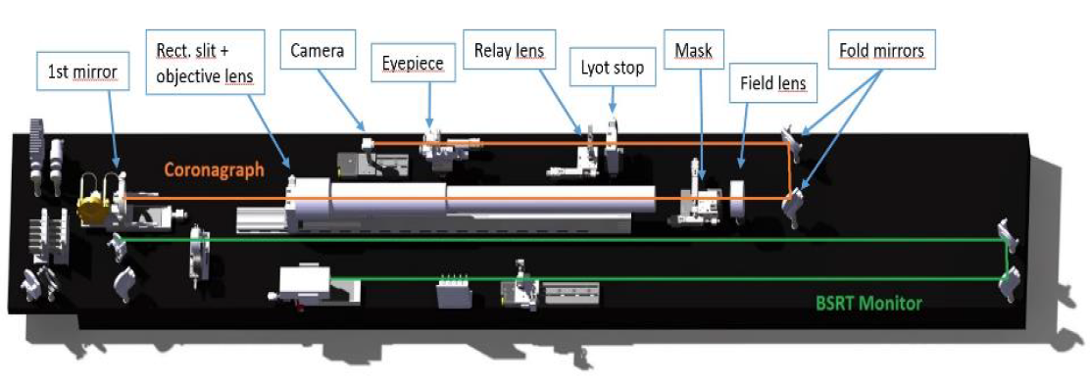
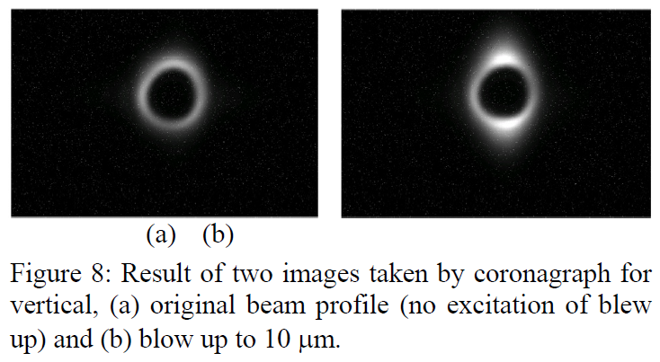
Coronagraph
OSR halo monitor at KEK employing Lyot Coronograph*
LHC coronagraph
*T. Mitsuhashi, EPAC 2004 and Faraday Cup Award presentation 2004
What if the beam core don’t have a regular shape?
T.M. Mitsuhashi et al., IPAC’17, Copenhagen, Denmark

Slide 37
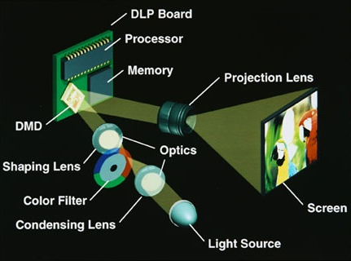
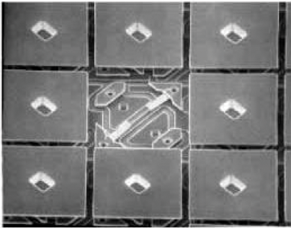
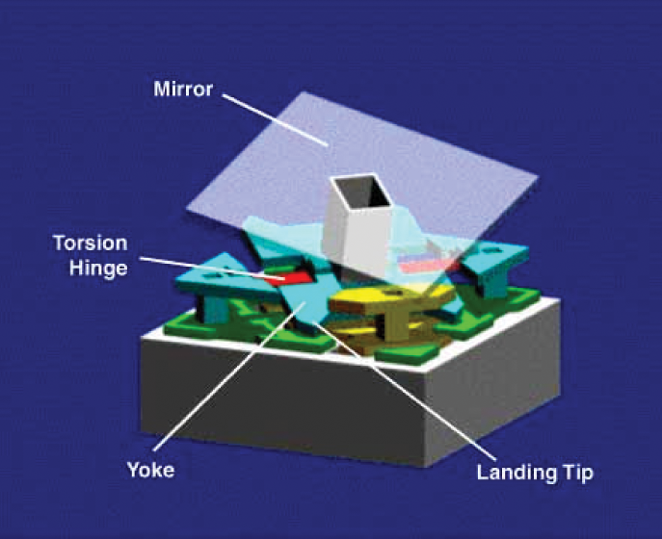
Digital Micro-mirror Device
Segment of DMD:
Micro-mirror architecture:
12⁰
13.68 um
*DLPTM Texas Instruments Inc.

Slide 38
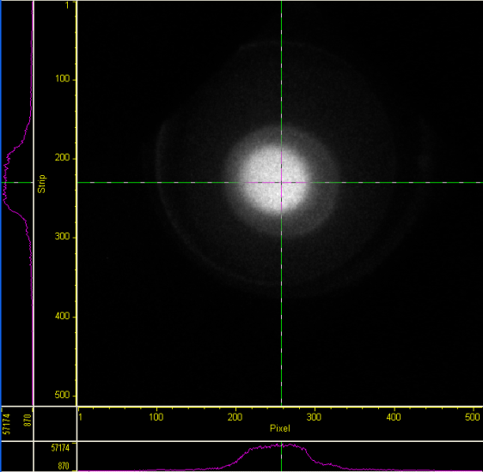
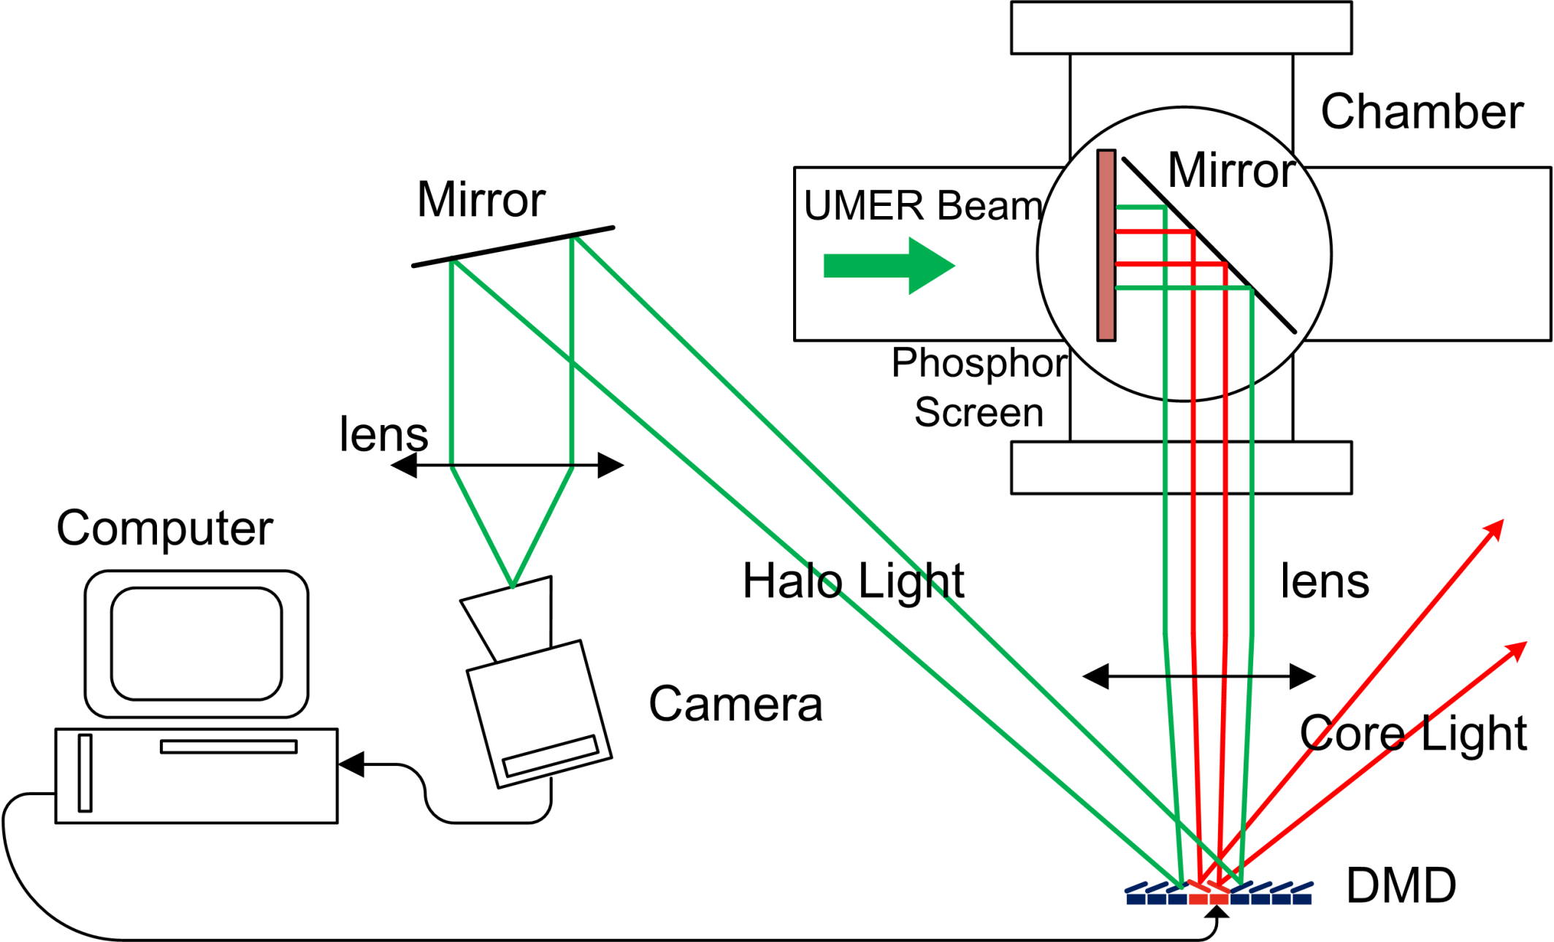
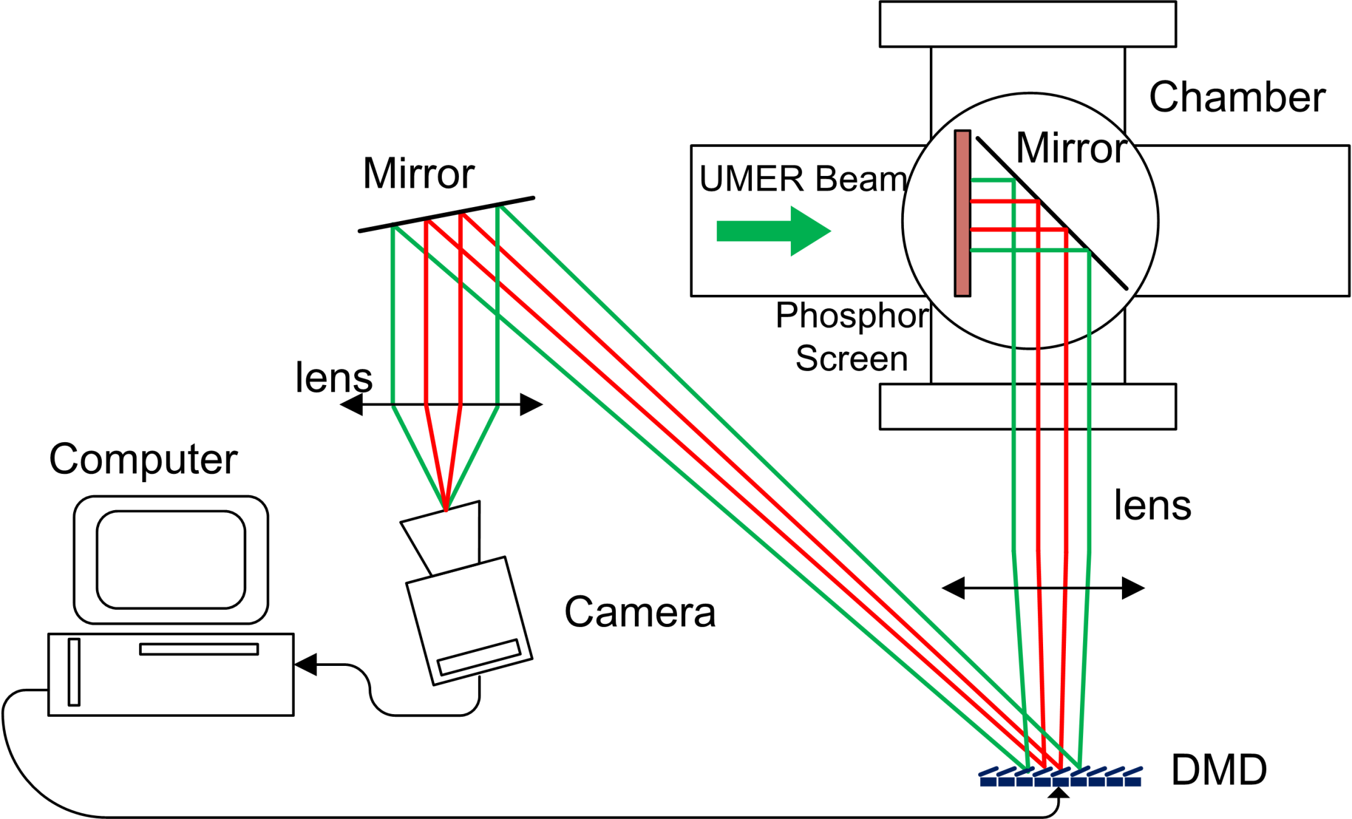
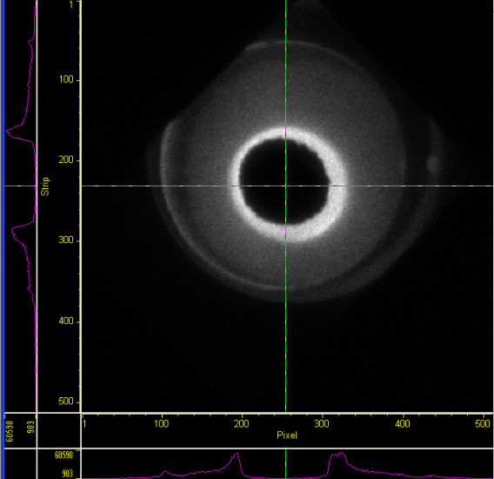
Optics System and Image process
32 mm
180 Frames
32 mm
C.P. Welsch et al.,
Proc. SPIE (2007)
J. Egberts, et al.,
JINST 5P04010 (2010)
H. Zhang, et al.,
Phys. Rev. STAB 15 (2012)
B. Lomberg, et al.
Proc. IBIC (2013)
900 Frames

Slide 39
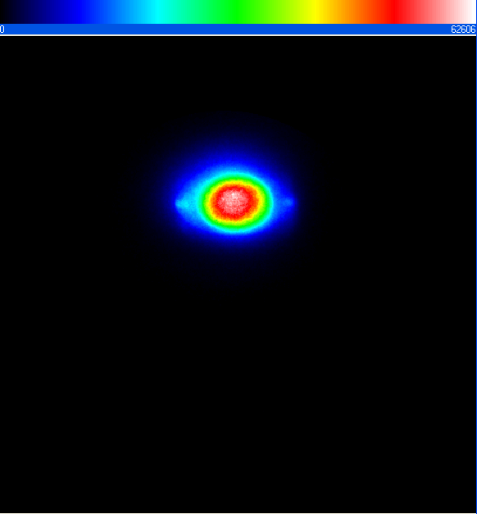







Demonstration of Adaptive Masking on UMER
Quadrupole Current
I_{Q}
82.9%I_{Q}
66.3%I_{Q}
49.7%I_{Q}
32mm
(a)
y
x
70
45
45
60
Different Beam / Different Mask Shape
(b)
280
640
660
250
6mA beam

Slide 40
Thank you for your attention

Slide 41
Reference
Workshops, conference and schools
  BIW, IBIC
  DITANET, OPAC, USPAS, JUAS, JAS, CAS
J. Harasimowicz et al., Rev. Sci. Instr. 81 (10), 2010
H. Koziol, BEAM DIAGNOSTICS FOR ACCELERATORS
P. Forck, Lecture Notes on Beam Instrumentation and Diagnostics, Joint University Accelerator School, January – March 2012
U. Raich, Accelerator Beam Diagnostics, USPAS, Albuquerque NM, June 23-26, 2009
H. Zhang, PhD thesis, university of Maryland, 2014
E. Bravin, Transverse Profile Measurements, CAS on Beam Instrumentation 2018, Tuusula, Finland
C. Welsch, Beam Diagnostics, CIPAS, 2015
J. Harasimowicz, et al., PRSTAB, 15, 122801 (2012)
A. Peter, Intensity Measurements, CAS on Beam Instrumentation 2018, Tuusula, Finland
W. Blokland, beam current monitor, Accelerator Beam diagnostics, USPAS 2009
T. Shea, Laser Diagnostics for H- beams, , Accelerator Beam diagnostics, USPAS 2009
S. Gibson, Application of lasers in beam instrumentation, CAS on Beam Instrumentation 2018, Tuusula, Finland

