Slide 1
Destructive detectors for low energy ion beams
Sergey Sadovich
CERN BE-BI-EA
AVA School on Low Energy Antimatter Physics
25-29 June 2018
CERN

Slide 2
Outline
1. Interaction of particles with matter
2. Faraday Cup
3. Scicnillators/screen
4. Silicon detector

Slide 3
Interaction of particles with matter
Ionization
  Creation of electrons/ions pairs
    Secondary electron emission (low energy electrons)
    Emission of photons (decay of excited states)
Elastic and Inelastic scattering
  Dislocations
  Production of secondary particles (high energy particles)
Radiation
  Cherenkov radiation
  Bremsstrahlung
  Optical transition radiation

Slide 4
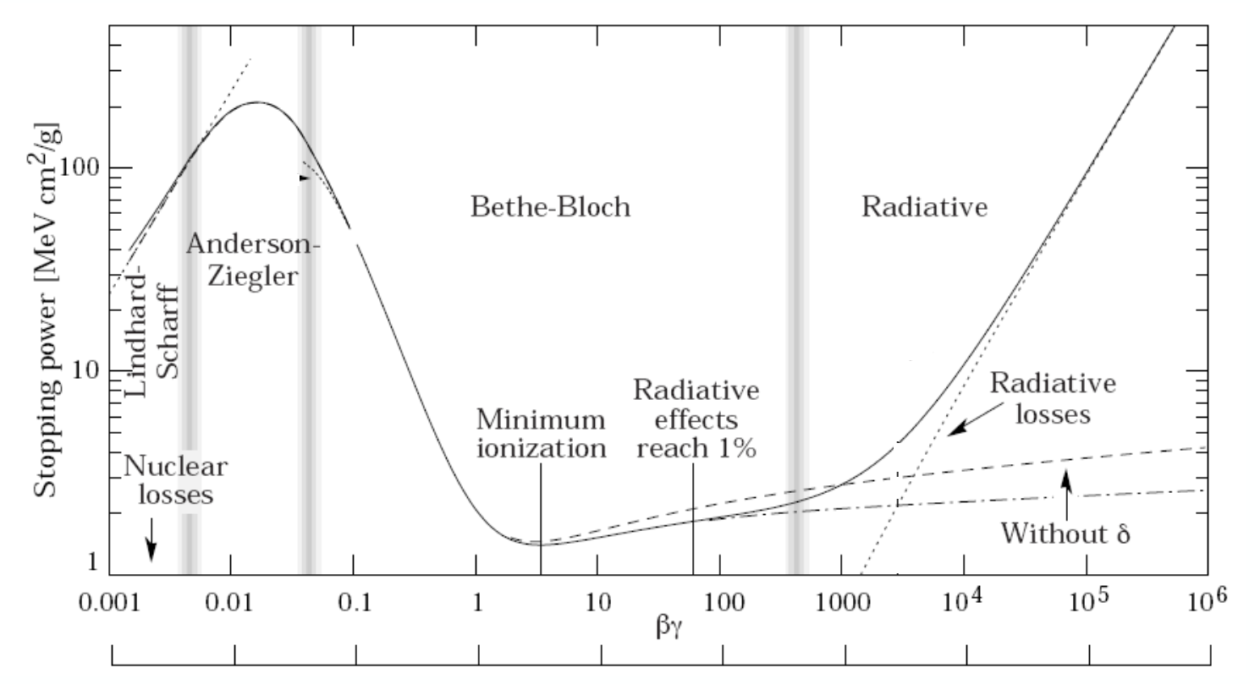
Energy deposition

Slide 5
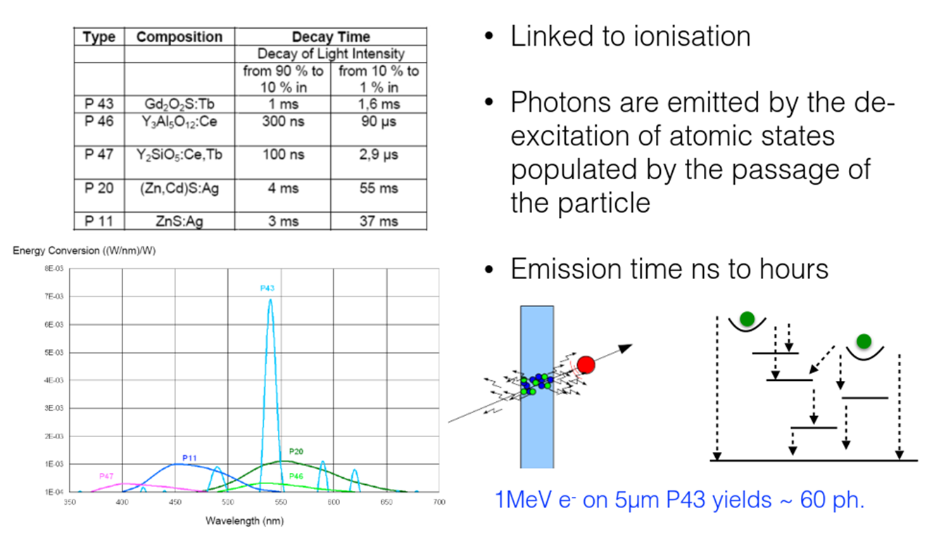
Scintillation
E.Bravin - Transverse profile measurements
CAS Beam Instrumentation 2018

Slide 6
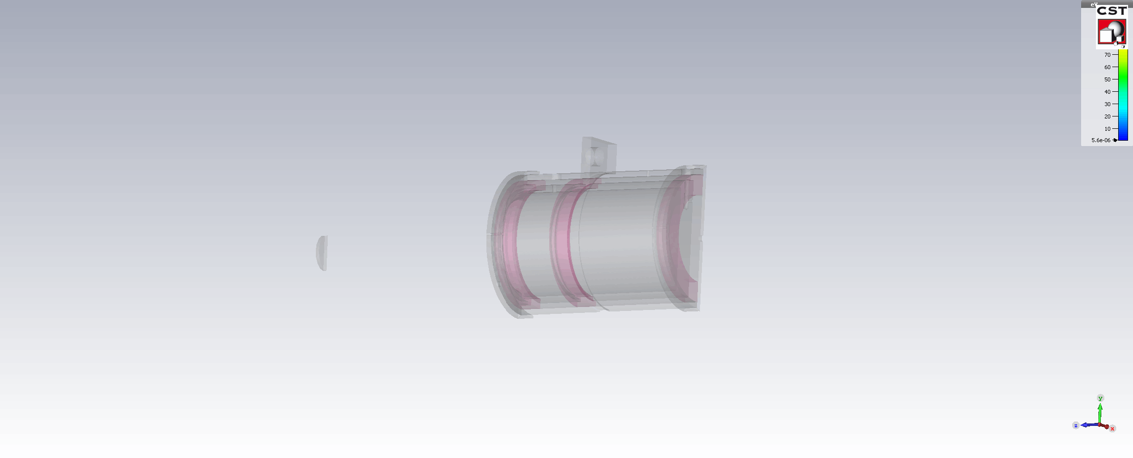
Faraday Cup
Repeller
Collector
<1 pA detection

Slide 7
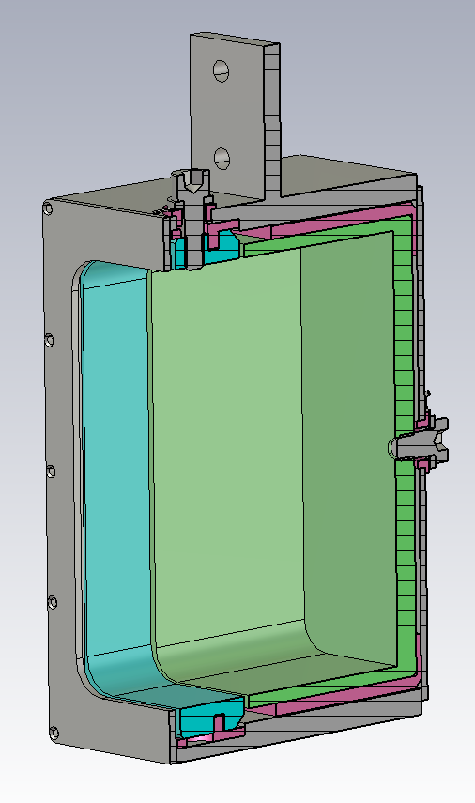
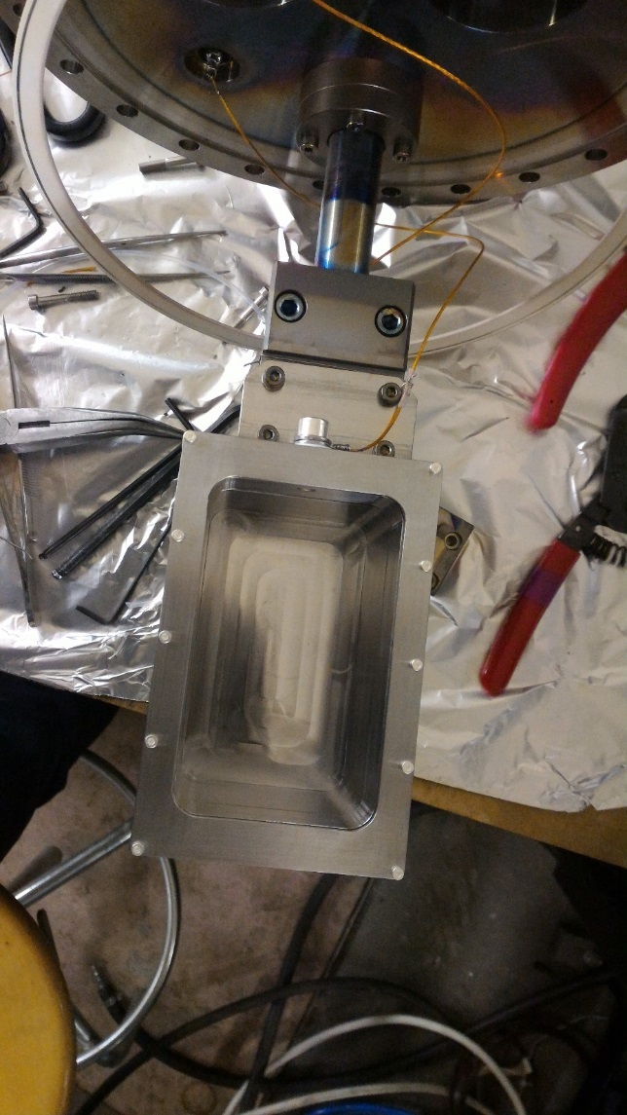
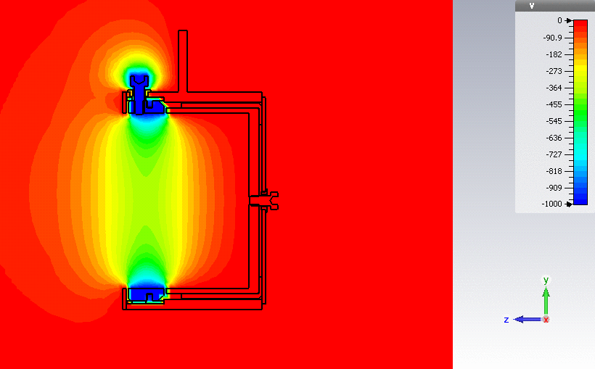
FC: Example 1
Large aperture – up to 1kV on repeller
Grounded shielding around repeller
Aperture 60x100 mm

Slide 8
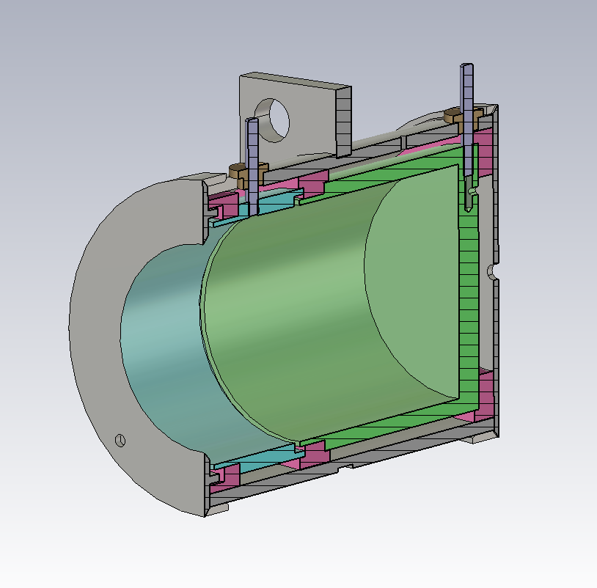
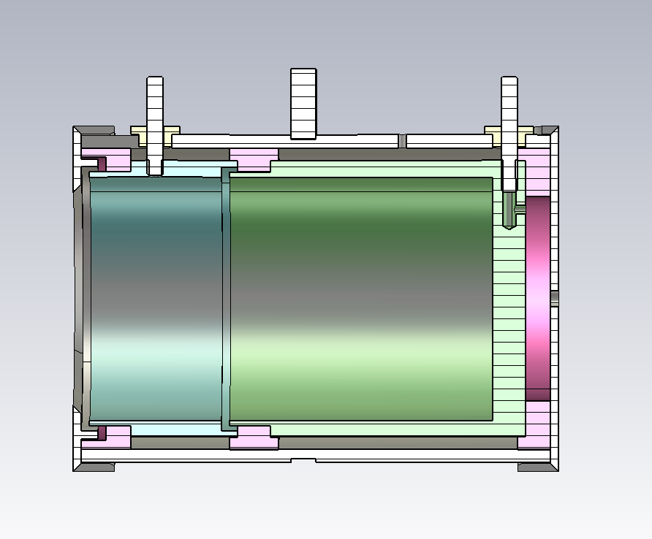
FC: Example 2

Slide 9
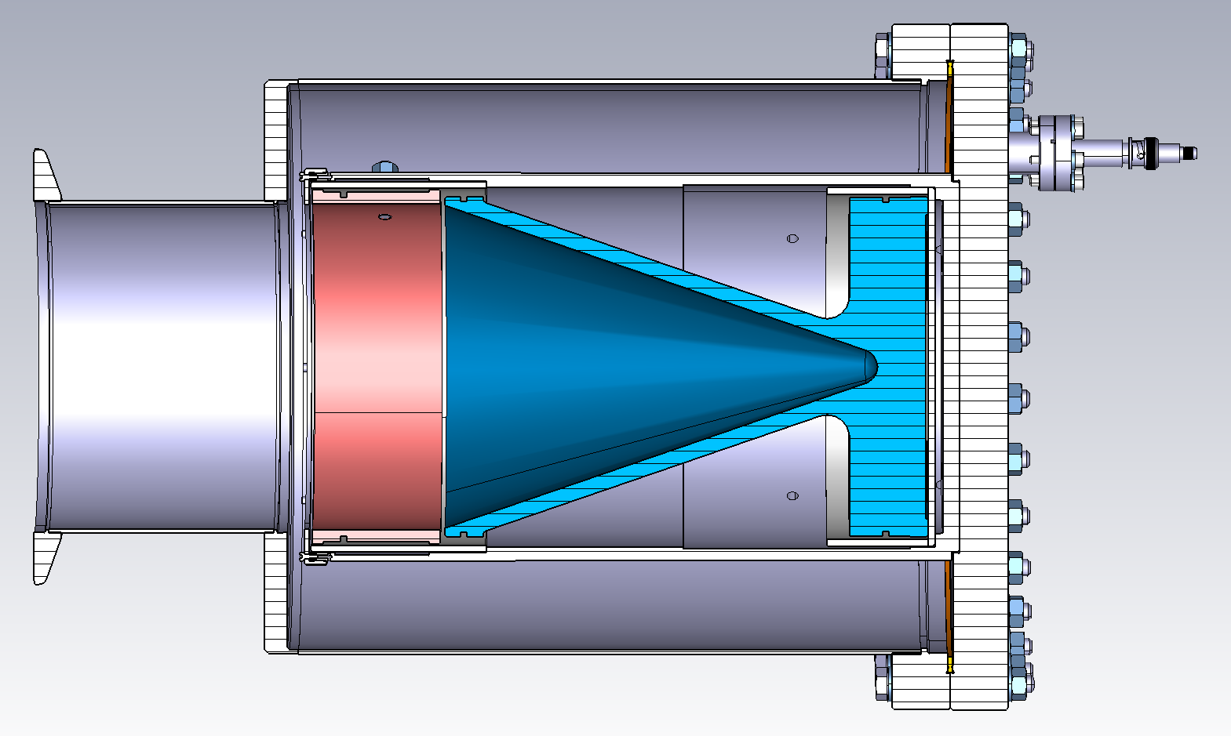
FC: Example 3
High current/density/energy:
V shape of the FC collector
Coating of the FC collector with refractory metals
Water cooling
Aperture 140mm

Slide 10
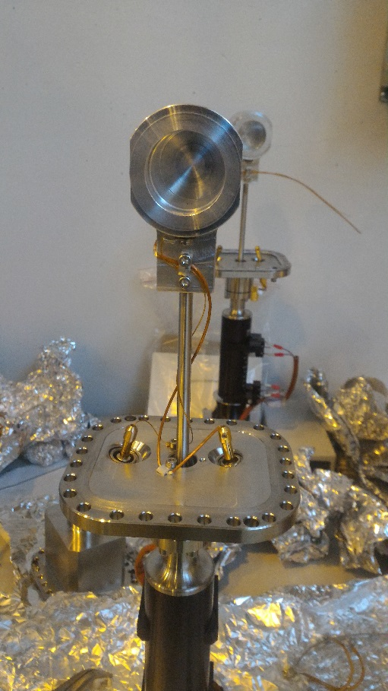
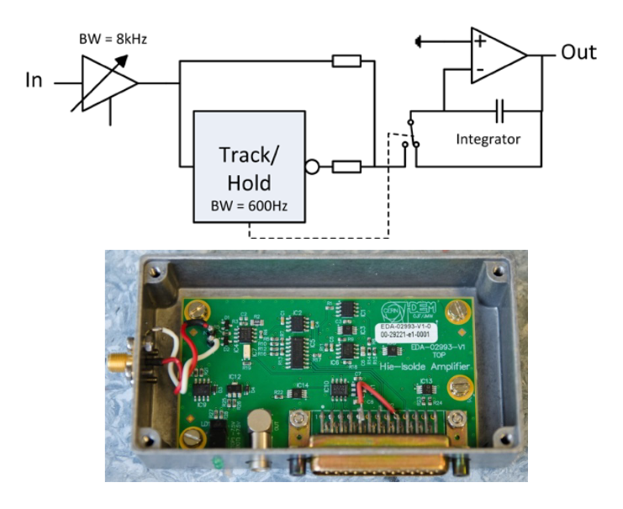
FC: Signal extraction
Microphonic/triboelectric effect /ground loops – proper cables/cabling/connectors are required
Preamplifier (low noise, changeable gain) + ADC

Slide 11
FC: application
Current
Profile/position
Emittance

Slide 12
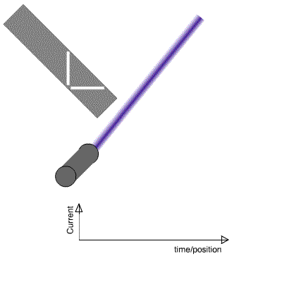
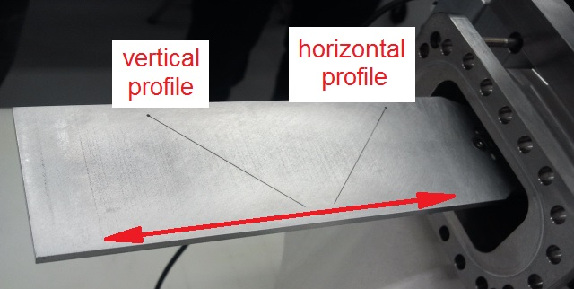
FC and Scanning slit (profile measurement)
beam
detector

Slide 13
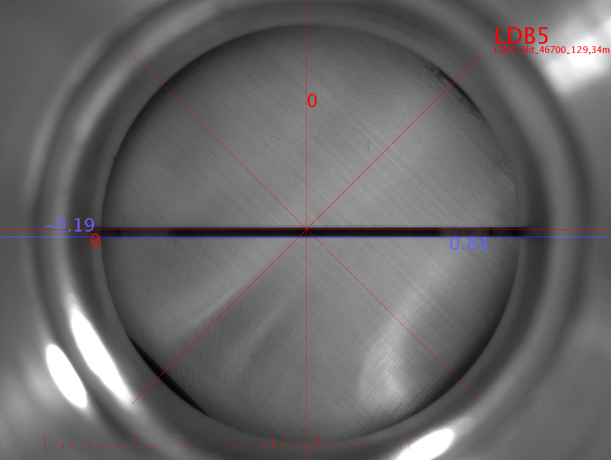
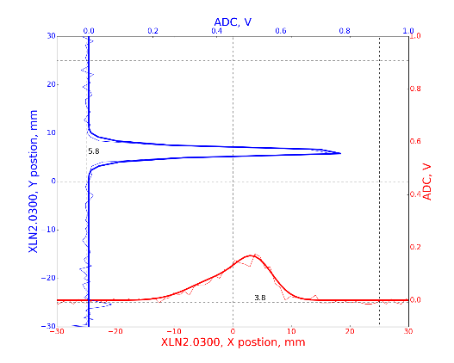
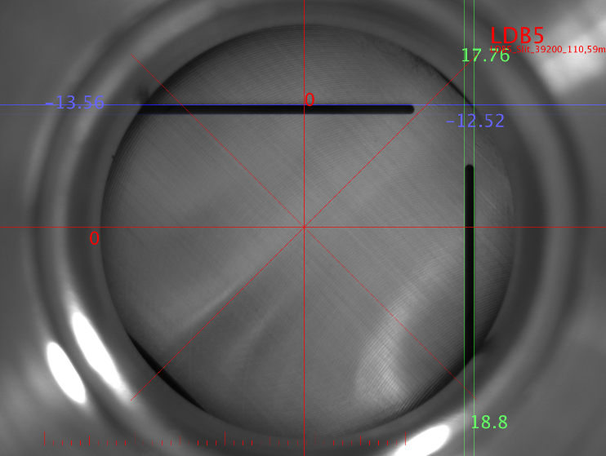
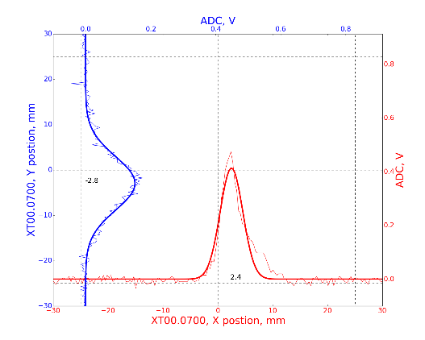
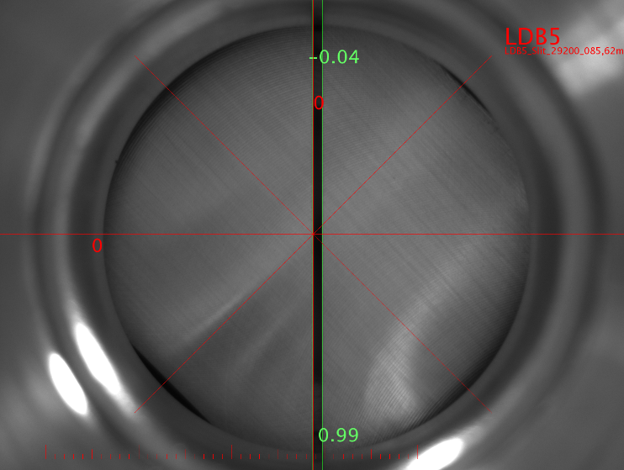
FC and Scanning slit (profile measurement)

Slide 14
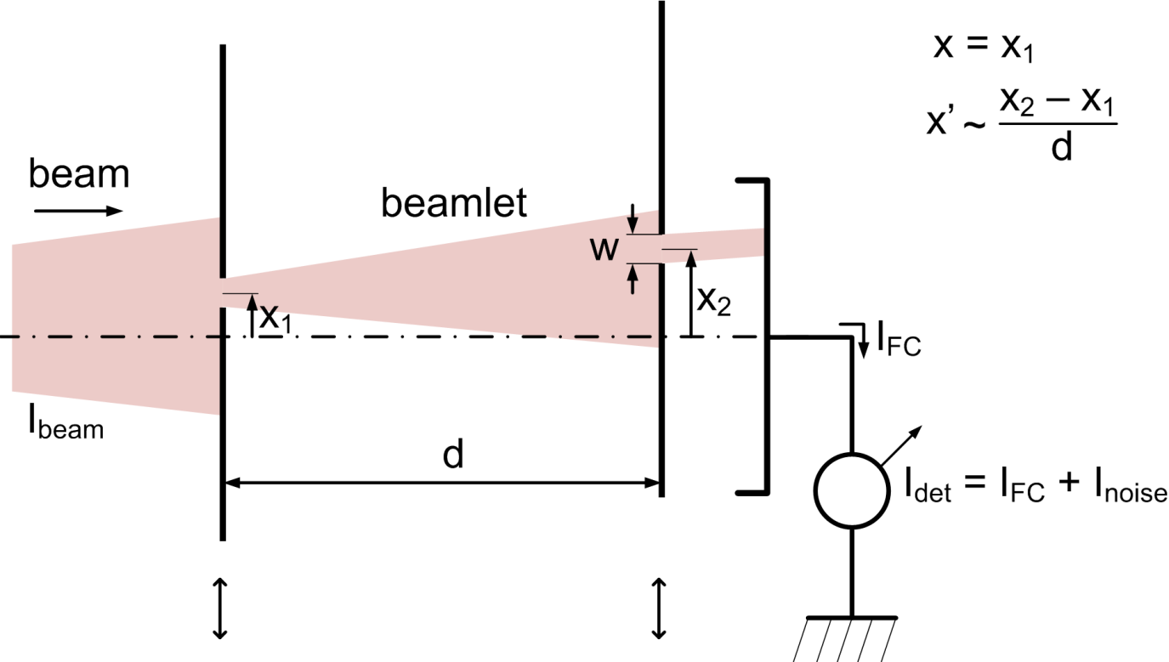
FC and 2 Scanning slits (transverse emittance)

Slide 15
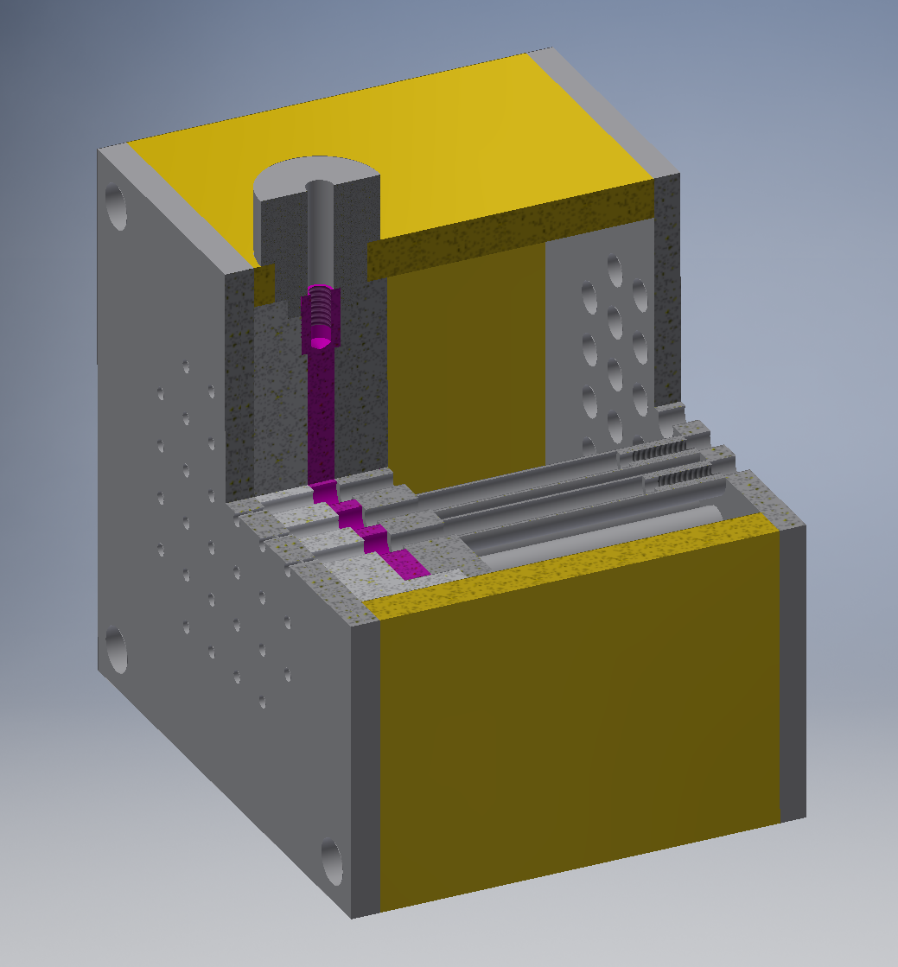
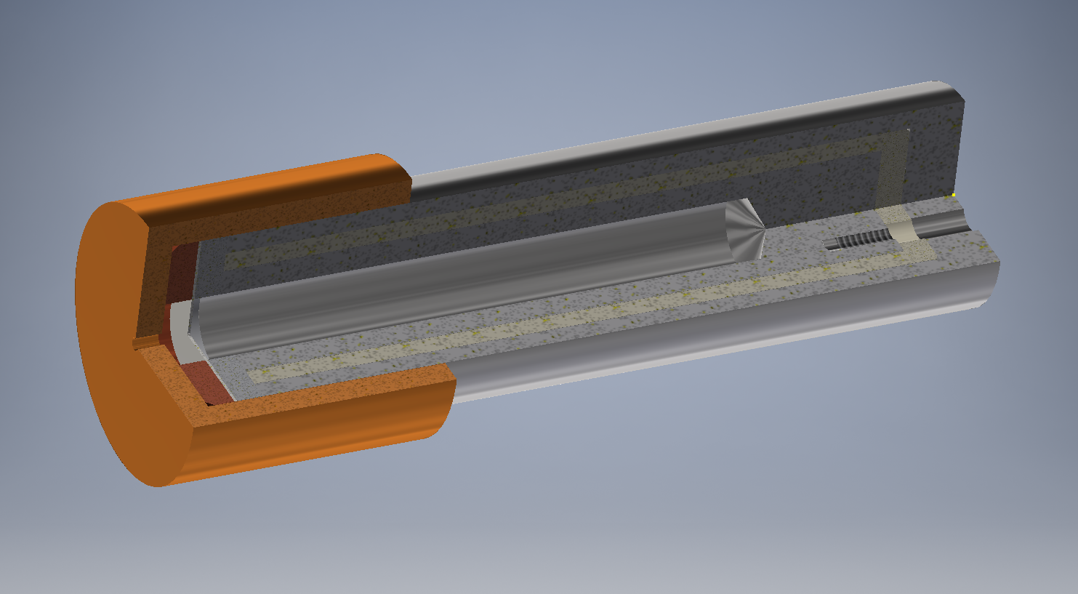
FC: pin-hole / array
1 mm aperture in molybdenum cup
Faraday Cup collector
0.2 mm aperture in tungsten foil

Slide 16
FC: summary
Cheap and robust device for current measurement (< 1 pA), for lower values magic with improving signal to noise ratio is required
Updated functionality with slit (profile and position measurement)
Beam stopper – energy absorption / dissipation

Slide 17
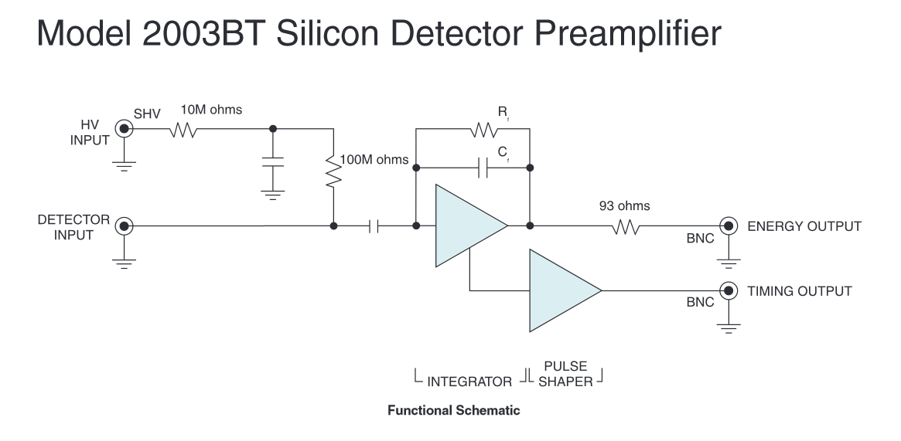
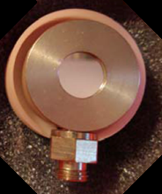
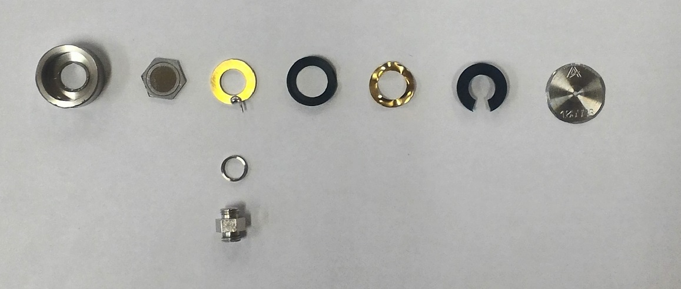
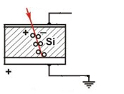
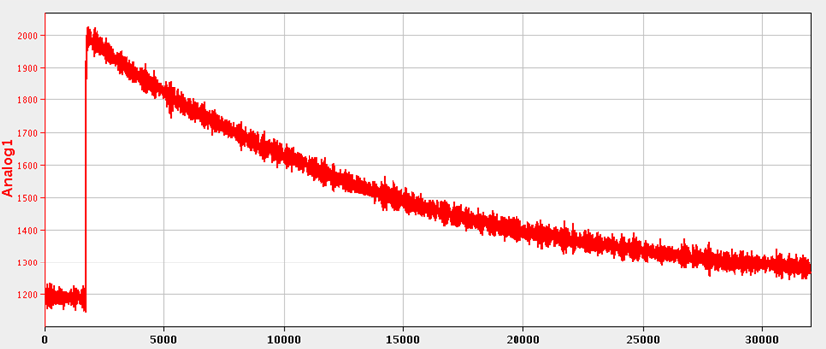
Silicon detector
Preamplifier (Operating as a charge to voltage converter) (0.45V per pC -> 20mV per MeV)
500 MeV for 0…10V digitizer
Single particle detection
Fragile/degradation

Slide 18
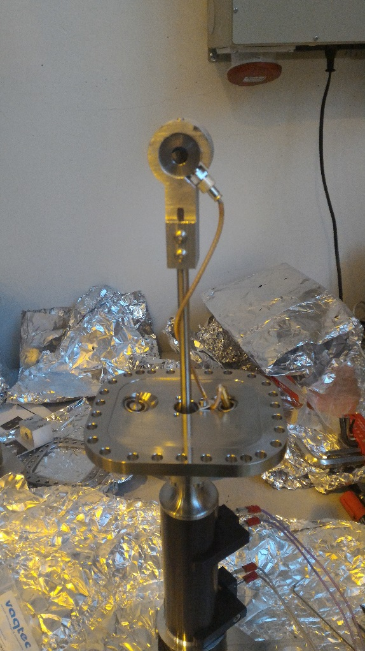
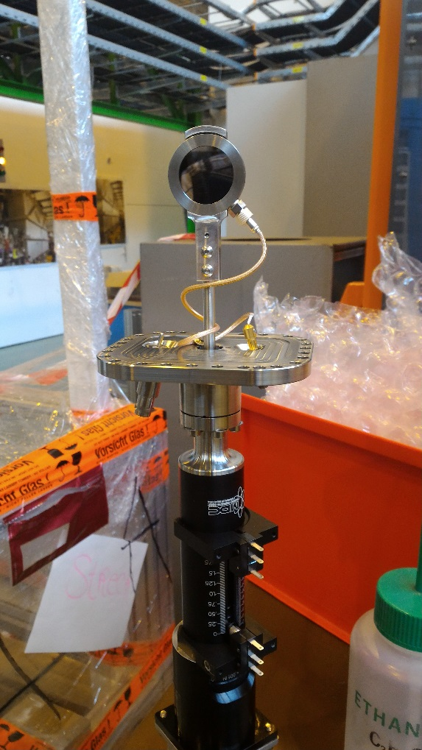
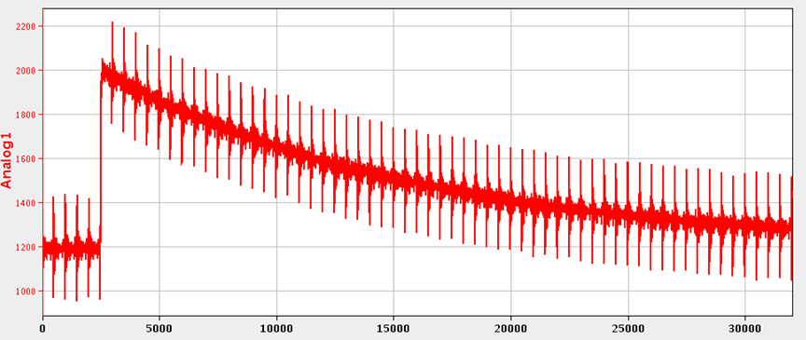
Silicon detector

Slide 19
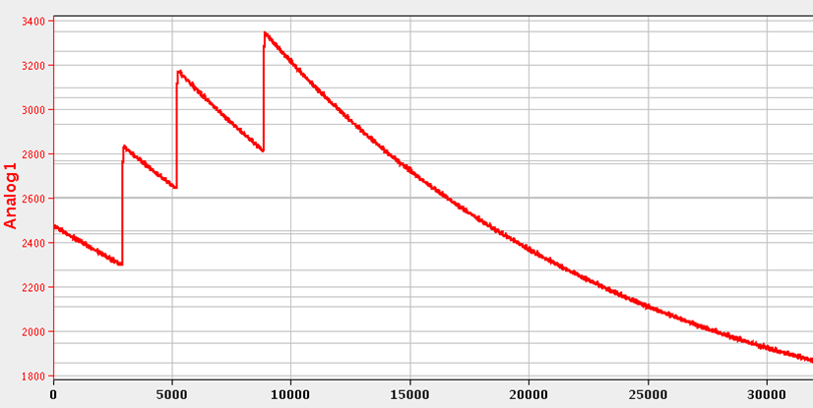
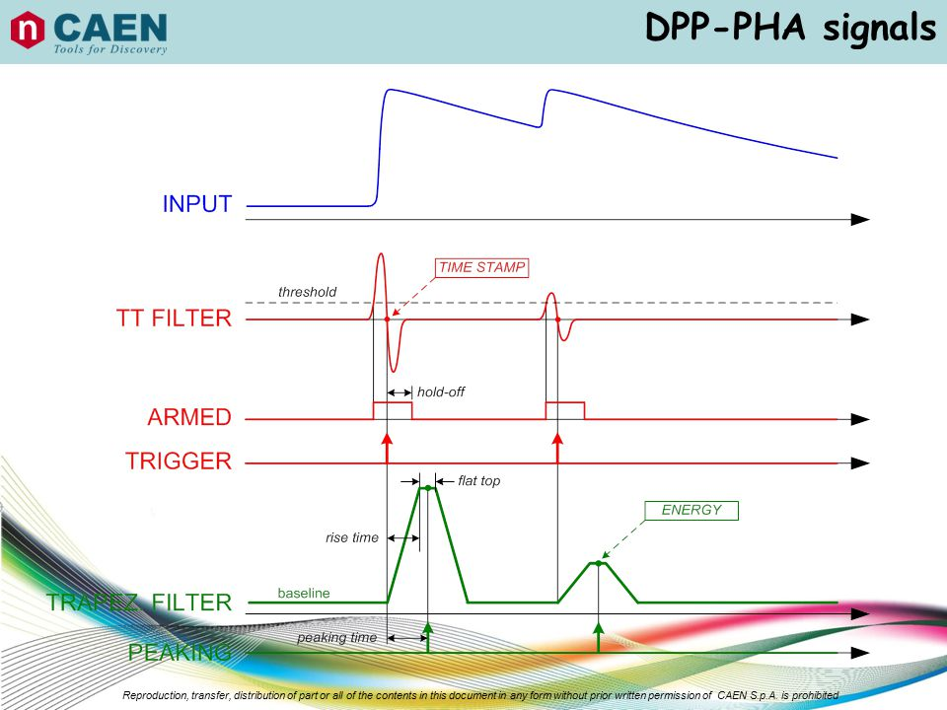
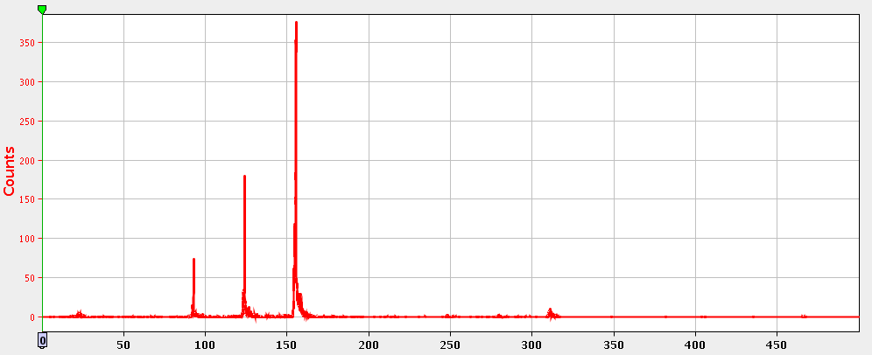
Silicon detector
DPP-PHA
Digital Pulse Processing – Pulse Height Analysis

Slide 20
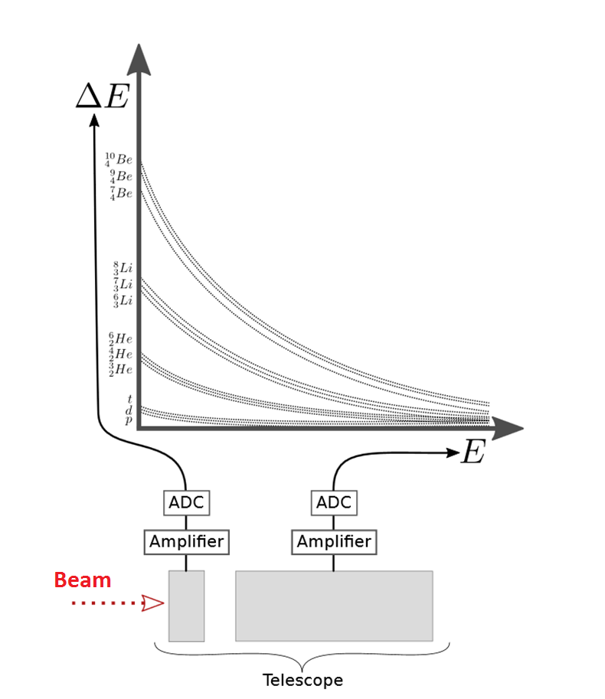
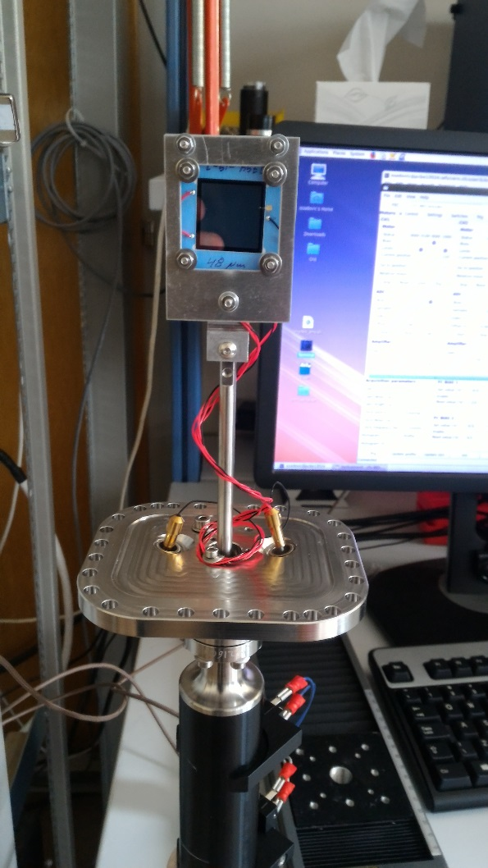
Silicon telescope
K.Schmidt and O.Wyszynski
An evolutionary strategy for ∆E-E identification

Slide 21
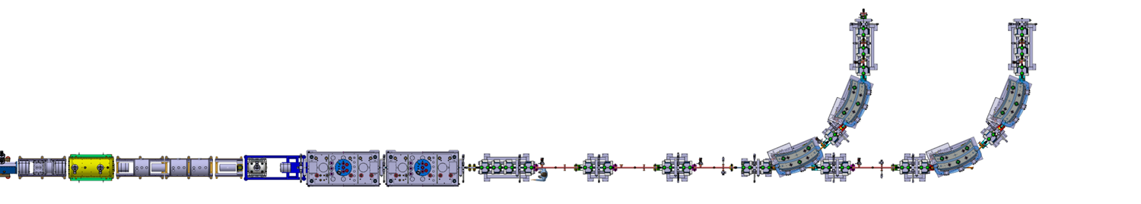
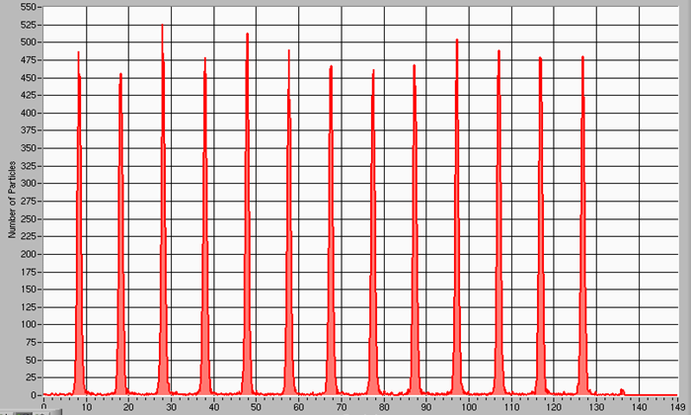
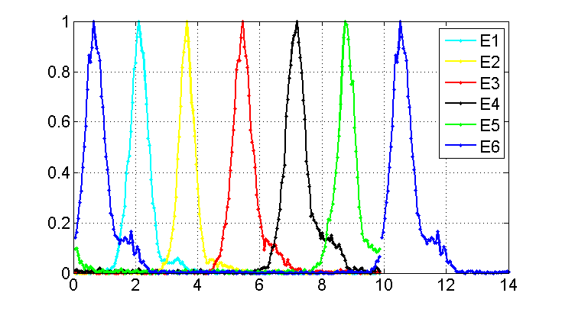
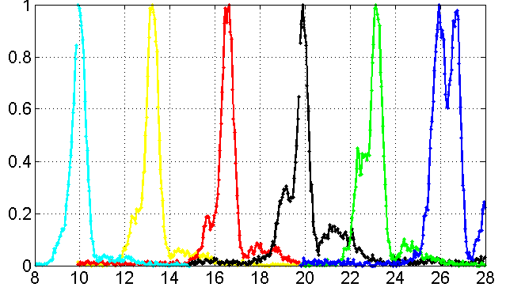

Silicon detector: TOF
7.76 m
Annular silicon detector
Bunch time structure for beams with different energies measured at SD1
Bunch time structure for beams with different energies measured at SD2
N / N_{MAX}
N / N_{MAX}
time [ns]
time [ns]
The TOF system uses the time information provided by two silicon detectors separated 7.76 m from each other
Energy changes smaller than 0.5 % could be easily resolved
Bunch structure in second Si detector has partially degraded

Slide 22
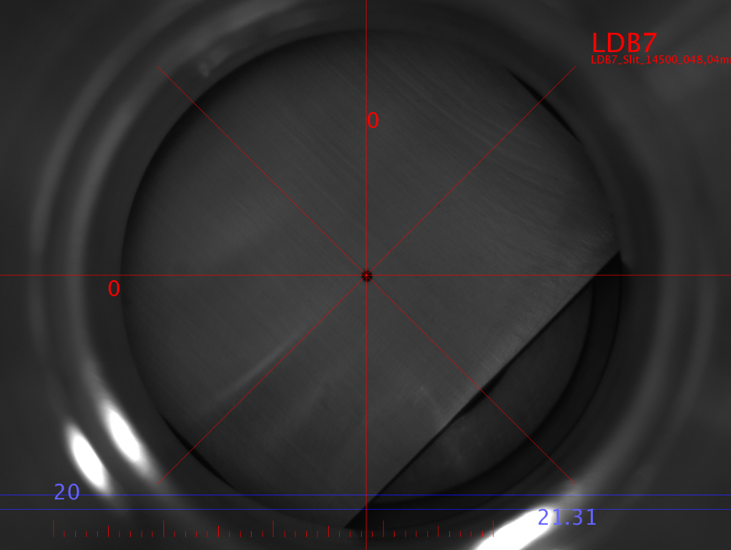
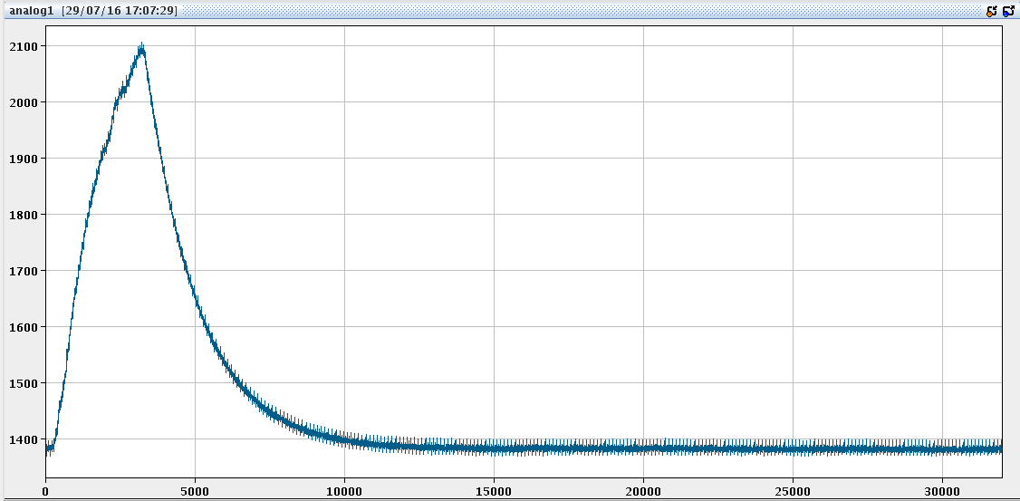
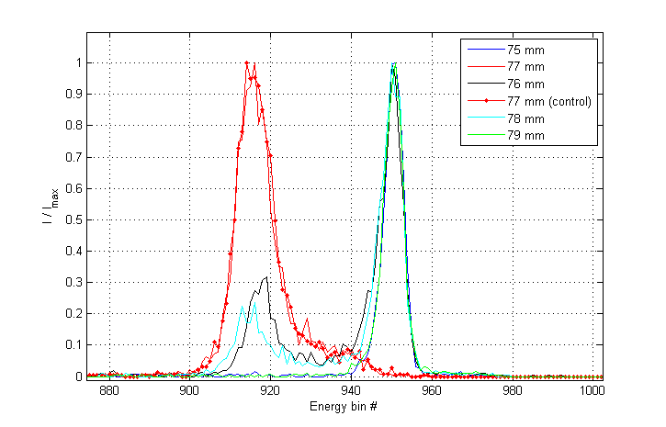
Degradation of SD
Typical leakage current: 2-5 nA
Leakage current increases during opration
Degradation (not critical for relative measurement, can affect final measurements)

Slide 23
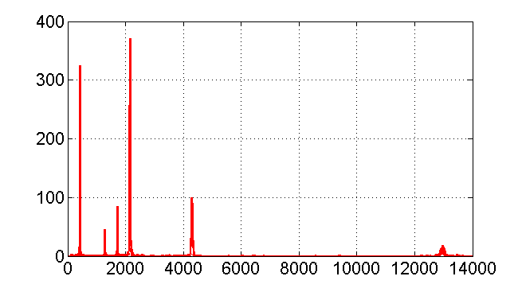
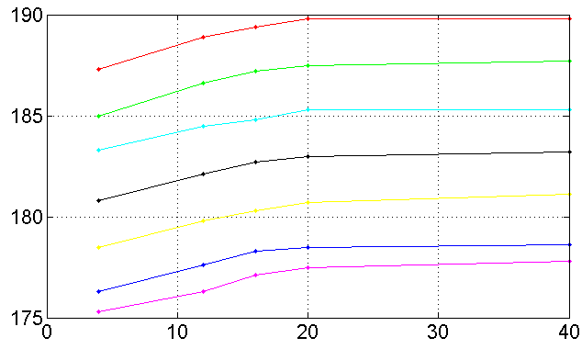
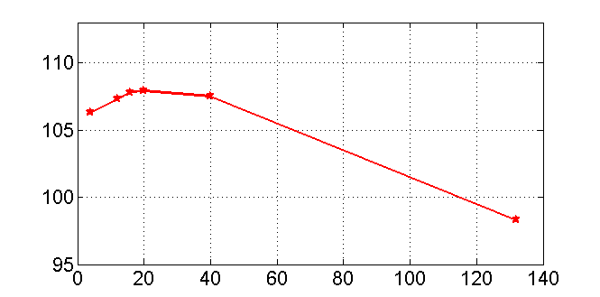
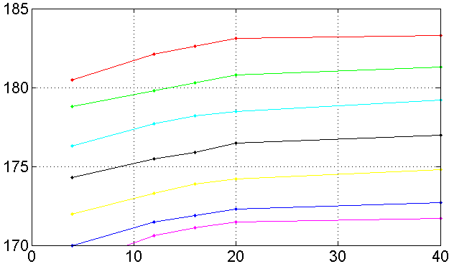
Energy measurement: Pulse Height Defect
Cocktail of beams (EBIS and Xe from GPS target) was sent to silicon detector
PHD is visible for heavy ions – time of flight technique should be used for energy measurement
⁴He¹⁺
Energy spectrum for a beam with A/q = 4.0 and REX energy
XT00.1000 deviation from linearity
²⁰Ne⁵⁺
# Counts
¹⁶O⁴⁺
⁴⁰Ar¹⁰⁺
Ebin# / A
¹³²Xe³³⁺
¹²C³⁺
Energy bin #
Mass Number (A)
Deviation from linearity as a function of mass number
XT00.1900 deviation from linearity
Ebin# / A
Ebin# / A
Mass Number (A)
Mass Number (A)

Slide 24
Silicon detectors: summary
Absolute energy measurement of the beam (0.5%): roughly measurement using energy output and fine correction using timing output
Single particle detection
Fragile – can be destroyed in one direct pulse
Degradation during operation (corrections for data analysis are required / calibration using alpha source)
Corrections for PHD should be taken into account for data analysis

Slide 25
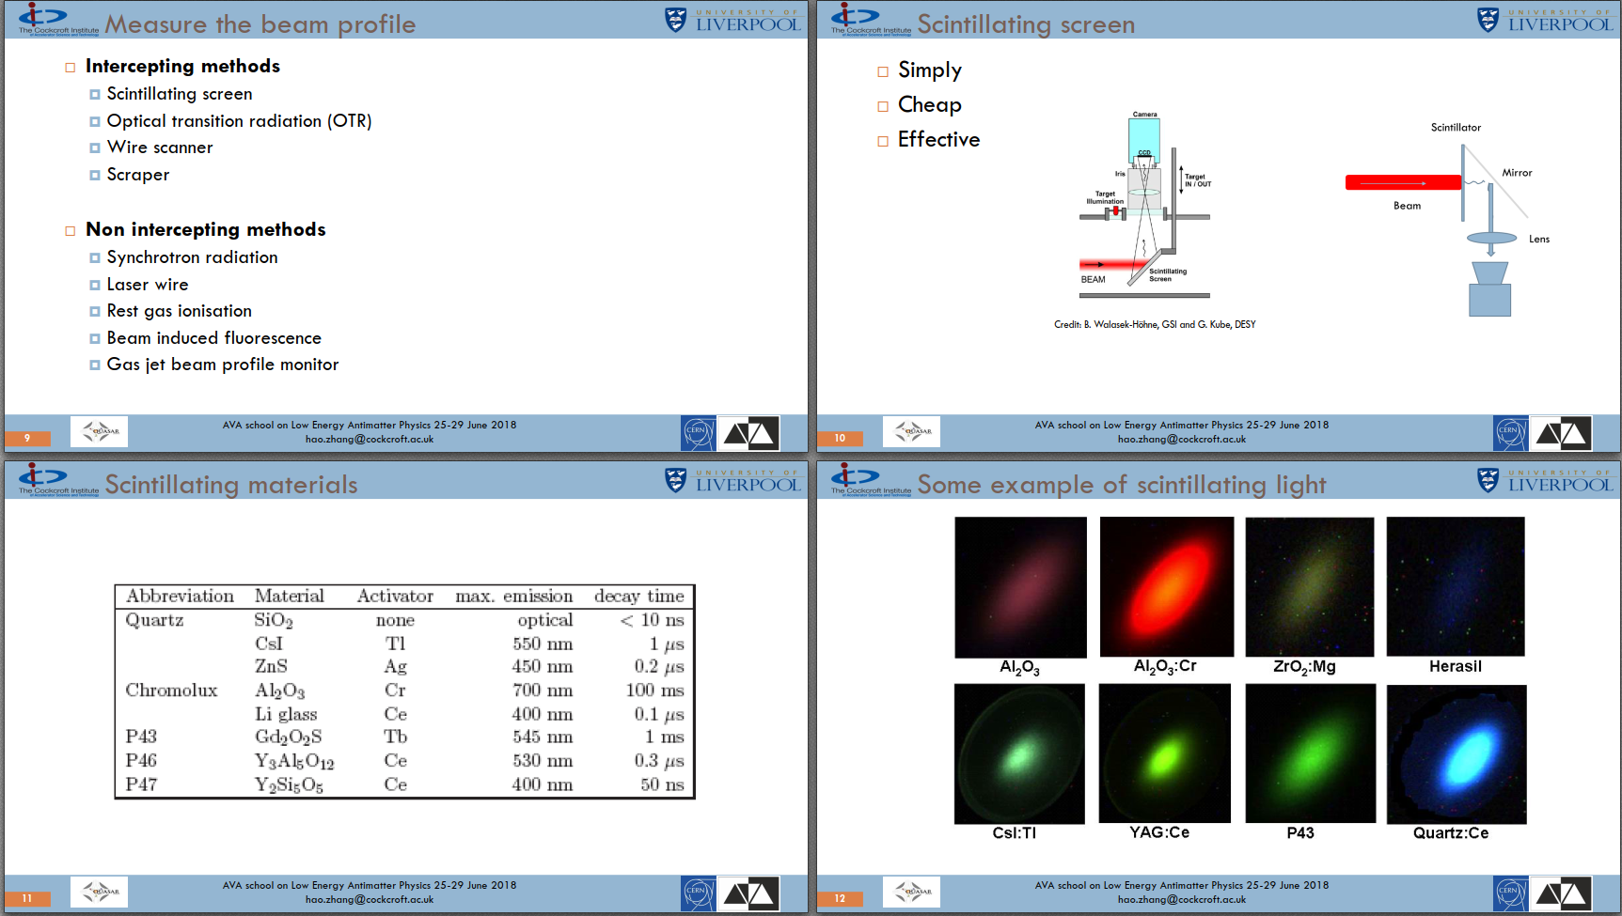

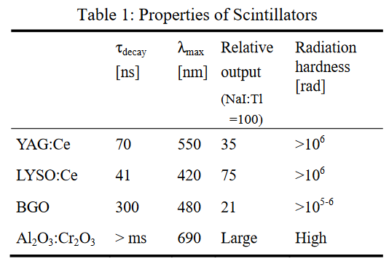
Scintillators
Widely used for beam profile measurements
Decay time
Radiation hardness
For chemical compound
Hao Zhang - Beam Diagnostics I (Destructive monitors)
Saturation with very dense beam (pC/mm²) is possible
F. Miyahara et all
Response of scintillating screens to high charge density electron beam

Slide 26
Scintillator: summary
Phosphors have very high light yields, but can only be used as thin coating on a rigid support and get damaged very quickly (often used in MCP)
Normally used for very low intensity beams
CHROMOX (Al₂O₃:Cr, Aluminum Oxide) is a very common choice because it is a very robust ceramic
ZZZ-doped YAG is also a very frequent choice (fast)
E.Bravin - Transverse profile measurements
CAS Beam Instrumentation 2018

Slide 27
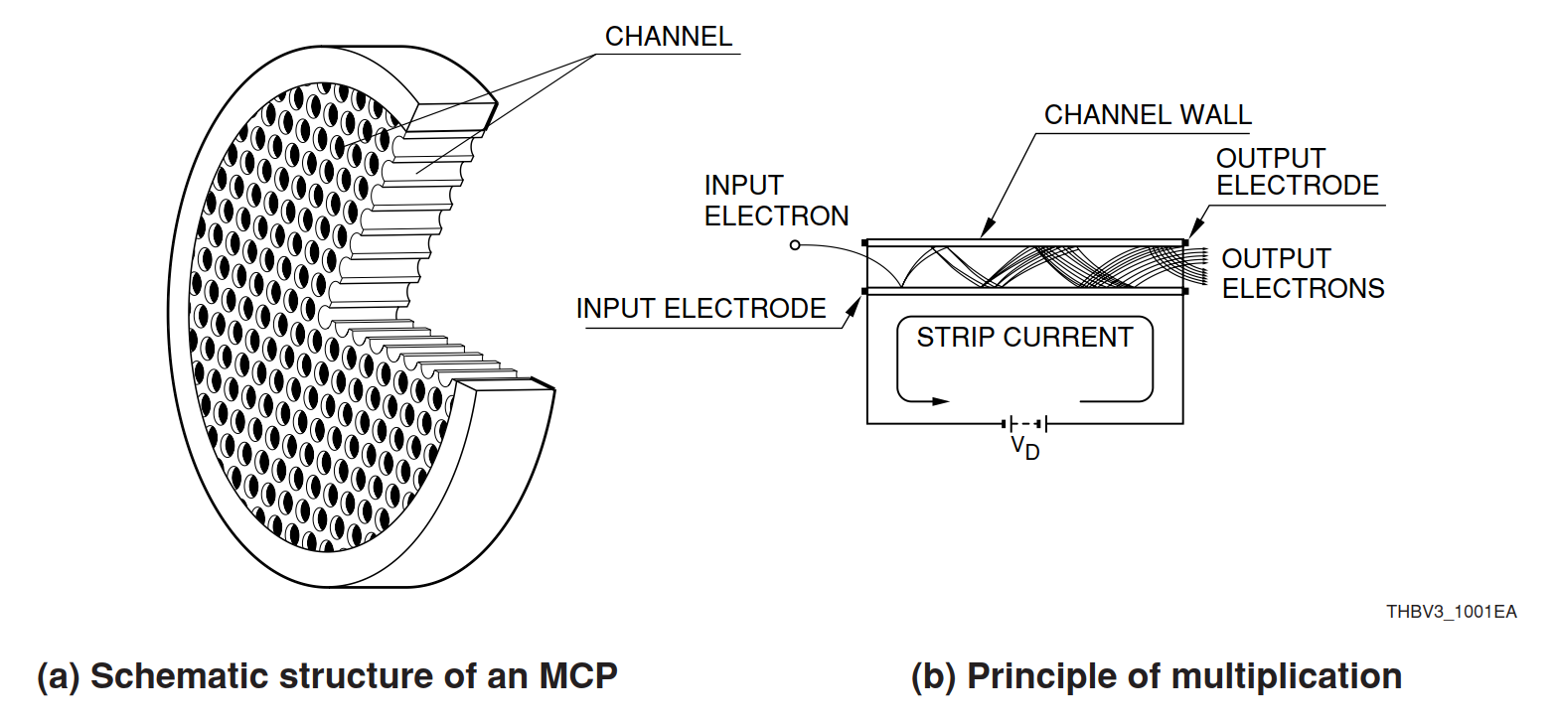
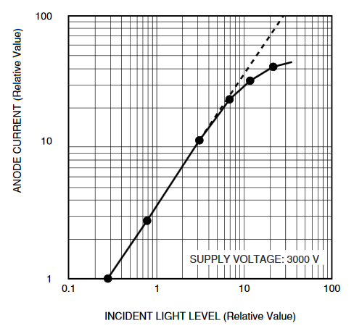
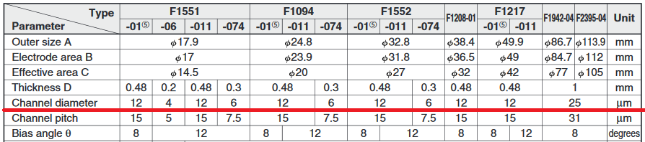
Micro Channel Plate
Saturation of the MCP (channels)
www.hamamatsu.com

Slide 28


PepperPot
Hao Zhang - Beam Diagnostics I (Destructive monitors)
www.dreebit-ibt.com

Slide 29



PepperPot: scanning plate

Slide 30




PepperPot: image processing

Slide 31


How to analyze images

Slide 32
MCP summary
Sensitive tool for particles detection
MCP-PMT with a single photon detection
Fragile
Linearity and working point (to avoid saturation)
Image processing can be non-trivial

Slide 33
The End

