Slide 1


Test for matter – antimatter imbalance in the Universe by studying neutral trapped antihydrogen atoms.
Experiment DAQ & Controls
AVA - CERN, Geneva, June 29th 2018
Petteri Pusa
Antihydrogen Laser PHysics Apparatus
http://alpha.web.cern.ch/

Slide 2

















University of California
Berkeley, USA
University of Wales
Swansea, UK
University of Aarhus,
Denmark
NRCN - Nucl. Res.
Center Negev, Israel
University of British
Columbia, Canada
RIKEN, Japan
Simon Fraser University,
Canada
TRIUMF,
Canada
Federal University of
Rio de Janeiro, Brazil
University of Tokyo,
Japan

Slide 3
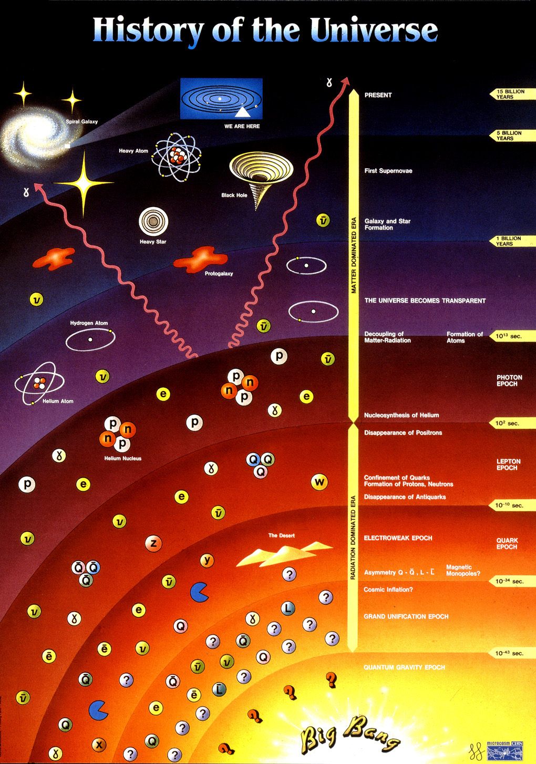
ALPHA probe for the anti – ‘World’
ALPHA probes beyond here
HEP experiments
The reason(s) for these events are not understood

Slide 4
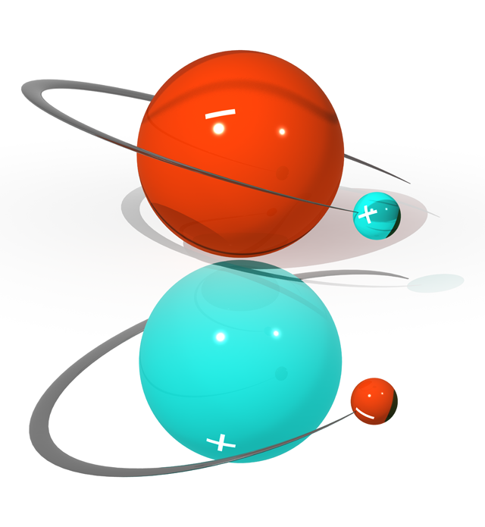
Overview of the experimental goal
- Ultimate long term goal 1S-2S comparison of antihydrogen atomic transition between hydrogen
- Haench et al. Currently measured at 10⁻¹⁵ precision. One of the best studied physical systems
- => Low energy region test for the CPT -symmetry conservation
- Extreme experimental difficulties in confining the antihydrogen
- Need 0.5K stable atoms, starting point at the moment @ 5.3 MeV antiprotons
- Physics is based on effective detection of single (anti)atom annihilation events

Slide 5
Making antihydrogen – the ingredients are:
Antiprotons
Positrons
Simple, but in real life, somewhat tricky.

Slide 6
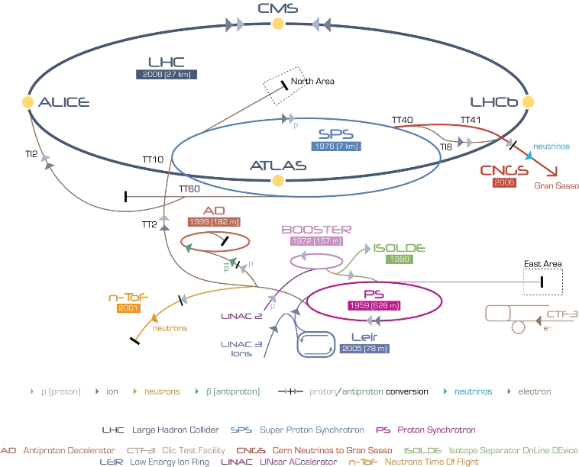

Slide 7
AD
PS production beam 1.5x10¹³ protons/cycle at 26 GeV/c
5x10⁷ pbars injected at 3.57 GeV/c
Stochastic and electron cooling, cycle 100s
Extract 3x10⁷ pbars every 100s at 100/300/500 Mev/c (5.3/47/126 MeV)

Slide 8
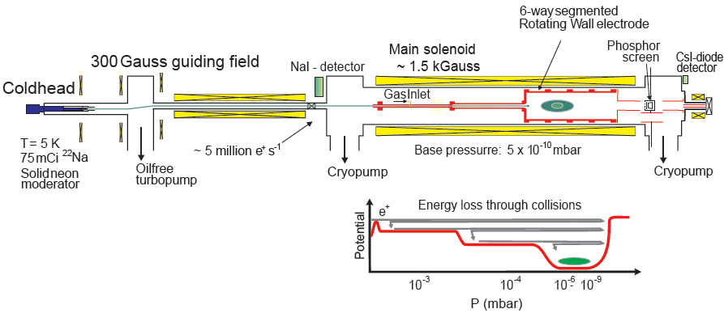
POSITRONS

Slide 9
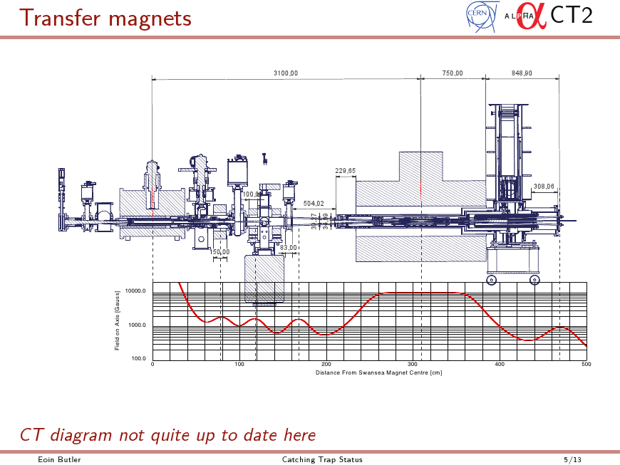
ALPHA - 2
pbar
e+

Slide 10
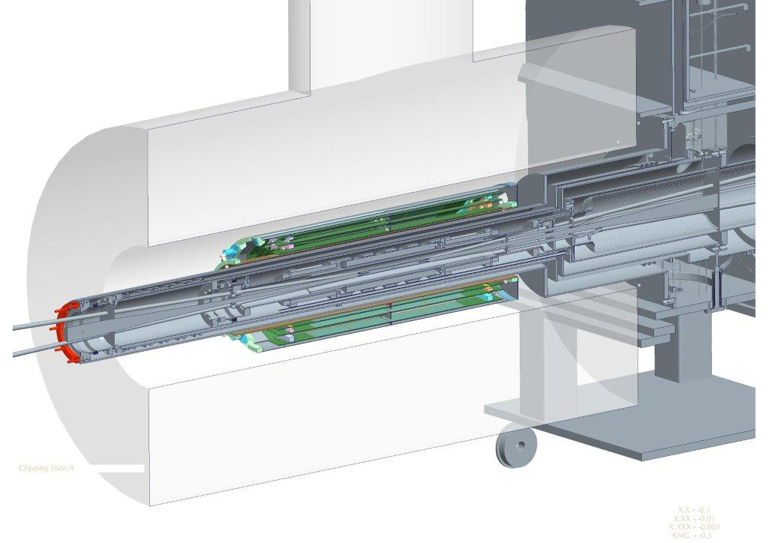
Neutral trap cut-through
Nested Ioffe-Pritchard & Penning traps
Cryostat
LASER access
Silicon Vertex Detector (in atmospheric pressure)

Slide 12
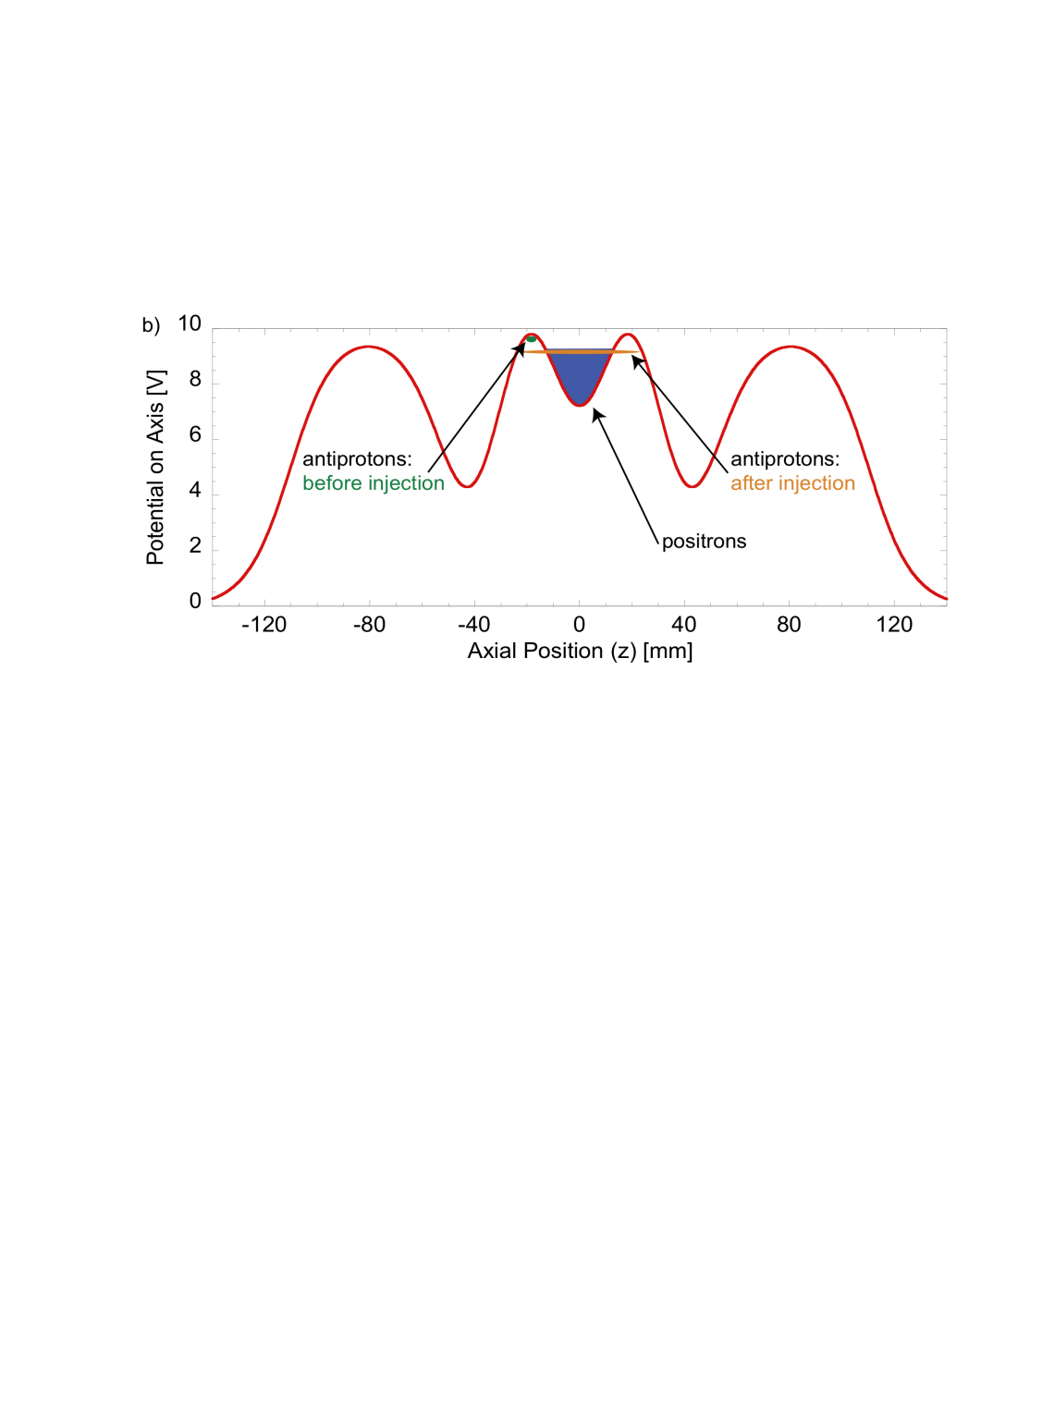
Antihydrogen production in A2
Starting point is ~10^5 antiprotons less than 60K and ~2M positrons at about 15K
Mix these by autoresonantly exciting the antiproton plasma or by direct mixing.
As result, some 10^5 antihydrogen atoms are created.
In average less than 15 remains in the 0.5K neutral trap
This cycle takes about 15-20 mins
  During this process neutral trap is being turned on

Slide 13
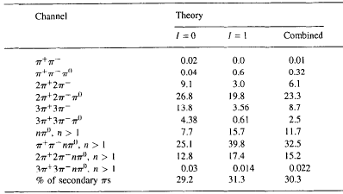
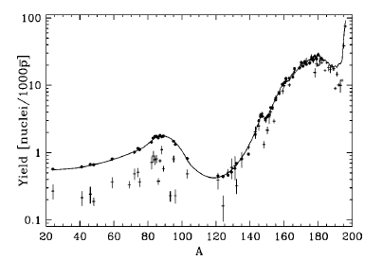
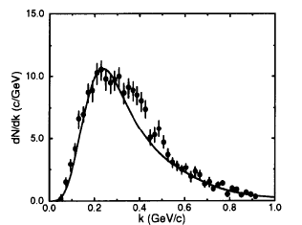
Antiproton annihilation detection principle
Antiprotons (antihydrogen) annihilates either with the residual gas of the trap vacuum or at the trap walls (gold coated).
Charged pions are emitted with high multiplicity, in average 3-4
In practice only the detectable charged high energy pions penetrate into detector region
Physical Review C 66, 044616 (2002)
Physics Letters B 357 (I 995) 446-450

Slide 14
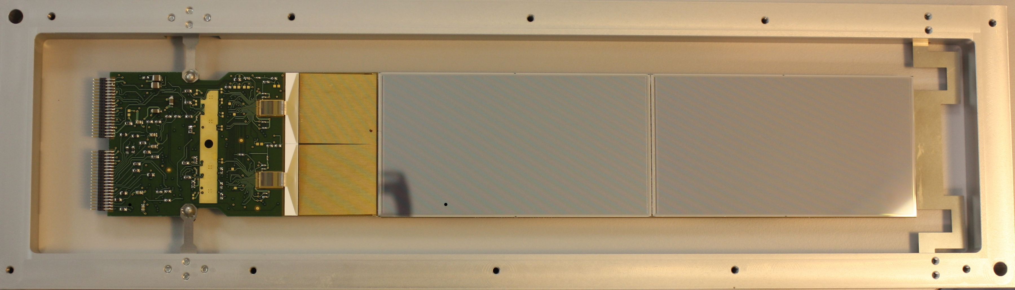
ALPHA -hybrids
- 300 μm p on n double sided strip detector
- 256x128 strips, pitches 229 / 890 μm
- Sensor size 60x115 mm, active 58x112 mm
- 1600 μm PCB, Nelco 4000 material
- Copper wiring thorough the PCB on the n -side.
- N -side externally AC coupled
- Four Va1Ta 128 channel ASICs
- Fast trigger shaper (75ns) / slow analogue shaper (typically 1μs)
- Programmable shaping parameters
- Dynamic range ±10 MIPs

Slide 15
Hybrid performance – test pulse
Estimated S/N:
- P-side 28
- N -side 16

Slide 16
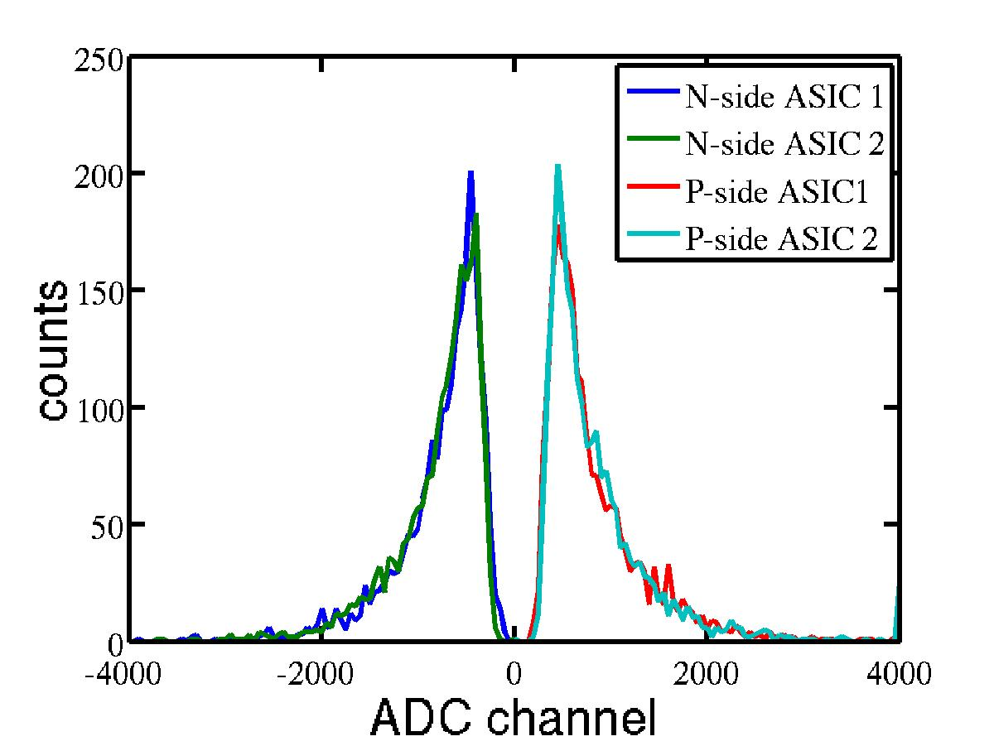
Hybrid performance – MIPs (cosmics)
S/N; median of the Landau distribution / RMS noise
- S/N p-side 33
- S/N n-side 15

Slide 17
ALPHA1 – ALPHA2 upgrade geometry
8 – 10 – 12 Inner 75mm, Outer 127mm
10 – 12 -14 Inner 89mm, Outer 133mm

Slide 18
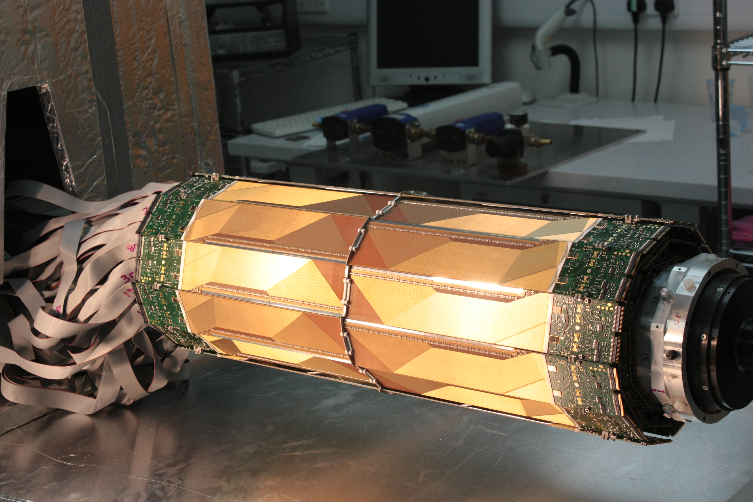
Silicon Vertex Detector (SVD) upgrade for ALPHA-2
72 hybrid modules in three layers,
each having 256x256 DSSD.
37k readout channels
Effectively 4.7 Mpixel 3D camera

Slide 19
DAQ Scheme

Slide 20
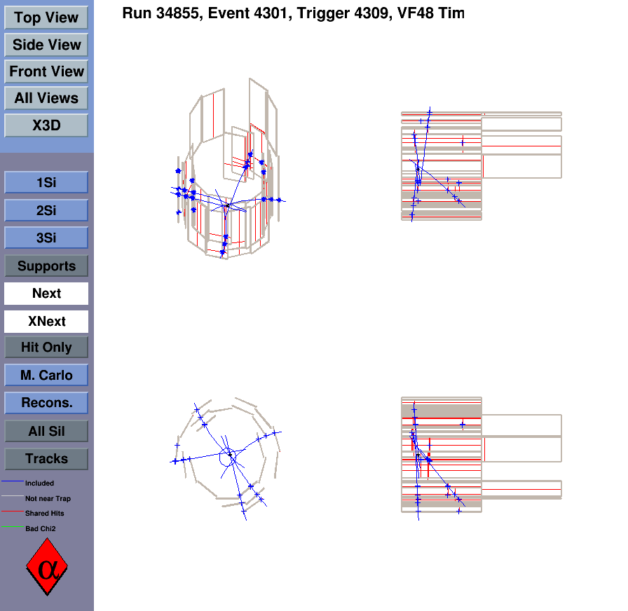
Annihilation event as seen by the SVD
- We achieve spatial resolution of ~6mm
- cosmic background can be rejected down to mHz level

Slide 21
Brief history of antihydrogen
1995 Antihydrogen produced at CERN’s LEAR
1997 Subsequently observed at Fermilab’s antiproton accumulator
2002 ATHENA (later ALPHA) and ATRAP produce first cold (<150 K) antihydrogen – Penning trap
2010 trapped antihydrogen at ALPHA – neutral trap.
2011 Long confinement of the neutral anti-atoms (ALPHA)
2011 Antihydrogen in CUSP trap (ASACUSA)
2012 Confirmation of long confinement (ATRAP)
2012 First spectroscopic measurement on trapped antihydrogen (ALPHA)

Slide 22
ALPHA highlights paving way for precision measurements of the properties of antihydrogen
2010 Trapped Antihydrogen, Nature 468, 673–676 (02 December 2010)
2011 Confinement of Hbar for 1000 seconds, Nature Physics 7, 558–564 (2011)
2012 Resonant quantum transitions in trapped antihydrogen atoms, Nature 483, 439–443 (22 March 2012) & observation of the hyperfine spectrum in antihydrogen, Nature 548, 66–69 (03 August 2017)
2013 Description and first application of new technique to measure the gravitational mass of antihydrogen, Nature Communications, 4, 1785 (2013)
2014 & 2016 An experimental limit on the charge of antihydrogen Nature Communications 5, 3955 (2014), Nature 529, 373–376 (2016)
ALPHA 1 => ALPHA 2 (Laser access)
2017 Observation of the 1S–2S transition in trapped antihydrogen, Nature 541, 506–510 (26 January 2017) – First laser probe on antihydroden.
2018 Characterization of the 1S–2S transition in antihydrogen, Nature (doi: 10.1038/s41586-018-0017-2).

Slide 23
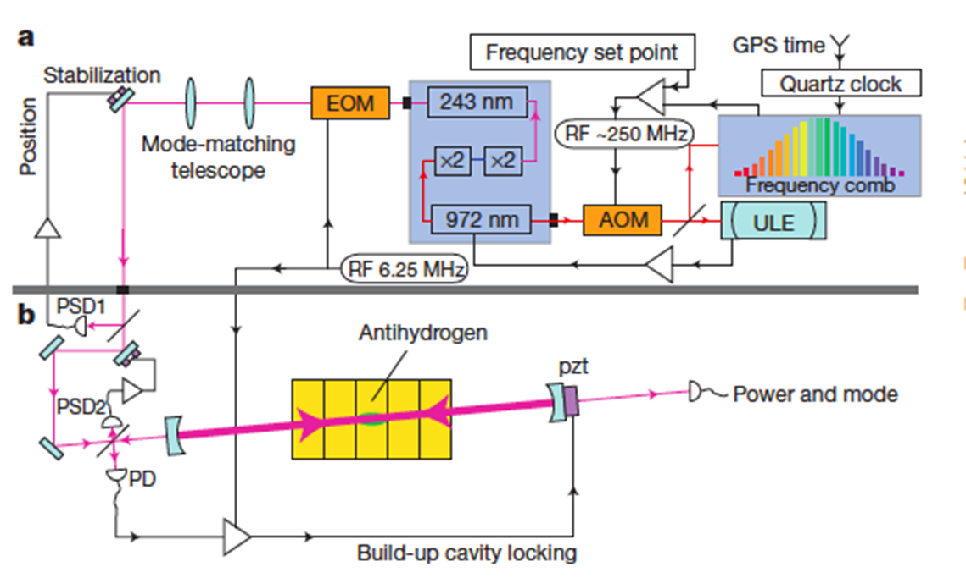
ALPHA-2 1S-2S Laser
243 nm CW UV –laser. Beam directed through the neutral atom trap. Locked in the enhancement cavity. Estimated continuous power 1W. Additional 121nm laser also installed

Slide 24
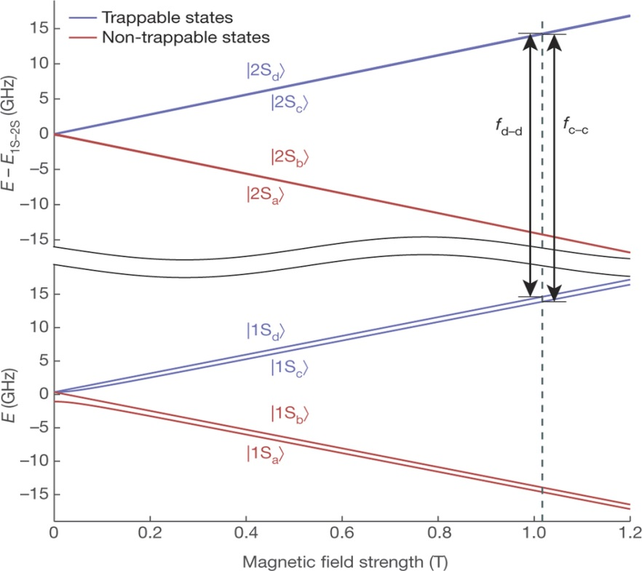
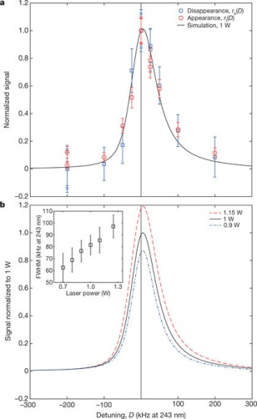
1S-2S Spectroscopy
Antihydrogen exposed to 243 nm ~1W CW laser for 300 s. After this the neutral trap ‘magnetic bottle’ is released in 1.5s fast magnet ramp down. Results indicate antihydrogen 1S-2S atomic transition is the same compared to hydrogen with relative precision of 2x10-12. Physics run 2018 => further lineshape measurement for improved precision

Slide 25
Conclusions
After 10 years of operation ALPHA produced the first element in the anti-periodic table and manages to trap and manipulate cold neutral antihydrogen and examine it in a well established and controlled way
ALPHA 2 facilitates lasers of 243nm, 121nm and μ-wave access
ALPHA uses a unique Silicon Vertex Detector which is capable of recording single atom annihilation events
First optical measurements of 1S-2S Antihydrogen atomic transition => Ongoing: Optical lineshape measurement for enhanced precision and preparing for antimatter gravity measurements

Slide 27
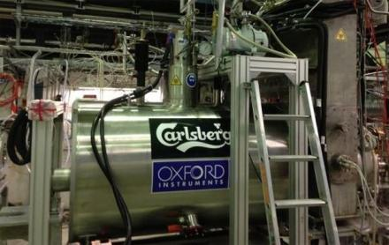
Thank you for your attention!

