Slide 1
Neutron induced reactions
From experimental observables to model parameters in the resonance region
3rd n_TOF Winter School
15 – 19 January 2018
Zermatt, Switzerland
Peter Schillebeeckx
JRC Geel, SN3S
peter.schillebeeckx@ec.europa.eu

Slide 2
From experimental observables to model parameters
Doppler broadening
SLBW
Adjustments in RRR: examples
Hauser-Feshbach + Width fluctuations
Production of average cross section data in URR
Adjustments in URR: examples

Slide 3
Neutron induced reaction cross sections
Cross sections are strongly energy dependent
Cross sections are different for each nuclide
Theoretical cross sections are required for nuclear energy applications
  Ensures full consistency, e.g.
  Consistency between energy regions
  Inter- and extrapolation in regions where no data are available
  Doppler broadening

Slide 4
Doppler broadening
  Reaction rate is maintained
  v : velocity incident neutron in laboratory system
  V : velocity target nucleus
  σ : cross section in CM system (nuclear cross section)
  σ(v) : Doppler broadened cross section (lab system)

Slide 5
Doppler broadening
  Reaction rate is maintained
  v : velocity incident neutron in laboratory system
  V : velocity target nucleus
  P(V) : target velocity distribution
  σ : cross section in CM system (nuclear cross section)
  σ(v,T) : Doppler broadened cross section (lab system)
  T : target temperature

Slide 6
Nuclear cross section (target nucleus at rest)
²³⁸U + n

Slide 7
Doppler broadened cross section
²³⁸U + n
Free gas model
F. Fröhner, JEFF Report 18

Slide 8
Doppler broadened cross section
²³⁸U + n
Free gas model

Slide 9
Doppler broadening: special cases
²³⁸U(n,γ)

Slide 10
Doppler broadening: special cases
²³⁸U(n,γ)

Slide 11
Doppler broadening: special cases
²³⁸U(n,n)

Slide 12
Doppler broadening: special cases
²³⁸U(n,n)
Cross sections in JANIS are mostly
Doppler broadened

Slide 13
Doppler broadening and self-shielding

Slide 14
Doppler broadening and self-shielding

Slide 15
Doppler broadening and self-shielding

Slide 16
Doppler broadening and self-shielding

Slide 17
Resolved Resonance Region : R-matrix theory
R-matrix theory
Lane and Thomas, Rev. Mod. Phys. 30 (1958) 257
Model parameters
R and (E_{R}, J^{π},Γ_{n}, Γ_{γ}, …,)_{j}
E_{R} resonance energy
Γ_{n}, Γ_{γ}, Γ_{f} partial widths
Γ total width
(Γ = Γ_{n} + Γ_{γ} + Γ_{f} …)
R scattering radius

Slide 18
SLBW for s-wave resonance (l = 0 )
(E_{R}, Γ_{n}, Γ_{γ} , J^{π}, R_{=0})
(n ,γ)
(n,n)
(n,tot)

Slide 19
Interference term : s-wave ℓ = 0
+ g 4π R²

Slide 20
Interference term : ℓ = 0
Iron filtered beams
Shielding problems

Slide 21
Interference term : s-wave ℓ = 0
2ϕ_{ℓ}
2ϕ_{ℓ}
ϕ_{ℓ}
α ≈ kR

Slide 22
Interference term : ℓ = 0 ⇔ ℓ = 1
2ϕ_{ℓ}
2ϕ_{ℓ}
ϕ_{ℓ}

Slide 23
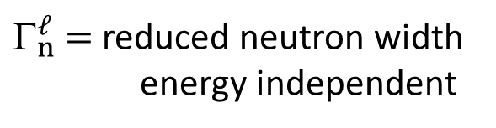
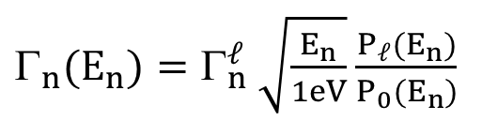
Energy dependence of neutron width
Neutron width Γ_{n} depends on ℓ and E_{n}
due to centrifugal-barrier penetrability
$_{n}^{ℓ}$ = reduced neutron width
energy independent
$_{n}(E_{n})=Γ_{n}^{ℓ} \sqrt{\frac{E_{n}}{1eV}}$ $\frac{P_{ℓ}(E_{n})}{P_{0}(E_{n})}$

Slide 24
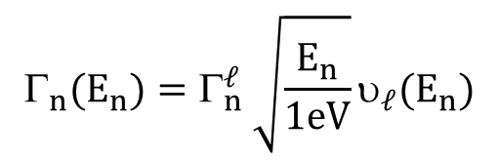
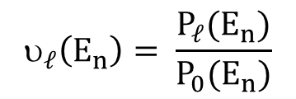

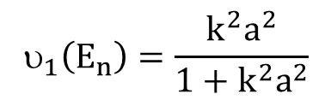
Energy dependence of neutron width
Neutron width Γ_{n} depends on ℓ and E_{n}
due to centrifugal-barrier penetrability
$_{n}^{ℓ}$ = reduced neutron width
energy independent
$_{n}(E_{n})=Γ_{n}^{ℓ} \sqrt{\frac{E_{n}}{1eV}}$ $\frac{P_{ℓ}(E_{n})}{P_{0}(E_{n})}$
$$_{n}(E_{n})=Γ_{n}^{ℓ} \sqrt{\frac{E_{n}}{1eV}}υ_{ℓ}(E_{n})$$
$$_{ℓ}\left(E_{n}\right)= \frac{P_{ℓ}(E_{n})}{P_{0}(E_{n})}$$
$$_{1}\left(E_{n}\right)=\frac{k^{2}a^{2}}{1+k^{2}a^{2}}$$
$$_{0}\left(E_{n}\right)=1$$

Slide 25
Energy dependence of neutron width
Neutron width Γ_{n} depends on ℓ and E_{n}
due to centrifugal-barrier penetrability
s – wave (ℓ = 0)
= reduced neutron width
(not energy dependent)

Slide 26

Energy dependence of neutron width
Neutron width Γ_{n} depends on ℓ and E_{n}
due to centrifugal-barrier penetrability
s – wave (ℓ = 0)
$$k=\frac{p}{ħ}=\frac{\sqrt{2mE}}{ħ}$$
1/v dependence in thermal region

Slide 27

Energy dependence of neutron width
Neutron width Γ_{n} depends on ℓ and E_{n}
due to centrifugal-barrier penetrability
s – wave (ℓ = 0)
p – wave (ℓ = 1)
$$k=\frac{p}{ħ}=\frac{\sqrt{2mE}}{ħ}$$
$$_{n}^{ℓ}$$
= reduced neutron width
(not energy dependent)

Slide 28
Cross section at v = 2200 m/s (thermal)
Cross section at v = 2200 m/s

Slide 29
Cross section at v = 2200 m/s (thermal)
Cross section at v = 2200 m/s
s-wave resonances with E_{R} > 0 (∼ 50%)
s-wave only contributes for 50 %
to the observed value at 25.3 meV

Slide 30
Cross section at v = 2200 m/s (thermal)
Cross section at v = 2200 m/s
s-wave resonances with E_{R} > 0 (∼ 50%)
+ bound state ?

Slide 31
Cross section at v = 2200 m/s (thermal)
Cross section at v = 2200 m/s
s-wave resonances with E_{R} > 0 (∼ 50%)
+ direct capture ?

Slide 32
Cross section at v = 2200 m/s (thermal)
Cross section at v = 2200 m/s
s-wave resonances with E_{R} > 0 (∼ 50%)
+ bound state(s)
+ direct capture ?

Slide 33
Positive s-wave resonances (unbound states)

Slide 34
Mirror bound state or negative resonance

Slide 35
Mirror bound state or negative resonance

Slide 36
Mirror bound state or negative resonance

Slide 37
Neutron induced reaction cross sections
Model parameters
R and (E_{R}, J^{π},Γ_{n}, Γ_{γ}, …,)_{j}
Resonance parameters cannot be predicted by theory
Parameters are adjusted to experimental data
Experimental data are required

Slide 38
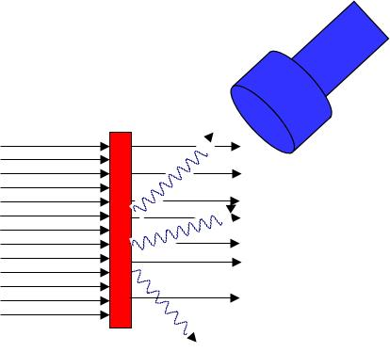
Cross section measurements
Transmission
Reaction
T : transmission
Fraction of the neutron beam traversing the sample without any interaction
Y_{r} : reaction yield
Fraction of the neutron beam creating a (n,r) reaction in the sample

Slide 39
Resonance shape analysis (RSA)
²⁴¹Am + n
Z_{exp} : experimental observable (Y_{exp}, T_{exp})

Slide 40
Resonance shape analysis (RSA)
²⁴¹Am + n
Z_{exp} : experimental observable (Y_{exp}, T_{exp})
Z_{M}(t,η,κ) : model for theoretical estimate of Z_{exp}
Model implemented in REFIT or SAMMY:
  R-matrix theory : parameterisation of σ by RP (η)
  Experimental conditions : parameter vector κ

Slide 41
Ideal experiment
In ideal conditions (Γ > Δ_{R} and Δ_{D} )
⇒ E_{R}, σ_{o}Γ_{γ}/Γ and Γ from one experiment

Slide 42
Theoretical yield: 1.15 eV resonance of ⁵⁶Fe
⁵⁶Fe 1.15 keV resonance

Slide 43
+ Doppler
⁵⁶Fe 1.15 keV resonance

Slide 44
+ Doppler + Response
⁵⁶Fe 1.15 keV resonance
L = 60 m

Slide 45
+ Doppler + Response
⁵⁶Fe 1.15 keV resonance
L = 60 m
L = 30 m

Slide 46
+ Doppler + Response
⁵⁶Fe 1.15 keV resonance
L = 60 m
L = 30 m
L = 12.5 m

Slide 47
Experimental observable when Γ < Δ_{R} or Δ_{D}
dominated by Δ_{R} or Δ_{D}
- Δ_{R} Experimental resolution
- Δ_{D} Doppler broadening
- Γ Total resonance width
⇒ effective experimental observable is resonance area
Δ_{FWHM} = 50 eV

Slide 48
Resonance area
Resonance area: σ(n,r)
(reaction Kernel)

Slide 49
Resonance area
Resonance area: σ(n,r)
Resonance area: σ(n,tot)
(reaction Kernel)

Slide 50
Experimental observables
Reaction
0.3
Yield
0.2
n : number of nuclei per unit area
0.1
3340
3350
3360
3370
Neutron energy / eV
Rae et al., Nucl. Phys. 5 (1958) 89

Slide 51
Experimental observables
Reaction
Transmission
0.3
Yield
0.2
n : number of nuclei per unit area
0.1
Transmission
Rae et al., Nucl. Phys. 5 (1958) 89
3340
3350
3360
3370
Neutron energy / eV

Slide 52
Experimental observables
Transmission

Slide 53
Experimental observables
Transmission
ℓ = 0 assignment
scattering radius

Slide 54
Experimental observables
Transmission
Reaction
ℓ = 0 assignment
scattering radius

Slide 55
Experimental observables
Transmission
Reaction
ℓ = 0 assignment
scattering radius

Slide 56
Experimental observables
Transmission
Reaction
ℓ = 0 assignment
scattering radius

Slide 57
Experimental observables
Transmission
Reaction
ℓ = 0 assignment
scattering radius
Higher sensitivity for weak resonances

Slide 58
Experimental observables
Transmission
Reaction
ℓ = 0 assignment
scattering radius
Higher sensitivity for weak resonances

Slide 59
Experimental observables
Transmission
Reaction
ℓ = 0 assignment
scattering radius
Higher sensitivity for weak resonances

Slide 60
Experimental observables
Transmission
Reaction
ℓ = 0 assignment
scattering radius
Higher sensitivity for weak resonances

Slide 61
Experimental observables
Transmission
Reaction
ℓ = 0 assignment
scattering radius
Higher sensitivity for weak resonances

Slide 62
Experimental observables
Transmission
Reaction
ℓ = 0 assignment
scattering radius
Higher sensitivity for weak resonances

Slide 63
Experimental observables
Transmission
Reaction
ℓ = 0 assignment
scattering radius
Higher sensitivity for weak resonances

Slide 64
Verify conditions before starting RSA: e.g. ²³²Th(n,γ)

Slide 65
4.9 eV resonance in ¹⁹⁷Au + n
E_{R} = 4.9 eV J^{π} = 2⁺ ( g = 5/8) Δ_{D} = 85 meV
Capture L = 30 m Δ_{R} = 8 meV
uncertainties only due to counting statistics
Γ_{n} = 15.31 (12) meV
Γ_{γ} = 118.0 (14 ) meV
ρ(Γ_{n}, Γ_{γ}) = - 0.50

Slide 66
4.9 eV resonance in ¹⁹⁷Au + n
E_{R} = 4.9 eV J^{π} = 2⁺ ( g = 5/8) Δ_{D} = 85 meV
Capture L = 30 m Δ_{R} = 8 meV
Transmission L = 50 m Δ_{R} = 5 meV
uncertainties only due to counting statistics
Γ_{n} = 15.31 (12) meV
Γ_{γ} = 118.0 (14 ) meV
ρ(Γ_{n}, Γ_{γ}) = - 0.50
Γ_{n} = 15.06 (8) meV
Γ_{γ} = 121.7 (13) meV
ρ(Γ_{n}, Γ_{γ}) = - 0.63

Slide 67
¹⁹⁷Au(n,γ) at L = 12 m

Slide 68
¹⁹⁷Au(n,γ) at L = 12 m

Slide 69
¹⁹⁷Au(n,γ) at L = 12 m and 30 m

Slide 70
¹⁹⁷Au(n,γ) at L = 12 m and 30 m

Slide 71
²⁴¹Am : transmission + capture

Slide 72
²⁴¹Am : transmission + capture

Slide 73
²⁴¹Am : transmission + capture
No reference cross section
required

Slide 74
²⁴¹Am : transmission + capture
Radiation width
almost constant
<Γ_{γ}> = 42.1 (3) meV
No reference cross section
required

Slide 75
²⁴¹Am : transmission + capture
N = 1.00 (2)
No reference cross section
required

Slide 76
²⁴¹Am(n,γ) : results of RSA with REFIT
σ(n_{th},γ) = 749 (35) b
g_{γ} = 1.00

Slide 77
²⁴¹Am(n,γ) : results of RSA with REFIT
σ(n_{th},γ) = 749 (35) b
g_{γ} = 1.00
Capture at 0.025 eV
30% from observed resonances
70% bound state

Slide 78
²⁴¹Am(n,γ) : results of RSA with REFIT
σ(n_{th},γ) = 749 (35) b
g_{γ} = 1.00
σ(n_{th},γ) = 749
g_{γ} = 1.04
Lampoudis et al., EPJ Plus 128 (2013) 86

Slide 79
Evaluation of σ_{γ} for ²⁴¹Am(n,γ) at E_{n} = 25.3 meV
Derived from:
□ integrated
reaction rates
● TOF-experiments

Slide 80
Evaluation of σ_{γ} for ²⁴¹Am(n,γ) at E_{n} = 25.3 meV
Derived from:
□ integrated
reaction rates
■ Corrected for
bias effects
● TOF-experiments
Žerovnik et al., NIMA 877 (2018) 300

Slide 81
Evaluation of σ_{γ} for ²⁴¹Am(n,γ) at E_{n} = 25.3 meV
σ_{γ} =720 (14) b
Derived from:
□ integrated
reaction rates
■ Corrected for
bias effects
● TOF-experiments
All experimental data reported in the literature were studied in detail
Not all experimental data were used due to lack of experiment description or uncertainty information:
10 spectrum integrated experiments not used
2 TOF data not used
Žerovnik et al., NIMA 877 (2018) 300

Slide 82
Special characteristics
Scattering radius R
Orbital angular momentum ℓ (or parity)
Spin (statistical factor)
Without use of angular differential cross section data or gamma-spectroscopic measurement data

Slide 83
Determination of scattering radius
+ g 4π R²
²⁰⁶Pb : L = 25 m
● = 0 from shape

Slide 84
Determination of scattering radius
+ g 4π R²
²⁰⁶Pb : L = 25 m
Interference
R = 9.55 (0.02) fm
● = 0 from shape
ℓ = 0 from shape
Borella et al., Phys. Rev. C 76 (2007) 014605

Slide 85
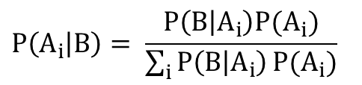
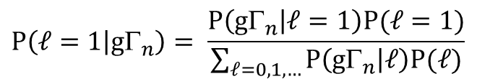
Determination of parity (ℓ = 0 or 1)
Bayesian approach based on
strength functions (results in color)
Bollinger and Thomas, PR 171 (1963) 1293-1297
$$P\left(A_{i} | B\right)= \frac{P\left(B | A_{i}\right)P(A_{i})}{\sum_{i}{P\left(B | A_{i}\right)}P(A_{i})}$$
$$P\left(ℓ=1 | g_{n}\right)= \frac{P\left(g_{n} | ℓ=1\right)P(ℓ=1)}{\sum_{ℓ=0,1,…}{P\left(g_{n} | ℓ\right)P(ℓ})}$$

Slide 86
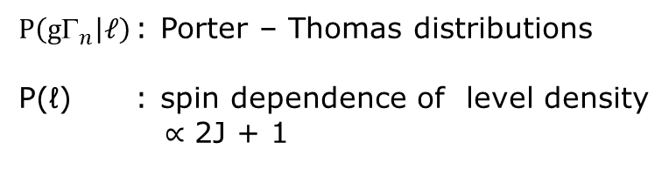
Determination of parity (ℓ = 0 or 1)
Bayesian approach based on
strength functions (results in color)
Bollinger and Thomas, PR 171 (1963) 1293-1297
²³⁸U + n
ℓ = 0
ℓ = 1
$$P\left(A_{i} | B\right)= \frac{P\left(B | A_{i}\right)P(A_{i})}{\sum_{i}{P\left(B | A_{i}\right)}P(A_{i})}$$
$$P\left(ℓ=1 | g_{n}\right)= \frac{P\left(g_{n} | ℓ=1\right)P(ℓ=1)}{\sum_{ℓ=0,1,…}{P\left(g_{n} | ℓ\right)P(ℓ})}$$
$P\left(g_{n} | ℓ\right)$ : Porter – Thomas distributions
P(ℓ) : spin dependence of level density
$∝$ 2J + 1
ℓ = 0
ℓ = 1

Slide 87

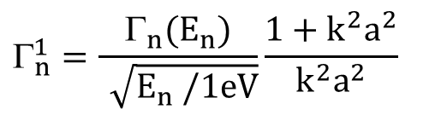
Determination of parity (ℓ = 0 or 1)
Bayesian approach based on
strength functions (results in color)
Bollinger and Thomas, PR 171 (1963) 1293-1297
or
Simple threshold on
²³⁸U + n
ℓ = 0
ℓ = 1
ℓ = 0
ℓ = 1
$$g_{n}^{1}$$
$$_{n}^{1}=\frac{Γ_{n}(E_{n})}{\sqrt{E_{n} /1eV}}\frac{1+k^{2}a^{2}}{k^{2}a^{2}}$$
ℓ = 1 J = 1/2, 3/2
Reduced neutron width for given ℓ
not dependent on spin
Kim et al., EPJA 52 (2016) 70

Slide 88


Determination of parity (ℓ = 0 or 1)
Bayesian approach based on
strength functions (results in color)
Bollinger and Thomas, PR 171 (1963) 1293-1297
or
Simple threshold on
²³⁸U + n
ℓ = 0
ℓ = 1
$$g_{n}^{0}$$
$$_{n}^{0}=\frac{Γ_{n}(E_{n})}{\sqrt{E_{n} /1eV}}$$

Slide 89
Determination of parity (ℓ = 0 or 1)
²³⁸U + n
ℓ = 0
ℓ = 1
ℓ = 0
ℓ = 1

Slide 90
Determination of parity (ℓ = 0 or 1)
Bayesian approach based on
strength functions (results in color)
Bollinger and Thomas, PR 171 (1963) 1293-1297
or
Simple threshold on
¹¹³Cd + n
ℓ
$$g_{n}^{1}$$
$$_{n}^{1}=\frac{Γ_{n}(E_{n})}{\sqrt{E_{n} /1eV}}\frac{1+k^{2}a^{2}}{k^{2}a^{2}}$$
Reduced neutron width for given ℓ
not dependent on spin
Volev et al., NIMB 300 (2013) 11

Slide 91
Determination of statistical spin factor
²⁰⁶Pb (I^{π} = 0⁺) + n
n = 1.6 x10⁻² at/b
n = 3.0 x10⁻² at/b

Slide 92
Determination of statistical spin factor
²⁰⁶Pb (I^{π} = 0⁺) + n
ℓ = 1 from shape
n = 1.6 x10⁻² at/b
J =1/2 or 3/2
g = 1 or 2
n = 3.0 x10⁻² at/b

Slide 93
Determination of statistical spin factor
²⁰⁶Pb (I^{π} = 0⁺) + n
ℓ = 1 from shape
n = 1.6 x10⁻² at/b
J =1/2 or 3/2
g = 1 or 2
J = 1/2
g = 1
n = 3.0 x10⁻² at/b

Slide 94
Determination of statistical spin factor
²⁰⁶Pb (I^{π} = 0⁺) + n
ℓ = 1 from shape
J =1/2 or 3/2
g = 1 or 2
J = 3/2
g = 2
J = 1/2
g = 1

Slide 95
Determination of statistical spin factor
²⁰⁶Pb (I^{π} = 0⁺) + n
ℓ = 1 from shape
J = 1/2
g = 1
J = 3/2
g = 2
J = 1/2
g = 1
Borella et al., Phys. Rev. C 76 (2007) 014605

Slide 96
Spin : capture and transmission data
²³²Th + n
ℓ = 1 from shape
J =1/2 or 3/2
g = 1 or 2
g = 1
Capture Yield
Transmission
199.0
200.0
Neutron Energy / eV

Slide 97
Spin : capture and transmission data
²³²Th + n
ℓ = 1 from shape
J =1/2 or 3/2
g = 1 or 2
g = 2
g = 1
Capture Yield
Capture Yield
Transmission
Transmission
199.0
200.0
199.0
200.0
Neutron Energy / eV
Neutron Energy / eV

Slide 98
Spin factor : capture and transmission data
²³²Th + n
ℓ = 1 from shape
J =1/2 or 3/2
g = 1 or 2
g = 2
g = 1
Capture Yield
Capture Yield
Transmission
Transmission
199.0
200.0
199.0
200.0
Neutron Energy / eV
Neutron Energy / eV

Slide 99
Use of average radiation width
¹¹⁰Cd
Capture Kernel vs gΓ_{n}
ℓ
J
1/2
1/2
3/2
Musgrove et al., J. Phys. G., 4 (1978) 771 - 785

Slide 100
Use of average radiation width
¹¹⁰Cd
Capture Kernel vs gΓ_{n}
Capture Kernel and <Γ_{γ}>
J
1/2
1/2
3/2
Musgrove et al., J. Phys. G., 4 (1978) 771 - 785
Volev et al., NIMB 300 (2013) 11

Slide 101
Remarks
Determination of complete set of resolved resonance parameters,
i.e. (J^{π}, Γ_{n}, Γ_{γ}, Γ_{f}, …) :
  is a complex process
  requires a set of complementary experimental data
  transmission data are (in principle) essential
Sometimes only resonance areas can be derived
⇒ Resonance parameters in evaluated data are not always based on experimental data
  J^{π} : most probable or even guessed
  Γ_{n} derived from gΓ_{n} without clear spin determination
  Γ_{γ} = <Γ_{γ}>

Slide 102
Unresolved resonance region
RRR
Resonance shape analysis
URR
Average σ(n,γ) + parameters

Slide 103
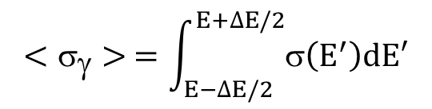
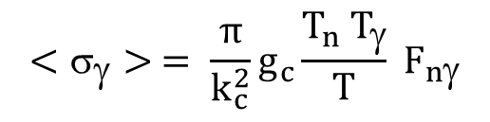
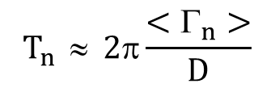
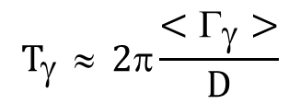
Hauser-Feshbach + width fluctuations
$$<σ_{γ}> =\int_{E−∆E/2}^{E+∆E/2}{σ\left(E^{′}\right)dE′}$$
$$<σ_{γ}> = \frac{π}{k_{c}^{2}}g_{c}\frac{T_{n}{ T}_{γ}}{T} F_{nγ}$$
$$T_{γ } ≈ 2π\frac{<Γ_{γ}>}{D}$$
$$T_{n } ≈ 2π\frac{<Γ_{n}>}{D}$$
T_{n} : neutron transmission coefficient (entrance channel)
T_{γ} : capture transmission coefficient (exit channel)
T : total transmission coefficient (T = T_{n} + T_{γ} + …)
F_{w} : width fluctuation correction factor
D : level distance

Slide 104
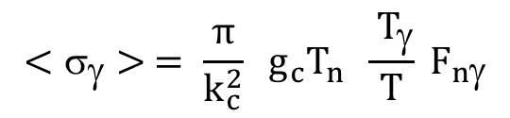
Hauser-Feshbach + width fluctuations
$$<σ_{γ}> =\int_{E−∆E/2}^{E+∆E/2}{σ\left(E^{′}\right)dE′}$$
$$<σ_{γ}> = \frac{π}{k_{c}^{2}}g_{c}\frac{T_{n}{ T}_{γ}}{T} F_{nγ}$$
$$<σ_{γ}> = \frac{π}{k_{c}^{2}} g_{c}T_{n} \frac{{ T}_{γ}}{T} F_{nγ}$$
$$T_{γ } ≈ 2π\frac{<Γ_{γ}>}{D}$$
$$T_{n } ≈ 2π\frac{<Γ_{n}>}{D}$$
T_{n} : neutron transmission coefficient (entrance channel)
T_{γ} : capture transmission coefficient (exit channel)
T : total transmission coefficient (T = T_{n} + T_{γ} + …)
F_{w} : width fluctuation correction factor
D : level distance

Slide 105
Hauser-Feshbach + width fluctuations
$$<σ_{γ}> =\int_{E−∆E/2}^{E+∆E/2}{σ\left(E^{′}\right)dE′}$$
$$<σ_{γ}> = \frac{π}{k_{c}^{2}}g_{c}\frac{T_{n}{ T}_{γ}}{T} F_{nγ}$$
$$T_{γ } ≈ 2π\frac{<Γ_{γ}>}{D}$$
$$T_{n } ≈ 2π\frac{<Γ_{n}>}{D}$$
T_{n} : neutron transmission coefficient (entrance channel)
T_{γ} : capture transmission coefficient (exit channel)
T : total transmission coefficient (T = T_{n} + T_{γ} + …)
F_{w} : width fluctuation correction factor
D : level distance

Slide 106
Hauser-Feshbach + width fluctuations
$$<σ_{γ}> =\int_{E−∆E/2}^{E+∆E/2}{σ\left(E^{′}\right)dE′}$$
$$<σ_{γ}> = \frac{π}{k_{c}^{2}}g_{c}\frac{T_{n}{ T}_{γ}}{T} F_{nγ}$$
$$T_{γ } ≈ 2π\frac{<Γ_{γ}>}{D}$$
$$T_{n } ≈ 2π\frac{<Γ_{n}>}{D}$$
T_{n} : neutron transmission coefficient (entrance channel)
T_{γ} : capture transmission coefficient (exit channel)
T : total transmission coefficient (T = T_{n} + T_{γ} + …)
F_{w} : width fluctuation correction factor
D : level distance

Slide 107
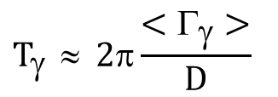
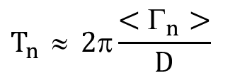
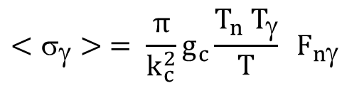
Width fluctuation factor
For a given spin and parity J^{π}, entrance channel c and exit channel c'
$$<σ_{γ}> = \frac{π}{k_{c}^{2}}g_{c}\frac{T_{n}{ T}_{γ}}{T} F_{nγ}$$
F_{nγ} : width fluctuation correction factor
$$T_{γ } ≈ 2π\frac{<Γ_{γ}>}{D}$$
¹⁹⁷Au(n,γ)
$$T_{n } ≈ 2π\frac{<Γ_{n}>}{D}$$

Slide 108
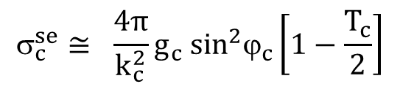
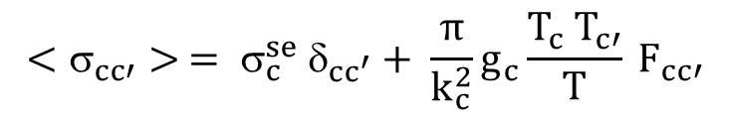
Hauser-Feshbach + width fluctuations
For a given spin and parity J^{π}, entrance channel c and exit channel c'
Shape elastic cross section
ϕ_{c} : hard sphere phase shift
$$<σ_{cc′}> = σ_{c}^{se} δ_{cc^{′}}+ \frac{π}{k_{c}^{2}}g_{c}\frac{T_{c}{ T}_{c′}}{T} F_{cc′}$$
$$_{c}^{se}≅ \frac{4π}{k_{c}^{2}}{g_{c} sin}^{2}ϕ_{c}\left[1−\frac{T_{c}}{2}\right]$$
T_{c} : transmission coefficient
T_{n} : neutron transmission coefficient
T_{γ} : capture transmission coefficient
T_{f} : fission transmission coefficient
T : total transmission coefficient T = T_{n} + T_{γ} + T_{f}
F_{cc'} : width fluctuation correction factor
Sirakov et al., ANE 35 (2008) 1223

Slide 109
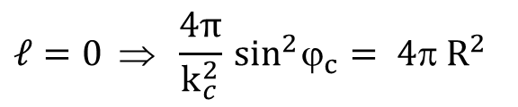
Hauser-Feshbach + width fluctuations
For a given spin and parity J^{π}, entrance channel c and exit channel c'
Shape elastic cross section
ϕ_{c} : hard sphere phase shift
α = k R
R = hard-sphere scattering radius
$$<σ_{cc′}> = σ_{c}^{se} δ_{cc^{′}}+ \frac{π}{k_{c}^{2}}g_{c}\frac{T_{c}{ T}_{c′}}{T} F_{cc′}$$
$$_{c}^{se}≅ \frac{4π}{k_{c}^{2}}{g_{c} sin}^{2}ϕ_{c}\left[1−\frac{T_{c}}{2}\right]$$
T_{c} : transmission coefficient
T_{n} : neutron transmission coefficient
T_{γ} : capture transmission coefficient
T_{f} : fission transmission coefficient
T : total transmission coefficient T = T_{n} + T_{γ} + T_{f}
F_{cc'} : width fluctuation correction factor
$$ℓ=0 ⇒ \frac{4π}{k_{c}^{2}}\sin^{2}ϕ_{c}= 4π R^{2}$$
Sirakov et al., ANE 35 (2008) 1223

Slide 110
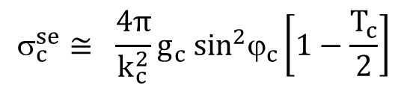
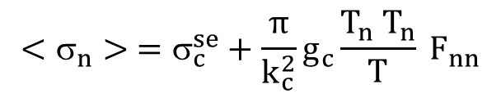
Hauser-Feshbach + width fluctuations
For a given spin and parity J^{π}, entrance channel c and exit channel c'
$$<σ_{cc′}> = σ_{c}^{se} δ_{cc^{′}}+ \frac{π}{k_{c}^{2}}g_{c}\frac{T_{c}{ T}_{c′}}{T} F_{cc′}$$
$$_{c}^{se}≅ \frac{4π}{k_{c}^{2}}{g_{c} sin}^{2}ϕ_{c}\left[1−\frac{T_{c}}{2}\right]$$
T_{c} : transmission coefficient
T_{n} : neutron transmission coefficient
T_{γ} : capture transmission coefficient
T_{f} : fission transmission coefficient
T : total transmission coefficient T = T_{n} + T_{γ} + T_{f}
F_{cc'} : width fluctuation correction factor
$$<σ_{n}> =σ_{c}^{se}+\frac{π}{k_{c}^{2}}g_{c}\frac{T_{n}{ T}_{n}}{T} F_{nn}$$

Slide 111
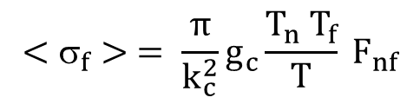
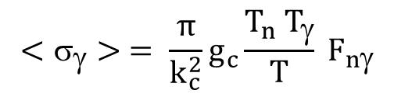
Hauser-Feshbach + width fluctuations
For a given spin and parity J^{π}, entrance channel c and exit channel c'
$$<σ_{cc′}> = σ_{c}^{se} δ_{cc^{′}}+ \frac{π}{k_{c}^{2}}g_{c}\frac{T_{c}{ T}_{c′}}{T} F_{cc′}$$
$$_{c}^{se}≅ \frac{4π}{k_{c}^{2}}{g_{c} sin}^{2}ϕ_{c}\left[1−\frac{T_{c}}{2}\right]$$
T_{c} : transmission coefficient
T_{n} : neutron transmission coefficient
T_{γ} : capture transmission coefficient
T_{f} : fission transmission coefficient
T : total transmission coefficient T = T_{n} + T_{γ} + T_{f}
F_{cc'} : width fluctuation correction factor
$$<σ_{n}> =σ_{c}^{se}+\frac{π}{k_{c}^{2}}g_{c}\frac{T_{n}{ T}_{n}}{T} F_{nn}$$
$$<σ_{γ}> = \frac{π}{k_{c}^{2}}g_{c}\frac{T_{n}{ T}_{γ}}{T} F_{nγ}$$
$$<σ_{f}> = \frac{π}{k_{c}^{2}}g_{c}\frac{T_{n}{ T}_{f}}{T} F_{nf}$$

Slide 112

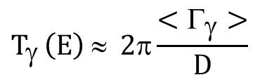
Capture transmission coefficient
For a given spin and parity J^{π}, entrance channel c and exit channel c'
$$<σ_{γ}> = \frac{π}{k_{c}^{2}}g_{c}\frac{T_{n}{ T}_{γ}}{T} F_{nγ}$$
<Γ_{γ}> : ≈ only parity dependent
in URR almost energy indepenent
D : inverse of level density
energy dependent
spin dependent
$$T_{γ }\left(E\right) ≈ 2π\frac{<Γ_{γ}>}{D}$$
$$= \frac{1}{D}$$

Slide 113
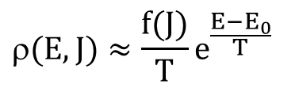
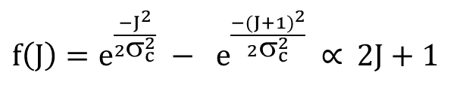

Capture transmission coefficient
For a given spin and parity J^{π}, entrance channel c and exit channel c'
$$<σ_{γ}> = \frac{π}{k_{c}^{2}}g_{c}\frac{T_{n}{ T}_{γ}}{T} F_{nγ}$$
<Γ_{γ}> : ≈ only parity dependent
in URR almost energy indepenent
D : inverse of level density
energy dependent
spin dependent
$$T_{γ }\left(E\right) ≈ 2π\frac{<Γ_{γ}>}{D}$$
$$= \frac{1}{D}$$
$T_{γ}^{J^{π}}\left(E\right)=T_{γ,0}^{J^{π}}$ $W_{γ}^{J^{π}}\left(E\right)$
$$(E,J)≈\frac{f(J)}{T}e^{\frac{E−E_{0}}{T}}$$
$f\left(J\right)=e^{\frac{−J^{2}}{2σ_{c}^{2}}} − e^{\frac{−{(J+1)}^{2}}{2σ_{c}^{2}}}$ $∝$ 2J + 1

Slide 114
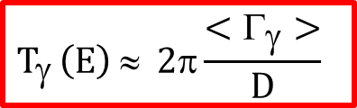
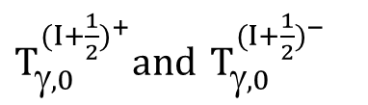
Capture transmission coefficient
For a given spin and parity J^{π}, entrance channel c and exit channel c'
$$<σ_{γ}> = \frac{π}{k_{c}^{2}}g_{c}\frac{T_{n}{ T}_{γ}}{T} F_{nγ}$$
<Γ_{γ}> : ≈ only parity dependent
in URR almost energy indepenent
D : inverse of level density
energy dependent
spin dependent
$$T_{γ }\left(E\right) ≈ 2π\frac{<Γ_{γ}>}{D}$$
$$= \frac{1}{D}$$
$T_{γ}^{J^{π}}\left(E\right)=T_{γ,0}^{J^{π}}$ $W_{γ}^{J^{π}}\left(E\right)$
$$(E,J)≈\frac{f(J)}{T}e^{\frac{E−E_{0}}{T}}$$
$f\left(J\right)=e^{\frac{−J^{2}}{2σ_{c}^{2}}} − e^{\frac{−{(J+1)}^{2}}{2σ_{c}^{2}}}$ $∝$ 2J + 1
Independent parameters to be determined
$T_{γ,0}^{{(I+\frac{1}{2})}^{+}}and$ $T_{γ,0}^{{(I+\frac{1}{2})}^{−}}$
Sirakov et al., ANE 35 (2008) 1223

Slide 115
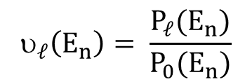
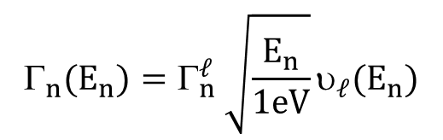

Neutron transmission coefficient
For a given spin and parity J^{π}, entrance channel c and exit channel c'
$$<σ_{γ}> = \frac{π}{k_{c}^{2}}g_{c}\frac{T_{n}{ T}_{γ}}{T} F_{nγ}$$
$$_{n}(E_{n})=Γ_{n}^{ℓ} \sqrt{\frac{E_{n}}{1eV}}υ_{ℓ}(E_{n})$$
$$T_{n}\left(E_{n}\right)≅ 2π\frac{<Γ_{n}>}{D}$$
$$_{ℓ}\left(E_{n}\right)= \frac{P_{ℓ}(E_{n})}{P_{0}(E_{n})}$$
α = ka

Slide 116
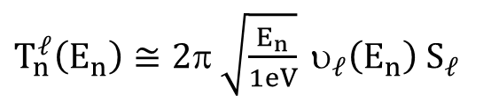
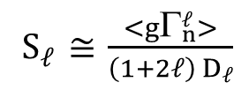
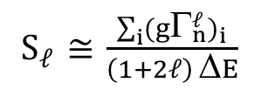
Neutron transmission coefficient
For a given spin and parity J^{π}, entrance channel c and exit channel c'
$$<σ_{γ}> = \frac{π}{k_{c}^{2}}g_{c}\frac{T_{n}{ T}_{γ}}{T} F_{nγ}$$
$$_{n}(E_{n})=Γ_{n}^{ℓ} \sqrt{\frac{E_{n}}{1eV}}υ_{ℓ}(E_{n})$$
$$T_{n}\left(E_{n}\right)≅ 2π\frac{<Γ_{n}>}{D}$$
$$_{ℓ}\left(E_{n}\right)= \frac{P_{ℓ}(E_{n})}{P_{0}(E_{n})}$$
$T_{n}^{ℓ}\left(E_{n}\right)≅2π \sqrt{\frac{E_{n}}{1eV}} υ_{ℓ}\left(E_{n}\right){ S}_{ℓ}$
${ S}_{ℓ}$ $≅$ $\frac{<gΓ_{n}^{ℓ}>}{\left(1+2ℓ\right) D_{ℓ}}$
${ S}_{ℓ}$ $≅$ $\frac{\sum_{i}{(g}Γ_{n}^{ℓ})_{i}}{\left(1+2ℓ\right) ΔE}$
α = ka

Slide 117

Neutron transmission coefficient
For a given spin and parity J^{π}, entrance channel c and exit channel c'
$$<σ_{γ}> = \frac{π}{k_{c}^{2}}g_{c}\frac{T_{n}{ T}_{γ}}{T} F_{nγ}$$
$$_{n}(E_{n})=Γ_{n}^{ℓ} \sqrt{\frac{E_{n}}{1eV}}υ_{ℓ}(E_{n})$$
$$T_{n}\left(E_{n}\right)≅ 2π\frac{<Γ_{n}>}{D}$$
$$_{ℓ}\left(E_{n}\right)= \frac{P_{ℓ}(E_{n})}{P_{0}(E_{n})}$$
$T_{n}^{ℓ}\left(E_{n}\right)≅2π \sqrt{\frac{E_{n}}{1eV}} υ_{ℓ}\left(E_{n}\right){ S}_{ℓ}$
${ S}_{ℓ}$ $≅$ $\frac{<gΓ_{n}^{ℓ}>}{\left(1+2ℓ\right) D_{ℓ}}$
$T_{n}^{ℓ}\left(E_{n}\right)=f({ S}_{ℓ}$)
${ S}_{ℓ}$ $≅$ $\frac{\sum_{i}{(g}Γ_{n}^{ℓ})_{i}}{\left(1+2ℓ\right) ΔE}$
α = ka

Slide 118

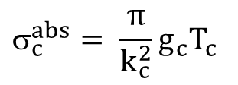

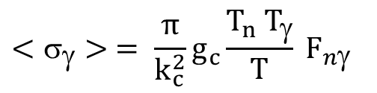

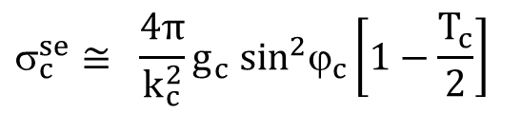
Hauser-Feshbach + width fluctuations
For a given spin and parity J^{π}, entrance channel c and exit channel c'
$$<_{tot}> =f {(R,S}_{ℓ=0,1,2})$$
$$<_{}> =g {(T_{,0}^{+},T_{,0}^{−},S}_{ℓ=0,1,2})$$
$${<_{tot,c}> = _{c}^{se}+ }_{c}^{abs}$$
$$<σ_{γ}> = \frac{π}{k_{c}^{2}}g_{c}\frac{T_{n}{ T}_{γ}}{T} F_{nγ}$$
$$_{c}^{se}≅ \frac{4π}{k_{c}^{2}}{g_{c} sin}^{2}ϕ_{c}\left[1−\frac{T_{c}}{2}\right]$$
$$_{c}^{abs}= \frac{π}{k_{c}^{2}}g_{c}T_{c}$$
Sirakov et al., ANE 35 (2008) 1223

Slide 119
Unresolved resonance region
Resonance Region D > Γ
  Resolved Resonance Region Δ_{R} < D
  Unresolved Resonance Region Δ_{R} > D
RRR
Resonance shape analysis
URR
Average parameters

Slide 120
From average T_{exp} to average σ_{tot}: e.g. ¹⁹⁷Au+n
Unresolved Resonance Region
• <T_{exp}>

Slide 121
From average T_{exp} to average σ_{tot}

Slide 122
From average T_{exp} to average σ_{tot}
o
<σ_{tot}> / b

Slide 123
From average T_{exp} to average σ_{tot}
F_{T} : by Monte Carlo simulations using probability tables simulating resonance structure
Average parameters are needed
Iterative procedure
(1 iteration is mostly sufficient)

Slide 124
From average T_{exp} to average σ_{tot}
•
o
<σ_{tot}> / b

Slide 125
Example: ¹⁹⁷Au + n
<σ_{tot}> / b

Slide 126
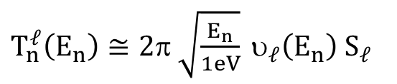

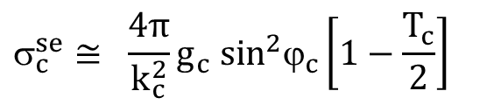
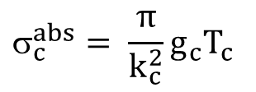
Parameterisation by average parameters: ¹⁹⁷Au + n
<σ_{tot}> = f(R, S_{ℓ=0,1,2})
$${<_{tot,c}> = _{c}^{se}+ }_{c}^{abs}$$
f(R,S_{ℓ=0,1,2})
$$_{c}^{se}≅ \frac{4π}{k_{c}^{2}}{g_{c} sin}^{2}ϕ_{c}\left[1−\frac{T_{c}}{2}\right]$$
<σ_{tot}> / b
$$_{c}^{abs}= \frac{π}{k_{c}^{2}}g_{c}T_{c}$$
$T_{n}^{ℓ}\left(E_{n}\right)≅2π \sqrt{\frac{E_{n}}{1eV}} υ_{ℓ}\left(E_{n}\right){ S}_{ℓ}$
α = kR

Slide 127
Parameterisation by average parameters: ¹⁹⁷Au + n
ℓ = 0
f(R,S_{ℓ=0,1,2})
<σ_{tot}> / b
100 x <σ_{tot,ℓ}> / <σ_{tot}>
ℓ = 1
ℓ = 2

Slide 128
Parameterisation by average parameters: ¹⁹⁷Au + n
f(R,S_{ℓ=0,1,2})
<σ_{tot}> / b

Slide 129
Parameterisation by average parameters: ¹⁹⁷Au + n
<σ_{tot}> = f(R, S_{ℓ=0,1,2})
f(R,S_{ℓ=0,1,2})
<σ_{tot}> / b
from OM
Sirakov et al., EPJ A 49 (2013) 144

Slide 130
Capture in URR
RRR
Resonance shape analysis
URR
Average parameters

Slide 131
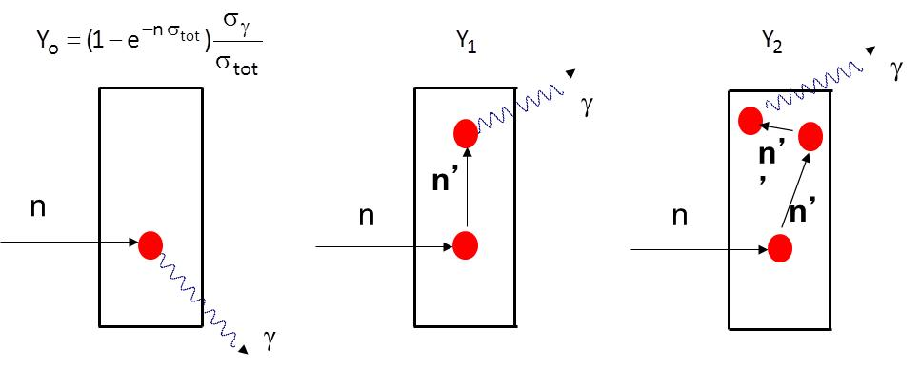
From average Y_{exp} to average σ_{γ} : e.g. ¹⁹⁷Au(n,γ)
(<σ_{γ}> E^{1/2}) / b keV^{1/2}

Slide 132
From average Y_{exp} to average σ_{γ} : e.g. ¹⁹⁷Au(n,γ)
(<σ_{γ}> E^{1/2}) / b keV^{1/2}
only for thin samples

Slide 133
From average Y_{exp} to average σ_{γ} : e.g. ¹⁹⁷Au(n,γ)

Slide 134
From average Y_{exp} to average σ_{γ} : e.g. ¹⁹⁷Au(n,γ)
(<σ_{γ}> E^{1/2}) / b keV^{1/2}
(σ_{γ} E^{1/2})/ (b keV^{1/2})

Slide 135
From average Y_{exp} to average σ_{γ} : e.g. ¹⁹⁷Au(n,γ)
(<σ_{γ}> E^{1/2}) / b keV^{1/2}
(σ_{γ} E^{1/2})/ (b keV^{1/2})

Slide 136
From average Y_{exp} to average σ_{γ} : e.g. ¹⁹⁷Au(n,γ)
        B_{w}(t) = c₀ + k₁C_{w,0}(t) + k₂ R_{n}(C_{w,Pb} – C_{w,0})(t)
(<σ_{γ}> E^{1/2}) / b keV^{1/2}
(σ_{γ} E^{1/2})/ (b keV^{1/2})
Massimi et al., EPJ A 50 (2014) 124

Slide 137
From average Y_{exp} to average σ_{γ} : e.g. ¹⁹⁷Au(n,γ)
LSQ analysis of
experimental data in EXFOR
(<σ_{γ}> E^{1/2}) / b keV^{1/2}
(σ_{γ} E^{1/2})/ (b keV^{1/2})

Slide 138
¹⁹⁷Au(n,γ) in URR
(<σ_{γ}> E^{1/2}) / b keV^{1/2}

Slide 139
¹⁹⁷Au(n,γ) in URR
(<σ_{γ}> E^{1/2}) / b keV^{1/2}
Between 5 and 100 keV : difference of about 8 %
in the region of interest for stellar calculations

Slide 140
¹⁹⁷Au(n,γ) in URR
(<σ_{γ}> E^{1/2}) / b keV^{1/2}

Slide 141
¹⁹⁷Au(n,γ) in URR
(<σ_{γ}> E^{1/2}) / b keV^{1/2}

Slide 142
Evaluation for ¹⁹⁷Au + n in URR
<σ_{tot}> / b
(<σ_{γ}> E^{1/2}) / b keV^{1/2}
(σ_{γ} E^{1/2})/ (b keV^{1/2})

Slide 143
Hauser-Feshbach + width fluctuations
For a given spin and parity J^{π}, entrance channel c and exit channel c'
$$<_{tot}> =f {(R,S}_{ℓ=0,1,2})$$
$$<_{}> =g {(T_{,0}^{+},T_{,0}^{−},S}_{ℓ=0,1,2})$$
$${<_{tot,c}> = _{c}^{se}+ }_{c}^{abs}$$
$$<σ_{γ}> = \frac{π}{k_{c}^{2}}g_{c}\frac{T_{n}{ T}_{γ}}{T} F_{nγ}$$
$$_{c}^{se}≅ \frac{4π}{k_{c}^{2}}{g_{c} sin}^{2}ϕ_{c}\left[1−\frac{T_{c}}{2}\right]$$
$$_{c}^{abs}= \frac{π}{k_{c}^{2}}g_{c}T_{c}$$
Sirakov et al., ANE 35 (2008) 1223

Slide 144
Contribution: ℓ = 0, 1, 2
ℓ = 0
ℓ = 0
100 x <σ_{tot,ℓ}> / <σ_{tot}>
ℓ = 1
100 x <σ_{γ,ℓ}> / <σ_{γ}>
ℓ = 1
ℓ = 2
ℓ = 2

Slide 145
Sensitivity to average parameters

Slide 146
Evaluation for ¹⁹⁷Au + n in URR
<σ_{tot}> / b
Sirakov et al., EPJA 49 (2013) 144

Slide 147
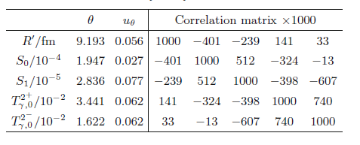
Evaluation for ¹⁹⁷Au + n in URR
<σ_{tot}> / b
(<σ_{γ}> E^{1/2}) / b keV^{1/2}
(σ_{γ} E^{1/2})/ (b keV^{1/2})
Average parameters are essential
for self-shielding calculations
ENDF file in URR:
Average resonance parameters : required
Average point wise cross section : optional
Massimi et al., EPJA 50 (2014) 124

Slide 148
(Z_{exp},V_{Zexp}) ⇒ (θ,V_{θ}) ⇒ (σ,V_{σ}) e.g. ¹⁹⁷Au + n
D_{u}
D_{u}

Slide 149
(Z_{exp},V_{Zexp}) ⇒ (θ,V_{θ}) ⇒ (σ,V_{σ}) e.g. ¹⁹⁷Au + n
u_{KT} / K_{T} = 2.0 %
u_{kT}/k_{T} = 2.0 %
  u_{kγ} / k_{γ} = 1.5 %
D_{u}
(D_{u},k_{T},k_{γ})
D_{u}
(D_{u},k_{T},k_{γ})

Slide 150
Experimental data for n + ²³⁸U: σ(n,tot)
Experimental data from :
Harvey et al.
<σ_{tot}> / b

Slide 151
Experimental data for n + ²³⁸U: σ(n,tot)
Experimental data from :
Harvey et al.
Tsubone et al.
<σ_{tot}> / b

Slide 152
Experimental data for n + ²³⁸U: σ(n,tot)
Experimental data from :
Harvey et al.
Tsubone et al.
Poenitz et al.
<σ_{tot}> / b

Slide 153
Experimental data for n + ²³⁸U: σ(n,tot)
Experimental data from :
Harvey et al.
Tsubone et al.
Poenitz et al.
Whalen et al.
<σ_{tot}> / b

Slide 154
Experimental data for n + ²³⁸U: σ(n,tot)
Experimental data from :
Harvey et al.
Tsubone et al.
Poenitz et al.
Whalen et al.
Gregoriev et al.
<σ_{tot}> / b

Slide 155
Experimental data for n + ²³⁸U: σ(n,tot)
Experimental data from :
Harvey et al.
Tsubone et al.
Poenitz et al.
Whalen et al.
Gregoriev et al.
Konovov et al.
<σ_{tot}> / b

Slide 156
GLSQ analysis for n + ²³⁸U: σ(n,tot)
Experimental data from :
Harvey et al.
Tsubone et al.
Poenitz et al.
Whalen et al.
Gregoriev et al.
Konovov et al.
⇒ GMA analysis (GLS)
<σ_{tot}> / b

Slide 157
Experimental data for ²³⁸U+n: σ(n,γ)
Experimental data from :
Standard 2007

Slide 158
Experimental data for ²³⁸U+n: σ(n,γ)
Experimental data from :
Standard 2007
Kim et al. (GELINA)

Slide 159
Experimental data for ²³⁸U+n: σ(n,γ)
Experimental data from :
Standard 2007
Kim et al. (GELINA)
Ullmann et al. (LANSCE)

Slide 160
Experimental data for ²³⁸U+n: σ(n,γ)
Experimental data from :
Standard 2007
Kim et al. (GELINA)
Ullmann et al. (LANSCE)
Mingrone et al. (n_TOF)

Slide 161
Experimental data for ²³⁸U+n: σ(n,γ)
Experimental data from :
Standard 2007
Kim et al. (GELINA)
Ullmann et al. (LANSCE)
Mingrone et al. (n_TOF)
Wright al. (n_TOF)

Slide 162
GLSQ analysis for n + ²³⁸U: σ(n,γ)
Experimental data from :
Standard 2007
Kim et al. (GELINA)
Ullmann et al. (LANSCE)
Mingrone et al. (n_TOF)
Wright al. (n_TOF)
⇒ GMA analysis (GLS)
(<σ_{γ}> E^{1/2}) / (b keV^{1/2})

Slide 163
GLSQ analysis for n + ²³⁸U: σ(n,tot) and σ(n,γ)
(<σ_{γ}> E^{1/2}) / (b keV^{1/2})
<σ_{tot}> / b
Sirakov et al., EPJA 53 (2017) 199

Slide 164
Contribution: ℓ = 0, 1, 2
ℓ = 0
ℓ = 1
ℓ = 1
100 x <σ_{tot,ℓ} > / <σ_{tot}>
100 x <σ_{γ,ℓ} > / <σ_{γ}>
ℓ = 2
ℓ = 0
ℓ = 2

Slide 165
Sensitivity to average parameters
(δ<σ_{tot}>/<σ_{tot}>) / (δθ/θ)
(δ<σ_{γ}>/<σ_{γ}>) / (δθ/θ)

Slide 166
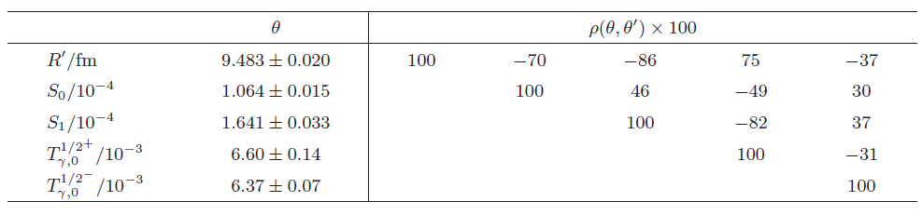
Evaluation for n + ²³⁸U in URR : 20 keV - 150 keV
+ file 32
+ file 32
(<σ_{γ}> E^{1/2}) / (b keV^{1/2})
<σ_{tot}> / b
Hauser-Feshbach + Width Fluctuations: adjustment to GMA data
S_{=0,1,2} derived from DCCOM (Quesada et al., NDS 118 (2014) 270)
σ(n,n'γ) including CN – direct interference effects (Capote et al., NDS 118 (2014) 26)
Energy dependence of T_{γ}^{J=1/2+} and T_{γ}^{J=1/2-} : due to energy dependence of level density
R', T_{γ}^{J=1/2+} and T_{γ}^{J=1/2-} at zero energy adjusted to experimental data
R' = 9.483 fm and <Γ_{γ}> = 22.5 meV for D₀ = 22.2 eV ⇒ consistent with RRR
Sirakov et al., EPJA 53 (2017) 199

Slide 167
Parameterisation by nuclear reaction theory
Exp. Data
RRR
R-Matrix
Exp. Data
Thermal
Res. Par.
E_{Rj} , Γ_{n,j} , Γ_{γ,j} , J_{j} , R
Level Statistics + R
D₀ , S_{o} , < Γ_{γ}>

Slide 168
Parameterisation by nuclear reaction theory
Exp. Data
RRR
R-Matrix
Exp. Data
Thermal
Res. Par.
E_{Rj} , Γ_{n,j} , Γ_{γ,j} , J_{j} , R
Level Statistics + R
D₀ , S_{o} , < Γ_{γ}>
URR
HF + WF

Slide 169
Parameterisation by nuclear reaction theory
Exp. Data
RRR
R-Matrix
Exp. Data
Thermal
Res. Par.
E_{Rj} , Γ_{n,j} , Γ_{γ,j} , J_{j} , R
Level Statistics + R
D₀ , S_{o} , < Γ_{γ}>
Exp. Data
URR
HF + WF
Average Par.
D_{o,1} , S_{o,1} , < Γ_{γ}>, R

Slide 170
Parameterisation by nuclear reaction theory
Exp. Data
RRR
R-Matrix
Exp. Data
Thermal
Res. Par.
E_{Rj} , Γ_{n,j} , Γ_{γ,j} , J_{j} , R
Level Statistics + R
D₀ , S_{o} , < Γ_{γ}>
Exp. Data
Exp. Data
URR
HF + WF
Average Par.
D_{o,1} , S_{o,1} , < Γ_{γ}>, R
High Energy
Optical Models

Slide 171
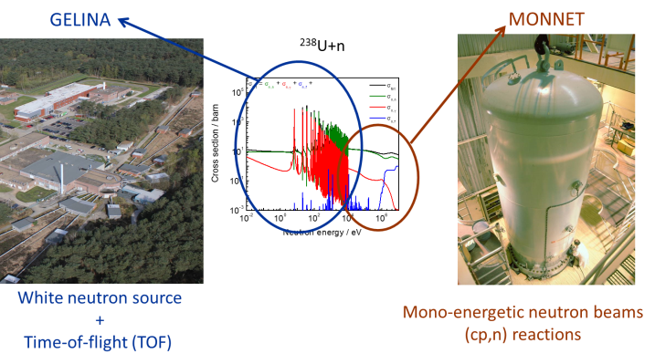
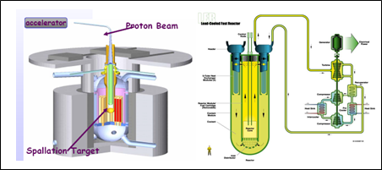
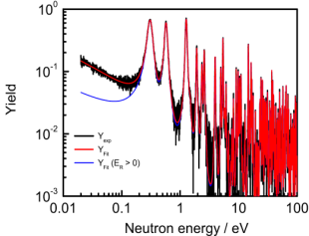
Nuclear data libraries for nuclear applications
NEA/OECD High Priority Request List
IAEA Coordinated Research Projects
New needs
& Feedback
Microscopic data
Industry
Validation & Testing
Evaluated Data Library
Evaluation
Regulatory bodies
Theory
Research & Development
Benchmark data
EXFOR library of experimental data
ENDF, JEFF, JENDL
and NDS/IAEA (standards, CIELO)

Slide 172
Evaluation for n + ²³⁸U in URR : 20 keV - 150 keV
Extensive validation by IAEA, KAERI and NEA
Example
Big-ten : k_{eff} = 1.0045 ± 0.0007 (experimental)
CIELO
Big-ten : k_{eff} = 1.00446 ± 0.00007
JEFF-3.3T1
Big-ten : k_{eff} = 1.00500 ± 0.00007
(<σ_{γ}> E^{1/2}) / (b keV^{1/2})

Slide 173
Evaluation for n + ²³⁸U in URR : 20 keV - 150 keV
Extensive validation by IAEA, KAERI and NEA
Example
Big-ten : k_{eff} = 1.0045 ± 0.0007 (experimental)
CIELO
Big-ten : k_{eff} = 1.00446 ± 0.00007
JEFF-3.3T1
Big-ten : k_{eff} = 1.00500 ± 0.00007
JEFF-3.3T1 + URR of ²³⁸U from CIELO
Big-ten : k_{eff} = 0.9999
Compensating effects in JEFF-3.3T to match specific benchmarks
(<σ_{γ}> E^{1/2}) / (b keV^{1/2})

Slide 174
Cross sections for neutron interactions

Slide 175


Evaluated data libraries

Slide 176
Thank you for your attention
Acknowledgement
M. Moxon, S. Kopecky, I. Sirakov
Literature
"R-Matrix Theory of Nuclear Reactions", A.M. Lane and R.G. Thomas
Review of Modern Physics 30 (1958) 257 - 352
"The Theory of Neutron Resonance Reactions", J.E. Lynn
ISBN-13: 978-0198512462
"Experimental Neutron Resonance Spectroscopy", J. Harvey
ISBN-13: 978-0123298508
"Evaluation and Analysis of Nuclear Resonance Data", F.H. Fröhner
https://www.oecd-nea.org/dbdata/nds_jefreports/jefreport-18/jeff18.pdf
"Determination of resonance parameters and their covariances from neutron induced reaction cross section data",
Nuclear Data Sheets 113 (2013) 3054 - 3100

Slide 177
Additional papers
Becker et al., EPJ Plus 129 (2014) 58
Borella et al., NIMA 577 (2007) 626
Kim et al., EPJA 52 (2016) 170
Lampoudis et al., EPJ Plus 128 (2013) 86
Massimi et al., EPJA 50 (2014) 124
Mondelaers and Schillebeeckx, Notizario Neutroni Luce Sincrotrone 11 (2006) 19
Schillebeeckx et al., Nucl. Data Sheets 113 (2013) 3054
Sirakov et al., EPJA 49 (2013) 144
Sirakov et al., EPJA 53 (2017) 199
Žerovnik et al., NIMA 877 (2018) 300

