Slide 1

Laurent Tassan-Got
CERN - Switzerland
Level densities and statistical decay

Slide 2
Aims of this session
Nuclear physics
Understand the physics of an excited nucleus
Understand the spectrum of emitted particles
Applications
Understand why a hot Pb nucleus emits mainly neutrons
Understand why in a (n,α) reaction on a mixture of Kr+CO2 the reactions on Kr are almost negligible
Content
Physics of the decay (detailed balance)
Inverse cross sections
Level densities
Simple example

Slide 3

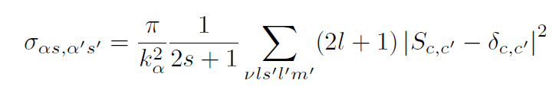

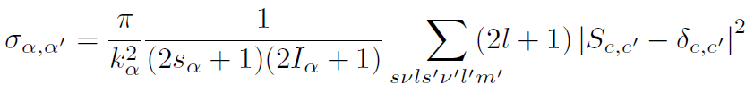
Collision formalism
Consider a collision a+A A’+a’
Note α the initial internal states, s the entrance spin, and α’ and s’ the same for the outgoing pair.
The total cross section for the process is:
Summing over the spin coupling (no polarisation):
The invariance in time reversal implies S_{c’,c}=S_{-c,-c’} where –c means the state c with spins, angular momentum and k reversed, so that :

Slide 4
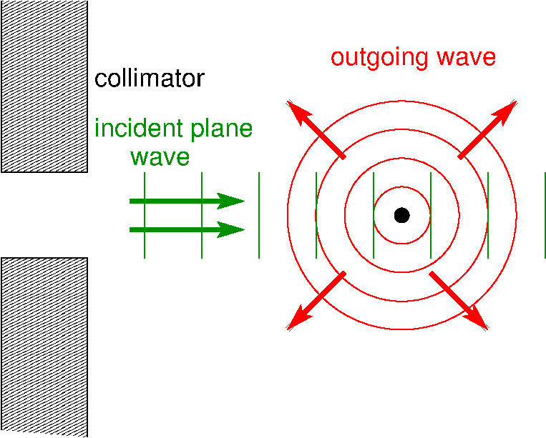
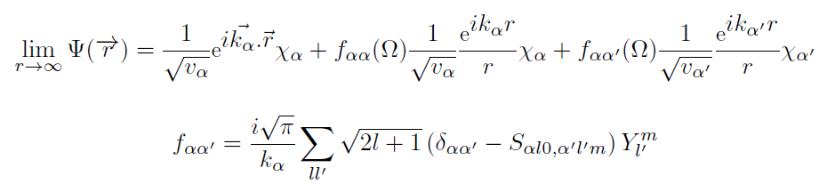
Collision formalism
This is the definition of the S matrix, which is the ratio of amplitudes of outgoing and ingoing waves.
By expanding the plane waves in in- out-going waves we see that if S_{c,c’}=δ_{c,c’} there is no reaction (plane wave alone).

Slide 5
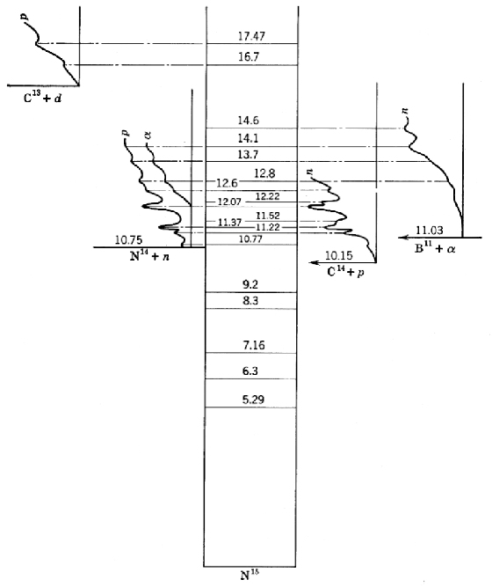
The compound nucleus
Example of compound ¹⁵N* nucleus
Produced by ¹³C+d or ¹⁴N+n or ¹⁴C+p or ¹¹B+α.
The probability of outgoing channels
is independent of the channel formation. It depends only on constants of motion

Slide 6



The compound nucleus
If the reaction occurs through a compound nucleus, the intermediate state forgets the formation history and only keeps track of the constants of motion (excitation energy, spin, parity).
It’s fate becomes independent of the way it has been formed.
Consequence:
σ_{C,α} is the inverse capture cross section
Injecting this expression into the the time reversal formula:
And summing over all possible outgoing channels:
The emission problem is reduced to a collision problem where the ingredient is the capture cross section which can be measured or calculated
But…
But the capture cross section (also called inverse cross section) refers generally to an excited state, and it is not measurable. However it can be calculated.

Slide 7
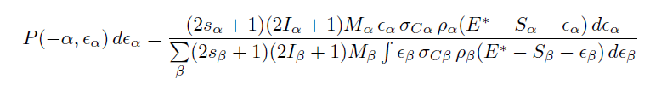
The compound nucleus
Usually the density of states in the compound nucleus is high and the sum over the states can be replaced by an integral over energy of the level density:
M_{α}, M_{β} are the reduced masses in the channels, and S_{α}, S_{β} are the separation energies and E* is the excitation energy of the compound nucleus.
The level densities refer to the residual nucleus (not the compound nucleus): density of the final states, consequence of time reversal as well.
The emission probability involves 2 main ingredients:
the inverse capture cross section
the level density

Slide 8






The compound nucleus
Lifetime of the compound nucleus
The cross section for capturing particle a into a state of the compound nucleus is:
with
Assuming an energy interval covering many resonances and ignoring the interference effects in the cross section (many overlapping resonances):
Inserting it in emission probability formula gives the expected
Summing over all channels:
And using the level density in the residual nucleus:

Slide 9




Inverse capture cross section
For very low kinetic energy and light nuclei the capture cross section is resonant-like. This corresponds to discrete level densities. Above 100 keV the cross section is regular and can be calculated by an optical model.
An optical model is the resolution of Schrödinger equation for a potential involving an imaginary part which is responsible for the absorption.
Prove that for a Schrödinger equation:
We have:
with
This shows that the particle density is not conserved:
W<0 : absorptive
W>0 : source of particles

Slide 10
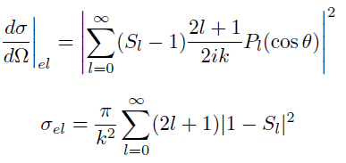
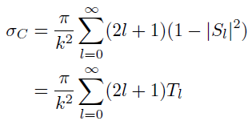
Optical model
An optical model calculates 2 quantities:
the angular distribution of the elastic scattering
the absorption cross section
This is obtained by solving the Schrödinger equation with a given potential including an imaginary part.
If the potential has no spin-orbit component, l is conserved and:
Elastic
Absorption
T_{l} are the transmission coefficients

Slide 11
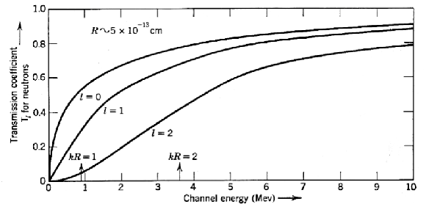
Optical model
Transmission coefficient T_{l}

Slide 12
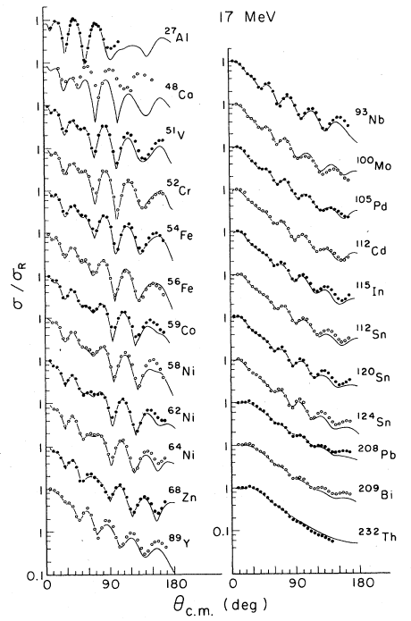
Optical model
Example of 17 MeV protons on different targets
The oscillations are very sensitive to the details of the potential (depth, diffuseness, damping with imaginary part).

Slide 13
Classical approximation
In the classical approximation the wavelength of the incident nucleus is short compared to the size of the target nucleus.
Example: calculate the wavelength of neutron at 10, 100, 300, 1000 MeV, and compare it to the size of ²⁷Al and ²⁰⁸Pb
²⁷Al R=4.2 fm ²⁰⁸Pb R=8.3 fm
n 10 MeV λ=9 fm
n 100 MeV λ=2.8 fm
n 300 MeV λ=1.5 fm
n 1000 MeV λ=0.7 fm
The approximation is valid above 100 MeV, but take care of the transparency.
Second hypothesis: the nucleus is black (fully absorptive within its radius R).

Slide 14
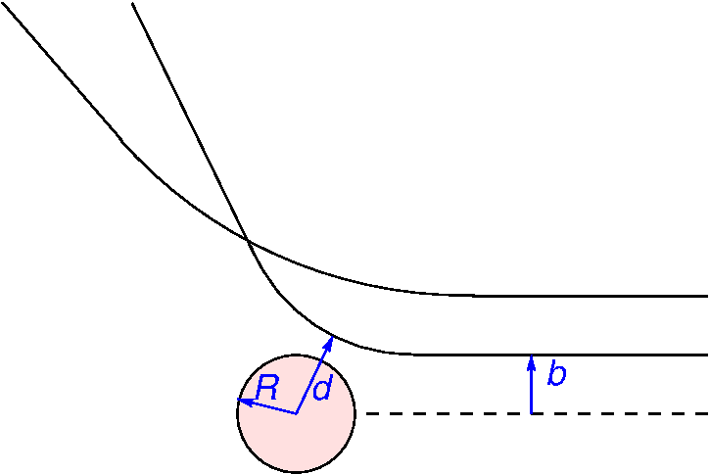



Classical approximation
Neutron σ_{C}=πR²
Charged particle
The Coulomb deviation has to be taken into account.
The cross section corresponds to the impact parameter b for a trajectory grazing the surface of the nucleus (d=R).
The relation between b and d is:
where V is the potential at minimum distance. The maximum impact parameter b_{max} is defined by:
where B is the Coulomb barrier. This leads to the cross section:

Slide 15
Level densities
How level density are measured ?
The level density can be accessed in 3 ways:
Counting of known levels. This is the most straightforward method but it is limited to low energy (a few MeV).
Counting of resonances for low energy neutron scattering and capture. This gives the level density in the region of the separation energy (5 to 8 MeV). This is the most informative method. Only resonances of a given spin (I,l,1/2) are seen and for the total density one relies on a modeled spin distribution.
Energy spectra of emitted particles. The method allows to go to much higher energies but the information is indirect (ratio of level densities, superimposition of different emissions).
Therefore a theoretical formulation of the level density is needed to guide the dependence over a broad excitation energy range.
Bohr & Mottelson, Benjamin Inc
Iljinov et al., Nucl. Phys. A543 (1992) 517
A. Junghans et al., Nucl. Phys.A629 (1998) 635

Slide 16
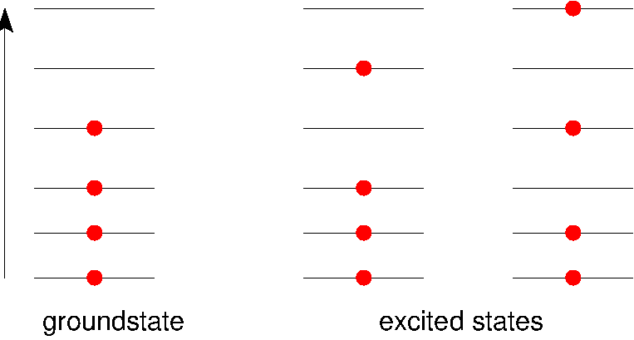



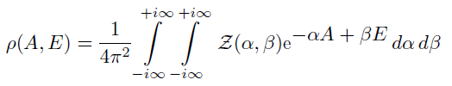
Level densities
Independent particle case (Fermi gas model)
Consider a gas of A fermions. In the groundstate they all occupy the lower individual states. The total energy is E (sum of the individual energies).
?
ε
with n_{i}=0 or n_{i}=1 only
The grand partition function is the Laplace transform of the level density (A,E):
It can be inverted as:

Slide 17




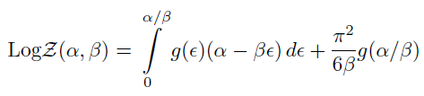

Level densities
Independent particle case
The trick of the grand partition is that it removes the constraint on A.
g(ε) is the density of individual states. A simple exact manipulation gives:
In the 2nd integral, expanding the Log in series, and neglecting the derivatives of g(ε):
Remark: is purely imaginary

Slide 18
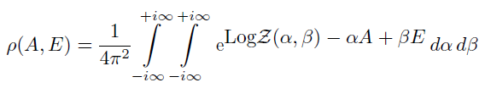

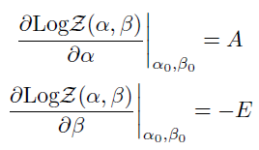

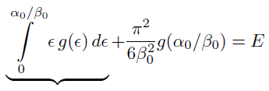

Level densities
Laplace inversion
The exponential is highly oscillatory and in the integral the negative and positive parts cancel. The only significant contribution comes from regions where the derivative of the argument vanishes, so that the phase is almost constant above a large interval (stationary phase approximation)
This central point (α₀,β₀) can be found by imposing:
E₀

Slide 19


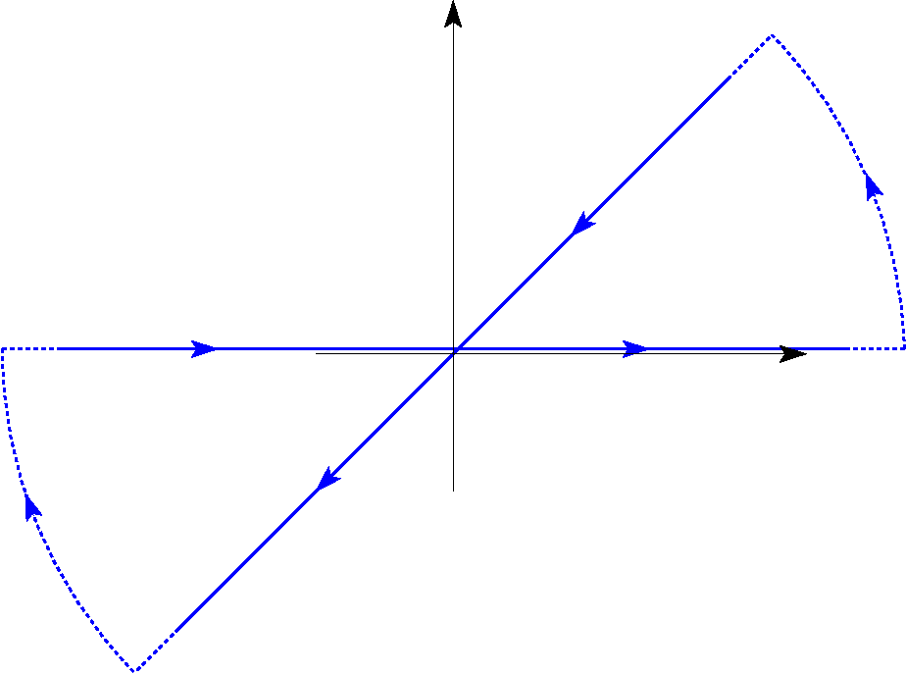
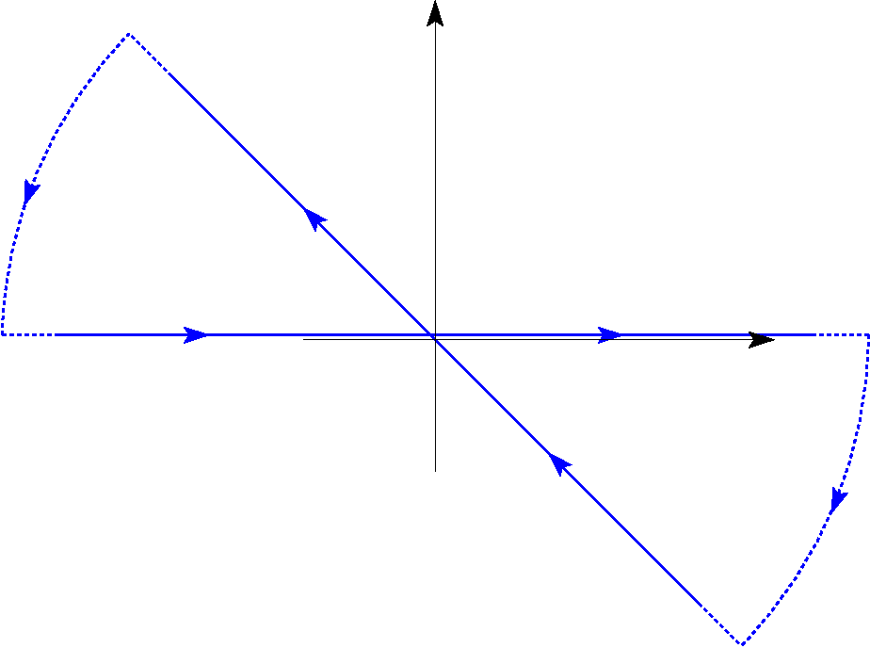

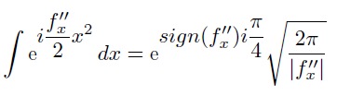
Level densities
Stationary point approximation (1D)
Consider the integral
g is a real smooth function and f is real with 1st derivatives null in x=0. After Taylor expansion and keeping only the contribution around 0:
f_{x}’’>0
As there is no pole (no residue) the integration over the contours is 0. The integration over the arcs is 0 at infinity.
I is equal to the integration over the diagonal. By variable substitution :
f_{x}’’<0
we get

Slide 20



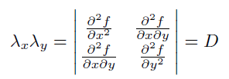


Level densities
Stationary point approximation (2D)
Taylor expansion:
Rotation in (x,y) to go along the eigenvectors:
with
Now we can use the 1D formula for x and y separately
with

Slide 21
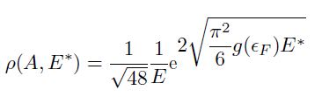
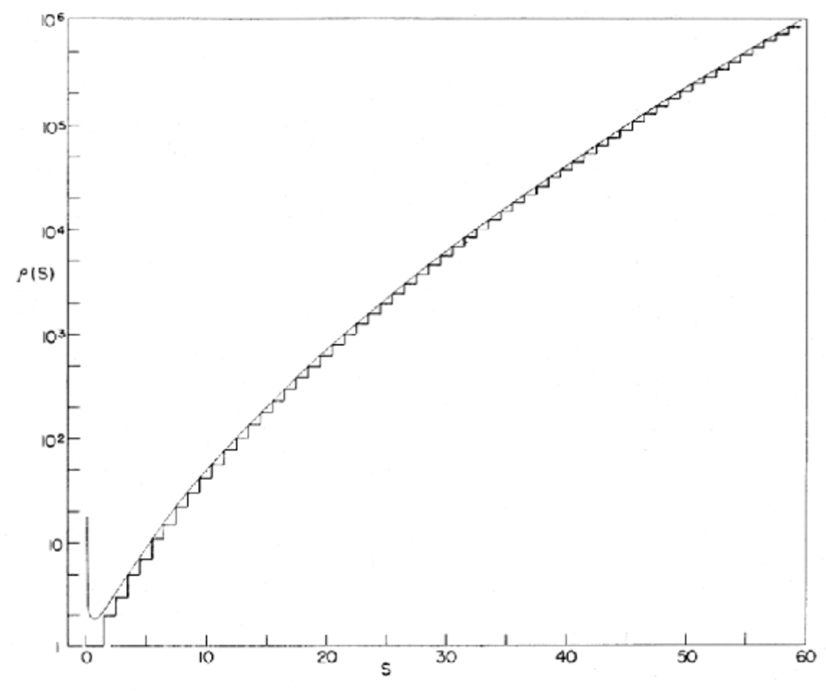
Level densities
Result:
Comparison with an exact equidistant model
Good agreement except at low energy
Divergence is an outcome of the stationary phase approximation

Slide 22
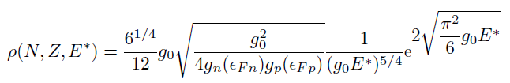


Level densities
Taking into account Z and N:
Taking into account the spin I:
The spin is not directly additive like the number of nucleons or the energy. Only its projection M is additive. So first ρ_{M}(M) is determined as before and ρ_{I}(J) is deduced from
result:
with
E_{th}* is interpreted as the pure thermal excitation after the subtraction of the energy deposited in the rotation (energy above the Yrast line)

Slide 23
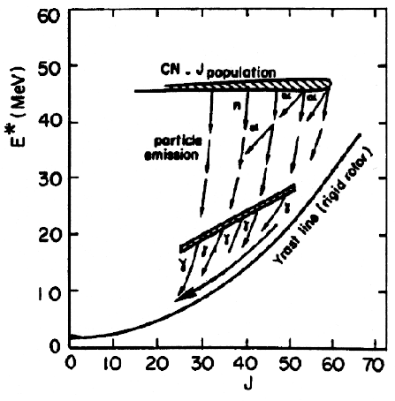
Level densities
Spin-excitation energy mapping
E_{th}*
E_{th}*

Slide 24







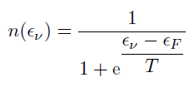
Level densities
Thermodynamical features
The energy dependence is of the form with
a is called the level density parameter. The dependence is dominated by the exponential term. By definition the temperature is defined by:
At reasonable energy the first term of the denominator dominates:
The temperature is a very useful quantity allowing to describe the level density in an energy domain. According to its definition:
It also governs the population of individual states (nucleonic states)

Slide 25







Level densities
How the level density parameter can be known ?
Measurement: low energy levels+spacing of neutron resonances
Back on the envelope calculation (classical limit):
Consider a spherical square potential well representing the nucleus, in which nucleons move independently. The kinetic energy of a nucleon is ε and its momentum is p. For high quantum numbers (close to the Fermi energy) the number of translation states in phase space is:
Each translational state can recieve 2 protons and 2 neutrons:

Slide 26




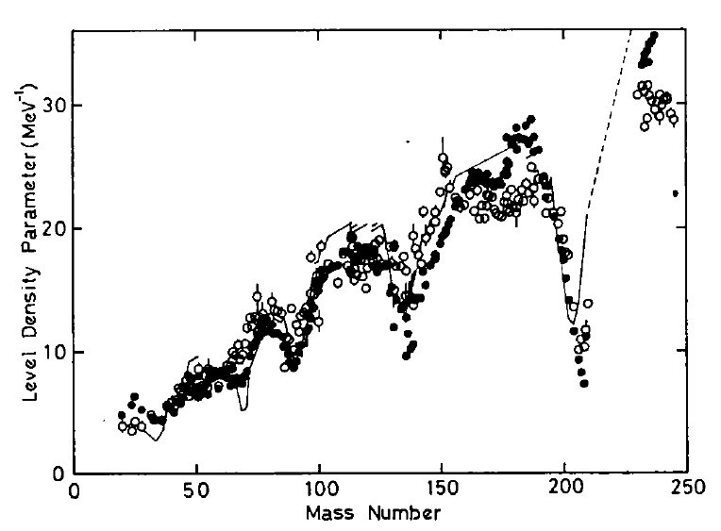
Level densities
How the level density parameter can be known ?
Classical limit (follow up):
Determination of ε_{F}:
a=A/7.5
Systematics from Baba Nucl Phys A159, 625
a deduced from resonance spacing.
a=A/13.5
Classical lower by a factor 2 compared to experimental data missing levels

Slide 27
Level densities
What else about the level density ?
Several important features of nuclear structure have been disregarded up to now:
pairing
collective states (rotational, vibrational)
shell effect
evolution of structure with excitation energy

Slide 28
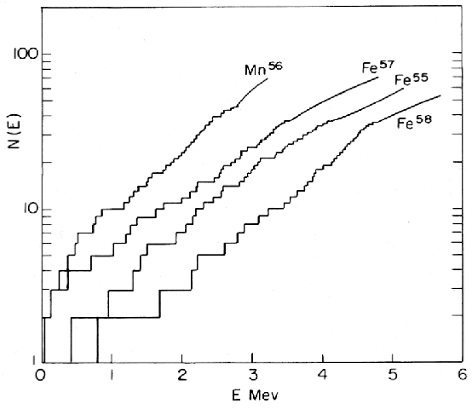


Level densities
Pairing
Z_{Mn}=25 Z_{Fe}=26
odd-odd
The density of even-even nuclei is smaller than for odd nuclei, which is smaller than odd-odd nuclei.
Odd A
even-even
A shift in energy shows up corresponding to the energy needed to break a pair.
E* E*-Δ

Slide 29
Level densities
Low excitation energy
Singularity of the Fermi gas formula at low energy: deficiency of the stationary phase approximation. A remedy has to be brought about.
The exponential shape of the level density suggests a constant temperature at low excitation. The Fermi gas formula should be switched off and replaced by a constant temperature behavior.
For a given E*/A, the lighter the nucleus, the higher the temperature.
At even lower excitations one can use the list of known levels.

Slide 30
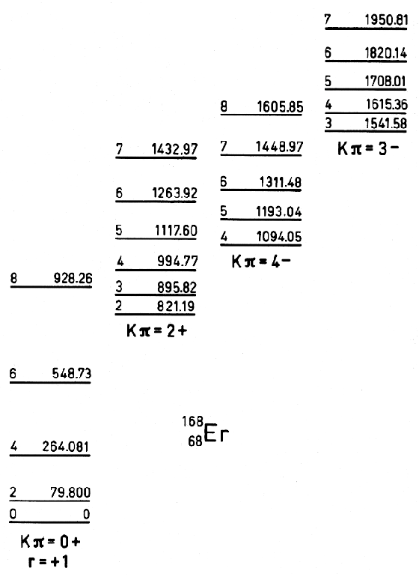
Level densities
Collective states (rotational, vibrational)
Rotational states of ¹⁶⁸Er, each rotational band is built on a state corresponding to an intrinsic excitation. The rotational states increase dramatically the density of states at low energy.
Rotational states also increase, to a lesser extent, the low energy density, especially for even-even nuclei.
Are the collective states new states not counted in the Fermi gas model ?

Slide 31

Level densities
Collective states (rotational, vibrational)
2 possibilities for including collective states:
Include explicit collective states built on the intrinsic excitations:
where K_{rot} and K_{vib} are enhancement factors depending on energy and deformation.
The rotational enhancement can be very strong for deformed nuclei (≈100)
Increase the level density parameter a to match the observed density at the neutron separation energy: a ≈ A/7.5.
This does not guarantee the correctness of the energy dependence but anyway the explicit description also suffers in this respect. On the other hand the handling is much easier.

Slide 32



Level densities
Shell correction
The neutron resonance measurements show a strong reduction of the level density parameter at shell closure.
Consistent with the large energy gap above the shell closure.
Although the Fermi gas formula is questionable in this case (low excitation energy) it is generally used, with a level density parameter a smaller.
δ_{SC} can be determined in 2 different ways:
as an independent correction for proton and neutrons (Gilbert & Cameron):
as a Strutinsky-type correction:
What is the problem now when increasing the excitation energy ?

Slide 33


Level densities
Energy dependence of the correction terms
At high excitation energy the collective states and shell effects should vanish so that the level density should follow the Fermi gas formula.
This is implemented through a damping of those corrections, calculated by Ignatyuk with microscopic calculations :
γ is the damping factor (≈0.05 MeV⁻¹)

Slide 34
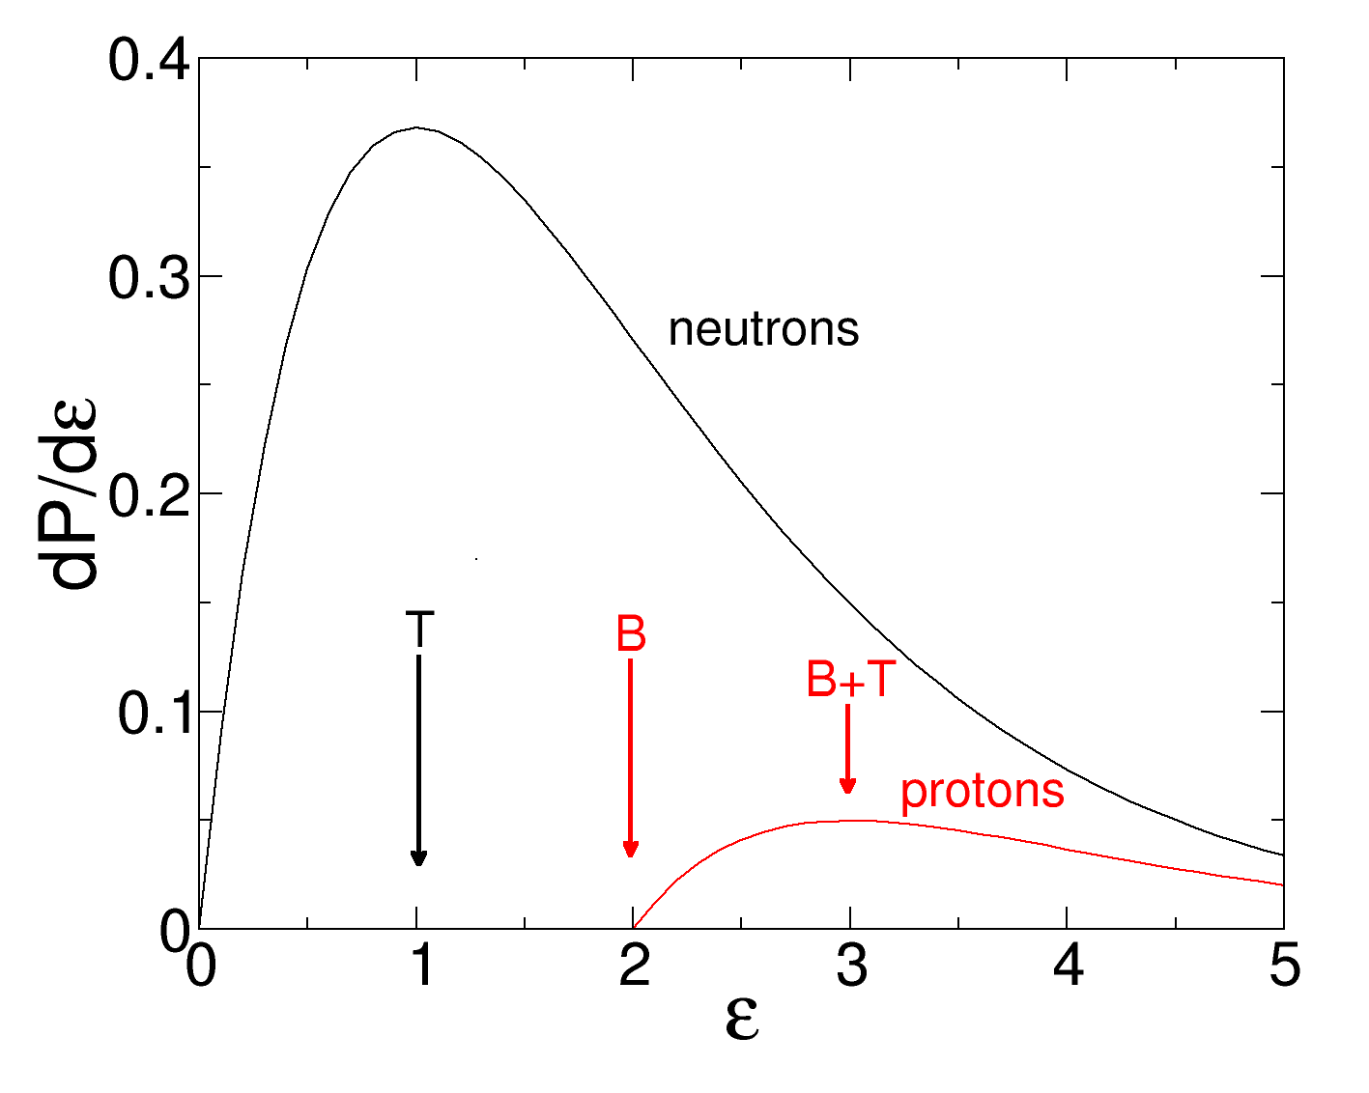


Statistical decay
Practical simple examples
We consider a heavy nucleus (²⁰⁸Pb) which is excited an may undergo proton or neutron emission.
Expanding the level density around E* neutron and proton:

Slide 35


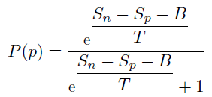




Statistical decay
Practical simple examples
After integration over energy:
and
Simplifying the level density formula we use:
with
MeV⁻¹
Let’s consider a ²⁰⁸Pb with at different excitation energies: 10, 50, 100, 400 MeV, calculate the temperature.
T=0.6, 1.4, 2., 3.9 MeV
The Coulomb barrier for protons is B=12 MeV, S_{n}=7.4 MeV, S_{p}=8.0 MeV, we get for P(p)
7 10⁻¹⁰ at 10 MeV and 0.04 at 400 MeV.
For the very neutron deficient ¹⁹³Pb, having S_{n}=10.4 MeV, S_{p}=3.7 MeV we still have 1.5 10⁻⁴ at 10 MeV and 0.2 at 400 MeV

Slide 36
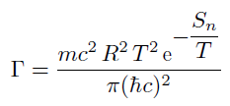
Statistical decay
Life time of the compound nucleus
By neglecting the spin factors, taking the classical geometrical cross section for neutrons, and expanding the level density around E*:
with R=10 fm
E* (MeV) | T (MeV) | τ (s)
10 | 0.6 | 5 10⁻¹⁶
50 | 1.4 | 8.6 10⁻²⁰
100 | 2 | 8.6 10⁻²¹
400 | 3.9 | 3.6 10⁻²²

Slide 37
Conclusion
The statististical decay relies on the compound nucleus
Its range of application is much broader than the case of binary capture (a+A). In spallation a compound nucleus is formed after the cascade state and the preequilibrium emission.
Above a few MeV the reaction may occur through preequilibrium emission (compound nucleus not yet formed) before the statistical decay. This is accounted in different ways
The decay of the compound nucleus is a cascade of emissions. The system is supposed to be equilibrated (amnesy hypothesis) between emissions.
Fission is one of the decay channels (level density at saddle point). But this is a special case due to the slow motion along the fission path. A time competition sets up and the statistical description has to be modified (recrossing effects, time effects).

