Slide 1
Nuclear Data &
Fission Nuclear Energy
N-Tof Winter school
Zermatt, January 2018
Xavier Doligez
Institut de physique nucléaire d’Orsay
doligez@ipno.in2p3.fr
From nuclear physic to energy prospective

Slide 2
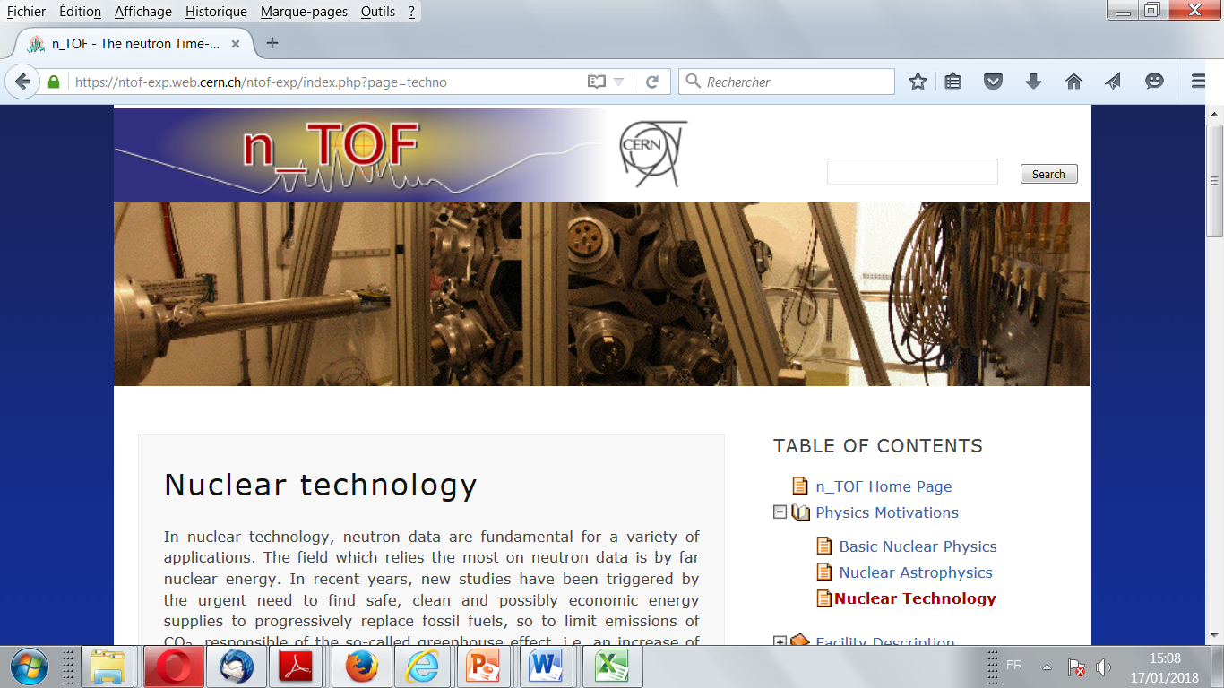
Introduction : preliminary remarks
Let’s be a little bit provocative !
« ADS : a solution to the waste problem »
« The advantage of the Th/U fuel cycle is the availability of Th (3 times more than U) »

Slide 3
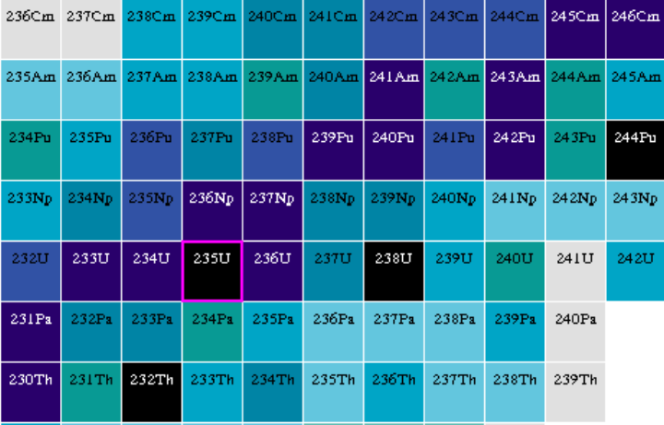
Introduction : preliminary remarks
Only two actinides present on earth : uranium and thorium
  → Only one fissile material : ²³⁵U → UOx : ²³⁸U + ²³⁵U
  Only two options for nuclear fuel → MOx : ²³⁸U + Pu
N-Tof measurements → for uranium saving or waste management

Slide 4
Outline:
Nuclear reactor physics 101
  Chain reaction and criticality
  Nuclear reactor technology
  Fuel evolution
Nuclear reactor models
  Neutron transport equation
  A two steps calculation
  Model precisions
Nuclear data Uncertainty Analysis
  Total Monte Carlo (TMC) Methods
  Perturbation theory
Natural uranium resources and waste production
  Radiotoxicity
  Waste management
  Uranium saving
Waste transmutation
  Fission products
  Minor actinides

Slide 5
Nuclear reactor physics 101
Fission = between 2 and 3 neutrons + 200 MeV + 2 Fission Fragments
A nuclear reactor core = a place where a chain reaction take place
Mean generation time:
Λ~10⁻⁶ s

Slide 6
Nuclear reactor physics 101
A critical chain reaction
“Sterile” absorption
Leakage
“Sterile” absorption
Leakage
capture
capture
Mean generation time
Λ~10⁻⁶ s
⇨Power release is constant over time

Slide 7


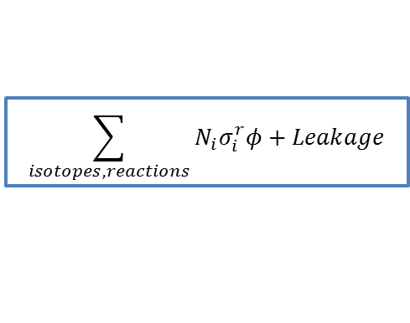




Nuclear reactor physics 101
The neutron multiplication factor : a way to quantify the chain reaction
$$k_{eff}=\frac{\text{Number} \text{of} \text{neutron} \text{at} \text{generation} \text{i}\text{+1}}{\text{N}\text{umber} \text{of} \text{neutron} \text{at} \text{generation} \text{i}}=\frac{ \text{Neutron} \text{production} \text{by} \text{fission}}{\text{Neu}tron disappearance}$$
Neutron reaction rate + neutron leakage
$$\sum_{isotopes, reactions}{N_{i}σ_{i}^{r}φ}+Leakage$$
Neutron fission rate x number of neutron by fission
$$ν.N_{f}σ_{f}φ$$
From neutron reaction cross section to reaction rate
Material : $N, σ$
$$v$$
Interaction probability on dx : $\frac{1}{λ}dx=N. σ.dx=N. σ.v.dt$
neutron
For $n$ neutrons per $cm^{3}$, the number of interaction over $dt$is : $n.N. σ.v$
$φ=n.v$ : neutron flux
Reaction rate : $τ=N. σ. φ$
In reactor physics, the neutron flux is a volume quantity
  → $φ$ is not a current

Slide 8

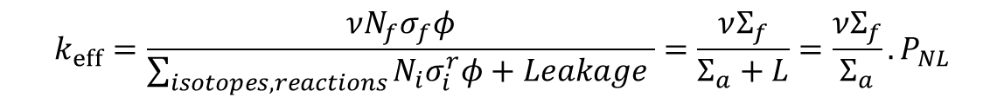
Nuclear reactor physics 101
The neutron multiplication factor : a way to quantify the chain reaction
$$k_{eff}=\frac{\text{Number} \text{of} \text{neutron} \text{at} \text{generation} \text{i}\text{+1}}{\text{N}\text{umber} \text{of} \text{neutron} \text{at} \text{generation} \text{i}}=\frac{ \text{Neutron} \text{production} \text{by} \text{fission}}{\text{Neu}tron disappearance}$$
$$k_{eff}=\frac{ν{N_{f}σ}_{f}φ}{\sum_{isotopes, reactions}{N_{i}σ_{i}^{r}φ}+Leakage }=\frac{νΣ_{f}}{Σ_{a}+L}=\frac{νΣ_{f}}{Σ_{a}}.P_{NL}$$
Characterization of materials ($=k_{∞}$)
Characterization of the reactor geometry
Some obvious remarks :
→ The criticality is not a function of the neutron flux (neither the reactor power)
The criticality is a time dependent quantity
→ The criticality is a global quantity
There is no such thing as “Local criticality”

Slide 9
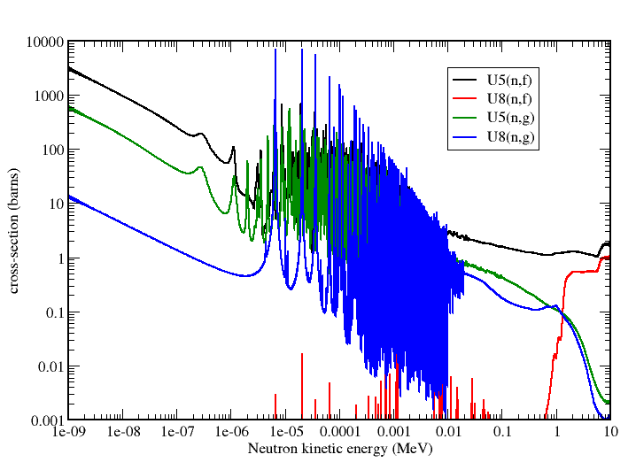
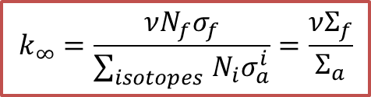
Criticality – slowing down and uranium enrichment
For neutrons, it’s a competition between fission and (capture + leakage)
Neutron cross section are obviously function of the kinematic energy
$$k_{∞}=\frac{νN_{f}σ_{f}}{\sum_{isotopes }{N_{i}σ_{a}^{i}}}=\frac{νΣ_{f}}{Σ_{a}}$$

Slide 10
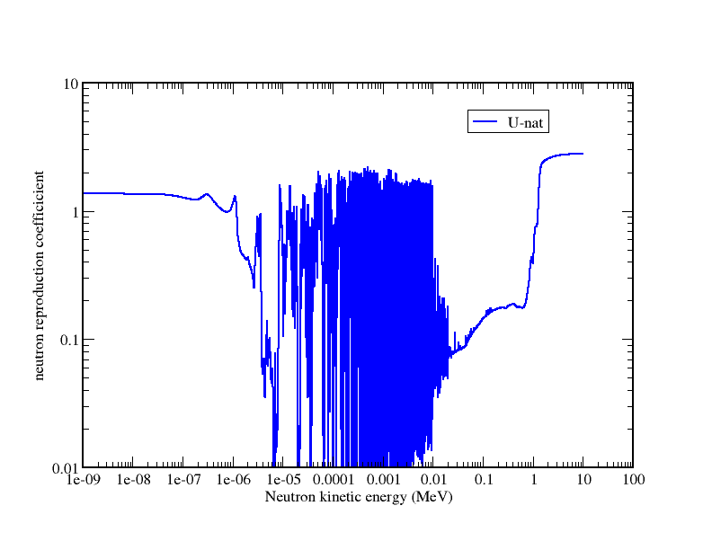
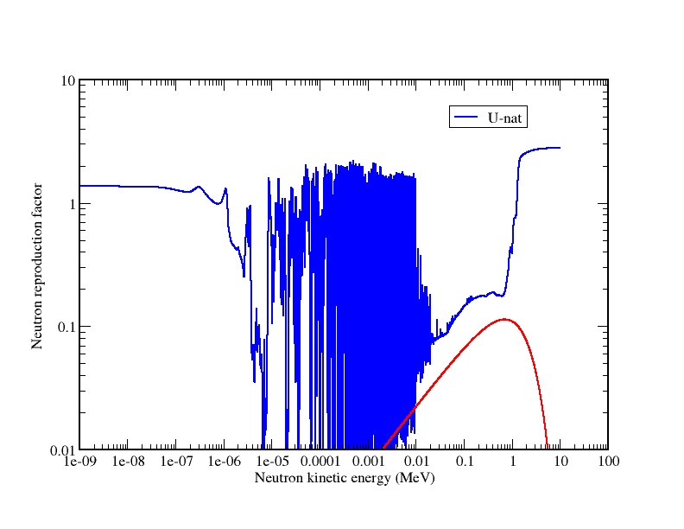

Criticality – slowing down and uranium enrichment
$$k_{∞}=\frac{νN_{f}σ_{f}}{\sum_{isotopes }{N_{i}σ_{a}^{i}}}=\frac{νΣ_{f}}{Σ_{a}}$$
Cross section ratio more favorable for criticality
Fission spectrum
No critical system are possible with uranium 238 !

Slide 11
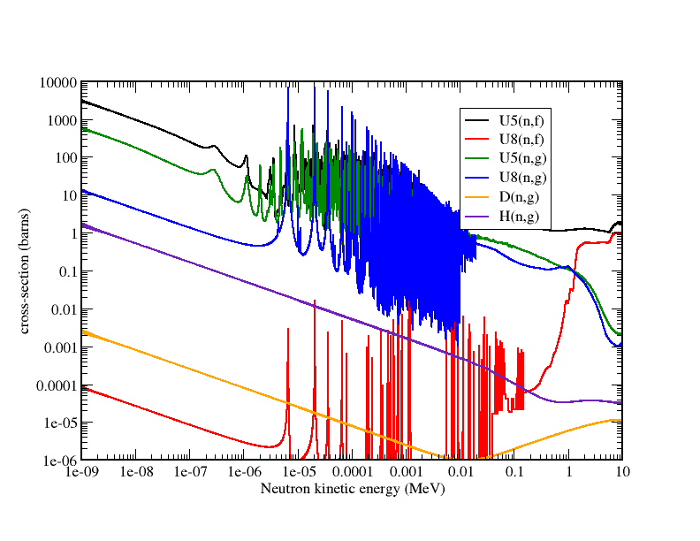
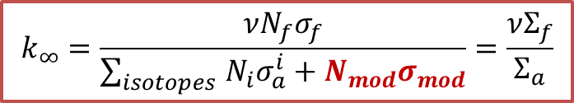
Slowing down by neutron moderation
$$k_{∞}=\frac{νN_{f}σ_{f}}{\sum_{isotopes }{N_{i}σ_{a}^{i}}+N_{mod}σ_{mod}}=\frac{νΣ_{f}}{Σ_{a}}$$
Slowing down process is assured by scattering on light nucleus !

Slide 12
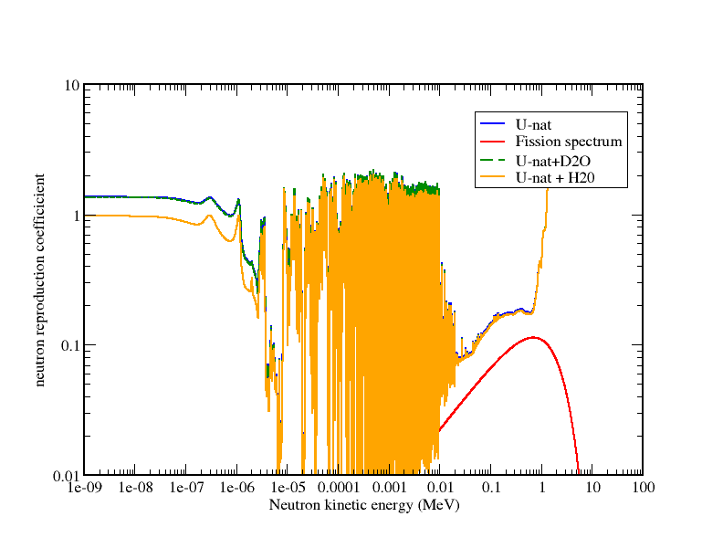
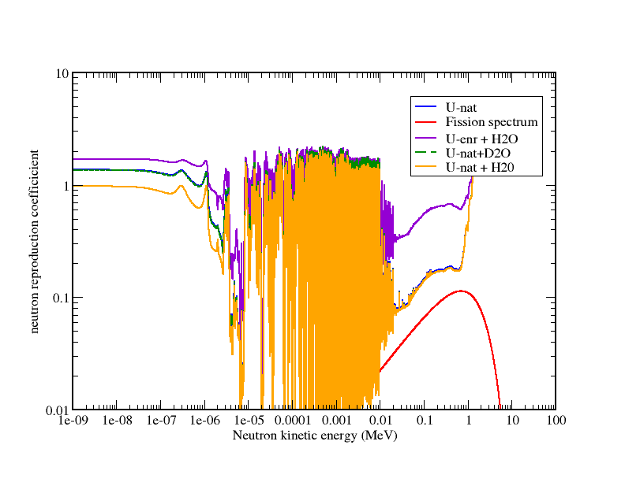
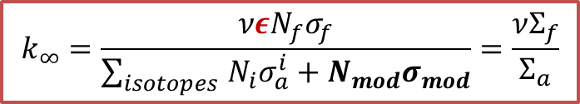
Criticality – slowing down and uranium enrichment
Neutron cross section are obviously function of the kinematic energy
$$k_{∞}=\frac{νεN_{f}σ_{f}}{\sum_{isotopes }{N_{i}σ_{a}^{i}}+N_{mod}σ_{mod}}=\frac{νΣ_{f}}{Σ_{a}}$$

Slide 13
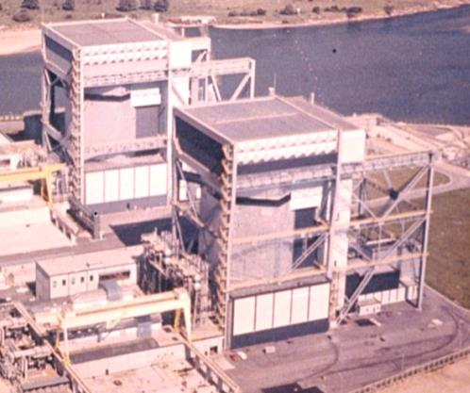
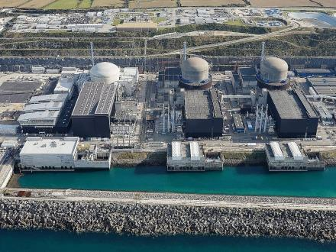
Reactor technology
A compromise between the fuel fabrication and the reactor fabrication
  uranium enrichment technology vs reactor technolgy
Coolant | Gaz (Air, CO2) | Light water | Heavy (light) water | Light Water
Moderator | Graphite | Graphite | Heavy water | Light Water
Fuel | Natural uranium | Enriched uranium | Natural uranium | Enriched uranium
  → Moderator = coolant
Based on the use of ²³⁵U
GEN I
GEN II (PWR, BWR, CANDU)
EPR, AP1000, CANDU6
~ 1960
~ 1975
~ 2010
Time

Slide 14

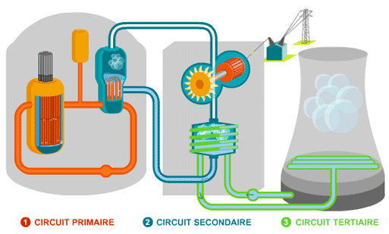

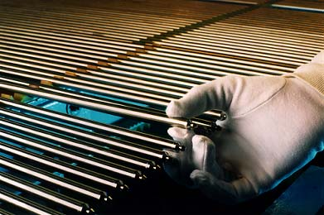
Reactor presentation
81 % of the reactors in the world are Light Water Reactors (435 operational reactors )
  (Boiling Water Reactors or Pressurized Water Reactors)
xy side cut
205 fuel assemblies
xy side cut
264 fuel pins

Slide 15

Reactor technology : towards future technology
  What about future reactors ?
  → A sustainable use of the resources :
²³⁸U+n ²³⁹U ²³⁹Np ²³⁹Pu
Fertile
Fissile
²³²Th+n ²³³Th ²³³Pa ²³³U
Fertile
Fissile
  No more moderation ! (see later)
Coolant | Liquid sodium | Liquid lead | Gaz | Molten salts
Moderator
Fuel | Uranium + plutonium | Uranium + plutonium | Uranium + plutonium (ceramic) | Thorium + uranium (molten salt)
Safer
Optimised waste production
Optimized resources consumption
As cheap as possible
Non proliferant
Paper reactors !

Slide 16
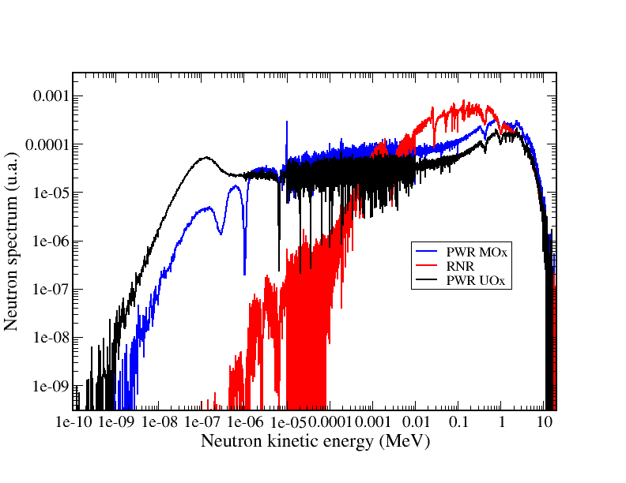
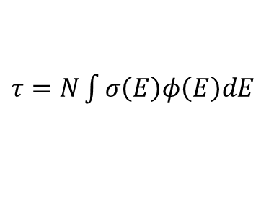
Neutron spectrum
Neutron spectrum is very dependent on reactor technology (and fuel ! )
$τ=N\int{σ\left(E\right)φ\left(E\right)dE}$
Reaction rates :
Fuel evolution depends on the neutron spectrum

Slide 17
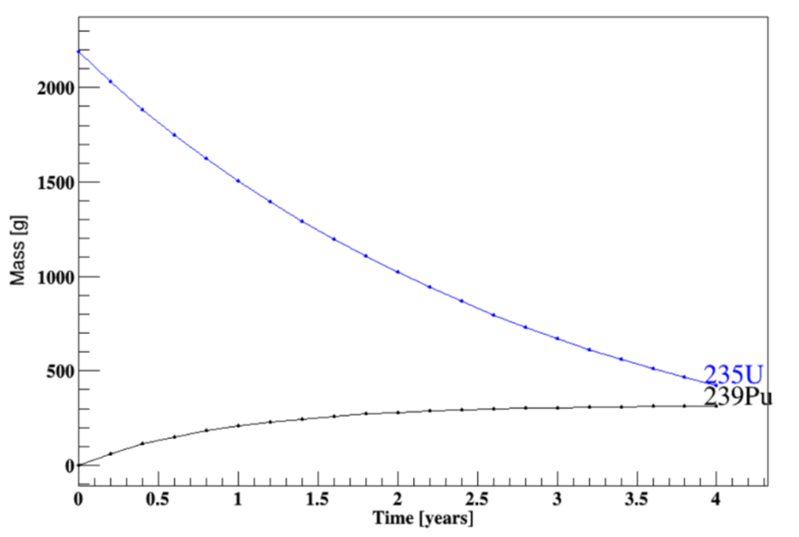
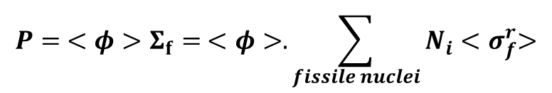
Fuel evolution
Bateman’s equation
$$\frac{∂N_{i}}{∂t}= \sum_{j}^{ }{λ_{j}^{j→i}N_{j}\left(t\right) −λ_{i}N_{i}\left(t\right)+ }\sum_{j′}{N_{j^{′}}\left(t\right)<σ_{j′}^{j^{′}→i}><Φ>−\sum_{r}{N_{i}\left(t\right)<σ_{i}^{r}><Φ}>}$$
Again, Criticality (and neutron spectrum) does not depend on the neutron flux !
  The reactor thermal power gives you the neutron flux
$$P= <φ>Σ_{f}= <φ>.\sum_{fissile nuclei}{N_{i}{<σ}_{f}^{r}>}$$
PWR UOX @ 3.5%
Evolution of the criticality

Slide 18
Fuel evolution
Bateman’s equation
$$\frac{∂N_{i}}{∂t}= \sum_{j}^{ }{λ_{j}^{j→i}N_{j}\left(t\right) −λ_{i}N_{i}\left(t\right)+ }\sum_{j′}{N_{j^{′}}\left(t\right)<σ_{j′}^{j^{′}→i}><Φ>−\sum_{r}{N_{i}\left(t\right)<σ_{i}^{r}><Φ}>}$$
Criticality (and neutron spectrum) does not depend on the neutron flux !
  The reactor thermal power gives you the neutron flux
Evolution of the criticality
Partial refueling allow a better use of the fuel

Slide 19
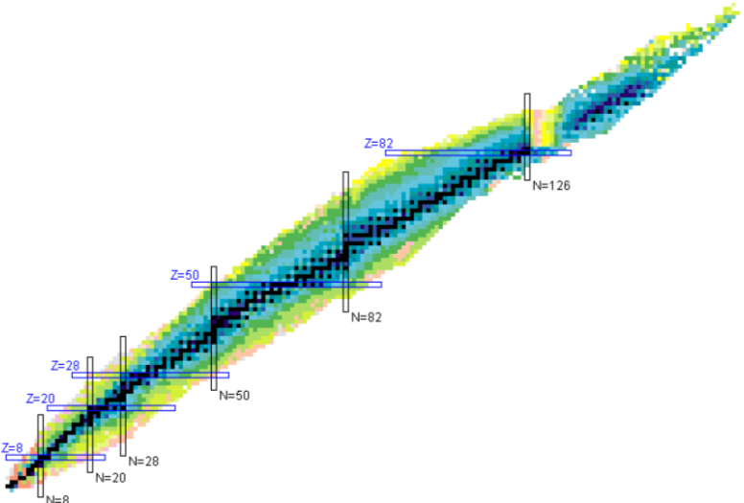
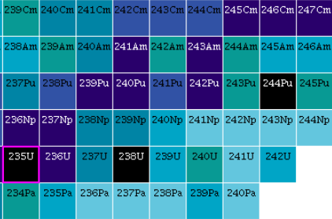
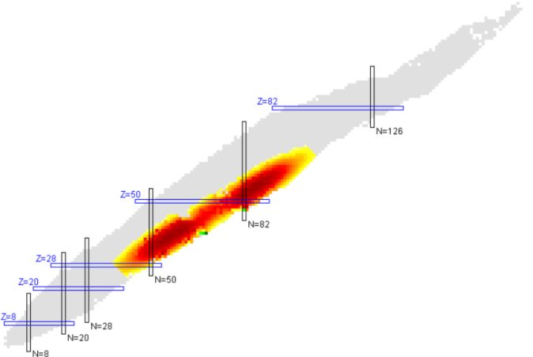
Nuclear wastes
Heavy nuclei =
Uranium + Plutonium + Minor actinides
Fission products
At the beginning of operation there are only uranium and oxygen in the fuel
At the end of cycle (EOC), there are :
  fission products (function of the produced energy)
  Heavy nuclei (function of the good use of the fuel)
The more the fuel produces energy, the more it is radioactive !
→ The cooling should be efficient especially on rector shut down phases

Slide 20
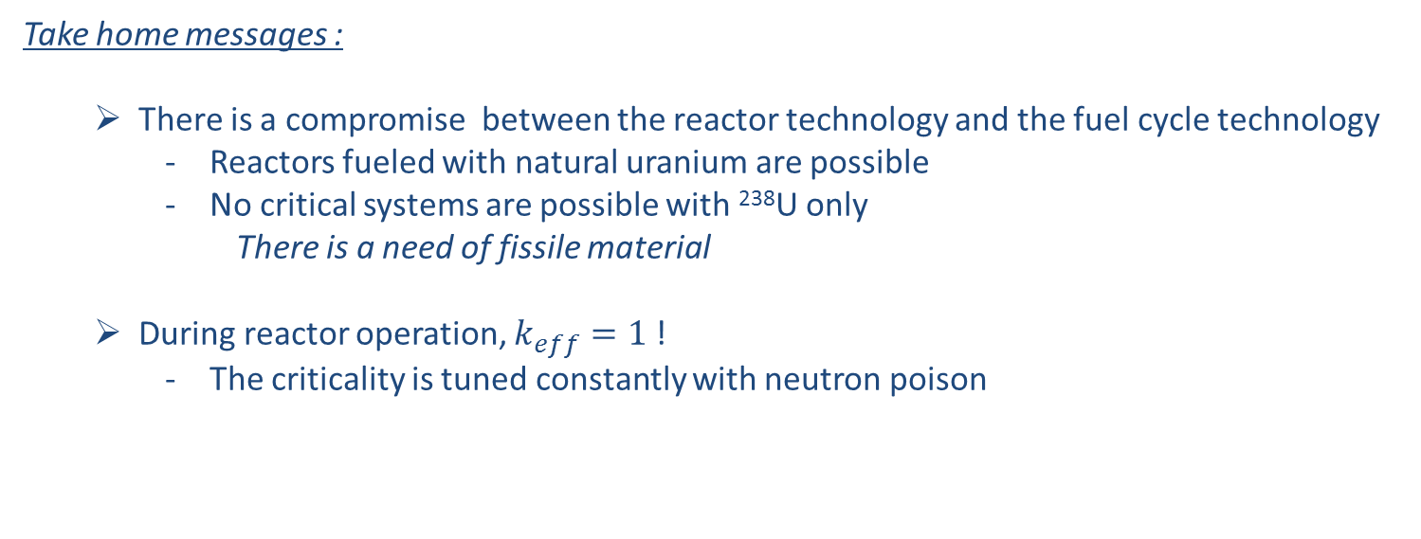
Outline :
Take home messages :
  There is a compromise between the reactor technology and the fuel cycle technology
    Reactors fueled with natural uranium are possible
    No critical systems are possible with ²³⁸U only
      There is a need of fissile material
  During reactor operation, $k_{eff}=1$ !
    The criticality is tuned constantly with neutron poison
PART II : Reactor models
  Neutron transport equation
  Deterministic vs stochastic methods
  Model precisions
Two main objectives :
- Prediction of the power deposit
- Prediction of reactions rates for fuel evolution
→ Prediction of the neutron flux

Slide 21








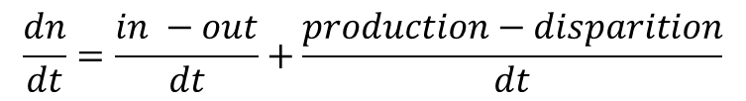
Boltzmann’s equation
Main goal : predict the power deposit
  → Predict the neutron flux as a function of space, direction and energy
3 variables for space
2 variables for direction
1 variable for energy
1 variable for time
$$d\vec{S}$$
7 dimensions ($d^{7}V$)
$$\vec{Ω}$$
$$\vec{r}$$
$$φ(\vec{r},\vec{Ω},t,E)=n(\vec{r},\vec{Ω},t,E).v$$
$$\frac{dn}{dt}=\frac{in −out}{dt}+\frac{production−disparition}{dt}$$
$in−out$→ introducing the neutron current
$$\vec{J}(\vec{r},\vec{Ω},E,t)=n\left(\vec{r},\vec{Ω},t,E\right).v. \vec{Ω}$$
$$leakage=\iint_{surface}{\vec{J}\left(\vec{r},\vec{Ω},E,t\right).d^{2}\vec{S}}=\iiint_{volume}{div\left(\vec{J}\right).}d^{3}\vec{r}$$

Slide 22
Boltzmann’s equation
Main goal : predict the power deposit
  → Predict the neutron flux as a function of space, direction and energy
3 variables for space
2 variables for direction
1 variable for energy
1 variable for time
7 dimensions ($d^{7}V$)
$$\vec{Ω}$$
$$\vec{r}$$
$$φ(\vec{r},\vec{Ω},t,E)=n(\vec{r},\vec{Ω},t,E).v$$
$$\frac{dn}{dt}=\frac{in −out}{dt}+\frac{production−disparition}{dt}$$
$disparition$ → any neutron reaction induces a change for the neutron
$$disparition=\iiint_{volume}{Σ_{abs+diffusion}\left(\vec{r},E\right).v.n(\vec{r},\vec{Ω},t,E).d^{2}\vec{Ω}dEd^{3}\vec{r}}$$

Slide 23
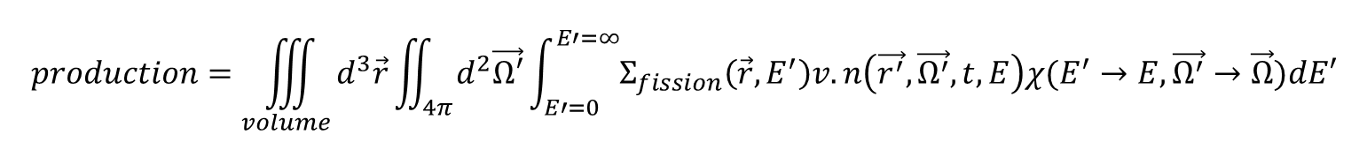

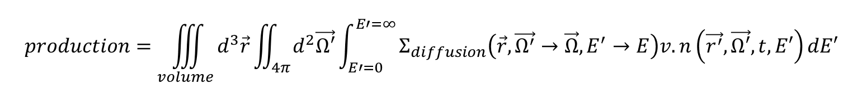

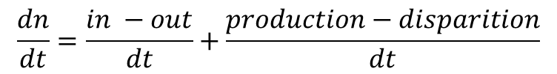


Boltzmann’s equation
3 variables for space
2 variables for direction
1 variable for energy
1 variable for time
7 dimensions ($d^{7}V$)
$$\vec{Ω}$$
$$\vec{r}$$
$$φ(\vec{r},\vec{Ω},t,E)=n(\vec{r},\vec{Ω},t,E).v$$
$$\frac{dn}{dt}=\frac{in −out}{dt}+\frac{production−disparition}{dt}$$
$production$→ scattering = a change in the angle, or in the energy
$$production=\iiint_{volume}{d^{3}\vec{r}}\iint_{4π}{d^{2}\vec{Ω′}}\int_{E′=0}^{E′=∞}{Σ_{diffusion}\left(\vec{r},{\vec{Ω^{′}}→\vec{Ω},E}^{′}→E\right)v.n\left(\vec{r^{′}},\vec{Ω′},t,E′\right)dE′}$$
$production$→fission = production of new neutrons
$$production=\iiint_{volume}{d^{3}\vec{r}}\iint_{4π}{d^{2}\vec{Ω′}}\int_{E′=0}^{E′=∞}{Σ_{fission}\left(\vec{r}, E^{′}\right)v.n\left(\vec{r^{′}},\vec{Ω^{′}},t,E\right)χ(E^{′}→E,\vec{Ω^{′}}→\vec{Ω})dE′}$$

Slide 24

Boltzmann’s equation
3 variables for space
2 variables for direction
1 variable for energy
1 variable for time
7 dimensions ($d^{7}V$)
$$φ(\vec{r},\vec{Ω},t,E)=n(\vec{r},\vec{Ω},t,E).v$$
$$\frac{dn}{dt}=\frac{in −out}{dt}+\frac{production−disparition}{dt}$$
$$\frac{dn}{dt}=\frac{1}{v}\frac{dφ}{dt}=−div\left(φ.\vec{Ω}\right)−Σ_{total}φ+\int_{E^{′},\vec{Ω^{′}}}{Σ_{s}\left(\vec{Ω^{′}}→\vec{Ω},E^{′}→E\right)φd^{2}\vec{Ω}dE^{′}}+\int_{E^{′},\vec{Ω^{′}}}{\overline{ν}\frac{1}{4π}χ\left(E\right) .Σ_{f}φ.d^{2}\vec{Ω}dE^{′}}+S$$
Transport
Slowing down
External sources + Neutron decays from FF
Fission production

Slide 25
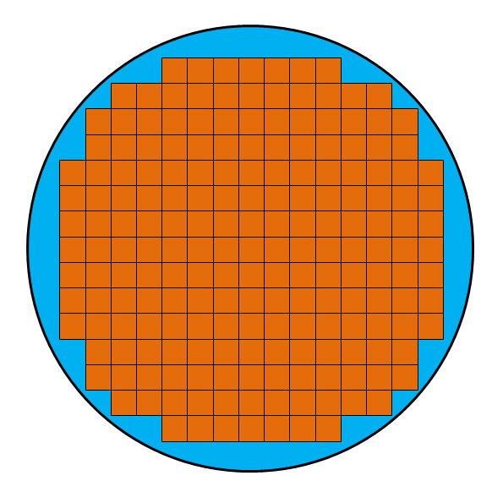

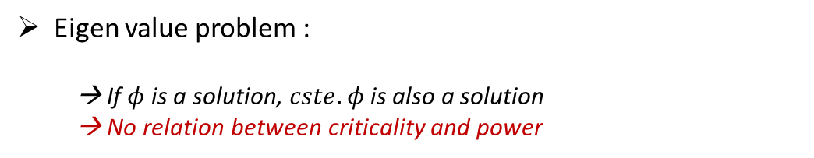
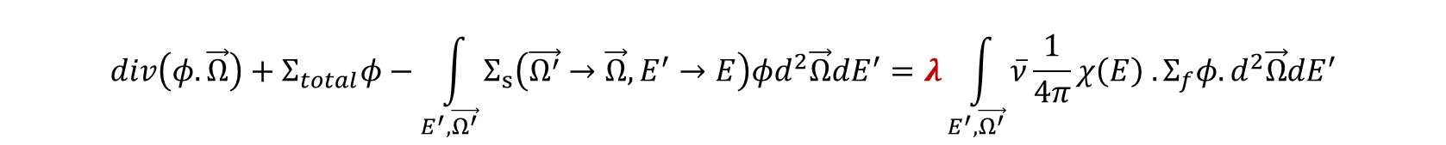

Stationary equation
No external sources
Adjustment of the fission production for steady state
$$div\left(φ.\vec{Ω}\right)+Σ_{total}φ−\int_{E^{′},\vec{Ω^{′}}}{Σ_{s}\left(\vec{Ω^{′}}→\vec{Ω},E^{′}→E\right)φd^{2}\vec{Ω}dE^{′}}=λ\int_{E^{′},\vec{Ω^{′}}}{\overline{ν}\frac{1}{4π}χ\left(E\right) .Σ_{f}φ.d^{2}\vec{Ω}dE^{′}}$$
Eigen value problem :
  → If $φ$ is a solution, $cste. φ$ is also a solution
  → No relation between criticality and power
$λ=\frac{1}{k_{eff}}$
$$Bφ=λFφ$$
Finite element method may solve this equation
Few order of magnitude :
- Neutron energy range : from 25 meV to 20 MeV
> 20 000 bins
- Neutron mean free path : ~cm
- Reactor fuel pin : ~ 1 cm
- Reactor fuel assembly : ~ 20 cm
- Reactor core typical dimension : ~m
>10⁹ bins for space (10³ in each direction)
> 1000 bins for angle

Slide 26


Boltzmann’s equation resolution : the stochastic way
With the use of Monte-Carlo methods, there are no approximations (almost…)
  - MCNP ; SERPENT
Interaction (nucleus + reaction)
Simulate the particle histories, a great number of time
No geometry discretization
No energy discretization
Neutron range
Source neutrons
Question : In a critical system, when does the story ends ?
→ Fissions end the story !
Fission : sample the number of emitted neutrons, their energy,…
$$γ$$
Initial neutron source :
(energy, position, direction)
Source propagation : recording fission location
Tallies are scored
Inactive cycles
Active cycles
Stories are not completely independent

Slide 27
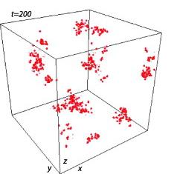
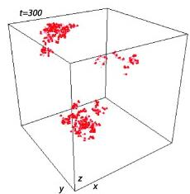
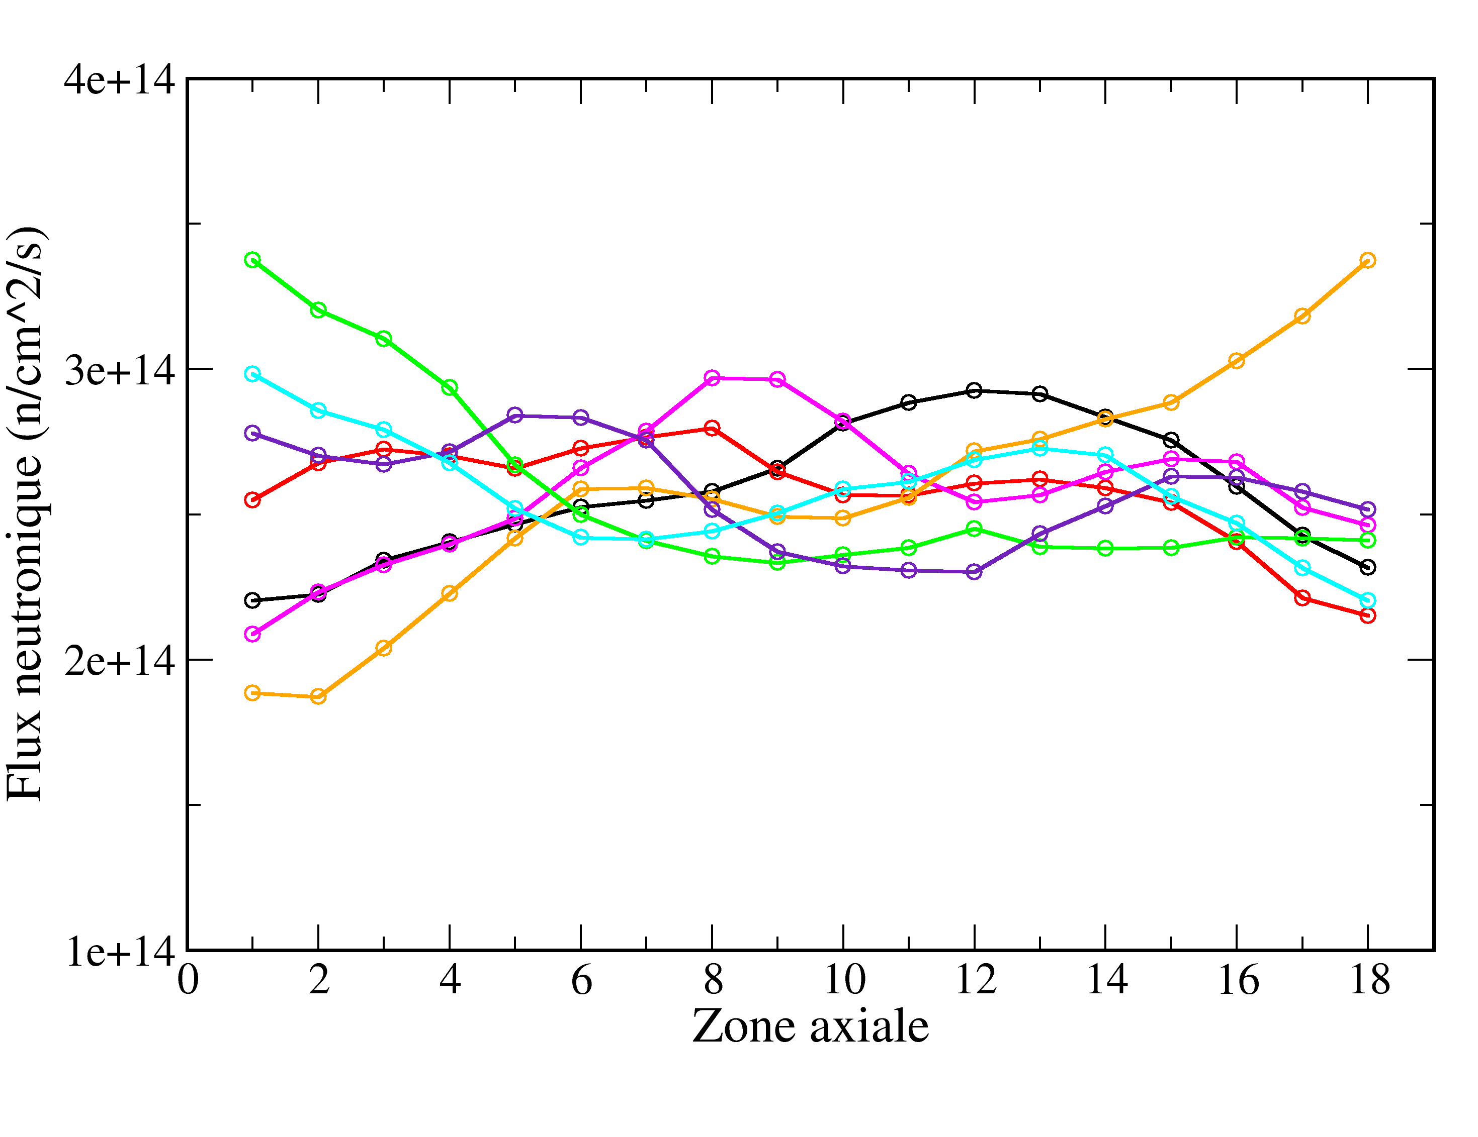
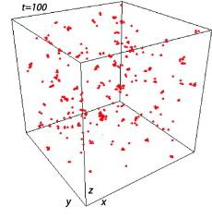
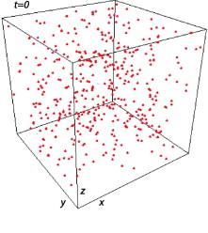

Boltzmann’s equation resolution : the stochastic way
With the use of Monte-Carlo methods, there are no approximations
With the use of Monte-Carlo methods, there are no approximations (almost…)
  - MCNP ; SERPENT
$$z \sim 4 m$$
N independant simulations
z
Dumonteil E., Malvagi F., Zoia A., Mazzolo A., Artusio D., Dieudonné C., De Mulatier C., Particle clustering in Monte Carlo criticality simulations, Annals of Nuclear Energy, Volume 63, January 2014, Pages 612-618
It is impossible to simulate a full core
At reasonable computer power

Slide 28
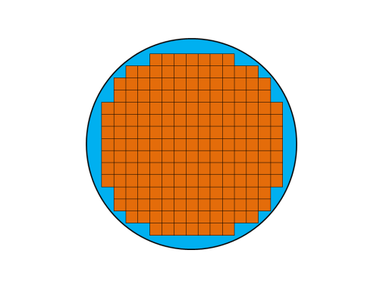





A two step simulations
Cell calculation
Resolution of the time independant Boltzmann’s equation on a single assembly with reflective conditions
$$\frac{1}{v}\frac{∂Φ}{∂t}=− div\left(\vec{Ω} Φ\right)−Σ_{tot}Φ+\int_{\vec{Ω^{′}}, E′}{Φ^{′}Σ^{′}f d \vec{Ω′} dE^{′}+\int_{0}^{∞}{Χ\left(E\right)νΣ_{f}dE } }$$
Angle $\vec{Ω}$
Energy $E$
S$pace \vec{r}$
Diffusion approximation
condensation
homogeneization
$$\vec{J}=−D grad Φ$$
Core calculation
$$−D ∆Φ= ν Σ_{f}Φ−Σ_{a}Φ$$
Diffusion equation resolution on a full core

Slide 29
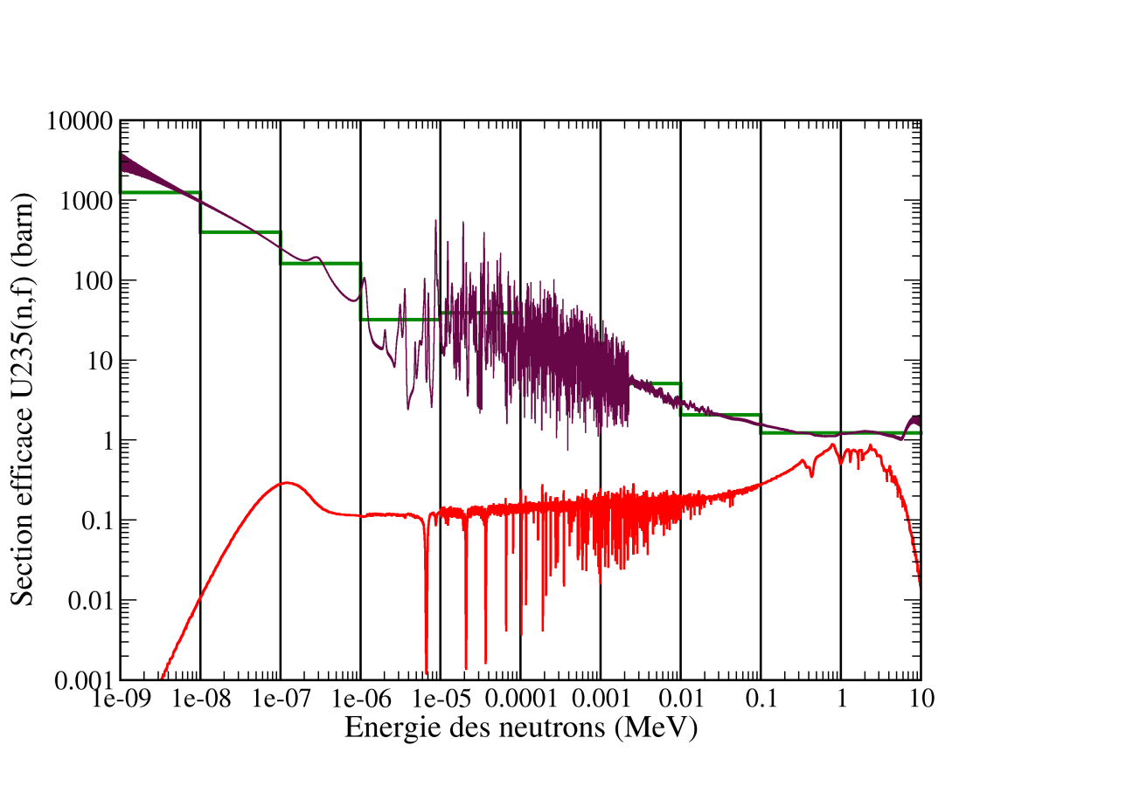
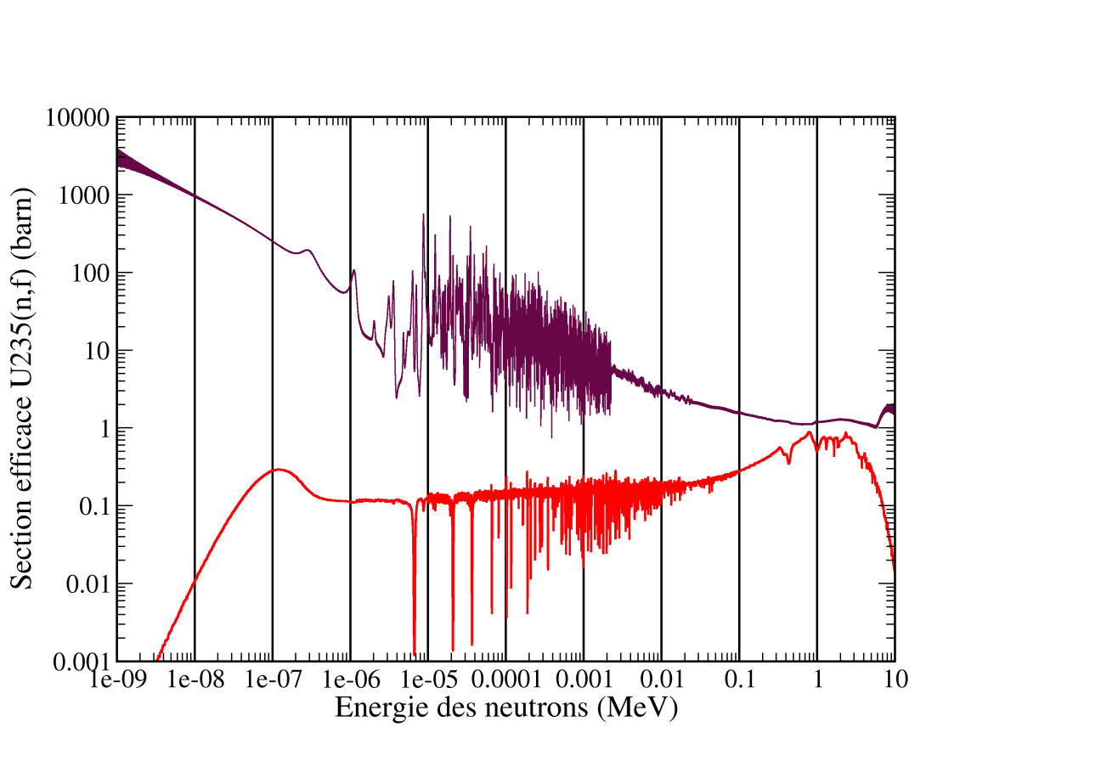
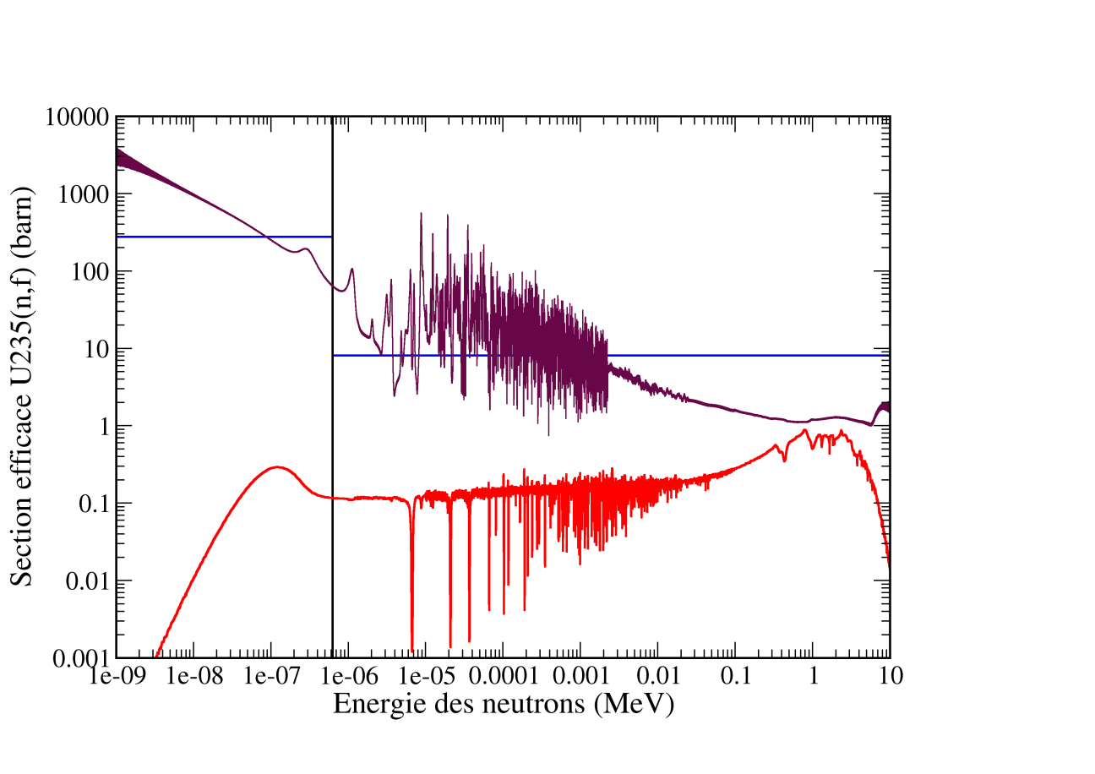



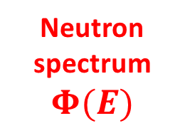
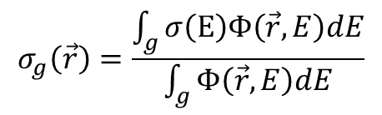
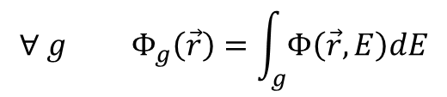
The condensation process
Microscopique cross-section
$${σ_{fiss}^{}}^{{}_{}^{235}U}$$
Neutron spectrum
$$Φ(E)$$
Multigroup Flux :
Multigroup cross section
$$∀ g Φ_{g}\left(\vec{r}\right)=\int_{g}{Φ\left(\vec{r},E\right)dE}$$
$$σ_{g}\left(\vec{r}\right)=\frac{\int_{g}{σ\left(E\right)Φ\left(\vec{r},E\right)dE}}{\int_{g}{Φ\left(\vec{r},E\right)dE}}$$
Hem… ? $Φ\left(\vec{r }, E\right)$ is unknown

Slide 30


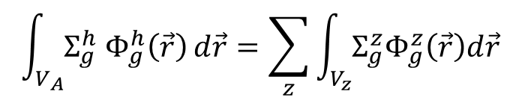






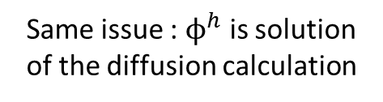

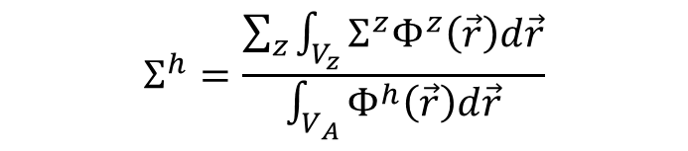
The homogenization process
Cell calculation
Core calculation
$$V_{M}$$
$$V_{C}+V_{M}$$
$$Σ_{r}^{h}=\frac{Σ_{r,C}^{}Φ_{C}V_{C}+Σ_{r,M}^{}Φ_{M}V_{M}}{Φ_{C}V_{C}+Φ_{M}V_{M}}$$
$$V_{C}$$
$$Φ^{h}$$
$$Σ_{}^{h}$$
$$Φ_{M}, Σ_{M}$$
$$Φ_{C}, Σ_{C}$$
Reaction rate conservation
$$\int_{V_{A}}{Σ_{g}^{h} Φ_{g}^{h}\left(\vec{r}\right)}d\vec{r}=\sum_{z}{\int_{V_{z}}{Σ_{g}^{z}Φ_{g}^{z}\left(\vec{r}\right)d\vec{r} }}$$
For each group g :
Same issue : $ϕ^{h}$ is solution of the diffusion calculation
$$Σ^{h}=\frac{\sum_{z}{\int_{V_{z}}{Σ^{z}Φ^{z}\left(\vec{r}\right)d\vec{r}}}}{\int_{V_{A}}{Φ^{h}\left(\vec{r}\right)d\vec{r}}}$$
Approximation : $ϕ^{h}$ ~ $Φ^{z}$

Slide 31
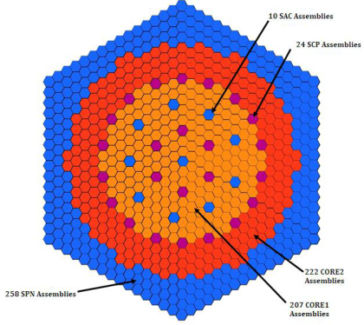



Precision on reactor models : examples
How it is done in « real industrial life » ?
  Hundreds of calculations are needed at each fuel refueling
  Tens of years of industrial knowledge
    Two groups cross-sections libraries fitted
    Precision on $k_{eff}<{5.10}^{−5}$
PWR
Fuel composition ?
Operation time = 1 years !
Prediction of the criticality of the first superPHENIX core = 2/360
How it is done in « real research life » ?
  0 power mock-up reactors
    MCNP calculations with deterministic code comparison for nuclear uncertainty analysis
    Precision on $k_{eff}<10\%$
Prediction of the criticality of the first VENUS-F core = 9/87

Slide 32

Outline:
Take home messages :
  Resolving the transport equation is still a challenge
    No easy calculation scheme, even for the static resolution ($k_{eff}$ calculations)
    The evaluated nuclear data is strongly tuned to fit industrial feedback
  For industrial use, hundreds of calculations are needed at each refueling for
    Criticality
    Cycle length
    Safety coefficients
  Model approximations can lead to strong uncertainties
    - In evolution, the end of cycle composition is up to 10% biaised
PART III : Nuclear data uncertainties
  TMC method
  Perturbation theory
  Fuel evolution

Slide 33


Total Monte Carlo method
A. Koning, D. Rockman, ANE 2008
Creation of a serie of evaluation
→ Code TALYS (NRG)
Sampling among all those evaluations
N MCNP calculations
N ENDF Files
Example : analysis of ²³⁹Pu nuclear data on SFR assembly calculations
²³⁹Pu(n,f)
100 calculations
k∝
σ_{ND}
1,294.10⁻²

Slide 34


Total Monte Carlo method
An other example : A PWR assembly with thorium fuel
σ_{ND} Th-232 | σ_{ND} U-233
1,05.10⁻² | 6,12.10⁻²
$k_{eff}$ uncertainty of approximately few %
Parameters are sampled to build different evaluations
  Each one is different from the other ($\overline{ν}, σ_{f}, σ_{a},…$)
  Not easy to understand
  Calculation needs are consequent

Slide 35







Perturbation theory : a smart way to study uncertainties
Boltzmann’s equation
Adjoint equation
$$S^{σ}=\frac{{∂σ}/σ}{{∂k_{eff}}/{k_{eff}}}$$
$$Bφ=λFφ$$
$$B^{∗}φ^{∗}=λF^{∗}φ^{∗}$$
$$\left\langle Bφ|φ^{∗}\right\rangle =\left\langle φ|B^{∗}φ^{∗}\right\rangle$$
$$−\frac{∂λ}{λ}=\frac{\left\langle φ^{∗}|\left(∂B−λ∂F\right)φ\right\rangle }{\left\langle φ^{∗}|Fφ\right\rangle }$$
$${\left(\frac{Δk_{eff}}{k_{eff}}\right)}^{2}={}_{}^{t}{S.Cov.S}$$
On a physical point of view, the adjoint flux represents the total contribution in the neutron balance of a new neutron at position $\vec{r}$, energy $E$ and direction $\vec{Ω}$
Picture taken from : Dos Santos N, Optimisation de l’approche de représentativité et de
transposition pour la conception neutronique de programmes expérimentaux dans les maquettes critiques, PhD thesis

Slide 36




Coherence between perturbations and TMC
With all the different evaluation from TALYS, it is possible to built the correlation matrixes
Fission
Capture
Fission
Capture
Energy
 | Th-233 | U-233
Capture only | 0.0105 | 0.0045
Fission only | 0.0012 | 0.0544
Capture + fission | 0.012 | 0.0599
TMC | 0.01 | 0.06
Good agreement with the Total Monte Carlo only if the number of group is high enough !
→ Low computational requirements

Slide 37



Extended perturbation theory
Recent developments allows perturbation based on continuous energy functions
$$\frac{dσ}{dΓ_{γ}}(E)$$
  → computed with NJOY (with the ERRORR module)
Aufiero M., Bidaud A., Kotlyar D., Leppänen J., Palmiotti G., Salvatores M., Sen S., Shwageraus E., Fratoni M., New Approaches and Applications for Monte Carlo Perturbation Theory, M&C 2017, Jeju, Korea, April 16-20, 2017

Slide 38




Evolution
During evolution, the coupling between neutron transport equation and Bateman’s equation is too strong to expect an easy application of the perturbation theory
TMC application : 1 fuel evolution calculation for each random cross section
$$<φ> =\frac{P}{N_{f}σ_{f}}$$
Reminder :
  All other reaction rates are correlated to fission cross section
$$\frac{δPu_{239}}{Pu_{239}}\sim 3\%$$

Slide 39
Outline :
Take home messages :
  Tools exist to quantify the impact on new measurements on precisions
    Typical uncertainty for criticality induced to nuclear data ~ few %
      Much higher than model uncertainties
    Typical uncertainty for fuel evolution induced to nuclear data ~5%
      → Lower (or same order of magnitude) than model uncertainties
  For the following, a 10% uncertainty on inventory at reactor discharge is fully acceptable !
PART III : Waste production and natural uranium consumption
  Waste definition
  Plutonium valorization

Slide 40




Nuclear wastes vs valuable matter
“96 % of the nuclear spent fuel is reusable”
Wastes : « Radioactive wastes are radioactive matter which NO further utilization is planed » European legislation (2006)
BOC
EOC
-Fission Product
-100% U et Pu
-100% Np, Am, Cm
U nat
U enr
Open cycle : ex USA
-Fission Product
-0,1% U et Pu
-100% Np, Am, Cm
U nat
U enr
« Closed » cycle : ex France
Pu monorecycling
U & Pu

Slide 41

Radiotoxicity : a way to quantify the impact of nuclear wastes
The Sievert is a unit built to quantify the damages of radiations on the human body
Spent UOx after 5 years of cooling
Radiotoxicity (u.a.)
Time in year

Slide 42

The use of Pu in current reactor to decrease radiotoxicity
Mox fuel aims to save natural uranium (see next part)
  → Will recycling Plutonium improve the radiotoxicity ?
7 Uox spent fuel are needed for 1 Mox assembly !
UOX
U_{enr}
UOX
U_{enr}
UOX
U_{enr}
UOX
U_{enr}
UOX
U_{enr}
UOX
U_{enr}
Open cycle
Radiotoxicité (u.a.)
Pu
MOX
Time (year)
Spent MOX fuel contains Pu → It is not a waste…
It is temporally stored for further use… (if there are uranium tension)

Slide 43



The long-term storage
Only one solution so far : geological disposal
  Granit (USA, Sweeden)
  Clay (France, Belgium)
  Salt mine (Germany)
Two types of long lived wastes
- High activities
- medium activities
Is it safe ?
Exemple : actinides diffusion after 500 000 years ~ 15 m
Maximum doses at the surface induced by the storage
Clay is adapted for actinides
the risk comes from fission products

Slide 44





Plutonium valorization and natural uranium comsumption
Based on the use of ²³⁵U (0,7% of natural uraniuml)
- 1 ton of fission
- 27 tons of enriched uranium
- 200 tons of natural uranium
- Improve the enrichment process
- Uranium recycling
- Plutonium recycling
PWR
1 ton/Gwe.y
$${}_{}^{238}{U+n→}{}_{}^{239}{Pu}$$
1 GWe.y
$${}_{}^{232}{Th+n→}{}_{}^{232}U$$
> 130 tons of Unat/GWe.y
Neutron balance :
Neutron production | Neutron consumption
$ν$ neutrons by fission | 1 n for fission + $α=\frac{σ_{c}}{σ_{f}}$ n for capture on fissile + $1+α$ neutrons on the fertile
$1+α$ fissile nuclei are disappearing for chain reaction
Production of fissile should be $>1+α$ at each fission

Slide 45

Breeding reactors
For breeding, the number of available neutrons $N_{d}=ν−2\left(1+α\right)>0$
Breeding capability depends (at first order) only on the fissile nucleus

Slide 46

Fissile inventory issue
Nucléaire durable : les réacteurs rapides
Fast neutron reactors do not value U-238
- In France, there are 200 000 tons of depleted uranium available (30 000 tons of Th)
Those reactors needs an initial fissile inventory ; and then, can be operated indefinitely
²³⁵U –fission
With thermal reactors, cross sections impose a uranium enrichment between 3 and 4%
²³⁵U –capture
With fast reactors, the enrichment should be higher : 10 to 12%
²³⁸U –capture
One Fast reactor initial inventory
12 t
of Pu
50 years of PWR operation
≈
≈

Slide 47


Sodium cooled - Fast Neutron Reactor
Why liquid sodium as coolant :
  Cheap element
  Good thermal properties (compact reactors)
  Sodium is unstable neither with water nor with air
  Positive void coefficient
Such reactors are developed to face a potential uranium lack on a world wide scale
  What are the uranium resources ?

Slide 48
Economic viability
Electricity price ($)
Breeder
PWR-type
“Maximum” natural price that defines the ultimate resources
Natural uranium price ($)
Investment for the reactor construction

Slide 49
Economic viability, with error bars !
Electricity price ($)
Breeder
PWR-type
“Maximum” natural :
From 130 $/kg until > 1000$/kg
Natural uranium price ($)
Today : 285 Gwe (Full power equivalent)
60 000 tons of natural uranium/years
Estimated resources 10 – 23 millions of tons

Slide 50
Natural uranium consumption
Nuclear power
Cumulated ressources consumption
400 $/kg
Year
Year
200t/(GWe.an)
130t/(GWe.an)
Initial SFR-Na inventory
≈
12 t
ofPu
≈
50 years of PWR production
Exemple : French fleet of 60 GWe (100% SFR-Na) : ≈ 1200 tonnes de Pu
In 2015 : 350 tons of Pu «available» = 30% of the needed Pu
Pu = valuable matter
A drastic increase of nuclear production before the end of the century
It’s a long term choice with a huge uncertainty

Slide 51
Outline:
Take home messages :
  Plutonium can be either the most painful waste, either a valuable matter
    Its definition would considerably change the game of waste management
    The valorization of plutonium into Mox fuel make sense if and only if there a development of GEN-IV reactors
  An urgent need of GEN-IV reactors implies a huge increase of nuclear power !
    Drastically means more than a factor 4
  If the plutonium is a valuable matter, what can be done for other radiotoxic elements
PART IV : Transmutation
- Fission products
- Minor actinides
Radiotoxicity (u.a.)
Time in year

Slide 52







Transmutation
The transmutation = recycling nuclei in reactors to make them disappear by nuclear reactions
    ⁹⁹Tc (210 000 y) + n ¹⁰⁰Tc ¹⁰⁰Ru (stable)
    ¹³⁵Cs (2.3 .10⁶ y) +n ¹³⁶Cs ¹³⁶Ba (stable)
    ¹³³Cs (stable) + 2 n ¹³⁵Cs (2.3 .10⁶ y)
β- (15s)
β-
$$\frac{dN_{i}}{dt}=−σ_{i}N_{i}φ−λ_{i}+Production by fission$$
→ A look on the evolution
At reactor level
$$N$$
At fleet level
$$N_{∞}=\frac{P}{σφ}$$
$$N$$
$$T_{trans}=\frac{Ln(2)}{σφ}$$
$$Time$$
$$Time$$

Slide 53

Transmutation
Principle contributors for radioactive pollution :
Isotope | Quantities produced in PWR (kg/Twhe) | Radio-active decay (years) | Cross section $σ$ (barns) |  | $T_{Trans}$ (years)
 |  |  | Fast spectrum | thermal spectrum | Fast spectrum | Thermal spectrum
79 Se | 0.02 | 6.5 .10⁴ | 0.03 | 0.1 | 730 | 2200
99 Tc | 2.9 | 1.5 .10⁶ | 0.2 | 4.3 | 110 | 51
129 I | 0.66 | 1.6 .10⁷ | 0.14 | 4.3 | 160 | 51
135 Cs | 1.4 | 2.3 .10⁶ | 0.07 | 0.07 | 310 | 170
  Only I and Tc transmutation is possible
The solution is to recycle fission products in dedicated target (with a special neutron moderation) in a high neutron flux available in fast reactors
No material that could contain iodine that may suffer irradiation have been found

Slide 54

Transmutation
Actinide transmutation = fission after one or several neutron capture on the given actinide
²⁴²Cm
²⁴³Cm
²⁴⁴Cm
²⁴⁵Cm
Fission
²⁴²Am
Capture
²⁴¹Am
²⁴³Am
²⁴⁴Am
*
²⁴²Am
Decay
²³⁸Pu
²³⁹Pu
²⁴⁰Pu
²⁴¹Pu
²⁴²Pu
²⁴³Pu
Fission and capture cross section of minor actinides impose a fast spectrum for transmutation
→ The reduction of safety coefficient is too important in current PWR
Two strategies are possible :
→ Single strata scenario
→ Double strata scenario
All fuel assemblies are contaminated with MA
MA are concentrated
SFR or PWR
MA
SFR
U, Pu, MA
U, Pu
AM + Pu

Slide 55



Double strata imposes ADS
Fission Yields of different actinides
$${}_{}^{87,88,89,90,92}{Br}$$
$${}_{}^{93}{Kr}$$
$${}_{}^{93,94}{Br}$$
Delayed neutron

Slide 56



Double strata imposes ADS
Fission Yields of different actinides
$${}_{}^{87,88,89,90,92}{Br}$$
$${}_{}^{93}{Kr}$$
$${}_{}^{93,94}{Br}$$
Delayed neutrons represent only a small fraction of the neutron production ($<0.6\%$)
They are essential for reactor operation
$$\frac{dn}{dt}=production rate −disparition rate$$
$$\frac{dn}{dt}=\frac{1}{Λ}\left(1−\frac{1}{k_{eff}}\right)n$$

Slide 57



Double strata imposes ADS
Simple quasi-static kinetic equation for a critical reactor :
$$n(t)=n_{0}e^{\left(\frac{k_{eff−1}}{Λ }\right)t}$$
$$Λ=βl_{delayed}+\left(1−β\right)l_{prompt}$$
$β=$ fraction of delayed neutron
⇨ allowed k_{eff} range for power increase is only ]1;1+β[
$$N_{fissions/s}=S\frac{k_{\text{eff}}}{ν\left(1−k_{\text{eff}}\right)}$$
In a ADS, the physics is completely different
Critical reactor
Δρ = +0.01
Critical reactor
Δρ = +0.001
ADS k=0,97
Δρ = +0.01
ΔP = +50%
ADS k=0,97
Δρ = +0.001
ΔP = +3%

Slide 58



Double strata imposes ADS
A European prototype for ADS
Safer than critical reactor ?

Slide 59

Waste compared to the in-cycle inventory
A small recall :
  Plutonium is very radiotoxic
  A SFR needs a lot of Pu to operate
X 1000
1000 years of operation will produce the same radiotoxicity of matter needed to the reactor fleet
Needs of “end of game” studies that would reduce the global inventory of plutonium and minor actinides

Slide 60
The impossible choice of transmutation
→
Transmutation efficiency function of:
→ Flux (consequently the power)
→ Irradiation time
Production
Transmutation term
No transmutation
2038 : beginning of transmutation
« delayed
transmutation
Quantity of wastes
Minor actinides inside glasses
Imediate transmutation
Time of operation
In 2150, the gain due to transmutation is low
The wastes produced before the deployment of Fast Reactors dominates the total wastes

Slide 61
Outline :
Take home messages :
  Transmutation is a pro-nuclear option
    It implies that plutonium is a valuable matter handled inside the fuel cycle
    Only minor actinides (even americium) are considered
      Curium and higher elements would imply neutron and gamma doses unacceptable in different facilities
      “The nuclear paradox”
Trust in next generations |  | Yes | No
Pro-nuclear | GEN-IV reactors | x
 | Transmutation |  | x
Anti-nuclear | GEN-IV reactors |  | x
 | Transmutations | x

Slide 62




Time importance for nuclear reactors transitions
The global nuclear power evolution is the key hypothesis for future nuclear studies
REP
Time constant that have to be combined with a 14 year decay constant
% power
EPR
RNR
year
Plutonium decay constant is not compatible with such times
  → Ice cream effect (eat it quickly or get dirty)
Study of flexible strategies
A mature reactor technology in 2040 implies urgent improvement on nuclear data and reactor modeling !
Thank you for your attention !

