Slide 1







Fusion, Neutronics and Nuclear Data
U. Fischer, KIT
Co-ordinator PPPT Neutronics & Nuclear Data

Slide 2
Outline
What is fusion ?
EU fusion roadmap
Neutronics simulations in fusion technology
Nuclear data for fusion applications
  Transport simulations
  Activation & transmutation
Nuclear data in the PPPT programme
Summary
Addendum:
DEMO nuclear analyses - examples

Slide 3
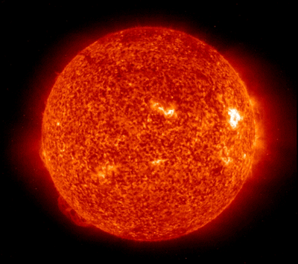
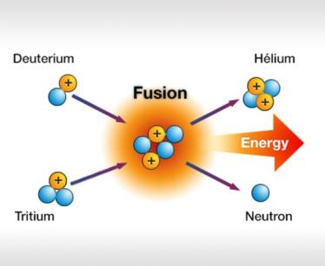
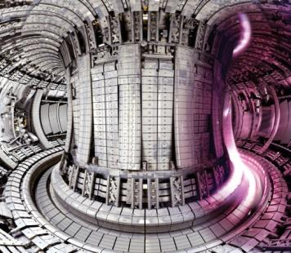
What is fusion?
  Bringing the power of the Sun to Earth
d + t ⇒ α + n + 17.58 MeV
Fusion is the process that powers the stars
Light nuclei fuse at very high temperatures
Release large amounts of energy
Need temperatures of >150,000,000º C
⇒ Plasma

Slide 4
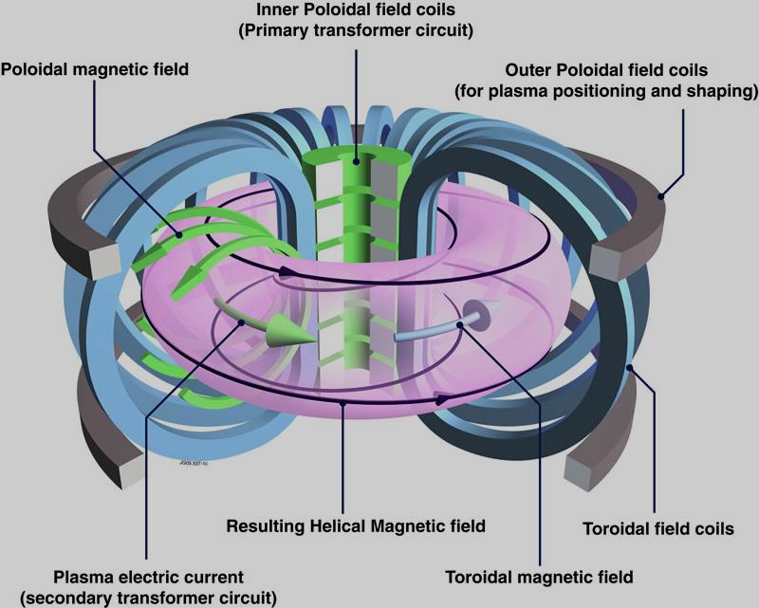
What is fusion?
Tokamak
Magnetic fields to confine the plasma
Tokamak most successful configuration
Several experiments in EU and the world

Slide 5
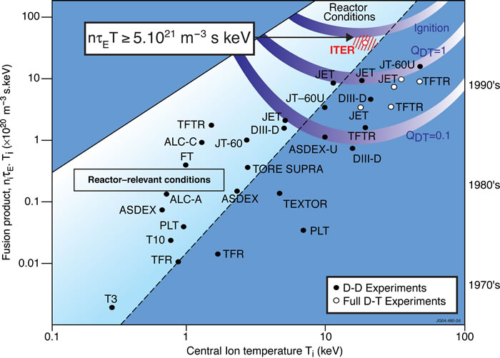
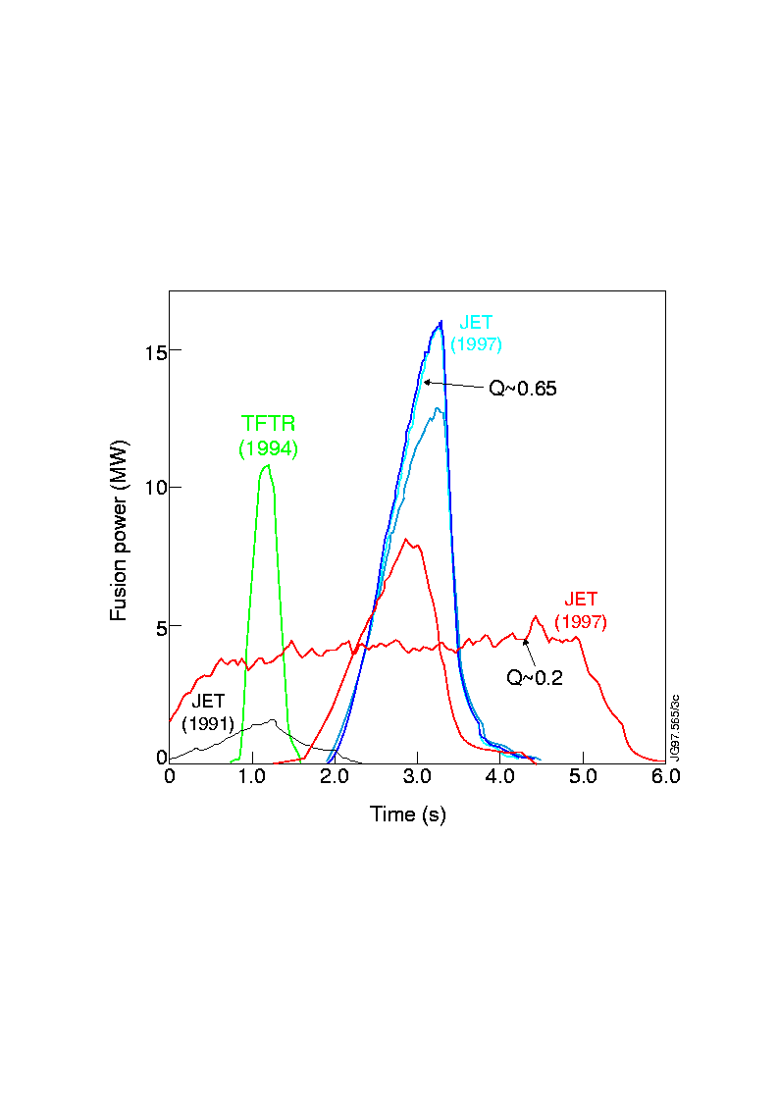
What is fusion?
Steady physics and engineering progress towards reactor conditions (sustained Q = power in/power out > 1) by increasing plasma density, temperature and confinement time

Slide 6
What is fusion ?
EU fusion roadmap
Neutronics simulations in fusion technology
Nuclear data for fusion applications
Nuclear data in the PPPT programme
Summary
Addendum:
DEMO nuclear analyses - examples

Slide 7
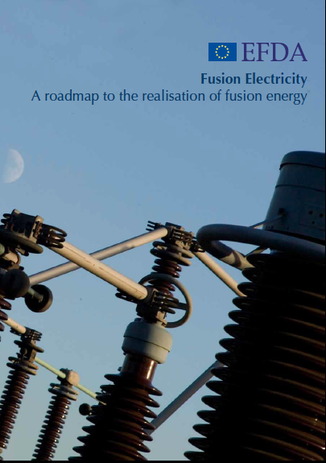

European Fusion Roadmap
Goal: Realization of fusion as energy source for electricity by 2050 (Fusion Power Plant, FPP, to provide electricity to the grid)
Included in Strategic Energy Technology Plan (“SET-Plan”).
“Horizon 2020”
  Implementation of Fusion Roadmap
  Aim: Achieve all know-how required to start construction of DEMO around 2030
Requires three major facilities:
  ITER – key facility for “next step”
  Dedicated “elementary” neutron source for material development (2025)
  “Early” DEMO (2030-35)

Slide 8
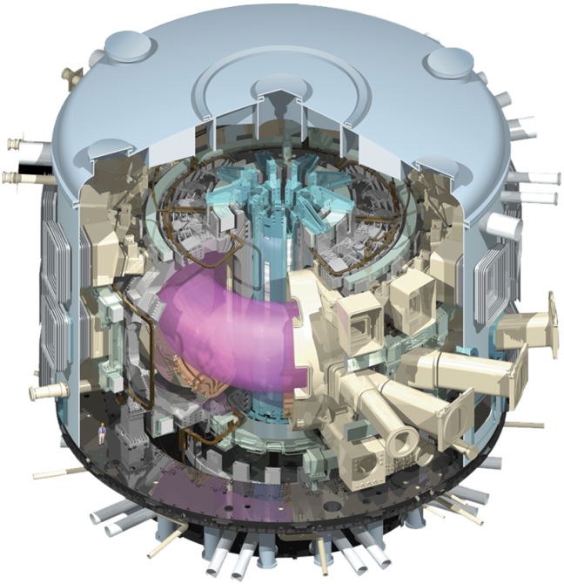
ITER – The way to fusion
Demonstrate that fusion is a viable source of energy
Test and integrate key fusion technologies for future reactors
On a larger scale than in present experiments
10 times as much power out (500 MW) as power in (Q=10)
Study “burning” plasma
and maintain for up to an hour

Slide 9
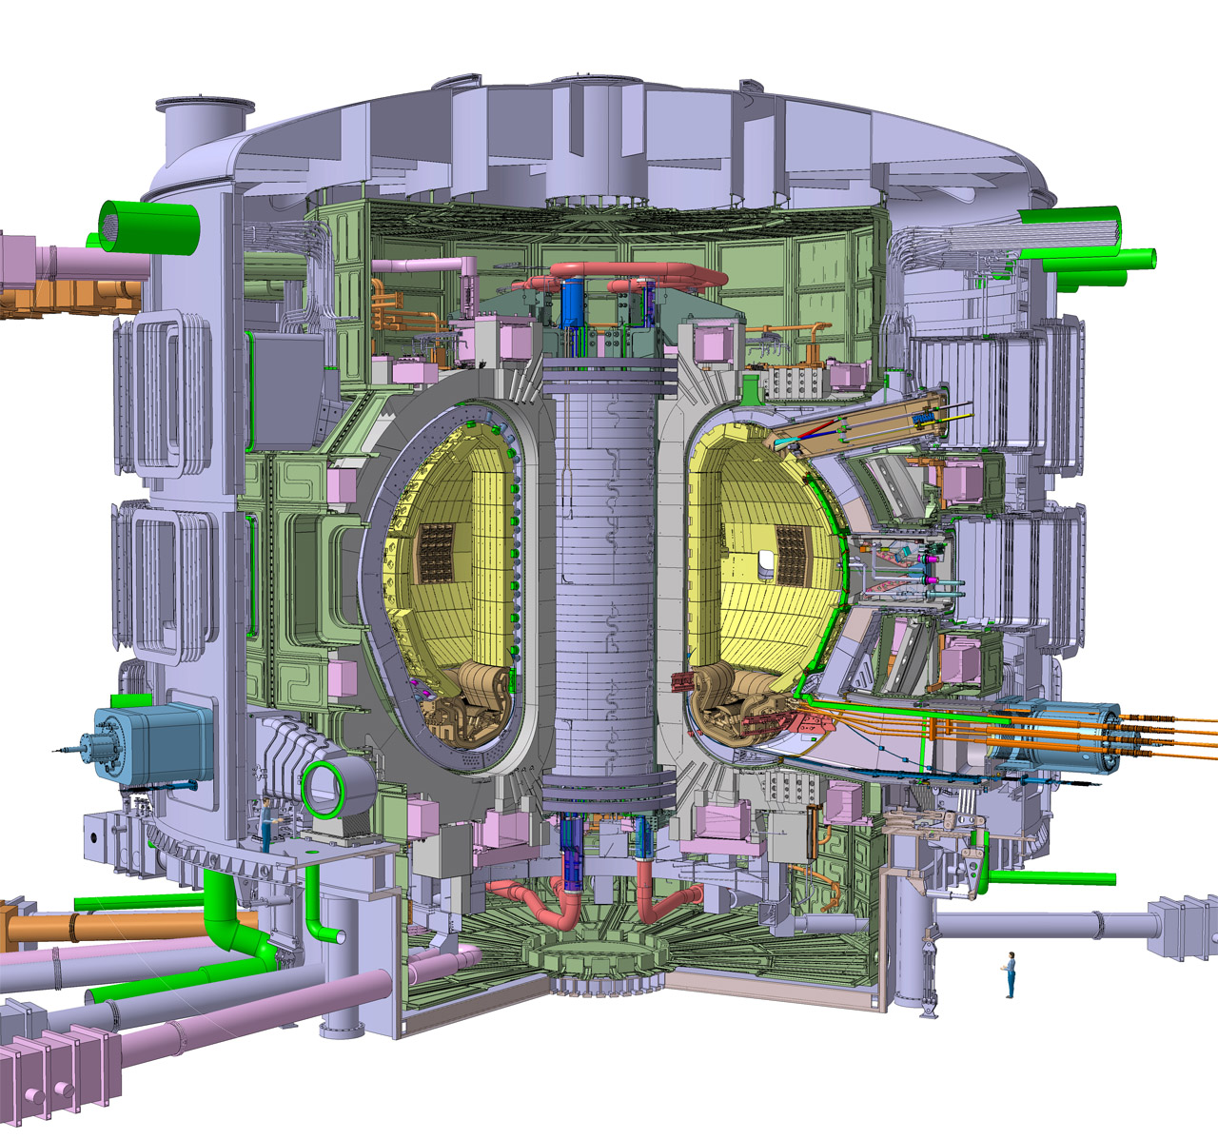
ITER
blanket modules
TF-magnet
test blanket port
plasma chamber
cryostat
divertor
vacuum vessel

Slide 10
EU Fusion Roadmap – once again
European Fusion Roadmap
  Realization of fusion as energy source for electricity by 2050
    Fusion Power Plant (FPP) providing electricity to the grid
“Horizon 2020” research framework programme
  Conceptual design of a fusion power demonstration plant (DEMO)
  Power Plant Physics and Technology (PPPT) programme conducted by EUROfusion Consortium for the Development of Fusion Energy
DEMO power plant
  Conceived as single step between ITER and commercial FPP
  Demonstrate tritium breeding capability, production of net electricity, all technologies required for the construction of commercial FPP
D-Li neutron source IFMIF-DONES
  Provide material irradiation data required for the construction of DEMO
Implemented in PPPT projects including design activities & supporting R&D

Slide 11
PPPT projects
PMI –System Engineering, Design and Physics Integration
BB – Breeder Blanket
SAE – Safety and Environment
MAT – Materials
DC – Diagnostic and Control
DIV – Divertor
RM – Remote Handling
ENS – Early Neutron Source (“IFMIF – DONES”)
S2 – Stellarator Engineering
Neutronics serves all these projects:
Provides data required for nuclear design of plant, systems & components
Evaluate & proof nuclear performance incl. licensing & safety related issues

Slide 12
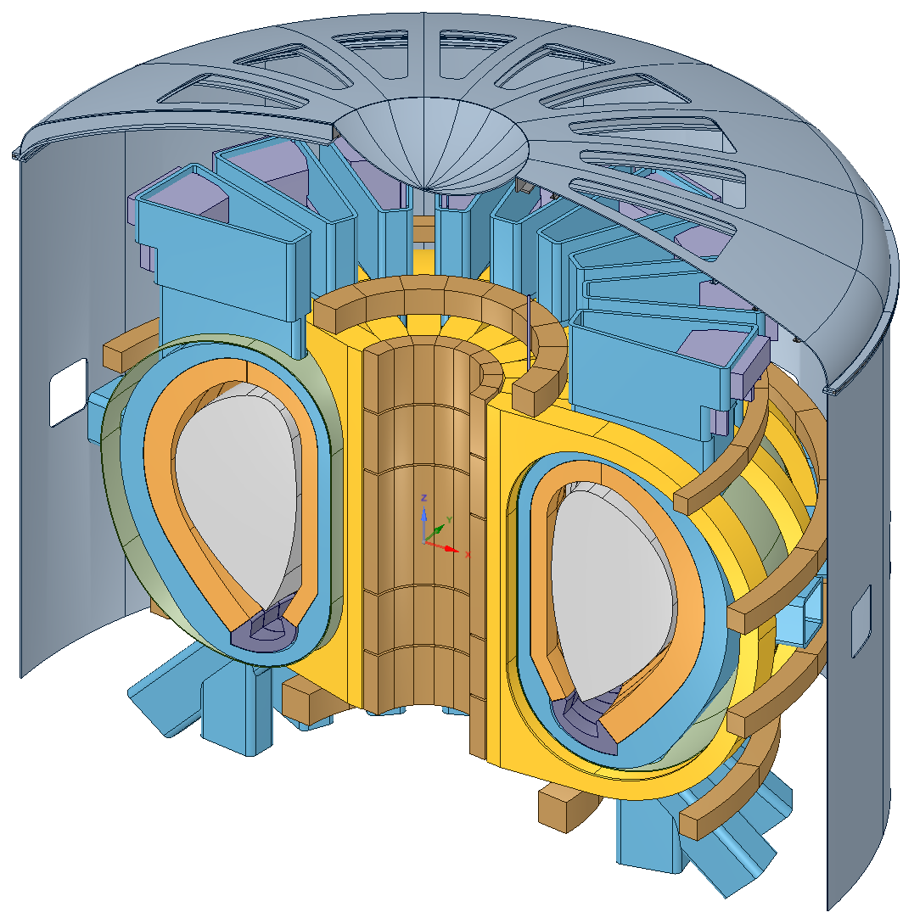
DEMO 2015 Baseline
“EU DEMO1 2015”
Main reactor parameters
No. of TF coils | 18
Major radius [m] | 9.072
Minor radius [m] | 2.927
Aspect ratio | 3.1
Plasma elongation, κ₉₅ | 1.59
Plasma triangularitry, δ₉₅ | 0.33
Average neutron wall loading [MW/m²] | 1.05
Fusion power [MW] | 2037
Net electric power [MW] | 500
CAD Configuration Management Model
⇒ New DEMO design underway !

Slide 13
Neutronics - Issues & nuclear responses
Tritium breeding capability
    Tritium Breeding Ratio (TBR); net TBR ≥ 1.0
      To be evaluated, optimized and proven
Nuclear power generation
          Total power produced in nuclear reactions, spatial distributions
            Reponses to be provided
Shielding performance
              Radiation loads to superconducting magnets, structural and sensitive components/elements
                To be evaluated, optimized and proven
Irradiation effects: Activation, transmutation, decay radiation
              Activity & nuclide inventories, decay heat, radiation damage to materials/components, radiation doses to materials & personnel
                To be evaluated & minimized – for operation, maintenance, safety, decommissioning and waste management
  Suitable computational approaches, tools and data needed to provide the required response data with sufficient accuracy.

Slide 14
IFMIF Intense Neutron Source
Deuteron beams:
  2 x 125 mA
  E_{d} = 40 MeV
Neutron production:
  ≈ 1.1 × 10¹⁷ s ⁻¹
  Max. neutron flux density (at back plate): 1.2 × 10¹⁵ cm⁻²s⁻¹

Slide 15

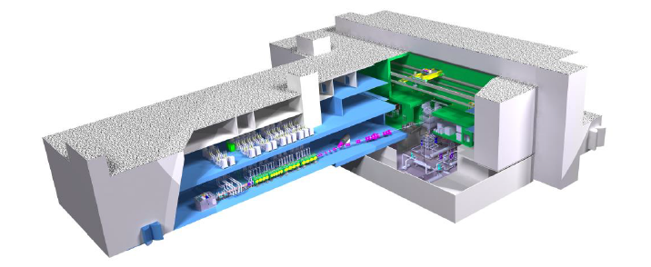
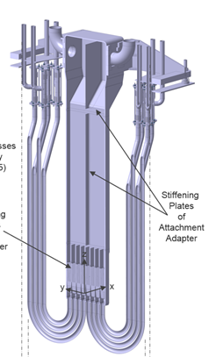
IFMIF-DONES Neutron Source
Demo Oriented Neutron Source
Utilizes one full IFMIF accelerator with a deuteron beam (125 mA, 40 MeV) producing half the neutron intensity of IFMIF.
Allows upgrading DONES at a later stage to the full IFMIF performance with a second accelerator.
Lithium target, Test Cell and HFTM of DONES and IFMIF are identical while other irradiation modules are not considered in DONES.
No hot cell, no Post Irradiation Examination (PIE) facility
High Flux Test Module (HFTM)
Target Test Cell (TTC)

Slide 16
IFMIF-DONES Neutron Source
Major neutronics issues/tasks
D-Li neutron source producing neutrons up to 55 MeV – McDeLicious approach
Nuclear performance of HFTM irradiation module
  Neutron/photon flux distribution & spectra
  Nuclear heating in HFTM container & specimens (Eurofer steel)
  Radiation damage & gas production in specimens
Target & Test Cell
  Nuclear design of Li target assembly, Li loop with quench tank, Test Cell with steel liner, concrete walls & plugs
  Issues: nuclear heating (cooling), activation, radiation doses in/around TTC & Li loop during operation & maintenance ⇒ radiation maps
Accelerator Facility (AF)
  Radiation during operation due to deuteron beam losses and subsequent activation of AF components ⇒ deuteron transport (MCUNED code) & interaction with AF materials (activation, neutron generation)
  Back streaming neutron radiation, shield design & optimization, beam dump

Slide 17
What is fusion ?
EU fusion roadmap
Neutronics simulations in fusion technology
Nuclear data for fusion applications
Nuclear data in the PPPT programme
Summary
Addendum:
DEMO nuclear analyses - examples

Slide 18
Neutronics simulations in Fusion Technology
Neutron (and photon) transport simulations
  Basis for providing all nuclear responses needed for the design and performance evaluation of FT facilities.
  Suitable computational approaches, tools and data required:
    Method/tool for simulation of neutron transport in complex 3D geometry
    Monte Carlo (MC) particle transport technique (MCNP, TRIPOLI, etc.)
    Nuclear cross-section data to describe the nuclear interaction processes
Coupled activation and radiation transport calculations
  Basis for assessment of activity inventories and radiation fields after shut-down as required for safety, licensing, waste management
  Computational approaches/tools and required:
    Nuclide inventory calculation with coupling to particle transport
    Large amount of neutron induced activation cross-section data
Neutronics simulations rely on variety and multitude of nuclear cross-section data (“nuclear data”) - and their quality !

Slide 19
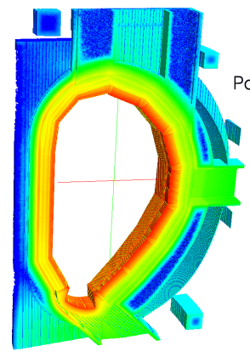
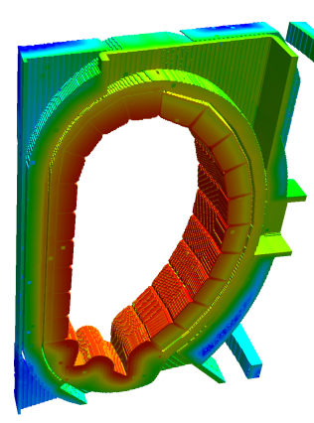

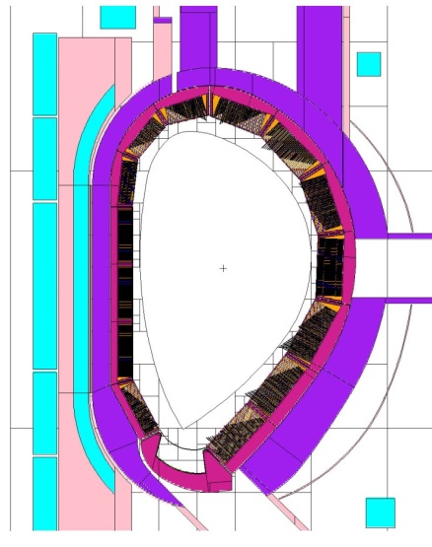
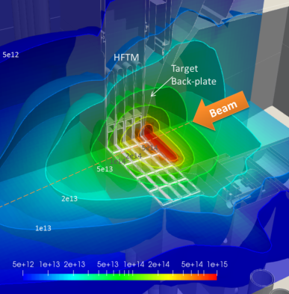
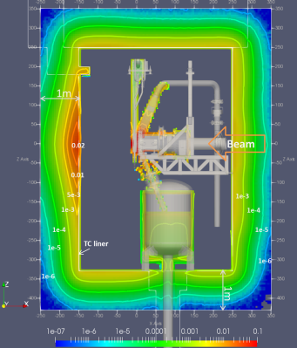
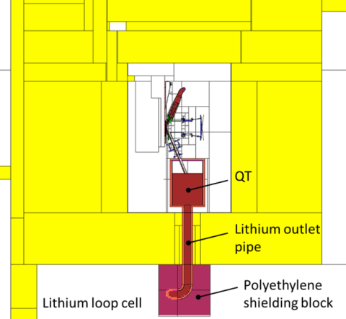
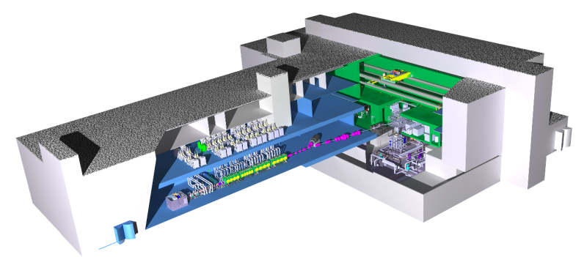
Neutronics Simulation Approach in FT
Facility design
Neutronics
simulation
Nuclear responses
DEMO
Nuclear heating
Decay gamma source
Tritium breeding, nuclear heating, activation & transmutation, radiation doses, …
IFMIF-DONES neutron source
Neutron flux
Nuclear heating
Displacement damage, gas production, nuclear heating, radiation doses, …

Slide 20
Faithful neutronics calculations
Suitable method for simulation of neutron transport in complex 3D geometries
High quality nuclear cross-section data to describe the nuclear interaction processes
Simulation models which replicate the real geometry without severe restrictions
Fulfilled by Monte Carlo (MC) particle transport technique
  Can handle any complex geometry with high fidelity and sufficient detail
  Can employ nuclear cross-section data without severe approximations
  Can be coupled with nuclide inventory codes for coupled radiation transport and activation calculations

Slide 21
Faithful neutronics calculations for DEMO
Reliability of employed MC particle transport code and its coupling to nuclide inventory calculations
  To be validated with fusion relevant benchmark experiments
  PPPT projects BB and SAE: R&D tasks on MC code TRIPOLI and European code system for coupled transport and activation calculations
Capability to describe in the simulation real reactor geometry with high fidelity and sufficient detail
  PPPT project BB: R&D task on CAD to MC conversion tool McCad
Quality of nuclear cross-section data for fusion applications
    To be checked against integral experiments
  Development and qualification of nuclear data relevant to DEMO and ENS; tasks implemented in PPPT projects PMI, BB, SAE, MAT and ENS
  To be supported by experimental programme, planned for implementation in PPPT programme in 2019

Slide 22
MC codes and related R&D in PPPT
MCNP-5, -6
  Developed by Los Alamos National Laboratory (LANL), USA
  Very powerful and versatile, well validated and benchmarked, user friendly, most suitable for fusion applications
  Standard MC code for ITER nuclear analyses, also used in PPPT
  Not freely available, subject to US export control regulations
  Alternative MC codes considered in previous exercise on suitability for fusion neutronics, in particular DEMO nuclear analyses, including e. g. open source codes SERPENT, GEANT, and …
TRIPOLI-4
  Developed by CEA Saclay, France, mainly for fission and shielding
  Mature MC code, well advanced in its functionalities, validated for fusion neutronics and benchmarked against MCNP for DEMO application
  Accepted as analysis code for PPPT neutronics; selected as suitable candidate for further development within PPPT

Slide 23
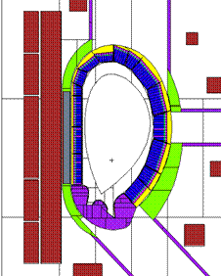
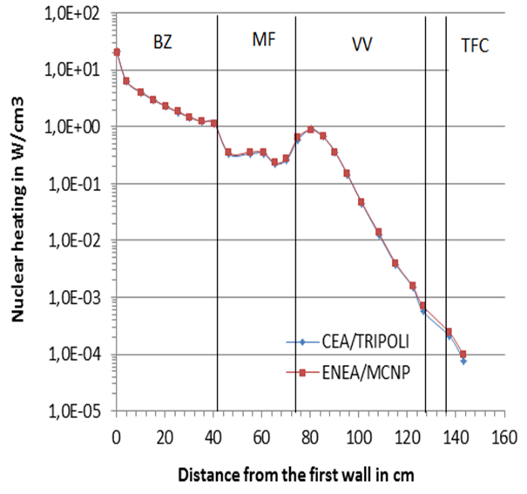
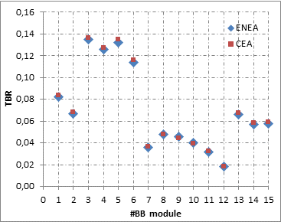
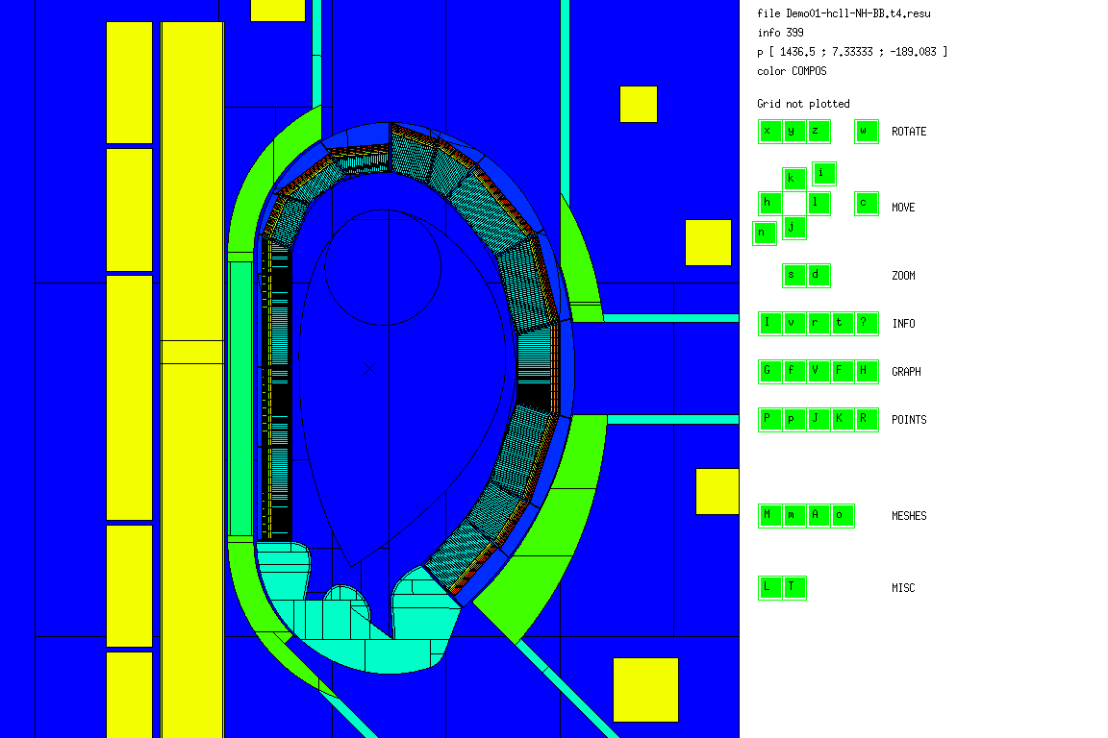
TRIPOLI-4 MC code
Benchmarking against MCNP for DEMO application
“DEMO 2014” with “Helium Cooled Lithium Lead” (HCLL) blanket
MCNP (ENEA)
Nuclear heating profile
Tritium breeding in modules
TRIPOLI (CEA)
Agreement mostly within statistical uncertainties
Current R&D work on TRIPOLI within PPPT:
  Coupling to activation calculation scheme using CEA depletion code MENDEL
  Nuclear data uncertainties propagation

Slide 24






McCad geometry conversion tool
Software tool for automatic conversion of CAD data into geometry representation of Monte Carlo codes, developed by KIT
Key features
  Based entirely on Open Source Software running under Linux and Windows Operating System, coded in C++
  Use of OpenCascade CAD kernel for geometry operations, Qt4 libraries for Graphical User Interface (GUI)
  Automatic generation of input decks for MCNP and Tripoli
  Algorithms for conversion, void completion, model analysis, error check and user operations
  Restricted to analytical surfaces (planes, cylinders, cones, spheres, etc.
Recent developments
  Improved decomposition algorithms, and functions
  Integrated to SALOME platform including capability for generation of mesh models and hybrid geometries for MCNP6
  Source code and binaries (Linux and Windows ) freely available on github: https://github.com/McCadKIT/McCad

Slide 25

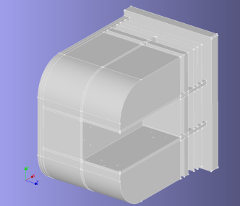
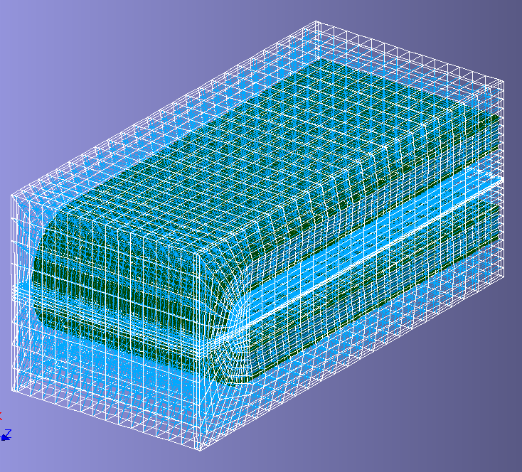
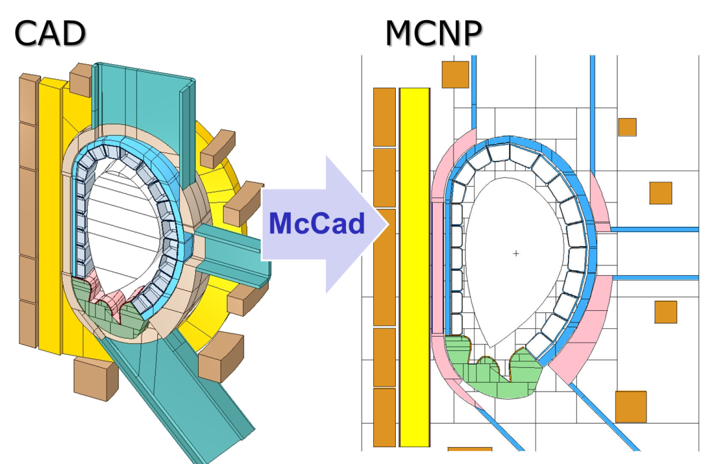
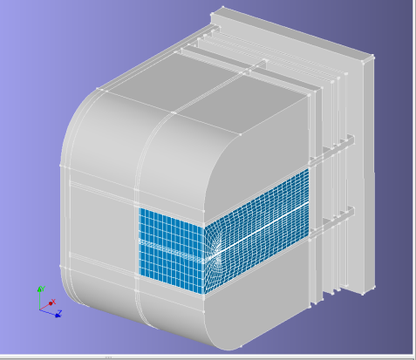
CAD to MC geometry conversion
Preparation on CAD platform (CATIA, SpaceClaim, ...)
  Fixing of geometry errors (gaps, overlaps, etc., )
  Removal of unnecessary small details
  Replacement of surfaces described by spline functions
  If required, pre-decomposition of complex models
Conversion + addition of void spaces (automated)
Hybrid geometry approach
Solids
Mesh
Conversion of DEMO 2014 CAD geometry model
Solids + mesh combined
⇒ Suitable for use with MCNP6

Slide 26
Coupled radiation transport and activation calculation schemes
Required for calculations of activation, decay heat and radiation fields post-irradiation (shut-down dose rates, SDR)
Two approaches:
  Direct 2-Step approach (“R2S”) developed by KIT, CCFE & UNED by coupling of MCNP transport calculations (neutrons, decay photons) and FISPACT/ACAB nuclide inventory calculations.
  Direct 1-Step approximation method (“D1S”) developed by ENEA & IO assuming prompt photons can be replaced by decay gammas in MCNP transport calculation.
    No inventory calculations required, just one single MC transport calculation.
R&D task in PPPT project SAE on development of joint European R2S code system (“cR2S”) from scratch.
Further development of D1S system for application to DEMO

Slide 27
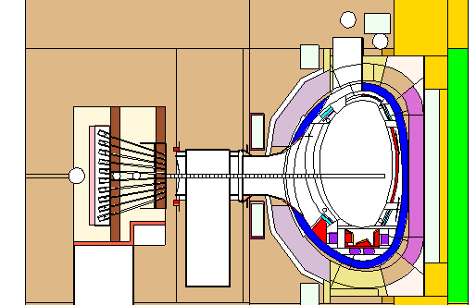
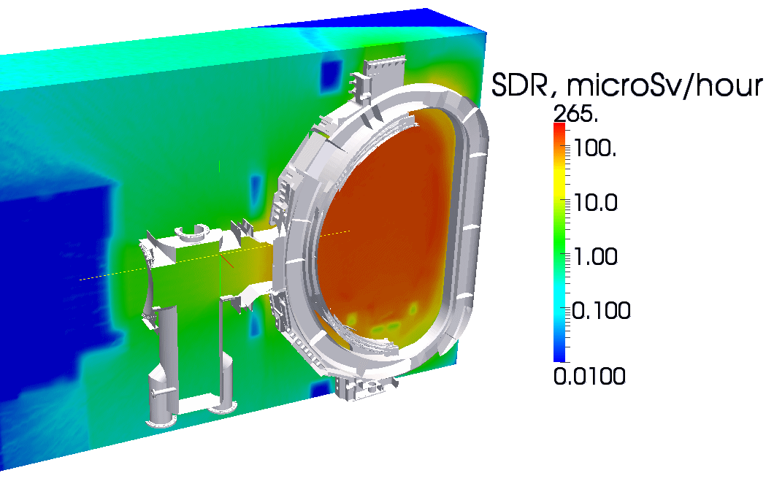
R2S/D1S validation on JET
Available R2S code systems (CCFE, KIT, UNED) and D1S (ENEA) validated on 14 MeV neutron generator experiments and JET.
Shut-down dose rate distribution (one week after August 2012 JET shut-down) overlaid to the Octant 1 CAD geometry model
Shut-down dose rate profiles along horizontal mid-plane port (Octant 1): Calculation results vs. measured dose rates
⇒ Agreement mostly within ± 30%

Slide 28
What is fusion ?
EU fusion roadmap
Neutronics simulations in fusion technology
Nuclear data for fusion applications
Nuclear data in the PPPT programme
Summary
Addendum:
DEMO nuclear analyses - examples

Slide 29
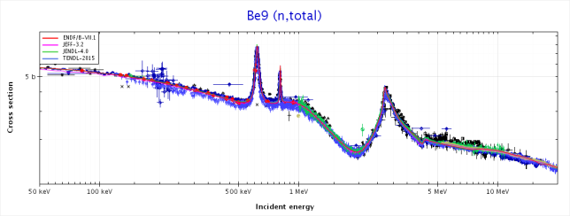
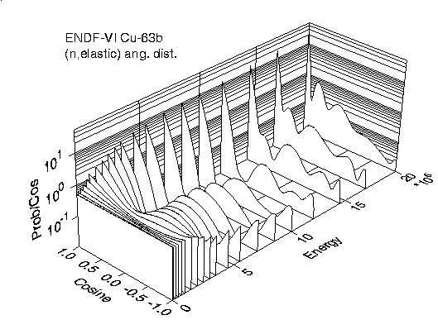
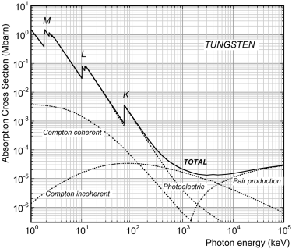
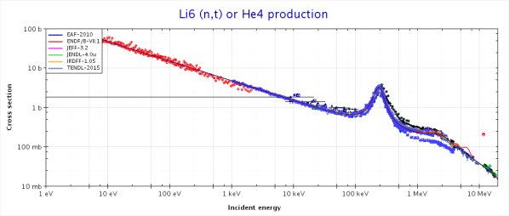
Nuclear data for FT applications
Neutron cross-sections for transport simulations
  Neutron absorption and total cross-sections: σ_{a} (E), σ_{tot}(E)
  Total neutron emission cross-section σ_{nem}(E,E’,μ)
  [E = neutron energy, μ=cos(θ), θ=scattering angle]
    Includes elastic scattering and inelastic reactions (n,n’γ), (n,2n),...
Cross-sections for photon transport simulations
  Neutron induced γ - production cross-sections and spectra
  γ - interaction cross-sections
Nuclear data for calculating reaction rates (”nuclear responses”)
  Cross-sections σ_{x} (E) for specific reactions (tritium, gas production, etc.), and energy deposition (heating)
Complete data evaluations required : all reactions, all data types, covering the entire energy range 10⁻³eV – 20 MeV, for all nuclides of interest to FNT, sufficient quality (!)

Slide 30





Nuclear data for FT applications
Nuclear data evaluations & libraries
  Evaluated nuclear cross-section data compiled in libraries, processed for application calculations, benchmarked and validated – as far as possible.
Nuclear data libraries for fusion technology
  FENDL - Fusion Evaluated Nuclear Data Library
    Developed under auspices of IAEA, tailored to the needs of ITER
    Current version FENDL-3.1c includes a set of sub-libraries, (n, p, d, activation, co-variances, etc.), up to 200 MeV
  JEFF - Joint Evaluated Fusion and Fission File
    Organised and maintained by NEA Data Bank, Paris, addressing needs of European nuclear fusion and fission communities
    EU fusion data evaluations are fed into JEFF and its sub-libraries
  JEFF serves as reference data library for PPPT nuclear analyses

Slide 31
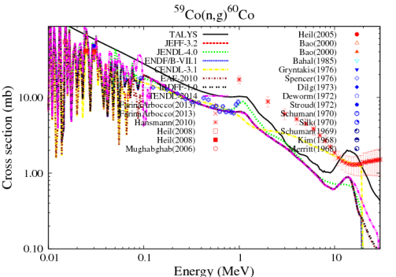
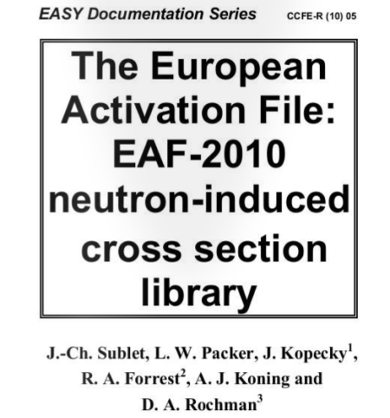
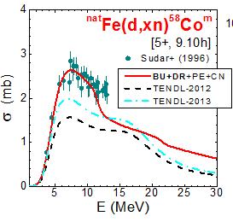
Nuclear data for FT applications
Activation cross-section data
  Excitation function σ_{x} (E) for any open reaction channel producing a radioactive product nuclide
  Calculated by nuclear model codes using experimental data, benchmarked and validated for important reactions
  European Activation File (EAF) developed by CCFE/NRG in the frame of EU fusion programme, serving both JEFF and FENDL
  EAF- 2010 latest version (frozen): 816 target nuclides ¹H to ²⁵⁷Fm, 66,256 excitation functions up to 60 MeV.
Deuteron induced cross-section data
  Required for IFMIF-DONES nuclear analyses
    Neutron generation in Li target and accelerator components
    Activation of deuteron beam facing materials of accelerator
  TENDL deuteron library, based on automated model calculations
  ⇒ To be updated with specific data evaluations/improvements

Slide 32
What is fusion ?
EU fusion roadmap
Neutronics simulations in fusion technology
Nuclear data for fusion applications
Nuclear data in the PPPT programme
Summary
Addendum:
DEMO nuclear analyses - examples

Slide 33
General Purpose Nuclear Data Evaluations
Evaluations performed previous within fusion programme (F4E nuclear data grants/partnership agreement)
n + ¹⁸¹Ta, ⁵⁵Mn, ^{63,65}Cu, ^{54, 56, 57, 58}Fe, ^{90, -91,- 92,-94, -96}Zr
Evaluations by JSI, KIT & TUW applying Bayesian approach taking into account experimental and model uncertainties.
Nuclear model calculations largely based on TALYS code (NRG) and different approaches for the generation of co-variance data.
Data files include all information/data required for FT applications (transport simulation, nuclear responses, uncertainties).
Evaluation activities implemented in PPPT, running in 2017 and planned for 2018 & later ⇒ JEFF-4
Adaptive R-matrix approach for cross-section evaluations of light mass nuclei (TUW)
  Trial application to n + ¹⁶O incl. production of prototype ENDF data file
  Plans for application to new evaluation of n + ⁹Be (2019/20)
New evaluation of W neutron cross-section data based on TALYS model calculations
  Evaluation of n + ¹⁸⁴W incl. co-variance data based on UMC approach (2017)
  Evaluations for n + ^{182, 186}W planned for 2018

Slide 34
Evaluated Neutron Cross-Section Data - Examples
Nuclear model calculations with TALYS and adjusted parameters
Geometry dependent hybrid (GDH) model for pre-equilibrium reactions
Unified Monte Carlo (UMC) approach for co-variance data generation
Neutron emission cross-sections
^{nat}Zr(n,xn) @ 14 MeV
⁶³Cu(n,2n) ⁶²Cu
⁶³Cu(n,n’)⁶³Cu
^{nat}Cu(n,xn) @ 14 MeV
⁹²Zr(n,p) ⁹²Y
⁹⁰Zr(n,2n) ⁸⁹Zr

Slide 35
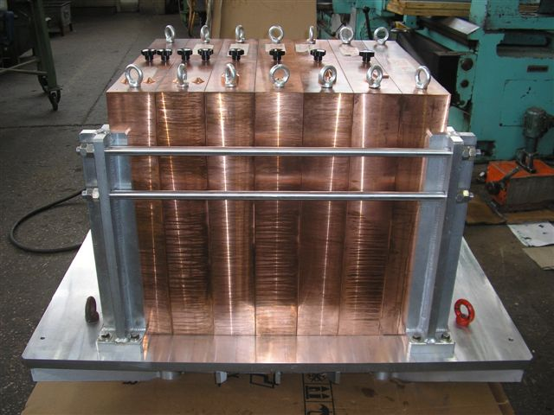
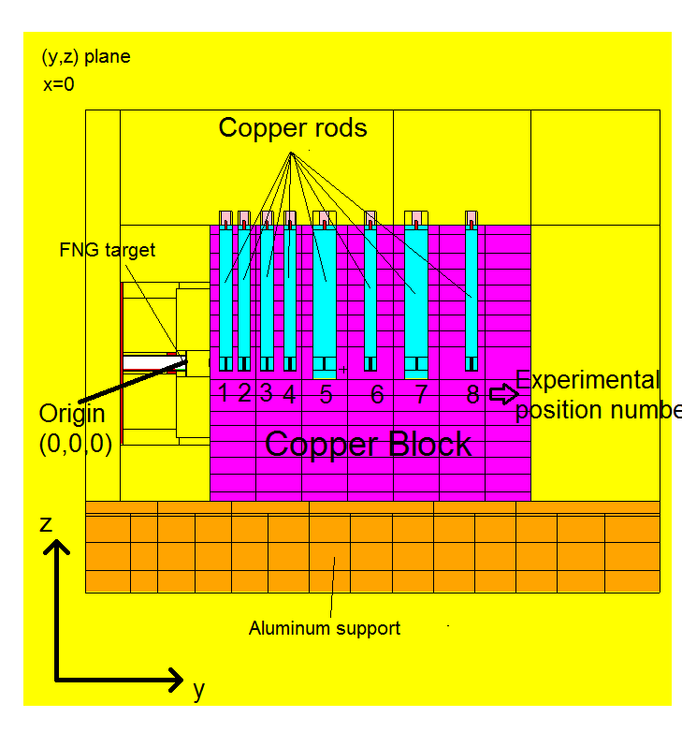
Benchmarking of Neutron Cross-Section Data - Cu
Integral experiments essential for checking quality of nuclear cross-sections in transport simulations
Irradiation of large material assembly by 14 MeV neutrons (FNG - Frascati Neutron Generator )
Cu benchmark experiment:
  Copper block of 60 cm x 70 cm x 60 cm
  Measurements of reaction rates with Au, Nb, Ni, Al, In and W activation foils , and neutron and photon flux spectra
Cu assembly at FNG laboratory
Revealed need to revise JEFF-3.2 Cu-evaluation for JEFF-3.3
MCNP model (vertical cut)

Slide 36
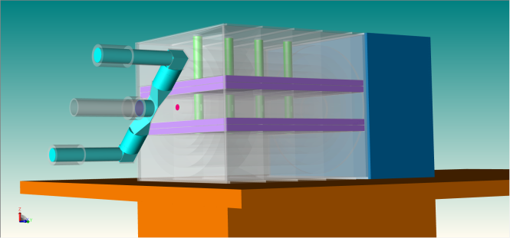
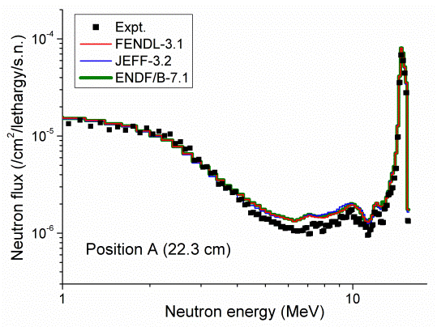
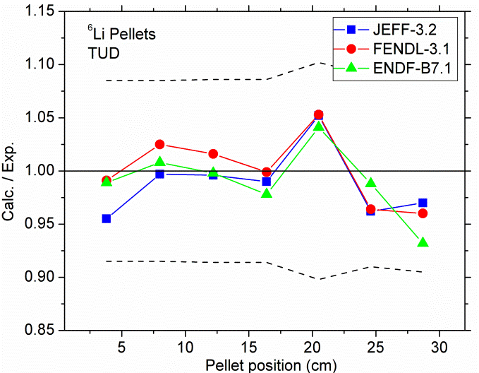
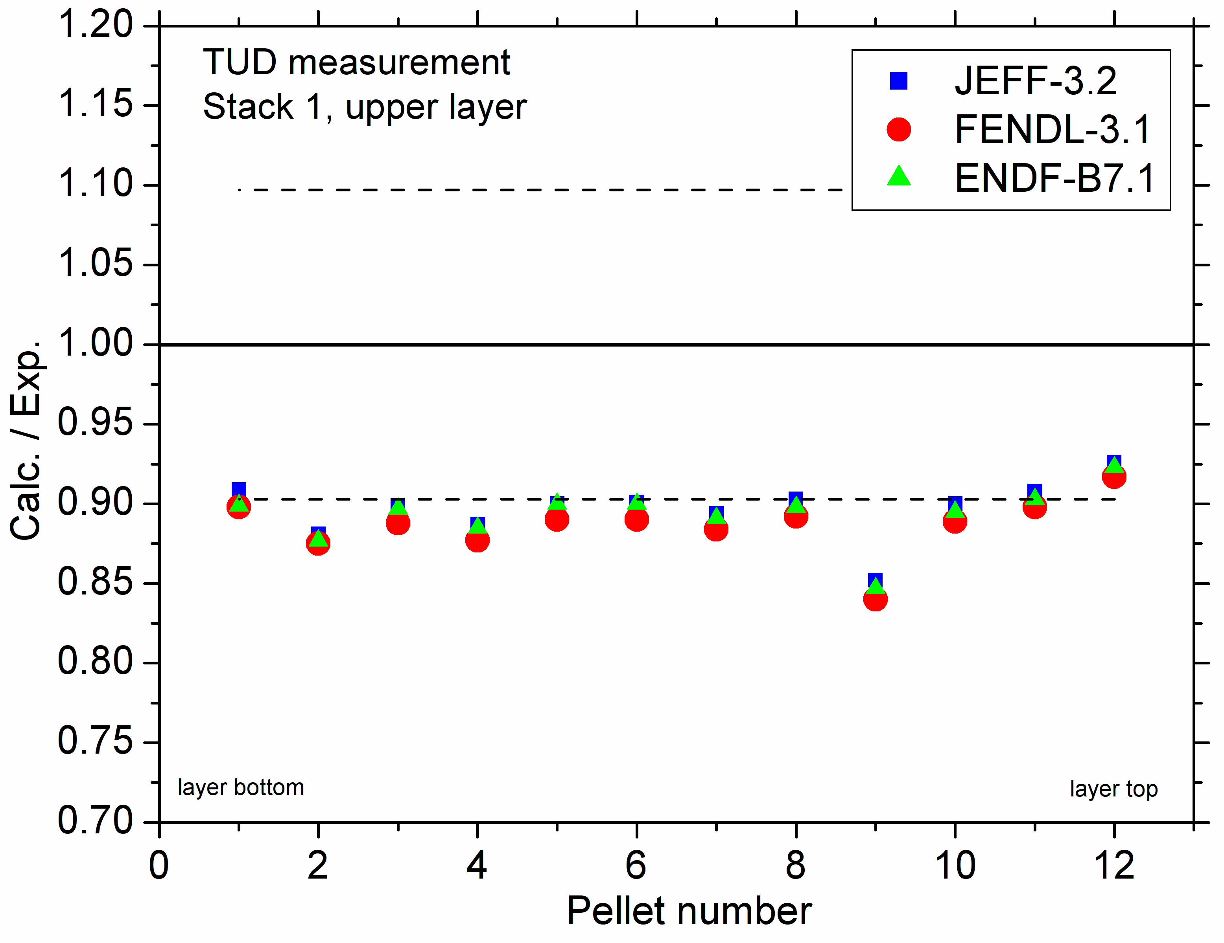
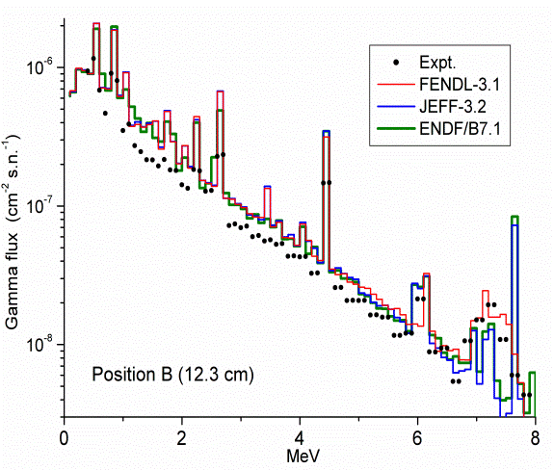
Benchmark analyses on tritium breeding experiments
HCPB mock-up
Analyses of breeder blanket mock-up experiments to check status of state-of-the-art nuclear data libraries for prediction of tritium production
  HCPB (Helium Cooled Pebble Bed) breeder blanket
  HCLL (Helium Cooled Lithium Lead) breeder blanket
  Experiments performed previously at FNG
Nuclear data libraries: JEFF-3.2, FENDL-3.1b, ENDF/B-VII.1
All evaluations produce similar results
Tritium production well predicted for HCLL, underestimated for HCPB
HCLL – neutron flux spectrum
HCLL – C/E tritium production
HCPB – C/E tritium production
HCLL – photon flux spectrum

Slide 37
Activation Cross-Section Data Library
  European Activation File (EAF):
EAF series developed by CCFE/NRG in the frame of EU fusion programme, EAF-2010 latest version (frozen, no further development)
Strategy adopted in PPPT programme: Establish TENDL as reference data library for activation calculations
TENDL - “TALYS based Evaluated Nuclear Data Library”
  Developed previously by NRG, now PSI, in collaboration with IAEA, CCFE, CEA and others
  Very comprehensive and complete data library, largely based on automated TALYS calculations with default and adjusted parameters and data from other source
  Includes cross-section data for n, p, d, t, ³He, α and γ induced nuclear reactions
TENDL to preserve or increase quality of EAF-2010 for activation calculations by including validated cross-sections and removing g deficiencies
  Deficient cross-sections identified and prioritised according to needs of fusion programme (DEMO, IFMIF-DONES, ITER) improved (N. Dzysiuk, NRG) and included in TENDL-2017 (D. Rochman, PSI)
  Generation of dedicated Activation Data File (“EAF format”) from TENDL-2017, to be adopted as reference data library for activation calculations in PPPT programme, superseding EAF-2010

Slide 38
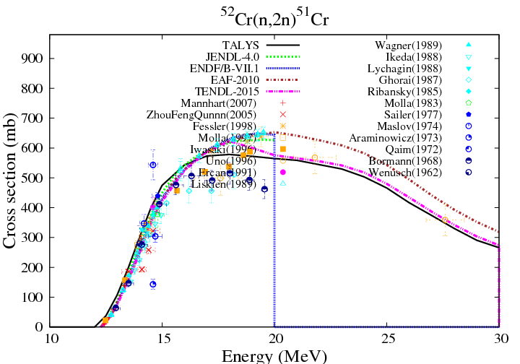
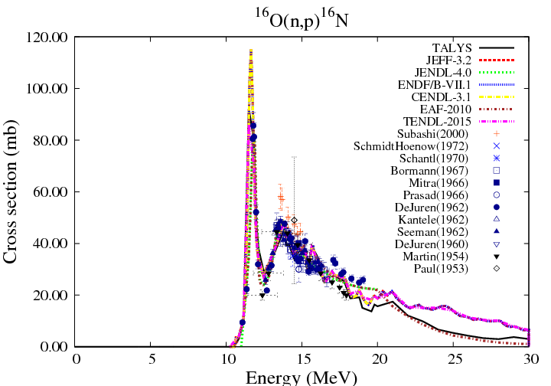
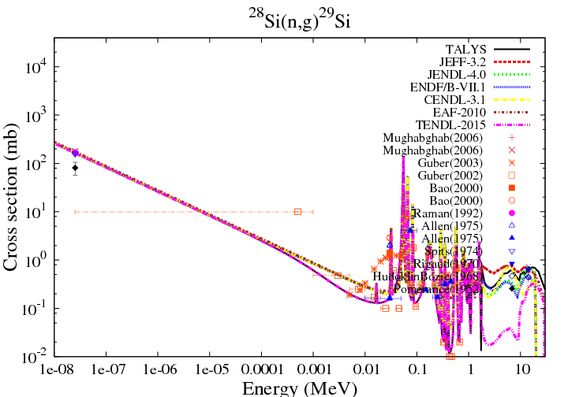
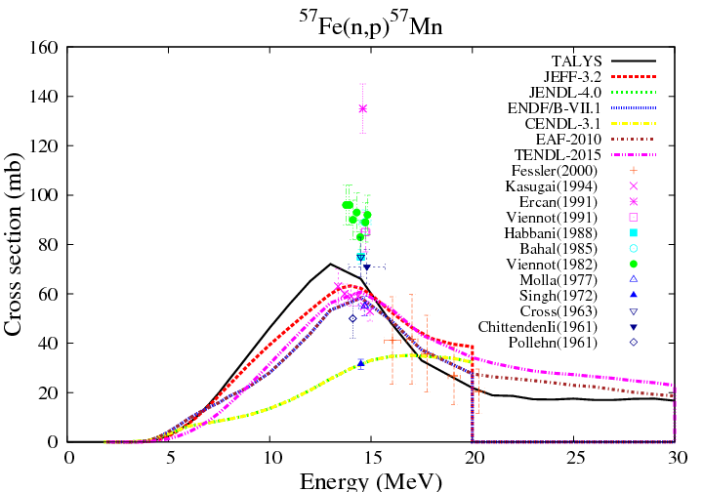
Improved Activation Cross-Sections in TENDL

Slide 39
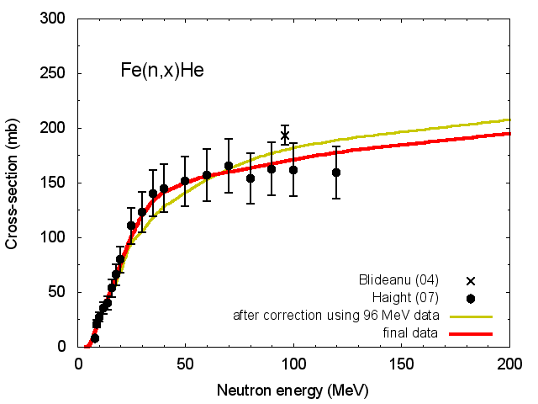
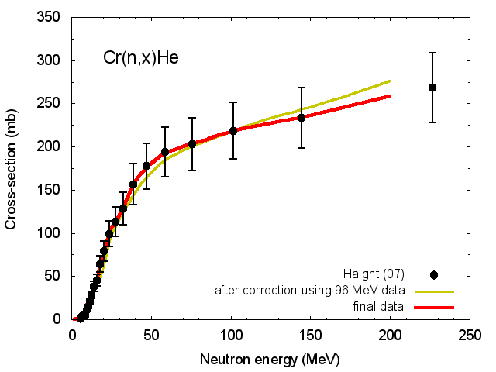
Gas Production Data Library
  Gas production is an important issue for material performance during irradiation !
  Gas production / damage ratio for specimens irradiated in IFMIF-DONES must match DEMO conditions
  Available gas production data library
  Systematically evaluated gas production cross-section for nuclides Z=12 to 83 up to 200 MeV neutron energy (A. Konobeev, KIT)
    Based on experimental data, evaluated data, nuclear model calculations and systematics, and statistical combination of experimental and theoretical data
    Includes production of protons, deuterons, tritons, ³He, and α-particles in neutron induced reactions on 262 stable nuclides
Fe(n,x)He
Cr(n,x)He
  Available at: https://www.inr.kit.edu/img/gas_production_files.zip

Slide 40
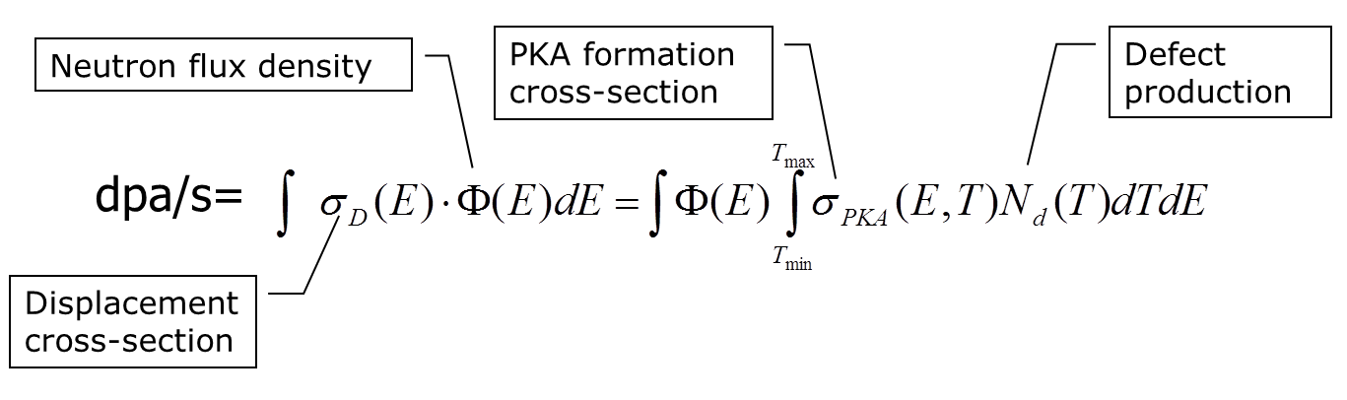

Displacement damage cross-section data
Displacement damage estimation
  σ_{d} (E) for calculation of displacement damage (dpa/s) induced by incident neutron through transfer of kinetic energy to colliding nucleus
  In general, use of (simple) NRT damage model to calculate number of lattice defects, recoil distributions from evaluated nuclear data files
  Advanced methodologies based e. g. on molecular dynamics (MD) simulations or “athermal recombination corrected” (arc) dpa formalism
Available DPA data
  Complete data libraries based on JEFF-3.2 (NRT) and JEF-3.3 (NRT + arc-dpa)
  Dedicated dpa cross-sections for Eurofer and SS-316, reference for PPPT
NRT damage model

Slide 41
Displacement Damage Cross-Section Data
  Advanced DPA cross-section data up to 150 MeV for Eurofer constituents (Fe, Cr, Mn, V, W, Ta, C, Si, and N) based on an atomistic modelling approach.
  Molecular Dynamics (MD) and Binary Collision Approximation (BCA) model simulations for the calculation of number of lattice defects
  Better agreement with experimental point defect production data.
  Displacement damage cross-sections of Eurofer and SS-316 e available through IAEA/NDS:
    Eurofer: https://www-nds.iaea.org/public/download-endf/DXS/EUROFER_dpa-XS/ACE
    SS-316: https://www-nds.iaea.org/public/download-endf/DXS/SS-316_dpa-XS/ACE/
  Provided as ACE data files for use with MCNP as dosimetry cross-sections
  Recommended for use in PPPT neutronics (“Guidelines for for Neutronic Analyses”)

Slide 42





Displacement Damage Cross-Section Data Library
  Complete DPA (NRT) cross-section data library up to 150 MeV for 53 elements (171 nuclides)
  Based on processing of JEFF-3.2 data with suitable extensions/corrections based on TENDL-2015
  New approach adopted in running PPPT programme :
  Arc dpa^{(*)} data which take into account lattice defects surviving thermal annealing
  Data library produced for elements Li to U based on cross-section data from JEFF-3.3.
  Available at NEA DB as sub-library to JEFF-3.3 (Nov. 2017)
⁵⁶Fe
⁵¹V
Arc dpa vs NRT dpa
Cu
W
⁴⁸Ti
^{(*)} K. Nordlund et al., NEA/NSC/DOC(2015)9, OECD 2015

Slide 43


Deuteron Induced Cross-Section Data
Required for IFMIF-DONES neutron source facility – ENS (Early Neutron Source) project in PPPT programme
Neutron generation in Li target: ^{6,7}Li(d, xn) cross-section data provided with McDeLicious MC code, validated with measured thin and thick target yield data
Deuteron cross – section data for activation calculations:
  Available with TENDL data library, largely based on automated TALYS calculations with default model and parameters lacking sufficient accuracy
  Dedicated effort in PPPT programme to improve nuclear models describing deuteron induced reaction mechanisms
Deuteron cross – section data for transport simulations:
    Available with the same TENDL deuteron data library
  Can be used in deuteron transport simulations with MC code code MCUNED (P. Sauvan, UNED)
  In general, poor data quality because of deficient reaction models in TALYS, to be improved !
Avrigeanu

Slide 44
Deuteron Induced Cross-Section Data
d-induced activation cross-sections available for ²⁷Al, ^{54,56,57,58}Fe, ^{58,60,61,62,64}Ni, ^{63,65}Cu, and ⁹³Nb up to 60 MeV deuteron energy with improved nuclear models (M. Avrigeanu, IFIN-HH)
Improved activation cross-sections to be included in new TENDL deuteron data library, extension to other nuclides
Deuteron transport : Parameterised representation of deuteron break-up implemented MCUNED code (P. Sauvan, UNED)
Successfully tested with ad-hoc modified TENDL deuteron data library
Cu(d,Xn)
Data for transport simulations to be improved in TENDL
E_{d} = 33 MeV
Θ = 0°
  Planned activities in PPPT (2018 and later) ⇒ JEFF-4
  Improved modelling of d induced reactions in TALYS code
  Updated versions of TENDL deuteron library for transport and activation simulations

Slide 45
Summary
Nuclear data for fusion technology
  High quality data essential for design optimization, performance evaluation; safety, maintenance and waste management
  Pre-requisite to ensure reliable analyses and results
Requires dedicated development efforts
  Tailored to PPPT project needs: DEMO, IFMIF-DONES
  Nuclear data for transport simulations – neutrons, deuterons
  Activation cross-section data - neutrons, deuterons
  Special purpose data, e. g. displacement damage, gas production
Requires benchmarking against integral experiments
  Neutron transport/shielding, breeding, activation
  To be conducted within PPPT programme according to project needs

Slide 46
What is fusion ?
EU fusion roadmap
Neutronics simulations in fusion technology
Nuclear data for fusion applications
Nuclear data in the PPPT programme
Summary
Addendum:
DEMO nuclear analyses - examples

Slide 47


DEMO Model Development (2015)
Generic DEMO neutronics model
DEMO
CMM model
CAD
MCNP
McCad
360 ° reactor
10 ° torus sector

Slide 48




Breeder Blanket Design
HCPB
Breeder blanket concepts considered in PPPT for DEMO:
  Helium Cooled Pebble Bed (HCPB) blanket, Beryllium as neutron multiplier and He gas as coolant,
  Helium Cooled Lithium Lead (HCLL), PbLi breeder and He gas as coolant,
  Water Cooled Lithium Lead (WCLL), PbLi as breeder and water as coolant,
  the Dual Coolant Lithium Lead (DCLL), PbLi as breeder and coolant, and He gas as coolant for the structure.
Required nuclear analyses:
  Design optimisation & evaluation (TBR, shielding)
  Nuclear heating for thermal-hydraulic layout
  Activation, afterheat for safety and waste management
HCLL
WCLL
DCLL

Slide 49






HCPB DEMO Model (2015)
CAD neutronics model
with blanket module segmentation
MCNP model
HCPB blanket module
Vertical cut
Horizontal cut
McCad
10 ° torus sector

Slide 50







HCLL DEMO Model (2015)
CAD model
TRIPOLI model
HCLL blanket segmentation
Generic neutronics model
Blanket interior structure filled in
HCLL blanket module
McCad
- vertical cut -

Slide 51
Tritium breeding potential
DEMO requires Tritium self-sufficiency:
                Net Tritium Breeding Ratio (TBR) > 1.0
DEMO design target: TBR ≥ 1.10 (To be proven by 3D Monte Carlo calculation without blanket ports).
Blanket | TBR (reference design) | TBR (design variations) | Remarks
HCPB | 1.20 | 1.17 – 1.37 | DEMO 2015 baseline, a variety of design variations considered
HCLL | 1.15 | 1.15 – 1.22 | DEMO 2015 baseline, some design variations considered
DCLL | 1.10 | - | DEMO 2014 baseline
WCLL | 1.13 | - | DEMO 2015 baseline with homogeneous breeder mixture
TBR performance for DEMO
⇒ All blanket concepts show sufficient tritium breeding capability for DEMO

Slide 52

Nuclear power generation in DEMO
HCPB DEMO
DEMO 2015
Fusion neutron power: 1630 MW
Energy multiplication through nuclear reactions
3D distribution of power density
 | Energy multiplication M_{E}
HCPB | 1.35
HCLL | 1.199
DCLL | 1.198
WCLL | 1.20
Power release fraction
Blanket modules | ≅ 90 %
Divertor | 5 – 6 %
VV/shield | balance

Slide 53

Shielding calculations
Shielding calculations in torus mid-plane (inboard)
Inboard mid-plane
Poloidal distribution of Neutron Wall Loading (NWL) in DEMO 2014

Slide 54





Shielding Performance of WCLL DEMO 2015
Radial profiles at DEMO inboard torus mid-plane
Neutron flux
He production
DPA accumulation
Power density in steel

Slide 55

Shielding Performance of HCPB DEMO 2015
Radial profiles at DEMO inboard torus mid-plane
Neutron flux
He production
Blanket back support structure (BSS) with manifold
DPA accumulation
Power density in steel
BSS shield options

Slide 56


Nuclear power in TFC
3D distribution of power density
TFC casing
TFC magnet
 | Power release in one TFC | Power release in all TFCs
TFC casing | 1.6 kW | 29 kW
TFC magnet | 620 W | 11 kW
Design limit of 50 W/m³ for TFC heating exceeded in divertor port area

Slide 57


Activation and afterheat
Irradiation scheme
Decay heat of blanket modules [MW]
DEMO 20014 (1572 MW fusion power)
1 week
Decay heat power
Typically 20 MW (≅ 1.5 %) @ 1s, ≅ 0.1 – 1 MW ( ≤ 0.1 %) @ 1 week after shut-down
Dominated by activation of Eurofer steel
Significant differences among blanket concepts only for longer decay times ( ≥ 1 week) ⇒ Neutron spectra effects

Slide 58


Vacuum vessel activation and decay heat
Specific activity [Bq/kg]
Decay heat density [kW/kg]
Significant effect of blanket types (mixtures) on VV activation
Highest VV activation for HCLL, lowest for HCPB and WCLL blanket mixtures
  Effect of neutron spectrum and flux attenuation across blanket modules
  Used for classification of radioactive waste

Slide 59



Radiation fields during maintenance
3D distributions of biological dose rates [Sv/h], 4 weeks after DEMO shut-down
HCPB DEMO 2014
    All irradiated components in place
    Divertor removed
    Upper port shield and outboard blanket segment removed
Similarly, radiation doses to materials/sensitive components
  Required for remote maintenance studies

